Slide 1
Deepclean: Denosing of Gravitational Wave using Machine Learning
Chia-Jui Chou
National Yang Ming Chiao Tung University, Taiwan
2022/01/25

Slide 2
GW Denoising
GW signals are small compared to the background noise.
Proper denosing will increase the Signal-to-Noise Ratio (SNR) and the sensitivity of the detector which gives better ability to detect events and imporve the accuracy of parameter estimation.
Independent Component Analysis (ICA) is designed for the denoising in data analysis.
Deepclean is designed to do the denoising for the low-latency online search.

Slide 3
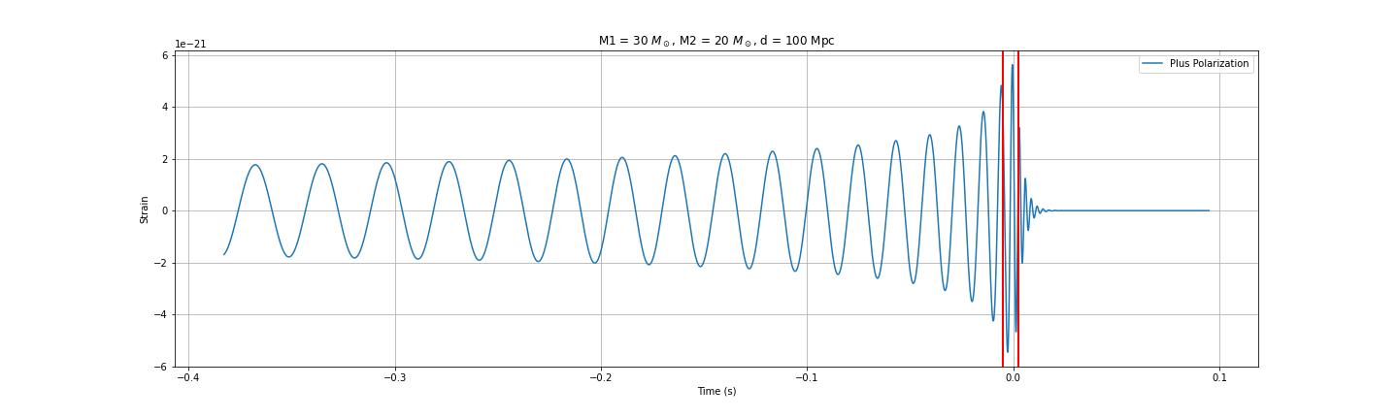
Deepclean and Low-latency GW Search
The detection of the GW of BNS or CCSN provides the early warning for the follow-up detection of X-ray and neutrino.
Fast denoising using Deepclean will increase the sensitivity in the low-latency GW search.
Inspiral
Merger
Ringdown

Slide 4
Calibration and Strain
Variation of h(t):
  C00 (Front-End Calibration): generated in the digital control,
  C10 (C00 in LIGO, Virgo): generated by the Low-Latency pipeline of calibration (Finite Impulse Response (FIR) filters based on gstlal library),
  C20 (C10 in LIGO, Virgo): generated by offline calibration several months after the data acquisition (gstlal-based).
DARM Loop
C00 (Front-End)
C10 (Low-Latency)
C20 (Offline)
Partial Calibration
Residual Calibration
Full Calibration

Slide 5
Deepclean and ICA
ICA is used to do the denoising of C20 strain.
DARM Loop
C00 (Front-End)
C10 (Low-Latency)
C20 (Offline)
cleaned h(t)
Partial Calibration
Residual Calibration
Full Calibration
ICA

Slide 6
Deepclean and ICA
ICA is used to do the denoising of C20 strain.
Deepclean is designed to do the fast denoising of low-latency C10 strain.
DARM Loop
C00 (Front-End)
C10 (Low-Latency)
C20 (Offline)
cleaned h(t)
Partial Calibration
Residual Calibration
Full Calibration
ICA
Deepclean
r(t) in low-latency

Slide 7
Deepclean: Denoising using PEM and Auxiliary Channels
w(t): witness channels that record the data from the auxiliary sensors and PEM.
p(t): predicted noise in strain.
Both w(t) and p(t) are 8-second long timeseries with the same sampling rate.
Ref: 2005.06534, 2108.12430
latent vector
TransposeConv1d
TransposeConv1d
TransposeConv1d
TransposeConv1d
w(t)
Conv1d
Conv1d
Conv1d
Conv1d
Conv1d
p(t)
Encoder (down-sampler)
Decoder (up-sampler)

Slide 8
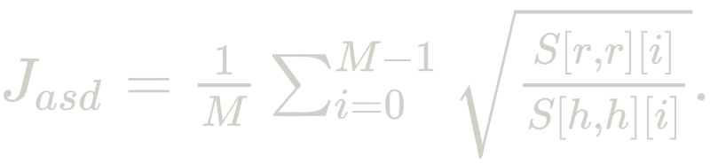
Deepclean: Training and Inferencing
h(t): raw strain data.
r(t) = h(t) - p(t): residual.
Loss function:
latent vector
TransposeConv1d
TransposeConv1d
TransposeConv1d
TransposeConv1d
w(t)
Conv1d
Conv1d
Conv1d
Conv1d
Conv1d
p(t)
-
r(t)
h(t)
Encoder (down-sampler)
Decoder (up-sampler)

Slide 9
Deepclean using 2 PEM Channels
O3GK run:
  2020/04/07-08:00:00 UTC (1270281618) ~ 2020/04/21-00:00:00 UTC (1271462418)
  Calibration parameters was switched on: 2020/04/15 23:00:30 UTC (1271026848)
Strain data used:
  K1:DCS-CALIB_STRAIN_C10
PEM channel used:
  K1:PEM-MIC_PSL_TABLE_PSL4_Z_OUT_DQ
  K1:PEM-SENSOR_RACK_OMC1_DSUB2_OUT_DQ
Frequency Filter: 55Hz ~ 65 Hz
Training Time: 1270299936 ~ 1270300064 (128 second)
Cleaning Time: 1270300064 ~ 1270300192 (128 second)

Slide 10
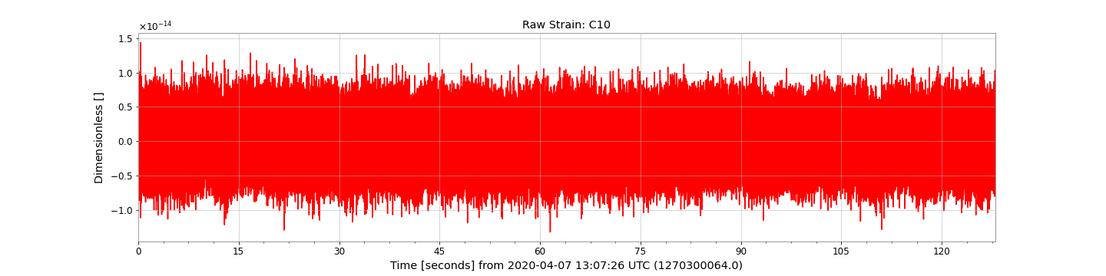
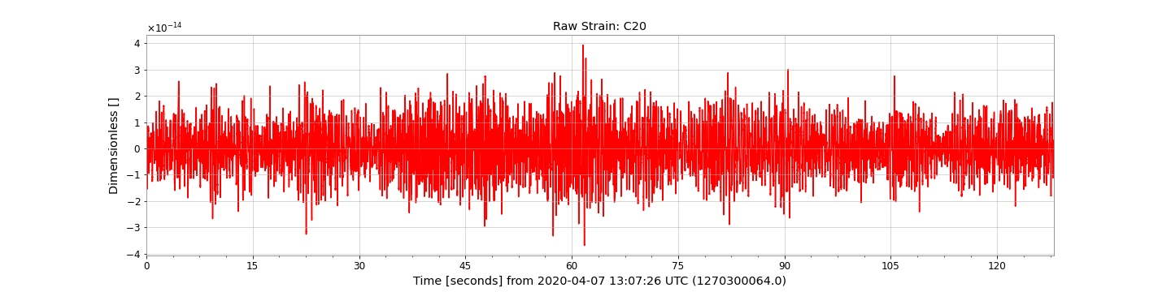
Deepclean using 2 PEM Channels: Raw Strain
h(t)

Slide 11
Deepclean using 2 PEM Channels: C20 State Vector
bit | Identifier | Description
0 | HOFT_OK | h(t) was successfully computed
1 | OBS_INTENT | The “observation intent” is set by the operator
2 | OBS_READY | Interferometer is in “observation ready” mode
3 | (not in use) | (not in use)
4 | NO_GAP | The input data was present (not a gap)
5 | NO_STOCH_HW_INJ | No stochastic hardware injections
6 | NO_CBC_HW_INJ | No compact binary coalescence hardware injections
7 | NO_BURST_HW_INJ | No burst hardware injections
8 | NO_DETCHAR_HW_INJ | No detector characterization hardware injections

Slide 12
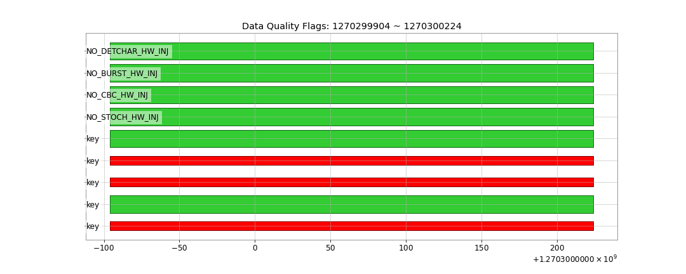
Deepclean using 2 PEM Channels: C20 Data Quality

Slide 13
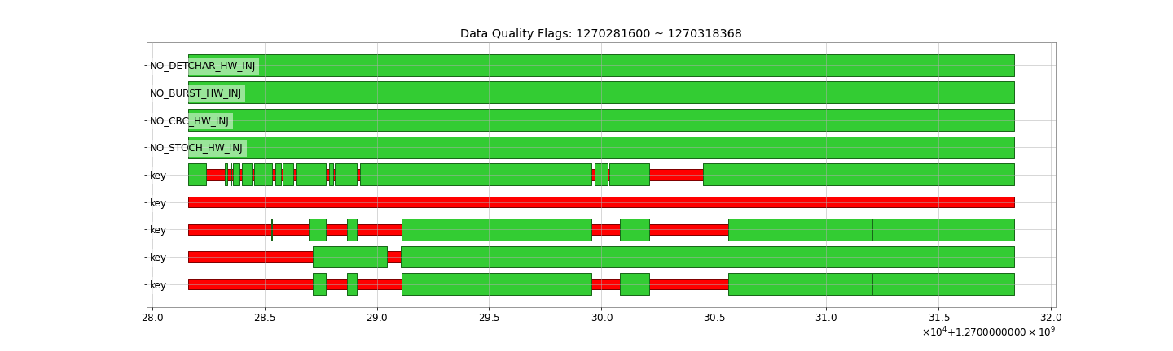
Deepclean using 2 PEM Channels: C20 Data Quality

Slide 14
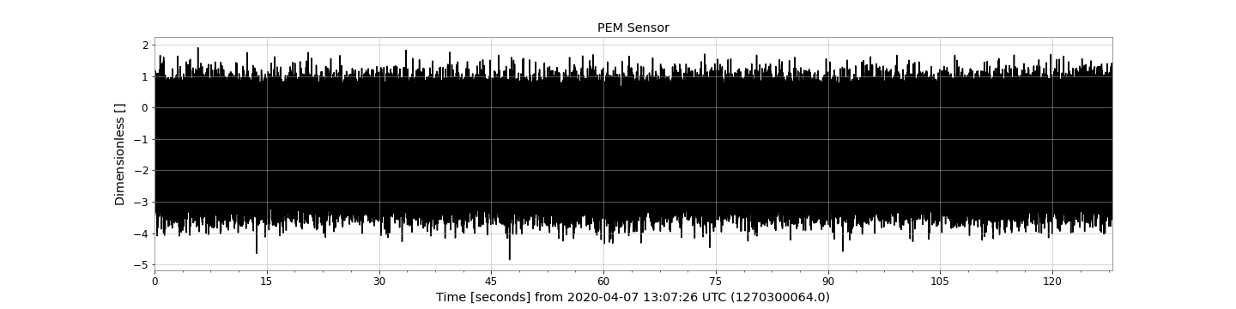
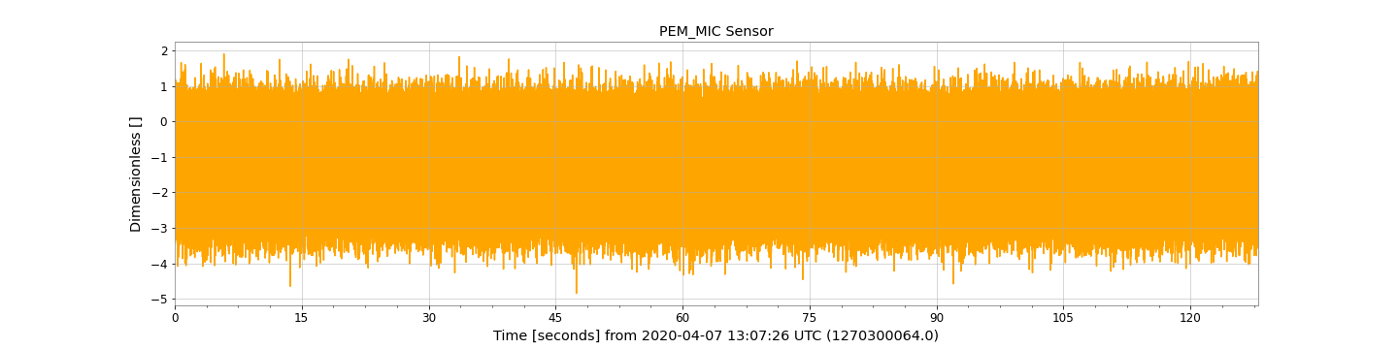
Deepclean using 2 PEM Channels: PEM Channels
w(t)

Slide 15
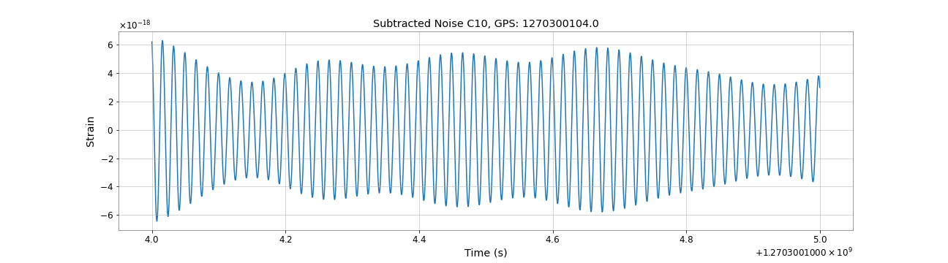
Deepclean using 2 PEM Channels: Predicted Noise
p(t)

Slide 16
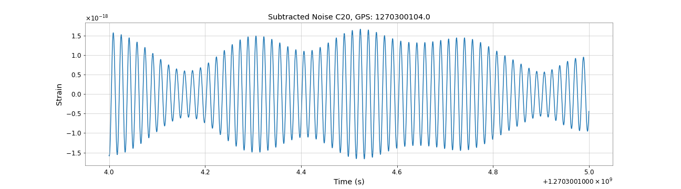
Deepclean using 2 PEM Channels: Predicted Noise
p(t)

Slide 17
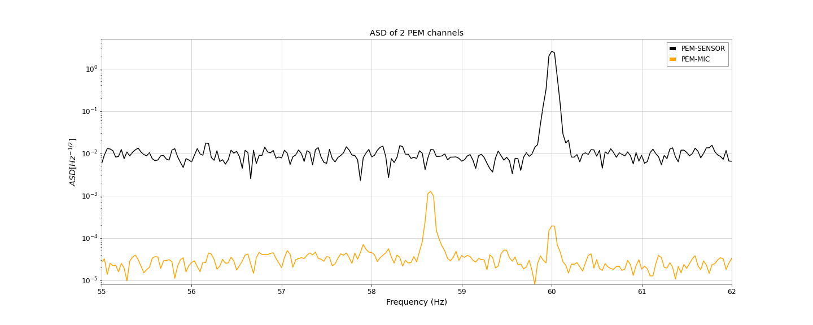
Deepclean using 2 PEM Channels: ASD of PEM Channels

Slide 18
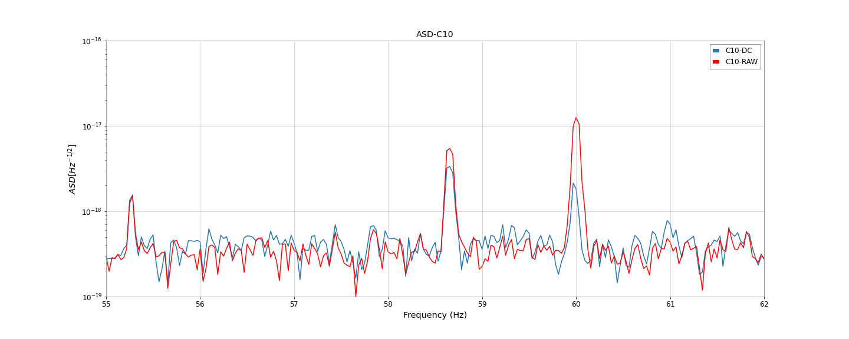
Deepclean using 2 PEM Channels: ASD of the Strain

Slide 19
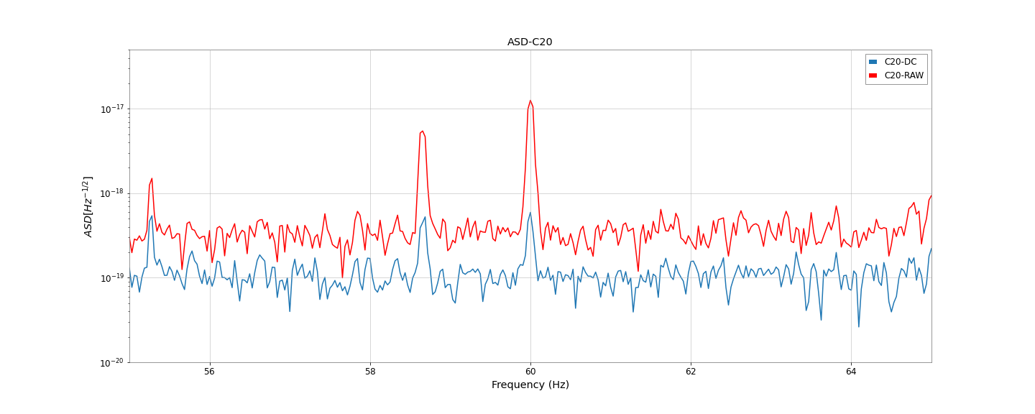
Deepclean using 2 PEM Channels: ASD of the Strain

Slide 20
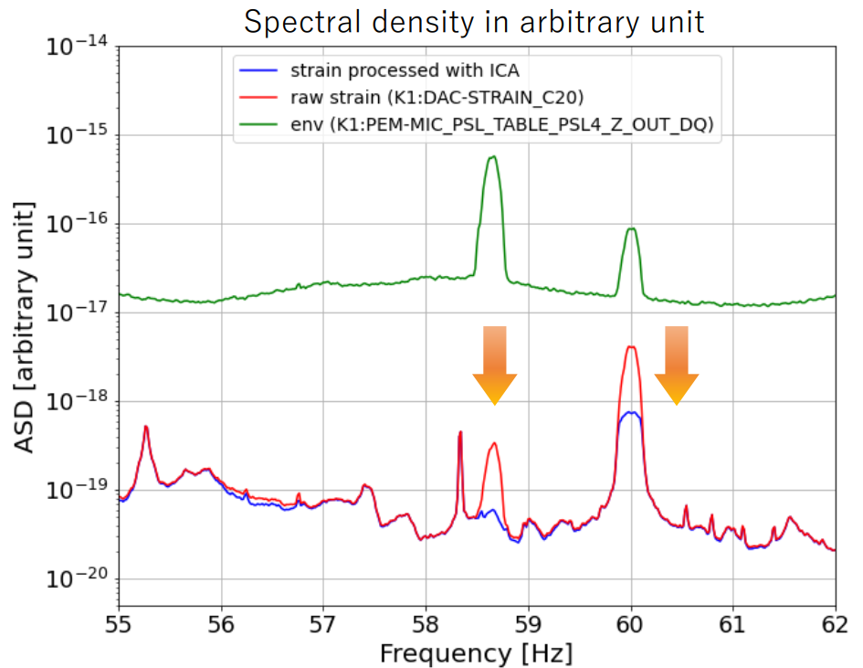
Comparison to Independent Component Analysis (ICA)
From Jun’ya Kume’s talk in 7th KAGRA International Workshop, 2020/12/19

Slide 21
Comparison to Independent Component Analysis (ICA)
We can see the 60Hz peak and the 58.68Hz peak in the ASD of C10 strain are decreased by the Deepclean.
Further optimization of Deepclean needs to be done.
ICA has better subtraction on the 58.68Hz peak.

Slide 22
Summary
Deepclean use the data from the auxiliary sensors and PEM to predict the noise p(t) in the strain h(t). The cleaned strain: h(t) - p(t).
Deepclean aims to do fast online denosing to increase the sensitivity of the detector in the low-latency search of GW.
We have shown that Deepclean has the ability to subtract the 60Hz and 58.68Hz noise captured by the PEM channels.
Low-frequency (8Hz ~ 22Hz) denoising is essential in early detection, which noise sources and related PEM channels we need to look at?

Slide 23
Thank you for the attention

Slide 24
Appendix

Slide 25
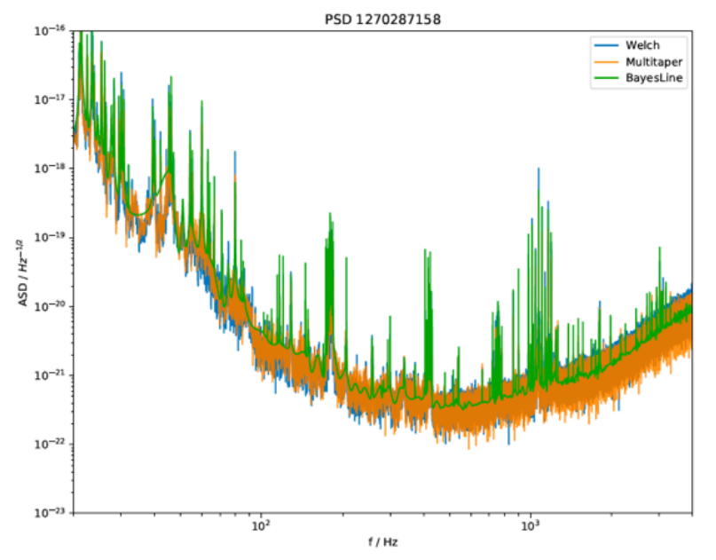
Amplitude Spectral Density
From Nami Uchikata (ICRR), Kideyuki Tagoshi (ICRR), Re-computing of O3GK BNS range, Detchar meeting 2020/01/28

Slide 26

Calibration and Strain
The strain:
Photon calibrator (PCAL) and gravity field calibrator (GCAL) are used for precise calibration.
Variation of h(t):
  C00: generated in the digital control,
  C10: generated by real time pipeline of calibration (Finite Impulse Response (FIR) filters using gstlal),
  C20: generated by offline calibration several months after the data acquisition (gstlal).

Slide 27
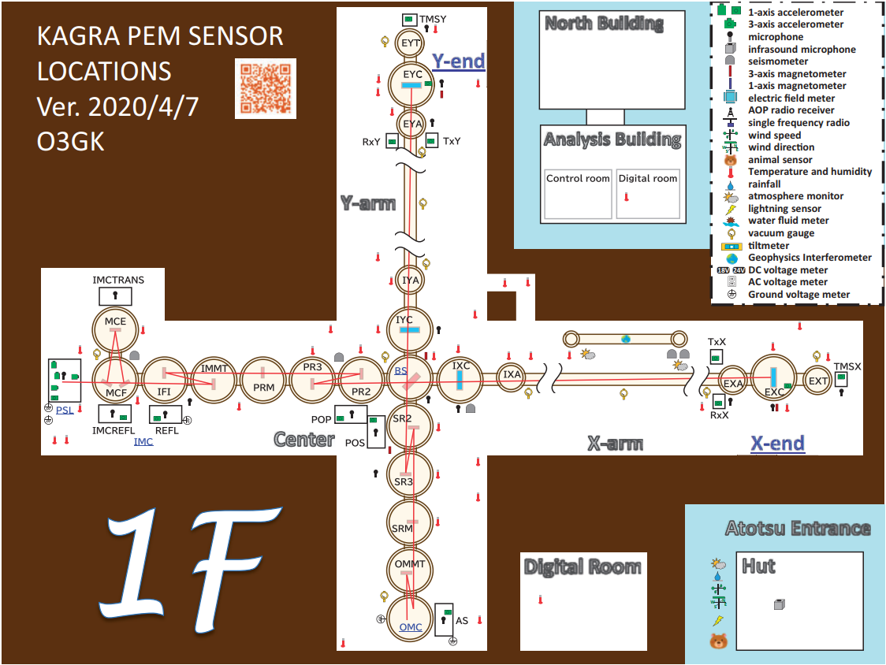
PEM in KAGRA

Slide 28
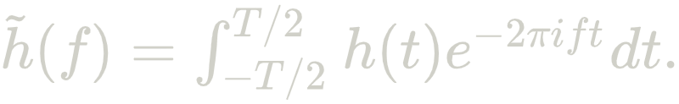
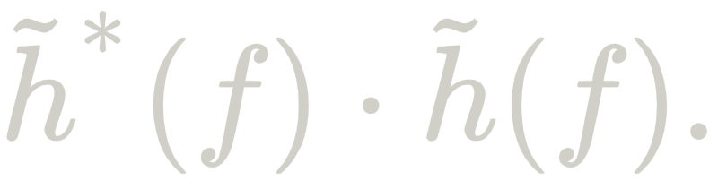
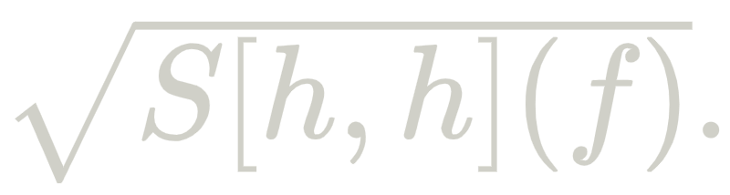
Amplitude Spectral Density
Pick a Fourier Transform Length T (usually 8 second).
Multiply h(t) wth a window function (hann) to avoid spectral leakage.
Apply Fourier transform to h(t):
Estimate the power of h in frequency domain:
Do the estimation above in many different time segements and get the average of all segements to get the power spectral density (PSD) of h(t):
Take the square root of the PSD to get the amplitude spectral density (ASD):

Slide 29
Denoising of 60Hz Powermain Noise
O3GK run:
  2020/04/07-08:00:00 UTC (1270281618) ~ 2020/04/21-00:00:00 UTC (1271462418)
  Calibration parameters was switched on: 2020/04/15 23:00:30 UTC (1271026848)
Strain data used:
  K1:DCS-CALIB_STRAIN_C10
  K1:DAC-STRAIN_C20
PEM channel used:
  K1:PEM-SENSOR_RACK_OMC1_DSUB2_OUT_DQ
Frequency Filter: 55Hz ~ 65 Hz
Training Time: 1270299936 ~ 1270300064 (128 second)
Cleaning Time: 1270300064 ~ 1270300192 (128 second)

Slide 30
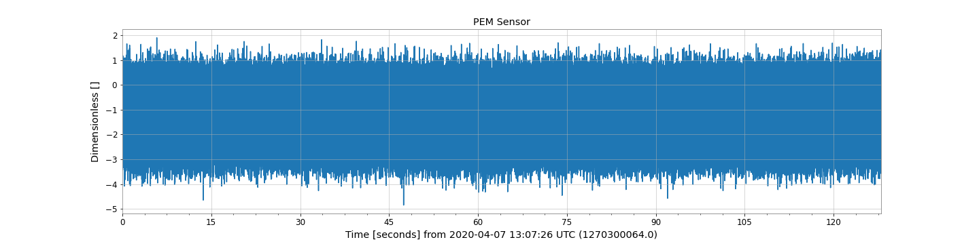
Denoising of 60Hz Powermain Noise: C10 (Low-latency)
w(t)

Slide 31
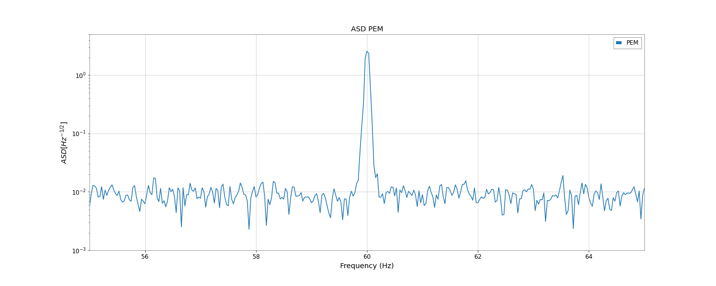
Denoising of 60Hz Powermain Noise: C10 (Low-latency)

Slide 32
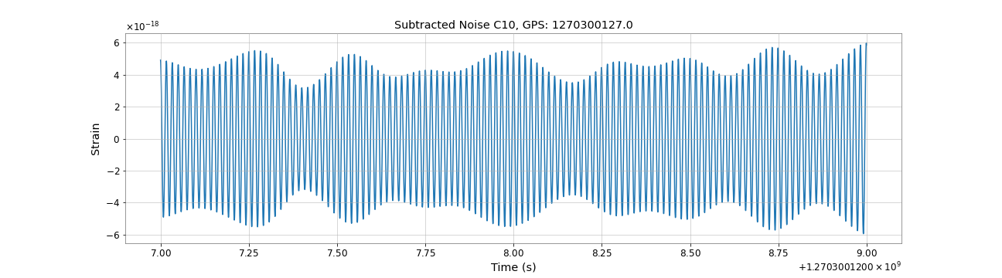
Denoising of 60Hz Powermain Noise: C10 (Low-latency)
p(t)

Slide 33
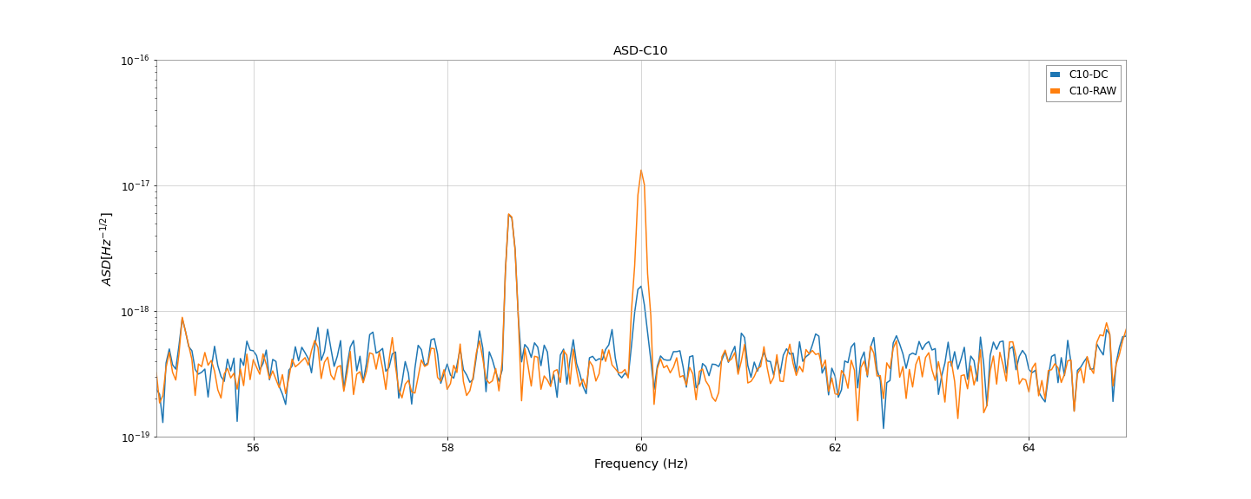
Denoising of 60Hz Powermain Noise: C10 (Low-latency)

Slide 34
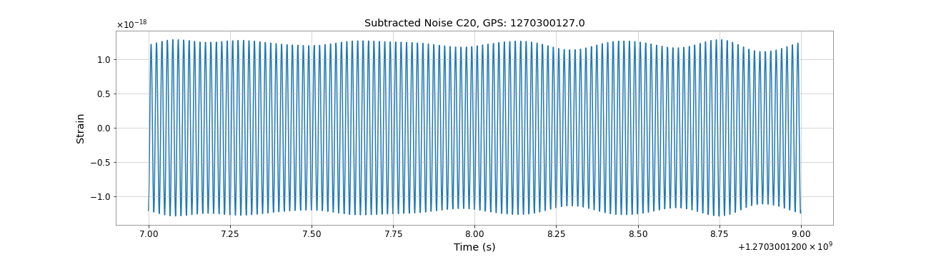
Denoising of 60Hz Powermain Noise: C20
p(t)

Slide 35
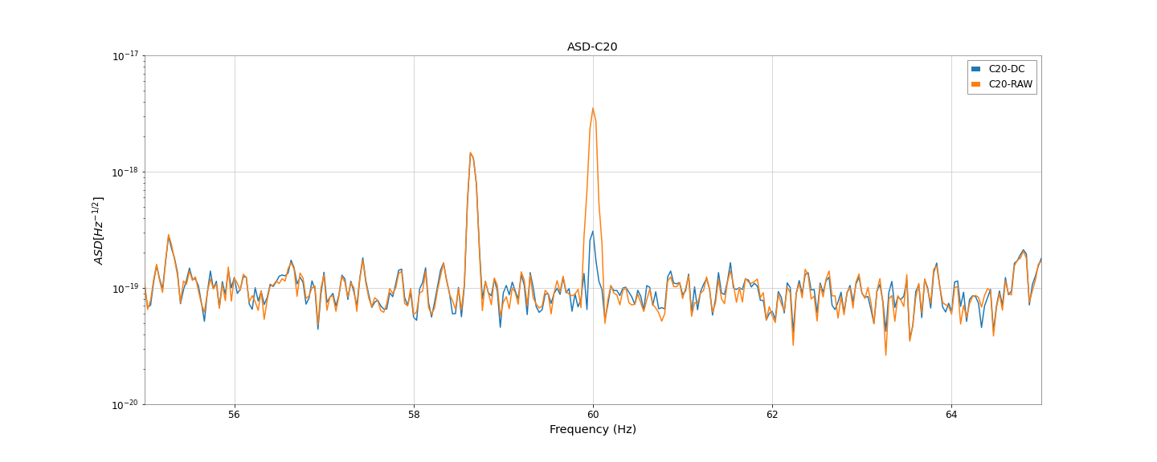
Denoising of 60Hz Powermain Noise: C20

Slide 36
Denoising of 58.68Hz using Microphone
O3GK run:
  2020/04/07-08:00:00 UTC (1270281618) ~ 2020/04/21-00:00:00 UTC (1271462418)
  Calibration parameters was switched on: 2020/04/15 23:00:30 UTC (1271026848)
Strain data used:
  K1:DCS-CALIB_STRAIN_C10
  K1:DAC-STRAIN_C20
PEM channel used:
  K1:PEM-MIC_PSL_TABLE_PSL4_Z_OUT_DQ
Frequency Filter: 55Hz ~ 65 Hz
Training Time: 1270299936 ~ 1270300064 (128 second)
Cleaning Time: 1270300064 ~ 1270300192 (128 second)

Slide 37
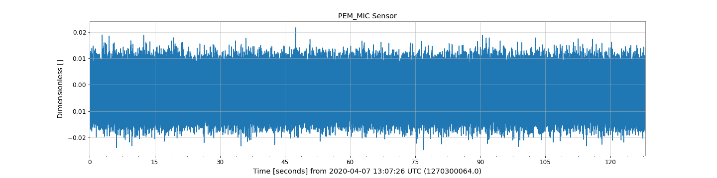
Denoising of 58.68Hz using Microphone: C10 (Low-latency)
w(t)

Slide 38
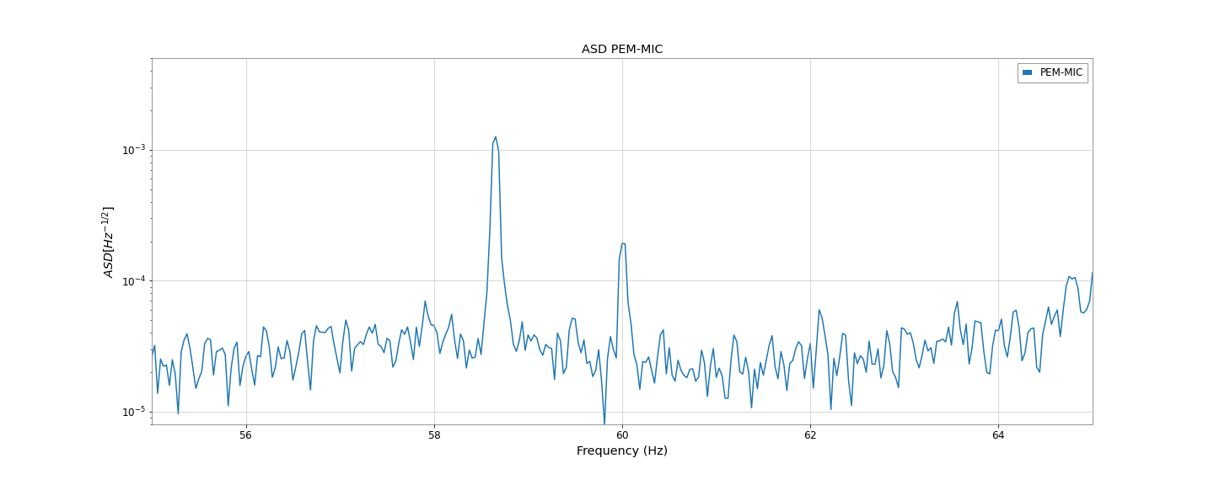
Denoising of 58.68Hz using Microphone: C10 (Low-latency)

Slide 39
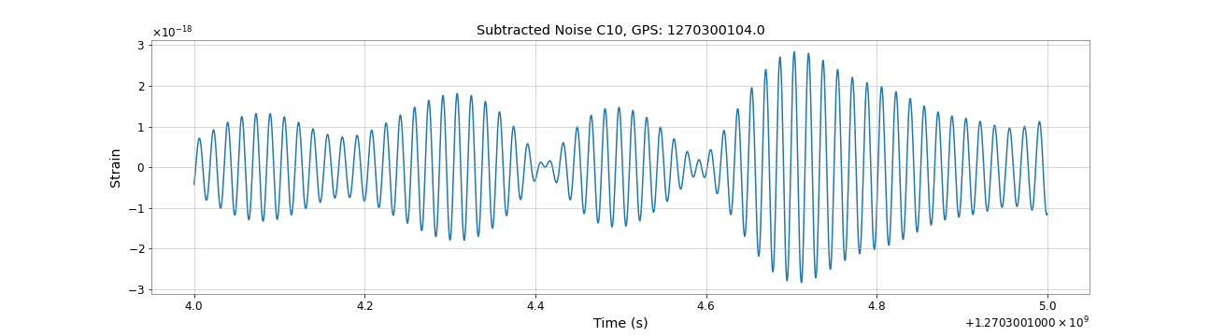
Denoising of 58.68Hz using Microphone: C10 (Low-latency)
p(t)

Slide 40
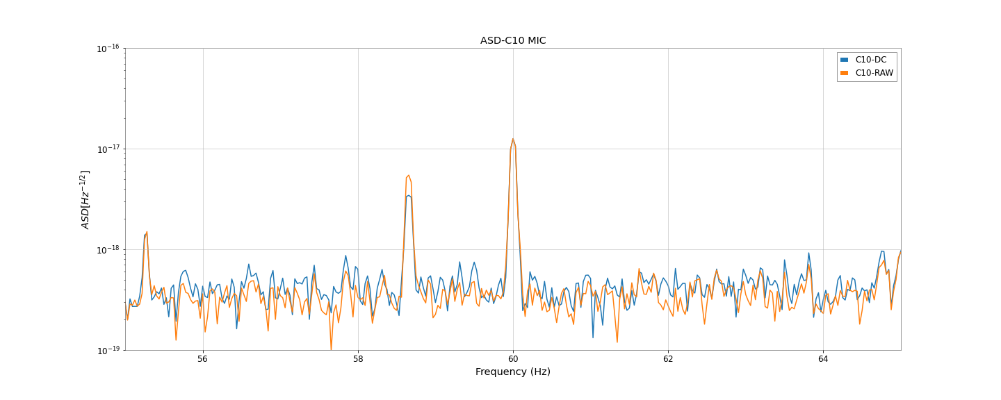
Denoising of 58.68Hz using Microphone: C10 (Low-latency)

Slide 41
Denoising of 58.68Hz using Microphone: C20
h(t)

Slide 42
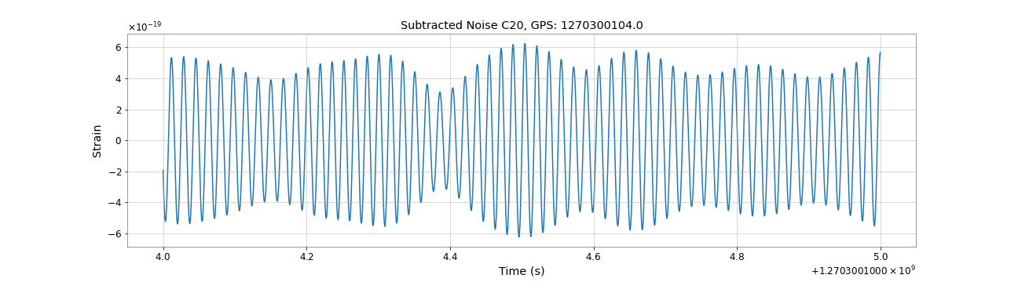
Denoising of 58.68Hz using Microphone: C20
p(t)

Slide 43
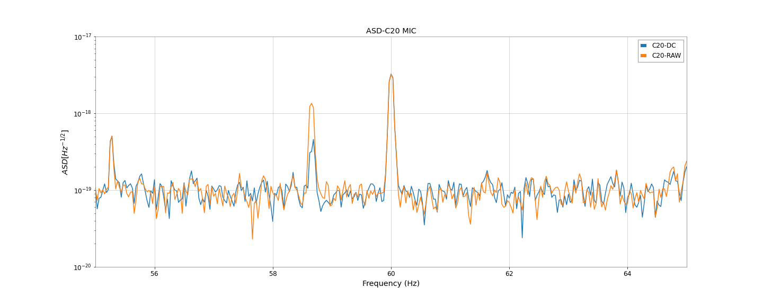
Denoising of 58.68Hz using Microphone: C20

