Slide 1
Calibration and Data Quality
Chia-Jui Chou
National Yang Ming Chiao Tung University, Taiwan
2022/01/18

Slide 2
GW Detector
Suspended cavities need to be kept on resonance with the laser by active control on the mirrors.
End Y Mirror
Y-arm Cavity
Input Y Mirror
Power Recycling Cavity
Input X Mirror
End X Mirror
Laser Output
Beam Spliter
Signal Recycling Cavity
X-arm Cavity
Photodiode

Slide 3
Pound-Drever-Hall Locking
End Y Mirror
DARM = Lx - Ly
CARM = (Lx + Ly)/2
MICH = Ix - Iy
PRCL = Ip + (Ix - Iy)/2
SRCL = Is + (Ix - Iy)/2
Ly
Input Y Mirror
Iy
Ip
Input X Mirror
End X Mirror
Laser Output
Ix
Lx
Is
Photodiode

Slide 4
Sensors in the Interferometer
Auxiliary sensors in optics and vibration-isolated system are used to investigate noise derived from control of the interferometer.
Physical envitonmental monitors (PEM).
Geophysics interferometer (GIF) in X-arm.

Slide 5

Calibration
The strain:
4 real-time digital feedback loops are used to control the lengths of the cavities.
Photon calibrator (PCAL) and gravity field calibrator (GCAL) are used for precise calibration.

Slide 6
Reconstruction Pipelines
C10: Low-latency pipeline
  Recieve DARM loop signals partially calibrated in the C00 pipline.
  Generate h(t) with a latency less than 10 s using “gstlal”.
  Calibration flags are provided.

Slide 7
Data Quality (DQ) State Vector
The recorded data are classified in 2 categories:
  GW search,
  Evaluation of detector and the noise status.
Data-quality state vectors are provided when some criteria of auxiliary channels are satisfied.
Each GW search pipeline evaluates the false alarm probability from the background noise.
Glitch pipelines detect bursts of excess power to identify transient noise.

Slide 8
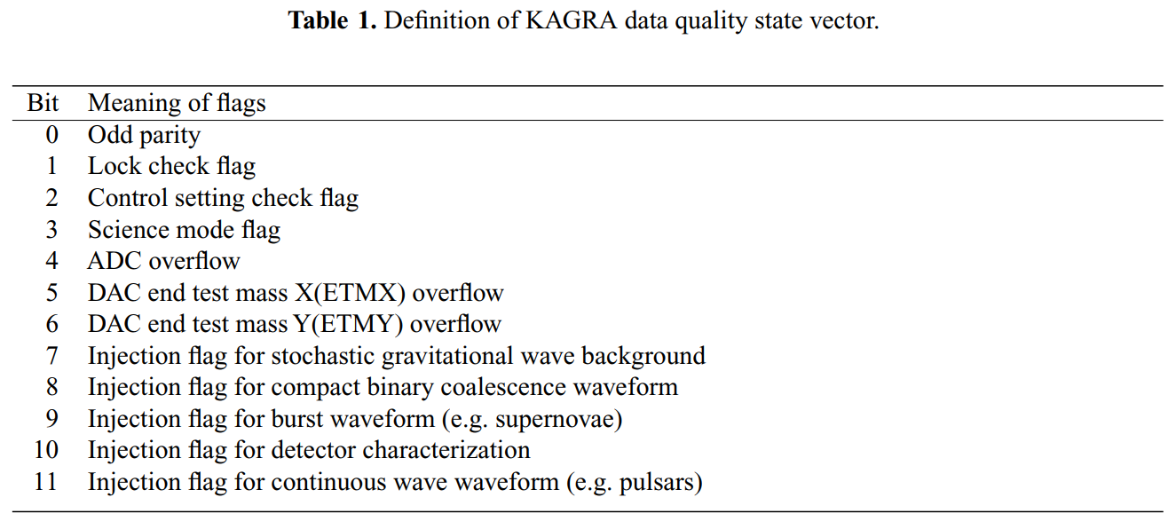
Data Quality (DQ) State Vector

Slide 9
Refs:
https://arxiv.org/abs/2009.09305
https://www.icrr.u-tokyo.ac.jp/~washimi/KAGRA/PEM/PEMmap/archives/O3GK/
http://gwwiki.icrr.u-tokyo.ac.jp/JGWwiki/KAGRA/Subgroups/DET/DataQuality
GWpy

