Slide 1
Deepclean on O3GK data and Future Plans
Chai-Jui Chou
National Yang Ming Chiao Tung University, Taiwan
2021/12/30

Slide 2
Outline
Subtraction of 60Hz powermain noise during O3GK run in KAGRA
How we did it using LIGO cluster and DiCOS cluster
Improving Deepclean and GW-IaaS:
  Hyperparameter Tuning
  Integration into GW-IaaS
  Reaching out to PEM and low-latency teams in KAGRA

Slide 3
Subtraction of 60Hz noise during O3GK run in KAGRA
O3GK run:
  2020/04/07-06:00:00 (1270274418) ~ 2020/04/20-00:00:00 (1271376018) UTC
Strain data used:
  K1:DAC-STRAIN_C20
  K1:DCS-CALIB_C10
  K1:CAL_CS_PROC_C00_STRAIN_DBL_DQ
PEM channel used:
  K1:PEM-SENSOR_RACK_OMC1_DSUB2_OUT_DQ
Training Time: 1270299936 ~ 1270300064 (128 second)
Cleaning Time: 1270300064 ~ 1270300192 (128 second)

Slide 4
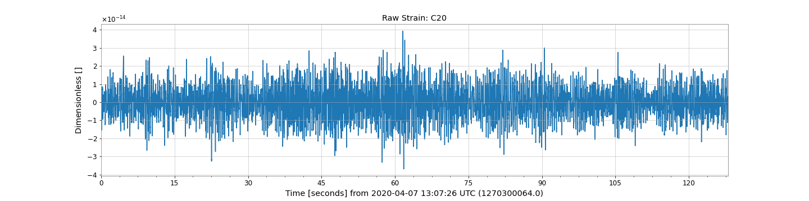
Raw Strain Data: C20

Slide 5
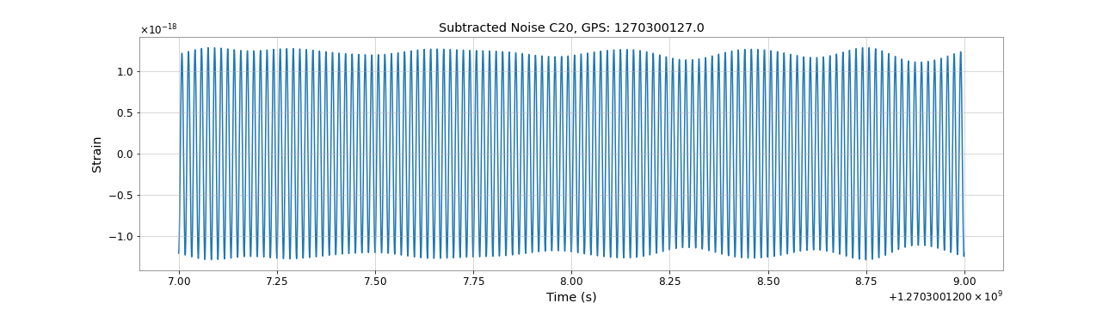
Subtracted Noise: C20

Slide 6
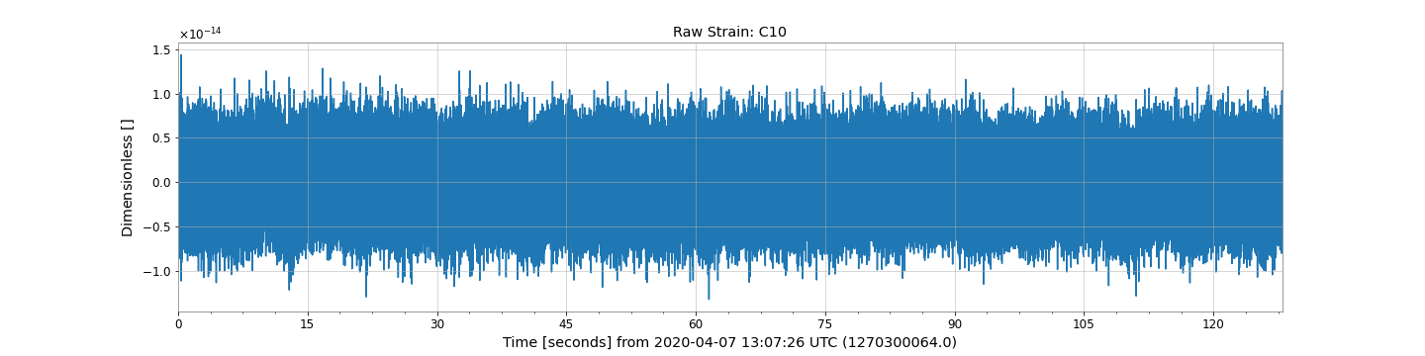
Raw Strain Data: C10 (low-latency)

Slide 7
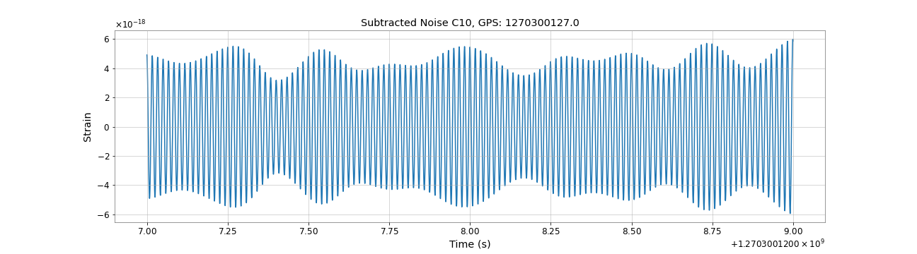
Subtracted Noise: C10 (low-latency)

Slide 8
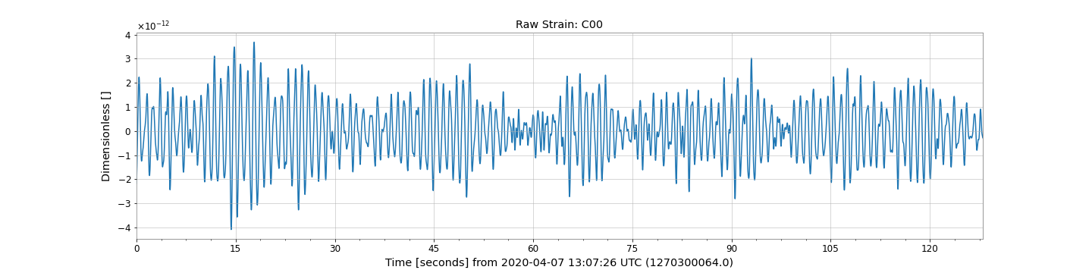
Raw Strain Data: C00

Slide 9
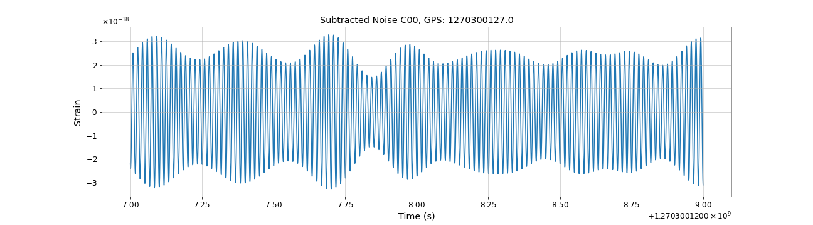
Subtracted Noise: C00

Slide 10
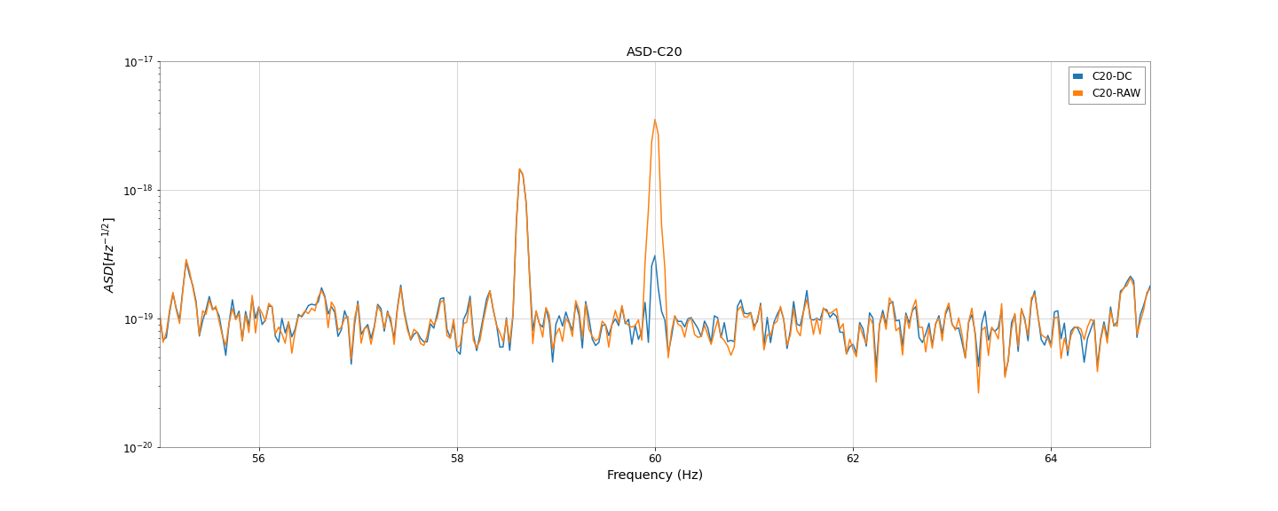
Amplitude Spectral Density: C20

Slide 11
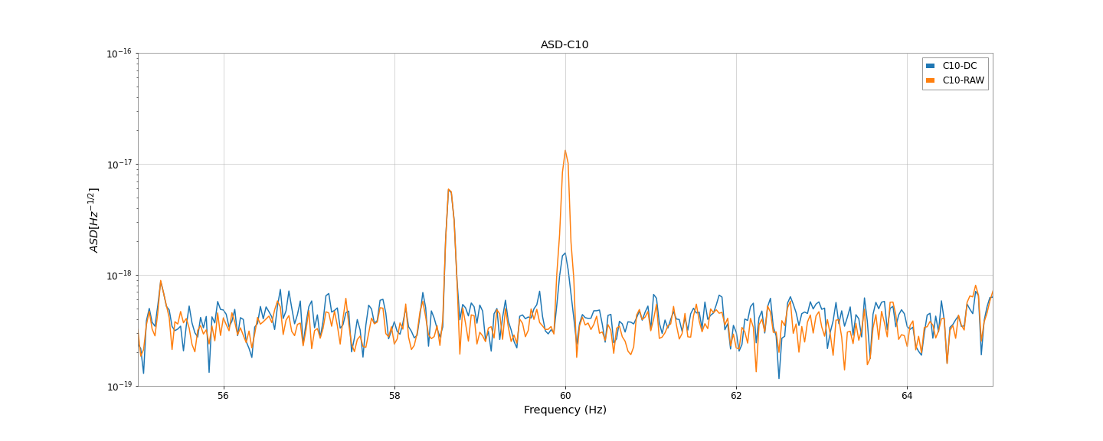
Amplitude Spectral Density: C10 (low-latency)

Slide 12
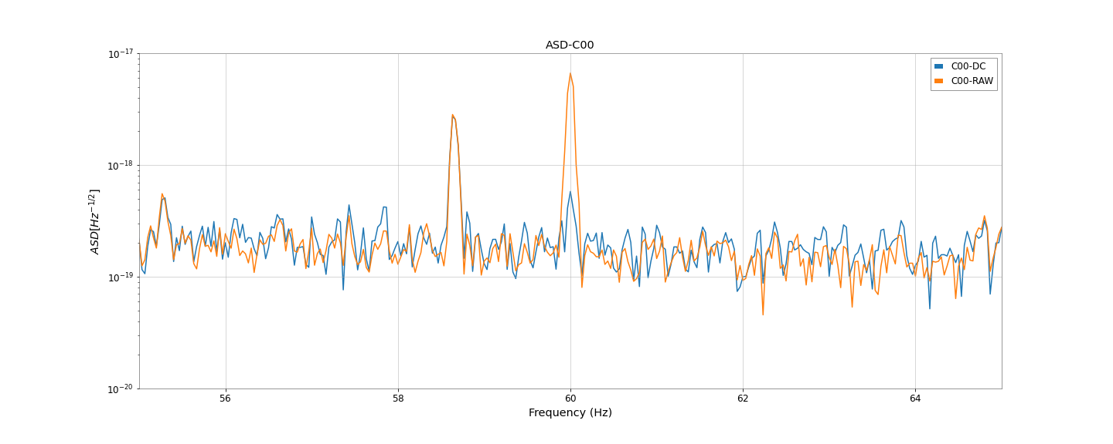
Amplitude Spectral Density: C00

Slide 13
How we do it: Environment Setup of DeepClean
We use dc-prod-py36: https://git.ligo.org/alec.gunny/deepclean-prod.git
On both LIGO cluster or DiCOS cluster, we can clone the git and use conda and the “environment.yml” in the “deepclean-prod” to create the conda environment. (Detailed Tutorial)
By editting chanslist.ini and basic_example.ini in the “example_configs” we can setup the needed witness channels and the raw strain.

Slide 14
How we do it: Data Preparation
dc-prod-py36 includes “nds2” package to fetch needed channels.
To access KAGRA data on the LIGO cluster, LIGO.ORG kerberos account is needed, but we don’t have it.
We have “kagra VO” credentials, so we download frame files on DiCOS, create the frame file contains the channels to do offline deepclean.
On DiCOS, we enountered the error: Unexpected bus error encountered in worker. This might be caused by insufficient shared memory (shm).
Then we upload the prepared framefile to the LIGO cluster to do the offline training and cleaning.

Slide 15
How we do it: Training and Cleaning
To run offline cleaning and multi-layer cleaning, we have to adjust the “deepclean-prod/timeseries.py” in the git.
Under the “fetch” function, replace the “data = TimeSeriesDict.get(...)” by “data = TimeSeriesDict.read(“<path_to_prepared_gwf>”, channels, t0, to+ duration)”.
Go back to deepclean-prod git directory and run “pip install .”.
I put the “chanslist.ini”, “config.ini”, “run_train.py”, “run_clean.py” and “prepared gwf file” under the same directory.

Slide 16
How we do it: Training and Cleaning
To train the model, run “python3 run_train.py <path_to_config.ini>” and run “python3 run_clean.py <path_to_config.ini>” to clean the raw strain.
The trained model is stored in the “train_dir/models” which we can use the “export” function in “gw-iaas” to export the model and upload to the triton server.
The cleaned strain is stored in the frame file in “outdir” and the raw strain and the channels are stored in “raw.h5” file.

Slide 17
GW-IaaS (using Triton Server to do low-latency online deepclean.)
We know how to export the trained model and upload the model to the container of triton server provided by NCHC.
Currently we are having trouble on sending jobs to the server using client code through rpc port. The problem is related to the internet connection in NCHC.
We have the data replay of llhoft data from Hanford (H1), we can prepare the data replay of llhoft data from KAGRA (K1) to test the client code .
nds2 package setting in KAGRA. We need to reach out to the data analysis team in KAGRA. (Haino in Academia Sinica)

Slide 18
Improving Deepclean and GW-IaaS
Systematic Framework of Hyperparameter Tuning of DeepClean.
Implementation of Random sampling methods, Bayesian-Optimization methods on the Deepclean.
What are the good evaluations of the performance of different models after Hyperparameter tuning?
ASDR?

Slide 19
Reaching out to PEM and low-latency teams in KAGRA
PEM team: Kume, Itoh, Yokoyama, Washimi, Yokozawa
Comparison to Independent Component Analysis (ICA)
Find out the noise in other frequency bands and the relevant witness channels. (PEM team, Data Analysis team)
Data Analysis team, detctor charactrization: Yuzurihara
Data Analysis team, low-latency search or MMA: Ueno (GstLAL, All-sky CBC search)

Slide 20
Physical Environmental Monitors
Seismometers, Accelerometers, Microphones, Magnetometers, Voltmeters, Thermometers, Weather station, Lightning sensor
Known noises: 17.2Hz, 44Hz, 160Hz, 280Hz, 360Hz
Geophysics interferometer (GIF):
  Unique features in KAGRA to measure the ground motions along the arms.

Slide 21
Other Denoising method in KAGRA: ICA
Independent Component Analysis (ICA) on the accoustic noise:
  363Hz, 372Hz, 402Hz
Power main noise:
  60Hz, 120Hz
From the slides of F2F meeting on 2020/12/19.
The channel used: “K1:DAC-STRAIN_C20”, ”K1:PEM-MIC_PSL_TABLE_PSL4_Z_OUT_DQ”
Kume, Itoh, Yokoyama, Washimi, Yokozawa

