Slide 1
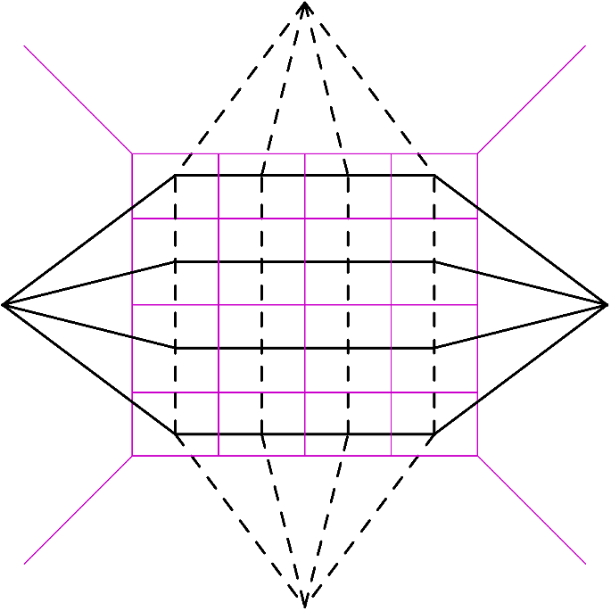

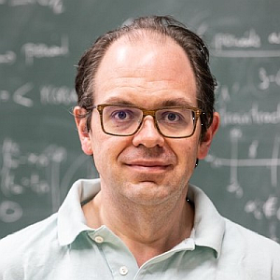


Antipodal (Self-)Duality in Planar N=4 SYM and Fishnet Theory
Lance Dixon (SLAC)
with Claude Duhr, 2502.00862
Amplitudes 2025
Seoul National University
20 June 2025

Slide 2
Outline & Summary
Bizarre “Antipodal (Self) Duality” [ASD] for (some) form factors / amplitudes in Planar N=4 Super Yang-Mills theory
All given by multiple polylogarithms with a Hopf algebra coaction whose maximal iteration is called the symbol
A(S)D involves writing the symbol backwards (antipode), together with some kinematic map
Antipode exchanges branch cuts and derivatives.
NEW: A(S)D extends to some individual integrals – which are also amplitudes – four-point fishnet integrals
Might help understand what physics underlies A(S)D

Slide 3

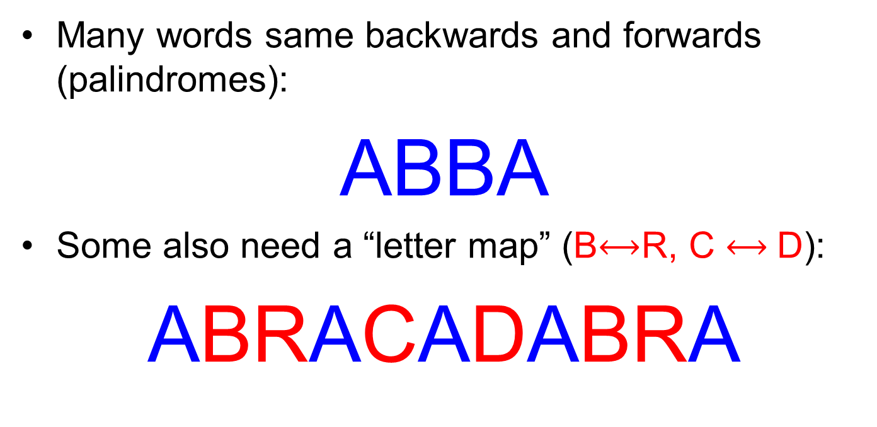
Reversing words
Many words same backwards and forwards (palindromes):
ABBA
Some also need a “letter map” (B$⟷$R, C $⟷$D):
ABRACADABRA

Slide 4
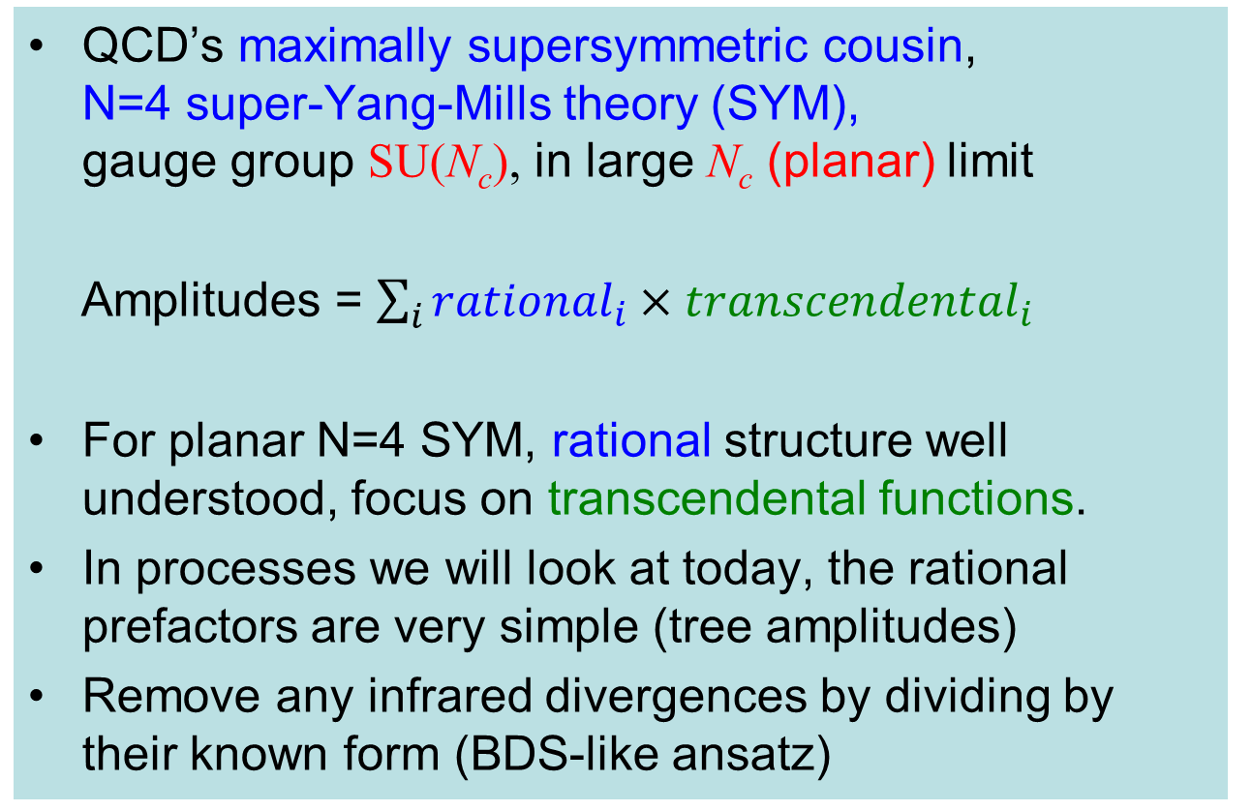
Planar N=4 SYM, testing ground for QCD amplitudes
QCD’s maximally supersymmetric cousin, N=4 super-Yang-Mills theory (SYM), gauge group SU(N_{c}), in large N_{c} (planar) limit
Amplitudes = $\sum_{i}{{rational}_{i}{×transcendental}_{i}}$
For planar N=4 SYM, rational structure well understood, focus on transcendental functions.
In processes we will look at today, the rational prefactors are very simple (tree amplitudes)
Remove any infrared divergences by dividing by their known form (BDS-like ansatz)

Slide 5
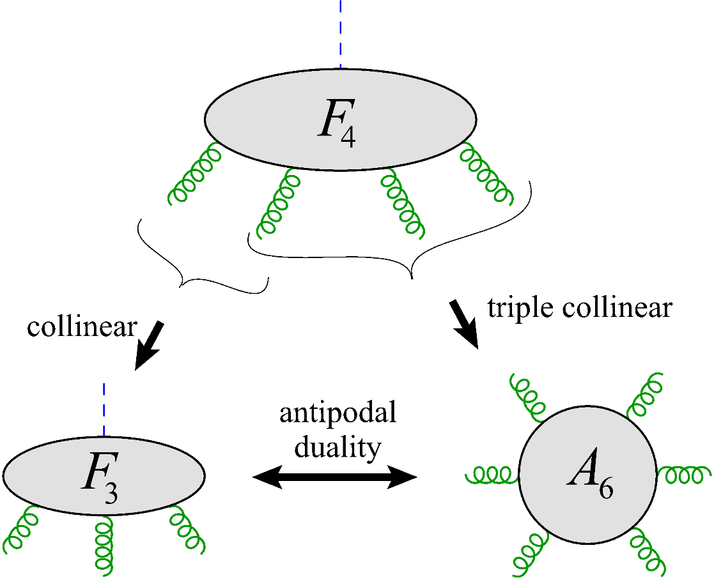



Antipodal Self Duality for a 4-point form factor in planar N=4 SYM
LD, Ö. Gürdoğan, Y.-T. Liu, A. McLeod, M. Wilhelm, 2212.02410
$$𝒪$$
$$𝒪=tr φ^{2}+…+tr{ G}_{μν}^{SD}G^{μν SD}$$
validated for 4 variables
to 3 loops
antipode map
reverses order
of letters in
symbol
$$𝒪$$
also requires a
kinematic map
validated for
2 variables
to 8 loops!
LD, Ö. Gürdoğan, A. McLeod, M. Wilhelm, 2112.06243

Slide 6
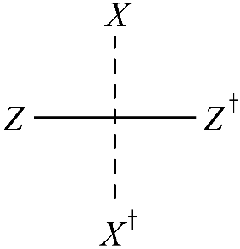
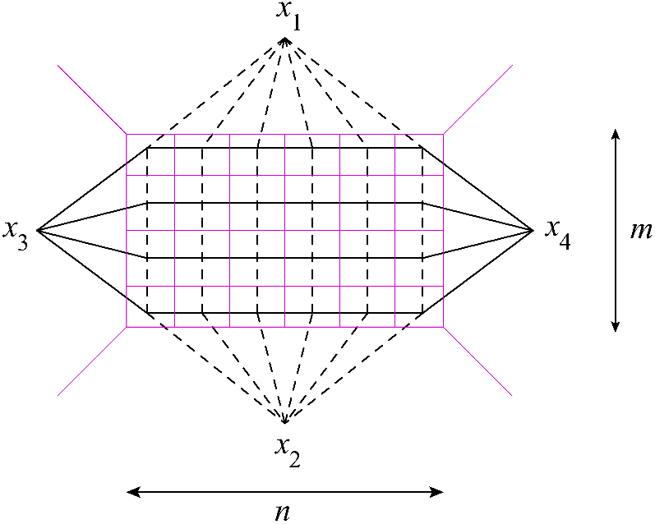
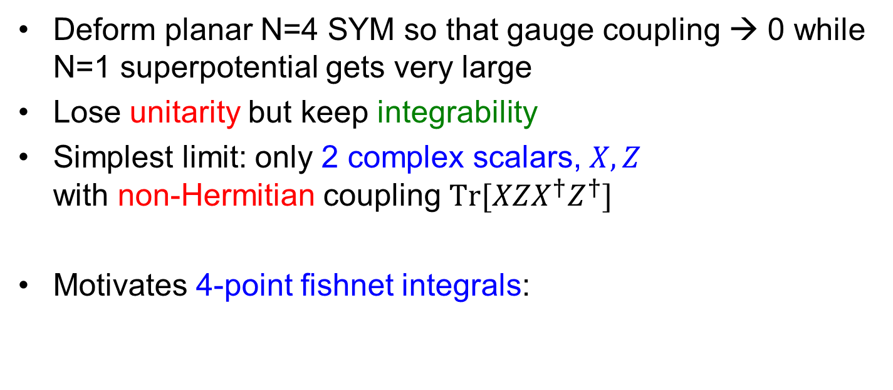

Strongly deformed planar N=4 SYM
Gürdoğan, Kazakov, 1512.06704; Caetano, Gürdoğan, Kazakov, 1612.05895
Deform planar N=4 SYM so that gauge coupling → 0 while N=1 superpotential gets very large
Lose unitarity but keep integrability
Simplest limit: only 2 complex scalars, $X,Z$ with non-Hermitian coupling $Tr[{XZX}^{†}Z^{†}]$
Motivates 4-point fishnet integrals:
$$<Tr[ X^{n}\left(x_{1}\right){Z^{m}\left(x_{3}\right)X}^{†n}\left(x_{2}\right)Z^{†m}\left(x_{4}\right)]> =$$
$$∝φ_{m,n}\left(u,v\right)= φ_{m,n}(z,\overline{z})$$

Slide 7
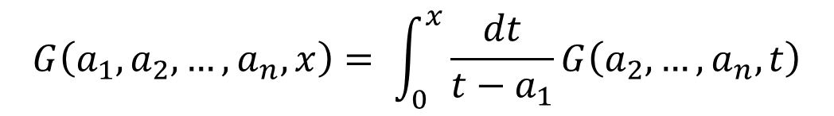
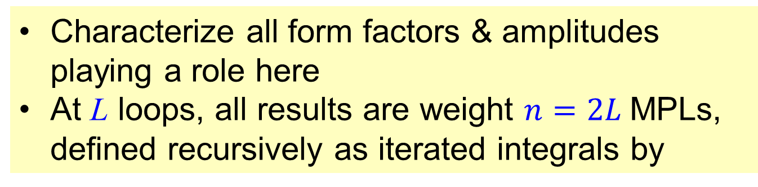
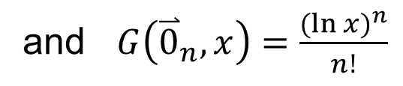
Multiple polylogarithms (MPLs)
talks by Britto, Hartanto, Volovich, Yang, Bourjaily,…
Characterize all form factors & amplitudes playing a role here
At L loops, all results are weight $n=2L$MPLs, defined recursively as iterated integrals by
$$G\left(a_{1},a_{2},…,a_{n},x\right)= \int_{0}^{x}{\frac{dt}{t−a_{1}}G\left(a_{2},…,a_{n},t\right)}$$
and $G\left({\overset{⃑}{0}}_{n},x\right)=\frac{{(\ln{x})}^{n}}{n!}$

Slide 8
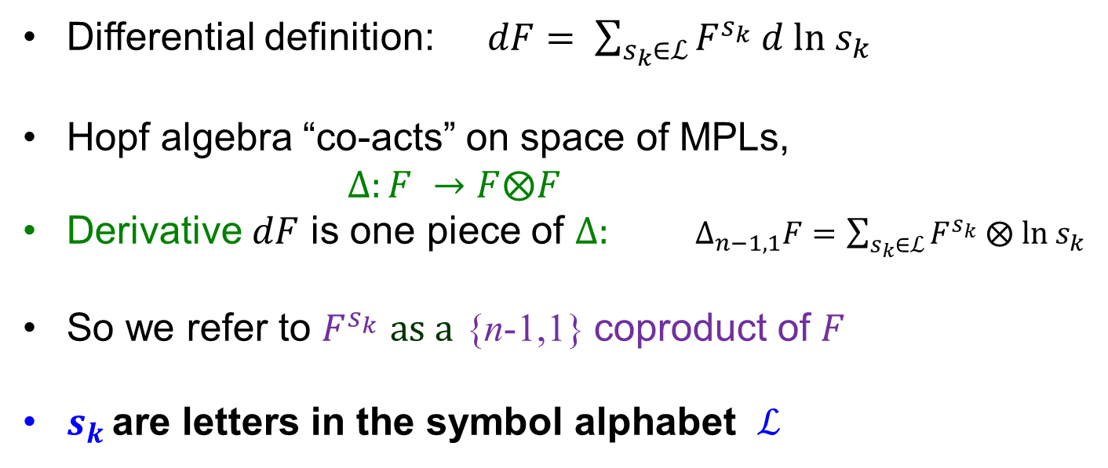
MPL Hopf algebra
Goncharov; Brown; Goncharov, Spradlin, Vergu, Volovich; Duhr, Gangl, Rhodes
Differential definition: $dF= \sum_{s_{k}∈ℒ}{F^{s_{k}} d ln s_{k}}$
Hopf algebra “co-acts” on space of MPLs,
$Δ:F →F⨂F$
Derivative $dF$ is one piece of $Δ:$ $Δ_{n−1,1}F=$ $\sum_{s_{k}∈ℒ}{F^{s_{k}} ⨂ ln s_{k}}$
So we refer to $F^{s_{k}}$ $as a$ {n-1,1} coproduct of $F$
$s_{k }$are letters in the symbol alphabet $ℒ$

Slide 9
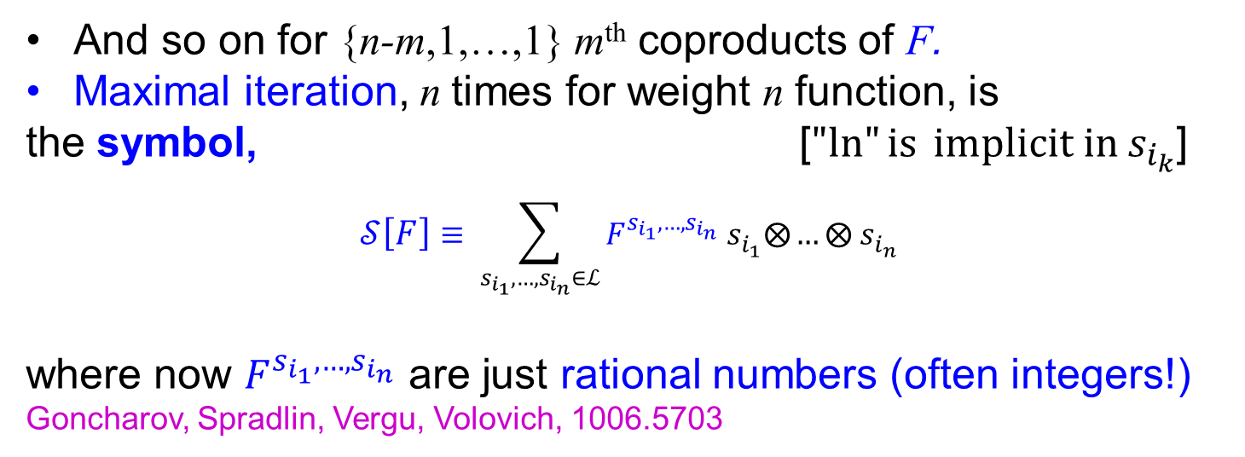
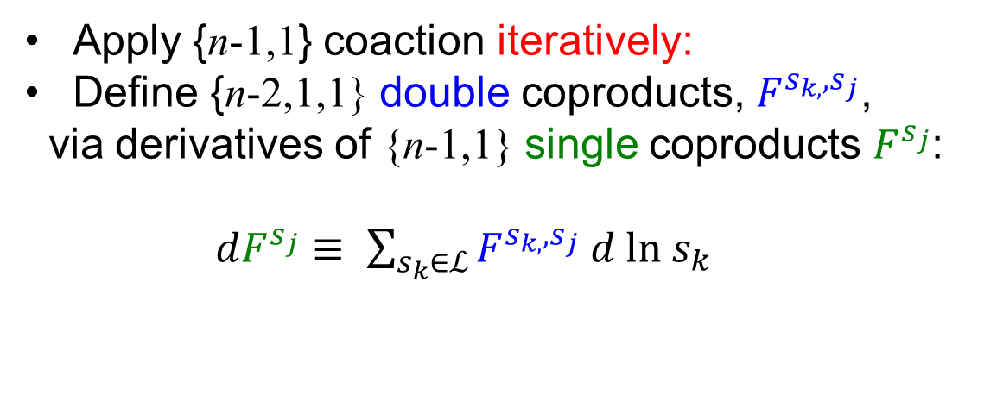
Iterate to get symbol
Apply {n-1,1} coaction iteratively:
Define {n-2,1,1} double coproducts, $F^{s_{k,},s_{j}}$,
via derivatives of {n-1,1} single coproducts $F^{s_{j}}$:
$dF^{s_{j}}≡ \sum_{s_{k}∈ℒ}{F^{s_{k,},s_{j}} d ln s_{k}}$
And so on for {n-m,1,…,1} m^{th} coproducts of F.
Maximal iteration, n times for weight n function, is
the symbol, [$"ln"{is} implicit in s_{i_{k}}$]
$$𝒮\left[F\right]≡ \sum_{s_{i_{1}},{…,s}_{i_{n}}∈ℒ}{F^{s_{i_{1}},…,s_{i_{n}}} s_{i_{1}}⨂…}⨂ s_{i_{n}}$$
where now $F^{s_{i_{1}},…,s_{i_{n}}}$ are just rational numbers (often integers!)
Goncharov, Spradlin, Vergu, Volovich, 1006.5703

Slide 10
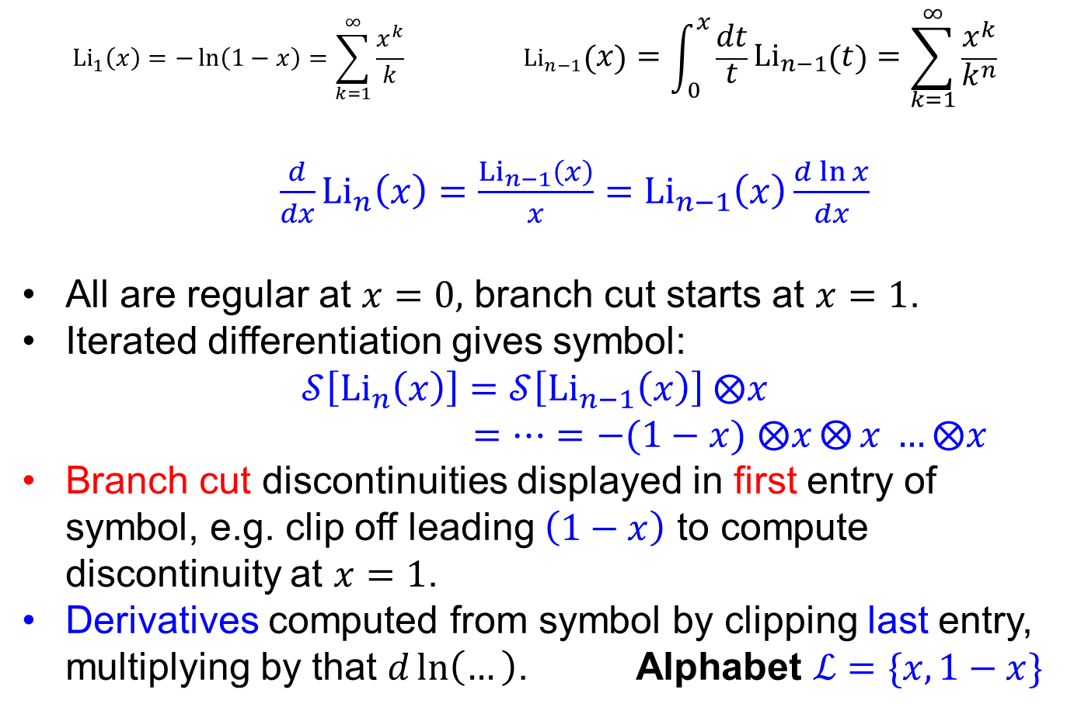
Example 1: Classical polylogarithms
$${{Li}_{1}\left(x\right)=−\ln\left(1−x\right)=\sum_{k=1}^{∞}{\frac{x^{k}}{k}} }_{ }{Li}_{n−1}\left(x\right)=\int_{0}^{x}{\frac{dt}{t}{Li}_{n−1}\left(t\right)}=\sum_{k=1}^{∞}{\frac{x^{k}}{k^{n}}}$$
${ \frac{d}{dx}Li}_{n}\left(x\right)=$ $\frac{{Li}_{n−1}\left(x\right)}{x}=$ ${Li}_{n−1}\left(x\right)\frac{d\ln{x}}{dx}$
All are regular at $x=0,$ branch cut starts at $x=1$.
Iterated differentiation gives symbol:
$$𝒮\left[{Li}_{n}\left(x\right)\right]=𝒮\left[{Li}_{n−1}\left(x\right)\right] ⨂x$$
$=…=−(1−x)$ $⨂x⨂{x }…⨂x$
Branch cut discontinuities displayed in first entry of symbol, e.g. clip off leading $\left(1−x\right)$ to compute discontinuity at $x=1$.
Derivatives computed from symbol by clipping last entry, multiplying by that $d\ln\left(…\right)$. Alphabet $ℒ=\{x,1−x\}$

Slide 11
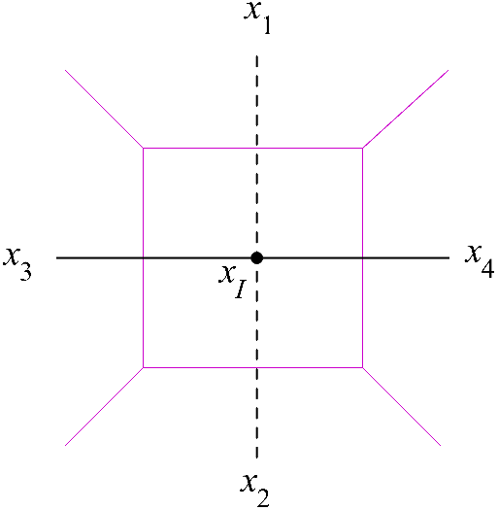
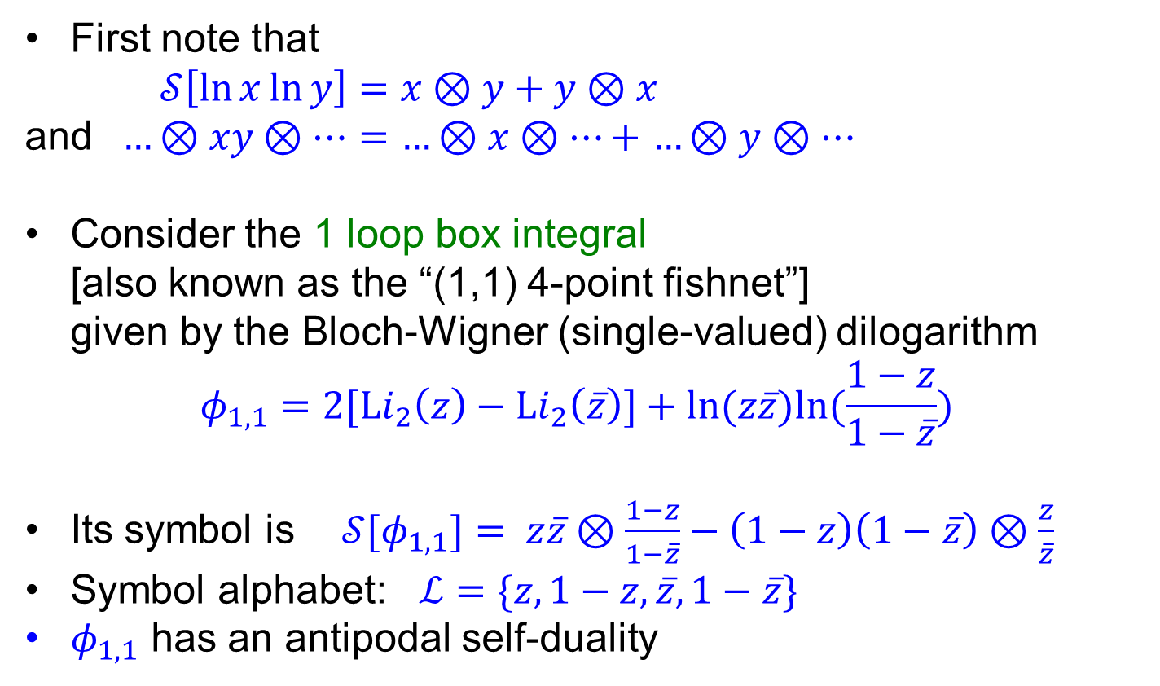

Example 2
First note that
$𝒮\left[\ln{x}\ln{y}\right]=x⊗y+y⊗x$
and $…⊗xy⊗…=$ $…⊗x⊗…+$ $…⊗y⊗…$
Consider the 1 loop box integral [also known as the “(1,1) 4-point fishnet”] given by the Bloch-Wigner (single-valued) dilogarithm
$$φ_{1,1}=2[{Li}_{2}\left(z\right)−{Li}_{2}\left(\overline{z}\right)]+ln⁡(z\overline{z})ln(\frac{1−z}{1−\overline{z}})$$
Its symbol is $𝒮[φ_{1,1}]= z\overline{z}⊗\frac{1−z}{1−\overline{z}}−\left(1−z\right)\left(1−\overline{z}\right)⊗\frac{z}{\overline{z}}$
Symbol alphabet: $ℒ=\{z,1−z,\overline{z},1−\overline{z}\}$
$φ_{1,1}$ has an antipodal self-duality
Bourjaily talk
Hodges (1977)
Bloch, Wigner (1978)
$$−\left(1−z\right)⊗z$$

Slide 12
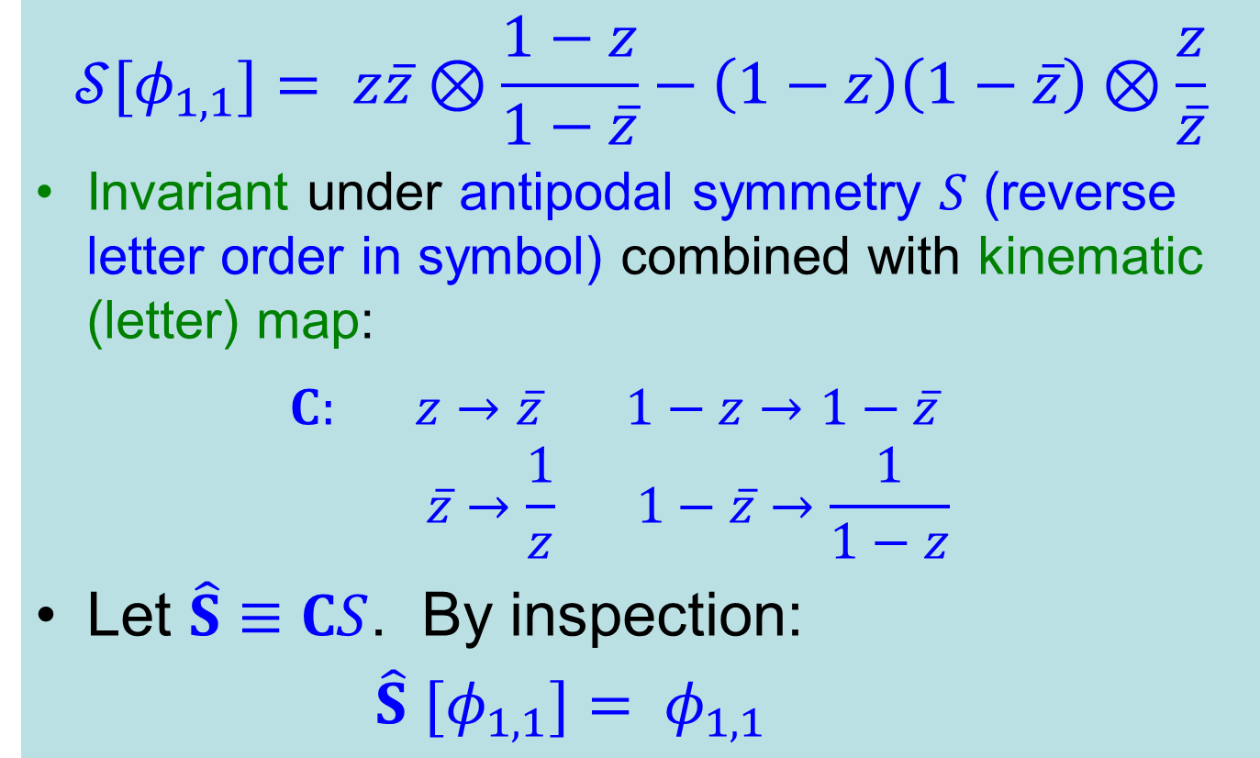
ASD for (1,1) fishnet [box]
$$𝒮[φ_{1,1}]= z\overline{z}⊗\frac{1−z}{1−\overline{z}}−\left(1−z\right)\left(1−\overline{z}\right)⊗\frac{z}{\overline{z}}$$
Invariant under antipodal symmetry $S$ (reverse letter order in symbol) combined with kinematic (letter) map:
$C: z→\overline{z} 1−z→1−\overline{z}$
$$\overline{z}→\frac{1}{z} 1−\overline{z}→\frac{1}{1−z}$$
Let $\hat{S}≡CS$. By inspection:
$\hat{S}$ $[φ_{1,1}]= φ_{1,1}$

Slide 13
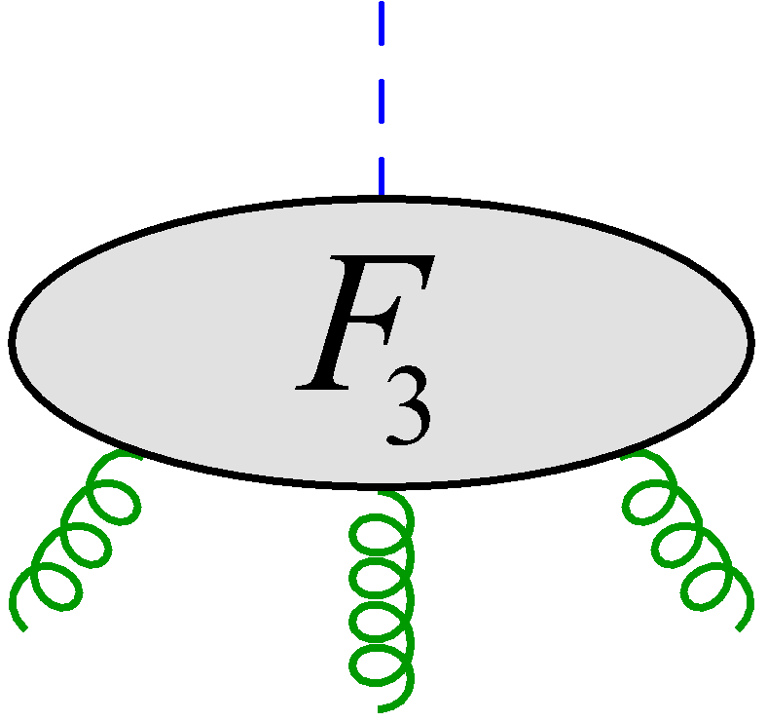
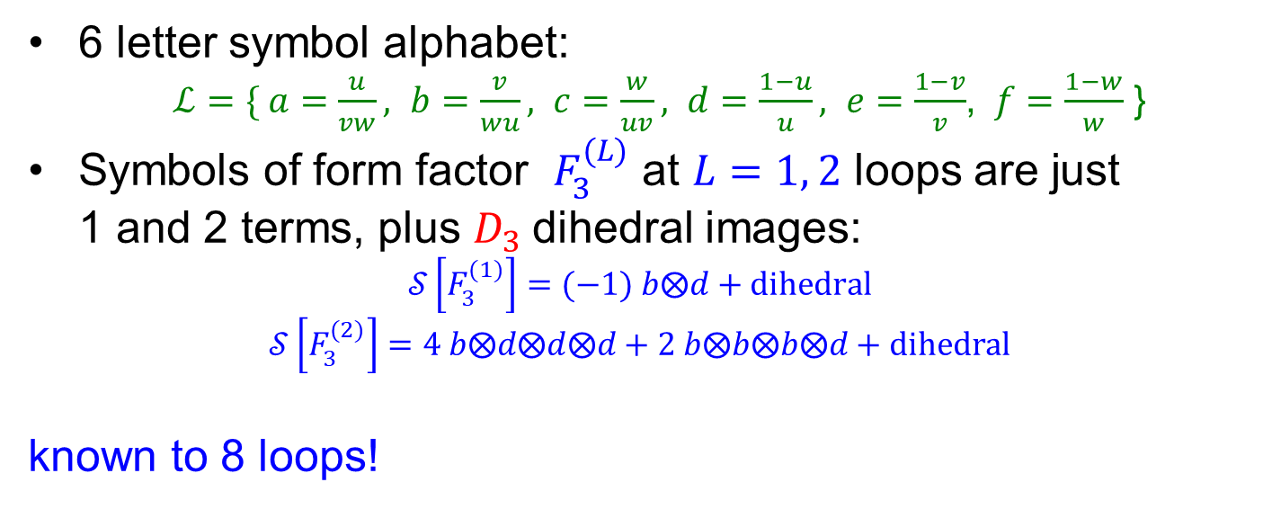

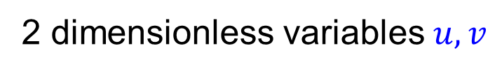




Three-gluon form factor
$$𝒪$$
2 dimensionless variables $u,v$
1
3
$$s_{123}=s_{12}+s_{23}+s_{31}=q_{}^{2}$$
$k_{i}^{2}=0 s_{ij}=(k_{i}+k_{j})^{2}$
2
$$k_{1}+k_{2}+k_{3}=−k_{𝒪}$$
$$u=\frac{s_{12}}{s_{123}} v=\frac{s_{23}}{s_{123}} w=\frac{s_{31}}{s_{123}}=1−u−v$$
6 letter symbol alphabet:
$ℒ=\{ a=\frac{u}{vw}, b=\frac{v}{wu}, c=\frac{w}{uv}, d=\frac{1−u}{u}, e=\frac{1−v}{v}$, $f=\frac{1−w}{w}$ }
Symbols of form factor $F_{3}^{(L)}$ at $L=1, 2$ loops are just 1 and 2 terms, plus $D_{3}$dihedral images:
$$𝒮\left[F_{3}^{(1)}\right]=(−1) b⨂d+dihedral$$
$$𝒮\left[F_{3}^{(2)}\right]=4 b⨂d⨂d⨂d+2 b⨂b⨂b⨂d+dihedral$$
known to 8 loops!
Brandhuber, Travaglini, Yang, 1201.4170
LD, Gürdoğan, A. McLeod, M. Wilhelm, 2204.11901

Slide 14
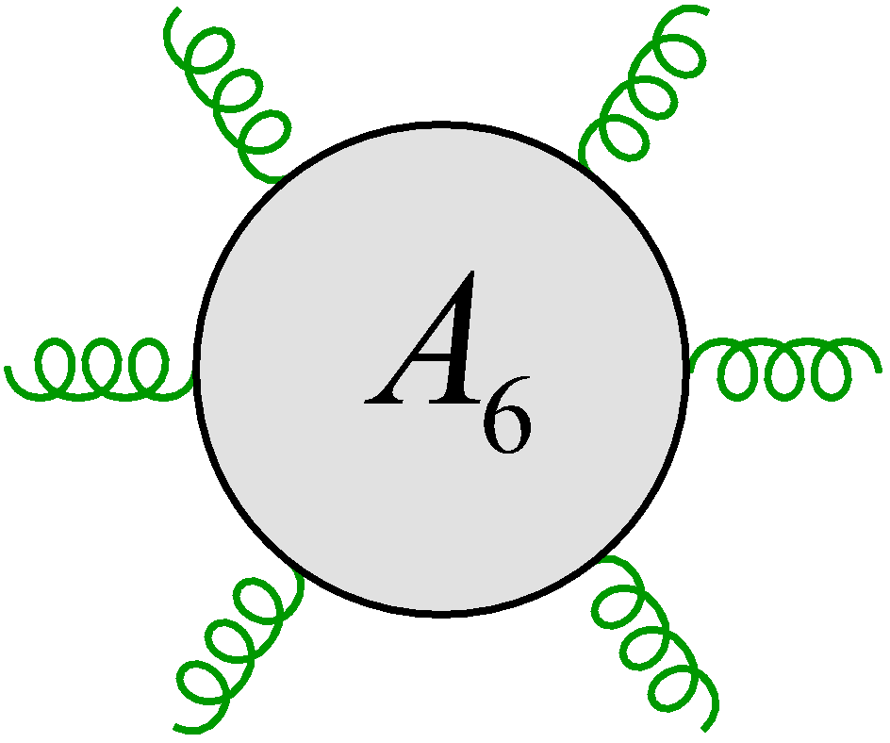
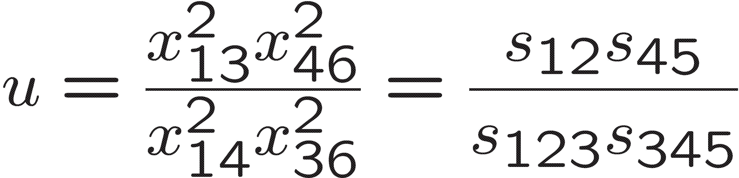
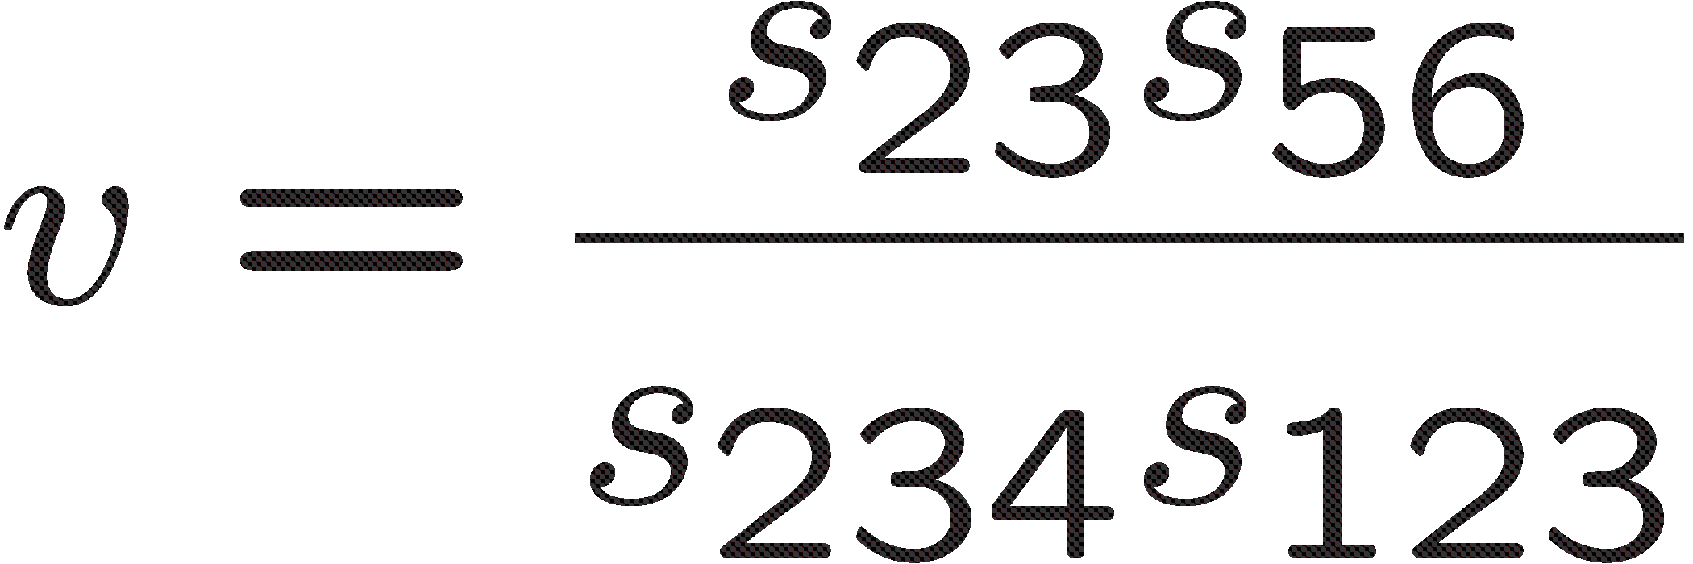
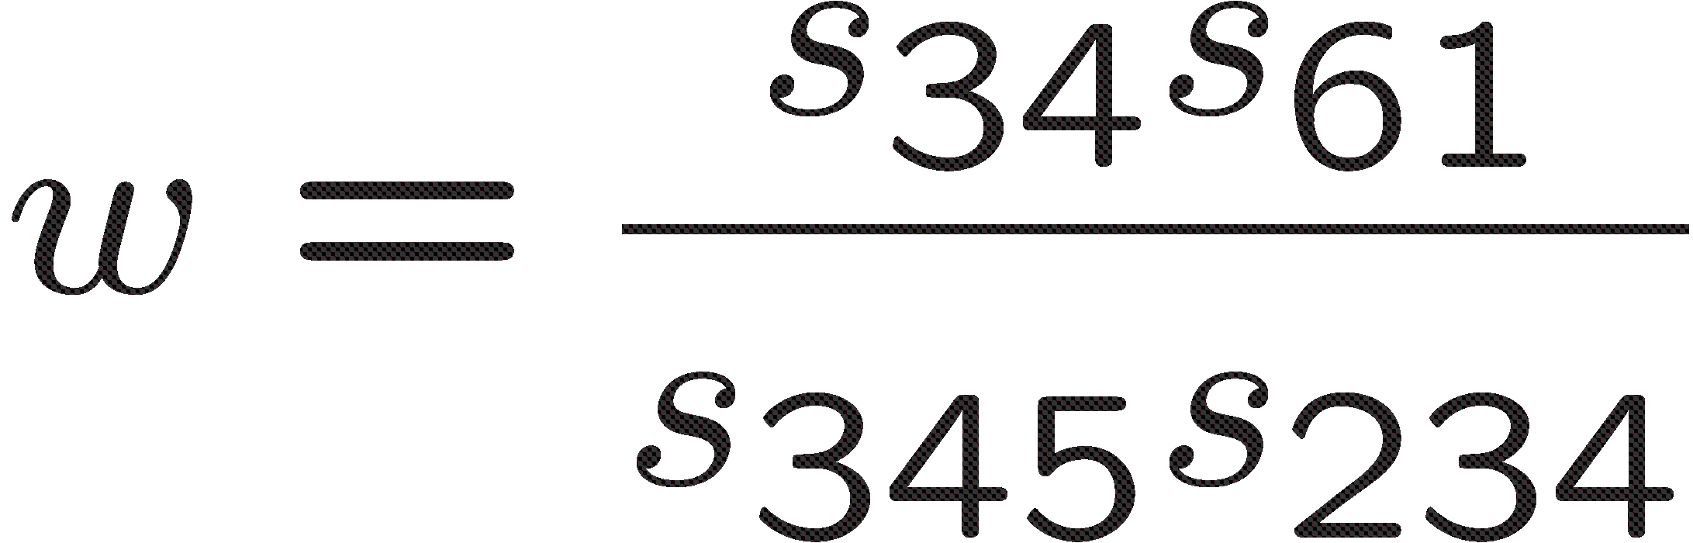




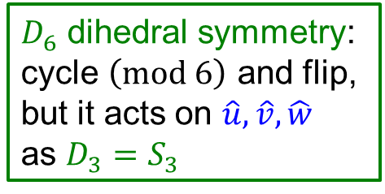

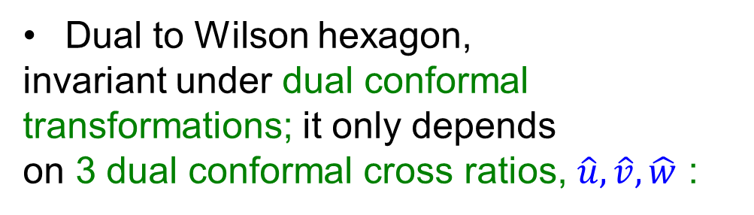





Six-gluon MHV amplitude
$$−$$
$$+$$
Dual to Wilson hexagon,
invariant under dual conformal
transformations; it only depends
on 3 dual conformal cross ratios, $\hat{u},\hat{v},\hat{w}$ :
$$+$$
$$+$$
6
1
$$−$$
$$+$$
$D_{6}$ dihedral symmetry:
cycle $\left(mod 6\right)$ and flip,
but it acts on $\hat{u},\hat{v},\hat{w}$
as $D_{3}=S_{3}$
5
2
4
3
Parity-preserving surface:
(lower-dimensional kinematics)
$$Δ≡(1−\hat{u}−\hat{v}−\hat{w})^{2}−4\hat{u}\hat{v}\hat{w}=0$$

Slide 15
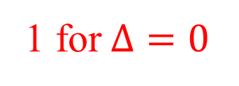
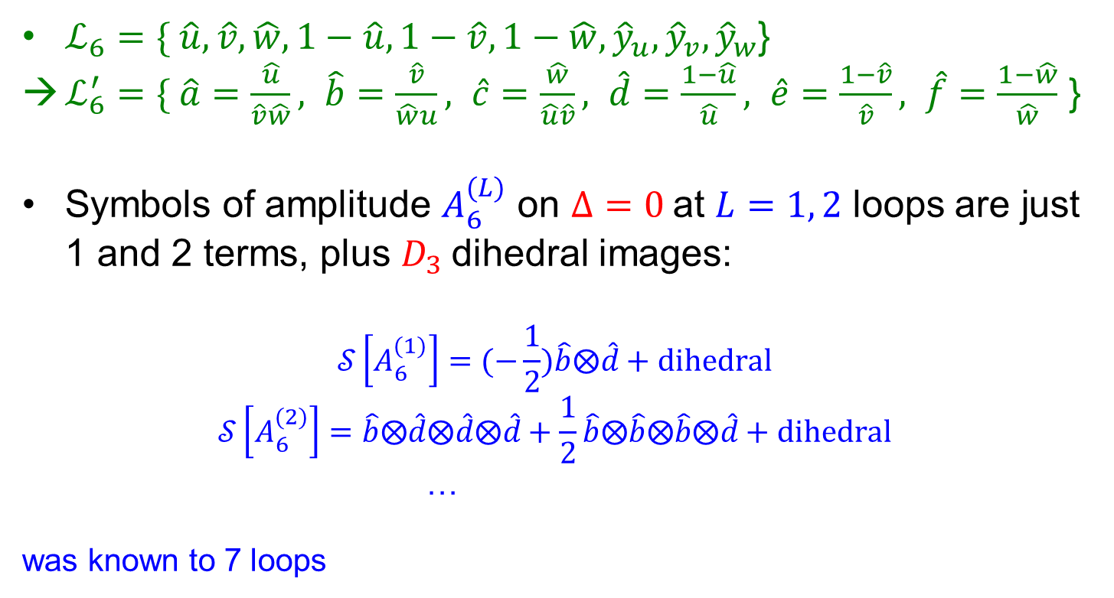
6-gluon symbol alphabet
talk by Volovich
1 for$Δ=0$
$ℒ_{6}=\{ \hat{u},\hat{v},\hat{w},1−\hat{u},1−\hat{v},1−\hat{w},{\hat{y}}_{u},{\hat{y}}_{v},{\hat{y}}_{w}$}
$ℒ_{6}^{′}=\{ \hat{a}=\frac{\hat{u}}{\hat{v}\hat{w}}, \hat{b}=\frac{\hat{v}}{\hat{w}u}, \hat{c}=\frac{\hat{w}}{\hat{u}\hat{v}}, \hat{d}=\frac{1−\hat{u}}{\hat{u}}, \hat{e}=\frac{1−\hat{v}}{\hat{v}}, \hat{f}=\frac{1−\hat{w}}{\hat{w}}$ }
Symbols of amplitude $A_{6}^{(L)}$ on $Δ=0$at $L=1, 2$ loops are just 1 and 2 terms, plus $D_{3}$dihedral images:
$$𝒮\left[A_{6}^{(1)}\right]=(−\frac{1}{2})\hat{b}⨂\hat{d}+dihedral$$
$$𝒮\left[A_{6}^{(2)}\right]=\hat{b}⨂\hat{d}⨂\hat{d}⨂\hat{d}+\frac{1}{2}\hat{b}⨂\hat{b}⨂\hat{b}⨂\hat{d}+dihedral$$
…
was known to 7 loops
Goncharov, Spradlin, Vergu, Volovich, 1006.5703, …,
Caron-Huot, LD, Dulat, McLeod, von Hippel, 1903.10890

Slide 16
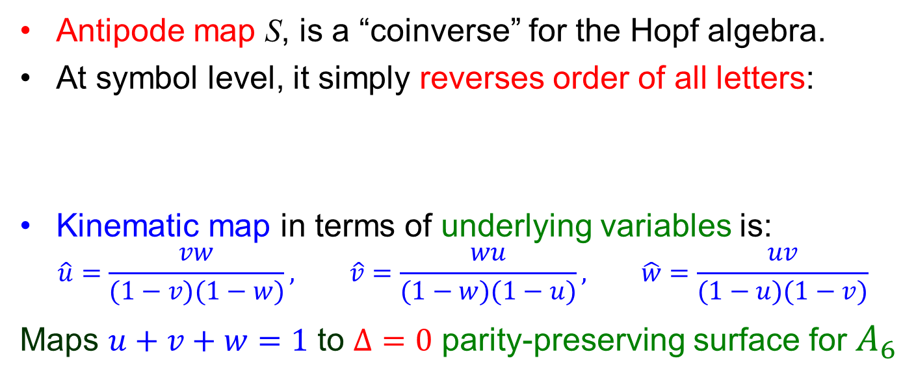
Antipodal duality (AD)
LD, Ö. Gürdoğan, A. McLeod, M. Wilhelm, 2112.06243
Antipode map S, is a “coinverse” for the Hopf algebra.
At symbol level, it simply reverses order of all letters:
Kinematic map in terms of underlying variables is:
$$\hat{u}=\frac{vw}{(1−v)(1−w)}, \hat{v}=\frac{wu}{(1−w)(1−u)}, \hat{w}=\frac{uv}{(1−u)(1−v)}$$
Maps $u+v+w=1$ to $Δ=0$ parity-preserving surface for $A_{6}$

Slide 17
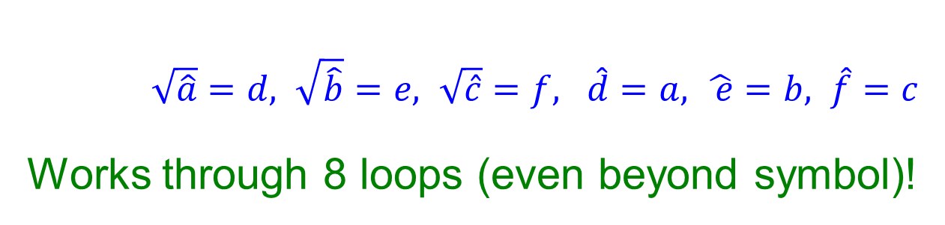
Kinematic map on letters
$\sqrt{\hat{a}}=d, \sqrt{\hat{b}}=e, \sqrt{\hat{c}}=f, \hat{d}=a, \hat{ e}=b, \hat{f}=c$
Works through 8 loops (even beyond symbol)!
LD, Liu, 2308.08199
in symbol
(number of nonzero
integers that match)
But why?!

Slide 18

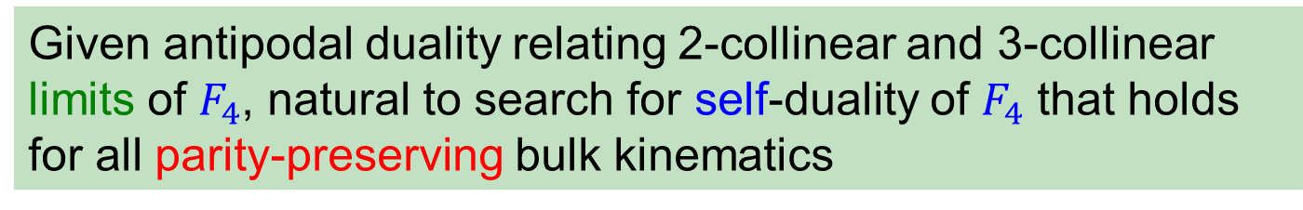


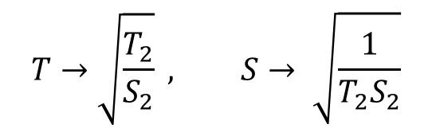
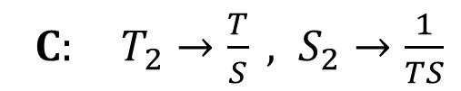
Antipodal Self Duality
Given antipodal duality relating 2-collinear and 3-collinear limits of $F_{4}$, natural to search for self-duality of $F_{4}$ that holds for all parity-preserving bulk kinematics
ASD
And it’s there!
$$F_{4}^{\left(L\right)}(u_{i}{,v}_{i})=S[F_{4}^{\left(L\right)}\left(C\left(u_{i}\right), C\left(v_{i}\right)\right)]$$
Kinematic map C simple in FFOPE variables:
$C: T_{2}→\frac{T}{S} , S_{2}→\frac{1}{TS}$
$$T→\sqrt{\frac{T_{2}}{S_{2}}} , S→ \sqrt{\frac{1}{T_{2}S_{2}}}$$
$$F_{3}^{\left(L\right)}(u_{i})=S[A_{6}^{\left(L\right)}\left({\hat{u}}_{i}\right)]$$
$$F_{2}=1$$

Slide 19
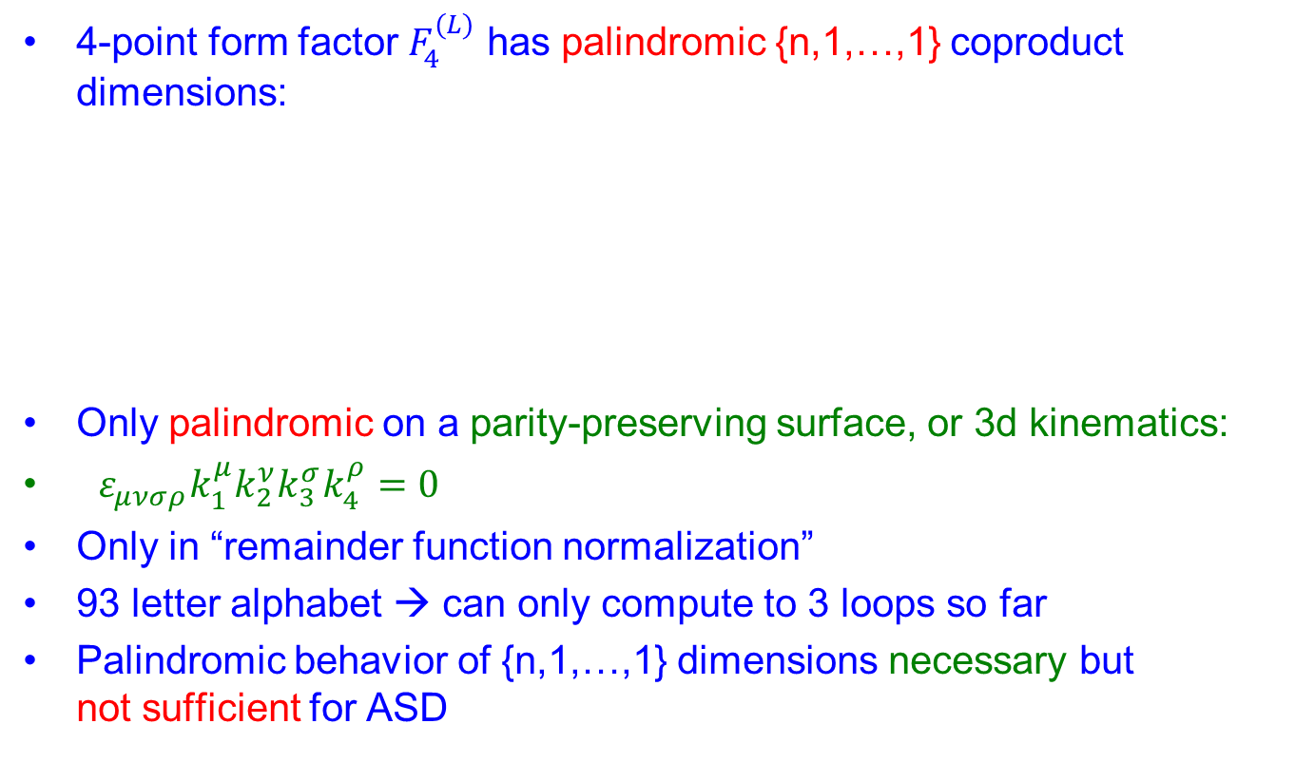
Antipodal Self Duality Evidence by Counting
4-point form factor $F_{4}^{(L)}$ has palindromic {n,1,…,1} coproduct dimensions:
Only palindromic on a parity-preserving surface, or 3d kinematics:
$ε_{μνσρ}k_{1}^{μ}k_{2}^{ν}k_{3}^{σ}k_{4}^{ρ}=0$
Only in “remainder function normalization”
93 letter alphabet → can only compute to 3 loops so far
Palindromic behavior of {n,1,…,1} dimensions necessary but not sufficient for ASD
LD, Ö. Gürdoğan, Y.-T. Liu,
A. McLeod, M. Wilhelm,
2212.02410
LD, Zhenjie Li, to appear

Slide 20

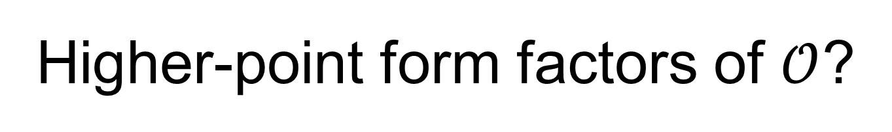
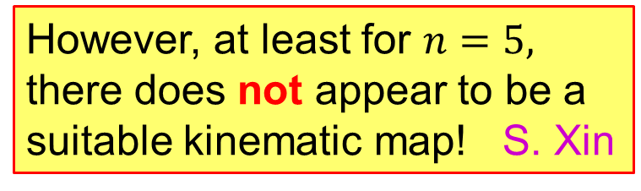
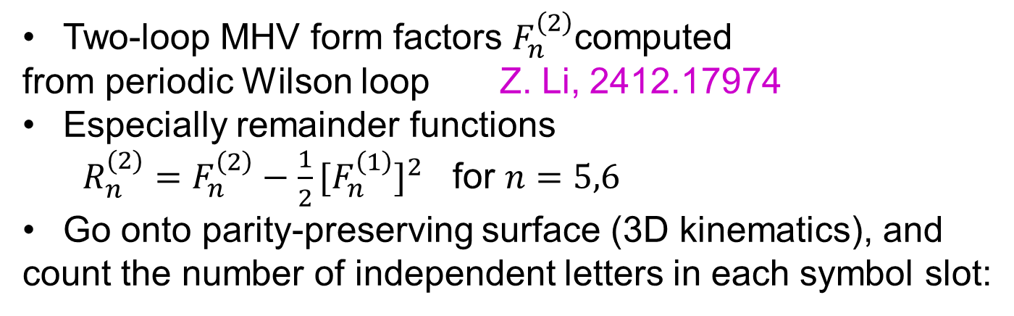
Higher-point form factors of $𝒪$?
Two-loop MHV form factors $F_{n}^{\left(2\right)}$computed
from periodic Wilson loop Z. Li, 2412.17974
Especially remainder functions
$R_{n}^{(2)}=F_{n}^{\left(2\right)}−\frac{1}{2}[F_{n}^{\left(1\right)}]^{2}$ for $n=5,6$
Go onto parity-preserving surface (3D kinematics), and
count the number of independent letters in each symbol slot:
However, at least for $n=5,$
there does not appear to be a
suitable kinematic map! S. Xin
Palindromic!

Slide 21
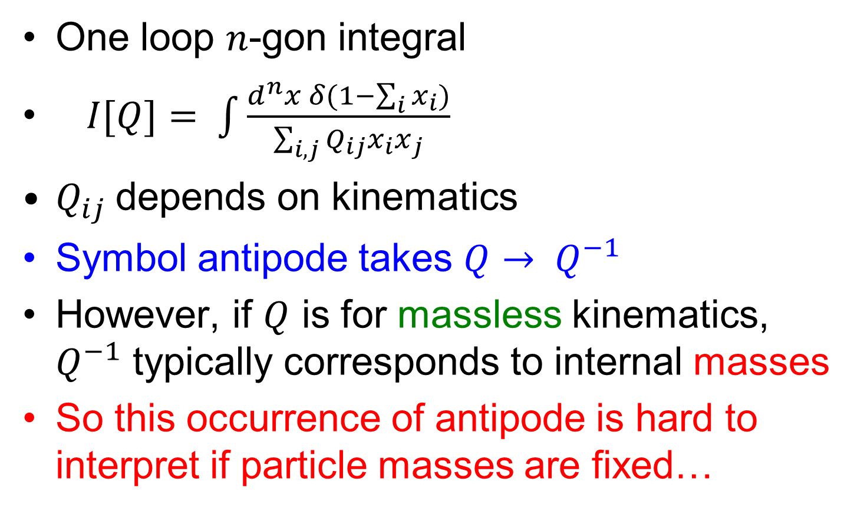
Antipodal self-duality for integrals?
One loop $n$-gon integral
$I[Q]= \int{\frac{d^{n}x δ(1−\sum_{i}{x_{i})}}{\sum_{i,j}{Q_{ij}x_{i}x_{j}}}}$
$Q_{ij}$depends on kinematics
Symbol antipode takes $Q→ Q^{−1}$
However, if $Q$ is for massless kinematics, $Q^{−1}$ typically corresponds to internal masses
So this occurrence of antipode is hard to interpret if particle masses are fixed…
Arkani-Hamed, Yuan, 1712.09991

Slide 22


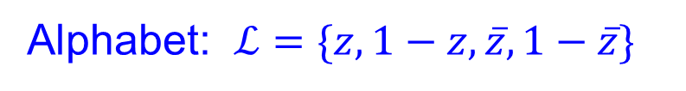
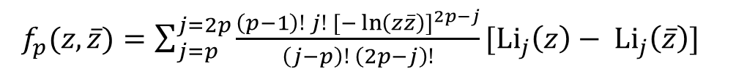

How about ladder integrals?
Usyukina, Davydychev, PLB305, 136 (1993)
$f_{p}(z,\overline{z})=\sum_{j=p}^{j=2p}{\frac{\left(p−1\right)! j! {[−\ln\left(z\overline{z}\right)]}^{2p−j}}{\left(j−p\right)! \left(2p−j\right)!}[{Li}_{j}\left(z\right)− {Li}_{j}\left(\overline{z}\right)]}$
$$p$$
Alphabet: $ℒ=\{z,1−z,\overline{z},1−\overline{z}\}$
all palindromic
But closer inspection
shows they can’t be self-dual

Slide 23
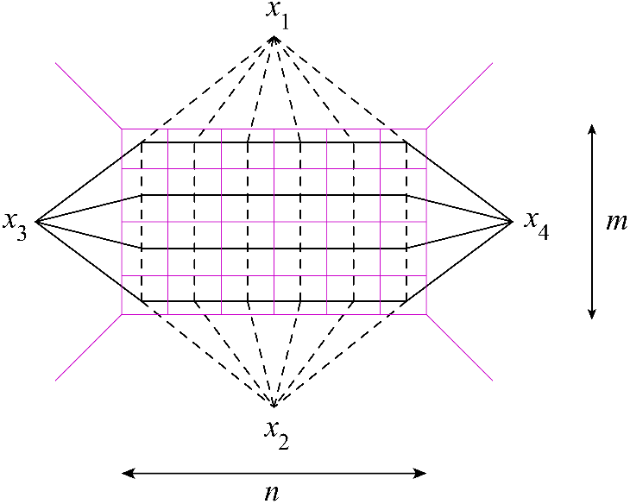

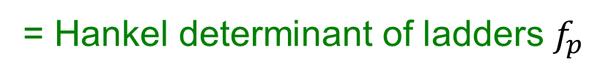

Counting for 4-point fishnet integrals
Basso, LD, 1705.03545; Derkachov and Olivucci, 1912.07588, 2007.15049; Basso et al., 2105.10514
$${∝ φ}_{m,n}=\det_{1≤i,j≤m}{(f}_{n−m+i+j−1})$$
= Hankel determinant of ladders $f_{p}$
palindromic only for $n=m$ – square!

Slide 24
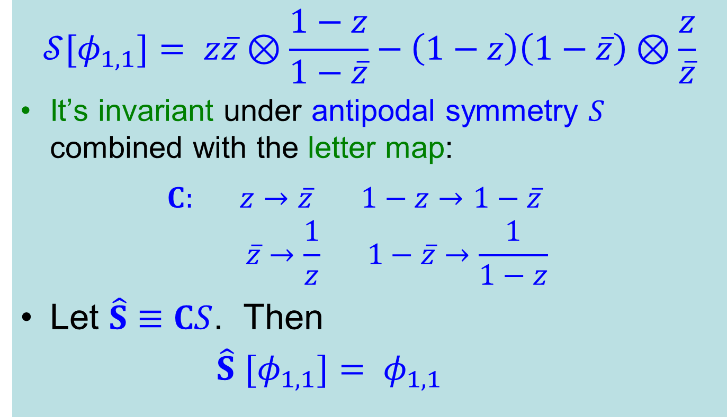
The (1,1) [box] symbol
$$𝒮[φ_{1,1}]= z\overline{z}⊗\frac{1−z}{1−\overline{z}}−\left(1−z\right)\left(1−\overline{z}\right)⊗\frac{z}{\overline{z}}$$
It’s invariant under antipodal symmetry $S$ combined with the letter map:
$C: z→\overline{z} 1−z→1−\overline{z}$
$$\overline{z}→\frac{1}{z} 1−\overline{z}→\frac{1}{1−z}$$
Let $\hat{S}≡CS$. Then
$\hat{S}$ $[φ_{1,1}]= φ_{1,1}$

Slide 25
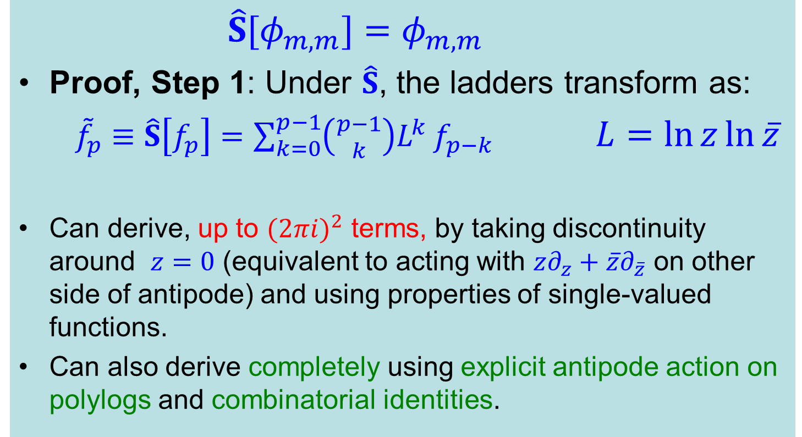
Square fishnet antipodal relation
LD, Duhr, 2502.00862
$\hat{S}[φ_{m,m}]=$ $φ_{m,m}$
Proof, Step 1: Under $\hat{S}$, the ladders transform as:
${\tilde{f}}_{p}≡\hat{S}\left[f_{p}\right]=\sum_{k=0}^{p−1}{\left({p−1 \atop k}\right)L^{k}}f_{p−k}$ $L=\ln{z}\ln{\overline{z}}$
Can derive, up to ${(2πi)}^{2}$ terms, by taking discontinuity around $z=0$ (equivalent to acting with $z∂_{z}+\overline{z}∂_{\overline{z}}$ on other side of antipode) and using properties of single-valued functions.
Can also derive completely using explicit antipode action on polylogs and combinatorial identities.

Slide 26
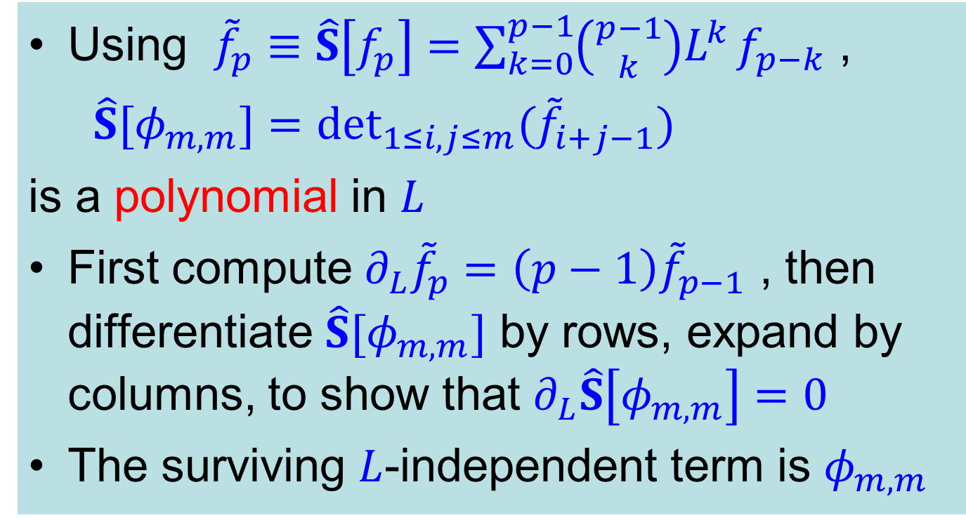
Proof, Step 2
Using ${\tilde{f}}_{p}≡\hat{S}\left[f_{p}\right]=\sum_{k=0}^{p−1}{\left({p−1 \atop k}\right)L^{k}}f_{p−k}$ ,
$\hat{S}[φ_{m,m}]=$ $\det_{1≤i,j≤m}{(\tilde{f}}_{i+j−1})$
is a polynomial in $L$
First compute ${∂_{L}\tilde{f}}_{p}=\left(p−1\right){\tilde{f}}_{p−1}$ , then differentiate $\hat{S}[φ_{m,m}]$ by rows, expand by columns, to show that $∂_{L}\hat{S}\left[φ_{m,m}\right]=0$
The surviving $L$-independent term is $φ_{m,m}$

Slide 27
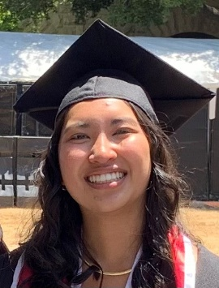
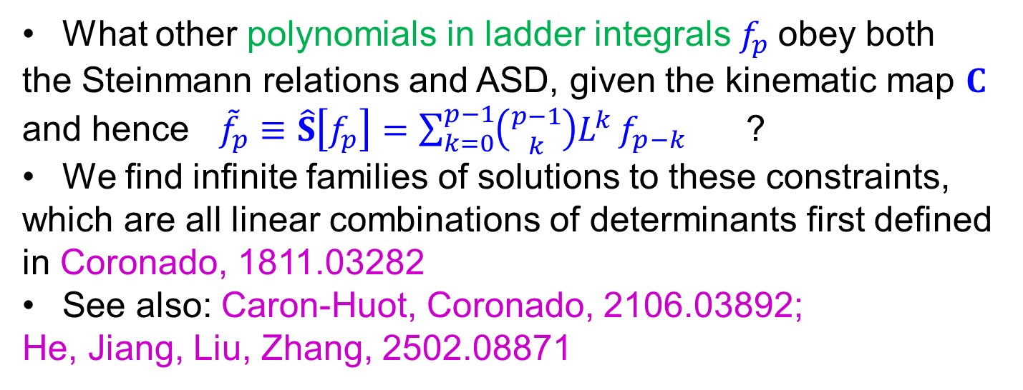
ASD “near” square fishnets?
in progress with Claude Duhr and Francesca Fernandes
What other polynomials in ladder integrals $f_{p}$obey both
the Steinmann relations and ASD, given the kinematic map $C$
and hence ${\tilde{f}}_{p}≡\hat{S}\left[f_{p}\right]=\sum_{k=0}^{p−1}{\left({p−1 \atop k}\right)L^{k}}f_{p−k}$ ?
We find infinite families of solutions to these constraints,
which are all linear combinations of determinants first defined
in Coronado, 1811.03282
See also: Caron-Huot, Coronado, 2106.03892;
He, Jiang, Liu, Zhang, 2502.08871

Slide 28
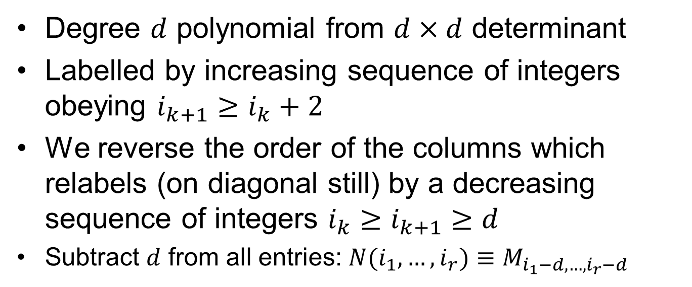
Coronado determinants
Degree $d$ polynomial from $d×d$ determinant
Labelled by increasing sequence of integers obeying $i_{k+1}≥i_{k}+2$
We reverse the order of the columns which relabels (on diagonal still) by a decreasing sequence of integers $i_{k}≥i_{k+1}≥d$
Subtract $d$ from all entries: $N(i_{1},…,i_{r})≡M_{i_{1}−d,…,i_{r}−d}$

Slide 29
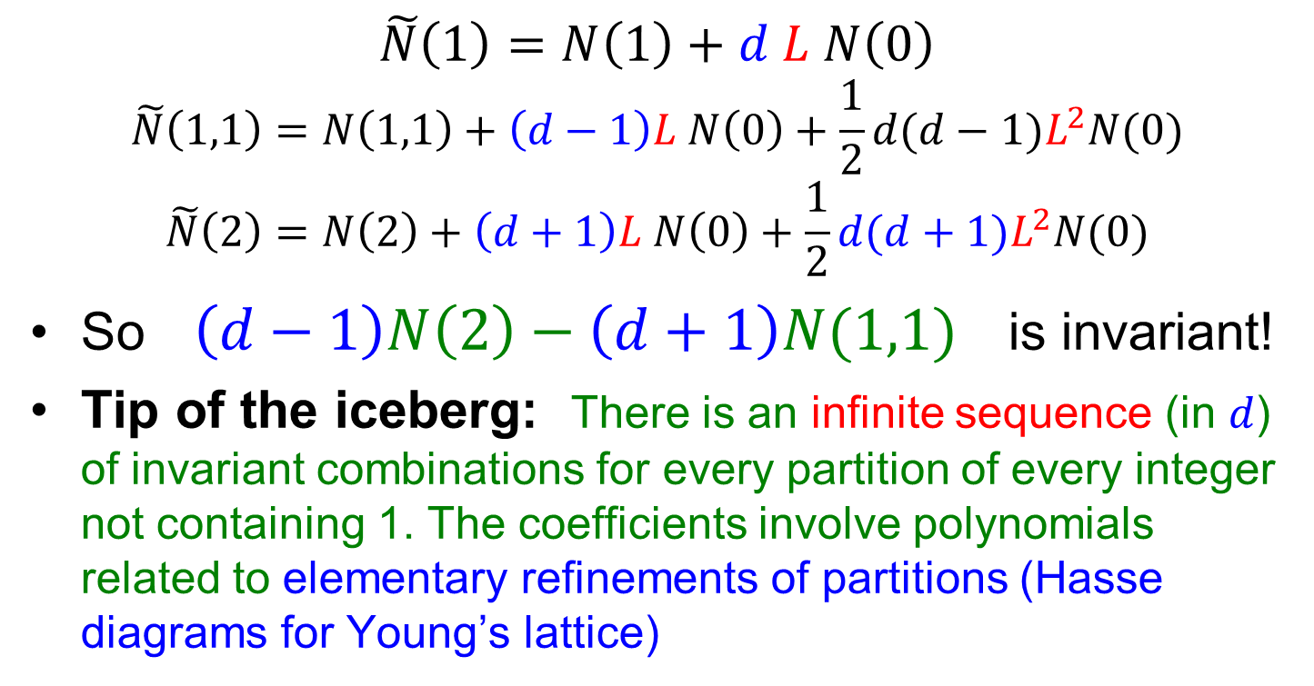

ASD transformations of $N$’s
$$\tilde{N}\left(1\right)=N\left(1\right)+d L N\left(0\right)$$
$$\tilde{N}\left(1,1\right)=N\left(1,1\right)+\left(d−1\right)L N\left(0\right)+\frac{1}{2}d(d−1)L^{2}N(0)$$
$$\tilde{N}\left(2\right)=N\left(2\right)+\left(d+1\right)L N\left(0\right)+\frac{1}{2}d(d+1)L^{2}N(0)$$
So $\left(d−1\right)N\left(2\right)−\left(d+1\right)N(1,1)$ is invariant!
Tip of the iceberg: There is an infinite sequence (in $d$) of invariant combinations for every partition of every integer not containing 1. The coefficients involve polynomials related to elementary refinements of partitions (Hasse diagrams for Young’s lattice)

Slide 30

Another $\tilde{N}$ example

Slide 31







$$\tilde{N}\left(λ\right)=\sum_{μ⊑λ}{\frac{L^{n_{λ}^{}−n_{μ}^{}}}{\left(n_{λ}−n_{μ}\right)!}p\left(λ,μ\right)Π\left(λ,μ,d\right)N(μ)}$$
# paths from $λ$ to $μ$
$μ$ is an elementary refinement of $λ$
$$λ=\left(λ_{1},…,λ_{r}\right), n_{λ}=\sum_{i}{λ_{i}}$$
$$Π\left(λ,μ,d\right)=\prod_{i}{(d−κ_{i}(μ))}$$
when $m→m−1$, add the integer
$\left(⋕≥m\right)−m$ to the set $\{κ_{i}\}$
The ASD invariant combinations can be described similarly

Slide 32
Summary & Open Questions
6-gluon amplitude ←→ 3-gluon form factor in planar N=4 SYM by strange new antipodal duality, swaps role of branch cuts and derivatives
Embedded in 4-gluon form factor antipodal self-duality
Who ordered that?
Can now find at least antipodal self-duality in square 4d fishnet integrals (which have integrability-based representations)
3-dimensional kinematics seems to play a crucial role in all cases (parity preserving surfaces, or only 3 momenta). Why?
Where else might it hold? 2d (elliptic) fishnet integrals? Duhr, Klemm, Loebert, Nega, Porkert, 2310.08625
How much more can we exploit A(S)D to learn more about amplitudes, form factors, integrals in planar N=4 & beyond?

Slide 33


Extra Slides

Slide 34

Triple Collinear Limit of 4-point form factor
→ 6-gluon amplitude
Bern et al., 0803.1465;
(also apparent from
FFOPE representation)

Slide 35


AD explains many patterns in $F_{3}$
Every term in the symbol starts with $a,b,c$; never $d,e,f$
Physical reason related to causality, which dictates where branch cuts can appear: only for ${(p_{i}+p_{j})}^{2}\sim 0$
Empirically, 12 pairs of adjacent letters are forbidden:
$$…a⨂d…, …b⨂e…, …c⨂f…$$
$$…d⨂a…, …e⨂b…, …f⨂c…$$
$$…d⨂e…, …e⨂f…, …f⨂d…$$
$$…e⨂d…, …f⨂e…, …d⨂f…$$
Resemble constraints from causality: Steinmann relations Steinmann, Helv. Phys. Acta (1960)
But not really, which mystified us for a while…
However, the relations are antipodally dual to the (extended) Steinmann relations for $A_{6}$ !!

Slide 36






Parity-preserving surface
$$\hat{w}$$
$$\hat{u}$$
$$\hat{v}$$
$$Δ≡(1−\hat{u}−\hat{v}−\hat{w})^{2}−4\hat{u}\hat{v}\hat{w}=0$$
$Δ=0$ means that kinematics lies in a
3d subspace of 4d spacetime → parity invariant

Slide 37







FFOPE kinematical variables for $F_{4}$
$$−u_{1}+u_{3}+v_{4}+v_{1}=1$$
$$u_{i}=\frac{s_{i,i+1}}{s_{1234}}, { v}_{i}=\frac{s_{i,i+1,i+2}}{s_{1234}}$$
$$−u_{2}+u_{4}+v_{1}+v_{2}=1$$
$$−u_{3}+u_{1}+v_{2}+v_{3}=1$$
$$u_{1}=\frac{T^{2}T_{2}^{2}}{(T^{2}+1)(S^{2}+T^{2}+T_{2}^{2}+1)}$$
$$u_{2}=\{1+T^{2}+\frac{S^{2}\left[\left(1+F_{2}^{2}\right)S_{2}T_{2}+F_{2}\left(1+S_{2}^{2}+T^{2}+T_{2}^{2}\right)\right]}{F_{2}S_{2}^{2}}\}^{−1}$$
$u_{3}=\frac{S^{2}}{(T^{2}+1)(S^{2}+T^{2}+T_{2}^{2}+1)}$
$u_{4}=\frac{{S^{2}T}^{2}}{S_{2}^{2}}$ $u_{2}$
$$v_{1}=\frac{T_{2}^{2}+1}{S^{2}+T^{2}+T_{2}^{2}+1}$$
OPE limit takes $T,T_{2}→0$, interpolates between
2-collinear limit $T_{2}→0$and 3-collinear limit $T→0$

Slide 38
ASD beyond 2 loops
LD, Ö. Gürdoğan, Y.-T. Liu, A. McLeod, M. Wilhelm, 2212.02410v2; LD, Z. Li, to appear
Bootstrapped symbol of F₄ at 3 loops, using same 113 letter (2-loop) alphabet.
Unique result, which obeys all the FFOPE predictions we could check.
2 loop symbol uses only 34 of the letters [3,784 terms]
3 loop symbol uses only 88 of the letters [3,621,202 terms]
4 loop symbol uses only 88 of the letters [???? terms]
No OPE checks yet at 4 loops, but few constraints
needed to fix it.
ASD holds in 3D at 4 loops!

Slide 39

Palindromic criterion not sufficient for ladders
First entries: $\{ z\overline{z}$, $\left(1−z\right)\left(1−\overline{z}\right) \}$
Last entries (for $p>1$): $\{ z, \overline{z} \}$
First pair of entries: 2 of 3 are products
Last pair of entries (for $p>2$): All 3 of 3 are products:
$$\{ z⊗z, z⊗\overline{z} +\overline{z}⊗z, \overline{z}⊗\overline{z} \}$$
Since dimensions of first-pair space and last-pair space differ after projecting out products, there is no kinematic map for which the $f_{p}$ ladders are antipodally self-dual ($p>2$)

