Slide 1
DAMSA at Fermilab PIP-II
Heavy Ion Meeting
May 26 – 27, 2023
Yeonsei University
Jaehoon Yu
University of Texas at Arlington
Outline
Introduction
What is DAMSA and are its Requirements?
What is in Fermilab PIP-II Era?
DAMSA Experiment Specifics
The Strategy, the Team and the Timeline
Conclusions

Slide 2
Who am I? – 1
Professor at U. Texas Arlington (2001 – present)
  High Energy Particle Physicist who worked on collider and fixed target experiment at Fermilab and CERN
  Responsible for field cage construction for the 1st two 17kt DUNE FD
  Led the Beyond the Standard Model (BSM) physics group in neutrino experiments in the completed U.S. HEP decadal study, Snowmass2021
  Founding convener of the BSM@ν group in 2013 (1st in the community!)
  Constructed three DUNE field cages for ProtoDUNE @CERN

Slide 3
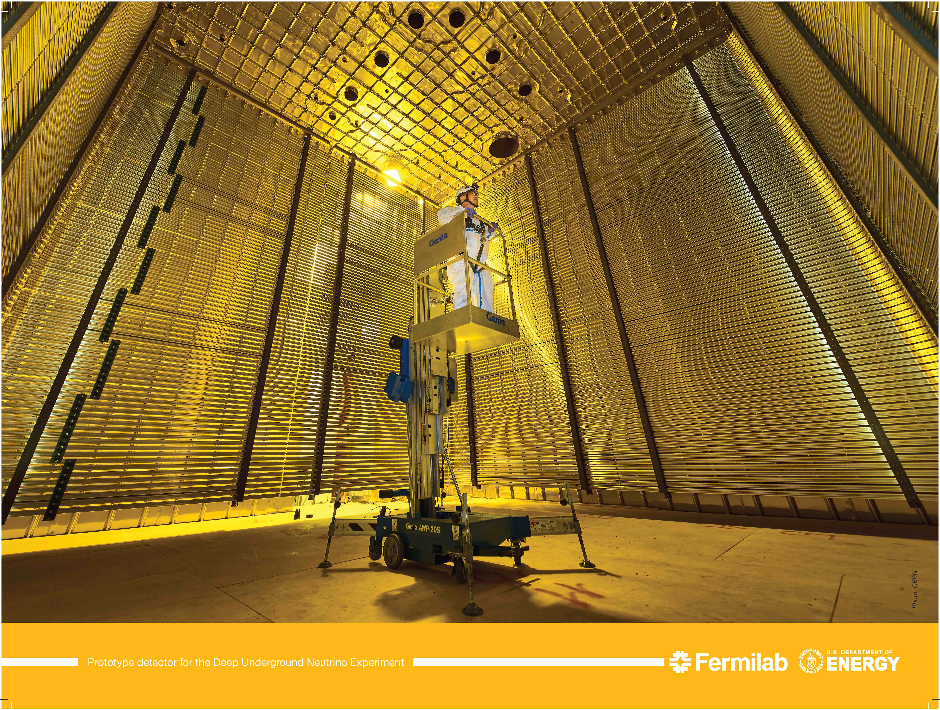
DUNE DP Prototype Detector @ CERN
6m
6m
Responsible for the Field Cage Construction as the only US Univ. In 2018
Fermilab Official Poster; photo used in many mass media world-wide

Slide 4
Who am I? – 1
Professor of physics at U. Texas Arlington (2001 – present)
  High Energy Particle Physicist who worked on collider and fixed target experiment at Fermilab and CERN
  Responsible for field cage construction for the 1st two 17kt DUNE FD Founding convener of the BSM@ν group in 2013 (1st in the community!)
  Led the Beyond the Standard Model (BSM) physics group in neutrino experiments in the completed U.S. HEP decadal study, Snowmass2021
  Constructed three DUNE field cages for ProtoDUNE @CERN
  Contributed to the 2012 Higgs discovery and the subsequent precision property measurements in ATLAS
  Convener of the International Linear Collider detector R&D beam testing
  Responsible for the design and implementation of D-Zero computing grid
    Led a physics group on discovery of Higgs in WW final states

Slide 5
Who am I? – 2
Commission leader of the upgraded D-Zero detector as a Fermilab staff scientist (98 – 2001)
1st postdoc at D-Zero with U. of Rochester (93 – 96) followed by the 2nd postdoc at Fermilab (96 – 98) on a neutrino experiment (NuTeV), built the calibration beamline, managed the calib program and published the results
Ph.D. in HEP at Stony Brook U. in 1993 on D-Zero @ FNAL
  Participated in prototyping, beam testing, construction, assembly, commissioning, data taking, collision data analysis, thesis writing and publication of the thesis
Physics B.S. and M.S. from Korea U., 1983 and 1985

Slide 6
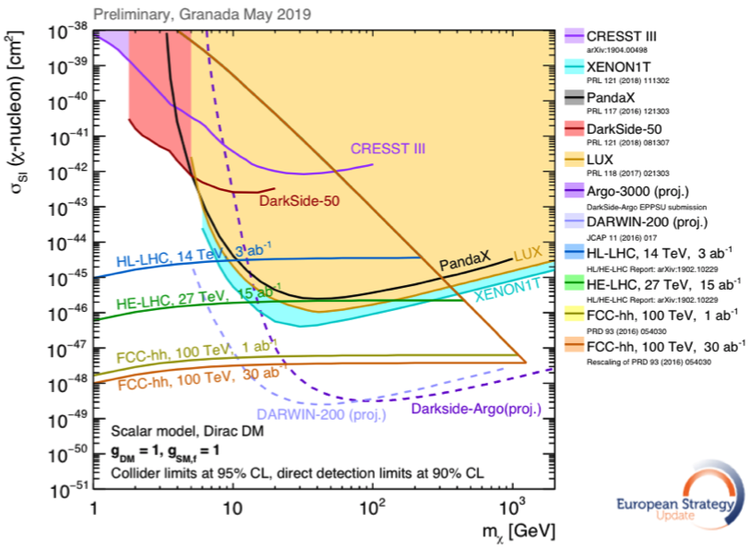
Physics Motivation For DSP
SM describes the visible ~5% of the matter in the universe ➔ becoming more solidly established, while the neutrinos sector requires modifications
Dark matter (Dark Sector Particle, DSP) makes up about 25% of the universe ➔must be explored better
Direct searches have limitations in kinematic reach, leaving low mass range un-explored
Strategy:
  Search for rare particles in unexplored kinematic regime
  Make and discover DSPs in accelerators
  Establish human infra on DM production
Focus
here
No DM

Slide 7
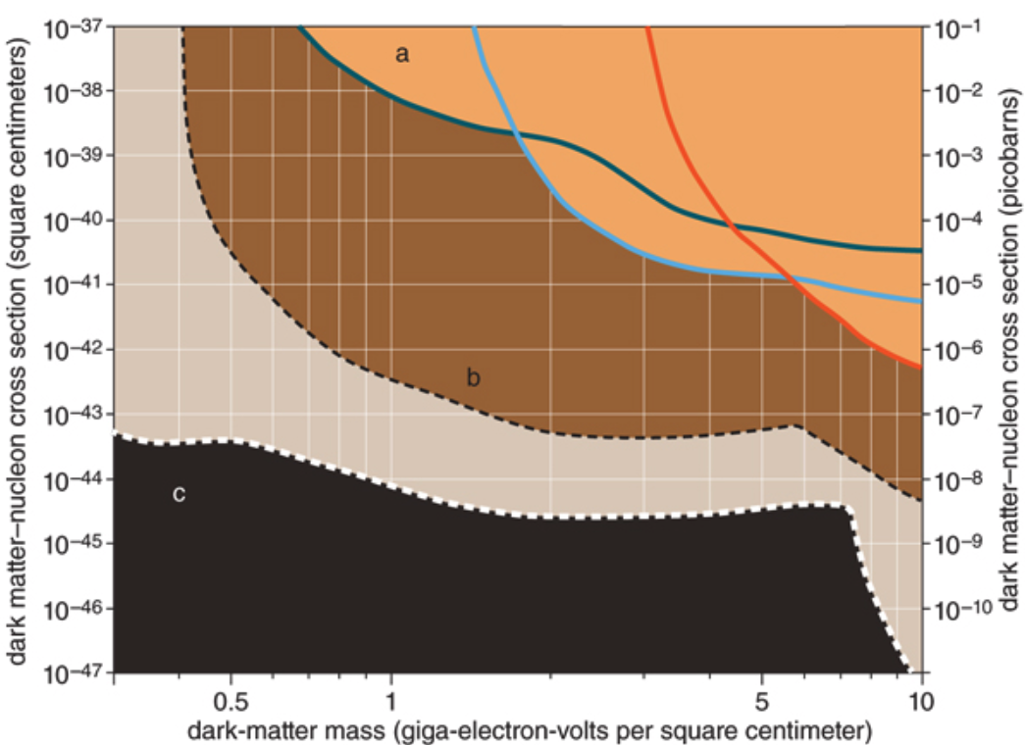
Lower DM Mass Range Expectation
Focus
here
No DM
Future: SuperCDMS SNOLAB
Solar Neutrino Background

Slide 8
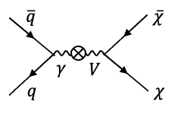
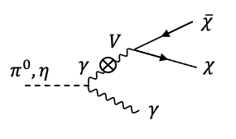
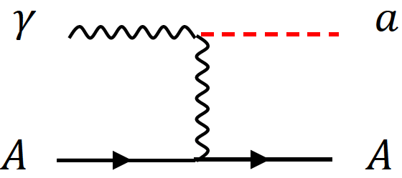
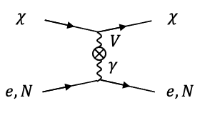
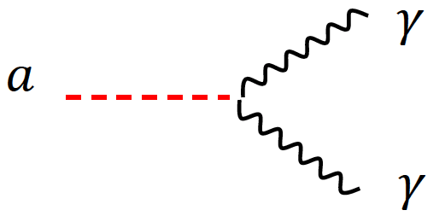
DSP’s? How do we make & see them?
Set of new particles which do not experience the known forces
DSPs can be weakly coupled to visible sector thru a mediator or “portal”
High intensity proton beams produce large number of photons from brem, DY and neutral mesons decays ➔ Make it possible to contemplate couplings of new U(1) gauge to SM γ
Detection through an electron scattering, N(n) recoil or 1, 2 γ final states

Slide 9
What’s needed to discover a DSP?
Direct Observation Signatures
  Requires high beam flux
  Large mass, high density detector for scattering
  Large volume, low density detector for decay
Inferred Observation Signatures from both beam and cosmogenic sources
  Leverage oscillatory behaviors
  Large mass detectors for interactions
What do we need to know?
  Signal flux and realistic behaviors in the detector
  Neutrino flux and their interactions in the detector as bck

Slide 10
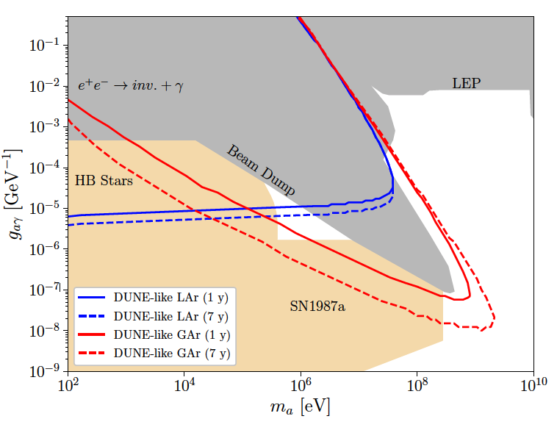
Opportunities on ALP Searches
Axion-like particles (ALP) can be produced via the Primakoff process in high intensity proton beams
Detection via the inverse Primakoff process either in a scattering with e/N + γ or decays of the ALP to two γ
A case study on DUNE ND shows a potential to fully close the cosmic triangle
  Brdar, Yu et al., PRL126, 201801 (2021)
Production in ν target
Detection - scattering
This edge constrained by the distance from the source to the detector
Oppo

Slide 11
What is DAMSA?
Dark sector particle (DSP) search concept at low E, high intensity proton beam facility
Stands for Dump produced Aboriginal Matter Search at an Accelerator (DAMSA)
  담사 (潭思) = 깊은생각 – Rumination or Reflection
    Jang et al., PRD 107, L031901 (2023)
Search for DSP in the low mass regime, using low energy, high intensity beam capability ➔ ideally below the pion threshold
  Originally developed for 600MeV proton beam at RAON
The 800MeV PIP-II LINAC beams fit the bill

Slide 12
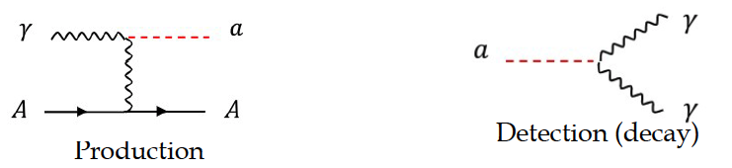
DAMSA Physics Strategy
Focus on Axion-like particles (ALP) search through their two- photon final state via the Primakoff process
Produce as many photons as possible in the beam source, namely the dump
Capture as many ALPs as possible in as wide a mass range as possible
  Shorten the distance from the source to the detector
  Increase the detector angular coverage
Minimize the backgrounds from neutral particles
  Neutron spallation → accidental photon overlaps
  Neutrino NC and QE interactions ➔ produce π⁰→ 2γ

Slide 13
DAMSA Exp. Concept
Inject and absorb as many low-E (1GeV or less) proton beam particles in the dump as possible
Allow higher mass ALP’s to decay with as small number of neutrons escaping the dump as possible
Place the detector as close to the dump as possible on axis to expand the mass reach to higher mass region
Vacuum Decay Volume
L=10m
Detector
Proton beam
Moderator
W Dump
L=1m

Slide 14
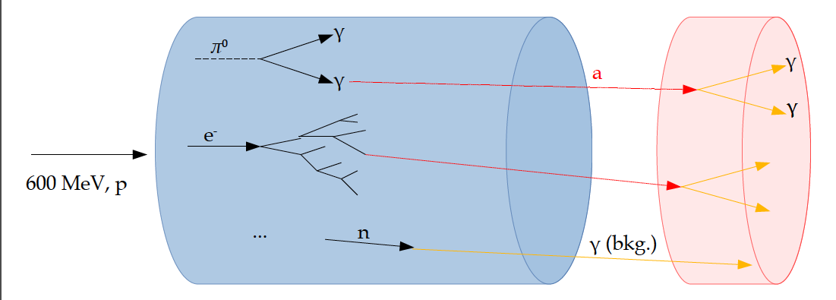
DAMSA Experiment Signature
Beam

Slide 15
Accelerator Complex in PIP-II Era
PIP-II provides
  New SRF LINAC for injection into Booster at 800MeV (present 400MeV)
  Booster cycle rates upgraded to 20Hz from current 15Hz
  Increased proton beam intensity at 8GeV for 1.2MW beam power from main injector
PIP-II era begins in 2029, DUNE 2031
  Mu2e (8GeV)
  Fixed target, test beams (120 GeV)
  0.8 GeV beam available for other exp, eg. With PAR and may be other options for beam dump
B. Flauger

Slide 16
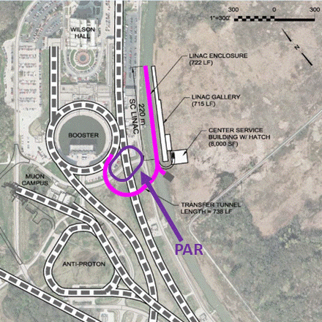
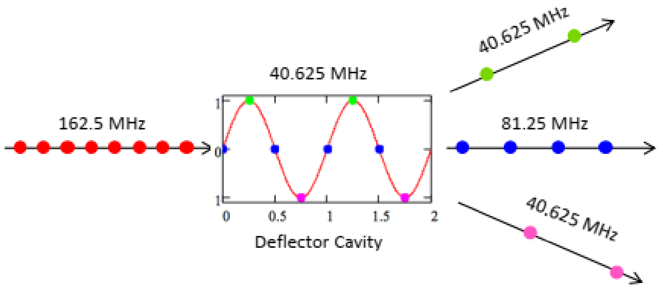
PIP-II Siting Enables Further Expansion
Magnetic switching elements and RF splitters can divide beam.
Real estate in TeV field allows for a variety of rings and lines, shapes and sizes.
Some
AR program
Mu2e-II
Linac Extension
LINAC Extension @2GeV
J. Eldred

Slide 17
DAMSA Requirements – The Beam
PIP-II LINAC’s 800MeV beam energy enables access to the tangible ALP mass range
Need to have as much beam as possible
  ~1x10²³ POT/yr was assumed in the PRD 600MeV physics study
  ~1x10²³ POT/yr for PIP-II 800MeV and 1GeV physics study
PIP-II CW beam characteristics (total proton current: 2mA)
  Bunch length: 1ns
  N_{p}/bunch : 8x10⁷ p/bunch
  Bunch spacing: 6.2ns
PIP-II CW Chopping possibility?
  micro-pulses w/ two 14x10⁷ p-bunches separated by 6.2ns and the next pair separated by 16.2ns, repeating every 22.4ns
  Each micro−pulse lasts for 0.6ms spaced every 50ms ➔ I=2mA/micro−pulse

Slide 18
DAMSA Requirements – The Dump
What material on what depth would be most optimal?
  Produce most photons per unit length
  Produce least number of neutrons out the dump
  Absorb most particles per unit length
GEANT4 based study shows 1m diameter, 1m long cylindrical shape tungsten dump (~10 nuclear interaction lengths) produces most photons and absorb ~99.995% 600MeV protons
  Neutrons produce additional photons in the dump, providing additional source for ALP

Slide 19
DAMSA Requirements – The Detector 1
What detector capabilities are needed to
  Capture as many ALP’s as possible in as wide a mass range as possible
    High mass ALP’s have shorter lifetime ➔ Need to be able to capture two photons from the ALP decays upstream of the detector
    Low mass ALP’s live longer ➔ Allow them to decay and interact in the detector and capture decay products upstream of the detector as much as possible
  Reject accidental backgrounds from neutron spallation in the detector
    Reduce the materials upstream of the detector for neutron to interact
Place a large decay volume in vacuum to fill the gap between the dump and the detector
  Vacuum decay chamber w/ 0.6cm SS wall thickness assumed ➔ this may have to be thicker
  Allows high mass ALPs to decay ➔ giving clear vertices where the two final state photons originate from
  Neutron interactions confined to the decay chamber walls

Slide 20
DAMSA Requirements – The Detector 2
What are other possible ways to further reduce the background from neutron spallation? ➔ Aim to reduce by order >=10¹⁰
  Leverage the speed of the neutrons ➔ Neutrons are 10 – 1000 times heavier than the ALPs, thus for the given momentum, the arrival time of the neutron induced photon accidentals would be slower than that of the ALP’s
  Leverage the distance of the closest approach of the two photon traces
  Require the traceback of the overlapping two photon momentum sum point the dump
  Invariant mass of the two photon momenta be within the interested mass range
  Arrival time difference between two photons
A large number of neutrons have low kinetic energy ➔ Require the photon energy to be greater than 5 MeV (detector threshold ~1MeV)

Slide 21
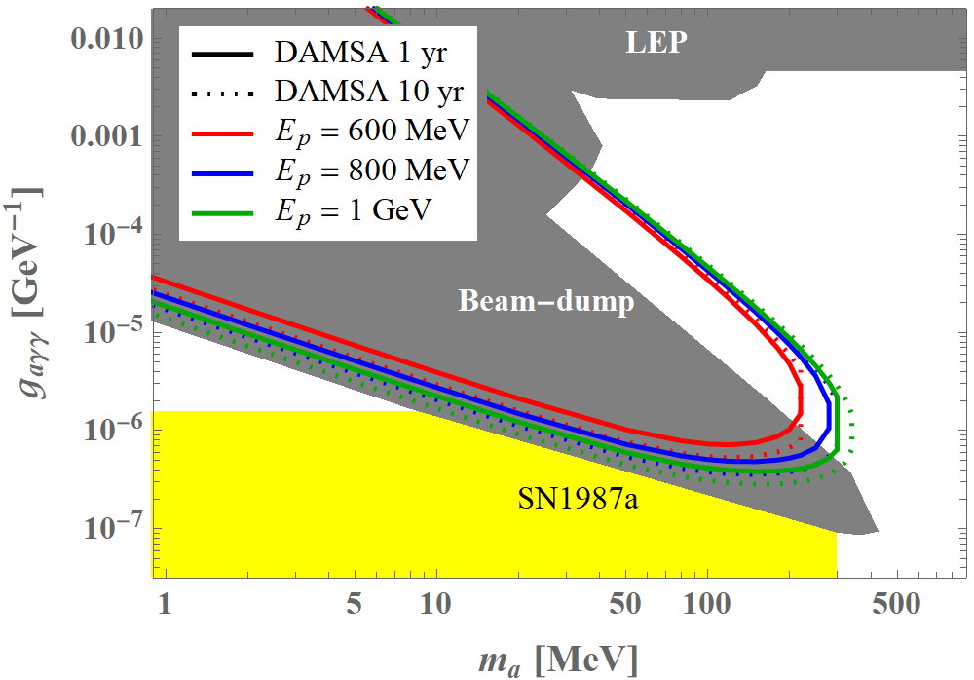
Expected DAMSA Sensitivity
Short lived! ➔ Capture decay products b4 det.
Long lived! ➔ Capture decays in the detector

Slide 22
DAMSA Detector Characteristics
Based on the concept studies using GEANT4 and neutron background rejection studies ➔ The detector must be
  Capable of measuring up to 500 MeV photons with a MeV or better mass resolution
  Fine granularity for superb shower position (1cm or better) and angular resolutions
  Fast timing capability, ideally at the sub-ns (100ps or better) level resolution

Slide 23
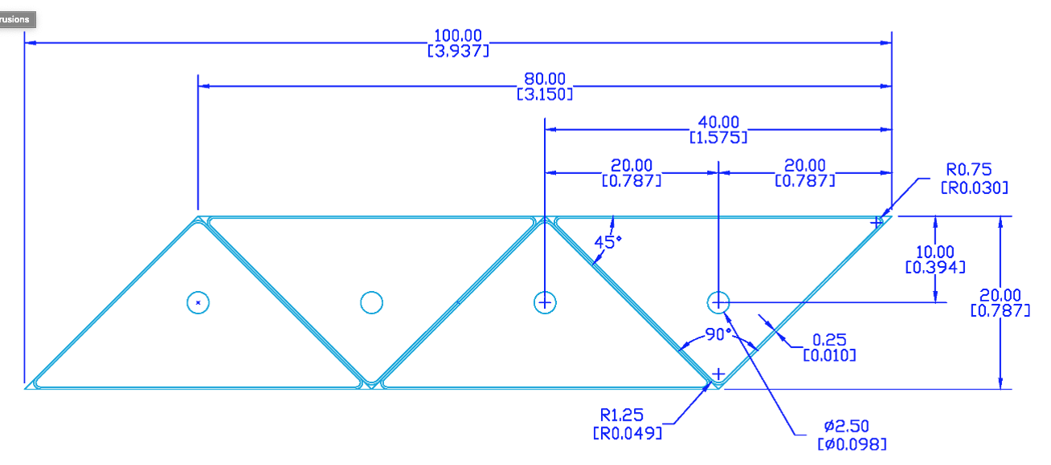
Potential DAMSA Detector Technology
A total absorption EM calorimeter
  Sufficient depth to absorb photons up to 500MeV
  Need further optimization for low mass ALP decays
Crystal or plastic scintillation counter with fine lateral and longitudinal granularity (M~160t)
  A thin (<5cm) triangular pixels with a fast photon detector attached to the pixel
    Lateral and longitudinal granularity
  SPAD, MCP, Hybrid SiPM, etc
A study to develop the most optimal detector for the physics has begun

Slide 24
Potential DAMSA Experiment Timeline
May – Dec. 23 : Form a team and prepare a proposal to Fermilab PAC
  Physics goals and sensitivity reach
  Detector design and rough cost estimates
Jan. 2024: Submit the DAMSA proposal to PAC
2024 – 2025/2026: experiment approval and project establishment
2025/2026 – 2028: experiment construction
2029: Complete the detector construction and start commissioning for data taking
Internationality would be important – Korean and European colleagues

Slide 25
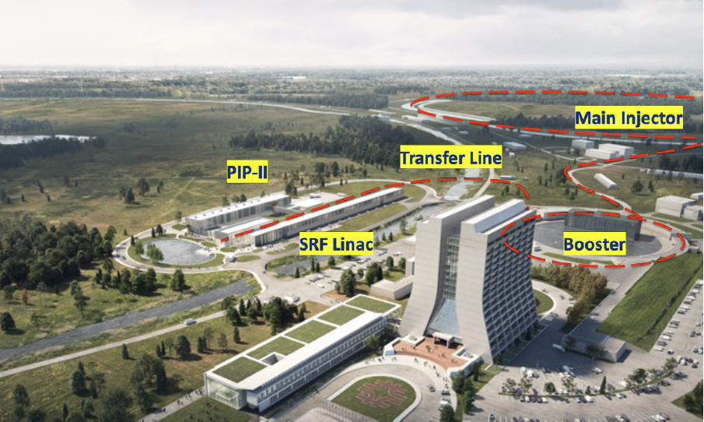
DAMSA@Fermilab PIP-II SRF LINAC
Capable of 2mA @ 800MeV (1.6MW)
  Translates to ~3x10²³ POT/year
DUNE and other higher energy programs use 1~2% of the proton flux
Continuous wave
Scheduled to complete by 2029
Prepare DAMSA to be ready for beam in time for the LINAC
DAMSA

Slide 26
DAMSA Experiment Strategy
Overarching strategic goal: Get the detector ready to take data in time for PIP-II LINAC completion in 2029
Design and build detectors to meet the requirements with minimal R&D
  Fast timing (~0.1ns or better)
  High position resolution (~0.1mm or better)
  Excellent energy and invariant mass resolution
  Low threshold energy
Discover Dark Sector Particles in the beam and produce the beam of them

Slide 27
DAMSA Experiment Team
DAMSA has been introduced to the community throughout the past 2 years, more intensely in 2023
  Multiple presentations made at conferences and workshops
  The concept was included in a few Snowmass2021 white papers
  At the physics opportunities at PIP-II BD and beyond at Fermilab 5/10 – 5/13/23, the discussion on DAMSA experiment occurred 5/12 – 5/12/23
  Introduced to Fermilab leadership April and May 2023
The team consists of
  Lead Investigators: Jae Yu and Juan Estrada (FNAL)
  Institutions expressed interests thus far:
    US (8): FNAL, OU, TAMU, UCR, UCI, U. of Kansas (TBC), LANL (TBC), UTA
    SK (8): SNU, Yeonsei U. (TBC), U. of Seoul, Chungnam U. (TBC), Jeonbuk U. (TBC), KNU-CHEP, Korea U., Korea U. - Chochiwon Campus
    Portugal: LIP (TBC)

Slide 28
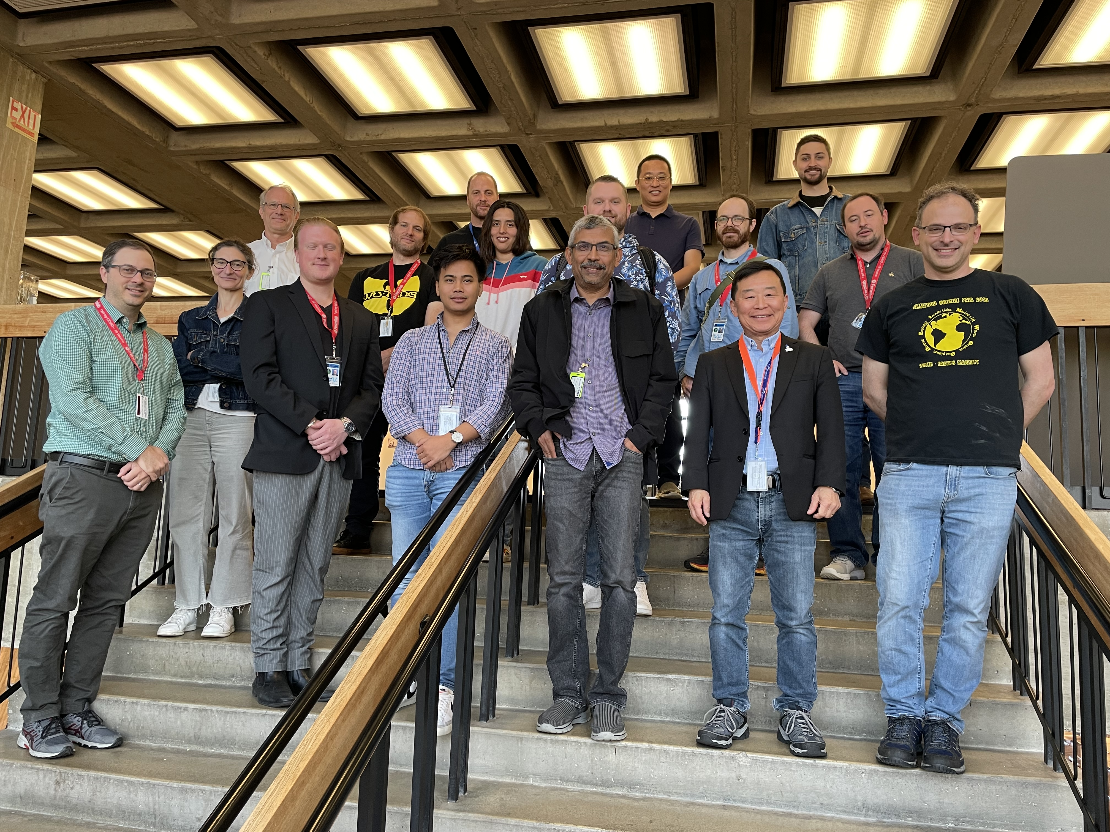
1st Workshop on Physics Opportunities at PIP-II
May 10 – May 13, 2023
Juan Estrada
Matt Toups

Slide 29
Conclusions
DAMSA is a DSP search and discovery experiment that leverages high intensity, low energy proton beams
ALP is the signal of interest but the experiment can explore variety of other BSM physics
GEANT based study has been performed for the 600MeV rare nuclear isotope facility and for 800MeV PIP-II LINAC cases
DAMSA team is forming to submit a proposal to PAC
  Collaborators are welcome!!
DAMSA presents an excellent opportunity for Korea to be an essential partner in transforming Fermilab’s PIP-II LINAC to a world-class DSP facility & to train the next generation physicists to lead dark matters in accelerators

