Slide 1

QM2012 Experimental Review II
+ some more from ALICE
@ HIM2012-12
Pusan Nat’l Univ. In-Kwon Yoo

Slide 2
Outline
Global Variables and Correlations (Hyppolyte, Rischke)
High pT and Jets (Solana, Milov)
EW Probes (L. Ruan)
Summary

Slide 3
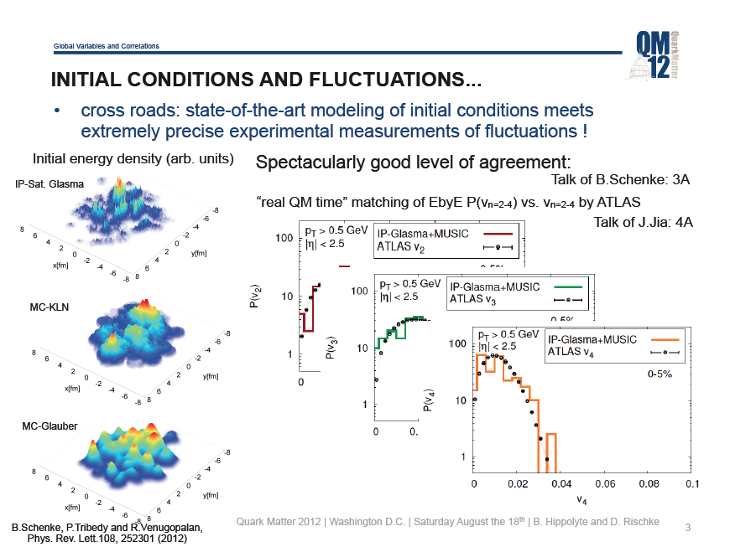

Slide 4
1. Hadron suppression

Slide 5

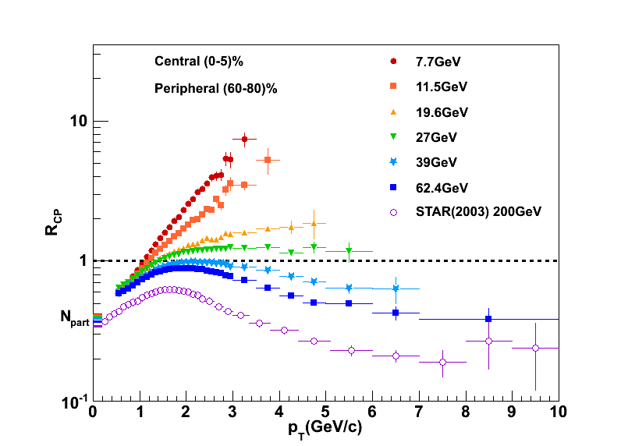
“Re-discovery” of suppression

Slide 6
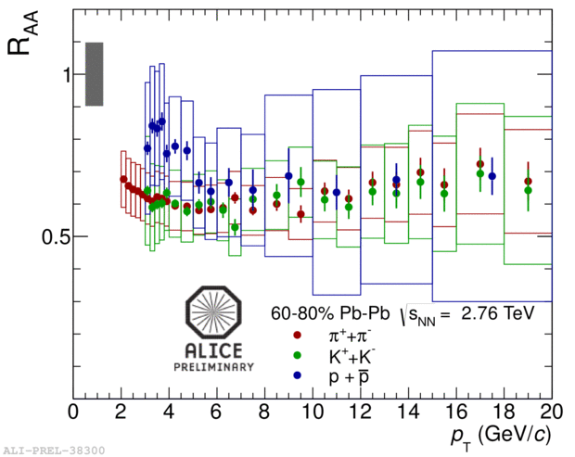
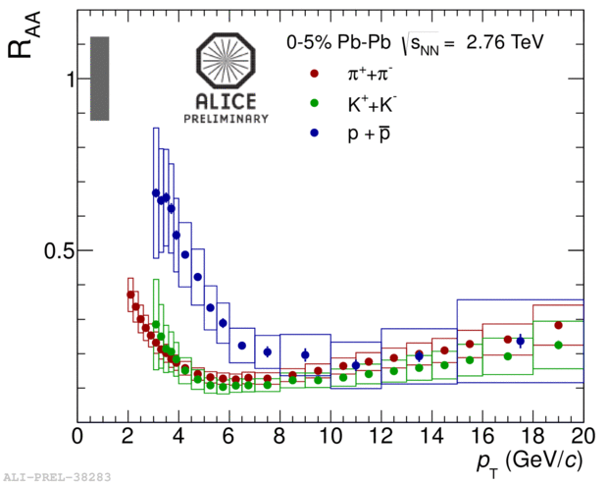
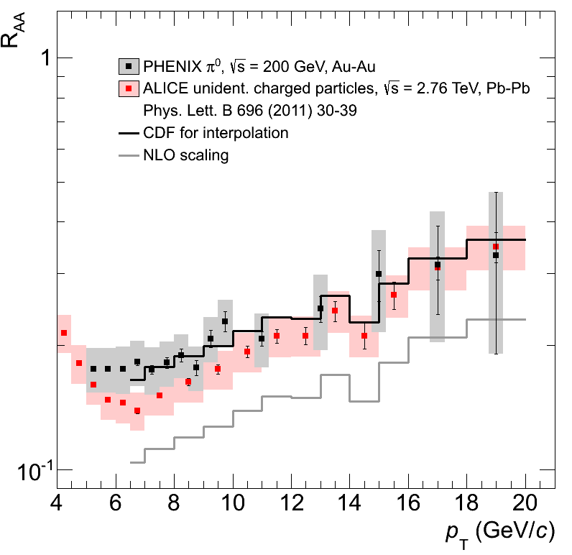
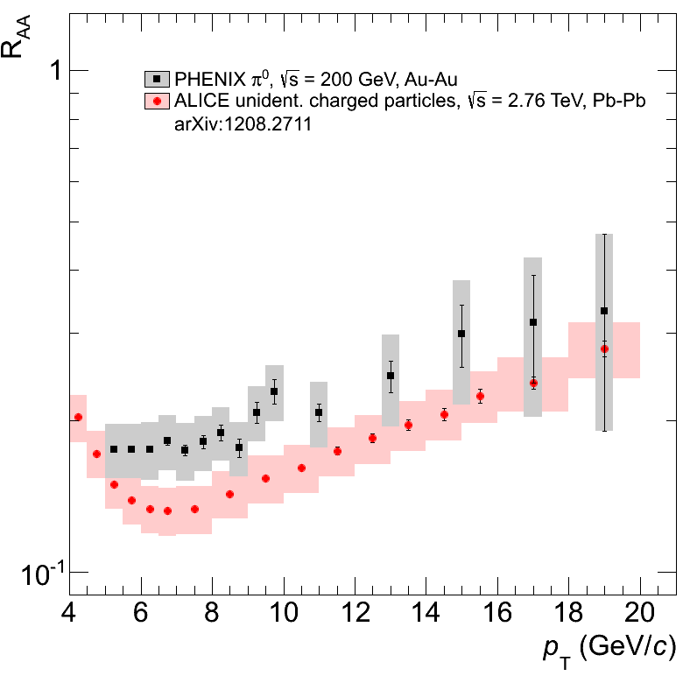

Suppression at RHIC and LHC
p+p reference

Slide 7
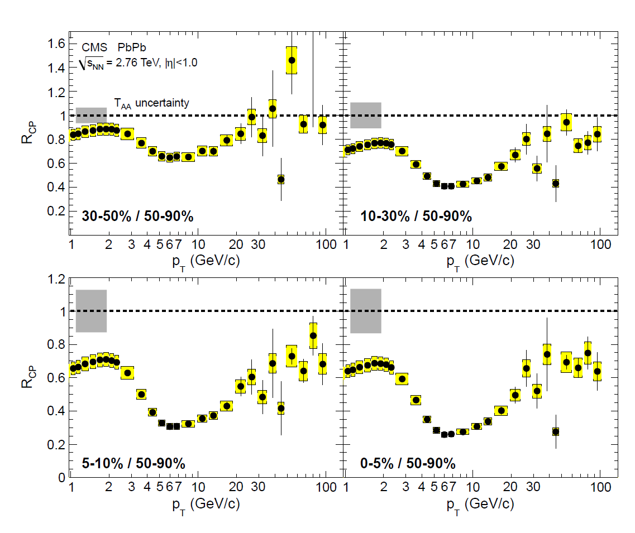
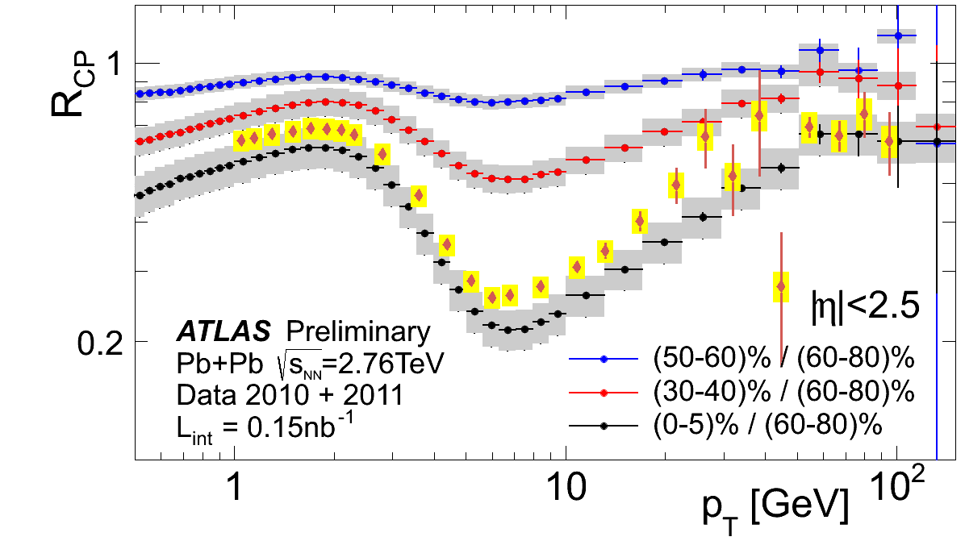
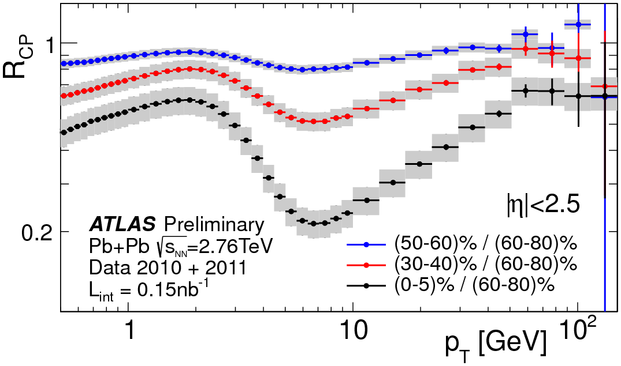
Suppression at high-p_{T}
Different peripheral bins ATLAS: 60-80% CMS: 50-90%

Slide 8
Summary of hadron R_{AA}
Suppression turns on at around √s_{NN} = 30 GeV
At high √s_{NN} for p_{T}>10 GeV/c all particle species are equally suppressed
Suppression reaches minimum at ~ 7GeV/c
LHC results are consistent between experiments
At minimum, suppression at LHC is ~50% larger than at RHIC
A combination of elastic and inelastic processes can provide a consistent picture for RHIC to LHC
Many uncertainties in medium models still remain.

Slide 9
2. Jet suppression

Slide 10
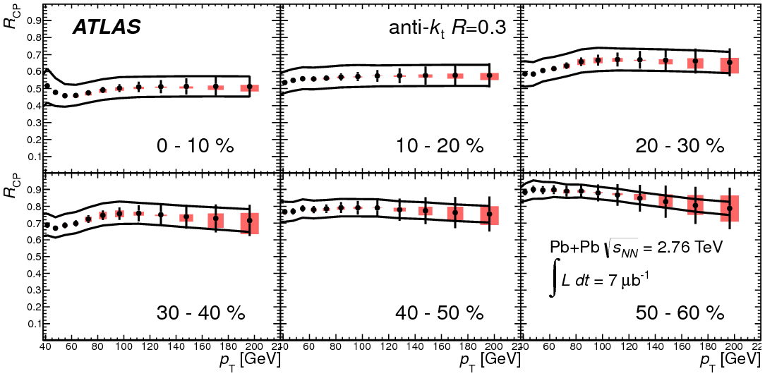
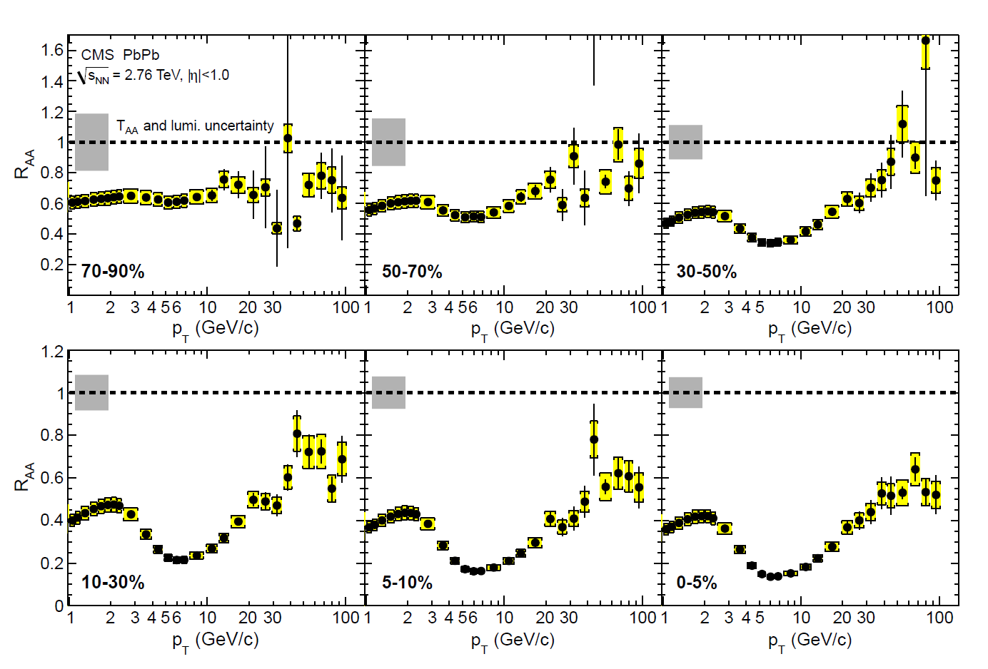
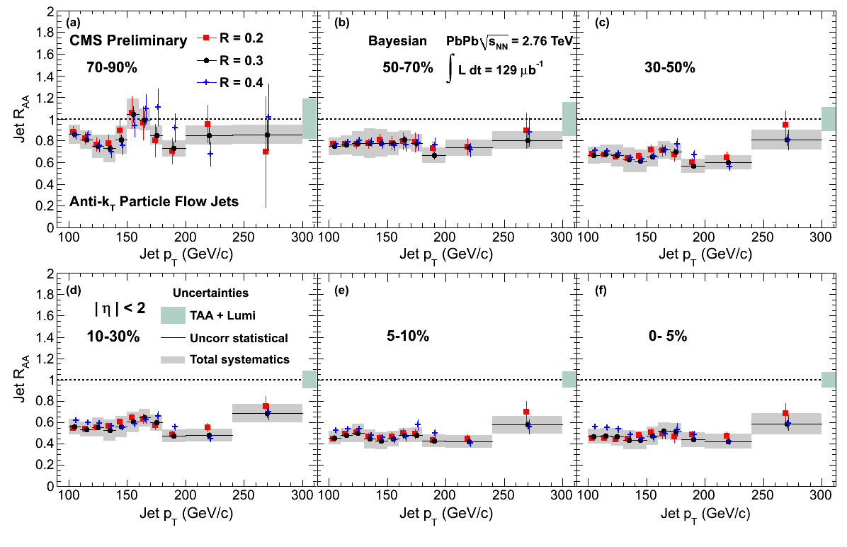
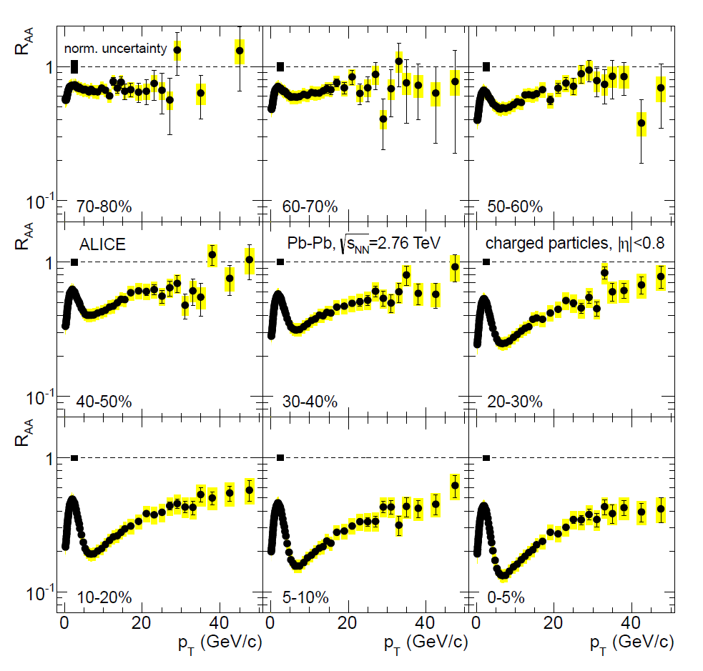
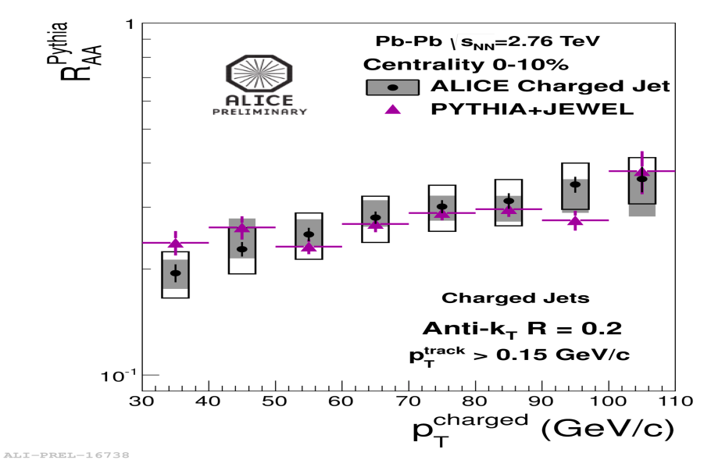
CMS

Slide 11
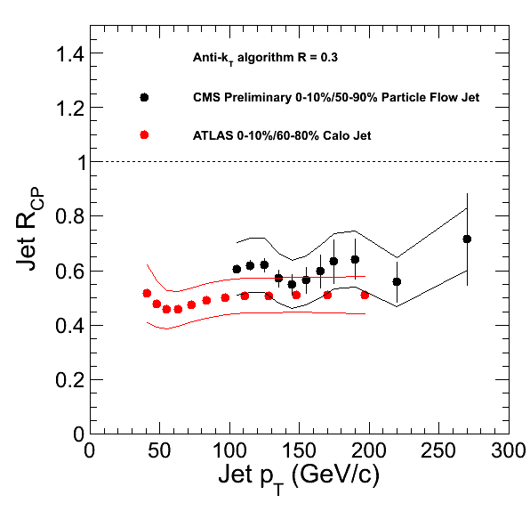
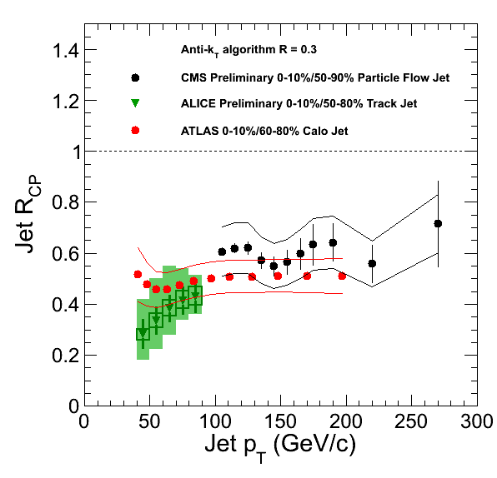
Jet R_{AA} at LHC
Using track-jets for ALICE

Slide 12
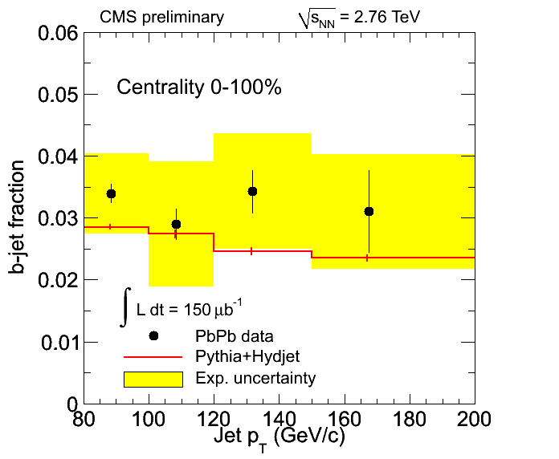
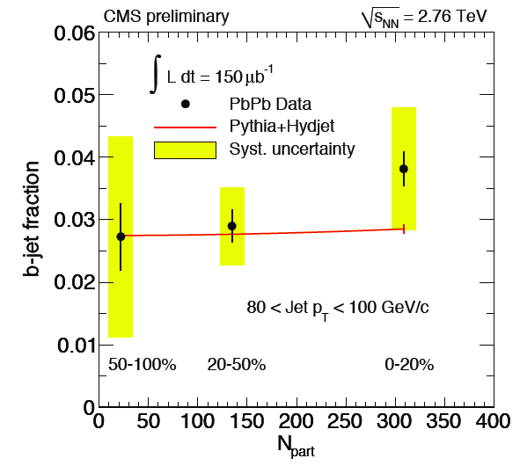
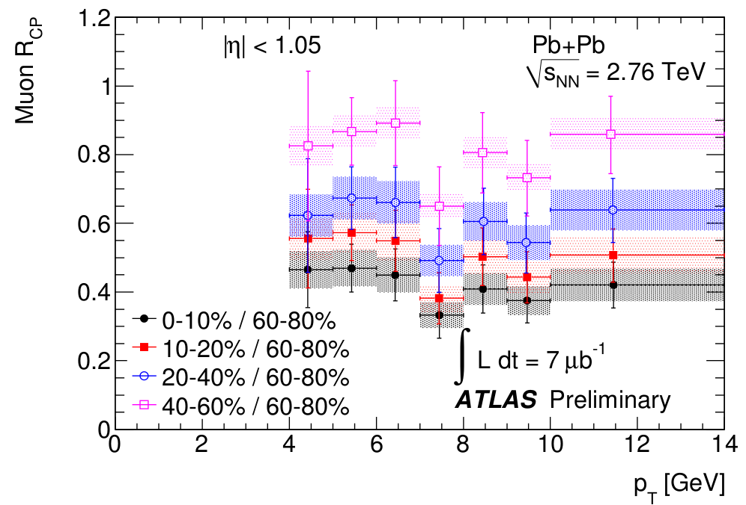
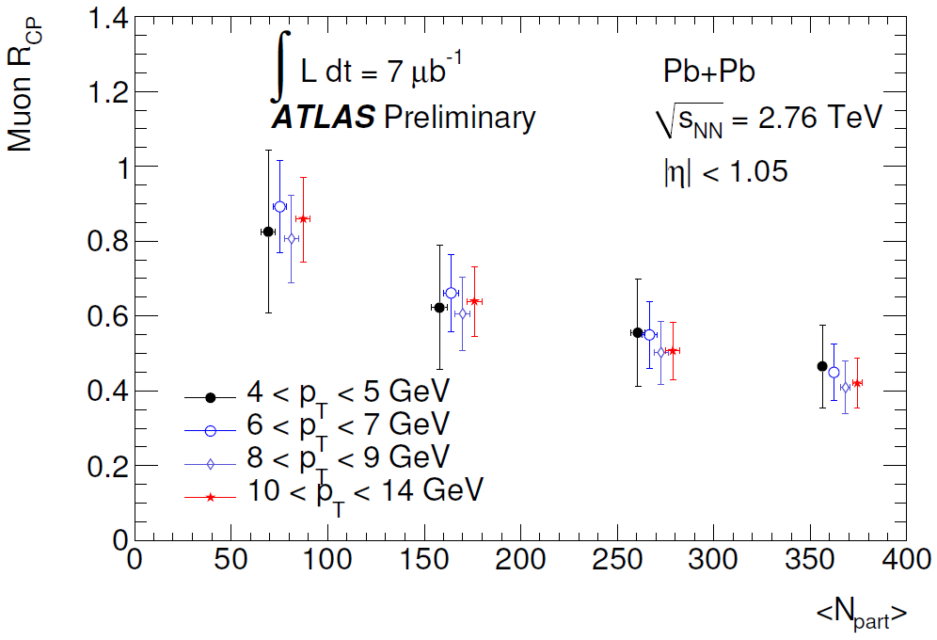
B-jet suppression

Slide 13
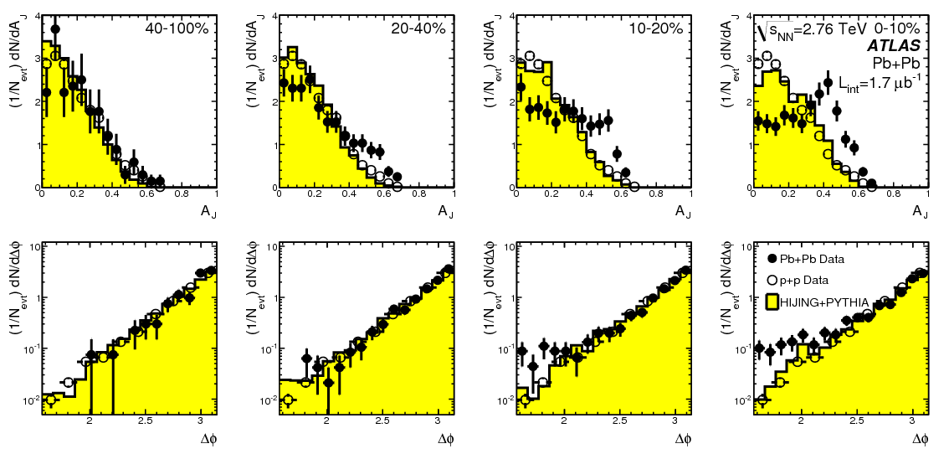
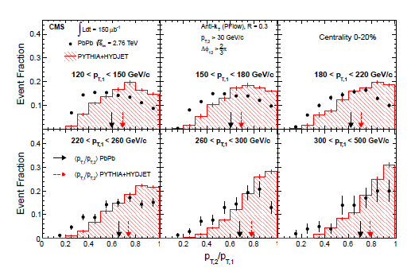
Di-jet correlation
PRL 105 (2010) 252303
PLB 712 (2012) 176

Slide 14
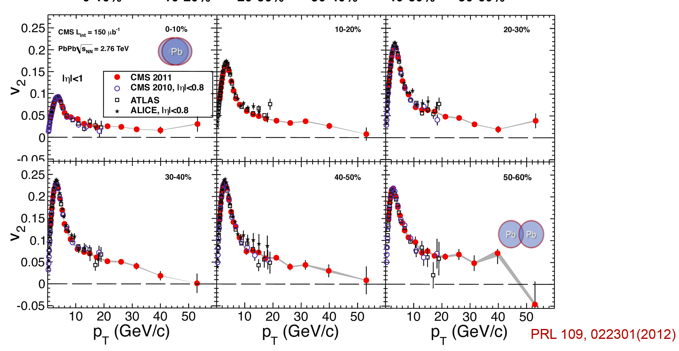
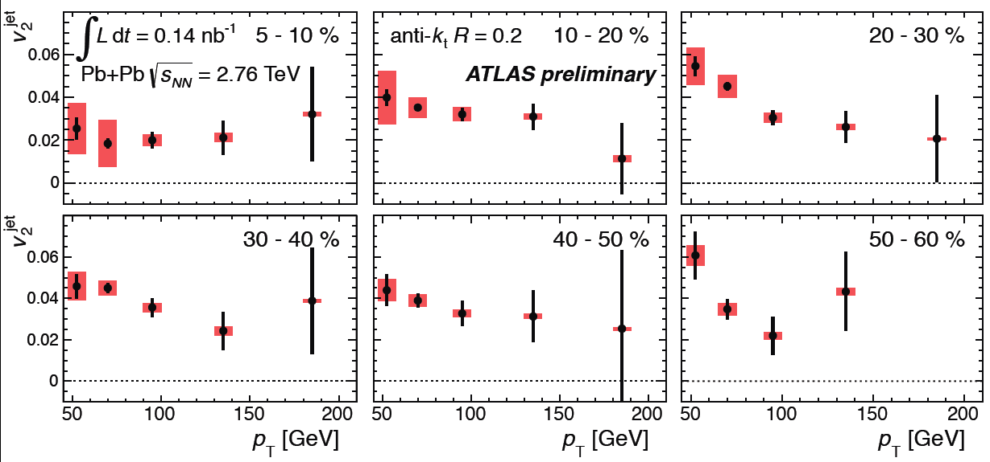
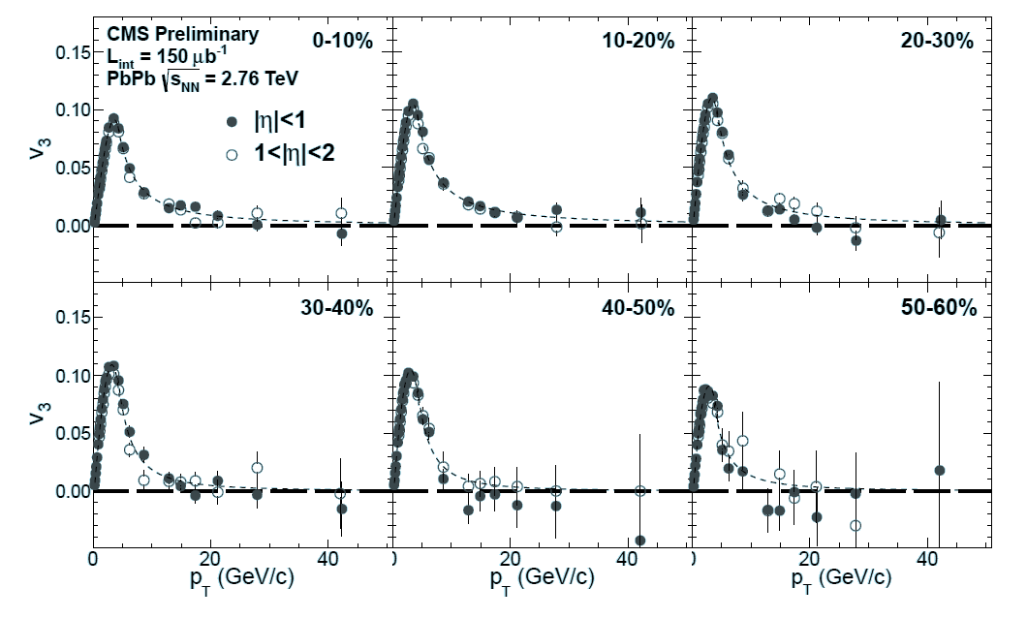
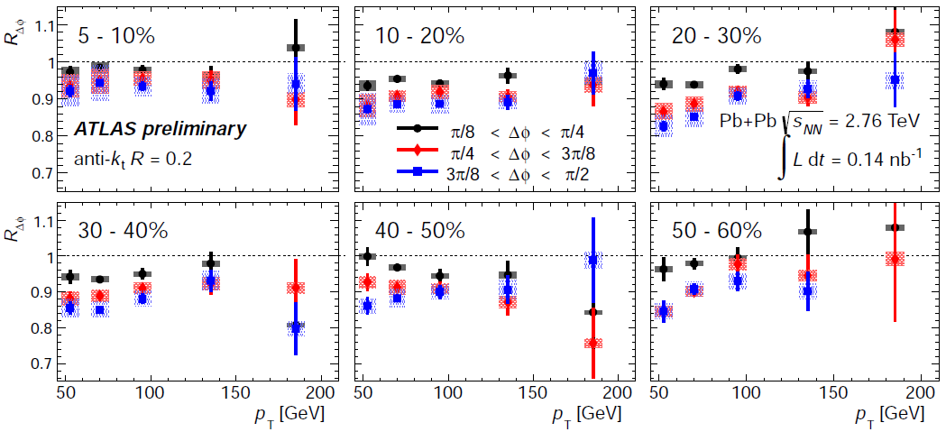
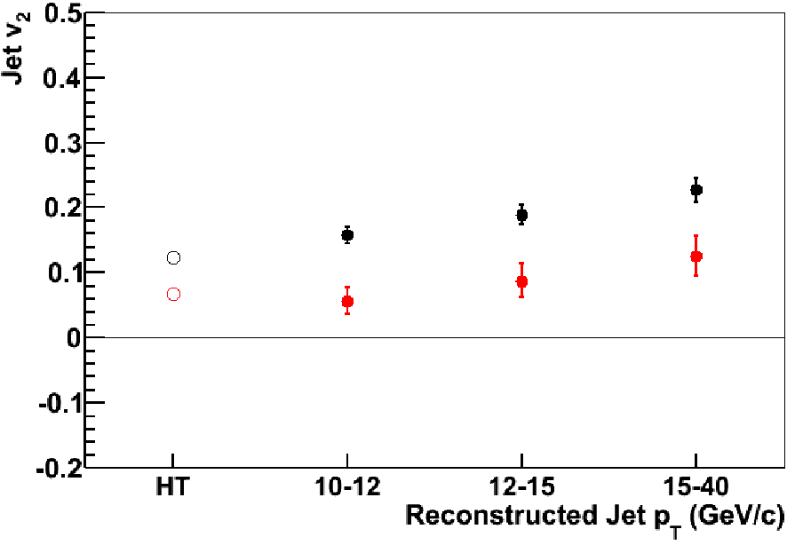
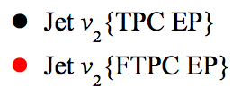
High p_{T} hadron and jet v₂
CMS
ATLAS
ATLAS
STAR Preliminary

Slide 15
3. CNM effects

Slide 16
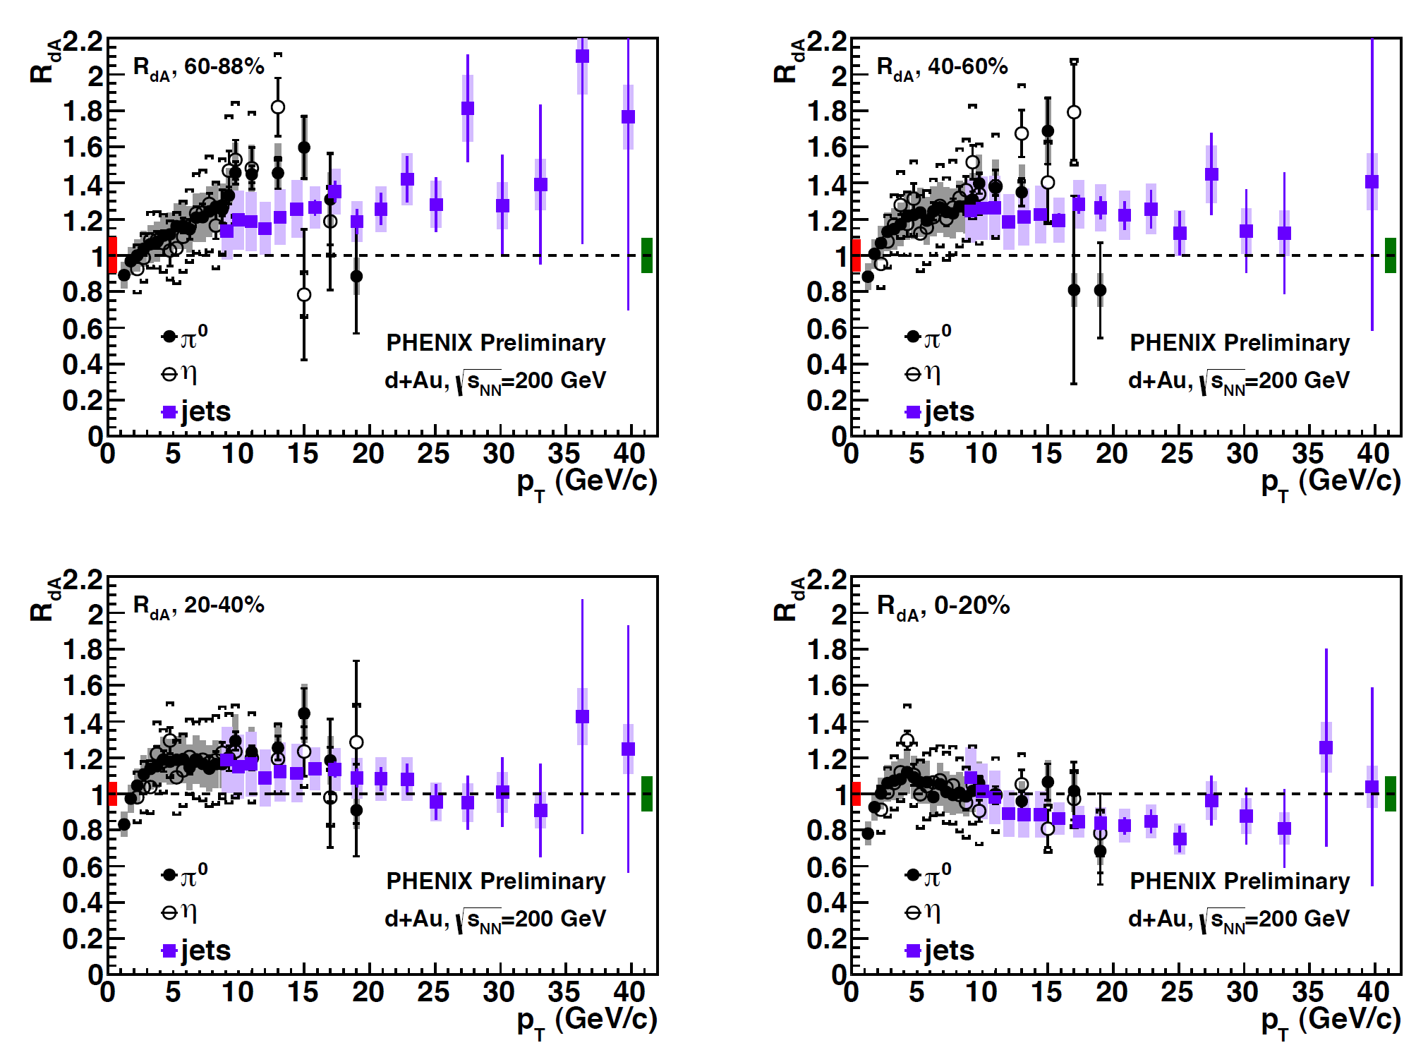
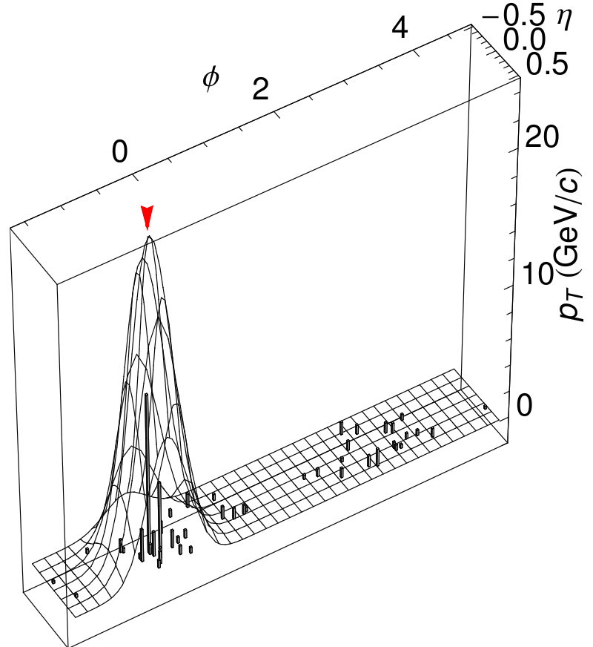
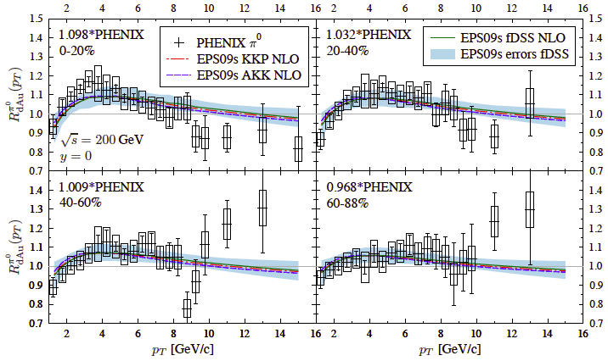
Enhancement in dAu
arXiv:1205.5359

Slide 17
Potentially Devastating Consequences
IF these preliminary data are confirmed:
Change in min-bias data demands a new nPDF fit
(eps 09 used the older data)
It is very hard to imagine how to incorporate the peripheral enhancement into an nPDF with any reasonable s⊥ dependence
(educated opinion of K. Escola and I. Helenius)
This would mean that collinear factorization approach to nuclear effects does not apply to pT as high as 30 GeV!
This is a basic assumption of all high pT calculations
This behavior could persist in p-Pb collisions at the LHC at very high pT (~ 100 GeV).

Slide 18

The experimental results
Outline:
  Heavy flavor: D, B, and their decayed
  e and μ
  Quarkonia: J/ψ, ϒ and their excited states
  Controlled Probes: W, Z, and γ
  Thermal di-leptons and photons: γ, e+e-, and μ+μ-

Slide 19
The measurements presented at QM2012
Experiment | Heavy flavor | Quarkonia | Electroweak
PHENIX | μ: 1.2<|y|<2.2 e: |y|<0.35 | J/ψ, ϒ→μμ J/ψ, ϒ→ee | γ, di-electron
STAR | e, D: |y|<1 | J/ψ, ϒ→ee | di-electron
ALICE | μ: 2.5<|y|<4 e,D: |y|<0.9 B→J/ψX→eeX | J/ψ→ μμ J/ψ→ ee | γ
ATLAS | μ: |y|<1.05, p_{T}>4 GeV/c |  | γ: |y|<1.3, E_{T} (45-200 GeV) W→μν: |η^{μ}|<2.7,p_{T}(μ)>7 GeV/c Z→µµ (ee): |y|<2.7 (|y|<2.5)
CMS | B→J/ψX→μμX | J/ψ→μμ: |y|<2.4, p_{T}>6.5 GeV/c ϒ→μμ |y|<2.4 | γ: |y|<1.44, E_{T} (20-80 GeV) W→μν: |η^{μ}|<2.1,p_{T}(μ)>25 GeV/c Z→μμ: |y|<2.1
Notes:
19

Slide 20
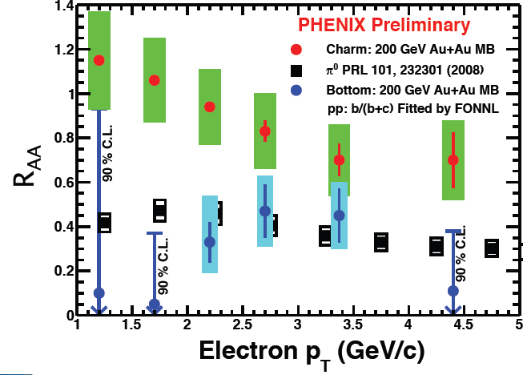
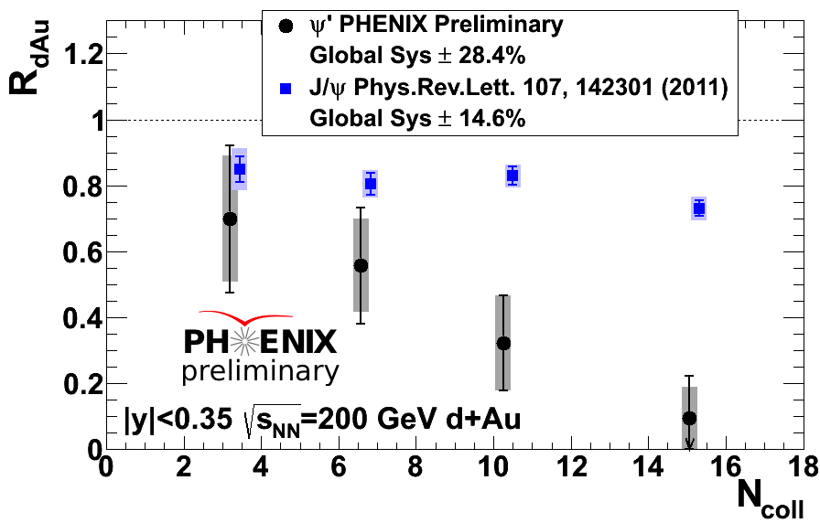
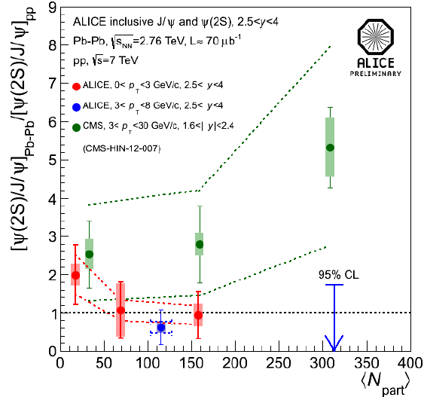
Surprising results at QM2012
PHENIX: McGlinchey, Nouicer, Rosati, Sakaguchi, Wysocki
PHENIX: R_{AA}(b→e) < R_{AA} (c→e)
at p_{T}=1-5 GeV/c in 200 GeV Au+Au
PHENIX: R_{dAu}(ψ’) < R_{dAu}(J/ψ) by a factor of 5 in most central d+Au
CMS: At 1.6<|y|<2.4, 3<p_{T}<30 GeV, ψ(2S) less suppressed than J/ψ in central Pb+Pb, not confirmed by ALICE with 2.5<|y|<4, 3<p_{T}<8 GeV.
CMS: Mironov, Moon, Roland; ALICE: Arnaldi, Safarik, Scomparin
Notes:
20

Slide 21
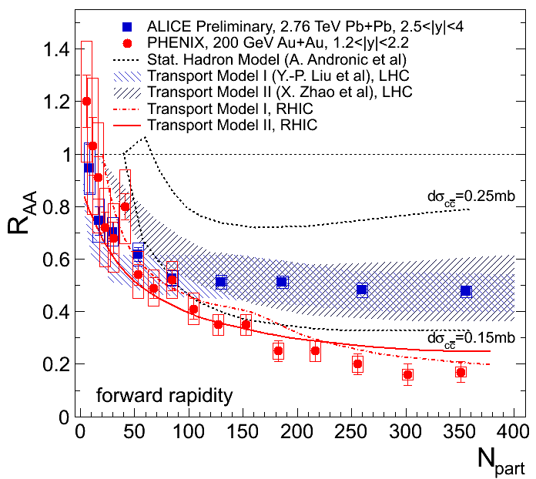
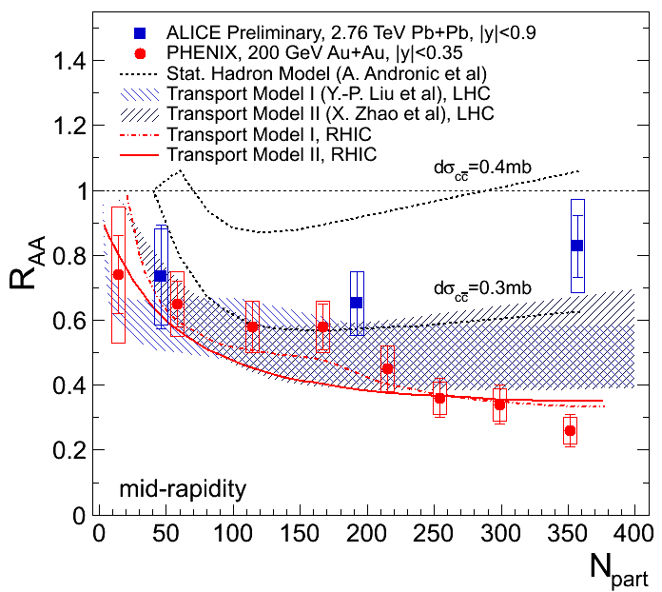
J/ψ results in A+A: centrality dependence
ALICE: Arnaldi, Arsene, Safarik, Scomparin
PHENIX: PRC84(2001)054912
N_{part} dependence of J/ψ R_{AA}: less suppression at LHC compared to at RHIC in central collisions
interplay between CNM, color screening and ccbar recombination
consistent with more significant contribution from ccbar recombination at LHC energies
Notes:
21

Slide 22
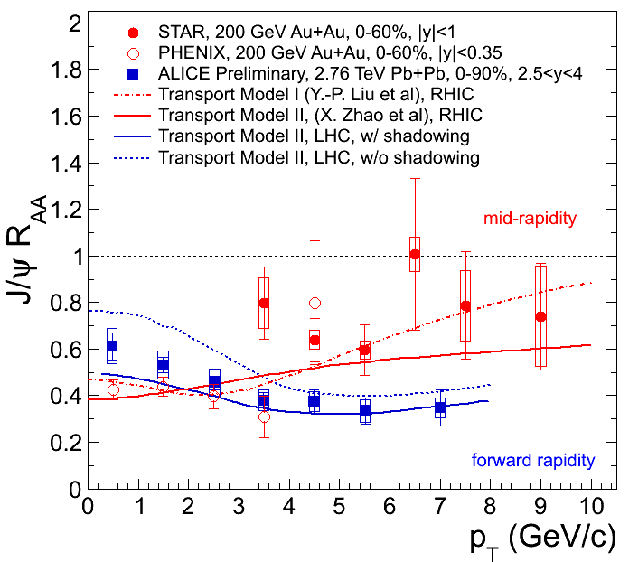
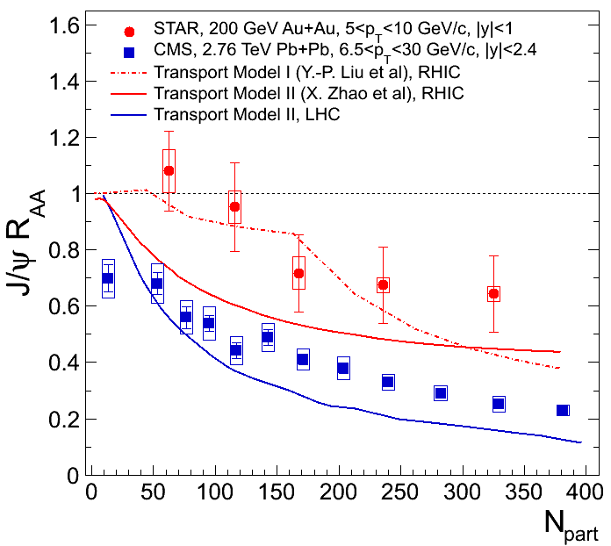
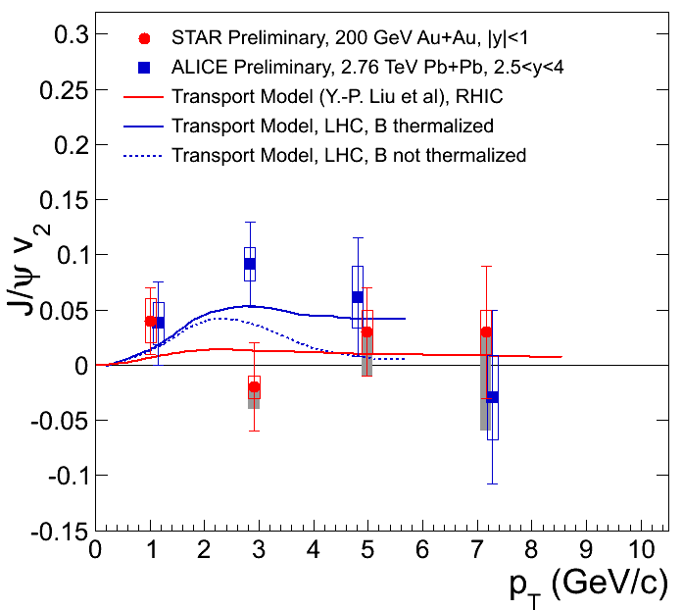
J/ψ results in A+A: p_{T} dependence
PHENIX: PRL98(2007)232301
STAR: arXiv: 1208.2736, Trzeciak, Xie
CMS: Mironov, Moon, Roland
ALICE: Arnaldi, Safarik, Scomparin, Yang
J/ψ R_{AA} decreases from low to high p_{T} at LHC.
J/ψ R_{AA} increases from low to high p_{T} at RHIC.
At high p_{T}, J/ψ more suppressed at LHC.
Hint for possible J/ψ flow at p_{T}=3 GeV/c at LHC.
Models incorporating color screening and
recombination can consistently describe the J/ψ
suppression pattern and flow measurements.
Notes:
22

Slide 23
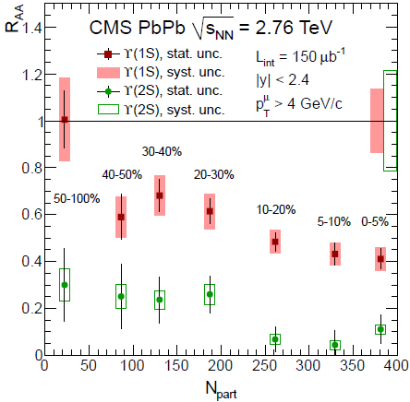
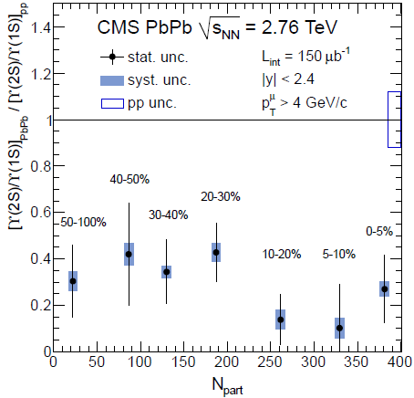
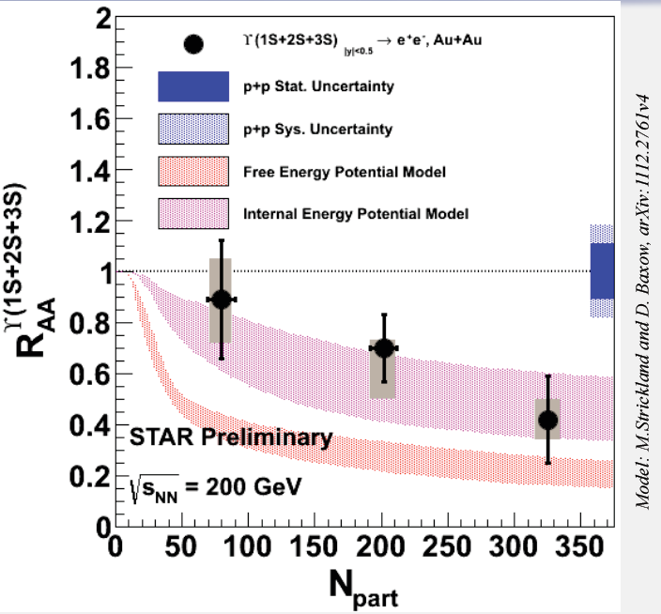
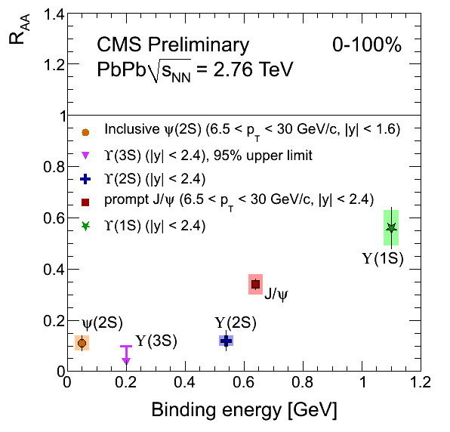
ϒ results in A+A
STAR: Dong, Trzeciak, Xie
CMS: arXiv: 1208.2826, Mironov, Rangel, Roland
ϒ(1s) suppression magnitude consistent with excited states suppression.
ϒ(2S) strongly suppressed, ϒ(3S) completely melted.
Now is the perfect time to study color screening features of hot, dense
medium in light of RHIC and LHC precise quarkonium measurements.
Notes:
23

Slide 24
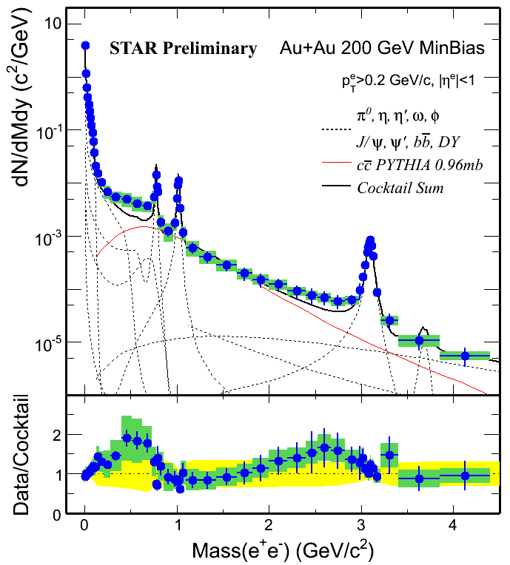
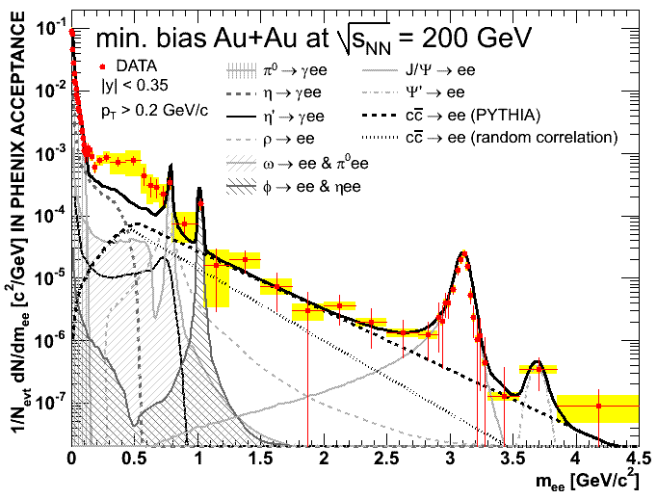
RHIC di-lepton results at last QM
PHENIX PRC 81 (2010) 034911
Enhancement factor in 0.15<M_{ee}<0.75 Gev/c2
 | Minbias (value ± stat ± sys) | Central (value ± stat ± sys)
STAR | 1.53 ± 0.07 ± 0.41 (w/o ρ) 1.40 ± 0.06 ± 0.38 (w/ ρ) | 1.72 ± 0.10 ± 0.50 (w/o ρ) 1.54 ± 0.09 ± 0.45 (w/ ρ)
PHENIX | 4.7 ± 0.4 ± 1.5 | 7.6 ± 0.5 ± 1.3
Difference | 2.0 σ | 4.2 σ
The discrepancy is in 0-20% central Au+Au collisions. The 0-20% HBD results will
be important to clarify the discrepancy experimentally.
Notes:
24

Slide 25
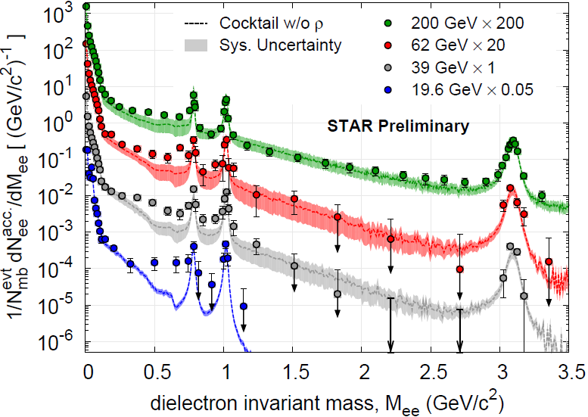
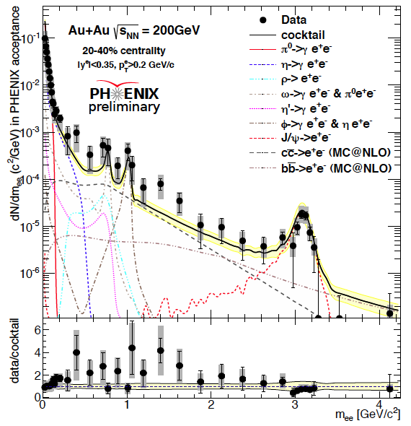
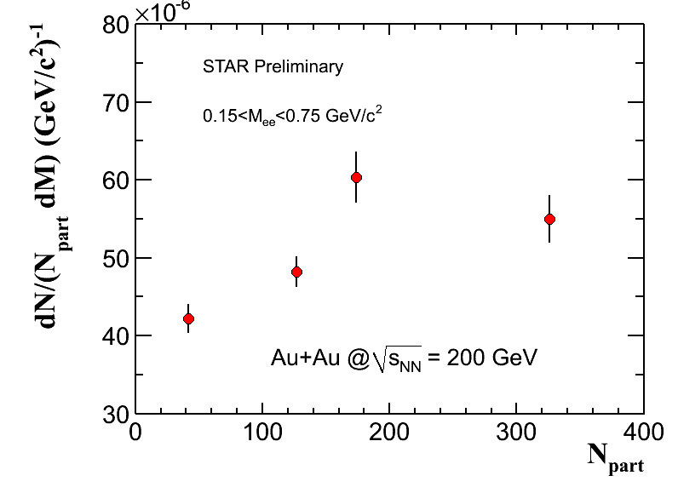
Energy dependence of di-electron spectra
20-40%
STAR: Dong, Geurts, Huang, Huck
PHENIX: Atomssa, Tserruya
PHENIX HBD results at 200 GeV : consistent with previous publication in 20-92% centrality.
STAR results: systematically study the di-electron continuum from 19.6, 39, 62.4 and 200
GeV. Note: enhancement factor (EF) depends on the reference:
using cocktail as a reference, which includes charm contribution, the EF has no
centrality dependence from STAR experiment.
using N_{part} as a reference, there is centrality dependence.
Notes:
25

Slide 26
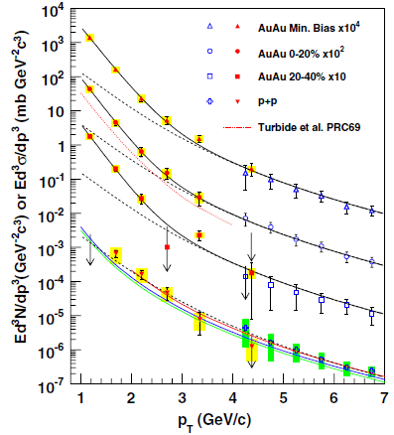

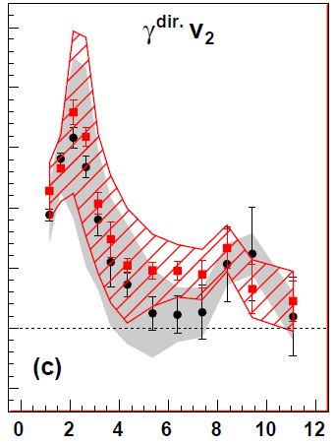

Direct photon spectra and elliptic flow v₂
PHENIX, arXiv: 1105.4126
ALICE: Wilde, Safarik
PHENIX: PRL104 (2010)132301
p_{T} (GeV/c)
Low p_{T} direct photon elliptic flow measurement could provide direct constraints on QGP dynamics (η/s, T, t₀…).
Excess of direct photon yield over p+p: T_{eff}=221 ± 19 ± 19 MeV in 0-20% Au+Au;
substantial positive v₂ observed at p_{T}<4 GeV/c.
Excess of direct photon yield over p+p at p_{T}<4 GeV/c: T_{eff}=304 ± 51 MeV in 0-40% Pb+Pb.
Di-lepton v₂ versus p_{T} & M_{ll}: probe the properties of the medium from hadron-gas dominated to QGP dominated. (R. Chatterjee, D. K. Srivastava, U. Heinz, C. Gale, PRC75(2007)054909)

Slide 27
The objectives of heavy-ion physics

Slide 28
Objectives
Extend the Standard Model of Particle Physics (SM) to dynamical complex system of finite size

Slide 29
Objectives
Extend the Standard Model of Particle Physics (SM) to dynamical complex system of finite size
Understand how macroscopic properties of matter emerge from the fundamental microscopic laws of particle physics

Slide 30
Objectives
Extend the Standard Model of Particle Physics (SM) to dynamical complex system of finite size
Understand how macroscopic properties of matter emerge from the fundamental microscopic laws of particle physics
Study the QGP, the state of matter between the electroweak phase transition (T ~ 100 GeV) and the hadron phase transition (T ~ 170 MeV)
Notes:
The experimental demonstration of the phase transition, the verification of the lattice QCD predictions reflecting the fundamental symmetries of the theory, and a detailed investigation of the properties of strongly interacting matter at high temperature are the principal aims of the ALICE scientific program. Precise determination of the QGP properties including critical temperature, degrees of freedom, speed of sound and in general transport coefficients and equation of state is the ultimate goal in the field.

Slide 31
The standarD model of heavy-ion collisions: SM_{HIC}

Slide 32

SM_{HIC}
t
Kinetic freeze out
Hadrons ➙ kinetic theory
QGP ➙ ideal hydro
g & q equilibrium ➙ viscous hydrodynamics
Strong fields ➙ classical dynamics
z
Notes:
At LHC energies, the wavefunction of high energy hadrons characterized by high high density of gluon, the part of the wavefunction with many gluons controls typical high energy processs. CGC ? This part of the wavefunction determines the processes in action at the LHC
Highly coherent color fields where most of the energy is in coherent field degrees of freedom, GLASMA ?
Quark gluon matter: degrees of freedom are not highly coherent, nor thermalized and can be thought about as quarks and gluons
QGP: matter after it has thermalized with the degrees of freedom are incoherent quarks and gluons
Lattice QCD predicts that even at several times the transition temperature, the energy density is still about 15% below that expected for the Stefan-Boltzmann law for an ideal gas of non-interacting quarks and gluons. This indicates that the effective degrees of freedom in a QGP at finite temperature are not bare quaeks and gluons but rather more complex formations whose nature has not yet been understood.
The kinetic theory of gases describes a gas as a large number of small particles (atoms or molecules), all of which are in constant, random motion.

Slide 33

Where do we start from and where to we end aT ?

Slide 34

Test the initial state
pQCD processes + soft interactions + shadowing models
Saturation models in difficulty ?
arXiv:1210.3615v1
Notes:
Forward-backward asymmetry between proton and lead hemisphere
Models including pQCD processes + soft interactions + nuclear modification of the initial parton distribution tuned to describe data of dAu at RHIC (DPMJET+HIJING)→ closest to the data
saturation models that employ coherence effects to reduce the number of soft gluons available for particle production below a given energy scale -> wrong shape and wrong magnitude

Slide 35

Temperature: chemical FO
Particle abundance described by statistical thermal model:
T = 152 MeV !!, μ_{B} = 1 MeV
Extrapolation from lower energies ?
Do final state interactions in hadronic phase modify the chemical composition ?
arXiv:1208.1974v1
Notes:
Relative particle abundances in thermal and chemical equilibrium are governed mainly by 2 parameters the chemical freeze-out temperature and the baryochemical potential, where the latter describes the net baryon content of the system
Prediction of the statistical model extrapolated from lower energy measurement for μB and T constant above √s= a few ten GeV, T from RHIC=164 MeV
Best fit T=152 MeV, data constrain μ_{B} within a few MeV from null, surprising lower than the RHIC value. Excluding protons from the fit, RHIC temperature is recovered
K*0 have short lifetime so that the decay particles (piK) can be rescattered so that the invariant mass cannot be reconstructed

Slide 36
Temperature: kinetic FO
Collective transverse expansion + hadronic FSI: ⟨β_{T}⟩ =0.65, T_{kin} = 95 MeV
Final state interactions in the hadronic phase may modify the chemical composition
BB annihilation ?
arXiv:1208.1974v1
Notes:
Particle momentum distributions reflect the conditions later in the evolution, at the kinetic freeze out from the hadron gas phase when elastic interactions end . The Pt distributions encode information about the collective transverse expansion (radial flow) and the temperature at kinetic freeze out
The spectra shapes show a significant change from RHIC to LHC energies having a distinctly harder distribution which implies a significantly stronger radial flow
Models with after the hydrodynamic phase introduce an hadronic cascade which further transports them until final decoupling. The hadronic phase builds additional radial flow due mostly to elastic interactions and affects particle ratios due to inelastic interactions.
At the LHC, hadronic final state interactions, and in particular baryon-anti-baryon annihilations (large cross section) may be an important ingredient for the description of particle yields.
Krakow models: introduces non-equilibrium corrections due to viscosity at the transition from the hydro description to particles, which chance T at chemical fo
Radial flow velocity is 10% larger than at RHIC → harder pT spectra, same kinetic freeze out temperature
Hydrodynamics is a general approach to fluid dynamics, describing the long-wavelength behaviour of a complex system in quasi-equilibrium and serves as a pwerful tool to determine the QGP properties.

Slide 37

FSI: proton–ANTI-proton
BB femtoscopy
Large densities may suppress p and Λ by annihilation
QM2012
Notes:
The p¯p correlations show a maximum for the low relative momentum due to Coulomb attraction, then a wide minimum caused by the annihilation part of the strong
FSI. ¯ correlation functions (right panel of Fig. 2) show a clear suppression at low relative momentum
The strength of the correlation e ect increases with more peripheral events, an indication that the emitting source size is shrinking for those events.
The correlations of pp and ¯p¯p pairs (left panel of Fig. 3) are due to a combination of Fermi-
Dirac statistics, Coulomb and Strong FSI which results in a distinct maximum for qinv 40 MeV/c
[14]. The height of this peak is related to the femtoscopic radius.
The source size is larger for central collisions than for peripheral ones, therefore the p-anti p are on average further apart reducing the anticorrelation

Slide 38

FSI: Λ–ANTI-Λ
BB femtoscopy
Large densities may suppress p and Λ by annihilation
QM2012

Slide 39

Direct photons
Peripheral PbPb
Peripheral PbPb
pQCD direct photons
QM2012
Notes:
Gamma conversion identified by the topological decay

Slide 40

DIRECT photons
Central PbPb
pQCD direct photons
Thermal direct photons
QM2012

Slide 41

INITIAL temperature
T > 300 MeV
Remember
  ε > 15 GeV/fm³
  V > 5000 fm³
  τ ~ 10 fm/c
  μ_{Β} = 1 MeV
QM2012
Notes:
In typical hydrodynamic models, the inverse slope parameter corresponds to an effective temperature averaged over the time evolution of the reaction, suggesting initial temperatures well above the critical QGP transition temperature of 150 􀀀 160 MeV.
RHIC was 220 MeV 35% larger
ε 3 x RHIC, V 2 x RHIC, τ + 30% RHIC
V is an homogeneity volume at freeze out. The length of homogeneity expresses the size of the region in which the source distribution in phase space does not change much.
2-particle correlations measure the width of the distribution of the relative space-time distances between every 2 particles at the point where they are set free

Slide 42
QGP
Learning about the properties of hot QCD matter
EVERYTHING FLOWS (dynamics)
EVERYTHING IS QUENCHED (transport)
Notes:
dynamics + transport are governed by fundamental properties of the medium such as viscosity speed of sound in the medium, EOS calculable ab initio starting from SM

Slide 43

QGP
Learning about the properties of hot QCD matter
EVERYTHING FLOWS
EVERYTHING IS QUENCHED
Notes:
probe the nature of matter produced in heavy-ion collisions and in general to study collective effects among produced particles
Anisotropic flow of identified hadrons is sensitive to the partonic degrees of freedom at the early times of the heavy-ion collision evolution
The initial geometrical anisotropy of non-central heavy-ion collisions is reflected in a momentum anisotropy of the produced particles caused by the di erent pressure gradients. It can be quantified by a Fourier decomposition of the azimuthal distribution of particles, ' , with respect to the event plane, defined by the beam direction and the impact parameter, ,
Non-central collisions, expansion under azimuth-dep. pressure gradient results in azimuth-dep. momentum distributions

Slide 44

Light flavours flow
444
40-50% centrality
Mass ordering
p_{T} < 2.5 GeV/c
Baryon/meson ordering
p_{T} > 2.5 GeV/c
QM2012
Notes:
flow at LHC is large and in rough agreement with expectation from the hydrodynamic model
at pT < 1–2 GeV/c the flow pattern is mostly determined by hydrodynamical flow exhibiting typical “mass splitting”
At large transverse momenta, pT > 10 GeV/c , the anisotropy is believed to be defined by the jet quenching mechanism
The intermediate pT region is less understood. It has been observed that in this region all baryons have similar flow which dffers from meson flow approximately in a 3:2 ratio. Such a scaling finds a natural explanation in the quark coalescence picture, the so-called Number of Constituent Quark (NCQ) scaling
As the quark anisotropic flow and hadronization via coalescence means the system being in a deconfined stage, the observation of such a scaling is very important
Remarkable is the flow of -meson, which exhibits a very strong mass dependence at low transverse momenta, but scales very much as other mesons at large pT .

Slide 45

quark scaling
40-50% centrality
Hydro flow at partonic level
p_{T} < 2.5 GeV/c
Quark coalescence
p_{T} > 2.5 GeV/c
More
Minwoo Kim (id flow)
Zhong Bao Yin (s & ms)
QM2012
Notes:
1. scaled with the constituent number of quarks, nq (2 for mesons and 3 for baryons) vs. kinetic energy, KE_{T} = √m² + p²_{T} per nq .
2. Such a scaling finds a natural explanation in the quark coalescence picture, the so-called Number of Constituent Quark (NCQ) scaling
Parallel talk on identified particles flow by Minwoo Kim
Parallel talk on strange and multi strange particles Zhong Bao Yin

Slide 46

Charm flow
u
c
c quarks produced in early stage of collision
thermalize in the medium and hadronize via recombination ?
QM2012
Notes:
Charm and beauty quarks are produced in the early stage of the collision.
On the other hand, if heavy quarks hadronize in the medium or if they re-interact strongly with it, heavy-flavor hadrons should inherit the medium azimuthal anisotropy.
Due to their large mass, c and b quarks should “feel” less the collective expansion: need frequent interactions with large coupling to build their v₂

Slide 47

Hidden Charm (J/ψ) flow
c
c
Hint for finite flow, an additional indication for charm recombination
QM2012
Notes:
In addition to the color screening mechanism proposed in [1] as the main source of suppression, it became soon clear that other eff ects may contribute, as dissociation in cold nuclear matter [2] and/ or in the hot confined medium [3]. Also initial state eff ects, such as nuclear shadowing [4] and initial state parton energy loss [5] are expected to play a role
The diff erential RAA results previously discussed can be considered as strong hints for an important contribution of (re)generated J/ at low pT in Pb-Pb collisions at the LHC. An in dependent confirmation of this hypothesis may come from the study of the elliptic flow of J/ . If (re)generation effects are sizeable, then the corresponding J/ would inherit the flow related to the collective expansion, which is experienced by the charm quarks contained in the fireball.

Slide 48
Hadronization
hydrodynamic flow
p_{T} < 2.5 GeV/c
recombination
2.5 < p_{T} < 10 GeV/c
parton fragmentation
p_{T} >10 GeV/c
QM2012
Notes:
Strong centrality dependent baryon to meson ratio carrying precious information on the hadronization mechanism

Slide 49
high p_{T} anisotropy
Anisotropy from jet quenching
p_{T} > 10 GeV/c
arXiv:1205.5761v1
Notes:
At large transverse momenta, pT > 10 GeV/c , the anisotropy is believed to be defined by the jet quenching mechanism

Slide 50

QGP
Learning about the properties of hot QCD matter
EVERYTHING FLOWS
EVERYTHING IS QUENCHED
Notes:
The relative production of particles in heavy-ion collisions with respect to that in nucleonnucleon interactions is commonly studied evaluating the nuclear modification factor, defined as the ratio between the yield in AA collisions (dNAA= dpT ), and the pp cross section (dpp= dpT ) normalized by the average nuclear overlap function (hTAAi ). TAA is the convolution of the colliding ions nuclear density profile and is evaluated in the Glauber model.

Slide 51

Charged hadrons
Energy loss in medium
Phys. Lett. B 696 (2011) 30-39,

Slide 52

Identified hadrons
Identical quenching magnitude for baryons and mesons at high p_{T}
Baryon to meson anomaly at low p_{T}
QM2012

Slide 53

pA
The quenching effect is definitively a final state effect due to QGP !
http://arxiv.org/abs/1210.4520v1

Slide 54

CHARMED MESONS
D⁰
arXiv:1203.2160
Notes:
Why Heavy Quarks?
Unique handle on Mass and Colour Charge dep. of energy loss
HQ preserve their identity (flavour) from production to detection → full information on medium evolution

Slide 55

CHARMED MESONS
D⁰
D⁺
arXiv:1203.2160

Slide 56

CHARMED MESONS
D⁰
D⁺
D*⁺
arXiv:1203.2160

Slide 57

CHARMED MESONS
D⁰
D⁺
D*⁺
arXiv:1203.2160
Notes:
HF-decay electrons up to 18 GeV/c
C - B separation ongoing
HF-decay muons at forward rapidity
Similar suppression as at central rapidity
Their spectra in heavy-ion interactions are influenced by the formation of hot and dense QCD matter. Heavy-quarks crossing through the QCD matter might interact with the medium and lose energy via various mechanisms. The radiative energy loss is expected to be proportional to the QCD Casimir coupling factor between the hard parton and the gluons of the medium [1]. Light-quarks should then lose less energy than gluons due to their color charge. In addition, due to their large mass, gluon-bremsstrahlung from heavy-quarks should be suppressed at small angles as a consequence of destructive quantum interferences

Slide 58

g, q, q transPort
Heavy quarks suppressed as light quark and gluons !
Color charge and mass dependence of parton transport ?
More
Renu Bala (HF)
Jianhui Zhu (single μ)
Shingo Sakai (HF e)
Tomoya Tsuji (π⁰)
arXiv:1203.2160
Notes:
Parallel talk on HF by Renu bala
Parallel talk on single muon from HF by Jianhui Zhu
Plenary on electrons from HF Shingo Sakai
Parallel on neutral pion Tomoya Tsuji

Slide 59

c, s RECOMBINATION
s
c
c quarks from hard processes hadronize with s quarks from the QGP ?
QM2012
Notes:
First measurement of D_{s}( c anti s ) in heavy ions
D_{s} enhancement expected, if c quarks recombine in the QGP (high strangeness content)

Slide 60

J/ψ transport in QGP
Less suppression at LHC than at RHIC !
  Suppression via Debye screening
  Regeneration via cc recombination
QM2012
Notes:
Predicted as a signature of deconfinement, due to the temperature (color charge density density) dependent
screening of the color charge in a Quark-Gluon Plasma

Slide 61

J/ψ transport in QGP
At low p_{T} suppression compensated by regeneration
Remember finite v₂
QM2012

Slide 62

J/ψ transport in QGP
At high p_{T} regeneration vanishes
Debye screening, thermometer ?
QM2012
Notes:
We find a smaller suppression at low transverse momentum (only accessible by ALICE)
J/ψ are suppressed in the QGP, as at lower energies, BUT are (re)generated from the large number of freely roaming charm quarks in the QGP (only important at low p_{T} !)
Picture emerging at the LHC: J/ melting in the QGP stage, followed
by subsequent regeneration in QGP or at freeze-out

Slide 63

ψ’ different from J/ψ ?
T_{c}
T_{c}
T_{c}
T_{c}
ψ(2S)
ψ(2S)
ψ(2S)
ψ(2S)
χ_{c}
χ_{c}
J/ψ
χ_{c}
J/ψ
χ_{c}
J/ψ
J/ψ
T~T_{c}
T~1.1T_{c}
T<T_{c}
T>>T_{c}
QM2012
Notes:
No firm conclusion on ψ’ enhancement or suppression with centrality within current stat. and syst. uncertainties
Large ψ’ enhancement with respect to J/ψ reported by CMS at p_{T} above 3 GeV/c not confirmed

Slide 64

JETS ARE QUENCHED AS WELL
But this is a different story
How is energy inside jet redistributed ?
QM2012
Notes:
Strong jet suppression observed for jets reconstructed with charged particles
– R_{AA} (jet) is smaller than inclusive hadron R_{AA}(h±) at similar parton p_{T}
– data are reasonably well described by JEWEL model
K.Zapp, I.Krauss, U.Wiedemann, arXiv:1111.6838

Slide 65


JET ANATOMY
Baryon/meson content
QM2012
Notes:
Near-side peak (after bulk subtraction): p/π ratio compatible with that of pp (PYTHIA) Bulk region: p/π ratio strongly enhanced – compatible with overall baryon enhancement Jet particle ratios not modified in medium? Could this still be surface bias?

Slide 66










Many more results …
LHC: pp, pA, AA, γΑ

