Slide 1
Design & production of silicon sensors for phenix mpc-ex
Jiman Ha
(Yonsei Univ.)
For PHENIX MPC-EX collaboration

Slide 2
MPC-EX
참여그룹
  국외 : Brookhaven Nation Laboratory, Iowa State University, University of California-Riverside, Los Alamos National Laboratory
  국내 : Yonsei University, ETRI, Ewha Womens University, Hanyang University, Chonbuk National University
발표관련 기여
  Sensor design : BNL, Yonsei & ETRI
  Sensor production : Yonsei & ETRI
  Sensor test : Yonsei, Ewha Womens University

Slide 3
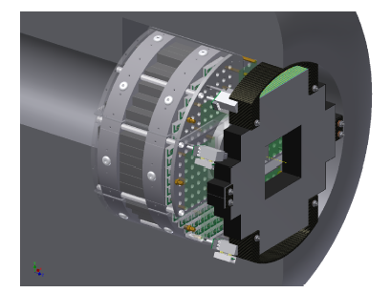
MPC-EX for PHENIX
Application as a pre-shower for EMCal (Electromagnetic calorimeter)

Slide 4

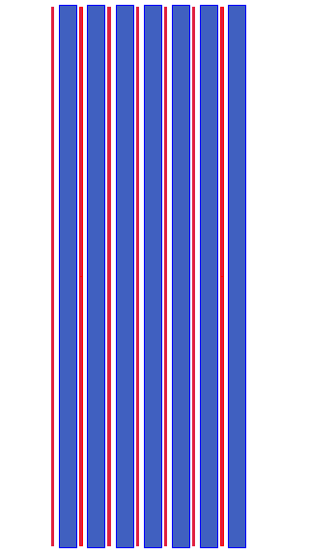
Electromagnetic Shower
(A schematic view)
~1X₀ x 20
PAD
STRIP
W
SEG0
SEG1
SEG2
-R_{M}<y<R_{M}
(EM Shower by single e)
y
z

Slide 5
Sensor Design

Slide 6
Sensor Geometry
6.2 cm
Total # of PADs = 128
# of PAD column =32
0.18cm
6.2 cm
1.5cm
# of PAD row =4

Slide 7
SOME DESIGN DETAILS
Edge Rounding
PADs of Sensor
Bonding PADs
Biased/Floating Guardring
Floating Guardring
(3 layer structure)

Slide 8
Mask design of silicon sensor

Slide 9
Production Mask

Slide 10
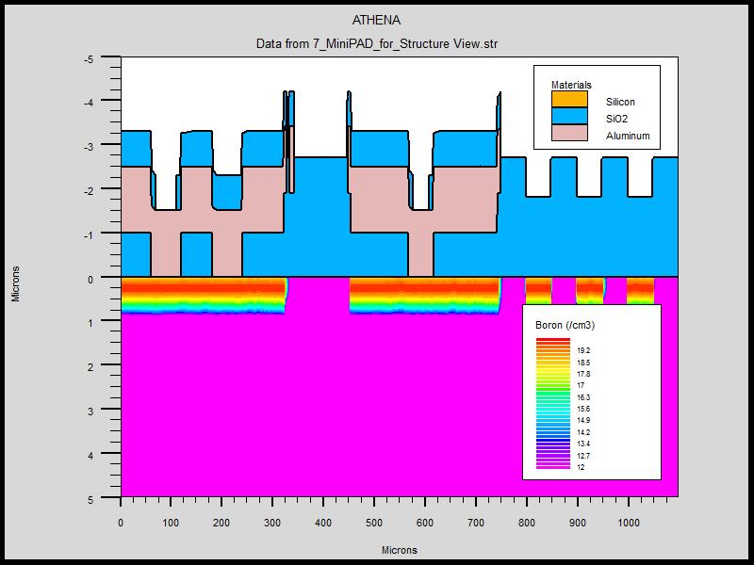
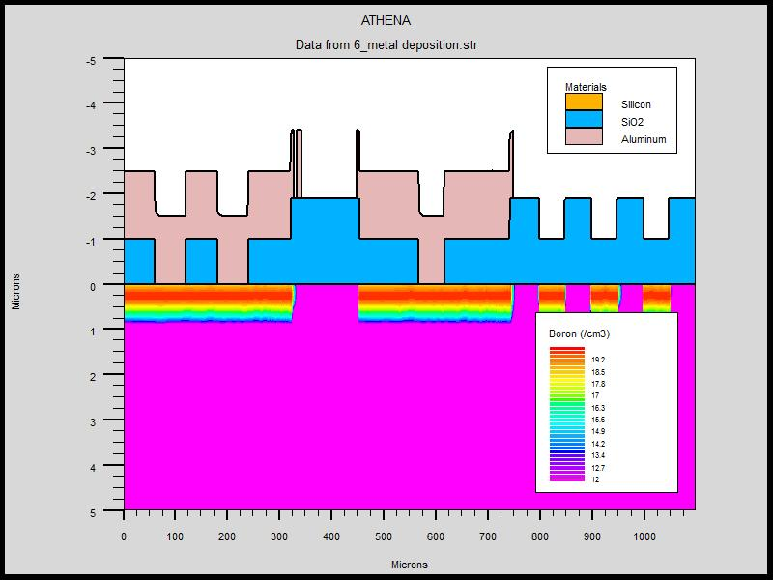
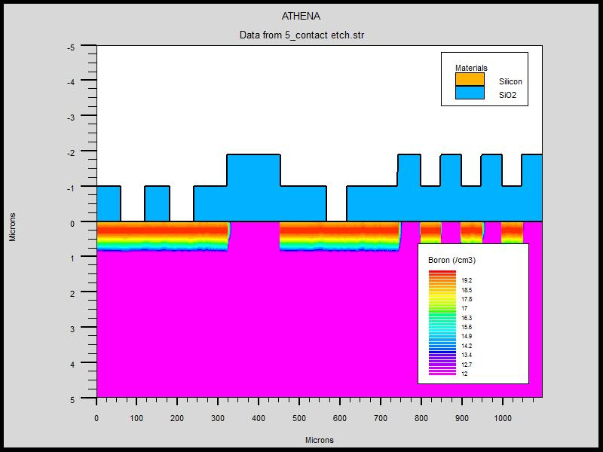
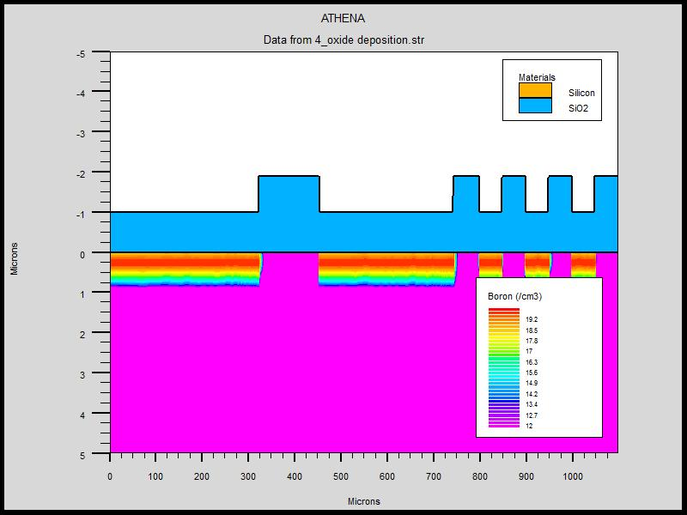
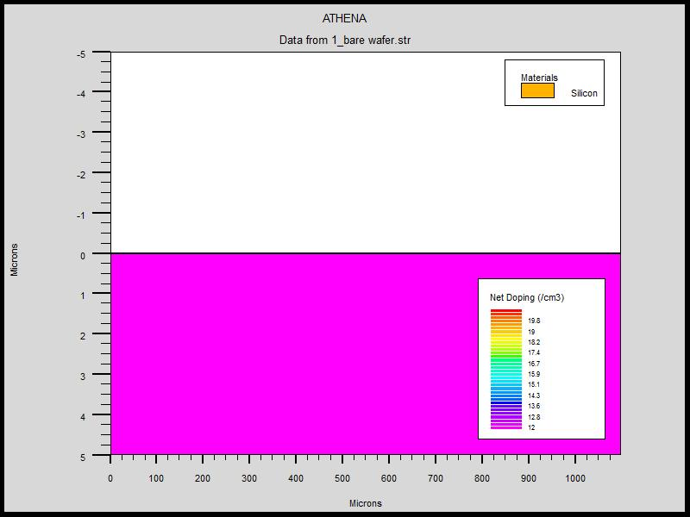
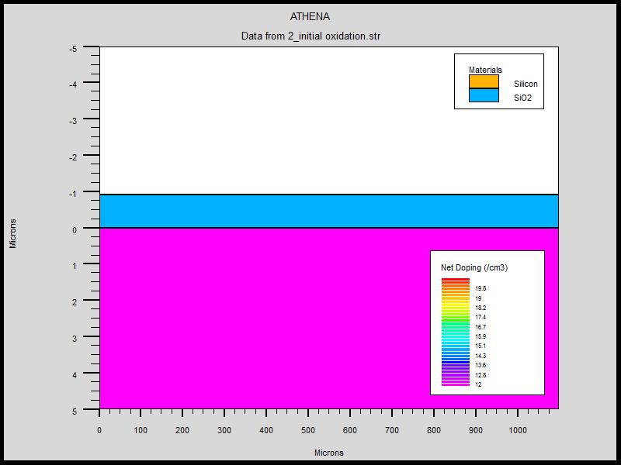
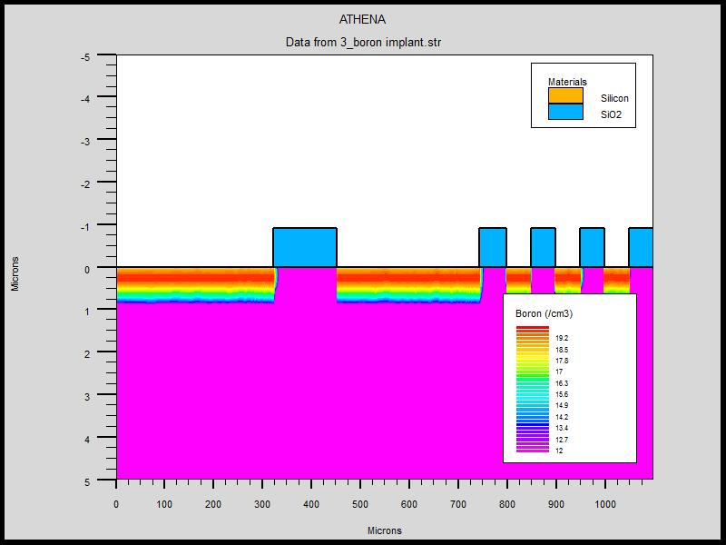
How do we make it?
(CMOS process)
Metal layer deposition
Passivation
Oxide layer deposition
Etch for contact
High purity Si wafer
Oxidation
Ion implant

Slide 11
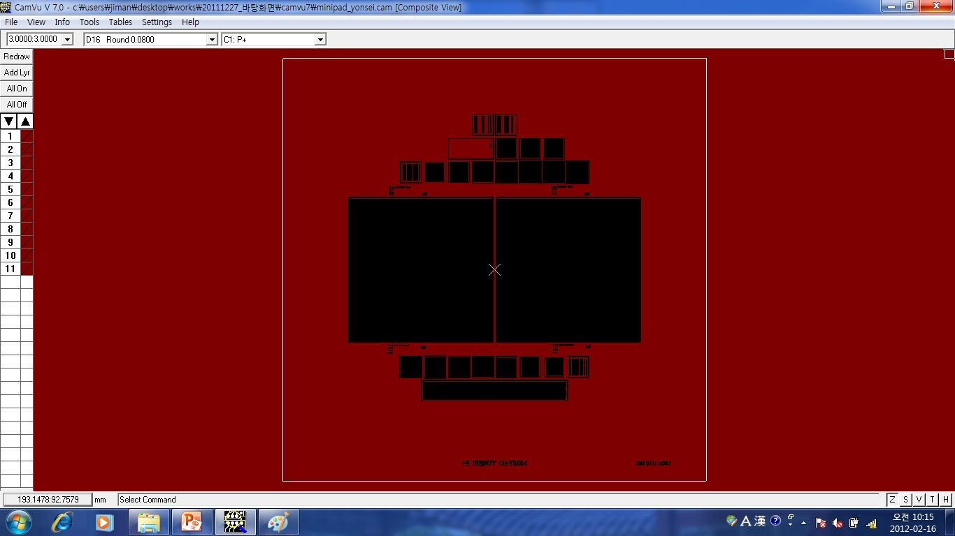
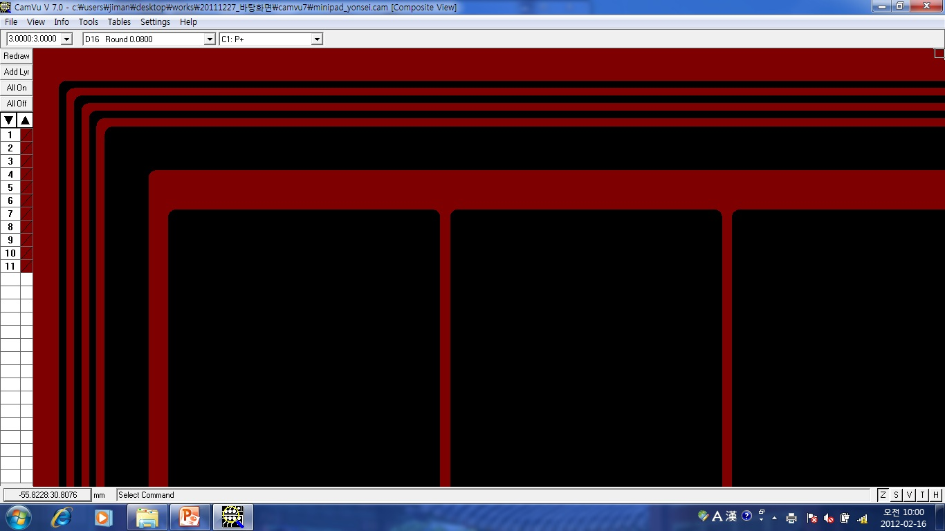
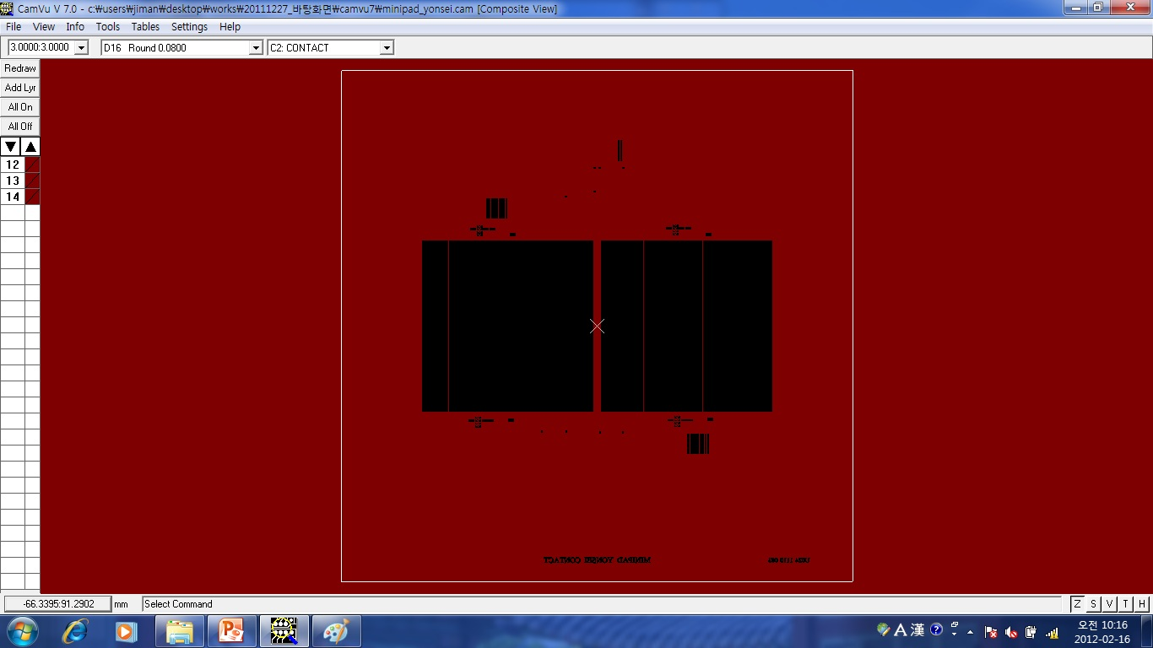
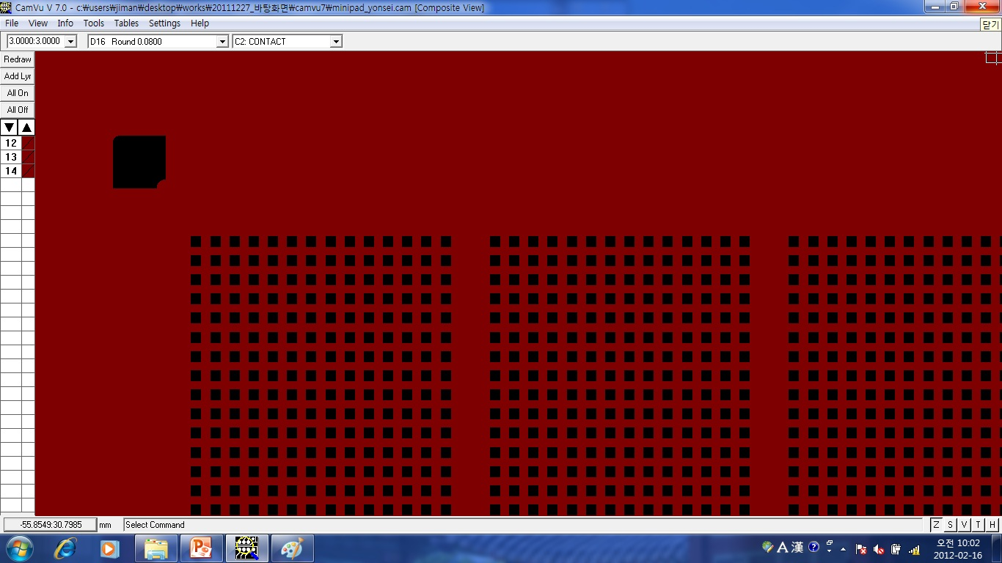
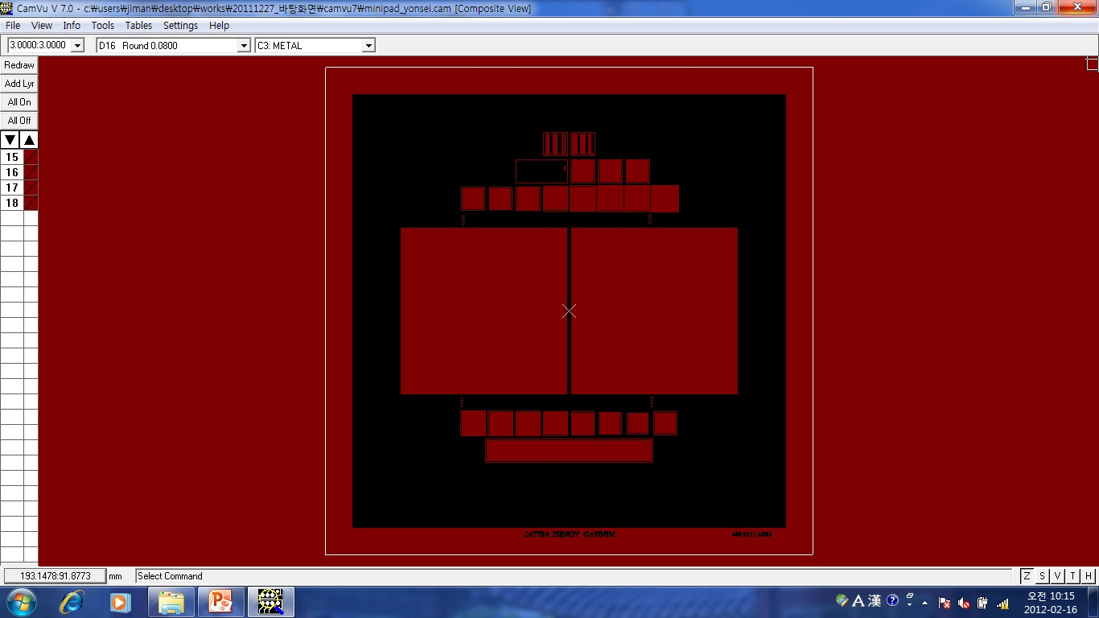
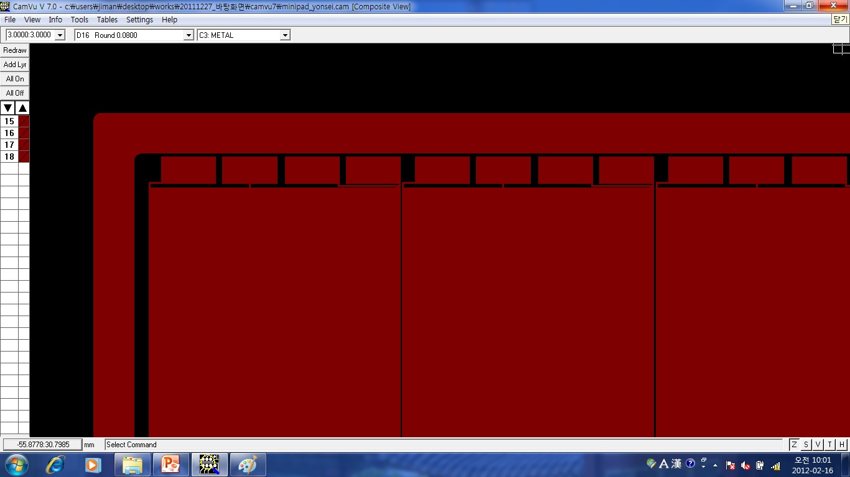
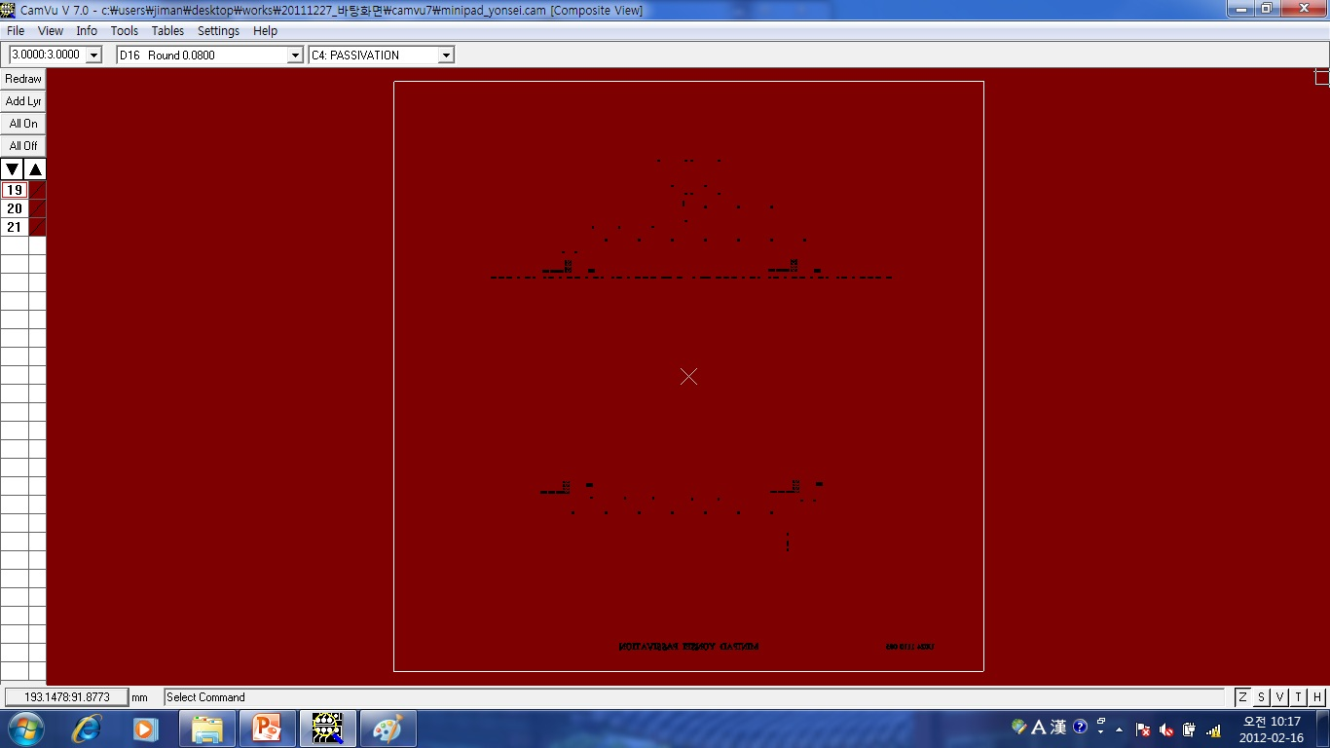
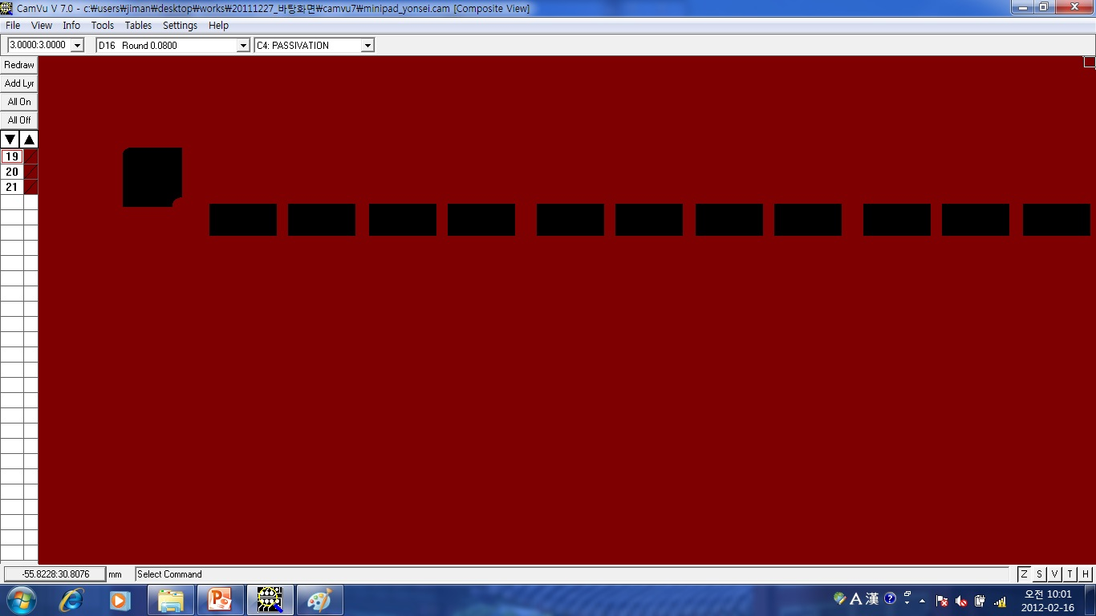

Slide 12
Simulations

Slide 13
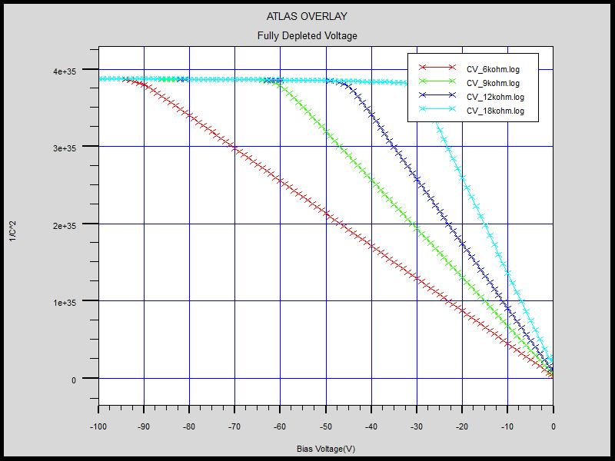

Capacitance–voltage Relation
Wafer – Resistivity = 6, 9, 12, 18kΩ∙cm / Thickness = 405μm, Orientation = <100>
Full Depletion Voltage = 90V(6kΩ∙cm),60V(9kΩ∙cm),45V(12kΩ∙cm),30V(18kΩ∙cm )
$$A=πr^{2}$$
Full Depletion
Bias Voltage (V)

Slide 14
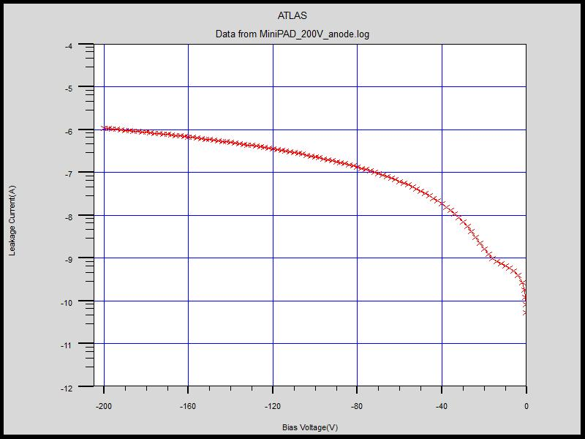
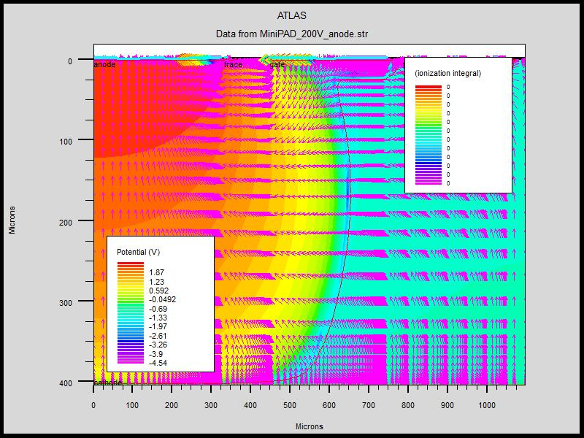
Current-Voltage relation
(ongoing work)
No breakdown upto 200V but somewhat large leakage current
Leakage current abruptly rise!
Leakage current flows from no bias guardring
No Breakdown !
Full Depletion
Notes:
large because carriers in no bias guardring doping region drift to Active region through depletion region by potential difference.

Slide 15
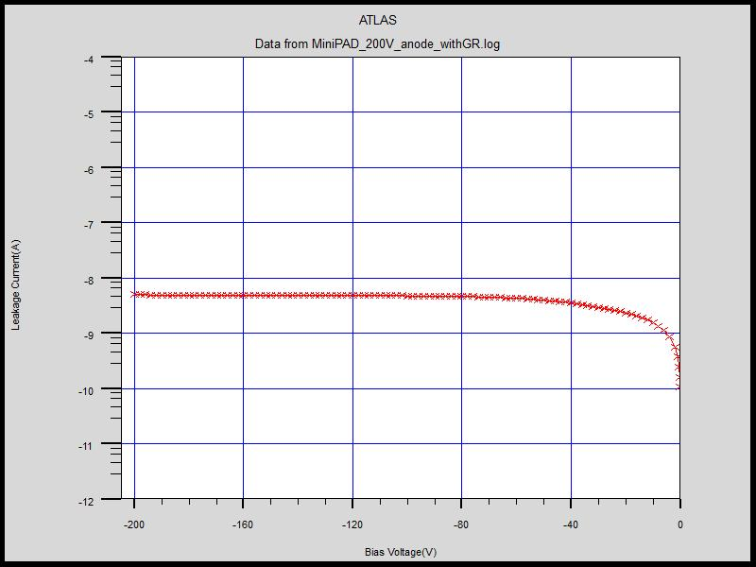
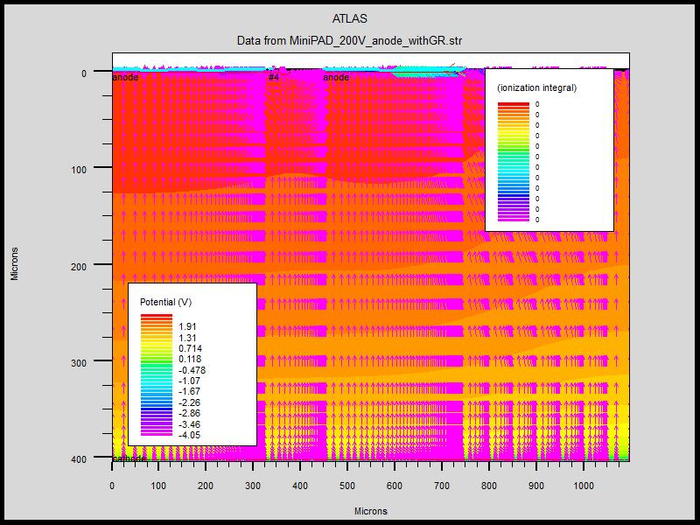
Current-Voltage relation
(ongoing work)
.
No breakdown upto 200V and reduced leakage current
No Breakdown !
Full Depletion

Slide 16
Fabrication Monitoring

Slide 17
AlignMENT

Slide 18
AlignMENT

Slide 19
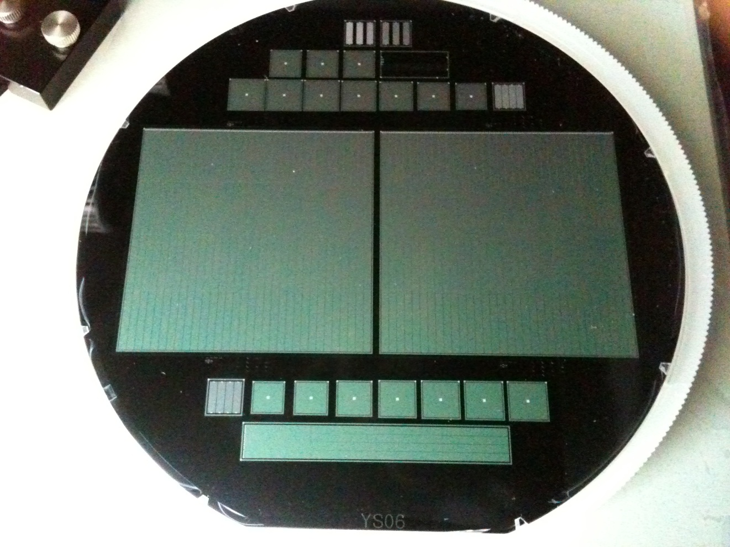
완성된 Wafer 사진

Slide 20
Summary
MPC-EX is a pre-shower detector in Si/W sandwich structure.
We designed and fabricated a prototype of the relevant Si sensor.

