Slide 1



Efforts for $\frac{1}{N_{event}}\frac{dN_{ch}}{dη}$ in pp collisions
Beomkyu Kim

Slide 2
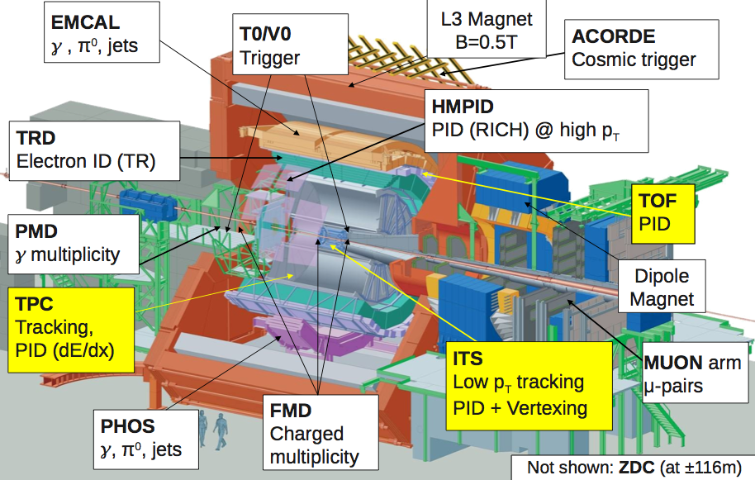
A Large Ion Collider Experiment
Notes:
LHC energy is far higher from soft hardronic physics and its gradual evolution to better understood pQCD regime
Eee
It is important to gather this fundamental reference in the same detectors

Slide 3
p+p studies in ALICE experiment
ALICE is the only dedicated heavy ­ion experiment at LHC
ALICE also studies p+p
  Several signals in heavy ion collisions are measured relative to p+p
  ALICE has a rich p+p program
ALICE special features for p+p physics
  Low momentum sensitivity
  Low material budget and low magnetic filed
  Excellent particle identification(PID) capability
 | Magnetic Field (T) | P_{T} cut-off (GeV/c) | Material Thickness X/X₀(%)
ALICE | 0.2-0.5 | 0.1-0.25 | 7
ATLAS | 2.0 | 0.5 | 30
CMS | 4.0 | 0.5 | 20
Notes:
LHC energy is far higher from soft hardronic physics and its gradual evolution to better understood pQCD regime
Eee
It is important to gather this fundamental reference in the same detectors

Slide 4

p+p studies in ALICE experiment
Published papers by ALICE for p+p collisions
Pseudo rapidity & multiplicity
  $\sqrt{s}$ = 900 GeV
  $\sqrt{s}$ = 2.36 TeV
  $\sqrt{s}$ = 7 TeV
$\overline{p}/p$ ratio($\sqrt{s}$ = 900GeV & 7TeV)
Momentum distribution(900GeV)
Bose-Einstein correlation(900GeV)
Strangeness(900GeV)
Rapidity & P_{T} distribution of J/Ps(7TeV)
Pion, kaon, proton yield(900GeV)
EJC: Vol. 65 (2010) 111
EPJC: Vol. 68 (2010) 89
EPJC: Vol. 68 (2010) 345
PRL: Vol. 105 (2010) 072002
PL B: Vol. 693 (2010) 53
PRD: Vol. 82 (2010) 052001
EPJC: Vol.71(2011) 1594
PLB: Vol. 704(2011) 442
Epjc: Vol.71(2011) 1655
dNdEta and multiplicity measurement
  Basic measurements to examine the global characteristics of the collision
  Useful to study QCD in the non-perturbative regime, and to constrain phenomenological models and event generators
Notes:
LHC energy is far higher from soft hardronic physics and its gradual evolution to better understood pQCD regime
Eee
It is important to gather this fundamental reference in the same detectors

Slide 5
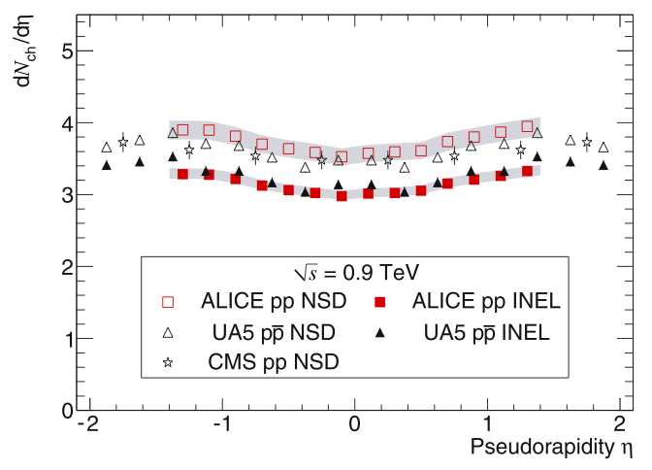
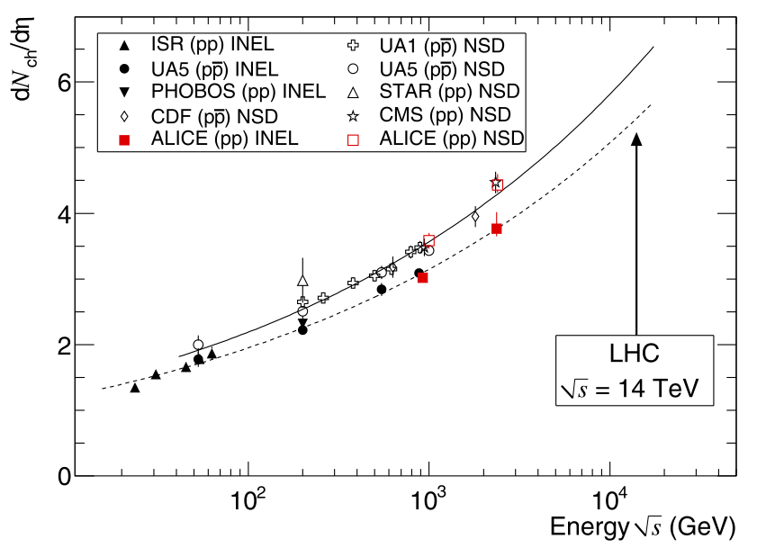
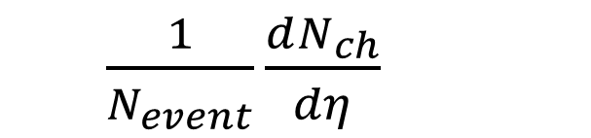


dN_{ch} /dη measurement
All # of primary charged particles
$\frac{1}{N_{event}}\frac{dN_{ch}}{dη}$
≡
@ η
All # of events
Typical $\frac{1}{N_{event}}\frac{dN_{ch}}{dη}$ distribtuion
$\frac{1}{N_{event}}{\frac{dN_{ch}}{dη}|}_{η=0}$vs. $\sqrt{s}$
If we integrate $\frac{1}{N_{event}}\frac{dN_{ch}}{dη}$ in the region |$η$|<0.5, we can have $\frac{1}{N_{event}}{\frac{dN_{ch}}{dη}|}_{η=0}$
Notes:
LHC energy is far higher from soft hardronic physics and its gradual evolution to better understood pQCD regime
Eee
It is important to gather this fundamental reference in the same detectors

Slide 6
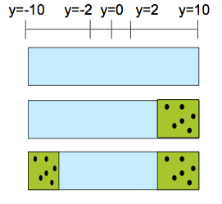



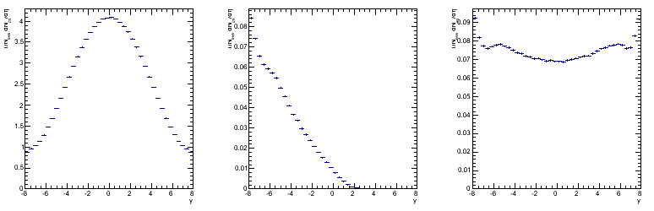

Physics motivation - diffraction
Why is the diffraction important in pp collisions?
  In HE p+p collisions, about 30% of $σ_{inelastic}$ comes from diffractive processes like
  Single diffraction(SD) + Double diffraction(DD)
  The default MC(pythia-perugia0) has a rate of diffractions as like,
  NSD = ND + DD(less dependent to a diffraction rate, easy to detect)
p
p
Elastic collision
p
p
p
X
Single Diffraction
p
p
p
X
Double Diffraction
p
X
Non Diffraction
Single Diffraction
(only -y(rapidity) region)
Double Diffraction
68% of total event
19% of total events
13% of total events\\\
Notes:
α_{p} –1= 0.12 ±0.02 (Kaidalov,91)
, both the total cross-section and the particle density, at η = 0, grow as a power law of s:

Slide 7
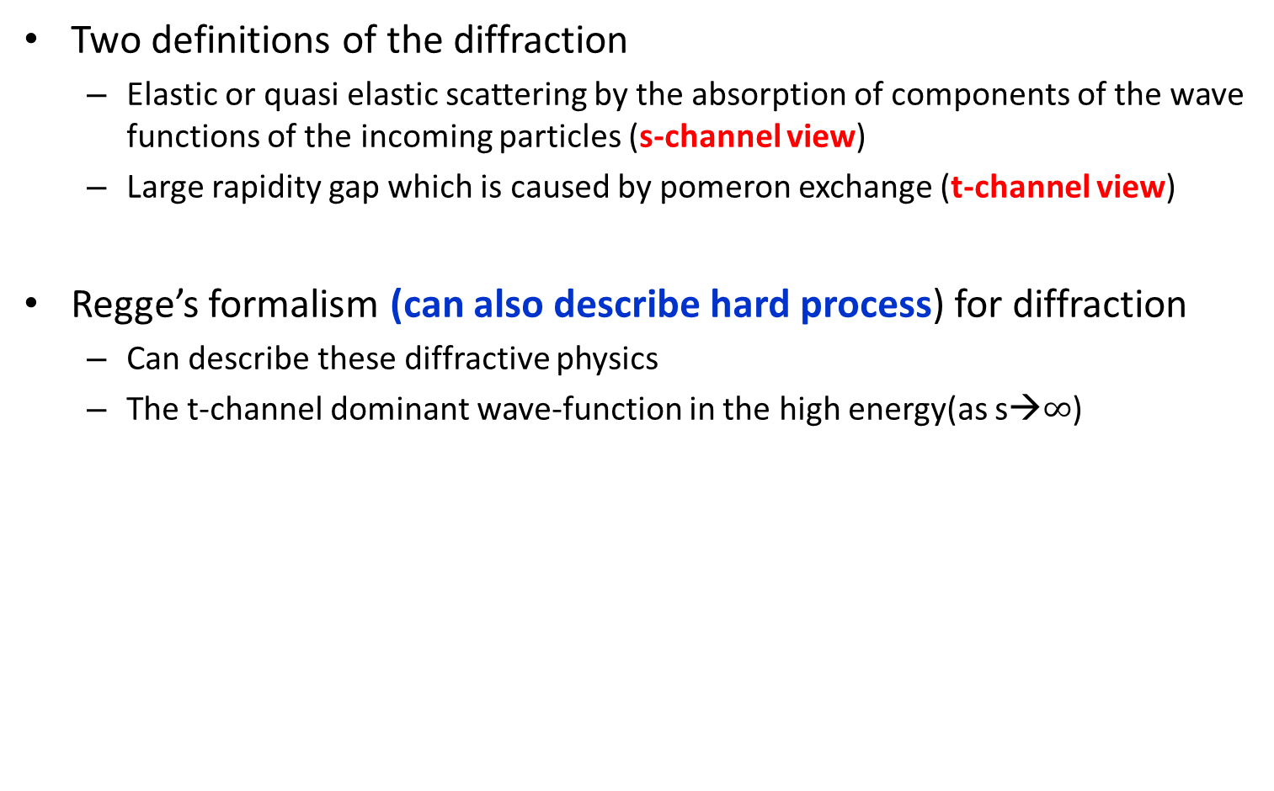
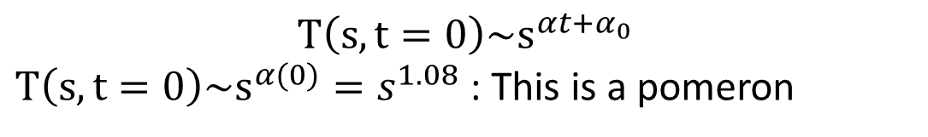
Physics motivation - diffraction
Two definitions of the diffraction
  Elastic or quasi elastic scattering by the absorption of components of the wave functions of the incoming particles (s-channel view)
  Large rapidity gap which is caused by pomeron exchange (t-channel view)
Regge’s formalism (can also describe hard process) for diffraction
  Can describe these diffractive physics
  The t-channel dominant wave-function in the high energy(as s→$∞$)
p
p
$$T\left(s,t=0\right)\sim s^{αt+α_{0}}$$
$T\left(s,t=0\right)\sim s^{α(0)}=s^{1.08}$ : This is a pomeron
p
p
Notes:
α_{p} –1= 0.12 ±0.02 (Kaidalov,91)
, both the total cross-section and the particle density, at η = 0, grow as a power law of s:
Elastic or quasi elastic scattering by the absorption of components of the wave functions of the incoming particles
A diffractive process is characterized by a large rapidity gap which is caused by pomeron exchange

Slide 8
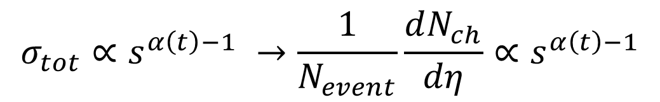
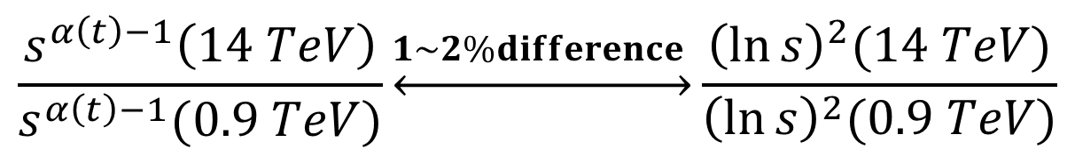
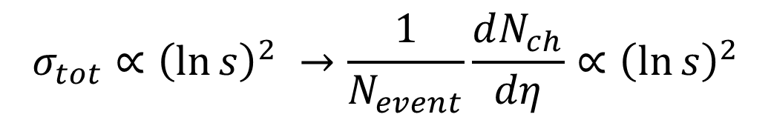
Physics motivation – parton saturation?
Parton saturation and break down of Regge theory
From Regge theory (no parton saturation), in asymptotic regime
On the other hand, the Froissart bound(partion saturation) limits the growth of σ_{tot}:
There will be an energy where the power law takes over the logarithm increase. However, with present value of α_{p}, at LHC top energy, both behaviours are the same:
$$σ_{tot}∝s^{α\left(t\right)−1} →\frac{1}{N_{event}}\frac{dN_{ch}}{dη}∝s^{α\left(t\right)−1}$$
$$σ_{tot}∝{\left(\ln{s}\right)}^{2} →\frac{1}{N_{event}}\frac{dN_{ch}}{dη}∝{\left(\ln{s}\right)}^{2}$$
$$σ_{tot}∝s^{α\left(t\right)−1} → σ_{tot}∝{\left(\ln{s}\right)}^{2}$$
$$\frac{s^{α\left(t\right)−1}\left(14 TeV\right)}{s^{α\left(t\right)−1}(0.9 TeV)}\underset{↔}{1\sim 2\%difference }\frac{{\left(\ln{s}\right)}^{2}(14 TeV)}{{\left(\ln{s}\right)}^{2}(0.9 TeV)}$$
Notes:
α_{p} –1= 0.12 ±0.02 (Kaidalov,91)
, both the total cross-section and the particle density, at η = 0, grow as a power law of s:
Woulb be ch
allening to reach this precision

Slide 9

Tracking methods in ALICE
·
ITS track
·
·
SPD1
SPD1
SPD1
SPD2
SPD2
SPD2
ITS
ITS
TPC
A SPD tracklet
ITSSA+ tracks
ITSTPC+ tracks
3 track counting methods
1) SPD tracklets(common method to count tracks)
2) ITSSA+: ITS detector’s tracks + SPD tracklets
3) ITSTPC+: TPC tracks
+ complementary ITS detector’s track
+ complementary SPD tracklets
SPD
SDD
SSD
Cross-section of ITS

Slide 10
Recent efforts in pp dNdEta
dNdEta measurements by the use of other tracking methods
  Old method : “Tracklet” for dNdEta and multiplicity
  New methods: ITSSA+ tracks , ITSTPC+ tracks
  Advantages of using new methods
    More tolerance to background
    Less possibility to lose tracks
    → Good method to go over to high multiplicity events
New dNdEta results with the modified diffraction rate
  Re-calcuate dNdEta with new MC(with new measured diffraction rate)
900GeV | Default MC | New MC
SD(%) | 22.5 | 19.45
DD(%) | 12.3 | 9.46
ND(%) | 100-SD-DD | 100-SD-DD
7TeV | Default MC | New MC
SD(%) | 19.2 | 17.85
DD(%) | 12.9 | 8.94
ND(%) | 100-SD-DD | 100-SD-DD

Slide 11
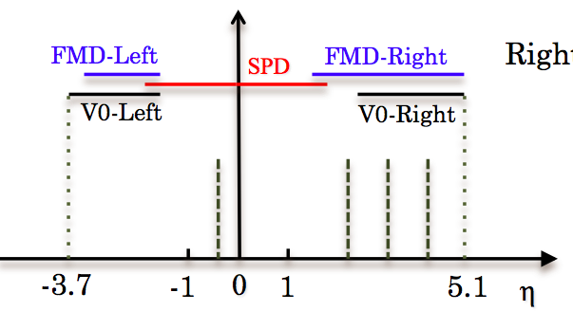
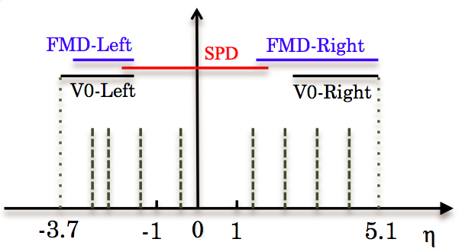
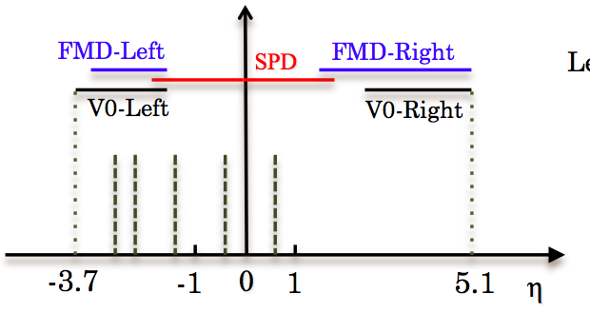
How to measure the new rate of diffraction
Corresponding trigger for SD and DD
Rapidity gap
Right arm trigger for right SD events
Two arm trigger for DD events
Left(right) SD events are sensitive to
“Left(Right) Arm Trigger”
A rapidity gap in “Two Arm Trigger”
is sensitive to DD events
Trigger and MC modulation of the diffraction rate → Possible to measure “true diffraction”
Left arm trigger for left SD events
M.Phoghosyan,QM2011

Slide 12
Event and track selection
Event selection
  Pileup rejection: Δ_{Z} ≥ 0.8 cm and N_{contributor} ≥ 3
  Vertex condition: -10cm<Z_{primary vertex} < 10 cm
Track selection
  SPD tracklet
  for each pair of hits: Δφ < 80 mrad, Δθ < 25mrad
  ITS track: |η|<1.3
  TPC track: |η|<0.9
  Secondary particle rejection by DCA cut
  (* DCA = Distance of Closest Approach)
·
·
·
SPD1
SPD2
A measured track
DCA
A measured primary vertex
Notes:
a signal in either V0A, V0C, or SPD:
, a signal in both V0A and V0C:

Slide 13
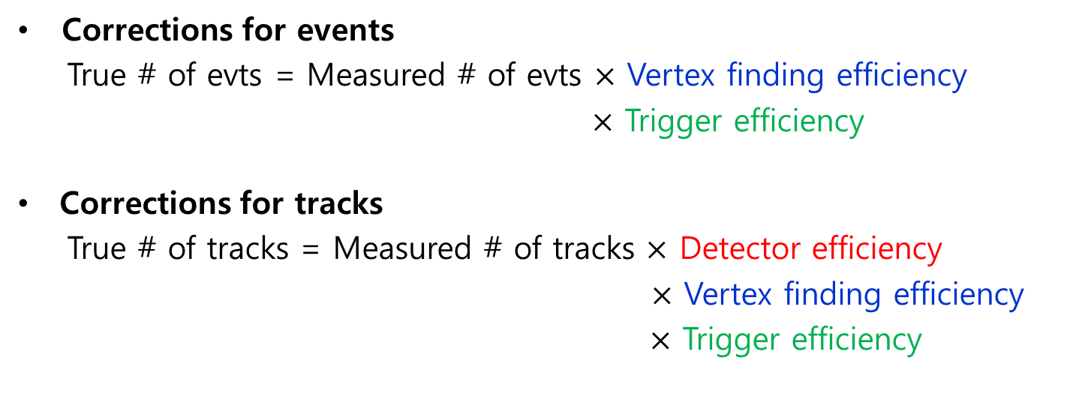
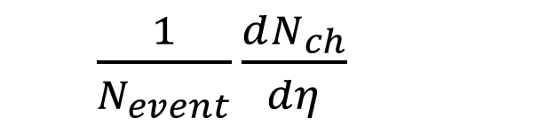
dNch/dη measurement
$\frac{1}{N_{event}}\frac{dN_{ch}}{dη}$
All tracks
Measured tracks
≡
≠
All events
Measured events
Corrections for events
  True # of evts = Measured # of evts $×$ Vertex finding efficiency
  $×$ Trigger efficiency
Corrections for tracks
  True # of tracks = Measured # of tracks $×$ Detector efficiency
  $×$ Vertex finding efficiency
  $×$ Trigger efficiency
13

Slide 14
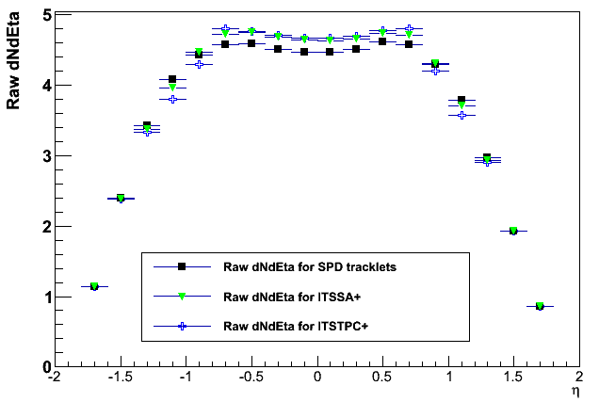
Results – Raw dNdEta distributions
For inelastic events @ 7TeV
*Raw yield of ITSTPC+ tracks or ITSSA+ tracks > SPD yields.
*As many detectors used, we can expect small background for ITSTPC+ tracks
Notes:
Pythia energy dependence.

Slide 15
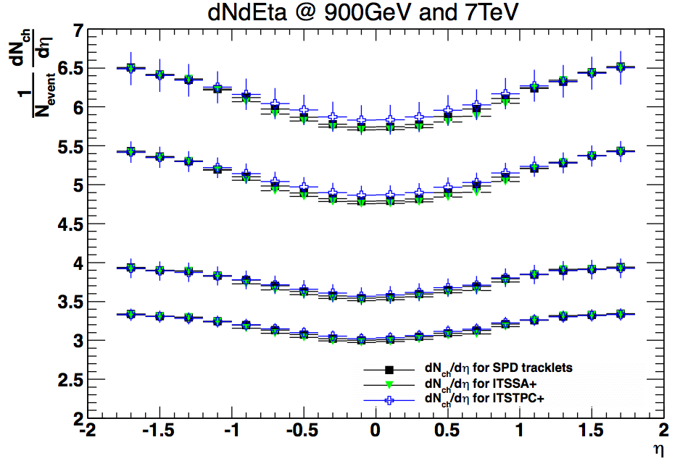
Results – dNdEta distribution
“Not official yet”
NSD events
@ 7TeV
INEL events
@7 TeV
NSD events
@ 900 GeV
INEL evets
@ 900 GeV
*Correction done with the MC, PYTHIA6 perugia0 for each energy
Notes:
Pythia energy dependence.

Slide 16
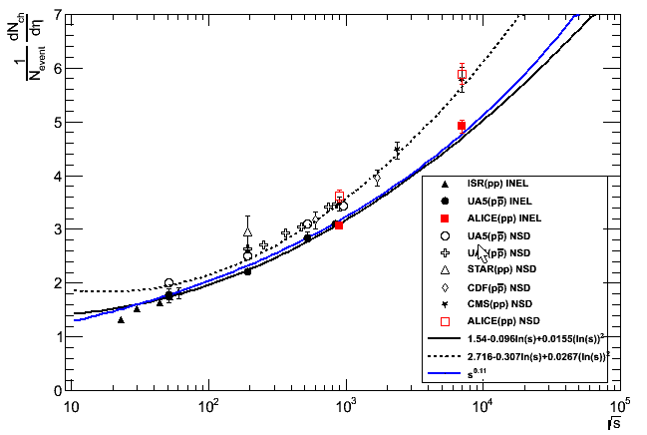

Results – η density
Pseudo-rapidity density vs. $\sqrt{s}$
“Not official yet”
*New data points(@ 0.9 and 7TeV) of ALICE are updated with new MC(with the modified diffraction rate)
Notes:
Pythia energy dependence.

Slide 17
Summary
dNdEta measurements done
  With new tracking methods(less particle loss)
  With newly measured diffraction rates(by Martin)
  New data points update for η density @ 0.9 & 7TeV
Study more
  How precisely can we measure the parton saturation in pp?
Next plan
  Gradual move to high-multiplicity events in p+p
Notes:
Pythia energy dependence.

