Slide 1
ALICE Overview
Ju Hwan Kang (Yonsei)
Heavy Ion Meeting 2011-06
June 10, 2011
Korea University, Seoul, Korea

Slide 2
2.76 TeV/N Pb-Pb Results
Most are extracted from ALICE talks presented at QM2011 (23-28 May 2011, Annecy)
  Spectra & Particle Ratios
  Flow & Correlations & Fluctuations
  R_{AA} of inclusive particles
  Heavy open Flavour
  J/Ψ

Slide 3
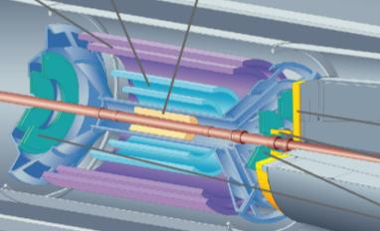

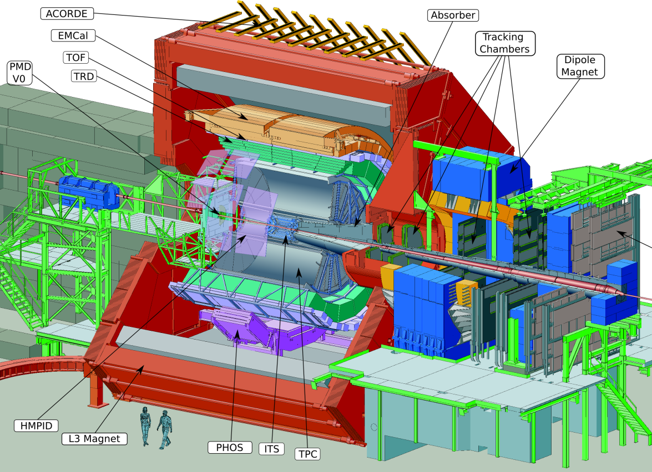
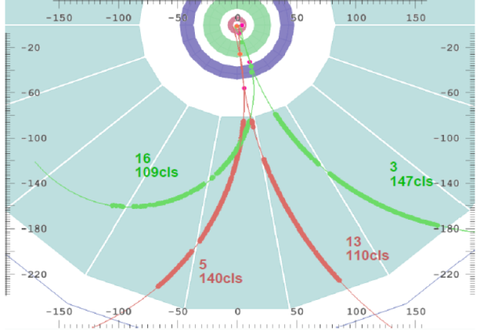
PID in ALICE
Inner tracking system
Low p_{T} standalone tracker
PID: dE/dx in the silicon (up to 4 samples)
TPC
Standalone and global (+ITS) tracks
PID: dE/dx in the gas (up to 159 samples)
Time of Flight
Matching of tracks extrapolated from TPC
PID: TOF, σ_{TOT} ~ 85ps(PbPb) – 120ps(pp)
Topological ID + Invariant Mass
Resonances, Cascades, V0s, Kinks
PID: indirect cuts to improve S/B
π⁰-> γ+γ -> e⁺e⁻e⁺e⁻
^{similarly K0, Λ, Ξ, Ω,...}

Slide 4
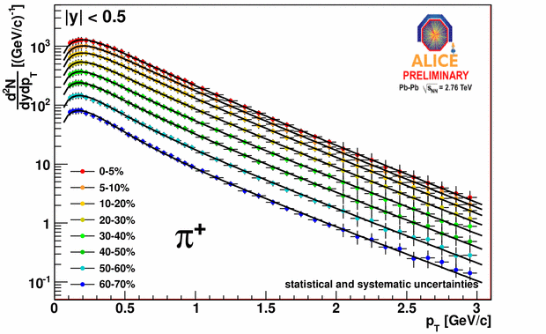
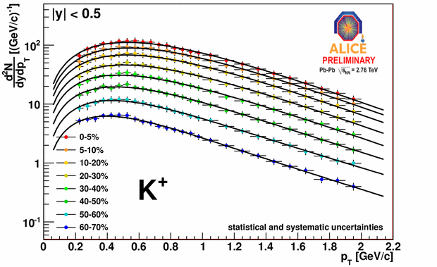
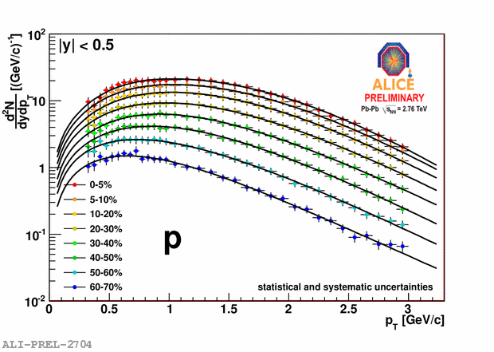
π/K/p Spectra
Combined analysis in
Inner Tracking System
Time Projection Chamber
TOF
p_{T} Range:
0.1 – 3 GeV/c (π)
0.2 – 2 GeV/c (K)
0.3 – 3 GeV/c (p)
Blast wave fits to individual particles
to extract yields

Slide 5
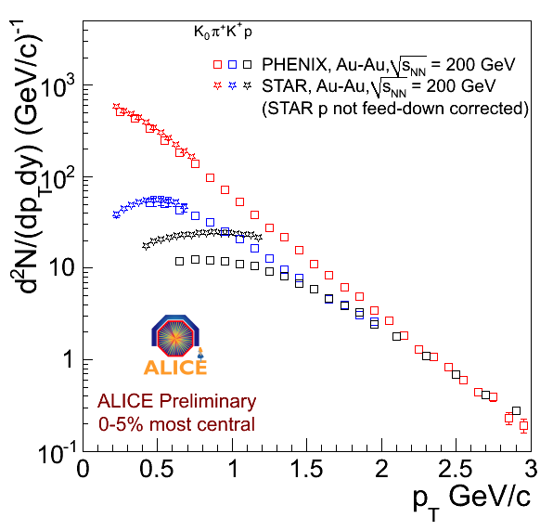
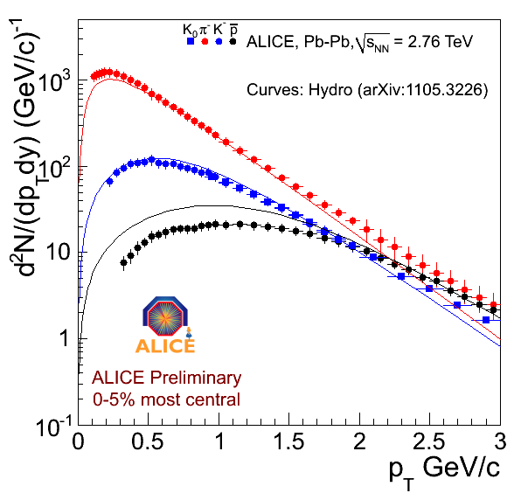
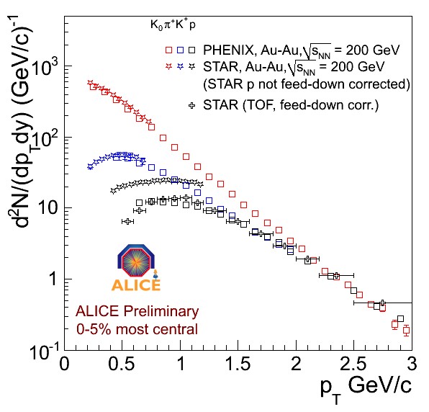
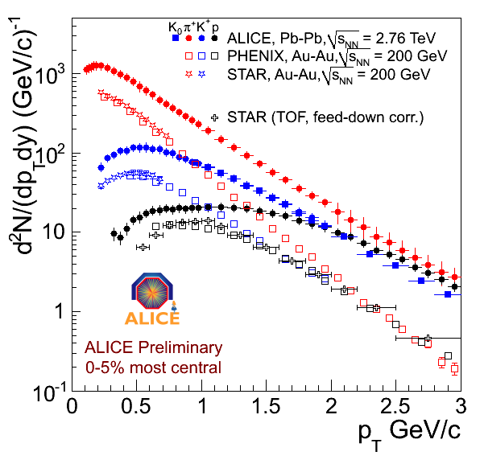

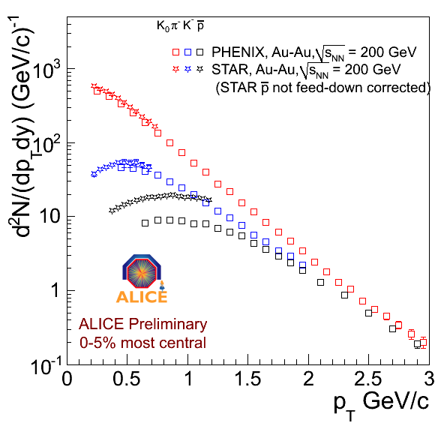
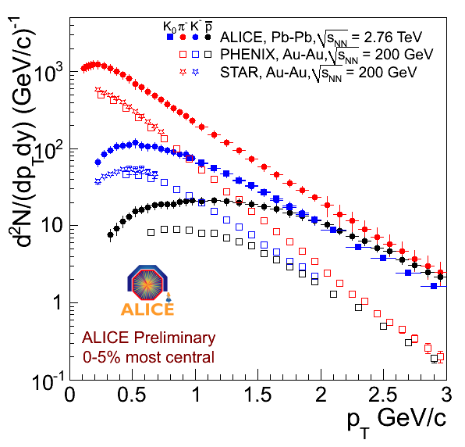
Comparison to RHIC (0-5% Central)
positive
negative
fitting spectra & v2 simultaneously
At RHIC: STAR proton data generally not feed-down corrected.
Large feed down correction
➔ Consistent picture with feed-down corrected spectra
At LHC: ALICE spectra are feed-down corrected
Harder spectra, flatter p at low pt
Strong push on the p due to radial flow?
STAR, PRL97, 152301 (2006)
STAR, PRC 79 , 034909 (2009)
PHENIX, PRC69, 03409 (2004)

Slide 6
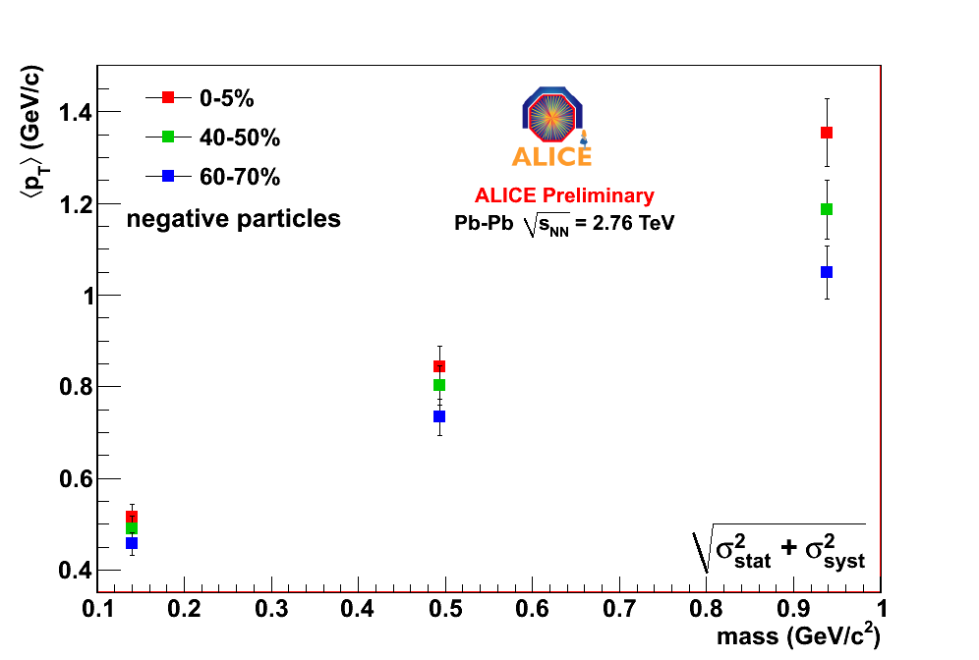
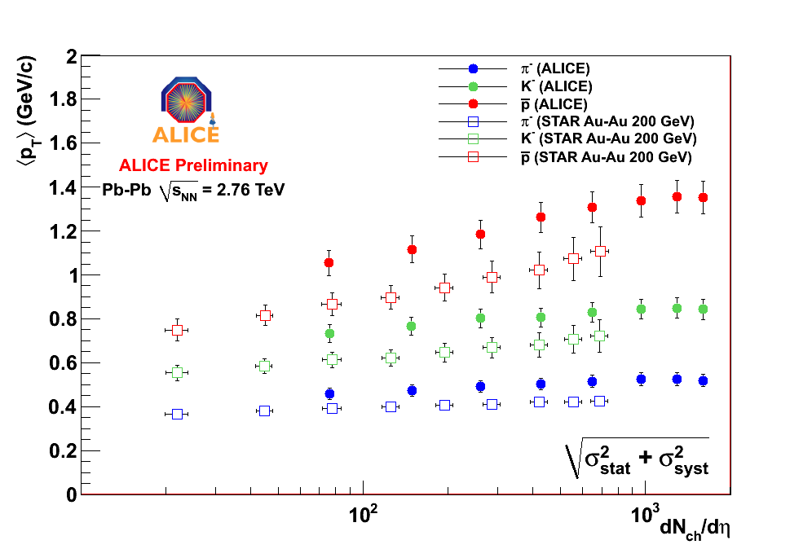
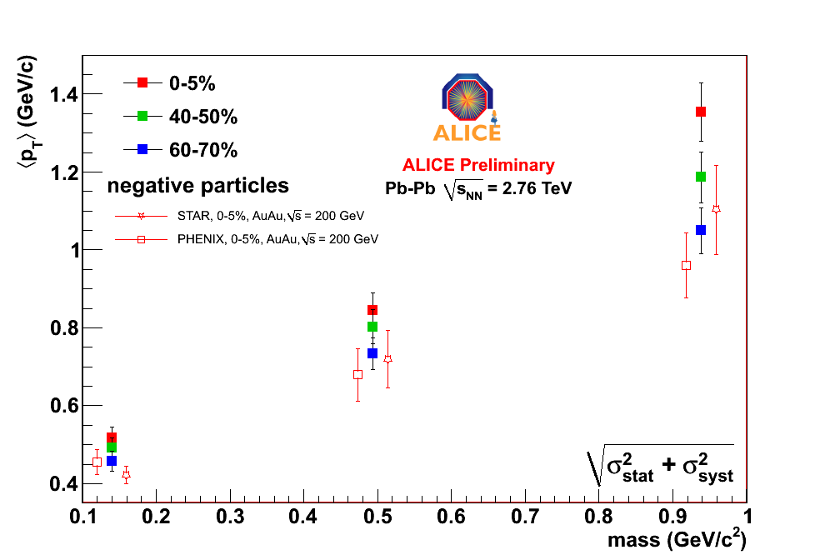
Mean p_{T}
Mean p_{T} increases linearly with mass
Higher than at RHIC (harder spectra, more radial flow?)
For the same dN/dη higher mean p_{T} than at RHIC

Slide 7
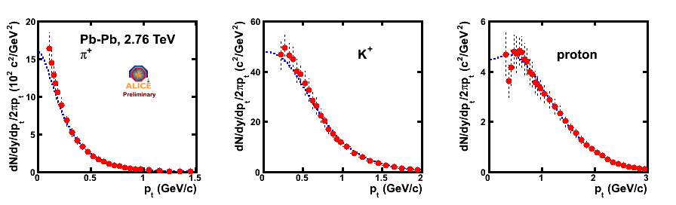
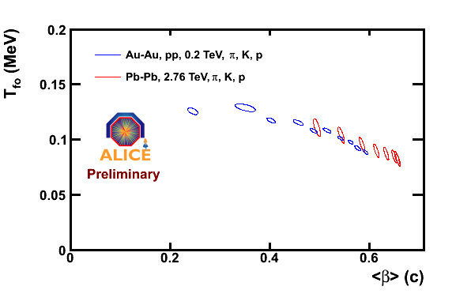
Blast wave fits
PRC48, 2462 (1993).
Blast wave fits → radial flow ~ 10% higher than at RHIC
Fit Range:
pions 0.3 – 1 GeV
kaons 0.2 – 1.5 GeV
protons 0.3 – 3 GeV
T depends on the pions and fit-range
(effect of resonances to be investigated)

Slide 8
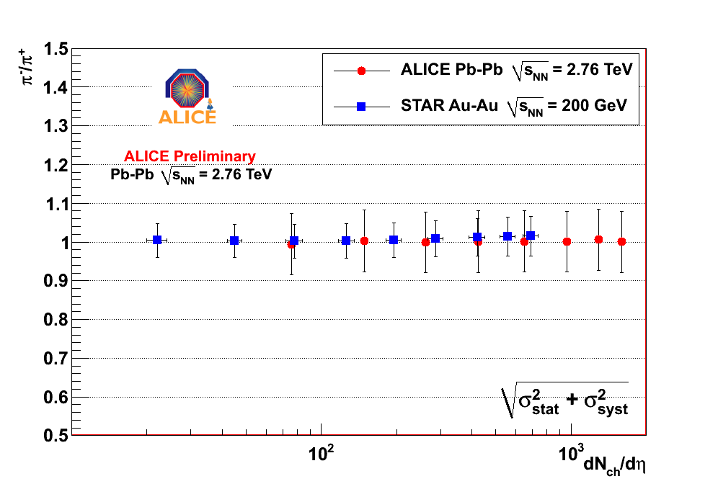
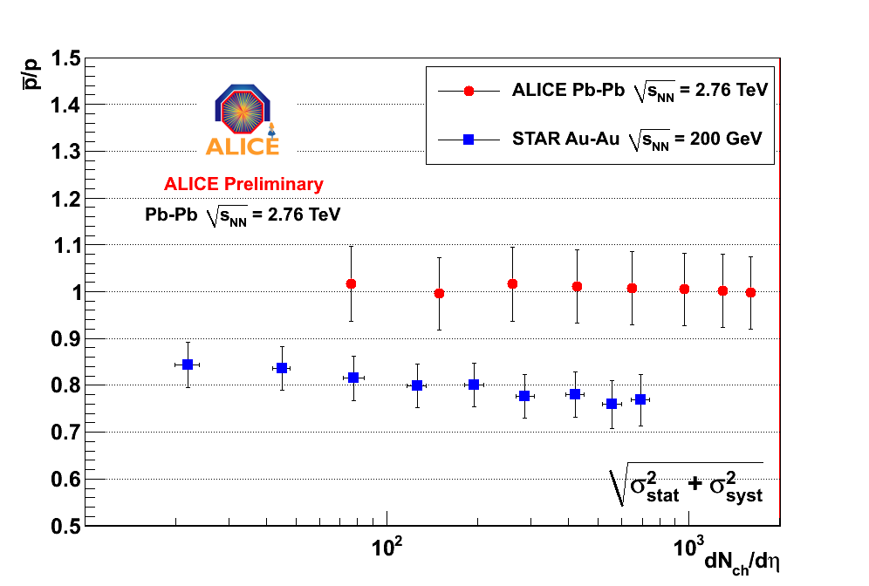
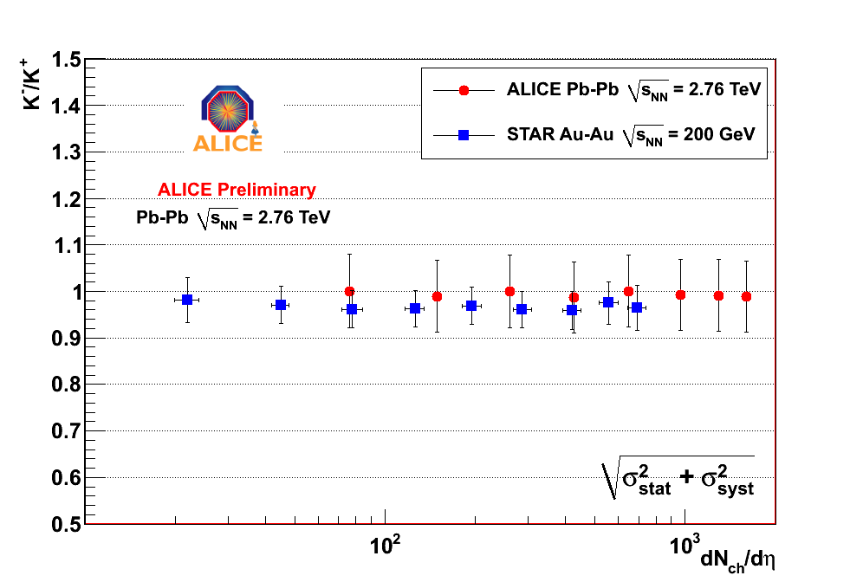
Integrated yields ratios
π⁺/π⁻
–
p/p
All +/- ratios are compatible with 1 at all centralities, as expected at LHC energies
K⁺/K⁻
STAR, PRC 79 , 034909 (2009)
Notes:
Backup?

Slide 9
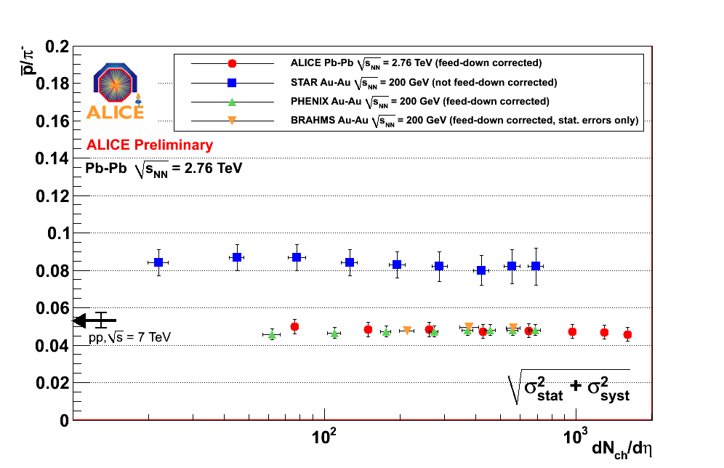
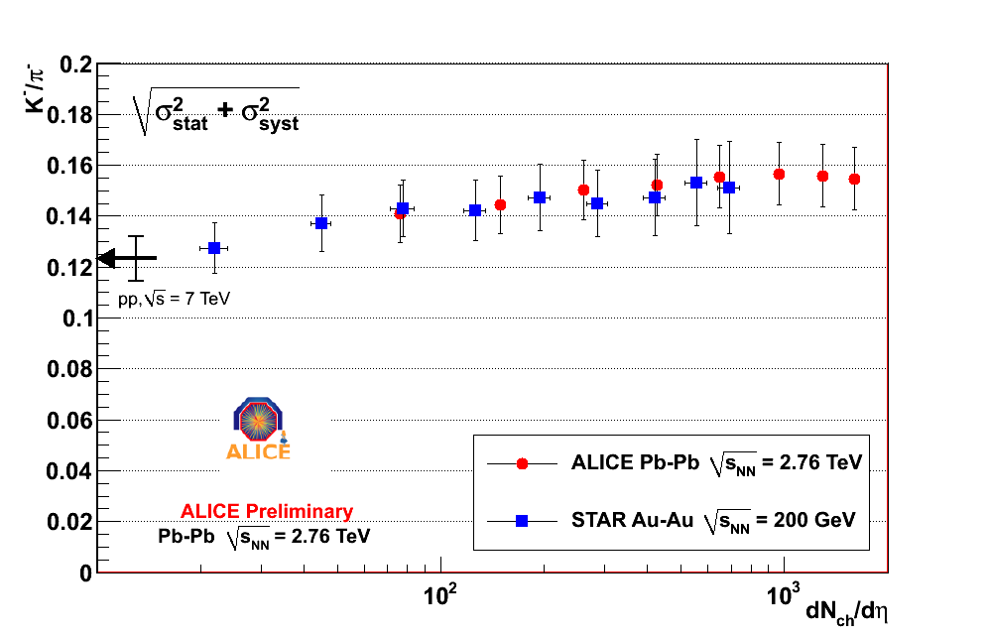
Integrated ratios vs Centrality
–
STAR (Not feed-down corrected)
p/π⁻
K⁻/π⁻
ALICE, BRAHMS, PHENIX (feed-down corrected)
STAR, PRC 79 , 034909 (2009)
PHENIX, PRC69, 03409 (2004)
BRAHMS, PRC72, 014908 (2005)
Predictions for the LHC
p/π: lower than thermal model predictions
Ratio | Data | (1) | (2)
p/π⁺ | 0.0454+-0.0036 | 0.072 | 0.090
p/π⁻ | 0.0458+-0.0036 | 0.071 | 0.091+0.009-0.007
K/π⁺ | 0.156 +- 0.012 | 0.164 | 0.180+0.001-0.001
K/π⁻ | 0.154 +- 0.012 | 0.163 | 0.179+0.001-0.001
p/π and K/π ratios are very similar at RHIC energies
(1) A. Andronic et al, Nucl. Phys. A772 167 (2006)
(2) J. Cleymans et al, PRC74, 034903 (2006)
T = 164 MeV, μ_{B} = 1 MeV
T = (170±5) MeV and μ_{B} =1+4 MeV

Slide 10
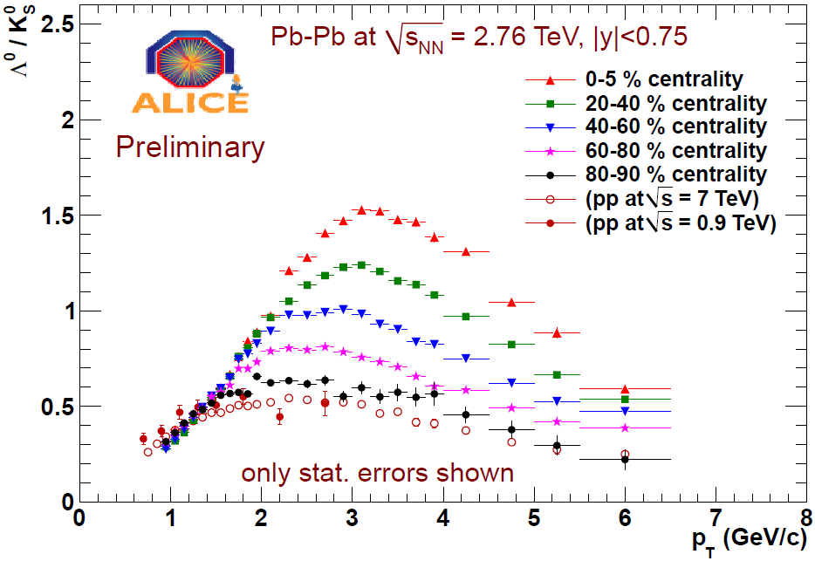
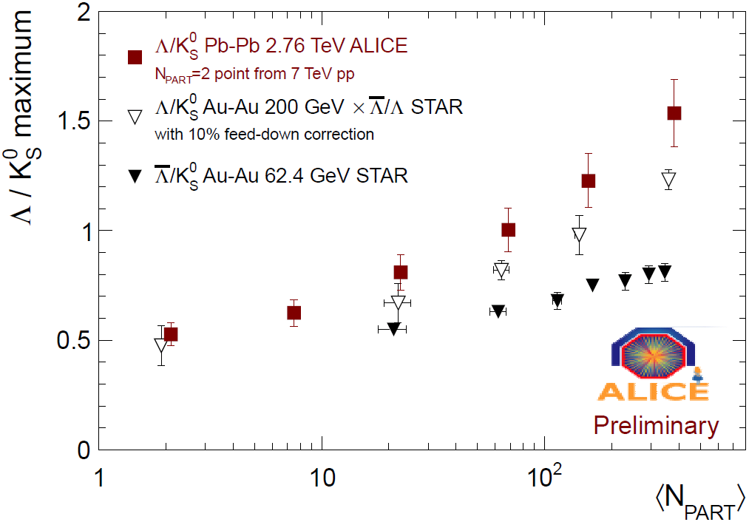
'Baryon anomaly': Λ/K₀
x 3
RHIC
Λ/K₀
Ratio at Maximum
Baryon/Meson ratio still strongly enhanced
x 3 compared to pp at 3 GeV
- Enhancement slightly larger than at RHIC 200 GeV
- Maximum shift very little in p_{T} compared to RHIC
despite large change in underlying spectra !

Slide 11
Summary – spectra/particle ratio
ALICE has very good capabilities for the
measurement of identified particles
PbPb Collision
  Spectral shapes show much stronger radial flow than at RHIC
  p_bar/p ≈ 1.0 (the state of zero net baryon number)
  p/π ≈ 0.05 (lower than thermal model predictions with T = 160-170 MeV )
  Baryon/meson anomaly: enhancement slightly higher and pushed to higher p_{T} than at RHIC
Notes:
Lambda/K0 ok?

Slide 12
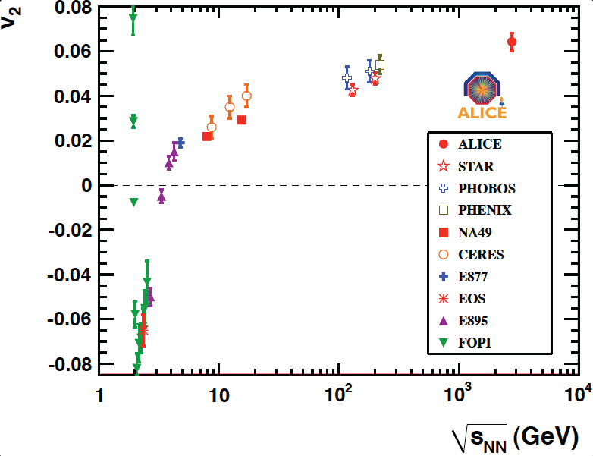
Azimuthal Flow: What next ?
Elliptic flow (v₂) and perfect fluid:
  large v₂ => strongly interacting "perfect" fluid
  from hydro: large v₂ => low η => large σ
  η/s = 1/4π => conjectured AdS/CFT limit
  current RHIC limit: η/s < (2-5) x 1/4π
  need precision measurement of η/s
  shear viscosity:
To get precision measurement of η/s (parameters in hydro) using flow v_{n} (experimental data):
  fix initial conditions (geometrical shape is model dependent, eg Glauber, CGC)
  quantify flow fluctuations σ (influence measured v₂, depending on method)
  measure non-flow correlations δ (eg jets)
  improve theory precision (3D hydro, 'hadronic afterburner', ...)
  .........

Slide 13


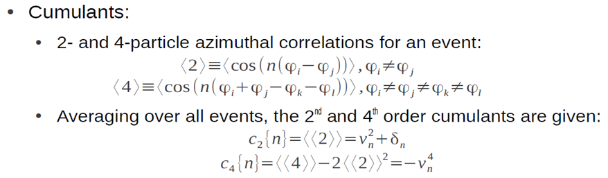
Experimental methods
φ
Ψ_{RP}
y
z
x
v₂ {2} and v₂{4} have different sensitivity to flow fluctuations (σ_{n}) and non-flow (δ)

Slide 14
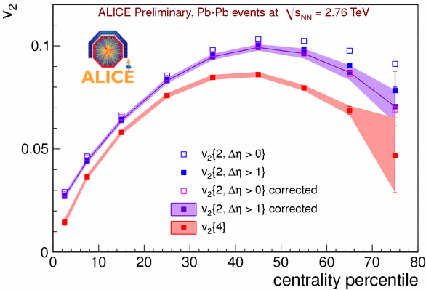
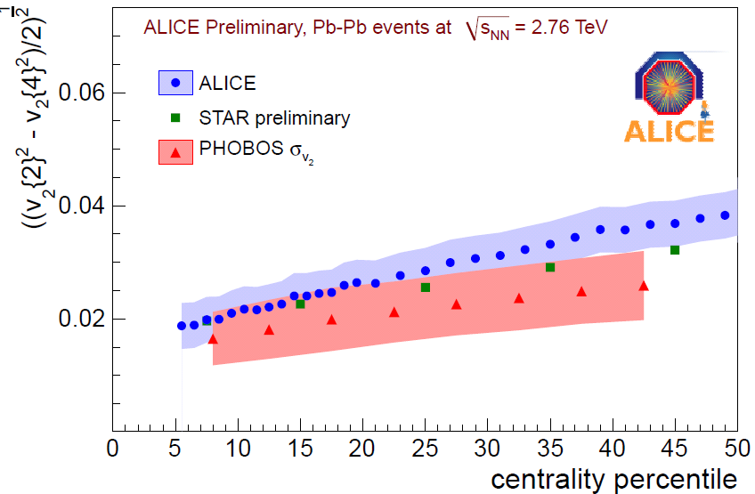
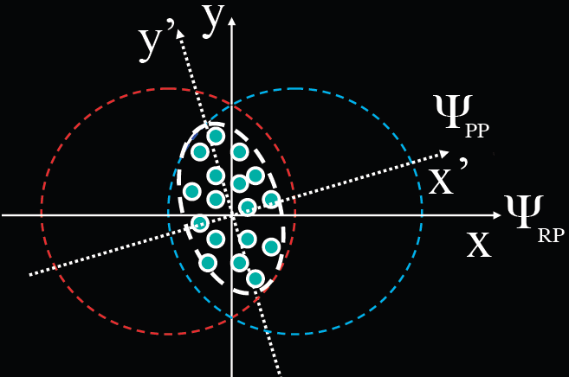
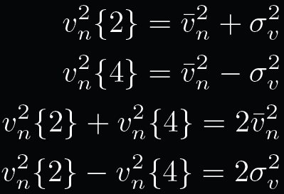
Elliptic Flow v₂
Non-Flow corrections
v₂ no eta gap between particles
v₂ |η|>1 to reduce non-flow such as jets
both v₂ corrected for remaining non-flow
using Hijing or scaled pp
With this, we can remove most of non-flow (δ)
v₂ Fluctuations
Plane of symmetry (Ψ_{PP}) fluctuate event-by-event around reaction plane (Ψ_{RP}) => flow fluctuation (σ_{n})

Slide 15
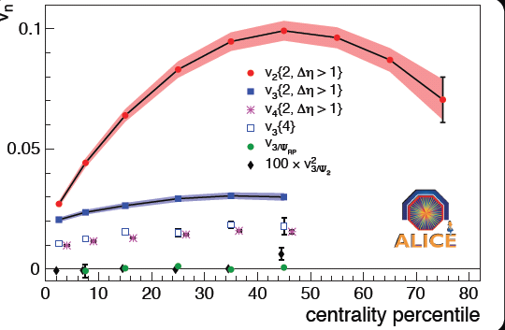
Higher Order Flow v₃,v₄,..
arXiv:1105.3865
V₂{2}
v₄{2} = <cos(4(φ₁-φ₂))>
v₃{2} = <cos(3(φ₁-φ₂))>
v₃{4} 4 particle cumulant
v₃ relative to reaction & participant planes
V₃:
small dependence on centrality
v₃{4} > 0 => not non-flow
v₃{4} < v₃{2} => fluctuations !
v₃{RP} ≈ 0
there should be no “intrinsic” triangular flow, unlike the elliptic flow due to the almond shape of overlapping region

Slide 16
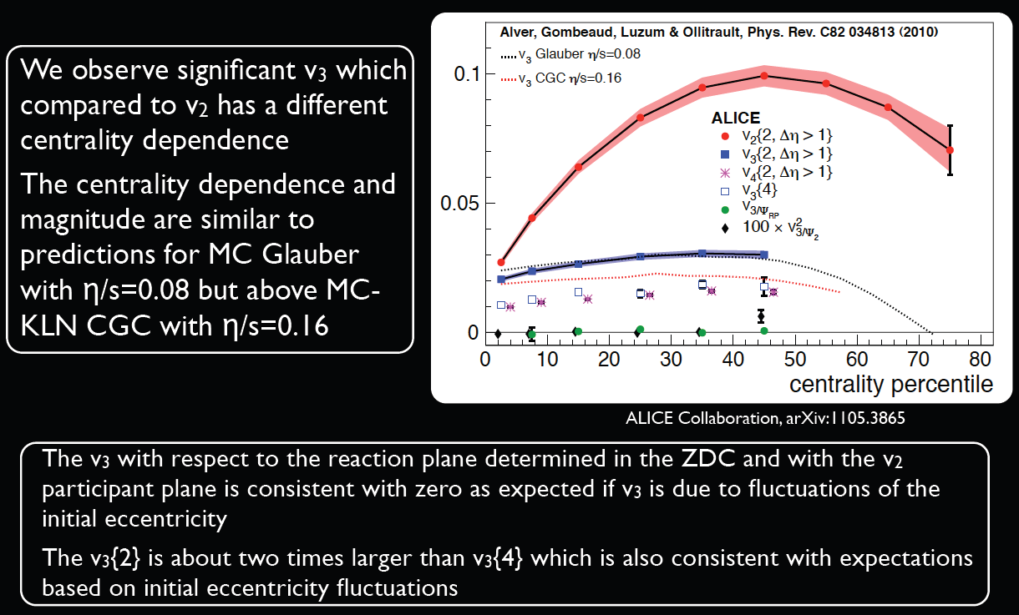
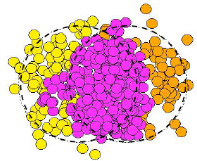
Triangular flow (v₃) – models
v₃{4} 4 particle cumulant
v₃{2} = <cos(3(φ₁-φ₂))>
v₃ relative to reaction & participant planes
V₃ measurements are consistent with initial eccentricity fluctuation
and similar to predictions for MC Glauber with η=0.08
Notes:
Lambda/K0 ok?

Slide 17
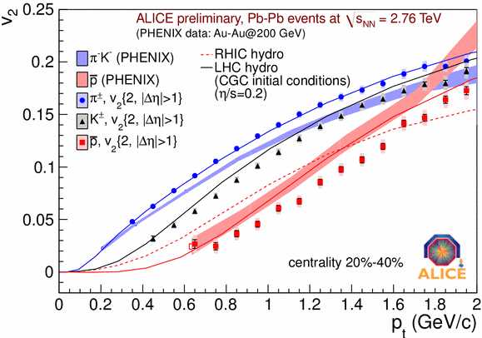
Elliptic Flow v₂ – PID and p_{t}
π/K/p v₂
RHIC
Hydro predictions
PID flow:
π and p are 'pushed' further compared to RHIC
v₂ shows mass splitting expected from hydro

Slide 18
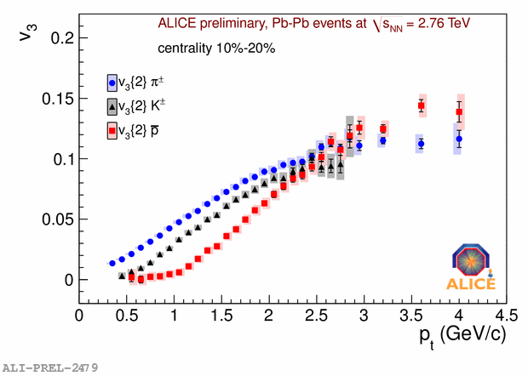
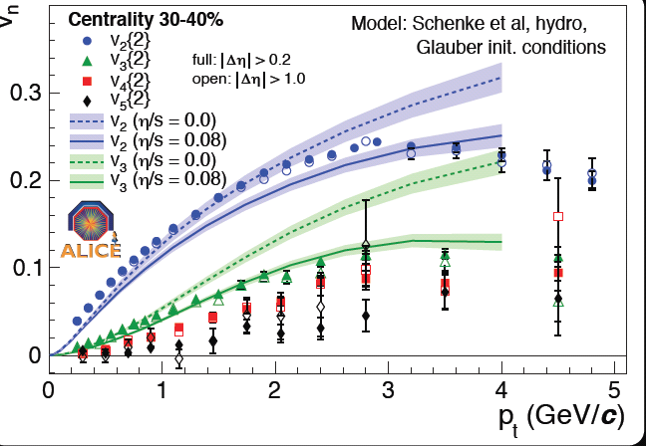
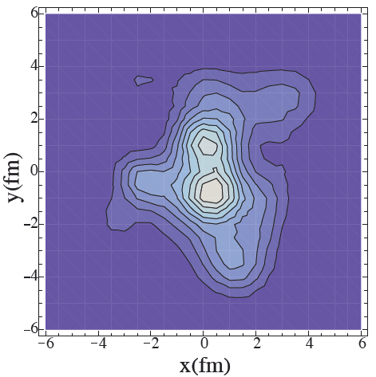
Triangular Flow v₃ – PID and p_{t}
v₃ for π/K/p
v₃ v₄ v₅ versus p_{T}
v₂
π
v₃
K
v₄
p
v₅
Hydro calculation for v₃
v₃ shows mass splitting expected from hydro
(shows different sensitivity to η/s than v₂)
energy momentum tensor components for 1 event with b=8fm (MC Glauber by G. Qin, H. Peterson, S. Bass. and B. Muller)
also possible to have initial eccentricity fluctuations for square flow v₄ and pentagonal flow v₅

Slide 19
Summary – flow
• Stronger flow than at RHIC which is expected for almost perfect fluid behavior
• First measurements of v3, v4 and v5, and have shown that these flow coefficients behave as expected from fluctuations of the initial spatial eccentricity
• New strong experimental constraints on η/s and initial conditions
• Flow coefficients at lower p_{t} showing mass splitting are in agreement with expectations from viscous hydrodynamic calculations

Slide 20
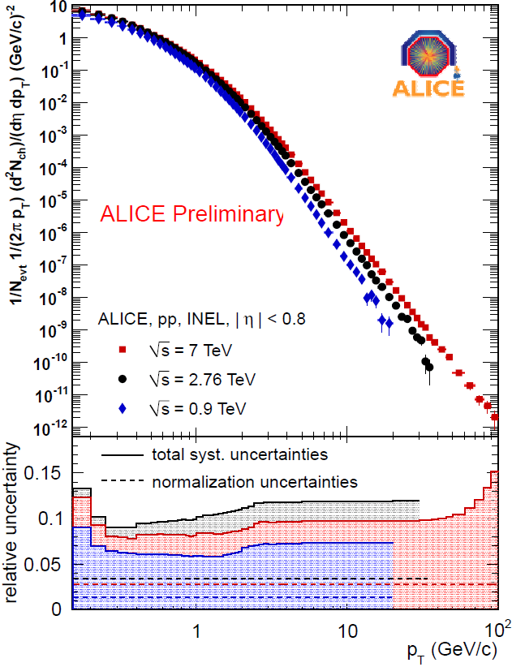
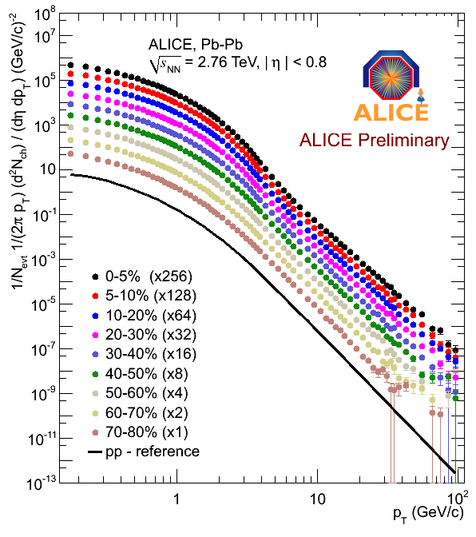
Charged Particle R_{AA:} Ingredients
pp spectrum
Pb-Pb
2.76 TeV
pp reference
Measured reference, still needs extrapolation for p_{T}> 30 GeV

Slide 21
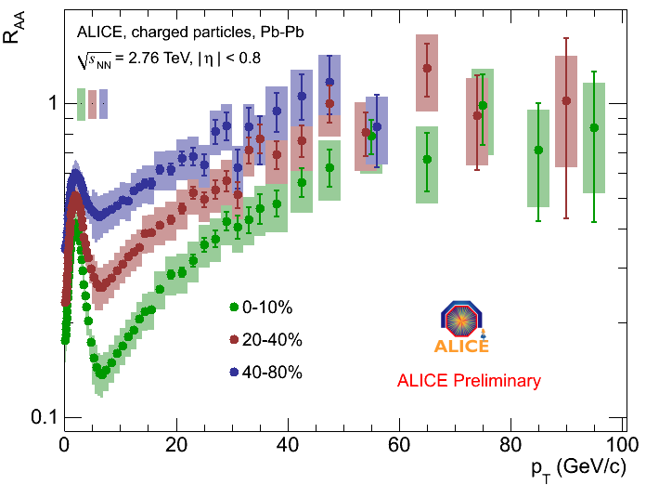
charged particle R_{AA}
pronounced centrality
dependence below
p_{T} = 50 GeV/c
minimum at
p_{T} ≈ 6-7 GeV/c
strong rise in
6 < p_{T} < 50 GeV/c
no significant centrality
and p_{T} dependence
at p_{T} > 50 GeV/c

Slide 22
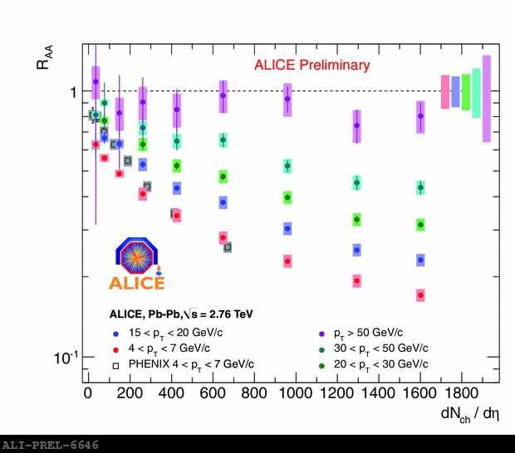
charged particle R_{AA}- centrality dependence
high p_{T}:
weak suppression,
no significant centrality
dependence
low p_{T}:
approximate scaling
with multiplicity density,
matching also RHIC
results

Slide 23
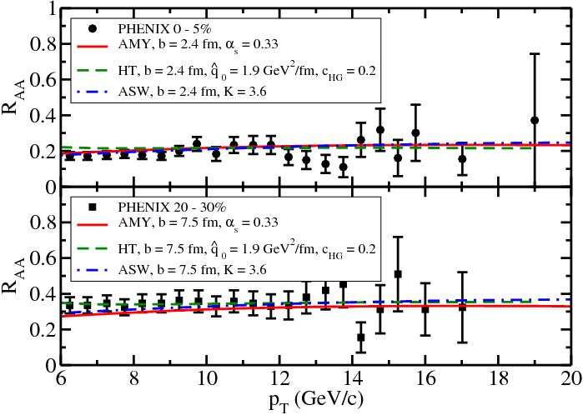
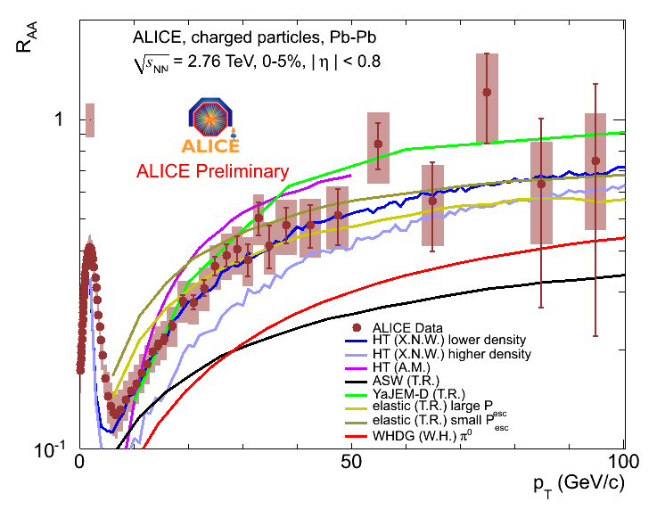
charged particle R_{AA} - models
pronounced p_{T} dependence
of R_{AA} at LHC
sensitivity to details of the
energy loss distribution

Slide 24
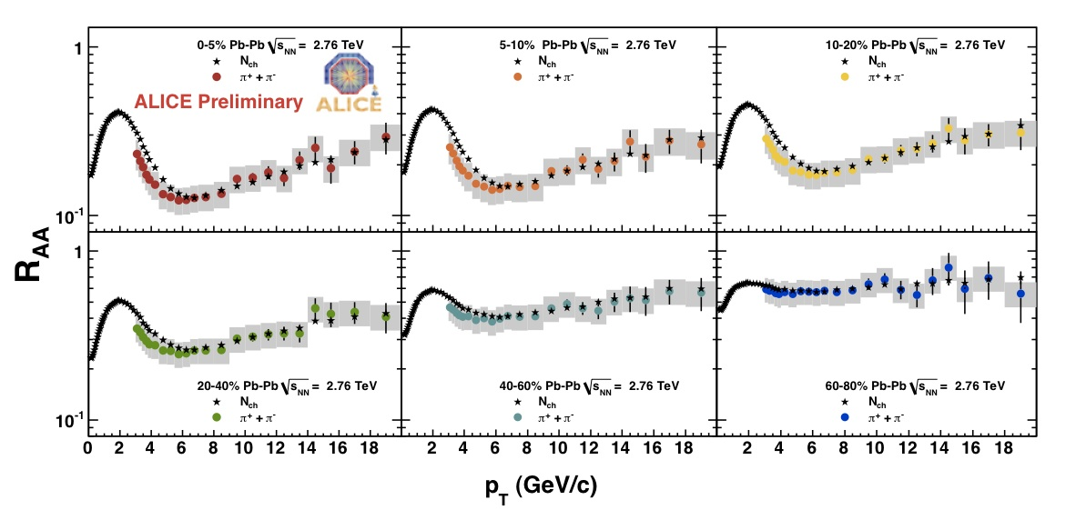
charged pion R_{AA}
agrees with charged particle R_{AA}
  - in peripheral events
  - for p_{T} > 6 GeV/c
is smaller than charged particle R_{AA} for p_{T} < 6 GeV/c

Slide 25
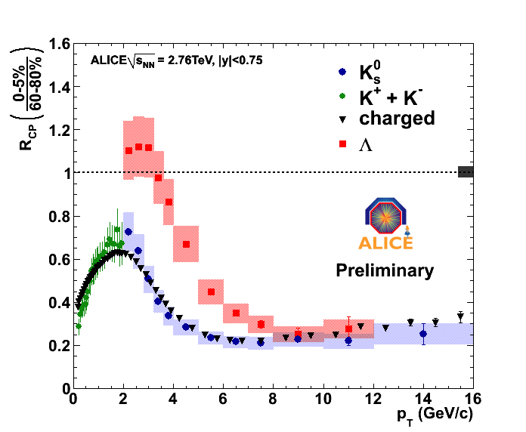
Λ and K⁰_{s} - R_{CP}
K⁰_{s} - R_{AA} very similar to that of
charged particles:
strong suppression of K⁰_{s} at
high p_{T}
Λ - R_{AA} significantly larger than
charged at intermediate p_{T}:
enhanced hyperon production
counteracting suppression
for p_{T} > 8 GeV/c, Λ and K⁰_{s} - R_{AA}
similar to charged particle R_{AA}:
strong high-p_{T} suppression also
of Λ

Slide 26
Summary – R_{AA}
Charged particle p_{T} spectra in Pb-Pb at √s_{NN} = 2.76 TeV measured
with ALICE at the LHC
Pronounced p_{T} dependence of R_{AA} at LHC
Comparison to RHIC data suggests that suppression scales with the
charged particle density for a given p_{T} window
At p_{T} > 50 GeV/c, no strong centrality dependence of charged particle
production is observed
Results on identified particles will allow to disentangle the interplay
between quark and gluon energy loss, and recombination mechanisms
at intermediate p_{T}

