Slide 1
Parton Cascade Simulation – Heavy Ion Collisions
HIM2011-06(고려대학교)
Shin, Ghi Ryang(신기량)
안동대학교
June 10, 2011

Slide 2
HIM2011-06(고려대학교)
Congratulation to Prof. Shim
I remember Prof. Shim is a senior professor who does not ask for to be a senior.
Wish to come to talk & work together

Slide 3

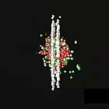
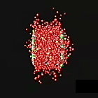
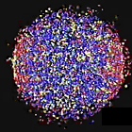
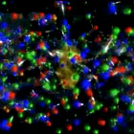
1. Introduction
HIM2011-06(고려대학교)
UrHIC at RHIC and LHC
stage 1 stage 2 stage 3 stage 4 stage 5
It is dream to understand these processes!

Slide 4
2. Quick Description of each process
HIM2011-06(고려대학교)
Possible dominant physics of each process

Slide 5
Stage 1: Parton distributions of nucleus
HIM2011-06(고려대학교)
Parton distribution of nucleon(p):
  CTEQ: only proton
  GRV : only proton
    Neutron: u ↔ d of proton
  EKS(include nucleon shadow effects)
  Wood-Saxon or constant density for spacial distribution
  Lorentz Boost and Contraction
CGC: KNV(Krasnitz, Nara, Venugopalan) model

Slide 6


For example, traditional model,
or KNV model,

Slide 7

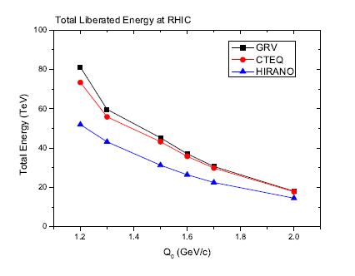
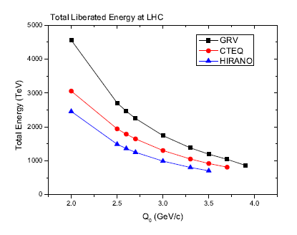
Stage 2: Primary Collisions
HIM2011-06(고려대학교)

Slide 8
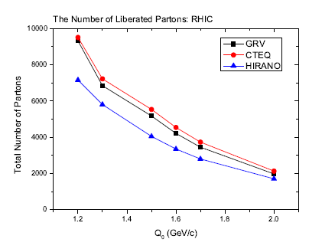
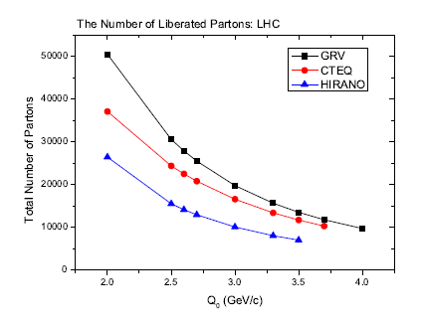
HIM2011-06(고려대학교)

Slide 9
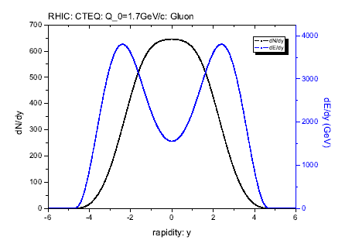
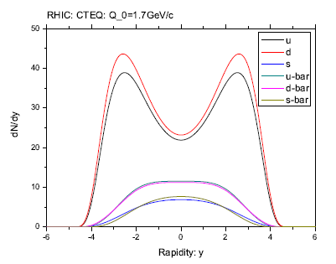
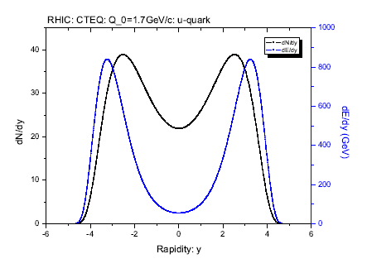
HIM2011-06(고려대학교)

Slide 10
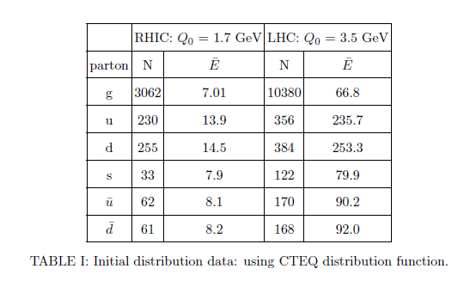
HIM2011-06(고려대학교)

Slide 11
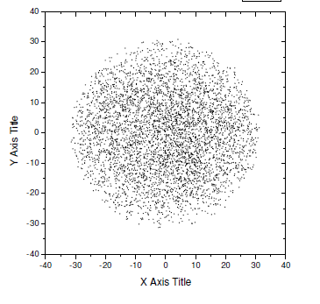
HIM2011-06(고려대학교)

Slide 12
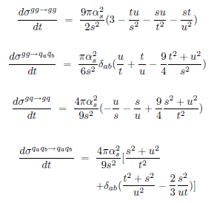
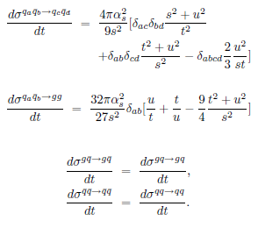
Stage 3: Secondary Collisions & QGP
HIM2011-06(고려대학교)
Picture 1: Assume ON-SHELL particles

Slide 13
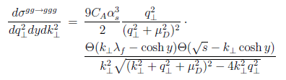
HIM2011-06(고려대학교)
Gluon radiation included (based on pQCD):

Slide 14
HIM2011-06(고려대학교)
Picture 2: Bremsstrahlung
  Primary partons have high virtuality
  The branching reduce the virtuality until the limited mass via pQCD
  Cons: elliptic flow cannot explained
  Real world: Off-shell partons will make collisions as well as branchings

Slide 15
HIM2011-06(고려대학교)
Once thermalized, we can follow the evolution using:
  Hydrodynamic Expansion:
    3+1 D Hydro developed by Jeon and Schenke
    Nonaka et al
  Boltzmann-like expansion:
    Many groups working on: ZPC, VNI, …

Slide 16
Stage 4: Hadronization:
HIM2011-06(고려대학교)
Model 1: Independent Fragmentation Model (Field-Feynman Model)
  Consider e+ e- → γ* → hX
  γ* → q q-bar
    q → q’ + M(q q’-bar), where M is a meson
    q-bar →q-bar’ + M(q’ q-bar)
  g→q q_bar and one of them has all the energy and monentum
  further hadron production
  Pros: explains reasonably the experiments
  Cons: energy & momentum non-conservation; need color & flavor neutralization; Distinguishable with collinear jets

Slide 17
HIM2011-06(고려대학교)
Model 2: String Model (PYTHIA,..)
  LUND model
  UCLA model
  String breaks up into hadron-sized piece through spontaneous q q-bar pair production
  If there is a gluon, = kink on the string to produce angular distribution
  Pros: more consistent and covariant picture
  Cons: for multi-parton system, there is ambiguity to connect string among them and kinks

Slide 18
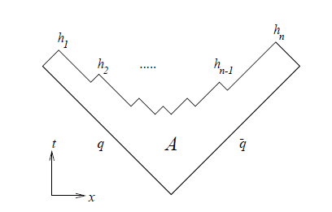
HIM2011-06(고려대학교)
One example of string model:

Slide 19
HIM2011-06(고려대학교)
Model 3: Cluster Model(HERWIG, …)
  Field-Wolfram, Weber-Marchesini, Gottschalk
  Initial partons will Bremsstrahlung or branching until some perturbative cutoff Q_0( ~ 1 GeV)
  All the gluon will split into q q_bar by force
  Non-perturbative set in, and combine neighboring quarks and antiquarks to produce colorless preconfinement clusters
  Each cluster decay into hadrons (usually 2)

Slide 20
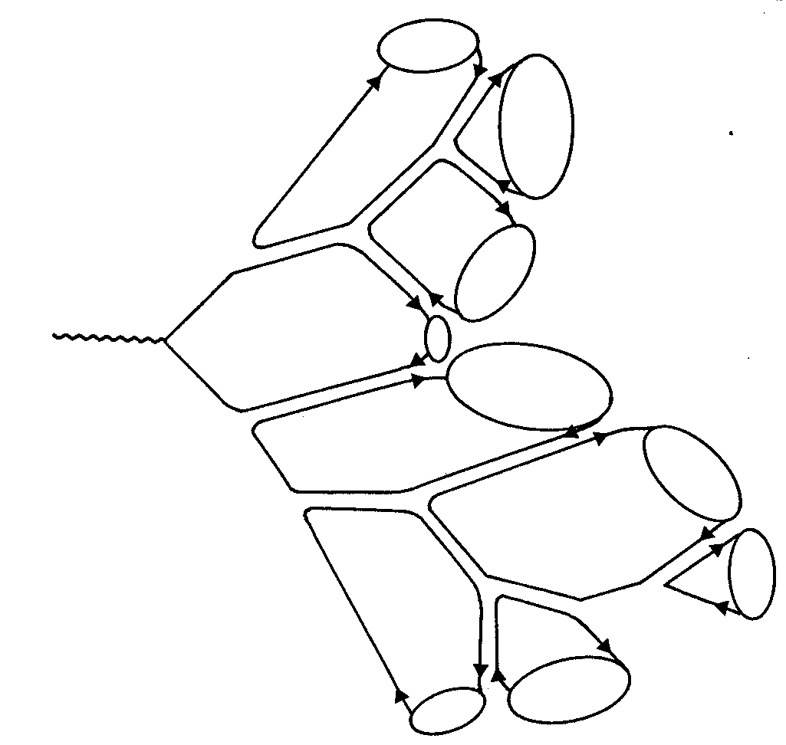
HIM2011-06(고려대학교)
One example of Cluster model:

Slide 21
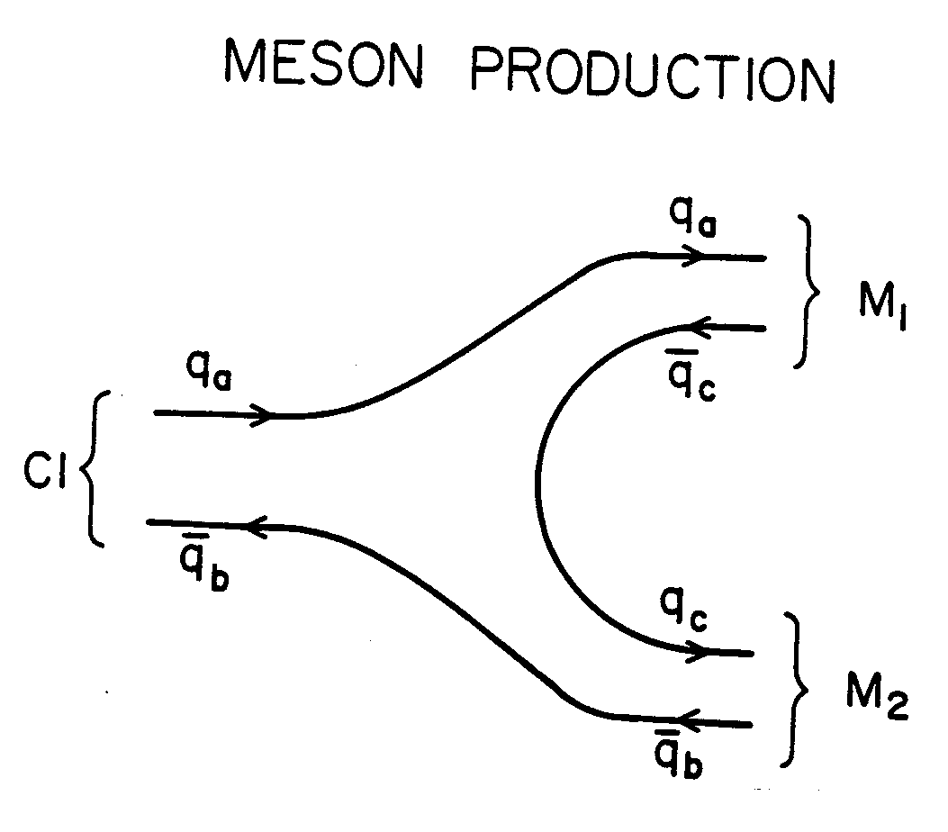
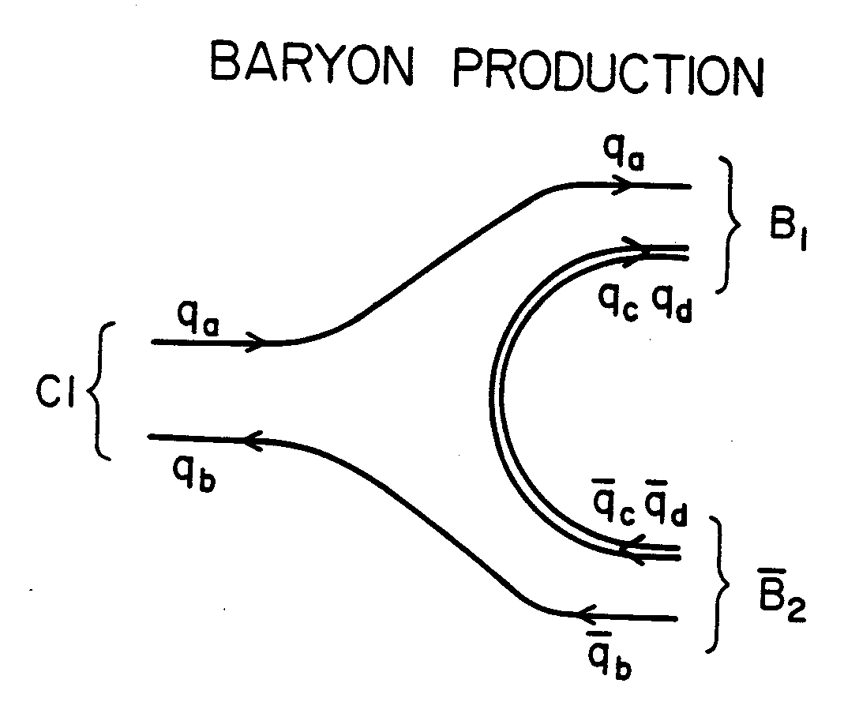
HIM2011-06(고려대학교)

Slide 22
HIM2011-06(고려대학교)
Possible Model: in our study
  Partons will make collision and radiation (gg → ggg )
  At the end of pQCD, gluons will split into q q-bar by force
  Colorless clusters (q q-bar, qqq) will be formed; if the mass (energy) is too large, it can make further cluster decay (Cl1 → Cl2 + Cl3)
  Each cluster will decay into two hadrons just like excited resonance of same quark constituents

Slide 23
Stage 5: Hadron Expansion
HIM2011-06(고려대학교)
UrQMD is good
But the free flow may be enough

Slide 24
3. Final Comments
HIM2011-06(고려대학교)
Need systematic studies with all the possible parameters and models
Compare the experiments to fix parameters and models
Hopely understand the non-perturbative phenomena
And study the exotic quantum state (QGP)

