Slide 1
\
String theory for Nuclear physics
Sang-Jin Sin (Hanyang U.)
@KPS meeting 2011.04

Slide 2
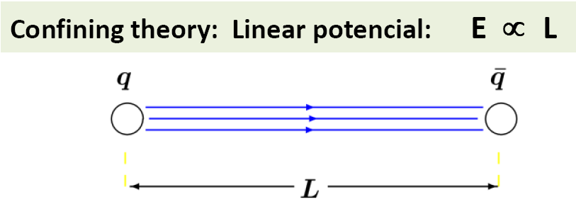
Why string theory?
I. Since there is a string in QCD
Confinement →
Flux string or QCD string
That is how string theory began 40 years ago.
But not the reason today.

Slide 3
Why string theory? II
Shear viscosity /entropy density in RHIC
experiment: < 0.1
pQCD:
String Theory : ~ 1/4π =0.09
The method used is AdS/CFT
Q: Confinement and Hadron physics?

Slide 4
Gauge/gravity duality (ads/cft)
Maldacena, GKP, Witten,
D brane can be described in 2 ways.
One is gauge theory
The other is string theory
in curved spacetime.
So they must be equivalent.
In certain limit,
the latter is Einstein gravity theory

Slide 5
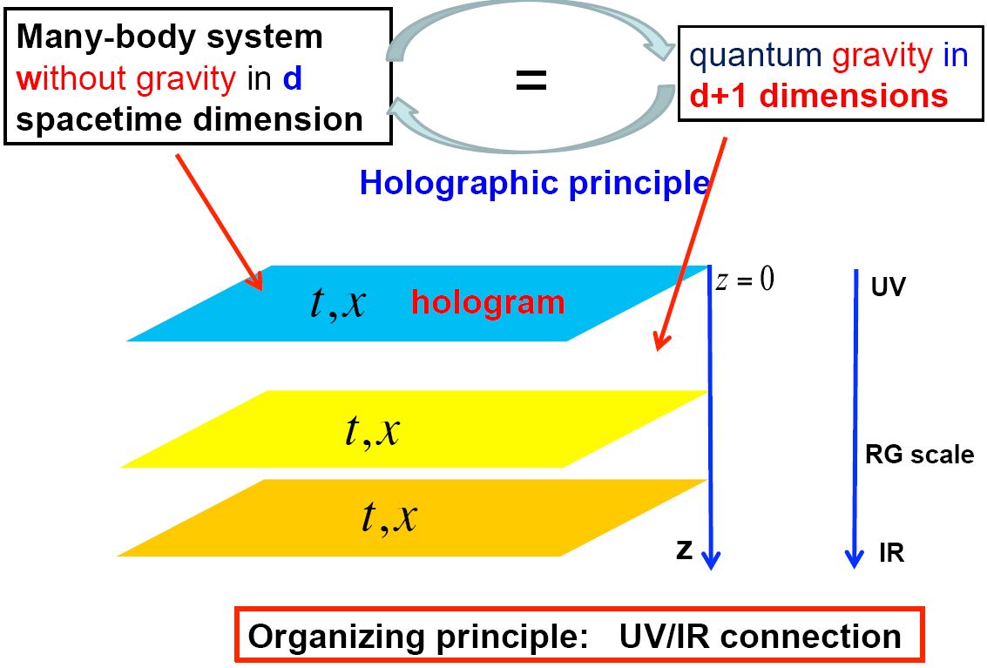
Character of AdS/CFT
1. Holographic:
5d gravity theory for 4d QCD
origin of +1 dim? Scale
z direction is warped! → ads
Stolen from Hong Liu

Slide 6

Character of AdS/CFT II
Within the validity,
Do not need loop calculation.
1. ls<<Rads
2. gs<<1
Large N theory. Good and Bad

Slide 7
Character of AdS/CFT III
Super-symmetry
Original version is N=4 SUSY.
SUSY can be broken by BC. T. d. etc
Is it QCD?
Hopefully some properties will be universal. Some results are too good to be irrelevant ……
[eta/s, glueon mass, ads/qcd, SS]

Slide 8
Ads/cft Dictionary
Let O(x) is an color singlet operator
with dimension and spin p
A(x) is an source of it.
Then AdS/CFT says:
Extend it to d+1(=5) dim by
If we know action and BC, it can be
calculated CLASSICALLY.
So is all correlation functions and its corollaries.

Slide 9




Density and chemical potential
In 4d, Source of
baryon number op is
Extend it to 5dim by

Slide 10



Gluon condensation and dilaton
Tr(F^2) is dual to scalar
Extend it to 5dim by

Slide 11



Chiral condensation and mass
Mass op. is dual to a scalar
Extend it to 5 dim by

Slide 12
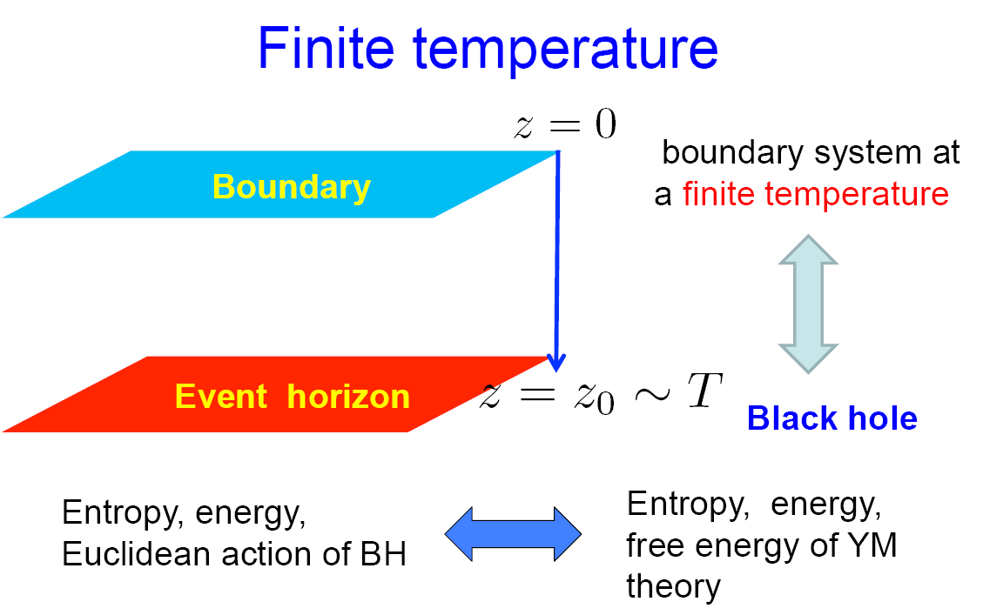
Temperature

Slide 13
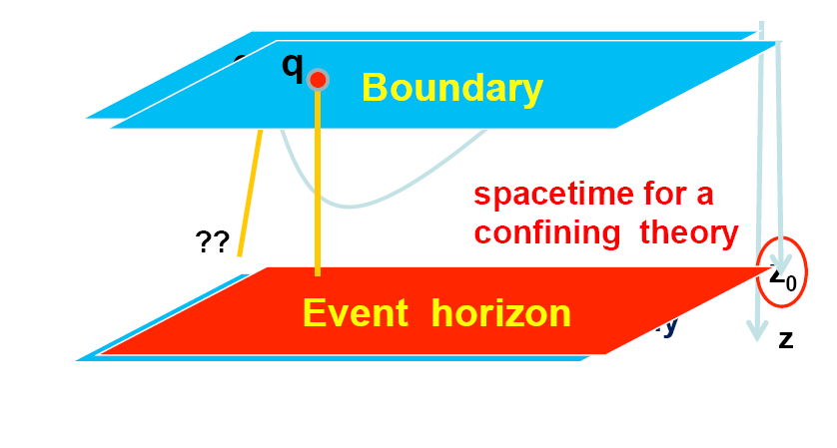
Gluon dynamics→ Geometry.
Confinement or deConfinement depends on geometry.

Slide 14
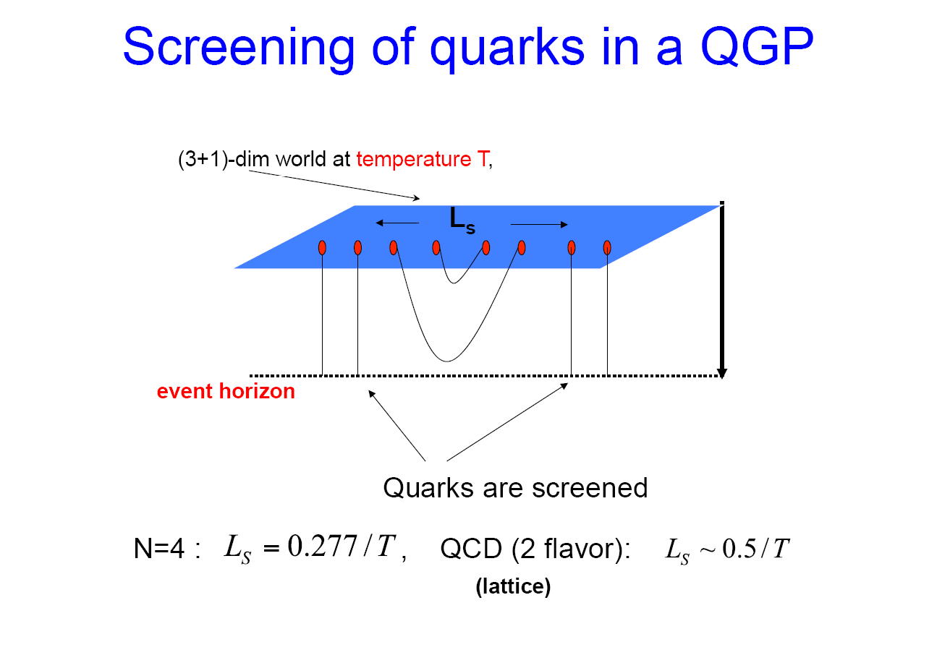
Goemetry with

Slide 15
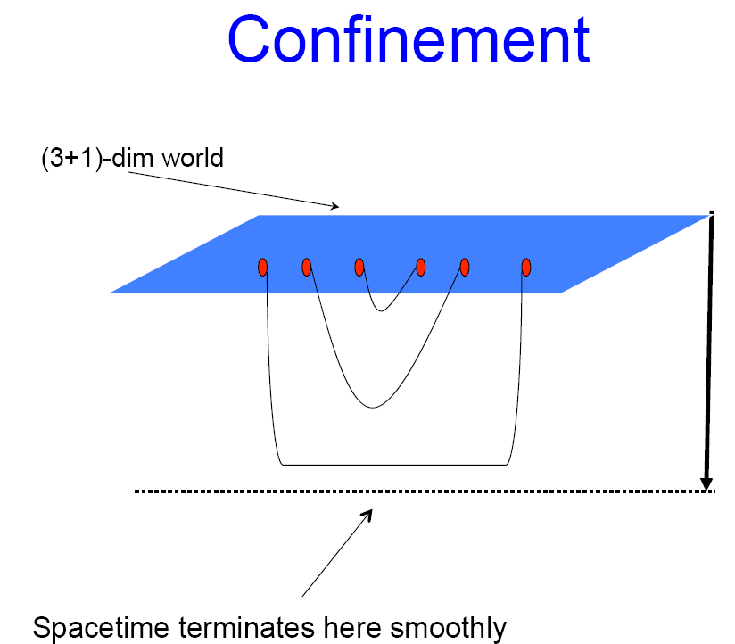
Geometry with
Zm

Slide 16
What can one do with it.
Phase transition, equation of state.
Two point function
→ Transports. Spectral fct
Viscosity conductivity heat cd
Elliptic flow(time dependence)
Dissipation and energy loss. (dragging)
Meson/Baryon spectrum
Symmetry energy
Lepto and Photo emission rate
…………..…….

Slide 17


Bottom up model
Write down linear sigma model in ads5.
with chiral symmetry SU(Nf)xSU(Nf)
Roughly, X=sU ,
<sigma> by hand. No Potential
No loop calcalculation: Point of the theory:
Throw away Kaluza Klein

Slide 18





Observables
Interaction: Overlapping integral
Decay constant:
GOR relation
Mass spectrum:

Slide 19
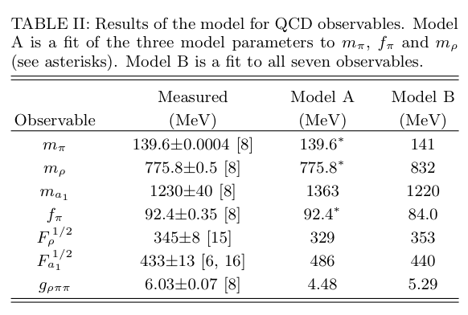


Resuls:
too good to be true?

Slide 20
Top down
Quark: Bifundamental,
Meson: adjoint
Dynamics: Dirac-Born-Infeld action
Baryon: compact D5
D7
D3

Slide 21


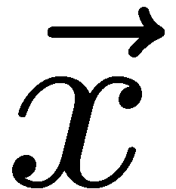
Baryon density and meson at probe D7

Slide 22



BR-scaling
In 1991, G.Brown and M.Rho
Q: Is it true?

Slide 23

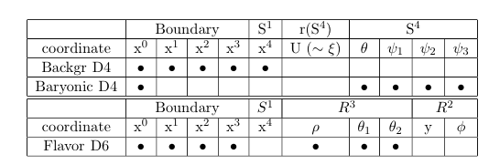

D4/D6 model
Confining geometry.

Slide 24
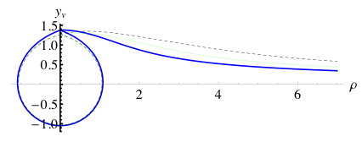


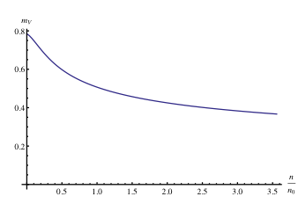
Result: Yes in a model.
Embedding:
Vector Mass
GOR relation is true in Medium.

Slide 25

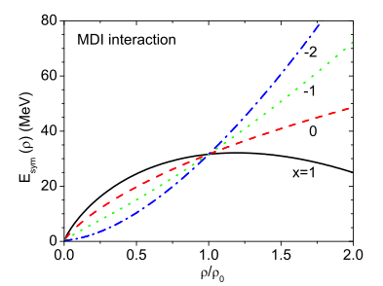
Symmetry energy I
Def:
Present status:

Slide 26
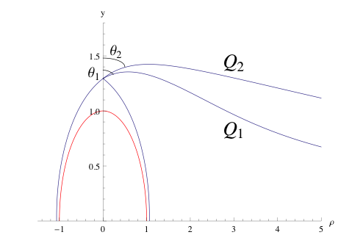
Symmetry energy II
Main idea: different isospin ~
different number of strings attached to two probe brane

Slide 27
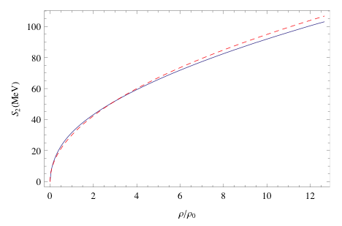

Symmetry energy : result
Stiff → neutron star crest is Thin.

Slide 28
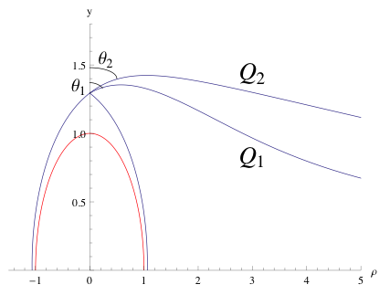

Pauli principle in hQCD.
two puzzles
in 4d: Driving force of Z=N is Pauli principle. Ads/cft is counting QM by classical dynamics. So how to count Pauli force.
In 5d: coulomb force by charge. But charge is dual to baryon number, which is global charge. So what is dual of the coulomb force?

Slide 29
String theory began as a Hadron Th.
Confinement →
Flux string or QCD string

Slide 30
Conclusion
One can do many things
Omitted:
Elliptic flow.
Photo/Lepto emission in LHC?
Non-fermiliquid
Color superconductivity
what I have shown is just tip of iceberg.
Not really QCD but may be relevant.
Can we do something together?

Slide 31
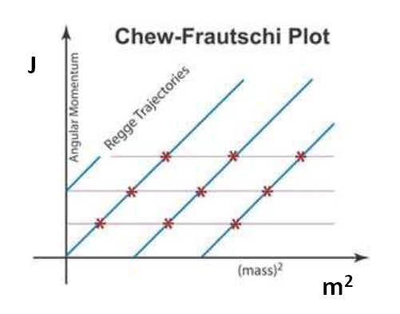
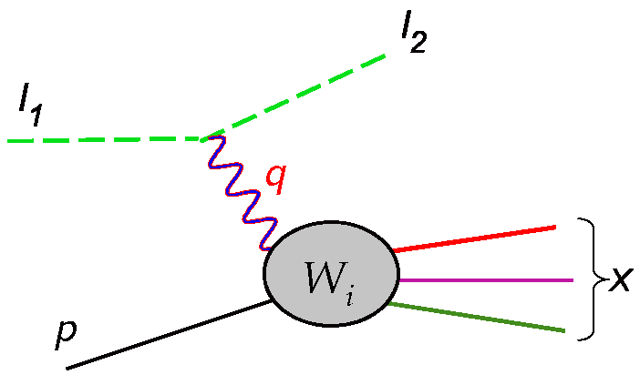
. QCD string: good for Reggestrajectory bad for deep inelastic scattering data

