Slide 1
Two point function, hydrodynamics and spectral function
Kwanghyun Jo
Hanyang Univ.
2011. 2. 28
Kps Meeting

Slide 2
Index
1. AdS/QCD
2. Computing Correlators in AdS/CFT
3. Hydrodynamics
- Perturbation in RN AdS5 background
4. Spectral function
- Photoemission rate
4. Remarks

Slide 3
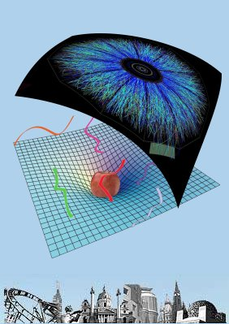
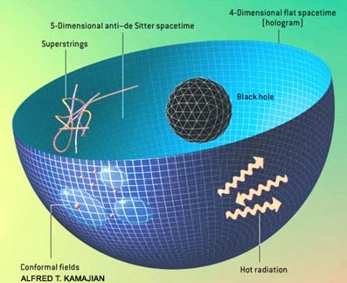
AdS/QCD
AdS/CFT : AdS₅ X S⁵ ~ N=4 SYM in 4 dim.
AdS/QCD :
aAdS_{d} ~ low energy Yang-Mills in d-1 dim.

Slide 4
Phase transition in AdS/QCD
T | Field theory side | Gravity side
T<Tc | Hadron | Thermal AdS
Tc | Confinement/deconfinement phase transition. | Hawking – Page transtition
T>Tc | Quarks and Gluons | AdS B.H.
Assume that confinement and chiral phase transition occurs at same scale, Tc.
T | Field theory side | Gravity side
T<Tc | Vev is not zero | Thermal AdS
Tc | Chiral symmetry breaking/restoration phase transition | Hawking – Page transtition
T>Tc | Vev is zero | AdS B.H.
SU(2)L X SU(2)R flavor sym. -> SU(2)V

Slide 5
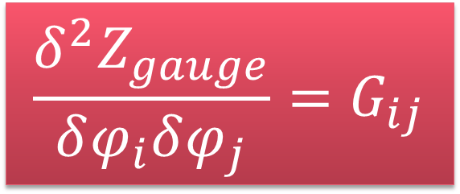
Two point function
Microscopic theory
(E > Λc) : Yang-Mills
Zgauge
Generating functional
perturbative
Low energy effective theory
(E < Λc) : Chiral Lagrangian, Walecka
Non perturbative
Intermediate energy regime
$$\frac{δ^{2}Z_{gauge}}{δφ_{i}δφ_{j}}=G_{ij}$$

Slide 6
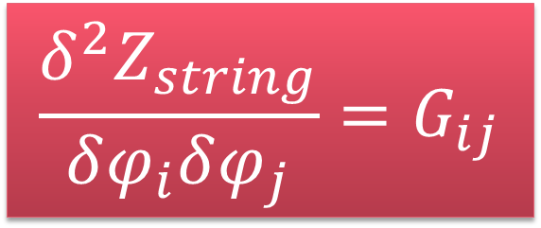
Two point function
Microscopic theory
(L < ls) : string theory
Zstring
Generating functional
perturbative
Low energy effective theory
(L > ls) : Einstein gravity
Non perturbative
Computable regime
$$\frac{δ^{2}Z_{string}}{δφ_{i}δφ_{j}}=G_{ij}$$

Slide 7
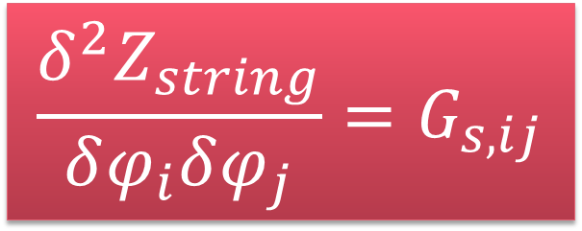
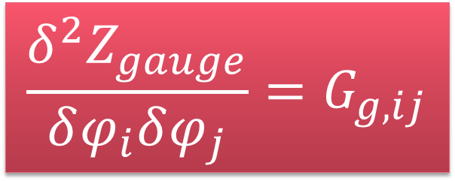
Two point function
Zgauge
Generating functional
AdS/CFT
Zstring
Generating functional
Non perturbative
Strongly coupled gauge theory
weakly coupled gravity theory
$$\frac{δ^{2}Z_{gauge}}{δφ_{i}δφ_{j}}=G_{g,ij}$$
$$\frac{δ^{2}Z_{string}}{δφ_{i}δφ_{j}}=G_{s,ij}$$

Slide 8

How to compute Green function
Find : $g_{ij}^{(0)}$, $A_{t}^{(0)}$ / Perturb : $g_{ij}^{(0)}$+δ$g_{ij}^{}$ , $A_{t}^{(0)}\text{+}\text{δ}A_{t}^{}$
Find and solve the equations of motion for δ$g_{ij}^{}$, $\text{δ}A_{t}^{}$
plug it into the original action : Seff
Differentiate Seff with respect to the source field

Slide 9
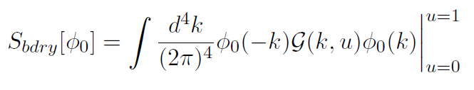

Correlators
th/0205051
Holography : Bulk(d+1 dim) projected onto the Boundary(d dim)
AdS/CFT says,
on-shell partition function of Gravity(Bulk)
= CFT partition function(Boundary)
solving Bulk e.o.m. and integrating extra dim of bulk action :
Boundary action (On-shell action).

Slide 10
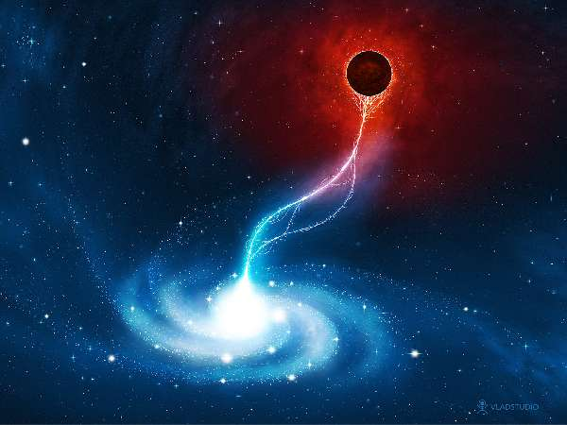

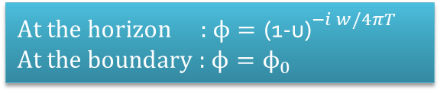

Boundary conditions
2nd order linear differential e.o.m.,
- two integration constants(boundary conditions)
$${\text{(1-}\text{u}\text{)}}^{i w/4πT}$$
BH
(u=1)
$${\text{(1-}\text{u}\text{)}}^{−i w/4πT}$$
Boundary
(u=0)
$${\text{At} \text{the} \text{horizon}\text{ : }ϕ=\text{(1-}\text{u}\text{)}}^{−i w/4πT}$$
$$\text{At} \text{the} \text{boundary}\text{ : }ϕ=ϕ_{0}$$
Black hole eat everything!

Slide 11
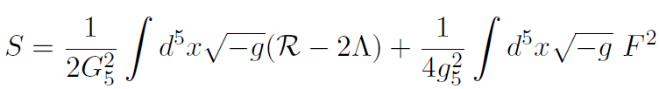
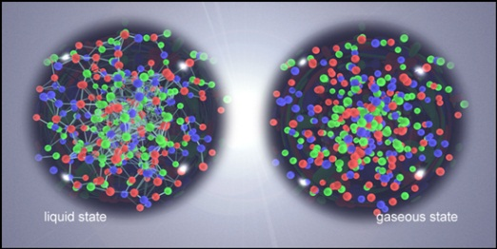
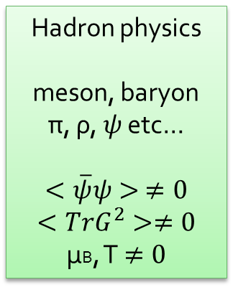
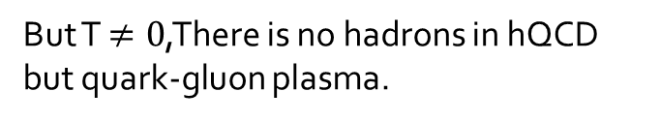
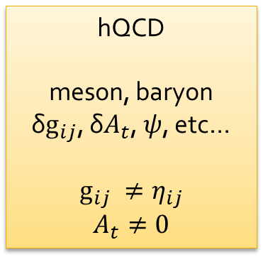
Bottom up approach
Five dimensional action : Einstein + Maxwell + cosmological constant
Hadron physics
meson, baryon
π, ρ, $ψ$ etc…
$$<\overline{ψ}ψ> ≠0$$
$$<TrG^{2}>≠0$$
μB, T$≠0$
hQCD
meson, baryon
δ$g_{ij}$, $\text{δ}A_{t}$, $ψ$, etc…
$$g_{ij} ≠η_{ij}$$
$$A_{t}≠0$$
Fluctuation
Non trivial background
But T$≠0$,There is no hadrons in hQCD
but quark-gluon plasma.

Slide 12
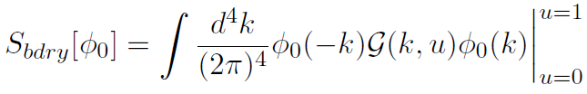
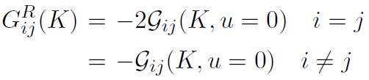

Recipe for Green function
EOM for perturbed fields : δ$g_{ij}$, $\text{δ}A_{t}$
On-shell action
and Green function

Slide 13



Hydrodynamics
Hydrodynamics describes the system
at large distance and time scale : (small w, k limit).
Basic equation :
conservation of energy momentum

Slide 14
Hydrodynamics
Transport coefficient : viscosity, thermalization time, vorticity etc.

Slide 15
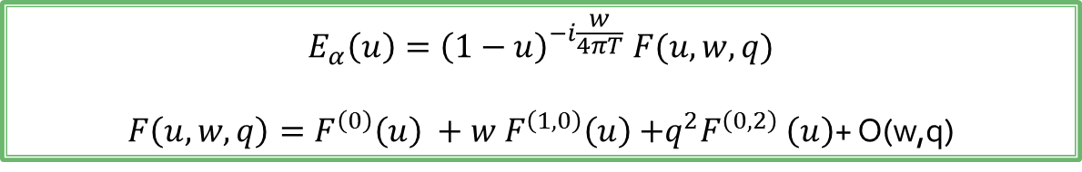
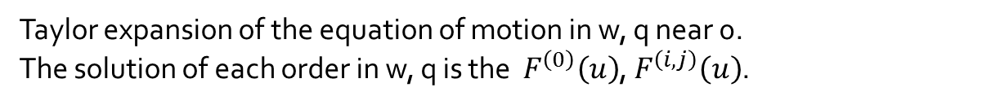
Hydrodynamics
Transport coefficient : viscosity, thermalization time, vorticity etc.
$$E_{α}\left(u\right)={\left(1−u\right)}^{−i\frac{w}{4πT}} F(u,w,q)$$
$F\left(u, w, q\right)=F^{\left(0\right)}\left(u\right) +{w F}^{\left(1,0\right)}\left(u\right){+q^{2}F}^{\left(0,2\right)}\left(u\right)$+ O(w,q)
Taylor expansion of the equation of motion in w, q near 0.
The solution of each order in w, q is the $F^{\left(0\right)}\left(u\right)$, $F^{\left(i,j\right)}\left(u\right)$.

Slide 16
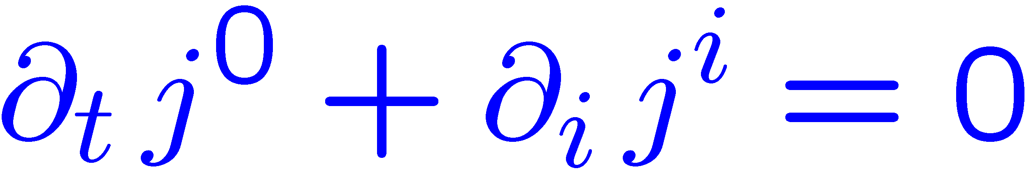
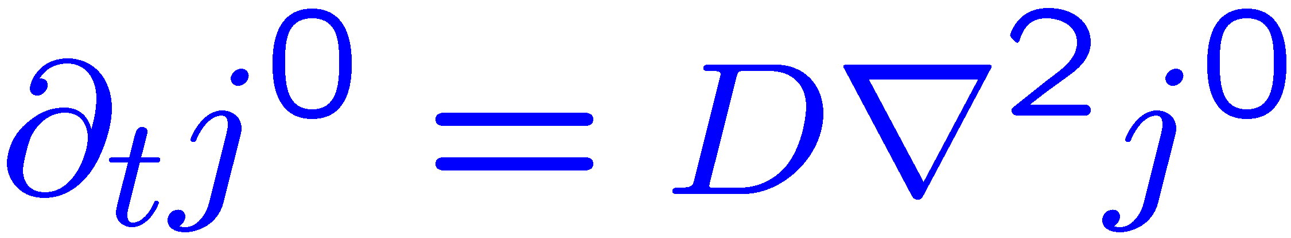
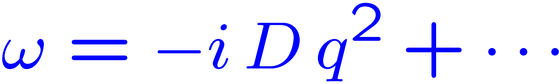

Hydrodynamics: fundamental d.o.f. = densities of conserved charges
Need to add constitutive relations!
Example: charge diffusion
Conservation law
Constitutive relation
[Fick’s law (1855)]
Diffusion equation
Dispersion relation
Expansion parameters:

Slide 17
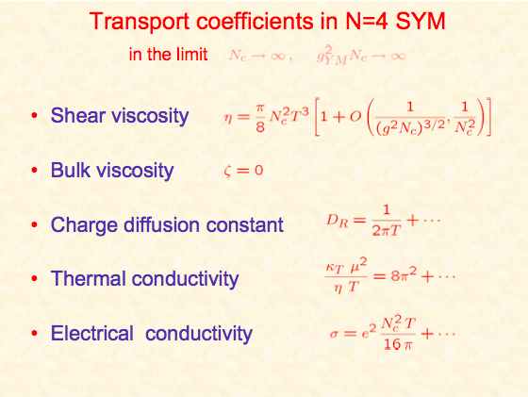
Hydrodynamics

Slide 18
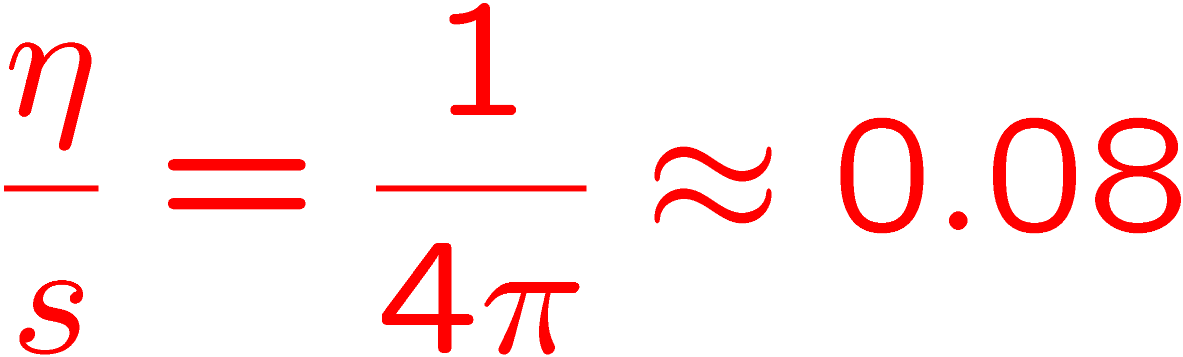
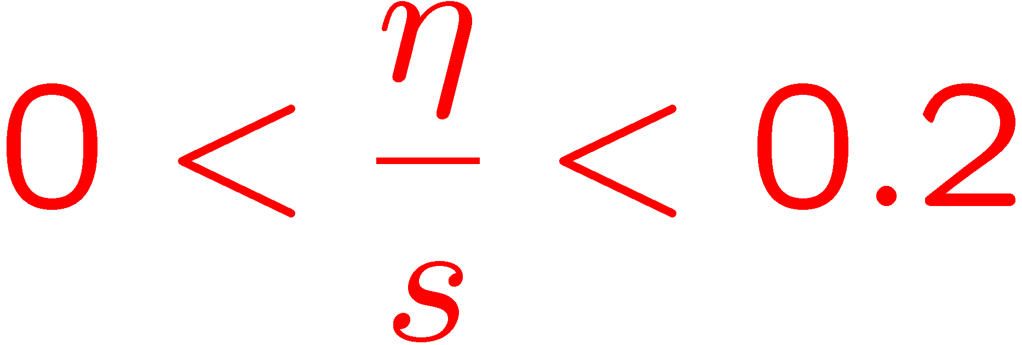
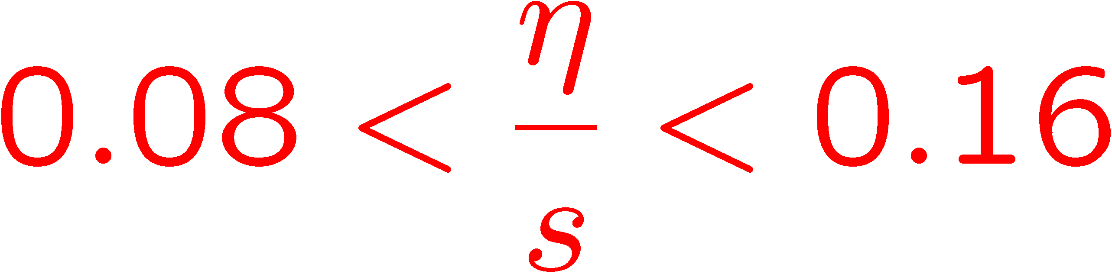
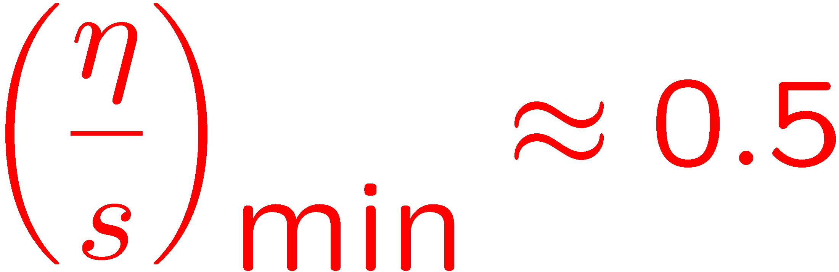
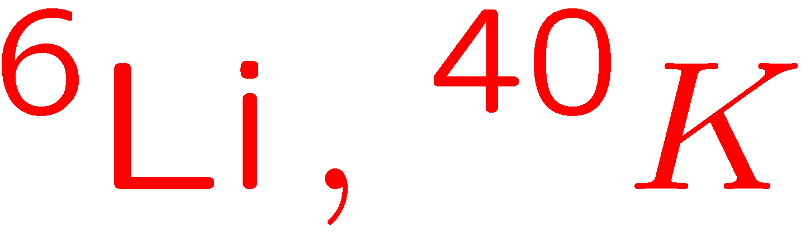
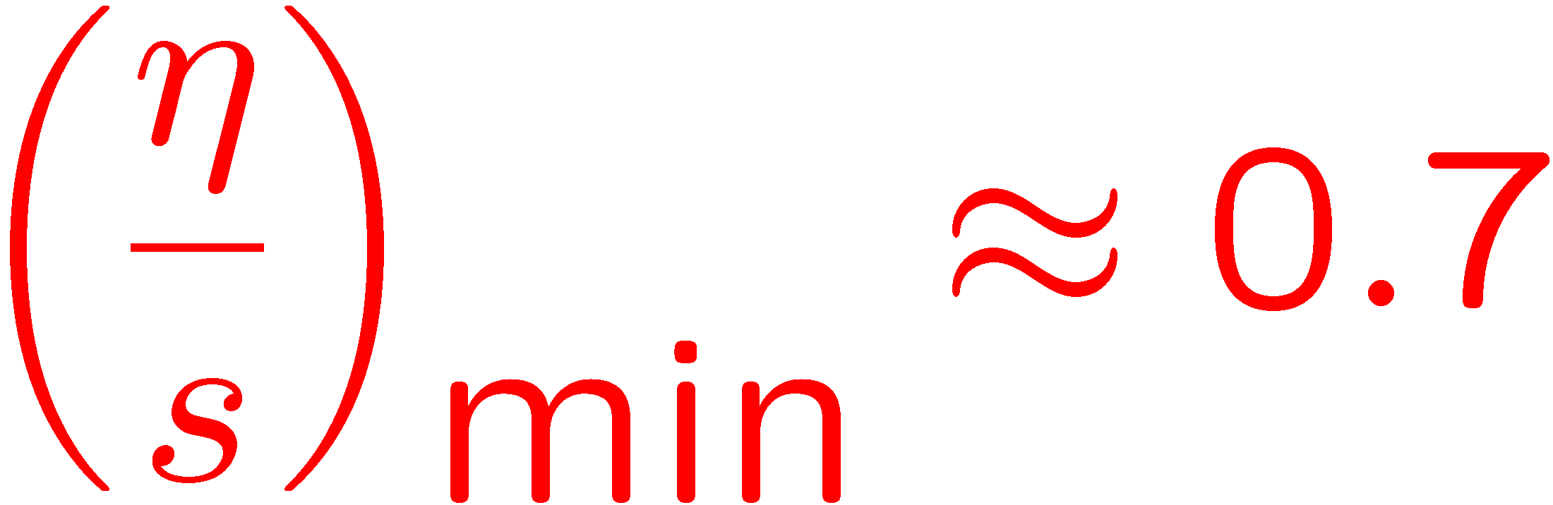
Viscosity/entropy ratio in QCD: current status
Theories with gravity duals in the regime
where the dual gravity description is valid
(universal limit)
Kovtun, Son & A.S; Buchel; Buchel & Liu, A.S
QCD: RHIC elliptic flow analysis suggests
QCD: (Indirect) LQCD simulations
H.Meyer, 0805.4567 [hep-th]
Trapped strongly correlated
cold alkali atoms
T.Schafer, 0808.0734 [nucl-th]
Liquid Helium-3

Slide 19






Hydrodynamics, ex1)
Black D3 metric and mode ( $φ=δg_{xy}$)
EOM
Eta/s
Solution
Greens function
Kubo formular
Shear viscosity

Slide 20





Hydrodynamics, ex2)
Black D3 metric and R charge current δA0 mode
EOM
Solution
Greens function
R-charge Diffusion constant

Slide 21





Hydrodynamics, ex3)
Black D3 metric and $T_{01}$ mode, $a_{0}={δg}_{01}$
EOM
Solution
Greens function
Bulk viscosity
Momentum diffusion constant

Slide 22

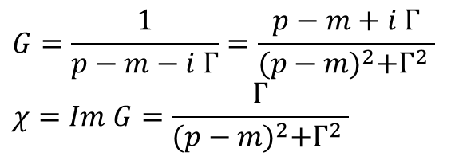
Spectral function
Imaginary part of Green function.
$$G=\frac{1}{p−m−i Γ}=\frac{p−m+i Γ}{{(p−m)}^{2}+Γ^{2} }$$
$$χ=Im G=\frac{Γ}{{(p−m)}^{2}+Γ^{2} }$$
Maximum value 1/$Γ$at p=m

Slide 23
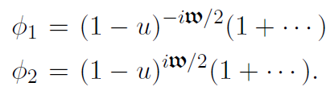
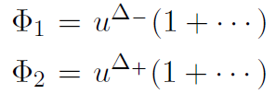


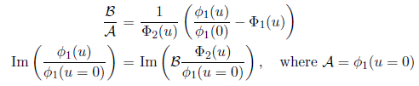

Correlator (Finite temperature)
N-point function = differentiating N times partition function
with respect to the source
Local series solutions : two indicial solutions
(2nd order differential equations)
Near horizon
Near boundary
Infalling condition

Slide 24
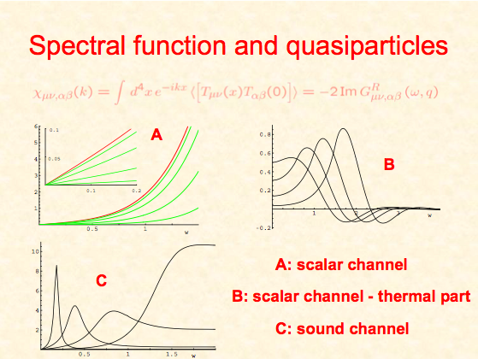

Slide 25
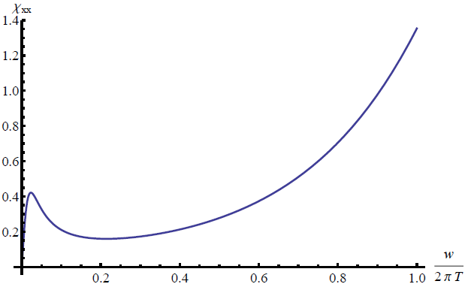
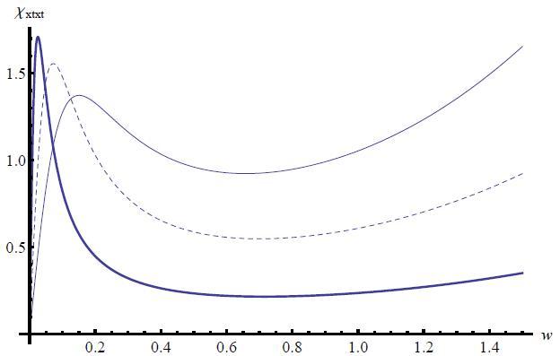
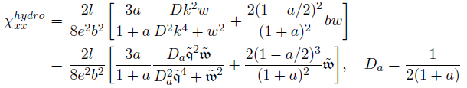
Spectral function (Im G)
Im G_{xx}
Im G_{xtxt}
q =0.7
q = 0.5
q =0.3

Slide 26
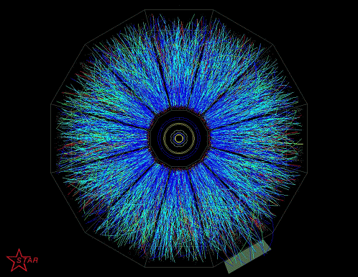
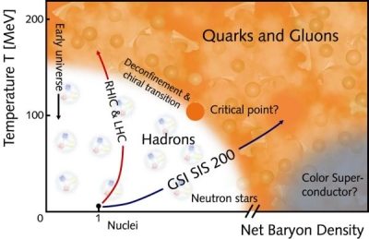
In medium effects of QCD
QCD phase diagram
Particle production
In RHIC

Slide 27

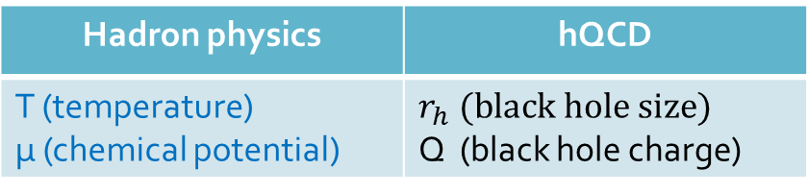
In medium effects of QCD
Hadron physics | hQCD
T (temperature) μ (chemical potential) | $$r_{h} (black hole size)$$ Q (black hole charge)
Theory has parameters
The w, k is scale by temperature
By changing μ, we will see the density effect on hydrodynamic quantities and spectral function

Slide 28
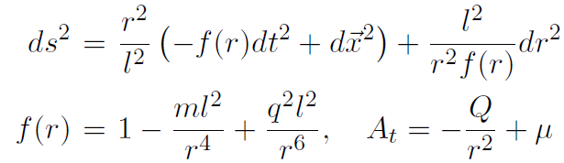
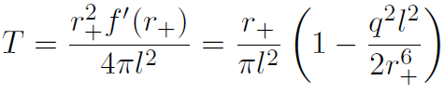

RN AdS5
Metric
Temperature
Chemical pot.

Slide 29

SO(p-1) classification
Tensor h_{ij}
Vector h_{ai}
Scalar h_{ab}
 |  |  | t | x | y | z | r
h_{MN} | = | a | h_{tt} | h_{tx} | h_{ai} |  | h_{μr}
 |  |  | h_{xt} | h_{xx}
 |  | i | h_{ia} |  | h_{yy} | h_{ij}
 |  |  |  |  | h_{ji} | h_{zz}
 |  | r | h_{rμ} |  |  |  | h_{rr}
AdSp+2 -> p+1 CFT
SO(p) rotational sym.
---(wave propagating)-->
SO(p-1) rotational sym.
h_{ai} : bi-vector
SO(1,1) X SO(p-1)
$$x^{M}=\left(x^{μ},r\right)=\left(x^{a},x^{i},r\right)$$
a=t,x i=y,z

Slide 30
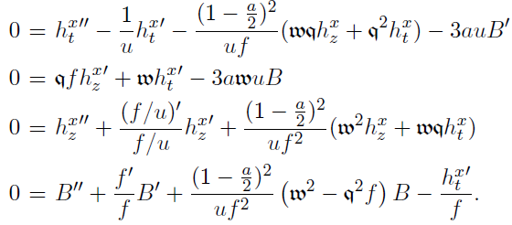


Metric and gauge field perturbation
: vector mode
1005.0200
Linearized Einstein eq.
Metric ( g = g₀ + h ) + gauge field ( A = A₀ + a )
With finite density h and a is coupled via background field g₀ and A₀ .
decoupling,
master variable

Slide 31






<J_{x}J_{x}> Correlator
Near boundary series solution of master variable
From the definition of master variables, get the transformation matrix R to convert original boundary value and their conjugates

Slide 32






Photoemission rate
th/0607237
# of emitted photon / Vol4
Leading in e^2 expandsion
(e is the EM coupling)
Wightman function of EM currents (not time-ordered)
Other way to get the Wightman function
Photo emission rate

Slide 33


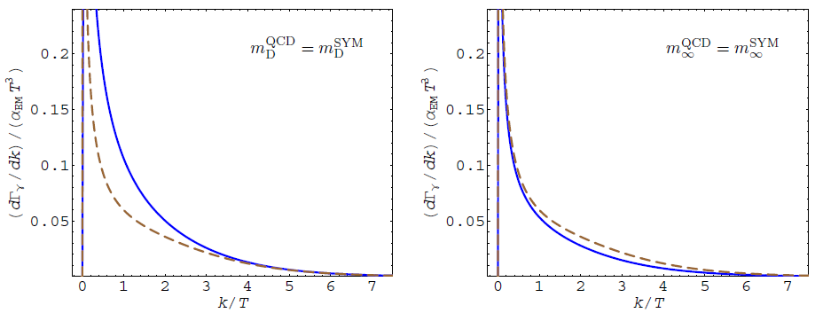
Photoemission rate
th/0607237
ph/0111107
3 flavor massless QCD (dashed curve) / SYM (Solid Blue)
SYM computation gives quite good hint of hot QGP
Matching Debye screening mass
Matching Asymptotic fermion mass
α_{SYM} = .025, α_{s} = .1
α_{SYM} = .011, α_{s} = .1

Slide 34
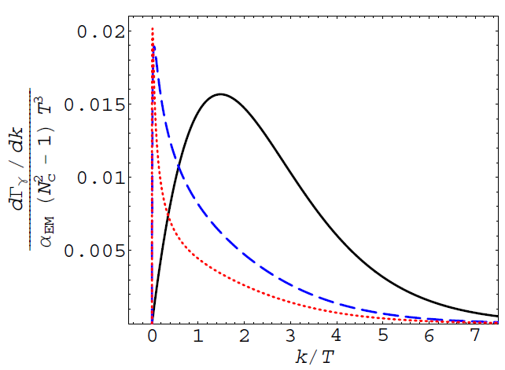



Photoemission rate
th/0607237
N=4 Super Yang-Mills computation with small t’ Hooft coupling
Solid Black (SYM : λ=∞)
Dashed Blue (λ = 0.5)
Dotted Red (λ = 0.2)
Known large k asymptote
Small frequency
Coupling indep.
$$k^{1/2}$$
$$k^{2/3}$$

Slide 35
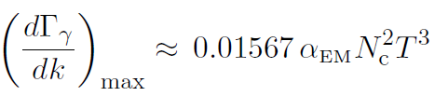
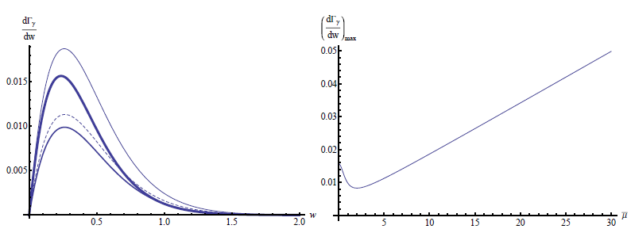
Photo emission rate
Photo emission rate with unit
Maximum at
μ=10
0
5
1
Maximum rate is decreased first and increased after

Slide 36
Remarks
Holography : two point function of QGP
Small w, k limit : Hydrodynamics
- transport coefficients
Full w, k regime : Spectral function
- quasi particle peaks, photoemission
Finite T and μ, RN AdS is holographic dual.
Thermal photon production is affected by density effects.

