Slide 1
Hadronic rescattering in elliptic flow & Heavy quarks at RHIC
Yongseok Oh
Kyungpook National University
Heavy Ion Meeting 2011-02, Muju Resort
Feb. 27-Mar. 1, 2011

Slide 2
Contents
Introduction
Hadronic rescattering in elliptic flow
  Deuteron elliptic flow
    Coalescence mode
    Dynamical model
    Transport model
Heavy quarks in RHIC
  Baryon to meson ratio
  Nuclear modification factor of non-photonic electrons

Slide 3
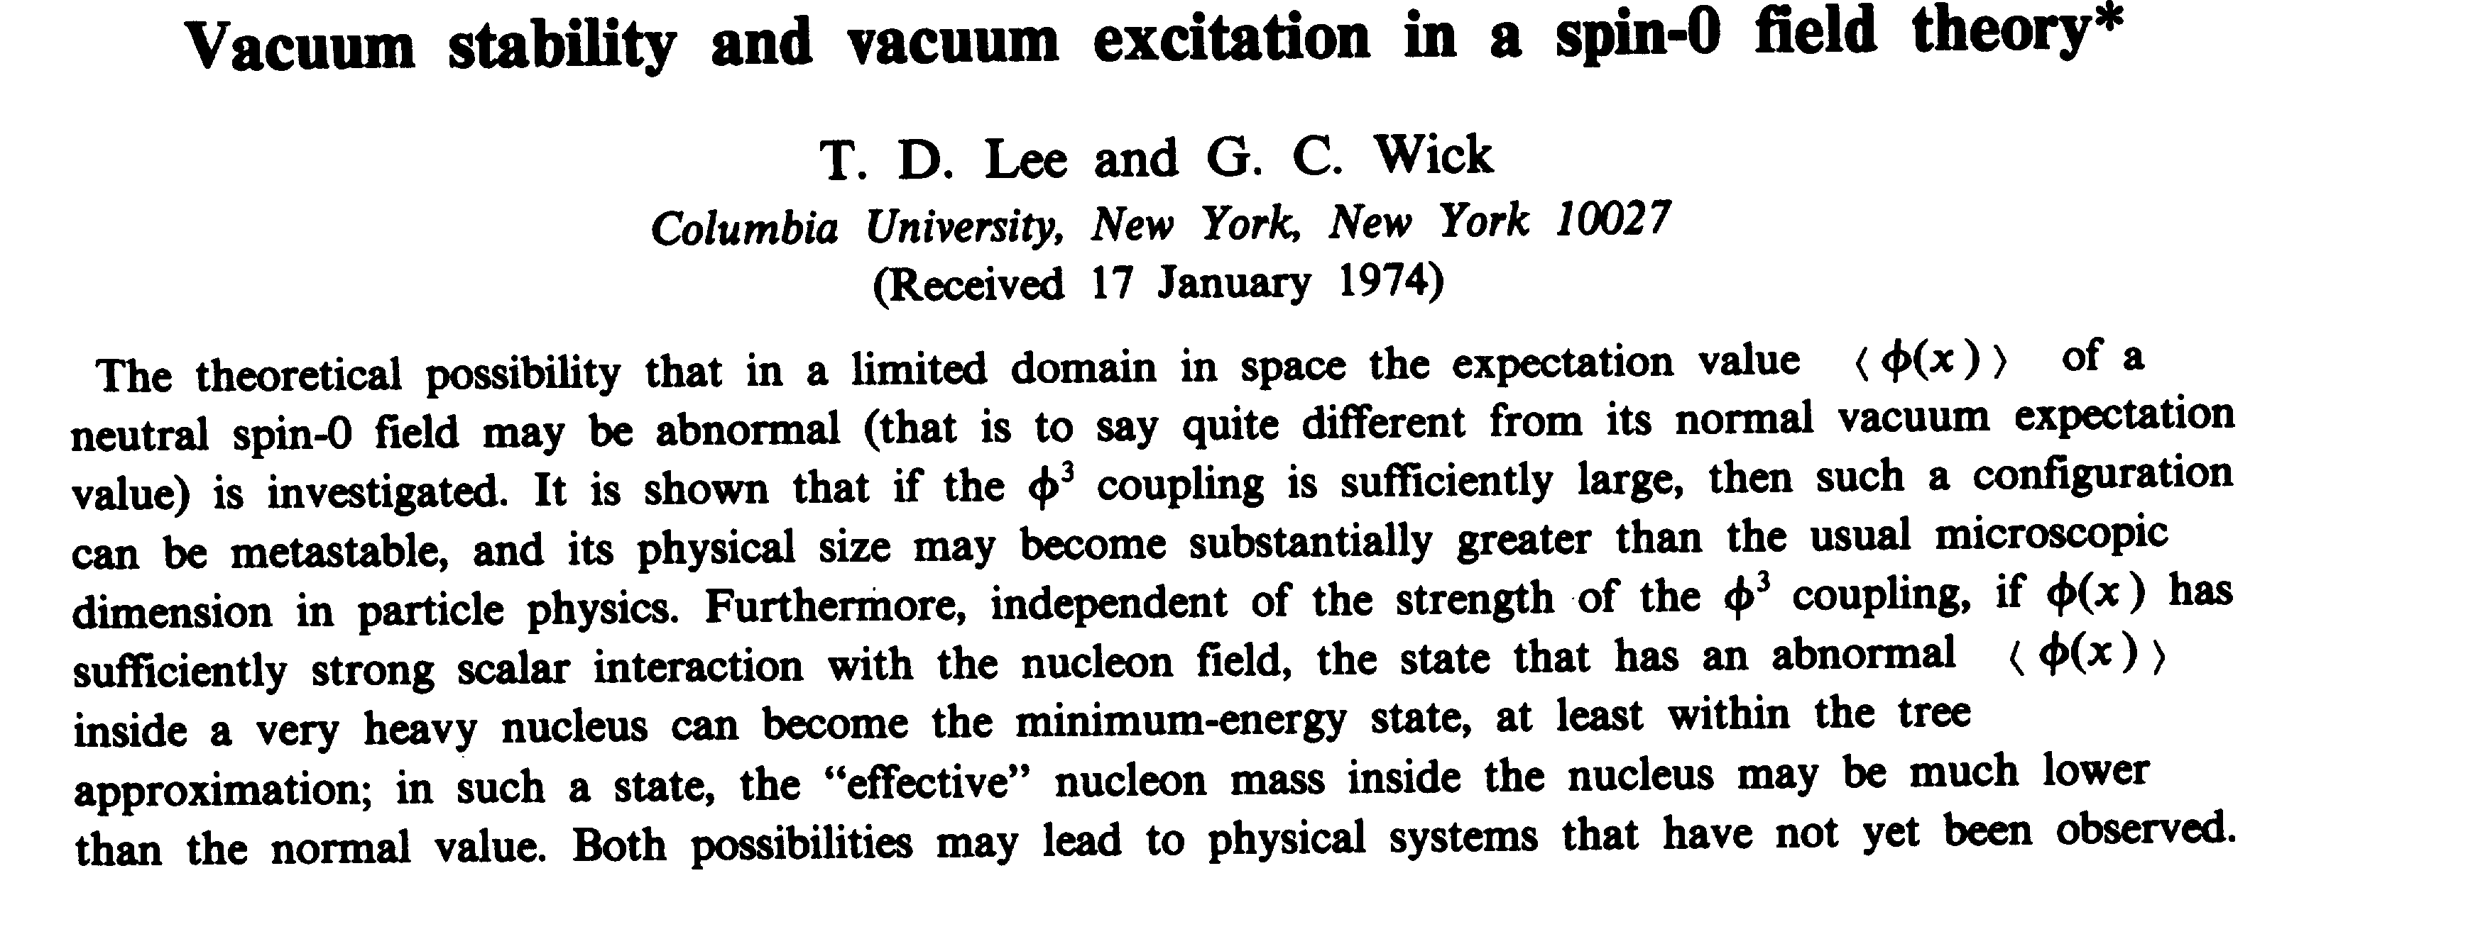
1. Introduction
Relativistic heavy ion collision
  QGP: a new state of matter
  sQGP (strongly interacting QGP)

Slide 4
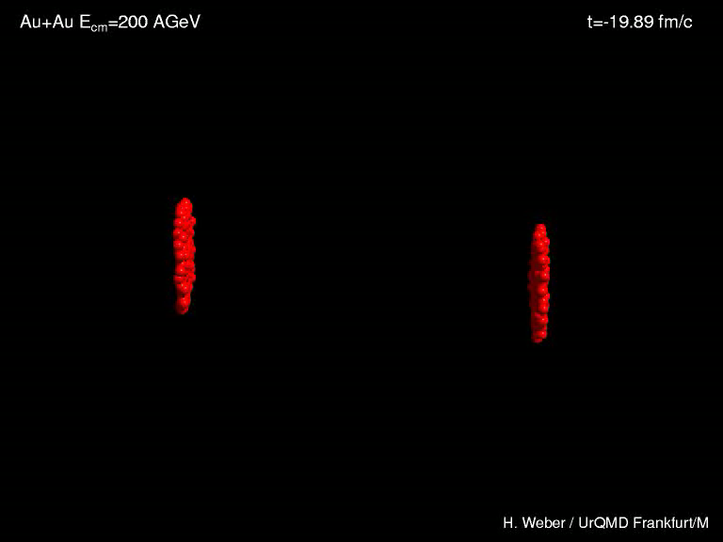
Relativistic Heavy Ion Collisions

Slide 5
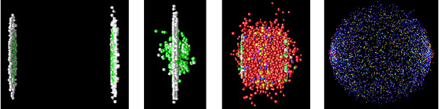
RHIC
QGP
Expansion
Freeze-out
Hadronization
Hadron rescattering
detector
Test of hadron models
  Large multiplicity
  Find the physical quantities that are sensitive to hadron models
QGP signals
  - Hadron rescattering effects

Slide 6
sQGP
Observed state in relativistic heavy ion collisions @ RHIC
  Perfect fluid behavior (hydrodynamics)
  Strong collective behavior (large elliptic flow)
    Strong coupling nature of Quark-Gluon Plasma
New lattice results
  bound state could survive at T > Tc
  Even at T > Tc, the interaction is still strong
    Possible existence of quasi bound states of quarks and gluons
    such as qq, gq, gg
  Diquarks in hadron physics
    Existence of a diquark in baryons?
Shuryak and Zahed, PRC 70
    Lichtenberg, Anselmino, Wilczek & others

Slide 7
Hadron rescattering in elliptic flow

Slide 8
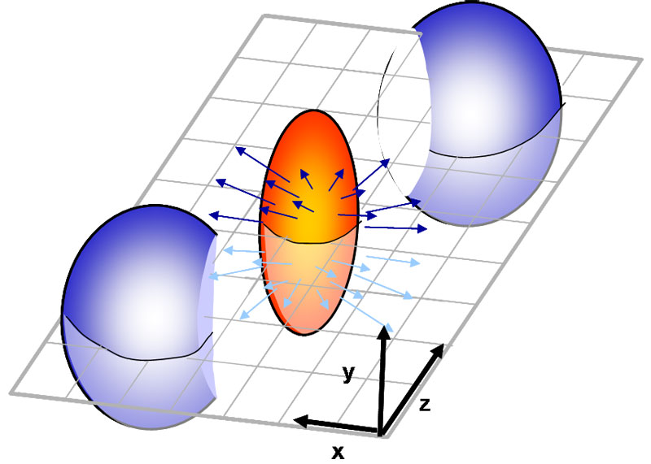
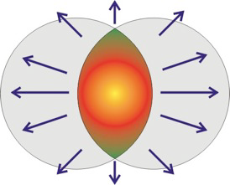
Elliptic Flow
Elliptic flow : a measure of the strength of the second Fourier
coefficient in the azimuthal angle distribution of particle
transverse momentum relative to the reaction plane
  a azimuthal anisotropy of the momentum distribution of particles
Elliptic Flow v₂: momentum
anisotropy
⇒ RHIC data show large
momentum anisotropy

Slide 9
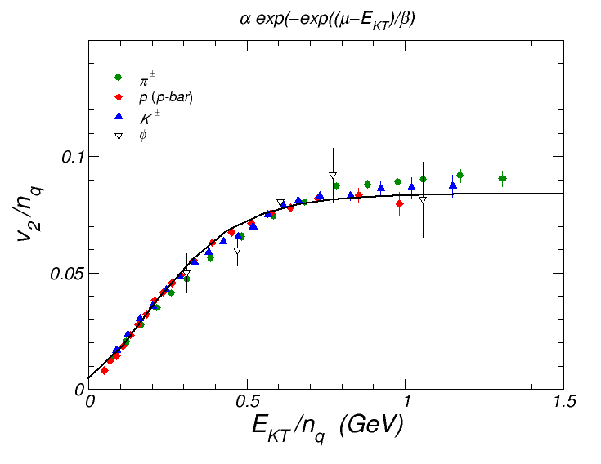
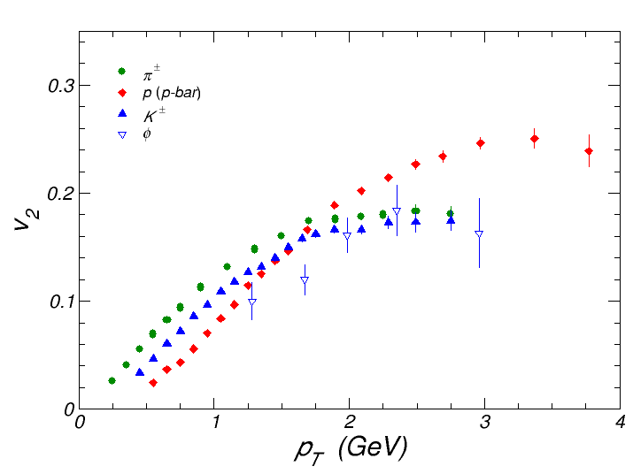
Elliptic flow
information on the properties of the hot dense matter formed
during the initial stage of RHIC
  Mass ordering: v₂ decreases with increasing hadron mass
  Constituent quark number scaling
Quark number scaling
(quark recombination)
Mass ordering
(hydrodynamics)
Fisher-Tippet
(Gumbel) distr.
Negative v₂ for
heavy mass?
E_{KT} or p_{T} scaling

Slide 10
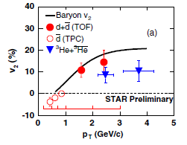
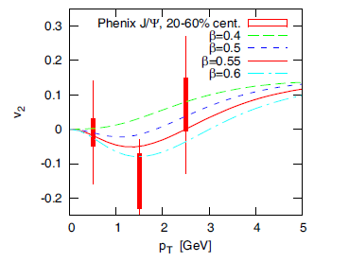
Elliptic flow
Negative elliptic flow at small pT for heavy particles?
  deuteron (~1.9 GeV)
  J/ψ (~3 GeV)

Slide 11
Elliptic flow (scaling)
Coalescence model
For J/ψ
  charm quark + charm anti-quark
  v₂ of the charm quark: negative at small p_{T}?
For deuteron
  proton + neutron
  v₂ of the nucleon: positive (by experiments)
Intriguing questions on the mechanism of particle production and their interactions

Slide 12
2. Deuteron elliptic flow
Coalescence model (the simplest version)
  The deuteron yield in momentum space is proportional to the
  product of the proton and neutron densities at half the momentum
  of produced deuteron
  The deuteron elliptic flow would satisfy exactly the nucleon number scaling and thus the quark number scaling as well.

Slide 13
Elliptic flow: blast-wave model
Blast-wave model
In cylindrical coordinates
  Transverse flow velocity

Slide 14
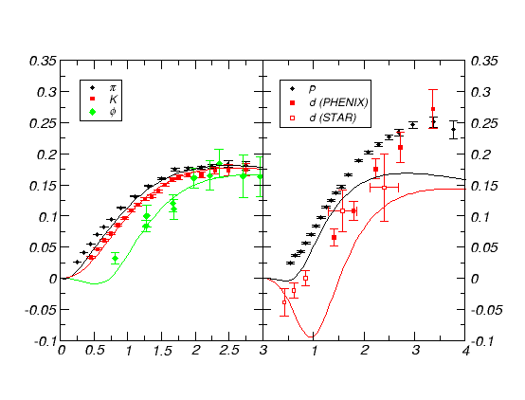
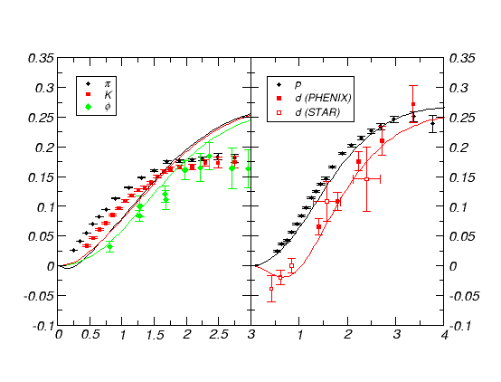
Test of a simple blast-wave model
  Transverse flow velocity
Fitted results
Requires different parameter sets!
Fitted for mesons
Fitted for baryons

Slide 15
Modified coalescence model
Take into account the momentum spread of the deuteron
wave function
Gives small deviation from the exact quark number scaling
Does not satisfy energy conservation.
  Effects of energy conservation?
Hulthen WF

Slide 16
Dynamical model
Use dynamical processes for deuteron production
  Dominant deuteron production reaction: two-body scattering
  Only the rate can be calculated.
  3-body reactions can be added such as
No a priori restriction such as
Energy is conserved as
well as momentum

Slide 17
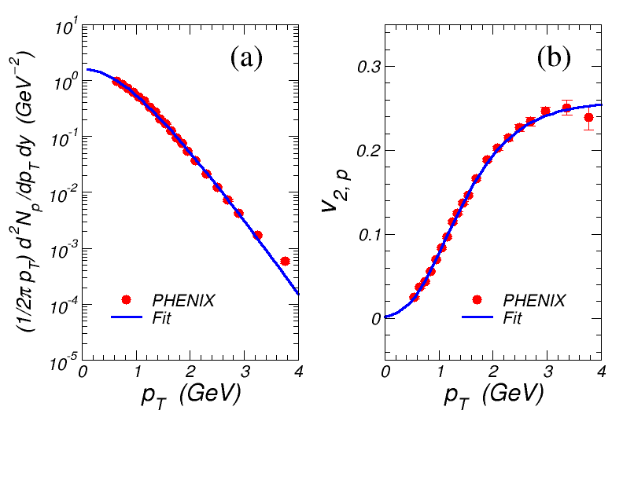
Dynamical model
Inputs (Nucleon spectrum)

Slide 18
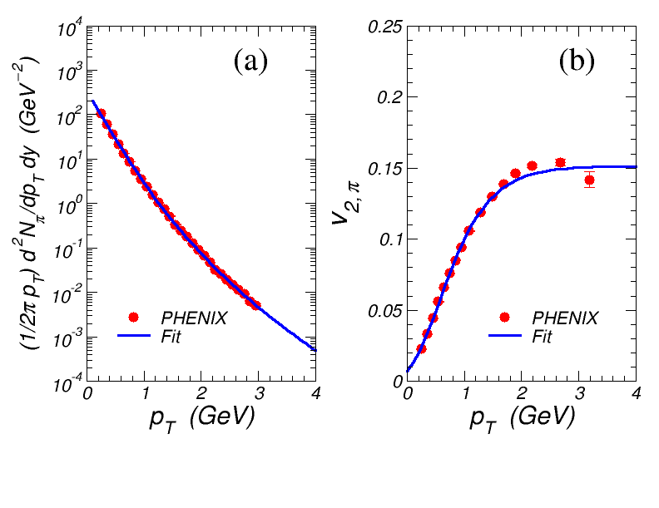
Dynamical model
Inputs (pion)

Slide 19
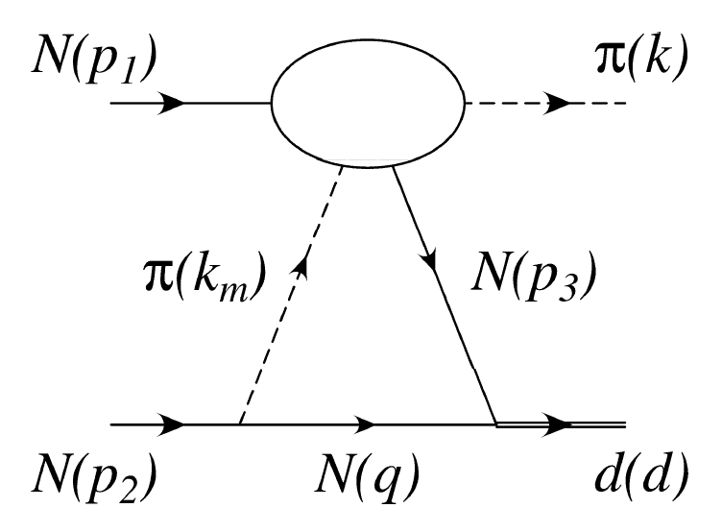
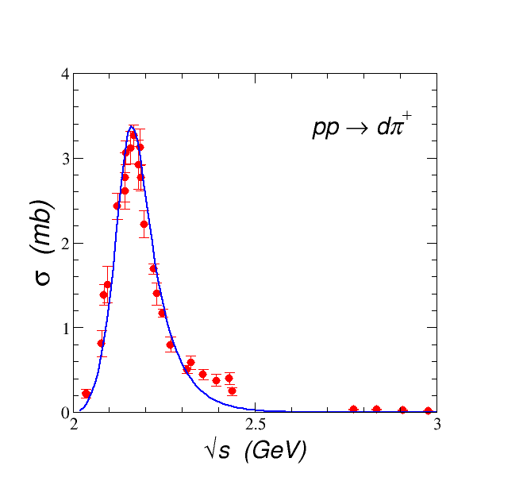
Dynamical model
Input for the production amplitude of
Adjusted to fit the data

Slide 20
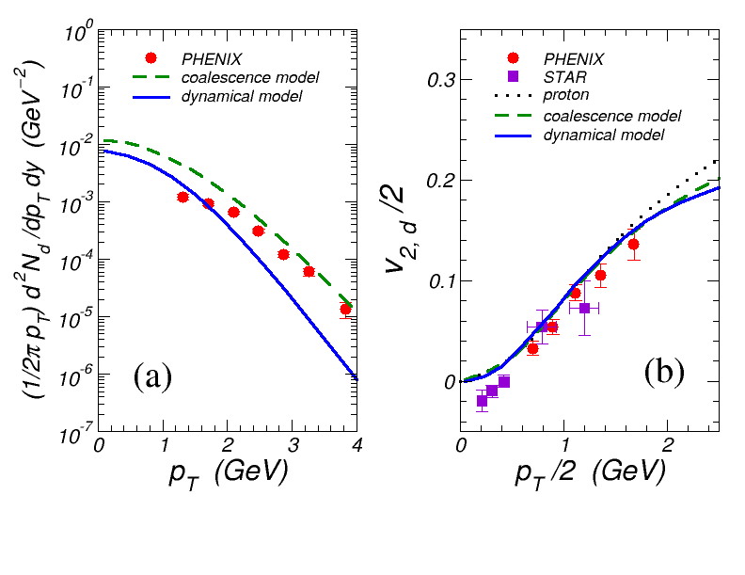
Dynamical model
Results
Oh and Ko, PRC76
Negative
v₂

Slide 21
Dynamical model
Results
  Deuteron spectrum
    Radial flow effect is not fully taken into account
  Deuteron elliptic flow
    Consistent with the PHENIX data
    Cannot explain the negative v₂ of preliminary STAR data
    Support coalescence model at medium p_{T}
    Momentum conservation has more important role in this region.
    Holds also for low momentum region?

Slide 22
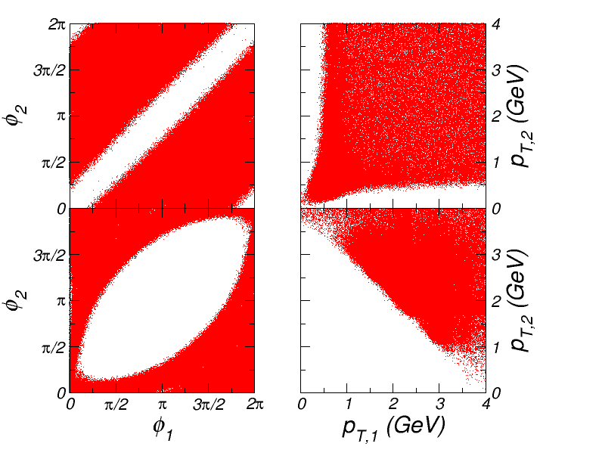
Dynamical model vs Coalescence model
In coalescence model, p_{d}/2=p₁=p₂
In dynamical model, energy-momentum conservation
determines the physical region
Allowed by the coalescence
model

Slide 23
Dynamical model vs Coalescence model
At low p_{T} region
  The momenta chosen by the coalescence model is not
  physically allowed region.
  So, the similarities between the dynamical model and coalescence
  model are accidental,
    If v₂ of the nucleon at low p_{T} is negative
      Coalescence model gives negative deuteron v₂
      Dynamical model gives positive deuteron v₂

Slide 24
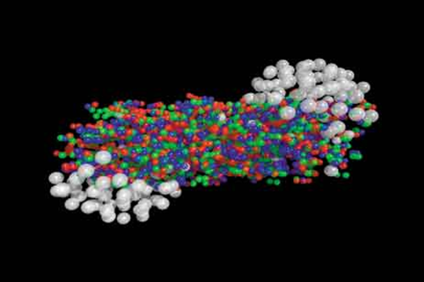
Transport model
Assume that initial hadrons formed by
the QGP are thermalized.
(blast-wave model)
⇒
and, then, hadronic rescattering
Initial state
Hadron rescatterings/collective
expansion via ART

Slide 25
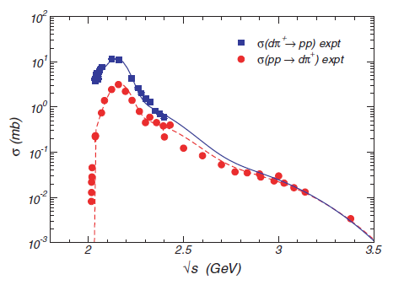
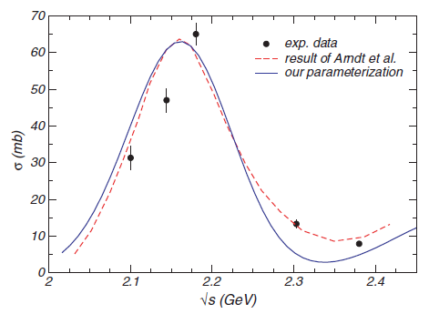
Transport model
Transport model ART (A Relativistic Transport model)
  includes
  mesons (π, ρ, ω, η, K, K*, φ)
  and baryons (N, Δ, Λ, Σ and their anti-particles)
  In this work, we include the interactions with the deuteron

Slide 26
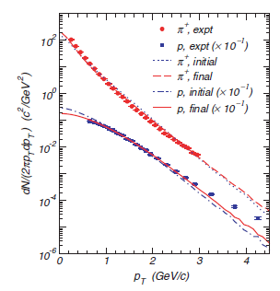
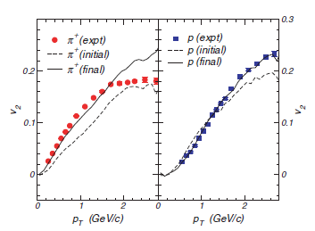
Transport model
Inputs
  The parameters for the initial state are determined
  to reproduce the measured pion/nucleon data
Large rescattering effects in the elliptic flow

Slide 27
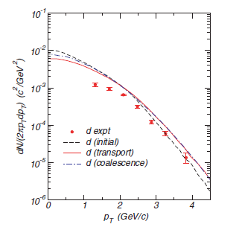
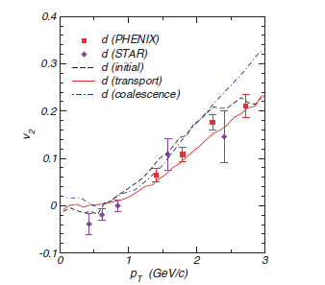
Transport model
Output
  Deuteron spectrum p_{T} spectrum and elliptic flow
Oh et al., PRC80

Slide 28
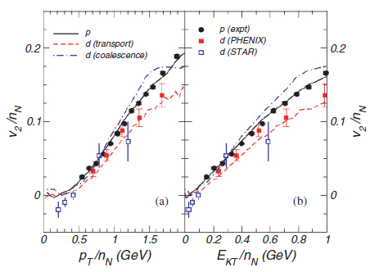
Transport model
Deviation from the scaling
behavior

Slide 29
Outlook
QGP
Expansion
Freeze-out
Hadronization
Hadron rescattering
Measurements
For more complete
simulation of RHIC
Modify Quark
recombination
Modify hadronic rescattering
Use improved hadron models: structure & interactions

Slide 30
Heavy quarks in rhic

Slide 31
Hadron models @ RHIC
Test of diquark model for baryons at RHIC
S.H. Lee et al., PRL100 (2008)
Sateesh, PRD45 (1992)
Wilczek
Three-quark model
Diquark model
The most attractive diquark channel: scalar diqaurk
How to distinguish diquark model from the three-quark model
: diquark + heavy-quark or three-quark
: three-quark
c use the production of and in relativistic heavy ion collisions
ratio will be enhanced by a factor of 4-8: S.H. Lee et al., PRL100 (2008)
ratio will be enhanced by a factor of 80: Sateesh, PRD45 (1992)

Slide 32
pp & AA collisions
PYTHIA model (pp)
Thermal model (AA)
Oh et al., PRC79, 044905
067902
Mostly due to D* decay: D*⁰ g D⁺π⁻ is prohibited by energy conservation

Slide 33
Thermal model (AA)
Role of resonance decays
Cf. In bottom sector,
the B* meson cannot
decay into the B meson.

Slide 34
Coalescence model (AA)
Coalescence model
  Production of a particle is proportional to the overlap integral of the
  wave functions of the constituents
  (parameters: fitted by the rms radii of the particles)
  Thermal distributions for light quarks and diquarks
  Heavy quark distributions: from pQCD

Slide 35
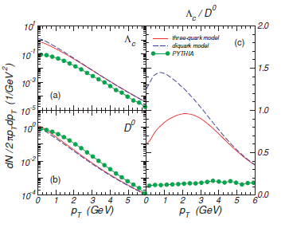
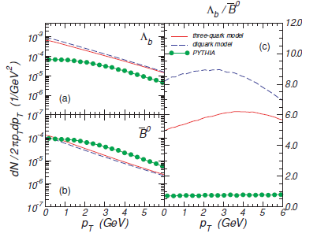
Results: Coalescence model (AA)
Larger than the thermal model
predictions
Results
Three-quark model
~1.6
times
diquark model
Meson/baryon ratio

Slide 36
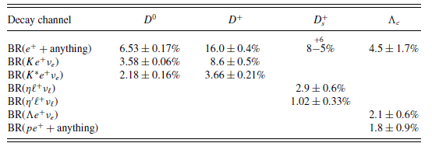
Nuclear modification factor
Non-photonic electron R_{AA}

Slide 37
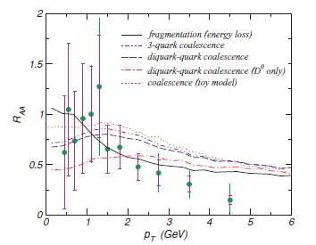
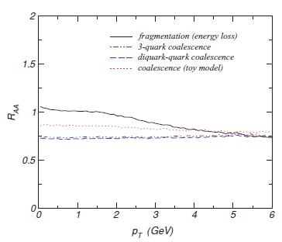
Nuclear modification factor
Non-photonic electron R_{AA}

