Slide 1
Revisiting Holographic Nuclear Matter in AdS/QCD
Kyung-il Kim, Youngman Kim
Feburary , 24th, 2009

Slide 2
Contents
Introduction to AdS/QCD model for Baryons
  Bottom-Up Approach
Nolen-Schiffer Anomaly
  Isospin density effect on nucleon masses
Vacuum shift effect on mass
  Nucleon masses under quark condensate change under low temperature and low density

Slide 3
Intoruction to AdS/QCD Model
For Baryons

Slide 4
AdS/CFT Correspondence
Closed String : Gravity
Open String : Gauge Theory
Propagate
Dual
AdS Gravity
N=4 SYM Theory
4D generating functional |  | 5D classical effective action
Operator |  | 5D bulk field
[Operator] |  | 5D mass
Current conservation |  | Gauge symmetry
Resonances |  | Klauza-Klein states

Slide 5
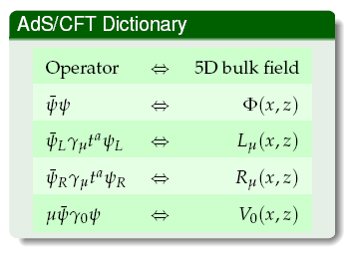
AdS/CFT Dictionary

Slide 6
Hard Wall Model
AdS5 space is compactified such that
z
UV
IR

Slide 7
Nucleons in Finite Densities
The effective action for nucleons,
The equation of motion is given by

Slide 8
Nucleons in Finite Densities
5D dual field of 4D quark field and 4D chemical potential
The scalar field at boundary
The time component of vector field
The equation of motion for proton with finite baryon densities,
where,

Slide 9
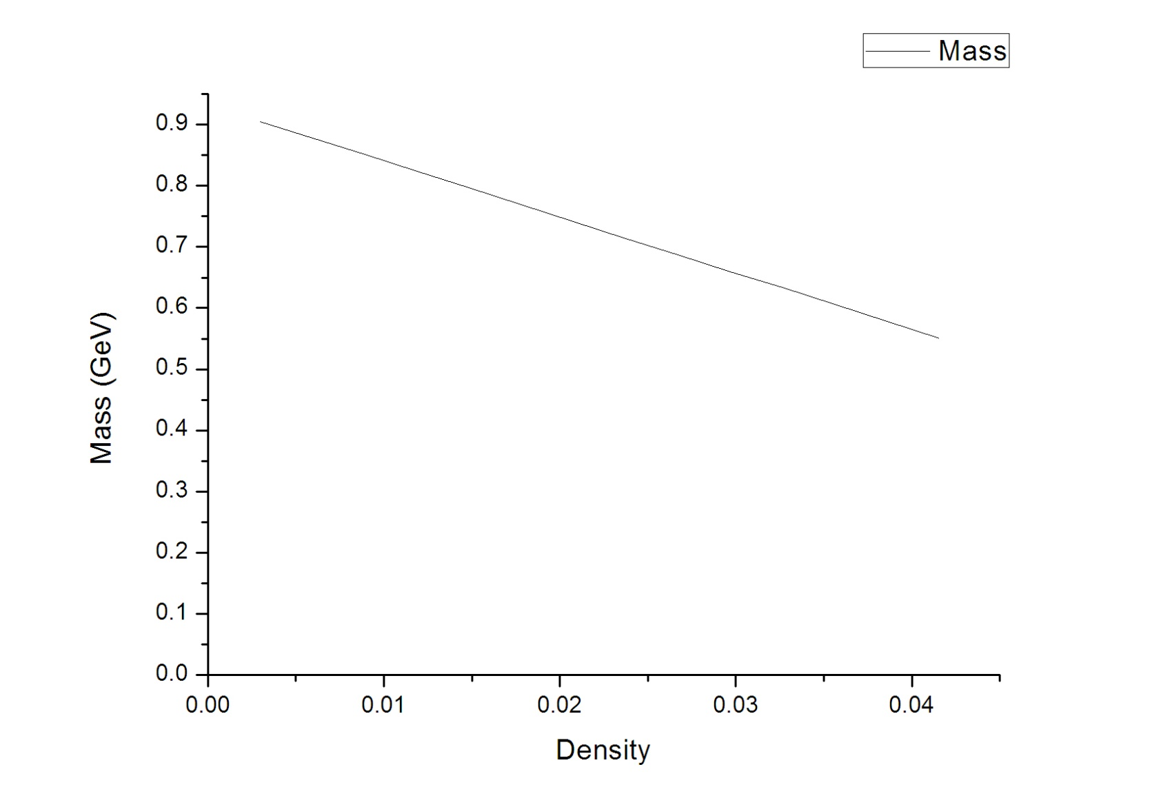
Nucleon in Dense Medium

Slide 10
2. Nolen-Schiffer Anomaly

Slide 11
Nolen-Schiffer Anomaly
The anomaly is the failure of theory to explain the mass differences between mirror nuclei or analog states.
increases with the mass number A and amounts to ~900 keV for A=208 .
The mass difference between mirror nuclei
If one assume that effective neutron-proton difference is constant, this equation is not satisfied
A possible resolution of the anomaly is the assumption that the effective mass diff. would decrease

Slide 12
AdS/QCD Approach
The isospin structure of model,
The quark mass difference
The isospin densities

Slide 13
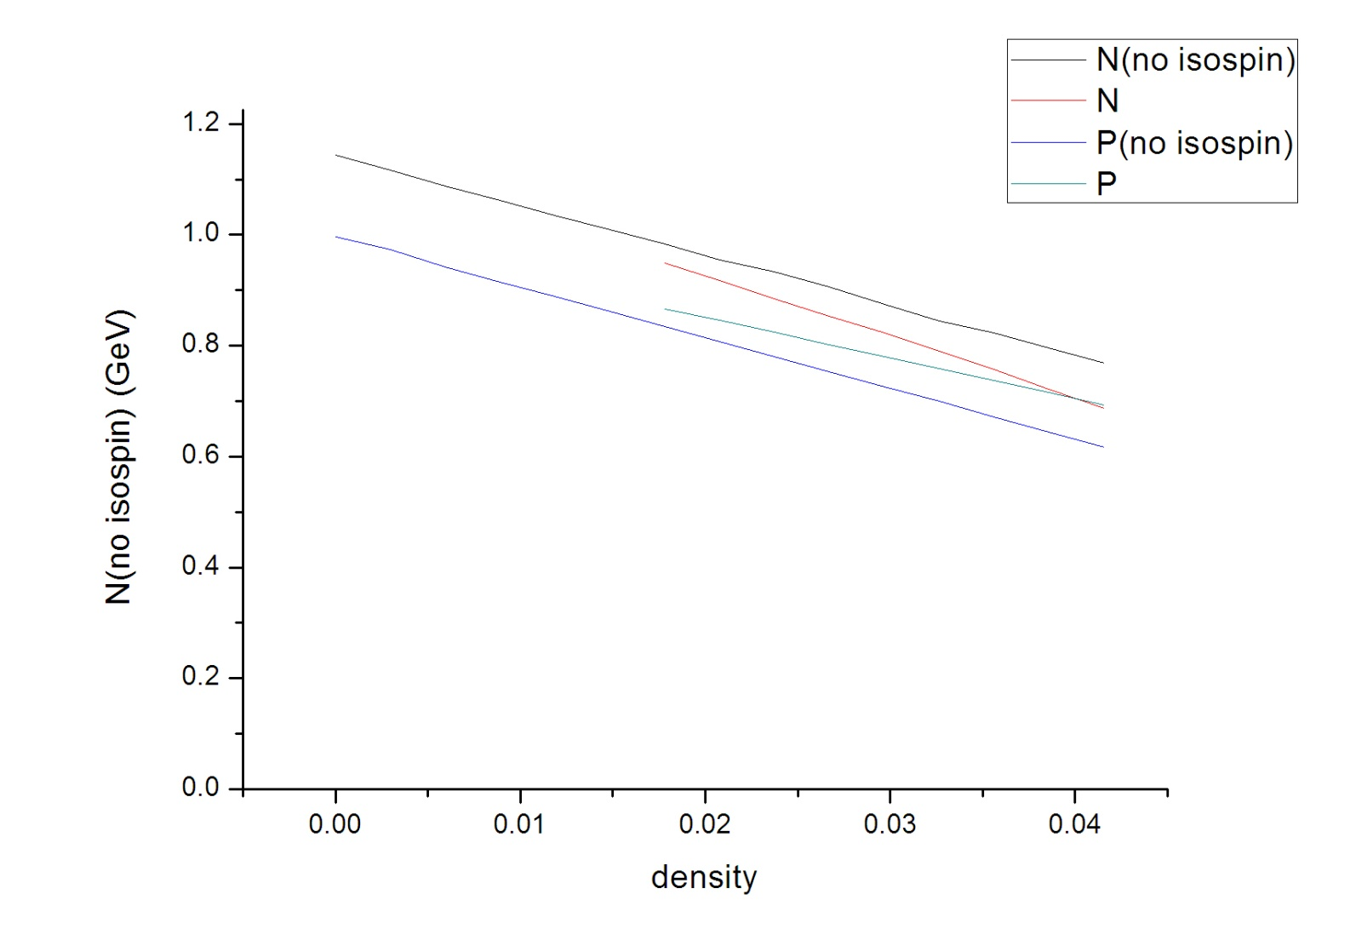
NS anomaly

Slide 14
3. Mass Decrease
by Vacuum Energy Shift

Slide 15
The Quark Condensate
The quark mass and condensate in AdS model.
The quark condensate at low temperature
The quark condensate at low density

Slide 16
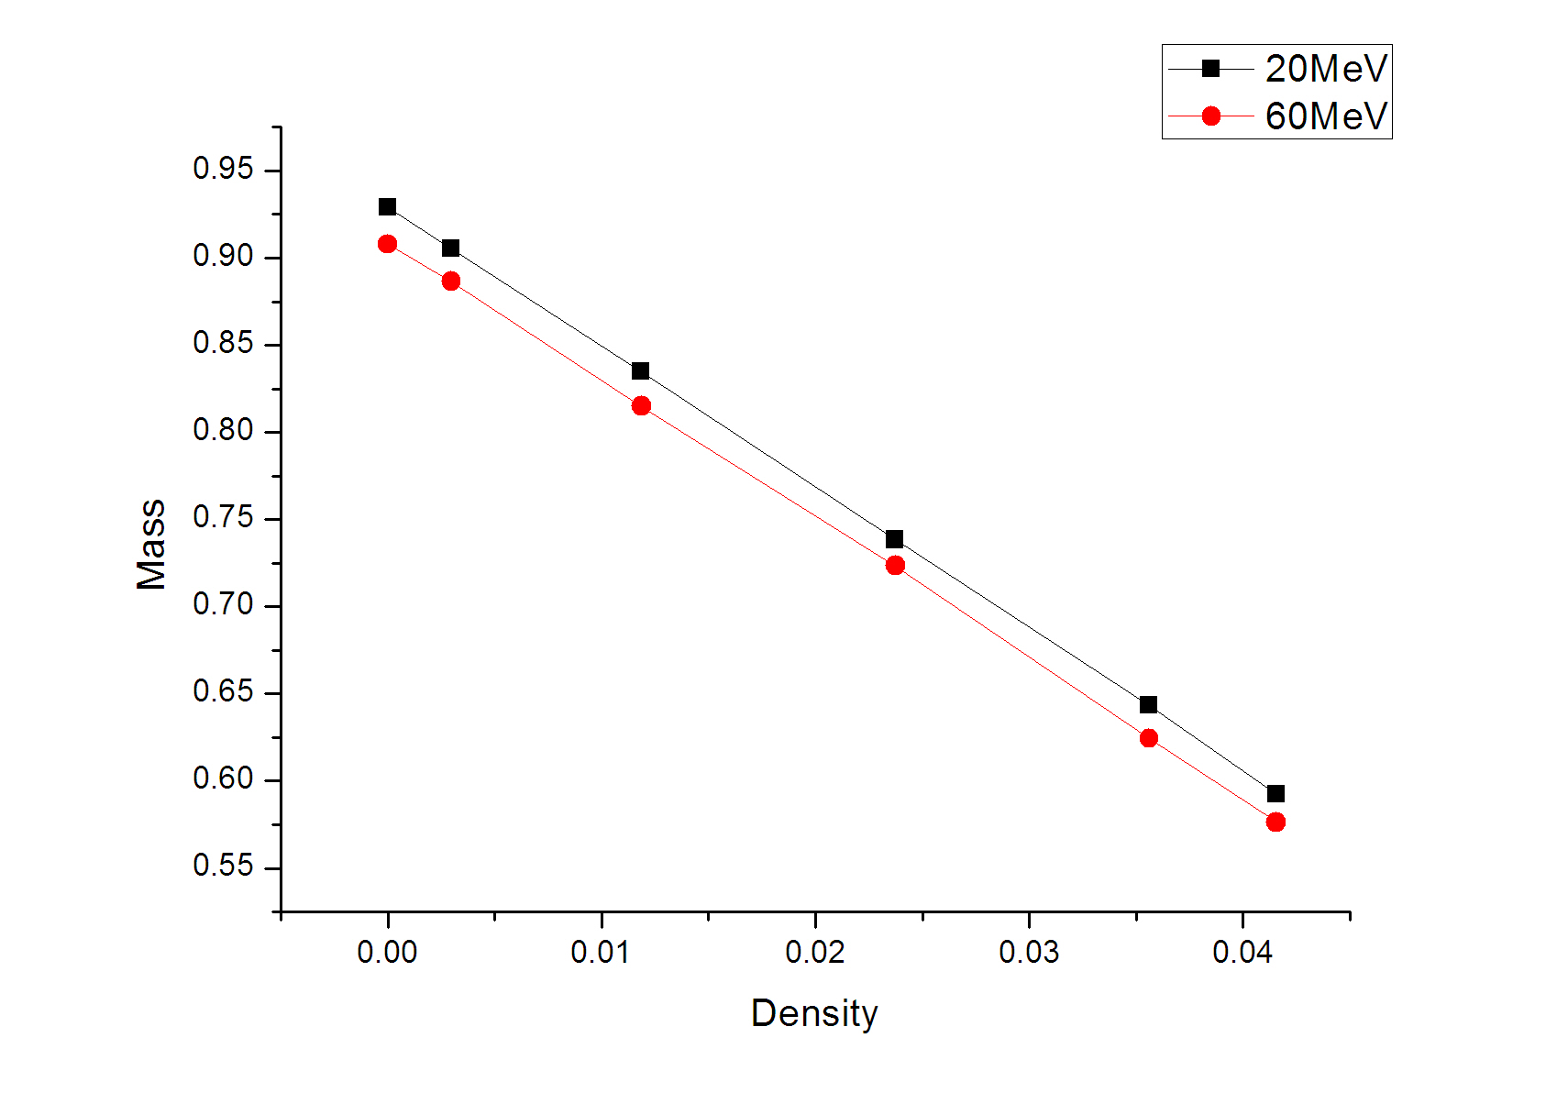
Proton mass with Low T and Low Density

Slide 17
Thank you!

Slide 18
Summary and Outlook

Slide 19
4. Walecka Model

Slide 20


Walecka Model

