Slide 1
Exotic mesons in holographic QCD
Youngman Kim(KIAS)
Hyun-Chul Kim and YK,
JHEP 0810:011,2008 (mixed condensate);
“Hybrid exotic meson with J^{PC}=1^{-+} in AdS/QCD,”
arXiv:0811.0645 [hep-ph]

Slide 2
Contents
Exotic mesons?
Exotic mesons in hQCD
Summary

Slide 3
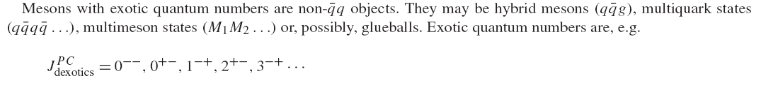
Exotic mesons?

Slide 4
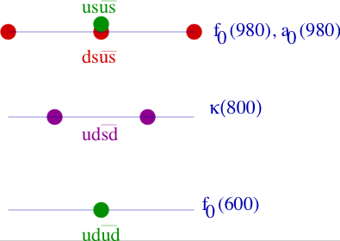
Scalar tetra-quark (Jaffe 76)

Slide 5
States with diquark – anti-diquark (Tetra-quark)
0⁺
u
d
d
u
→
0⁻
d
0⁻
u
d
u
Binding = (Mass of 2 Mesons) – (Mass of Tetraquark)
1⁺
u
d
c
c
→
0⁻
c
1⁻
T_{cc}
u
d
c
T_{cc} found to be stable in QCD sum rules and quark model
S.H. Lee

Slide 6
X(3872), Y(4260),
Z(4430)→ ψ’π
Z(4051),Z(4248)→ χ_{c1}π (arXiv:0806.4098)
Must contain cc ?
Z(4248) ?
Tetraquark ?
S.H. Lee

Slide 7
“Observation of candidate exotic mesons containing heavy quarks with Belle,”
S.-K. Choi, for the Belle Collaboration ,e-Print: arXiv:0810.3546 [hep-ex]

Slide 8

Quark-gluon hybrid states

Slide 10
Exotic mesons in hQCD
A holographic model for non-exotic mesons

Slide 11
AdS/CFT Dictionary
4D CFT (QCD) ←→ 5D AdS
4D generating functional ←→ 5D (classical) effective action
Operator ←→ 5D bulk field
[Operator] ←→ 5D mass
Current conservation ←→ gauge symmetry
Large Q ←→ small z
Confinement ←→ Compactified z
Resonances ←→ Kaluza-Klein states

Slide 12
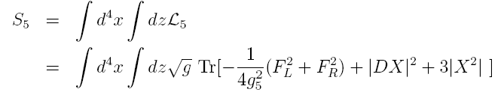

Hard wall model

Slide 13
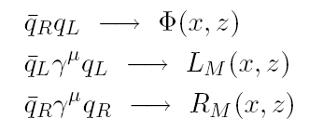
5D field contents
Operator → 5D bulk field
[Operator] → 5D mass

Slide 14
5D Symmetry
Current conservation → gauge symmetry
SU(2)_{L}XSU(2)_{R} gauge symmetry in AdS₅
Background: AdS₅

Slide 15
Chiral condensate?
Klebanov and Witten, 1999

Slide 16









Confinement
Polchinski & Strassler, 2000
Confinement → IR cutoff in 5th direction

Slide 17
Hard wall model
V~ L+R
A~ L-R

Slide 19
A holographic model for quark-gluon hybrid mesons

Slide 20
A holographic model for mixed condensate
Hyun-Chul Kim and YK, JHEP 0810:011,2008

Slide 23
A holographic model for pi₁ (1400)
Hyun-Chul Kim and YK, arXiv:0811.0645 [hep-ph]

Slide 24
Vector-vector correlator

Slide 26


Decay constant

Slide 27
Summary
Experiments are discovering (candidates of) exotic mesons.
Quark-gluon mixed condensate is encoded in the hard wall model
Predicted mass and decay constant of Pi₁(1400) are reasonable.
What about charmed tetra-quark mesons in hQCD? ~ 4.83 GeV for a vector state
[Kyung-il Kim, YK, S. H. Lee, in progress].

