Slide 1

Instanton vacuum
at finite density
Hyun-Chul Kim
Department of Physics
Inha University
S.i.N. and H.-Ch.Kim, Phys. Rev. D 77, 090014 (2008)
S.i.N., H.Y.Ryu, M.Musakhanov and H.-Ch.Kim, arXiv:0804.0056 [hep-ph]
S.i.N. and H.-Ch.Kim, Phys. Lett. B 666, 324 (2008)
Pohang Meeting, 14.11.08-16.11.08

Slide 2
Introduction
QCD, the underlying theory for the strong interaction.
Difficulties in QCD in the low energy region: Nonperturbative feature
Developing models guided by symmetries
Spontaneous Breakdown of Chiral Symmetry
Chiral bag, NJL, Skyrmion, HLS etc…
But… what is the origin of this interesting phenomena?
Highly nontrivial QCD vacuum
It also effects on QCD phase structure, represented by <qq>, <qq>,…
Investigations on the vacuum itself: Instanton, dyon, caloron, etc.
Pohang Meeting, 14.11.08-16.11.08

Slide 3



Instanton
Classical ground state solution of the QCD in Euclidean space
QED (solid-state physics): electron & phonon vs. QCD : quark & instanton
Minimizing the YM action: Self-dual condition
(Singular gauge) instanton solution
Nonperturbative part of gluons replaced by instantons
(Anti)quarks moving around this effective potential-like ensemble
So called, quark zero-mode solution.
‘t Hooft symbol
Pohang Meeting, 14.11.08-16.11.08
Instanton size ~ 1/3 fm

Slide 4


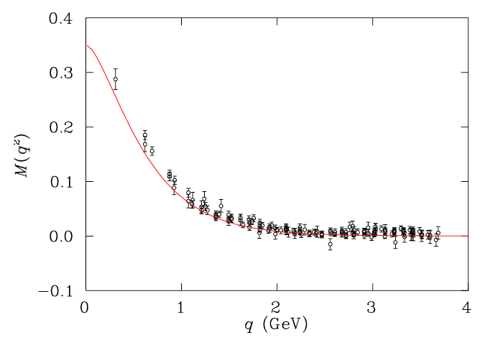
Instanton
Quark propagator in the instanton effects
Momentum-dependent quark mass via Fourier transformation of Φ
Playing a role of a natural UV regulator in the framework
Ex) Non-zero chiral condensate, ⟨qq⟩ ≠ 0 → SBCS
Fourier transform
of the zero-mode solution
Pohang Meeting, 14.11.08-16.11.08
Lattice data via
Extrapolation to the chiral limit
(Improved staggered fermion)
P.Bowman et al.,hep-lat/0209129

Slide 5
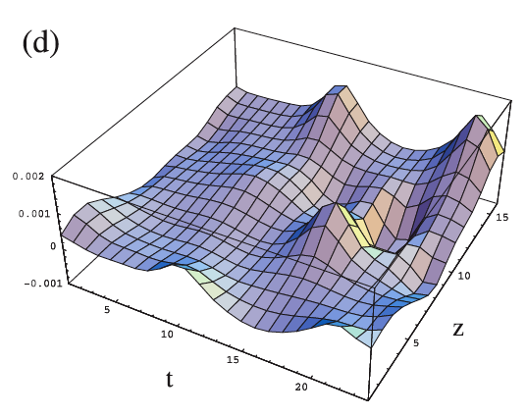
Instanton
Merits of the instanton framework
· Preserving all relevant QCD symmetries
· U(1)_{A} included via nonzero topological susceptibility
· Natural scale parameter: average instanton size & inter-distance
· No adjustable free parameters (at least for light quarks in leading Nc)
· Natural UV regulator: M(k)
· Nonlocal interaction between quarks
· Natural derivations of (almost) NJL and Skyrme mode
But No confinement
What is the instanton distribution? (δ-function)
Pohang Meeting, 14.11.08-16.11.08
Instanton fluctuation at zero-point
(topological charge density)
M.-C.Chu et al.,PRD49,6039(1994)

Slide 6
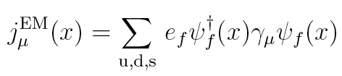

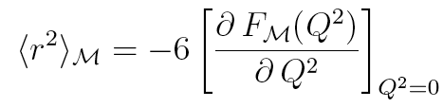
S.i.N. and H.Ch.Kim, PRD77, 090014 (2008)
Pion Electromagnetic form factor
Pion Electromagnetic (EM) matrix element
EM current
Normalization conditions corresponding to the Ward-Takahashi identity
EM charge radius
Pohang Meeting, 14.11.08-16.11.08

Slide 7



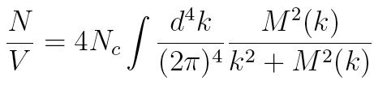
Pion electromagnetic form factor
Effective chiral action modified by external EM source
Momentum-dependent quark mass and covariant derivative
Parameterized instanton form factor, Λ~ 600 MeV ~ 1/ρ
M0 via the saddle-point equation
Pohang Meeting, 14.11.08-16.11.08

Slide 8
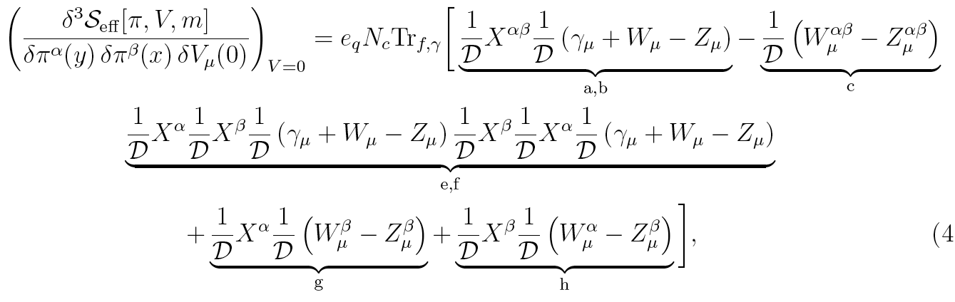
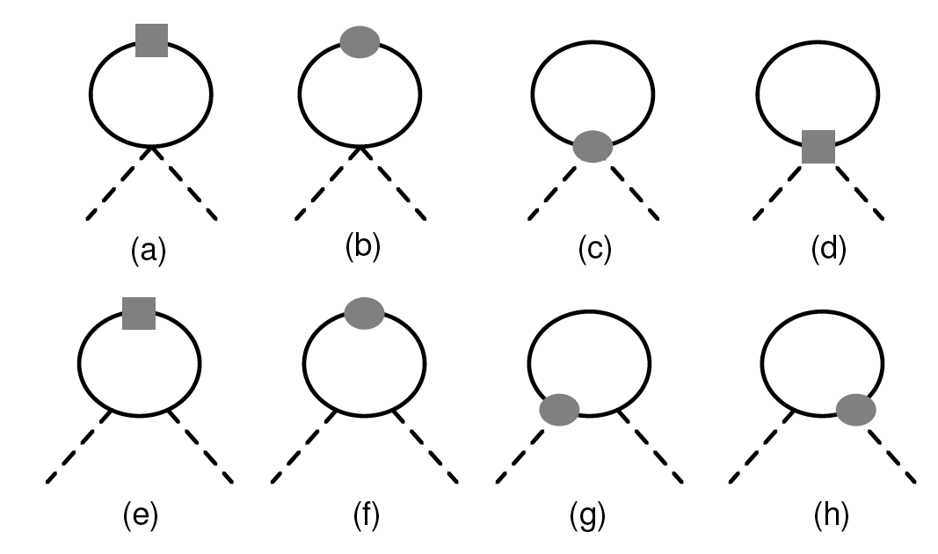



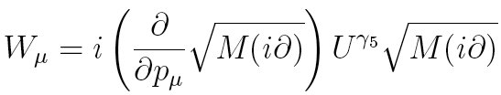

Pion electromagnetic form factor
Mesonic matrix element
Pohang Meeting, 14.11.08-16.11.08
Nonlocal interaction
Local interaction

Slide 9
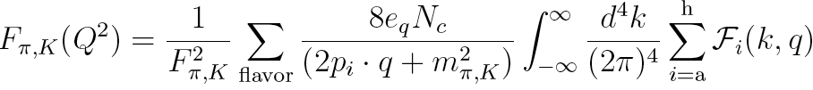
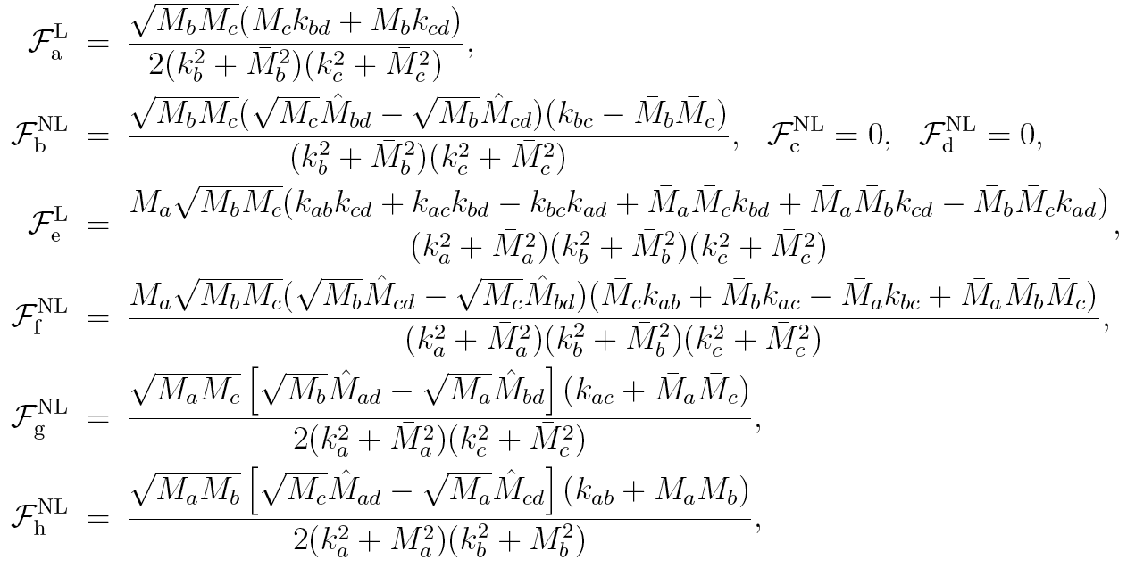
Pion electromagnetic form factor
Analytic expression for the pion EM FF via NχQM
Pohang Meeting, 14.11.08-16.11.08

Slide 10
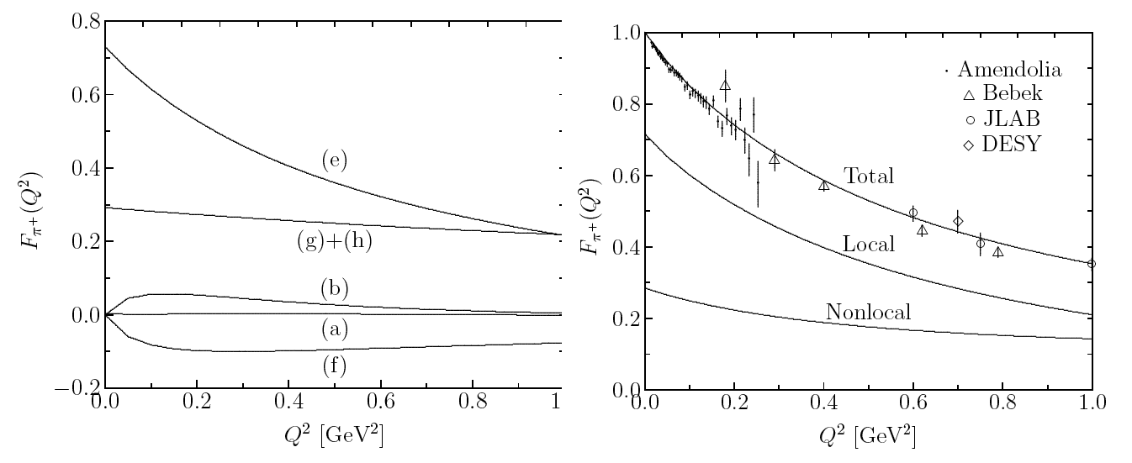
YITP, Kyoto University
Pion electromagnetic form factor
Pohang Meeting, 14.11.08-16.11.08
Charge Radius
Shape & strength

Slide 11
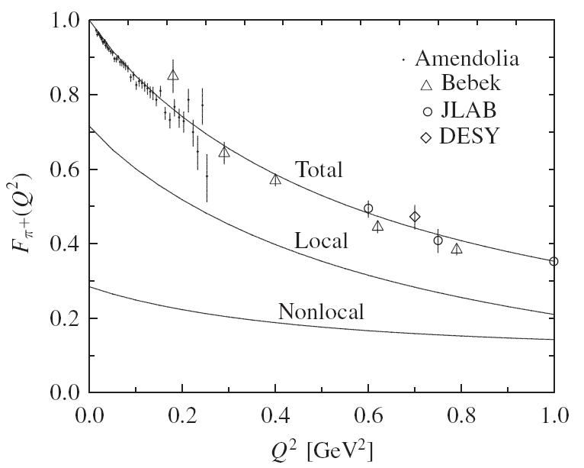
YITP, Kyoto University
Pohang Meeting, 14.11.08-16.11.08
Pion electromagnetic form factor

Slide 12
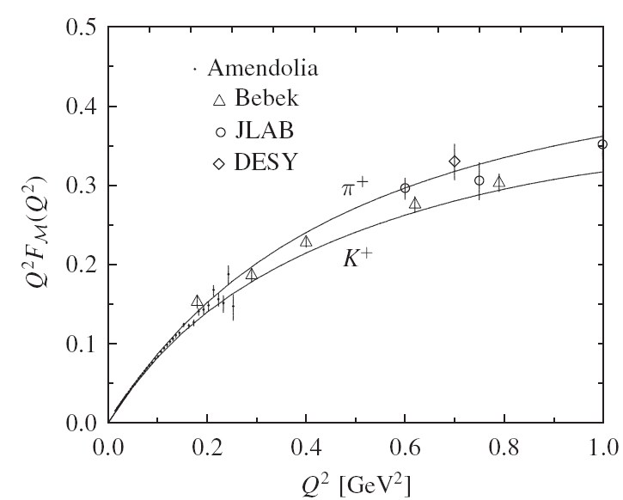
YITP, Kyoto University
Pohang Meeting, 14.11.08-16.11.08
Pion electromagnetic form factor

Slide 13
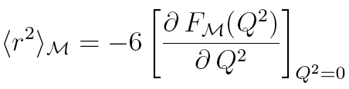
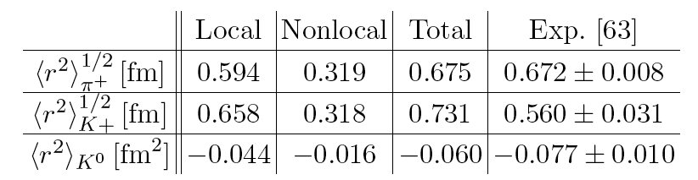
YITP, Kyoto University
Pion electromagnetic form factor
Pion and kaon EM charge radii
Good agreement for the pion without explicit ρ-meson d.o.f.
Considerable disagreements for the kaon FFs?
Improper normalization in the model: smaller F_{K} ~ 108 MeV
Meson-loop corrections necessary?
Pohang Meeting, 14.11.08-16.11.08
A.E.Dorokhov,PRD70,094011 (2004)
S.i.N. and H.Ch.Kim, PRD75, 094011 (2007)

Slide 14

Instanton at finite quark chemical potential (μ)
Considerable successes in the application of the instanton
Extension of the instanton model to a system at finite ρ and T
QCD phase structure: nontrivial QCD vacuum: instanton
At finite density
· Simple extension to the quark matter:
· Breakdown of the Lorentz invariance
At finite temperature (future work!!)
· Instanton at finite temperature: Caloron with Polyakov line
· Very phenomenological approach such as the pNJL
· Using periodic conditions (Matsubara sum)
Focus on the basic QCD properties at finite quark-chemical potential, μ
Pohang Meeting, 14.11.08-16.11.08

Slide 15


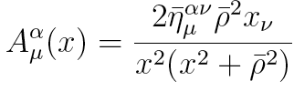


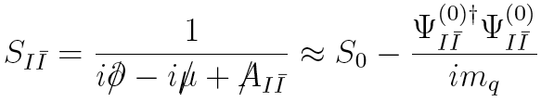
Instanton at finite μ
Modified Dirac equation with m
Instanton solution (singular gauge)
Low-energy dominated by zero-mode
Quark propagator with m
Assumption:
No modification from μ
Pohang Meeting, 14.11.08-16.11.08

Slide 16
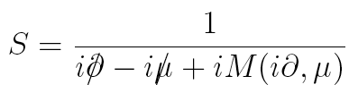

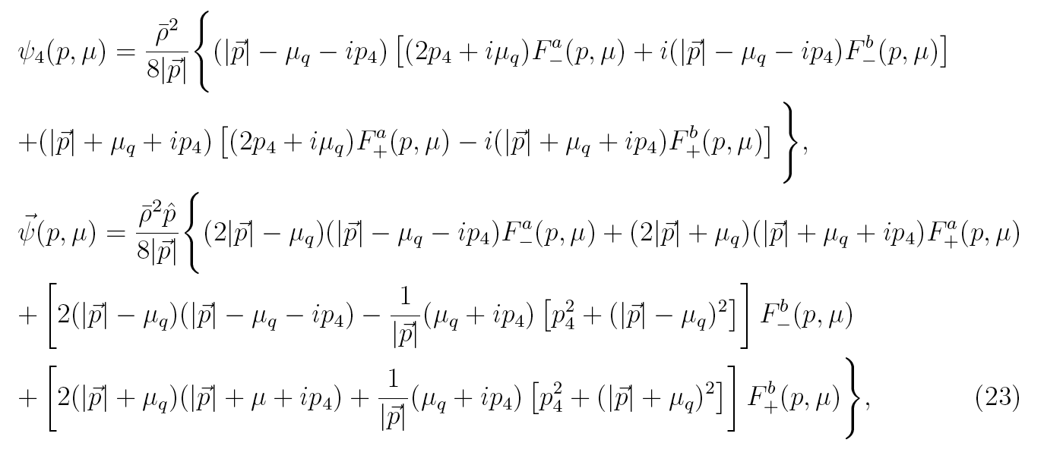
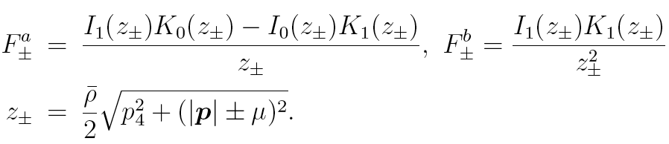
Instantons at finite μ
Quark propagator with the Fourier transformed zero-mode solution,
Pohang Meeting, 14.11.08-16.11.08

Slide 17
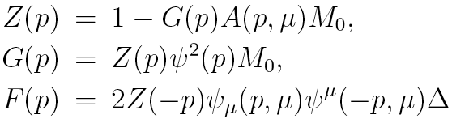
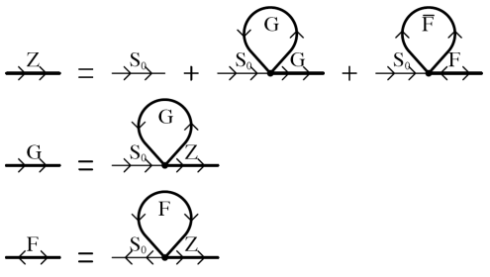
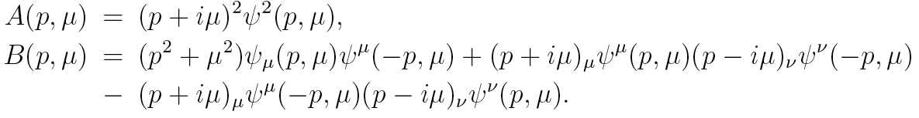
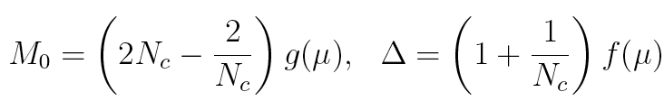
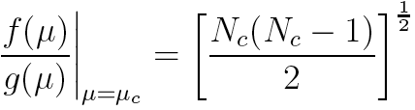
Schwinger-Dyson-Gorkov equation (N_{f}=2, N_{c}=3)
G.W.Carter and D.Diakonov,PRD60,016004 (1999)
Pohang Meeting, 14.11.08-16.11.08

Slide 18
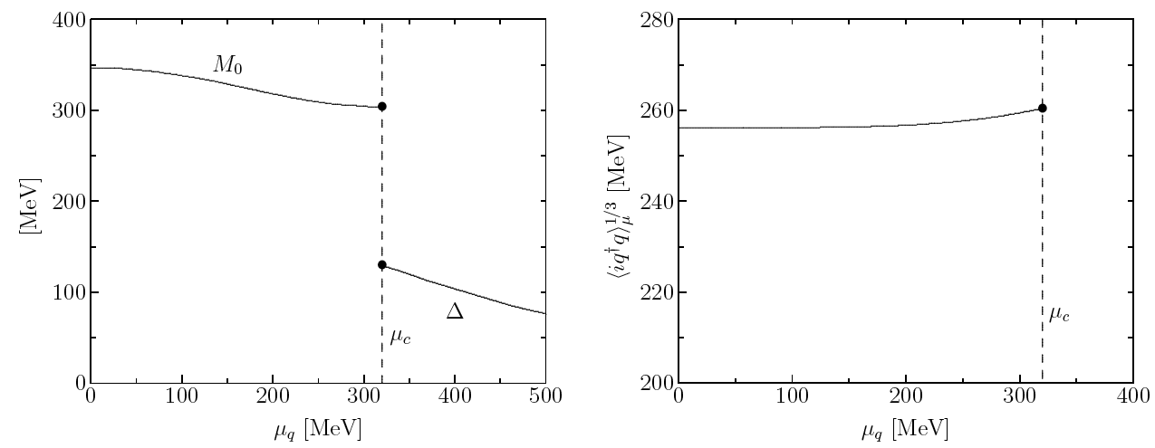
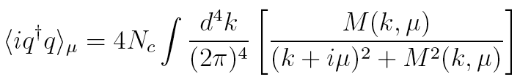
M₀, Δ, and <iq⁺q> (N_{f}=2)
1st order phase transition occurred at μ ~ 320 MeV
Metastable state (mixing of σ and Δ) ignored for simplicity here
Chiral condensate with μ
NG
phase
CSC
phase
CSC
phase
NG
phase
Pohang Meeting, 14.11.08-16.11.08

Slide 19

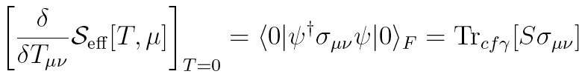
S.i.N. H.Y.Ryu, M.Musakhanov and H.Ch.Kim, arXiv:0804.0056 [hep-ph]
Magnetic susceptibility at finite μ
QCD magnetic susceptibility with externally induced EM field
Magnetic phase transition of the QCD vacuum
Effective chiral action with tensor source field T
Evaluation of the matrix element
Only for the NG phase!!
Pohang Meeting, 14.11.08-16.11.08

Slide 20
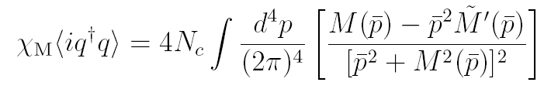
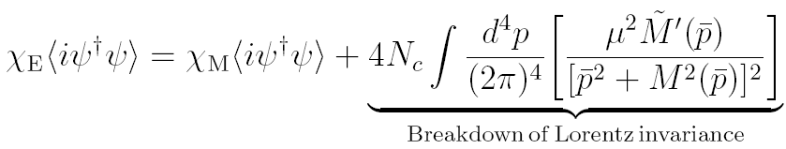
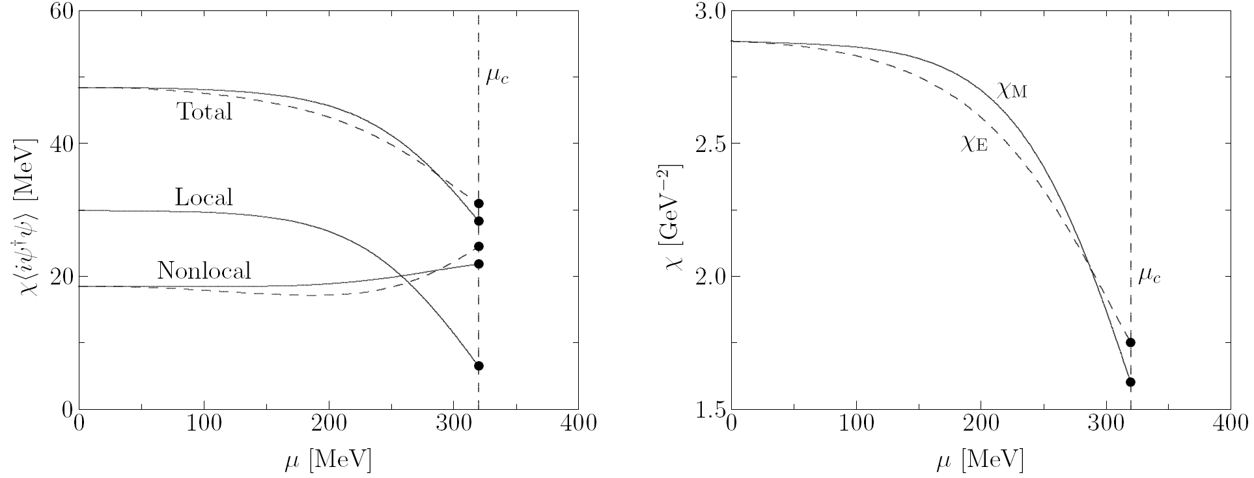
Magnetic susceptibility at finite μ
Pohang Meeting, 14.11.08-16.11.08
NG
phase
CSC
phase
CSC
phase
Magnetic
phase transition
NG
phase
1st order magnetic phase transition at μ_{c}

Slide 21


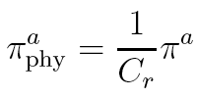
S.i.N. and H.Ch.Kim, arXiv:0805.0060 [hep-ph], accepted for publicaion in PLB
Pion weak decay constant at finite μ
Pion-to-vacuum transition matrix element
Separation for the time and space components
Effective chiral action with μ
Renormalized auxiliary pion field corresponding to the physical one
Pohang Meeting, 14.11.08-16.11.08

Slide 22
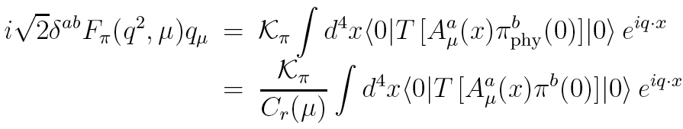
Pion weak decay constant at finite μ
Effective chiral action with axial-vector source
Using the LSZ (Lehmann-Symanzik-Zimmermann) reduction formula
Pohang Meeting, 14.11.08-16.11.08

Slide 23
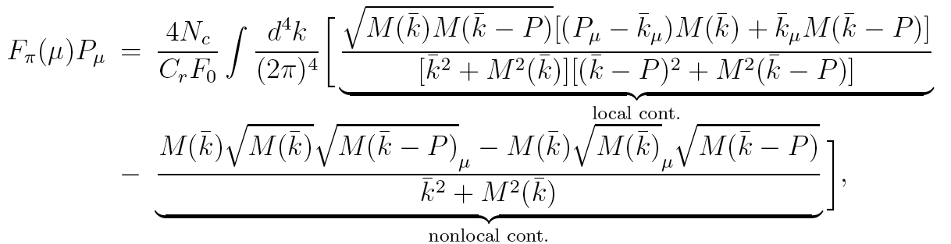

Pion weak decay constant at finite μ
Analytic expression for the pion weak decay constant
Pohang Meeting, 14.11.08-16.11.08

Slide 24
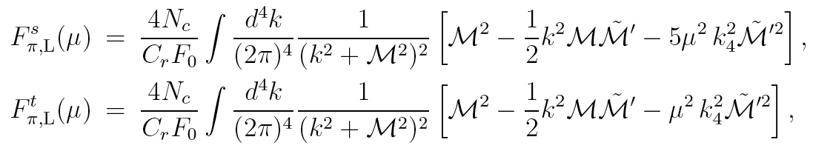
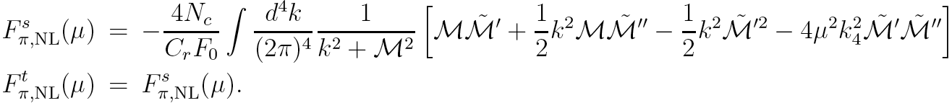
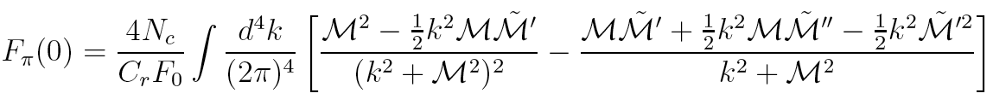
Pion weak decay constant at finite μ
Local contributions
Nonlocal contributions
When the density switched off,
Pohang Meeting, 14.11.08-16.11.08

Slide 25
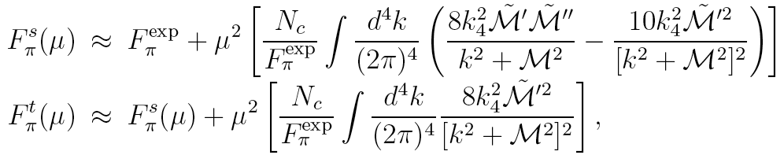
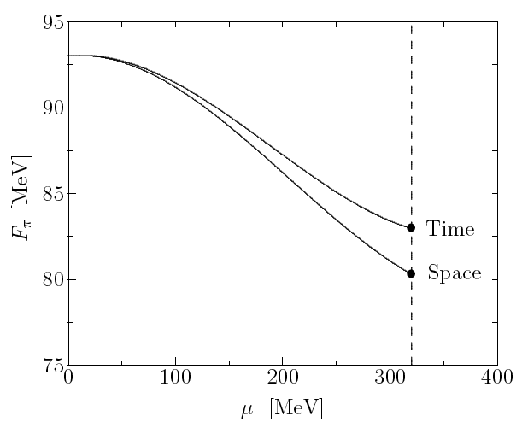
Pion weak decay constant at finite μ
Time component > Space component
Pohang Meeting, 14.11.08-16.11.08
CSC
phase
NG
phase

Slide 26
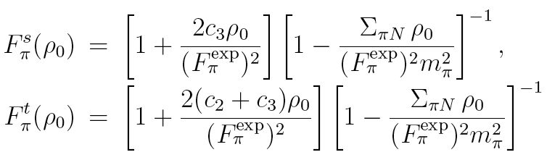

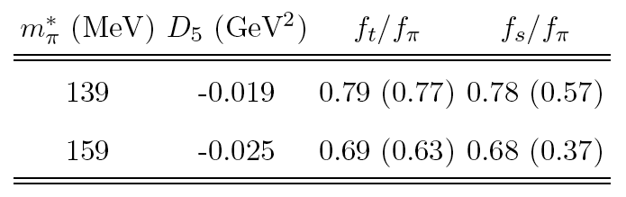
Pion weak decay constant at finite μ
Comparison with the in-medium ChPT
Comparison with the QCD sumrule
K.Kirchbach and A.Wirzba, NPA616, 648 (1997)
F ^{s} / F ^{t} < 0.5
Critical p-wave contribution
Pohang Meeting, 14.11.08-16.11.08
H.c.Kim and M.Oka, NPA720, 386 (2003)

Slide 27
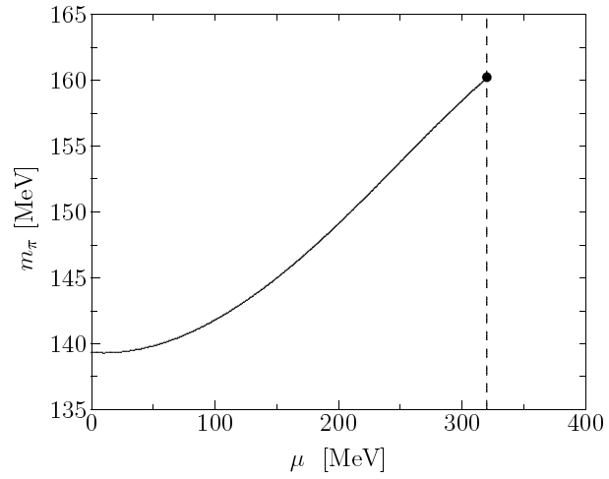

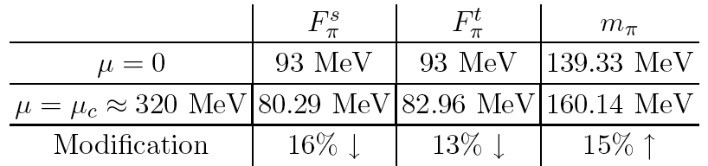
Pion weak decay constant at finite μ
Changes of the pion properties with μ
GOR relation satisfied
within the present framework
NG
phase
CSC
phase
Pohang Meeting, 14.11.08-16.11.08

Slide 28
Summary and Conclusion
Instanton with finite μ applied to following problems
· Pion EM FF for free space as an example
· QCD magnetic susceptibility: 1st-order magnetic phase transition
· Pion weak decay constant at finite density: p-wave contribution?
Perspectives
Systematic studies for nonperturbative hadron properties with μ
Several works (effective chiral Lagrangian, LEC..) under progress
Extension to the finite T (Dyon with nontrivial holonomy, Caloron)
Pohang Meeting, 14.11.08-16.11.08

Slide 29
Thank you very much
for your attention!!
Pohang Meeting, 14.11.08-16.11.08

