Slide 1
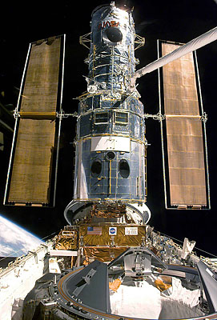
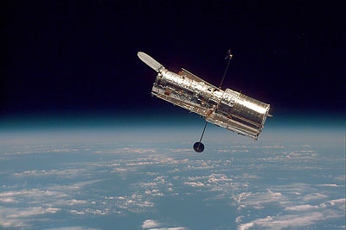
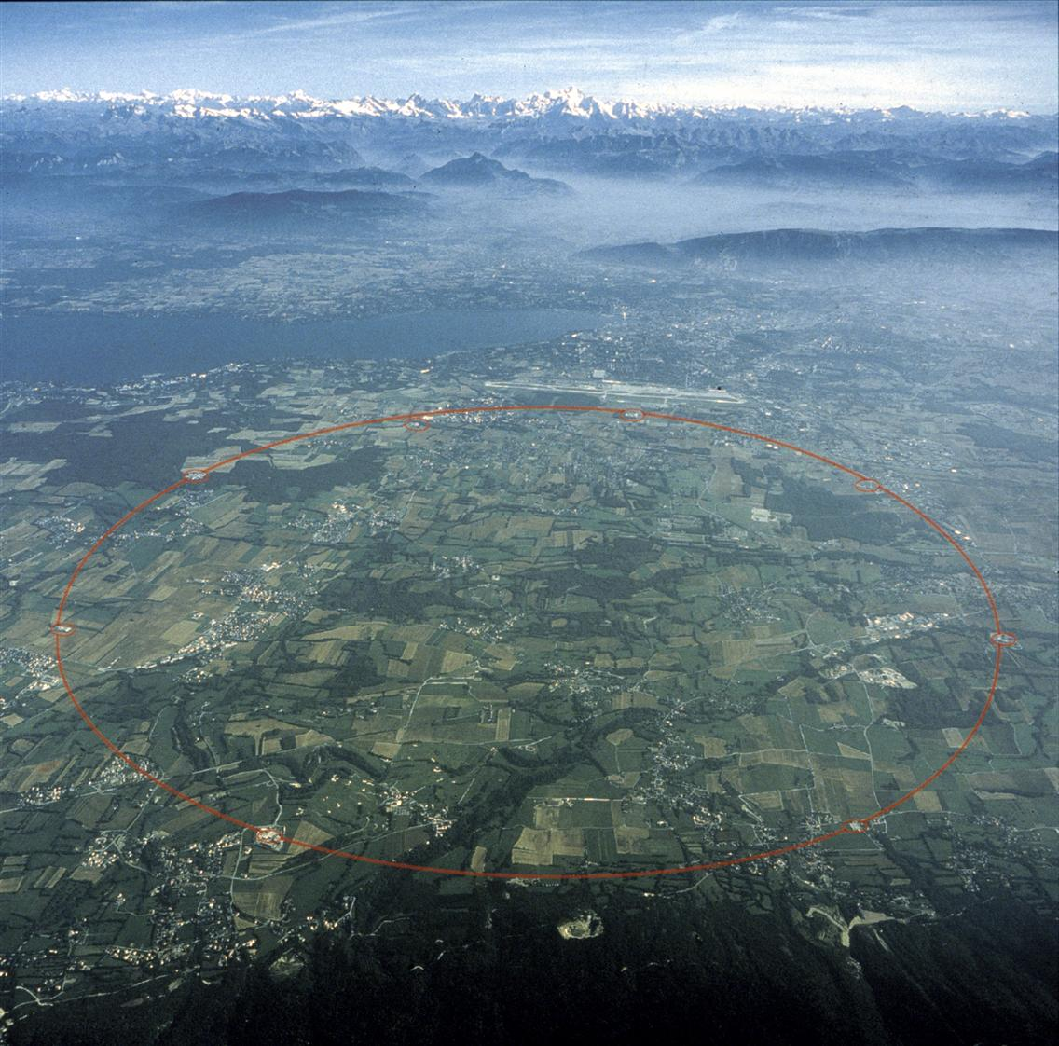
The structure of neutron star by using the quark-meson coupling model
Heavy Ion Meeting (2008. 11. 14)
C. Y. Ryu
Soongsil University, Korea
Notes:
I would like to talk about the structure of neutron star by using the quark-meson coupling model.
My name is C.Y.Ryu and he is my collaborator, M.K. Cheoun.
I am working in Soongsil university in Korea.

Slide 2
Outline
1. Introduction and motivation
- Structure of neutron star
- Mass and radius relation
- The observed masses of neutrons star
- Motivation
2. Theory
- Quark-meson coupling model (dense matter)
- Exotic phases
: hyperons, kaon condensation
- Finite temperature
3. Results
4. Summary
Notes:
This is my outline. First I will introduce the structure of neutron star
And explain my motivation from observed masses and the experiment for kaon deeply bound state.
We use the quark-meson coupling model to calculate the neutron star with exotic phases such as hyperons and kaon condensation. After that, I will show you the results and the summary is followed.

Slide 3
Introduction
and
motivation

Slide 4
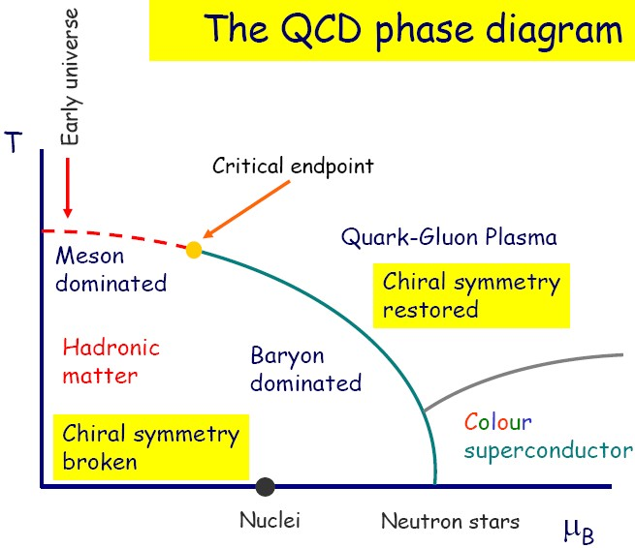

Slide 5
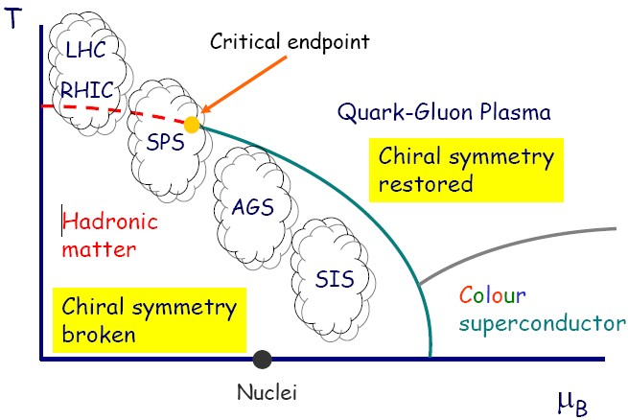
Hot and dense matter I
- Heavy ion collision

Slide 6
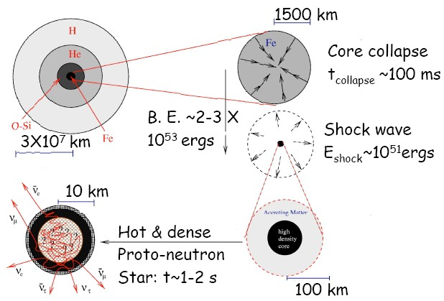
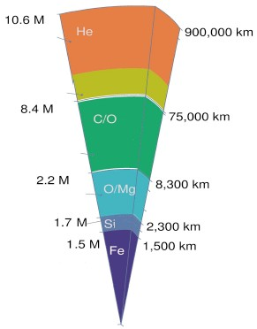
Hot and dense matter II
- Proto-neutron star
The structure of supernovae
The production of proto-neutron star

Slide 7
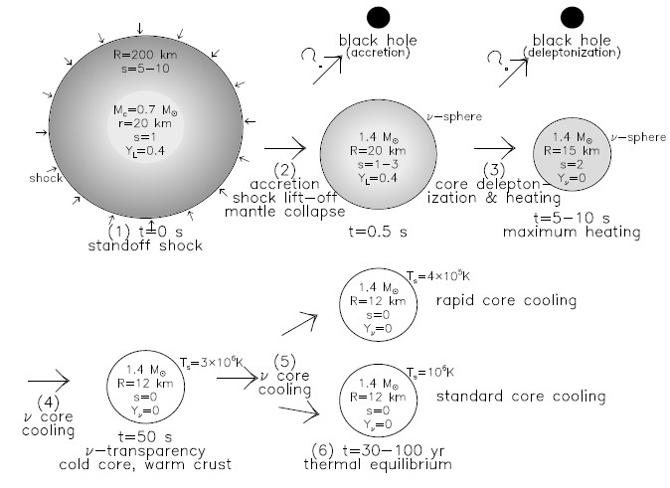
The production of neutron star
Notes:
A supernovae has the shell structure like this. The iron core collapses, causing shock waves, and then a neutron star is produced after cooling process by deleptonization.

Slide 8
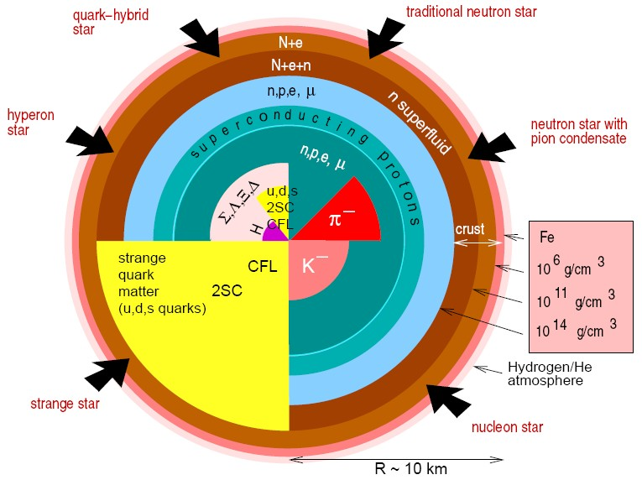
The structure of neutron star
Notes:
The produced neutron star can have the various exotic phases such as hyperons, meson condensation and quark matter. In this work, I will focus on hyperons and kaon condensation.

Slide 9
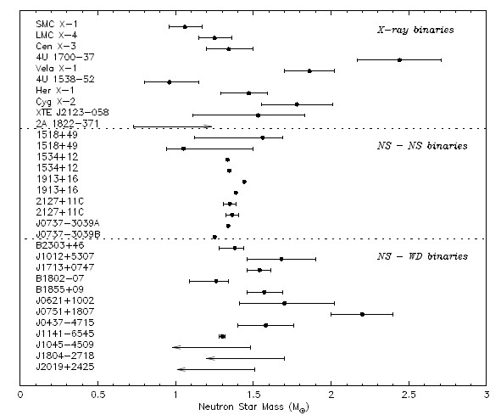
The observed masses
Maybe, blackhole
A. Van der Meer et al.,
astro-ph:0707.280201(2007)
Best fit : 1.35 M⊙
Recent observations :
large masses
Notes:
Let’s see the observed neutron star. This is summarized in 2007. The important points are that first the best fit is 1.35 times solar mass and the other is the recent data show the large masses. However, this may be blackhole and this point goes down around here. So, the data still show small masses.

Slide 10
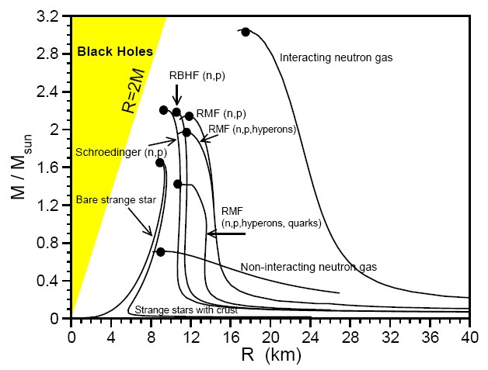
Motivation I
1) No strangeness : 2-3 M๏
2) Strangeness : 1-2 M๏
- hyperons(Λ, Σ, Ξ)
- kaon condensation
- quark matter(u, d, s)
Notes:
Thus, our first motivation is strangeness. Various models, especially, RMF model indicates the result without strangeness gives above 2 times solar mass, while that with strangeness gives low masses around 1.5 solar mass.

Slide 11
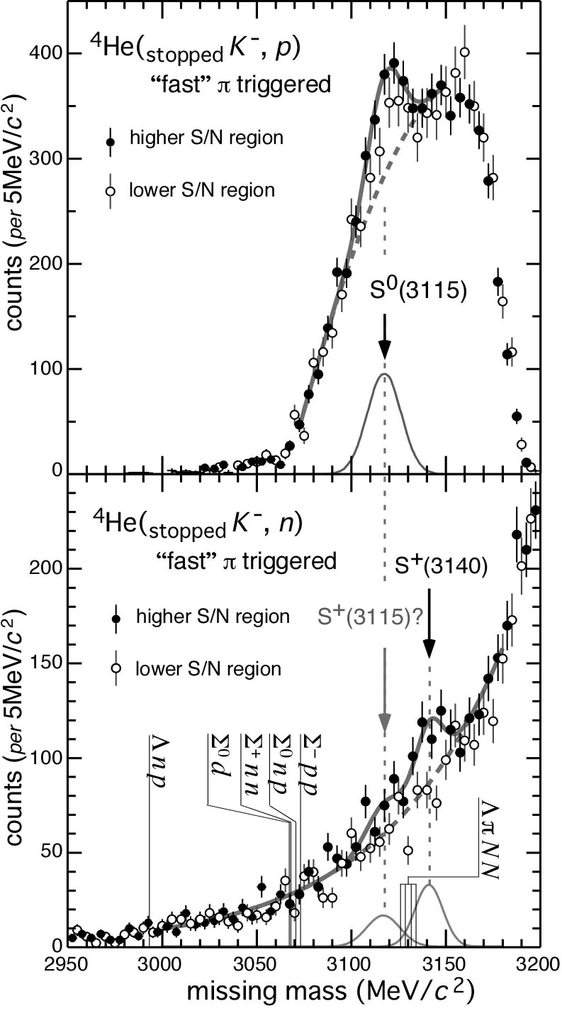
Motivation II
- Deeply bound kaonic nuclear states
Ramos & E. Oset, Nucl. Phys. A671 (2000)
V. K. Magas, E.Oset, A.Ramos, H.Toki, nucl-th/0611098
Chirally-motivated potentials
Shallow optical potential
V₀ ≈ -50 MeV
Deep optical potential
V₀ ≈ -120 MeV
Y. Akaishi & T. Yamazaki, PRC65 (2002)
N. Kaiser, P.B. Siegel & W. Weise, NPA594 (1995)
J. Mares, E.Friedman and A. Gal,Nucl.Phys.A770 (2006)
KEK PS-E471 (2004)
Notes:
Next, the second motivation is kaon condensation considered by deeply bound state of antikaons. This figure show us the K- pp bound state. Now, there is still competition between shallow potential and deep potential of antikaon in medium. In last KPS meeting, I heard the FINUDA confirmed this bound state. I assume theat the interaction bewteen antikaon and nucleons are very strong.

Slide 12
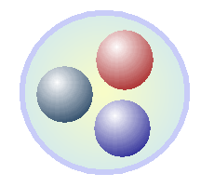
Motivation III
Model dependency
- Haron degree of freedom :
Quantum Hadrodynamics (QHD)
- Quark degree of freedom :
Quark-meson coupling model (QMC) model
σ, ω
σ, ω
Notes:
The last motivation is model dependency about how to treat baryons. In this work, we use the quark-meson coupling model. In the model, all baryons are regarded as MIT bags in which quarks interact with each other exchanging the sigma and omega mesons. So, we compare the results from both models.

Slide 13
2. Theory

Slide 14
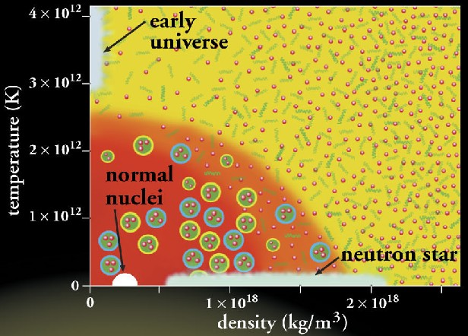
Quark-meson coupling model
- MIT bag + mean fields
Quark-meson coupling
(QMC) model
MIT bag + σ, ω mesons
σ, ω
Neutron star
Notes:
Let’s me introduce the quark-meson coupling model shortly called QMC model. As mentioned before, all baryons are treated as MIT bags, while the sigma and omega meson fields are regarded as point-like particles, describing the attraction and repulsion, respectively.

Slide 15

The QMC model at saturation
Infinite, static and uniform matter
The properties of nuclear matter
Saturation density ρ₀ = 0.17 fm⁻³
Binding energy B/A = ε/ρ – m _{N} = 16 MeV
Effective mass of a nucleon m _{N}*/m _{N} = 0.7 - 0.8 (0.78)
Compression modulus K⁻¹ = 200 - 300 MeV
Symmetric energy a_{sym}= 32.5 MeV
3) The Lagrangian of QMC model for infinite nuclear matter
Notes:
With the model, we can reproduce the satuation point very well. In order to describe neutron star, first we have to consider the infinite nuclear matter, so that all coupling constants are fiited to reproduce saturation point.

Slide 16
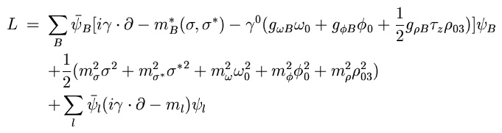
QMC model for hyperonic matter
Lagrangian density for baryon octet and leptons
σ–ω–ρ(only u(d) quark)
+ σ*(980) –φ(1050) (only s quark)
Baryon octet : p, n, Λ, Σ⁺, Σ⁰, Σ⁻, Ξ⁰, Ξ⁻, lepton : e, μ
Notes:
The model can be extended to include hyperons, also treating hyperons as MIT bags. To describe the interaction between hyperons, namely s-quarks, sigma star and phi mesons are considered. In this model, sigma, omega and rho mesons interact with just u and d quarks, while sigma star and phi mesons do only s-quark.

Slide 17

Naive picture of K⁻ potential
u
u
OZI rule : s-quark does not interact with u and d quarks
σ, ω
S
d
u
d
u
u
2) Antiparticle may feel
very strong attraction.
p
K⁻
p
3) Potential of particle
Scalar (attractive)+ Vector (repulsive)
4) Potential of antiparticle – strong attraction
Scalar (attractive)+ Vector (attractive)
Notes:
Let’s consider the naïve picture of antikaon potential. In QMC picture,

Slide 18
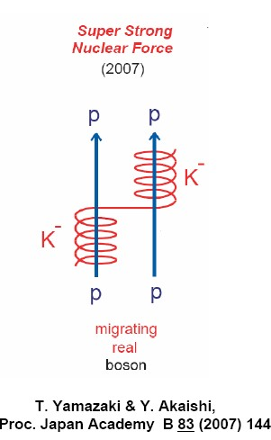
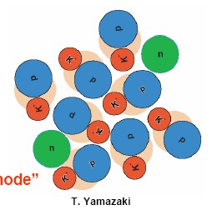
Strong force of K⁻ N and kaon condensation
Kaon condensation in medium
K⁻ pp system

Slide 19


The RMF for kaon and antikaon
Lagrangian density for baryon octet and leptons
Langrangian density for kaon
The potential of K⁻ : U_{K-} = - gσ – g ω₀

Slide 20
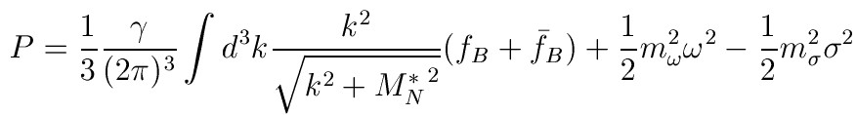
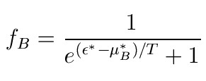
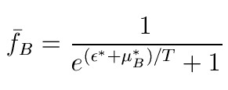
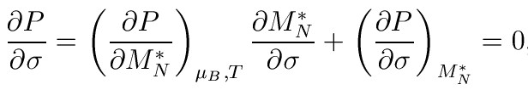
The QMC model at finite temperature
Thermodynamic grand potential :
Ω = ε – TS - μρ
2. Pressure is
Where
3. The condition for equilibrium – minimize Ω or maximize P.

Slide 21

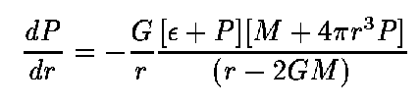
TOV equation
Macroscopic part – General relativity
Microsopic part – QMC model
Einstein field equation :
Static and spherical symmetric neutron star (Schwarzschild metric)
Static perfect fluid
Diag T_{μν} = (ε, p, p, p)
TOV equation :
equation of state (pressure, energy density)

Slide 22






The conditions in neutron star
Baryon number conservation :
Charge neutrality :
chemical equilibrium (Λ, Σ, Ξ)
※ The condition for K⁻ condensation
μ_{K} = μ_{e}

Slide 23
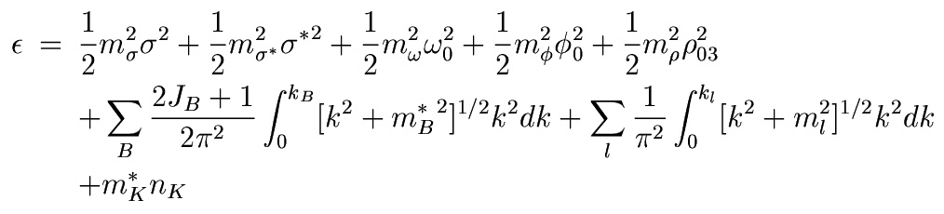
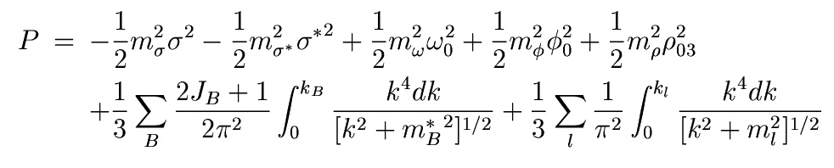
Eq. of state in kaon+hyperonic matter
The energy density :
The pressure :

Slide 24
3. Results

Slide 25
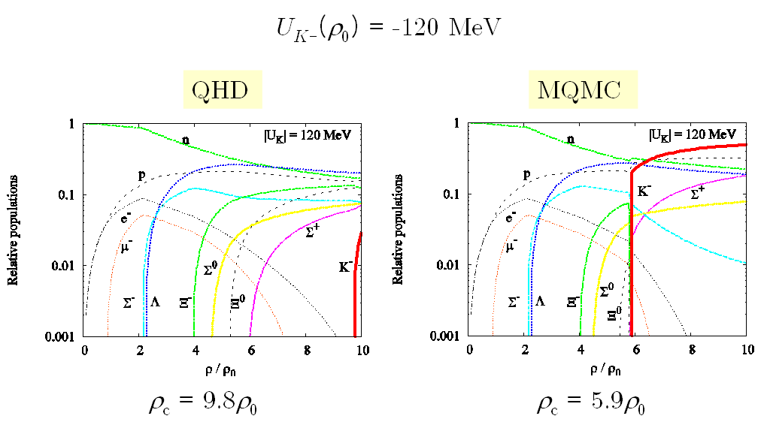
The population of particles
in neutron star

Slide 26
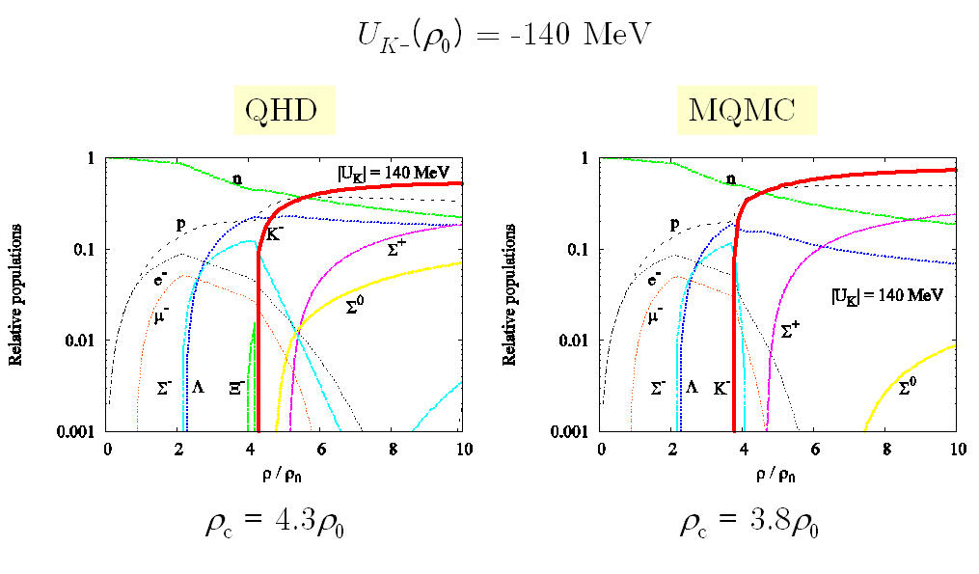
The population of particles
in neutron star

Slide 27
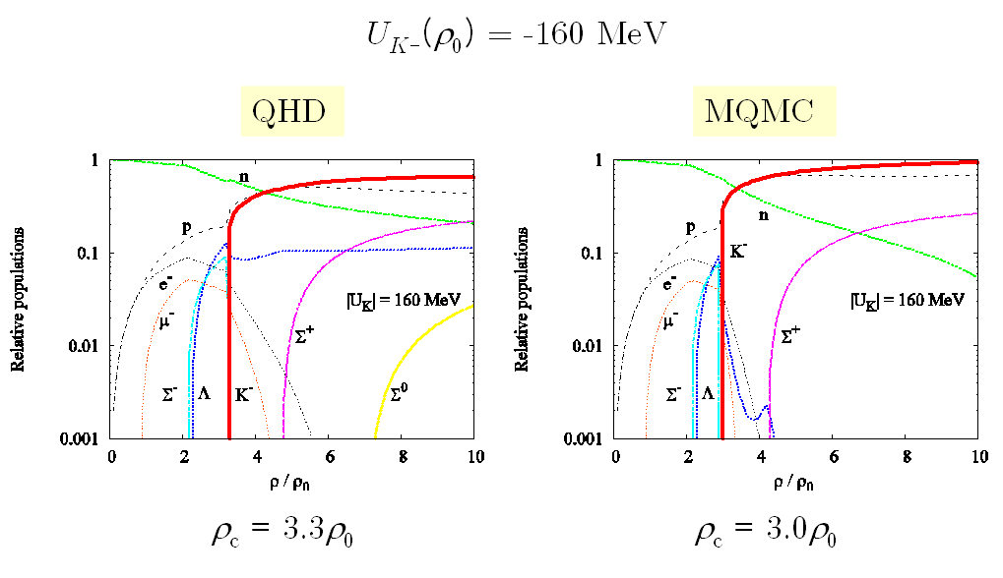
The population of particles
in neutron star

Slide 28
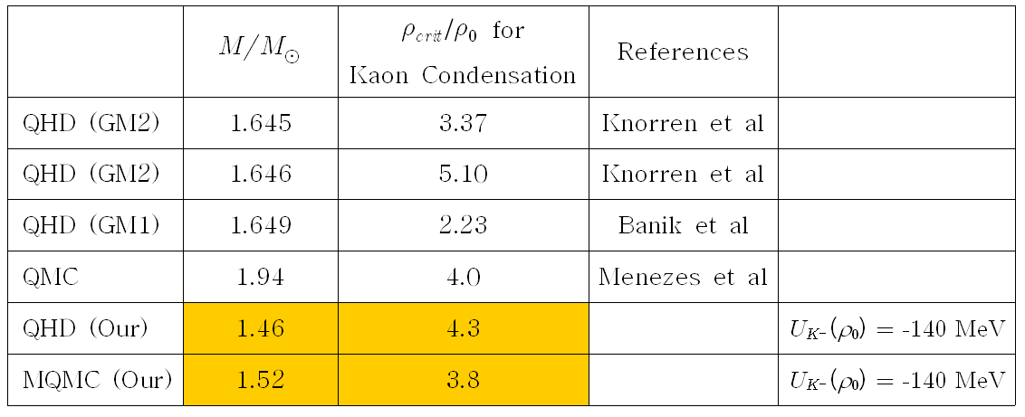
The mass of a neutron star and
kaon condensation

Slide 29
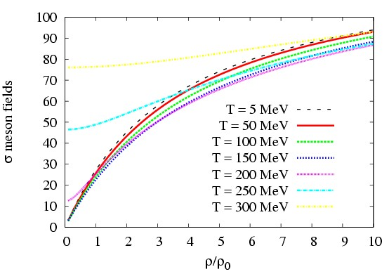
σmeson fields at finite temperature

Slide 30
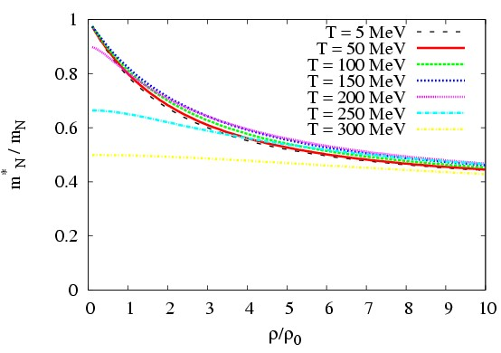
The effective masses of a nucleon at finite temperature

Slide 31
Summaries
Hadronic phases : QHD and QMC models
i) Proto-neutron star – 2.0 solar mass
ii) Hyperons - 1.6-7 Solar mass
iii) Kaon condensation – 1.4-5 solar mass
But, we can see the model dependency in both.
2. All results depend on the coupling constants and the potentials of kaon and baryons.
– Experiment has to confirm them.
3. If the observed mass is larger than 2.0 solar mass, all exotic phases are ruled out(?).
4. Finite temperature – symmetric matter

