Slide 1

Symmetry energy in the era of advanced gravitational wave detectors
Heavy Ion Meeting 20313-05 , Asan Science Hall, Korea University, May 24 2013
Hyun Kyu Lee
Hanyang University

Slide 2
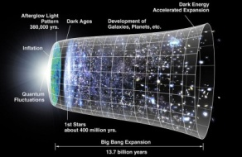
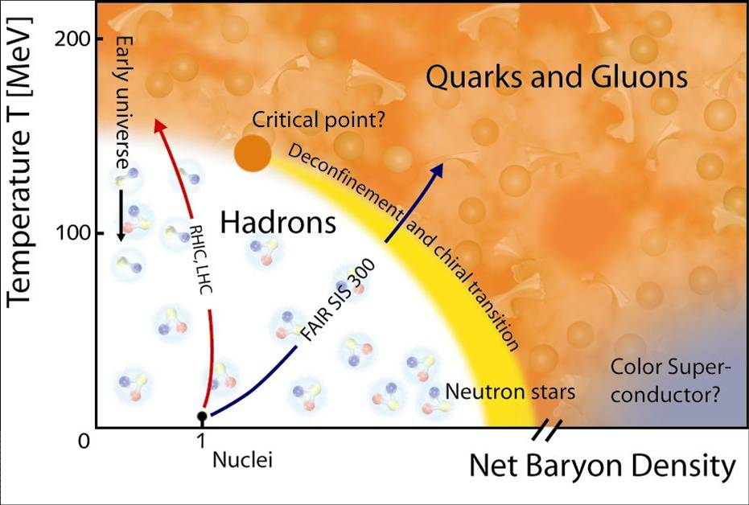
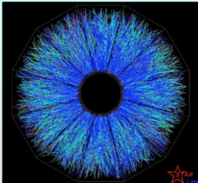
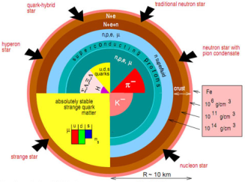
0. Introduction
Temperature frontier
Density frontier
Notes:
High baryon number density beyond n_0, Unexplored area either theoretically or experimentally.
High energy density, or high temperature, field theoretical method,
Lattice calculation, RHIC, LHC, : early Universe

Slide 3
High baryon number density
RIB Machines(FAIR, RAON, ..): n > n_0
Neutron star
1 solar mass inside 10km :
n ~ 10^15g/cm^3 >> n_0
→ Binary coalescence : Gravitational wave

Slide 4
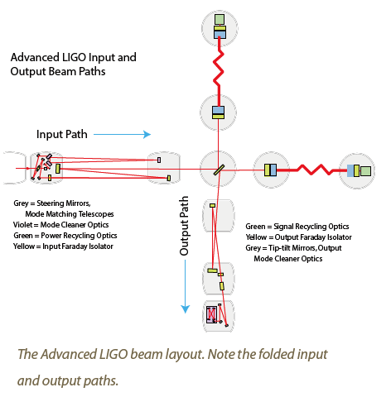
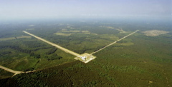
I. Advanced LIGO: 2015 →

Slide 5
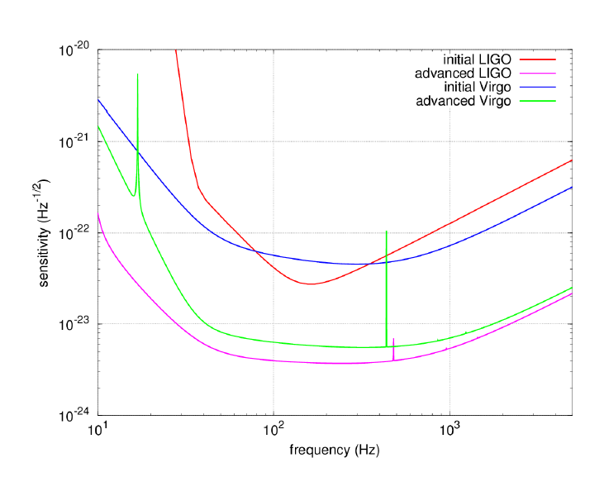
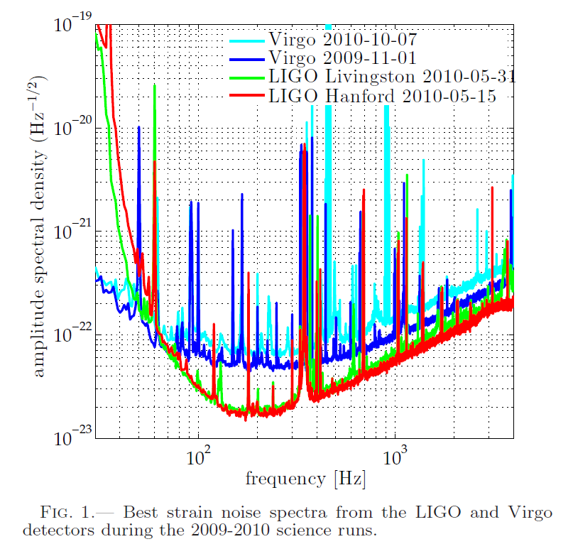
LIGO, 1205.2216
Eric Chassande-Mottin, 1210.7173
Improvement of Sensitivity : 10-times

Slide 6
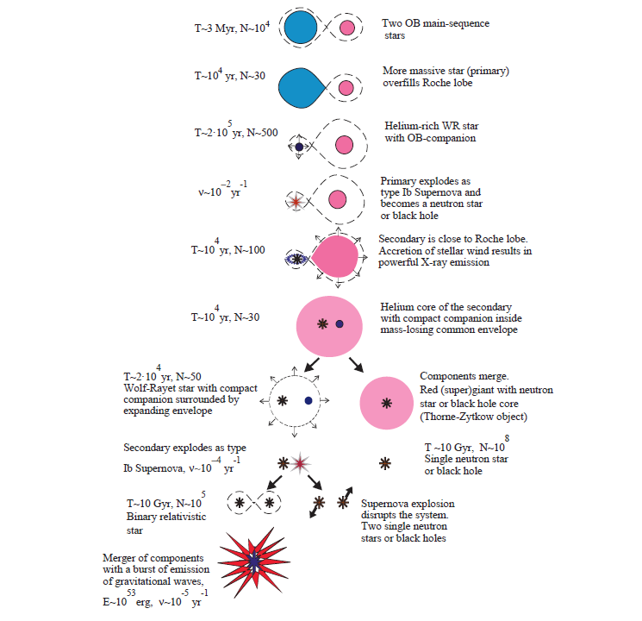
Formation and merging of binary compact stars

Slide 7
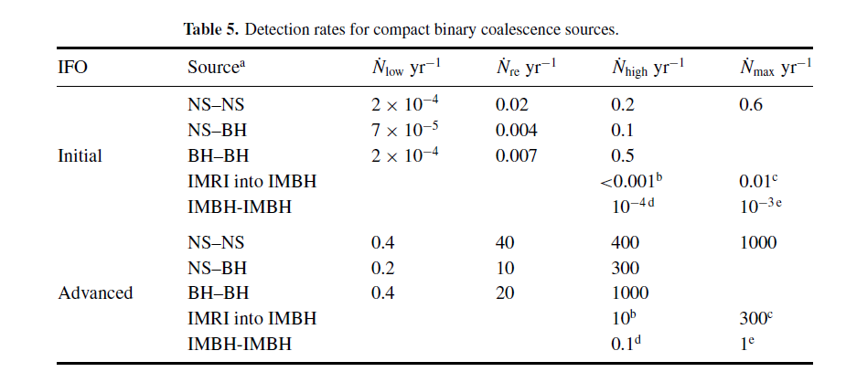
Higher rate of GW detection
NS-NS coalescence : 0.02/yr → 40/yr
J.Abadie, et al. Class. Quantum Grav. 27,173001(2010)
GW amplitude detection: increase of 10 times sensitivity → increase of 10^3 times volume for observation.

Slide 8
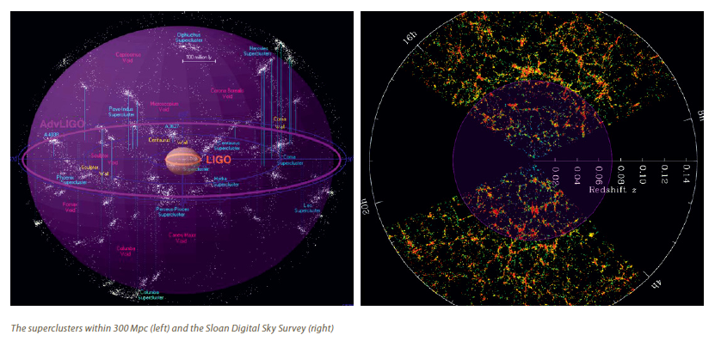

Slide 9
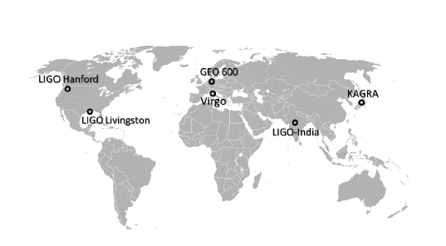
Current and future GW interferometric detectors
Eric Chassande-Mottin, 1210.7173

Slide 10
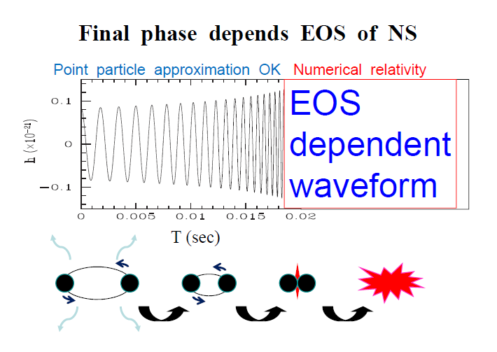
EoS in Binary merger
a. inspiral period: mass
b. coalescing period : EoS (soft or stiff)
Shibata, 2011
Notes:
Thanks to the development of numerical relativity, the wave forms are supposed to have quite
different forms depending on the EoS of compact stars. Black hole has a rather simple EoS
defined by only its mass. However neutron star is rather complicated, radius and mass are very
dependent of EoS in detail.

Slide 11
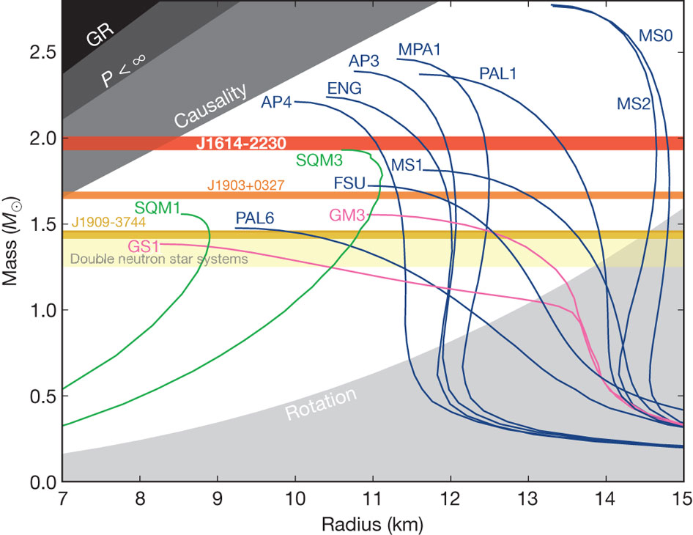
constraint on EoS from NS observations

Slide 12
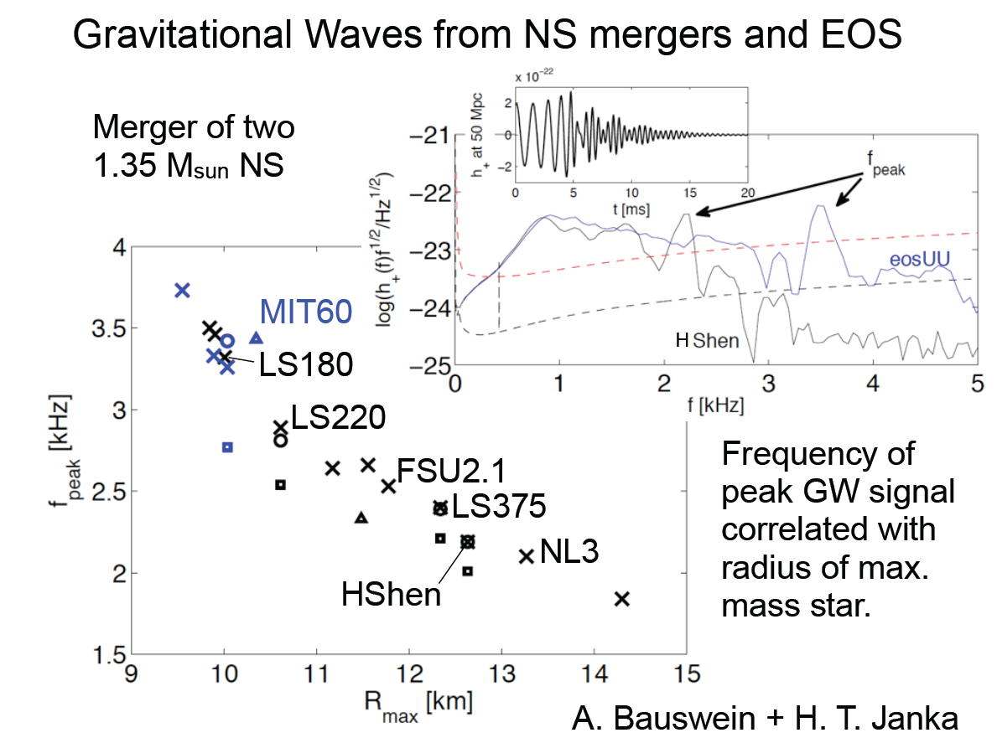
Third Year of APCTP-WCU Focus program April , 2012
C.Horowitz:
Notes:
Some examples of numerical simulations: show clearly different wave forms depending on EoS’s.
Hence GW can provide opportunity to investigate EoS of dense baryonic matter at the
higher density which can not be attained in the laboratory experiment

Slide 13
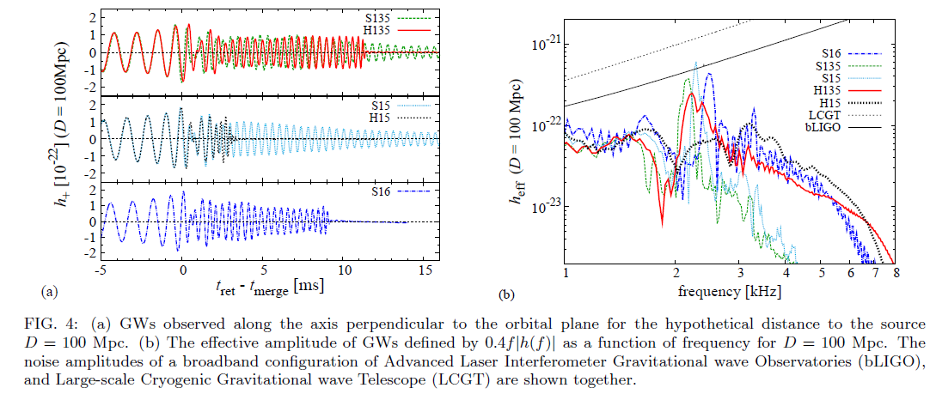
Effect of hyperons
Sekiguchi, Kiuchi, Kyutoku, Schibata PRL 107, 211101(2011)
Notes:
Present observations of neutron
stars mostly give us the information only on the masses of neutron stars not the radii such that it
Cannot fix the relevant EoS. However the above examples indicate that it can probe also the radii
as well as masses. New degre of freedom, interactions,…

Slide 14
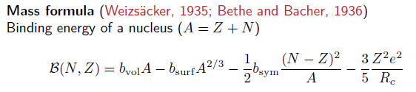

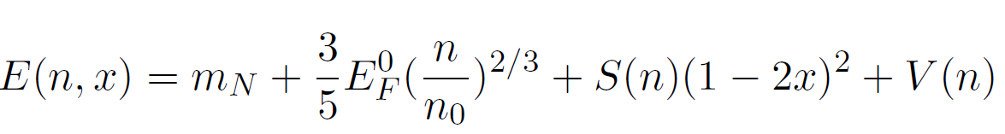
II. Symmetry energy
Nuclei
Nuclear matter
Symmetry energy:
measure of n-p asymmetry in nuclear matter

Slide 15

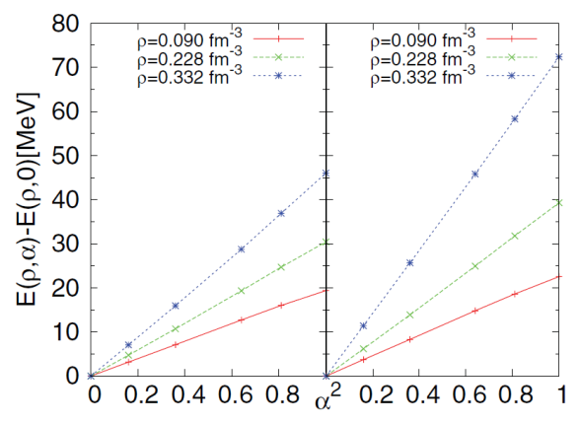

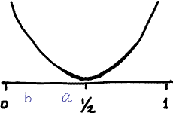
Driving force toward symmetric matter
J.M. Lattimer and M. Prakash, Phys. Rep. (2000),
H.Dong, T.T.S. Kuo, R. Machleitd, PRC 83(2011)

Slide 16
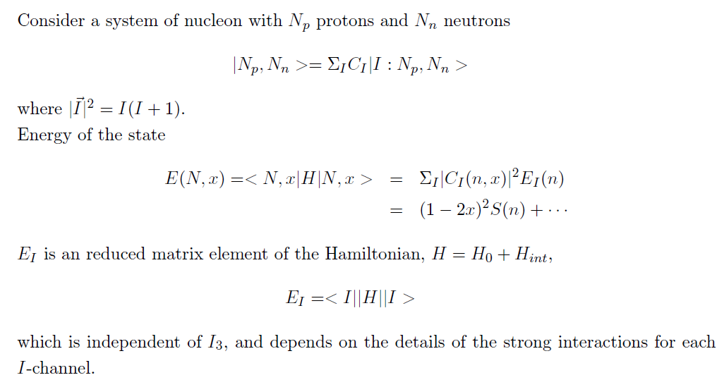
Iso-spin symmetry and symmetry energy
example: SU(2) Casimir operator and Pauli principle

Slide 17
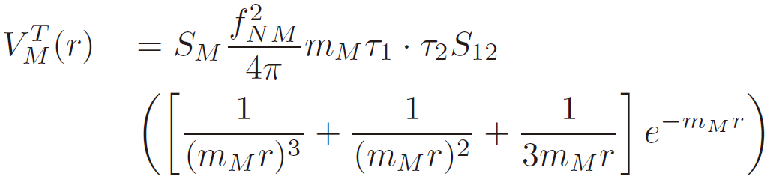
Tensor force

Slide 18
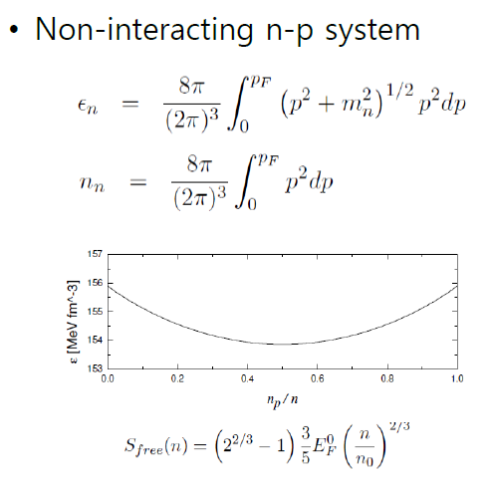
Pauli exclusion principle for nucleon
n
p
n
p
E(x~0) > E(x=1/2)
→ additional degrees of freedom reduce energy of the baryonic matter

Slide 19
Strange quark matter (SQM) Witten(1984)
- More stable than nucleon matter at higher density
- Energy for u, d and s quark matter is lower than u and d quark matter → SQM
u
d
s
u
d
s
E(s=0) > E(s=1/3)

Slide 20
Examples of asymmetric configuration
a. Heavier nuclei with N> Z
Coulomb interaction due to proton
→ less proton number
(asymmetric config.)
Strong interaction
symmetry energy → symmetric config.
x ~ 1/2
Notes:
Proton capture electron → neutron(weak interaction), energy minimum moves to x→0 . Appearance of proton moves minimum x< ½

Slide 21
b. Neutron star matter
N >> Z → N ~ Z
Strong interaction
Symmetry energy → more protons
Charge neutrality and Weak interaction :
→ Weak equilibrium
x ~ 0 – 1/2

Slide 22
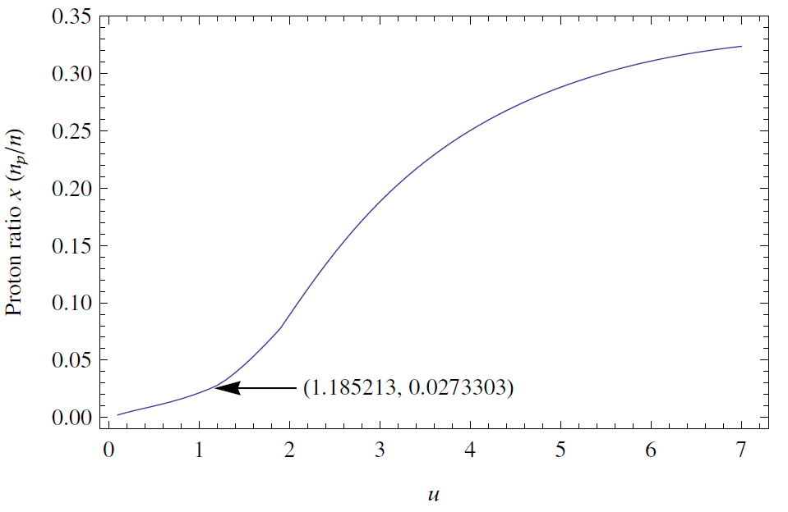

Slide 23
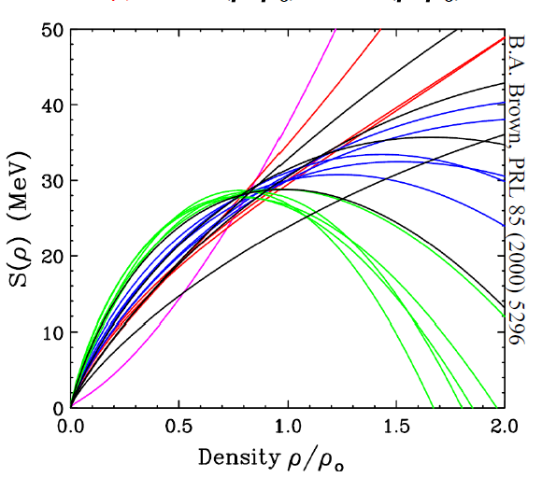
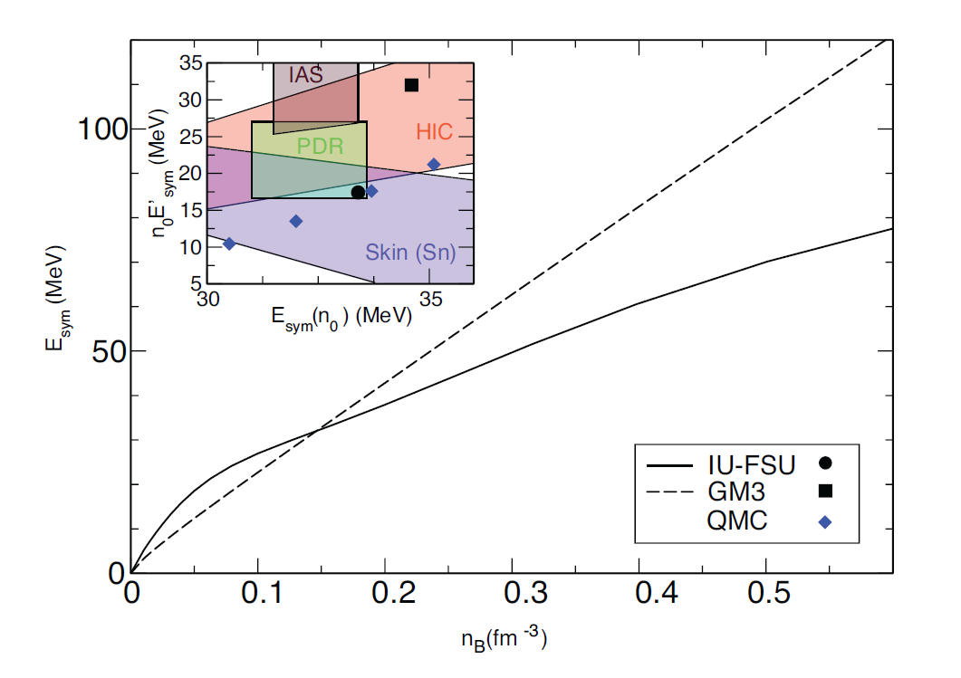
L.F. Roberts et al. PRL 108, 1103(2012)
S(n) beyond n_0: ?

Slide 24
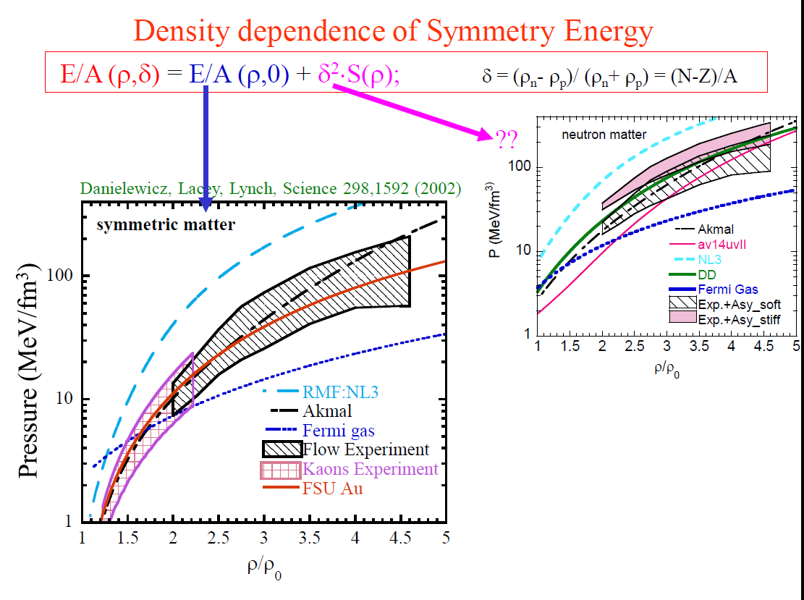

Slide 25

Anatomy of symmetry energy
HKL and M. Rho 2013, arXiv:1201. 6486

Slide 26





Slide 27
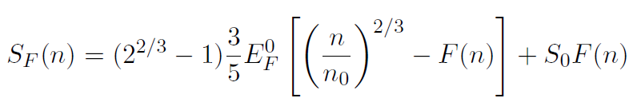
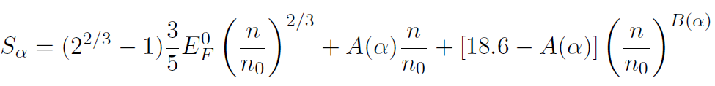
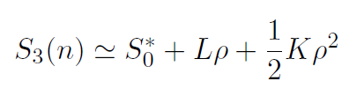
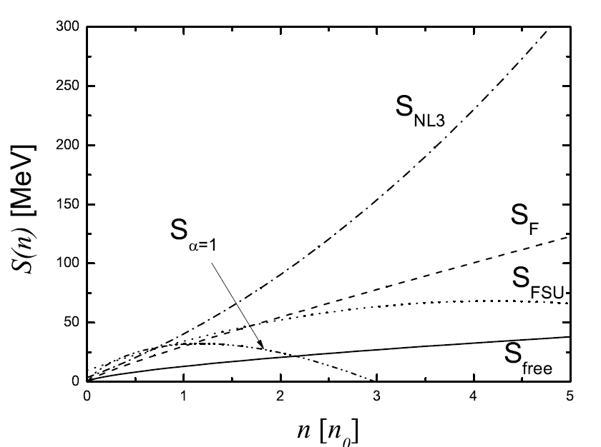
Phenomenological forms of symmetry energy

Slide 28
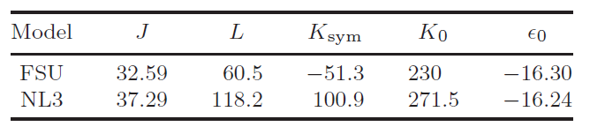
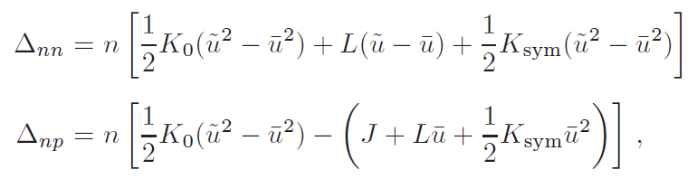
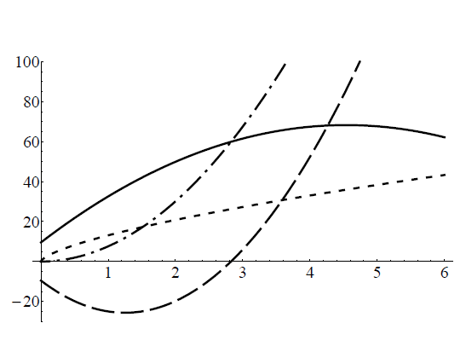

Slide 29
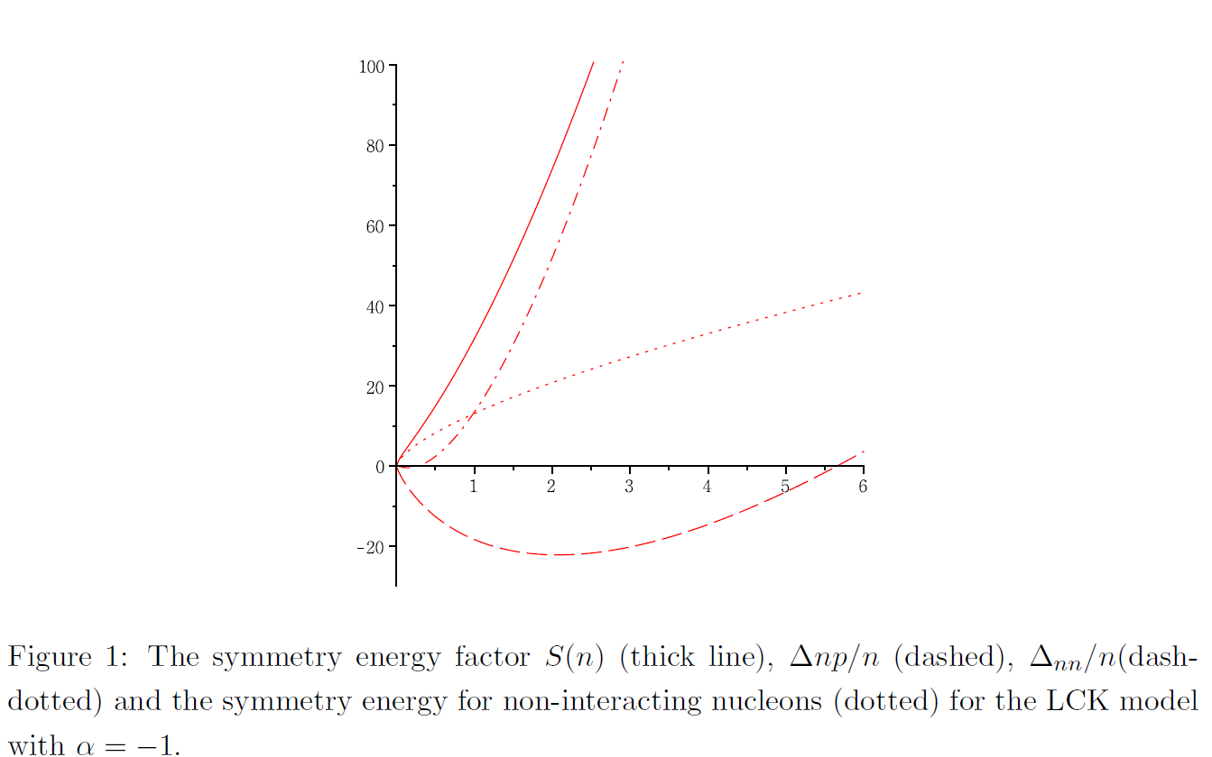
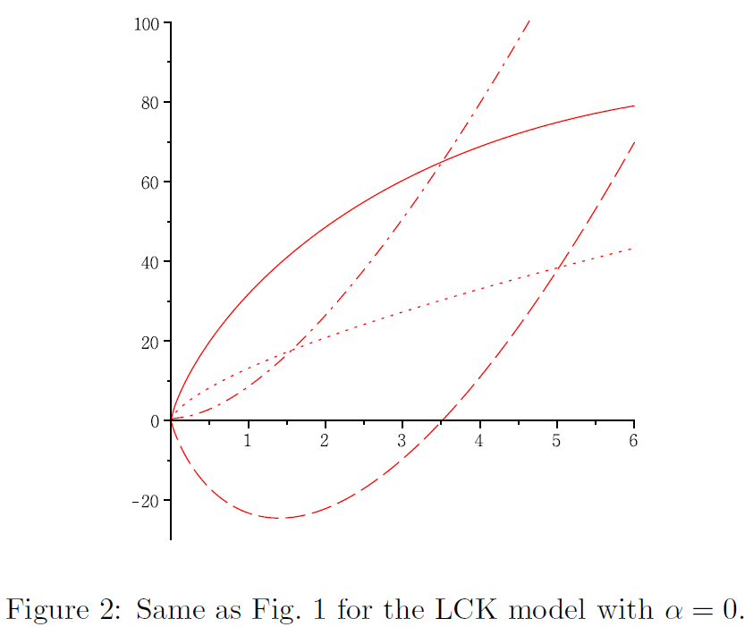
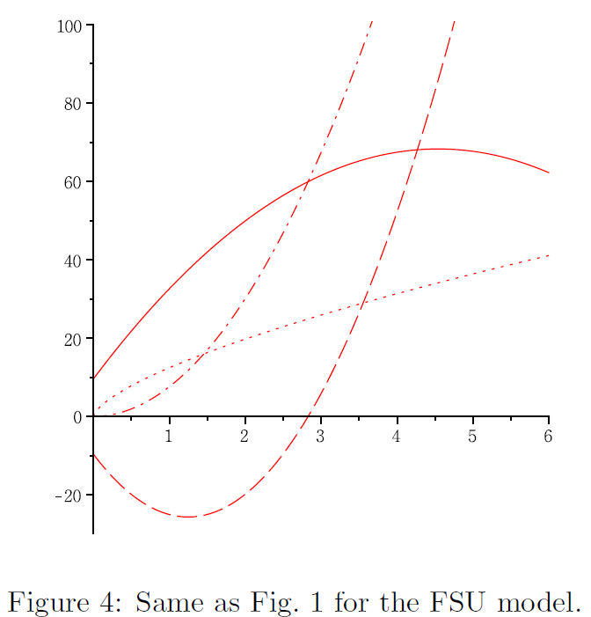
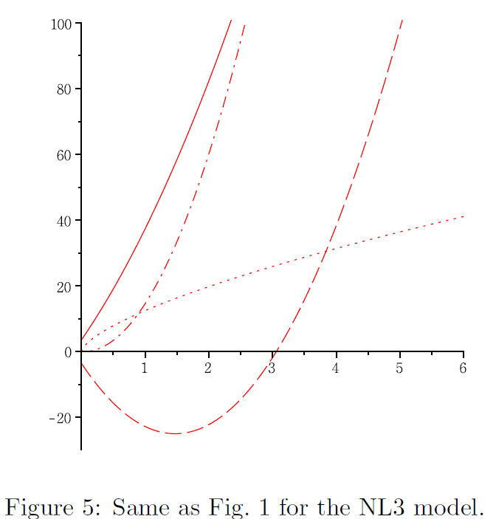

Slide 30
Tensor force

Slide 31
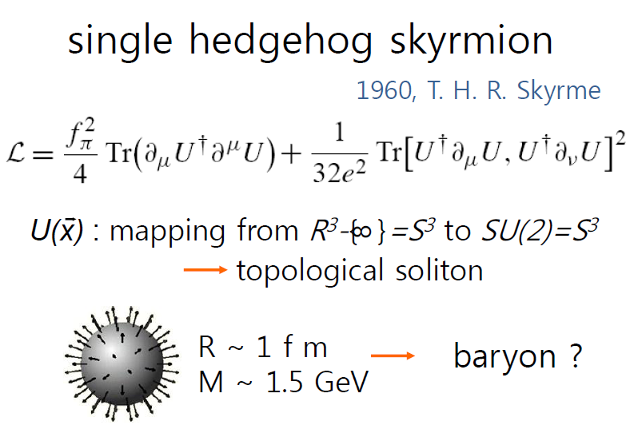
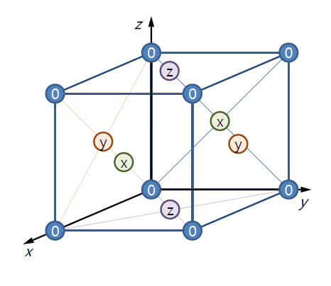

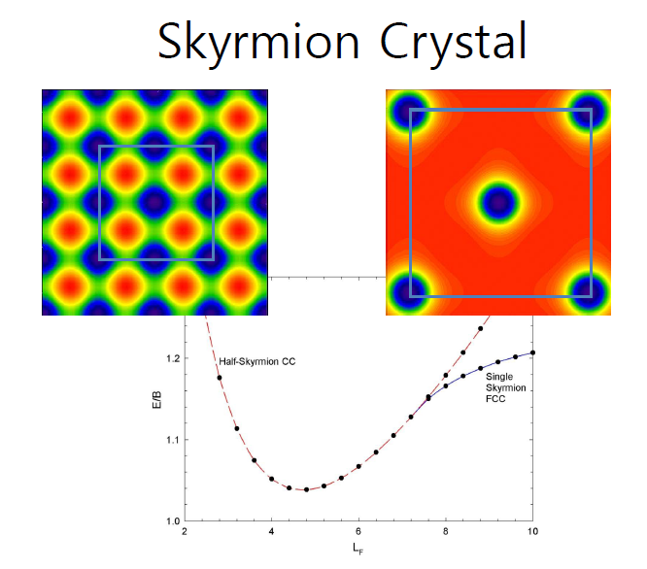
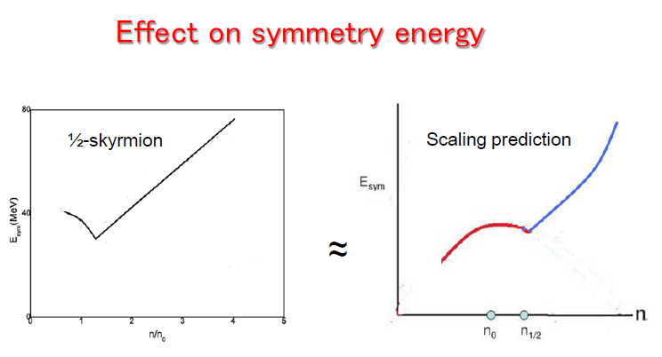
III. Half skyrmion and new scaling(BLPR)
HKL, Park and Rho, PRC83, 025206(2011)
Goldhaber and Manton(1987)
Byung-yoon Park et al. (2003), …

Slide 32
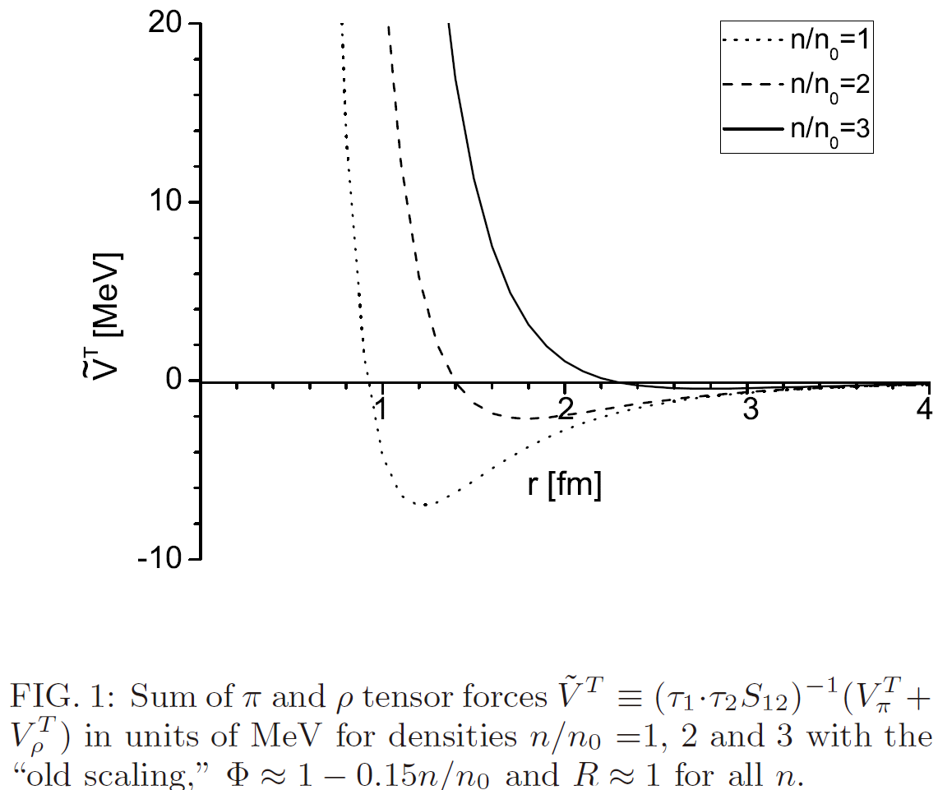

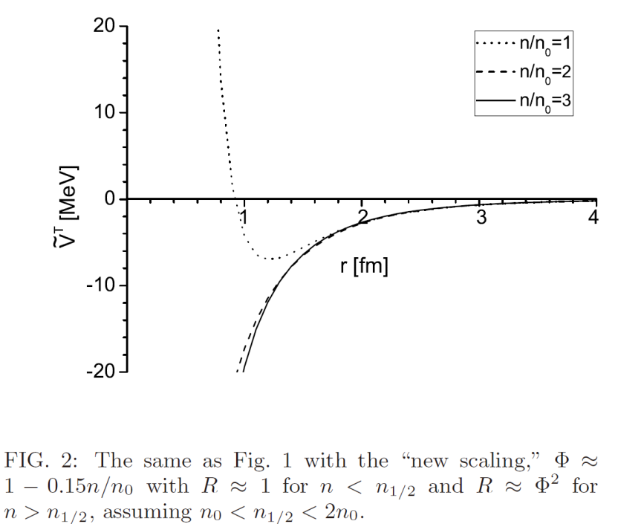

(a) Suppression of rho-mediated tensor force
Notes:
Mean field calculation is now in progress

Slide 33

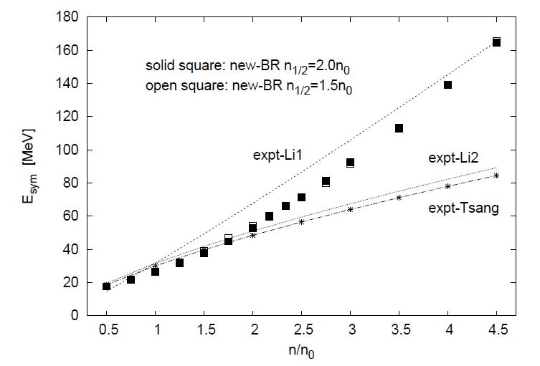
(b) stronger attraction in n-p channel
→ stiffer symmetry energy S(n)
Dong, Kuo, HKL,Machleidt, Rho(12)
Notes:
Mean field calculation is now in progress

Slide 34
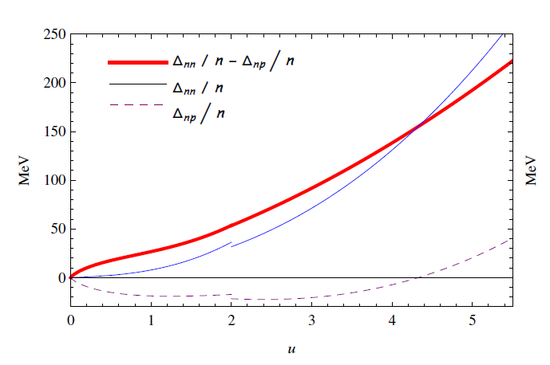

Slide 35
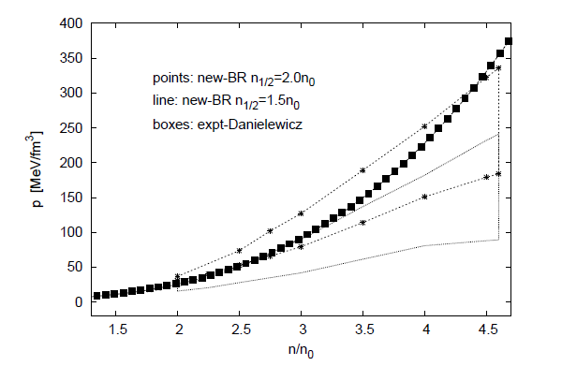
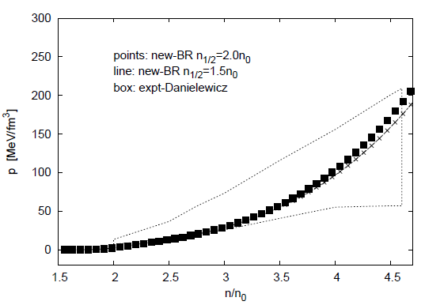
(c) EoS with new scaling, BLPR
Dong, Kuo, HKL, Machleidt, Rho, 1207.0429
Stiffer EoS for massive neutron star

Slide 36
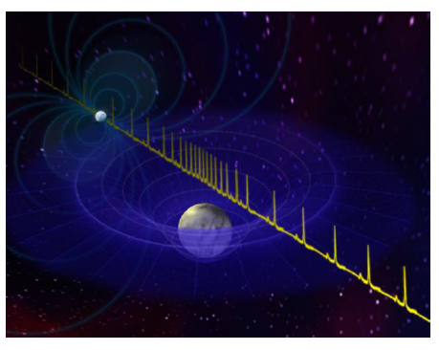
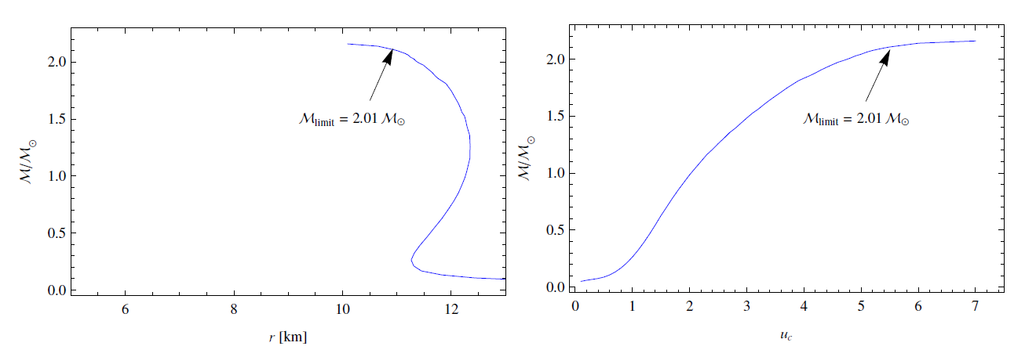
massive neutron star
PSR J1614-2230
(1.97 ± 0.04)M⊙

Slide 37
Remark I
How does low density nuclear matter (laboratory experiment-nuclear physics), constrains the high density hadronic matter(compact star-observations)?
EM observations of neutron stars(mass and radius)
Detection of gravitational waves
Laboratory for QCD at high density
EoS → GW waveform

Slide 38


Remark II
Symmetry energy S(n)
(1) thresholds for new degree of freedom
(2) composition of degrees of freedom
in star matter

