Slide 1
Low-energy scattering and resonances within the nuclear shell model
Andrey Shirokov
Skobeltsyn Institute of Nuclear Physics
Lomonosov Moscow State University
Collaborators: J. Vary, P. Maris (Iowa State University)
V. Kulikov (Moscow State University)
A. Mazur, I. Mazur (Pacific National University)
Daejeon, August 28, 2015

Slide 2
Plan
Introduction to the nuclear shell model
HORSE (J-matrix) formalism as a natural extension of SM
SS-HORSE
How it works: Model problem
Application to n-α scattering within the no-core shell model
Summary

Slide 3
Shell Model
SM is a standard traditional tool in nuclear structure theory
Core SM: e.g., ¹⁹F=core(¹⁶O)+p+n+n − inert core ¹⁶O times antisymmetrized function of 3 nucleons
No-core SM: antisymmetrized function of all nucleons
Wave function:
Traditionally single-particle functions are harmonic oscillator wave functions

Slide 4
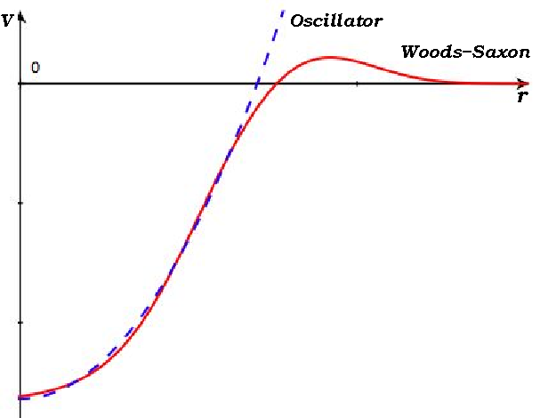
Why oscillator basis?
Any potential in the vicinity of its minimum at r=r₀ has the form V(r)=V₀+a(r-r₀)²+b(r-r₀)³+…, i.e., oscillator is the main term
Oscillator is a good approximation for the standard Woods–Saxon potential for light nuclei
Since Shell Model was introduced, oscillator become a language of nuclear physics; a well-developed technique for calculation of many-body matrix elements of various operators (kinetic and potential energy, EM transitions, etc.) has been developed for the harmonic oscillator; the spurious C.M. motion can be completely removed in the oscillator basis only, etc.

Slide 5
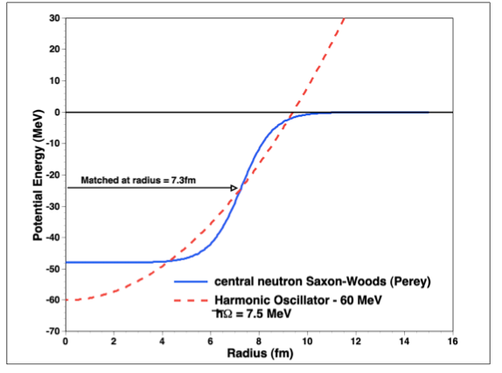
Why oscillator basis?
The situation is worse in heavy nuclei, but the harmonic oscillator remains a standard language of nuclear physics…

Slide 6
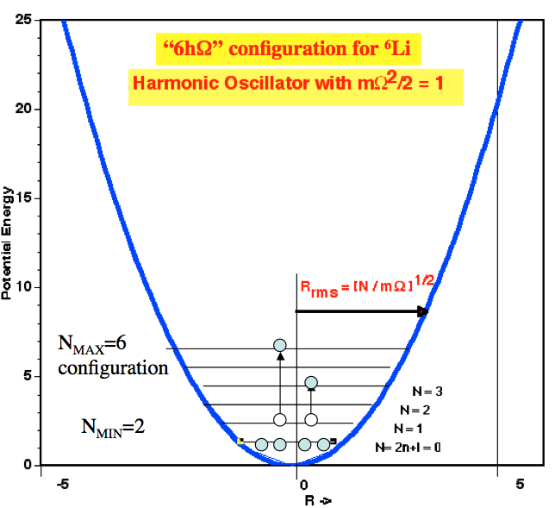
N_{max} truncation
All many-body states with total oscillator quanta up to some N_{max} are included in the basis space (N_{max} or NħΩ truncation).
This truncation makes it possible to completely separate spurious CM excited states

Slide 7
Shell Model
Shell model is a bound state technique, no continuum spectrum; not clear how to interpret states in continuum above thresholds − how to extract resonance widths or scattering phase shifts
HORSE (J-matrix) formalism can be used for this purpose

Slide 8
Shell Model
Shell model is a bound state technique, no continuum spectrum; not clear how to interpret states in continuum above thresholds − how to extract resonance widths or scattering phase shifts
HORSE (J-matrix) formalism can be used for this purpose
Other possible approaches: NCSM+RGM; Gamov SM; Continuum SM; SM+Complex Scaling; …
All of them make the SM much more complicated. Our aim is to interpret directly the SM results above thresholds obtained in a usual way without additional complexities and to extract from them resonant parameters and phase shifts at low energies.

Slide 9
Shell Model
Shell model is a bound state technique, no continuum spectrum; not clear how to interpret states in continuum above thresholds − how to extract resonance widths or scattering phase shifts
HORSE (J-matrix) formalism can be used for this purpose
Other possible approaches: NCSM+RGM; Gamov SM; Continuum SM; SM+Complex Scaling; …
All of them make the SM much more complicated. Our aim is to interpret directly the SM results above thresholds obtained in a usual way without additional complexities and to extract from them resonant parameters and phase shifts at low energies.
I will discuss a more general interpretation of SM results

Slide 10
J-matrix (Jacobi matrix) formalism in scattering theory
Two types of L² basises:
Laguerre basis (atomic hydrogen-like states) — atomic applications
Oscillator basis — nuclear applications
Other titles in case of oscillator basis:
HORSE (harmonic oscillator representation of scattering equations),
Algebraic version of RGM

Slide 11
J-matrix formalism
Initially suggested in atomic physics (E. Heller, H. Yamani, L. Fishman, J. Broad, W. Reinhardt) :
H.A.Yamani and L.Fishman, J. Math. Phys 16, 410 (1975). Laguerre and oscillator basis.
Rediscovered independently in nuclear physics (G. Filippov, I. Okhrimenko, Yu. Smirnov):
G.F.Filippov and I.P.Okhrimenko, Sov. J. Nucl. Phys. 32, 480 (1980). Oscillator basis.

Slide 12
HORSE:
J-matrix formalism with oscillator basis
Some further developments (incomplete list; not always the first publication but a more transparent or complete one):
Yu.I.Nechaev and Yu.F.Smirnov, Sov. J. Nucl. Phys. 35, 808 (1982)
I.P.Okhrimenko, Few-body Syst. 2, 169 (1987)
V.S.Vasievsky and F.Arickx, Phys. Rev. A 55, 265 (1997)
S.A.Zaytsev, Yu.F.Smirnov, and A.M.Shirokov, Theor. Math. Phys. 117, 1291 (1998)
J.M.Bang et al, Ann. Phys. (NY) 280, 299 (2000)
A.M.Shirokov et al, Phys. Rev. C 70, 044005 (2004)

Slide 13
HORSE:
J-matrix formalism with oscillator basis
Active research groups:
Kiev: G. Filippov, V. Vasilevsky, A. Nesterov et al
Antwerp: F. Arickx, J. Broeckhove et al
Moscow: A. Shirokov, S. Igashov et al
Khabarovsk: S. Zaytsev, A. Mazur et al
Ariel: Yu. Lurie

Slide 14
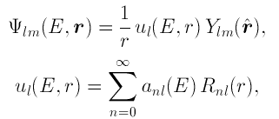
HORSE:
Schrödinger equation:
Wave function is expanded in oscillator functions:
Schrödinger equation is an infinite set of algebraic equations:
where H=T+V,
T — kinetic energy operator,
V — potential energy

Slide 15
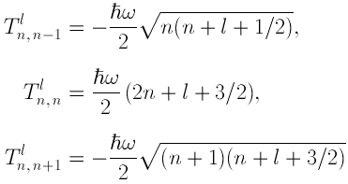
HORSE:
Kinetic energy matrix elements:
Kinetic energy is tridiagonal:
Note! Kinetic energy tends to infinity as n and n’=n, n±1 increases:

Slide 16
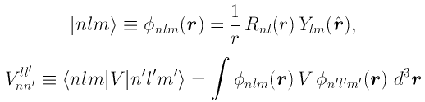



HORSE:
Potential energy matrix elements:
For central potentials only
Note! Potential energy tends to zero as n and/or n’ increases:
Therefore for large n or n’:
A reasonable approximation when n or n’ are large

Slide 17
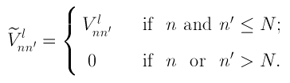


HORSE:
In other words, it is natural to truncate the potential energy:
This is equivalent to writing the potential energy operator as
For large n, the Schrödinger equation
takes the form

Slide 18
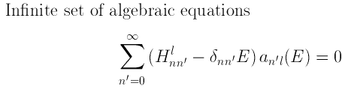
General idea of the
HORSE formalism

Slide 19
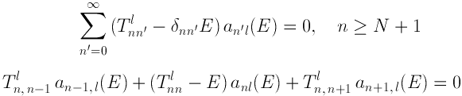
General idea of the
HORSE formalism

Slide 20

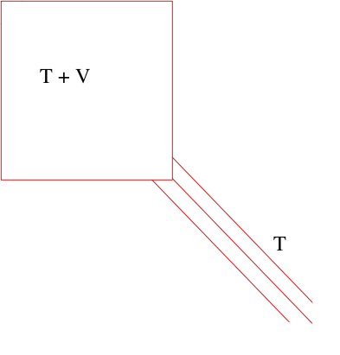

General idea of the
HORSE formalism

Slide 21
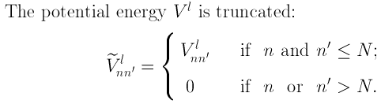
General idea of the
HORSE formalism

Slide 22

General idea of the
HORSE formalism

Slide 23
General idea of the
HORSE formalism

Slide 24
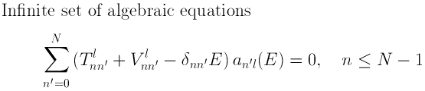
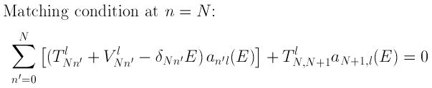
General idea of the
HORSE formalism
This is an exactly solvable algebraic problem!

Slide 25
General idea of the
HORSE formalism
And this looks like a natural extension of SM where both potential and kinetic energies are truncated
This is an exactly solvable algebraic problem!

Slide 26
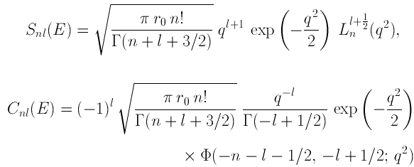

Asymptotic region n ≥ N
Schrödinger equation takes the form of three-term recurrent relation:
This is a second order finite-difference equation. It has two independent solutions:
where dimensionless momentum
For derivation, see S.A.Zaytsev, Yu.F.Smirnov, and A.M.Shirokov, Theor. Math. Phys. 117, 1291 (1998)

Slide 27
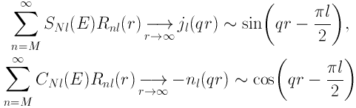
Asymptotic region n ≥ N
Schrödinger equation:
Arbitrary solution a_{nl}(E) of this equation can be expressed as a superposition of the solutions S_{nl}(E) and C_{nl}(E), e.g.:
Note that

Slide 28


Asymptotic region n ≥ N
Therefore our wave function
Reminder: the ideas of quantum scattering theory.
Cross section
Wave function
δ in the HORSE approach is the phase shift!

Slide 29


Internal region
(interaction region) n ≤ N
Schrödinger equation
Inverse Hamiltonian matrix:

Slide 30

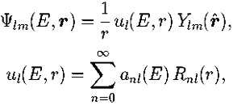

Matching condition at n=N
Solution:
From the asymptotic region
Note, it is valid at n=N and n=N+1. Hence
This is equation to calculate the phase shifts.
The wave function is given by
where

Slide 31
Problems with direct HORSE application
A lot of E_{λ} eigenstates needed while SM
codes usually calculate few lowest states only
One needs highly excited states and to get
rid from CM excited states.
are normalized for all states including the CM excited ones, hence renormalization is needed.
We need for the relative n-nucleus coordinate r_{nA} but NCSM provides for the n coordinate r_{n} relative to the nucleus CM. Hence we need to perform Talmi-Moshinsky transformations for all states to obtain in relative n-nucleus coordinates.
Concluding, the direct application of the HORSE formalism in n-nucleus scattering is unpractical.

Slide 32
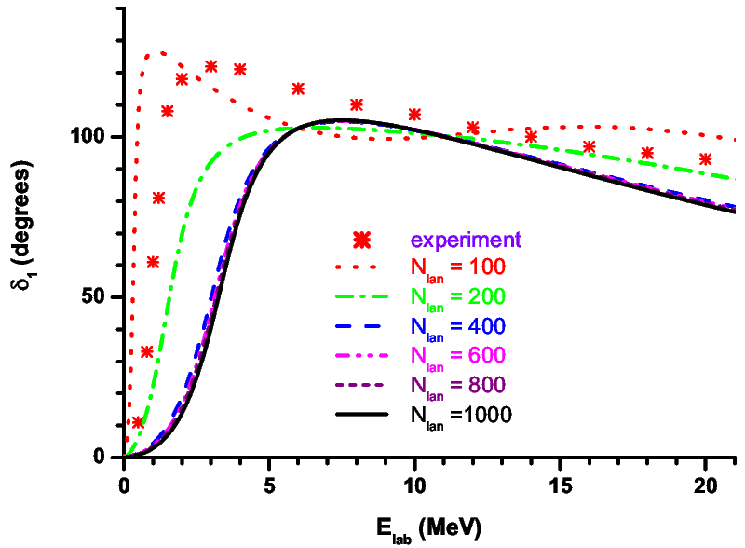
Example: nα scattering

Slide 33
Single-state HORSE
(SS-HORSE)
Suppose E = E_{λ}:
E_{λ} are eigenstates that are consistent with scattering information for
given ħΩ and N_{max}; this is what you should obtain in any calculation
with oscillator basis and what you should compare with your ab initio results.

Slide 34
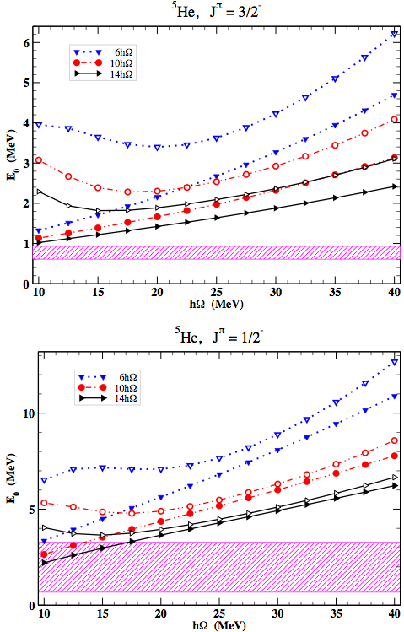
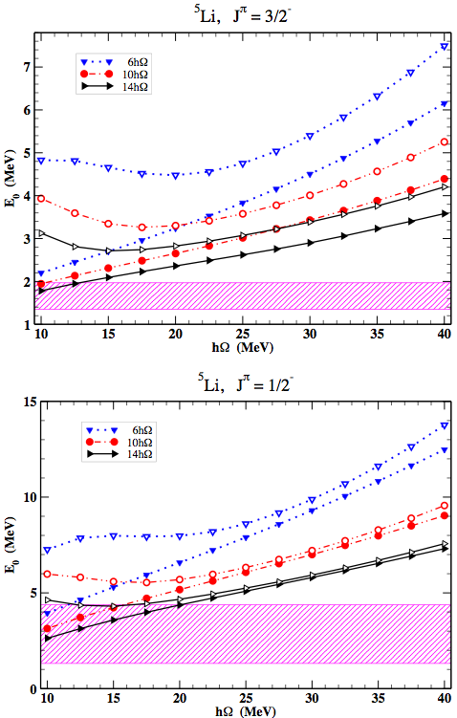
Nα scattering and NCSM, JISP16

Slide 35
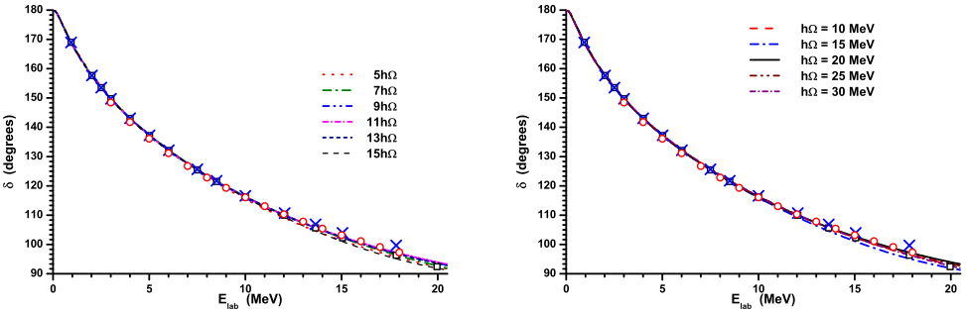
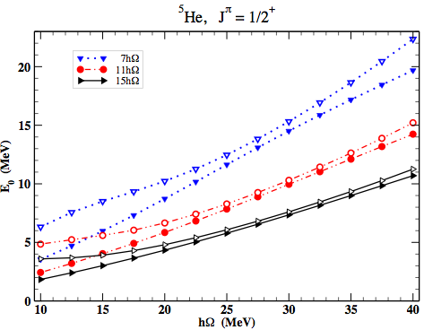
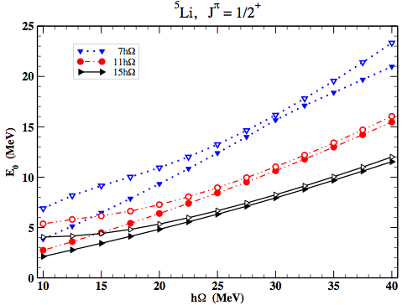
Nα scattering and NCSM, JISP16

Slide 36
Single-state HORSE
(SS-HORSE)
Suppose E = E_{λ}:
Calculating a set of E_{λ} eigenstates with different ħΩ and N_{max} within SM, we obtain a set of values which we can approximate by a smooth curve at low energies.

Slide 37
Single-state HORSE
(SS-HORSE)
Suppose E = E_{λ}:
Calculating a set of E_{λ} eigenstates with different ħΩ and N_{max} within SM, we obtain a set of values which we can approximate by a smooth curve at low energies.
Note, information about wave function disappeared in this formula, any channel can be treated

Slide 38
S-matrix at low energies
Symmetry property:
Hence
As
Bound state:
Resonance:

Slide 39
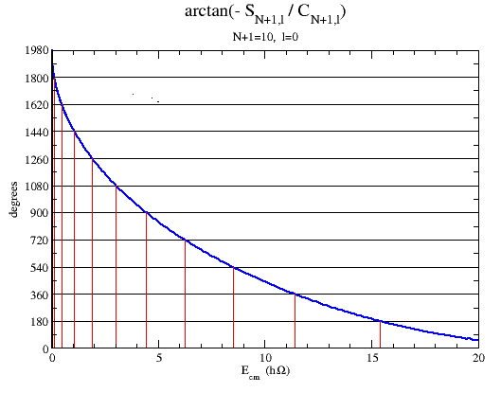
Universal function

Slide 40
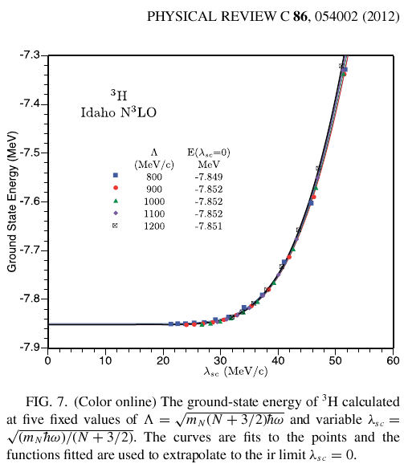
S. Coon et al extrapolations
S. A. Coon, M. I. Avetian,
M. K. G. Kruse, U. van Kolck,
P. Maris, and J. P. Vary, PRC 86, 054002 (2012)
What is λ_{sc} dependence for resonances?

Slide 41
scaling with

Slide 42
Universal function scaling
S.Coon et al (ir cutoff)
l=2

Slide 43
How it works
Model problem: nα scattering by Woods-Saxon potential J. Bang and C. Gignoux, Nucl. Phys. A, 313 , 119 (1979).
UV cutoff of S. A. Coon, M. I. Avetian, M. K. G. Kruse, U. van Kolck, P. Maris, and J. P. Vary, PRC 86, 054002 (2012) to select eigenvalues:

Slide 44
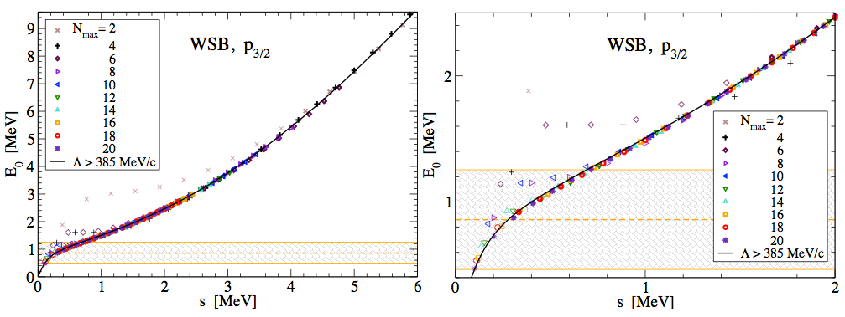
Model problem

Slide 45
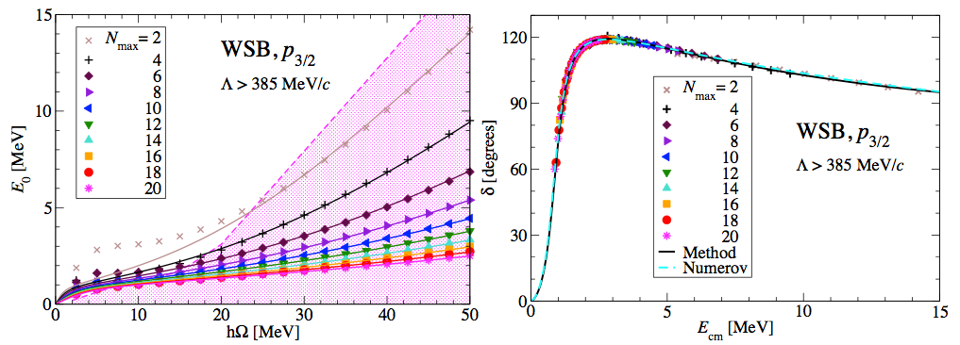
Model problem

Slide 46
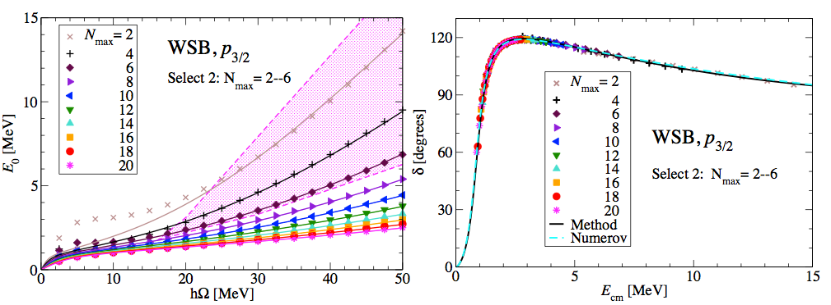
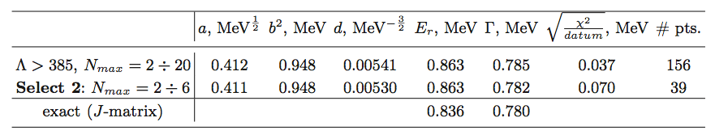
Model problem

Slide 47
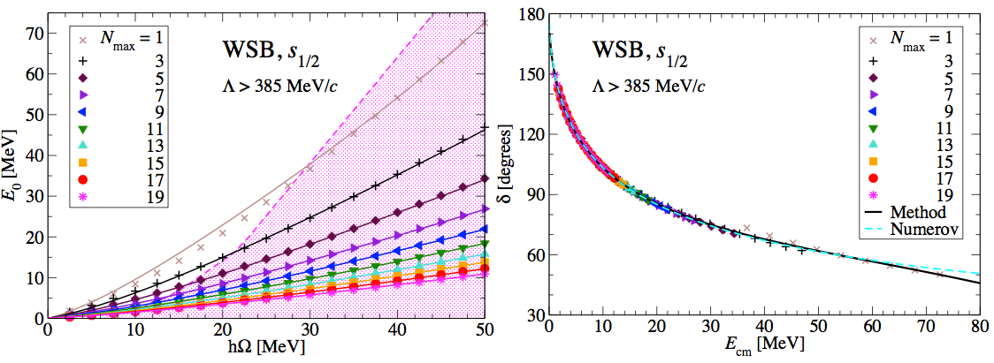
Model problem

Slide 48
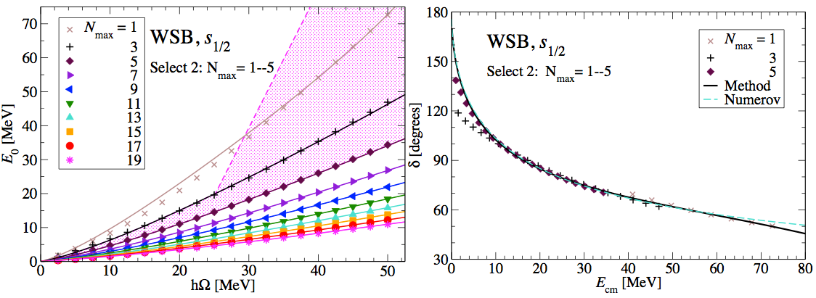
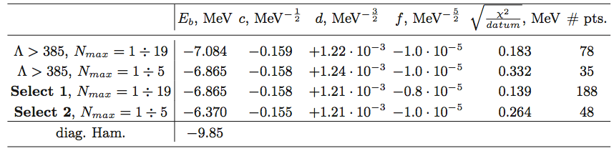
Model problem

Slide 49
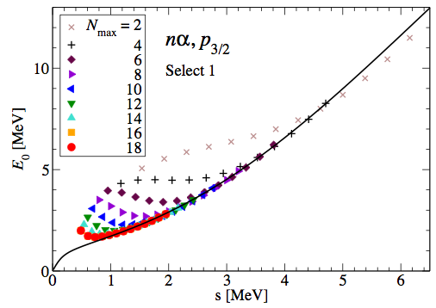
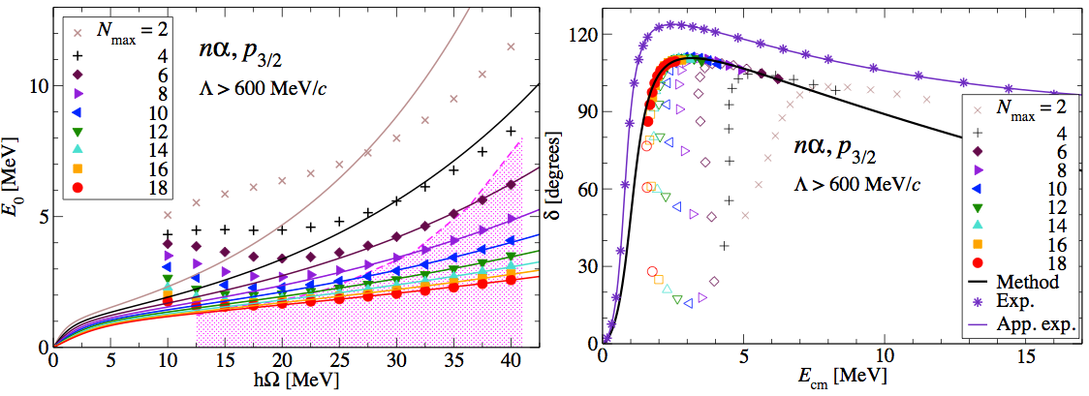
nα scattering: NCSM, JISP16

Slide 50
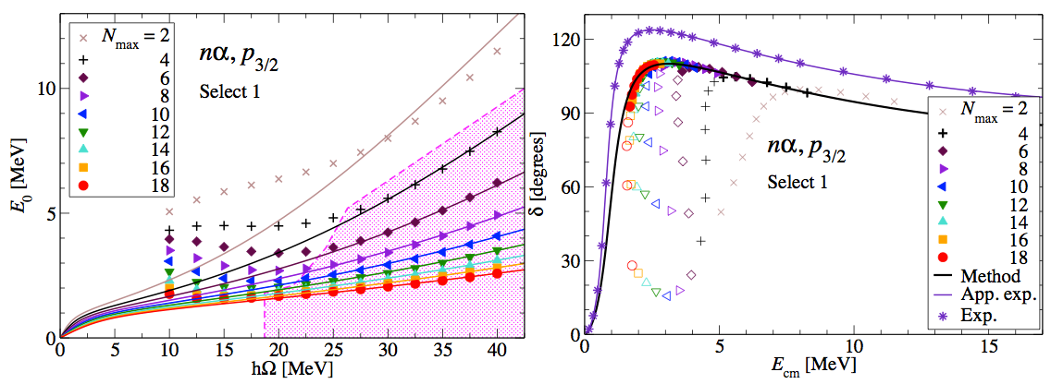
nα scattering: NCSM, JISP16

Slide 51
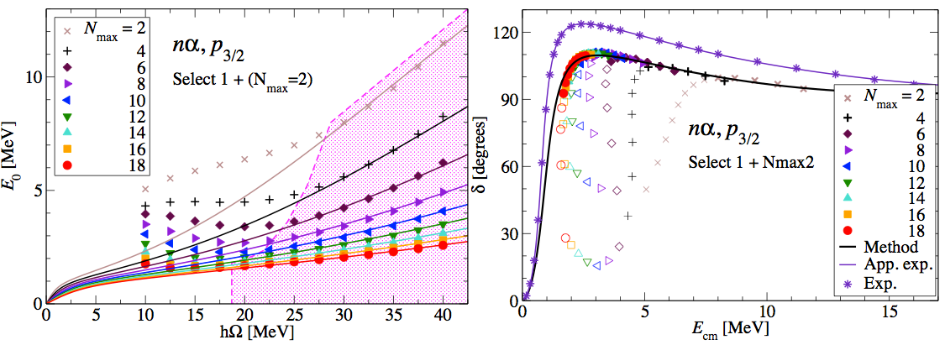
nα scattering: NCSM, JISP16

Slide 52
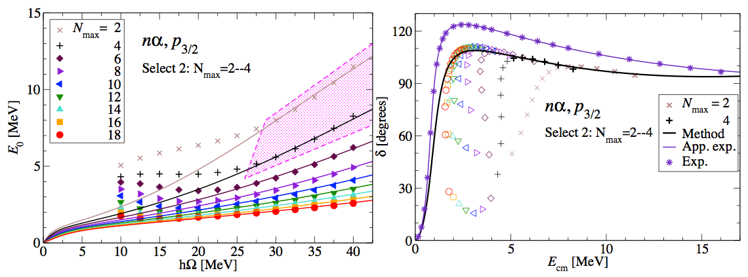
nα scattering: NCSM, JISP16

Slide 53
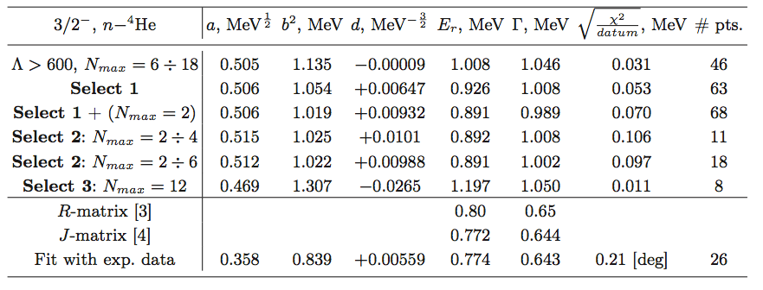
nα scattering: NCSM, JISP16

Slide 54
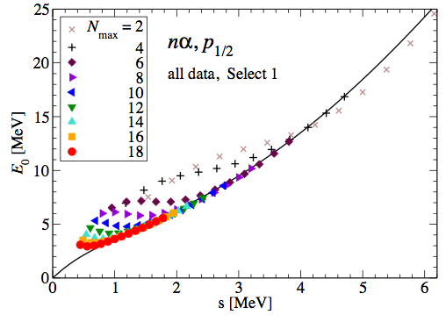
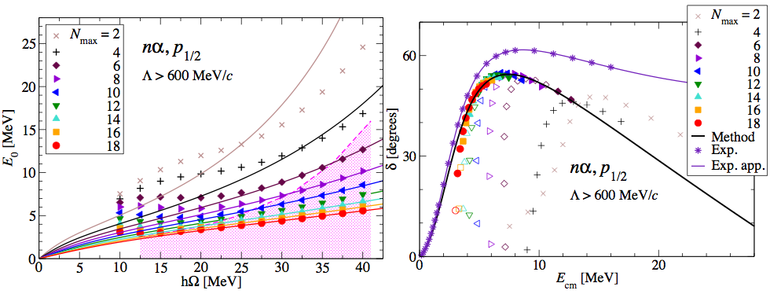
nα scattering: NCSM, JISP16

Slide 55
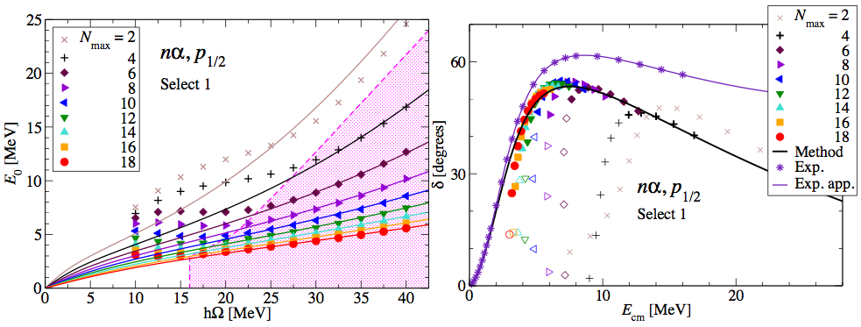
nα scattering: NCSM, JISP16

Slide 56
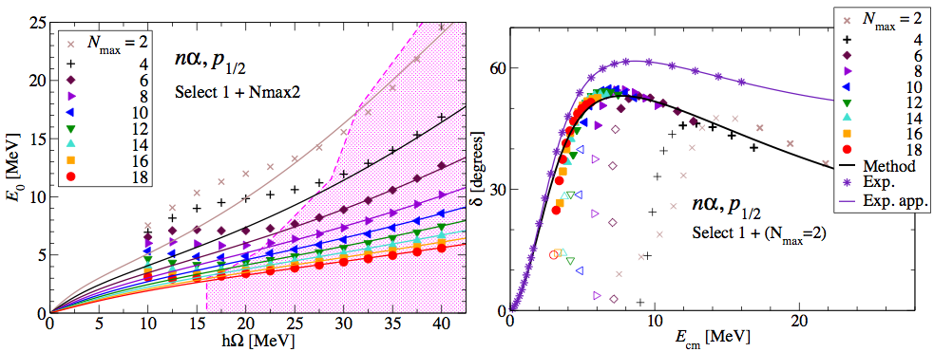
nα scattering: NCSM, JISP16

Slide 57
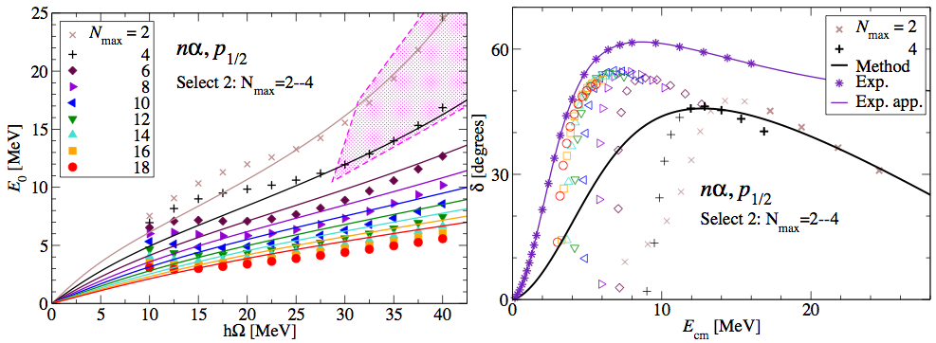
nα scattering: NCSM, JISP16

Slide 58
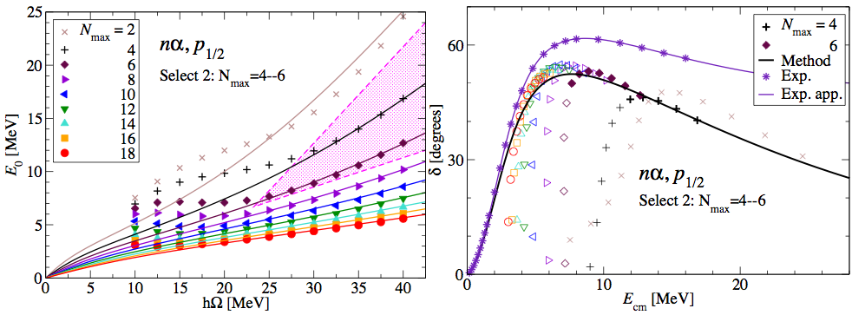
nα scattering: NCSM, JISP16

Slide 59
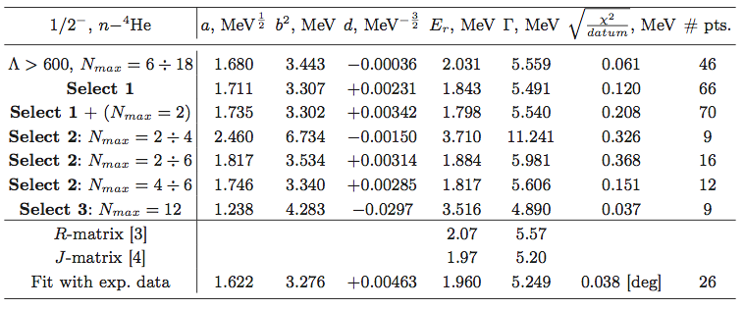
nα scattering: NCSM, JISP16

Slide 60
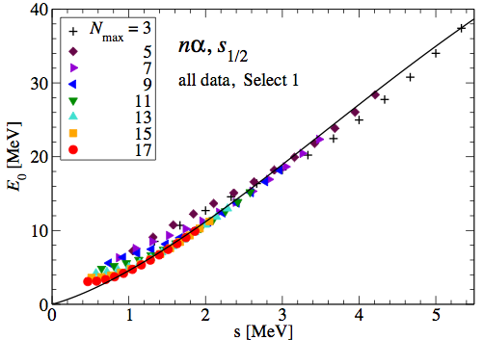
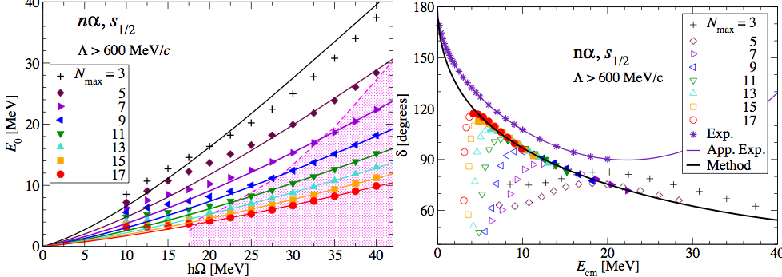
nα scattering: NCSM, JISP16

Slide 61
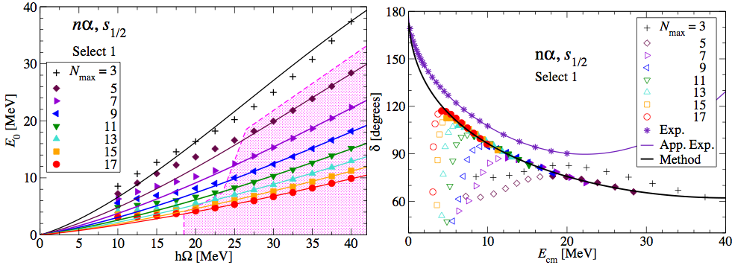
nα scattering: NCSM, JISP16

Slide 62
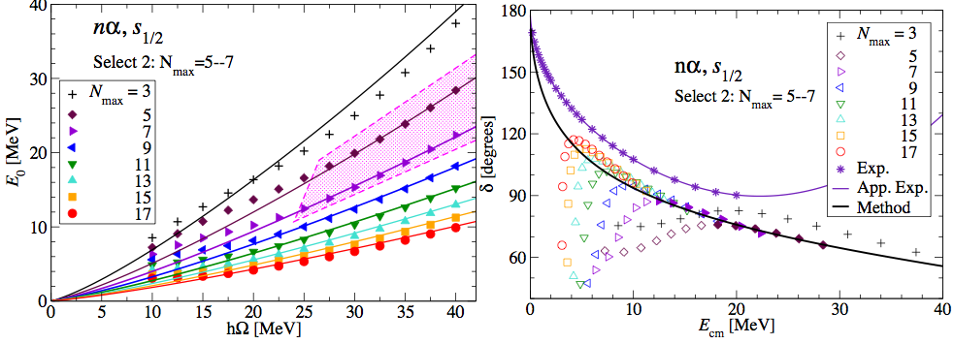
nα scattering: NCSM, JISP16

Slide 63
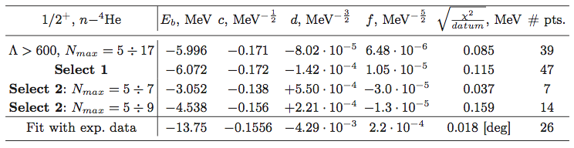
nα scattering: NCSM, JISP16

Slide 64
Coulomb + nuclear interaction
SS-HORSE:
Scaling at

Slide 65
S-matrix and phase shift
No relation between a, b and c.

Slide 66
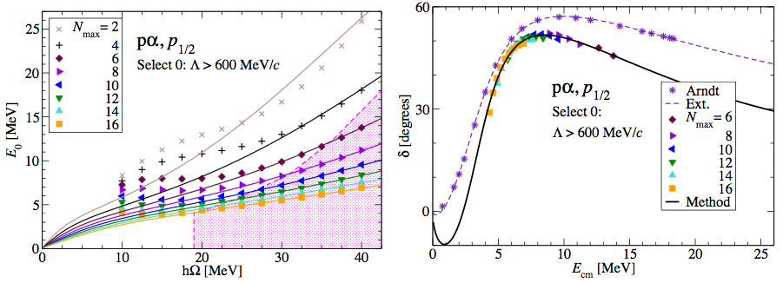
pα scattering: NCSM, JISP16

Slide 67

pα scattering: NCSM, JISP16

Slide 68

pα scattering: NCSM, JISP16

Slide 69

pα scattering: NCSM, JISP16

Slide 70

pα scattering: NCSM, JISP16

Slide 71

pα scattering: NCSM, JISP16

Slide 72

pα scattering: NCSM, JISP16

Slide 73
Summary
SM states obtained at energies above thresholds can be interpreted and understood.
Parameters of low-energy resonances (resonant energy and width) and low-energy phase shifts can be extracted from results of conventional Shell Model calculations
Generally, one can study in the same manner S-matrix poles associated with bound states and design a method for extrapolating SM results to infinite basis. However this is a more complicated problem that is not developed yet.

Slide 74
Thank you!

Slide 76
Why oscillator basis?
Any potential in the vicinity of its minimum at r=r₀ has the form V(r)=V₀+a(r-r₀)²+b(r-r₀)³+…, i.e., oscillator is the main term

Slide 77

Why oscillator basis?
Any potential in the vicinity of its minimum at r=r₀ has the form V(r)=V₀+a(r-r₀)²+b(r-r₀)³+…, i.e., oscillator is the main term
Oscillator is a good approximation for the standard Woods–Saxon potential for light nuclei

Slide 78
Why oscillator basis?
Any potential in the vicinity of its minimum at r=r₀ has the form V(r)=V₀+a(r-r₀)²+b(r-r₀)³+…, i.e., oscillator is the main term
Oscillator is a good approximation for the standard Woods–Saxon potential for light nuclei

