Slide 1






Deep Learning for the detection of Unmodelled Gravitational-Wave Transients
A deep learning approach
Michael Norman, Kyle Willets, Wasim Javed, Vasileios Skliris, Patrick Sutton

Slide 2





What is gravity?
1. Mass deforms spacetime
2. Spacetime moves mass
3. More mass creates more deformation
4. More deformation moves mass more

Slide 3
What are gravitational waves?
1. Asymmetric motion of mass creates ripples in spacetime
2. Therefore objects in orbit create gravitational waves
3. And more massive objects in orbit create larger waves

Slide 4
How do we detect gravitational waves?
t₀
t₀ + dt
Deformations in spacetime changes the real distance between freely floating points
If we can measure changes in the distance between two freely floating points we can measure changes in spacetime

Slide 5
How do we detect gravitational waves?
End mirror
Input mirror
Laser source
End mirror
Beam Splitter
Input mirror
Photodetector
We can do this using interferometers
A laser is split into two orthogonal cavities, and reflected back to destructively interfere
A photodiode reads the resulting power

Slide 6
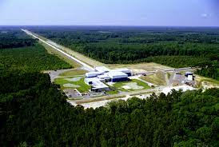
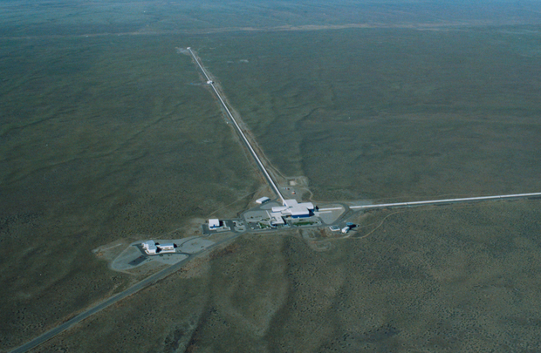
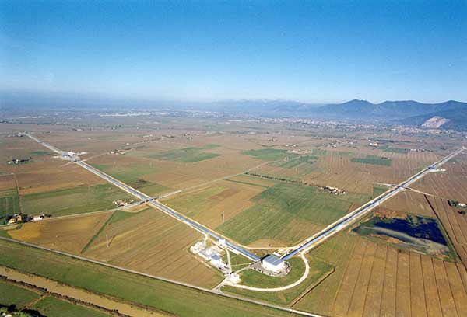
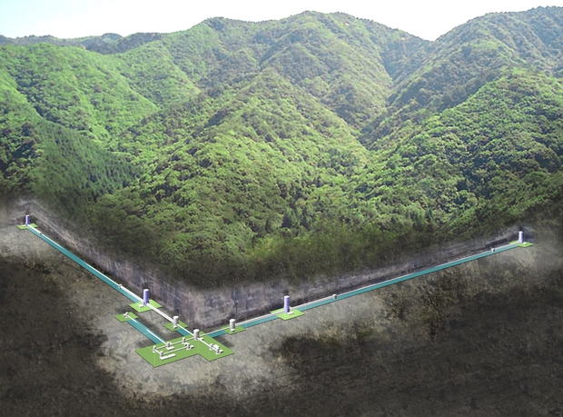
How do we detect gravitational waves?

Slide 7
Interferometer Locations
GEO
Virgo
LIGO Livingston
  KAGRA

Slide 8
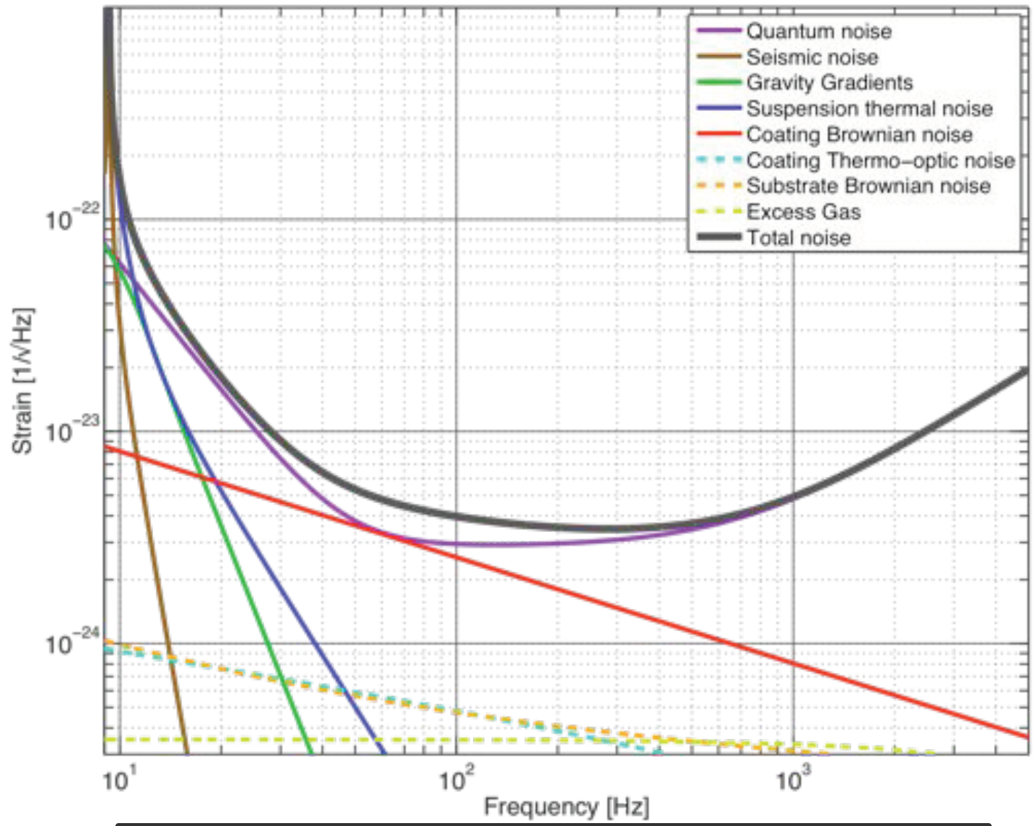
How do we detect find signals from noise?
The output of the photodetector takes the form of a 1D timeseries at 16kHz
Care is taken to insulate detectors from noise, but noise is still present at various frequencies
Thus a method is needed to extract real gravitational wave signals from terrestrial noise

Slide 9
How do we detect find signals from noise?
  Matched Filtering
Known Signal
Single Detector

Slide 10
What about other signal types?
  Matched Filter
  Coherence detection
Known Signal
Detector A
Detector B
Single Detector

Slide 11
COHERENCE DETECTION
  Pros
  Doesn’t require prior knowledge of (exact) signal shape
  Cons
  Is not as sensitive as matched filtering
  Existing pipelines can be quite slow

Slide 12
MLy PIPELINE
Team: Vasileios Skliris, Wasim Javed, Kyle Willets, Michael Norman, Patrick Sutton
Machine learning pipeline
Low-latency, unmodelled burst detection for use in Multi-messenger astronomy
CNN for detection, basic PE, and localization
Currently in review for deployment in O4
Methods paper:
https://arxiv.org/abs/2009.14611

Slide 13
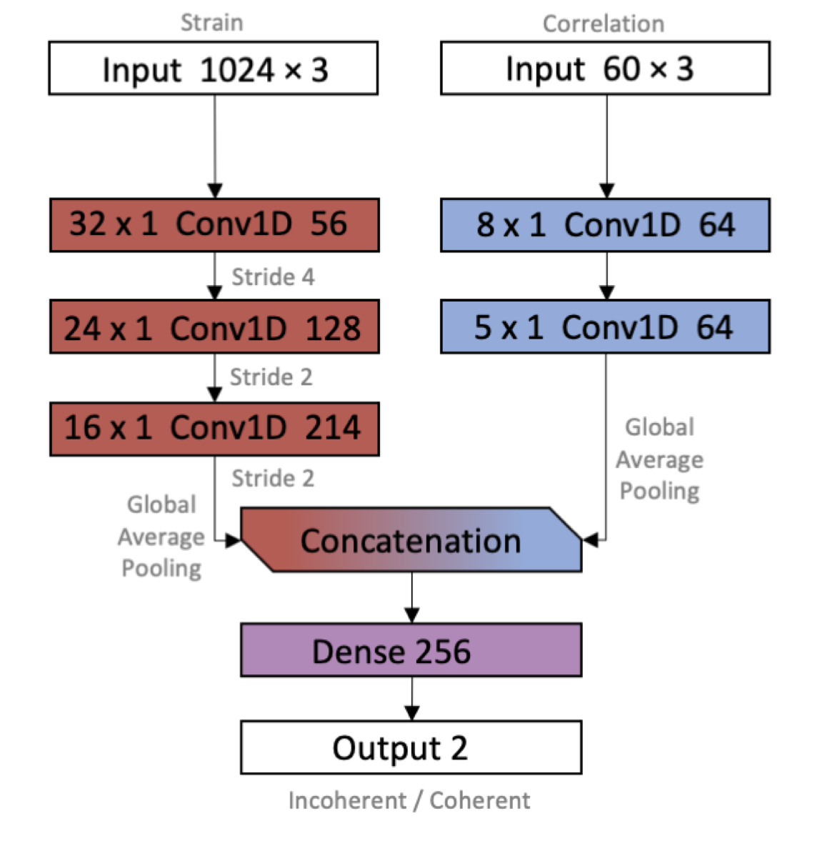
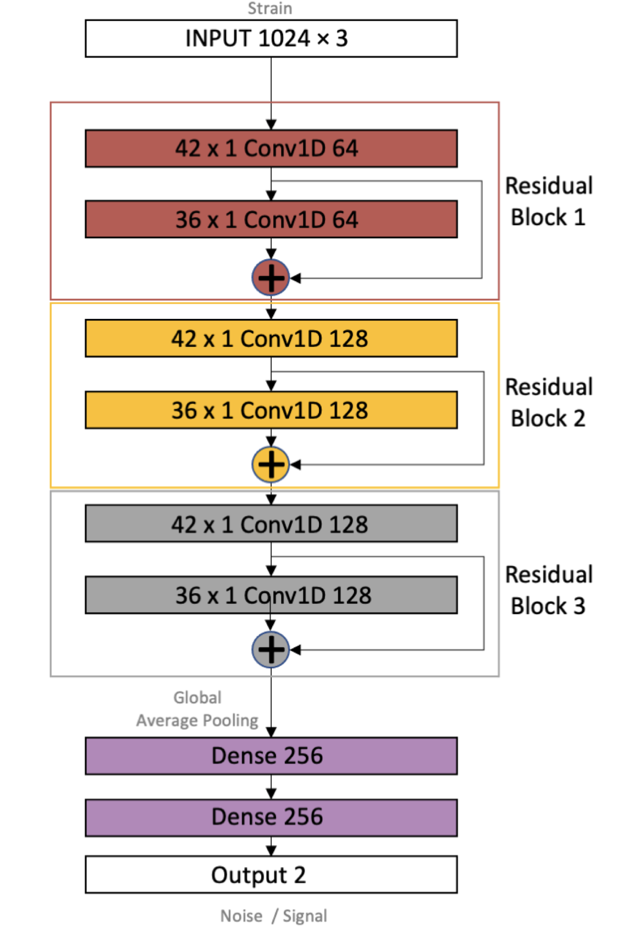
CURRENT MLy ARCHITECTURE

Slide 14
THE PROBLEM WITH CNNs
1 Conv Layer 1 Dense Layer
i₁
i₂
o₁
Toy example:
Input Size = 4
Output Size = 3
Filter Size = 3
Number of filters = 3
i₃
i₄
o₂
o₃

Slide 15
A DRAWBACK OF CNNs
Examining one filter…
i₁
Receptive field size = 3:
Conv layers are best for focusing on local features not global features
For multi-detector case unknown arrival time difference between detectors disrupts local features
i₂
Filter does not see i₄
i₃
i₄
Filter does not see i₁

Slide 16
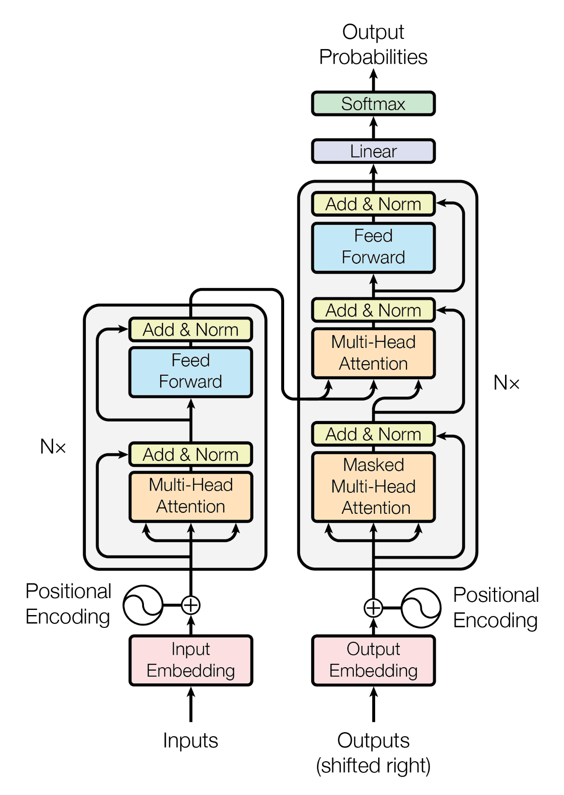
INTRODUCING TRANSFORMER MODELS
[1] https://arxiv.org/abs/1706.03762
Transformers embed global context locally using attention

Slide 17
The quick brown fox jumped over the lazy dog
NATURAL LANGUAGE PROCESSING (NLP)
A quick foray…

Slide 18
The quick brown fox jumped over the lazy dog
NATURAL LANGUAGE PROCESSING (NLP)
A quick foray…
  is brown
  has jumped
  is quick

Slide 19
The quick brown fox jumped over the lazy dog
NATURAL LANGUAGE PROCESSING (NLP)
A quick foray…
  embedding
quick
fox
jumped
lazy
0.5446 0.6679
0.4814 0.9332
0.6221 0.8440
0.6403 0.9711
0.9261 0.3278
0.2621 0.3681
brown
0.5446 0.6679
0.4814 0.9332
0.6221 0.8440
0.6403 0.9711
0.9261 0.3278
0.2621 0.3681
0.5446 0.6679
0.4814 0.9332
0.6221 0.8440
0.6403 0.9711
0.9261 0.3278
0.2621 0.3681
over
0.5446 0.6679
0.4814 0.9332
0.6221 0.8440
0.6403 0.9711
0.9261 0.3278
0.2621 0.3681
dog
0.5446 0.6679
0.4814 0.9332
0.6221 0.8440
0.6403 0.9711
0.9261 0.3278
0.2621 0.3681
0.5446 0.6679
0.4814 0.9332
0.6221 0.8440
0.6403 0.9711
0.9261 0.3278
0.2621 0.3681
0.5446 0.6679
0.4814 0.9332
0.6221 0.8440
0.6403 0.9711
0.9261 0.3278
0.2621 0.3681

Slide 20
NATURAL LANGUAGE PROCESSING (NLP)
A quick foray…
  for each token…
Query Matrix*
Word
Query
0.5446 0.6679
0.4814 0.9332
0.6221 0.8440
0.6403 0.9711
0.9261 0.3278
0.2621 0.3681
0.5446 0.6679
0.4814 0.9332
0.6221 0.8440
0.6403 0.9711
0.9261 0.3278
0.2621 0.3681
=
word
0.5446 0.6679
0.4814 0.9332
0.6221 0.8440
0.6403 0.9711
0.9261 0.3278
0.2621 0.3681
Word
Value
0.5446 0.6679
0.4814 0.9332
0.6221 0.8440
0.6403 0.9711
0.9261 0.3278
0.2621 0.3681
Value Matrix*
0.5446 0.6679
0.4814 0.9332
0.6221 0.8440
0.6403 0.9711
0.9261 0.3278
0.2621 0.3681
Key Matrix*
Word
Key
0.5446 0.6679
0.4814 0.9332
0.6221 0.8440
0.6403 0.9711
0.9261 0.3278
0.2621 0.3681
0.5446 0.6679
0.4814 0.9332
0.6221 0.8440
0.6403 0.9711
0.9261 0.3278
0.2621 0.3681
  *weights matrices are learned,
  identical for each token

Slide 21
NATURAL LANGUAGE PROCESSING (NLP)
A quick foray…
quick_{v}
0.5446 0.6679
0.4814 0.9332
0.6221 0.8440
0.6403 0.9711
0.9261 0.3278
0.2621 0.3681
0.5446 0.6679
0.4814 0.9332
0.6221 0.8440
0.6403 0.9711
0.9261 0.3278
0.2621 0.3681
0.5446 0.6679
0.4814 0.9332
0.6221 0.8440
0.6403 0.9711
0.9261 0.3278
0.2621 0.3681
quick_{k}
quick_{k}
brown_{v}
0.5446 0.6679
0.4814 0.9332
0.6221 0.8440
0.6403 0.9711
0.9261 0.3278
0.2621 0.3681
0.5446 0.6679
0.4814 0.9332
0.6221 0.8440
0.6403 0.9711
0.9261 0.3278
0.2621 0.3681
0.5446 0.6679
0.4814 0.9332
0.6221 0.8440
0.6403 0.9711
0.9261 0.3278
0.2621 0.3681
brown_{k}
brown_{k}
0.5446 0.6679
0.4814 0.9332
0.6221 0.8440
0.6403 0.9711
0.9261 0.3278
0.2621 0.3681
fox_{v}
0.5446 0.6679
0.4814 0.9332
0.6221 0.8440
0.6403 0.9711
0.9261 0.3278
0.2621 0.3681
0.5446 0.6679
0.4814 0.9332
0.6221 0.8440
0.6403 0.9711
0.9261 0.3278
0.2621 0.3681
fox_{k}
fox_{k}
0.5446 0.6679
0.4814 0.9332
0.6221 0.8440
0.6403 0.9711
0.9261 0.3278
0.2621 0.3681
jumped_{v}
0.5446 0.6679
0.4814 0.9332
0.6221 0.8440
0.6403 0.9711
0.9261 0.3278
0.2621 0.3681
0.5446 0.6679
0.4814 0.9332
0.6221 0.8440
0.6403 0.9711
0.9261 0.3278
0.2621 0.3681
jumped_{k}
jumped_{k}
over_{v}
0.5446 0.6679
0.4814 0.9332
0.6221 0.8440
0.6403 0.9711
0.9261 0.3278
0.2621 0.3681
0.5446 0.6679
0.4814 0.9332
0.6221 0.8440
0.6403 0.9711
0.9261 0.3278
0.2621 0.3681
0.5446 0.6679
0.4814 0.9332
0.6221 0.8440
0.6403 0.9711
0.9261 0.3278
0.2621 0.3681
over_{k}
over_{k}
0.5446 0.6679
0.4814 0.9332
0.6221 0.8440
0.6403 0.9711
0.9261 0.3278
0.2621 0.3681
lazy_{v}
0.5446 0.6679
0.4814 0.9332
0.6221 0.8440
0.6403 0.9711
0.9261 0.3278
0.2621 0.3681
lazy_{k}
0.5446 0.6679
0.4814 0.9332
0.6221 0.8440
0.6403 0.9711
0.9261 0.3278
0.2621 0.3681
lazy_{k}
0.5446 0.6679
0.4814 0.9332
0.6221 0.8440
0.6403 0.9711
0.9261 0.3278
0.2621 0.3681
dog_{v}
0.5446 0.6679
0.4814 0.9332
0.6221 0.8440
0.6403 0.9711
0.9261 0.3278
0.2621 0.3681
0.5446 0.6679
0.4814 0.9332
0.6221 0.8440
0.6403 0.9711
0.9261 0.3278
0.2621 0.3681
dog_{k}
dog_{k}

Slide 22
NATURAL LANGUAGE PROCESSING (NLP)
A quick foray…
=
0.5446 0.6679
0.4814 0.9332
0.6221 0.8440
0.6403 0.9711
0.9261 0.3278
0.2621 0.3681
0.5446 0.6679
0.4814 0.9332
0.6221 0.8440
0.6403 0.9711
0.9261 0.3278
0.2621 0.3681
0.62
quick_{k}
fox_{k}
=
0.5446 0.6679
0.4814 0.9332
0.6221 0.8440
0.6403 0.9711
0.9261 0.3278
0.2621 0.3681
0.5446 0.6679
0.4814 0.9332
0.6221 0.8440
0.6403 0.9711
0.9261 0.3278
0.2621 0.3681
0.58
brown_{k}
fox_{k}
=
0.5446 0.6679
0.4814 0.9332
0.6221 0.8440
0.6403 0.9711
0.9261 0.3278
0.2621 0.3681
0.5446 0.6679
0.4814 0.9332
0.6221 0.8440
0.6403 0.9711
0.9261 0.3278
0.2621 0.3681
0.98
fox_{k}
fox_{k}
=
0.5446 0.6679
0.4814 0.9332
0.6221 0.8440
0.6403 0.9711
0.9261 0.3278
0.2621 0.3681
0.5446 0.6679
0.4814 0.9332
0.6221 0.8440
0.6403 0.9711
0.9261 0.3278
0.2621 0.3681
0.41
jumped_{k}
fox_{k}
=
0.5446 0.6679
0.4814 0.9332
0.6221 0.8440
0.6403 0.9711
0.9261 0.3278
0.2621 0.3681
0.5446 0.6679
0.4814 0.9332
0.6221 0.8440
0.6403 0.9711
0.9261 0.3278
0.2621 0.3681
0.32
over_{k}
fox_{k}
=
0.5446 0.6679
0.4814 0.9332
0.6221 0.8440
0.6403 0.9711
0.9261 0.3278
0.2621 0.3681
0.5446 0.6679
0.4814 0.9332
0.6221 0.8440
0.6403 0.9711
0.9261 0.3278
0.2621 0.3681
lazy_{k}
fox_{k}
0.01
=
0.5446 0.6679
0.4814 0.9332
0.6221 0.8440
0.6403 0.9711
0.9261 0.3278
0.2621 0.3681
0.5446 0.6679
0.4814 0.9332
0.6221 0.8440
0.6403 0.9711
0.9261 0.3278
0.2621 0.3681
0.33
dog_{k}
fox_{k}

Slide 23
NATURAL LANGUAGE PROCESSING (NLP)
A quick foray…
=
0.5446 0.6679
0.4814 0.9332
0.6221 0.8440
0.6403 0.9711
0.9261 0.3278
0.2621 0.3681
0.5446 0.6679
0.4814 0.9332
0.6221 0.8440
0.6403 0.9711
0.9261 0.3278
0.2621 0.3681
0.33
quick_{k}
dog_{k}
=
0.5446 0.6679
0.4814 0.9332
0.6221 0.8440
0.6403 0.9711
0.9261 0.3278
0.2621 0.3681
0.5446 0.6679
0.4814 0.9332
0.6221 0.8440
0.6403 0.9711
0.9261 0.3278
0.2621 0.3681
brown_{k}
dog_{k}
0.01
=
0.5446 0.6679
0.4814 0.9332
0.6221 0.8440
0.6403 0.9711
0.9261 0.3278
0.2621 0.3681
0.5446 0.6679
0.4814 0.9332
0.6221 0.8440
0.6403 0.9711
0.9261 0.3278
0.2621 0.3681
0.41
fox_{k}
dog_{k}
=
0.5446 0.6679
0.4814 0.9332
0.6221 0.8440
0.6403 0.9711
0.9261 0.3278
0.2621 0.3681
0.5446 0.6679
0.4814 0.9332
0.6221 0.8440
0.6403 0.9711
0.9261 0.3278
0.2621 0.3681
0.33
jumped_{k}
dog_{k}
=
0.5446 0.6679
0.4814 0.9332
0.6221 0.8440
0.6403 0.9711
0.9261 0.3278
0.2621 0.3681
0.5446 0.6679
0.4814 0.9332
0.6221 0.8440
0.6403 0.9711
0.9261 0.3278
0.2621 0.3681
0.33
over_{k}
dog_{k}
=
0.5446 0.6679
0.4814 0.9332
0.6221 0.8440
0.6403 0.9711
0.9261 0.3278
0.2621 0.3681
0.5446 0.6679
0.4814 0.9332
0.6221 0.8440
0.6403 0.9711
0.9261 0.3278
0.2621 0.3681
0.62
lazy_{k}
dog_{k}
=
0.5446 0.6679
0.4814 0.9332
0.6221 0.8440
0.6403 0.9711
0.9261 0.3278
0.2621 0.3681
0.5446 0.6679
0.4814 0.9332
0.6221 0.8440
0.6403 0.9711
0.9261 0.3278
0.2621 0.3681
0.98
dog_{k}
dog_{k}

Slide 24
NATURAL LANGUAGE PROCESSING (NLP)
A quick foray…
=
+
+
fox_{v}
brown_{v}
0.5446 0.6679
0.4814 0.9332
0.6221 0.8440
0.6403 0.9711
0.9261 0.3278
0.2621 0.3681
quick
quick_{v}
0.5446 0.6679
0.4814 0.9332
0.6221 0.8440
0.6403 0.9711
0.9261 0.3278
0.2621 0.3681
0.5446 0.6679
0.4814 0.9332
0.6221 0.8440
0.6403 0.9711
0.9261 0.3278
0.2621 0.3681
0.33
0.5446 0.6679
0.4814 0.9332
0.6221 0.8440
0.6403 0.9711
0.9261 0.3278
0.2621 0.3681
0.41
0.01
=
+
+
fox_{v}
brown_{v}
0.5446 0.6679
0.4814 0.9332
0.6221 0.8440
0.6403 0.9711
0.9261 0.3278
0.2621 0.3681
brown
quick_{v}
0.5446 0.6679
0.4814 0.9332
0.6221 0.8440
0.6403 0.9711
0.9261 0.3278
0.2621 0.3681
0.5446 0.6679
0.4814 0.9332
0.6221 0.8440
0.6403 0.9711
0.9261 0.3278
0.2621 0.3681
0.33
0.5446 0.6679
0.4814 0.9332
0.6221 0.8440
0.6403 0.9711
0.9261 0.3278
0.2621 0.3681
0.41
0.01
…

Slide 25
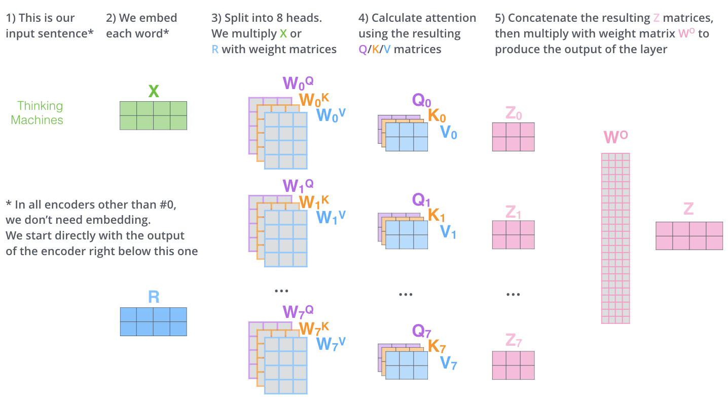
NATURAL LANGUAGE PROCESSING (NLP)
A quick foray…

Slide 26
NATURAL LANGUAGE PROCESSING (NLP)
A quick foray…
Encoder
Output
Encoder
Encoder
Dense
Self-Attention
Input
Encoder

Slide 27
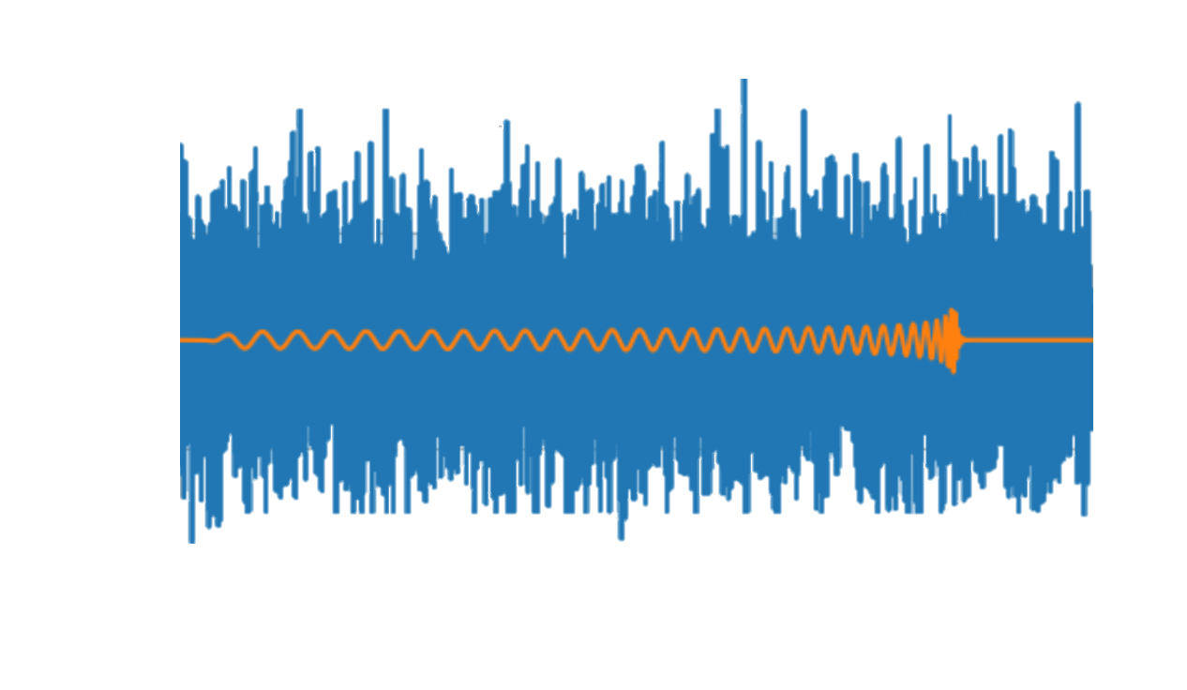
BACK TO GRAVITATIONAL WAVES
0.5446 0.6679
0.4814 0.9332
0.6221 0.8440
0.6403 0.9711
0.9261 0.3278
0.2621 0.3681
0.5446 0.6679
0.4814 0.9332
0.6221 0.8440
0.6403 0.9711
0.9261 0.3278
0.2621 0.3681
0.5446 0.6679
0.4814 0.9332
0.6221 0.8440
0.6403 0.9711
0.9261 0.3278
0.2621 0.3681
0.5446 0.6679
0.4814 0.9332
0.6221 0.8440
0.6403 0.9711
0.9261 0.3278
0.2621 0.3681
0.5446 0.6679
0.4814 0.9332
0.6221 0.8440
0.6403 0.9711
0.9261 0.3278
0.2621 0.3681
0.5446 0.6679
0.4814 0.9332
0.6221 0.8440
0.6403 0.9711
0.9261 0.3278
0.2621 0.3681
SINGLE DETECTOR BBH DETECTION AS PROOF OF CONCEPT
EXPAND TO COHERENT CASE IN FUTURE WORK

Slide 28
Positional Encoding
0.5446 0.6679
0.4814 0.9332
0.6221 0.8440
0.6403 0.9711
0.9261 0.3278
0.2621 0.3681
0.5446 0.6679
0.4814 0.9332
0.6221 0.8440
0.6403 0.9711
0.9261 0.3278
0.2621 0.3681
0.5446 0.6679
0.4814 0.9332
0.6221 0.8440
0.6403 0.9711
0.9261 0.3278
0.2621 0.3681
0.5446 0.6679
0.4814 0.9332
0.6221 0.8440
0.6403 0.9711
0.9261 0.3278
0.2621 0.3681
0.5446 0.6679
0.4814 0.9332
0.6221 0.8440
0.6403 0.9711
0.9261 0.3278
0.2621 0.3681
0.5446 0.6679
0.4814 0.9332
0.6221 0.8440
0.6403 0.9711
0.9261 0.3278
0.2621 0.3681
+ Positional Encoding

Slide 29
CNN* Transformer Conv Transformer
Conv 64, 8
Conv 1, 128
Conv 64, 8
Conv 32, 8
Conv 32, 8
+ positional encoding
Accuracy
Conv 32, 16
Conv 32, 16
Transformer Encoder
Conv 16, 16
Conv 16, 16
Conv 16, 32
Conv 16, 32
Conv 16, 32
Dense 512
Conv 16, 128
Dense 2
+ positional encoding
Dense 64
Transformer Encoder
Dense 2
SNR
*Architecture from Gabbard et al. https://journals.aps.org/prl/abstract/10.1103/PhysRevLett.120.141103
Dense 512
Dense 2

Slide 30
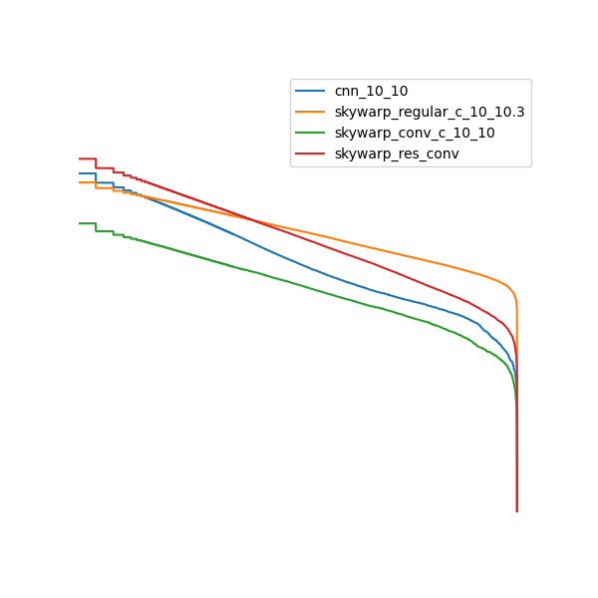
Preliminary Results
Accuracy
SNR

Slide 31
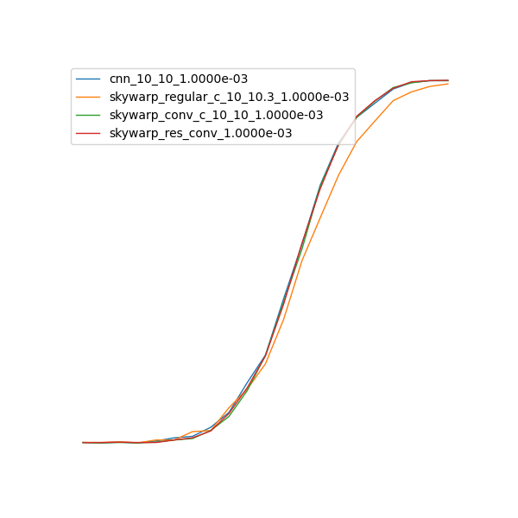
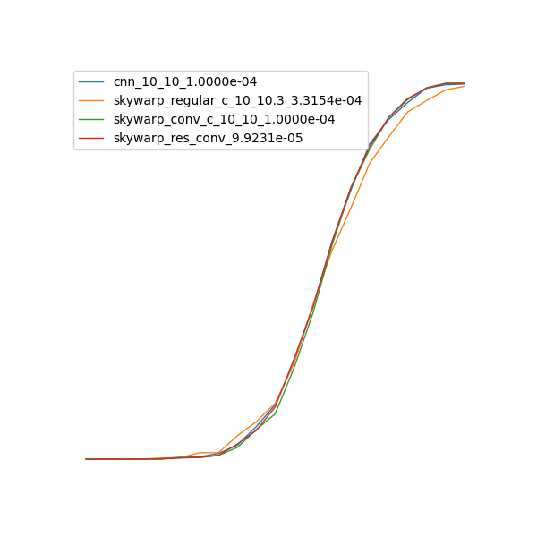
Preliminary Results
Accuracy
SNR

Slide 32
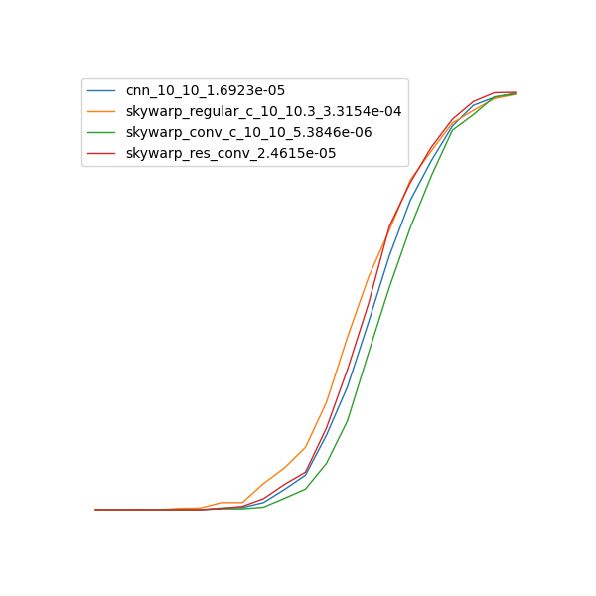
Preliminary Results
Accuracy
SNR

Slide 33
FUTURE PLANS
Extend to multi detector case for coherent analysis
Special encoding as well as temporal
Detector agonistic - spatially and perhaps also conditioned on PSD

Slide 34
FUTURE PLANS – UNICRON
+ spacial token
+ Positional Encoding
Classification
Signal reconstruction at earth centre coordinates?
Accuracy
UNICRON
+ spacial token
+ Positional Encoding
SNR
Vary detector positions during training

Slide 35
ANY QUESTIONS?
Michael Norman, Kyle Willets, Wasim Javed, Vasileios Skliris, Patrick Sutton

