Slide 1

Automated Optimisation of Industrial X-Ray CT
Iwan T. Mitchell, Franck P. Vidal
i.t.mitchell@bangor.ac.uk
November 2022

Slide 2
Talk Outline
X-ray CT - What is it?
  What is Computed Tomography?
  Medical and Industrial Scanners
  Filtered Back Projection Reconstruction
Simulating virtual X-rays
  X-ray Equation and Monte-Carlo Methods
  Fast Reconstruction with GPU
  WebCT – Interactive and accurate X-ray scanner simulator for training and planning
Optimising Scanners
  Automatic CAD Model Registration
  Future Work

Slide 3
X-ray CT - What is it?
A brief primer on X-ray Computed Tomography

Slide 4
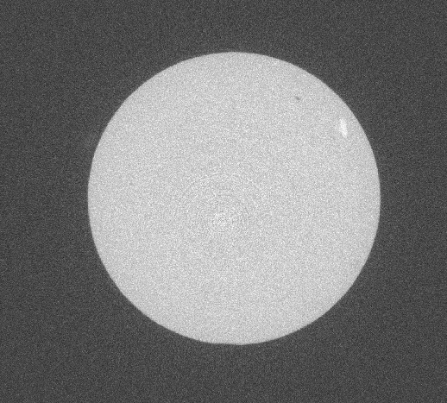
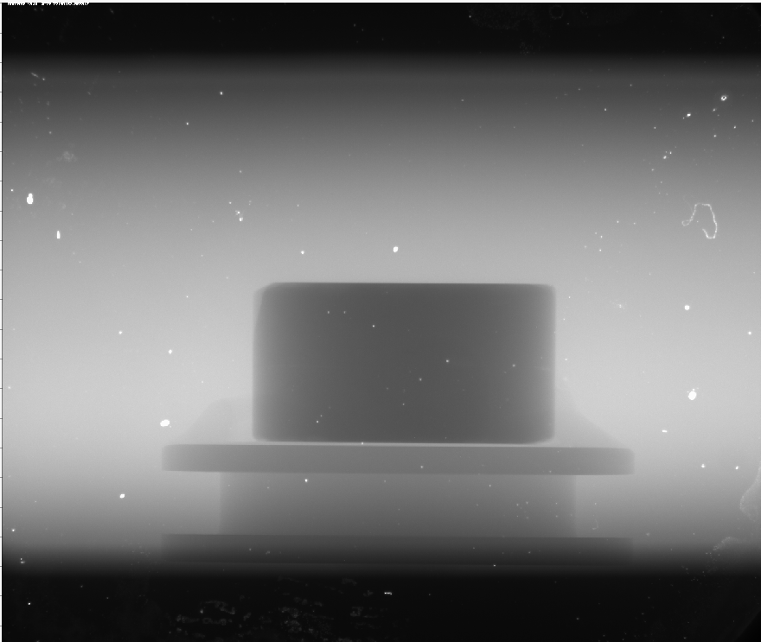
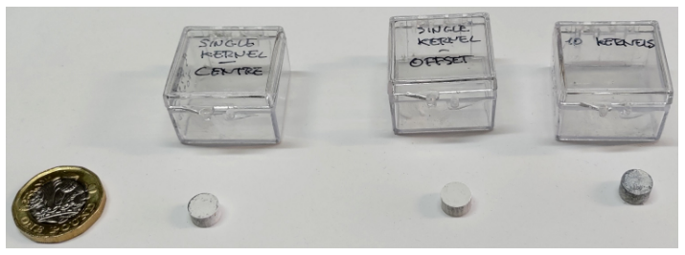
X-ray Computed Tomography
Tomography is the practice of using penetrating waves to generate arbitrary image slices from objects.
Multiple X-ray images are taken at different angles around an object, and used to create a volumetric image using reconstruction.
X-ray CT is one of the most popular methods for visualising interiors of objects, and has many practical applications.
Sample
X-ray Radiograph
Tomographic Reconstruction

Slide 5
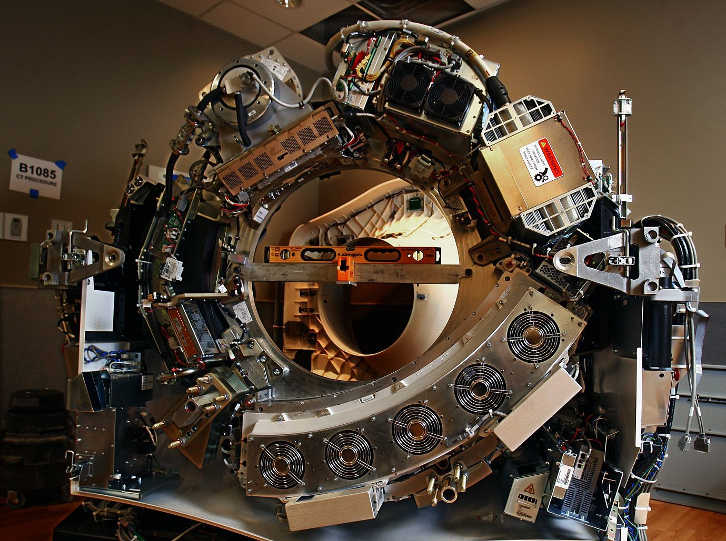
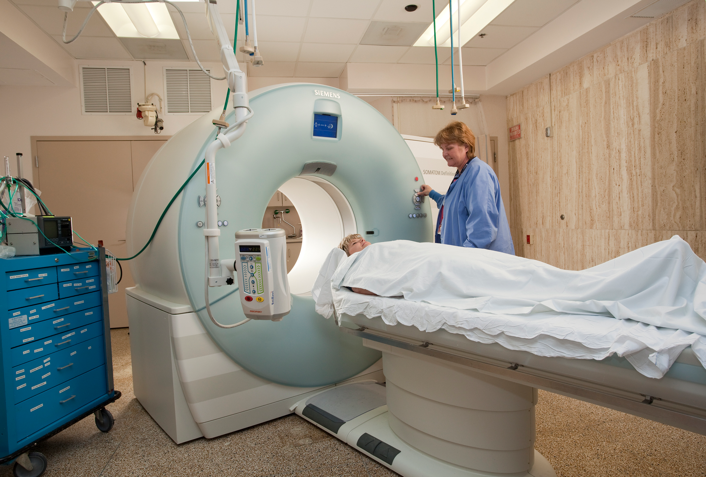
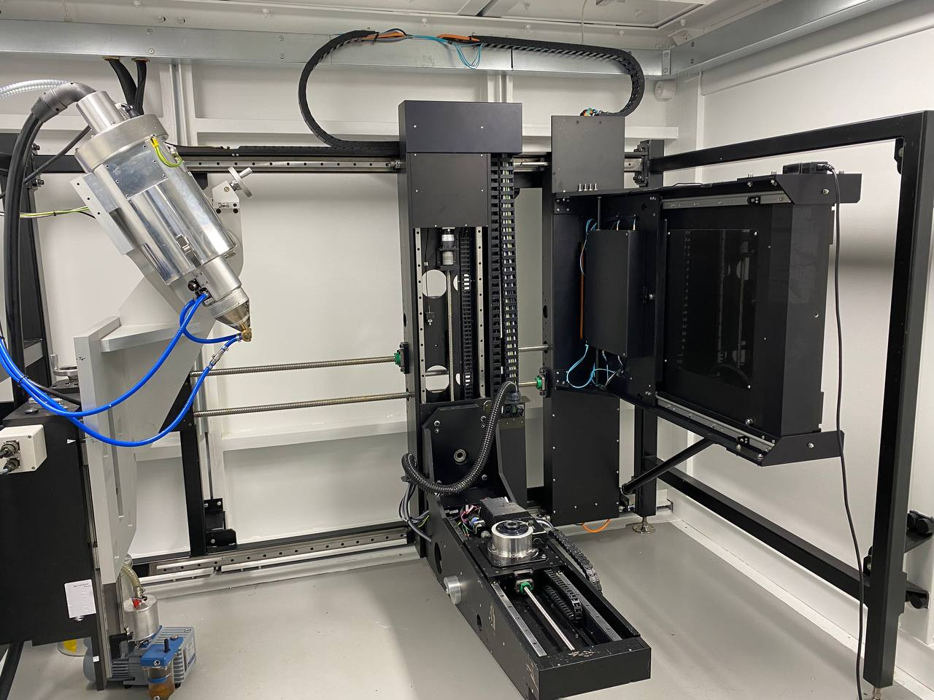
Two Approaches to XCT
Medical Scanning Devices
Lab/Industrial Scanning
X-Ray Beam
X-Ray Detector

Slide 6
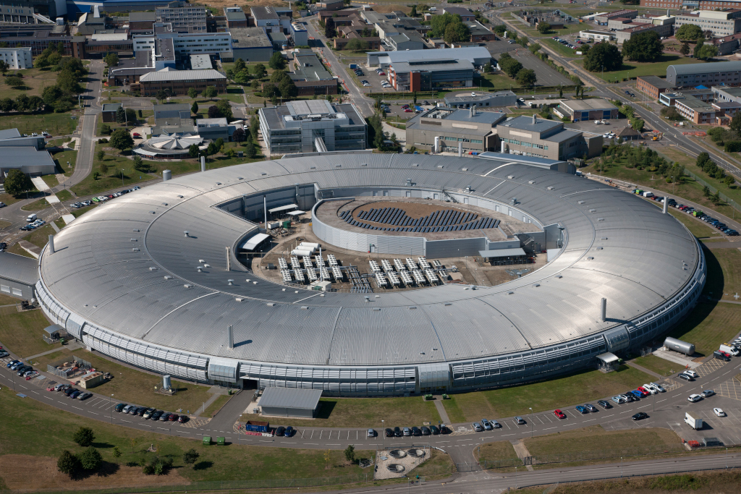

… Technically three approaches
Synchrotron sources use particle acceleration to generate high-flux parallel beams.
Similar to custom Lab CT methods, with dramatically different beamline setups and detectors.
Getting access is a multi-month process including bidding applications, months of review, and plenty of waiting.

Slide 7
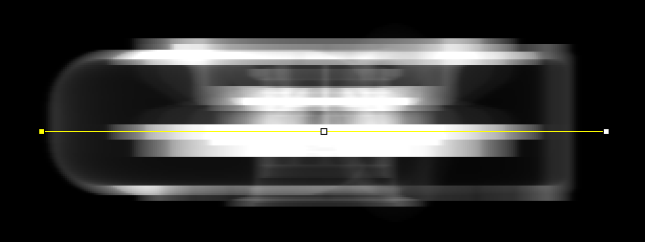
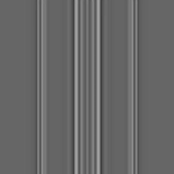
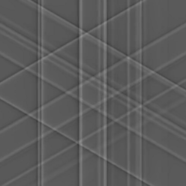
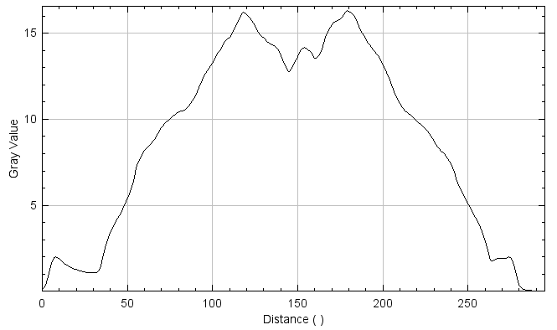
Reconstruction with FBP
Filtered Back Projection is a simple and commonly used method to perform a tomographic reconstruction using x-ray radiographs.

Slide 8
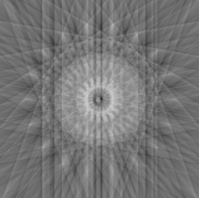
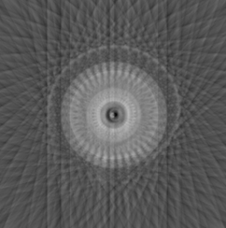
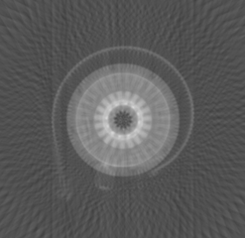
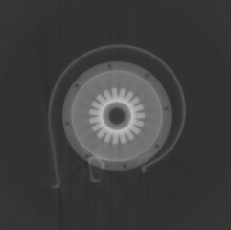
Reconstruction with FBP
10 Projections
20 Projections
50 Projections
200 Projections

Slide 9
Simulating virtual X-rays
Recreating scanners in the virtual world.

Slide 10
X-Ray Simulation
X-Ray simulation is increasing in popularity with the push towards digital twinning, component testing and machine learning.
Simulated results can answer feasibility questions without requiring beam time. Can you scan this component on your setup? What is the best tube voltage? Etc.
Due to the dramatic number of parameters, current machine learning models are bespoke for each scanning environment and require retraining if the environment changes.
  One example: Noise profile between different scanning setups can dramatically affect standard neural-network classifiers.
XCT machines are super expensive!!
  A single lab μ-XCT machine costs about £1.5 million (~₩2.4 billion).
  Often time is rented from machine owners, with a high cost per hour.

Slide 11
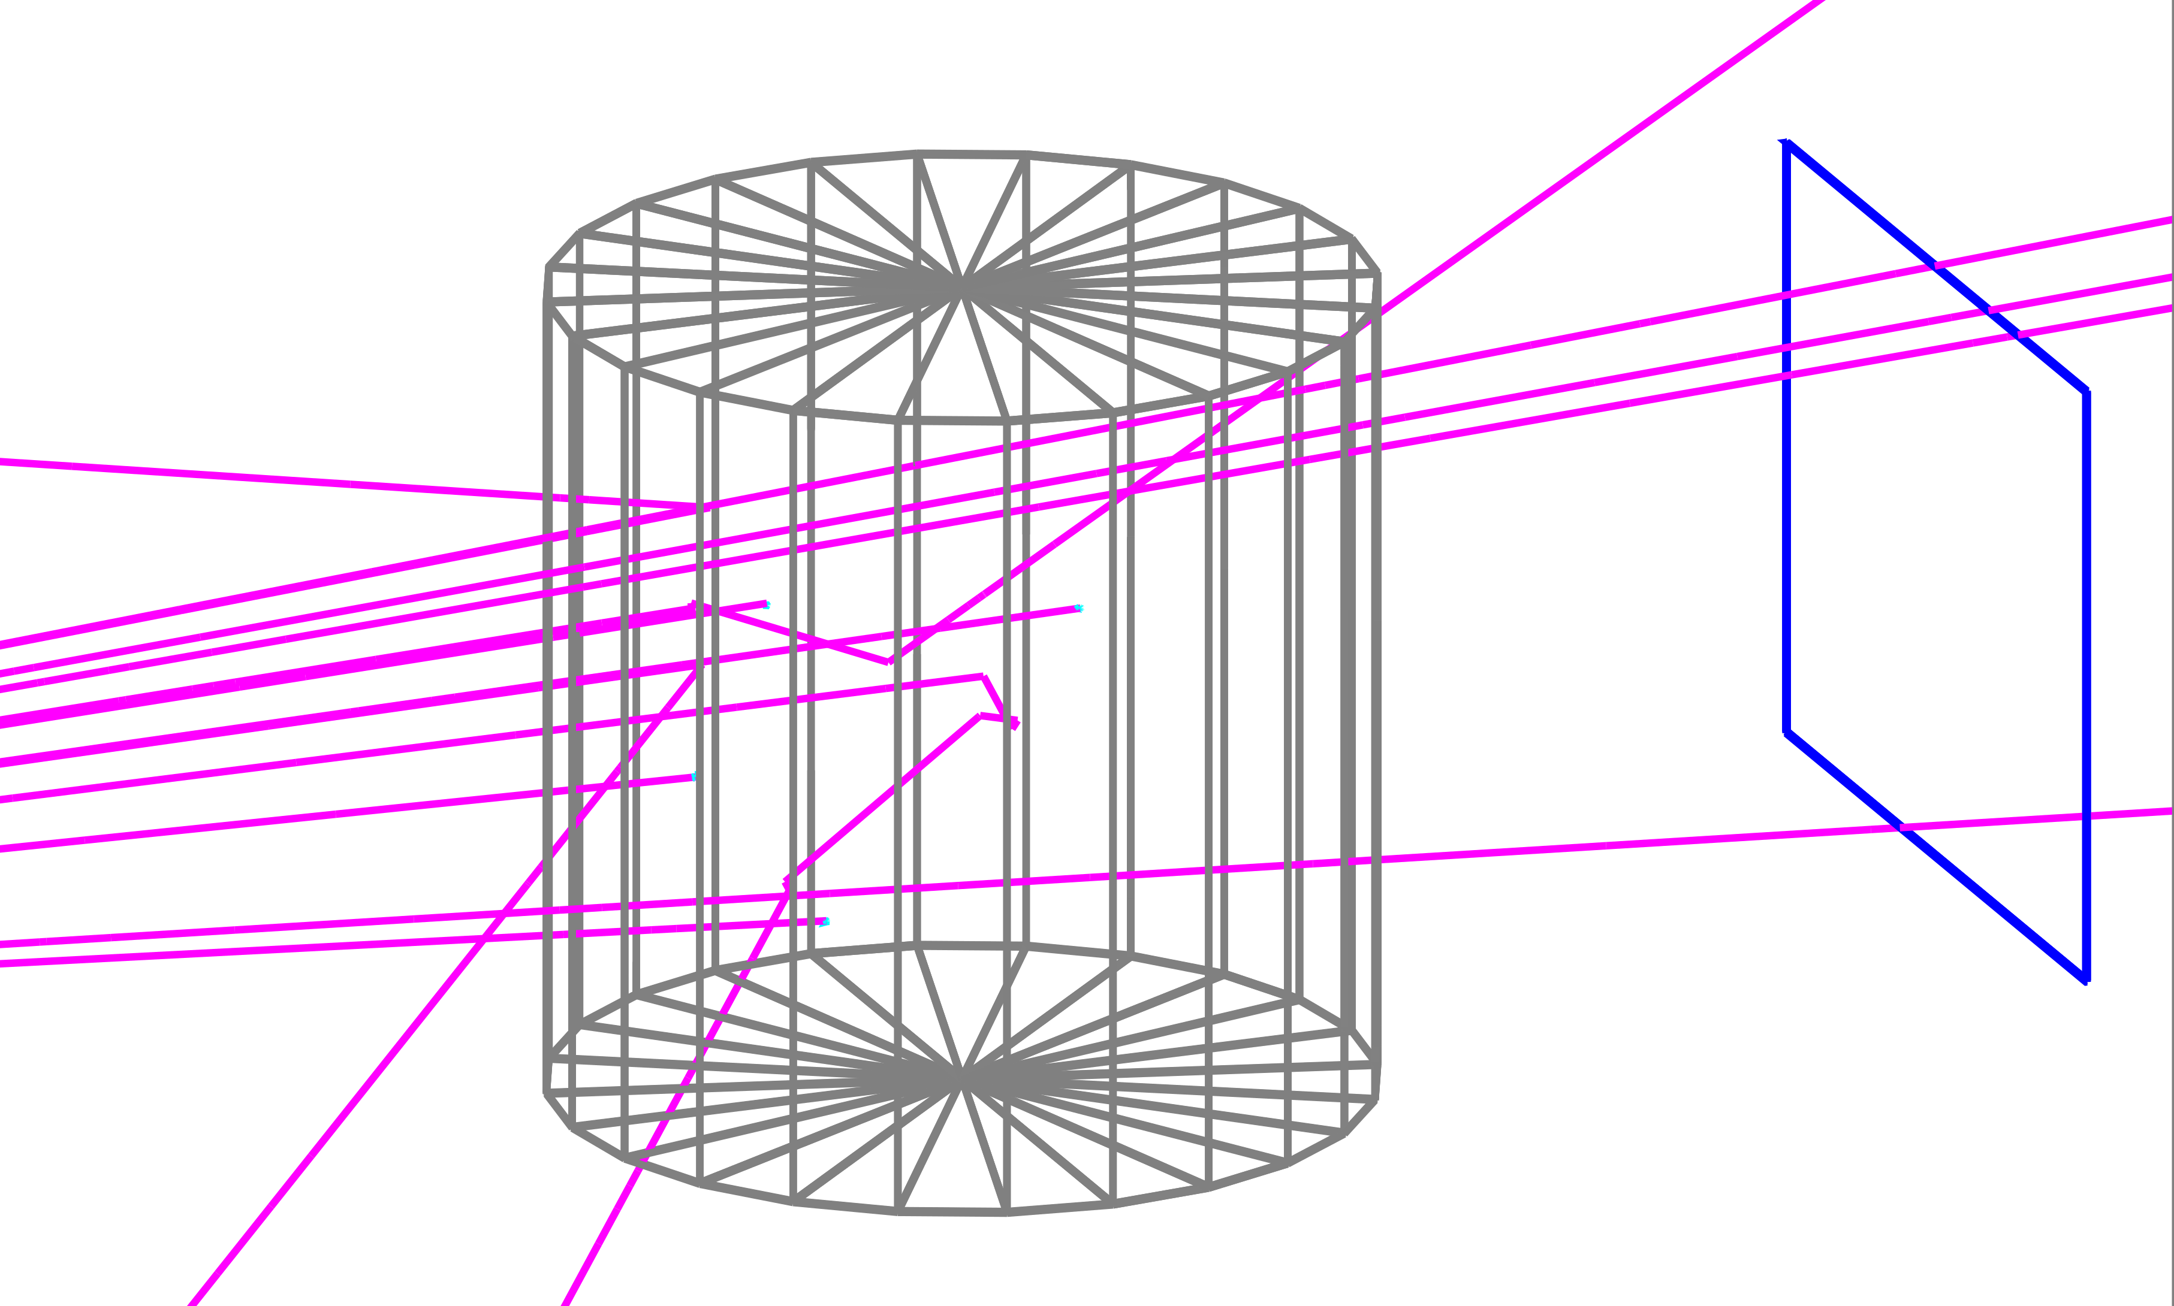
The Beer-Lambert Law
X-ray imaging works by detecting the number of photons that don’t interact with a sample.
Higher attenuating materials will more often interact with photons and reduce the count rate.

Slide 12
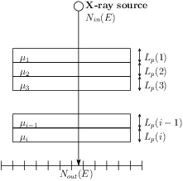
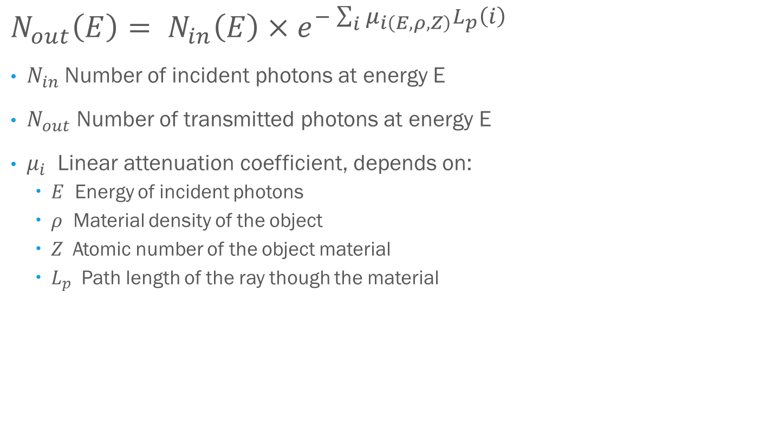
The Beer-Lambert Law
$$N_{out}\left(E\right)= N_{in}\left(E\right)×e^{−\sum_{i}{μ_{i\left(E, ρ,Z\right)}L_{p}\left(i\right)}}$$
$N_{in}$Number of incident photons at energy E
$N_{out}$ Number of transmitted photons at energy E
$μ_{i}$ Linear attenuation coefficient, depends on:
  $E$ Energy of incident photons
  $ρ$ Material density of the object
  $Z$ Atomic number of the object material
  $L_{p}$ Path length of the ray though the material

Slide 13

Monte-Carlo Simulations
A very common approach for simulating X-rays is to use the Monte-Carlo method.
Monte-Carlo methods allow for accurate simulation of every individual photon, resulting in the most realistic simulations.
However, Monte-Carlo simulations are dramatically slow, with even a single projection taking multiple hours or days on a supercomputer.
  Not everyone has a super computer.
  Waiting multiple months for one CT scan makes rapid iteration impossible.
Lack of speed dramatically hinders artificial dataset generation for machine learning applications.

Slide 14
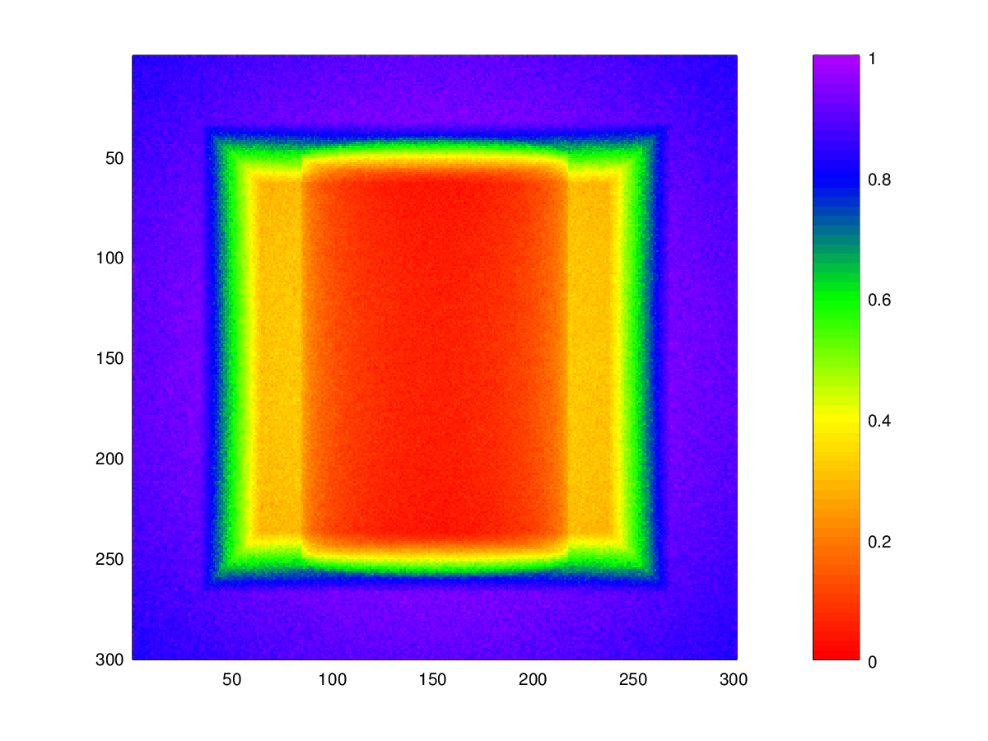
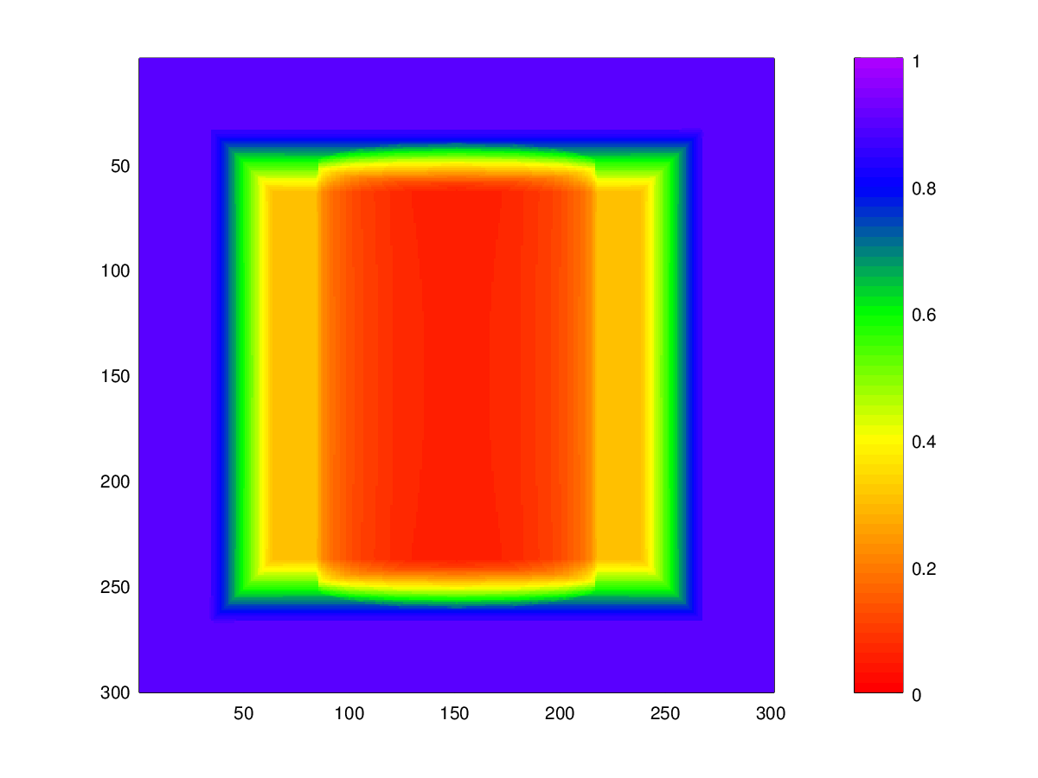
GPU-Accelerated Simulations
Software exists for utilizing the large parallel processing of GPUs to simulate X-ray images, however most are commercial non-scriptable software.
gVirtualXRay is an open-source library developed by Dr. Frank Vidal at Bangor University which provides accurate and validated X-ray simulation at real-time speeds.
GATE Monte-Carlo Simulation
(2 Weeks on a supercomputer)
gVXR GPU Simulation
<100ms on a laptop

Slide 15
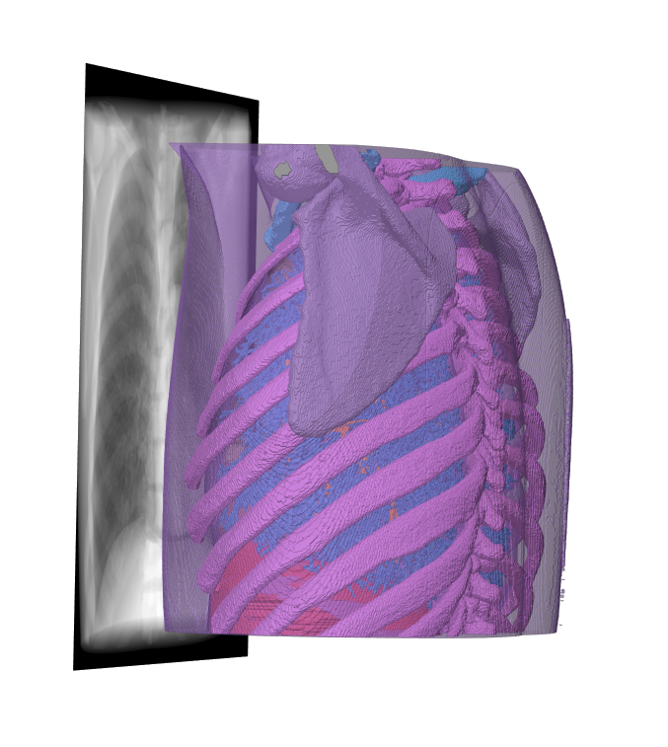

GPU-Accelerated Simulations

Slide 16


WebCT: Web-based X-ray CT Simulator
Beam Spectra Generation
Fast X-Ray Simulation
CT Reconstruction Libraries
Xpecgen
ASTRA Tomography Toolbox
TIGRE GPU Reconstruction Library
Spekpy

Slide 17
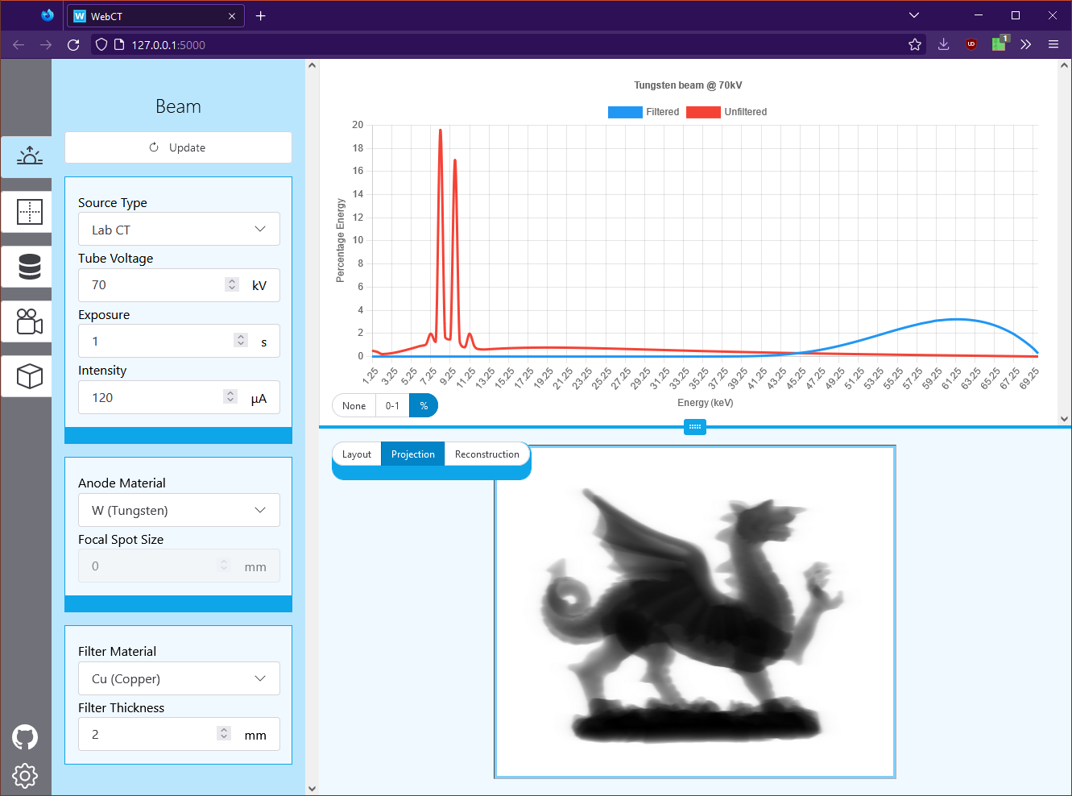
WebCT: Web-based X-ray CT Simulator
Lowers the barrier of entry for X-ray simulation.
Perfect for planning scanning parameters before wasting beamtime.
Rapidly prototype beam sources, detectors, models, materials, reconstruction parameters, etc…
All data and configuration is exportable for use with bulk-processing applications.

Slide 18
Optimising Scanners
Novel methods of using ML on scanning parameters

Slide 19
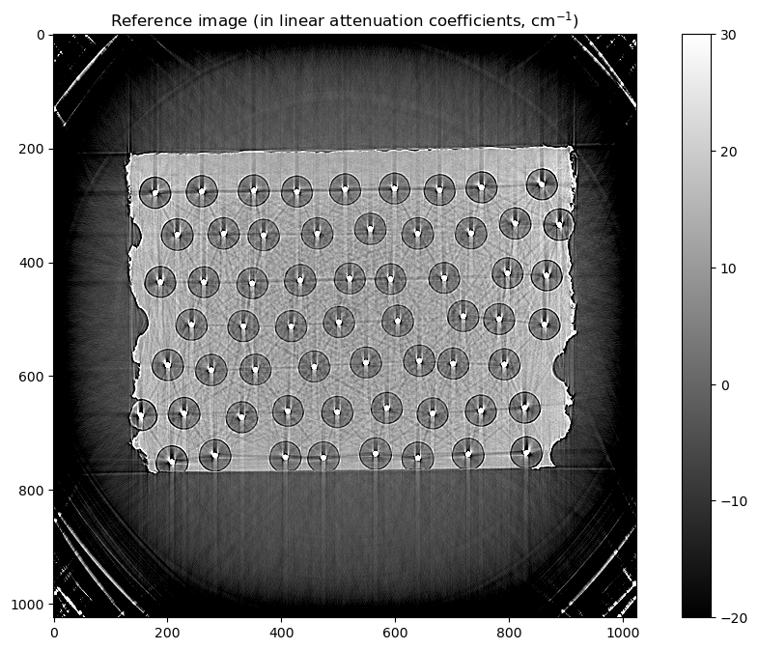
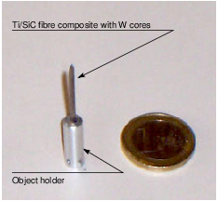
Automatic CAD model registration
Most ML done using X-ray CT data is a forward process;- data analysis is done on the final product (CT slices).
The power of rapid simulation allows us to perform the inverse;- using final data to change our experiment configuration.
The use of optimisers allow us to use comparison methods to change model geometry for accurate sample reconstruction, even in the presence of heavy artefacts.
Vidal, F.P., Mitchell, I.T. and Létang, J.M. (2022) “Use of fast realistic simulations on GPU to extract CAD models from microtomographic data in the presence of strong CT artefacts,” Precision Engineering, 74, pp. 110–125. Available at: https://doi.org/10.1016/j.precisioneng.2021.10.014.

Slide 20
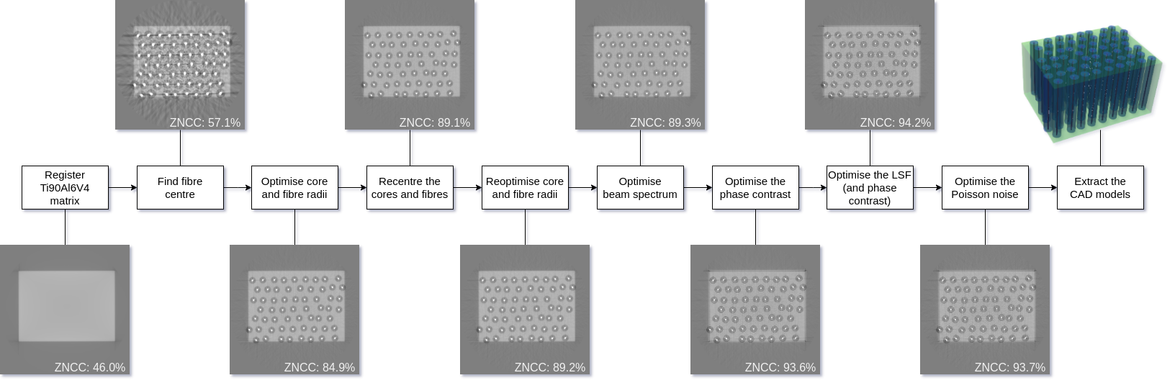
Automatic CAD model registration
Vidal, F.P., Mitchell, I.T. and Létang, J.M. (2022) “Use of fast realistic simulations on GPU to extract CAD models from microtomographic data in the presence of strong CT artefacts,” Precision Engineering, 74, pp. 110–125. Available at: https://doi.org/10.1016/j.precisioneng.2021.10.014.

Slide 21
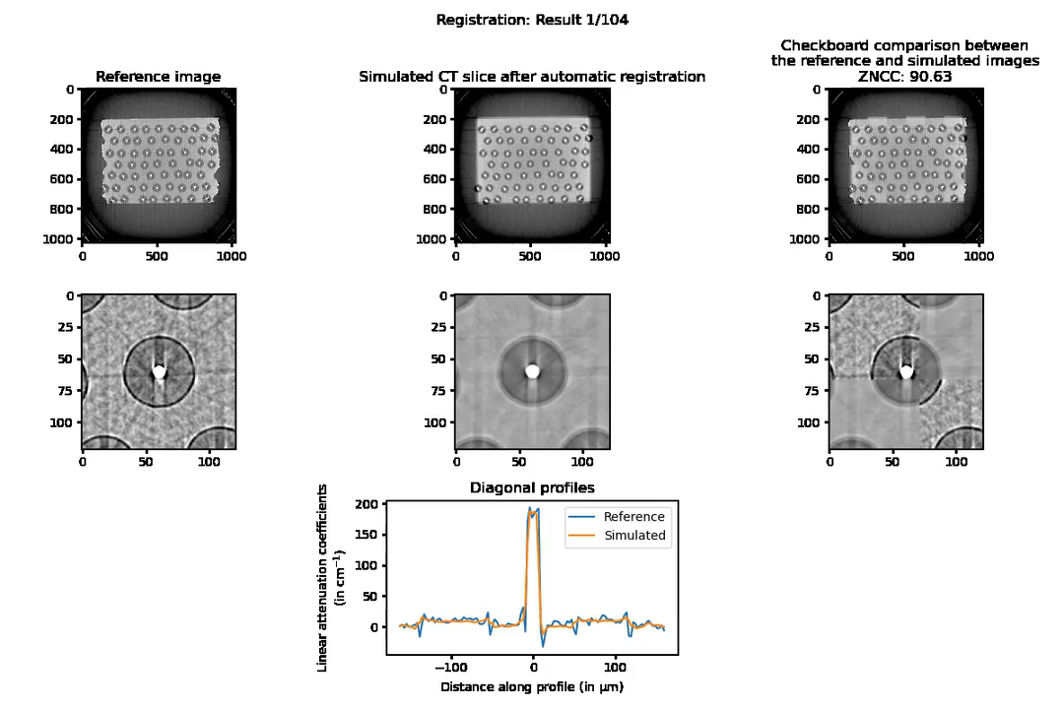
Automatic CAD model registration
Vidal, F.P., Mitchell, I.T. and Létang, J.M. (2022) “Use of fast realistic simulations on GPU to extract CAD models from microtomographic data in the presence of strong CT artefacts,” Precision Engineering, 74, pp. 110–125. Available at: https://doi.org/10.1016/j.precisioneng.2021.10.014.

Slide 22
Future Work
The virtual scanning setup allows for rapidly X-raying different versions of components with accurate results compared to real-life scanning.
  Current work is based around defects in nuclear fuel pellets, where scanning quality on lab setups is bad due to the highly attenuating uranium.
Since we can represent physical scanners, creating a database of validated real-world scanning setups could be used to optimize per-scanner configurations.
  E.g material-aware lab scanner tuning for maximum feature contrast.
Simulations enable splitting artefacts separately from the ‘perfect’ scan.
  With a large training set, it should be feasible to create a classifier.

Slide 23
Thanks for Listening

Slide 24
Appendix - Links
gVirtualXRay: https://sourceforge.net/projects/gvirtualxray/
  Python package: https://pypi.org/project/gVXR/
WebCT: https://webct.io
  Still in active development

