Slide 1


Novel Classes and Epistemic Uncertainty In Medical Imaging
Will Robinson (wgr)
Supervised by Bernie Tiddeman and Reyer Zwiggelaar

Slide 2
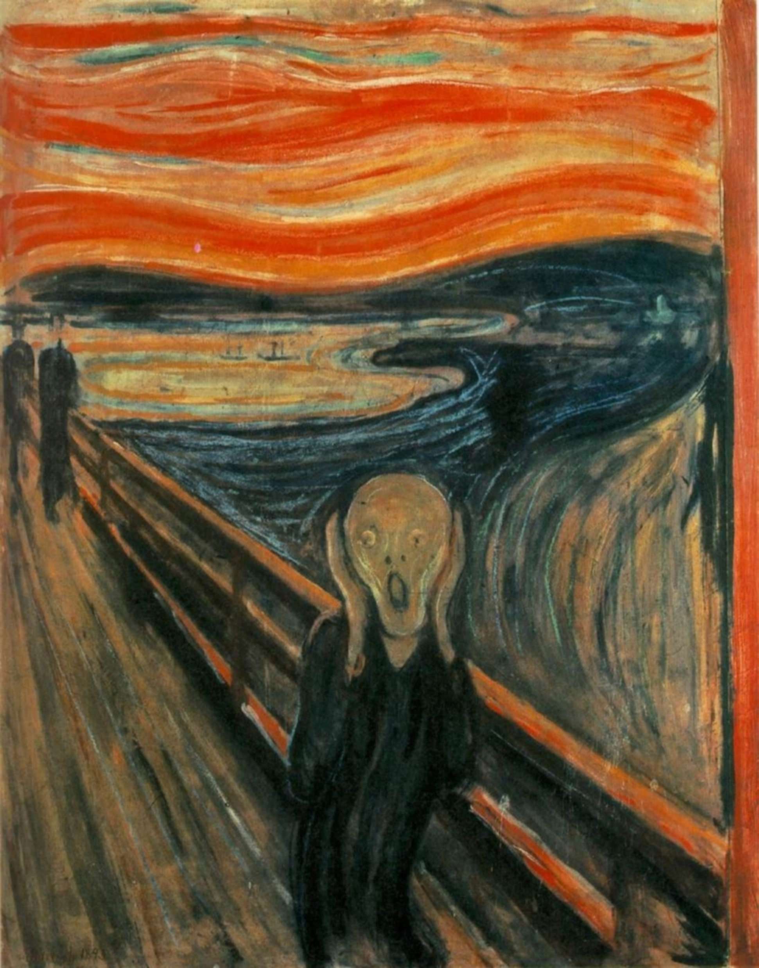
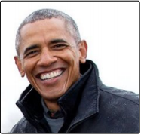
The Out-of-Distribution Problem
Unknown examples produce unpredictable behaviour
Error and Overconfidence
Image Recognition networks the best-known examples
Dust Cover, 52% confidence (ResNet 152)
Tench, 36% confidence (DenseNet 161)
A. Shafaei, M. Schmidt and J. J. Little, "A Less Biased Evaluation of Out-of-distribution Sample Detectors," in British Machine Vision Conference, Cardiff, 2019.

Slide 3
The Matrix of Knowledge Problems
Philosophical “Knowledge Problem” deals with epistemological standpoint
“Known unknowns” etc.
More useful to consider systemic attributes.
Is the information valid?
Does it remain constant within the dataset?
 | Constant | Inconstant
Valid | Novel Class | Domain Shift
Invalid | Classed Noise | Junk Data

Slide 4
Medical Imaging Uncertainty
The medical imaging literature uses a different taxonomy
Aleatoric Uncertainty describes predicable statistical error caused by human variance
Epistemic Uncertainty describes underlying situations distorting the distribution
Some sources of error can be described in both ways (eg juvenile hypertrophy – underlying unspecified distorting factor, but is part of human biological variance)

Slide 5

The Topology of Error
A different way of looking at the problem is by envisaging the complete set of possible samples as a hyperspace. We can then model several volumes within that hyperspace.
Aleatoric Domain
The original training distribution forms an irregular volume. Statistical variation will mean that there will be a “halo” of valid samples around that volume. This is the aleatoric domain.

Slide 6
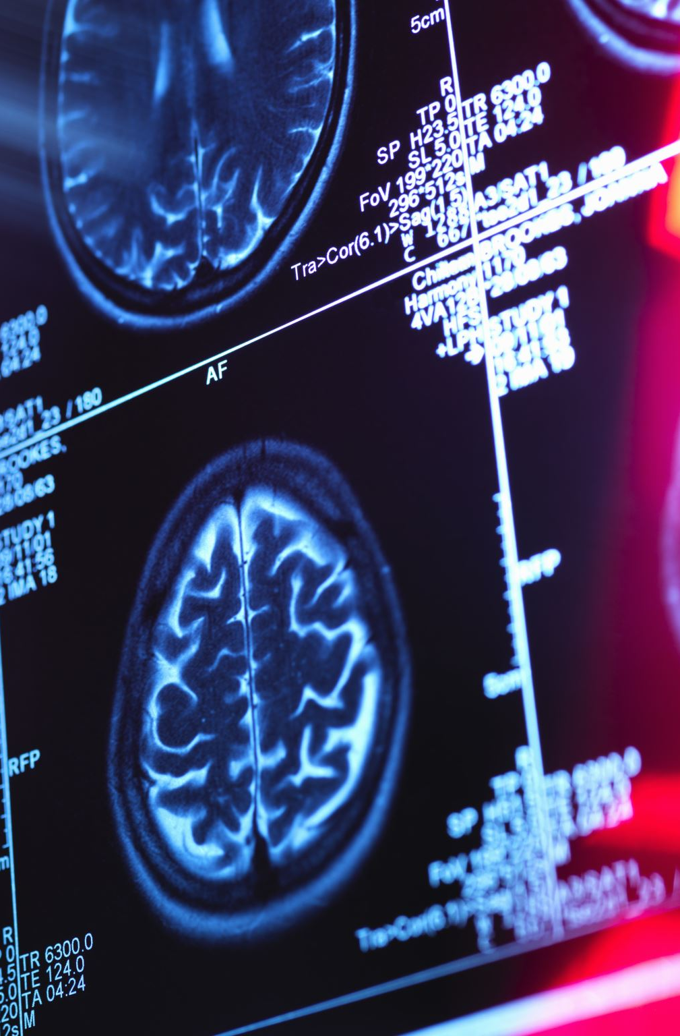
Bounding Aleatoric Uncertainty
PAC-Bayes is a major field of interest for bounding ML models.
Stochastic neural networks can be used to sustain the entire embedding space as a set of likelihood ratios instead of sample points (analogous to Variational Autoencoders).
All bounding models have a habit of finding vacuous bounds (likelihood higher than 1.0), especially on high-variance datasets.
Recent work has successfully found non-vacuous bounds on stochastic convolutional models for medical imaging (Sicilia et al 2021)
Since these bounds are derived from the training data, they are inherently unable to bound the validity volume.

Slide 7
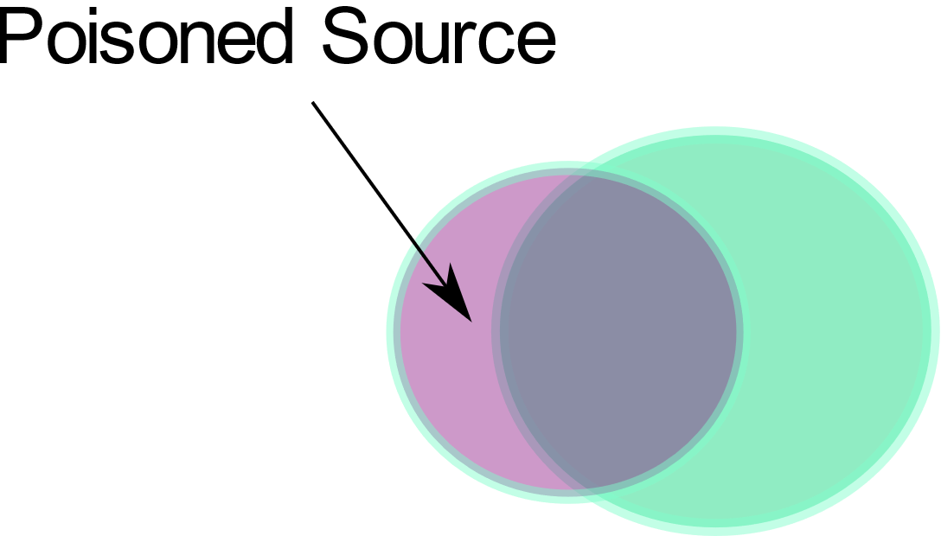
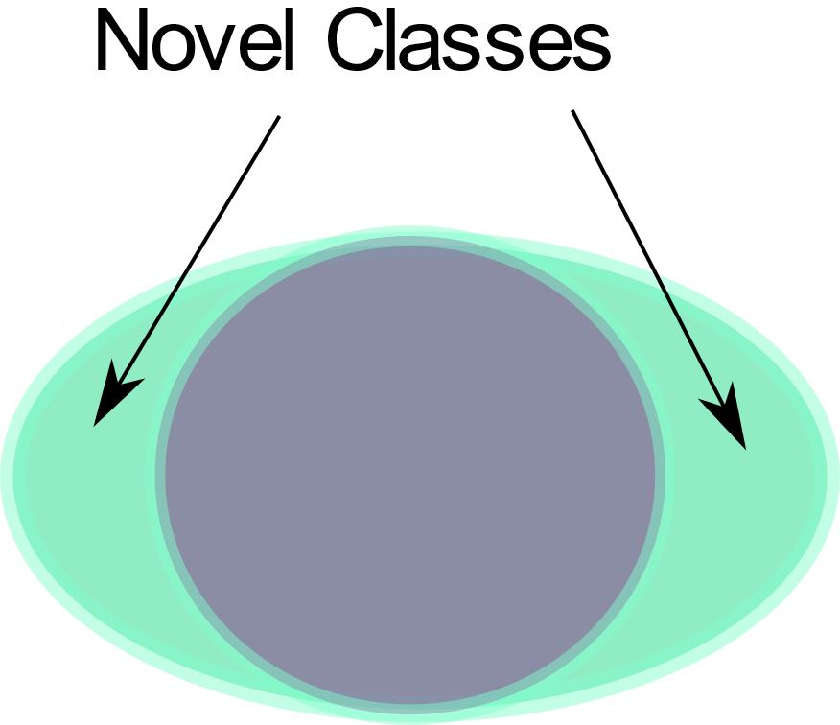
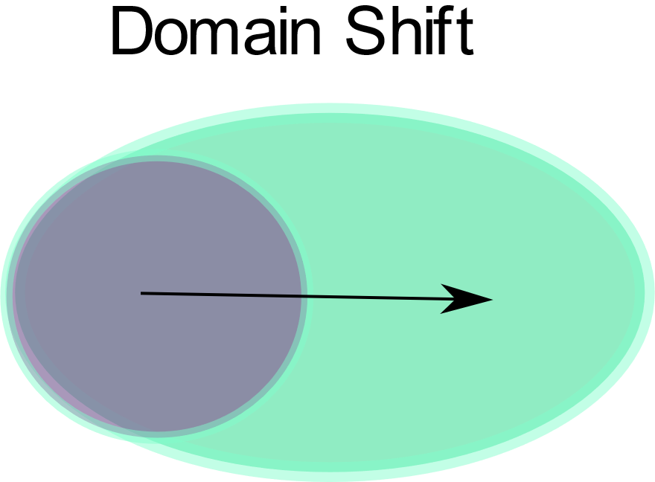
Epistemic Errors
We can presume a volume of all possible valid samples. This is the epistemic domain, whose bounds are defined by domain validity rather than statistical variance.
These forms of error extend from differences between the training volume and the epistemic domain. Each type of error can only be bounded with underlying domain knowledge.

Slide 8
Measures of Epistemic Uncertainty
While we cannot universally bound epistemic uncertainty, we can use domain knowledge to measure specific elements of the validity volume.
Examples:
Dropped Class (Novel Class)
Contextual Interpolation (Domain Shift)
Adversarial Retraining (Distributional Invalidity)
Note that these are harder to do with medical imaging than classical image sets, as medical error is both complex and infrequent.

Slide 9
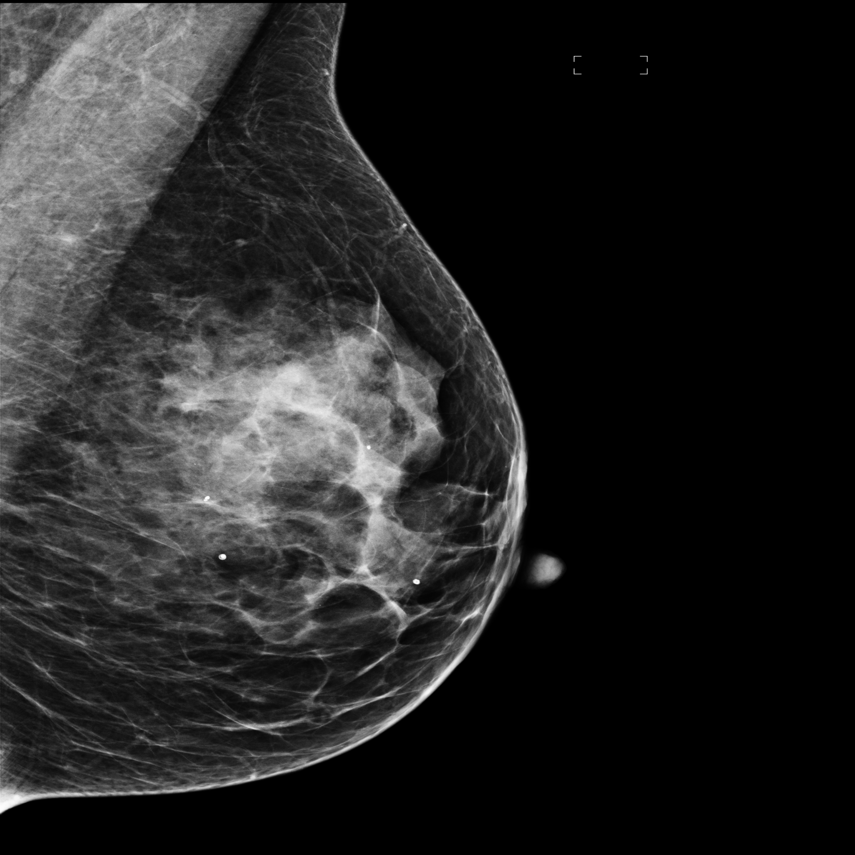
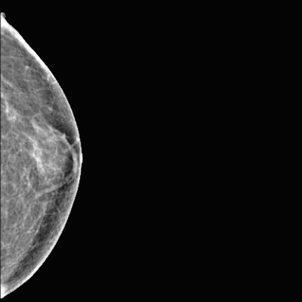
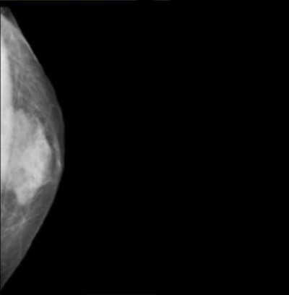
Novel Class Problems
Cross-domain class of problem
One or more unseen classes
Valid / Constant
Linear Example: Hexadecimal MNIST
Orthogonal Example: Gynecomastia/Juvenile Hypertrophy
Sources: OPTIMAM, Public Domain Collection

Slide 10
Novel Class Ensemble
Concept
Classes naturally share much in common.
NNs find an exclusionary minimum
Therefore it is hard to train a non-linear function around a subset of existing classes which includes potential classes
Distinguishing one class from the others would produce a set of representations of distinctions
The idea – does this set of distinctions in summation produce a representation of the elements of a “generic class”?
Additional questions
Is there an effect from the relative inter-class similarity?
Underfitting? Overfitting?

Slide 11
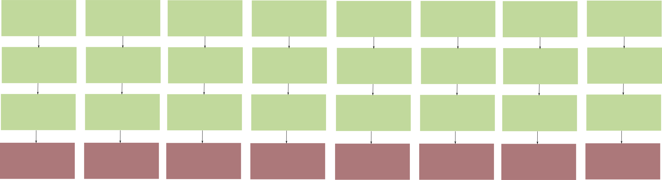
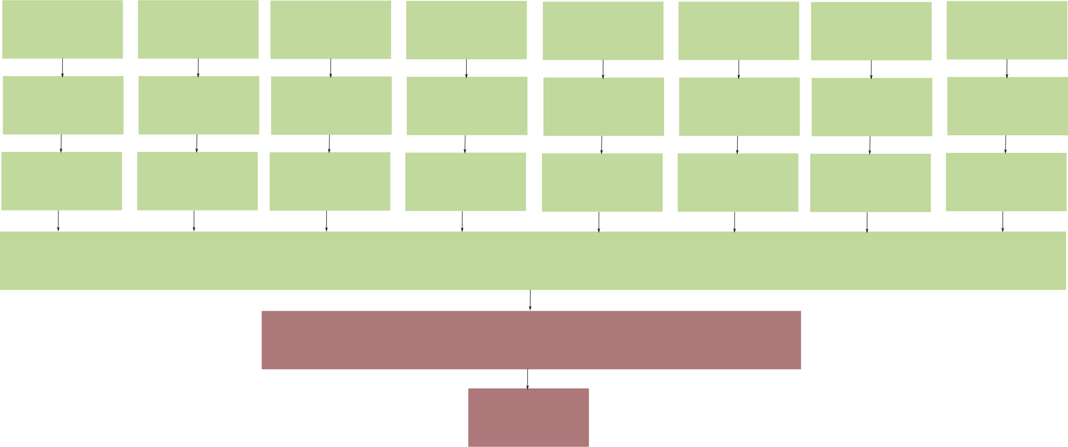
Novel Class Ensemble
Architecture
Step 1: Ensemble of n-2 simple convolutional subnetworks pretrained as binary classifiers for one class.
Step 2: Combine locked ensemble filter outputs together into a larger network
Step 3: Train combined network to recognise one dropped class from noise/junk
Step 4: Test combined network on remaining dropped class and noise/junk

Slide 12
Novel Class Ensemble Results
Single-class accuracy (baseline 0%/33%):
MNIST 35%
CIFAR 16%
Note that in both cases the ensemble can distinguish junk data with very high accuracy (>95%).
Mean SSIM between all classes:
MNIST: 0.38670
CIFAR: 0.18803

Slide 13
Medical Imaging Application
High structural similarity (especially in mammography)
However, many medical classes are not discrete, but instead progressive (eg BIRADS)
Dropped class not usable for binary classification or segmentation
Skin cancer provides a convenient discrete class problem
ISIC 2018 and 2019 provide convenient examples

Slide 14
Current Challenges
Network is often unstable
ISIC sets produce degenerate inter-class distinctions
Unbalanced datasets
Overfitting in combined network

Slide 15
Summary
Out-of-distribution (OOD) problems
Taxonomies of Error
Aleatoric vs Epistemic Uncertainty
Novel Class Problems
Ensemble of Binary Subnetworks
Early positive results
Lots of work to do!

