Slide 1

Nucleon with One Dynamical Gluon in
Basis Light-Front Quantization
Siqi Xu
With
Xingbo Zhao, Chandan Mondal,
Yang Li, James Vary
Institute of Modern Physics , Chinese Academy of Sciences
Lanzhou, China
Light Cone 2021 : Physics of Hadrons on the Light Front
November 28- December 4, 2021, Jeju island, Korea

Slide 2
Outline
Basis Light-Front Quantization (BLFQ)
Nucleon Structure in BLFQ
  Nucleon Structure with leading Fock Sector
  Nucleon Structure with One Dynamical Gluon
Conclusion

Slide 3
Basis Light-Front Quantization
Solve the time-independent Schrödinger Equation:
[Vary, et.al, Phys.Rev.C ’10]
$$P^{−}\left|\left.β\right\rangle =P_{β}^{−}\right|\left.β\right\rangle$$
$P^{−}$: Light-Front Hamiltonian;
$|\left.β\right\rangle$: Eigenstates;
$P_{β}^{−}$: Eigenvalues for eigenstates.
Quantum numbers of basis states in BLFQ:
Longitudinal direction
  — discrete longitudinal momentum (labeled by k):
Transverse direction
  — 2-dimensional harmonic oscillator (labeled by n , m)
$$P^{+}=\frac{2π}{L}k$$
Truncation : $\left\{\begin{aligned}Nmax \\ Kmax\end{aligned}\right.$
$$Φ_{n,m}^{b}\left(p_{⊥}\right)=\frac{1}{b\sqrt{π}}\sqrt{\frac{n!}{\left(n+\left|m\right|\right)!}}e^{−\frac{p^{2}}{2b^{2}}}e^{−imφ}{\left(\frac{p}{b}\right)}^{\left|m\right|}L_{n}^{\left|m\right|}(\frac{p^{2}}{b^{2}})$$
Prof. Xingbo Zhao’s Talk
At Firday noon, QCD AB II
4/16

Slide 4
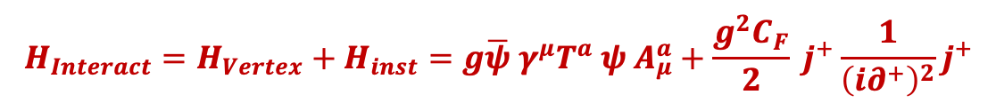

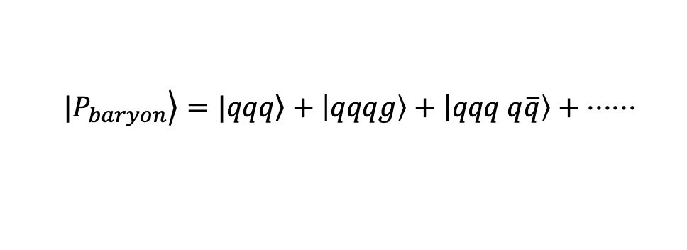
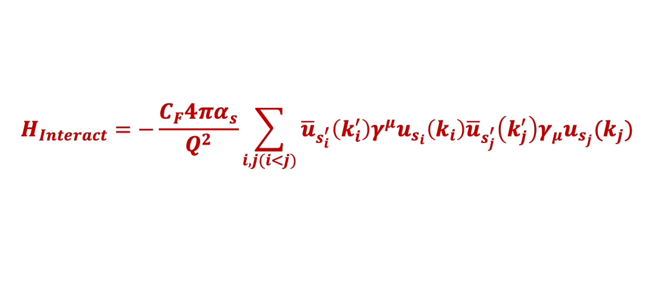
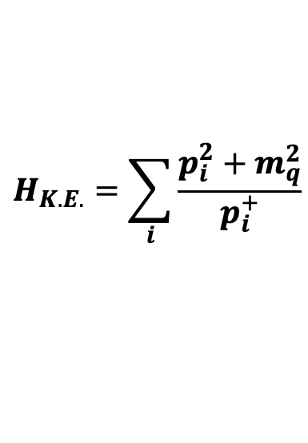
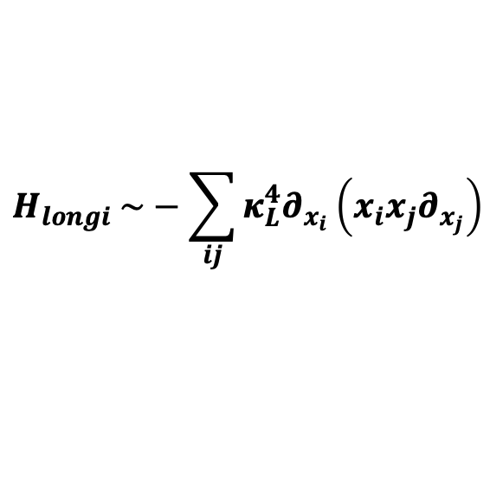
Light-Front Hamiltonian
$$P^{−}=H_{K.E.}+H_{trans}+H_{longi}+H_{Interact}$$
$$H_{K.E.}=\sum_{i}{\frac{p_{i}^{2}+m_{q}^{2}}{p_{i}^{+}}}$$
$H_{trans} \sim κ_{T}^{4}r^{2}$
-- Brodsky, Teramond arXiv: 1203.4025
$$H_{longi} \sim −\sum_{ij}{κ_{L}^{4}∂_{x_{i}}\left(x_{i}x_{j}∂_{x_{j}}\right)}$$
---Y Li, X Zhao , P Maris , J Vary, PLB 758(2016)
  $$|\left.P_{baryon}\right\rangle =|\left.qqq\right\rangle +\left|qqqg\right\rangle +\left|qqq q\overline{q}\right\rangle + ⋅⋅⋅⋅⋅⋅$$
Only include first Fock sector
$$H_{Interact}=−\frac{C_{F}4πα_{s}}{Q^{2}}\sum_{i,j(i<j)}{{\overline{u}}_{s_{i}^{′}}\left(k_{i}^{′}\right)γ^{μ}u_{s_{i}}\left(k_{i}\right){\overline{u}}_{s_{j}^{′}}\left(k_{j}^{′}\right)γ_{μ}u_{s_{j}}(k_{j}) }$$
Include the first and second Fock sector
$$H_{Interact}=H_{Vertex}+H_{inst}=g\overline{ψ} γ^{μ}T^{a} ψ A_{μ}^{a}+\frac{g^{2}C_{F}}{2} j^{+}\frac{1}{{\left(i∂^{+}\right)}^{2}}j^{+}$$

Slide 5
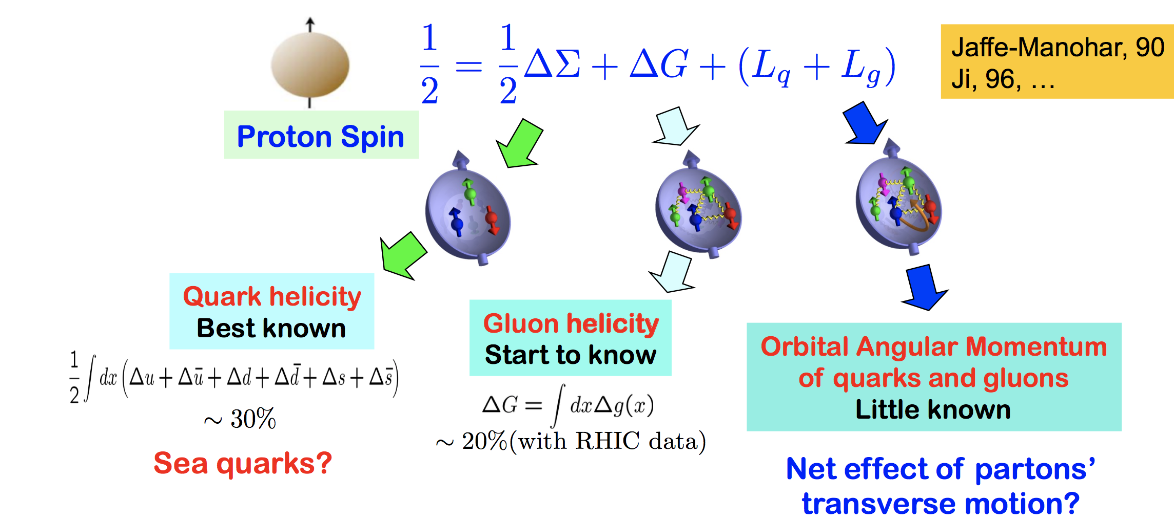
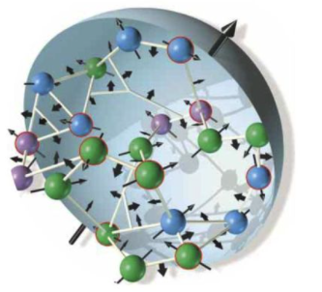
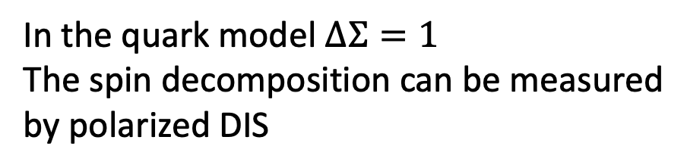
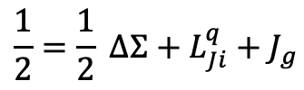
Angular Momentum Distributions
Spin decomposition
Jaffe-Manohar Decomposition
In the quark model $ΔΣ=1$
The spin decomposition can be measured by polarized DIS
Ji decomposition:
$$\frac{1}{2}=\frac{1}{2} ΔΣ+L_{Ji}^{q}+J_{g}$$

Slide 6
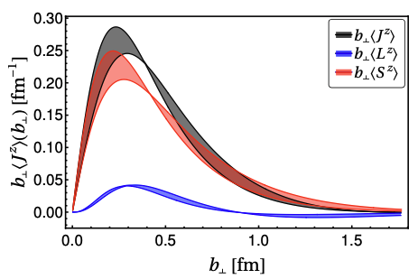

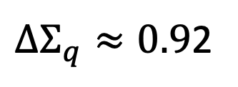
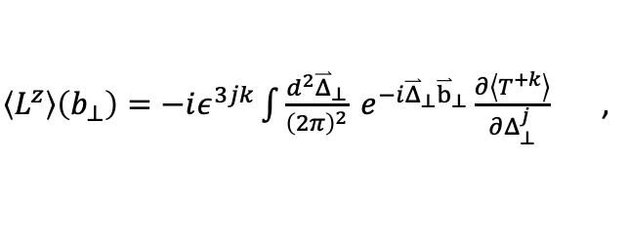
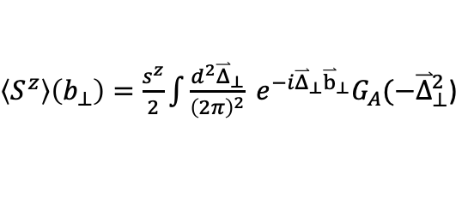


Angular Momentum Distributions
Total angular momentum density:
[In preparation, Ping Yi, Siqi Xu, C. Mondal et.al ]
$$\left\langle J^{z}\right\rangle \left(b_{⊥}\right)=\left\langle L^{z}\right\rangle \left(b_{⊥}\right)+⟨S^{z}⟩(b_{⊥})$$
$\left\langle L^{z}\right\rangle \left(b_{⊥}\right)=−iε^{3jk}\int{\frac{d^{2}{\overset{⃑}{Δ}}_{⊥}}{{\left(2π\right)}^{2}}} e^{−i{\overset{⃑}{Δ}}_{⊥}{\overset{⃑}{b}}_{⊥}}\frac{∂\left\langle T^{+k}\right\rangle }{∂Δ_{⊥}^{j}}$ ,
$\left\langle S^{z}\right\rangle \left(b_{⊥}\right)=\frac{s^{z}}{2}\int{\frac{d^{2}{\overset{⃑}{Δ}}_{⊥}}{{\left(2π\right)}^{2}}} e^{−i{\overset{⃑}{Δ}}_{⊥}{\overset{⃑}{b}}_{⊥}}G_{A}(−{\overset{⃑}{Δ}}_{⊥}^{2}$)
$ΔΣ_{q}≈0.9$2
$$ΔΣ_{u}≈1.18$$
$$ΔΣ_{d}≈−0.26$$
Quark Helicity > 90%
No Gluon contribution

Slide 7
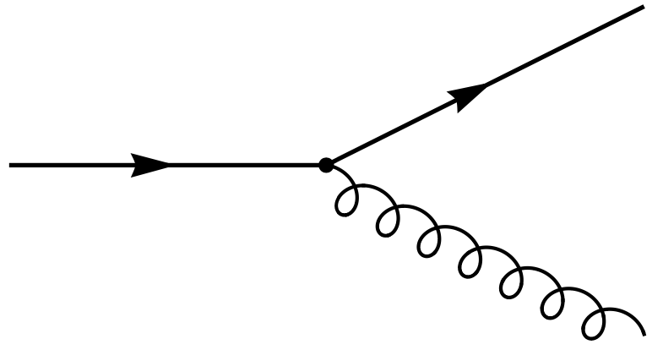
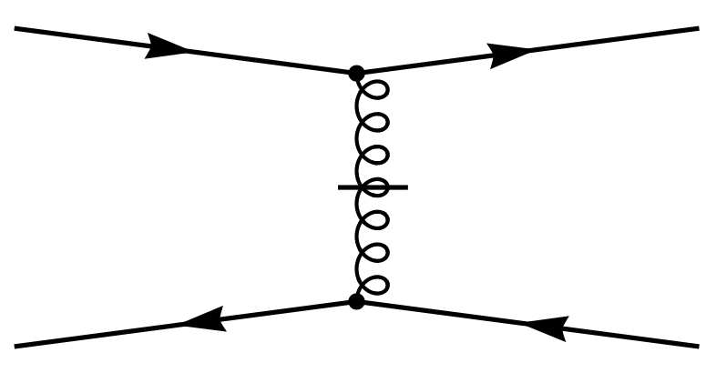

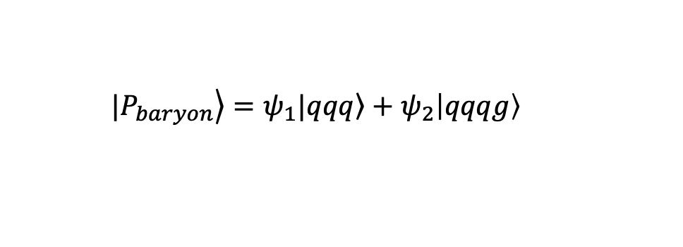

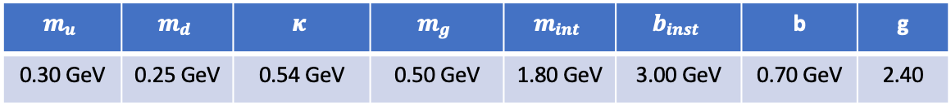
Light-Front QCD Hamiltonian
  $$|\left.P_{baryon}\right\rangle =ψ_{1}|\left.qqq\right\rangle +ψ_{2}\left|qqqg\right\rangle$$
$$H_{Interact}=H_{Vertex}+H_{inst}=g\overline{ψ} γ^{μ}T^{a} ψ A_{μ}^{a}+\frac{g^{2}C_{F}}{2} j^{+}\frac{1}{{\left(i∂^{+}\right)}^{2}}j^{+}$$
$$N_{max}=9, K=16.5$$
Higher Fock Sector effect
Remove Soft Gluon effect
$$m_{u}$$ | $$m_{d}$$ | $$κ$$ | $$m_{g}$$ | $$m_{int}$$ | $$b_{inst}$$ | b | g
0.30 GeV | 0.25 GeV | 0.54 GeV | 0.50 GeV | 1.80 GeV | 3.00 GeV | 0.70 GeV | 2.40
Different Mass
Asymmetry of u and d
UV Cutoff
In Instantaneous term

Slide 8
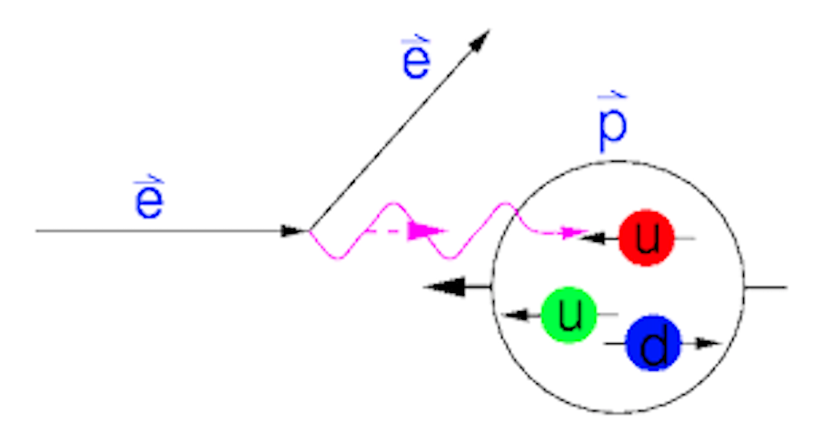
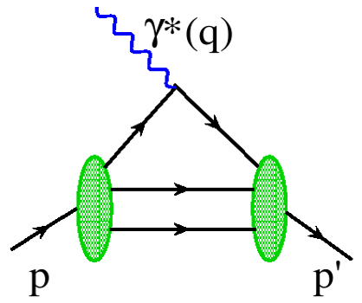
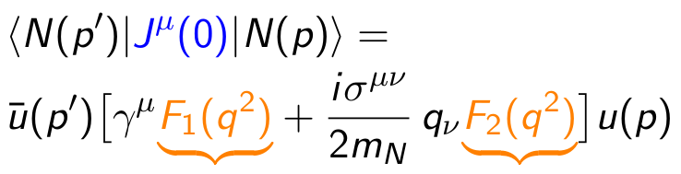

Electromagnetic Form Factor
Elastic scattering of proton
[ R. Hofstadter, Nobel Prize 1961 ]
$$e\left(p\right)+h\left(P\right)→e\left(p^{′}\right)+h(P^{′})$$
Elastic electron scattering established the extended nature of the proton (proton radius).
The Fourier transformation of these form factors provide spatial distributions (charge and magnetization distributions).
Dirac Form Factor
Pauli Form Factor

Slide 9
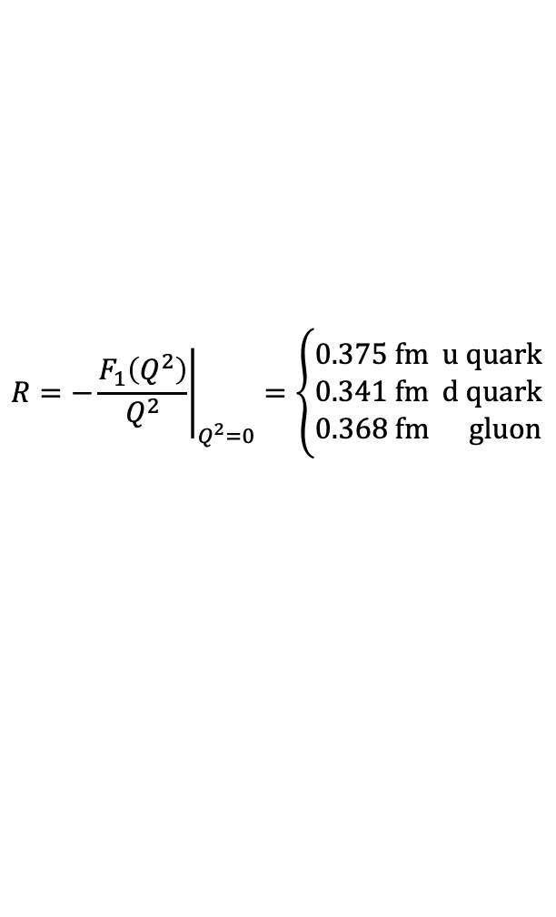
Form Factor with Dynamical Gluon
[In preparation, Siqi Xu, C. Mondal et.al ]
Including the One Dynamical Gluon Fock Sector, the valence quark distributions are almost same with effective interaction results
the gluon distributions are always smaller than the d quarks distributions.
$$R={\left.−\frac{F_{1}\left(Q^{2}\right)}{Q^{2}}\right|}_{Q^{2}=0}=\left\{\begin{matrix}0.375 fm u quark \\ 0.341 fm d quark \\ 0.368 fm gluon\end{matrix}\right.$$
R is a variable related to the radii of particle distribution

Slide 10
Form Factor with Dynamical Gluon
[In preparation, Siqi Xu, C. Mondal et.al ]
Including the One Dynamical Gluon Fock Sector, the valence quark distributions are almost same with effective interaction results

Slide 11

Form Factor with Dynamical Gluon
[In preparation, Siqi Xu, C. Mondal et.al ]
$$2$$
At $Q^{2}≫m^{2}=0.09 GeV^{2}$, we find our Form Factor ratio is proportional to $\log^{2}{(Q^{2}/Λ)/Q^{2}}$.
In our calculation, we use the quark mass around $0.3 GeV$, and fix the proton mass around $0.94$ GeV

Slide 12
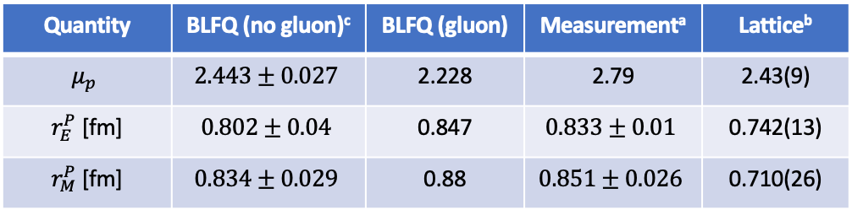
Nucleon Observable
Nucleon radii and magnetic moment
[In preparation, Siqi Xu, C. Mondal et.al ]
Quantity | BLFQ (no gluon)^{c} | BLFQ (gluon) | Measurementª | Lattice^{b}
$$μ_{p}$$ | $$2.443±0.027$$ | 2.228 | 2.79 | 2.43(9)
$r_{E}^{P}$ [fm] | $$0.802±0.04$$ | 0.847 | $$0.833±0.01$$ | 0.742(13)
$r_{M}^{P}$ [fm] | $$0.834±0.029$$ | 0.88 | $$0.851±0.026$$ | 0.710(26)
a. C. Alexandrou et al. Phys. Rev. D 96, no. 11, 114509
b. M.Tanabashi et al. [Particle Data Group], Phys. Rev. D 98, no.3, 030001
c. 2108.03909 [hep-ph], Siqi Xu, C. Mondal, et al. , accepted by PRD

Slide 13
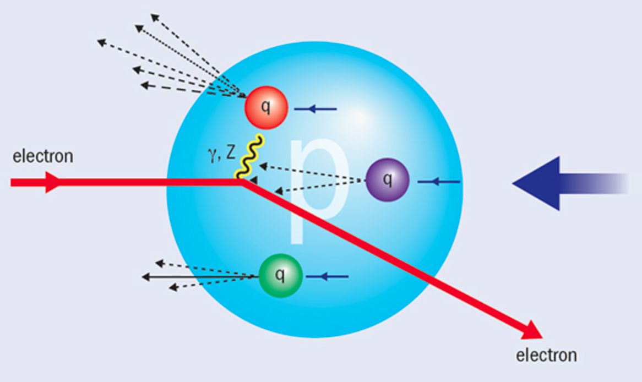
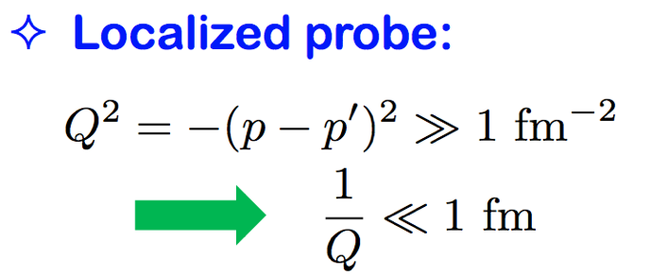

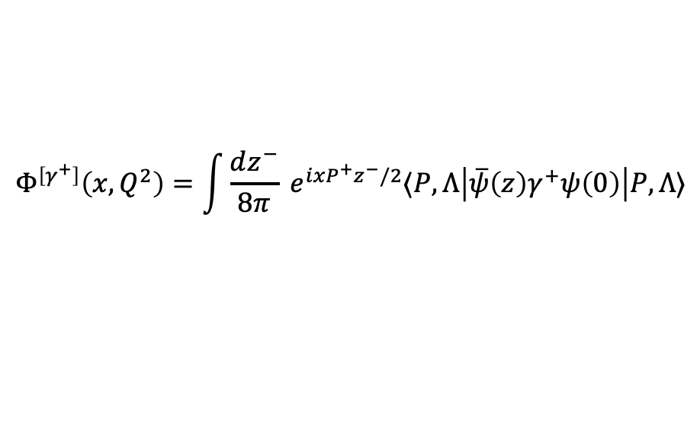


Parton Distribution Functions (PDF)
Deep Inelastic Scattering (SLAC 1968)
$$X$$
$$e\left(p\right)+h\left(P\right)=e^{′}\left(p^{′}\right)+X(P^{′})$$
$$X$$
Discovery of spin ½ quarks and partonic structure
Parton distribution functions (PDFs) are extracted from DIS processes.
$$Φ^{\left[γ^{+}\right]}\left(x,Q^{2}\right)=\int{\frac{dz^{−}}{8π}} e^{ixP^{+}z^{−}/2}⟨P,Λ\left|\overline{ψ}\left(z\right)γ^{+}ψ\left(0\right)\right|P,Λ⟩$$
PDFs encode the distribution of longitudinal momentum and polarization carried by the constituents

Slide 14
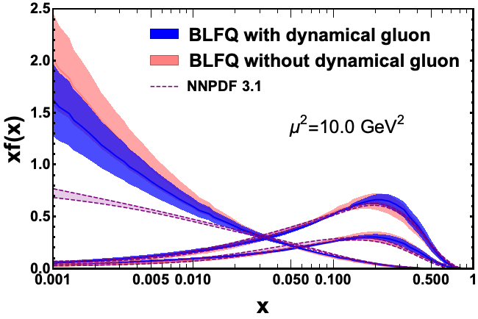



Unpolarized Parton Distribution Functions
Preliminary results
$$μ_{0}^{2}=0.25±0.02 GeV^{2}$$
$$μ_{0}^{2}=0.19±0.02 GeV^{2}$$
$$\frac{xf^{g}\left(x\right)}{10}$$
Without second Fock sector $\left|qqqg\right\rangle$, the gluon is generated dynamically from the DGLAP evolution。
Including the One Dynamical Gluon Fock Sector, the gluon distribution is closer to the global fit.
[Work in progress, C. Mondal, Siqi Xu, et.al ]
[EPJC 77 (2017) 663]

Slide 15

Unpolarized Parton Distribution Functions
Preliminary results
$$μ_{0}^{2}=0.25±0.02 GeV^{2}$$
$$μ_{0}^{2}=0.19±0.02 GeV^{2}$$
$$\frac{xf^{g}\left(x\right)}{10}$$
$$\frac{xf^{g}\left(x\right)}{10}$$
Without second Fock sector $\left|qqqg\right\rangle$, the gluon is generated dynamically from the DGLAP evolution。
Including the One Dynamical Gluon Fock Sector, the gluon distribution is closer to the global fit.
[Work in progress, C. Mondal, Siqi Xu, et.al ]
[EPJC 77 (2017) 663]

Slide 16
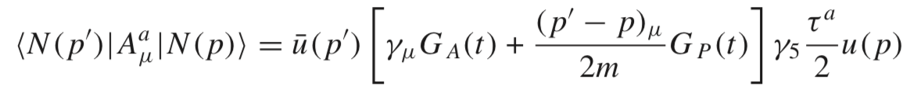





Axial Form Factor of The Proton
Provide information on spin-isospin distributions
Including the dynamic gluon, the u quark’s contribution is suppressed and closer to the experimental data results.
$$ΔΣ_{q}≈0.7$$
$$ΔΣ_{u}≈0.86$$
$$ΔΣ_{d}≈0.16$$
$$ΔG≈0.13<0.2$$
(COMPASS)
[Chandan Mondal, EPJC 2017]
[In preparation, Siqi Xu, C. Mondal et.al ]
[COMPASS, EPJC 77 (2017) 209]

Slide 17
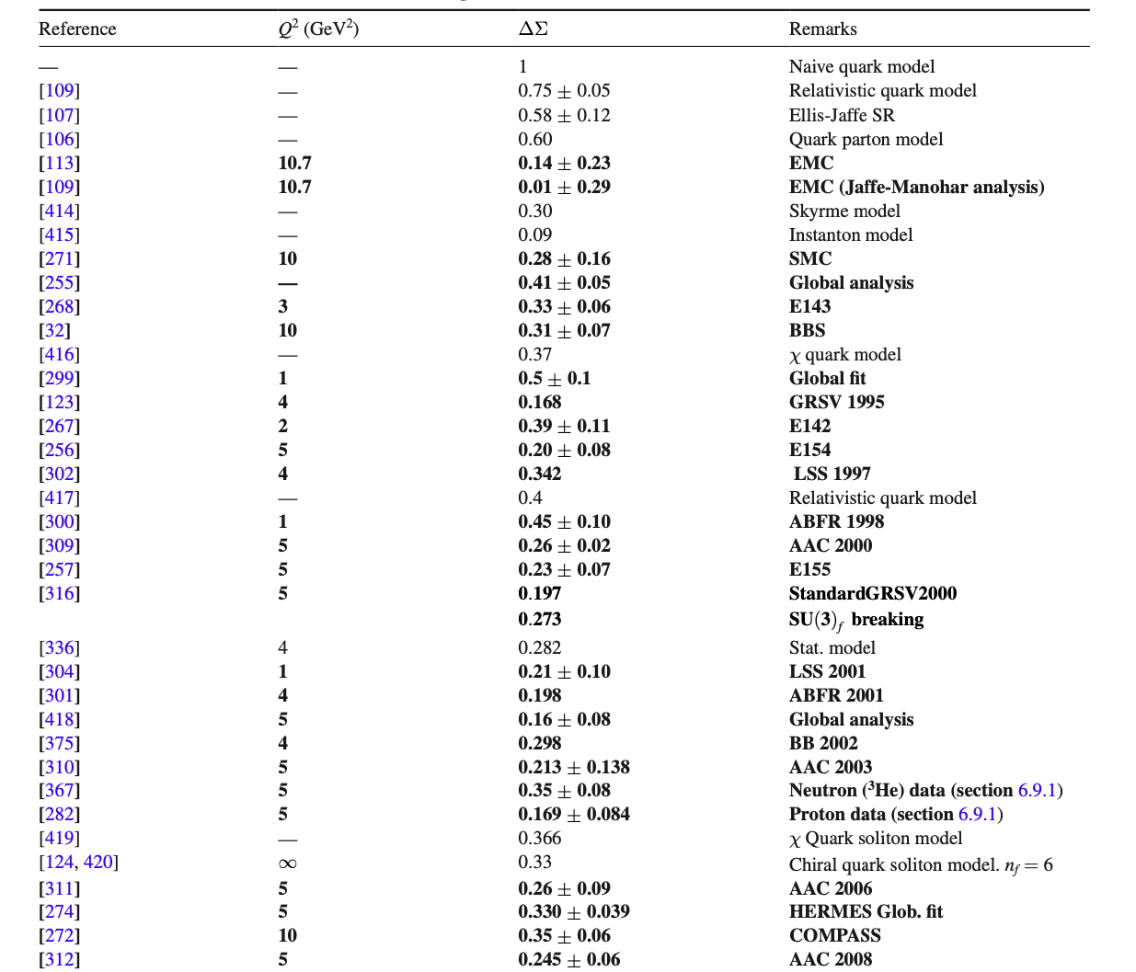
Prediction of Other Approach
[Alexandre Deur et al 2019 Rep. Prog. Phys. 82 076201]

Slide 18
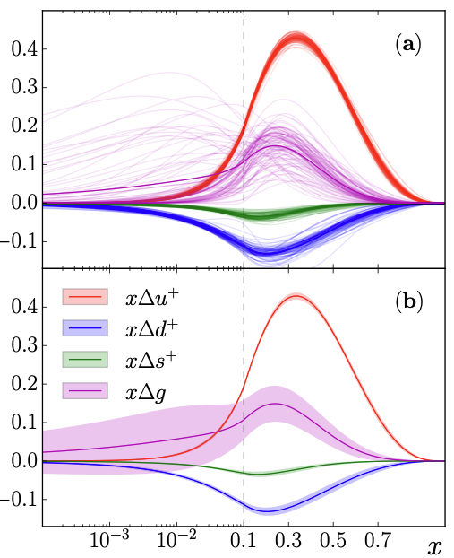


Helicity Parton Distribution Functions
Preliminary results
JAM
$$μ^{2}=1.0 GeV^{2}$$
$$μ_{0}^{2}=0.25 GeV^{2}$$
Including the One Dynamical Gluon Fock Sector, the valence quark distributions at small x region are improved.
[In preparation, Siqi Xu, C. Mondal et.al ]

Slide 19

Helicity Parton Distribution Functions
Preliminary results
u quark
d quark
$$μ_{0}^{2}=0.25 GeV^{2}$$
Without second Fock sector $\left|qqqg\right\rangle$, the gluon is generated dynamically from the DGLAP evolution。
Including the One Dynamical Gluon Fock Sector, the valence quark distributions at small x region and x larger than 0.5 region are improved.
[In preparation, Siqi Xu, C. Mondal et.al ]

Slide 20
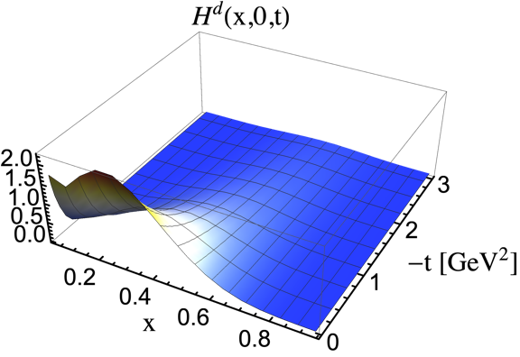
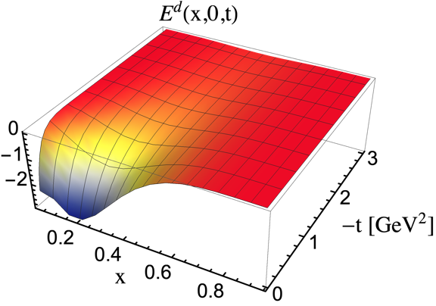
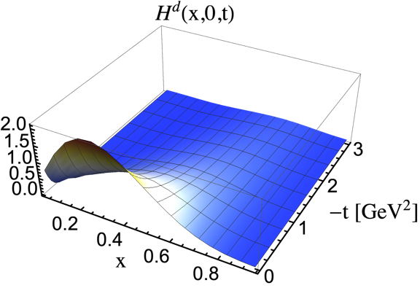
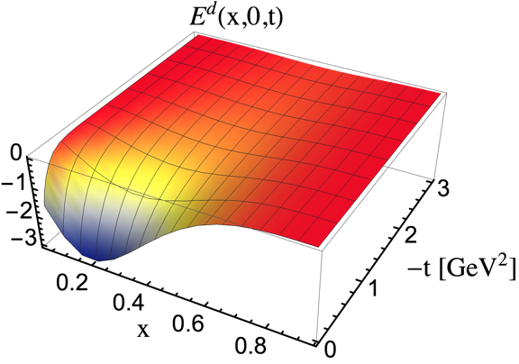
Generalized Parton Distribution Functions (GPD)
With dynamical gluon
Without dynamical gluon
[In preparation, Siqi Xu, C. Mondal et.al ]

Slide 21
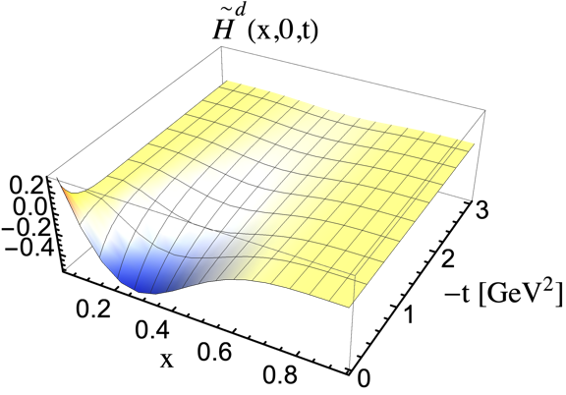
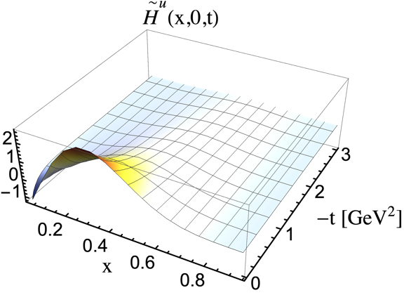
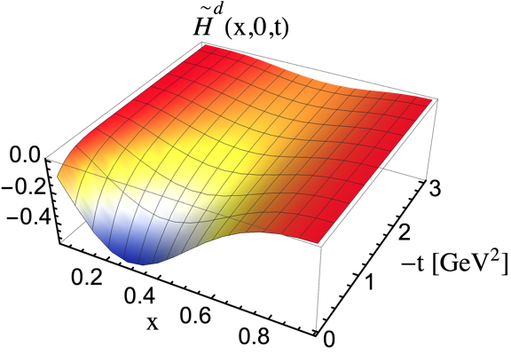
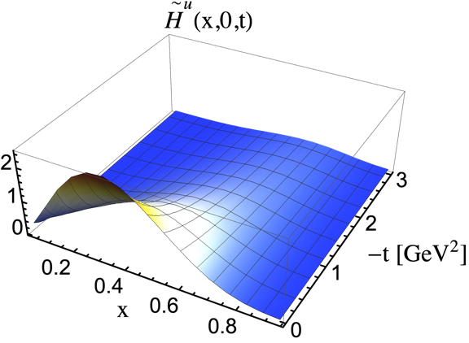
Generalized Parton Distribution Functions (GPD)
With dynamical gluon
Without dynamical gluon
[In preparation, Siqi Xu, C. Mondal et.al ]

Slide 22
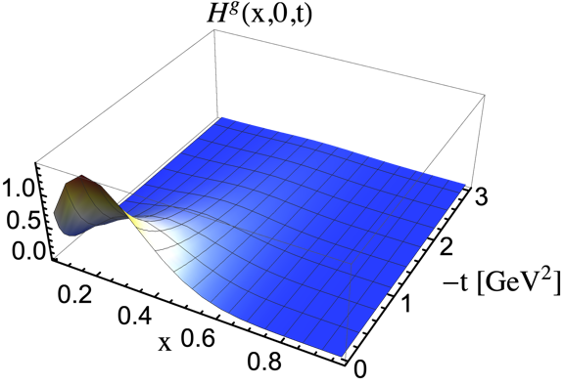

Generalized Parton Distribution Functions (GPD)
Generalized Parton Distribution Functions For Gluon
Including the One Dynamical Gluon Fock Sector, we can calculate the gluon distribution at initial scale and Increase the distribution of gluon at large x region.
[In preparation, Siqi Xu, C. Mondal et.al ]

Slide 23




Transversity Parton Distribution Functions
Preliminary results
[In preparation, Siqi Xu, C. Mondal et.al ]
[Phys. Rev. D87, 094019(2013)]
We are still working on the calculation of the gluon transversity PDF.
$$μ_{0}^{2}=0.25 GeV^{2}$$
Due to the gluon distribution, we can’t evolve the PDF from initial scale to experimental scale.
u quark
$$g_{T}^{u}=0.55, g_{T}^{d}=−0.29$$
dynamical Gluon
d quark
$$g_{T}^{u}=0.94, g_{T}^{d}=−0.20$$
no dynamical Gluon
$$g_{T}^{u}={0.39}_{−0.12 }^{+0.18}, g_{T}^{d}=−{0.25}_{−0.10}^{+0.30}$$
Extracted
Without Dynamical Gluon

Slide 24
Conclusion
Light-front Hamiltonian approach: mass spectrum and structure.
Investigate the structure of the nucleon from the eigenstates of effective Hamiltonians and one dynamical gluon effective Hamiltonians.
Wavefunctions lead to a good description of various observables such as electromagnetic form factors, PDFs, GPDs, etc.
While including higher Fock Sectors, the effective interaction is replaced by the QCD vertex function and the gluon distribution can be explored.
Including the one dynamical gluon Fock Sector, the Axial Form Factor of u quark is suppressed, and the d quark’s Axial FF is almost same with only the leading Fock sector case.
As we include the gluon contribution at initial scale, the gluon distributions are closer to the NNPDF results.
Thank you

Slide 25
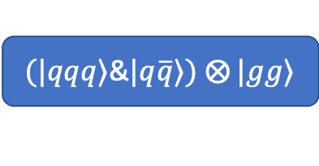
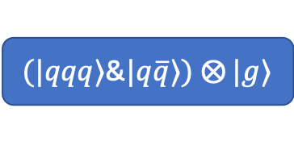
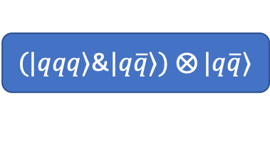
Future plan
Gauge Link
study various spin asymmetries of the nucleon.
Systematic study of various gluon distributions
investigate spin sum rules
Mass decomposition,
Mechanical properties:
pressure and forces inside hadron.
$(|qqq⟩$&$|q\overline{q}⟩)$ $⨂{|g⟩}$
Hadron
include more fundamental QCD interactions
address color confinement of partons.
$(|qqq⟩$&$|q\overline{q}⟩)$ $⨂{|gg⟩}$
spin sum rules
Mass decomposition,
Mechanical properties:
pressure and forces inside hadron.
Study sea structure of hadron and its contribution to spin, mass
$(|qqq⟩$&$|q\overline{q}⟩)$ $⨂{|q\overline{q}⟩}$

Slide 26
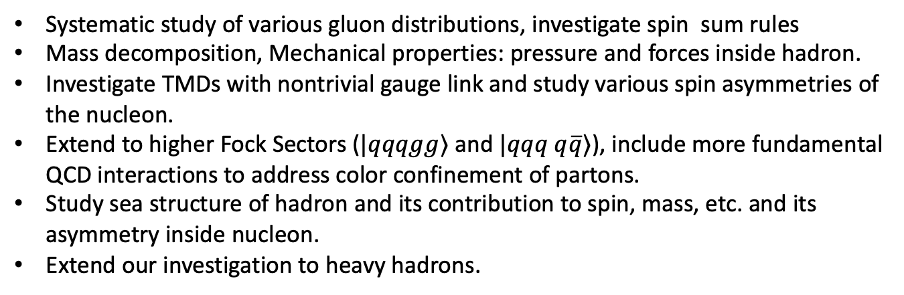
Future plan
Systematic study of various gluon distributions, investigate spin sum rules
Mass decomposition, Mechanical properties: pressure and forces inside hadron.
Investigate TMDs with nontrivial gauge link and study various spin asymmetries of the nucleon.
Extend to higher Fock Sectors ($|qqqgg⟩$ and $|qqq q\overline{q}⟩$), include more fundamental QCD interactions to address color confinement of partons.
Study sea structure of hadron and its contribution to spin, mass, etc. and its asymmetry inside nucleon.
Extend our investigation to heavy hadrons.

Slide 27
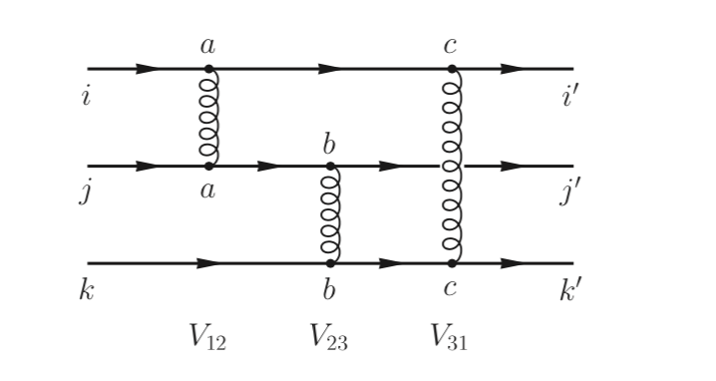

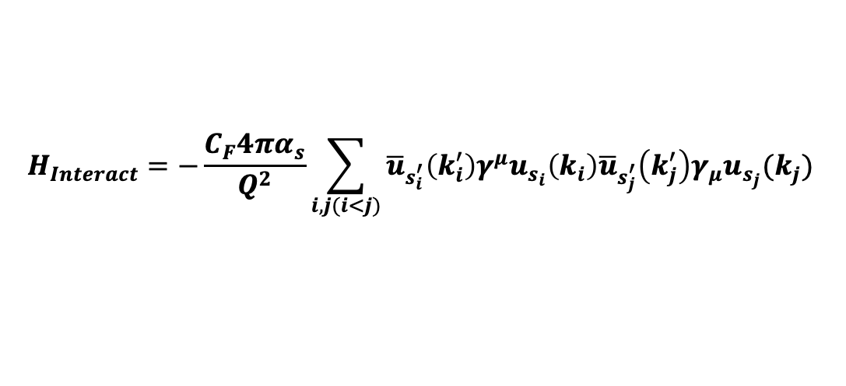
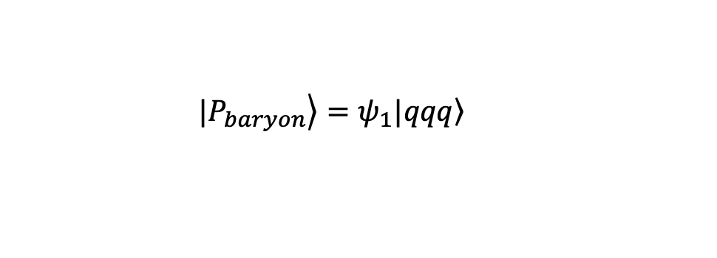

Effective Hamiltonian
  $$|\left.P_{baryon}\right\rangle =ψ_{1}|\left.qqq\right\rangle$$
$$H_{Interact}=−\frac{C_{F}4πα_{s}}{Q^{2}}\sum_{i,j(i<j)}{{\overline{u}}_{s_{i}^{′}}\left(k_{i}^{′}\right)γ^{μ}u_{s_{i}}\left(k_{i}\right){\overline{u}}_{s_{j}^{′}}\left(k_{j}^{′}\right)γ_{μ}u_{s_{j}}(k_{j}) }$$
$$N_{max}=10, K=16.5$$
Note: In our calculation, we fix the basis scale b equal to 0.6 GeV

Slide 28
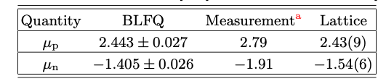
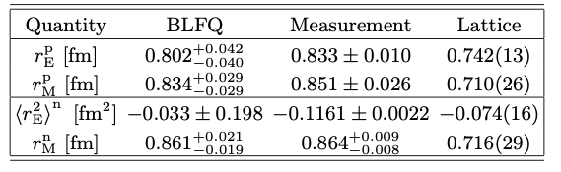
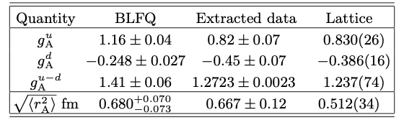
Nucleon Radii and Axial Charges
The magnetic moment of the proton and neutron
The radii of the proton and neutron
The axial charge and axial radius
[ 2108.03909 [hep-ph], Siqi Xu, C. Mondal, et.al ], accepted by PRD

Slide 29
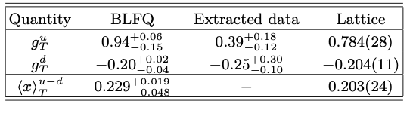




The Quark Tensor Charge in The Proton
The first moment of the transversity PDF
$$μ^{2}=2.4 GeV^{2}$$
The BLFQ predicts the tensor charges for the down quark in good agreement with the global QCD qnqlysis
The second moment of the transversity PDF
$$μ^{2}=2.4 GeV^{2}$$
The BLFQ prediction for ${\left\langle x\right\rangle }_{T}^{u−d}$agrees reasonably well with the lattice data.
[ 2108.03909 [hep-ph], Siqi Xu, C. Mondal, et.al ], accepted by PRD

Slide 30
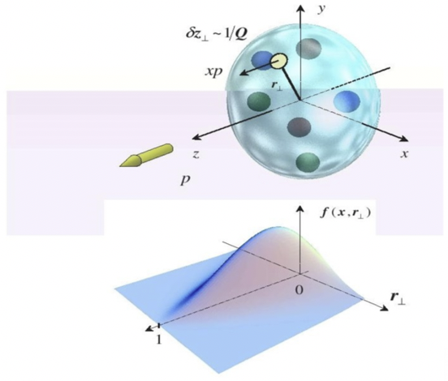








Generalized Parton Distribution Functions (GPD)
[ 2108.03909 [hep-ph], Siqi Xu, C. Mondal, et.al ]
Encode the information about three dimensional spatial structure the spin and orbital angular momentum
With increasing momentum transfer ($t$), the peaks of distributions shift to larger $x$;
$$t=Δ^{2},x=\frac{k^{+}}{P^{+}}, ζ=\frac{Δ^{+}}{P^{+}}=0$$
$$b_{⊥}\underset{→}{FT} Δ_{⊥}$$
Impact parameter distribution ($b_{⊥}$):

Slide 31




Generalized Parton Distribution Functions (GPD)
$$t=Δ^{2},x=\frac{k^{+}}{P^{+}}, ζ=\frac{Δ^{+}}{P^{+}}=0$$
$$Δ \underset{→}{Fourier Transform}b$$
[In preparation, Ping Yi, Siqi Xu, C. Mondal et.al ]

Slide 32



Angular Momentum Distributions
Total angular momentum density:
[In preparation, Ping Yi, Siqi Xu, C. Mondal et.al ]
$$\left\langle J^{z}\right\rangle \left(b_{⊥}\right)=\left\langle L^{z}\right\rangle \left(b_{⊥}\right)+⟨S^{z}⟩(b_{⊥})$$
$\left\langle L^{z}\right\rangle \left(b_{⊥}\right)=−iε^{3jk}\int{\frac{d^{2}{\overset{⃑}{Δ}}_{⊥}}{{\left(2π\right)}^{2}}} e^{−i{\overset{⃑}{Δ}}_{⊥}{\overset{⃑}{b}}_{⊥}}\frac{∂\left\langle T^{+k}\right\rangle }{∂Δ_{⊥}^{j}}$ ,
$\left\langle S^{z}\right\rangle \left(b_{⊥}\right)=\frac{s^{z}}{2}\int{\frac{d^{2}{\overset{⃑}{Δ}}_{⊥}}{{\left(2π\right)}^{2}}} e^{−i{\overset{⃑}{Δ}}_{⊥}{\overset{⃑}{b}}_{⊥}}G_{A}(−{\overset{⃑}{Δ}}_{⊥}^{2}$)
Belinfante-improved tensors
$$\left\langle J^{z}\right\rangle \left(b_{⊥}\right)=\left\langle J_{Bel}^{z}\right\rangle \left(b_{⊥}\right)+⟨M^{z}⟩(b_{⊥})$$
Quark Helicity > 90%

