Slide 1
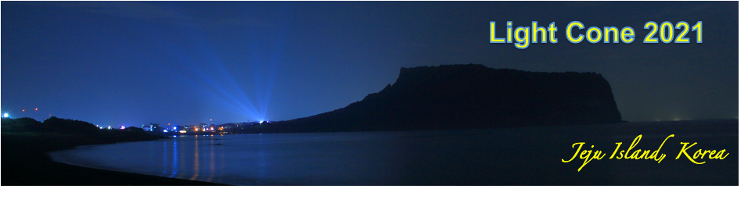
Two Schrodinger-like equations for hadrons
Ruben Sandapen
Physics of hadrons on the light-front
7 November 2021 to 4 December 2021

Slide 2
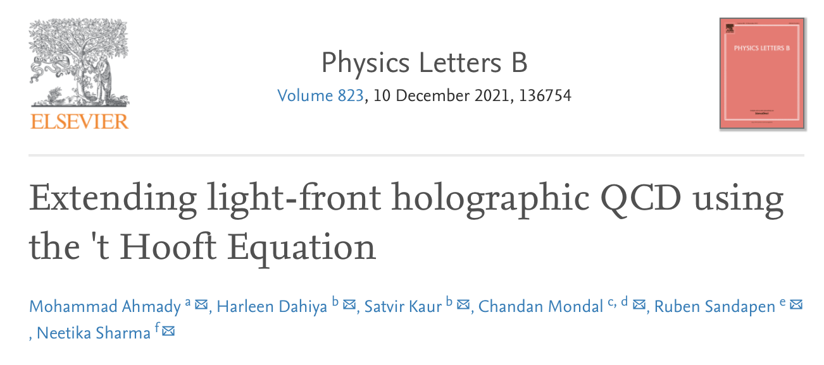
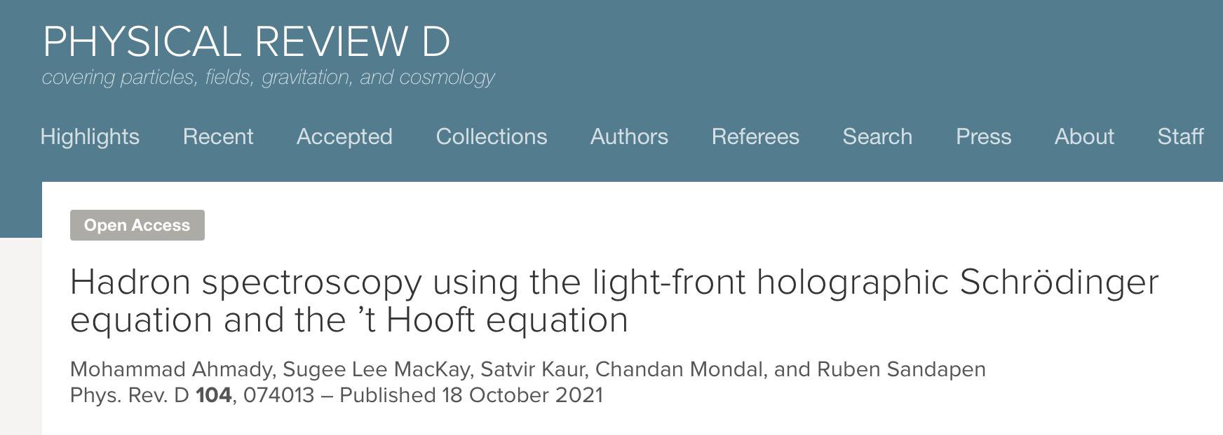
Two recent papers
This talk is based on these two references

Slide 3
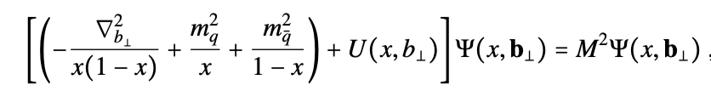
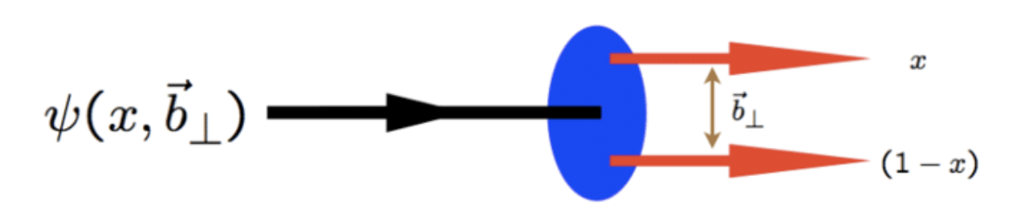
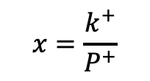
Meson masses in light-front QCD
Complicated QCD bound state dynamics
See also Stan Brodsky’s talk at this conference
Valence meson light-front wavefunction
$$x=\frac{k^{+}}{P^{+}}$$
Light-front momentum fraction carried by quark
Transverse quark-antiquark separation at equal light-front time
Brodsky, de Teramond, Dosch, Erlich, Phys. Rep. 584, 1 (2015)
(review with original references)

Slide 4






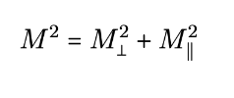

Light-front factorization
$$L={|L}_{z}^{max}|$$
LF orbital angular momentum
Assumption
Exact derivation of confining potentials in QCD: open question

Slide 5
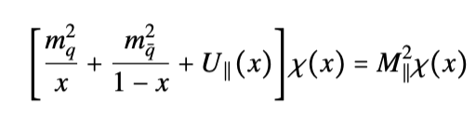
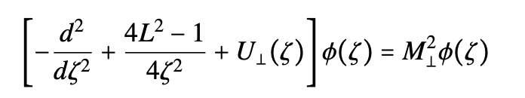

Transverse and longitudinal dynamics
Longitudinal dynamics
Transverse dynamics at fixed $x$

Slide 6


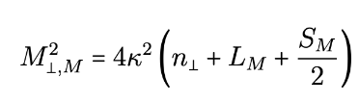


Holographic Schrodinger Equation
Neglecting quark masses and longitudinal confinement
Holographic mapping to AdS₅
$$ζ↔z_{5}$$
Fixed by conformal symmetry
and holographic mapping
$κ:$emerging mass scale
Underlying conformal symmetry
Massless pion as expected in chiral QCD

Slide 7
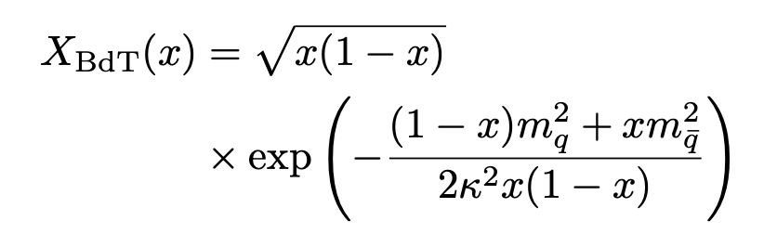
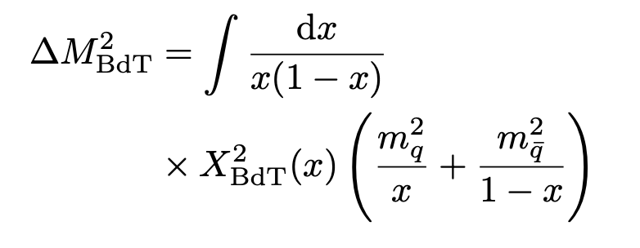

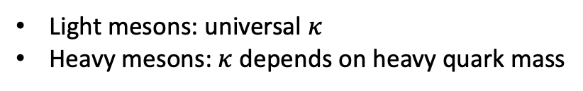
Quark masses
Non-zero quark masses were previously taken into account using the Brodsky-de Teramond ansatz
Spectroscopy
Light mesons: universal $κ$
Heavy mesons: $κ$depends on heavy quark mass

Slide 8
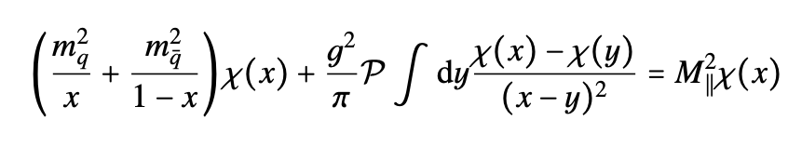
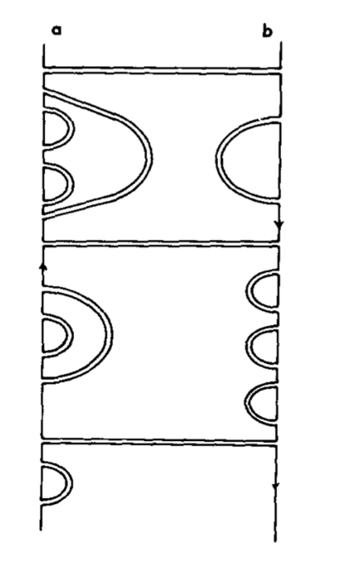
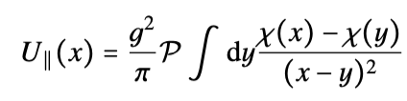
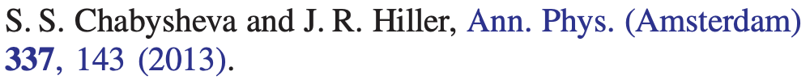


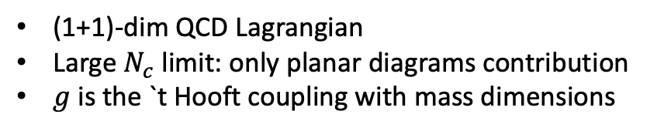
The `t Hooft Equation
`t Hooft, Nucl. Phys. B 75 461 (1974)
(1+1)-dim QCD Lagrangian
Large $N_{c}$ limit: only planar diagrams contribution
$g$ is the `t Hooft coupling with mass dimensions
Momentum space
Original idea to use `t Hooft Equation
Fourier
with
Position space

Slide 9
Other work
Several other groups are investigating longitudinal dynamics using different models
de Teramond, Brodsky, arXiv: 2103.10930 [hep-ph]
Yang Li, Vary. arXiv: 2103.09993 [hep-ph]
Weller and Miller: 2111.03194[hep-ph]
All in 2021

Slide 10



Chiral symmetry
Gell-Mann-Oakes-Renner (GMOR) relation
$$M_{π}^{2}∝m_{u/d}$$
Pion
Holographic SE
$$M_{π}=0$$
`t Hooft Equation
$$M_{π}^{2}∝gm_{u/d}$$
Together, hSE and `t Hooft Eq reproduce the GMOR relation provided $g$ does not depend on $m_{u/d}$

Slide 11


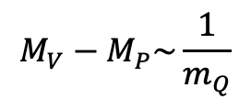
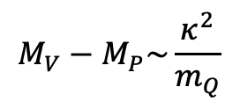

Heavy Quark symmetry
Heavy Quark Effective Theory
$$M_{V}−M_{P}\sim \frac{1}{m_{Q}}$$
Mass difference between vector and pseudoscalar
mesons in their ground states is suppressed
by heavy quark mass
Heavy-light mesons
Holographic SE
$$M_{V}^{2}\sim κ^{2}, M_{P}^{2}=0$$
$$M_{V}−M_{P}\sim \frac{κ^{2}}{m_{Q}}$$
if
$$m_{Q}≫κ$$
`t Hooft Equation
$$M_{V,P}^{2}\sim m_{Q}^{2}$$
Together, hSE and `t Hooft Eq reproduce HQET constraint provided $κ$ does not depend on $m_{Q}$

Slide 12




Rotational symmetry
Heavy-heavy meson
Holographic
Light-front potentials
`t Hooft
Relation between light-front
and instant-form CM potentials
Instant form potentials
Rotational symmetry is restored in the non-relativistic limit if $g=κ$

Slide 13
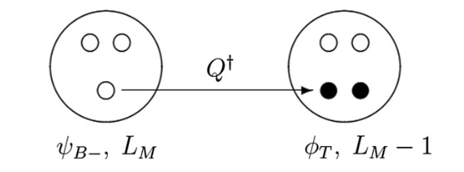
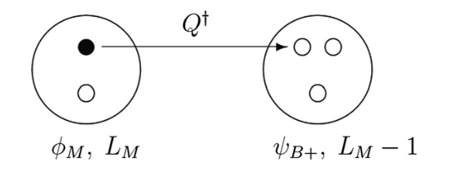
Supersymmetry
Brodsky, de Teramond, Dosch, Lorce, Phys. Lett. B 759 (2016)
Dosch, de Teramond, Brodsky, Phys. Rev. D 95 034016 (2017)
Neilson, Brodsky, Phys. Rev. D 97 114001 (2018)
Color ${SU(3)}_{Nc}$: a cluster of $N_{C}−1$ constituents can be in the same color representation as the anticonstituent
quark-antiquark
quark-diquark
quark-diquark
diquark-antidiquark
A baryon has two superpartners : a meson and a tetraquark
Same color confinement scales $(κ,g)$ within a family of superpartners

Slide 14
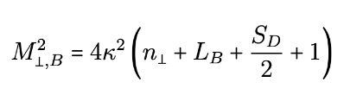
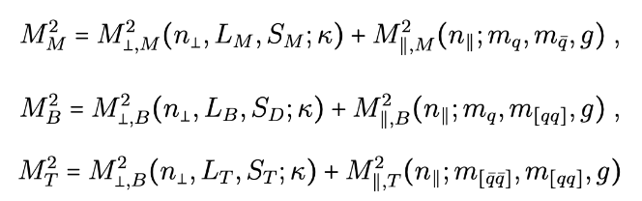

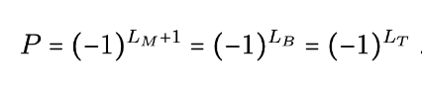


Computing the hadron spectrum
SuSy Holography
`t Hooft
Diquark mass=2 x quark mass
A radial and/or orbital transverse excitation $⟺$ a longitudinal excitation

Slide 15
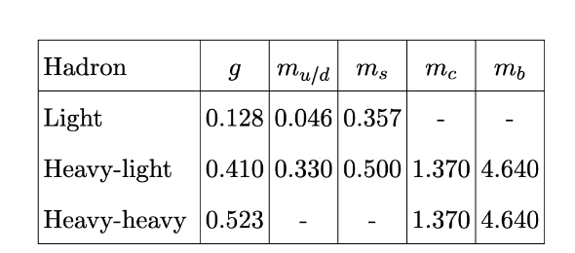

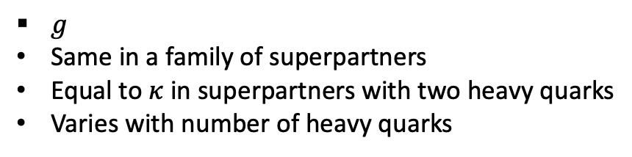
Confinement scales and quark masses
Effective quark masses
In GeV
$κ=0.523$ GeV
Universal (same for all hadrons)
$g$
Same in a family of superpartners
Equal to $κ$in superpartners with two heavy quarks
Varies with number of heavy quarks

Slide 16
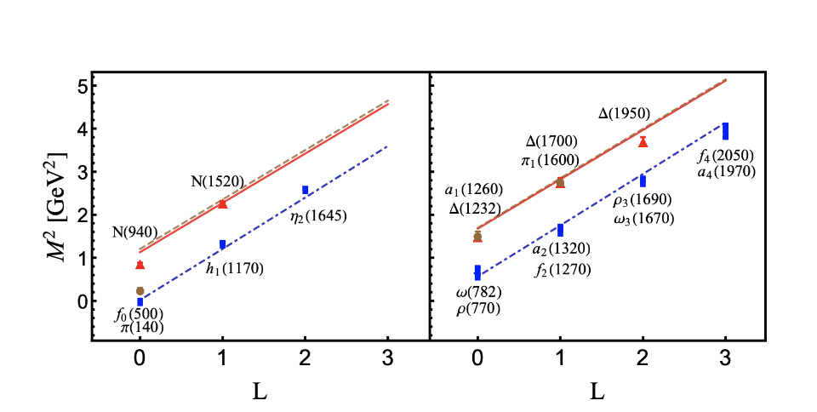
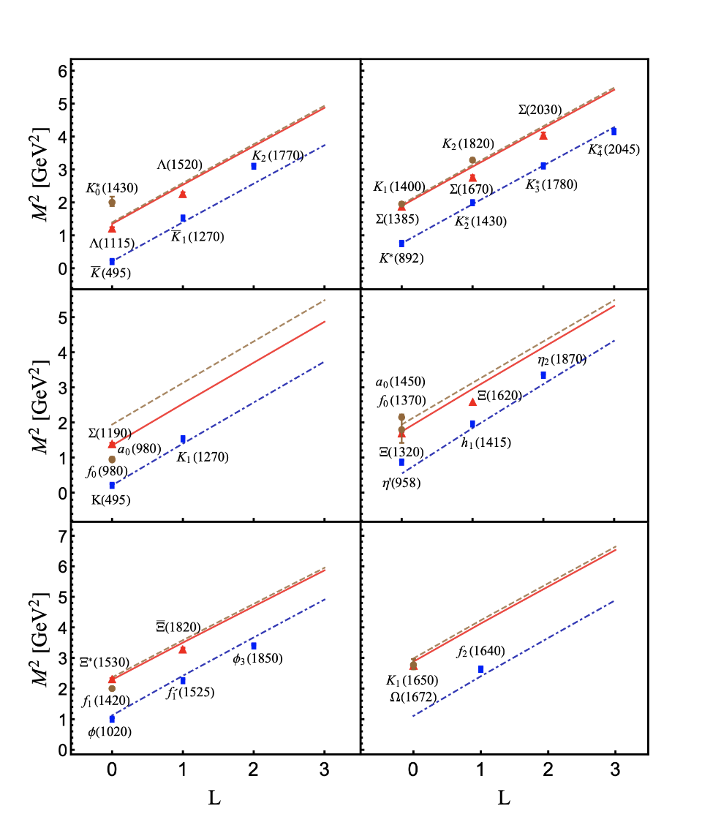
Light hadrons
Blue: mesons
Red: baryons
Brown: tetraquarks

Slide 17
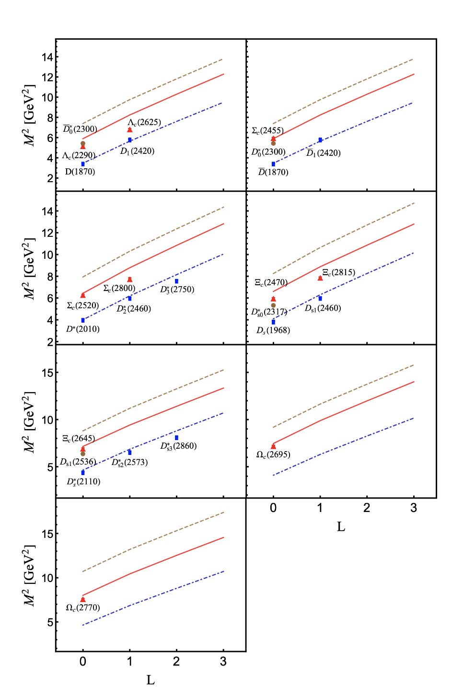
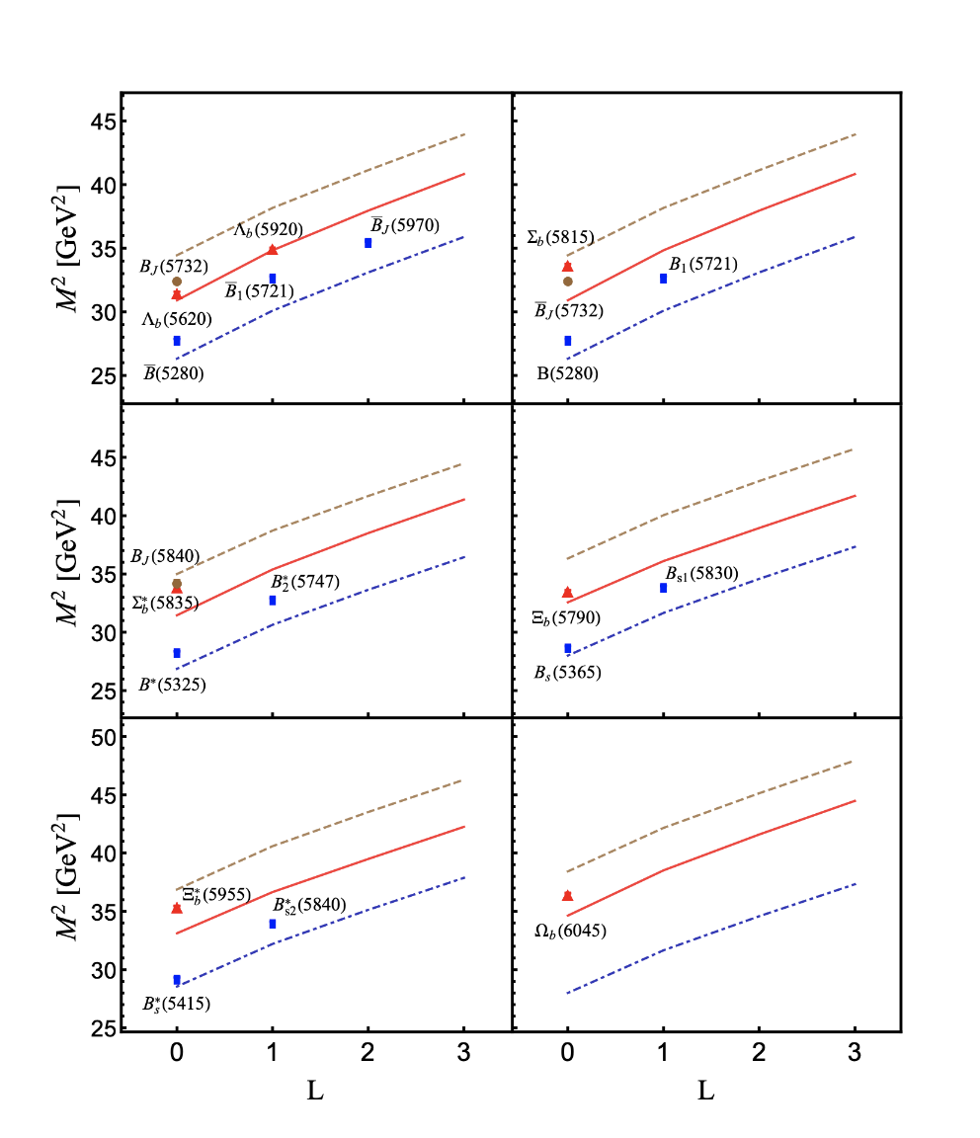
Heavy-light hadrons
Blue: mesons
Red: baryons
Brown: tetraquarks

Slide 18
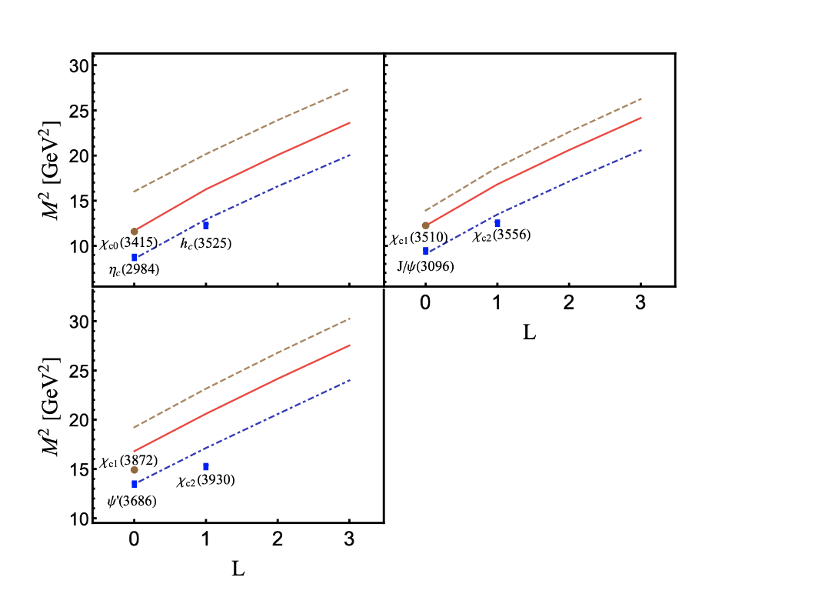
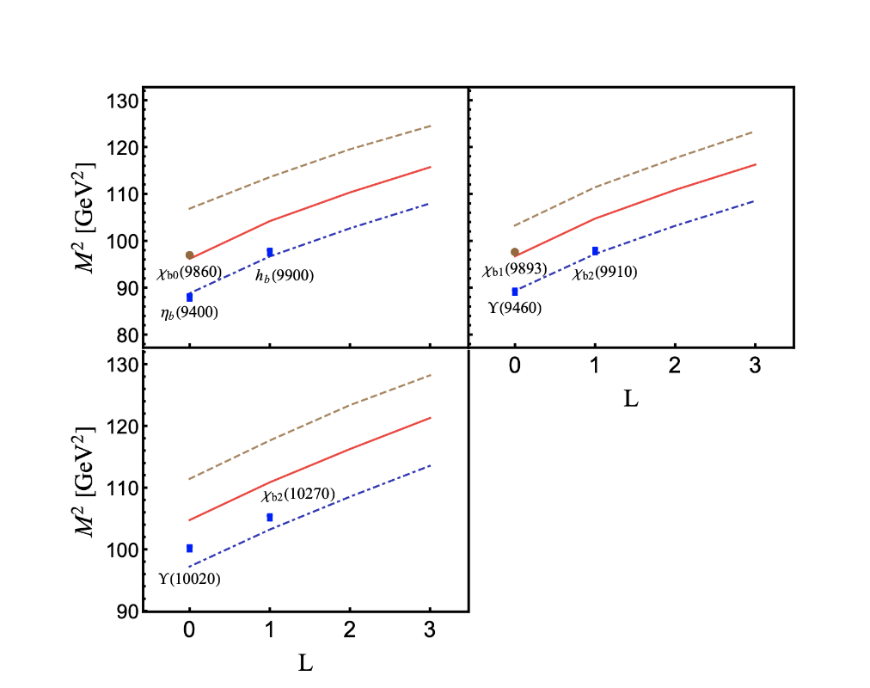
Heavy-heavy hadrons
Blue: mesons
Red: baryons
Brown: tetraquarks

Slide 19
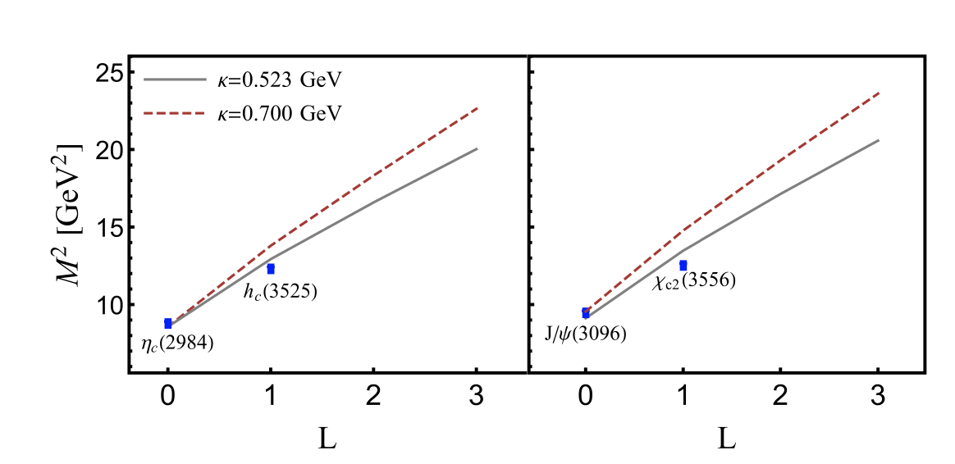
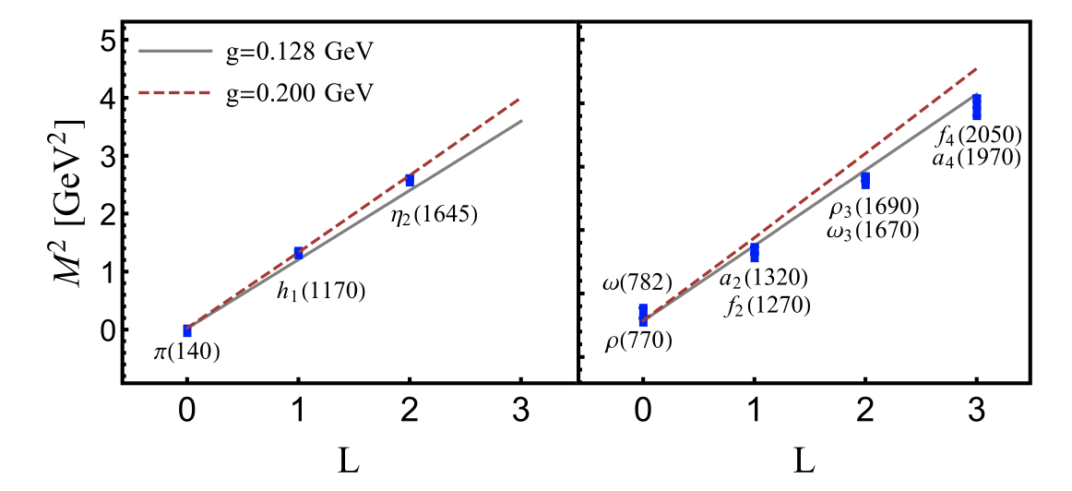
Results
Agreement is within $13\%$ for all mesons and baryons (except for $η^{′}(958)$ where it is $21\%)$
Notable disagreement for tetraquark candidates $f_{0}\left(500\right), f_{0}(980)$ (already present without longitudinal dynamics)
Precise slopes of Regge trajectories sensitive to both $κ$and $g$ across the full spectrum

Slide 20

Conclusions and Acknowledgements
The holographic Schrodinger Equation and the `t Hooft Equation seem to be complementary in describing hadron spectroscopy
I thank my co-authors (M. Ahmady, H. Dahiya, S. Lee Mackay, C. Mondal S. Kaur, N. Sharma) of the two papers reported here
I also thank S. Brodsky, G. de Teramond and G. Miller for useful discussions
This research is supported by the Natural Sciences and Engineering Research Council (NSERC) of Canada

