Slide 1
Cluster Effective Field Theory and nuclear reactions
EPJA (2021) 57:21
Shung-Ichi Ando
Sunmoon U.
November 30, 2021@LC2021

Slide 2
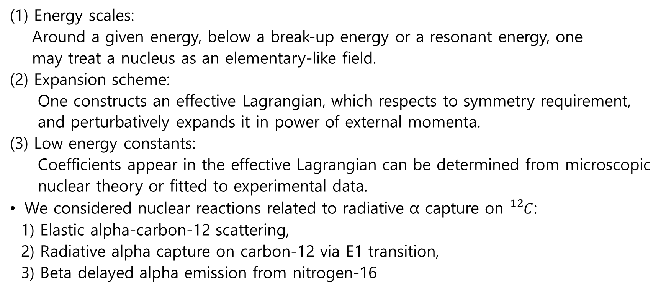
Introduction: cluster EFT
(1) Energy scales:
Around a given energy, below a break-up energy or a resonant energy, one
may treat a nucleus as an elementary-like field.
(2) Expansion scheme:
One constructs an effective Lagrangian, which respects to symmetry requirement,
and perturbatively expands it in power of external momenta.
(3) Low energy constants:
Coefficients appear in the effective Lagrangian can be determined from microscopic
nuclear theory or fitted to experimental data.
We considered nuclear reactions related to radiative α capture on ${}_{}^{12}C$:
1) Elastic alpha-carbon-12 scattering,
2) Radiative alpha capture on carbon-12 via E1 transition,
3) Beta delayed alpha emission from nitrogen-16

Slide 3
Outline of the talk
Introduction
Basics of nitrogen-16 beta decay and motivation
Formalism
Numerical results
Discussion and future plan

Slide 4
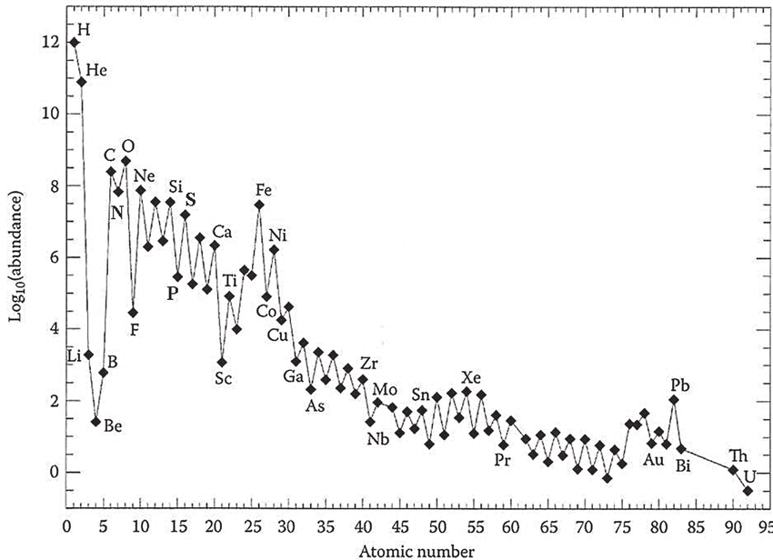

Introduction
Average cosmic
abundance of
the elements
${}_{}^{12}C$/${}_{}^{16}O$ ratio is
determined by
${}_{}^{12}C$($α$,$γ$)${}_{}^{16}O$

Slide 5
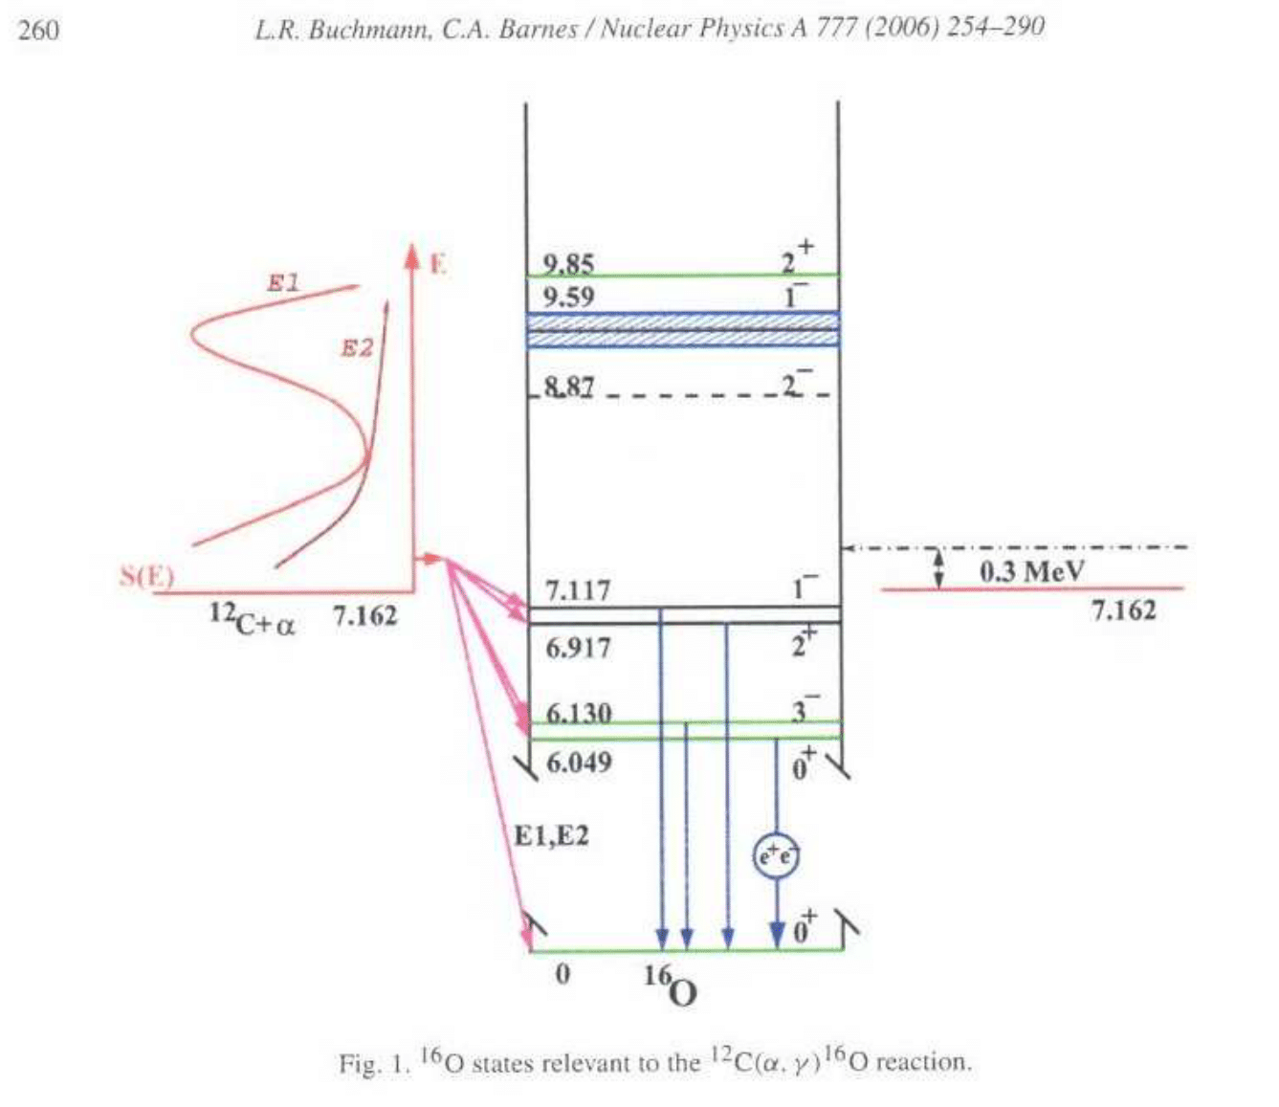

E1 and E2
transitions of
${}_{}^{12}C$($α$,$γ$)${}_{}^{16}O$ are
dominant
The E1 transition
is constrained by
$β$ delayed $α$
emission from ${}_{}^{16}N$

Slide 6
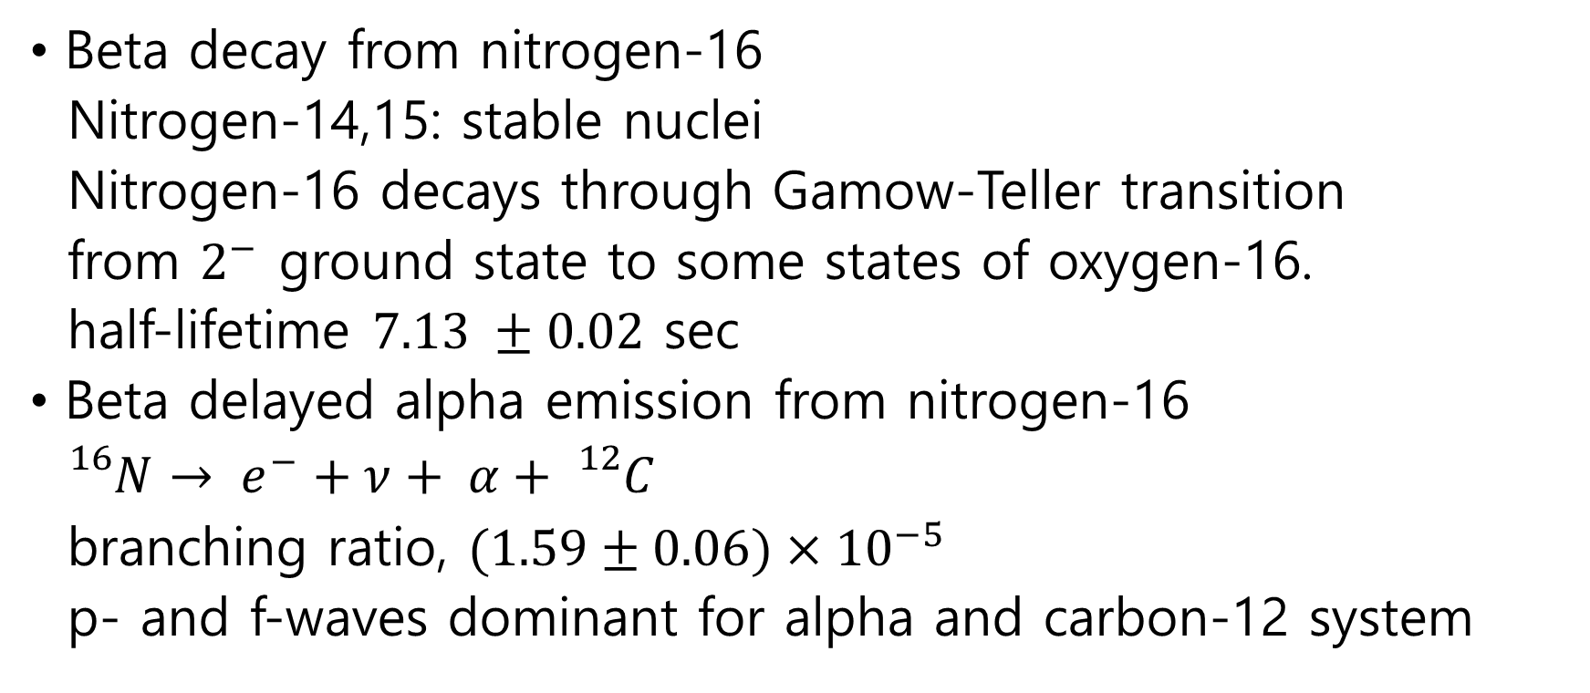
Basics of nitrogen-16 beta decay
Beta decay from nitrogen-16
Nitrogen-14,15: stable nuclei
Nitrogen-16 decays through Gamow-Teller transition
from $2^{−}$ ground state to some states of oxygen-16.
half-lifetime $7.13 ±0.02$ sec
Beta delayed alpha emission from nitrogen-16
${}_{}^{16}N→ e^{−}+ν+ α+ {}_{}^{12}C$
branching ratio, $(1.59±0.06)×{10}^{−5}$
p- and f-waves dominant for alpha and carbon-12 system

Slide 7
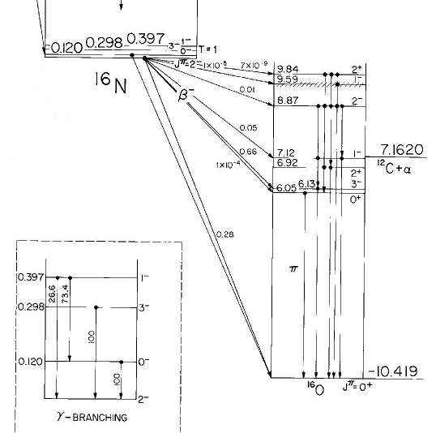

Slide 8
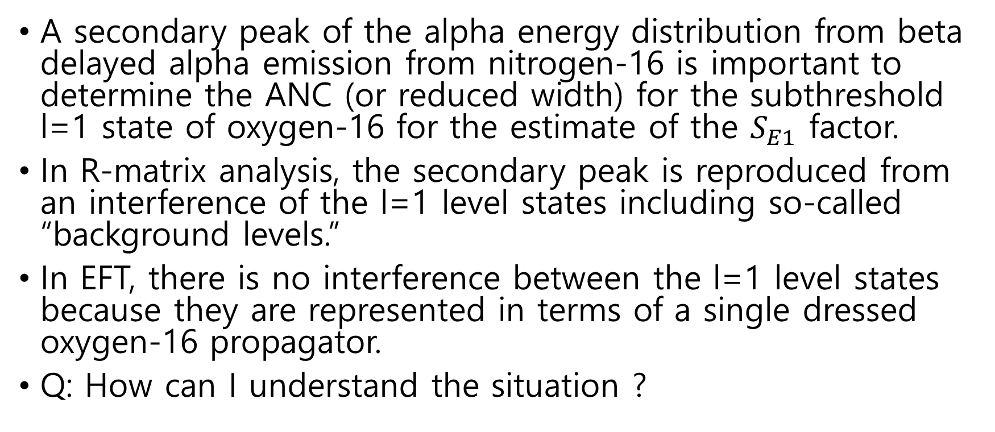
Motivation of the work
A secondary peak of the alpha energy distribution from beta delayed alpha emission from nitrogen-16 is important to determine the ANC (or reduced width) for the subthreshold l=1 state of oxygen-16 for the estimate of the $S_{E1}$ factor.
In R-matrix analysis, the secondary peak is reproduced from an interference of the l=1 level states including so-called “background levels.”
In EFT, there is no interference between the l=1 level states because they are represented in terms of a single dressed oxygen-16 propagator.
Q: How can I understand the situation ?

Slide 9
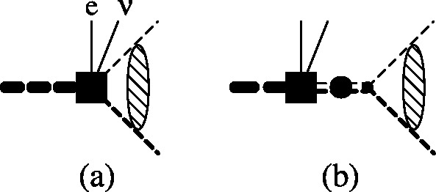
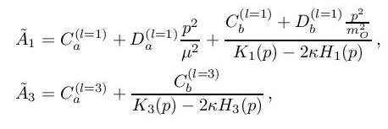
Formalism
Diagrams
Reduced amplitudes

Slide 10
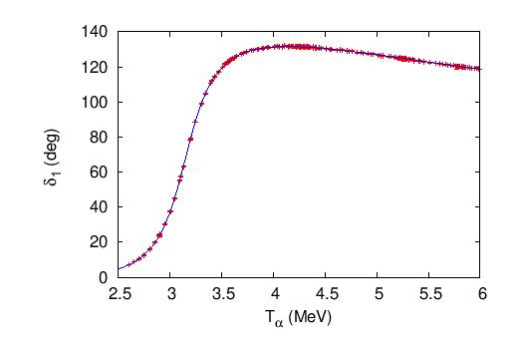

Dressed oxygen-16 propagator
Phase shift for l=1
(elastic scattering data)

Slide 11
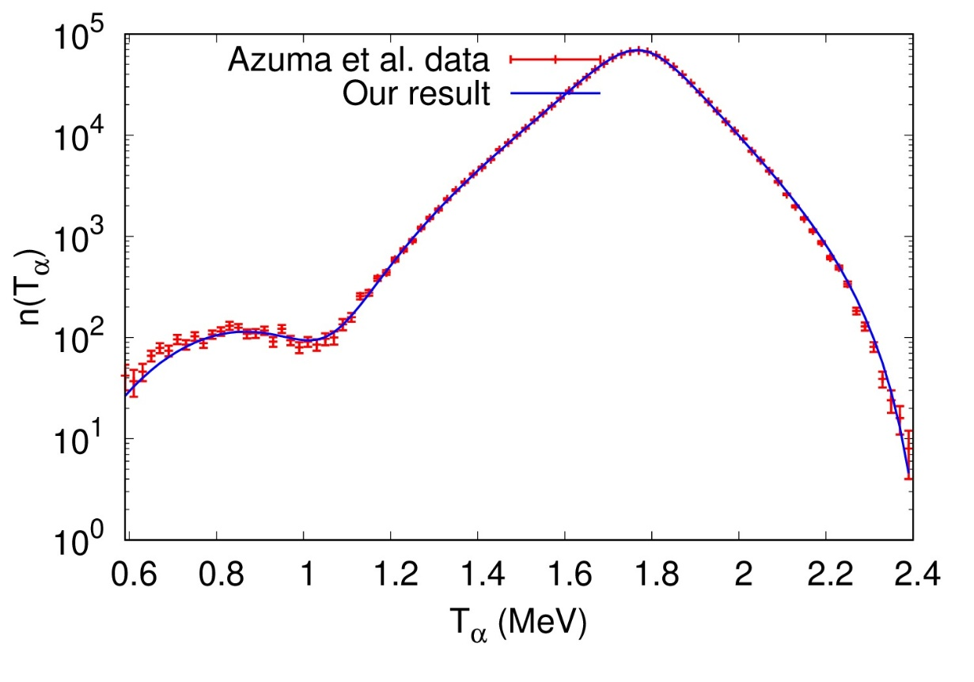
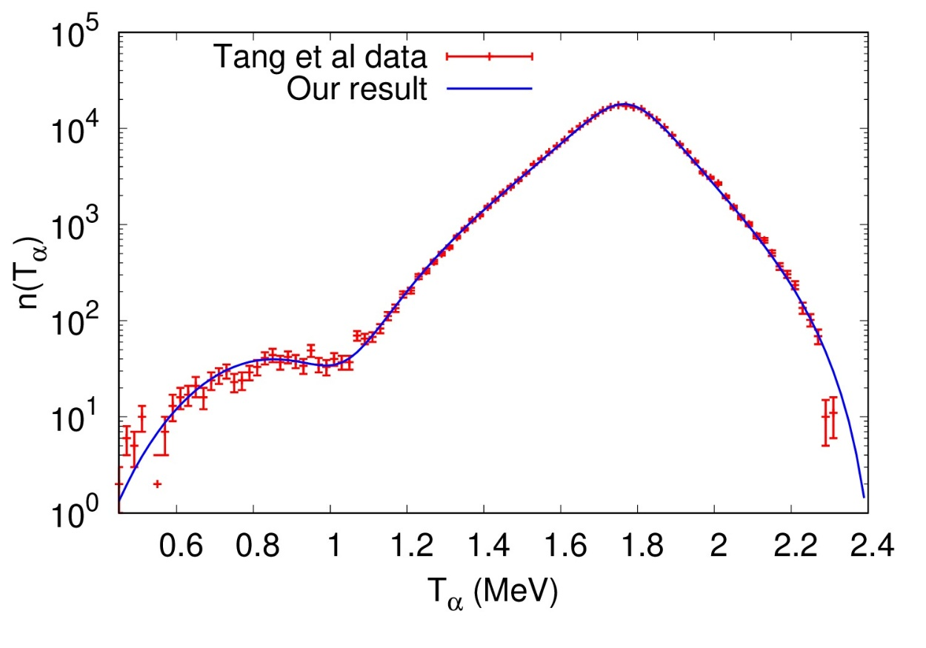
Numerical results
Beta delayed alpha energy distributions from nitrogen-16

Slide 12
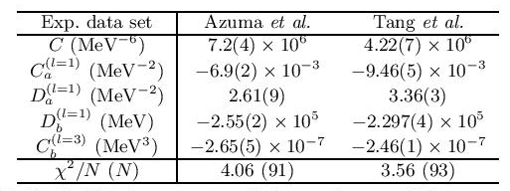
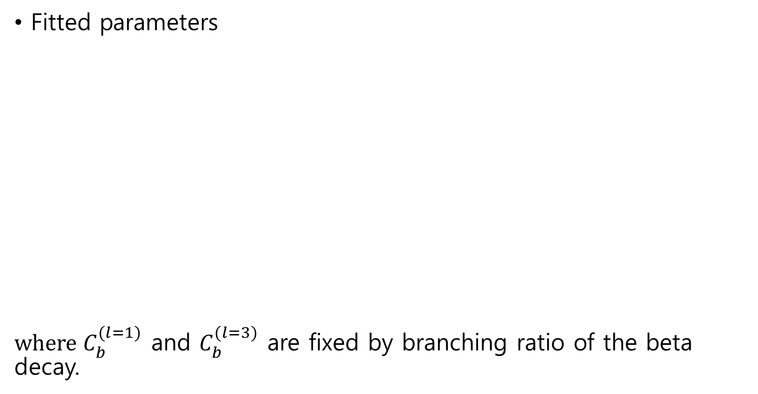
Fitted parameters
where $C_{b}^{(l=1)}$ and $C_{b}^{(l=3)}$ are fixed by branching ratio of the beta decay.

Slide 13
Discussion
The cluster EFT reproduces well the data of beta delayed alpha emission from nitrogen-16.
The ‘’background levels’’ introduced in R-matrix are now interpreted as a “non-pole contribution.”
We confirm that the two sets of the experimental data are not consistent with each other. New experiment will be worth doing.

Slide 14
Future plan
Elastic alpha-carbon-12 scattering for the d-wave channel including two resonant states of oxygen-16 explicitly
Radiative proton capture on nitrogen-15 for the study of transition between CNO cycle and hot-CNO cycle
Alpha transfer reaction from initial litium-7 and carbon-12 state to estimate the ANCs for the subthreshold states of oxygen-16

