Slide 1


Forward quark jet-nucleus scattering in a light-front Hamiltonian approach
Meijian Li
Department of Physics, University of Jyväskylä, Finland
Helsinki Institute of Physics, University of Helsinki, Finland
In collaboration with: Tuomas Lappi (U. Jyväskylä) and Xingbo Zhao (IMPCAS)
Based on work: Phys. Rev. D 104, 056014 (2021)
Light Cone 2021: Physics of Hadrons on the Light Front
November 29 - December 4, 2021, Jeju Booyoung Hotel & ZOOM

Slide 2
Motivation
Studying the quark-color field scattering establishes a foundation for understanding more complicated processes
High-energy quark nucleus scattering
  Interests: sub-eikonal effects
Jet quenching in colored medium
  Interests: interplay between coherence time of gluon emission and the timescales of the scattering centers of the medium
The eikonal
picture
Sub-eikonal corrections:
finite-width field, gluon emission, spin flip,…
…
Using a nonperturbative approach, we could
  Relax the infinite-energy approximation
  Explicitly solve the time evolution and therefore study the scattering and gluon emission/absoprtion at the same time

Slide 3
Outline
Methodology
A time-dependent light-front Hamiltonian approach
Results
Bare quark as an initial state [Phys. Rev. D 104, 056014 (2021)]
Gluon emission and absorption
Dressed quark as an initial state [preliminary]
QCD eigenstate
Interaction with background field
Summary and outlooks
Interaction with a background color field
Application to quark-nucleus scattering in |𝑞⟩ +|𝑞𝑔⟩ Fock space

Slide 4
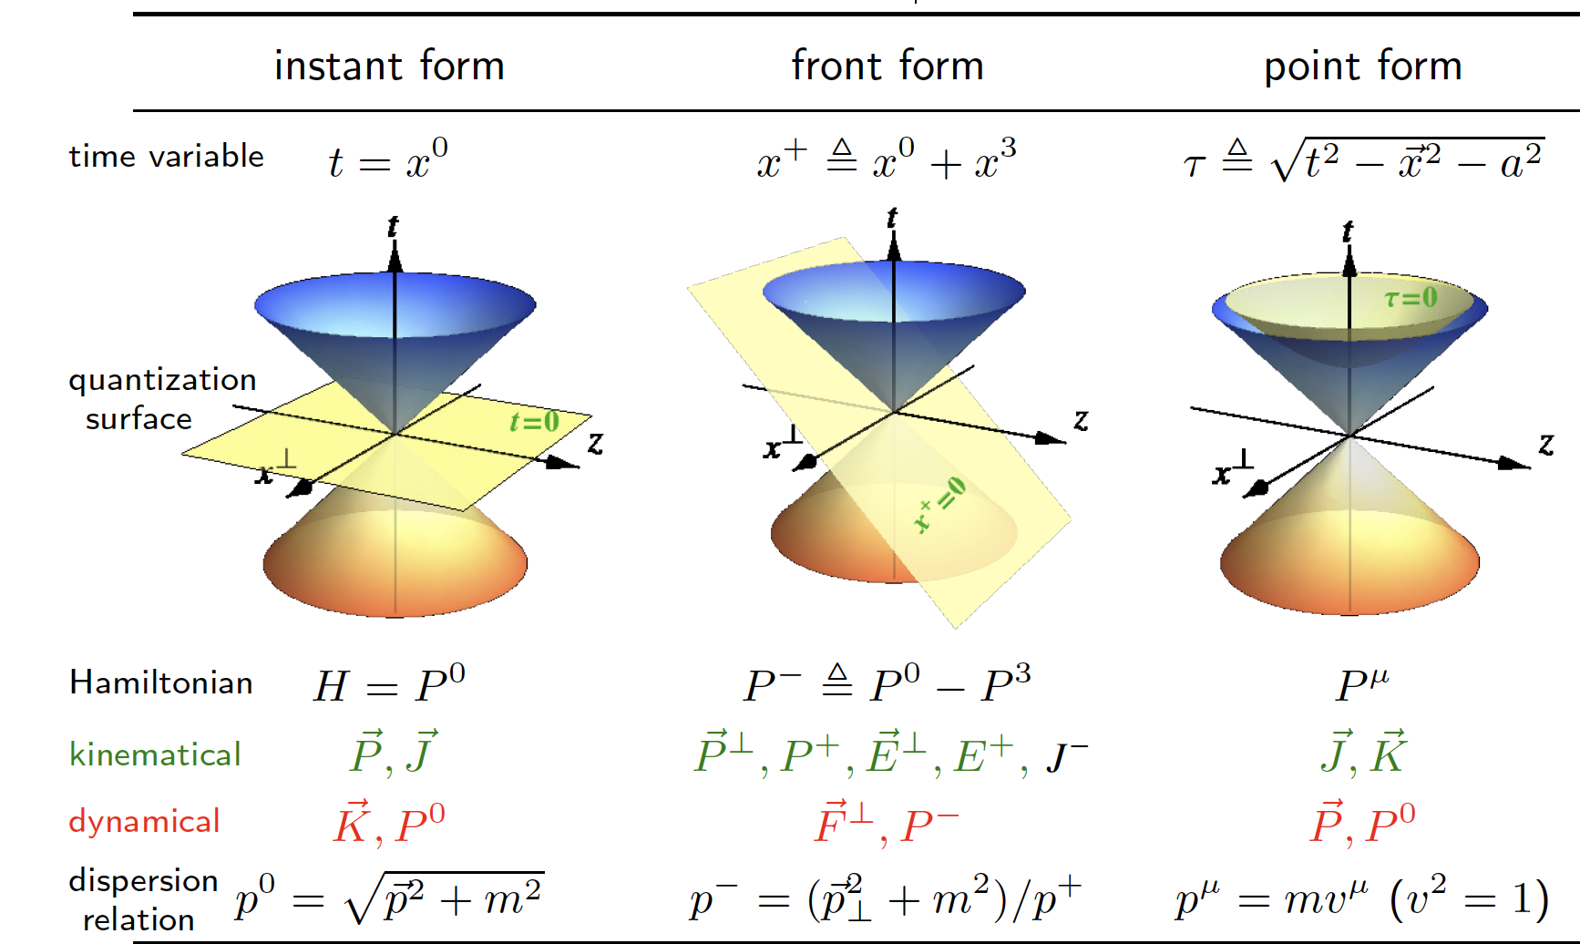

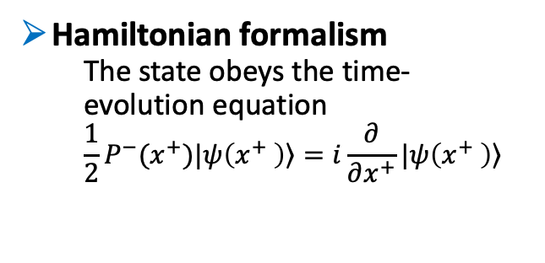
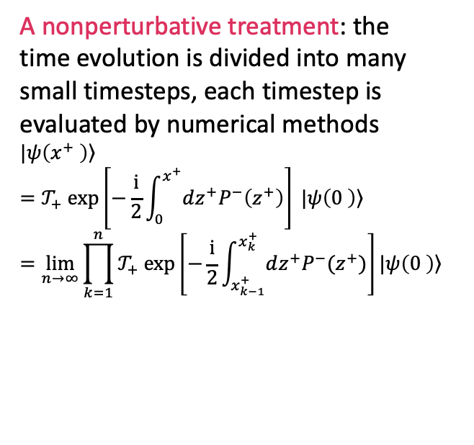
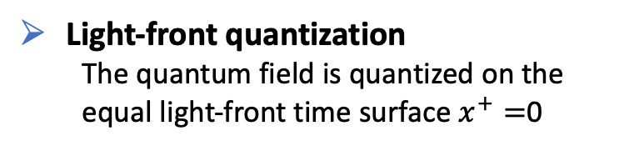
Methodology: Time-dependent Basis Light-Front Quantization (tBLFQ)¹
Light-front quantization
  The quantum field is quantized on the equal light-front time surface $x^{+}=$0
Hamiltonian formalism
  The state obeys the time-evolution equation
  $$\frac{1}{2}P^{−}(x^{+})|\left.ψ\left(x^{+} \right)\right\rangle =i\frac{∂}{∂x^{+}}|\left.ψ\left(x^{+} \right)\right\rangle$$
  A nonperturbative treatment: the time evolution is divided into many small timesteps, each timestep is evaluated by numerical methods
$$\left.|ψ\left(x^{+} \right)\right\rangle =𝒯_{+} exp\left[−\frac{i}{2}\int_{0}^{x^{+}}{dz^{+}P^{−}\left(z^{+}\right)}\right] |\left.ψ\left(0 \right)\right\rangle =\lim_{n→∞}{\prod_{k=1}^{n}{𝒯_{+} exp\left[−\frac{i}{2}\int_{x_{k−1}^{+}}^{x_{k}^{+}}{dz^{+}P^{−}(z^{+})}\right]}}|\left.ψ\left(0 \right)\right\rangle$$
Basis representation
Optimal basis has the symmetries of the system, and is key to numerical efficiency
1. J. P. Vary, H. Honkanen, Jun Li, P. Maris, S. J. Brodsky, A. Harindranath, G. F. de Teramond, P. Sternberg, E. G. Ng, C. Yang., Phys. Rev. C81, 035205 (2010); X. Zhao, A. Ilderton, P. Maris, and J. P. Vary, Phys. Rev. D88, 065014 (2013).

Slide 5
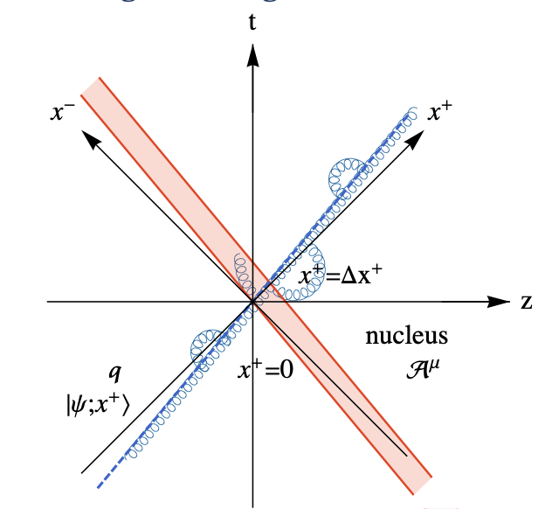


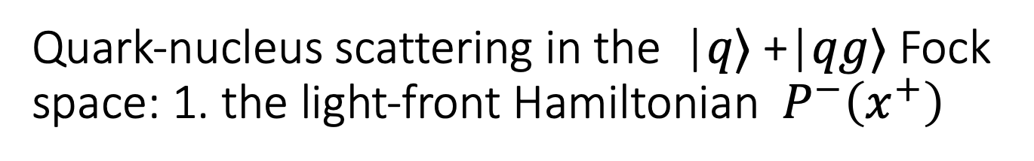




Quark-nucleus scattering in the |𝑞⟩ +|𝑞𝑔⟩ Fock space: 1. the light-front Hamiltonian${ P}^{−}\left(x^{+}\right)$
We consider scattering of a high-energy quark moving in the positive z direction, on a high-energy nucleus moving in the negative z direction.
The light-front Hamiltonian is derived from the QCD Lagrangian with a background color field $𝒜_{μ}$ in the |𝑞⟩ +|𝑞𝑔⟩ space
where $D_{μ}=∂_{μ}+ig(A_{μ}+𝒜_{μ})$.
$$P^{−}\left(x^{+}\right)=P_{KE}^{−}+V_{qg}+V_{𝒜}(x^{+})$$
$$P_{QCD}^{−}$$
background field

Slide 6
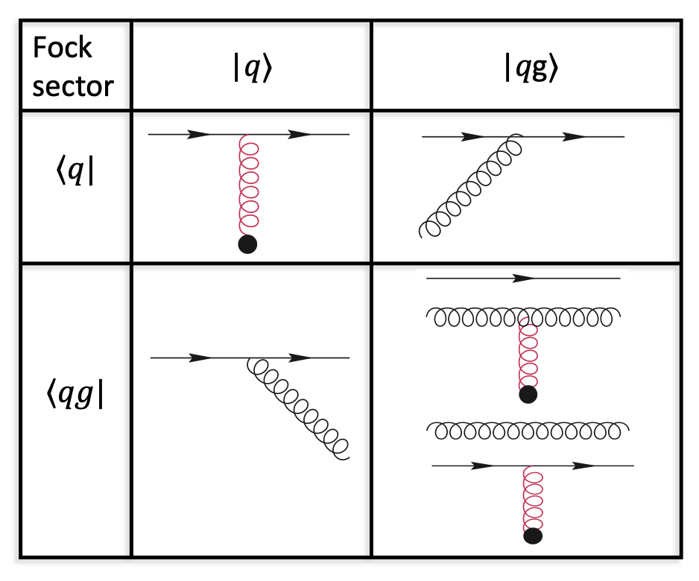
Quark-nucleus scattering in the |𝑞⟩ +|𝑞𝑔⟩ Fock space: 1. the light-front Hamiltonian${ P}^{−}\left(x^{+}\right)$
We consider scattering of a high-energy quark moving in the positive z direction, on a high-energy nucleus moving in the negative z direction.
The light-front Hamiltonian is derived from the QCD Lagrangian with a background color field $𝒜_{μ}$ in the |𝑞⟩ +|𝑞𝑔⟩ space
where $D_{μ}=∂_{μ}+ig(A_{μ}+𝒜_{μ})$.
$$P^{−}\left(x^{+}\right)=P_{KE}^{−}+V_{qg}+V_{𝒜}(x^{+})$$
$$P_{QCD}^{−}$$
background field
Interaction matrix

Slide 7


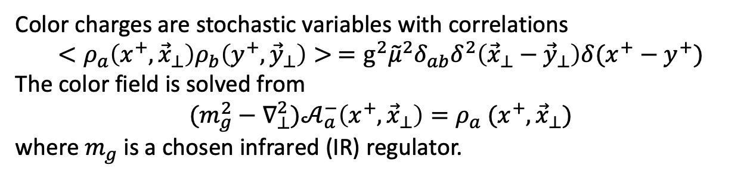


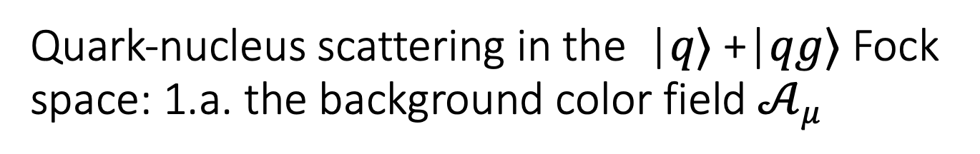



Quark-nucleus scattering in the |𝑞⟩ +|𝑞𝑔⟩ Fock space: 1.a. the background color field $𝒜_{μ}$
The background field from the nucleus, $𝒜(x^{+},{\vec{x}}_{⊥})$, is a classical gluon field described by the MV model¹
Color charges are stochastic variables with correlations
$$<ρ_{a}\left(x^{+},{\vec{x}}_{⊥}\right)ρ_{b}\left(y^{+},{\vec{y}}_{⊥}\right)> =g^{2}{\tilde{μ}}^{2}δ_{ab}δ^{2}\left({\vec{x}}_{⊥}−{\vec{y}}_{⊥}\right)δ(x^{+}−y^{+})$$
The color field is solved from
$$(m_{g}^{2}−∇_{⊥}^{2})𝒜_{a}^{−}\left(x^{+},{\vec{x}}_{⊥}\right)=ρ_{a} (x^{+},{\vec{x}}_{⊥})$$
where $m_{g}$ is a chosen infrared (IR) regulator.
$$x^{+}$$
The color sources of different layers are independent of each other, simulating the quarks from different nucleons of the heavy ion
  The duration of the interaction: $x^{+}=\left[0,L_{η}\right]$
  Number of layers: $N_{η}$
  The duration of each layer: ${τ=L_{η}/N}_{η}$
…
$$x_{f}^{+}=L_{η}$$
…
$$x^{+}=τ$$
$x_{i}^{+}$=0
¹L. D. McLerran and R. Venugopalan, Phys. Rev. D49, 2233 (1994); L. D. McLerran and R. Venugopalan, Phys. Rev. D49, 3352 (1994); L. D. McLerran and R. Venugopalan, Phys. Rev. D50, 2225 (1994).

Slide 8
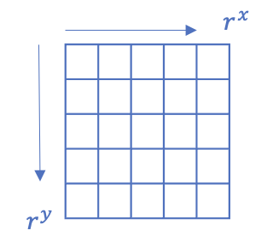
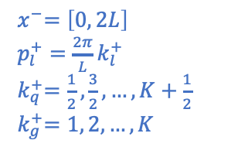
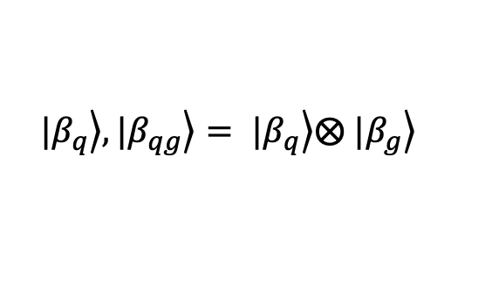
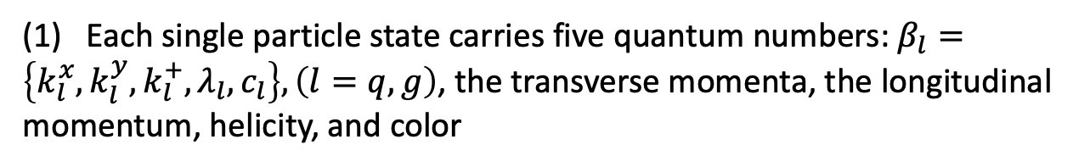

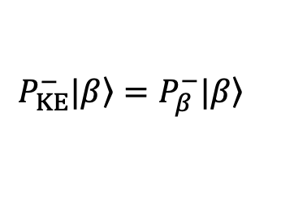
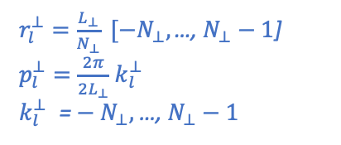

Quark-nucleus scattering in the |𝑞⟩ +|𝑞𝑔⟩ Fock space: 2. basis representation
$$P_{KE}^{−}|\left.β\right\rangle =P_{β}^{−}|\left.β\right\rangle$$
We choose the momentum states as the basis states:
(1) Each single particle state carries five quantum numbers: $β_{l}=\left\{k_{l}^{x},k_{l}^{y},k_{l}^{+}, λ_{l},c_{l}\right\}, \left(l=q, g\right)$, the transverse momenta, the longitudinal momentum, helicity, and color
The transverse space:
The longitudinal space:
$r_{l}^{⊥}=\frac{L_{⊥}}{N_{⊥}} [{−N}_{⊥}, \text{…}\text{, }N_{⊥}−1\text{]}$
$p_{l}^{⊥}=\frac{2π}{2L_{⊥}}$ $k_{l}^{⊥}$
$k_{l}^{⊥} {\text{=}−N}_{⊥},$…, $N_{⊥}−1$
$$0 (2L)$$
$${ x}^{−}=\left[0, 2L\right]$$
$p_{l}^{+}=\frac{2π}{L}k_{l}^{+}$
${ k}_{q}^{+}=\frac{1}{2}, \frac{3}{2},…,K+\frac{1}{2}$
$${ k}_{g}^{+}=1, 2,…, K$$
(2) In each Fock sector, the many-particle basis states are direct products of single particle states:
$$|\left.β_{q}\right\rangle , |\left.β_{qg}\right\rangle = |\left.β_{q}\right\rangle ⨂ |\left.β_{g}\right\rangle$$
The quark state is expanded in the basis space, and the information of the state is encoded in the wavefunction as basis coefficients:
$$|\left.ψ;x^{+}\right\rangle =\sum_{β}{c_{β}(x^{+})|β⟩}$$
Basis size: $N_{tot}={\left(2N_{⊥}\right)}^{2}×2×3+{K×\left(2N_{⊥}\right)}^{4}×4×24$

Slide 9
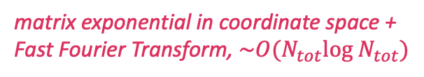


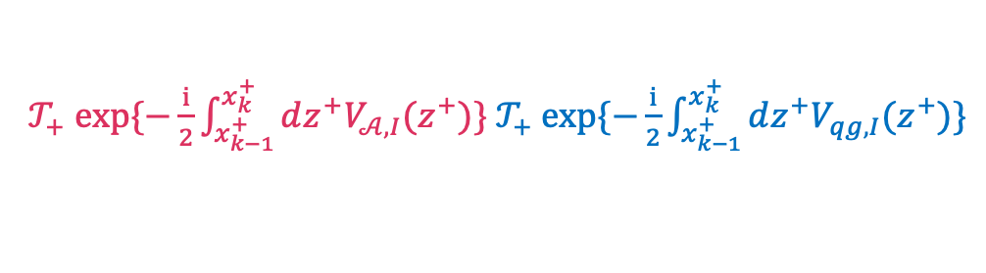
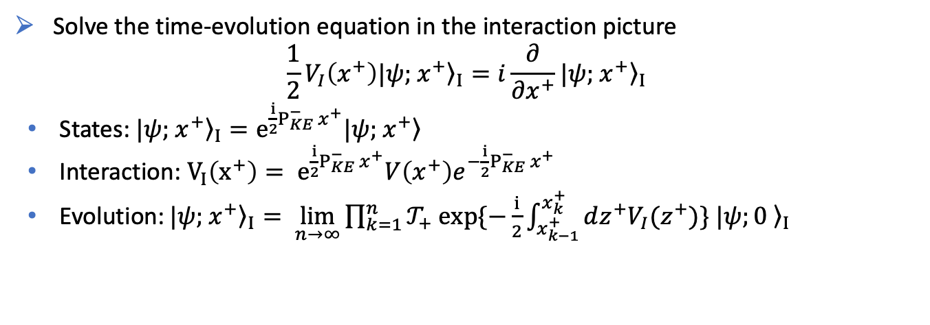
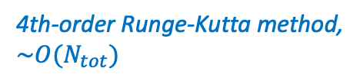
Quark-nucleus scattering in the |𝑞⟩ +|𝑞𝑔⟩ Fock space: 3. time evolution
Solve the time-evolution equation in the interaction picture
  $$\frac{1}{2}V_{I}\left(x^{+}\right)|{\left.ψ;{ x}^{+}\right\rangle }_{I}=i\frac{∂}{∂x^{+}}|{\left.ψ;{ x}^{+}\right\rangle }_{I}$$
  States: $|{\left.ψ;{ x}^{+}\right\rangle }_{I}=e^{\frac{i}{2}P_{KE}^{−}{ x}^{+}}|\left.ψ;{ x}^{+}\right\rangle$
  Interaction: ${V_{I}\left(x^{+}\right)= e}^{\frac{i}{2}P_{KE}^{−}{ x}^{+}}V\left(x^{+}\right)e^{−\frac{i}{2}P_{KE}^{−}{ x}^{+}}$
  Evolution: $|{\left.ψ;{ x}^{+}\right\rangle }_{I}= \lim_{n→∞}{\prod_{k=1}^{n}{𝒯_{+} exp\{−\frac{i}{2}\int_{x_{k−1}^{+}}^{x_{k}^{+}}{dz^{+}V_{I}(z^{+})}\} |{\left.ψ;0 \right\rangle }_{I}}}$
  Each timestep contains two successive operations, computed with optimal numerical methods:
$${\left|ψ;0 \right\rangle }_{I}$$
$${\left|ψ;x^{+}\right\rangle }_{I}$$
  $𝒯_{+} exp\{−\frac{i}{2}\int_{x_{k−1}^{+}}^{x_{k}^{+}}{dz^{+}V_{𝒜,I}(z^{+})}\} 𝒯_{+} exp\{−\frac{i}{2}\int_{x_{k−1}^{+}}^{x_{k}^{+}}{dz^{+}V_{qg,I}(z^{+})}\}$
matrix exponential in coordinate space +
Fast Fourier Transform, $\sim O(N_{tot}log{ N}_{tot})$
4th-order Runge-Kutta method,
$\sim O(N_{tot})$
Total computational complexity of each timestep: $O(N_{tot}log{ N}_{tot})$

Slide 10
Outline
Methodology
A time-dependent light-front Hamiltonian approach
Results
Bare quark as an initial state [Phys. Rev. D 104, 056014 (2021)]
Gluon emission and absorption
Dressed quark as an initial state [preliminary]
QCD eigenstate
Interaction with background field
Summary and outlooks
Interaction with a background color field
Application to quark-nucleus scattering in |𝑞⟩ +|𝑞𝑔⟩ Fock space

Slide 11

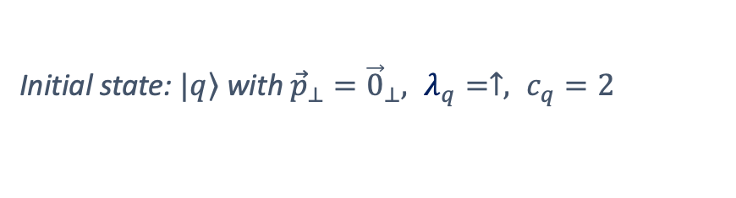



Results: 1.a. Gluon emission and absorption
The initial state is a single quark state, testing the physical effects of different parts of the Hamiltonian in a clean and tractable setup.
The interaction contains the gluon emission/absorption term,
$${V_{I}\left(x^{+}\right)= e}^{\frac{i}{2}P_{KE}^{−}{ x}^{+}}V_{qg}e^{−\frac{i}{2}P_{KE}^{−}{ x}^{+}}$$
Initial state: $|\left.q\right\rangle$ with ${\vec{p}}_{⊥}={\vec{0}}_{⊥}, λ_{q}=↑, c_{q}=2$
Transition
$$p^{+}=8.5 GeV$$
boost invariant
$$p^{+}=4.25 GeV$$
The probability of the initial $|\left.q\right\rangle$state decreases, the $|\left.qg\right\rangle$sector increases.

Slide 12
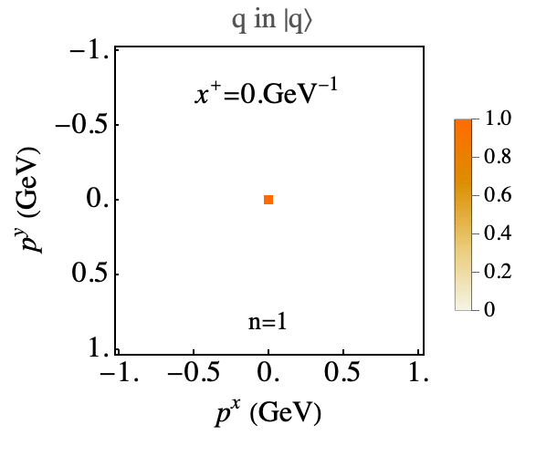
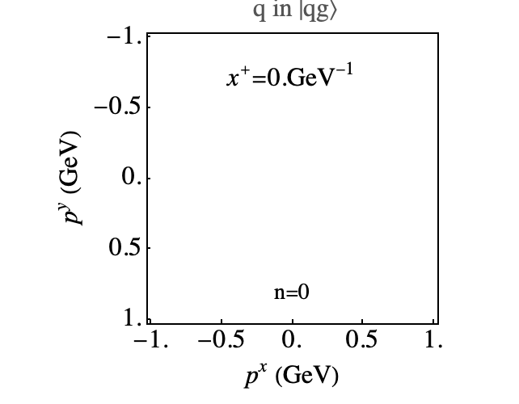

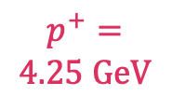
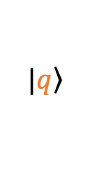



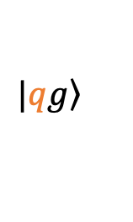

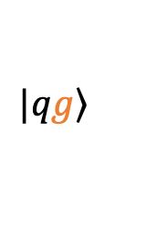
Results: 1.b. Gluon emission and absorption
Evolution in ${\vec{p}}_{⊥}$space
Initial state: $|\left.q\right\rangle$ with ${\vec{p}}_{⊥}={\vec{0}}_{⊥}, λ_{q}=↑, c_{q}=2$
$|\left.q\right\rangle$
$$|\left.qg\right\rangle$$
$$|\left.qg\right\rangle$$
$$p^{+}=$$
$$8.5 GeV$$
boost invariant
$$p^{+}=$$
$$4.25 GeV$$
The total momentum is conserved. Different ${\vec{p}}_{⊥}$ modes oscillate out of phase due to phase factor $e^{−\frac{i}{2}P_{KE}^{−}{ x}^{+}}$.

Slide 13
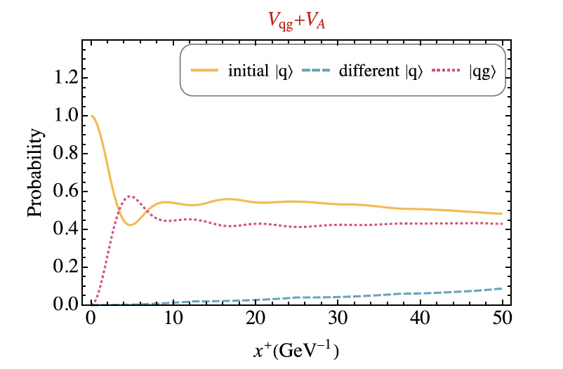
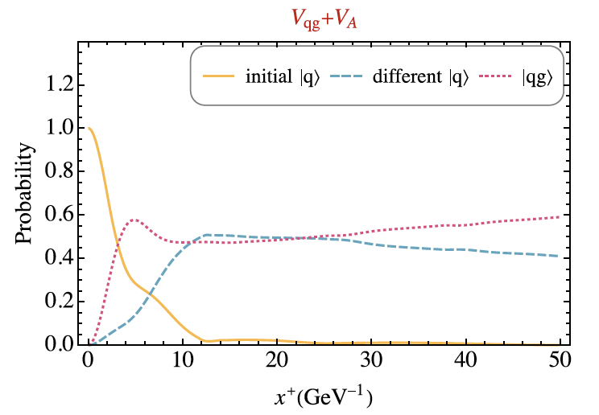

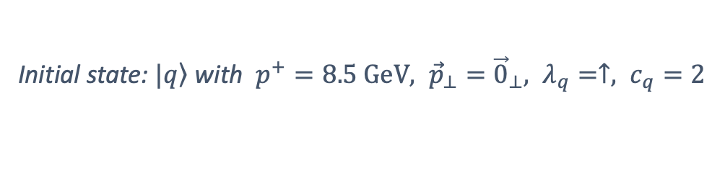


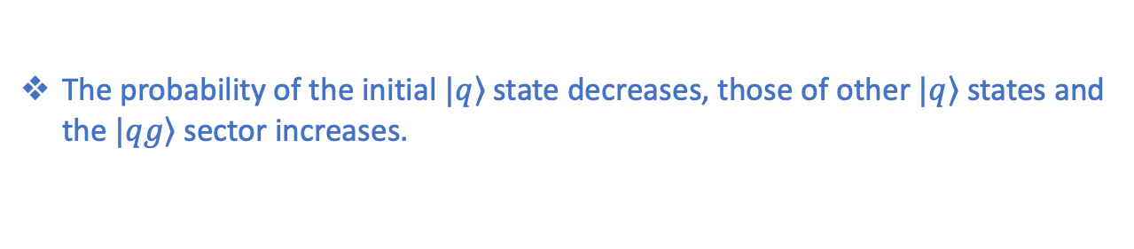
Results: 2.a. Interaction with a background field
The interaction contains the gluon emission/absorption, and the background field term $V_{I}\left(x^{+}\right)= e^{\frac{i}{2}P_{KE}^{−}{ x}^{+}}[V_{qg}\text{+ }V_{𝒜} \left(x^{+}\right)]e^{−\frac{i}{2}P_{KE}^{−}{ x}^{+}}$
Transition
Initial state: $|\left.q\right\rangle$ with $p^{+}=8.5 GeV, {\vec{p}}_{⊥}={\vec{0}}_{⊥}, λ_{q}=↑, c_{q}=2$
$g^{2}\tilde{μ}=0.018 {GeV}^{3/2}$
Stronger background
$$g^{2}\tilde{μ}=0.144 {GeV}^{3/2}$$
The probability of the initial $|\left.q\right\rangle$state decreases, those of other $|\left.q\right\rangle$states and the $|\left.qg\right\rangle$sector increases.

Slide 14

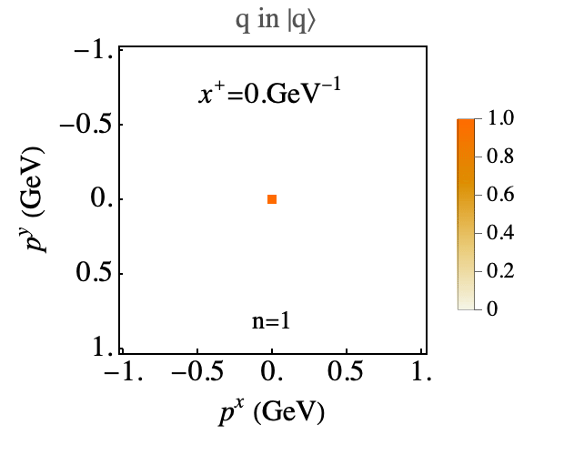

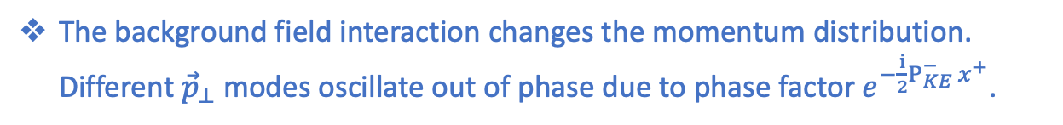
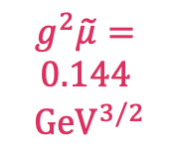
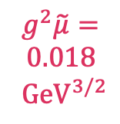
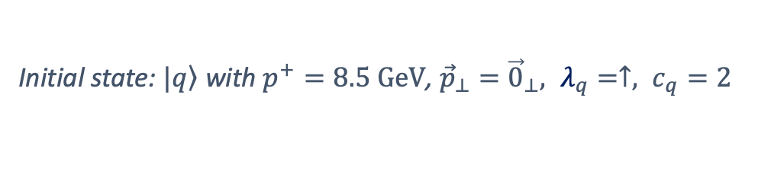
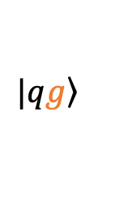
Results: 2.b. Interaction with a background field
Evolution in ${\vec{p}}_{⊥}$space
Initial state: $|\left.q\right\rangle$ with $p^{+}=8.5 GeV$, ${\vec{p}}_{⊥}={\vec{0}}_{⊥}, λ_{q}=↑, c_{q}=2$
$|\left.q\right\rangle$
$$|\left.qg\right\rangle$$
$$|\left.qg\right\rangle$$
$g^{2}\tilde{μ}=$
$$0.018$$
$${GeV}^{3/2}$$
Stronger
background
$$g^{2}\tilde{μ}=$$
$$0.144$$
$${GeV}^{3/2}$$
The background field interaction changes the momentum distribution. Different ${\vec{p}}_{⊥}$ modes oscillate out of phase due to phase factor $e^{−\frac{i}{2}P_{KE}^{−}{ x}^{+}}$.

Slide 15
Outline
Methodology
A time-dependent light-front Hamiltonian approach
Results
Bare quark as an initial state [Phys. Rev. D 104, 056014 (2021)]
Gluon emission and absorption
Dressed quark as an initial state [preliminary]
QCD eigenstate
Interaction with background field
Summary and outlooks
Interaction with a background color field
Application to quark-nucleus scattering in |𝑞⟩ +|𝑞𝑔⟩ Fock space

Slide 16
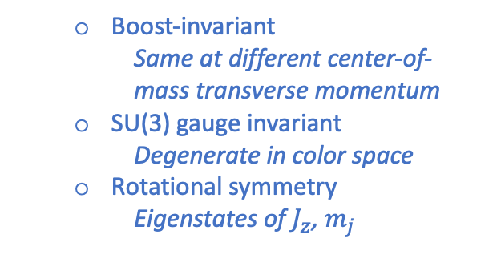
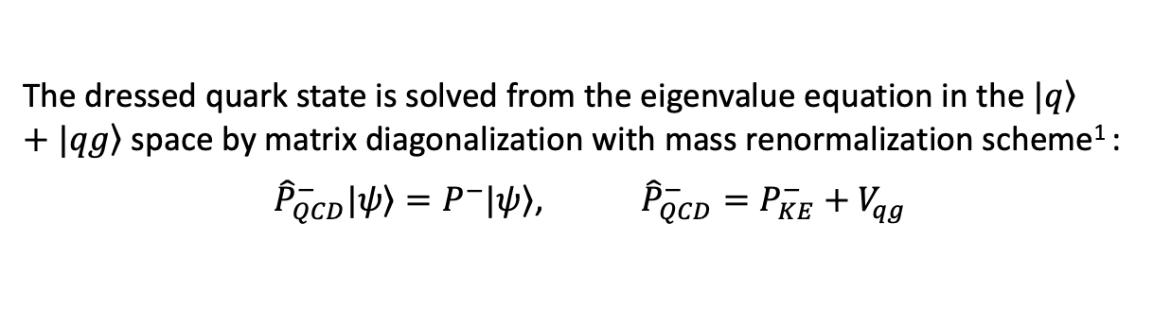

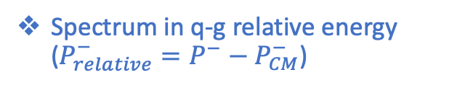
Results (preliminary): 3. Dressed quark
In a physical high-energy scattering process, the initial quark state has already developed a gluon cloud before the interaction.
The dressed quark state is solved from the eigenvalue equation in the $|\left.q\right\rangle$ $+|\left.qg\right\rangle$ space by matrix diagonalization with mass renormalization scheme¹ :
${\hat{P}}_{QCD}^{−}|\left.ψ\right\rangle =P^{−}|\left.ψ\right\rangle$, ${{\hat{P}}_{QCD}^{−}=P}_{KE}^{−}+V_{qg}$
Spectrum in q-g relative energy ($P_{relative}^{−}={P^{−}−P}_{CM}^{−}$)
  Boost-invariant
    Same at different center-of-mass transverse momentum
  SU(3) gauge invariant
    Degenerate in color space
  Rotational symmetry
    Eigenstates of $J_{z}$, $m_{j}$
excited states
ground states ($P^{+}P^{−}−P_{⊥}^{2}=m_{q}^{2}$)
1. V.A. Karmanov, J.-F. Mathiot, A.V. Smirnov, Phys.Rev.D 77 (2008), 085028; Phys.Rev.D 86 (2012) 085006.

Slide 17
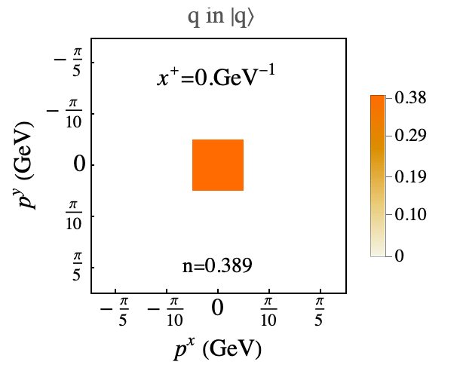
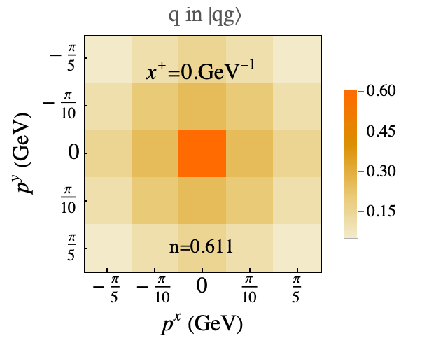

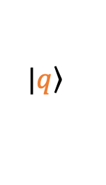


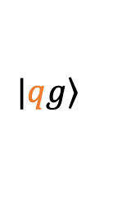

Results (preliminary): 3. Dressed quark
In a physical high-energy scattering process, the initial quark state has already developed a gluon cloud before the interaction.
The dressed quark state is solved from the eigenvalue equation in the $|\left.q\right\rangle$ $+|\left.qg\right\rangle$ space by matrix diagonalization with mass renormalization scheme¹ :
${\hat{P}}_{QCD}^{−}|\left.ψ\right\rangle =P^{−}|\left.ψ\right\rangle$, ${{\hat{P}}_{QCD}^{−}=P}_{KE}^{−}+V_{qg}$
Evolution in ${\vec{p}}_{⊥}$space
Initial state is the $|\left.q\right\rangle$ $+|\left.qg\right\rangle$ ground state
$|\left.q\right\rangle$
$$|\left.qg\right\rangle$$
$$|\left.qg\right\rangle$$
The background field interaction stimulates the ground state to excited states.
1. V.A. Karmanov, J.-F. Mathiot, A.V. Smirnov, Phys.Rev.D 77 (2008), 085028; Phys.Rev.D 86 (2012) 085006.

Slide 18
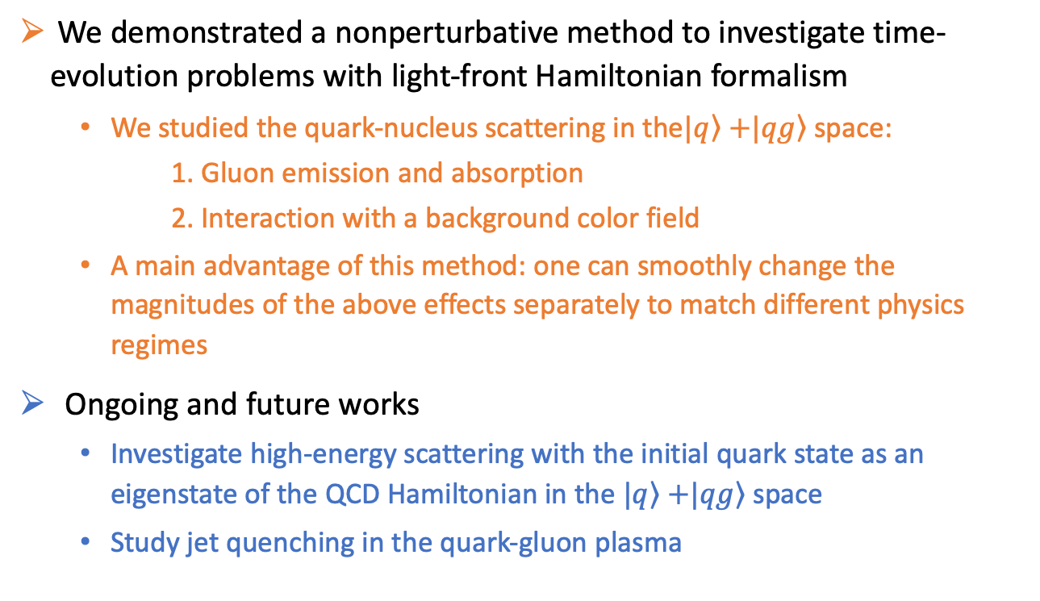
Summary and outlooks
We demonstrated a nonperturbative method to investigate time-evolution problems with light-front Hamiltonian formalism
  We studied the quark-nucleus scattering in the$|\left.q\right\rangle$ $+|\left.qg\right\rangle$ space:
      Gluon emission and absorption
      Interaction with a background color field
  A main advantage of this method: one can smoothly change the magnitudes of the above effects separately to match different physics regimes
Ongoing and future works
  Investigate high-energy scattering with the initial quark state as an eigenstate of the QCD Hamiltonian in the $|\left.q\right\rangle$ $+|\left.qg\right\rangle$ space
  Study jet quenching in the quark-gluon plasma
Thank you!

Slide 19
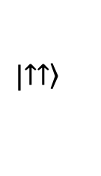
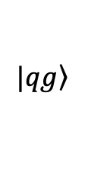
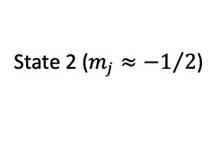






[Backup] Results (preliminary): Dressed quark
Distribution amplitudes of the two $|\left.q\right\rangle +|\left.qg\right\rangle$ground states in the relative transverse-momentum space, summed over $p_{q}^{+}$ states
State 1 ($m_{j}≈1/2$)
State 2 ($m_{j}≈{−1}/2$)
$$|\left.qg\right\rangle$$
$$|\left.↑↑\right\rangle$$
$$|\left.↑↓\right\rangle$$
Relative momentum:
${\vec{Δ}}_{m}=−$ ${\vec{p}}_{⊥,q}+\frac{p_{q}^{+}}{P^{+}}{\vec{P}}_{⊥}$
Center-of-mass:
${\vec{P}}_{⊥}$= ${\vec{p}}_{⊥,q}+$ ${\vec{p}}_{⊥,g}$
$$P^{+}=p_{q}^{+}+p_{g}^{+}$$
$$|\left.↓↑\right\rangle$$
$$|\left.↓↓\right\rangle$$

