Slide 1

Regge approach to backward electromagnetic production of meson with parton contributions
(Daresbury NINA data 1977 / JLab F$π$-2 data 2019)
B.-G. Yu* & K.-J. Kong
Korea Aerospae Univ.
Light Cone 2021
Dec. 3, 2021, Jeju

Slide 2
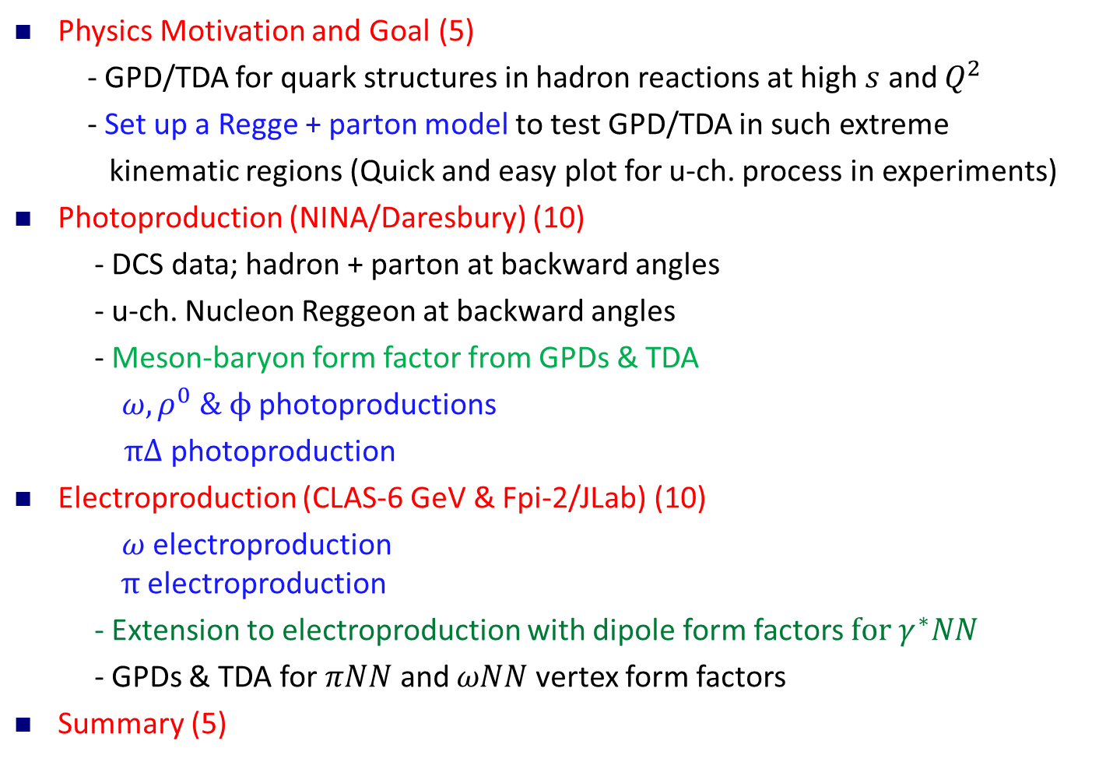
Outline
Physics Motivation and Goal (5)
- GPD/TDA for quark structures in hadron reactions at high $s$ and $Q^{2}$
- Set up a Regge + parton model to test GPD/TDA in such extreme
kinematic regions (Quick and easy plot for u-ch. process in experiments)
Photoproduction (NINA/Daresbury) (10)
- DCS data; hadron + parton at backward angles
- u-ch. Nucleon Reggeon at backward angles
- Meson-baryon form factor from GPDs & TDA
$ω, ρ^{0} \& ϕ$ photoproductions
$π∆$ photoproduction
Electroproduction (CLAS-6 GeV & Fpi-2/JLab) (10)
$ω$electroproduction
$π$electroproduction
- Extension to electroproduction with dipole form factors$for γ^{∗}NN$
- GPDs & TDA for $πNN$ and $ωNN$ vertex form factors
Summary (5)
Notes:
One needs hadron models to test predictions of QCD based theories and numerical consequences in underlying parton physics in hadron reactions.

Slide 3
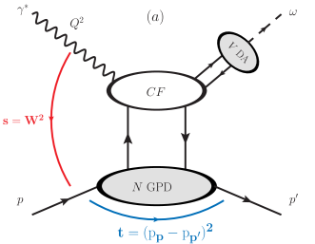
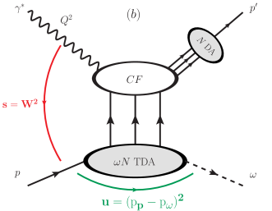






1. Electromagnetic production of $ω$
1. Physics Motivation and Goal
FORWARD
BACKWARD
$$π$$
$$N$$
$πNN$ form factor
$ωNN$ form factor
Nucleon GPD: VGG model
Nucleon TDA: PSS model
Phys. Rev. D 56 (1997) 2982
Phys. Rev. D 91, 094006 (2015)
→ 8
→$24$

Slide 4
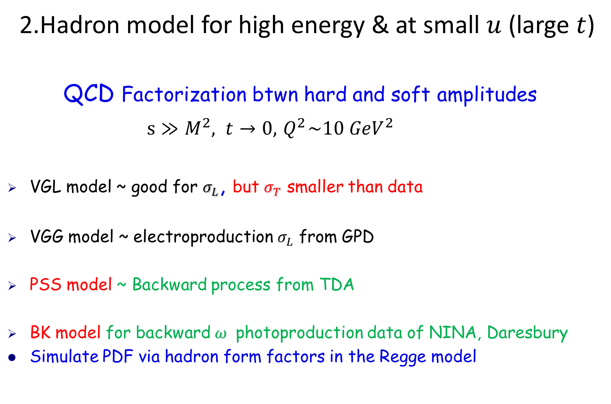
1. Physics Motivation and Goal
2.Hadron model for high energy & at small $u$ (large $t$)
QCD Factorization btwn hard and soft amplitudes
$s≫M^{2}, t→0, { Q}^{2}\sim 10 {GeV}^{2}$
VGL model ~ good for $σ_{L}$, but $σ_{T}$ smaller than data
VGG model ~ electroproduction $σ_{L}$ from GPD
PSS model ~ Backward process from TDA
BK model for backward $ω$ photoproduction data of NINA, Daresbury
Simulate PDF via hadron form factors in the Regge model

Slide 5
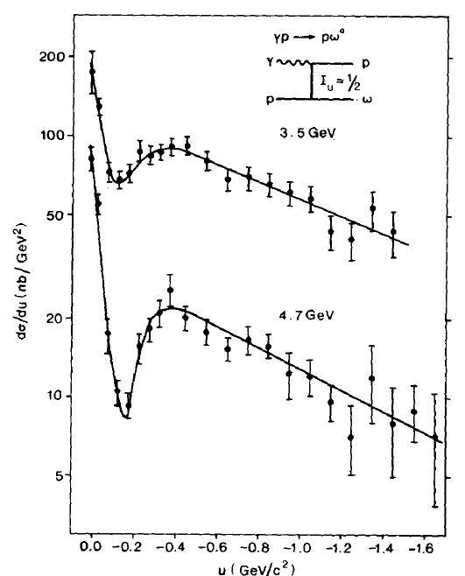
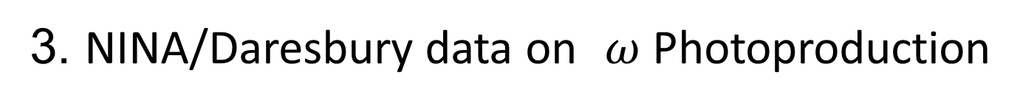
2. Photoproduction
3. NINA/Daresbury data on $ω$ Photoproduction
Isoscalar channel

Slide 6
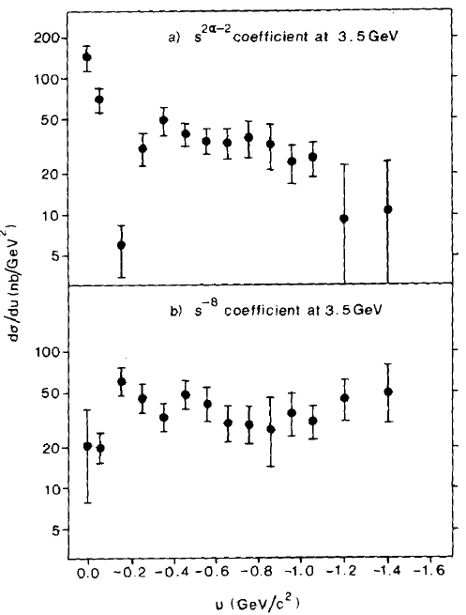
2. Photoproduction

Slide 7
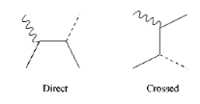
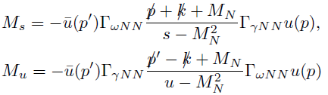
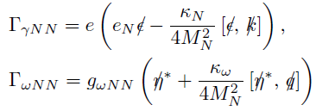
2. Photoproduction
1. Reggeization of nucleon exchange in the u-ch
Gauge invariance needs s-ch. Proton pole

Slide 8


2. Photoproduction

Slide 9






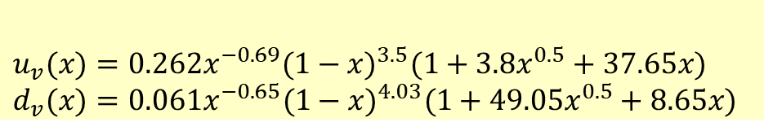
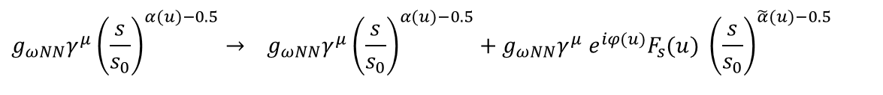
2. Photoproduction
2. Parton contribution
$$g_{ωNN}γ^{μ}{\left(\frac{s}{s_{0}}\right)}^{α(u)−0.5}→ g_{ωNN}γ^{μ}{\left(\frac{s}{s_{0}}\right)}^{α(u)−0.5}+g_{ωNN}γ^{μ}{ e}^{iφ(u)}F_{s}(u) {\left(\frac{s}{s_{0}}\right)}^{\tilde{α}(u)−0.5}$$
M. Guidal, M.V. Polyakov, A. V. Radyushkin, M. Vanderhaeghen, PRD 72, 054013 (2005)
$$u_{v}(x)=0.262x^{−0.69}(1−x)^{3.5}(1+3.8x^{0.5}+37.65x) \\ d_{v}(x)=0.061x^{−0.65}(1−x)^{4.03}(1+49.05x^{0.5}+8.65x)$$

Slide 10
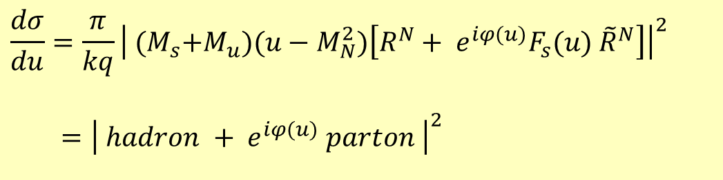
Nucleon Reggeon+ meson poles
2. Photoproduction
3. Regge+parton model for simulating NINA data
$$\frac{dσ}{du}=\frac{π}{kq}{\left| {(M}_{s}{+M}_{u})(u−M_{N}^{2})\left[R^{N}+ e^{iφ(u)}F_{s}(u) {\tilde{R}}^{N}\right]\right|}^{2}$$
$={\left| hadron + e^{iφ(u)} parton \right|}^{2}$
Parton

Slide 11
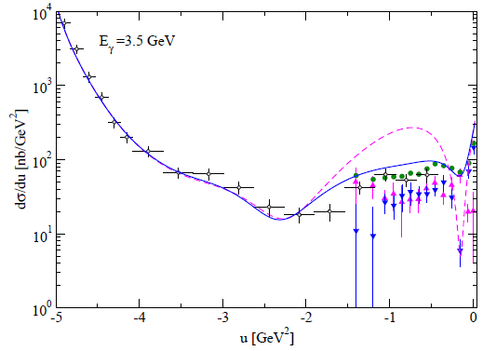


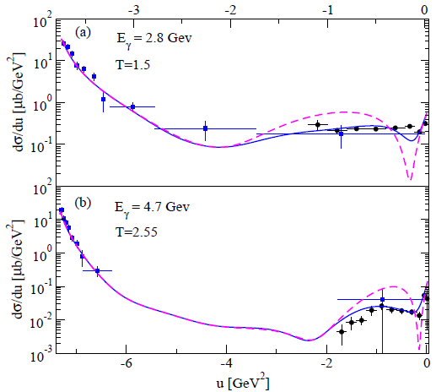
2. Photoproduction
4. Results

Slide 12
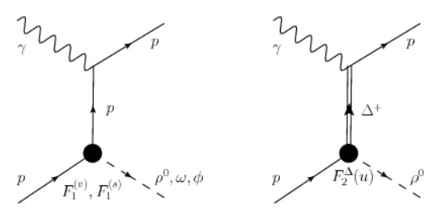
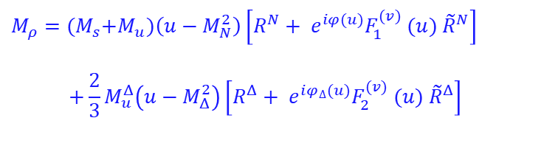

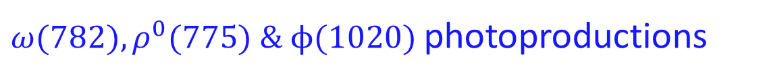
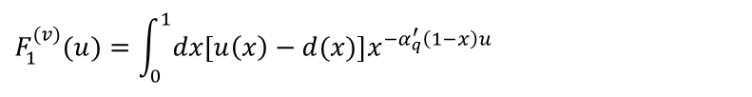



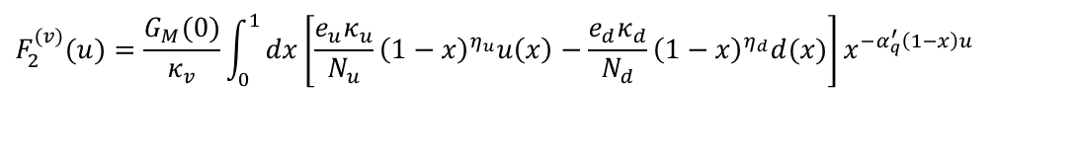

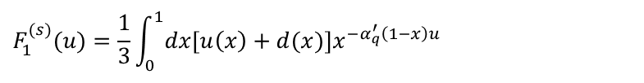

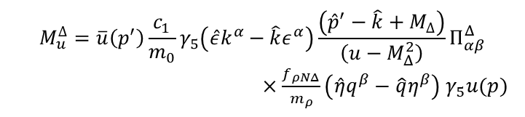
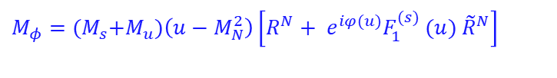

2. Photoproduction
5. Applications
$ω(782),ρ^{0}(775) \& ϕ(1020)$ photoproductions
* Study GPD contents of nucleon & delta isoscalar/vector FF in u-channel
$ω \& φ$ cases
$$M_{φ}={(M}_{s}{+M}_{u})\left(u−M_{N}^{2}\right)\left[R^{N}+ e^{iφ(u)}F_{1}^{(s)} (u) {\tilde{R}}^{N}\right]$$
${ ρ}^{0}$ case
$$M_{ρ}={(M}_{s}{+M}_{u})\left(u−M_{N}^{2}\right)\left[R^{N}+ e^{iφ(u)}F_{1}^{(v)} (u) {\tilde{R}}^{N}\right]$$
$$+\frac{2}{3}M_{u}^{Δ}\left(u−M_{Δ}^{2}\right)\left[R^{Δ}+ e^{iφ_{∆}(u)}F_{2}^{(v)} (u) {\tilde{R}}^{Δ}\right]$$
$F_{2}^{N∆}(u)$= $F_{2}^{\left(v\right)}(u)$
$Baryon Regge pole$
GPD FF for meson-baryon FF
$$R^{J}(s,u)=α_{J}^{′}Γ\left[J−α_{J}(u)\right]\frac{1}{2}\left[1±e^{i{ π(α}_{J}(u)−0.5)}\right]{\left(\frac{s}{s_{0}}\right)}^{α_{J}(u)−J}$$
$$F_{1}^{(s)}(u)=\frac{1}{3}\int_{0}^{1}{dx\left[u\left(x\right)+d(x)\right]x^{−α_{q}^{′}\left(1−x\right)u}}$$
$Δ^{+} exchange$
$$F_{1}^{(v)}(u)=\int_{0}^{1}{dx\left[u\left(x\right)−d(x)\right]x^{−α_{q}^{′}\left(1−x\right)u}}$$
$$M_{u}^{∆}=\overline{u}\left(p^{′}\right)\frac{c_{1}}{m_{0}}γ_{5}\left(\hat{ε}k^{α}−\hat{k}ε^{α}\right)\frac{\left({\hat{p}}^{′}−\hat{k}+M_{∆}\right)}{\left(u−M_{Δ}^{2}\right)}Π_{αβ}^{Δ}$$
$×\frac{f_{ρNΔ}}{m_{ρ}}\left(\hat{η}q^{β}−\hat{q}η^{β}\right)$ $γ_{5}u(p)$
$$F_{2}^{(v)}(u)=\frac{G_{M}(0)}{κ_{v}}\int_{0}^{1}{dx\left[\frac{e_{u}κ_{u}}{N_{u}}{\left(1−x\right)}^{η_{u}}u\left(x\right)−\frac{e_{d}κ_{d}}{N_{d}}{\left(1−x\right)}^{η_{d}}d(x)\right]x^{−α_{q}^{′}\left(1−x\right)u}}$$
${(α}_{q}^{′}=0.3 {GeV}^{−2})$

Slide 13
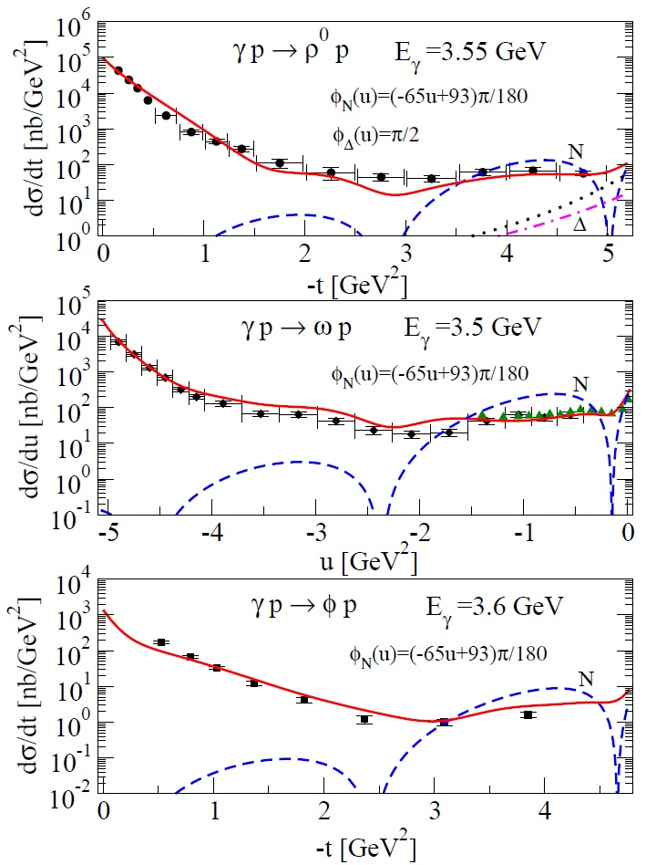



















2. Photoproduction
N $exchange$
$$g_{ω}^{v}=15.6, g_{ω}^{t}=0$$
$$g_{φ}^{v}=3.2, g_{φ}^{t}=0$$
$$g_{ρ}^{v}=2.6, g_{ρ}^{t}=2.6∗3.7$$
$$R^{N}=canon.$$
$$α_{N}\left(u\right)=0.9u−0.365$$
$${\tilde{R}}^{N}=canon.$$
$${\tilde{α}}_{N}\left(u\right)=0.9u−0.56$$
$$φ_{N}\left(u\right)=\left(−65u+93\right)π/180$$
$$Δ^{+} exchange$$
$$c_{1}=−2.68e, f_{ρNΔ}=5.05$$
$$G_{M}\left(0\right)=3.02, κ_{V}=3.7$$
$$κ_{u}=1.673, κ_{d}=−2.033$$
$$η_{u}=1.713, η_{d}=0.566$$
$$R^{Δ}=complex$$
$$α_{Δ}\left(u\right)=0.9u−0.25$$
$${\tilde{R}}^{Δ}=canon.$$
$${\tilde{α}}_{Δ}\left(u\right)=0.9u+0.2$$
$$φ_{Δ}\left(u\right)=π/2$$

Slide 14
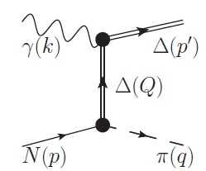
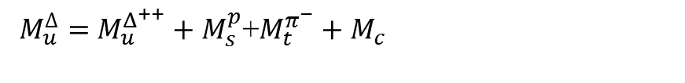
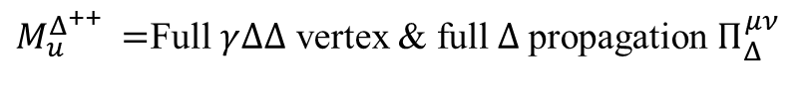

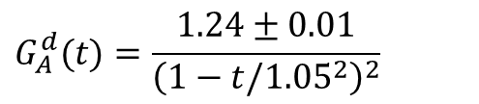
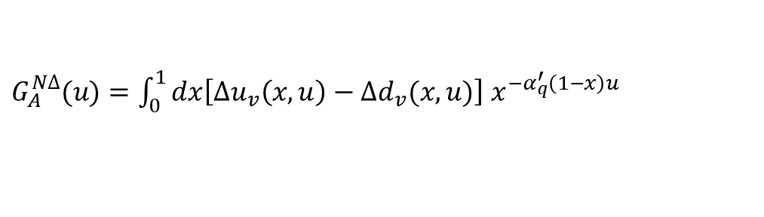
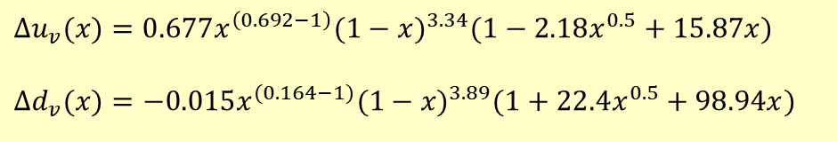
2. Photoproduction
$π^{−}∆^{++}$ photoproduction
* Study GPD contents of $NΔ$ axial vector FF in u-channel
$$M_{Δ}= M_{u}^{Δ}\left(u−M_{Δ}^{2}\right)\left[R^{Δ}+ e^{iφ_{∆}(u)}G_{A}^{NΔ} (u) {\tilde{R}}^{Δ}\right]$$
Gauge invariance $e_{p}−e_{Δ^{++}}−e_{π^{−}}=0$
$M_{u}^{∆}=$ $M_{u}^{Δ^{++}}+M_{s}^{p}$+$M_{t}^{π^{−}}+M_{c}$
$M_{u}^{Δ^{++}} =$Full $γ∆∆$ vertex & full $Δ$propagation $Π_{Δ}^{μν}$
$G_{A}^{N∆}(u)=\int_{0}^{1}{dx\left[Δu_{v}\left(x,u\right)−Δd_{v}(x,u)\right]}$ $x^{{−α}_{q}^{′}\left(1−x\right)u}$
D. de Florian, R. Sassot, M. Stratmann, W. Vogelsang, PRD 80, 034030 (2009)
$$Δu_{v}(x)=0.677x^{\left(0.692−1\right)}(1−x)^{3.34}(1−2.18x^{0.5}+15.87x)$$
$$Δd_{v}(x)=−0.015x^{(0.164−1)}(1−x)^{3.89}(1+22.4x^{0.5}+98.94x)$$
$$G_{A}^{d}(t)=\frac{1.24±0.01}{{\left(1−t/1.05^{2}\right)}^{2}}$$

Slide 15
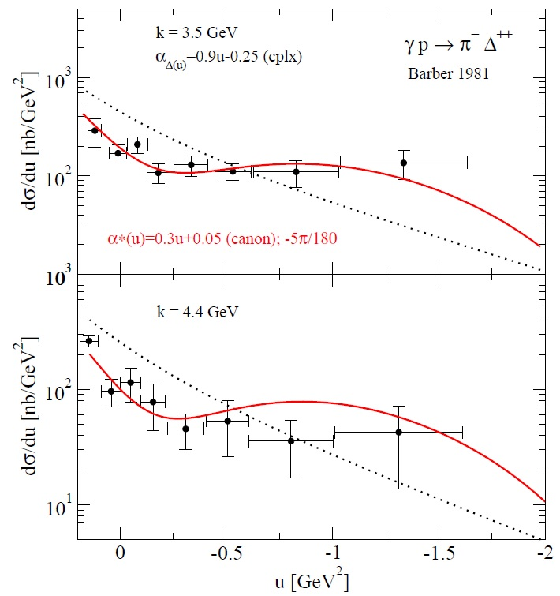

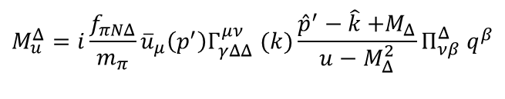








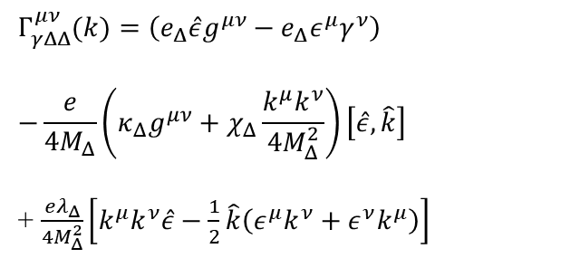
2. Photoproduction
$$Δ^{++} exchange$$
$$M_{u}^{Δ}{=i\frac{f_{πNΔ}}{m_{π}}{\overline{u}}_{μ}\left(p^{′}\right)Γ}_{γΔΔ}^{μν}(k)\frac{{\hat{p}}^{′}−\hat{k}{+M}_{Δ}}{u−M_{Δ}^{2}}Π_{νβ}^{Δ}{ q}^{β}$$
$$α_{q}^{′}=0.3 {GeV}^{−2}$$
$f_{πNΔ}$=1.7
$$Γ_{γΔΔ}^{μν}(k)=\left(e_{Δ}\hat{ε}g^{μν}−e_{Δ}ε^{μ}γ^{ν}\right)$$
$$−\frac{e}{4M_{Δ}}\left(κ_{Δ}g^{μν}+χ_{Δ}\frac{k^{μ}k^{ν}}{4M_{Δ}^{2}}\right)\left[\hat{ε}, \hat{k}\right]$$
+ $\frac{eλ_{Δ}}{4M_{Δ}^{2}}\left[k^{μ}k^{ν}\hat{ε}−\frac{1}{2}\hat{k}\left(ε^{μ}k^{ν}+ε^{ν}k^{μ}\right)\right]$
QSR ← K. Azizi, K. Azizi, EPJC61, 311 (2009)
$κ_{Δ}=4.34, χ_{Δ}=12.34,$ $λ_{Δ}$=6.18
$$R^{Δ}=complex$$
$$α_{Δ}\left(u\right)=0.9u−0.25$$
$${\tilde{R}}^{Δ}=canon.$$
$${\tilde{α}}_{Δ}\left(u\right)=0.3u+0.05$$
$$φ_{Δ}\left(u\right)=−5π/180$$

Slide 16

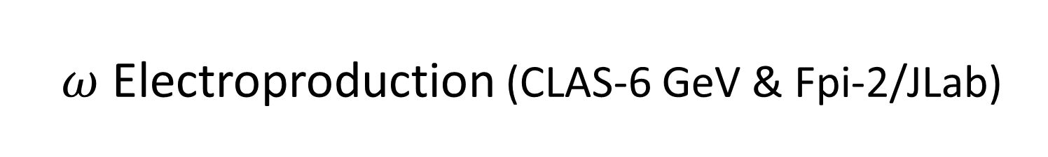
$ω$ Electroproduction (CLAS-6 GeV & Fpi-2/JLab)
3. Electroproduction
$$γ^{∗}\left(k\right)+p\left(p\right)→ω^{0}\left(q\right)+p(p′)$$
FORWARD
BACKWARD

Slide 17
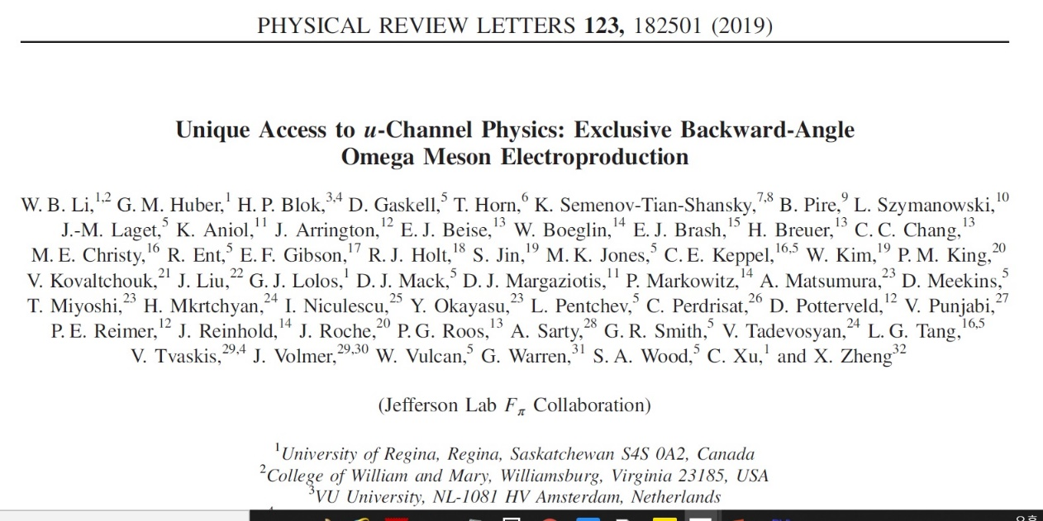
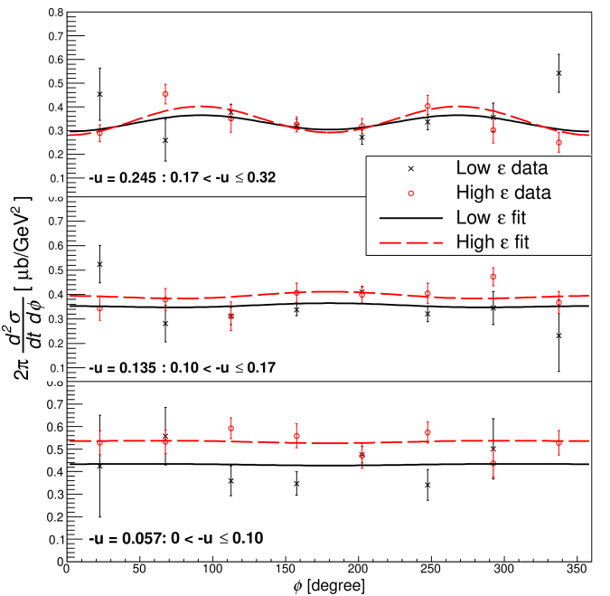

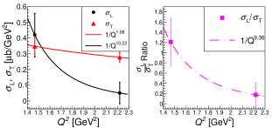


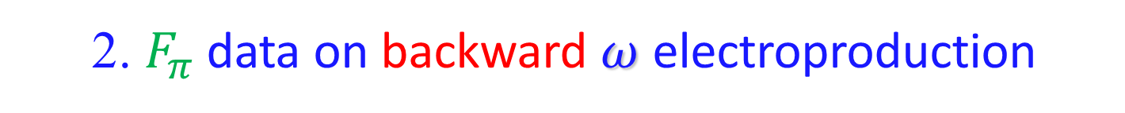



3. Electroproduction
2. $F_{π}$ data on backward $ω$ electroproduction
$W=2.21 GeV$,
$$Q^{2}=1.6, 2.45 {GeV}^{2}$$
- $σ_{T}\sim 1/Q$, $σ_{L}\sim 1/Q^{8}$
- Dominance of $σ_{T}$ over $σ_{L}$ ~ TDA ?
$$u=−u_{min}$$

Slide 18
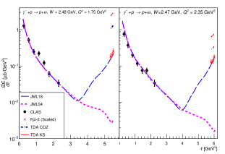
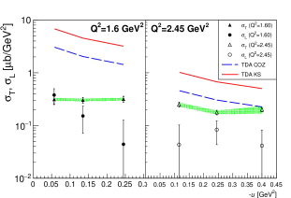

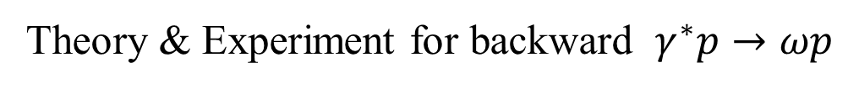

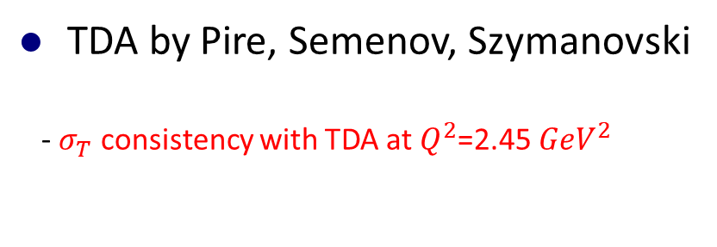


3. Electroproduction
Theory & Experiment for backward $γ^{∗}p→ωp$
Regge model by JM Laget
- Meson exchange in the t-ch
- Nucleon exchange in the u-ch
- Cuts in t-ch & u-ch baryon cuts,
- 2 gluon exch
$$10$$
J. M. Laget, PRD 70, 054023 (2004)
J. M. Laget, Prog. Part. Nucl. 111, 103737 (2020)
$$0.1$$
TDA by Pire, Semenov, Szymanovski
- $σ_{T}$ consistency with TDA at $Q^{2}$=2.45 ${GeV}^{2}$
Phys. Rev. D 91, 094006 (2015)
$$σ_{T}$$
$$σ_{L}$$

Slide 19
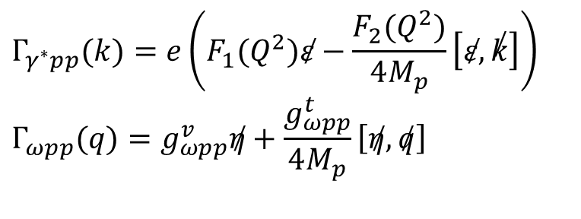
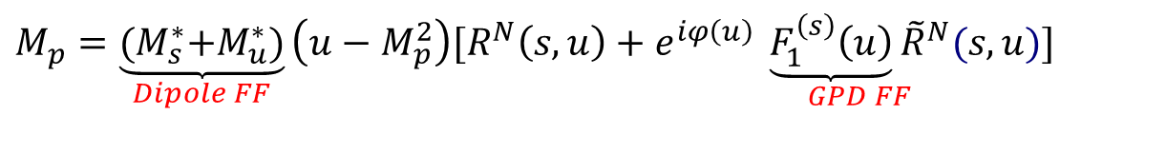
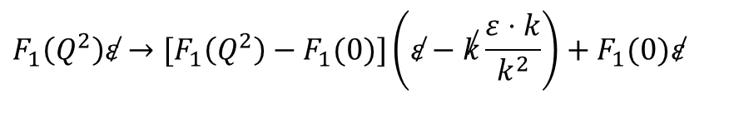
Extension to electroproduction
3. Electroproduction
t-ch. exch. as background contribution
1. Nucleon Born terms for electroproduction
$$M_{p}=\underset{Dipole FF}{\underbrace{{(M}_{s}^{∗}+M_{u}^{∗})}}\left(u−M_{p}^{2}\right)[R^{N}\left(s,u\right)+e^{iφ\left(u\right)} \underset{GPD FF}{\underbrace{F_{1}^{\left(s\right)}\left(u\right)}{\tilde{R}}^{N}}(s,u)]$$
EM FF at $γ^{∗}NN$ and $ωNN$ vertices
$$Γ_{γ^{∗}pp}(k)=e\left(F_{1}(Q^{2})\overset{̸}{ε}−\frac{F_{2}(Q^{2})}{4M_{p}}\left[\overset{̸}{ε},\overset{̸}{k}\right]\right) \\ Γ_{ωpp}(q)=g_{ωpp}^{v}\overset{̸}{η}+\frac{g_{ωpp}^{t}}{4M_{p}}\left[\overset{̸}{η},\overset{̸}{q}\right]$$
Gross-Riska prescription for gauge invariance of nucleon charge form factor
$$F_{1}\left(Q^{2}\right)\overset{̸}{ε}→[F_{1}\left(Q^{2}\right)−F_{1}(0)]\left(\overset{̸}{ε}−\overset{̸}{k}\frac{ε⋅k}{k^{2}}\right)+F_{1}(0)\overset{̸}{ε}$$

Slide 20
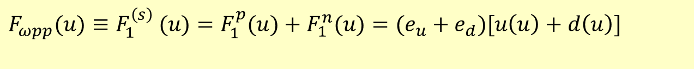

3. Electroproduction
2. Parton contribution to nucleon Born terms
Nucleon electromagnetic form factors at $γ^{∗}NN$ vertex
(1) PDF
Following concept of collinear factorization
(2) Dipole-form factor for consistency with photoproduction $Q^{2}=0$
$ωNN$ strong coupling form factor
(1) PDF
$$F_{ωpp}(u)≡F_{1}^{\left(s\right)} (u)=F_{1}^{p}(u)+F_{1}^{n}(u)=(e_{u}+e_{d})[u\left(u\right)+d\left(u\right)]$$

Slide 21


3. Result: Conventional Model
3. Electroproduction
Production mechanism
- Nucleon exch. w/o partons
- Meson exch in t-ch
- Conventional model fails with on-shell cutoff-mass for EMFF

Slide 22
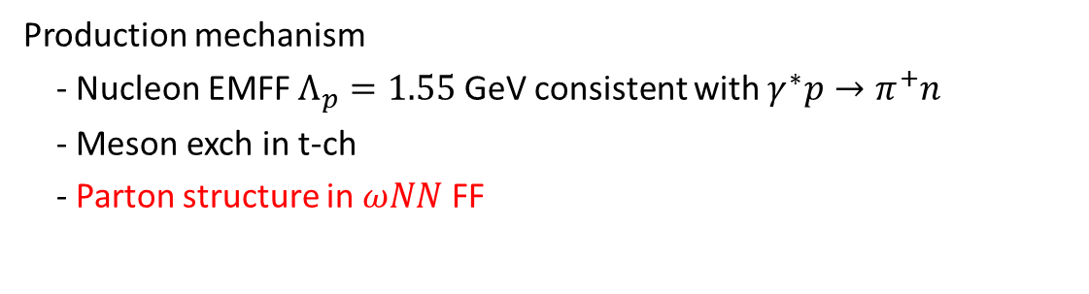
4. Result: Regge + parton Model
3. Electroproduction
Production mechanism
- Nucleon EMFF $Λ_{p}=1.55$ GeV consistent with $γ^{∗}p→π^{+}n$
- Meson exch in t-ch
- Parton structure in $ωNN$ FF

Slide 23
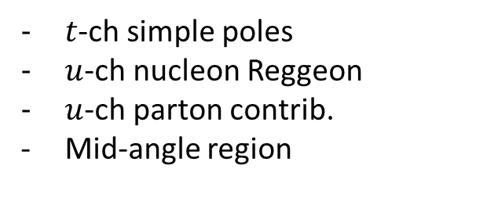
5. Result: Photoproduction vs. electroproduction
3. Electroproduction
$t$-ch simple poles
$u$-ch nucleon Reggeon
$u$-ch parton contrib.
Mid-angle region

Slide 24
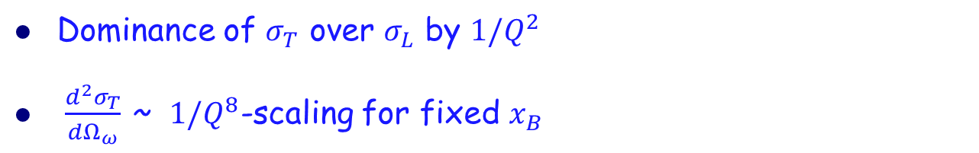
6. Result: Regge vs. Nucleon transition distribution amplitude (TDA)
3. Electroproduction
B. Pire, Kirill M. Semenov-Tian-Shansky, L. Szymanowski
Phys. Rev. D 91, 094006 (2015)
Test these signs in experiments
Dominance of $σ_{T}$ over $σ_{L}$ by $1/Q^{2}$
$\frac{d^{2}σ_{T}}{dΩ_{ω}}$ ~ $1/Q^{8}$-scaling for fixed $x_{B}$

Slide 25
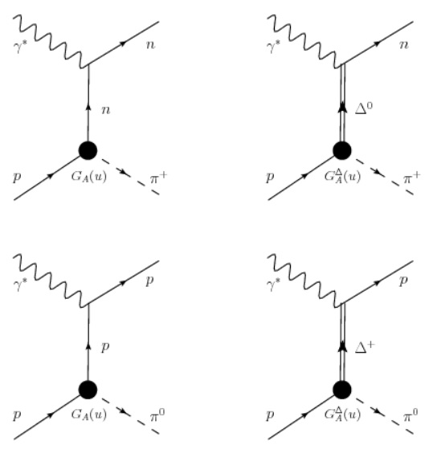










3. Electroproduction
$π electro$production with CLAS 6
${M\left(γ^{∗}p→π^{+}n\right)=\sqrt{2} M}_{n}−\frac{\sqrt{2}}{3}M_{Δ^{0}}$
$$M_{n}=M_{u}^{∗}(n) (u−M_{n}^{2})(R^{N}+e^{iφ\left(u\right)}G_{A}^{N}(u){\tilde{R}}^{N})$$
$$M_{Δ^{0}}=M_{u}^{∗}(Δ^{0}) (u−M_{Δ}^{2})(R^{Δ}+e^{iφ_{Δ}(u)}G_{A}^{Δ}(u){\tilde{R}}^{Δ})$$
$$M_{u}^{∆}=\overline{u}\left(p^{′}\right)F_{Δ}\left(Q^{2}\right)\frac{c_{1}}{m_{0}}γ_{5}\left(\hat{ε}k^{α}−\hat{k}ε^{α}\right)$$
$×\frac{\left({\hat{p}}^{′}−\hat{k}+M_{∆}\right)}{\left(u−M_{Δ}^{2}\right)}Π_{αβ}^{Δ}{\frac{if_{πNΔ}}{m_{π}}q}^{β}u(p)$
$F_{Δ}\left(Q^{2}\right)$=${\left(\frac{1}{1+\frac{Q^{2}}{Λ_{Δ}^{2}}}\right)}^{2}, Λ_{Δ}^{2}=Λ_{N}^{2}=1.55 {GeV}^{2}$
$G_{A}^{N∆}(u)$= $G_{A}^{N}(u)$
${M\left(γ^{∗}p→π^{0} p\right)=\sqrt{2} M}_{p}+\frac{2}{3}M_{Δ^{+}}$
$G_{A}^{N∆}(u)=\int_{0}^{1}{dx\left[Δu−Δd\right]}$ $x^{{−α}_{q}^{′}\left(1−x\right)u}$
$$G_{A}^{N∆}(u)=\int_{0}^{1}{dx\left[2Δu+Δd\right]x^{{−α}_{q}^{′}\left(1−x\right)u}}$$
$$M_{p}={(M}_{s}^{∗}+M_{u}^{∗})(p) (u−M_{p}^{2})(R^{N}+e^{iφ_{N}(u)}G_{A}^{N}(u){\tilde{R}}^{N})$$
$$M_{Δ^{+}}=M_{u}^{∗}(Δ^{+}) (u−M_{Δ}^{2})(R^{Δ}+e^{iφ_{Δ}(u)}G_{A}^{Δ}(u){\tilde{R}}^{Δ})$$

Slide 26
















K. Park et al. (CLAS Collaboration), Phys. Lett. B780, 340 (2018)
3. Electroproduction
N $exchange$
$$g_{πNN}=13.4$$
$$R^{N}=complex$$
$$α_{N}\left(u\right)=0.9u−0.365$$
$${\tilde{R}}^{N}=complex$$
$${\tilde{α}}_{N}\left(u\right)=0.9u−0.56$$
$$φ_{N}\left(u\right)=\left(−65u+100\right)π/180$$
$$Δ^{+} exchange$$
$$c_{1}=−2.68e, f_{πNΔ}=2.2$$
$$R^{Δ}=complex$$
$$α_{Δ}\left(u\right)=0.9u−0.25$$
$${\tilde{R}}^{Δ}=complex$$
$${\tilde{α}}_{Δ}\left(u\right)=0.1u+0.5$$
$$φ_{Δ}\left(u\right)=30π/180$$
Comments
$π^{0} cross sections are larger than{ π}^{+} cases.$
$σ_{LT} \& σ_{TT} are reversed between π^{0} and{ π}^{+} cases.$

Slide 27

Summary & conclusions
4. Summary
To simulate NINA data on backward photoproduction the Regge+parton model considers PDF at the meson-baryon vertex form factor in the u-channel nucleon (and delta) Reggeon.
The Regge+parton model provides an economic way to plot empirical cross sections for backward hadron reaction.
Application to pi delta photoproduction provide the axial vector contents of helicity parton distributions, while the case of vector meson production leads to the vector contents of unpolarized parton distributions at high energies and large $Q^{2}$. More data are needed to constrain model parameters, e.g. the relative phase between hadron and partons.
Dipole type of nucleon EM form factors are favored for consistency with photoproduction, the Regge model with GPD form factors at meson-baryon vertex is extended to investigate parton dynamics in backward pion and omega electroproduction experiments at JLab.
Regge approach with hadron form factor parameterized by PDF can be a tool complementary to GPD/TDA to analyze experiments on parton structures at high enough $s >> |t|$and large $−t$ (small $−u$) such as CLAS-12 upgrade, JPARC, and future EIC.

Slide 28
Back up

