Slide 1

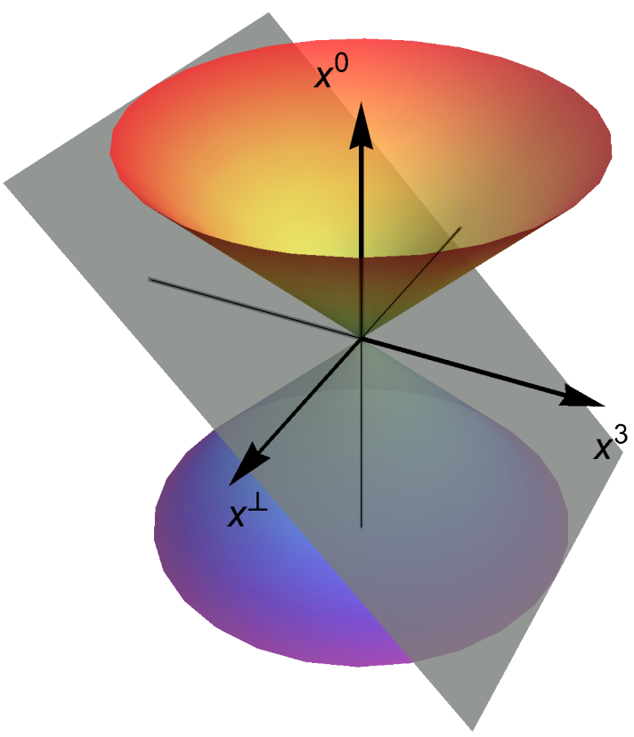
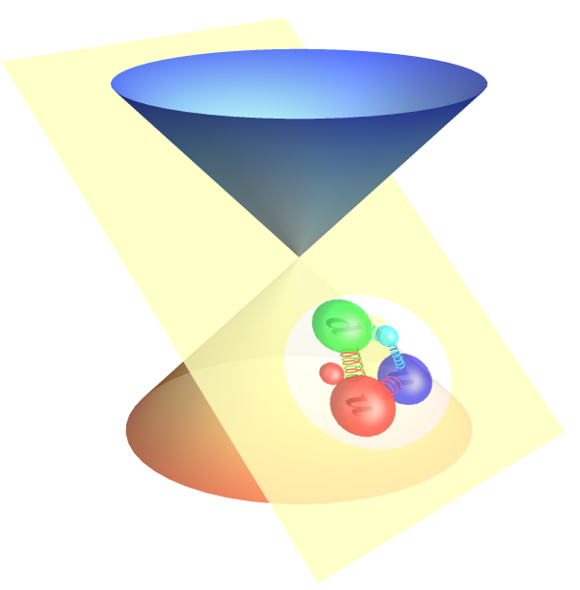



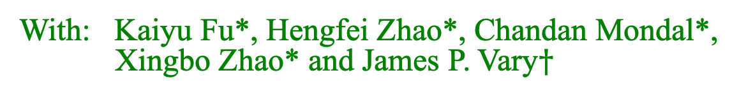
Light Meson Structure from
Basis Light-front Quantization
Jiangshan Lan*
With: Kaiyu Fu*, Hengfei Zhao*, Chandan Mondal*, Xingbo Zhao* and James P. Vary$†$
*Institute of Modern Physics, CAS, Lanzhou, China
$†$Iowa State University, Ames, US
Jeju Island, Korea, November 29 - December 4, 2021

Slide 2
Outline
Basis Light-front Quantization approach
Application to Light Mesons
  A review of BLFQ-NJL
  Light mesons with one dynamical gluon
  (LFWF, EMFF, PDA, TFF, PDF, GPD & TMD)
Summary & Outlook

Slide 3
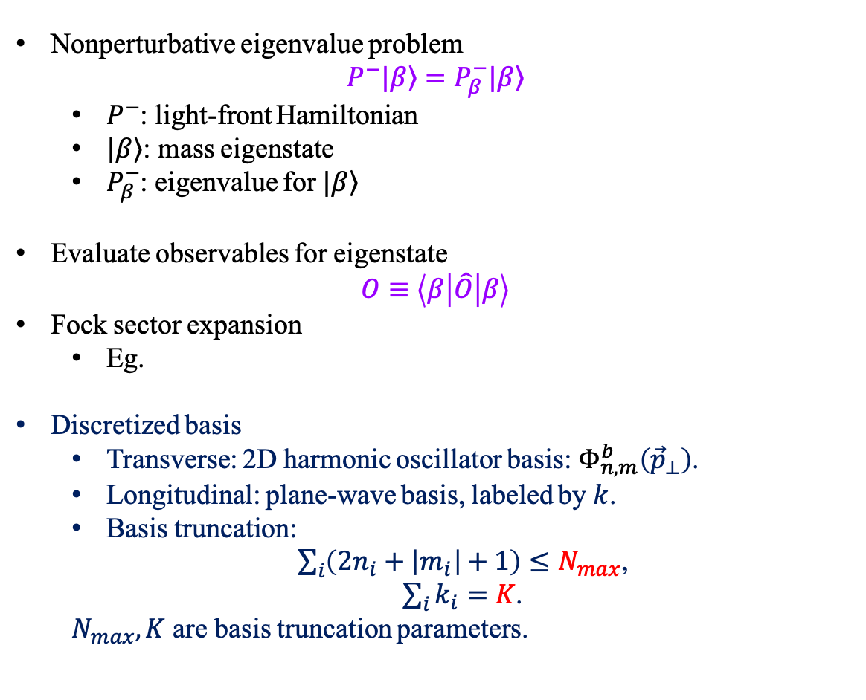
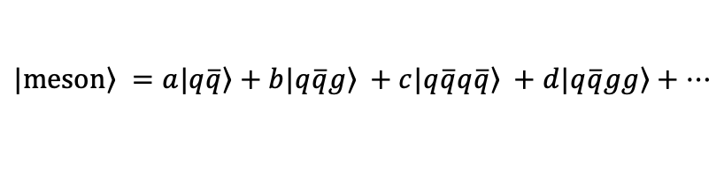
Basis Light-front Quantization
Nonperturbative eigenvalue problem
$$P^{−}|\left.β\right\rangle =P_{β}^{−}|\left.β\right\rangle$$
  $P^{−}$: light-front Hamiltonian
  $|\left.β\right\rangle$: mass eigenstate
  $P_{β}^{−}$: eigenvalue for $|\left.β\right\rangle$
Evaluate observables for eigenstate
$$O≡\left\langle β | \hat{O} | β\right\rangle$$
Fock sector expansion
  Eg.
Discretized basis
  Transverse: 2D harmonic oscillator basis:${ Φ}_{n,m}^{b}\left({\vec{p}}_{⊥}\right)$.
  Longitudinal: plane-wave basis, labeled by $k$.
  Basis truncation:
  $\sum_{i}{\left(2n_{i}+\left|m_{i}\right|+1\right)}≤N_{max}$,
  $\sum_{i}{k_{i}}=K$.
  $N_{max}, K$ are basis truncation parameters.
[Vary et al, 2008]
$$\left.|meson\right\rangle =a\left.|q\overline{q}\right\rangle +b\left.|q\overline{q}g\right\rangle +c\left.|q\overline{q}q\overline{q}\right\rangle +d\left.|q\overline{q}gg\right\rangle +…$$
Large $N_{max}$ and $K$ : High UV cutoff & low IR cutoff
Notes:
1.

Slide 4
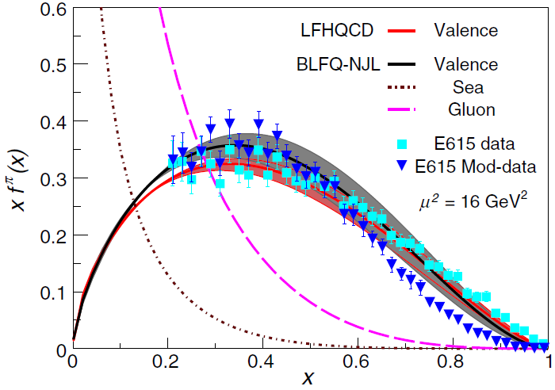
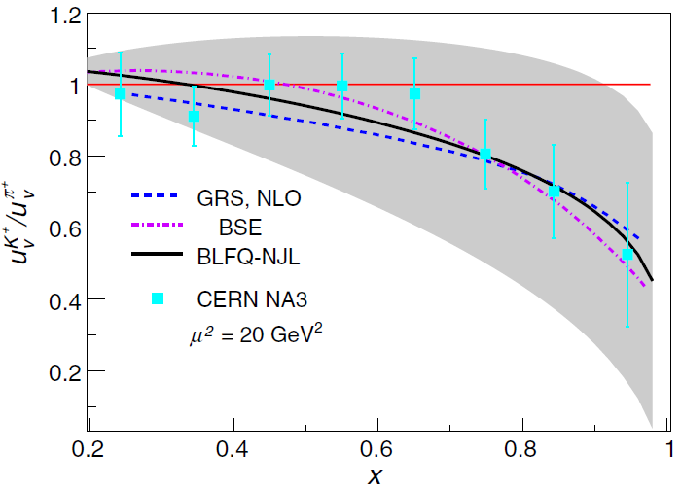

PDFs for Light Mesons
$$H_{eff}=\frac{{\vec{k}}_{⊥}^{2}+m_{q}^{2}}{x}+\frac{{\vec{k}}_{⊥}^{2}+m_{\overline{q}}^{2}}{1−x}+κ^{4}x\left(1−x\right){\vec{r}}_{⊥}^{2}−\frac{κ^{4}}{{\left(m_{q}+m_{\overline{q}}\right)}^{2}}∂_{x}\left(x\left(1−x\right)∂_{x}\right)+H_{eff}^{NJL}$$
Diagonalizing $H_{eff}$
LF wave function
Initial PDFs
Scale evolution
Pion PDF
Valence u PDF Kaon/Pion
[Lan, Mondal, Jia, Zhao, Vary, PRL122, 172001(2019)]
Agree with experimental results

Slide 5
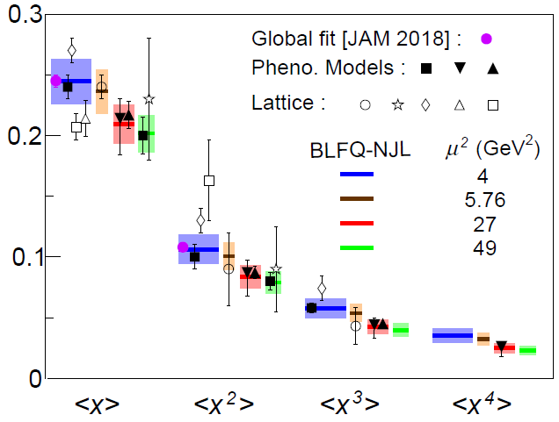
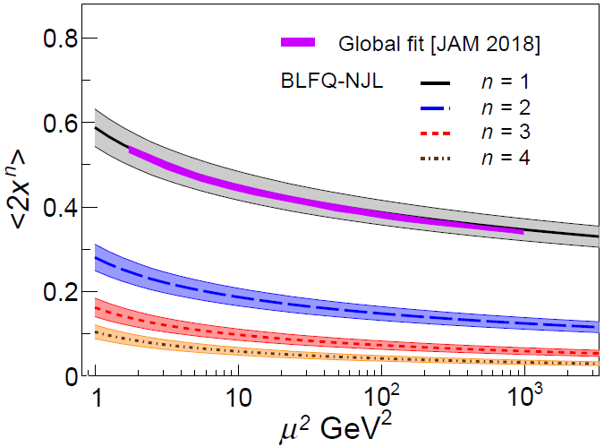
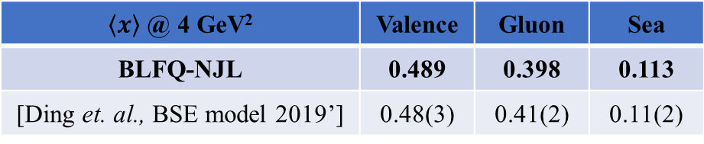
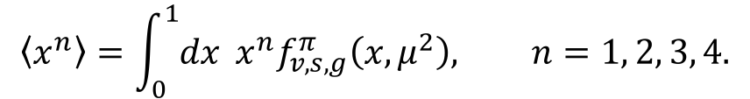
Moments of Pion PDF
$$\left\langle x^{n}\right\rangle =\int_{0}^{1}{dx} x^{n}f_{v,s,g}^{π}\left(x,μ^{2}\right), n=1, 2, 3, 4.$$
 | Valence | Gluon | Sea
BLFQ-NJL | 0.489 | 0.398 | 0.113
[Ding et. al., BSE model 2019’] | 0.48(3) | 0.41(2) | 0.11(2)
Agree with other results
[Lan, Mondal, Jia, Zhao, Vary, PRD101,034024(2020), arXiv: 2003.12249]

Slide 6
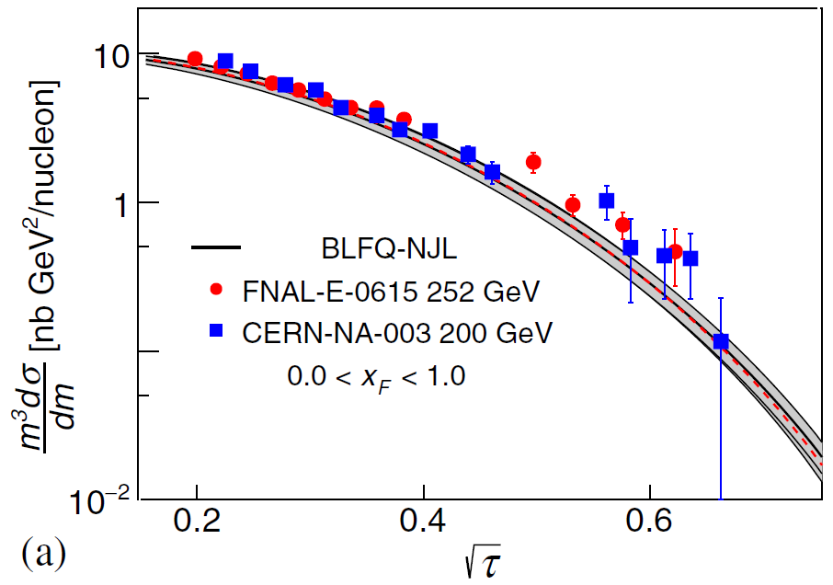
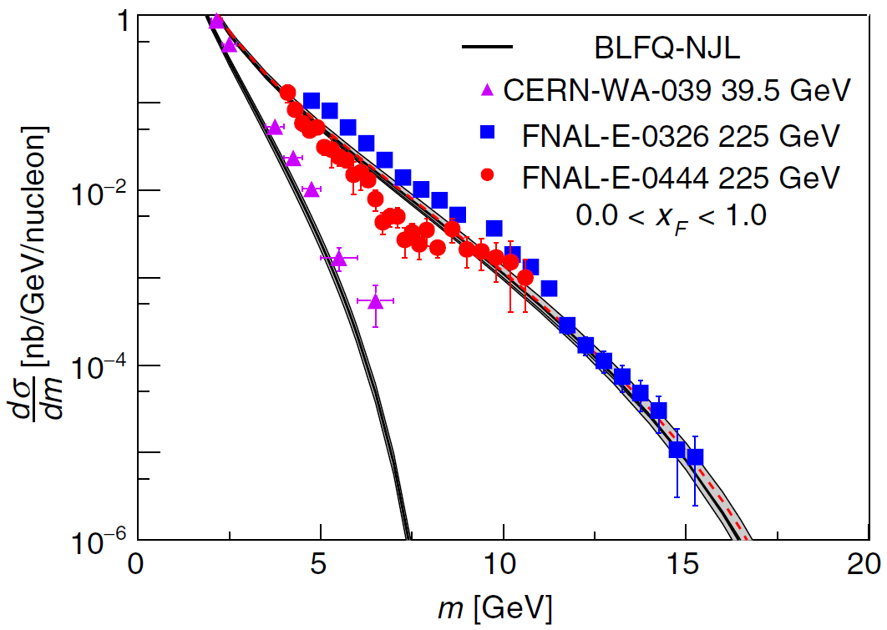

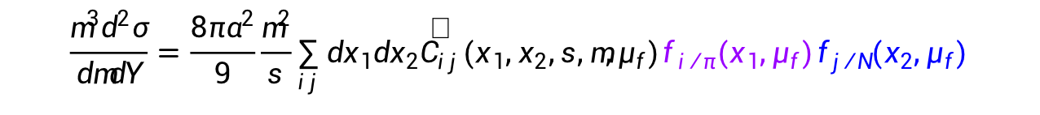
Drell-Yan Cross Section
[S. D. Drell and T.-M. Yan, PRL (1970)]
[T. Becher et al, JKEP07(2008)030]; [P. C. Barry et al, PRL121(2018)152001]
[C. Anastasiou et al, PRL91(2003)182002]
[nCTEQ 2015]
$$\frac{m^{3}d^{2}σ}{dmdY}=\frac{8πα^{2}}{9}\frac{m^{2}}{s}\sum_{ij}{dx_{1}dx_{2}{\tilde{C}}_{ij}(x_{1},x_{2},s,m,μ_{f})f_{i/π}(x_{1},μ_{f})f_{j/N}(x_{2},μ_{f})}$$
W
W
C
W
Pt
Agree with experimental data (FNAL E615, 326, 444, & CERN NA3, WA-039).
[Lan, Mondal, Jia, Zhao, Vary, PRD101,034024(2020)]

Slide 7
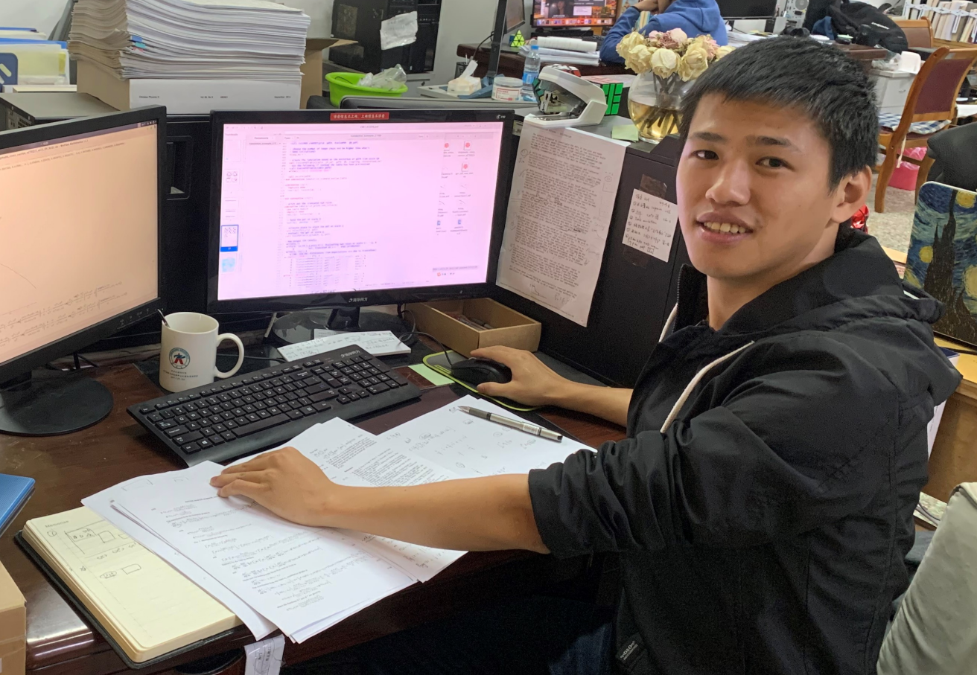


$$\left.|meson\right\rangle =\left.|q\overline{q}\right\rangle +…$$
$$\left.|meson\right\rangle =a\left.|q\overline{q}\right\rangle +b\left.|q\overline{q}g\right\rangle +…$$

Slide 8
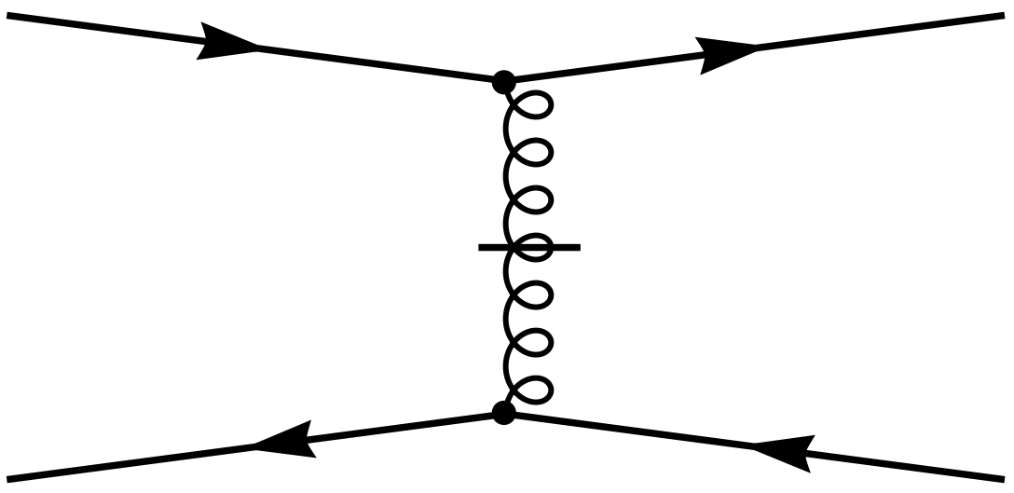
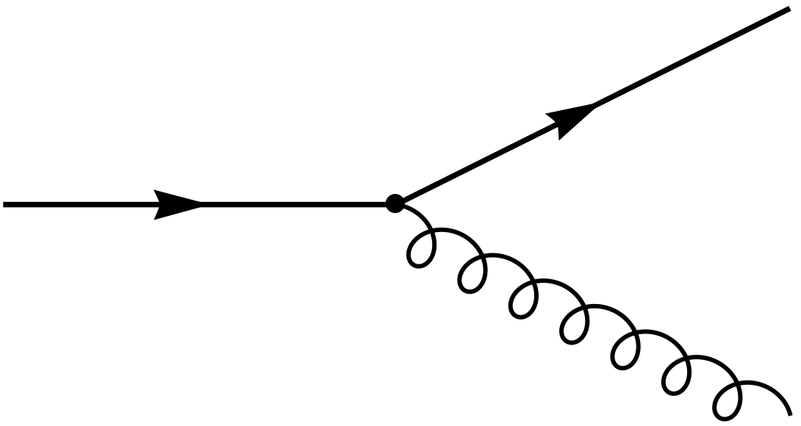
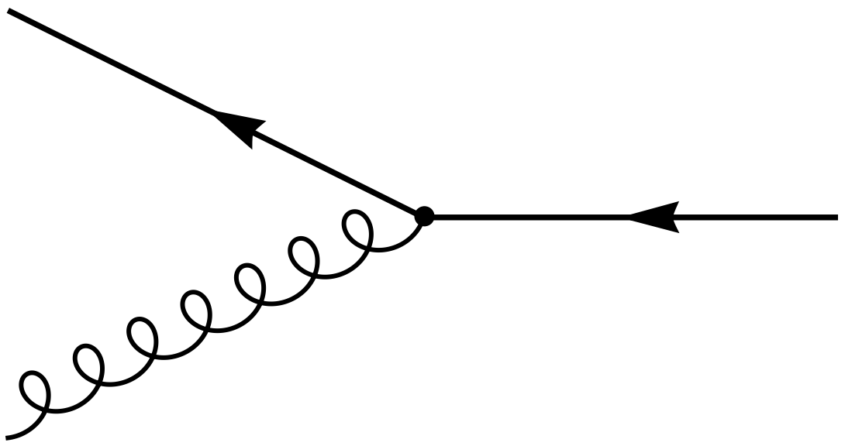





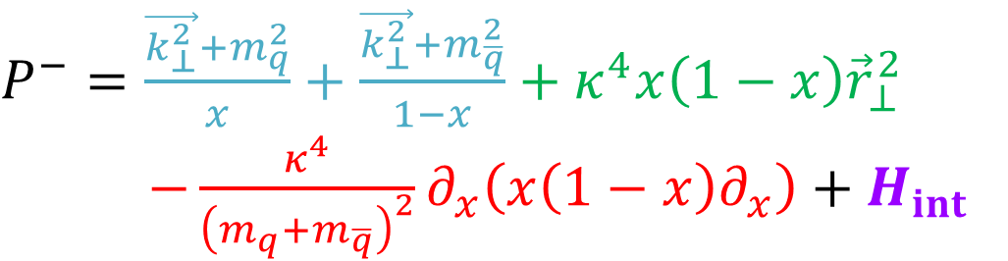
Interaction Part of Hamiltonian
$$\left.|meson\right\rangle =a\left.|q\overline{q}\right\rangle +b\left.|q\overline{q}g\right\rangle +…$$
 |  | 0
$$H_{int}$$
$$\left.|q\overline{q}\right\rangle$$
$$\left.|q\overline{q}g\right\rangle$$
$$\left\langle q\overline{q}|\right.$$
$$\left\langle q\overline{q}g|\right.$$
$P^{−}=\frac{\vec{k_{⊥}^{2}}+m_{q}^{2}}{x}+\frac{\vec{k_{⊥}^{2}}+m_{\overline{q}}^{2}}{1−x}+κ^{4}x\left(1−x\right){\vec{r}}_{⊥}^{2}$
$−\frac{κ^{4}}{{\left(m_{q}+m_{\overline{q}}\right)}^{2}}∂_{x}\left(x\left(1−x\right)∂_{x}\right)+H_{int}$

Slide 9
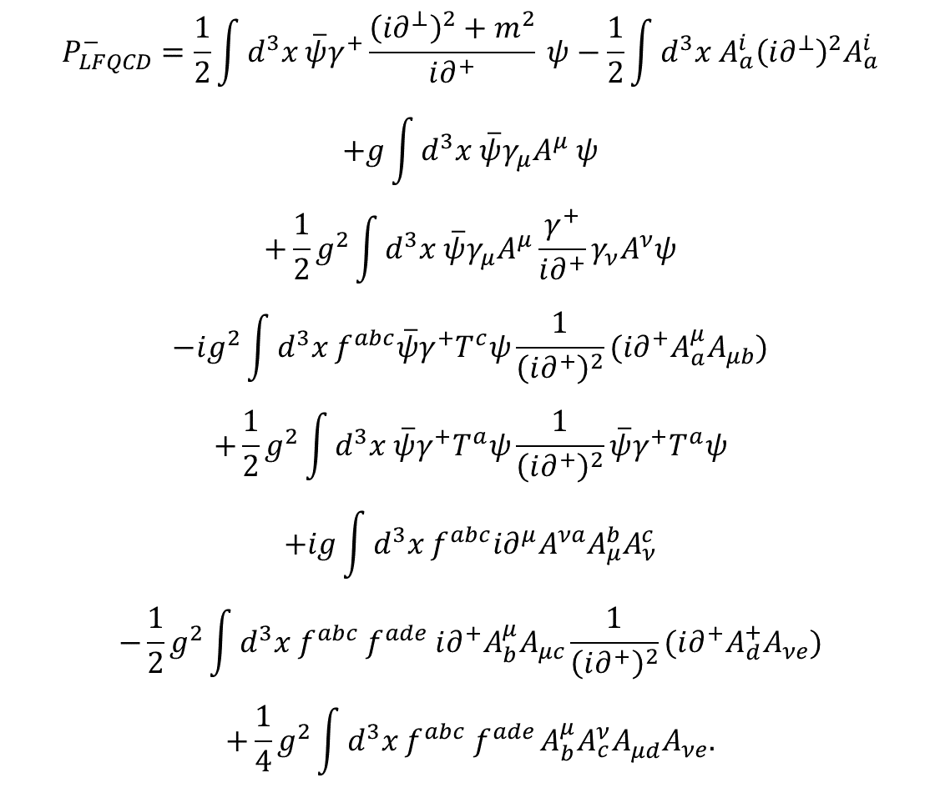
Light-front QCD Hamiltonian
[Brodsky et al, 1998]
$$P_{LFQCD}^{−}=\frac{1}{2}\int{d^{3}x \overline{ψ}γ^{+}\frac{{\left(i∂^{⊥}\right)}^{2}+m^{2}}{i∂^{+}} ψ}−\frac{1}{2}\int{d^{3}x A_{a}^{i}{\left(i∂^{⊥}\right)}^{2}A_{a}^{i}}$$
$$+g\int{d^{3}x \overline{ψ}γ_{μ}A^{μ} ψ}$$
$$+\frac{1}{2}g^{2}\int{d^{3}x \overline{ψ}γ_{μ}A^{μ}\frac{γ^{+}}{i∂^{+}}γ_{ν}A^{ν}ψ}$$
$$−ig^{2}\int{d^{3}x f^{abc}\overline{ψ}γ^{+}T^{c}ψ\frac{1}{{\left(i∂^{+}\right)}^{2}}}(i∂^{+}A_{a}^{μ}A_{μb})$$
$$+\frac{1}{2}g^{2}\int{d^{3}x \overline{ψ}γ^{+}T^{a}ψ\frac{1}{{\left(i∂^{+}\right)}^{2}}}\overline{ψ}γ^{+}T^{a}ψ$$
$$+ig\int{d^{3}x{ f}^{abc}i∂^{μ}A^{νa}A_{μ}^{b}A_{ν}^{c}}$$
$$−\frac{1}{2}g^{2}\int{d^{3}x{ f}^{abc}{ f}^{ade} i∂^{+}A_{b}^{μ}A_{μc}^{}}\frac{1}{{\left(i∂^{+}\right)}^{2}}(i∂^{+}A_{d}^{+}A_{νe})$$
$$+\frac{1}{4}g^{2}\int{d^{3}x{ f}^{abc}{ f}^{ade}}A_{b}^{μ}{A_{c}^{ν}A_{μd}^{}A}_{νe}^{}.$$

Slide 10
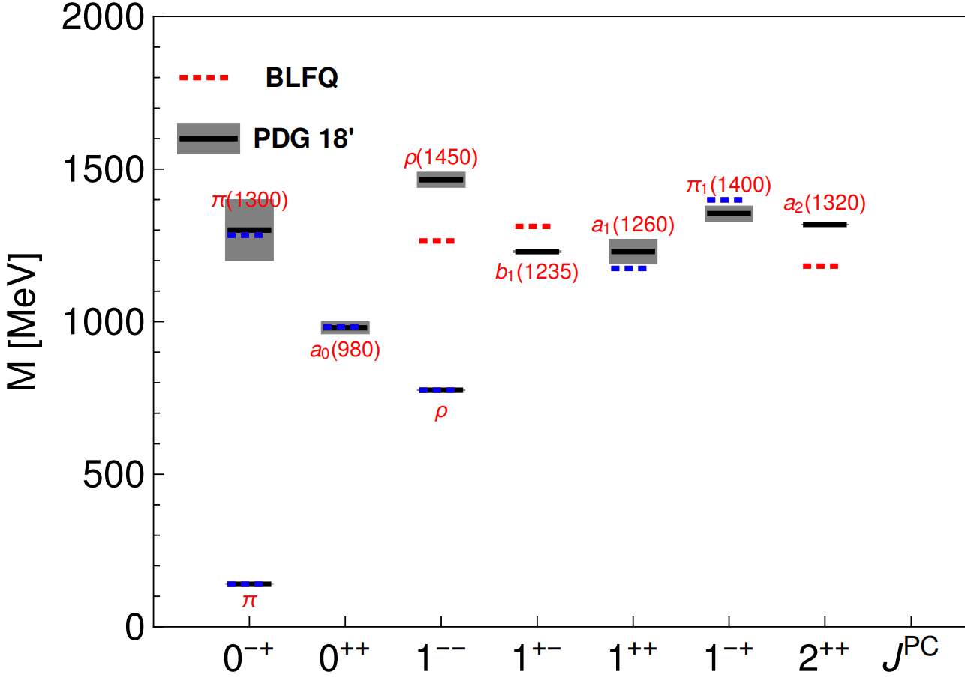
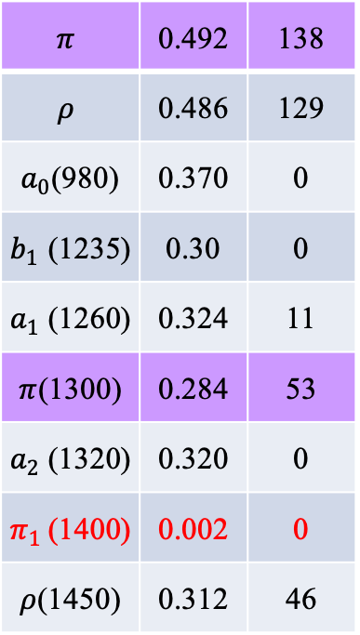

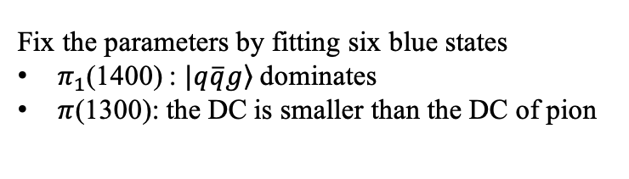
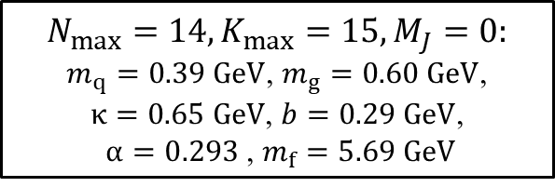
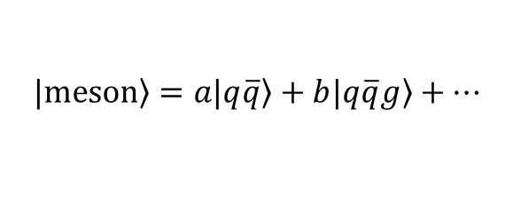
Mass Spectrum
Norm$q\overline{q}$
DC[MeV]
$$π$$ | 0.492 | 138
$$ρ$$ | 0.486 | 129
$a_{0}$(980) | 0.370 | 0
$b_{1}$(1235) | 0.30 | 0
$a_{1}$(1260) | 0.324 | 11
$π$(1300) | 0.284 | 53
$a_{2}$(1320) | 0.320 | 0
$π_{1}$(1400) | 0.002 | 0
$ρ$(1450) | 0.312 | 46
$$N_{max}=14,K_{max}=15, M_{J}=0:$$
$m_{q}=0.39 GeV$, $m_{g}=0.60 GeV$,
$κ=0.65 GeV$, $b=0.29 GeV$,
$α=0.293$, $m_{f}=5.69 GeV$
Fix the parameters by fitting six blue states
$π_{1}$(1400) : $\left.|q\overline{q}g\right\rangle$dominates
$π$(1300): the DC is smaller than the DC of pion
$$\left.|meson\right\rangle =a\left.|q\overline{q}\right\rangle +b\left.|q\overline{q}g\right\rangle +…$$
[Lan, Fu, Mondal, Zhao, Vary, arXiv 2106.04954]

Slide 11
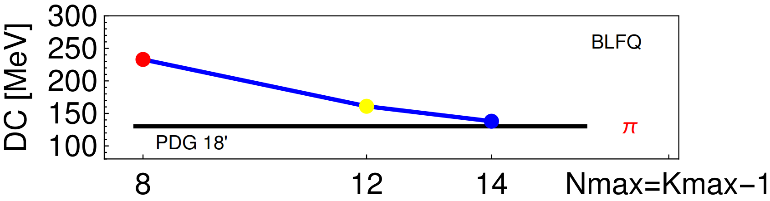
Pion Decay Constant
With increasing basis size, the DC approaches the experimental value

Slide 12
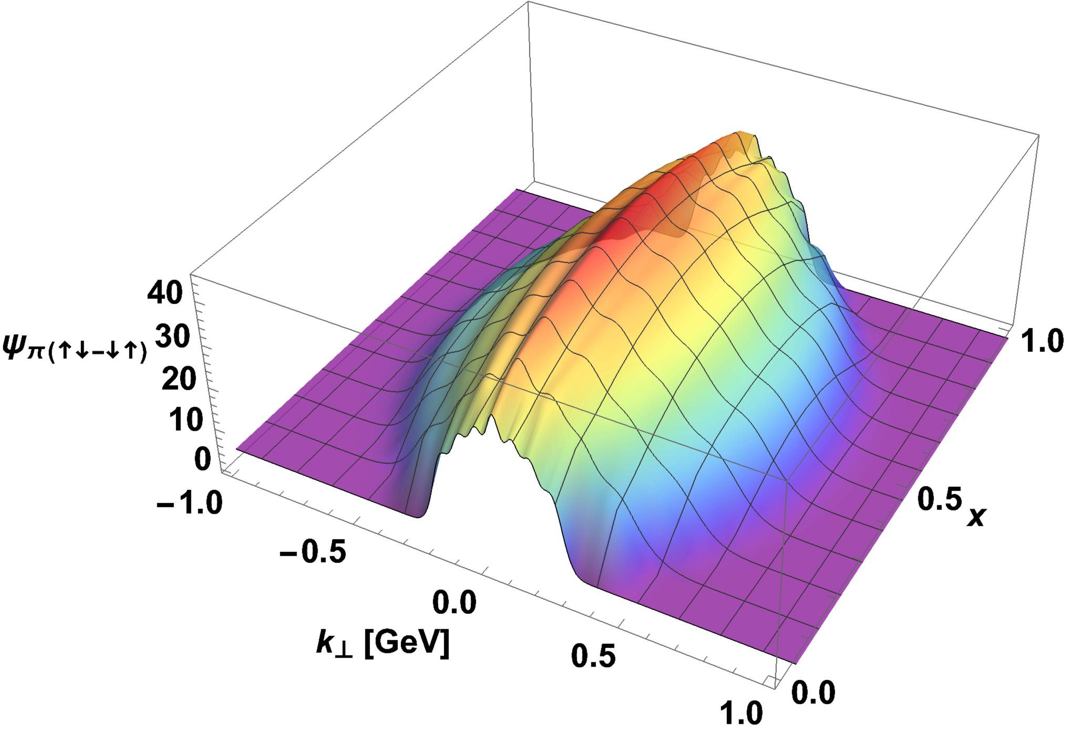

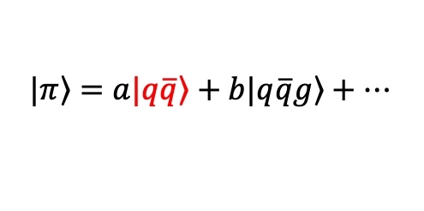
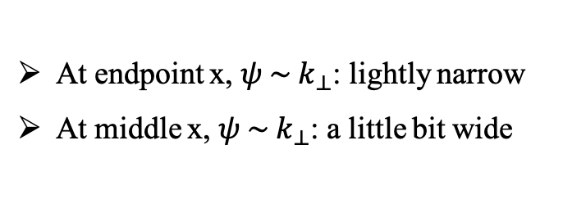
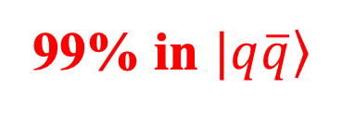
Wave Function
$$\int{\frac{dx d^{2}k_{⊥}}{16π^{3}}{\left|ψ_{q\overline{q}}\right|}^{2}}=1$$
$$\left.|π\right\rangle =a\left.|q\overline{q}\right\rangle +b\left.|q\overline{q}g\right\rangle +…$$
99% in $\left.|q\overline{q}\right\rangle$
At endpoint x, $ψ \sim k_{⊥}$: lightly narrow
At middle x, $ψ \sim k_{⊥}$: a little bit wide
Preliminary

Slide 13
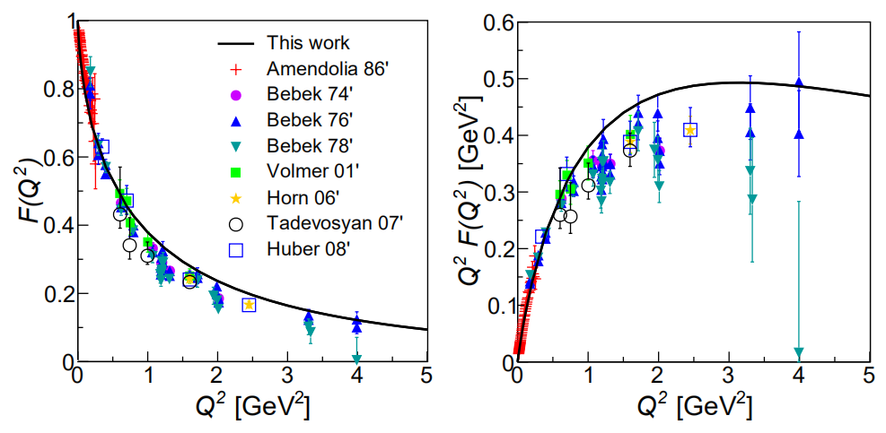
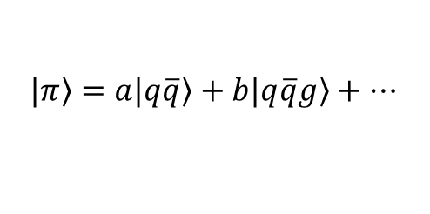
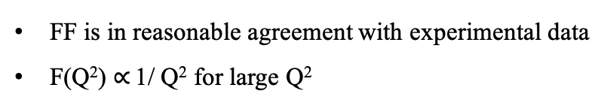
Pion Electromagnetic Form Factor
$$\left.|π\right\rangle =a\left.|q\overline{q}\right\rangle +b\left.|q\overline{q}g\right\rangle +…$$
FF is in reasonable agreement with experimental data
F(Q²) $∝$ 1/ Q² for large Q²
[Lan, Fu, Mondal, Zhao, Vary, arXiv 2106.04954]

Slide 14
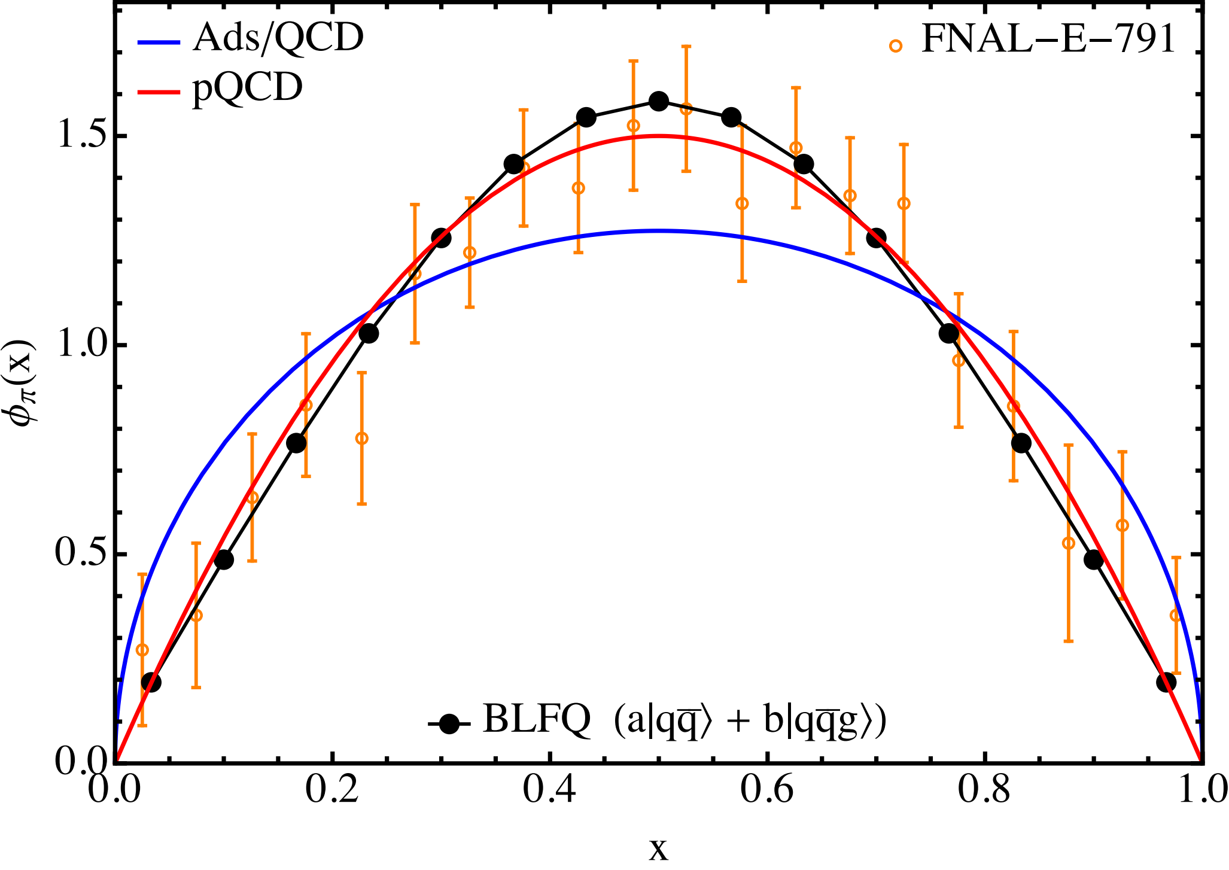
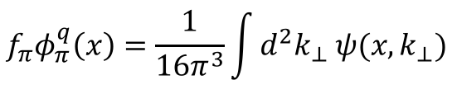

Pion PDA
$$f_{π}φ_{π}^{q}\left(x\right)=\frac{1}{16π^{3}}\int{d^{2}k_{⊥} ψ(x,k_{⊥})}$$
$$\left.|π\right\rangle =a\left.|q\overline{q}\right\rangle +b\left.|q\overline{q}g\right\rangle +…$$
Endpoint behavior almost agrees with pQCD
Consistent with FNAL-E-791 experiment
Preliminary

Slide 15
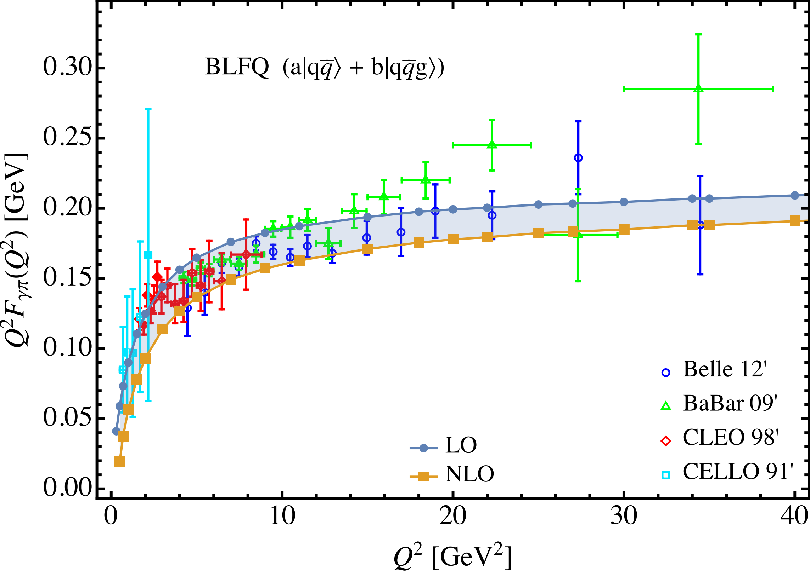

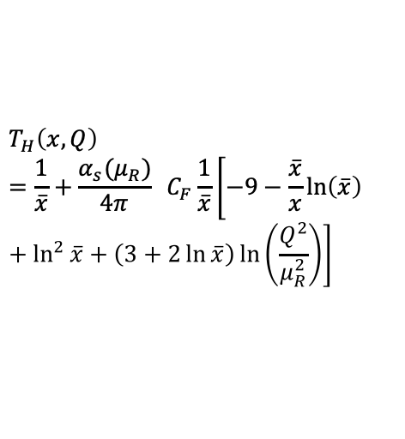
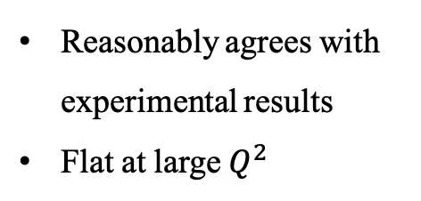
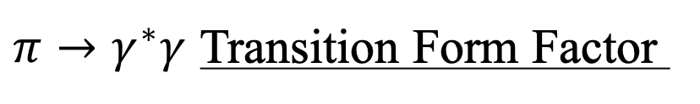
$π→γ^{∗}γ$ Transition Form Factor
[Brodsky et al, PRD 84, 033001 (2011)]
Preliminary
$$Q^{2}F_{γπ}\left(Q^{2}\right)=\frac{4}{\sqrt{3}}\int_{0}^{1}{T_{H}\left(x,Q\right) dx }\int_{0}^{\overline{x}Q}{\frac{d^{2}k_{⊥}}{16π^{3}} ψ_{q\overline{q}}(x,k_{⊥}^{2})}$$
$$T_{H}\left(x,Q\right)=\frac{1}{\overline{x}}+\frac{α_{s}(μ_{R})}{4π} C_{F}\frac{1}{\overline{x}}\left[−9−\frac{\overline{x}}{x}\ln\left(\overline{x}\right)\right.+\ln^{2}{\overline{x}}+\left.\left(3+2\ln{\overline{x}}\right)\ln\left(\frac{Q^{2}}{μ_{R}^{2}}\right)\right]$$
Reasonably agrees with experimental results
Flat at large $Q^{2}$

Slide 16
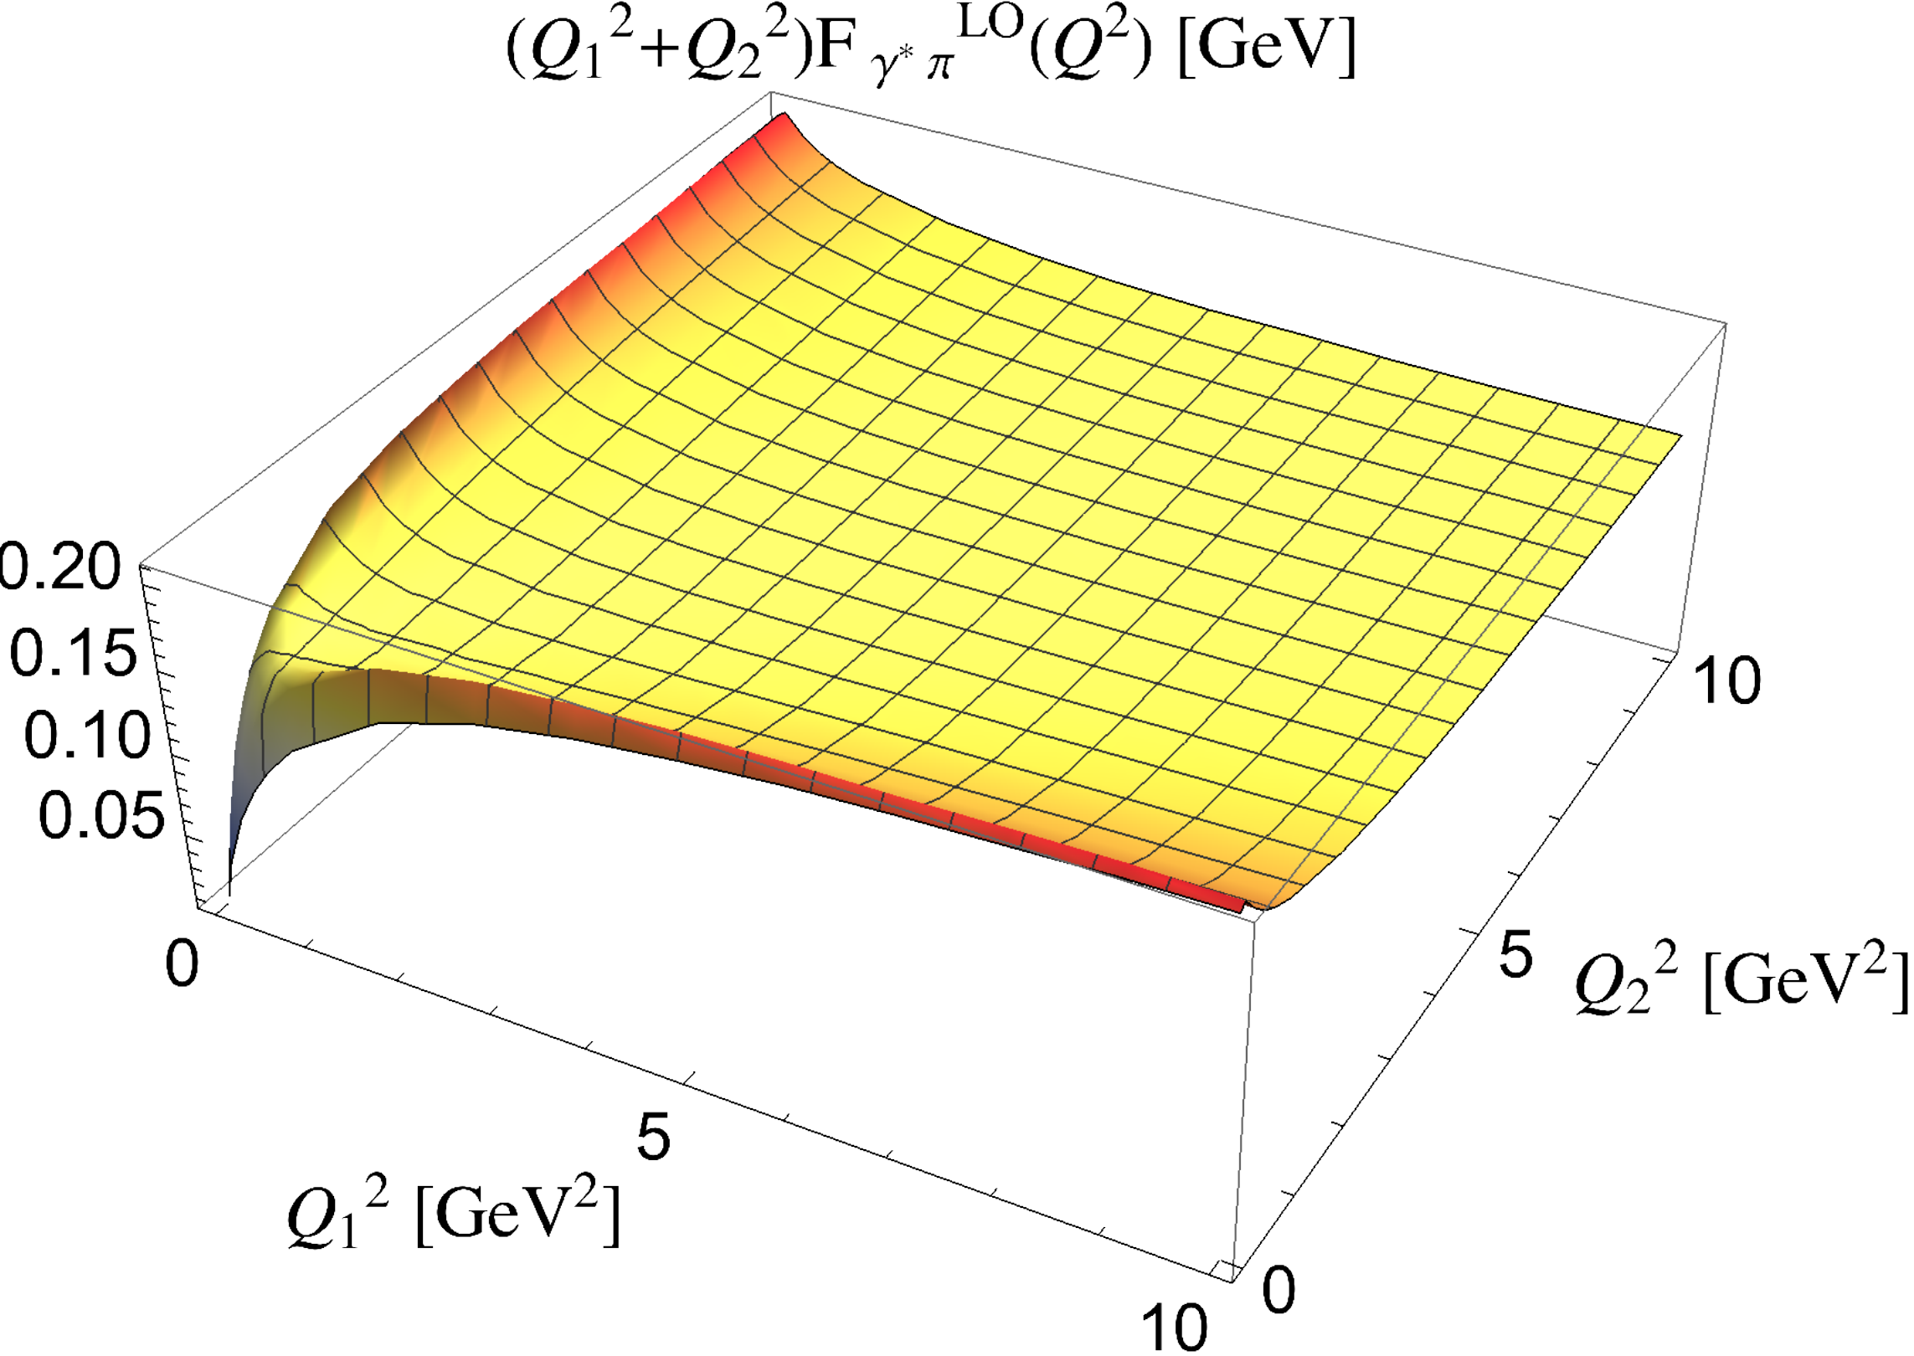
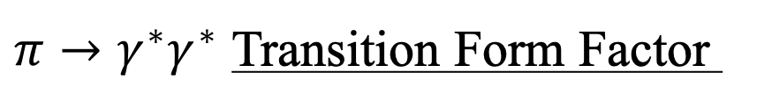
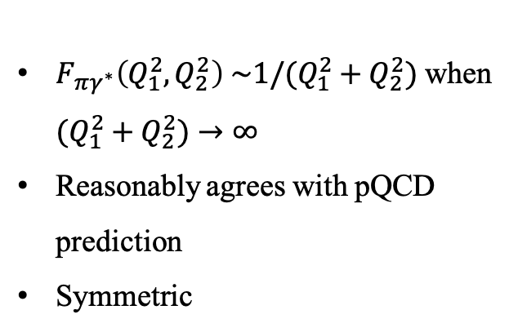
$π→γ^{∗}γ^{∗}$ Transition Form Factor
[Brodsky et al, PRD 84, 033001 (2011)]
[CM et al, Phys. Rev. D 104, 094034 (2021)
Preliminary
$$(Q_{1}^{2}+Q_{2}^{2})F_{γ^{∗}π}\left(Q_{1}^{2},Q_{2}^{2}\right)=\frac{4}{\sqrt{3}}\int_{0}^{1}{\frac{dx}{\overline{x}Q_{1}^{2}+xQ_{2}^{2}} }\int_{0}^{\overline{x}Q_{1}+xQ_{2}}{\frac{d^{2}k_{⊥}}{16π^{3}} ψ_{q\overline{q}}(x,k_{⊥}^{2})}$$
$F_{πγ^{∗}}\left(Q_{1}^{2},Q_{2}^{2}\right) \sim 1/(Q_{1}^{2}+Q_{2}^{2})$ when $(Q_{1}^{2}+Q_{2}^{2})→∞$
Reasonably agrees with pQCD prediction
Symmetric

Slide 17
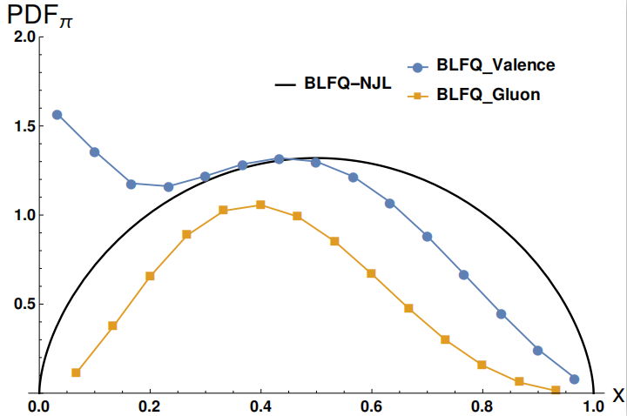







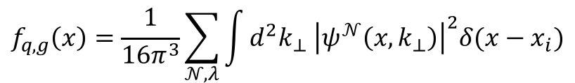
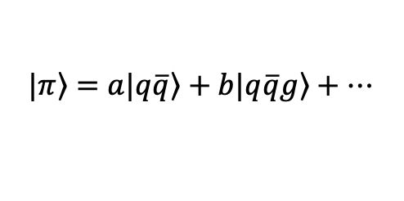
Pion initial PDF
$$f_{q,g}\left(x\right)=\frac{1}{16π^{3}}\sum_{𝒩,λ}{\int{d^{2}k_{⊥} {\left|ψ^{𝒩}\left(x,k_{⊥}\right)\right|}^{2}δ(x−x_{i})}}$$
$$\left.|π\right\rangle =a\left.|q\overline{q}\right\rangle +b\left.|q\overline{q}g\right\rangle +…$$
large $x$
$$μ_{0BLFQ−NJL}^{2}=0.240 {GeV}^{2}$$
${\left\langle x\right\rangle }_{gluon}=0$; ${\left\langle x\right\rangle }_{valence u}=0.5$
${(1−x)}^{0.596}$
$$μ_{0BLFQ}^{2}=0.34 {GeV}^{2}$$
${\left\langle x\right\rangle }_{gluon}=0.216$; ${\left\langle x\right\rangle }_{valence u}=0.392$
${(1−x)}^{1.4}$
[Lan, Fu, Mondal, Zhao, Vary, arXiv 2106.04954]

Slide 18
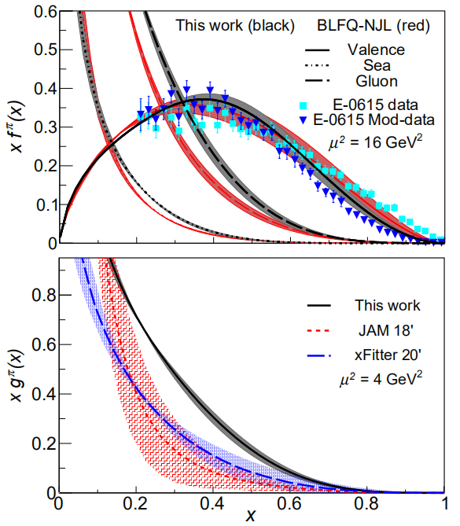
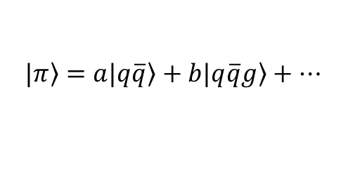
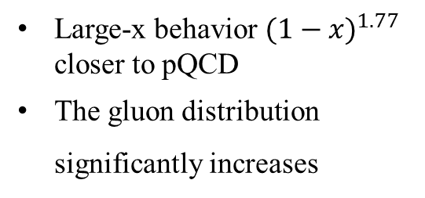
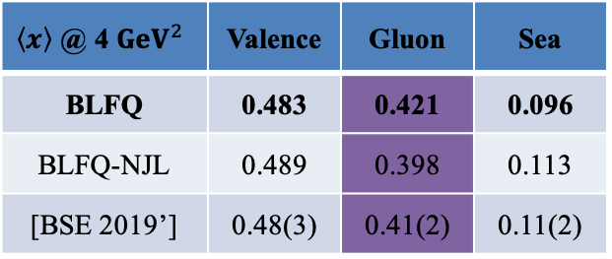
Pion PDF
$$\left.|π\right\rangle =a\left.|q\overline{q}\right\rangle +b\left.|q\overline{q}g\right\rangle +…$$
Large-x behavior ${(1−x)}^{1.77}$ closer to pQCD
The gluon distribution significantly increases
$\left\langle x\right\rangle$ @ 4 ${GeV}^{2}$ | Valence | Gluon | Sea
BLFQ | 0.483 | 0.421 | 0.096
BLFQ-NJL | 0.489 | 0.398 | 0.113
[BSE 2019’] | 0.48(3) | 0.41(2) | 0.11(2)
[Lan, Fu, Mondal, Zhao, Vary, arXiv 2106.04954]

Slide 19
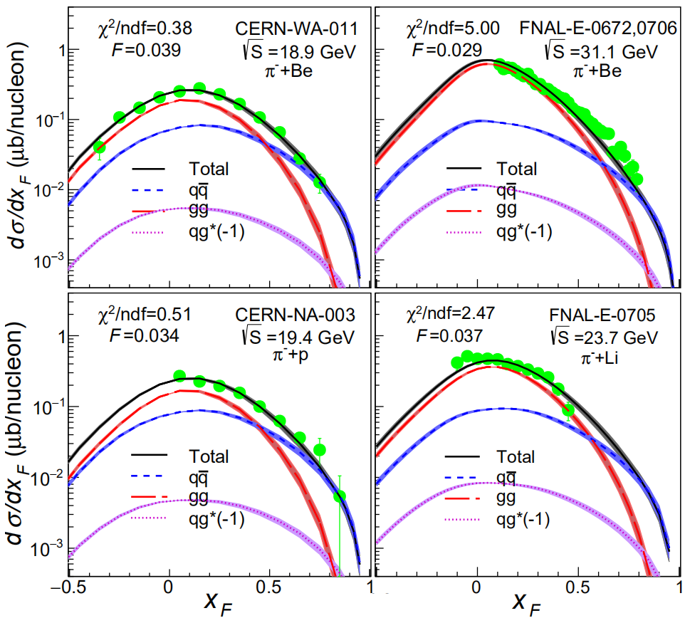



$J/ψ$ production cross section
$π^{±} N→J/ψ X$
$$\frac{dσ}{dx_{F}}\left|J/ψ\right.=F\sum_{i,j=q,\overline{q},g}{\int_{2m_{c}}^{{2m}_{D}}{dM_{c\overline{c}}\frac{2M_{c\overline{c}}}{S\sqrt{x_{F}^{2}+\frac{4M_{c\overline{c}}^{2}}{S}}}{\hat{σ}}_{ij}}(s,m_{c}^{2},μ_{R}^{2},μ_{F}^{2})f_{i}^{π^{±}}(x_{1},μ_{F}^{2})f_{j}^{N}(x_{2},μ_{F}^{2})}$$
[nCTEQ 2015]
CEM
[Chang, et al, PRD 102 (2020) 054024];
[Nason, et al, NPB 303 (1988) 607];
[Mangano, et al, NPB 405 (1993) 507]
significantly gg contribution
various energies of pions
different target
Agree with experimental data (FNAL E672, E706, E705, CERN NA3,WA11).
[Lan, Fu, Mondal, Zhao, Vary, arXiv 2106.04954]

Slide 20





Pion Structure function
[Lan, Mondal, Jia, Zhao, Vary, PRD101,034024(2020)]
$$\left.|π\right\rangle =a\left.|q\overline{q}\right\rangle +b\left.|q\overline{q}g\right\rangle +…$$
$$F_{2}^{π}\left(β,μ^{2}\right)=\sum_{q,g}{e_{q}^{2}β\{f_{q}^{π}\left(β,μ^{2}\right)+f_{\overline{q}}^{π}\left(β,μ^{2}\right)+\frac{α_{s}\left(μ^{2}\right)}{2π}[C_{q,2}⨂\left(f_{q}^{π}+f_{\overline{q}}^{π}\right)+2C_{g,2}⨂f_{g}^{π}]\}}$$
$$μ=2m_{c}=3 GeV$$
Different BLFQ-NJL results
Higher initial scale
less gluon/sea quark at small x
Preliminary
in future
$$\left.|π\right\rangle =a\left.|q\overline{q}\right\rangle +b\left.|q\overline{q}g\right\rangle +c\left.|q\overline{q}q\overline{q}\right\rangle +…$$

Slide 21





Preliminary
Pion GPD
[M. Diehl, Phys. Rep. 388 (2003) 41-277]
$$\left.|π\right\rangle =a\left.|q\overline{q}\right\rangle +b\left.|q\overline{q}g\right\rangle +…$$
$$H_{π}^{q}\left(x,ξ=0,t\right)=\frac{1}{2}\int{\frac{dz^{−}}{2π}}e^{ixP^{+}z^{−}}{\left\langle π,P+\frac{Δ}{2} | \overline{q}\left(−\frac{z}{2}\right)γ^{+}q\left(\frac{z}{2}\right) | π,P−\frac{Δ}{2}\right\rangle }_{\begin{aligned}z^{+}=0 \\ z_{⊥}=0\end{aligned}}$$
$$H_{π}^{g}\left(x,ξ=0,t\right)=\frac{1}{P^{+}}\int{\frac{dz^{−}}{2π}}e^{ixP^{+}z^{−}}{\left\langle π,P+\frac{Δ}{2} | G^{+μ}\left(−\frac{z}{2}\right)G_{μ}^{+}\left(\frac{z}{2}\right) | π,P−\frac{Δ}{2}\right\rangle }_{\begin{aligned}z^{+}=0 \\ z_{⊥}=0\end{aligned}}$$
Quark content enhanced at small $x$ with $|q\overline{q}g⟩$
Falls slowly at larger x
Emerge at larger x range for larger $−t$

Slide 22


Pion GPD with Scale Evolution
Preliminary
[M. Diehl, Phys. Rep. 388 (2003) 41-277]
$$\left.|π\right\rangle =a\left.|q\overline{q}\right\rangle +b\left.|q\overline{q}g\right\rangle +…$$
$$H_{π}^{q}\left(x,ξ=0,t\right)=\frac{1}{2}\int{\frac{dz^{−}}{2π}}e^{ixP^{+}z^{−}}{\left\langle π,P+\frac{Δ}{2} | \overline{q}\left(−\frac{z}{2}\right)γ^{+}q\left(\frac{z}{2}\right) | π,P−\frac{Δ}{2}\right\rangle }_{\begin{aligned}z^{+}=0 \\ z_{⊥}=0\end{aligned}}$$
BLFQ-NJL
$$μ_{0}^{2}=0.24 GeV^{2}$$
Including valence quark only
[Adhikari et al, arXiv: 2110.05048]
Scale evolution performed using DGLAP equation (HOPPET)

Slide 23


Pion Polarized GPD
Preliminary
[Adhikari et al, arXiv: 2110.05048]
$$\left.|π\right\rangle =a\left.|q\overline{q}\right\rangle +b\left.|q\overline{q}g\right\rangle +…$$
$$E_{Tπ}^{q}\left(x,ξ=0,t\right) \sim \frac{1}{2}\sum_{s}{\int{\frac{d^{2}k_{⊥}}{{\left(2π\right)}^{2}}}}\left[{\left(−i\right)}^{j}ψ_{↑s}^{∗}\left(x,{\vec{k}}_{⊥}^{′}\right)ψ_{↓s}^{}\left(x,{\vec{k}}_{⊥}^{}\right)+{\left(i\right)}^{j}ψ_{↓s}^{∗}(x,{\vec{k}}_{⊥}^{′})ψ_{↑s}^{}(x,{\vec{k}}_{⊥}^{})\right]$$
$$E_{Tπ}^{g}\left(x,ξ=0,t\right) \sim \frac{1}{2}\sum_{s}{\int{\frac{d^{2}k_{⊥}}{{\left(2π\right)}^{2}}}}\left[{\left(−i\right)}^{j}ψ_{↑s}^{∗}\left(x,{\vec{k}}_{⊥}^{′}\right)ψ_{↓s}^{}\left(x,{\vec{k}}_{⊥}^{}\right)+{\left(i\right)}^{j}ψ_{↓s}^{∗}(x,{\vec{k}}_{⊥}^{′})ψ_{↑s}^{}(x,{\vec{k}}_{⊥}^{})\right]$$
accessible polarized gluon GPD

Slide 24




Preliminary
Pion TMD
[Boer & Mulders PRD 57 (1998) 5780]
[Pasquini et al, PRD 90 (2014) 014050]
$$\left.|π\right\rangle =a\left.|q\overline{q}\right\rangle +b\left.|q\overline{q}g\right\rangle +…$$
$$f_{1}^{q}\left(x,k_{⊥} \right)=\frac{1}{2}\int{\frac{dz^{−}d^{2}z_{⊥}}{{\left(2π\right)}^{3}}}e^{i{(z^{−}k}^{+}−z_{⊥}k_{⊥})}{\left\langle π,P | \overline{q}\left(−\frac{z}{2}\right)γ^{+}q\left(\frac{z}{2}\right) | π,P\right\rangle }_{z^{+}=0}$$
$$f_{1}^{g}\left(x,k_{⊥} \right)=\frac{1}{{xP}^{+}}\int{\frac{dz^{−}d^{2}z_{⊥}}{{\left(2π\right)}^{3}}}e^{i{(z^{−}k}^{+}−z_{⊥}k_{⊥})}{\left\langle π,P | G^{+μ}\left(−\frac{z}{2}\right)G_{μ}^{+}\left(\frac{z}{2}\right) | π,P\right\rangle }_{z^{+}=0}$$
The TMD decreases with $k_{⊥}$
Vanishes after $k_{⊥}$ ~ 0.7 GeV

Slide 25

Conclusion & Outlook
Light-front Hamiltonian approach: mass spectrum structure
Compared to NJL interaction, dynamical gluon in light meson:
  Explains the properties of excited/exotic states such as $π(1300)$, $π_{1}(1400)$
  Describes EMFF, F(Q²) $∝$ 1/ Q² for large Q²
  Improves endpoint behavior in PDF/PDA
  Reasonable TFF
  Generates more gluon at moderate x/less gluon at small x
  Improves agreement on $J/ψ$ production cross section with experimental data
  Improves $π$ structure function at small x
Preliminary results on (polarized) gluon GPDs and TMDs of light mesons
Systematically expandable by including higher Fock sectors
  $$\left|Meson\right\rangle =a\left|q\overline{q}\right\rangle +b\left|q\overline{q}g\right\rangle +c\left|q\overline{q}q\overline{q}\right\rangle +…$$
Thank you !
4A: Siqi Xu “Nucleon structure with dynamic gluon”

