Slide 1

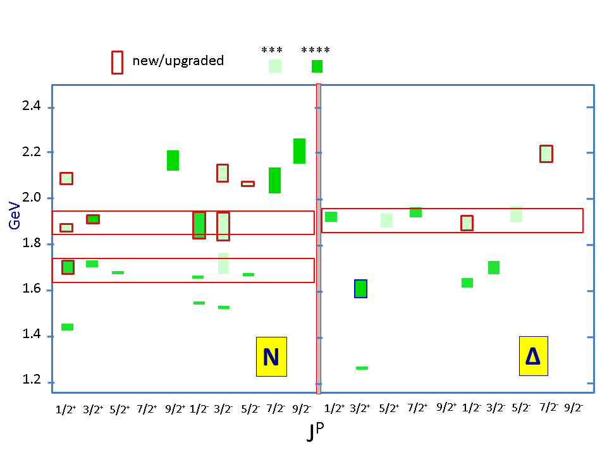
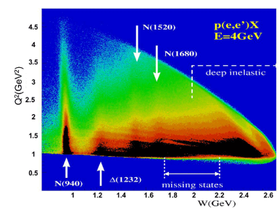


Advances in Exploration of the Nucleon Resonance Spectrum and Structure
V.I. Mokeev
Jefferson Lab
Talk outline:
Discovery of new baryon states
Insight into N* structure and strong QCD from γ_{v}pN* electrocouplings
Shedding light on emergence of hadron mass
Prospects with CLAS12 and beyond
`
1

Slide 2
SU(6)xO(3) Spin-Flavor Symmetry and ``Missing” Resonances
PDG2012 status
Continuum QCD: C. Chen et al., PRD 100 (2019) 054009; Si-xue Qin et al., FBS 60 (2019) 26
Lattice QCD: R. Edwards et al.,
PRD 84 (2011) 074508
SU(6)×O(3)
“missing” states
Studies of the N*-spectrum were driven by a guess for the ``missing” baryon states expected from underlying SU(6)xO(3) symmetry and supported by continuum and lattice QCD results on the N*-spectrum
2
Notes:
This shows the 2010 status of baryon states that have been associated with quark model states shown in this SU(6)xO(3) symmetry scheme. The color code indicating the confidence level in their existence. Clearly there are many open boxes where states are predicted but have not observed.

Slide 3
Advances in the Exploration of the N* Spectrum in Photoproduction
Several new nucleon resonances were established in a global multi-channel analysis of exclusive photoproduction data
Nucleon resonances listed in Particle Data Group (PDG) tables
N*/Δ* Spectrum 2020
State N(mass)J^{P} | PDG pre 2012 | PDG 2020*
N(1710)1/2⁺ | *** | ****
N(1880)1/2⁺ |  | ***
N(1895)1/2⁻ |  | ****
N(1900)3/2⁺ | ** | ****
N(1875)3/2⁻ |  | ***
N(2100)1/2⁺ | * | ***
N(2120)3/2⁻ |  | ***
N(2000)5/2⁺ | * | **
N(2060)5/2⁻ |  | ***
Δ(1600)3/2⁺ | *** | ****
Δ(1900)1/2⁻ | ** | ***
Δ(2200)7/2⁻ | * | ***
Description of the exclusive electroproduction data off the proton with the same masses and hadronic decay widths as in photoproduction will validate the existence of new baryon states.
Combined studies of the CLAS π⁺π⁻p photo-/electroproduction off proton data allow us to observe
a new N’(1720)3/2⁺ baryon state in addition to those listed above.
3

Slide 4
Interpretation of the Structure at W~1.7 GeV in π⁺π⁻p Electroproduction
M. Ripani et al., CLAS Collaboration
Phys. Rev. Lett. 91, 022002 (2003)
conventional states only, consistent with PDG 02
implementing N’(1720)3/2⁺ candidate or only conventional states with different N(1720)3/2⁺ Nππ decays than in PDG 02
Two equally successful ways for the data description:
No new states, different than in PDG 02’ N(1720)3/2⁺ Nππ hadronic decay widths:
 | Γ_{tot,} MeV | BF(πΔ) % | BF(ρp) %
N(1720)3/2⁺ decays fit to the CLAS Nππ data | 126±14 | 64-100 | <5
N(1720)3/2⁺ PDG 02’ | 150-300 | <20 | 70-85
σ, μbn
new N’(1720)3/2⁺ and regular N(1720)3/2⁺:
 | Γ_{tot,} MeV | BF(πΔ) % | BF(ρp) %
N’(1720)3/2⁺ New | 119±6 | 47-64 | 3-10.
N(1720)3/2⁺ Conventional | 112±8 | 39-55 | 23-49
W, GeV
V.I. Mokeev, Light Cone 2021 November 27-December 4 2021

Slide 5
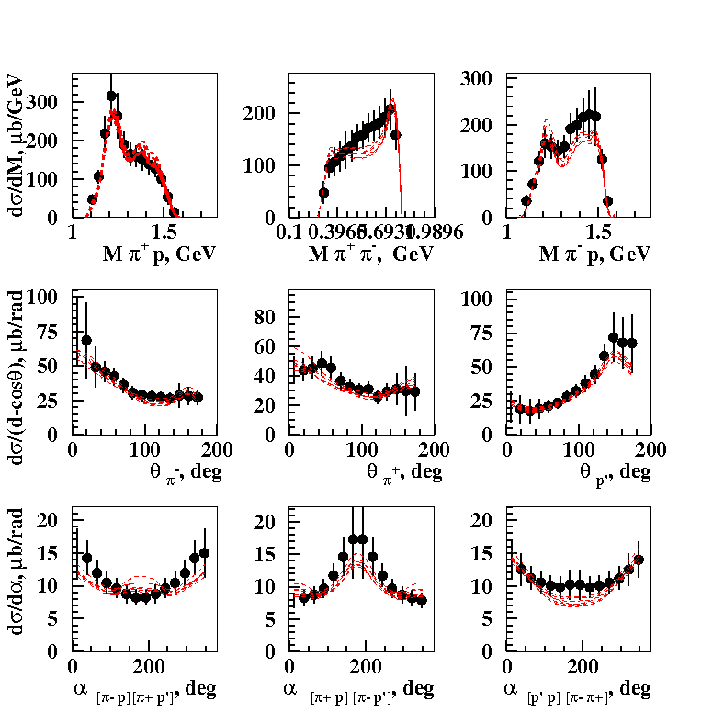
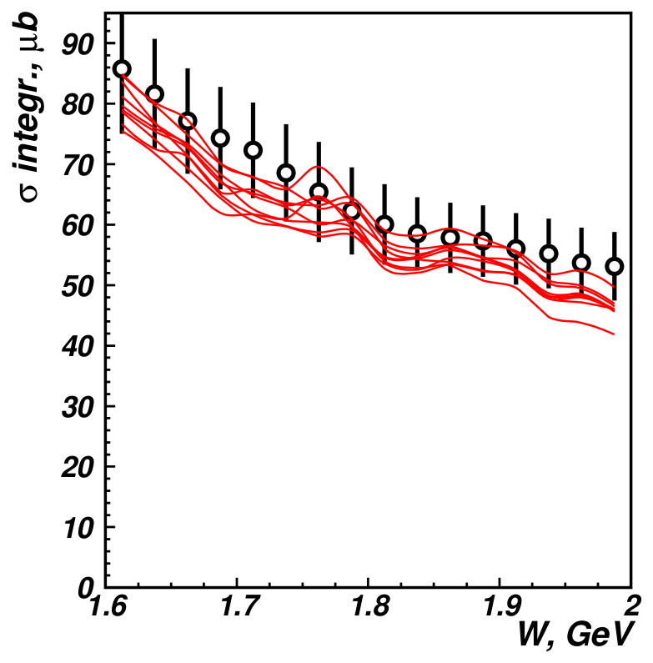
Description of the CLAS π⁺π⁻p Photoproduction off Protons Data with/without the New State N’(1720)3/2⁺
E.N. Golovach et al., CLAS Collaboration, Phys. Lett. B 788, 371 (2019).
One-fold differential cross sections
Fully integrated cross sections
W=1.71 GeV
Almost the same quality of description of the photoproduction data was achieved with and without the new N’(1720)3/2⁺ state:
N(1720)3/2⁺ and N’(1720)3/2⁺ 1.19 < χ²/d.p. < 1.28
N(1720)3/2⁺ only 1.08 < χ²/d.p. < 1.26
Would it be possible to describe the photo- and electroproduction data with Q²-independent resonance masses
and total and partial hadron decay widths?
V.I. Mokeev, Light Cone 2021 November 27-December 4 2021
5

Slide 6
Evidence for the Existence of the New State N’(1720)3/2⁺ from Combined π⁺π⁻p Analyses in both Photo- and Electroproduction
V.I. Mokeev et al., Phys. Lett. B 805, 135457 (2020)
N(1720)3/2⁺ hadronic decays from the CLAS data fit with
conventional resonances only
N* hadronic decays from the data fit that
incorporates the new N’(1720)3/2⁺ state
 | BF(πΔ), % | BF(ρp), %
electroproduction | 64-100 | <5
photoproduction | 14-60 | 19-69
Resonance | BF(πΔ), % | BF(ρp), %
N’(1720)3/2⁺ electroproduction photoproduction | 47-64 46-62 | 3-10 4-13
N(1720)3/2⁺ electroproduction photoproduction | 39-55 38-53 | 23-49 31-46
Δ(1700)3/2⁻ electroproduction photoproduction | 77-95 78-93 | 3-5 3-6
The contradictory BF values for N(1720)3/2⁺ decays to the πΔ and ρp final states deduced from photo- and electroproduction data make it impossible to describe the data with only conventional states.
The successful description of the π⁺π⁻p photo-
and electroproduction data achieved by
implementing the new N’(1720)3/2⁺ state with
Q²-independent hadronic decay widths of
all resonances contributing at W~1.7 GeV
provides strong evidence for the existence of
the new N’(1720)3/2⁺ state.
V.I. Mokeev, Light Cone 2021 November 27-December 4 2021

Slide 7
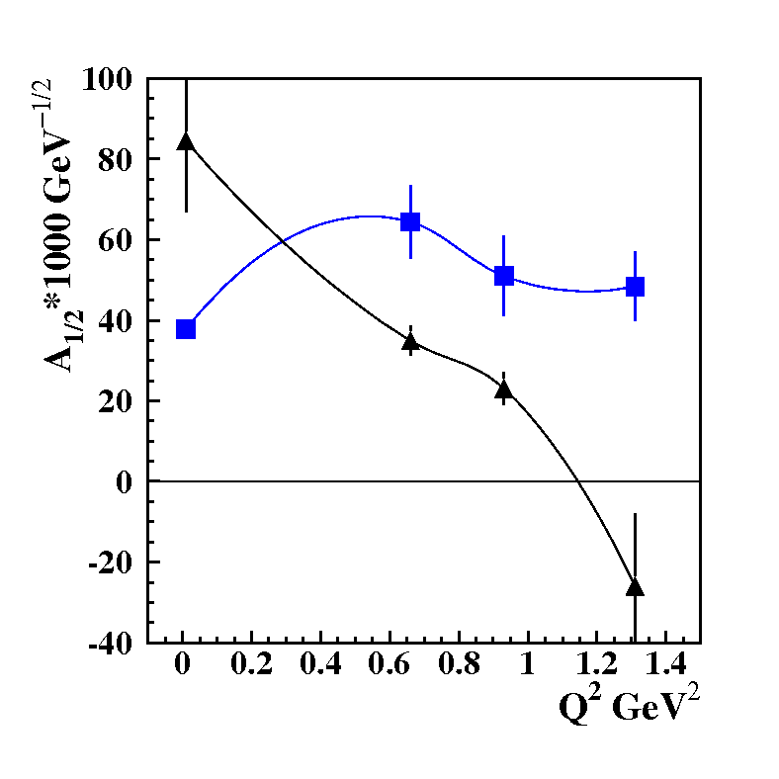
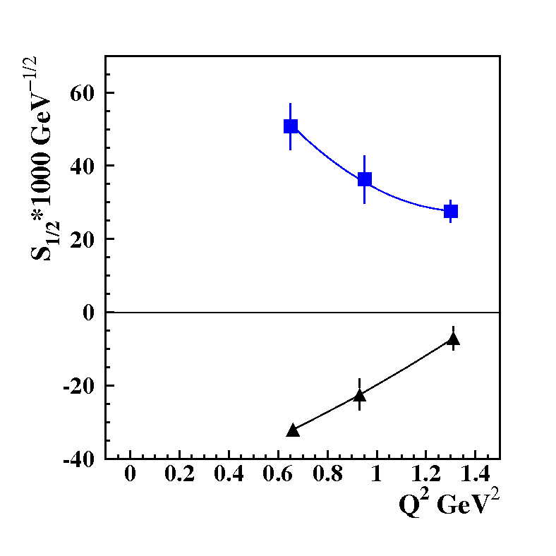
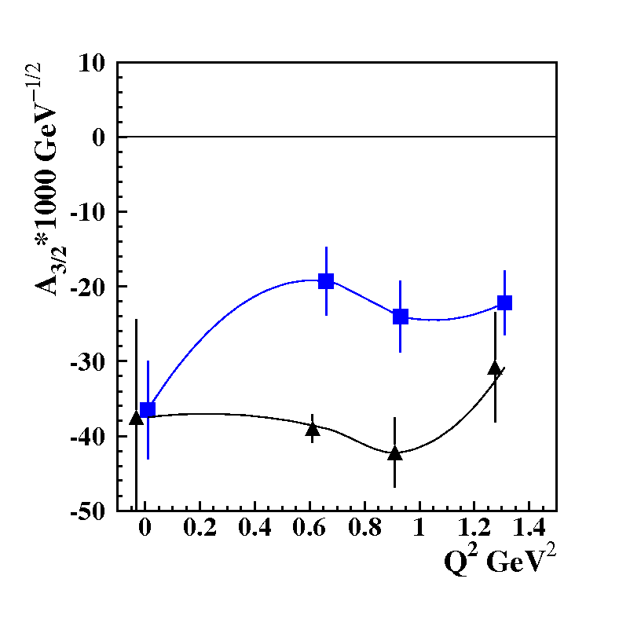
The Parameters of the New N’(1720)3/2⁺ State from the CLAS Data Fit
The photo-/electrocouplings of the N’(1720)3/2⁺ and conventional N(1720)3/2⁺ states
N’(1720)3/2⁺
Resonance | Mass, GeV | Total width, MeV
N’(1720)3/2⁺ | 1.715-1.735 | 120±6
N(1720)3/2⁺ | 1.743-1.753 | 112±8
N(1720)3/2⁺
The N’(1720)3/2⁺ is the only new resonance for which data on electroexcitation amplitudes have become available.
Gaining insight into the ``missing” resonance structure will shed light on their peculiar structural features that have made them so elusive, as well as on the emergence of new resonances from QCD.
V.I. Mokeev, Light Cone 2021 November 27-December 4 2021

Slide 8
N* Structure in Experiments with CLAS/CLAS12
The experimental program on the studies of N* structure in exclusive meson photo-/electroproduction with CLAS/CLAS12 seeks to determine:
  γ_{v}pN* electrocouplings at photon virtualities up to 10 GeV² for most excited proton states through analyzing major meson electroproduction channels from CLAS/CLAS12 data.
  Explore hadron mass emergence (EHM) and elucidate the trace anomaly by mapping out the dynamical dressed-quark mass which is one of the most fundamental expression of the trace anomaly in QCD.
An important part of the efforts on the exploration of strong QCD from data of the experiments with the electromagnetic probes:
S.J. Brodsky et al., Int. J. Mod. Phys. E29, 203006 (2020).
C.D. Roberts, Symmetry 12, 1468 (2020).
M. Barabanov et al., Prog. Part. Nucl. Phys. 103835 (2021).
Yin-Zhen Xu, et al., e-Print: 2107.03488 [hep-ph]
A unique source of information on many facets of strong QCD in generating excited nucleon states with different structural features:
I.G. Aznauryan and V.D. Burkert, Prog. Part. Nucl. Phys. 67, 1 (2012).
D.S. Carman, K. Joo, and V.I. Mokeev, Few Body Syst. 61, 29 (2020).
V.D. Burkert and C.D. Roberts, Rev. Mod. Phys. 91, 011003 (2019).
V.I. Mokeev, Light Cone 2021 November 27-December 4 2021

Slide 9
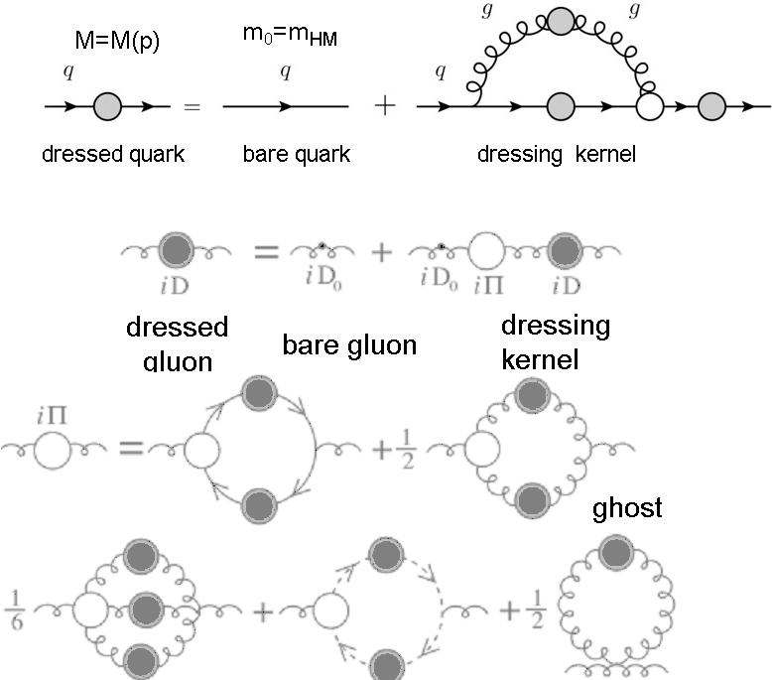
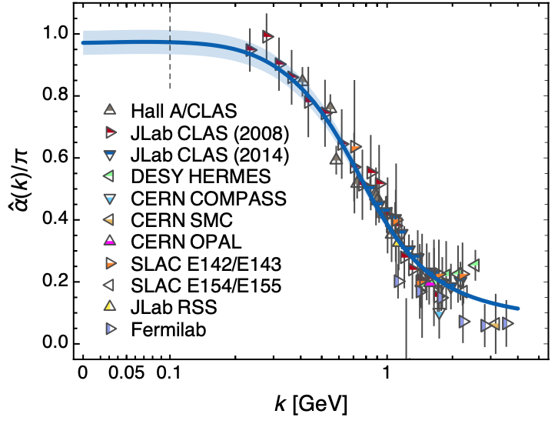
Basics for Insight into EHM: Continuum and Lattice QCD Synergy
Emergence of Dressed Quarks and Gluons
D. Binosi et al., Phys. Rev. D 95, 031501 (2017)
QCD Running Coupling α(k)
Zh-F. Cui et al., Chin. Phys. C 44, 083102 (2020)
In the regime of the QCD running coupling comparable with unity, the dressed quarks and gluons with distance (momentum) dependent masses emerge from QCD, as follows from the equation of the motion for the depicted QCD fields.
9

Slide 10
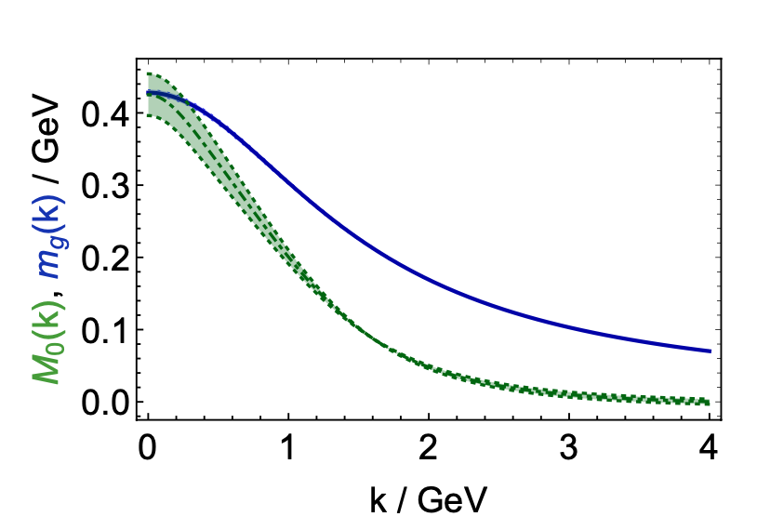
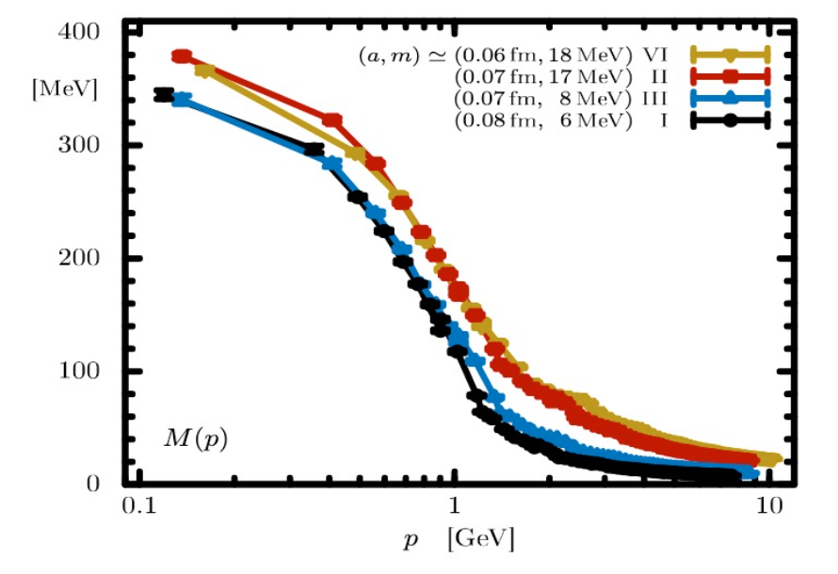
Basics for Insight into EHM: Continuum and Lattice QCD Synergy
Dressed Quark/Gluon Masses (Continuum QCD)
C.D. Roberts, Symmetry 12, 1468 (2020)
Dressed quark/gluon masses converge at the complete QCD mass scale of 0.43(1) GeV - value impacted by Higgs mechanism.
Continuum QCD predictions are confirmed by LQCD simulations.
So far, a unique insight to the QCD trace anomaly. Vector meson photo-production analyses by employing VDM can not provide access to the QCD trace anomaly (Ref. [4], slide #8).
Insight into the dressed quark mass function from data on hadron structure represents a challenge for experimental hadron physics.
Dressed
gluons
Dressed
quarks
Inferred from QCD Lagrangian with only the Λ_{QCD} parameter
Dressed Quark Mass (Lattice QCD)
O. Olivera et al., Phys. Rev. D 99, 094506 (2019)
10

Slide 11
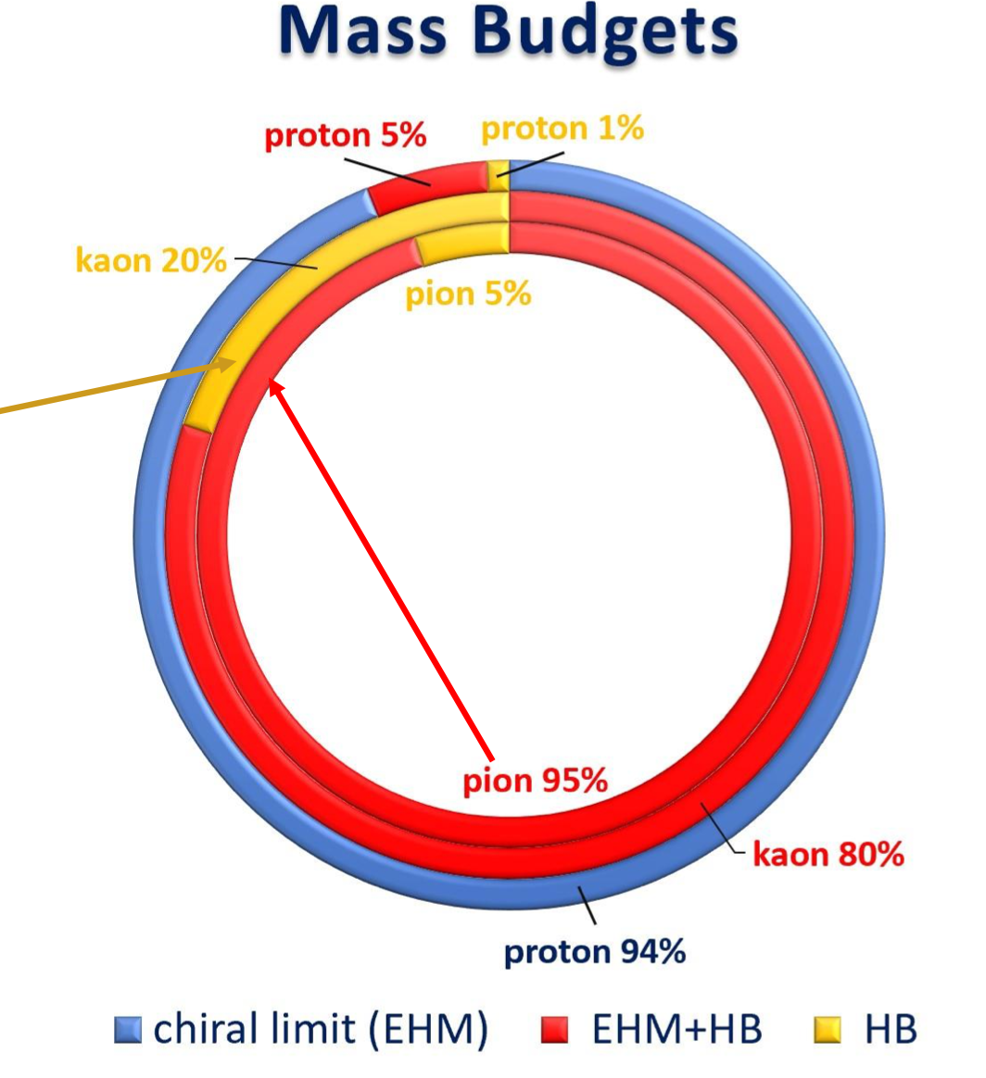
Insight into EHM from Data on N/N* Structure
Studies of the structure of the ground and excited states of the nucleon allow us to explore the dressed quark mass function in the environment where the sum of the dressed quark masses is the dominant contribution to the physical masses of the ground and excited states of the nucleon.
Consistent results on the momentum dependence of the dressed quark mass function from independent studies of the pseudoscalar mesons and the ground and excited state nucleon structure are of particular importance for the validation of insight into EHM.
11

Slide 12
Nucleon Resonance Electrocouplings from Data On Exclusive Meson Electroproduction with CLAS
Exclusive meson electroproduction channels | Excited proton states | Q²-ranges for extracted γ_{v}pN* electrocouplings, GeV²
π⁰p, π⁺n | Δ(1232)3/2⁺ N(1440)1/2⁺,N(1520)3/2⁻, N(1535)1/2⁻ | 0.16-6.0 0.30-4.16
π⁺n | N(1675)5/2⁻, N(1680)5/2⁺ N(1710)1/2⁺ | 1.6-4.5
ηp | N(1535)1/2⁻ | 0.2-2.9
π⁺π⁻p | N(1440)1/2⁺, N(1520)3/2⁻ Δ(1620)1/2⁻, N(1650)1/2⁻, N(1680)5/2⁺, Δ(1700)3/2⁻, N(1720)3/2⁺, N’(1720)3/2⁺ | 0.25-1.50 2.0-5.0 (preliminary) 0.5-1.5
The N* electroexcitation amplitudes (γ_{v}pN* electrocouplings) have become available in a broad range of Q²<5.0 GeV²
In the mass range of W<1.6 GeV the γ_{v}pN* electrocoupling were obtained from independent studies of πN, ηp, and π⁺π⁻p electroproduction
Recent results can be found in: A.N. Hiller Blin et al, PRC100, 035201 (2019)

Slide 13

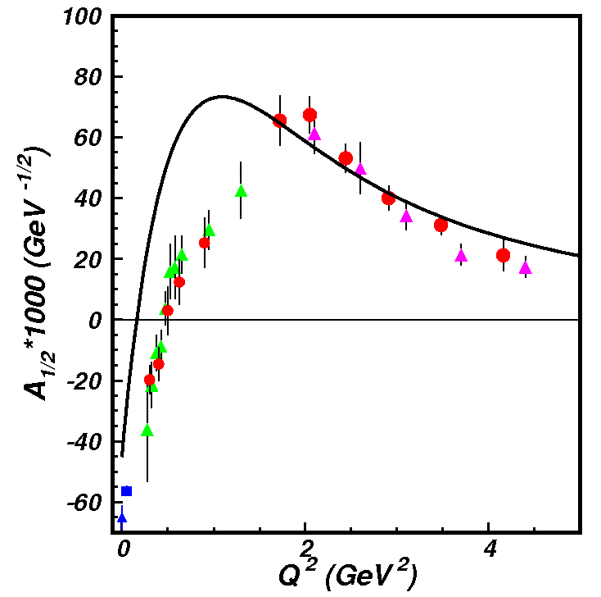
Insight into EHM From Resonance Electrocouplings
N→Δ(1232)3/2⁺ magnetic from factor
Jones-Scadron convention
Substantial
contributions
from meson-
baryon cloud
Quark core
dominance
Quark core
dominance
Dyson-Schwinger Equations
(DSE):
J. Segovia et al., PRL 115, 171801 (2015)
J. Segovia et al., FBS 55, 1185 (2014)
Substantial
contributions
from meson-
baryon cloud
quark mass:
frozen
running
Good data description at Q²>2.0 GeV² achieved with the same dressed quark mass function for the ground and two excited nucleon states of distinctively different structure validates the continuum QCD results on the momentum dependence of the dressed quark mass. γ_{v}pN* electrocoupling data offer access to the strong QCD dynamics underlying hadron mass generation.
One of the most important achievements in hadron physics of the last decade in synergistic efforts between experimentalists, phenomenologists, and theorists
Notes:
The experimental results from CLAS on electrocouplings of low-lying resonances have a profound impact on the development of the continuum QCD approaches which are capable to relate the phenomenological information on Q2-evolution of the resonance electrocouplings to the momentum dependence of dressed quark mass M(p). For the first time elecrocouplings of D(1323)3/2+ amd N(1440)1/2+ resonances were successfully described at Q2>2.0 GeV2 within continuum QCD approaches under a traceble connection to the QCD Lagrangian. Studies of the nucleon resonances with CLAS demonstrated that their structure is coming from a complex interplay between inner core of three constituent quarks and the external meson-baryon cloud. Currently, the continuum QCD approaches account for the contributions from quark core only. Therefore they can be directly confronted to the data only at higher enough Q2 where the contributions from quark core become the biggest.
The leading p→D megnetic transition form factor (left plot) was computed within continuum QCD within two ansatz for qq-interaction. In the first exploratory evaluations the simplifies contact qq-interaction was used. This interaction results in frozen momentum independent dressed quark mass, however account for the generation of 360 MeV quark mass in the dressing processes. The transition N-→D magnetic form factors computed with frozen quark mass is shown in magenta on the left plot. The computation overestimate the data at Q2>1.0 GeV2. The discrepancies between the data and computations increases with Q2. Eventually, contact ansatz for qq interaction has been replaced by the most advances ansatz inferred from the QCD Lagrangian within the continuum QCD approach. This advanced ansatz results in the momentum dependent mass of dressed quark. The N-→D magnetic form factor computed with running quark mass is shown in the left plot in blue. Use of running quark mass allow us to reproduce the CLAS data in entire range of Q2>0.8 GeV2. Analysis of the CLAS results wqithin the continuum QCD approaches conclusively demonstrated that dressed quark mass function is in fact running.
Remarkably, a successful description of Roper resonance electrocouplings (right part) has been achieved with exactly the same dressed quark mass function M(p) as used previously for a successful description of the pion, nucleon elastic form factor and D(1322)3/2+ electroexcitation amplitude. The structure of D(1323)3/2+ and N(1440)1/2+ resonances are completely different. The D(1232)3/2+ state represents the spin-isospin fl;ip for three quarks in the ground nucleons, while N(1440)1/2+ state is the first radial excitation of three dressed quarks. Consistent results on the dressed quark mass function from independent studies of pion/nucleon elastic amplitudes and from the electroexcitation amplitudes for the resonances of distinctively different structure strongly suggest the relevance of dressed quark with running mass computed within comtinuus QCD approaches as active degrees of freeom in the structure of pion, ground, and excited nucleon states. This success also demonstrated the capability to map out the momentum dependence of dressed qirak mass from the experimental resultson nucleon elastic form factors and the nucleon resonance electroexcitation amplitudes

Slide 14
Δ(1600)3/2⁺ Electrocouplings: Continuum QCD Predictions vs. CLAS Data
continuum QCD predictions w/o adjustable
parameters, Ya Lu et al., Phys. Rev. D100,
034001 (2019)
preliminary results on Δ(1600)3/2⁺
electrocouplings from the CLAS π⁺π⁻p
electroproduction data
CLAS results are consistent with the continuum QCD predications solidifying evidence for reliable insight into the emergence of hadron mass
V.I. Mokeev, Light Cone 2021 November 27-December 4 2021
15

Slide 15
Toward Exploration of EHM from Orbital Nucleon Excitations
Continuum QCD Breakthrough: N(1535)1/2⁻ electrocouplings computed under a traceable connection to the QCD Lagrangian (green area).
C.D Roberts et al., private communication
The first preliminary continuum QCD evaluation of electro-excitation amplitudes of the [70,1⁻] supermultiplet resonances (L_{3q}=1) with the same dressed quark mass mass function as used for the resonances with L_{3q}=0
lQCD+LCSR
V. Braun et al.
Studies of electroexcitation amplitudes for the resonances in the second region suggest the universality of the dressed quark mass function for the ground and different excited states of the nucleon, including the first spin-isospin flip, the first radial, and the first orbital (L_{3q}=1) excitations.

Slide 16
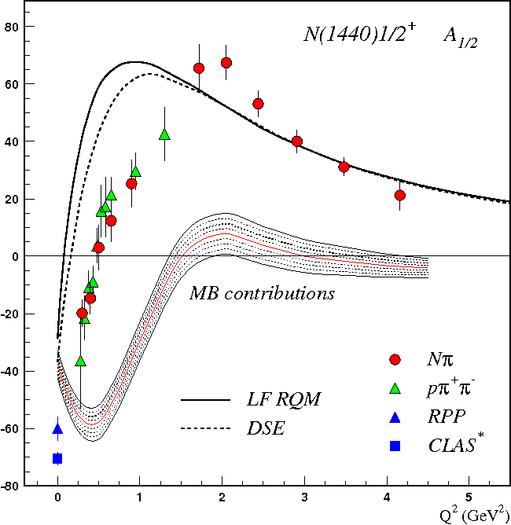
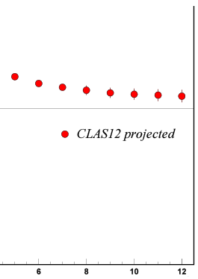
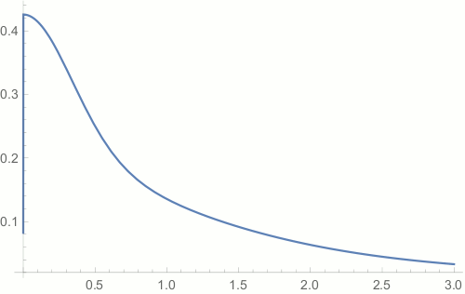

Emergence of Hadron Mass and Quark-Gluon Confinement
N* electroexcitation studies at JLab during and after 12 GeV era will address the critical questions:
How is >98% of visible mass generated?
How does confinement emerge from QCD and how is it related to Dynamical Chiral Symmetry Breaking?
(S.J, Brodsky et al., Int. J. Mod. Phys. Rev. E29, 2030006 (2020))
Mapping-out quark mass function from the results on γ_{v}pN* electrocouplings of spin-isospin flip, radial, and orbital excited nucleon resonances at 5<Q²<36 GeV² is needed to explore the full range of distances where the dominant part of hadron mass is generated
Access to the dressed quark/hadron mass generation
//
N(1440)1/2⁺
$p_{q}$=$\sqrt{Q^{2}}$/3
CLAS12
range
Full range of quark momenta
where hadron mass is generated
A_{1/2} (GeV^{-1/2}) *1000
confinement (approaching
constituent quark mass)
Dressed Quark Mass, GeV
approaching bare Higgs quark mass and pQCD regime
//
Q² (GeV²)
CLAS results vs. theory expectations with running quark mass
Quark Momentum p_{q}, GeV
17

Slide 17
Conclusions and Outlook
Several long-awaited new, so-called ``missing” nucleon resonances, have been discovered from global analyses of exclusive meson photo- and hadroproduction data with decisive impact from the KY photoproduction channels measured with CLAS.
New N’(1720)3/2⁺ resonance has been observed in combined studies of π⁺π⁻p photo- and electroproduction data. New N’(1720)3/2⁺ state is the only new resonance for which the results on Q²-evolution of γ_{v}pN* electrocouplings have become available. Analyses of the results on the new resonance electrocouplings in collaborative efforts with hadron structure theory will shed light on particular features of the ``missing” resonance structure that have made them so elusive for detection.
High-quality meson electroproduction data from CLAS have allowed us to determine the electrocouplings of most resonances in the mass range up to 1.8 GeV with consistent results from analyses of π⁺n, π⁰p, ηp, and π⁺π⁻p electroproduction channels. Resonance electrocouplngs will become available for N* in the mass range <2.0 GeV and at Q²<5.0 GeV² (CLAS) and at Q²<10 GeV² (CLAS12).
A good description of CLAS results on Δ(1232)3/2⁺, N(1440)1/2⁺, N(1535)1/2⁻ and Δ(1600)3/2⁺, electroexcitation amplitudes achieved with the same dressed quark mass function as used previously in successful evaluations of the elastic ground nucleon and pion form factors, pion PDF validate insight to the dynamics that underlie the emergence of hadron mass.
19

Slide 18
Conclusions and Outlook
CLAS12 is the only facility in the world capable of obtaining the electrocouplings of all prominent N* states at still unexplored ranges of highest photon virtualities from 5.0 to 10 GeV² from Nπ, π⁺π⁻p, and KY electroproduction allowing us to map out the dressed quark mass function at quark momenta < 1.3 GeV, addressing the most challenging problems of the Standard Model on the nature of >98% of hadron mass and of quark-gluon confinement.
Extension of the results on γ_{v}pN* electrocouplings into the Q² range from 10 GeV² to 36 GeV² from the measurements at the future facilities with luminosity >10³⁶ cm⁻²s⁻¹ and with detector of nearly 4π acceptance will provide information on dressed quark mass function within full range of distances where the transition from quark-gluon confinement to pQCD regime is expected.
Studies of γ_{v}pN* electrocouplings and inclusive structure functions in the Q² range from 10 GeV² to 36 GeV² motivate extension of experiments at JLab beyond 12 GeV era paving a way to explore the emergence of hadron mass and structure from QCD.
20

Slide 19
Back Up

Slide 20
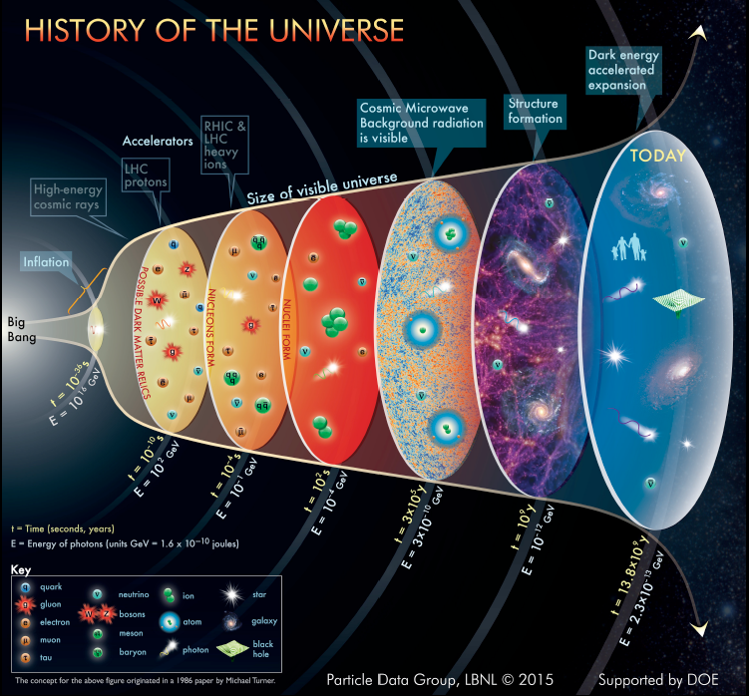
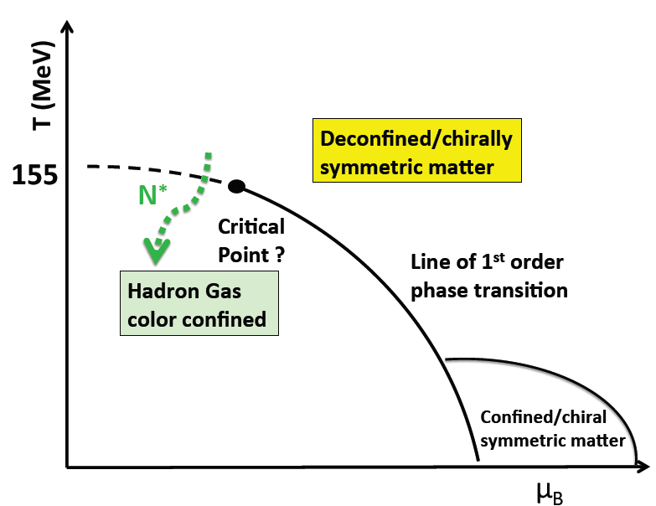
Nucleon Resonances in the Emergence of Hadronic Matter
Dramatic events occurred in the micro-second old universe during the transition from the deconfined quark and gluon phase to the hadron phase.
N*
hot QCD
Quark-gluon confinement emerges
Chiral symmetry of QCD broken
Quarks and gluons acquire mass
Baryon resonances form
strong QCD
??
This transition was shaped by the full meson and baryon spectra
V.I. Mokeev, Light Cone 2021 November 27-December 4 2021
2

Slide 21
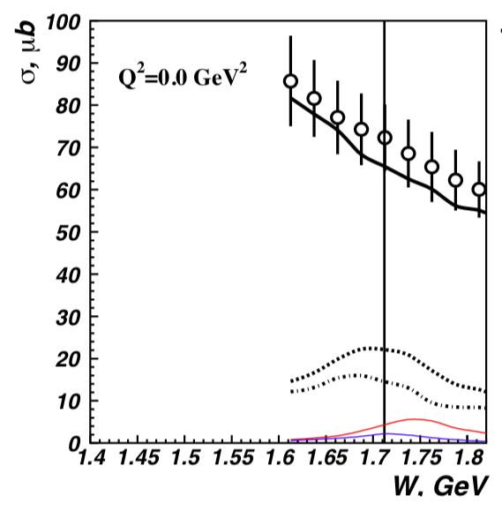
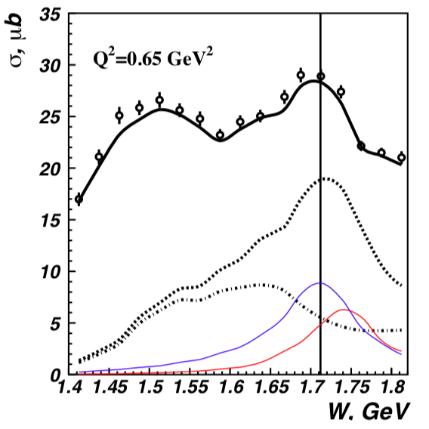
Newly Discovered N’(1720)3/2⁺
π⁺π⁻p photoproduction
π⁺π⁻p electroproduction
V.I. Mokeev et al., Phys. Lett. B 805, 135457 (2020)
N(1720)3/2⁺
Resonant part
N’(1720)3/2⁺
N’(1720)3/2⁺
Resonant part w/o
N’(1720)3/2⁺,
& N(1720)3/2⁺
N(1720)3/2⁺
Evidence of a new N’(1720) 3/2⁺ resonance in the photo- and electroproduction of the π⁺π⁻p channel
V.I. Mokeev, Light Cone 2021 November 27-December 4 2021

Slide 22
SU(6)-Assignment for N’(1720)3/2⁺ and N(1720)3/2⁺
New resonances discovered from exclusive meson photoproduction data revealed the following
pattern of the high-lying resonance spectrum under approximate SU(6)xO(3) symmetry
[70,2⁺] multiplet
S_{q}=3/2
N(1880)1/2⁺ N(1900)3/2⁺ N(2000)5/2⁺ N(2000)7/2⁺
M_{avg} (S_{q}=3/2)=1.96 GeV ΔM(S_{q}=3/2) = 0.075 GeV
S_{q}=1/2
N’(1720)3/2⁺ N(1860)5/2⁺
ΔM(S_{q}=3/2-S_{q}=1/2)[70,2⁺] = ΔM(S_{q}=3/2-S_{q}=1/2)[70,1⁻] = 0.16 GeV
M_{avg} (S_{q}=1/2) = M_{avg} (S_{q}=3/2) - ΔM(S_{q}=3/2-S_{q}=1/2)[70,2⁺] = 1.96-0.16 = 1.80 GeV
M(N’(1720)3/2⁺⁾ = M_{avg} (S_{q}=1/2) - ΔM(S_{q}=3/2) = 1.80-0.075 =1.73 GeV consistent with the mass of N’(1720)3/2⁺ inferred from the π⁺π⁻p photo-/electroproduction data
N’(1720)3/2⁺: three constituent quarks of total spin S_{q}=1/2 and orbital momentum L=2 in
[70,2⁺] multiplet, double orbital excitation
N(1720)3/2⁺: three constituent quarks of total spin S_{q}=1/2 and orbital momentum L=2 in
[56,2⁺] multiplet
Quark model evaluation of γ_{v}pN* electrocouplings under the aforementioned assignments for
N(1720)3/2⁺ and N’(1720)3/2⁺ states will shed light on peculiar features in N’(1720)3/2⁺ structure
V.I. Mokeev, Light Cone 2021 November 27-December 4 2021
10

Slide 23
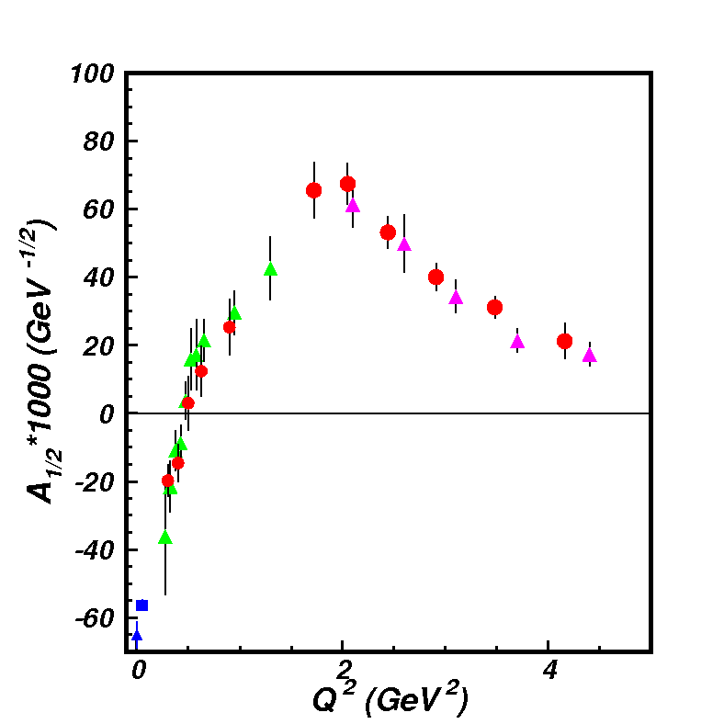
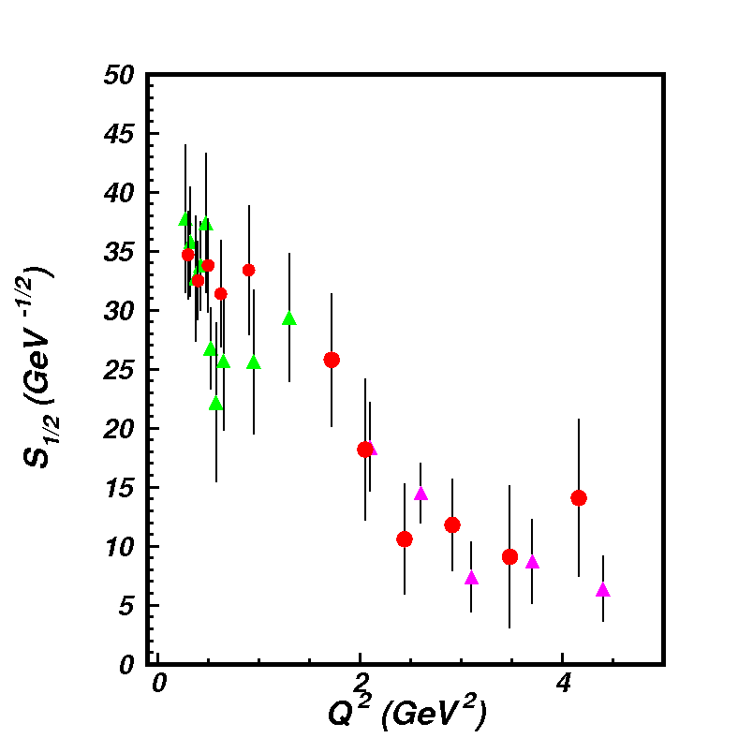
Electrocouplings of N(1440)1/2⁺ from πN and π⁺π⁻p
Electroproduction off Proton Data
A_{1/2}
pπ⁺π⁻ CLAS
preliminary
S_{1/2}
Consistent results on N(1440)1/2⁺ electrocouplings from independent studies of two major πN and π⁺π⁻p electroproduction channels with different non-resonant contributions allow us to evaluate the systematic uncertainties of these quantities in a nearly model-independent way.

Slide 24
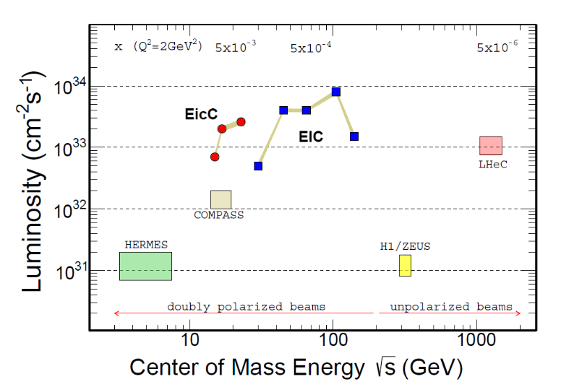
Studies of γ_{v}pN* Electrocouplings at Q² > 10 GeV²
Energy and luminosity increase up to >10³⁶ cm⁻²s⁻¹ are needed in order to obtain information on the γ_{v}pN* electrocouplings at Q²>10 GeV², allowing us to map out the momentum dependence of the dressed quark mass within the entire range of distances where the dominant part of hadron mass is generated
Both EicC and EIC would need much higher (but likely unfeasible) luminosity
The exclusive electroproduction
measurements foreseen at JLab after
completion of the 12 GeV program:
Beam energy at fixed target: 24 GeV
Nearly 4π coverage
High luminosity
Offer maximal achievable luminosity for extraction of γ_{v}pN* electrocouplings at Q²>10 GeV²
18

