Slide 1
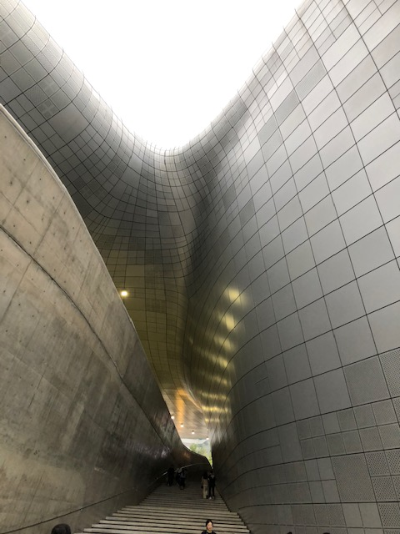
NEPLES 2019
New Physics at the
Low Energy Scales
KIAS, Seoul
September 23 - 27, 2019
A Y Smirnov

Slide 2
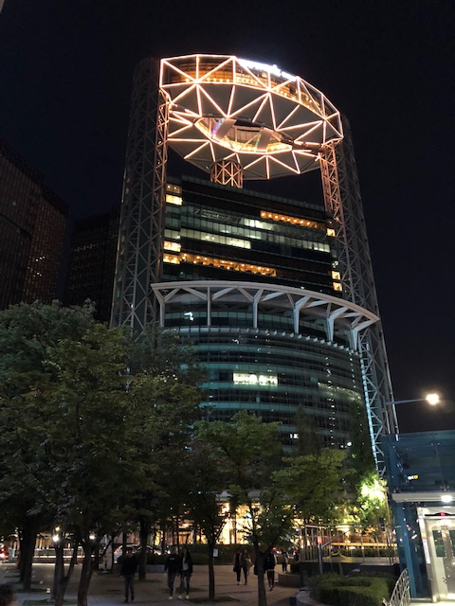
TOPLESS 2019
Theoretical and Observational
Physics at the
Low Energy ScaleS
sounds better
covers not only light BSM particles but also
new SM physics

Slide 3
… reflects the change of the paradigm
Reflects the present situation when nothing is found
(well established) above the electroweak scale at the LHC and other experiments
Nothing on the top?
This changes the paradigm of searches for new physics
from High to Low and Very low energy scales.
With new (yet relatively inexpensive) experiments
Explosion of activity in the last 5 – 6 years
with key notions

Slide 4

Portals,
Mediators
& Hidden
worlds

Slide 5
New field of research?
Key notions and topics
Axions
Light , ultralight
Dark photons
ALP’s
scalars
Sterile neutrinos
Dark neutrinos
Portal and Mediators
Dark, Hidden sectors
Various topics are not new being “invented”
and discussed 30-40 years ago
Interesting and rich physics, new phenomena

Slide 6
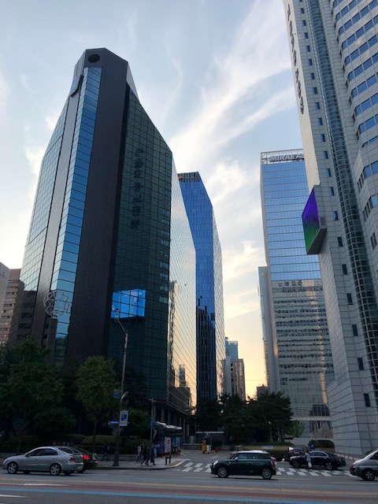
Δm₄₁² = 1 - 2 eV²
Motivations:
LSND
Experimental
hints

Slide 7
Evidences of low scale physics?
Axions, keV steriles, fuzzy DM …
Dark
Matter
CDM- problems
EDGES
Dark
Energy
indeed indicates
small energy scale
ANITA
Gallium
anomaly
LSND
MiniBooNE
Neutrino
Anomalies
Reactor neutrino
anomaly
KamLAND-Solar tension
5 MeV bump
neutron
lifetime
Origins of
ν - mass
B-decays
Be anomaly
g_{μ} - 2

Slide 8

Δm₄₁² = 1 - 2 eV²
Motivations:
LSND
Theory?

Slide 9
Second desert?
M_{Pl}
10²⁰
10¹⁰
10⁰
10⁻¹⁰
10⁻²⁰
10⁻³⁰
10⁻⁴⁰
M_{GUT}
High scale desert
14 – 17 orders
Standard masses
of the SM particles
V_{EW}
Strange pattern
of masses
m_{e}
BSM origins?
m_{ν}
M, GeV
Why not worry about
the low scale desert?
Λ
V_{EW}²/M_{Pl}
Low scale desert
> 40 orders
Hierarchy problem?
m_{γ}
Γ_{p}
1/t_{U}

Slide 10
νMSM and nothing more?
nuMSM with UV completion at the string-Planck scale
L
BAU
R
- small neutrino mass, seeesaw,
lepton asymmetry via oscillations
can be produced in
B-decays (BR ~ 10⁻¹⁰ ) etc., SHiP
0.1 - few GeV
split ~ few kev
WDM
3 - 10 kev
- decouples from generation
of neutrino mass, RHN?
- radiative decays →
3.5 keV line?
- one active neutrino is massless

Slide 11
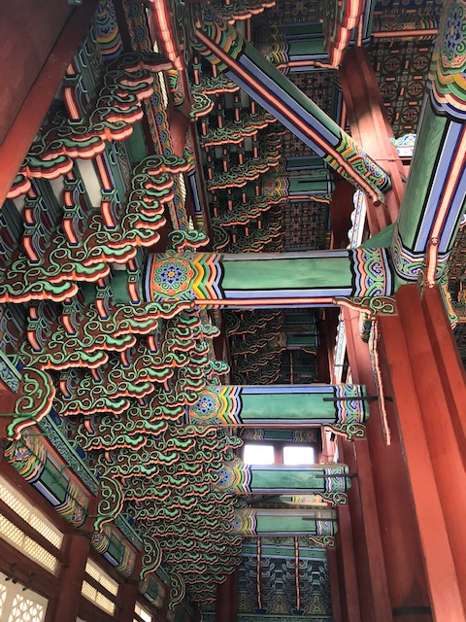
Connections
Strong CP problem, Axions
Gauge Hierarchy?
Extra Dimensions
Modulinos

Slide 12
Neutrino mass and mixing from the Dark sector
Visible sector
Dark (hidden) sector
Φ
SM + ν_{R}
Φ
S
S
flavons
S
Φ
S
S
Singlets (fermions, bosons)
L-R
Neutrino
portal
Sterile
neutrinos
P-S
Scale?
Axions, Majorons, DM
GUT
Origins of smallness of neutrino mass and large (maximal mixing)
Strings

Slide 13

Questions

Slide 14
SM new physics – impressive progress in detection of small recoils, momenta transfer – new capacities
Is detection of relic neutrinos feasible?
Concerning new physics BSM at low scales
Are we looking for nothing?
- just move borders of unexplored territory without clear indications where to look for?
What are real evidences of low scale new physics?
What is the status of various anomalies and their interpretation in terms of sterile neutrinos or other light particles?

