Slide 1
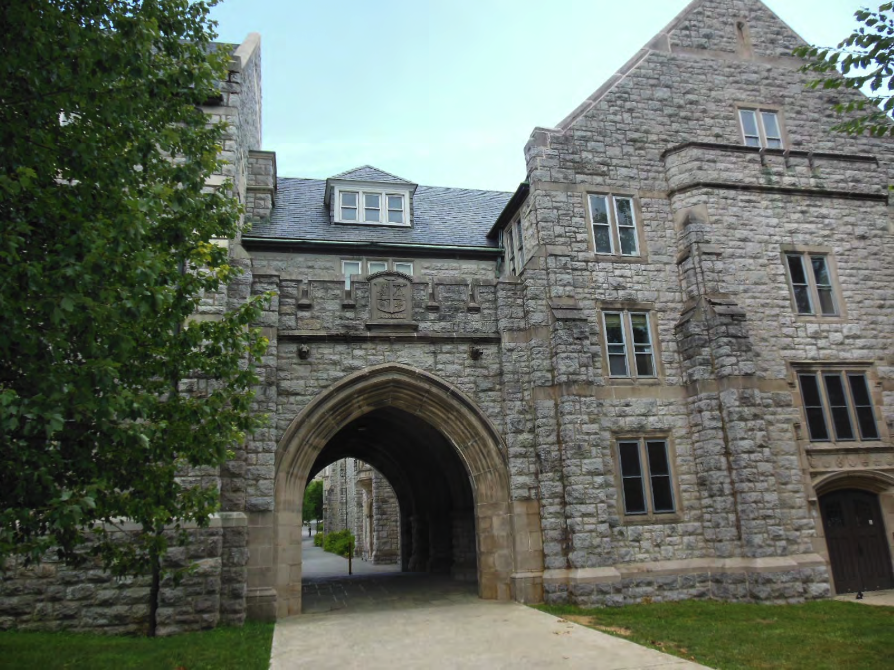
Possible new physics through search for unitarity violation
Hisakazu Minakata, Center for Neutrino Physics, Virginia Tech
With: Chee Sheng Fong, Hiroshi Nunokawa, Ivan Martinez-Soler, Peter Denton

Slide 2
My starting point was..
How can we conclude the neutrino story if high-scale seesaw is nature designed ?
Unitarity test at super-high precision..
But, I learned SU(2) x U(1) prevail at high scale, Charge lepton constraints more powerful

Slide 3
High- vs low-scale unitarity violation: more generic differences
High-scale UV >> m_{W}
Low-scale UV << m_{W}
lepton flavor universality: NO
zero distance neutrino flavor transition: YES
“Model-independent” formalism = integrate out high-E NP
lepton flavor universality: YES
zero distance neutrino flavor transition: NO
Model-independent” formalism?
A big difference between High-scale and Low-scale UV is: SU(2)xU(1) at high-scale UV new physics → Severer constraints from charged lepton sector

Slide 4

Model independent framework in low-scale UV?

Slide 5
It looks hard..
How to integrate various scenarios of BSM physics at low energies ?
Not obvious…
My style now is: Let try one by one
Yet, I want to avoid # of trial = # of models
So we started “general sterile” = (3+N) model = “indep of details of sterile sector” (with C.-Sheng Fong and H. Nunokawa)
Fong, HM, Nunokawa JHEP2017, JHEP2019

Slide 6

3-active + N-sterile unitary model

Slide 7


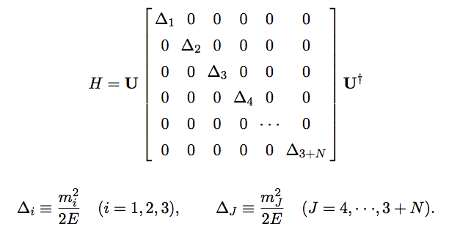
3 active +N sterile unitary model in vacuum
My previous N matrix = U now…..3x3
Schechter-Valle, PRD1980
NxN
We try fast oscillation averaged out regime for “model-independent” framework for low-scale UV

Slide 8
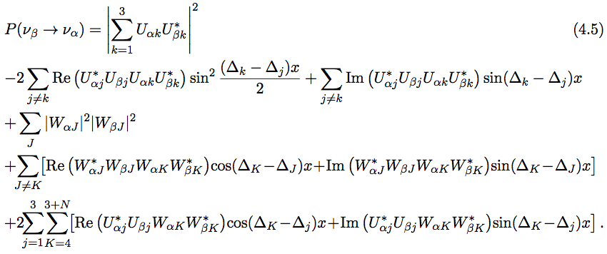

Probability in vacuum
What is this?
Active-active, active-sterile, sterile-sterile oscillations
If Δm²_{as} (Δm²_{ss}) > 0.1 eV², “fast oscillation” due to active-sterile and sterile-sterile Δm² are averaged out

Slide 9
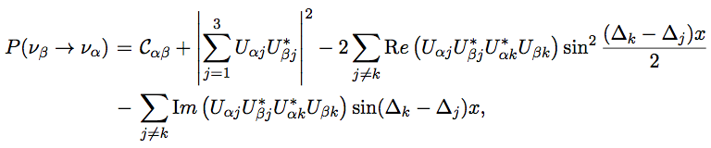


P looks almost standard one, but there is a P leaking term
Both 4th order in W, have to be kept!
Probability leakage !
Appearance
U = non-unitary “MNS”
Disappearance
Order ~ W⁴, small!!

Slide 10
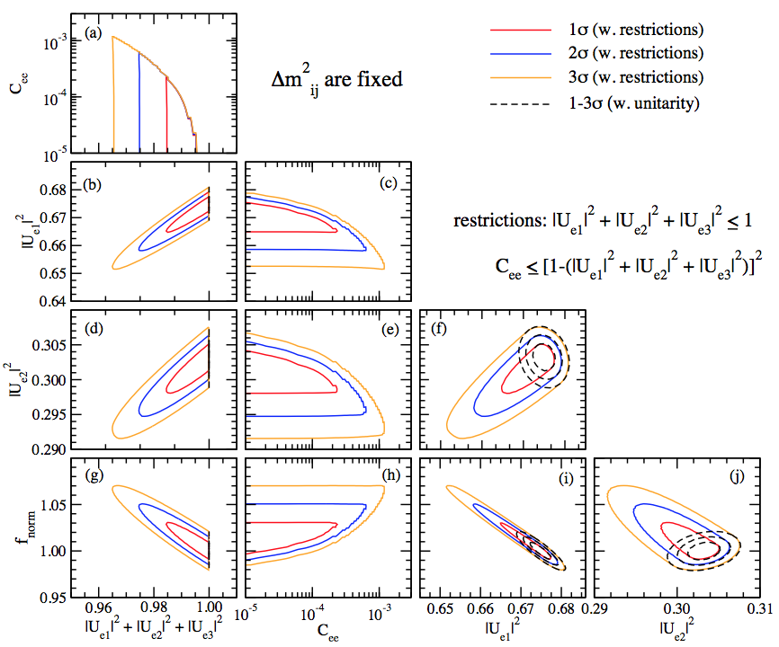
Sensitivity to C_{ee} and 1-Σ|U_{ei}|² from JUNO
5 years
Fong, HM, Nunokawa JHEP2017
3% flux uncertainty assumed
C_{ee} ~ 10⁻⁴ (1 σ)
1-Σ|U_{ei}|² ~ 0.01

Slide 11
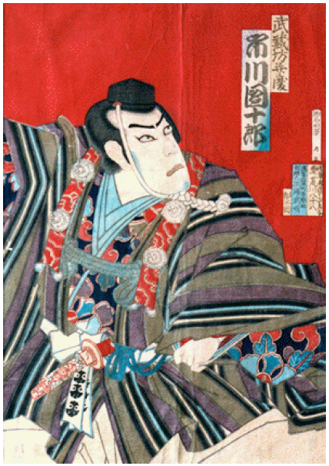
In matter? A long story…
One page summary here!

Slide 12
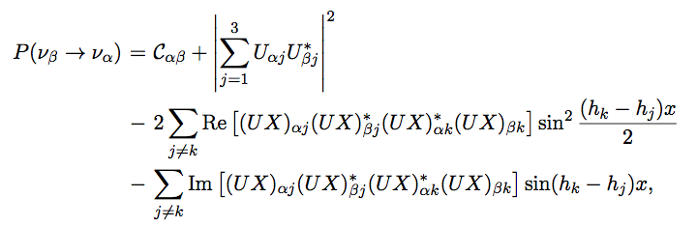
A simple formula for oscillation probability in matter w/o unitarity: leading order in W perturbation
X=…
All W² & W⁴ terms avaraged out or suppressed if Δm² > 0.1 eV² except for P leaking term!!
UV effect is in: (1) explicit W correction term, (2) non-unitary U matrix
Fong, HM, Nunokawa JHEP2019

Slide 13
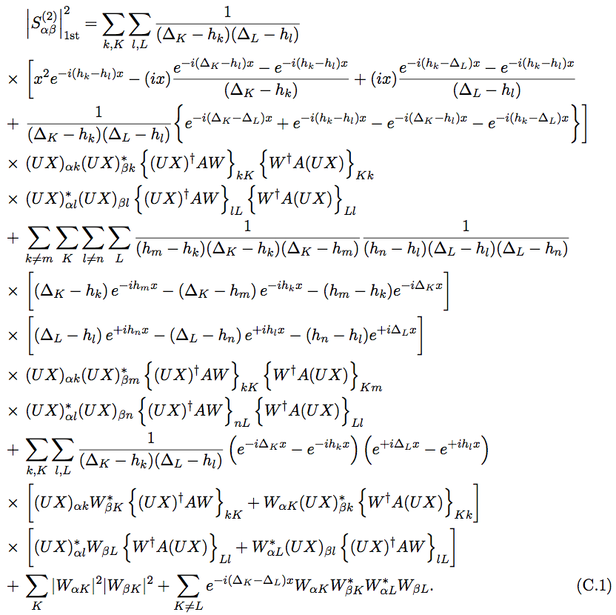
Looking for P leaking term in W⁴ terms…
Here is !!

Slide 14
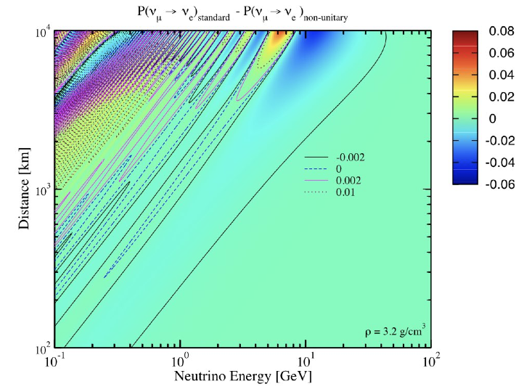
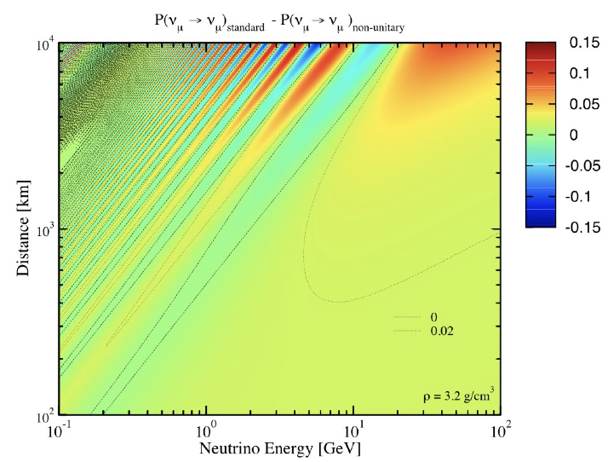
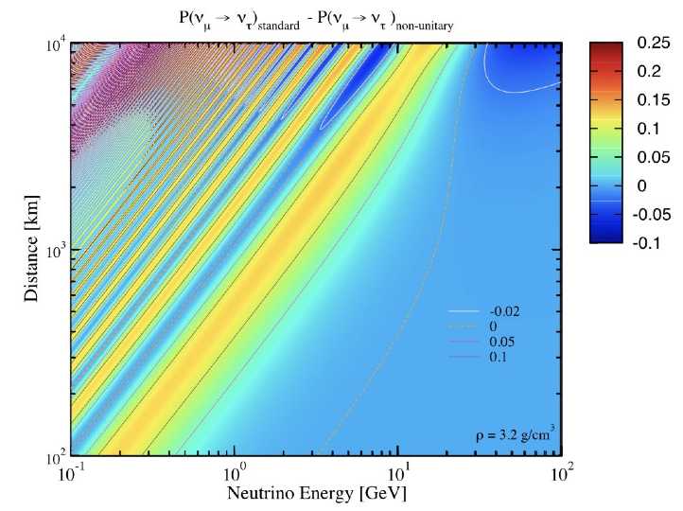
Leading order terms = Zeroth order in W
ΔP large at solar- and atm- MSW enhanced regions

Slide 15

Leading order in W expansion: our current status

Slide 16
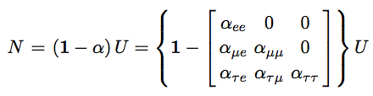

α parametrization (δ vs. α correlation)
Alpha parametrization
δ and alpha always come in this combination!
Let us call “canonical phase combination”
Ivan Martinez-Soler, HM, arXiv:1806.10152

Slide 17
Deep Core 2011-14 (3years, 6-60 GeV)
−0.07 < ατμ ~< 0.03, |αμμ | ~< 0.08
20% flux normalization error
Peter Denton, Ivan Martinez-Soler, HM, to appear

Slide 18
IceCube (1 year)
(400 GeV-20 TeV) vs DeepCore
50% flux normalization error
For α_τμ (α_μμ ) high-E (low E) is more constraining
Peter Denton, Ivan Martinez-Soler, HM, to appear

Slide 19
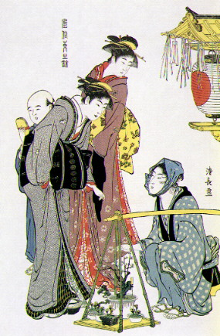
Second order corrections: characteristic to low-scale UV

Slide 20

Hunting W² terms: need theory…

Slide 21
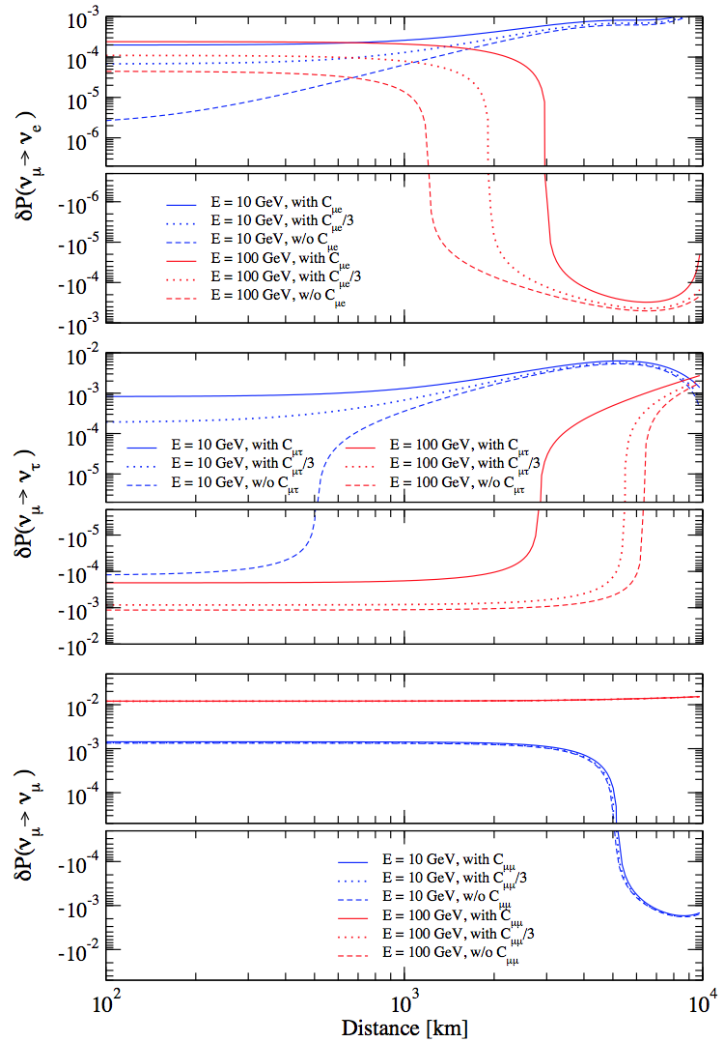
W2 corrections
small in most of the regions of L-E, but sizeable in limited places
Peculiar zenith angle dep
High energy, long baseline → IceCube, PINGU, Hyper-K

Slide 22
Conclusion
I introduced UV scenarios, at high-scale and low-scale
Low-scale UV = relatively new, nu experiments play a role, yet no systematic way of “integrating out” new physics sector
(3+N) unitary model examined
new terms appeared: P-leaking constant + W² correction terms
Probably they are “model-indep” features of low-scale UV

