Slide 1
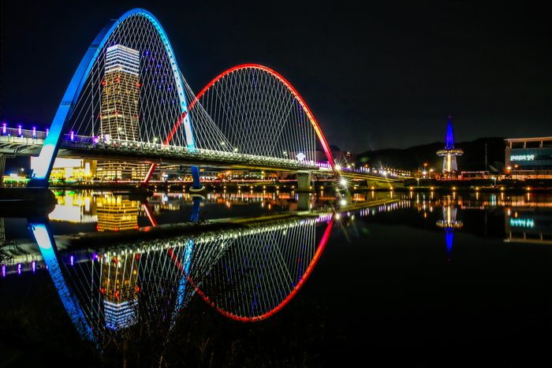
Axion Haloscope Searches
Light Dark World 2024
August 12, 2024 KAIST
SungWoo YOUN
Center for Axion and Precision Physics Research (CAPP)
Institute for Basic Science (IBS)

Slide 2

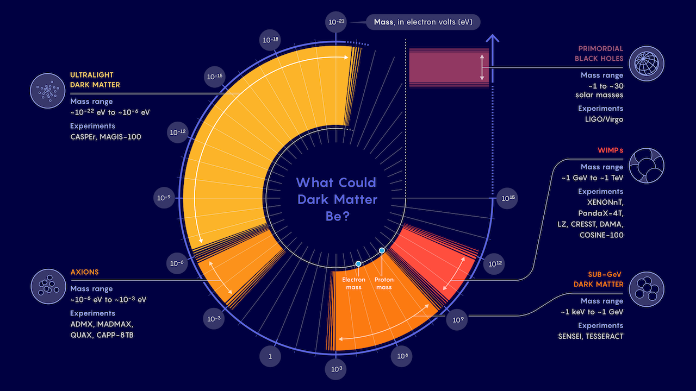
Dark matter business expanding
WIMPs may be down, but not out
Samuel Velasco/Quanta Magazine

Slide 3

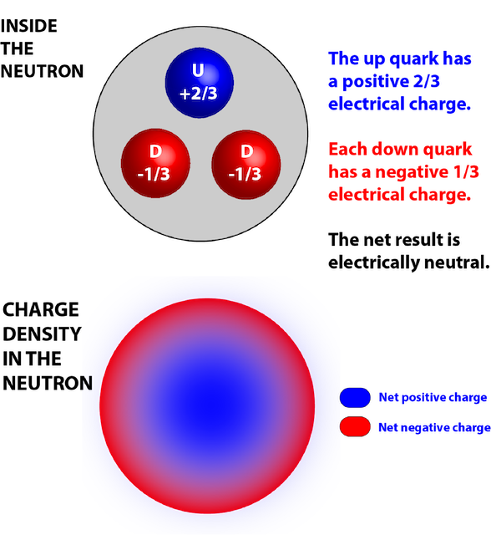
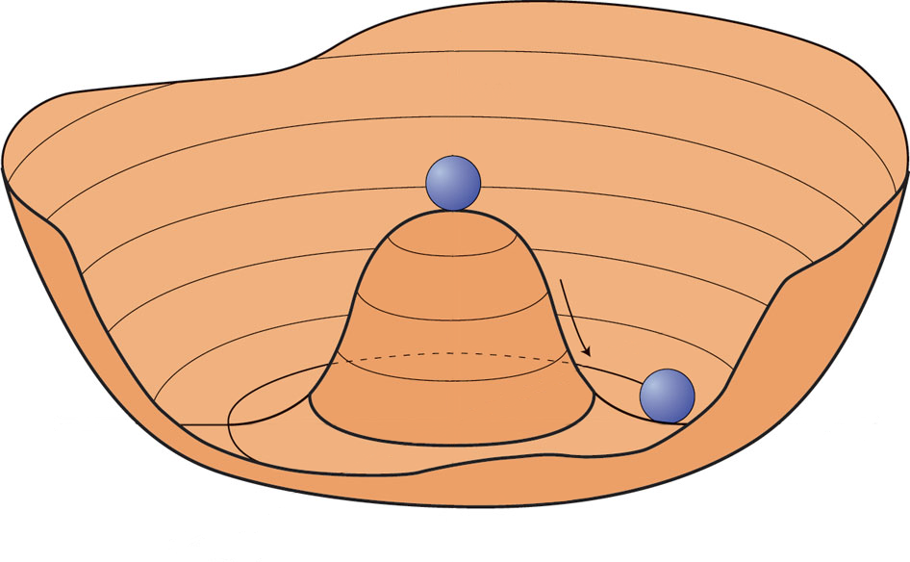
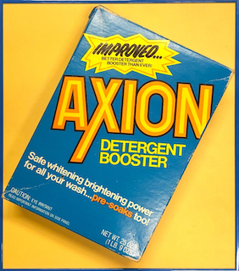
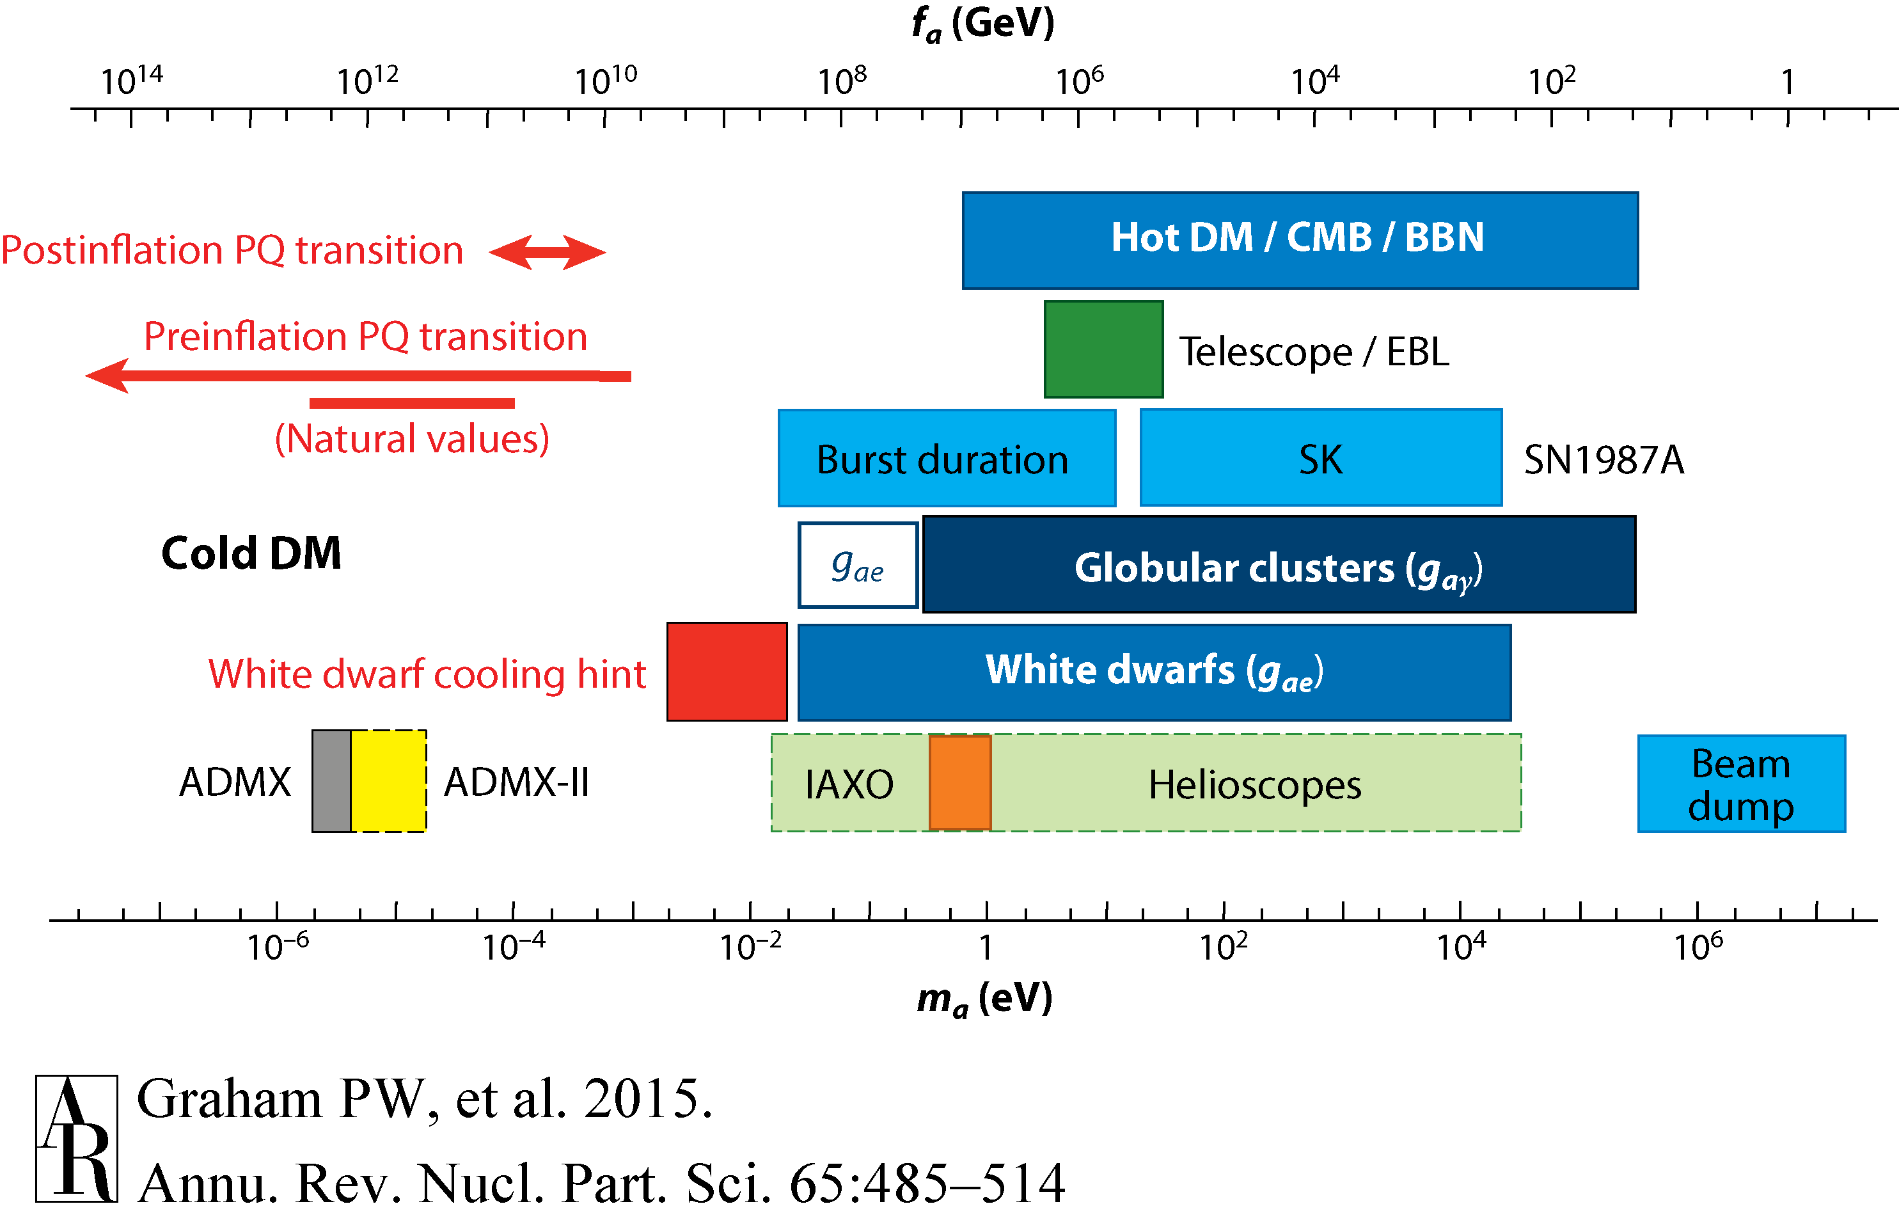
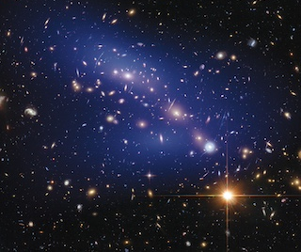
Axion
Axion dark matter
Strong CP problem
  PQ mechanism (1977)
    U(1) global symmetry and scalar field
    SSB => axion field (1978)
  QCD axion: $m_{a}^{2}f_{a}^{2}∼m_{π}^{2}f_{π}^{2}$ (cf. ALP)
  Invisible axion (1979): $m_{a}≈{10}^{−6}eV\frac{{10}^{12} GeV}{f_{a}}$
Cosmological implication
  Accounting for dark matter (1983)
Absence of nEDM
vs.
$$L_{QCD}∋θ\frac{α_{s}}{32π}G\tilde{G}$$
$$⟹ \left[θ−\frac{a(x)}{f_{a}}\right]\frac{α_{s}}{32π}G\tilde{G}$$
Spontaneous Symmetry Breaking
Goldstone boson
$a(x)=θ×fa$ at minimum
Annu. Rev. Nucl. Part. Sci. 65 485 (2016)

Slide 4
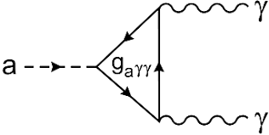
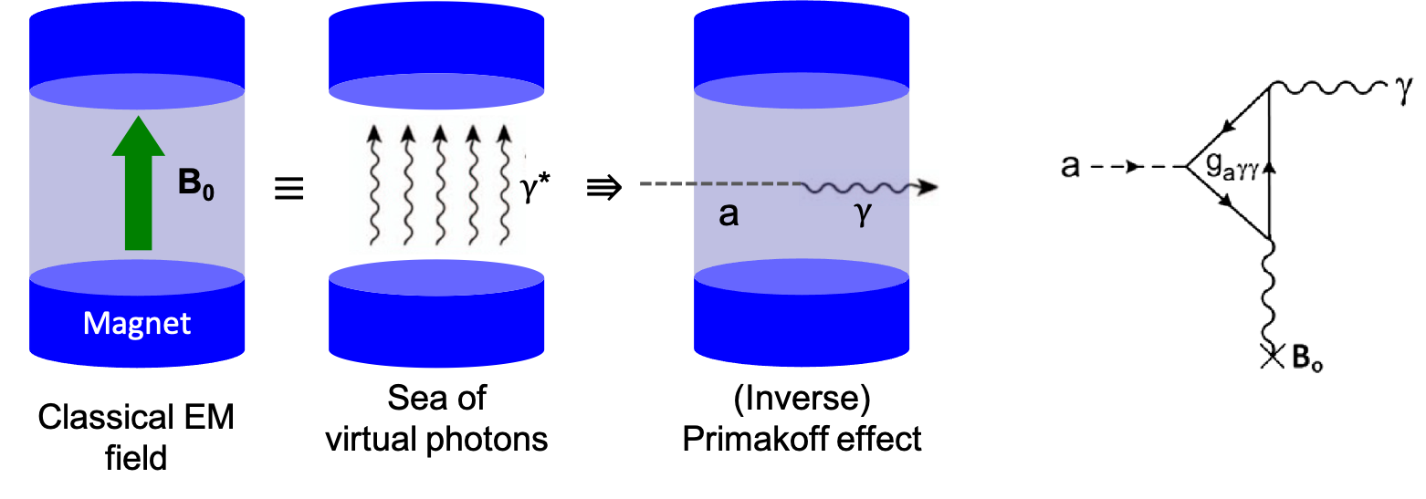
Axion models and detection
Axion coupling to SM
Axion models
Detection principle
  Sikivie effect (1983)
    Macroscopic Primakoff
 | Photons | Fermions | nEDMs
Hamiltonian | $$g_{aγγ}aE⋅B$$ | $$g_{aff}∇a⋅\hat{S}$$ | $$g_{EDM}a\hat{S}⋅E$$
Observable | Photon | Spin precession | Oscillating EDM
Detection | Power spectrum, photon counter, … | Magnetometer, NMR, … | NMR, polarimeter, …
PQWW | DFSZ | KSVZ
SM ferminons |  | BSM fermions
2 Higgs | 2Higgs+singlet | Higgs+singlet
Standard ($f_{a} \sim v_{EW}$) | Invisible ($f_{a}≫v_{EW}$)
Ruled out | Benchmark
SM fermions
BSM fermions
PQWW
(2Higgs)
DFSZ
(2Higgs+singlet)
KSVZ
(Higgs+singlet)
Standard ($f_{a} \sim v_{EW}$)
Invisible ($f_{a}≫v_{EW}$)

Slide 5
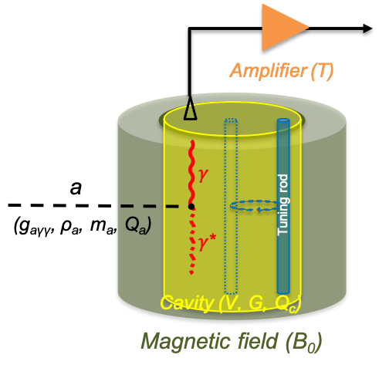
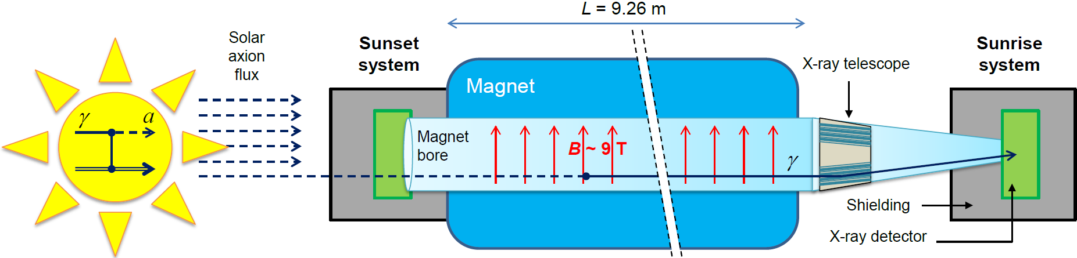
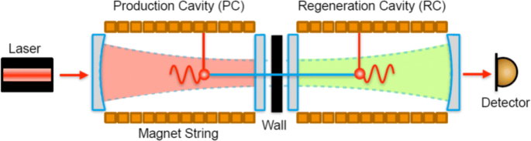
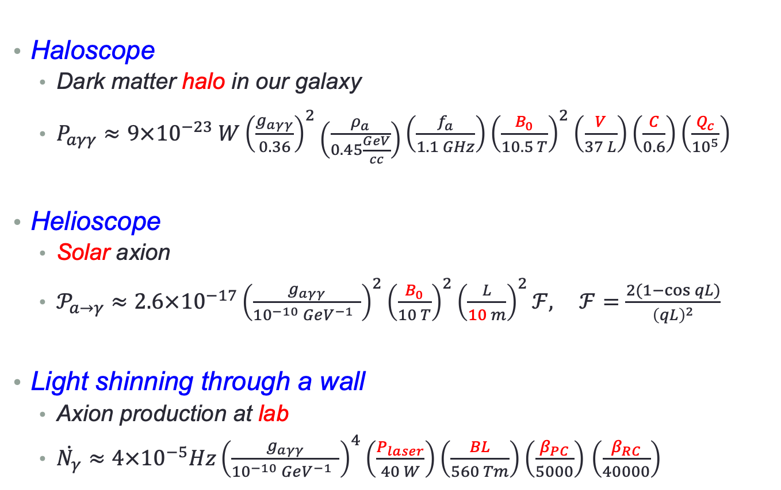
Search strategies
Haloscope
  Dark matter halo in our galaxy
  $P_{aγγ}≈9×{10}^{−23} W{\left(\frac{g_{aγγ}}{0.36}\right)}^{2}\left(\frac{ρ_{a}}{0.45\frac{GeV}{cc}}\right)\left(\frac{f_{a}}{1.1 GHz}\right){\left(\frac{B_{0}}{10.5 T}\right)}^{2}\left(\frac{V}{37 L}\right)\left(\frac{C}{0.6}\right)\left(\frac{Q_{c}}{{10}^{5}}\right)$
Helioscope
  Solar axion
  $𝒫_{a→γ}≈2.6×{10}^{−17}{\left(\frac{g_{aγγ}}{{10}^{−10} GeV^{−1} }\right)}^{2}{\left(\frac{B_{0}}{10 T}\right)}^{2}{\left(\frac{L}{10 m}\right)}^{2}ℱ, ℱ=\frac{2(1−\cos{qL})}{{\left(qL\right)}^{2}}$
Light shinning through a wall
  Axion production at lab
  $\dot{N_{γ}}≈4×{10}^{−5}Hz{\left(\frac{g_{aγγ}}{{10}^{−10} GeV^{−1} }\right)}^{4}\left(\frac{P_{laser}}{40 W}\right)\left(\frac{BL}{560 Tm}\right)\left(\frac{β_{PC}}{5000}\right)$ $\left(\frac{β_{RC}}{40000}\right)$
~100 photons/sec
~10 photons/day
~1 photons/day

Slide 6
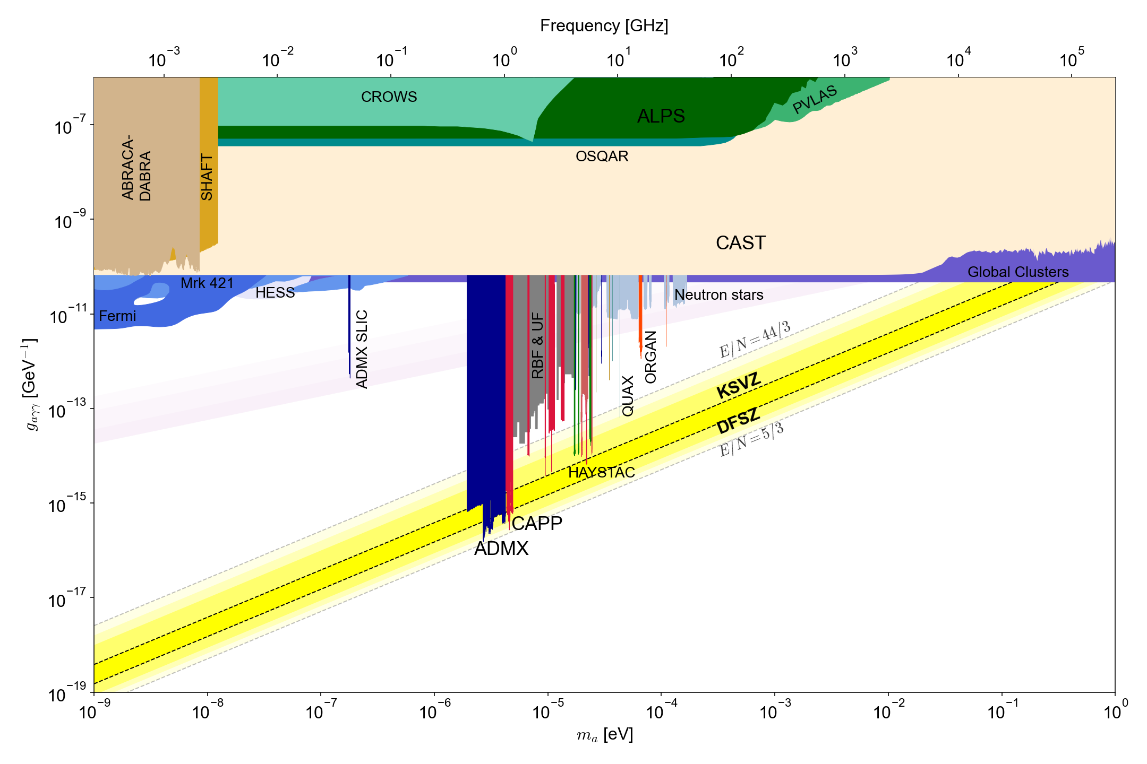
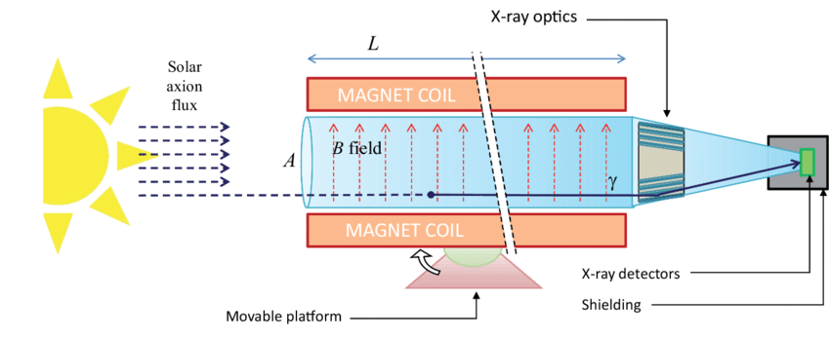
Axion searches
1 GHz = 4.2 ueV
Helioscope (solar axion)
LSW (axion at lab)
Cosmological boundary
Astrophysical constraints
Haloscope (DM axion)

Slide 7
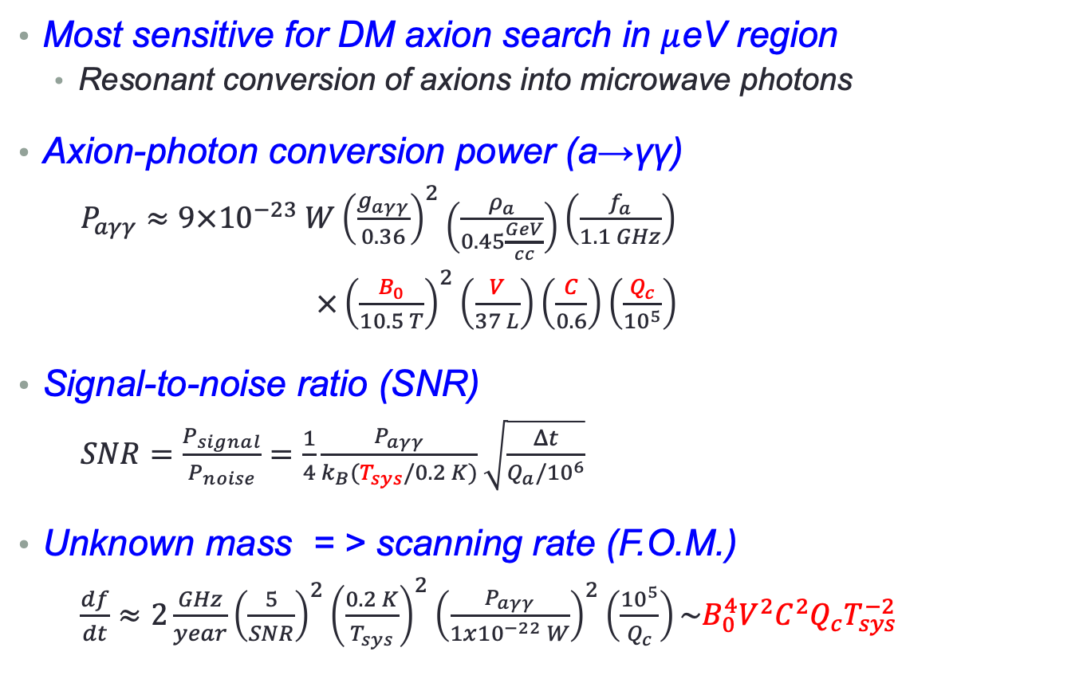
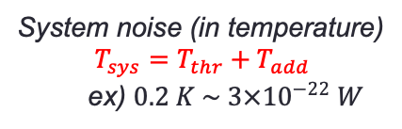
Cavity haloscope
Most sensitive for DM axion search in $μ$eV region
  Resonant conversion of axions into microwave photons
Axion-photon conversion power (a→γγ)
  $P_{aγγ}≈9×{10}^{−23} W{\left(\frac{g_{aγγ}}{0.36}\right)}^{2}\left(\frac{ρ_{a}}{0.45\frac{GeV}{cc}}\right)\left(\frac{f_{a}}{1.1 GHz}\right)$
  $×{\left(\frac{B_{0}}{10.5 T}\right)}^{2}\left(\frac{V}{37 L}\right)\left(\frac{C}{0.6}\right)\left(\frac{Q_{c}}{{10}^{5}}\right)$
Signal-to-noise ratio (SNR)
  $SNR=\frac{P_{signal}}{P_{noise}}=\frac{1}{4}\frac{P_{aγγ}}{k_{B}(T_{sys}/0.2 K)}\sqrt{\frac{Δt}{Q_{a}/{10}^{6}}}$
Unknown mass = > scanning rate (F.O.M.)
  $\frac{df}{dt}≈2\frac{GHz}{year}{\left(\frac{5}{SNR}\right)}^{2}{\left(\frac{0.2 K}{T_{sys}}\right)}^{2}{\left(\frac{P_{aγγ}}{1x{10}^{−22} W}\right)}^{2}\left(\frac{{10}^{5}}{Q_{c}}\right)\sim B_{0}^{4}V^{2}C^{2}Q_{c}T_{sys}^{−2}$
(~120 photons/sec)
System noise (in temperature)
$$T_{sys}=T_{thr}+T_{add}$$
ex) $0.2 K \sim 3×{10}^{−22} W$

Slide 8
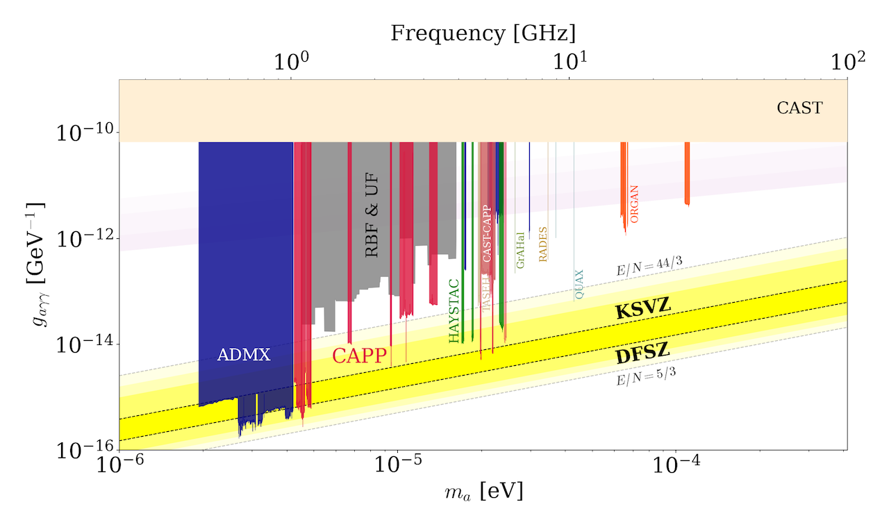
Haloscope searches

Slide 9
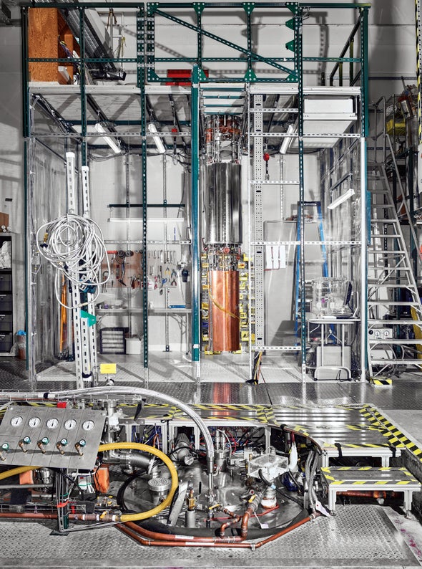
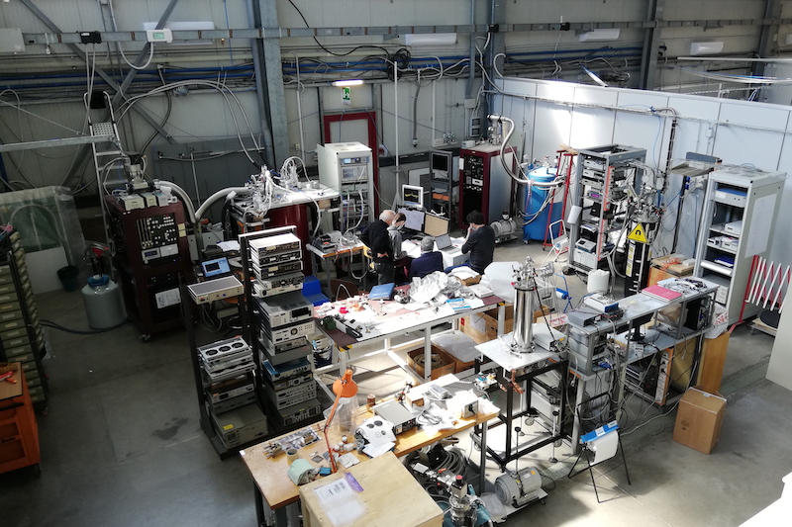
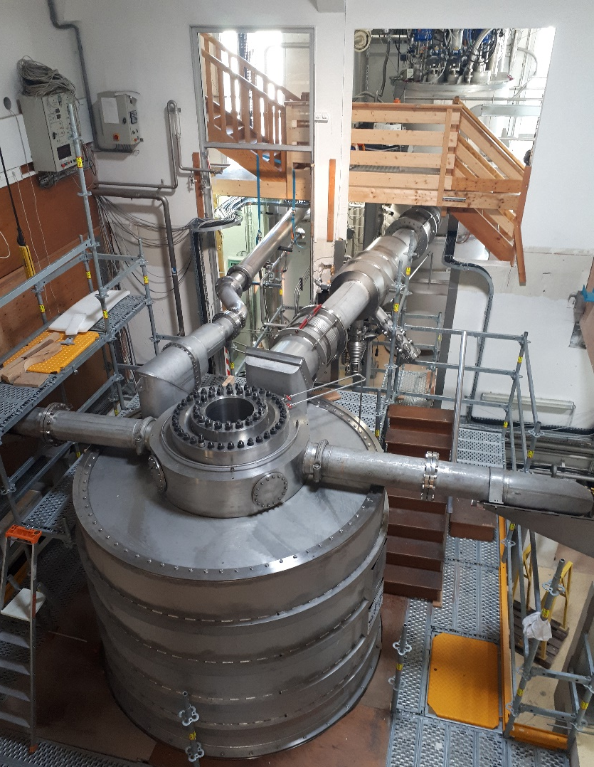
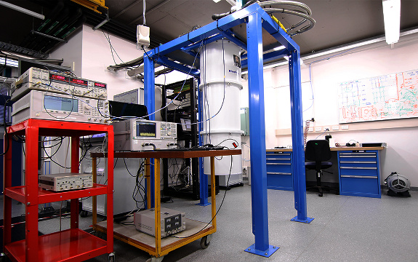
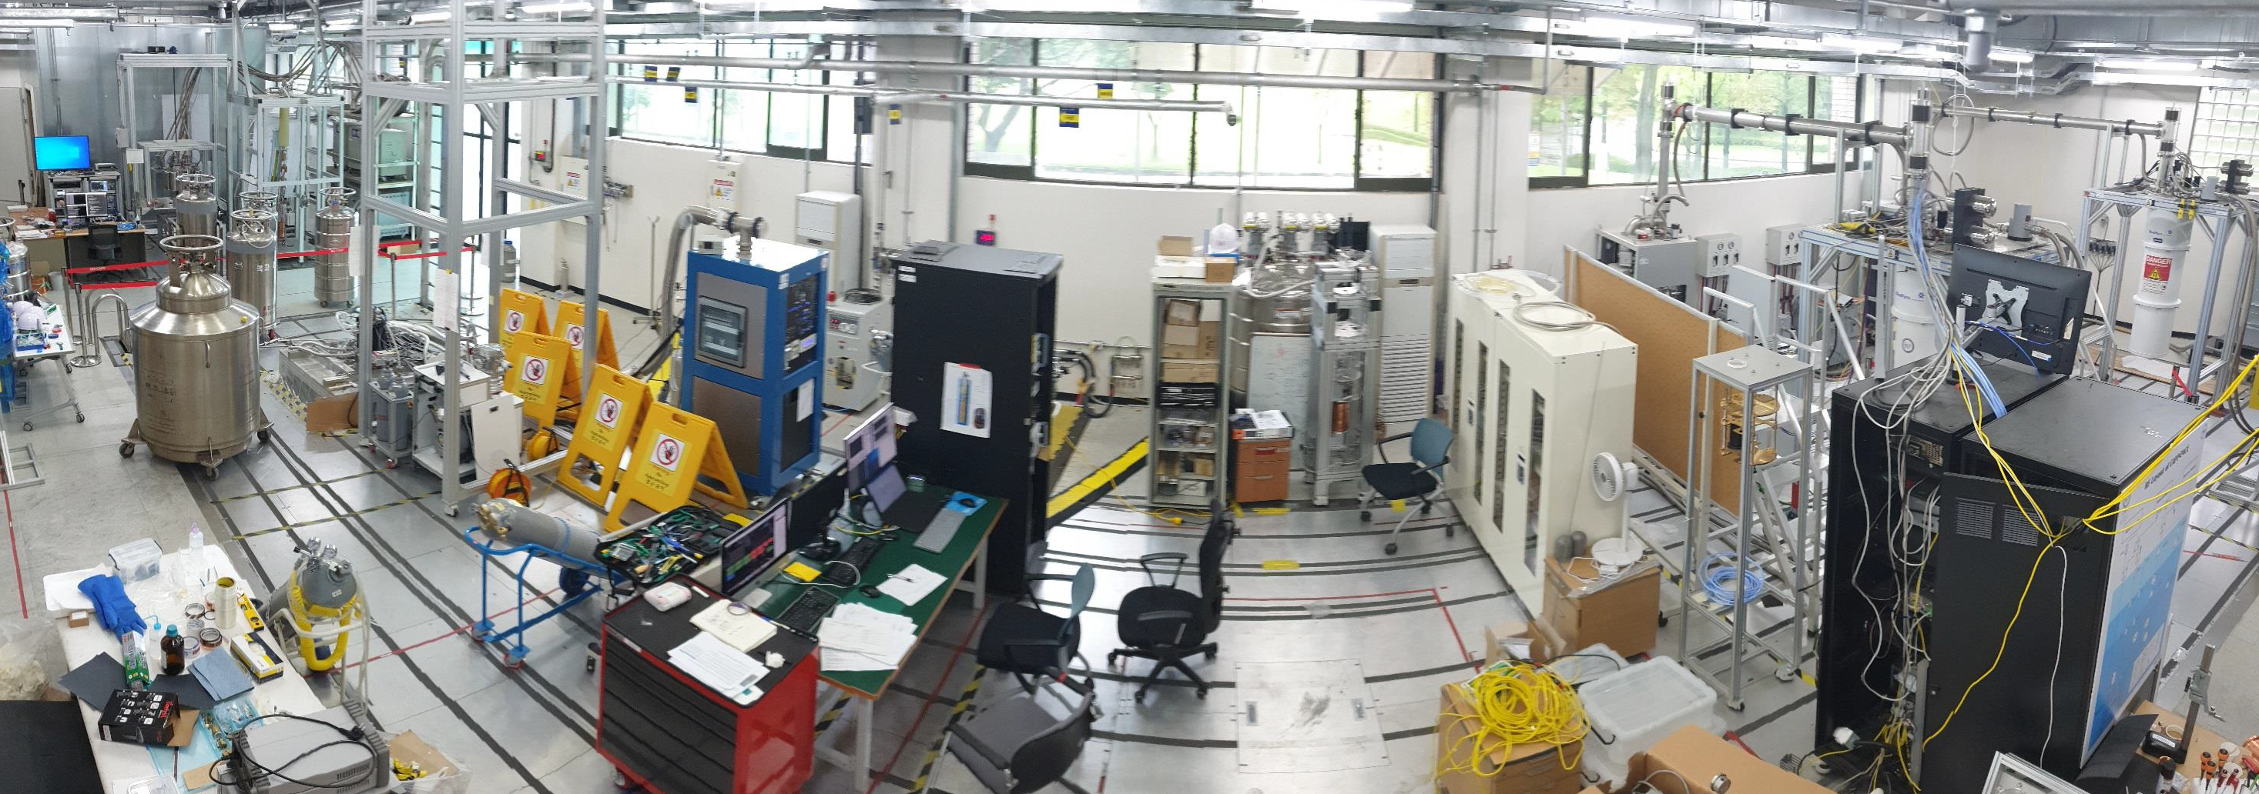
Cavity haloscopes
ADMX
QUAX
GraHal
ORGAN
CAPP

Slide 10
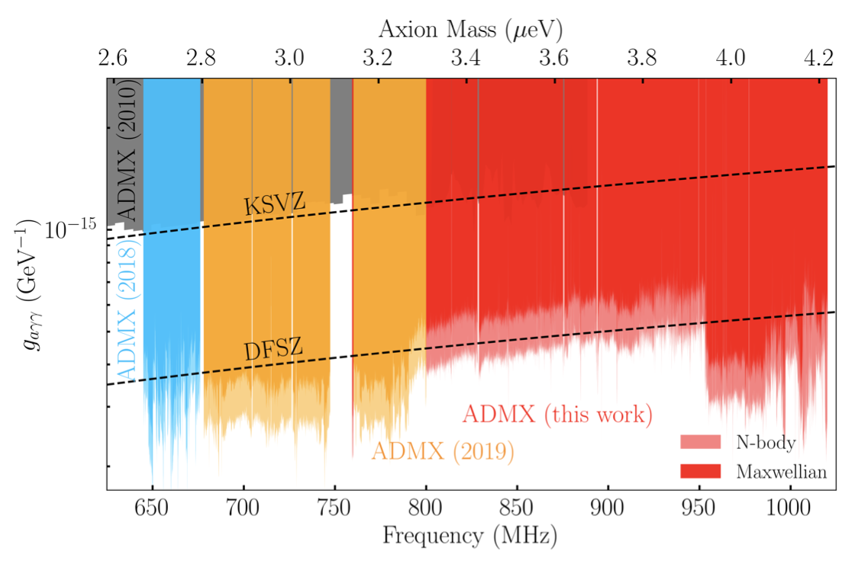
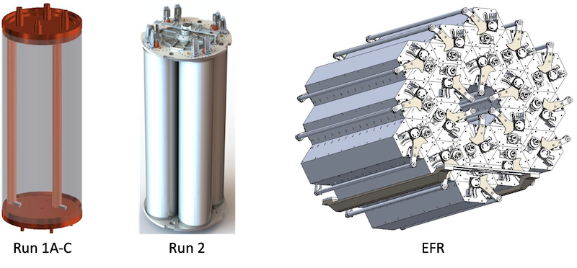
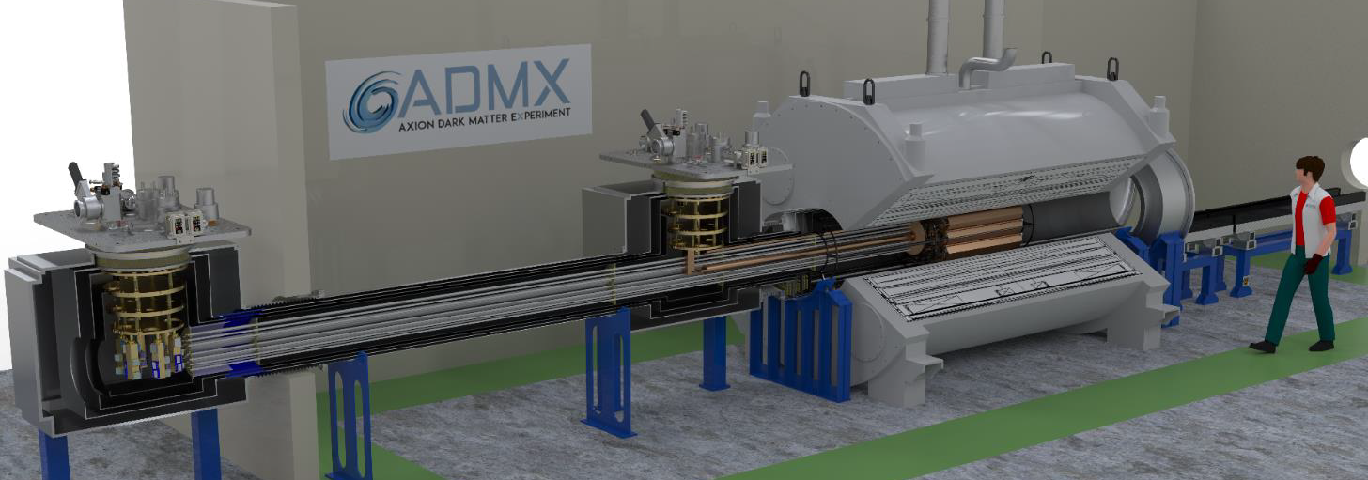
ADMX
ADMX
PRL 127 261803 (2021)
EFR: 2027 ~
MRI (9.8T, 80cm)

Slide 11
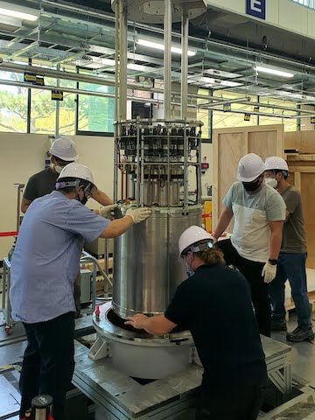
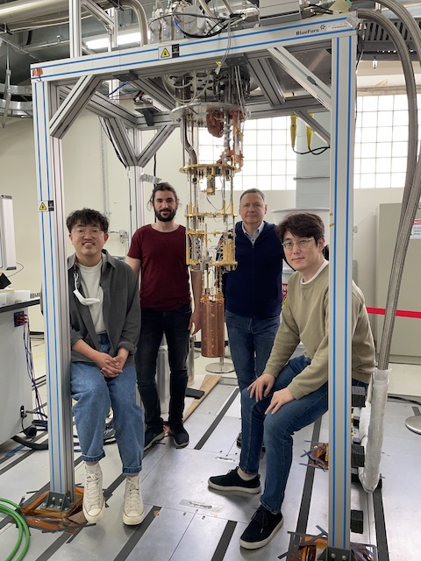
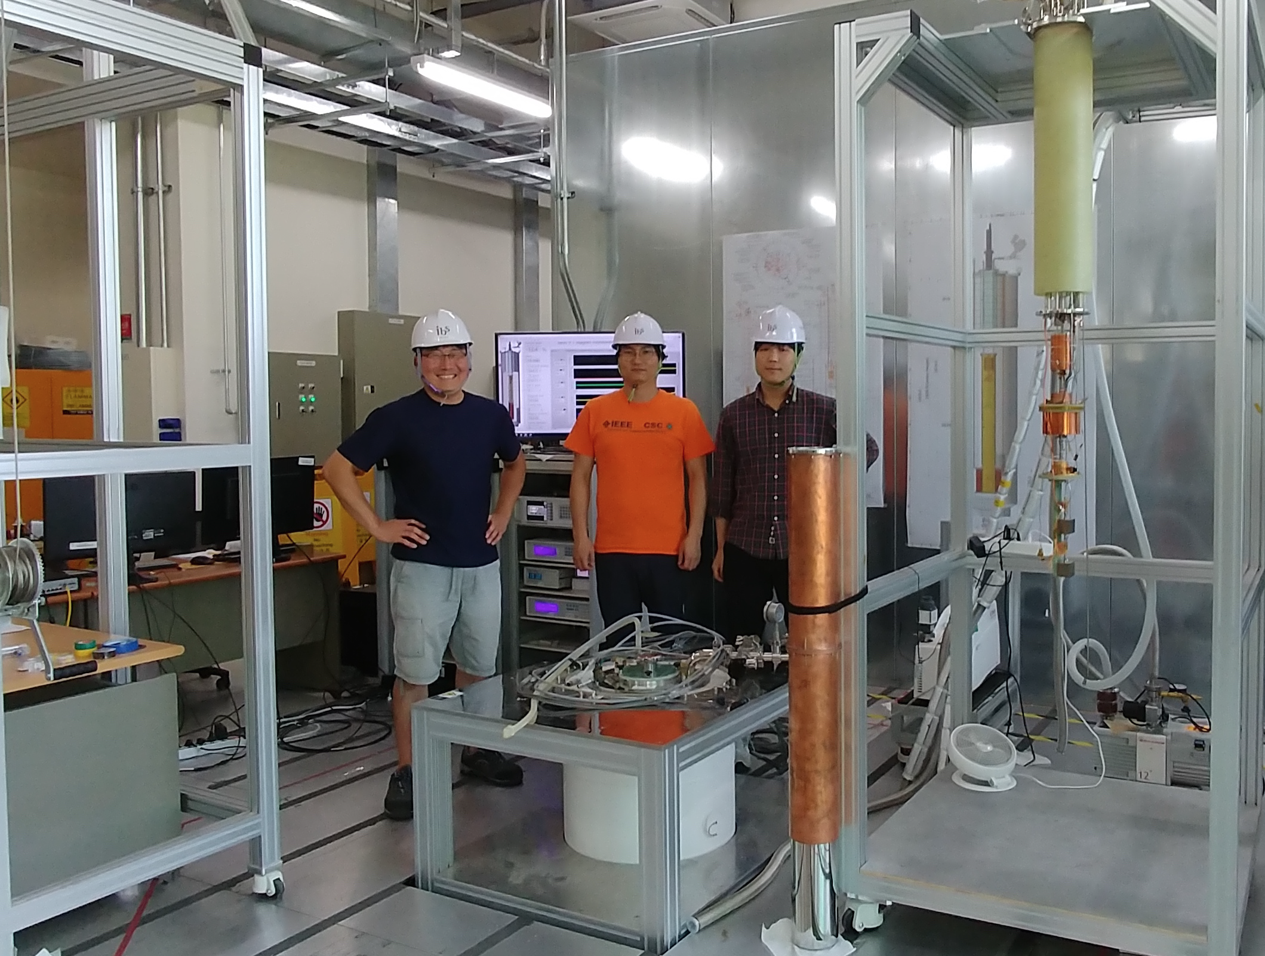
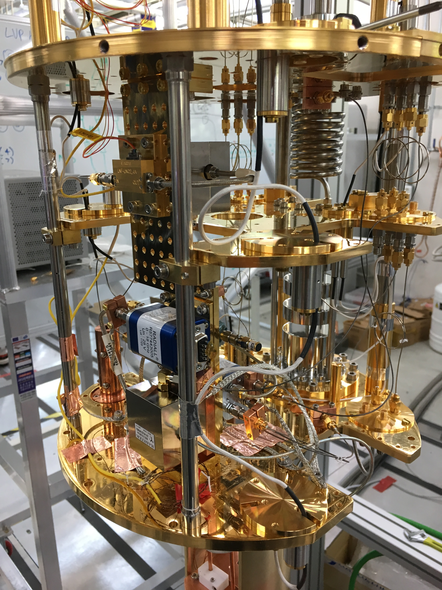
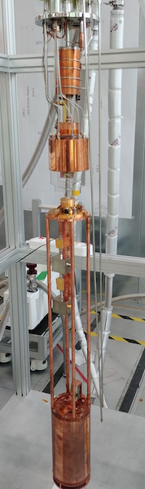
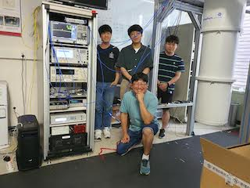
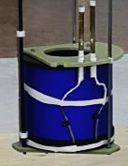
IBS-CAPP
CAPP-9T
CAPP-12TB
CAPP-12T
CAPP-8T
CAPP-8TB

Slide 12
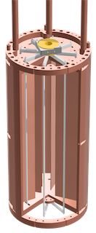
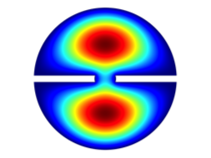
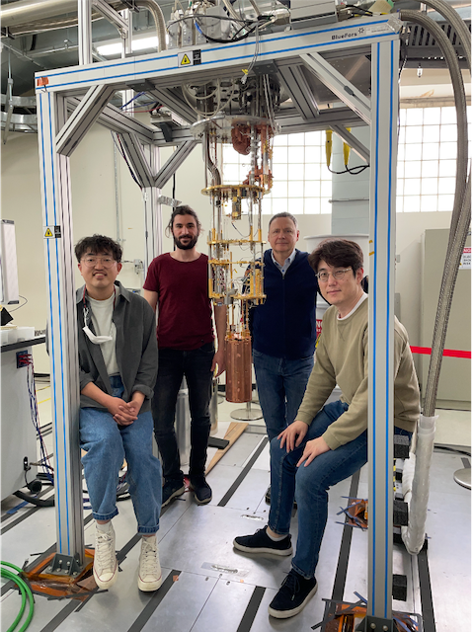
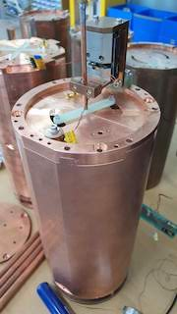
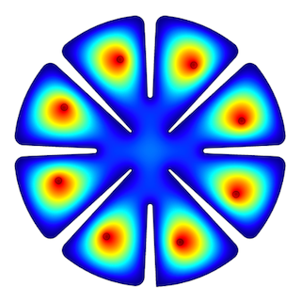
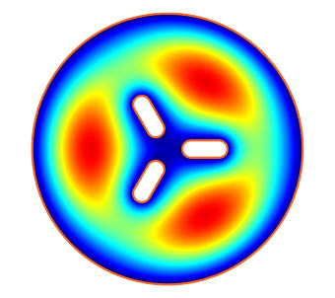
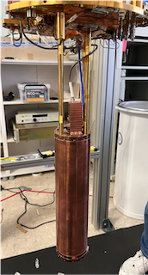
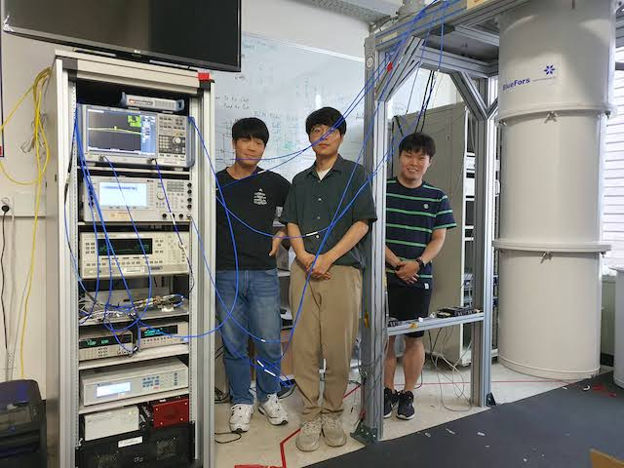
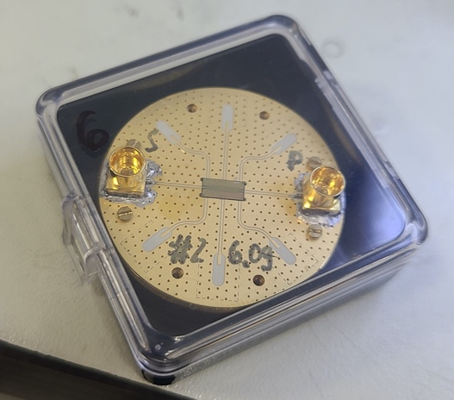
CAPP (I)
CAPP-9T
(9T/127mm)
2-cell pizza (3.2 GHz)
PRL 125 221302 (2020)
CAPP-8TB
(8T/165mm)
8-cell + JPA
(5.9 GHz, 400 mK)
Near KSVZ sensitivity
Paper in preparation
CAPP-12T
(12T/96m)
3-cell + JPA
(5.3 GHz, 400 mK)
KSVZ sensitivity
NM algorithm
arXiv:2312.11003 (PRL)

Slide 13
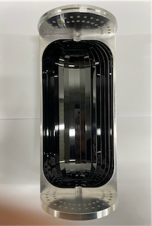
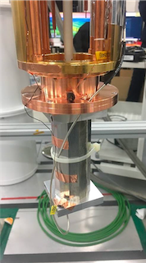
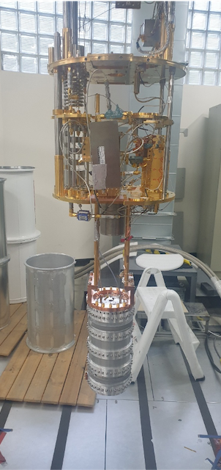
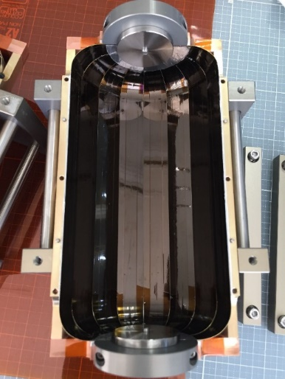
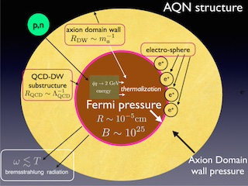
CAPP (II)
CAPP-8T
(8T/125mm)
HTS SC cavity + JPA
(2.3 GHz, Q ~ 3.5 M)
AQN search
Paper in preparation
CAPP-8T
(8T/125mm)
HTS SC cavity + JPA
(2.3 GHz, Q ~ 0.5 M)
KSVZ sensitivity
Paper in preparation

Slide 14
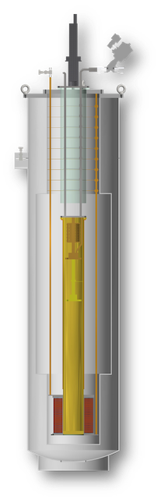
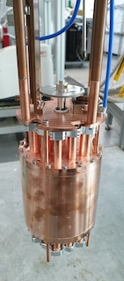
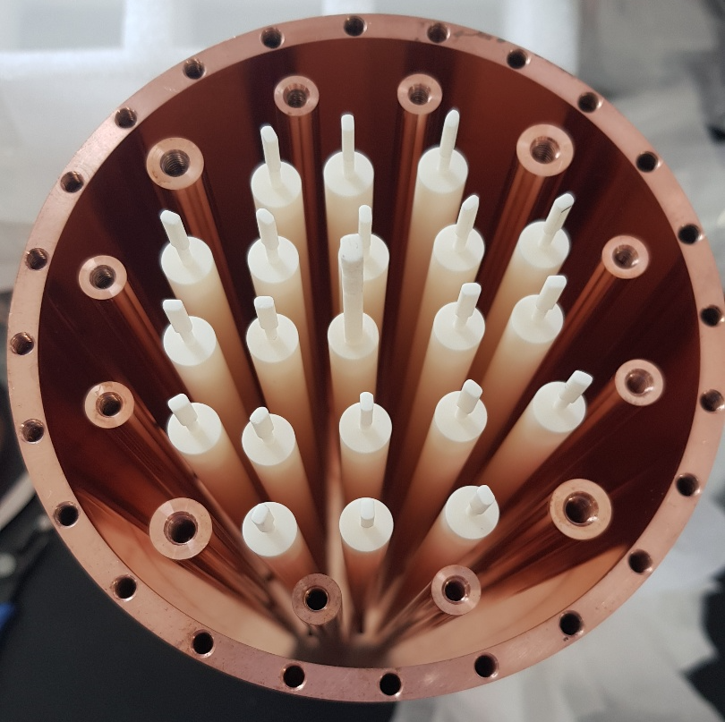





CAPP (III)
CAPP-9T
(9T/127mm)
Photonic crystal (>10 GHz)
Ready for physics run
CAPP-12T
(12T/96m)
TM₀₂₀ + Kirigami + JPA
(5.1 GHz)
KSVZ run is about to begin
CAPP-9T
(9T/127mm)
TM₀₂₀ + Kirigami (5.2 GHz)
Demonstration
arXiv:2403.13390

Slide 15



CAPP (IV)
CAPP-12TB
(12T/320mm)
f > 1 GHz, V = 37 L, T_{sys} < 250 mK
df/dt ~ 2 MHz/day @ DFSZ
PRL 130 071002 (2023)
Extended scan ($∆f$~120 MHz)
arXiv:2402.12892 (PRX)
Preparation for 300 MHz run w/ SC cavity

Slide 16






QUAX
QUAX (LNL)
QUAX (LNF)
Dielectric cavity
PRApplied 17 054013 (2022)
FINUDA
B = 1.1 T
R = 1.4 m
PRD 99 101101 (2019)
TWPA
PRD 108 062005 (2023)
SC (NbTi) cavity
FLASH

Slide 17



ORGAN
ORGAN
Sci. Adv. 8 abq3765 (2022)
ALP genesis + SMASH

Slide 18




GrAHal
GraHal
2 m
Field [T] | $Φ$ [mm] | B²V [T²m³] | f [GHz]
9 | 800 | 40 | 0.34
17.5 | 375 | 6.6 | 0.79
27 | 170 | 3.5 | 2.67
40 | 50 | 0.6 | 6.76
43 | 34 | 0.5 | 11.5

Slide 19

Cavity haloscopes
ADMX
QUAX
GraHal
ORGAN
CAPP
${1≲f}_{a}≲10 GHz$

Slide 20

Searches vs. predictions

Slide 21






MADMAX
Dielectric power booster
Proof-of-concept
3 disks
Suitable for high-freq. search
Full scale experiment
20 disks
30cm diameter
Prototype (2024)
Morpurgo (1.6T)

Slide 22






ALPHA
Plasma haloscope
  Wire array => plasma metamaterial
    Axion-plasmon interaction
$ωp2=\frac{2π}{a2\log{(\frac{a}{2r})}}$
$ωp$ independent of the detector size
Large conversion volume at high frequencies
PRD 107 055013 (2023)
Physics data
in 2026
Prototype cavity of 10x10 array

Slide 23









CAPP-HF
Multiple-cell (pizza)
Higher-mode (wheel)
Photonic crystal
PLB 777 412 (2018)
Mode | f_{rel} | Q_{rel} | V_{rel} | C_{abs}
TM₀₁₀ | 1 | 1 | 1 | 0.69
TM₀₃₀ | 3.6 | 1.9 | 1 | 0.05
PRD 107 015012 (2022)
JPG 47 035203 (2020)
vs.
Larger volume
Simpler receiver chain
~4 x f_{TM010}
f $∝$ spacing
~10 x f_{TM010}
Boosting effect

Slide 24
Other haloscopes
CAST-CAPP
  Phase-matched cavities, ~20 ueV Nat. Comm. 13 6180 (2022)
RADES
  HTS cavity, 11.7 T, ~36.5 ueV arXiv:2403.07790
Taiwan Axion Search Experiment with Haloscope
  4.7 GHz, 11 x g_{arr}^{KSVZ} PRL 129 111802 (2022)
Broadband Reflector Experiment for Axion Detection
  Parabolic reflector, THz region PRL 132 131004 (2024)
SUPerconducting AXion search
  SC cavity, 14T, 8.4 GHz PoS EPS-HEP2023 (2024) 140
Canfranc Axion Detection Experiment
  90 GHz (W-band), Kinetic Induction Detectors JCAP 11 044 (2022)

Slide 25

Summary
Axion could address two fundamental questions
  Strong CP problem & dark matter mystery
Enormous experimental effort to explore the parameter space
  Different technologies targeting at different mass ranges
Haloscope is among the most sensitive search methods
  Resonant effects to enhance detection sensitivity
  New results, new groups and new ideas
Progress is gradual yet unwavering
  Endurance within the scientific community is essential.
  Next few decades are promising to unveil the nature of dark matter

Slide 27




Microwave signal detection
Power detection
(w/ amplifiers)
vs. photon counting
(w/ single photon detector)
HEMT
Transistor-based
(T_{N} ~ K)
f = 10 GHz
Single photon detector
(SPD)
↓
Game changer
at high frequencies
and low temperatures
JPA
Quantum limited
(T_{SQL} ~ 50 mK x f [GHz])
Single photon counting
Not subject to SQL
(T_{N} << T_{SQL})
Quantum squeezing (T_{N} < T_{SQL} )
Notes:
Now slightly changing the topic.
Axion signal detection has typically relied on power detection using amplifiers.
Nowadays, most experiments utilize quantum noise limited amplifiers.
There was also an attempt to overcome the quantum limit using the so-called quantum squeezing technology.
In the mean time, people started jumping into single photon detector development.
It is mainly because counting photons is not subject to the quantum limit, such that you can in principle reduce noise level considerably.
In particular, such advantage manifests itself at high frequencies and low temperatures.
So the single photon detector will be the game changer in the future.

Slide 28



SPD schemes
Excitation
Interference
Bolometer
 | Excitation | Intereference | Bolometer
Basis | Qubit | JJ-Qubit | JJ-TES
Quantity | Electron | Phase | Heat
Pros | High sensitivity | Non-demolition | Wide bandwith Robust
Cons | Bandwidth vs. Dark cout rate Low tunability | Narrow bandwidth Low tunability | High noise level Dead (relaxation) time
Notes:
There are several single photon detection schemes depending on excitation and interference of a qubit system or bolometry such as transition edge sensors.
There are pros and cons for each scheme.
Typically, qubit systems are applicable to our business since the technology is mature in the GHz range.
However, it has a critical drawback – bandwidth is narrow and frequency tunability is extremely low.

Slide 29








Axionic chiral magnetic effect
Low temperature Axion Chiral Magnetic Effect
ABRACADABRA |  | LACME
$$−{\frac{1}{4}g}_{aγ}aF_{μν}{\tilde{F}}^{μν}$$ | Coupling | $$g_{ae}δ_{μ}aψγ^{μ}γ_{5}ψ$$
Effective current (vacuum) | Axion | Chemical potential (polarized medium)
$$g_{aγ}\sqrt{2ρ_{a}}\cos{(m_{a}t)}B$$ | j_{(eff)} | $$v_{F}\frac{e^{2}}{2π}g_{ae}\sqrt{2ρ_{a}}\cos{(m_{a}t)}B$$
$$μ_{5}=g_{ae}\sqrt{2ρ_{a}}\cos{(m_{a}t)}$$
$μ_{5}$ adds $p$ to $e^{−}$along $\hat{S}$
$B$ polarizes $e^{−}$
Helicity imbalance => current flow
$$g_{ae}$$
Chiral medium
Notes:
\mu

Slide 30





HTS cavities
High-Temp. Superconductor (HTS)
Normal state
Vortex state
PRA 17 6 (2022)
Meissner state
13.7 M
AMSC
ReBCO HTS tapes (2D)
Stabilizer (Cu) 20 um
Protection layer (Ag) 2 um
TM010
TM011
Superconducting
layer (GdBCO) 2 um
Buffer layer (MgO) 0.7 um
Substrate [Hastelloy) 50 um
Generation | 1st | 2nd | 3rd
Material | YBCO | GdBCO | EuBCO+APC
Manufacture | AMSC | Theva | Fujikura
V [L] | 0.3 | 1.5 | 1.5 | 0.2
f [GHz] | 6.9 | 2.3 | 2.2 | 5.4
Q | 0.33 M | 0.5 M | 3.5 M | 13 M
+ 3D body = SC cavity

Slide 31





QNL amplification
Flux-driven Josephson parametric amplifiers (JPAs)
SST 34 085013 (2021)
Frequency tuning
$$I_{C}=IC_{c}cos\left(\frac{πΦ}{Φ_{0}}\right)$$
Parametric amplification
$$L\left(I\right)=\frac{Φ_{0}}{2πI_{c}}\left[1+\frac{1}{2}\frac{I^{2}}{I_{c}^{2}}\right]$$
SQUID
(nonlinear inductance)
Standard quantum limit
Best performance
in axion search application
U. of Tokyo & RIKEN
Notes:
quarter-wave coplanar waveguide resonator

Slide 32

QNL amplification
Flux-driven Josephson parametric amplifiers (JPAs)
SST 34 085013 (2021)
Best performance!
S. Uchaikin
~30 chips
Frequency tuning
Parametric amplification
SQUID
(nonlinear inductance)
But, … limited bandwidth!
U. of Tokyo & RIKEN

Slide 33


QNL amplification
Flux-driven Josephson parametric amplifiers (JPAs)
Parallel-Serial configuration
S. Uchaikin
~30 chips
Pump
Wideband search
But, … limited bandwidth!
Standard quantum limit
U. of Tokyo & RIKEN

