Slide 1


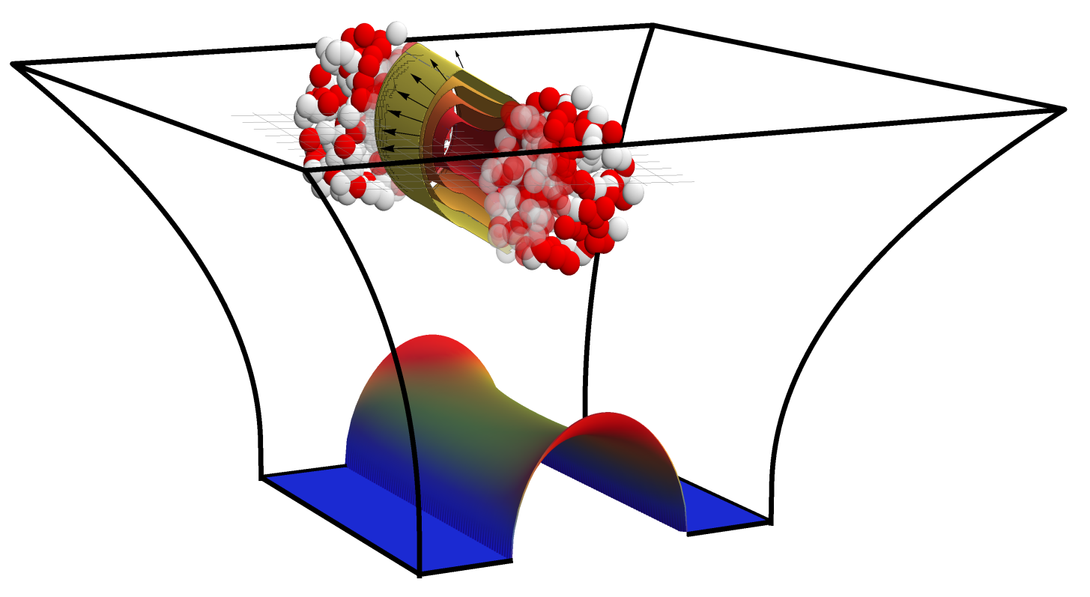
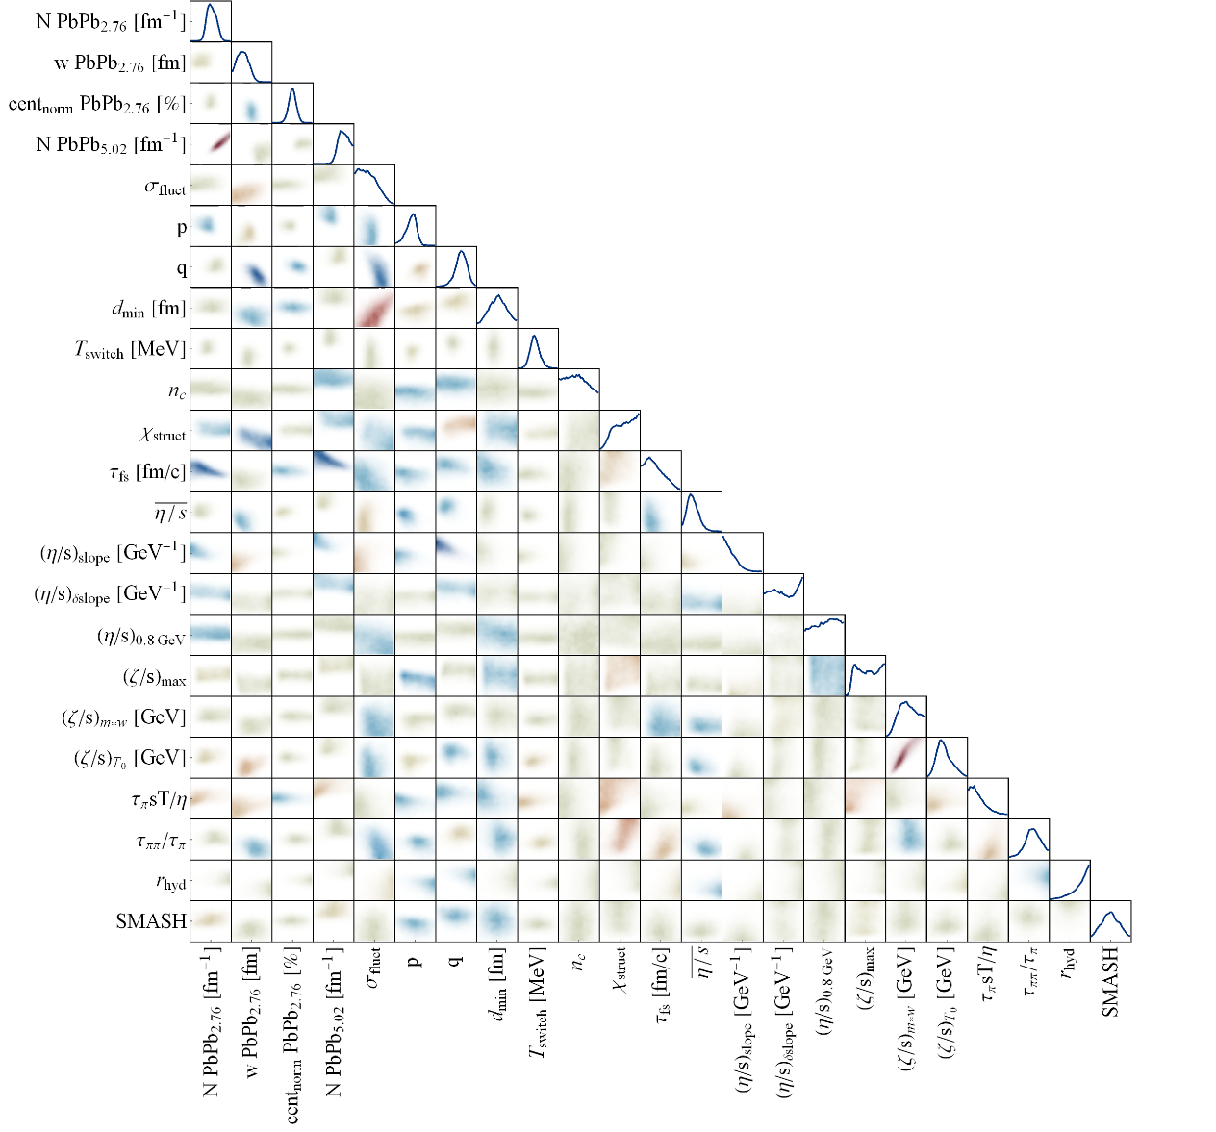
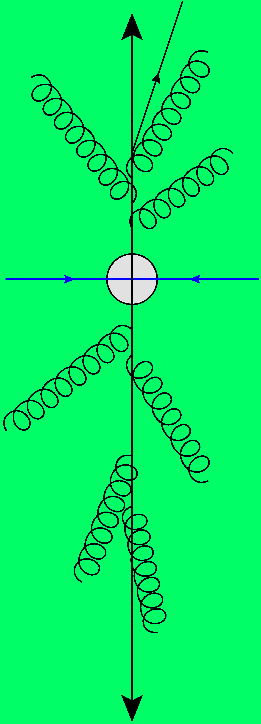
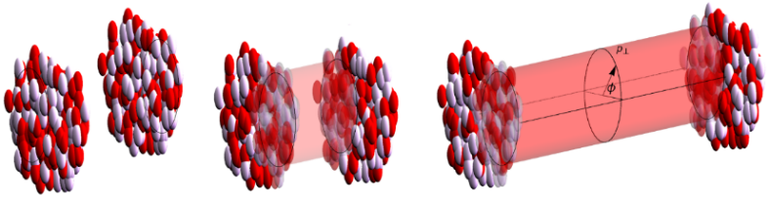
From far-from-equilibrium to attractors:
Initial conditions for nuclear collisions
Towards a precision analysis of heavy ion collisions
Work mostly with Govert Nijs, Aleksi Kurkela and Urs Wiedemann
Wilke van der Schee
Quantum Dynamics at Ghent 2025
6 February 2025

Slide 2

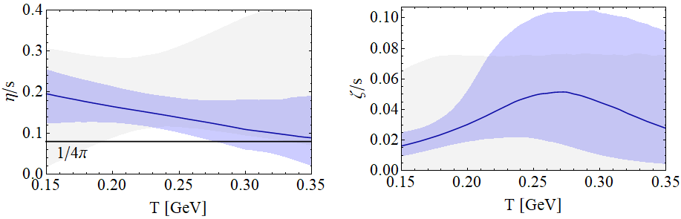
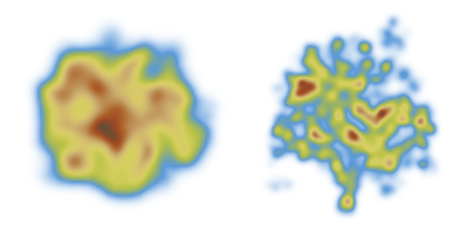
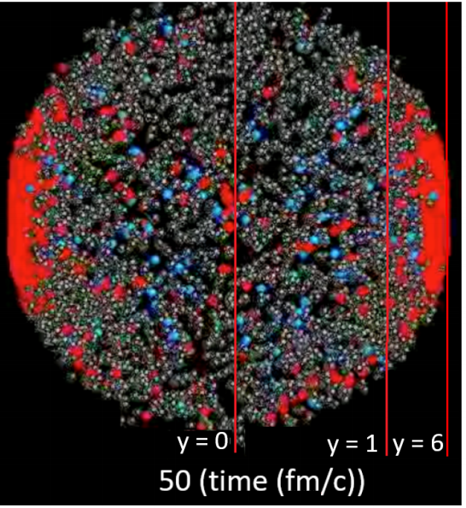
Standard model of heavy ion collisions
Wilke van der Schee, CERN/Utrecht
(# parameters)
Initial stage (13)
Viscous hydrodynamics (10)
Cascade of hadrons (2)
SMASH
Subnucleonic structure? (8)
Non-thermal flow? (2)
with hydrodynamised initial stage
Fluctuations? (1)
Shape (2)
Shear viscosity (4)
Bulk viscosity (3)
Second order transports: 2
EOS: 1
Jonah Bernhard, Scott Moreland and Steffen Bass, Bayesian estimation of the specific shear and bulk viscosity of quark–gluon plasma (2019)
Govert Nijs, WS, Umut Gursoy and Raimond Snellings, A Bayesian analysis of Heavy Ion Collisions with Trajectum (2020)

Slide 3
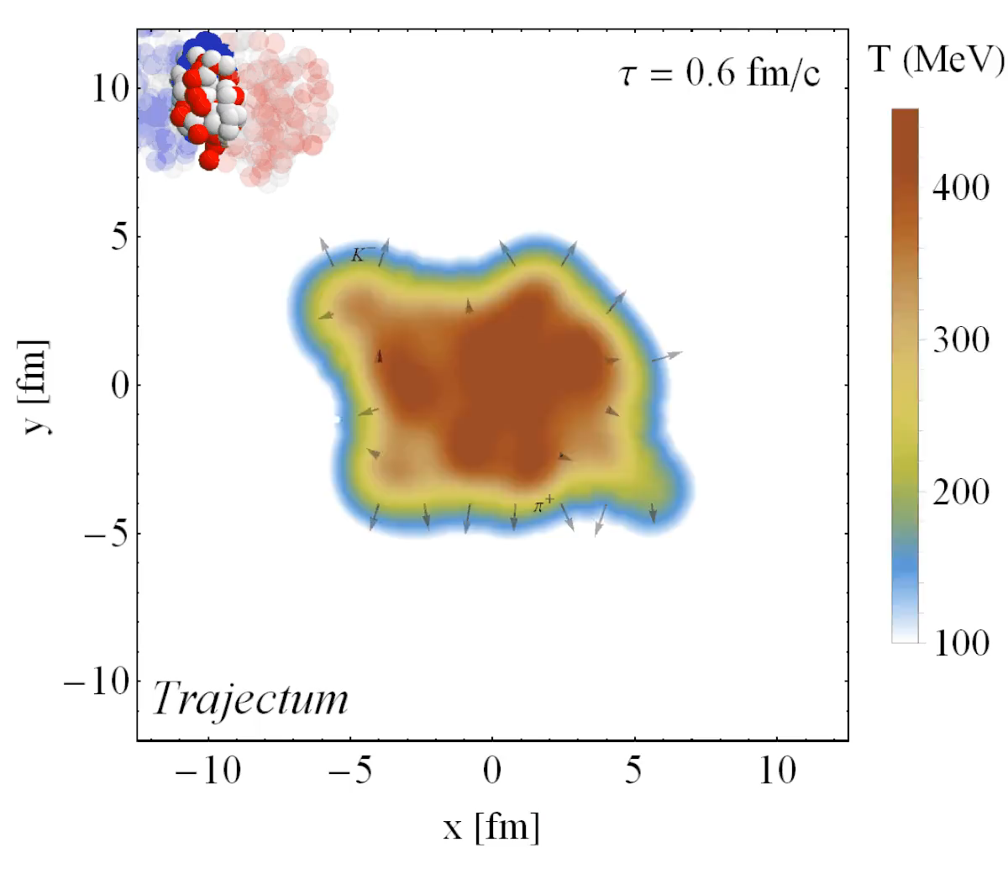
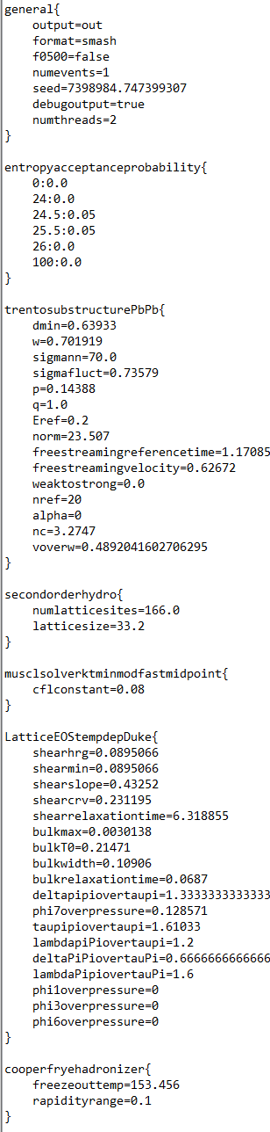
Trajectum
Quite straightforward to use
(see param file, right)
Includes analyse routine
  Parallelised: can analyse unlimited number of events
http://sites.google.com/view/govertnijs/trajectum
http://wilkevanderschee.nl/trajectum

Slide 4
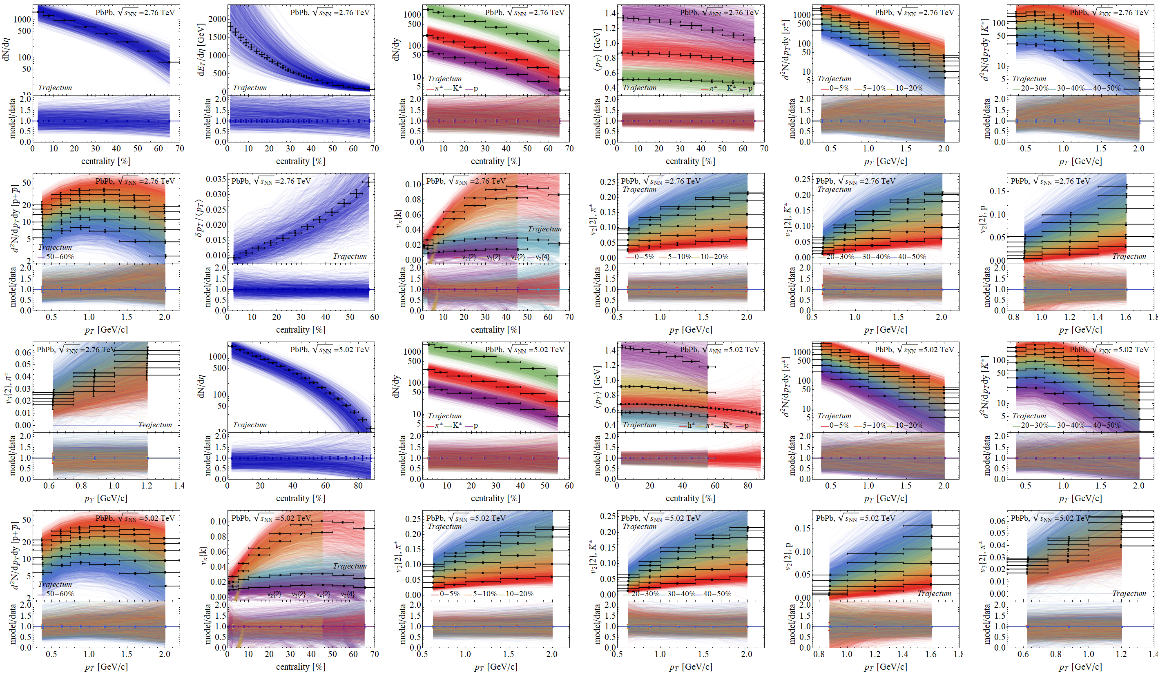
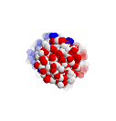
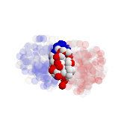
Experimental observables: a wealth of data
Prior

Slide 5
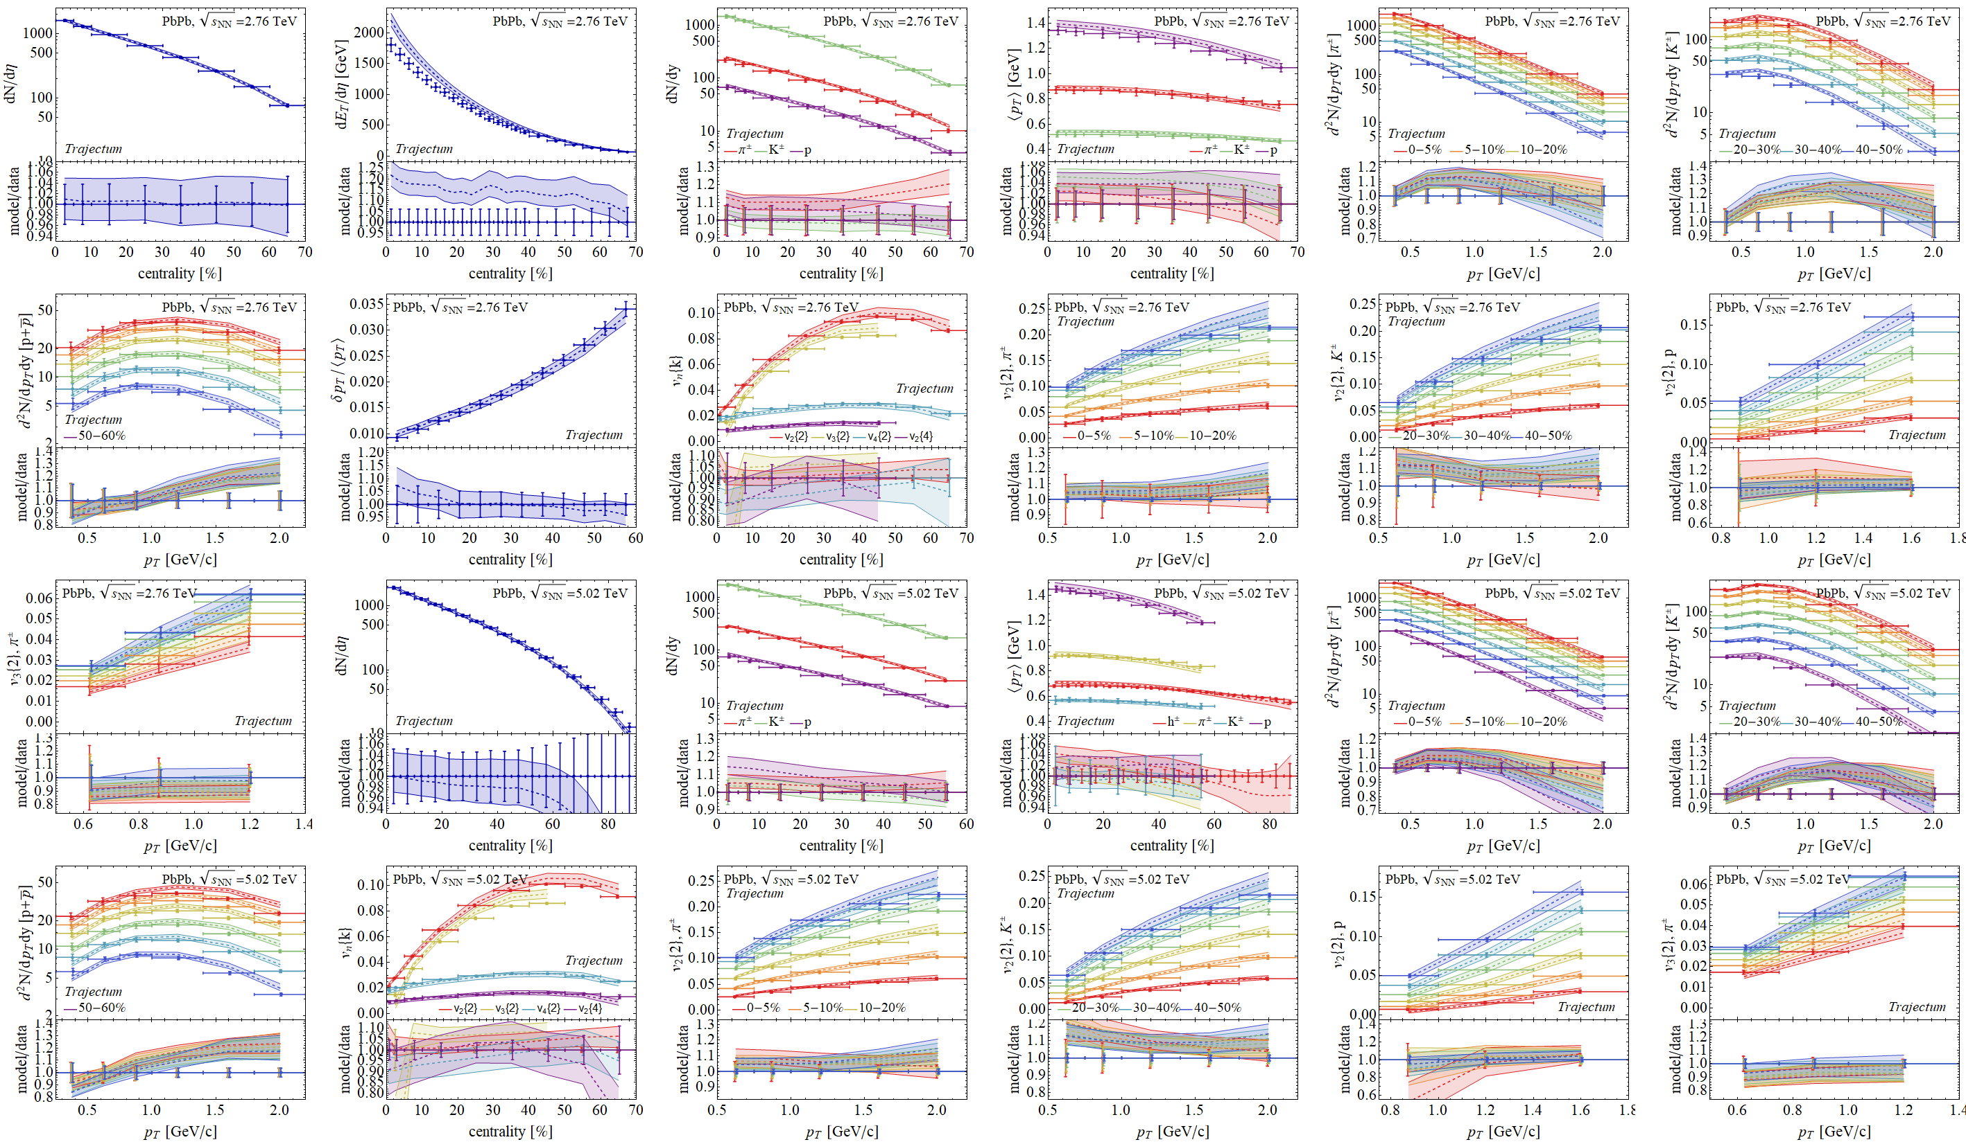
Experimental observables: a wealth of data
Posterior

Slide 6
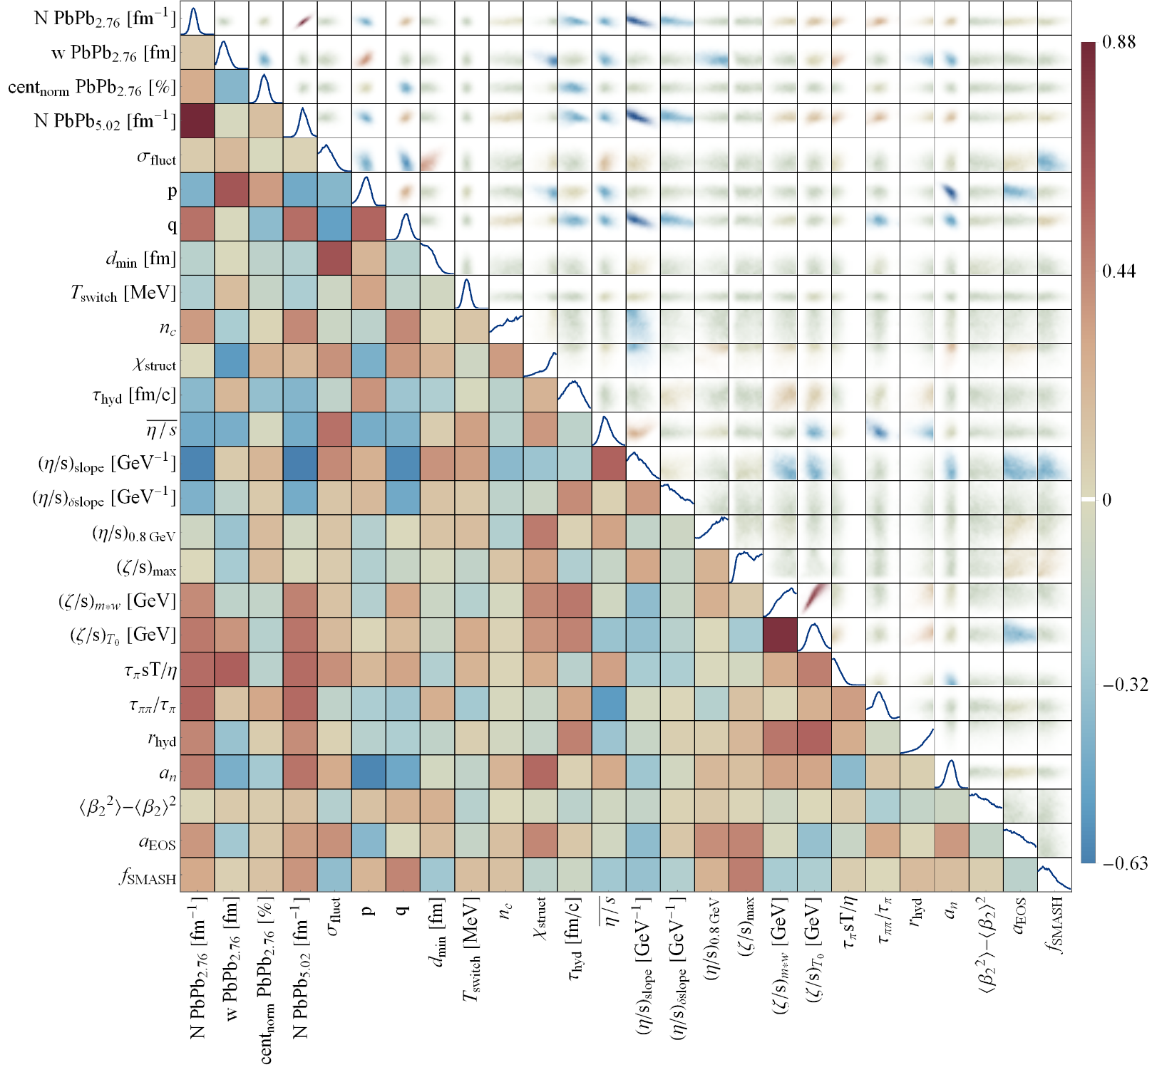
Full posterior distributions
Wilke van der Schee, CERN/Utrecht
Some parameters better constrained than others
  Correlations add important information, e.g. p and q are correlated (comes back later)

Slide 7

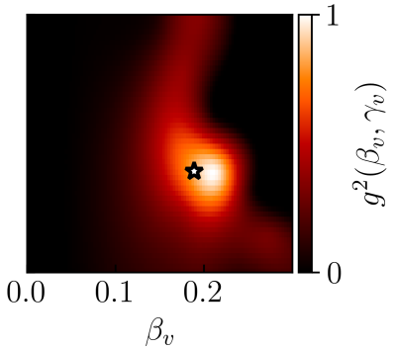
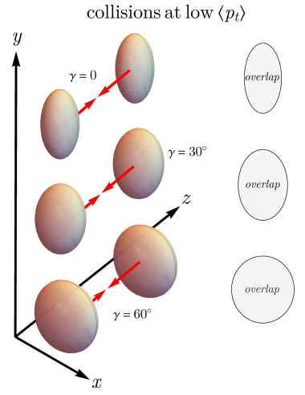
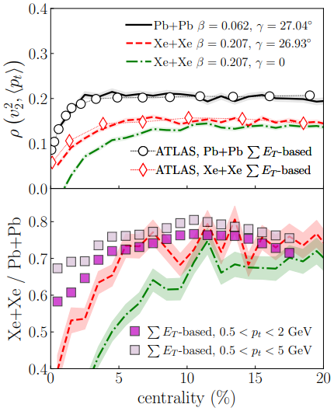
Recent work: Xenon-129, an example of a triaxial nucleus
Smart trick: two selections and ρ₂: correlation: v₂, p_{T}
Central and large (full overlap, low p_{T})
Prolate: large v₂ (negative ρ₂)
Oblate: small v₂ (positive ρ₂)
Conclusion ρ₂ determines γ
Alternatively:
Central and spherical (full overlap, low v₂)
Prolate: small area, high p_{T} (negative ρ₂)
Oblate: large area , low p_{T} (positive ρ₂)
Conclusion ρ₂ determines γ
Note: just v₂ doesn’t work, β₂ gives v₂ in both cases (!)
prolate
oblate
Benjamin Bally, Michael Bender, Giuliano Giacalone and Vittorio Soma, Evidence of the triaxial structure of ¹²⁹Xe at the Large Hadron Collider (2021)

Slide 8
What do we need to start hydro?
Wilke van der Schee, CERN/Utrecht
Energy density at the start of hydrodynamics
  Attractor: normalisation constant and a power of free streaming energy density
  Transverse profile determined by shape nuclei + small correction (assume free streaming)
Fluid velocity at the start of hydrodynamics
  Boost invariance should be excellent: even in holographic shocks the velocity is boost invariant
  Radial velocity is universal at early times when given the anisotropy (Pratt-Vredevoogd):
Do we need the shear tensor?
  Argument: no (!). Assuming hydro means assuming hydrodynamised plasma
  Shear tensor can be computed:
  Quite unlike free streaming shear tensor (!)

Slide 9
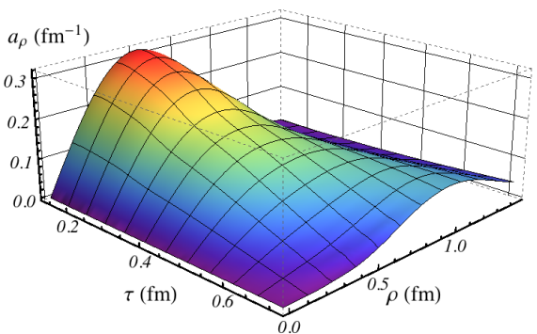
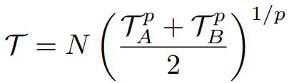
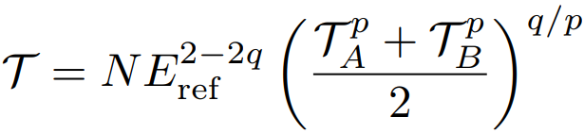
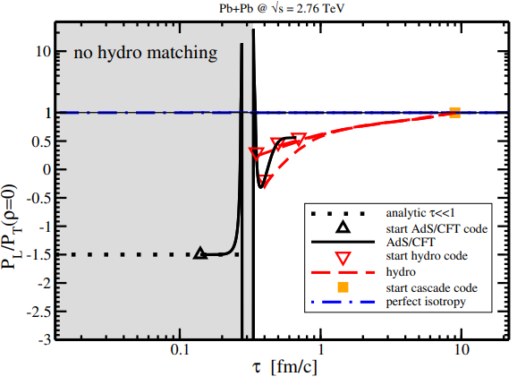

The initial stage and a generalised Trento model
Introduce a power q in the Trento formula:
  T_{A/B} is thickness function of colliding left- and right moving nuclei
  Can interpolate between participant (p=1) and binary scaling (q=2, p=0)
  Can account for `attractor’ behaviour
  Interpretation ambiguity as energy or entropy density is now included in the q parameter
Fluid velocity: Pratt-Vredevoogd:
  1/3 depends on anisotropy (!)
  1/3 is exact for free streaming (P_{L} = 0), for AdS/CFT it is numerical:
Joshua Vredevoogd and Scott Pratt, Universal Flow in the First Stage of Relativistic Heavy Ion Collisions (2008)
WS, Paul Romatschke and Scott Pratt, Fully Dynamical Simulation of Central Nuclear Collisions (2013)
Govert Nijs and WS, A generalized hydrodynamizing initial stage for Heavy Ion Collisions (2023)

Slide 10
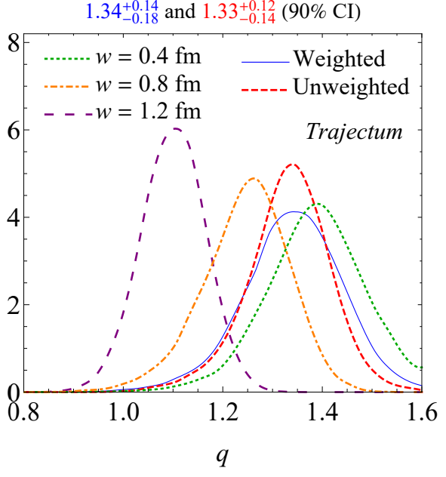
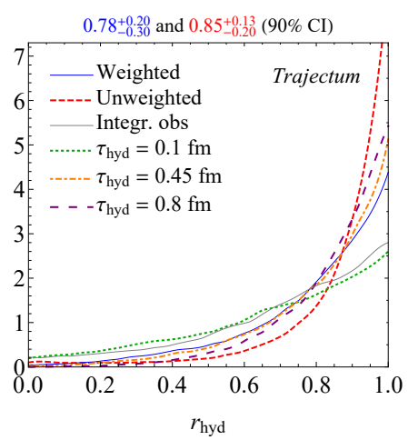
The initial stage and a generalised Trento model
Shear tensor:
  Free streaming: follows from stress energy tensor
  Hydrodynamisation: follows from constitutive equation*:
  Trajectum interpolates:
Posterior distributions:
  Strong preference for hydrodynamisation (!)
  Evidence for T as `entropy’ instead of energy
*Morally speaking; in reality there are 2nd order terms that are important for stability
Govert Nijs and WS, A generalized hydrodynamizing initial stage for Heavy Ion Collisions (2023)

Slide 11
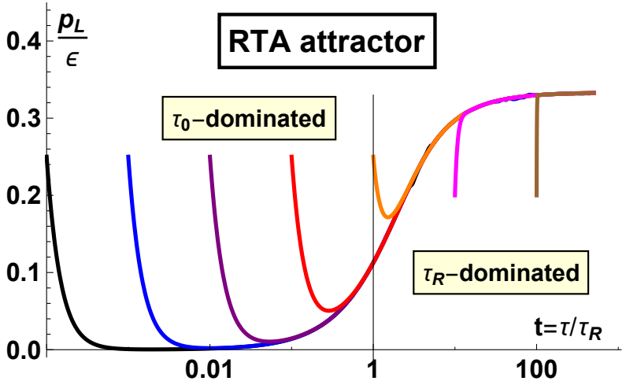
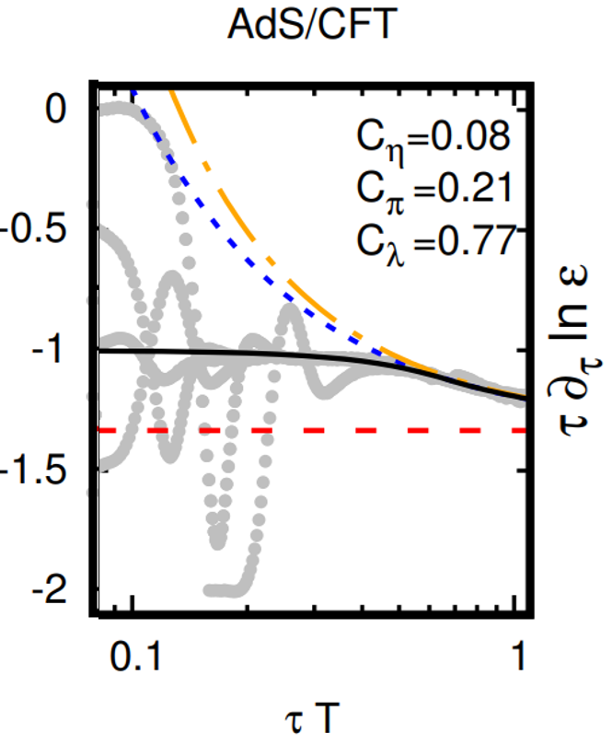
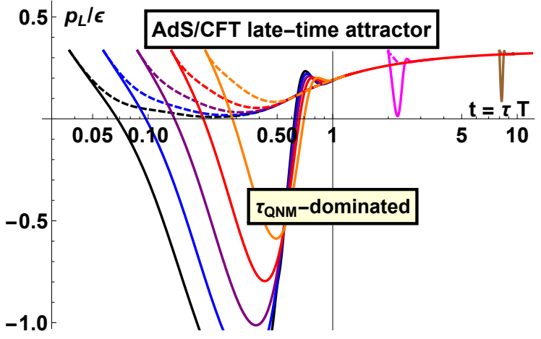
Attractor in ads/cft revisited
Berta
Wilke van der Schee, CERN/Utrecht
Old attractor: seems natural to start at p_{L}=0
  But is there really an argument?
Start at seven different initial times
  UV + IR profiles, fixing initial isotropy + derivative
  Can distinguish a `profile-dependent’ attractor (?)
Approach to attractor
  Kinetic theory: within starting time
  Strong coupling: within 1/T
Aleksi Kurkela, WS, Urs Achim Wiedemann and Bin Wu, Early- and Late-Time Behavior of Attractors in Heavy-Ion Collisions (2019)
Paul Romatschke, Fluid Dynamics Far From Local Equilibrium (2017)
11/14
Notes:
Many states + linearized

Slide 12
Why does ads/cft decay `slowly’?
Wilke van der Schee, CERN/Utrecht
UV and IR profiles contain higher-point correlation functions
  Impossible to put correlations on lengths >> 1/T (because of horizon)
  IR: strong correlation on scale 1/T
  UV: constructed to have only small-scale correlations
Causality: system cannot relax before a time 1/T has passed (IR)
  RTA can relax much faster
Somewhat against weak/strong coupling intuition ☺
  But perhaps it’s all about initial conditions…
12/14
Notes:
Many states + linearized

Slide 13
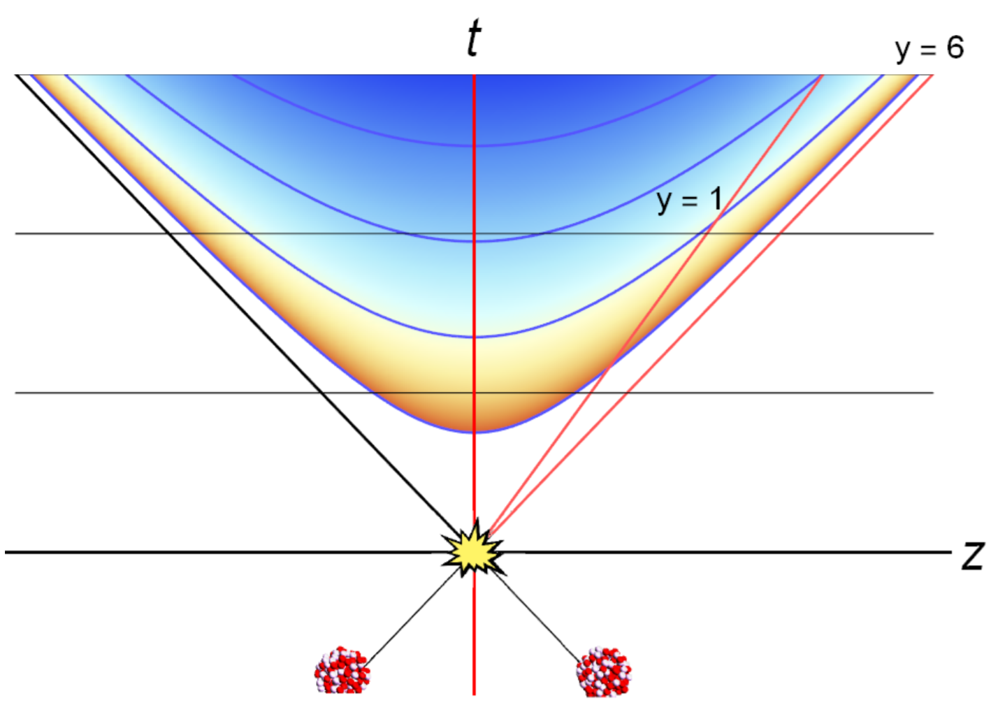
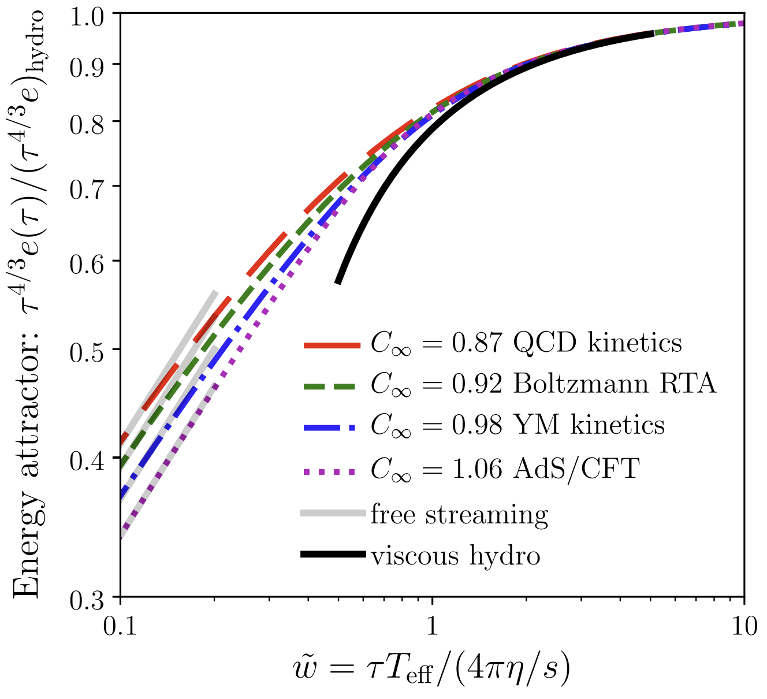



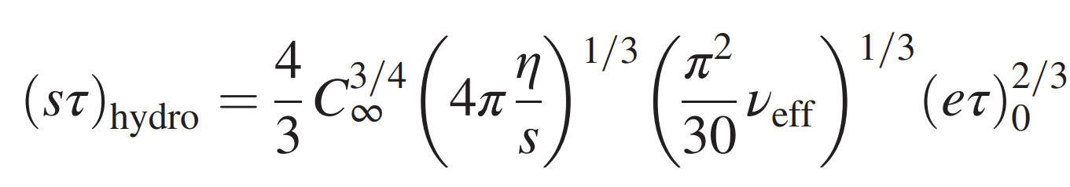
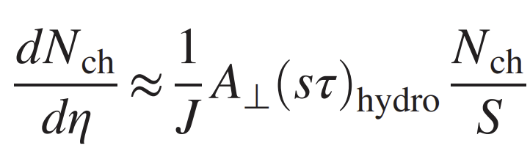
Attractors and QGP
Wilke van der Schee, CERN/Utrecht
Energy density vs time, boost-invariant: 0+1D
  Late time:
  Early time: assumed free streaming:
  Attractor = approach to hydro
  Depends (crucially) on η/s
  Depends (slightly) on theory ( )
Can be used to estimate entropy:
13/14
G. Giacalone, A. Mazeliauskas and S. Schlichting Hydrodynamic attractors, initial state energy and particle production in HIC (2019)
Notes:
Many states + linearized

Slide 14
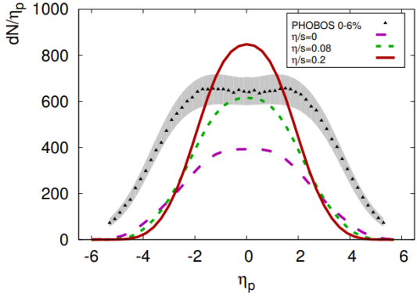
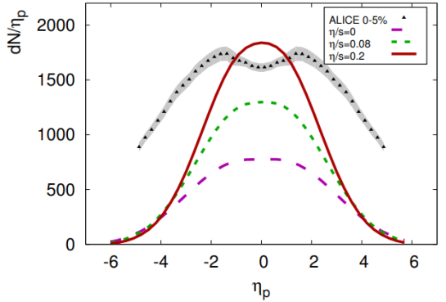


Two related puzzles for discussion
In shock wave collisions: rapidity profile is a Gaussian with unit width
  Does not increase much with finite coupling corrections (Gauss-Bonnet)
  In experiment the width increases much faster
The entropy generated in scale invariant theories grows too fast:
  Dimensional analysis and locality in transverse plane:
  implies
  Experiment:
  Evidence for `saturation’ scale?
Work by Gubser, Pufu, Yarom, Kiritsis, recent follow ups by Yaffe-Waeber
WS and Bjoern Schenke, Rapidity dependence in holographic heavy ion collisions (2015)
Sašo Grozdanov and WS, Coupling Constant Corrections in a Holographic Model of Heavy Ion Collisions (2016)

Slide 15
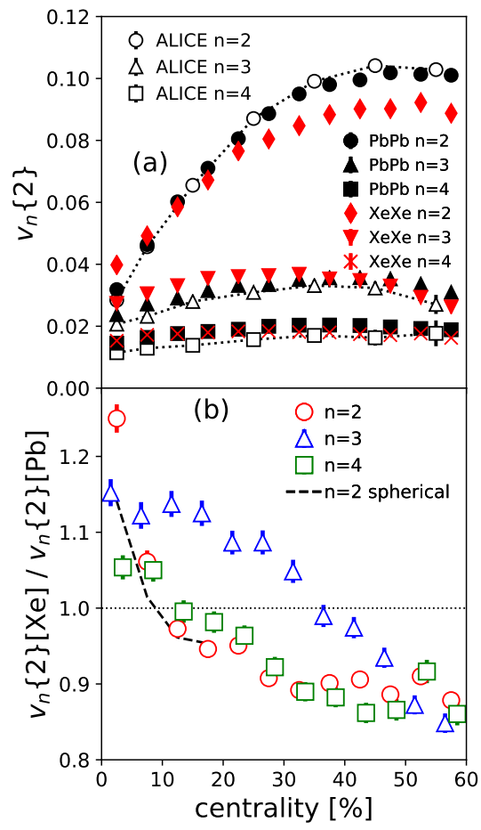
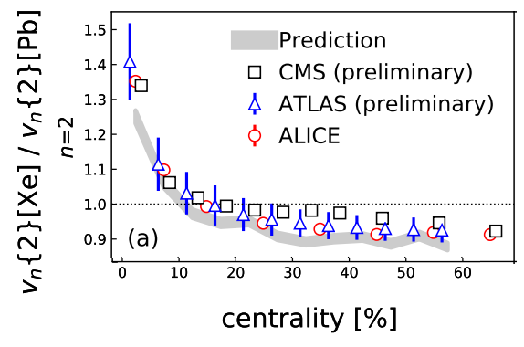
Prediction
Experiment
Xenon-129: a deformed nucleus
Elliptic deformation (β₂):
Was known from nuclear structure (0.16)
Prediction (MSc thesis Giacalone)
Xenon 6 (!) hour run: slightly bigger effect
Sophisticated nuclear structure (PGCM)
confirms slightly larger β₂ (0.19)
Improved theory
Giuliano Giacalone, Jacquelyn Noronha-Hostler, Matthew Luzum and Jean-Yves Ollitrault, Hydrodynamic predictions for 5.44 TeV Xe+Xe collisions (2017)
Giuliano Giacalone, Jacquelyn Noronha-Hostler, Matthew Luzum, Jean-Yves Ollitrault, Confronting hydrodynamic predictions with Xe-Xe data (2018)
Benjamin Bally, Michael Bender, Giuliano Giacalone and Vittorio Soma, Evidence of the triaxial structure of ¹²⁹Xe at the Large Hadron Collider (2021)

Slide 16
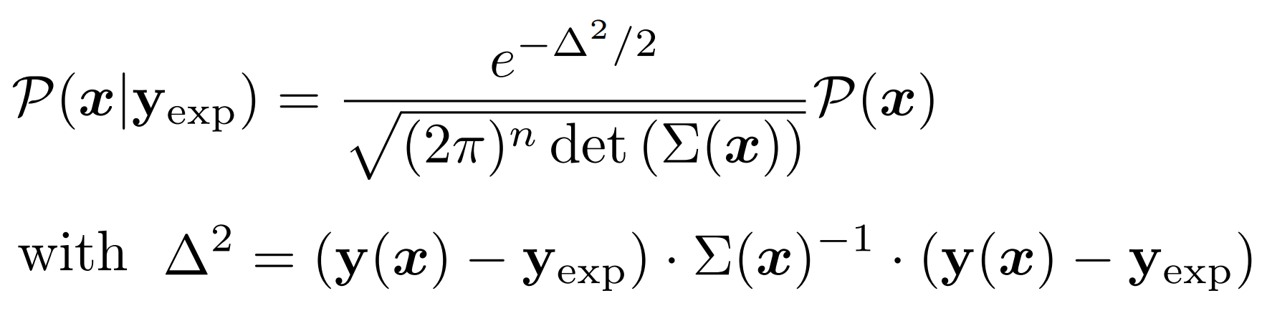
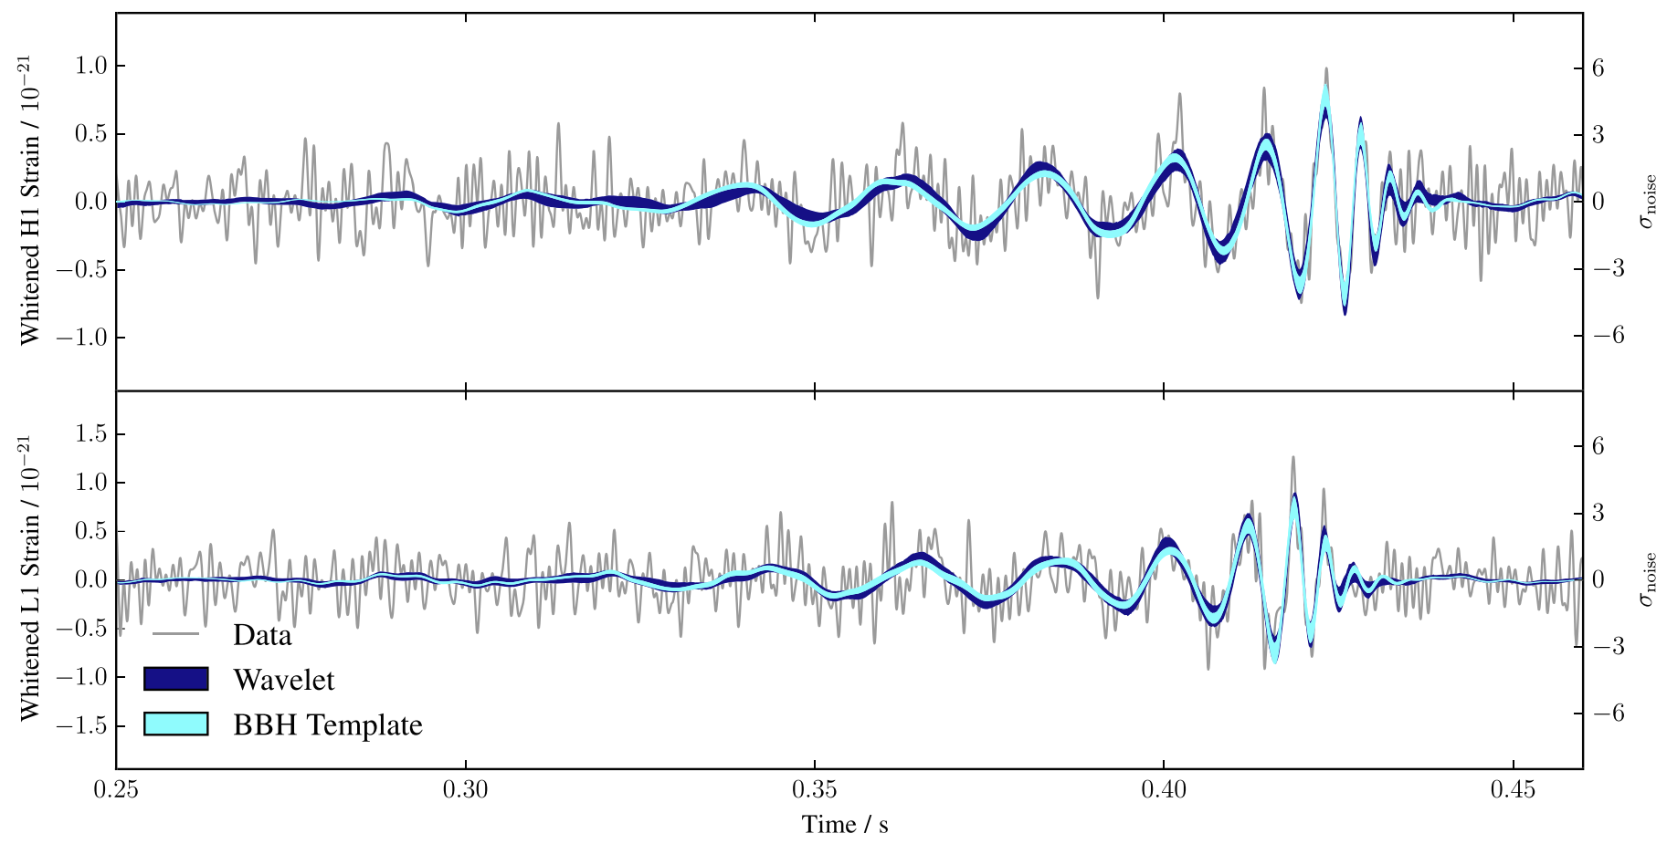
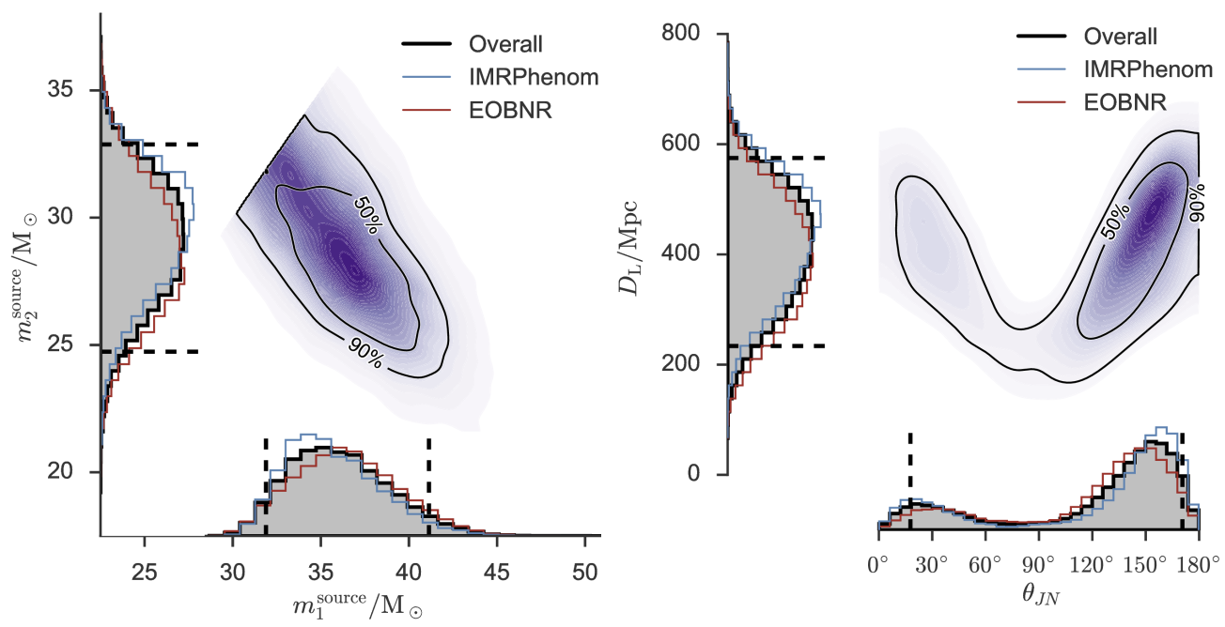
Performing a global analysis
Wilke van der Schee, CERN/Utrecht
Bayes theorem:
Same technique: gravitational waves
Model depends on parameters non-linearly
  Run model on 3000 `design’ points
  Use an emulator for any point in parameter space (GP)
Markov Chain Monte Carlo
  653 data points
  Obtain posterior probability density of parameters
Compare posterior with data
  Can include high statistics run
LIGO, Properties of the Binary Black Hole Merger GW150914 (2016)
Notes:
Parameters influence observables in complex and non-linear way
Global analysis needed
Run on design points + emulate
MCMC with Bayes theorem and over 500 datapoints
Verify that high probability parameter set works well with other observables
Similar to gravitational waves with for instance waveform determines correlation between distance and inclination

Slide 17
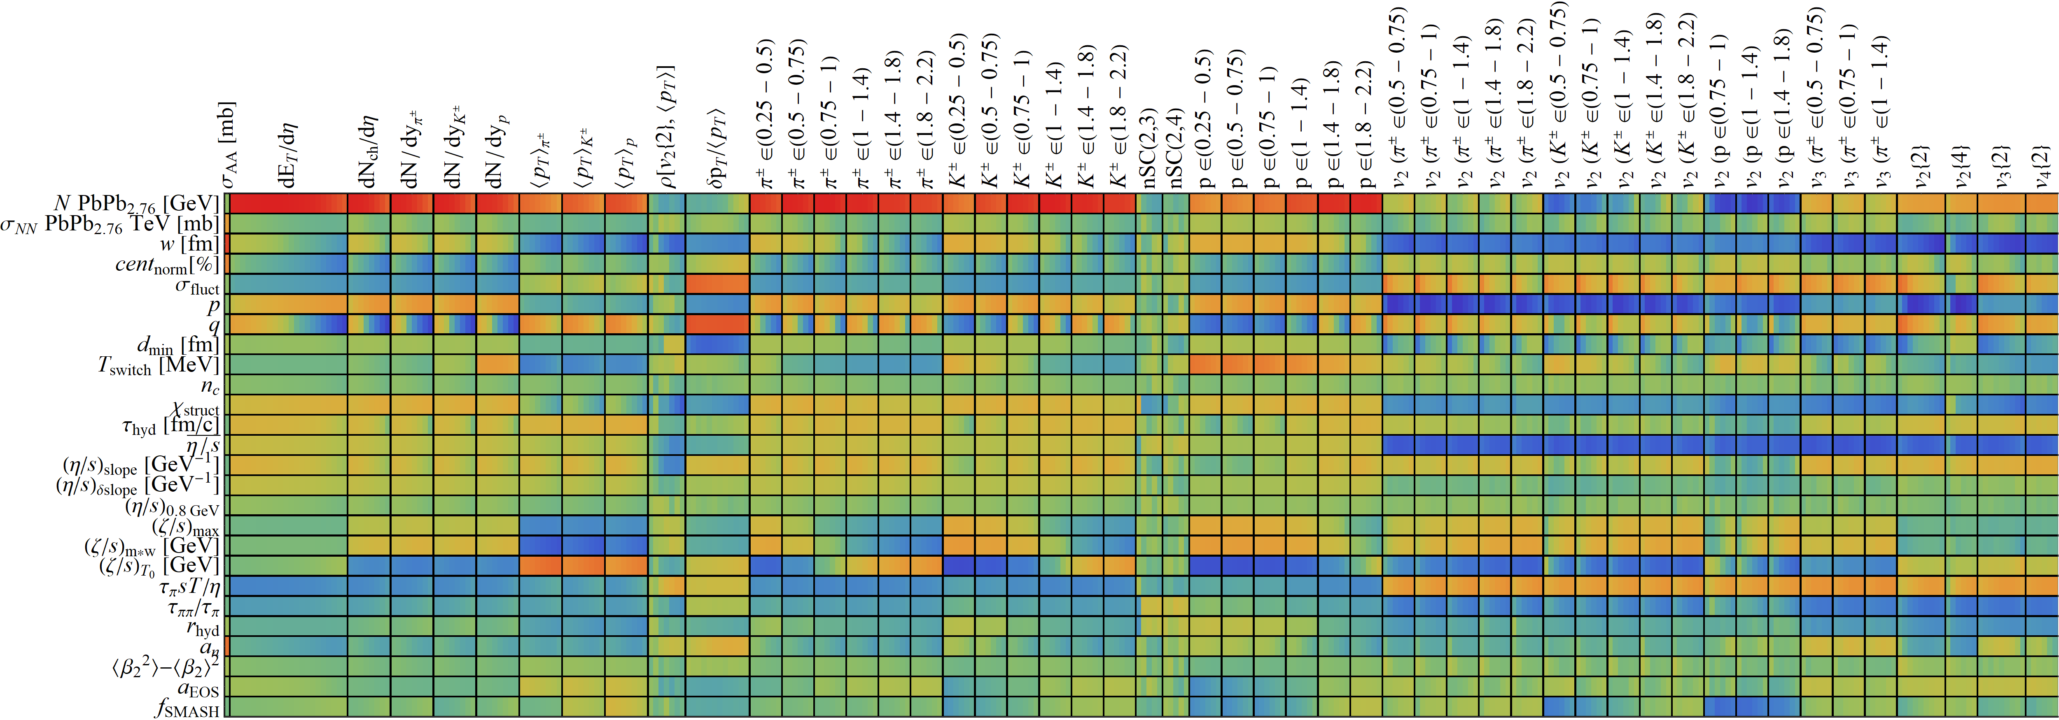
Design parameter-observable correlations:
Wilke van der Schee, CERN/Utrecht

Slide 18
A prediction: extremely ultracentral collisions

Slide 19
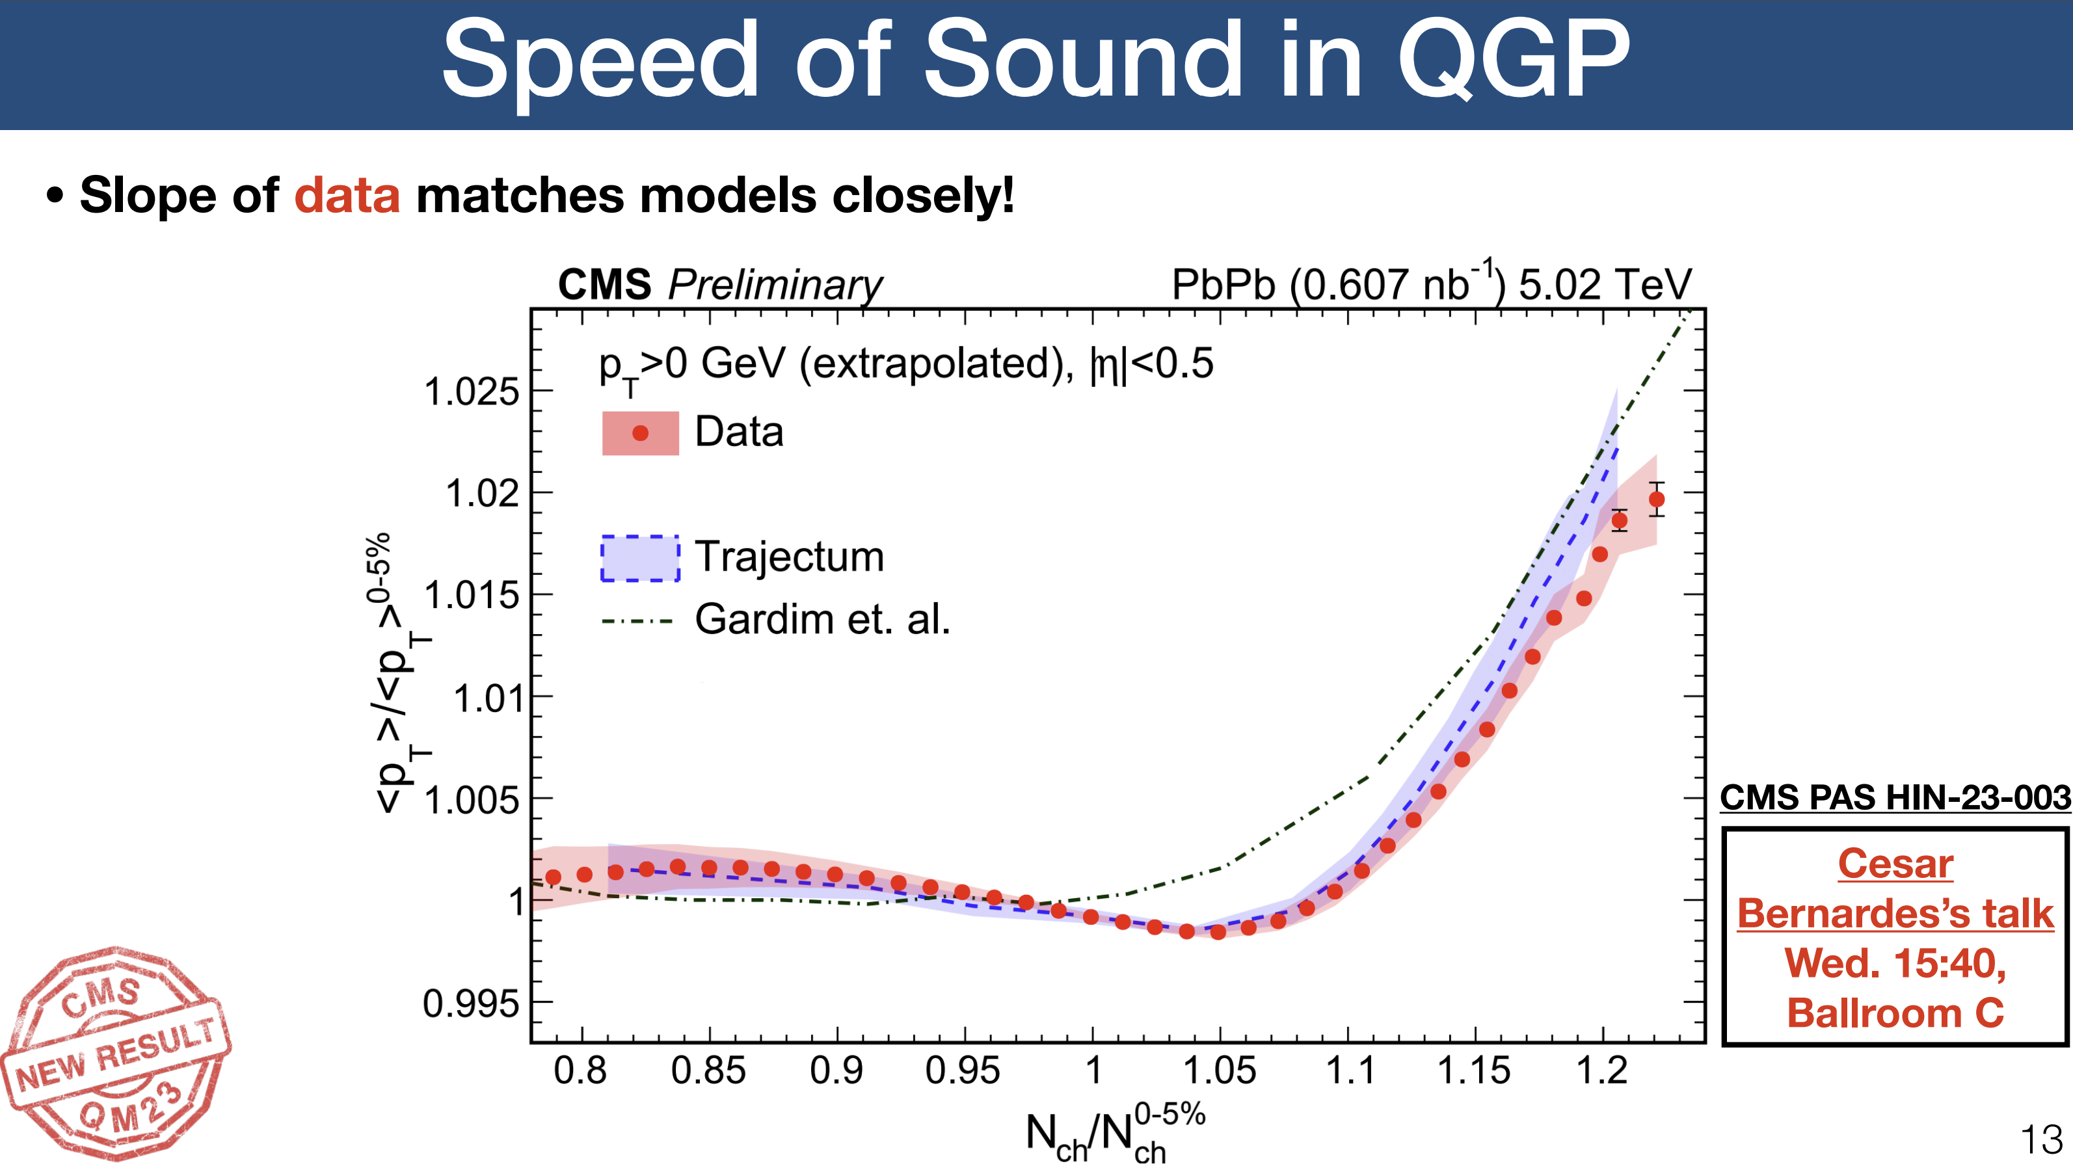
A true prediction using hydrodynamics (rare these days…)
  Non-trivial curve; non-monotonicity was unexpected
  Extremely precise (<0.1%) due to uncertainty cancellations in the ratio (theory & experiment (!))
Fernando G. Gardim, Giuliano Giacalone and Jean-Yves Ollitrault, The mean transverse momentum of ultracentral heavy-ion collisions: A new probe of hydrodynamics (2019)
Govert Nijs and WS, Predictions and postdictions for relativistic lead and oxygen collisions with the computational simulation code Trajectum (2021)
Austin Baty, Overview of Recent CMS results, https://indico.cern.ch/event/1139644/contributions/5343932/ (see also Cesar Bernardes)

Slide 20
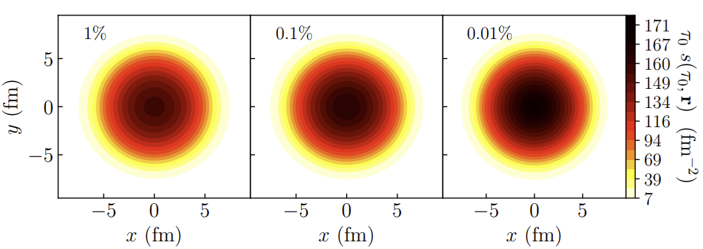
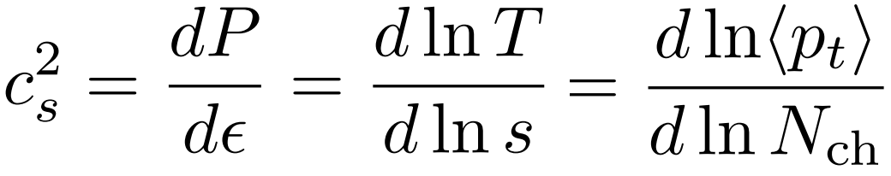
What is happening?
(Extremely) ultracentral collisions are not driven by impact parameter
  Size does not extend beyond radius Lead nucleus
  (Local) fluctuations drive up multiplicity
  Average temperature can still increase
A simplified picture:
  Entropy increase → multiplicity increases
  Temperature increases → mean pt increases (assuming ideal hydro + constant `work’ done in rapidity direction)
  Slope: sensitive to speed of sound (solely ?!):
Fernando G. Gardim, Giuliano Giacalone and Jean-Yves Ollitrault, The mean transverse momentum of ultracentral heavy-ion collisions: A new probe of hydrodynamics (2019)

Slide 21
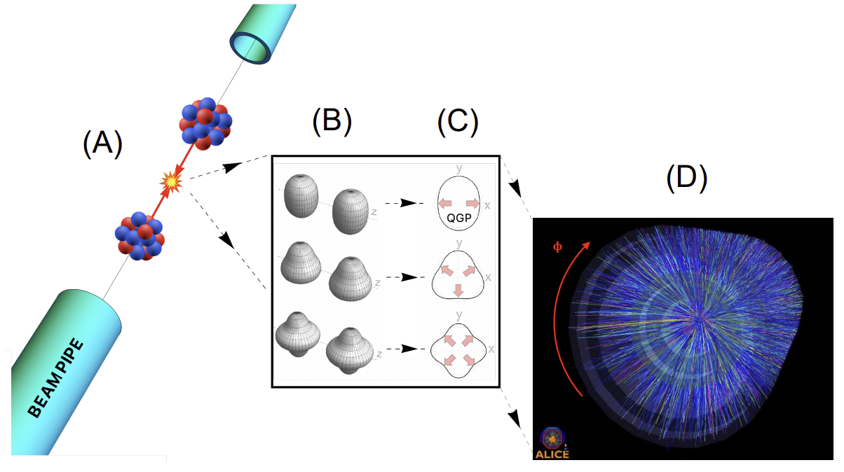
The shape of nuclei
Benjamin Bally, James Daniel Brandenburg, Giuliano Giacalone, Ulrich Heinz, Shengli Huang, Jiangoyng Jia, Dean Lee, Yen-Jie Lee, Wei Li, Constantin Loizides, Matthew Luzum, Govert Nijs, Jacquelyn Noronha-Hostler, Mateusz Ploskon, WS, Bjoern Schenke, Chun Shen, Vittorio Somà, Anthony Timmins, Zhangbu Xu and You Zhou
Imaging the initial condition of heavy-ion collisions and nuclear structure across the nuclide chart (2022)

Slide 22


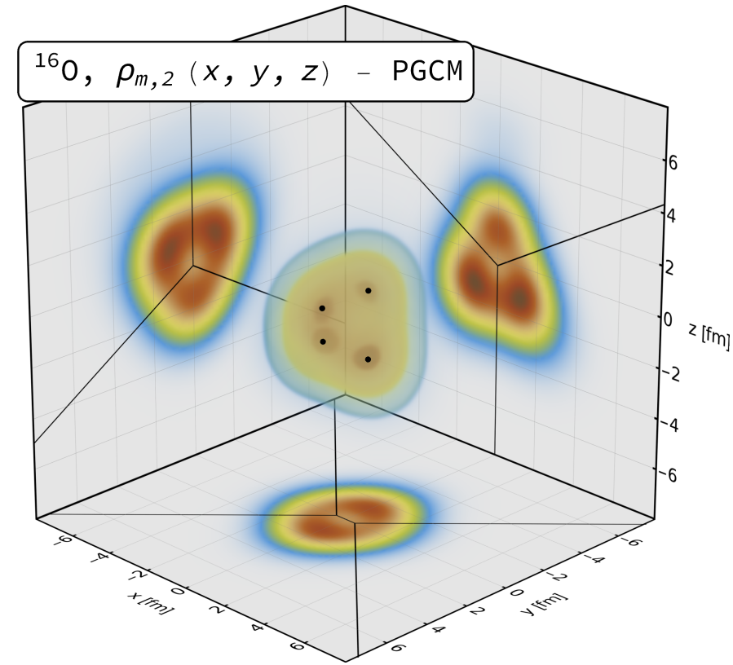
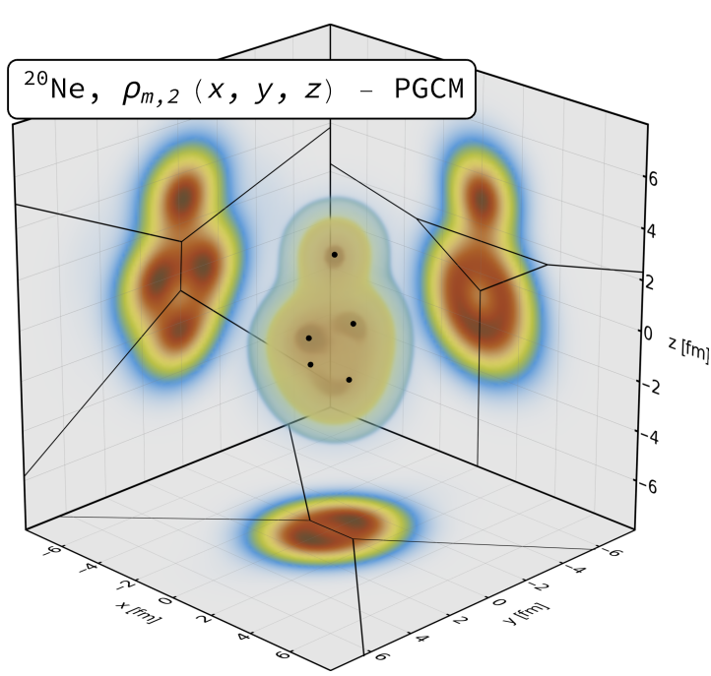
¹⁶Oxygen and ²⁰Neon nuclear structure
Do we understand and/or need to understand the shape of O and Ne?
  Seems so, need precision understanding of anisotropic flow
  Interesting by itself: combination of 4 or 5 alpha particles
Studied using two complementary nuclear structure methods:
State-of-the-art Projected Generator Coordinate Method (PGCM)
`Pinhole’ configurations from
Nuclear Lattice Effective Field Theory (NLEFT)
Giuliano Giacalone, Benjamin Bally, Govert Nijs, Shihang Shen et al,The unexpected uses of a bowling pin: exploiting 20Ne isotopes for precision characterizations of collectivity in small systems (2024)

Slide 23
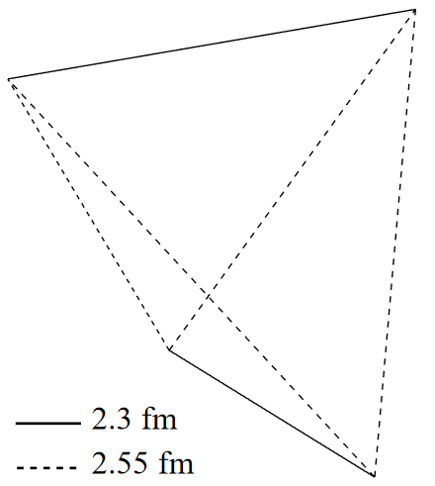
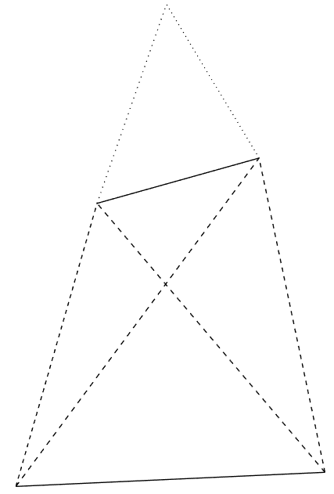
Alphas from nuclear structure
Two big surprises (at least to me ☺)
¹⁶O alphas do not form a regular tetrahedron (!)
→ more like two coupled rods
Similar results in NLEFT
²⁰Ne alphas do not form a bipyramid (!)
→ seemingly randomly placed on top…
(was a challenge to find due to breaking of
symmetry, credit to Benjamin Bally)
Of course the intuition of alphas as point particles
with interaction energy is really quite naïve…
Giuliano Giacalone, Benjamin Bally, Govert Nijs, Shihang Shen et al,The unexpected uses of a bowling pin: exploiting 20Ne isotopes for precision characterizations of collectivity in small systems (2024)

