Slide 1
Quasinormal modes of nonthermal fixed points
Matisse De Lescluze
4/02/2025
Based on 2502.01622

Slide 2
Overview
Introduction
General statements on perturbations
Explicit example in FP kinetic theory
Outlook

Slide 3
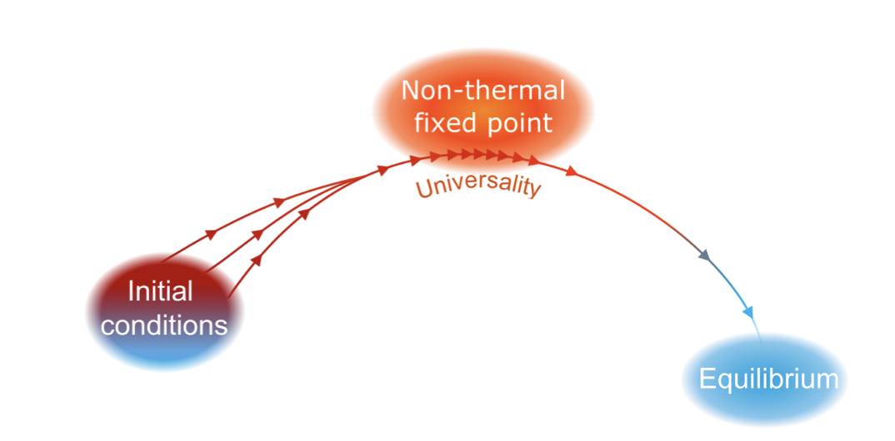
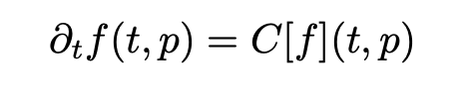
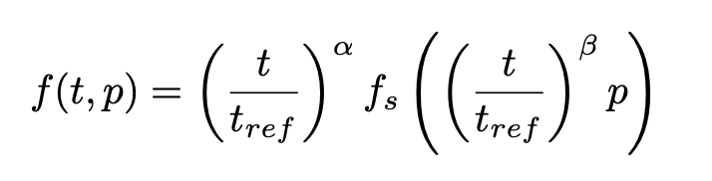
Non-thermal fixed points
From 1805.11881
Cold atom experiments, ultra-relativistic heavy-ion collisions, early universe dynamics
Kinetic theory
What is needed?
Conservation law
Collision kernel scales homogeneously in time

Slide 4
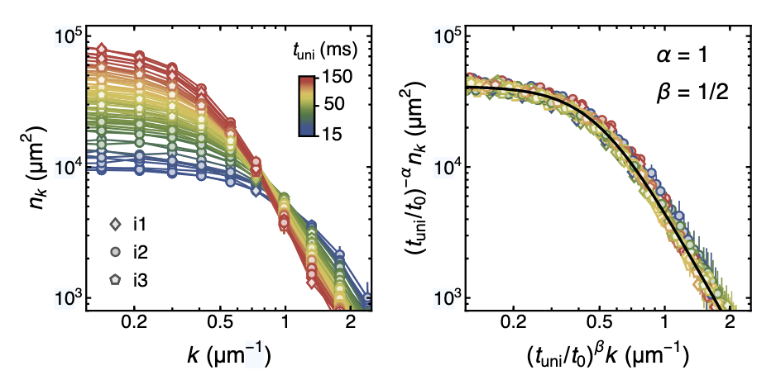
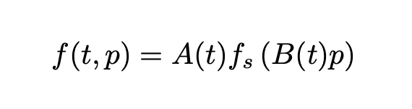
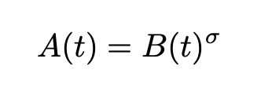
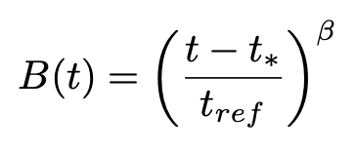

Prescaling
2307.07545
M. Gazo, A. Karailiev, T. Satoor,1 C. Eigen, M. Gałka and Z. Hadzibabic
Finite time effect!
$$t_{uni}=t−t_{∗}$$

Slide 5
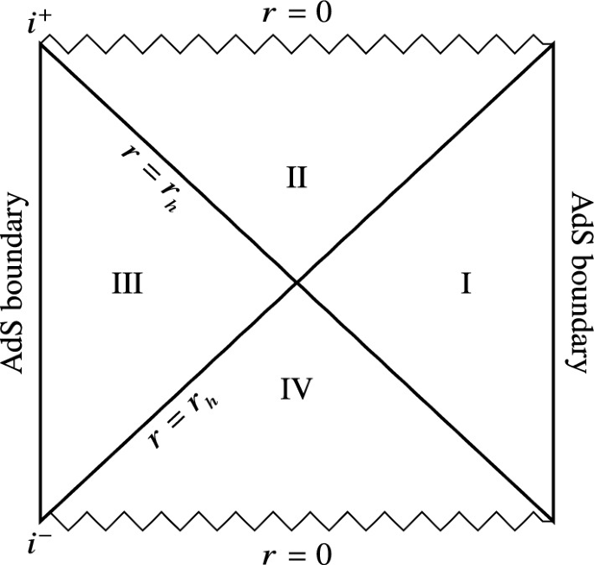
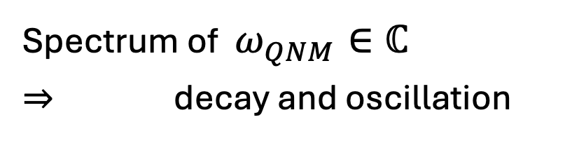


Quasinormal modes
AdS/CFT: thermal state on boundary dual to black hole spacetime
Perturbation of black hole spacetime $φ$
Event horizon: ingoing boundary condition
Spectrum of $ω_{QNM}∈ℂ$
$⇒$ decay and oscillation
$e^{−iωt}$:
From Grumiller, D., Sheikh-Jabbari, M.M. Black Hole Physics

Slide 6

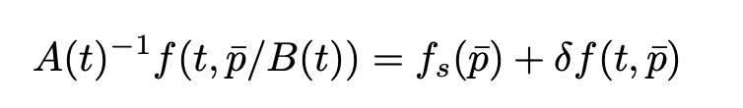
Static frame of scaling function
Static frame of scaling function
Can relaxation be described by QNMs?
Add a perturbation

Slide 7
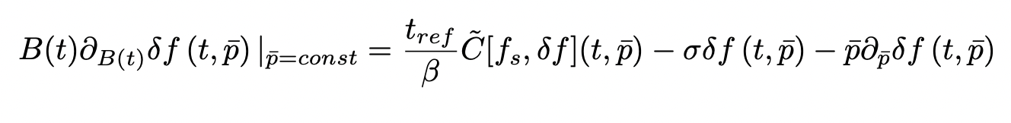
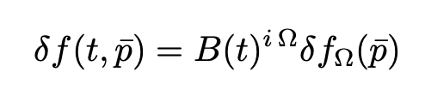
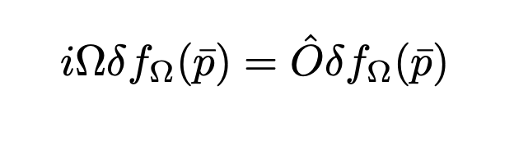
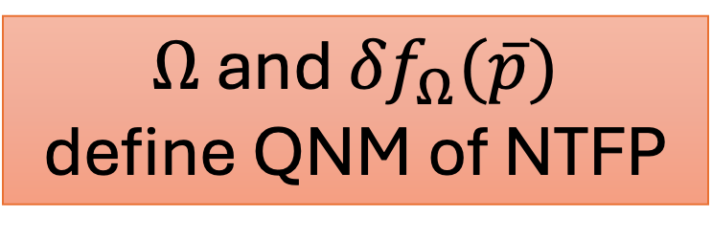
Linearized equation
Time dependence factorizes
Results in eigenvalue equation
$Ω$ and ${δf}_{Ω}(\overline{p})$
define QNM of NTFP
Power law!

Slide 8
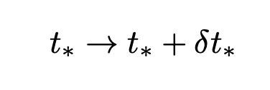
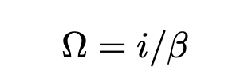
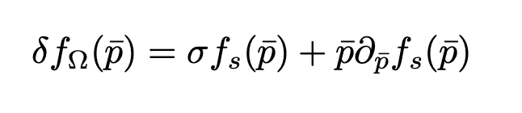
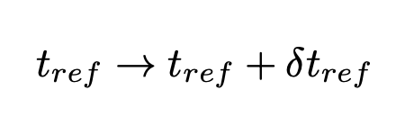
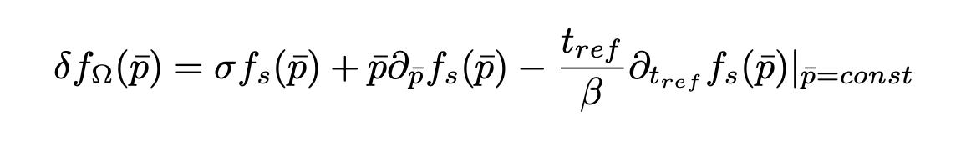
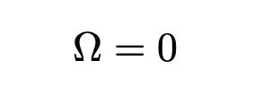


Two predicted modes
.
.
$$⟹$$
&
$$⟹$$
&
Zero mode!

Slide 9
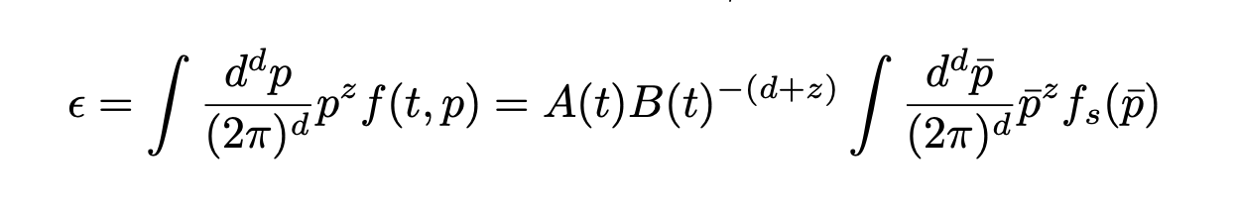

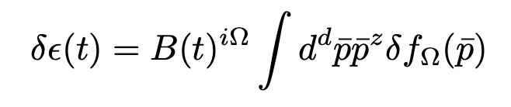


Role of conservations laws
Consider energy density
Energy density of perturbation
Constant if:
1) $Ω=0$
Or
2) $δε_{Ω}=0$
$$≡δε_{Ω}$$

Slide 10
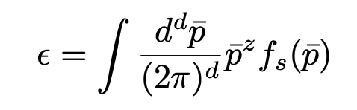
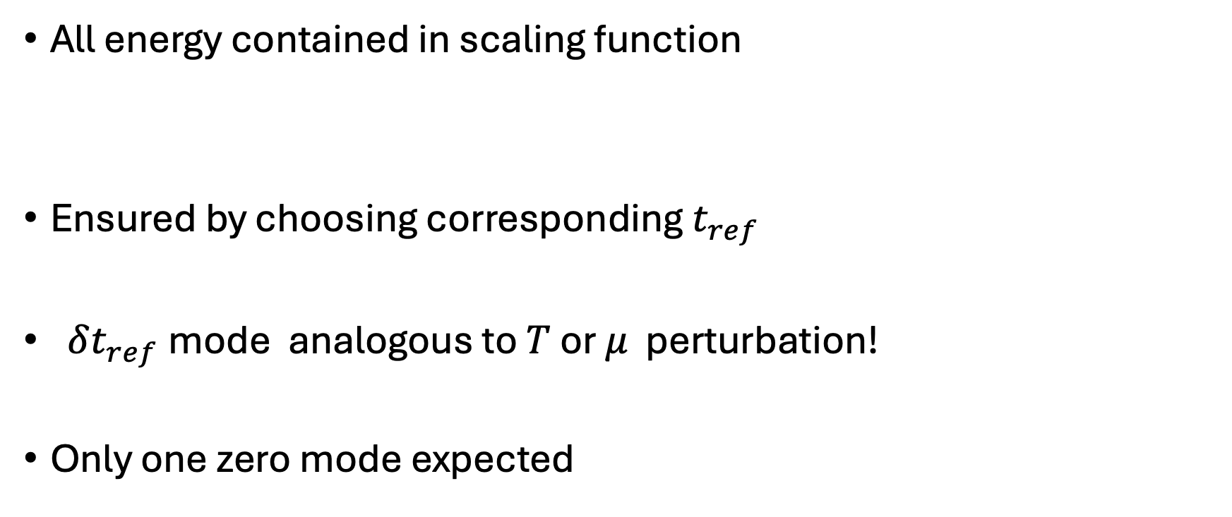
Interpretation zero mode
All energy contained in scaling function
Ensured by choosing corresponding $t_{ref}$
$δt_{ref}$mode analogous to $T$ or $μ$ perturbation!
Only one zero mode expected

Slide 11
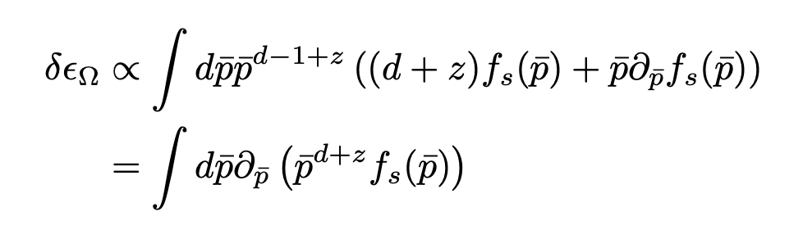
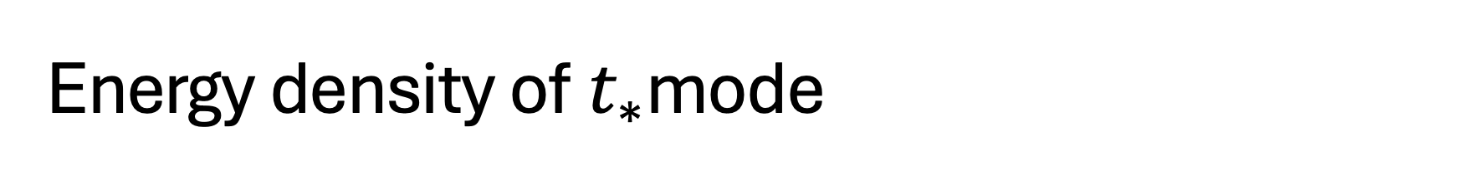
Energy density of${ t}_{∗}$mode
Only boundary terms contribute

Slide 12
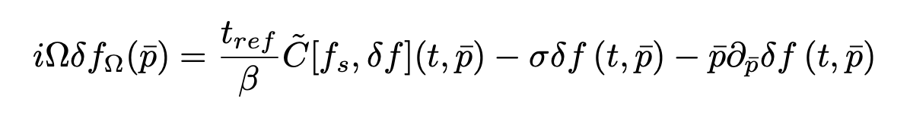

Coupling dependence?
Eigenvalue equation independent of coupling
Change in coupling equivalent to change in$t_{ref}$

Slide 13
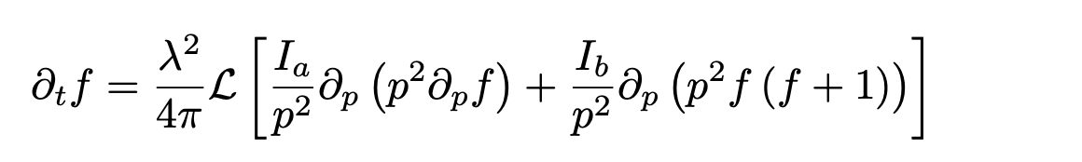
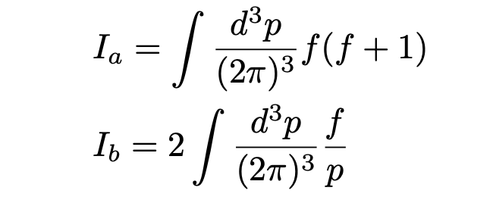
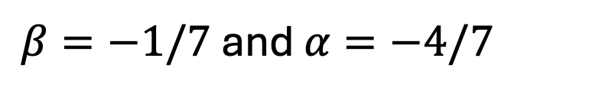
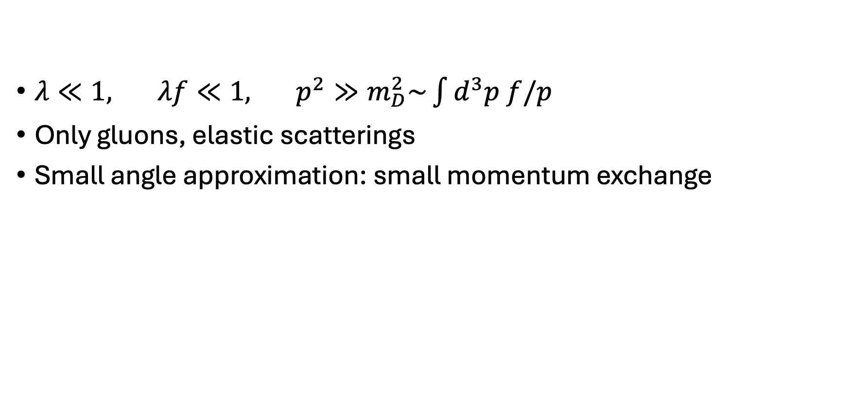
Fokker-Planck kinetic theory
$λ≪1, λf≪1, p^{2}≫m_{D}^{2}\sim \int{d^{3}p f/p}$
Only gluons, elastic scatterings
Small angle approximation: small momentum exchange
$β=−1/7$ and $α=−4/7$

Slide 14
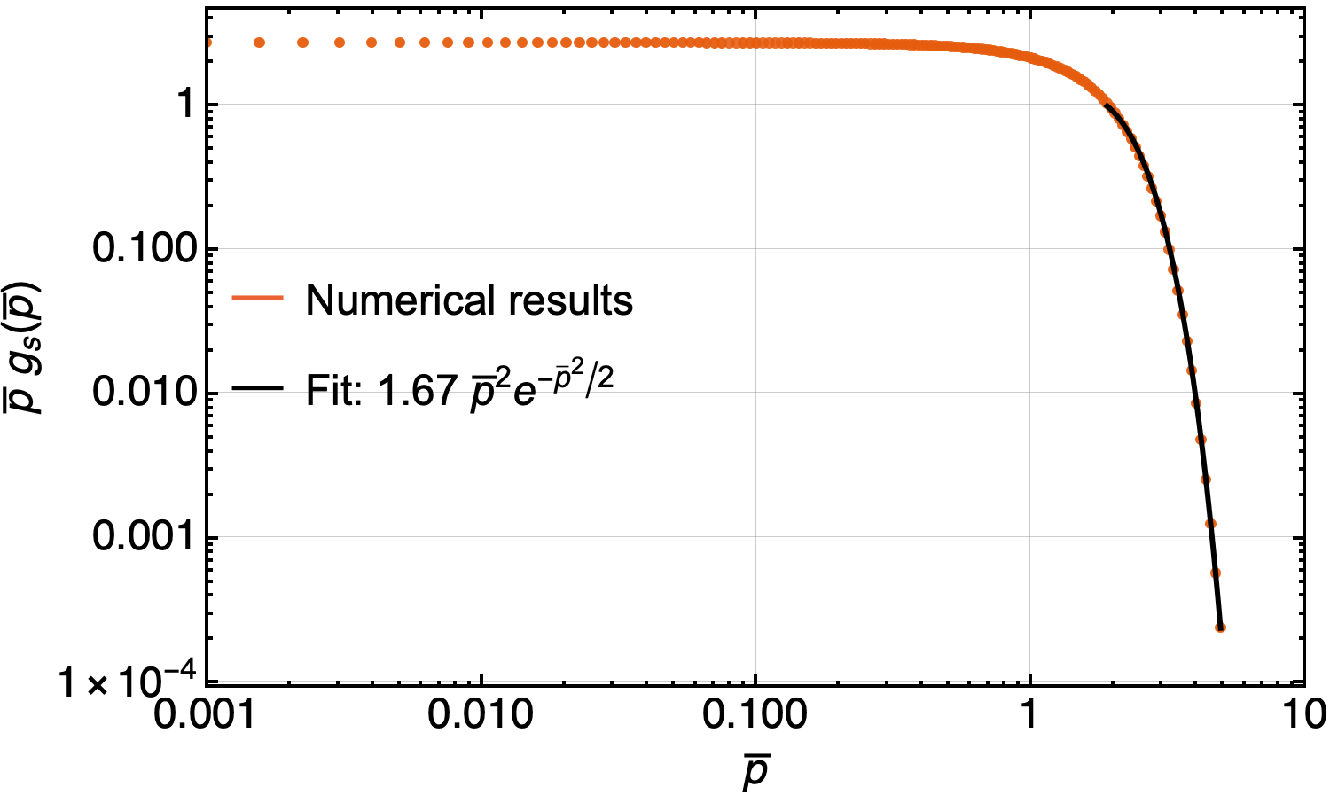

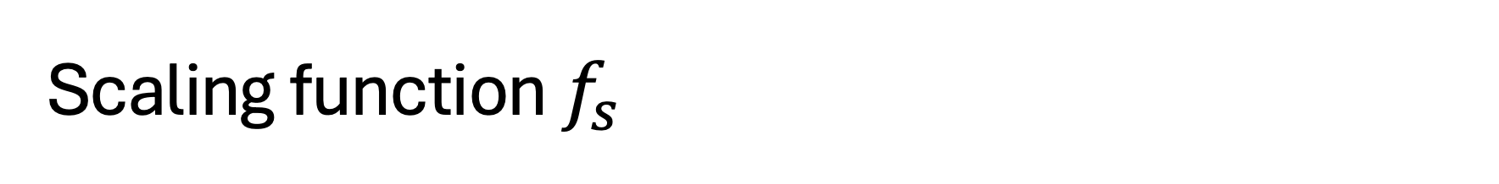

Scaling function $f_{s}$
$g_{s}$ related to $f_{s}$
by overall amplitude
$\overline{p}=\frac{u}{1−u}$
$$∝1/\sqrt{t_{ref}}$$

Slide 15
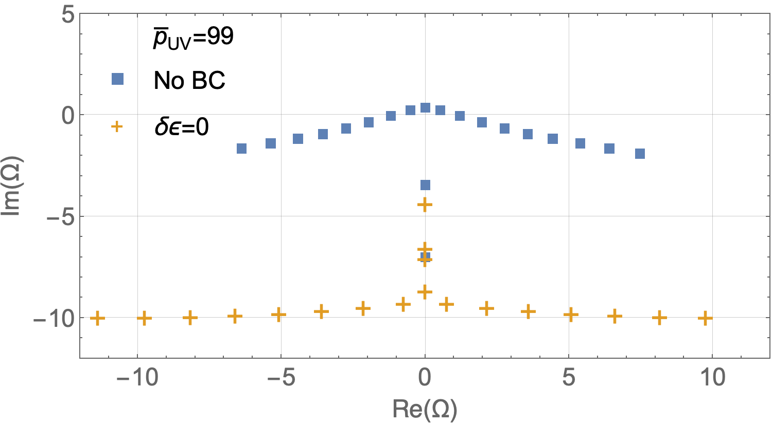
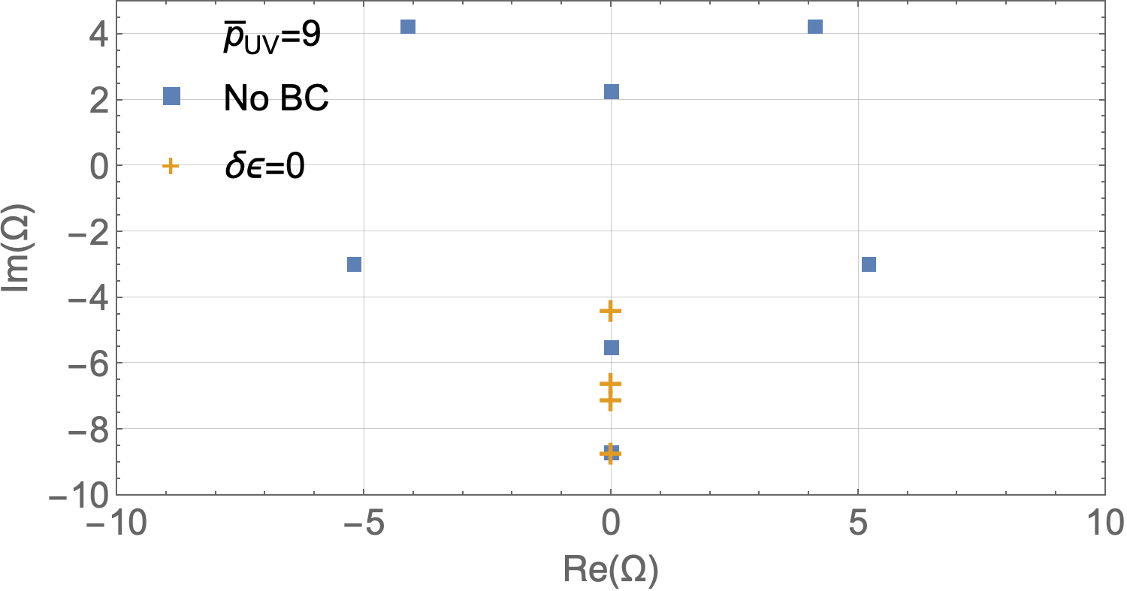
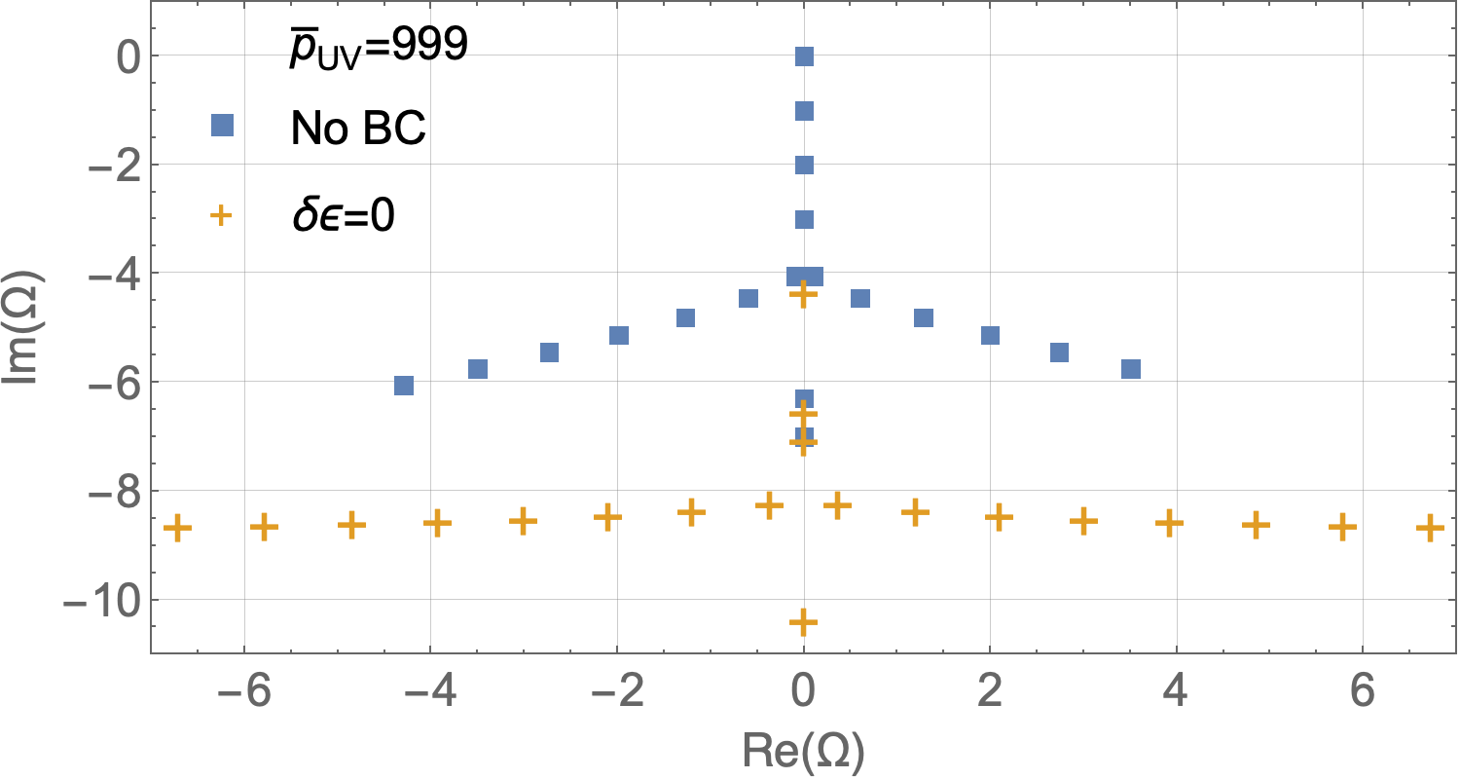
QNM spectra
Attractor

Slide 16
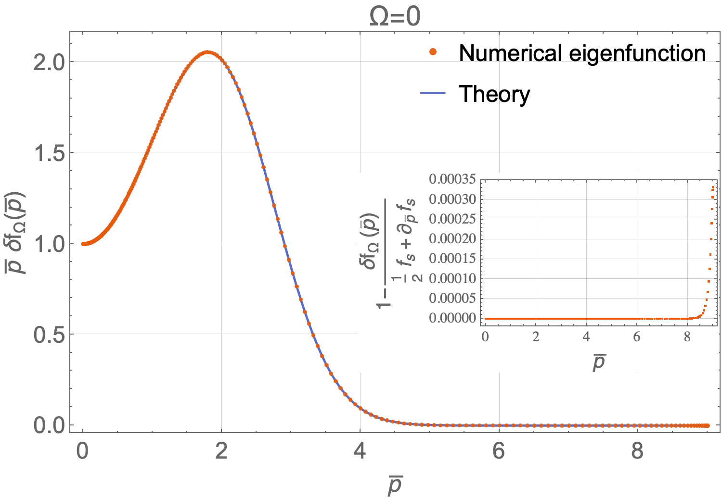
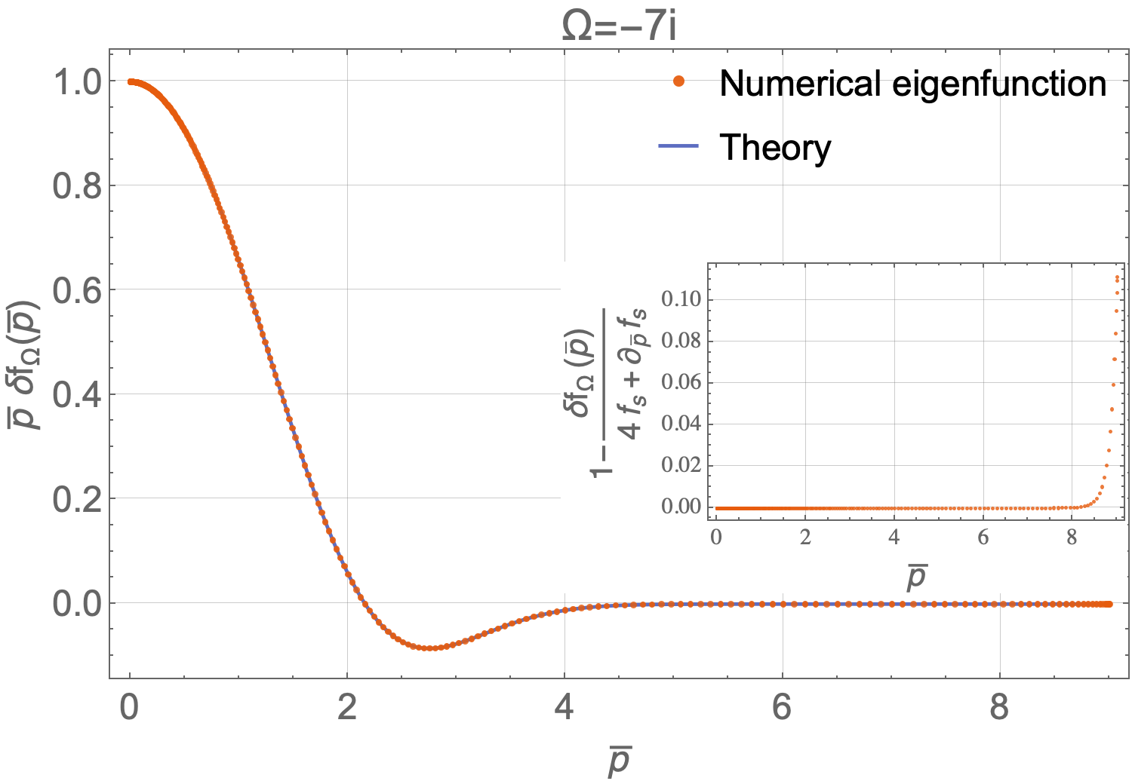
Comparison to predicted modes

Slide 17
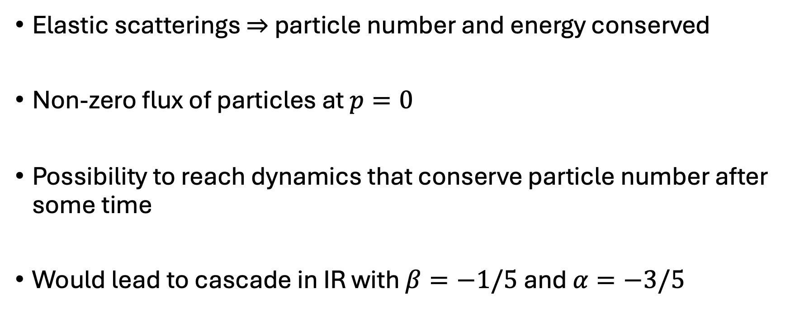
Possibility of IR cascade in this model?
Elastic scatterings $⇒$ particle number and energy conserved
Non-zero flux of particles at $p=0$
Possibility to reach dynamics that conserve particle number after some time
Would lead to cascade in IR with $β=−1/5$ and $α=−3/5$

Slide 18
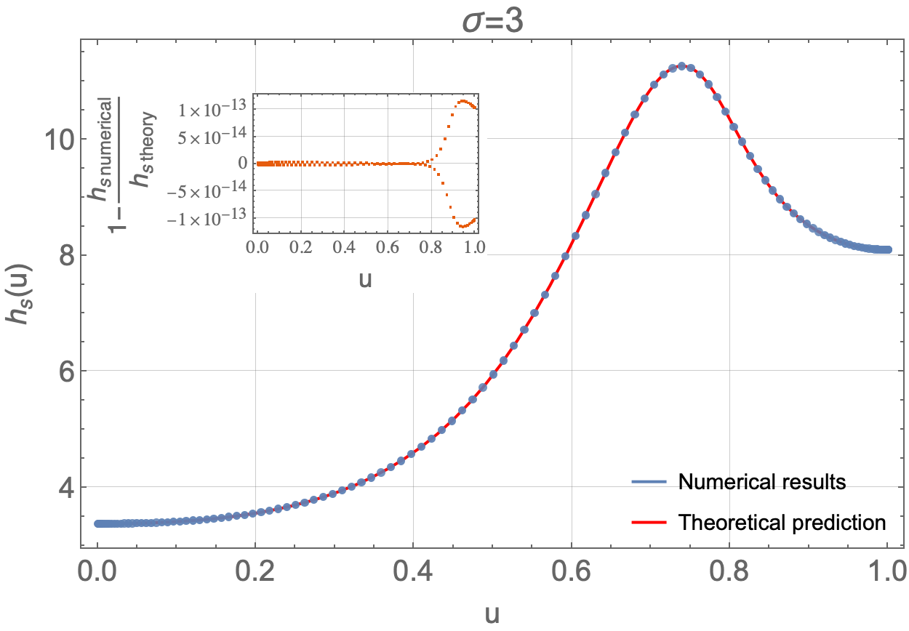
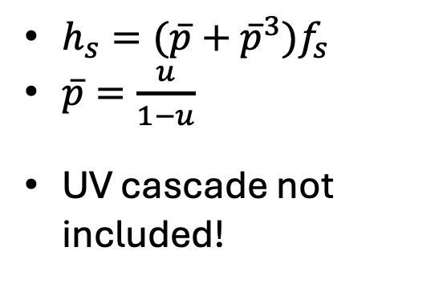
Scaling function for IR cascade
$h_{s}=(\overline{p}+{\overline{p}}^{3})f_{s}$
$\overline{p}=\frac{u}{1−u}$
UV cascade not included!

Slide 19
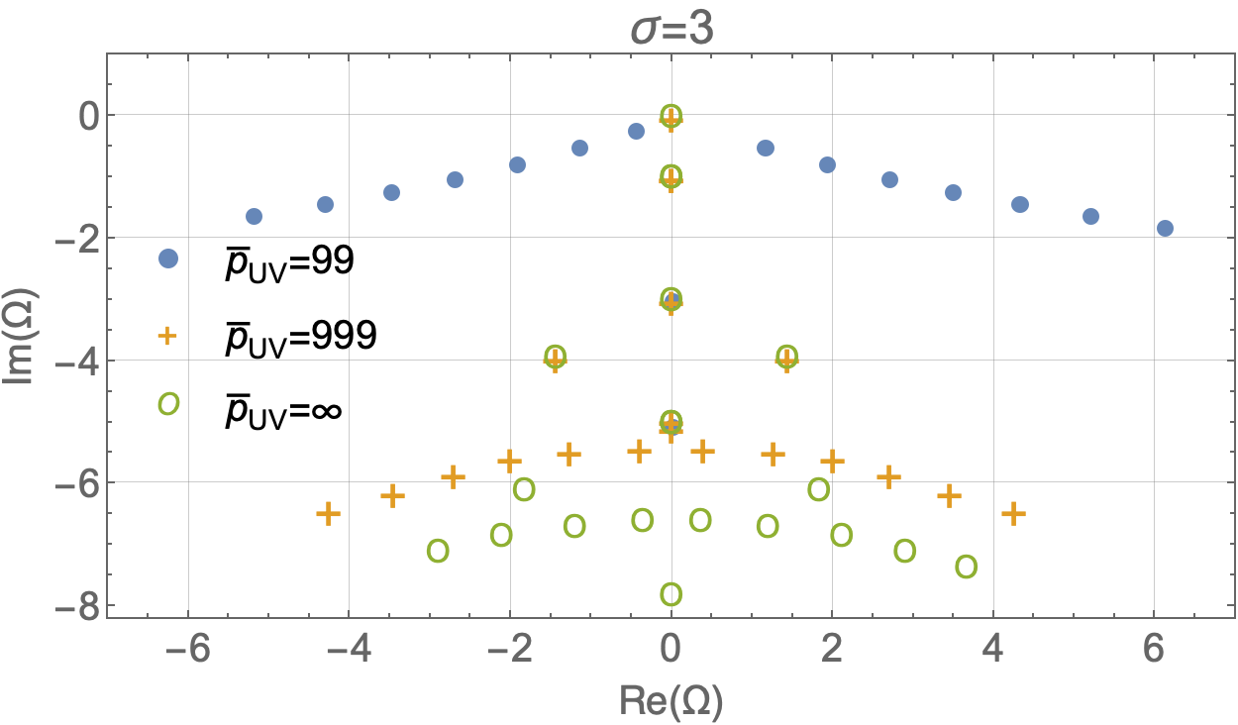
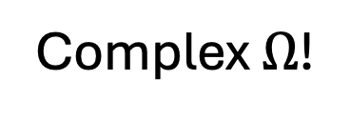
Spectrum for IR cascade
Dependence on UV cut-off
due to boundary contributions
Complex $Ω$!

Slide 20
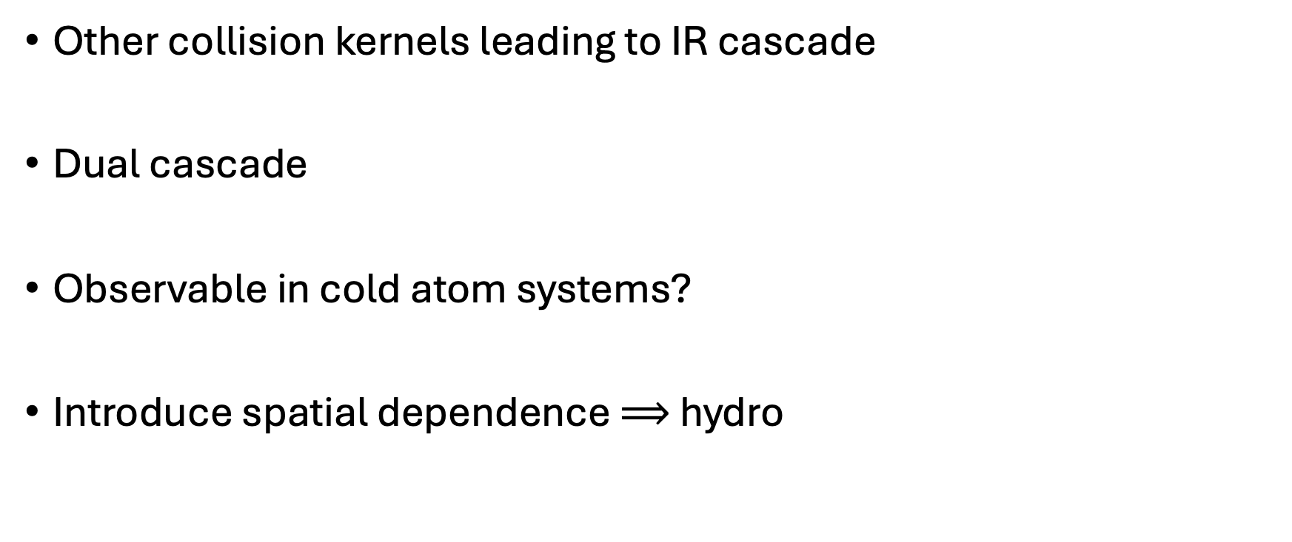
Outlook
Other collision kernels leading to IR cascade
Dual cascade
Observable in cold atom systems?
Introduce spatial dependence $⟹$ hydro

