Slide 1
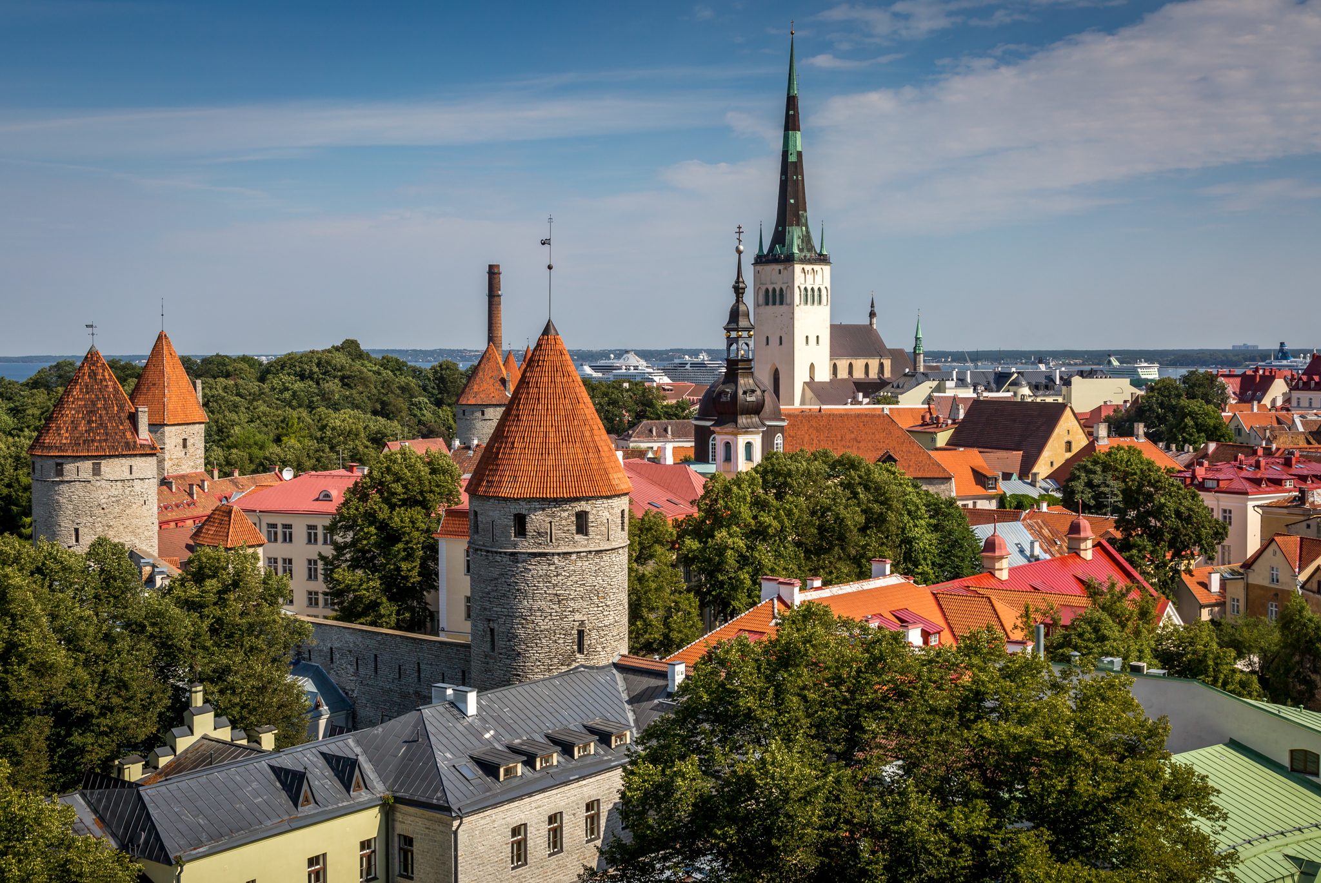
Multi-phase criticality
Martti Raidal
NICPB, Tallinn
2102.01084 [hep-ph]
2201.00824 [hep-ph]
2204.01744 [hep-ph]
Work in progress

Slide 2
Outline
Explain hierarchies in physics scales (absence of NP at the LHC) with:
Multi-phase criticality and Coleman-Weinberg mechanism
Freeze-out in DM induced multi-phase dynamical symmetry breaking
Freeze-in in DM induced multi-phase dynamical symmetry breaking
Conclusions

Slide 3
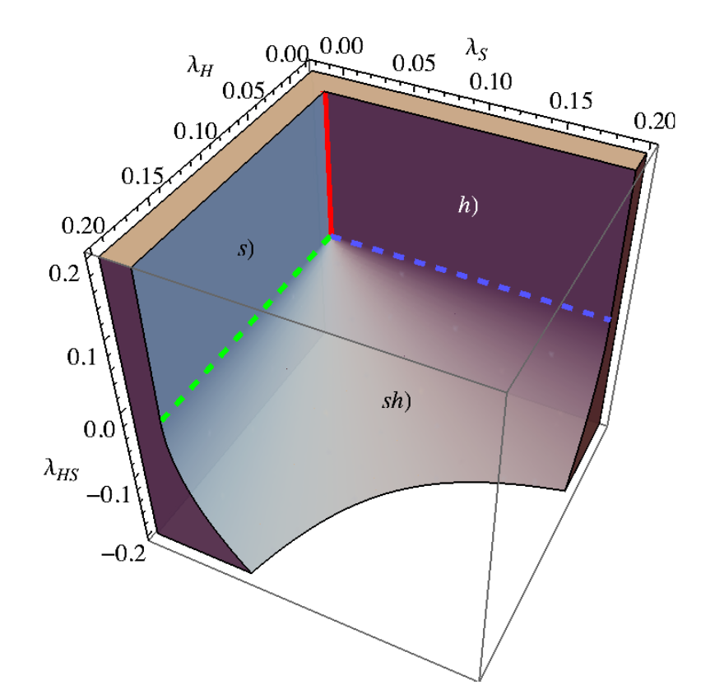
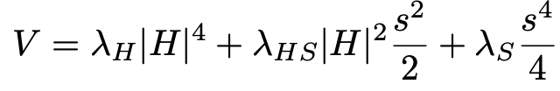






Classically scale invariant Higgs-Dilaton model
Phase
Phase
Phase
Multi-phase criticality: masses and mixings vanish

Slide 4
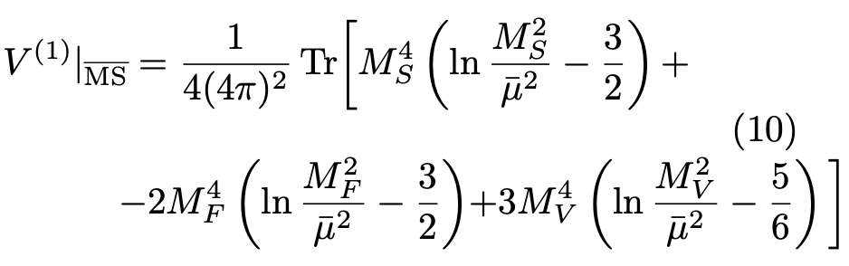
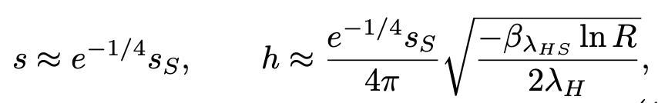

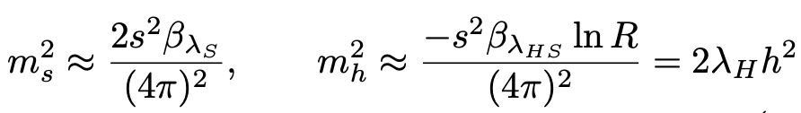
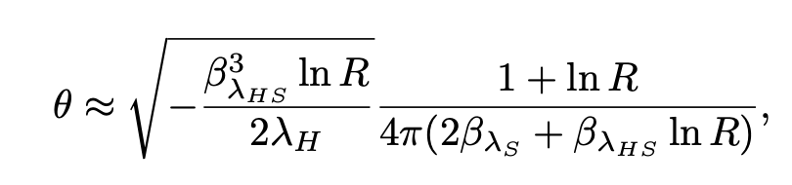
CW mechanism and multi-phase criticality
Dynamical symmetry breaking around the MP criticality: GW not good
𝜷-function suppressed
𝜷-function suppressed
𝜷-function suppressed
For small couplings the CW must be treated with better precision than the Gildener-Weinberg approximation

Slide 5
The origin of the effect
Arrange tree-level Gildener-Weinberg flat direction along the s-axis
Quantum effects bend the flat direction to a banana
Usually this is just neglected small effect
Due to the multi-phase criticality, the EW scale is loop suppressed

Slide 6

Comments
In realistic models couplings never run to zero at the same scale:
Small quartic couplings: inflaton 𝜆<10⁻¹², Higgs 𝜆(10¹⁰GeV), freeze-in
Top Yukawa affects perpendicular direction of the flat direction
In realistic models one need more scalar couplings to have dynamical symmetry breaking along the multi-phase criticality direction

Slide 7
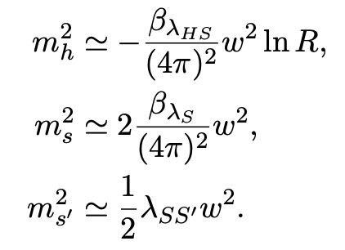
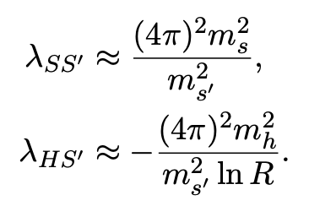
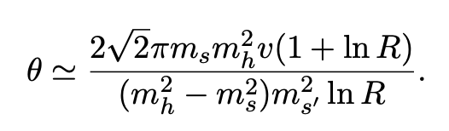
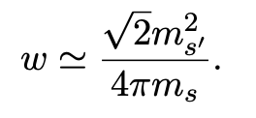
DM induced multi-critical dynamical symmetry breaking
The scalar model: the Higgs, a dilaton and scalar DM
Scalar DM must be heavy, the dilaton can be heavier or lighter than the Higgs boson
One scale w

Slide 8
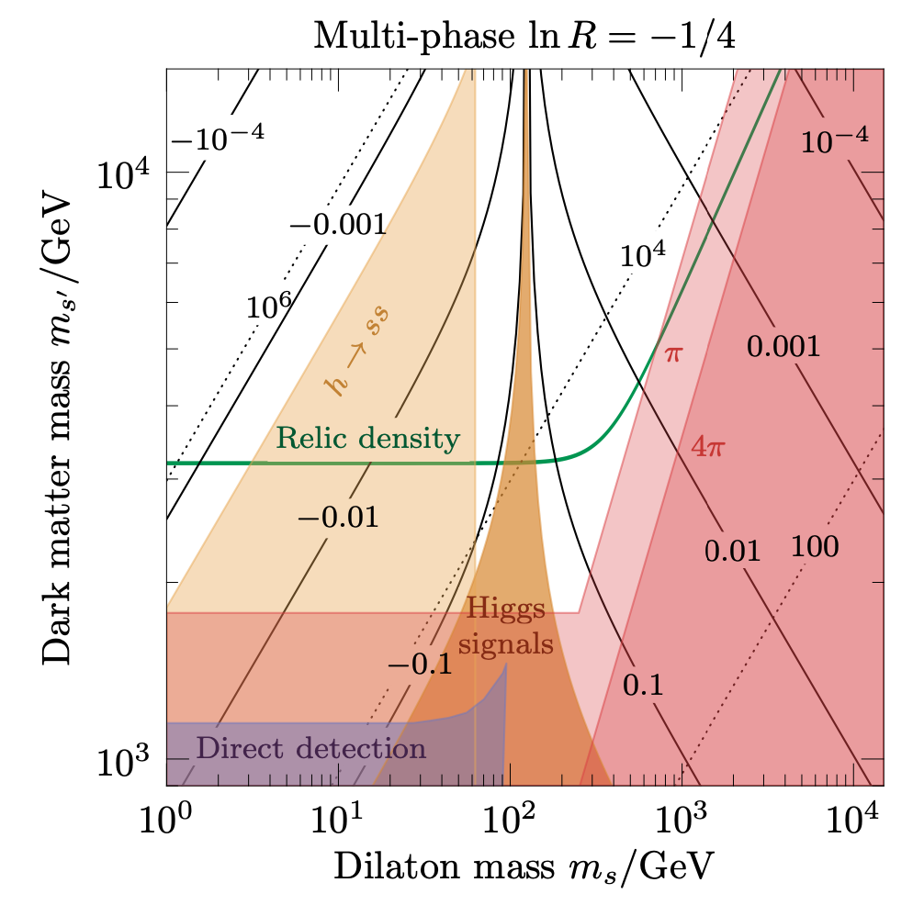
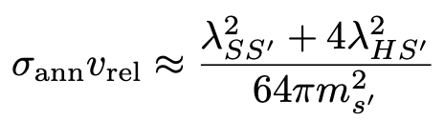


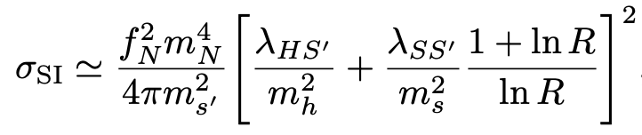
DM freeze out in this model

Slide 9
DM freeze out in the Gildener-Weinberg limit

Slide 10

DM freeze-in in the multi-critical framework
All scalar couplings, except the Higgs quartic, must be super small
Criticality naturally embedded:
A possibility: introduce RH neutrinos N
Neutrino masses and leptogenesis coming from the same framework

Slide 11
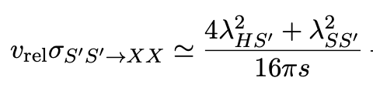
DM induced CW and freeze-in results
Dilaton never thermalizes

Slide 12
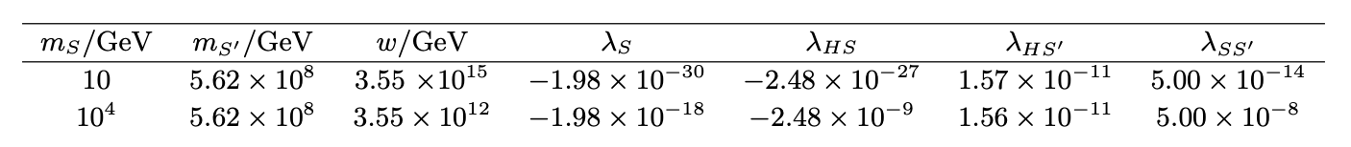
DM induced hierarchy in scales

Slide 13
Conclusions
Multi-phase criticality combines “small” and “large” scalar couplings
The scalar DM is heavy, it triggers the CW and the loop-suppressed EW scale
Huge but technically natural hierarchy between the EW and DM scales
Neutrino masses and leptogenesis may be obtained in a standard way
This scenario predicts one more light scalar, the dilaton, which may be lighter or heavier than the SM Higgs boson.

