Slide 1
Proton and ion filling schemes for the LHC
Accelerators
  Cycles & supercycles
  CERN’s accelerator complex, quick virtual tour of the (old) proton chain
Production of the LHC proton beam
  Linac: intensity
  PSB: emittance
  PS: bunch structure
  SPS: bunch placement in the LHC
Production of the LHC ion beam:
modifications to the existing complex
  ECR source + Linac 3
  LEIR, the Low Energy Ion Ring
  The “Proton” Synchrotron
  The TT2 transfer line
  The “nominal” scheme

Slide 2
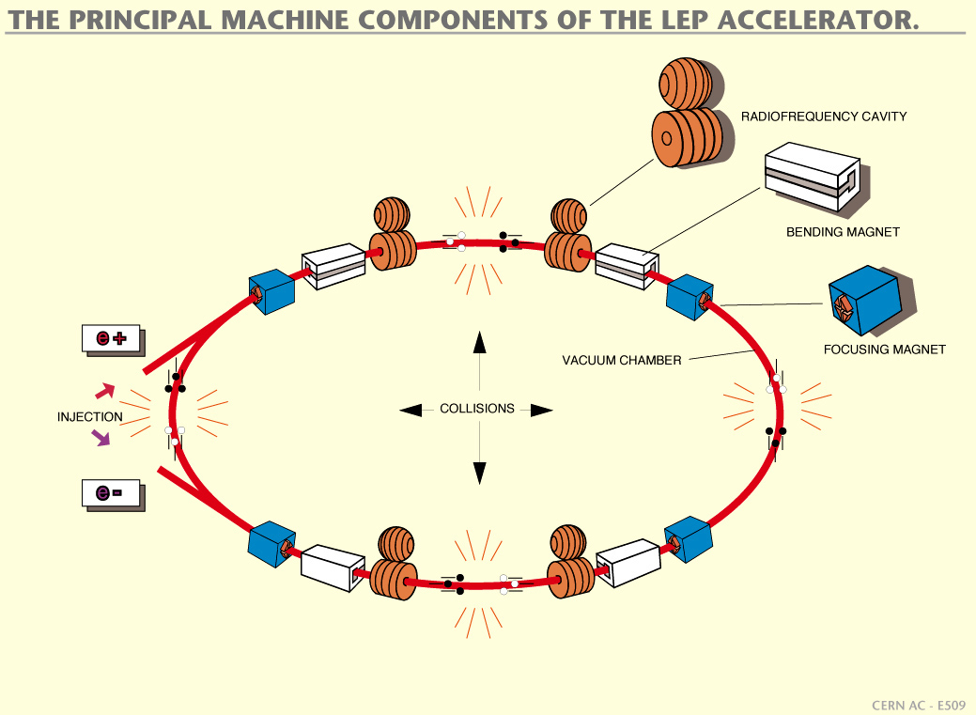

Slide 3
Cycles & Supercycles
Cycle:
  Injection plateau or flat bottom
  acceleration ramp
  ejection plateau or flat top
  field decrease ramp
B
I_{P}

Slide 4
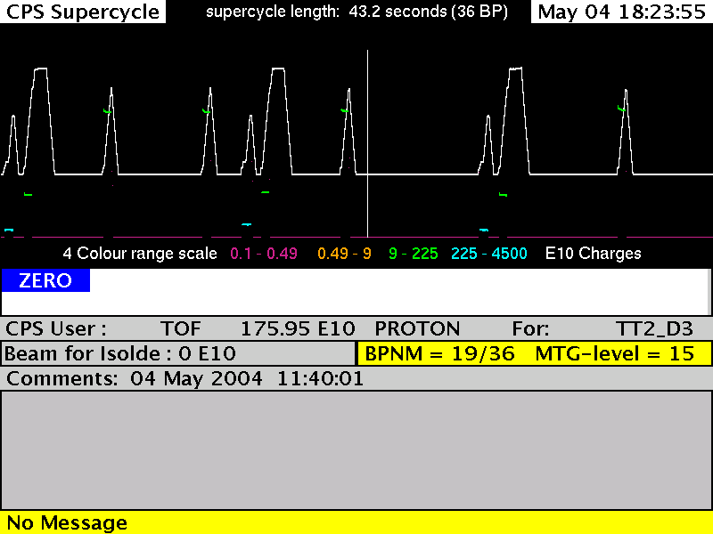
PS Supercycle
Energy, Intensity, Destination…

Slide 5
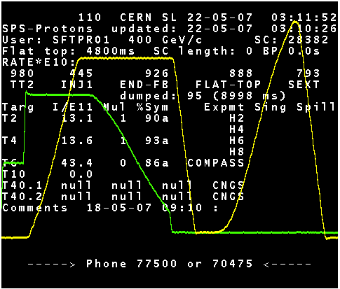
SPS supercycle
Extraction
Double
injection
Acceleration ramp
Fixed target cycle
LHC pilot cycle

Slide 6
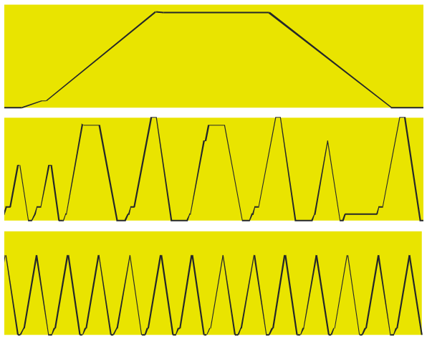
Cycles & Supercycles
SPS
CPS
PSB

Slide 7
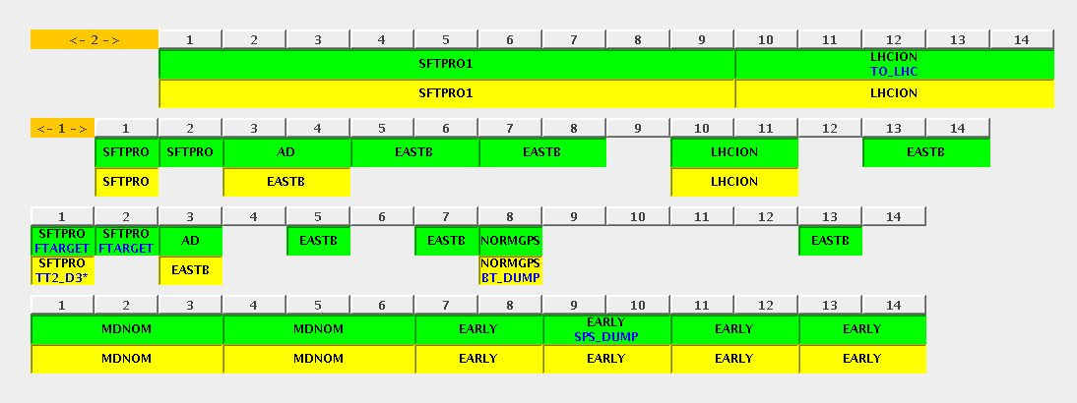
Cycles & Supercycles

Slide 9
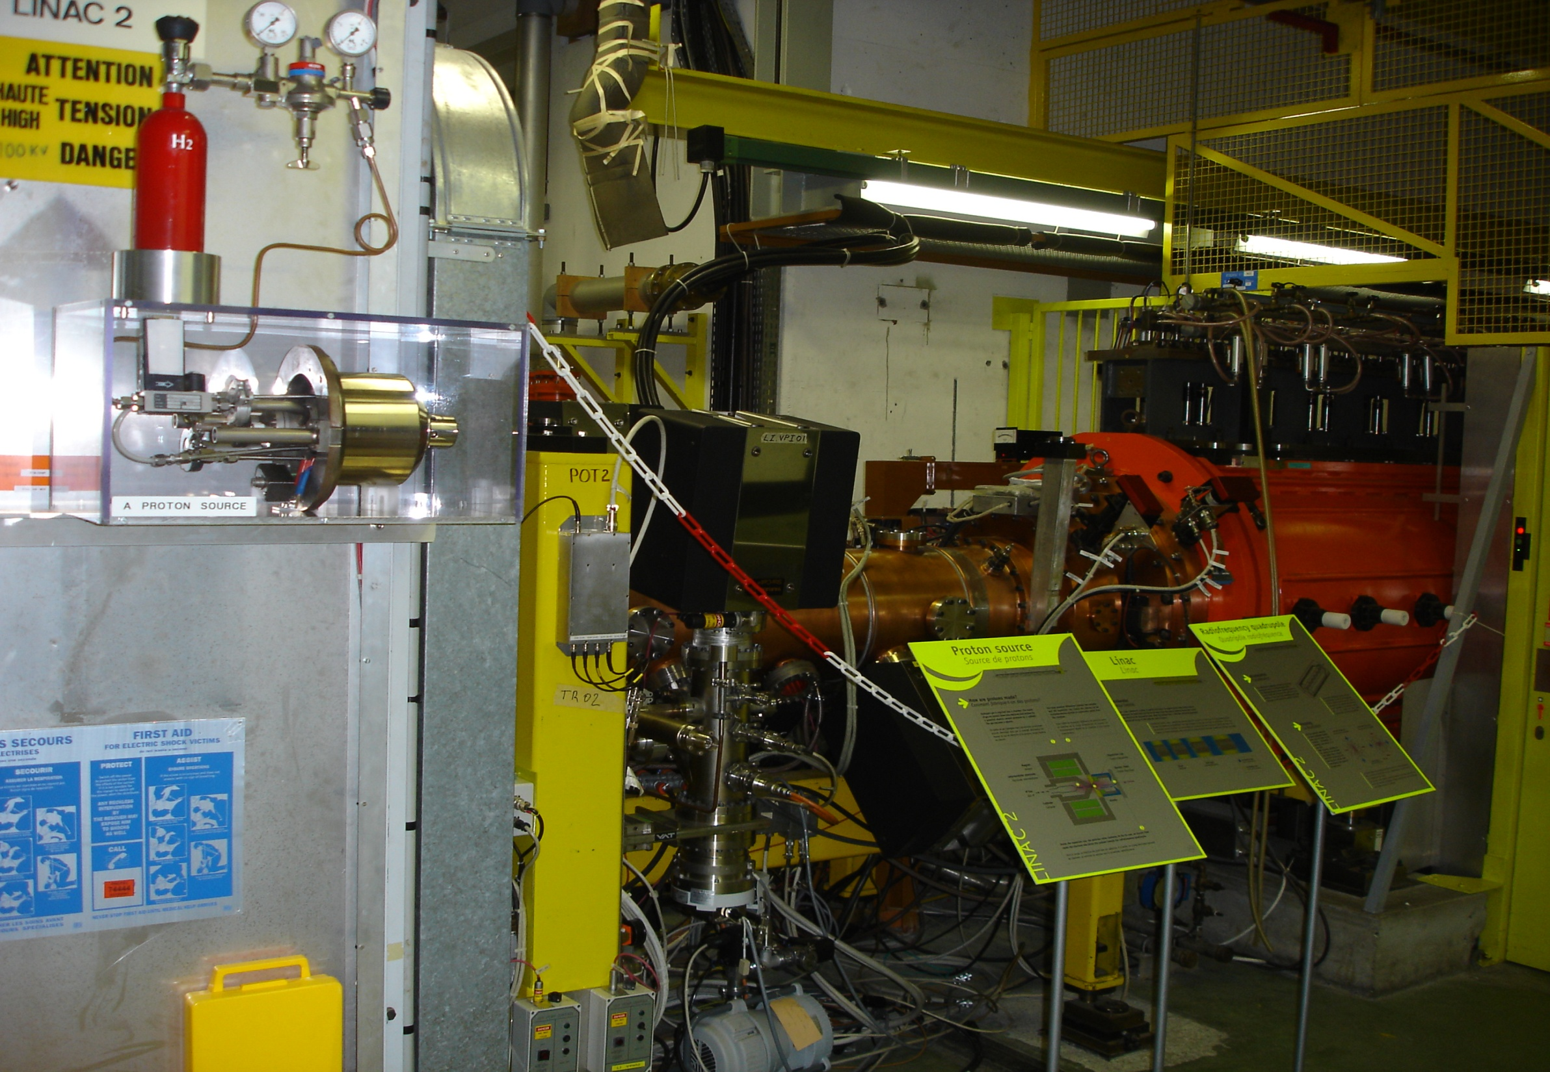
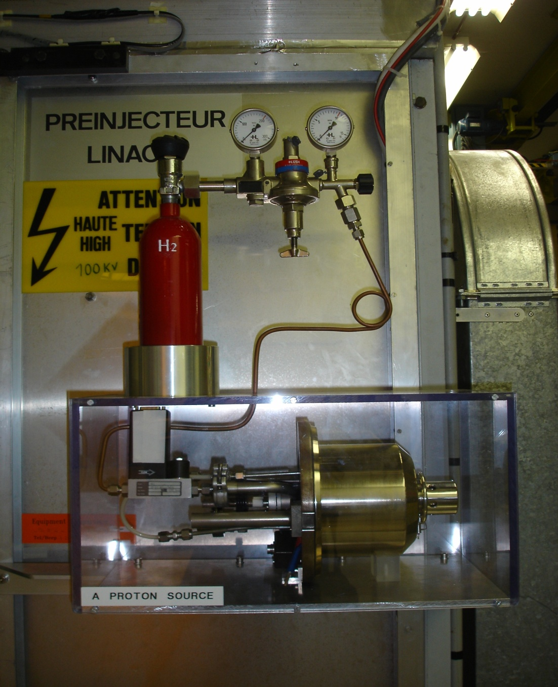
Duoplasmatron proton source
90keV ; 500mA
Radio Frequency Quadrupole (RFQ)
~1m ; 750keV

Slide 10
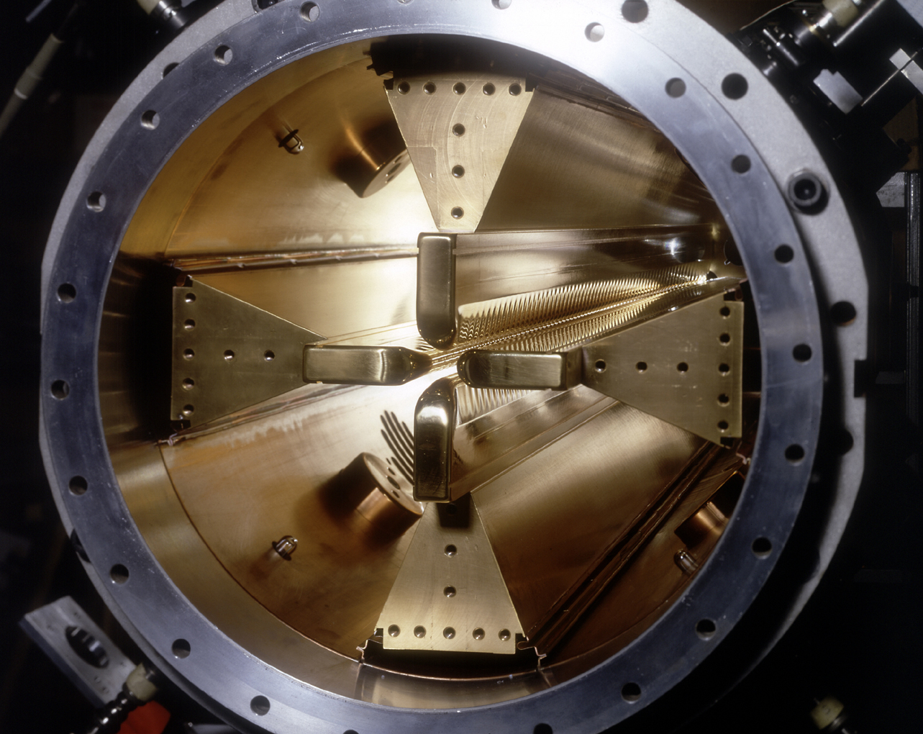
The accelerator complex at CERN
PSB, PS, SPS
Radio Frequency Quadrupole (RFQ)
~1m ; 750keV

Slide 11
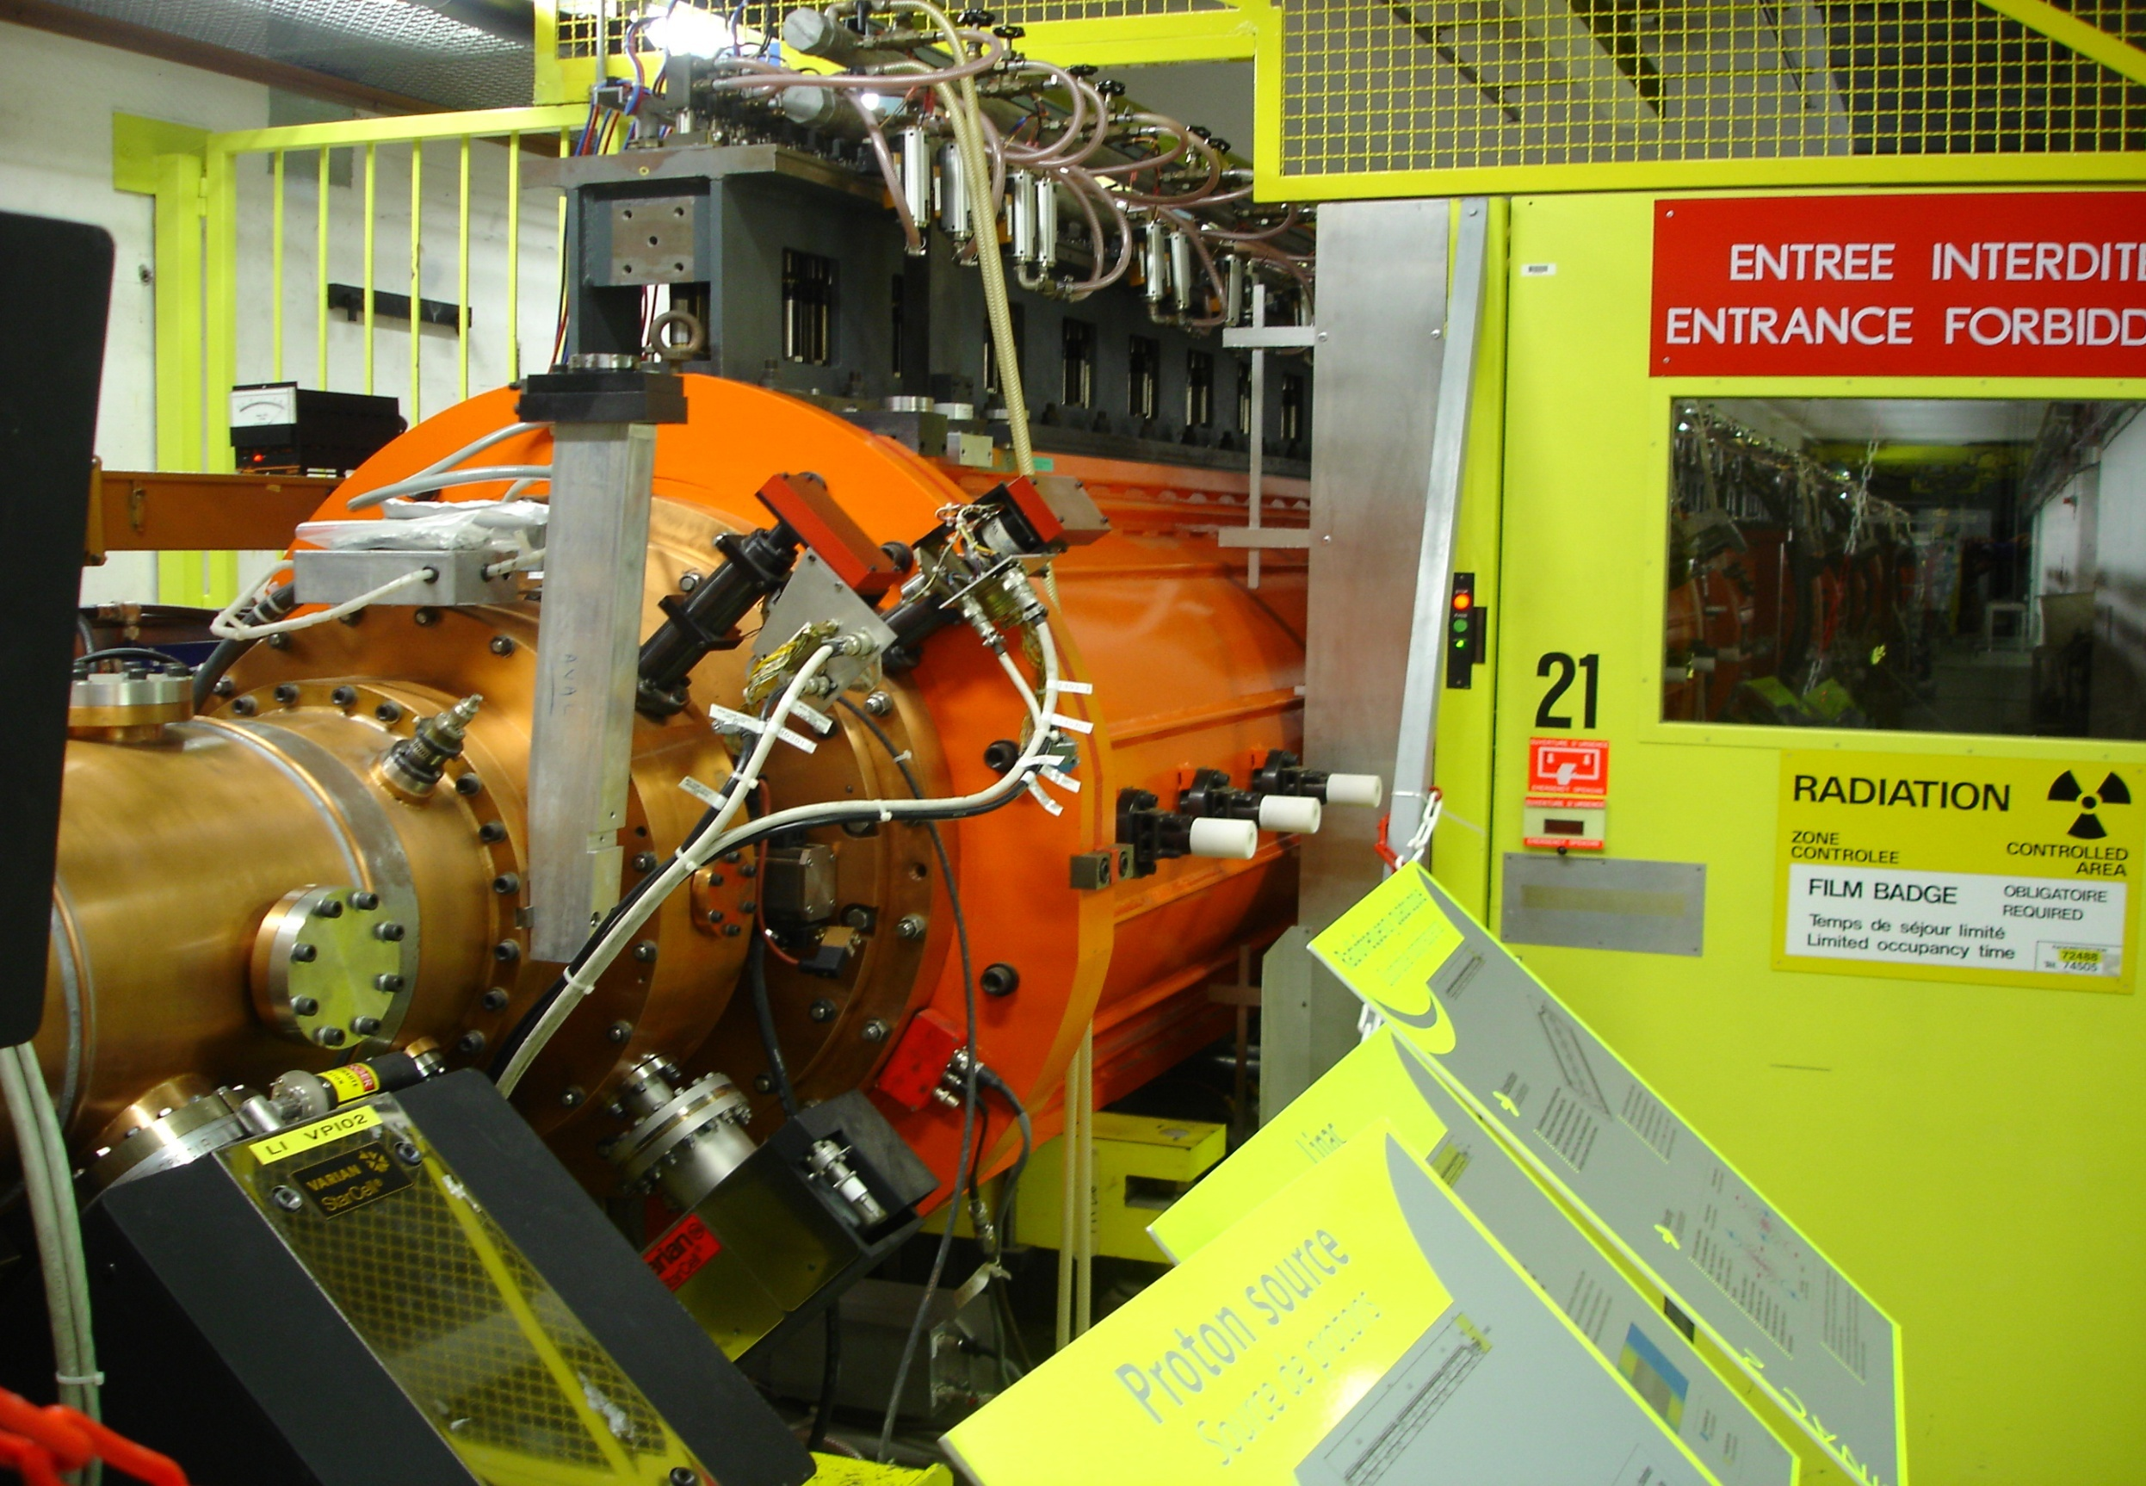
Linac 2
30m ; 50MeV ; 180mA

Slide 12
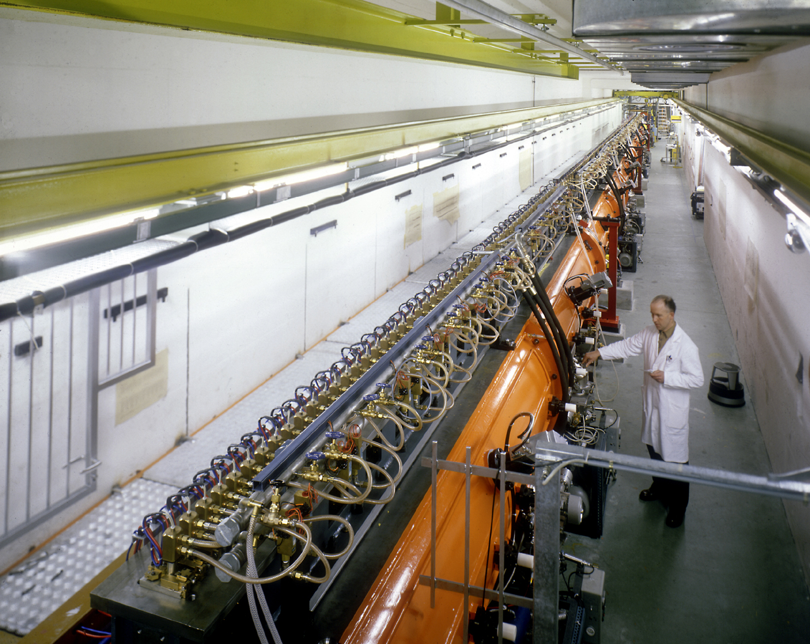
Linac 2
30m ; 50MeV ; 180mA

Slide 13
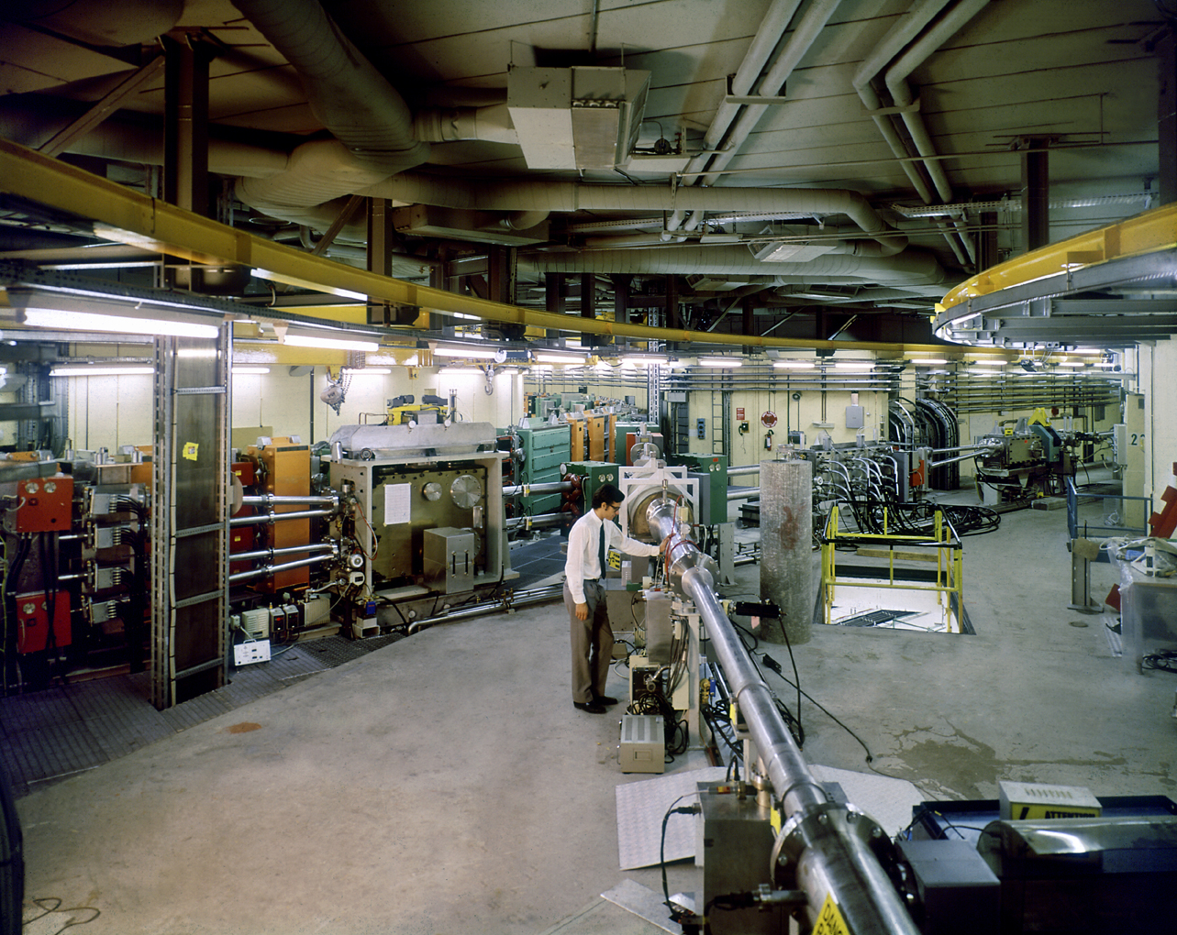
PSB distributor
Transfer line from Linac 2 to Proton Synchrotron Booster (PSB)

Slide 14
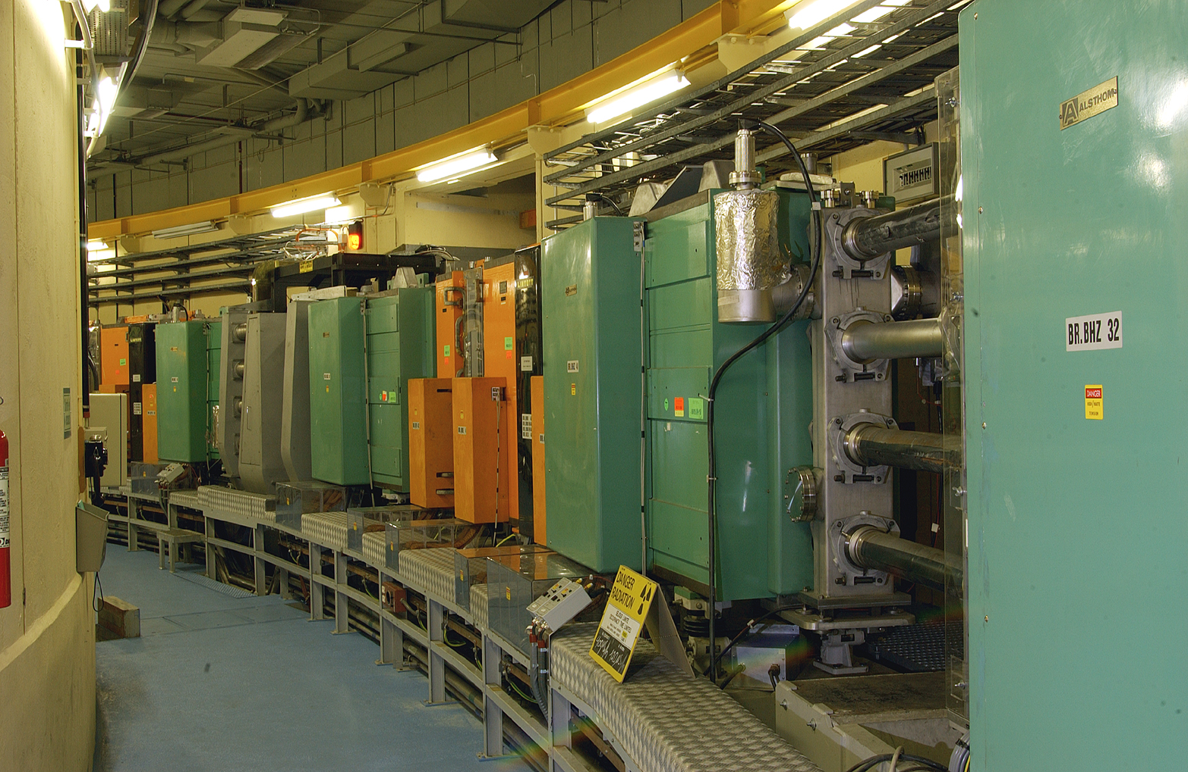
Proton Synchrotron Booster
4 rings ; 157m each
1.4GeV ; 10¹³ p⁺/ring

Slide 15
Extraction line from PSB to Proton Synchrotron (PS)
& Isolde
Individual extraction lines from each ring of the PSB
Recombinations
1+2 & 3+4
Recombinations
(1-2) + (3-4)

Slide 16
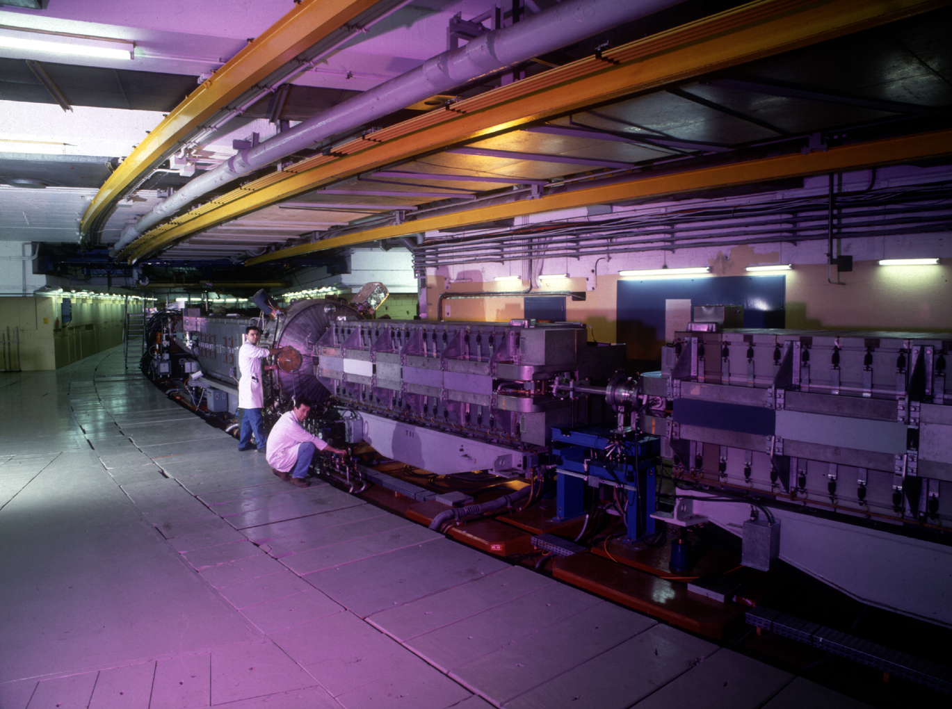
Proton Synchrotron (1959)
628 m
25 GeV ; 3x10¹³ p⁺
[5.9 GeV/u Pb⁵⁴⁺]

Slide 17
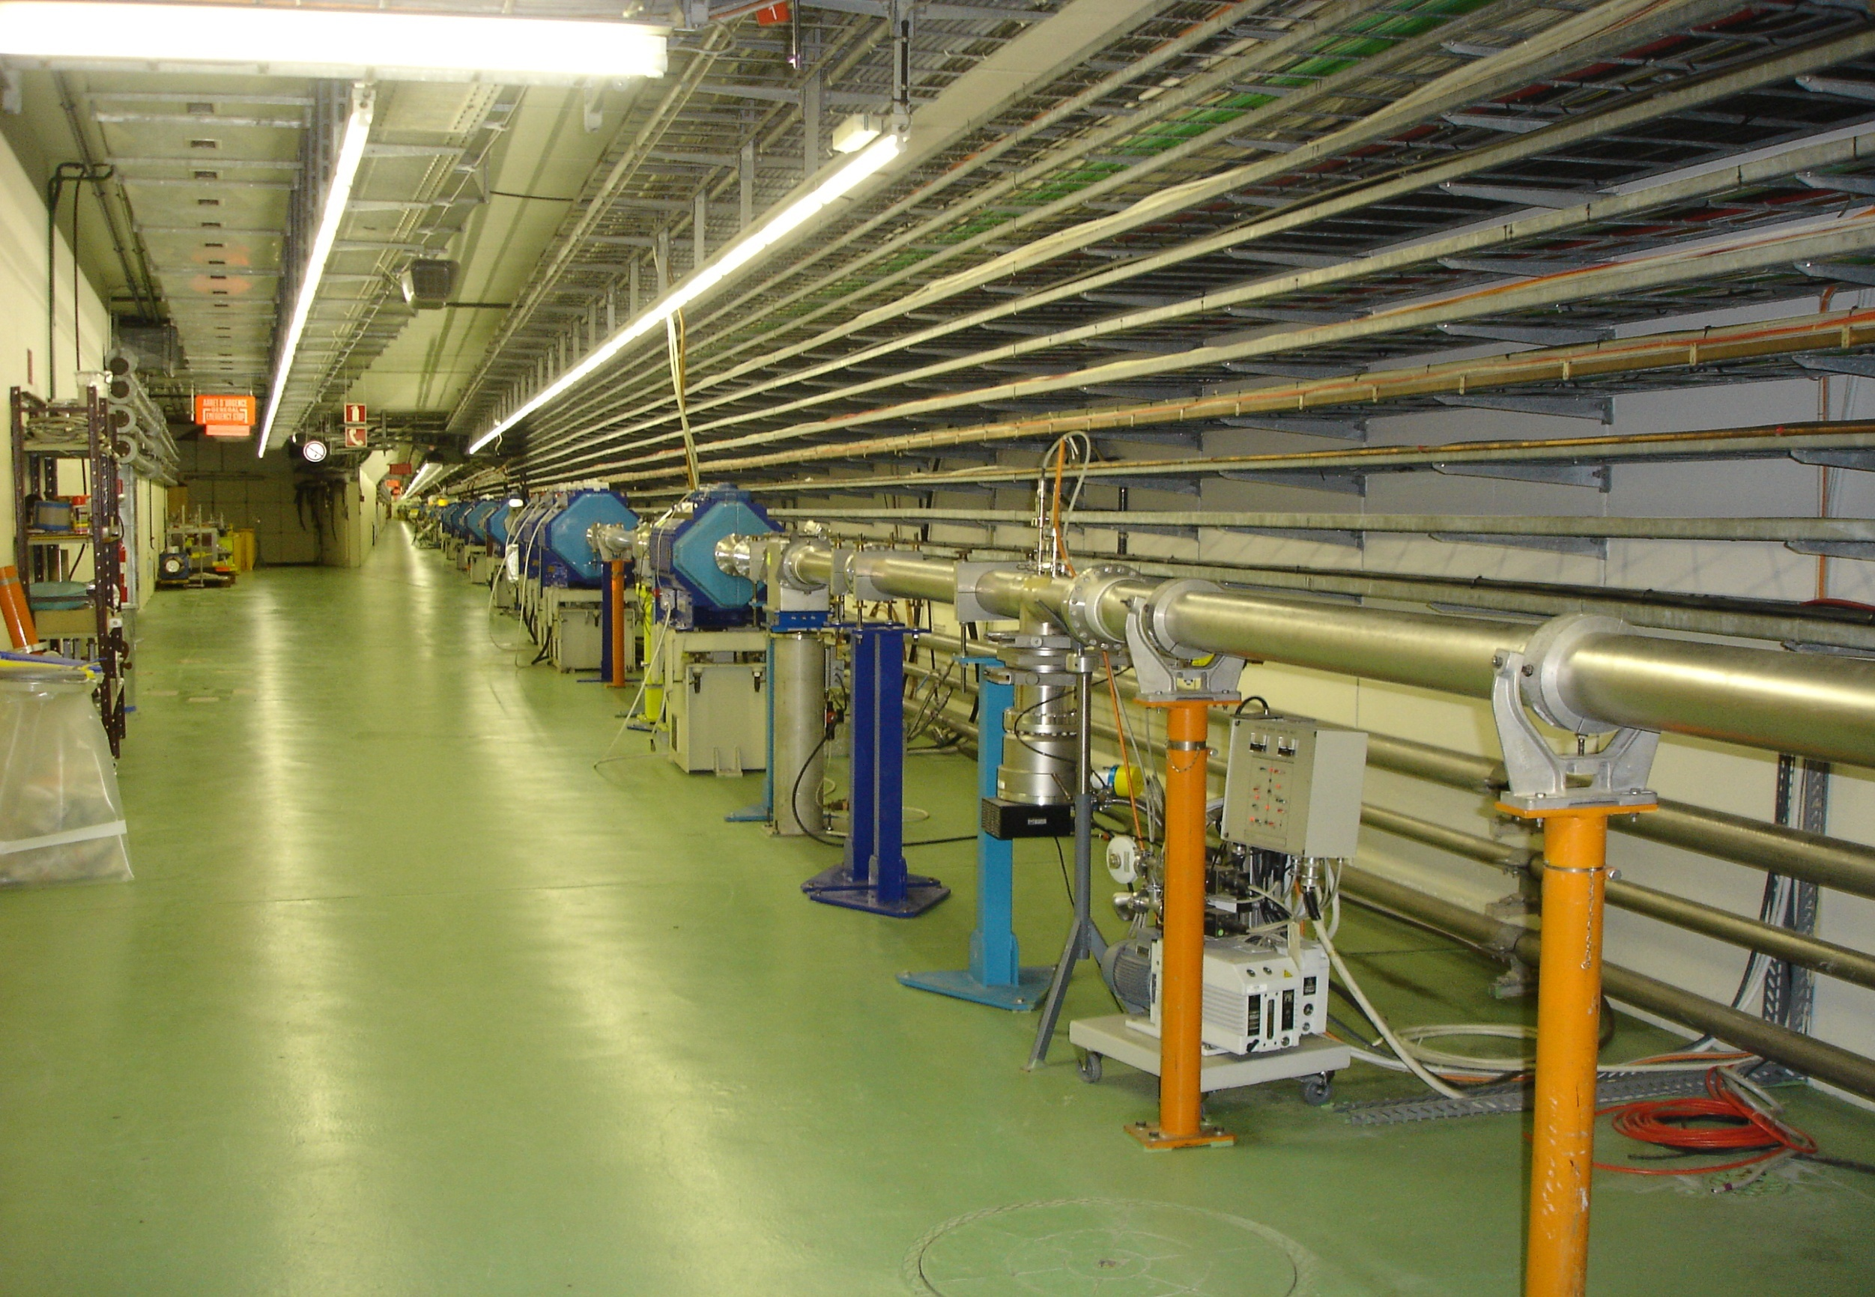
TT2 transfer line from PS to SPS, AD, nTOF, and D3 dump

Slide 18
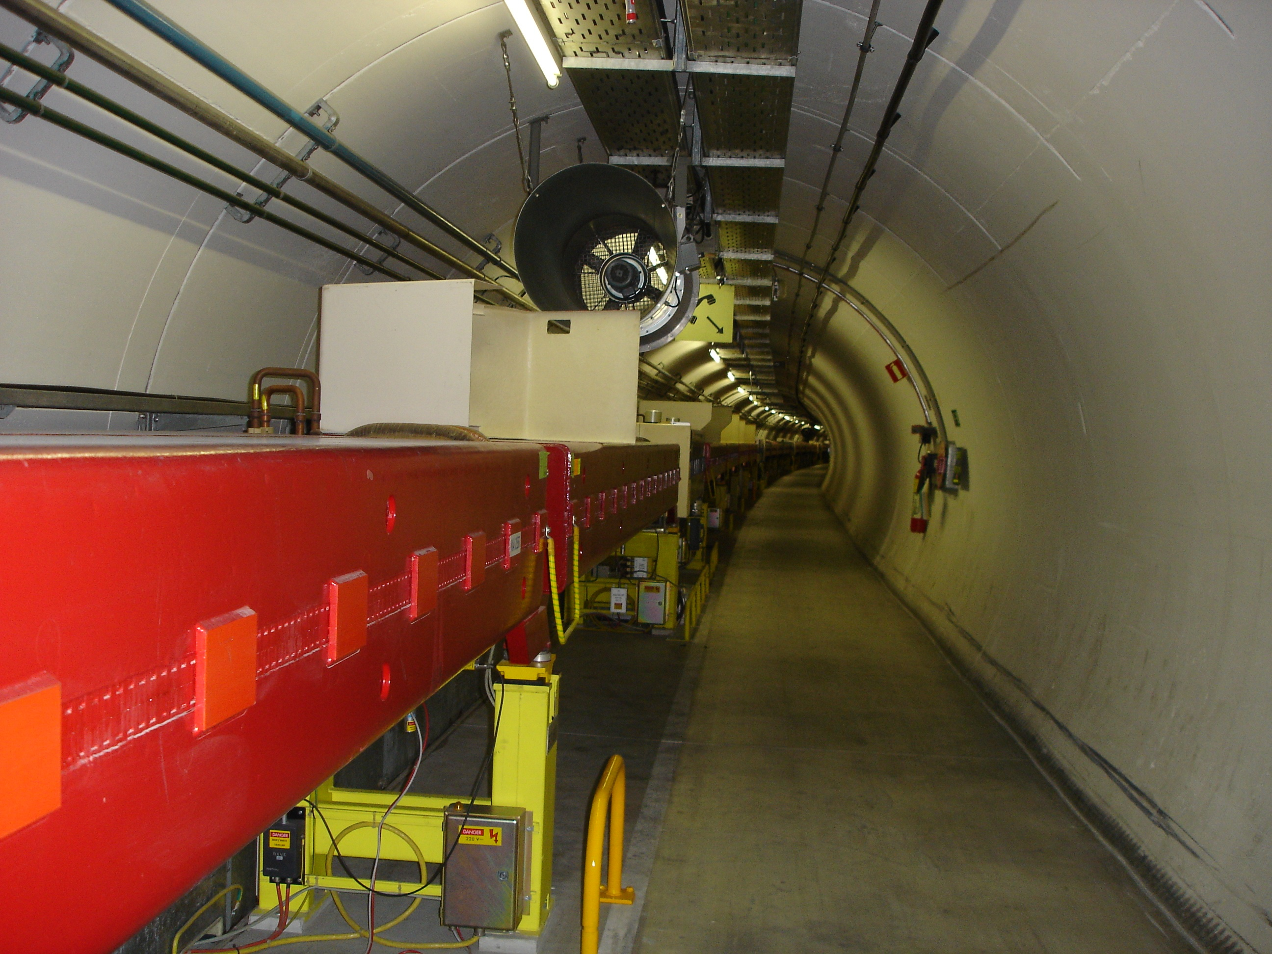
Super Proton Synchrotron (SPS)
6.9 km
450 GeV ; 5x10¹³ p⁺
[177 GeV/u Pb⁸²⁺]

Slide 19
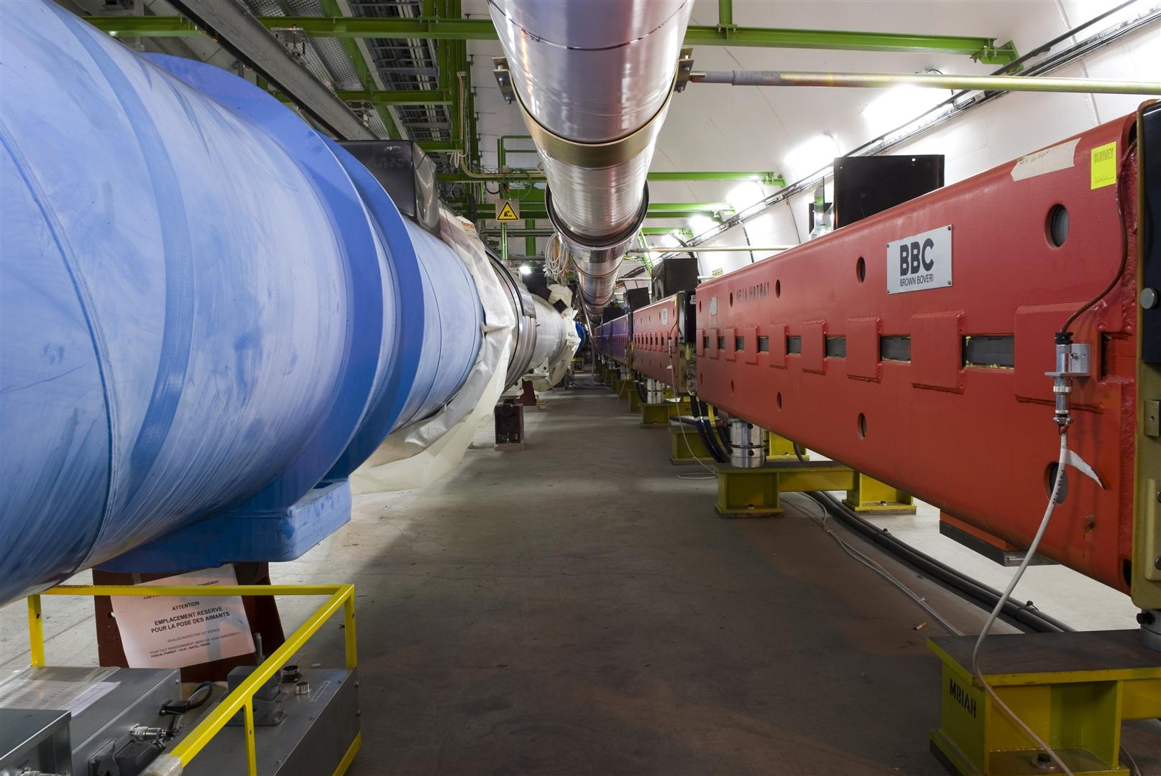
TI8 counter-clockwise transfer line from SPS to LHC

Slide 20
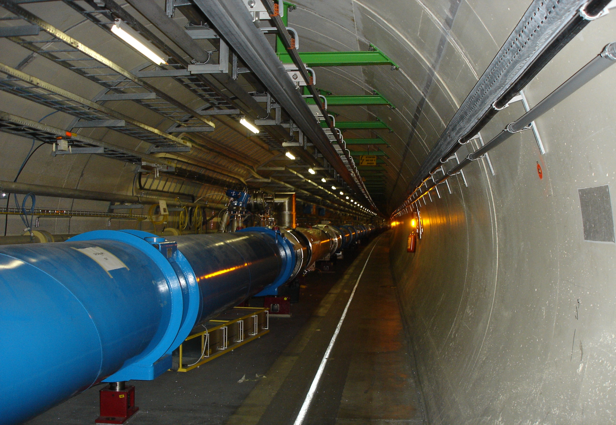
Large Hadron Collider (LHC)
2 interleaved rings; 26.7 km
7 TeV ; 3x10¹⁴ p⁺/ring
[2.8 TeV/u Pb⁸²⁺]

Slide 21
Proton beam production for LHC
  Linac2 (50MeV)
  PSB (1.4GeV) 4+2 bunches
  PS (25GeV) 72 bunches
  SPS (450 GeV) 4 x 72 bunches
  LHC (7 TeV) 2 x 2808 bunches

Slide 22
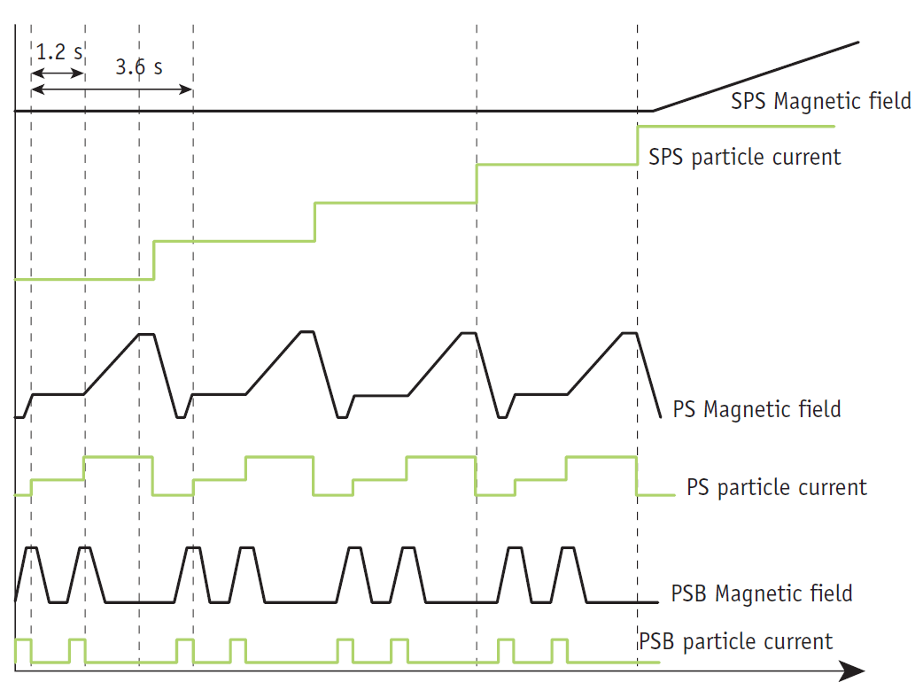

Slide 23
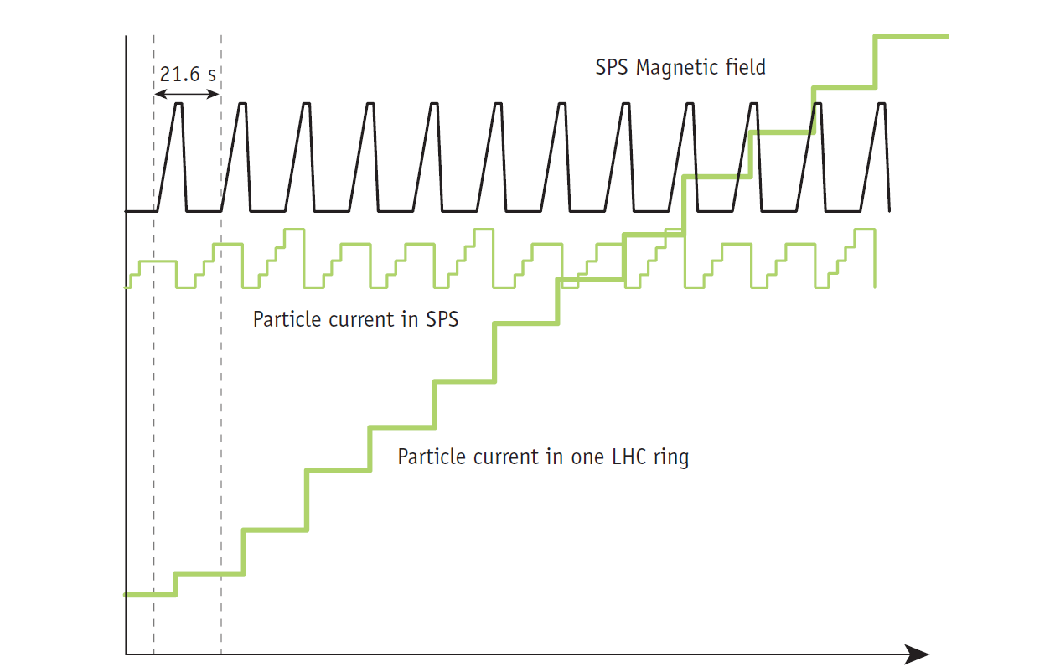

Slide 24
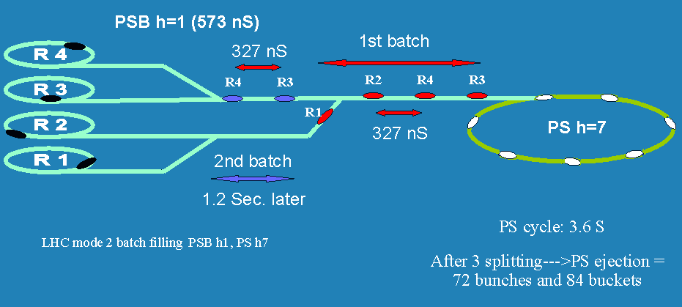
Double batch injection from PSB to PS
[M.Lindroos]

Slide 25
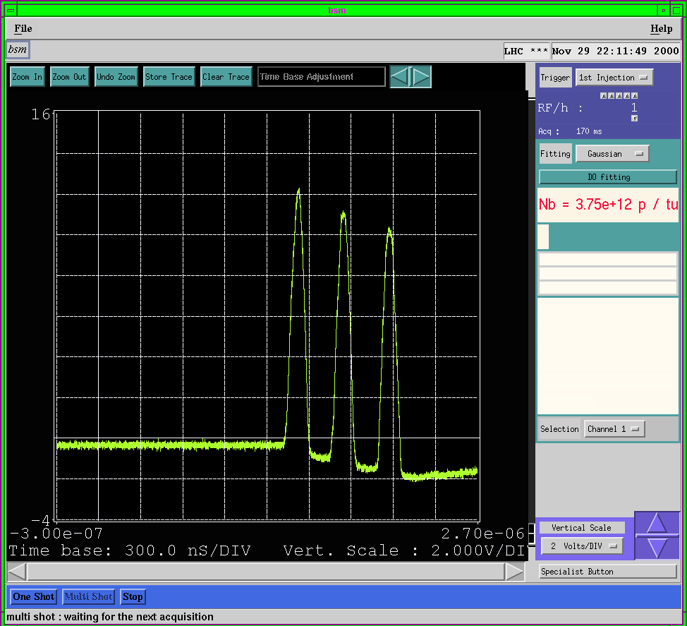

Slide 26
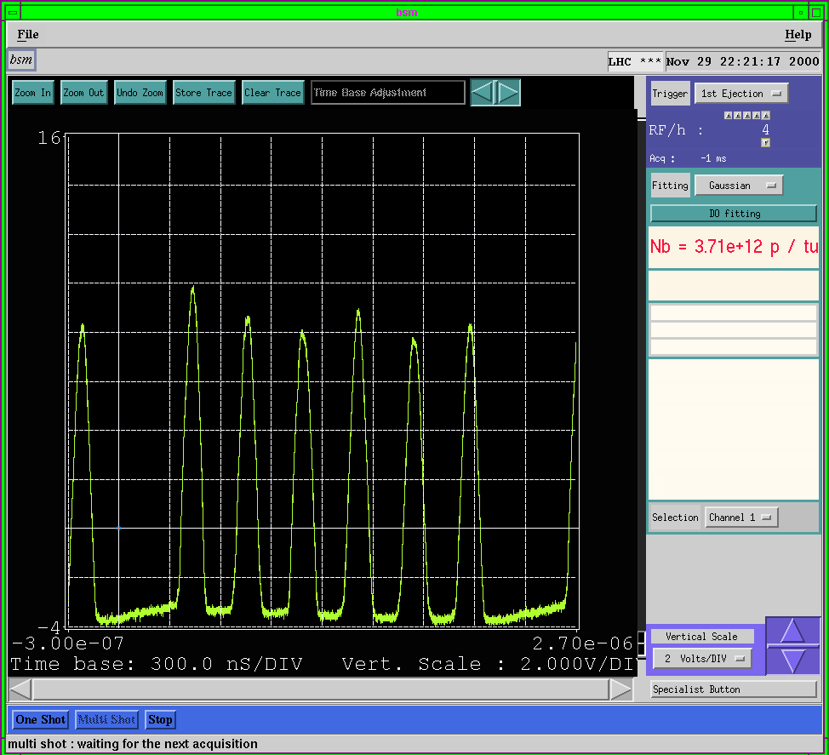

Slide 27
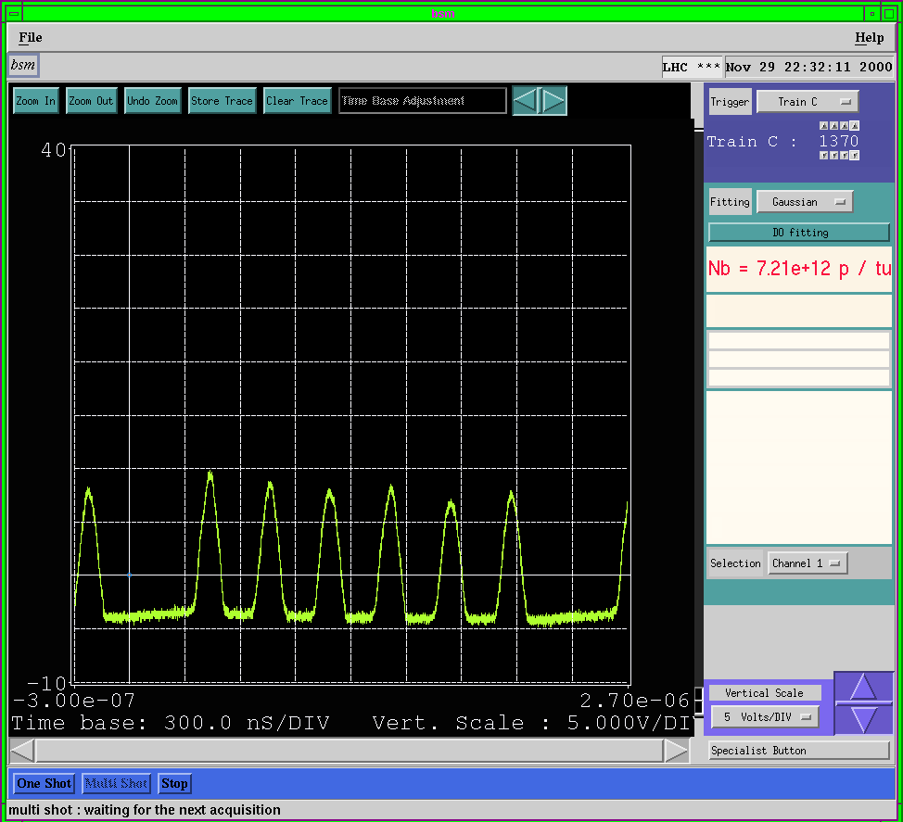

Slide 28
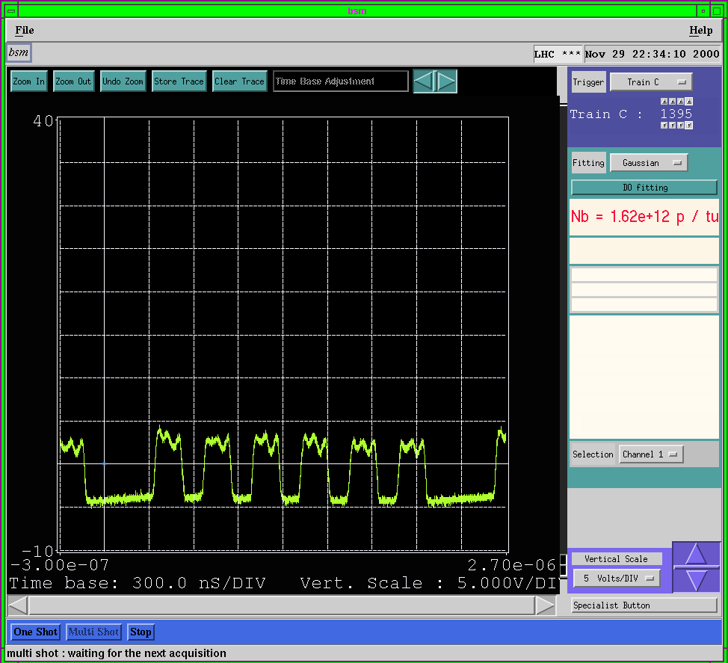
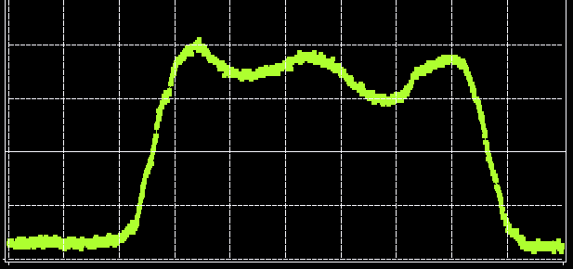

Slide 29


Slide 30


Slide 31

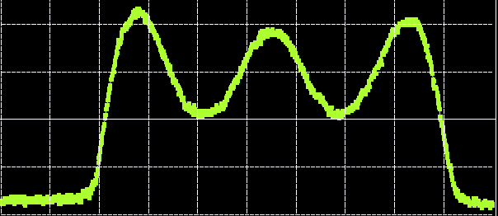

Slide 32

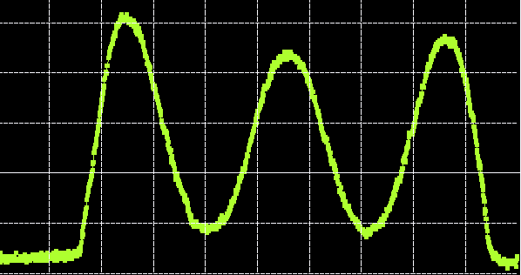

Slide 33

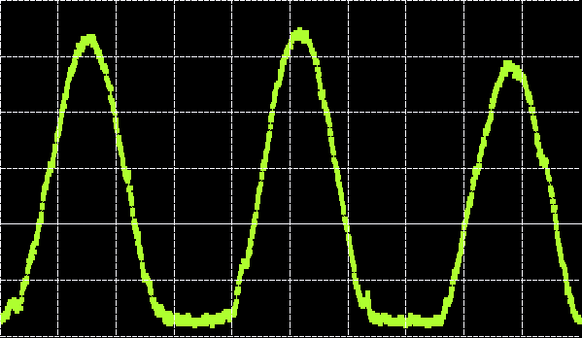

Slide 34
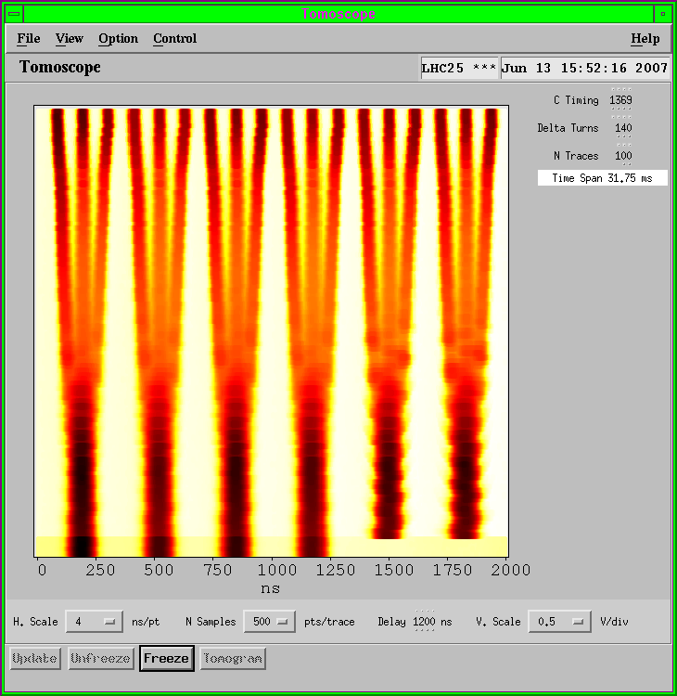
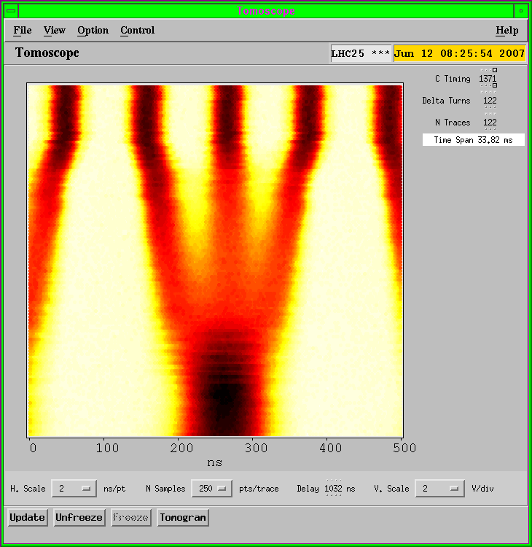
Triple bunch splitting in PS
“Waterfall” representation: V=time, H=position, colour=density
time
position

Slide 35
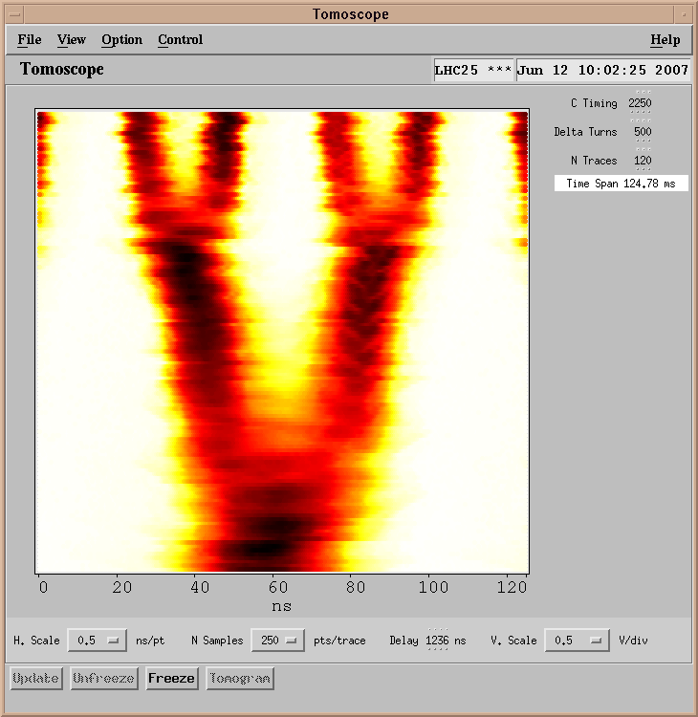
Two more bunch splittings in PS

Slide 36
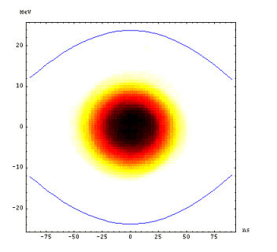

Slide 37


Slide 38
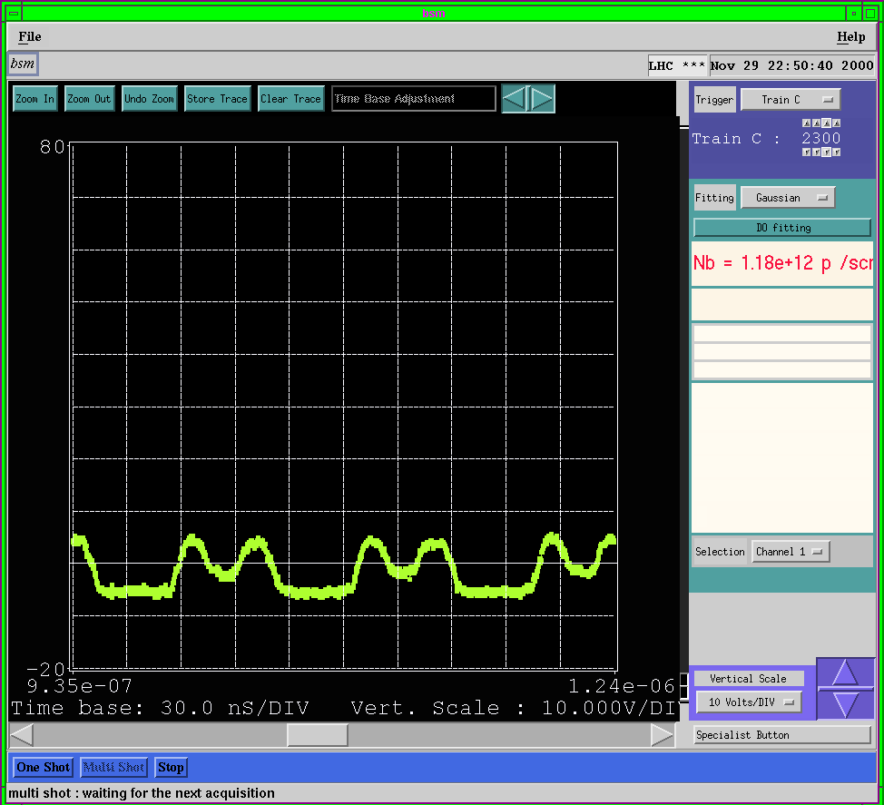

Slide 39
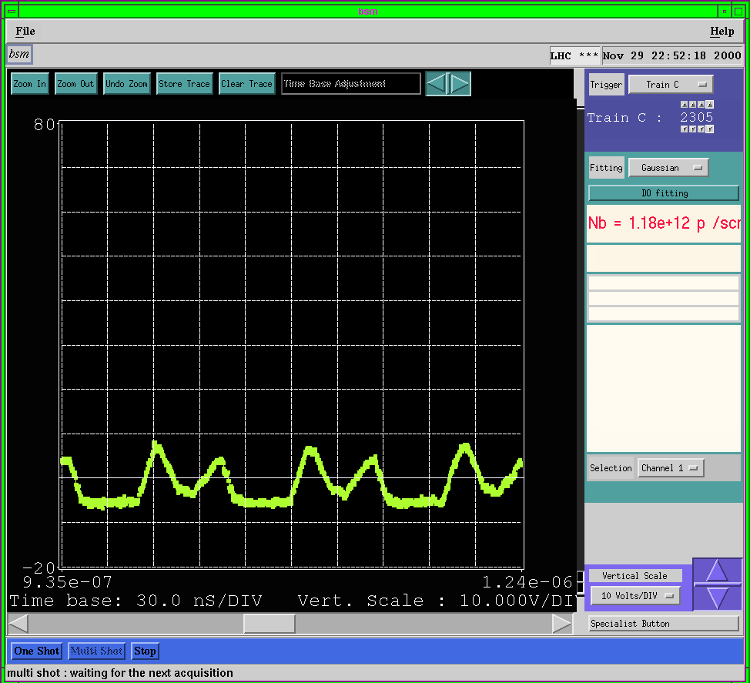

Slide 40


Slide 41


Slide 42
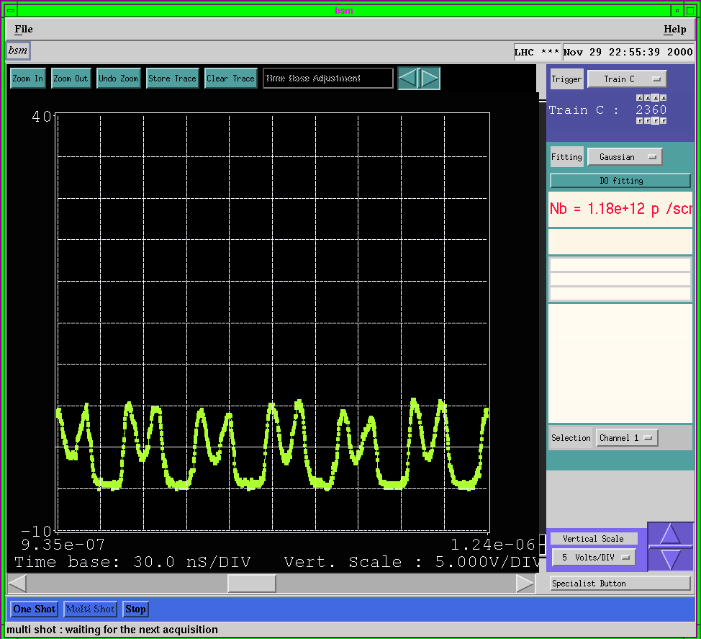

Slide 43
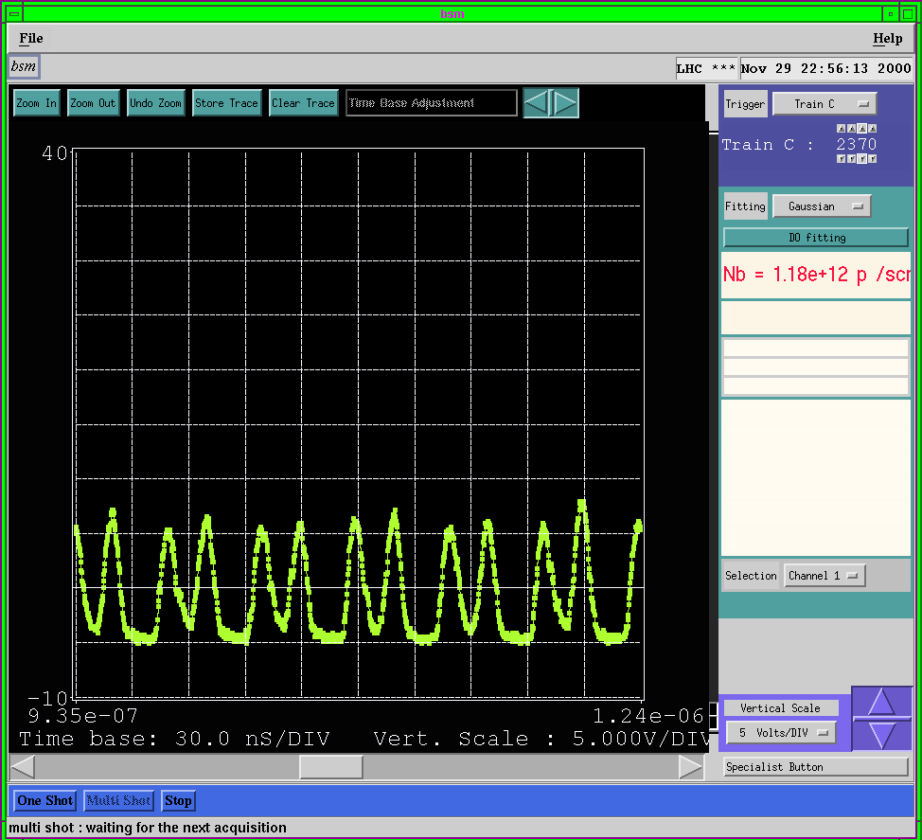

Slide 44


Slide 45


Slide 46
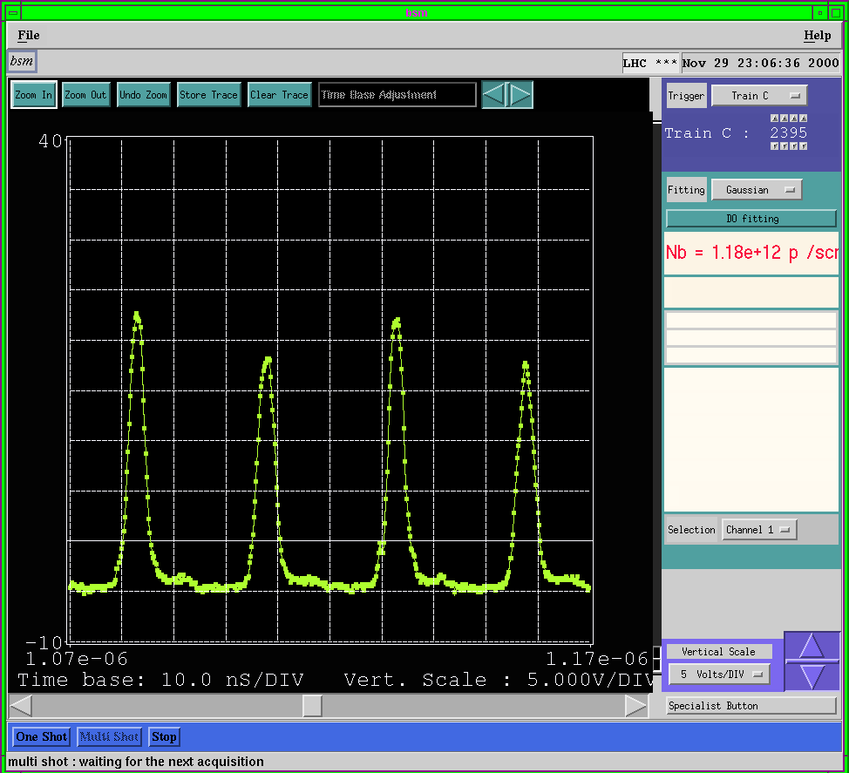

Slide 47
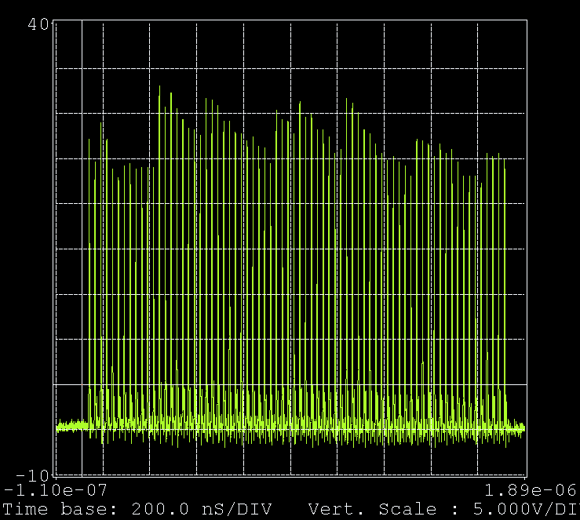
72-bunch train ready to be sent to `the SPS

Slide 48
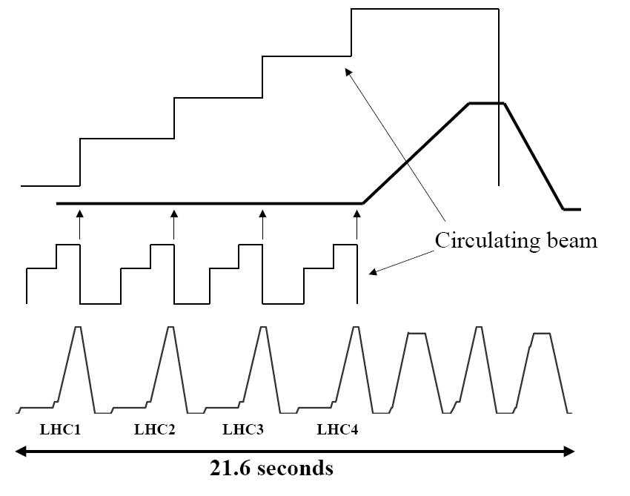
4 bunch trains from PS to SPS

Slide 49
1.2 s
3.6 s
SPS magnetic field
Intensity in SPS
in
PS magnetic field
Intensity in PS
PSB magnetic field
Intensity in PSB

Slide 50
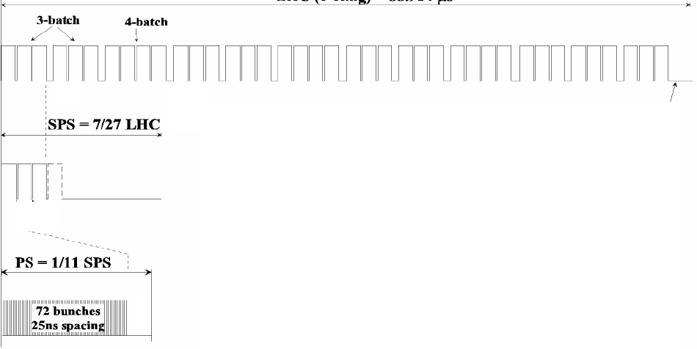
12 injections from SPS to LHC
The gaps between trains are necessary to make room for rise/fall times of injection/ejection/abort kicker magnets.

Slide 51
Ion beam production for LHC
  Linac3
  LEIR
  PS
  SPS
  LHC

Slide 52
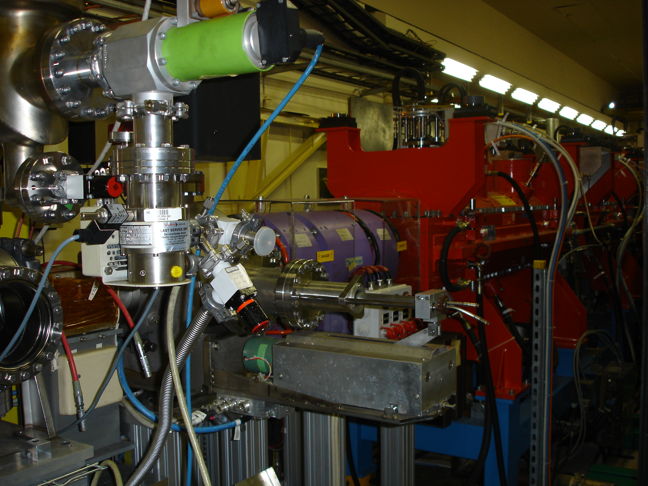
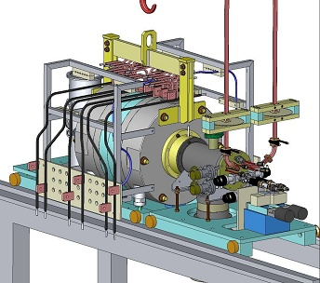
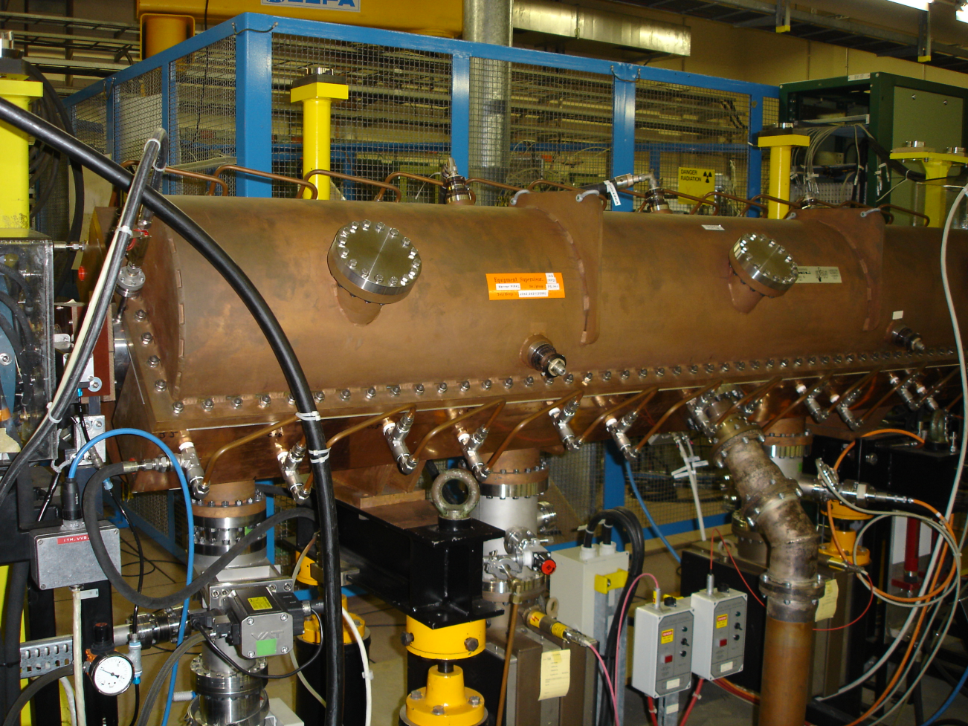

Slide 53
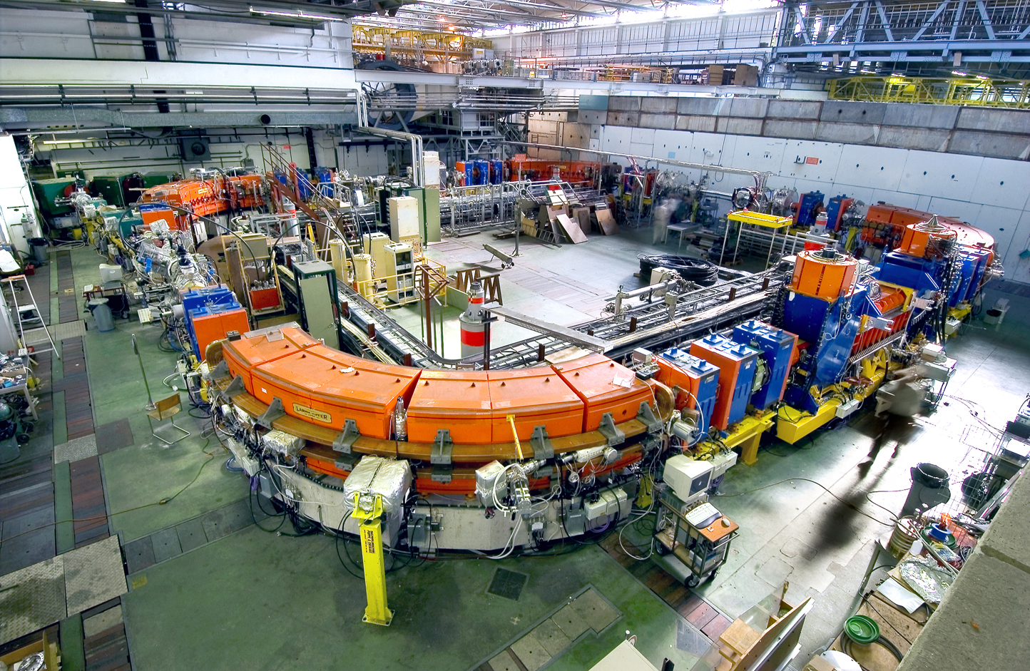

Slide 54
Lead ion injector chain
ECR ion source (2005)
  Provide highest possible intensity of Pb²⁹⁺
RFQ + Linac 3
  Adapt to LEIR injection energy
  strip to Pb⁵⁴⁺
LEIR (2005)
  Accumulate and cool Linac 3 beam
  Prepare bunch structure for PS
PS (2006)
  Define LHC bunch structure
  Strip to Pb⁸²⁺
SPS (2007)
  Define filling scheme

Slide 55


ECR ion source, RFQ, Linac 3
Re-designed after Fixed Target programme (1990’s)
Injection into PS Booster insufficient performance for I-LHC
  Source upgrade (still ongoing)
  Increase of Linac3 repetition rate to 5Hz
  Injection into a new storage ring: LEIR

Slide 56
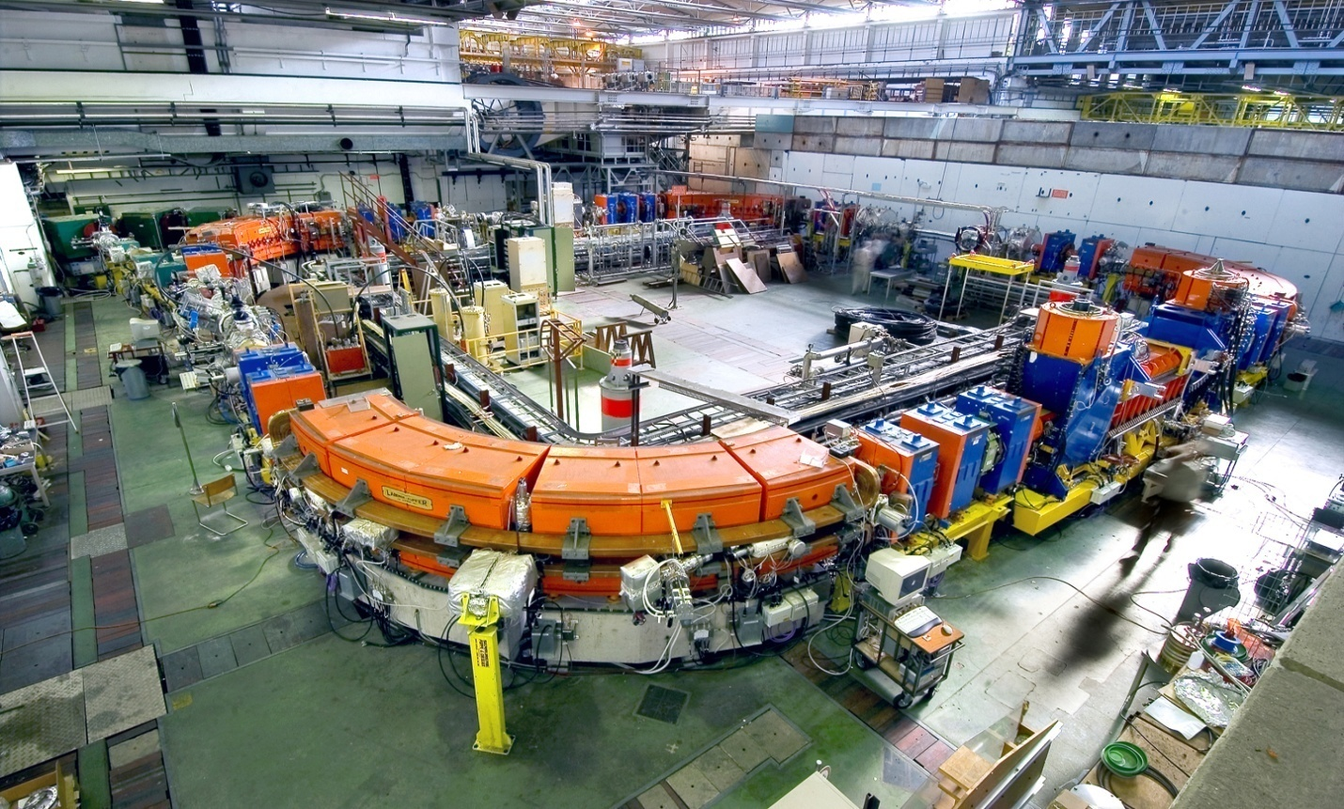
LEIR
Accumulate enough ions for LHC bunches
Keep their H, V and // emittances small
Bring Linac3 ion beam to PS injection
energy range
3 plane stacking
Cooling
Acceleration

Slide 57
LEIR layout
Square shaped “circular machine”
Circumference = 78.54m
= PS/8 = SPS/88
Operated below transition γ_{t}≈2.87
4x90º bending magnets
2 SS’s with Q doublets, 2 SS’s with Q triplets,
Common injection/ejection line
Electron cooling
(M.Chanel)

Slide 58
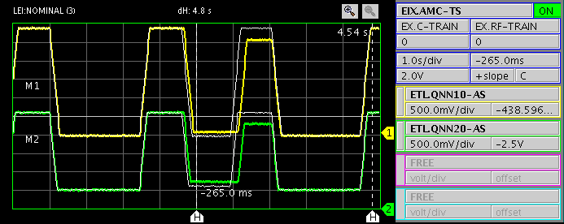
Injection and ejection lines
Part of the line is used for
injection at 4.2 MeV/u and
extraction at 72 MeV/u:
-> laminated, pulsed magnets
-> Complicated behaviour for the power converters
Ejection
PS ring
ITE loop
LEIR ring
Bi-directional ETL line
Linac 3
Injection
(C.Carli)

Slide 59
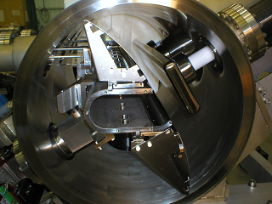
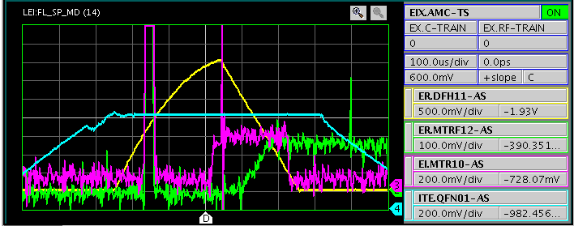
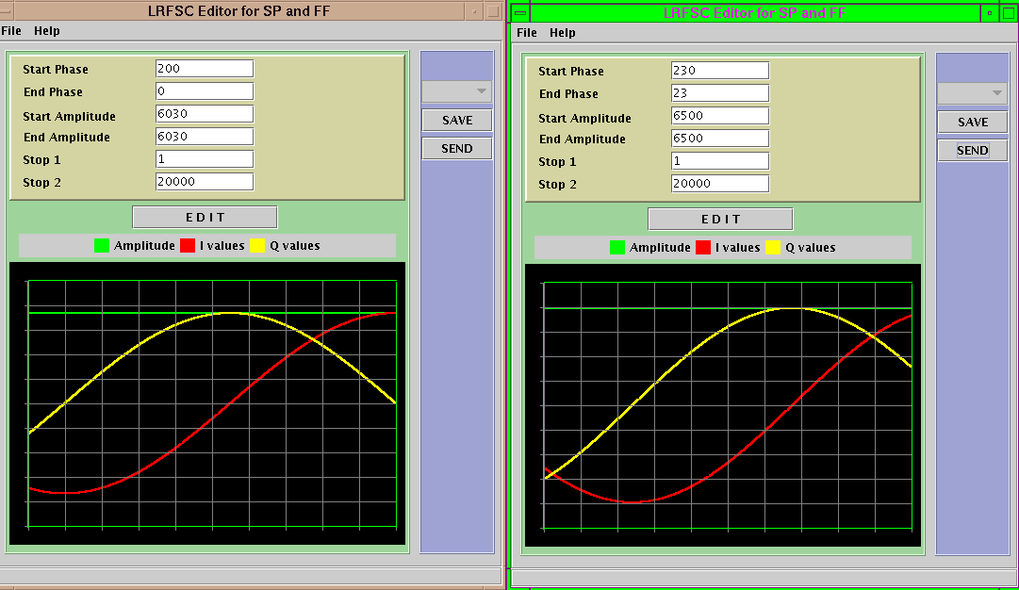
LEIR’s 3-plane stacking
Multiturn injection with additional stacking in vertical phase space
Needs:
inclined electrostatic injection septum
(complicated geometry of the injection line)
a horizontal bump
momentum ramping cavity in injection line
Efficiency on paper ≈70 % for ≈70 turns injected
up to 50% achieved

Slide 60
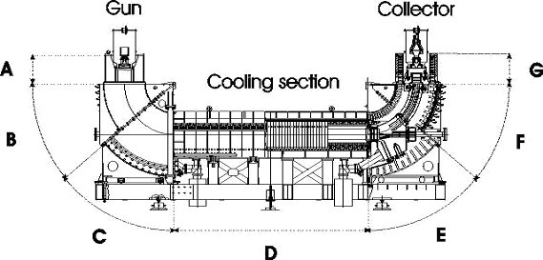

Electron Cooling
Principle: an electron beam with same velocity as the ion beam is merged with it over a fraction of the circumference (~3%)
In the moving frame, collisions between electrons and ions correspond to the mixture of a hot ion gas with a cool electron gas
The heat exchange leads to cooling, i.e. emittance reduction, in all 3 planes
(H,V, //) of the ion beam

Slide 61


PS
Transformation of antiproton ejection line and elements
(to LEAR)
For ion injection from LEIR: SMH26, KFH28, BSW26
Design of complicated RF gymnastics
Low intensity challenge for beam diagnostics

Slide 62

TT2
1mm Al stripper foil converts Pb⁵⁴⁺ to Pb⁸²⁺
Low beta insertion around stripper
  To minimize emittance blowup
β_{H}=5.5 m β_{V}=5.7 m

Slide 63
Parameters for Nominal Luminosity
 | ECR Source | Linac 3 |  | LEIR |  | PS | SPS | LHC
Output energy | 2.5 KeV/u |  | 4.2 MeV/u |  | 72.2 MeV/u | 5.9 GeV/u | 177 GeV/u | 2.76 TeV/u
²⁰⁸Pb charge state | 29+ |  | 29+ ➔54+ |  | 54+ | 54+ ➔82+ | 82+ | 82+
Output Bρ [Tm] |  |  | 2.12 ➔1.14 |  | 4.80 | 86.7 ➔57.3 | 1500 | 23350
bunches/ring |  |  |  |  | 2 (1/8 of PS) | 4 | 52 | 592
ions/pulse | 9 10⁹ |  | 1.15 10⁹ |  | 9 10⁸ | 4.8 10⁸ | 4.7 10⁹ | 4.1 10¹⁰
ions/LHC bunch | 1.1 10^{10.} |  | 1.45 10⁹ |  | 2.25 10⁸ | 1.2 10⁸ | 9 10⁷ | 7 10⁷
bunch spacing [ns] |  |  |  |  |  | 100 | 100 | 100
ε∗(norm. rms) [μm] | 0.07 |  | 0.25 |  | 0.7 | 1.0 | 1.2 | 1.5
ε (phys., rms) [μm] | 30 |  | 2.6 |  | 1.75 | 0.14 | 0.0063 | 0.0005
Repetition time [s] | 0.2-0.4 |  | 0.2-0.4 |  | 3.6 | 3.6 | ~50 | ~10’fill/ring

Slide 64
Nominal scheme
Pb ions /
(future) LHC bunch
Harmonic number / Frequency
4 injections
LEIR
(9 10⁸ Pb ions / 3.6 s)
2
2.25 10⁸
16–14-12-24
PS after splitting
24-21
-169-423
12 10⁷
SPS at injection (43.7 s flat-bot),
after 13 (12, 8) transfers from PS
200 MHz
9 10⁷
SPS at extraction,
after 13 (12, 8) transfers from PS
200 MHz
7 10⁷
LHC at injection,
after 12 transfers from SPS
400 MHz
β* = 0.5 m -> L = 10²⁷ cm⁻² s⁻¹
(J.P.Riunaud)

Slide 65

Nominal scheme: PS RF gymnastics
Two bunches from LEIR injected in PS straight section 26
Accelerated to intermediate plateau
Batch expansion (H16->H14->H12)
Splitting (H12 -> H24)
Batch expansion (H24->H21)
Acceleration on H21 through transition
Synchronisation on SPS RF
Rebucketing on H169 (80MHz)
Fast extracted in Section 16
Stripped in TT2 (new low-beta optics)
(J.L.Vallet)

Slide 66

Thanks (again) for your attention!

