Slide 1
Colliders and The Large Hadron Collider
I. LHC layout
II. LHC Operational cycle
III. Beam measurements
[R. Alemany]
[CERN BE/OP]
Lectures ULB (05.02.2021)

Slide 2





Why colliders?
What is the centre of mass energy ➔ the interesting energy because it is the only one available for the collision products ➔ when two particles of masses m1 and m2 collide?
Four-momentum
Square of the four-momentum:
CASE 1:
(m1,p1)
(m2,0)
CASE 2:
(m1,p1)
(m2,-p1)

Slide 3
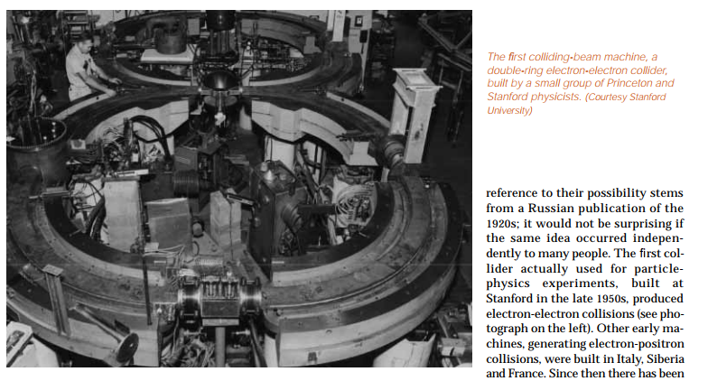
Why colliders?
CASE 1:
To get a Ecm = 630 GeV to do a SppS collider (SPS in the 80’s discovered the weak neutral currents with this collider), what should be the value of E1,lab?
E1,lab ~ 212 TeV
To get a Ecm = 14 TeV to do an LHC collider (LHC discovered the Higgs in 2012) what should be the value of E1,lab?
E1,lab ~ 100 PeV
First collider
If colliders would not have been invented we would not have been discovered yet many particles

Slide 4
Why colliders?
From the point of view of the energy, a collider is very very interesting
However it has some disadvantages:
The beam is several orders of magnitude less dense than a fixed target ➔ less number of interactions per second
  How do we overcome this issue?
We collide for many hours ➔ e.g. LHC collisions ~ 12 – 15 hours
2. The collision products go out in all directions ➔ experiment has to cover all the space around the beam pipe
  Experiments located around the beam pipe are difficult to take in/out to install a new experiment.
  Fixed target experiments are more flexible, e.g. SPS north area: tens of experiments per year.

Slide 5
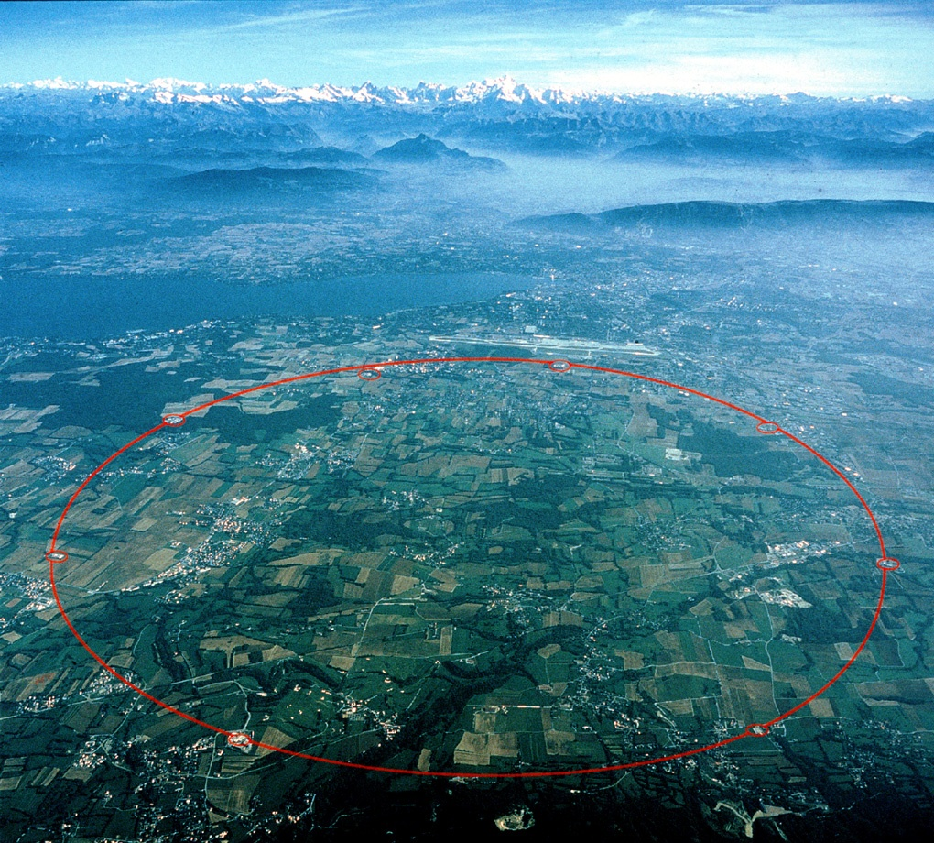

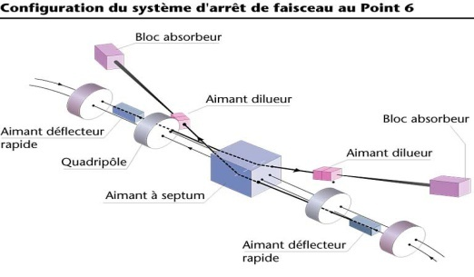




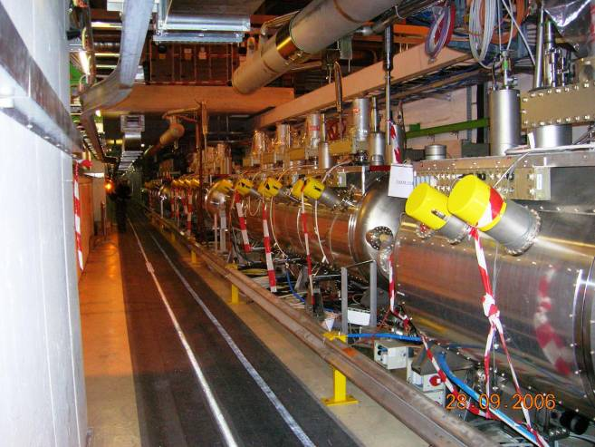
I. Basic layout of the machine
Betatron cleaning collimators
Beam Dump System
IP8
IR7
IP1
IR6
IT
SPS (~7 km)
IP5
LHC (27 km)
IP2
Sector 34
Momentum cleaning collimators
DS
MS
IR4
ARC
IR3

Slide 6
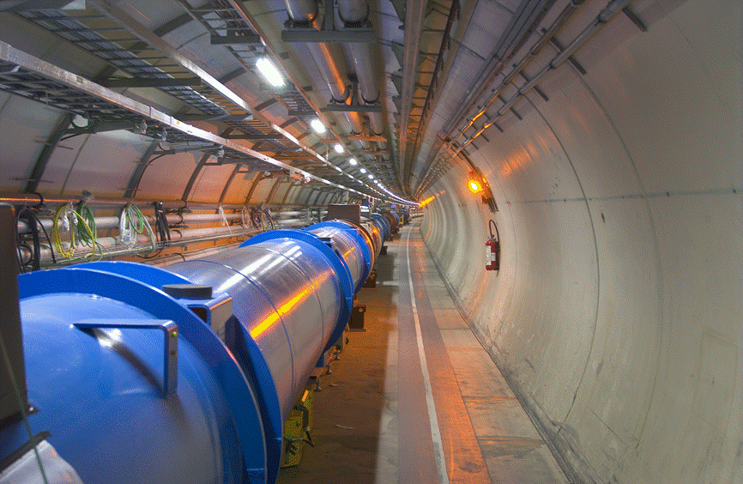

I. Basic layout of the machine: the arc
LHC arc cells = FoDo lattice* with
~ 90º phase advance per cell in the V & H plane
o
o
F
D
B1
F
B2
D
LHC TDR
MB: main dipole
MQ: main quadrupole
MQT: Trim quadrupole
MQS: Skew trim quadrupole
MO: Lattice octupole (Landau damping)
MSCB: Skew sextupole +
Orbit corrector (lattice chroma+orbit)
MCS: Spool piece sextupole
MCDO: Spool piece octupole +
Decapole
BPM: Beam position monitor

Slide 7

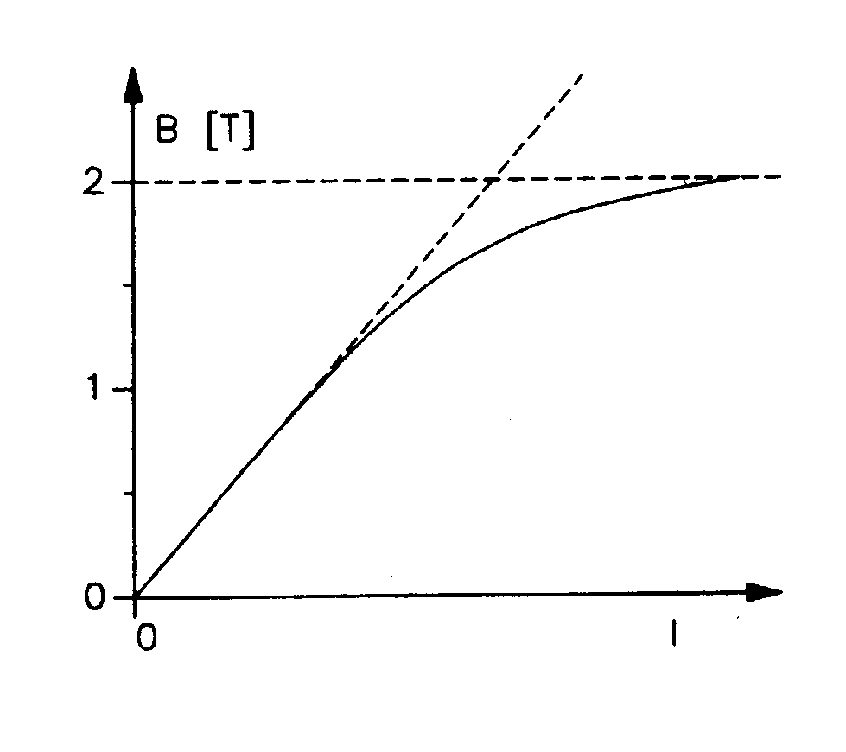

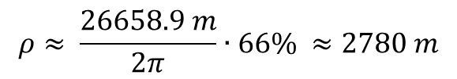
I. Basic layout of the machine
Golden formula (you should know by heart)
Circumference ➔ FIXED!!! by LEP
FIXED, no choice
$$ρ≈ \frac{26658.9 m}{2π}∙66\% ≈2780 m$$
~ 66% of the lattice elements are dipoles
p = nucleon momentum ➔ defined by the physics case ➔ TeV range ➔ 7 TeV
We need SUPERCONDUCTING technology
Field limit for normal conducting magnets due to saturation

Slide 8
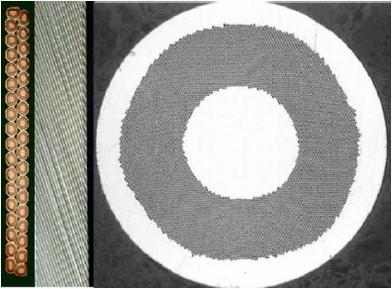
I. Basic layout of the machine:
Superconducting magnets
Superconducting cables of Nb-Ti
6 µm Ni-Ti filaments
He gas ➔ liquid @ 4.2 K ➔ superfluid @ 2.17 K
1 mm
LHC ~ 27 km circumf. with 20 km of superconducting magnets operating @8.3 T. An equivalent machine with normal conducting magnets would have a circumference of 100 km and would consume 1000 MW of power ➔ we would need a dedicated nuclear power station for such a machine. LHC consumes ~ 10% nuclear power station
λ point
Total amount of He used @LHC ~500-700 T

Slide 9

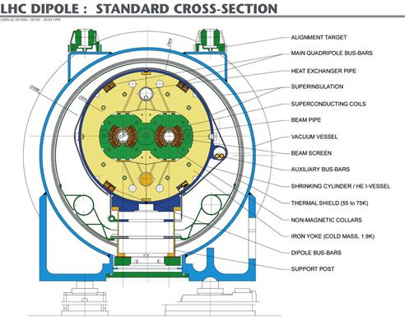
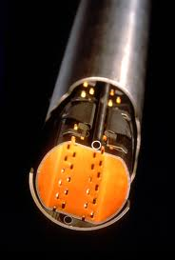

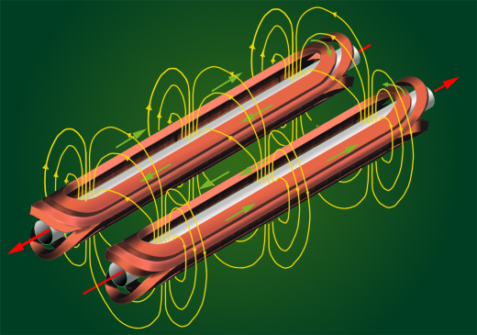
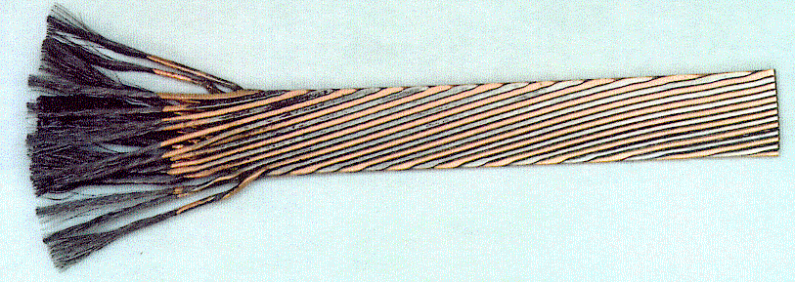
I. Basic layout of the machine: main cryodipoles (two dipoles in one)
The geometry of the main dipoles
(Total of 1232 cryodipoles)
Heat
exchanger
  Beam pipe (Ultrahigh beam vacuum 10⁻¹⁰ Torr like at 1000 km over see level)
Collars
Beam Screen
(Stainless Steel
+ Cu)
Cold bore non-magnetic austenitic steel
36.9 mm
He Vessel
46.5 mm
Thermal shield
Iron yoke
Superconducting coils
Vacuum vessel (10⁻⁶ mbar)
L ~ 15 m
8.3 T, 11.87 kA
T = 1.9 K, ~27.5 ton

Slide 10
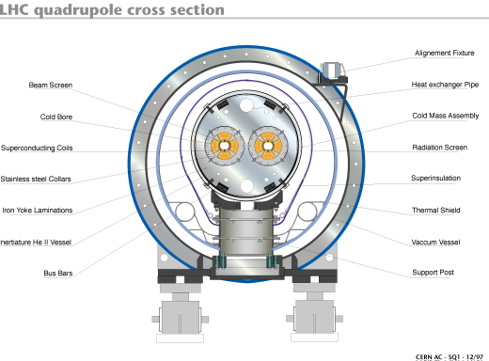

I. Basic layout of the machine: main quadrupoles
55 per sector
56 mm (warm)
194 mm (cold)
Integrated gradient = 690 T
Nominal gradient = 223 T/m
Inominal = 11.87 kA
L=3.1 m

Slide 11

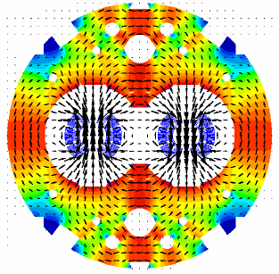
I. Basic layout of the machine: main dipoles ➔Field quality
tough
The magnetic field of the main dipoles:
The stability of the geometry of the superconducting
coils is essential to the field quality.
Mechanical stress during coil assembly
Thermal stresses during cool-down
Electromagnetic stresses during operation
Additional sources of field errors are the dimensional tolerances of the magnet components and of the manufacturing and assembling tooling.
The relative variations of the integrated field and of the field shape imperfections must not exceed ~ 10 ⁻⁴ and
= sources of deformations of the coil geometry
Reference: LHC Project Report 501
“Field Quality Specification for the LHC Main Dipole Magnets”

Slide 12
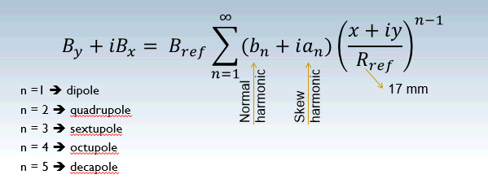
I. Basic layout of the machine: main dipoles ➔Field quality
Why the tolerances are so tight?
➔ Because the field quality determines how long the particles can circulate in the accelerator
Up to which order do we care?
➔ Up to n = 7 at least
~ 10⁻⁴

Slide 13
I. Basic layout of the machine: main dipoles ➔Field quality
Error | Side effects if error is > few 10⁻⁴ | Corrected with
a1 | Closed orbit perturbations and thus feed-down contributions from higher order multiple errors | Dipole correctors (MCB)
b1
a2 | Linear coupling and vertical dispersion | Skew quadrupoles (MQS)
b2 | Tune change, β and dispersion beating | Trim quadrupoles (MQT)
a3 | Chromatic coupling and Q’’ | Skew sextupoles (MSS)
b3 | b2 feed-down at injection (persistent current effect) and off-momentum β-beat | Sextupole (MCS)
a4 | Dynamic aperture (DA) at injection
b4 | DA and Q’’ at injection | Octupole (MCO)
a5 | DA for off-momentum particles at injection
b5 | DA and Q’’’ at injection | Decapole (MCD)
a6 to b7 | DA at injection
Sextupole
Sextupole+octupole

Slide 14
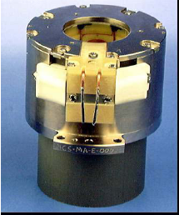
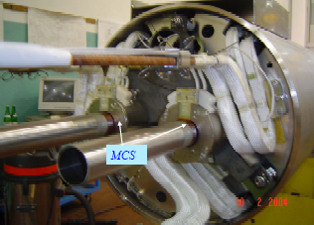
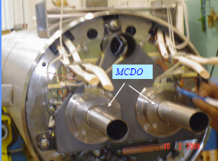
I. Basic layout of the machine: dipole corrector magnets
o
o
F
D
MCS
MCDO
LHC TDR
5.8 cm
MCD:
Nominal main field strength ~ 120 T/m⁴
Inominal = 550 A, 1.9 K, L=11 cm, ~6 kg
MCO:
Nominal main field strength = 8200 T/m³
Inominal = 100 A, 1.9 K, L=11 cm, ~6 kg
Nominal main field strength = 1630 T/m²
Inominal = 550 A, 1.9 K, L=15.5 cm, ~10 kg

Slide 15
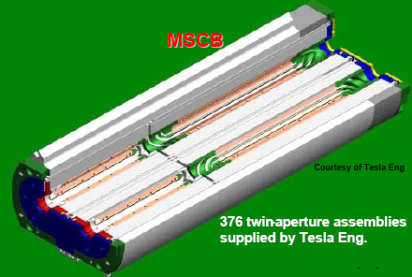
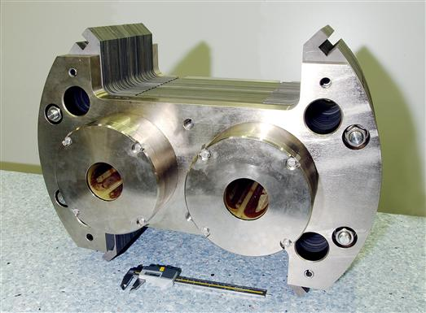
I. Basic layout of the machine: quadrupole corrector magnets
o
o
F
D
MSCB
LHC TDR
Orbit
MQT/MQS
Landau damping
MQT: Trim quadrupole
MQS: Skew trim quadrupole
Chromaticity
MO
MQT/MQS:
Nominal main field strength = 123 T/m
Inominal = 550 A, 1.9 K L=38 cm, ~250 kg
MSM (sextupole):
Nominal main field strength = 4430 T/m²
Inominal = 550 A, 1.9 K, L=45.5 cm, ~83 kg
MCBM (dipole):
Nominal main field strength = 2.93 T
Inominal = 55 A, 1.9 K, L=78.5 cm, ~143 kg
MO:
Nominal main field strength = 63100 T/m³
Inominal = 550 A, 1.9 K L=38 cm, ~8 kg

Slide 16

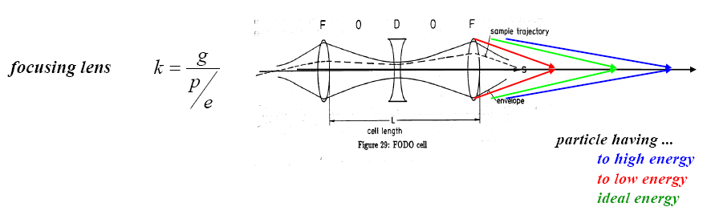
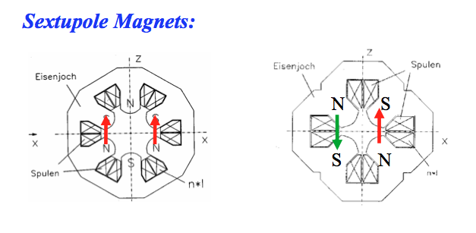
I. Basic layout of the machine: quadrupole corrector magnets
(Courtesy of B. Holzer)
F
o
D
o
Why the orbit and sextupole correctors are placed close to a quadrupole?
LHC TDR

Slide 17
I. Basic layout of the machine: quadrupole corrector magnets
β (m)
Magnet strength
QF
D (m)
(Natural chromaticity term)
Chromaticity correction terms

Slide 18
I. Basic layout of the machine
Betatron cleaning collimators
Beam Dump System
IP8
IR7
IP1
IR6
IT
SPS (~7 km)
IP5
LHC (27 km)
IP2
Sector 34
Momentum cleaning collimators
DS
MS
IR4
ARC
IR3

Slide 19
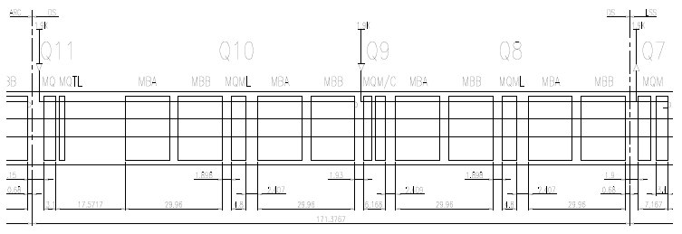
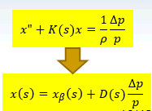
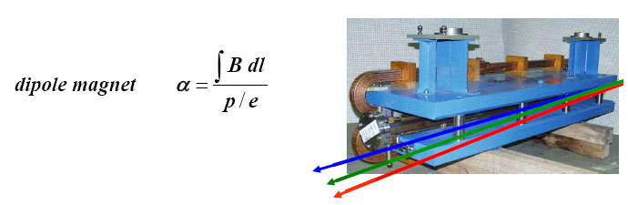
I. Basic layout of the machine: Dispersion suppression
ARC
DS
LSS
Q11
Q10
Q9
Q8
empty
MBARC
The schema applies to all DS except the ones in IR3 and IR7
Cancels the horizontal dispersion generated on one side by the arc dipoles and on the other by the separation/recombination dipoles and the crossing angle bumps
Helps in matching the insertion optics to the periodic solution of the arc
If only dipoles are used they cannot fully cancel the dispersion, just by a factor 2.5. Therefore individual powered quadrupoles are required (Q8-Q11 with I ~ 6000 A)
(Courtesy of B. Holzer)

Slide 20
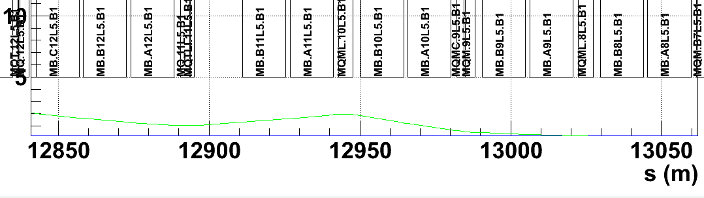
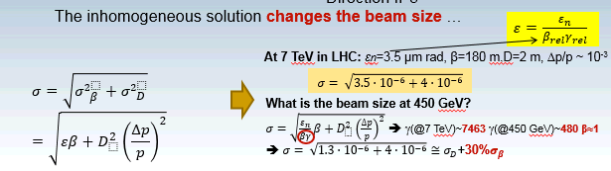
I. Basic layout of the machine: Dispersion suppression
D(s) is created by the dipole magnets and afterwards focused by the quadrupoles
Dispersion (m)
ARC
DISPERSION SUPPRESION
2 m
0 m
Beam size here?
Direction IP5
The inhomogeneous solution changes the beam size …
When you design your beam pipe you have to take into account the contribution of D(s)
Why do we suppress dispersion before reaching the IP?

Slide 21
I. Basic layout of the machine
Betatron cleaning collimators
Beam Dump System
IP8
IR7
IP1
IR6
IT
SPS (~7 km)
IP5
LHC (27 km)
IP2
Sector 34
Momentum cleaning collimators
DS
MS
IR4
ARC
IR3

Slide 22
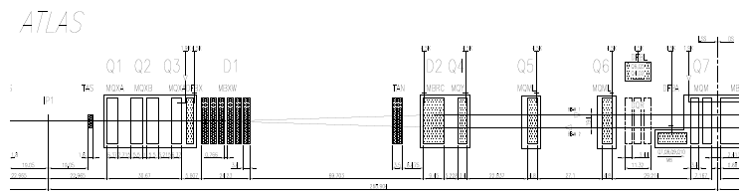
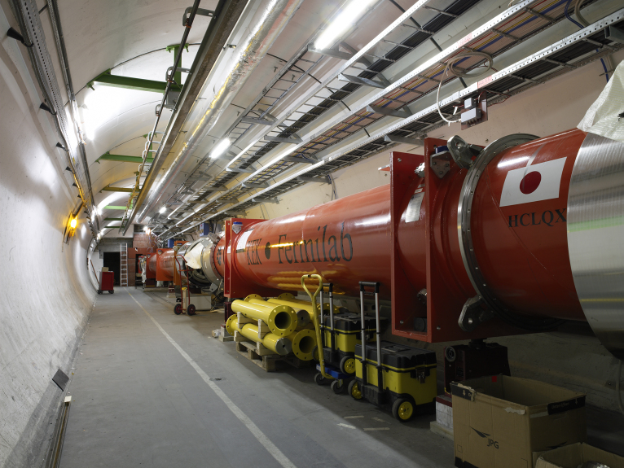
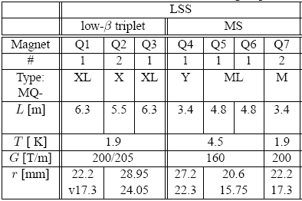
I. Basic layout of the machine: Luminosity insertions
ATLAS
R1
Inner Triplet
Separation/ Recombination
Matching Quadrupoles
DS
Q1 Q2 Q3
D1
(1.38 T)
Tertiary collimators
D2 Q4
(3.8 T)
Q5
Q6
Q7
TAS*
TAN*
IP1
188 mm
1.9 K
Warm
1.9 K
4.5 K
4.5 K
4.5 K
6.45 kA
10.63 kA
Q2
Q3
Q1
23.85
18.95
29.0
24.0
22.5
17.6
To provide sufficient aperture for the Xangle
* Protect Inner Triplet (TAS) and D2 (TAN) from particles coming from the IP
The mechanical aperture of the inner triplets limits the maximum β* @IPs and the maximum Xangle ➔ limit peak lumi

Slide 23




Luminosity
Two figures of merit in a collider: energy and luminosity
Luminosity = number of interactions per unit of time
cross-section at the given energy of the interested physics
w
w
h
h
l
l
Number of particles of the first beam in the cube:
The orange beam is crossed by n2 particles per unit of time:
with I = q/t
t

Slide 24

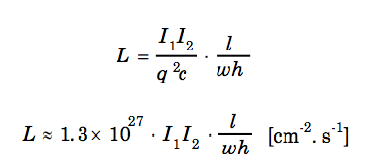
Luminosity
The number of events per unit of time for two beams of 1 cm2 is:
and for beams of a general area s = wh
If we replace q = 1.6e-19 coulomb and c = 3e10 cm/s:

Slide 25
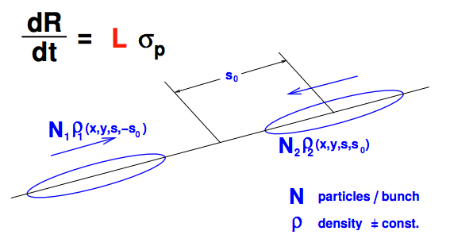
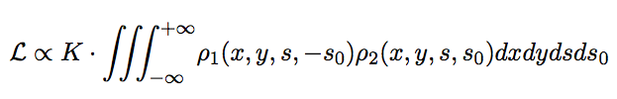
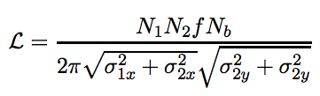
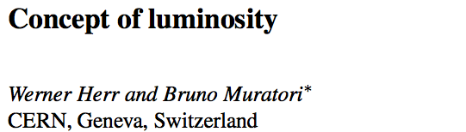
Luminosity for bunched beams
For two bunches colliding HEAD ON with Gaussian beam density distribution and equal beam sizes:
Ni: number of particles in one bunch
f: revolution frequency
Nb: number of bunches in one beam
sigma: beam size
Reference:

Slide 26
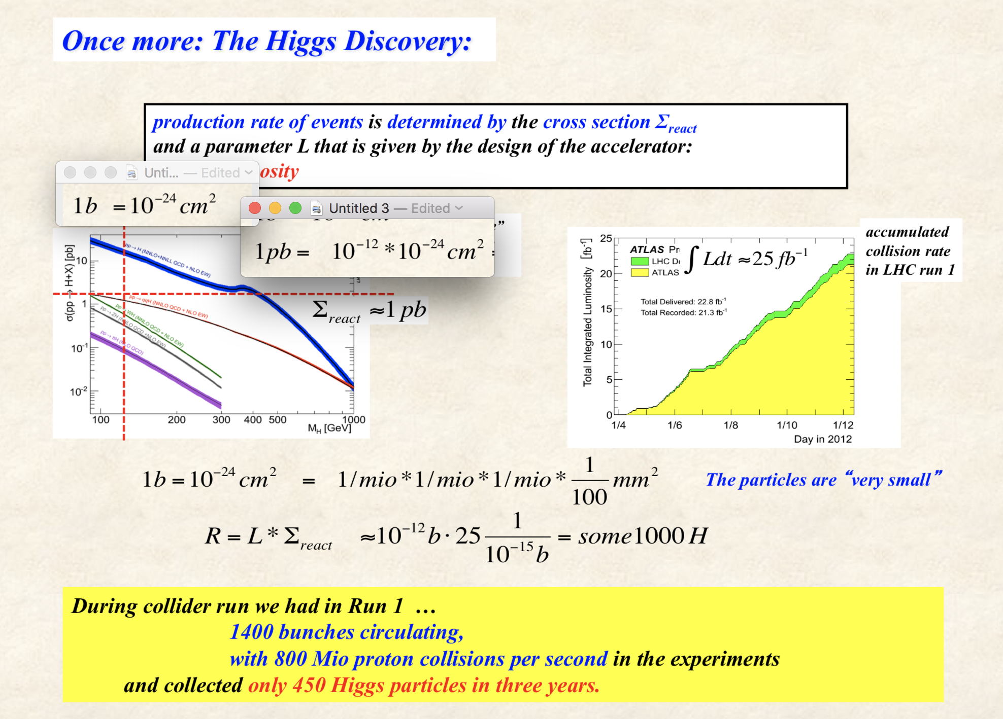
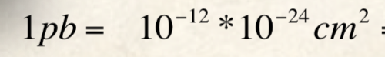

Slide 27
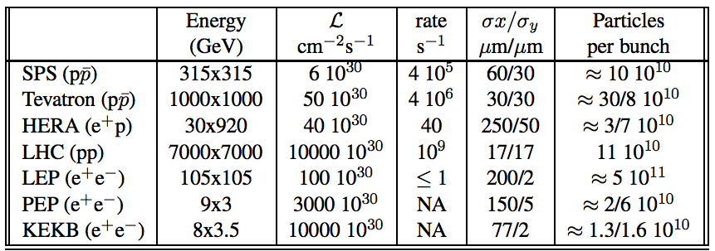
Luminosity for bunched beams
Examples:

Slide 28
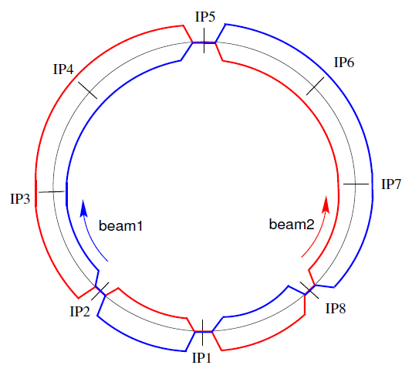
I. Basic layout of the machine: Luminosity insertions
D2
D2
D1
Q3
Q2
Q1
IP
Q1
Q2
Q3
D1

Slide 29
I. Basic layout of the machine: Luminosity insertions
D2
D2
D1
Q3
Q2
Q1
IP
Q1
Q2
Q3
D1
With nominal LHC parameters:
2808 bunches separated 25 ns
We can have up to 30 parasitic interactions around the IP

Slide 30
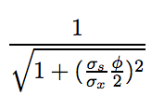
I. Basic layout of the machine: Luminosity insertions
D2
D2
D1
Q3
Q2
Q1
IP
Q1
Q2
Q3
D1
Crossing angle reduces the luminosity

Slide 31


I. Basic layout of the machine: Luminosity insertions
D2
Aperture limitation
D2
D1
Q3
Q2
Q1
IP
Q1
Q2
Q3
D1
Crossing angle (e.g. 285 µrad )
Beam-beam separation
Beam-beam separation = f(σ)
Aperture limitation = f(σ, beam pipe size)
β is very small at the IP, but very big at the Inner triplets ➔
Therefore, the quadrupoles around the IP have such a big apertures

Slide 32
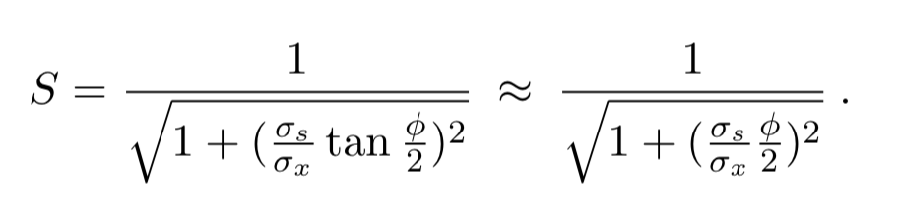
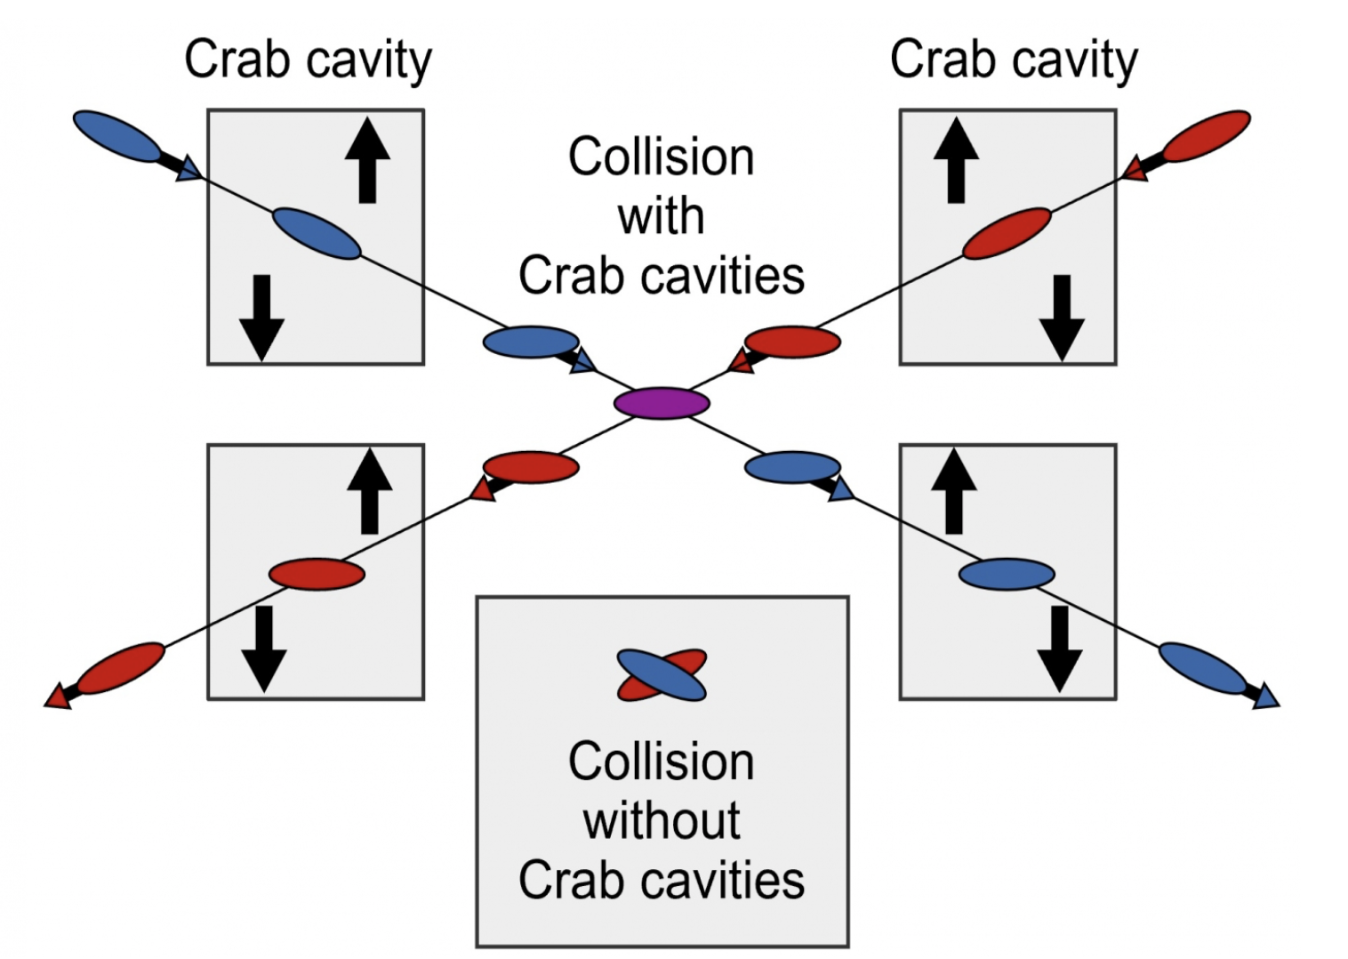
I. Basic layout of the machine: Luminosity insertions
LHC crossing angle of around 300 µrad ➔ luminosity reduction factor in LHC ~ 20%

Slide 33
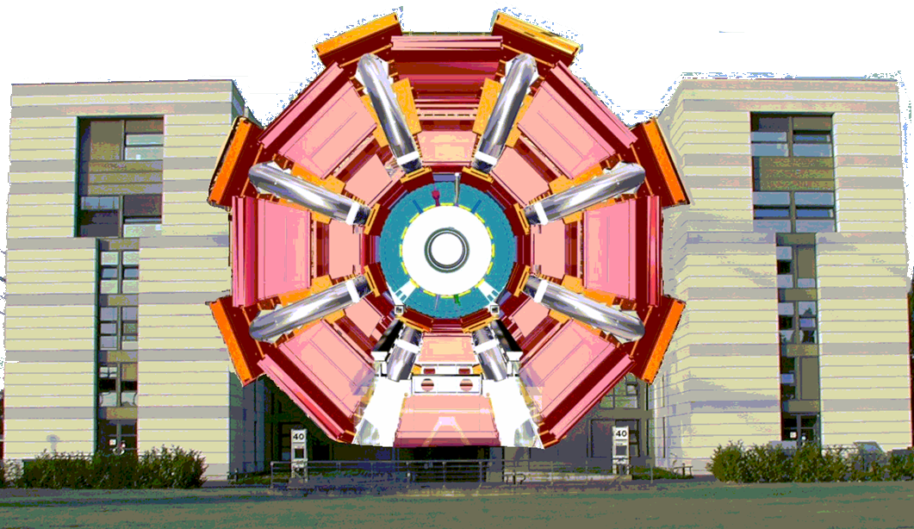
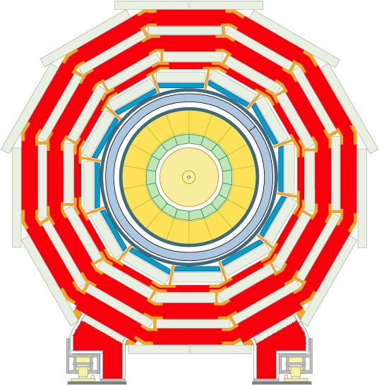
I. Basic layout of the machine:
High luminosity insertions
ATLAS
CMS
five-storey building

Slide 34
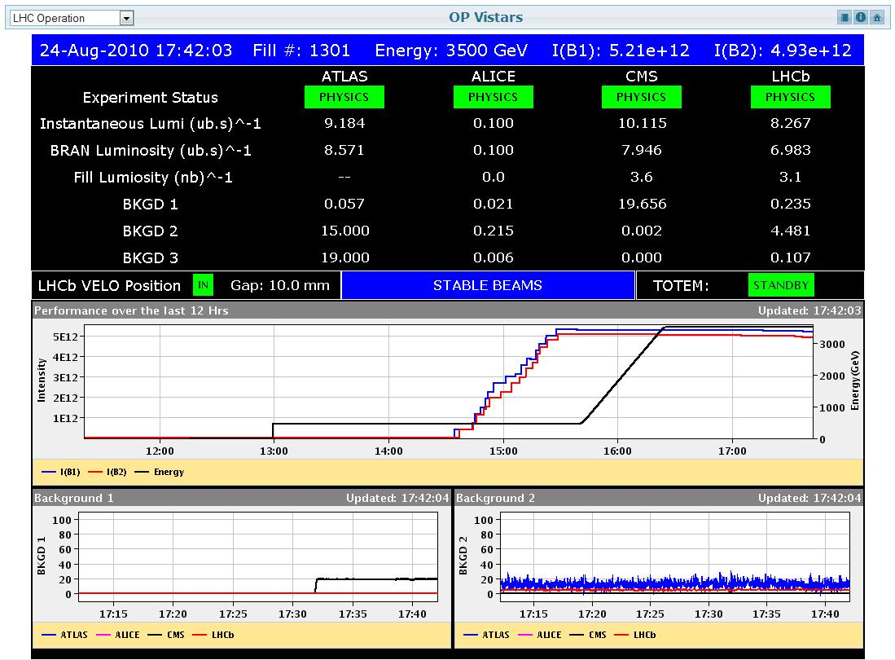
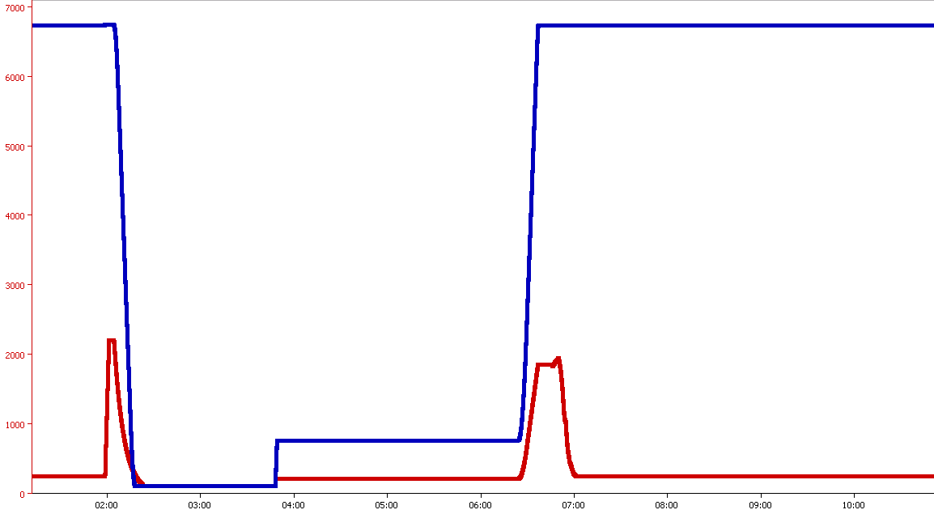

II. LHC Operational cycle
~ 2 hours
Exp-LHC
FLATOP
Current (A)
RAMPDOWN
SETUP
SQUEEZE
RAMP
ADJUST
INJECTION PROBE
PREPARE RAMP
INJECTION PHYSICS
STABLE BEAMS…
10 to 15 hours
RB.A12
RQ6.L1
Time

Slide 35
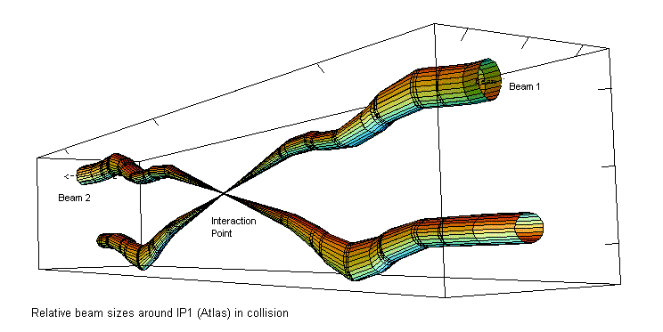

II. LHC Operational cycle:
Squeeze ➔ reduce β*
Squeeze the beam size down as much as possible at the collision point to increase the chances of a collision
So even tough we squeeze our N1,2=100,000 million protons per bunch down to 16 microns (1/5 the width of a human hair) at the interaction point. We get only around 20 collisions per crossing with nominal beam currents.
The bunches cross (every 25 ns) so often we end up with around 600 million collisions per second - at the start of a fill with nominal current.
Most protons miss each other and carry on around the ring. The beams are kept circulating for hours ➔ 10 hours

Slide 36
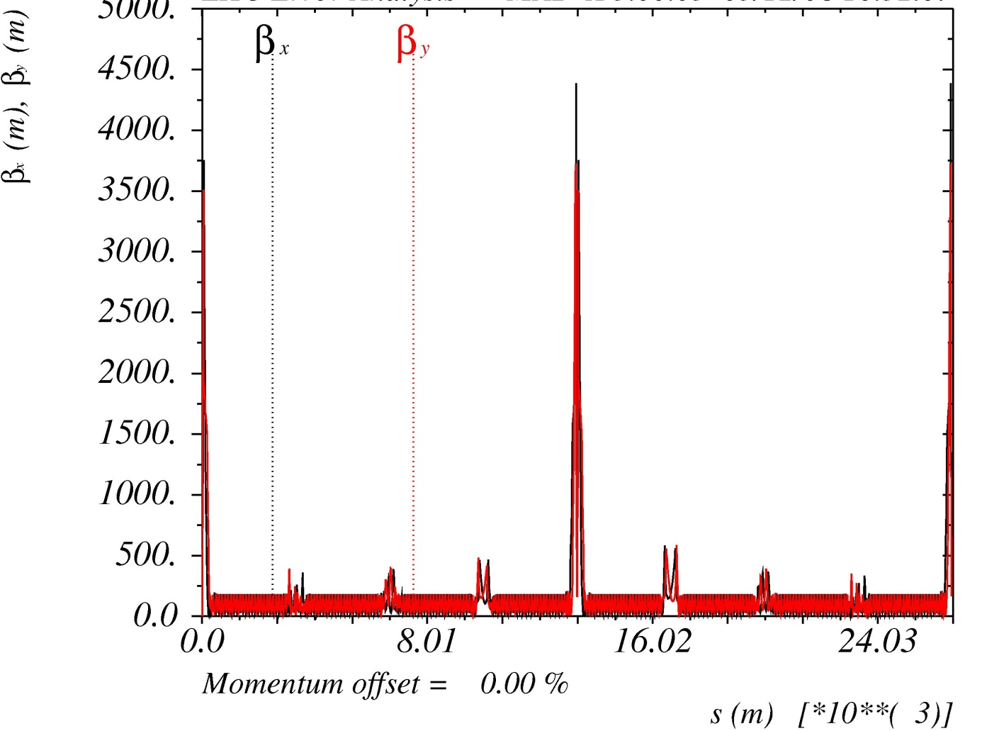
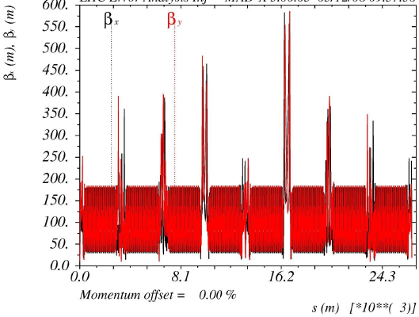

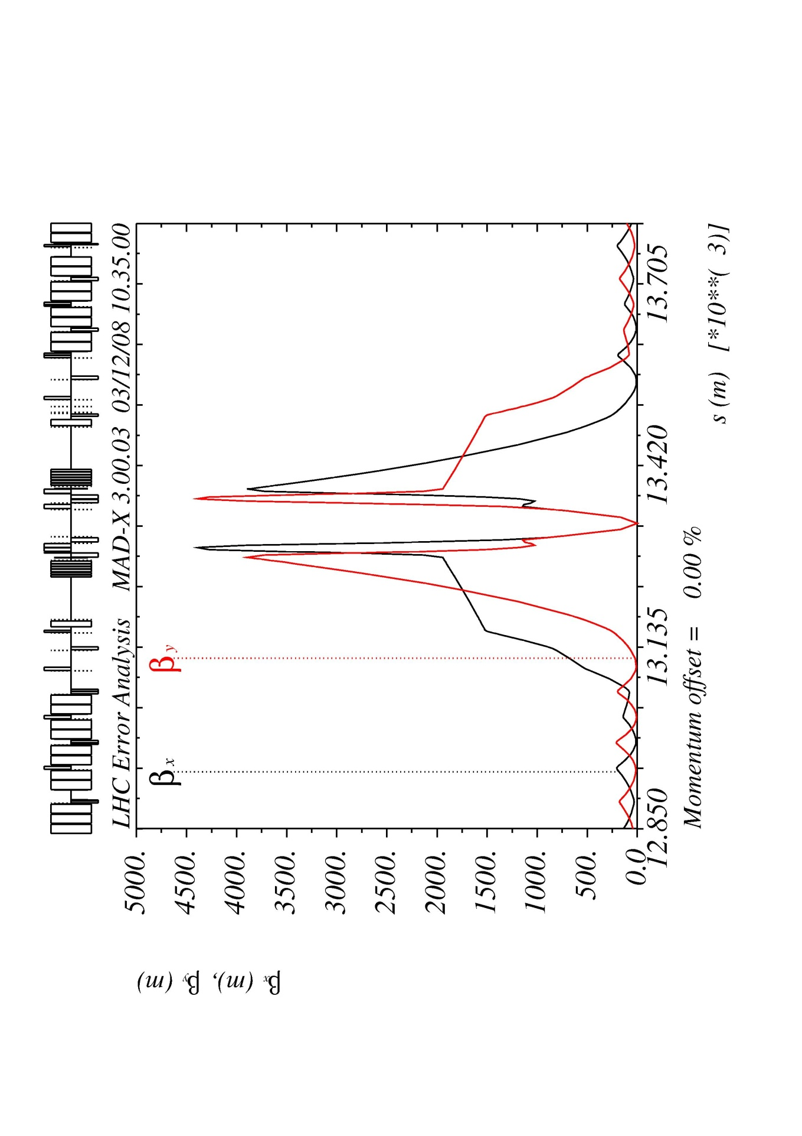

II. LHC Operational cycle:
Squeeze ➔ reduce β* (β @IP)
Beta function at Injection
Beta function at top energy and after squeeze
4500 m
180 m
IR1
IR5
IR1
250 m
IR5
180 m
IR1
IR2
IR3
IR4
IR6
IR7
IR8
IR1
IR2
IR3
IR4
IR6
IR7
IR8
Why we cannot have β*= 0.5 m at injection?
@IP β*=0.5 m
β=4500 m
γ(@450 GeV)~480
εn=3.5 µm rad
Rbeampipe~29/24 mm
we could only accommodate ~ 4 times the beam size and we need at least 7σ clearance
Inner Triplets
Remember: there is no D(s) here
σ ~ 6 mm !!
@ 7 TeV
σIT ~ 1.2 mm

Slide 37


II. Beam measurements:
Beam trajectory
If you count the number of betatron oscillations,
which beam parameter do you get?
Betatron oscillation
Each point is a BPM (Beam Position Measurement)
A
B
beam
ARC BPMs
TA
TB
49 mm aperture

Slide 38

II. Beam measurements:
Beam trajectory correction
MSCB
Orbit
Chromaticity
F
o
D
o
LHC TDR
Why the orbit and sextupole correctors are placed close to a quadrupole?
MSM (sextupole)
MCBM (dipole)

Slide 39


II. Beam profile measurements:
Beam 1 on TDI screen – 1st and 2nd turns
Scintillator screen for LBDS
ALICE

Slide 40


II. Beam profile measurements:
Emittance measurement - Wire scanner
Emittance is the figure of merit for profile measurements.
But it is a derived quantity from the beam size ($σ=\sqrt{βε}$)
Where would you install a wire scanner in LHC to get the beam size and then the emittance?
σ
➔ ε = σ²/β
Which we measured before
Courtesy of A. Guerrero

Slide 41

II. Beam measurements:
Aperture scan
BLM*
*Beam Loss Monitor = Ionization chamber

Slide 42

II. Beam measurements:
Dispersion measurement
Horizontal Dispersion (m)
OFF-MOMENTUM particles cleaning system
D(s) = 0 m
IR3
Vertical Dispersion (m)
RF

Slide 43

II. Beam measurements:
Beta measurement
1st Change quadrupole strength in steps
2nd Measure Tune
3rd Plot Tune vs Quadrupole strength
Qx,Qy
kL
Courtesy of B. Holzer (lectures)

Slide 44


II. Beam measurements:
Fast BCT (Beam Current Transformer)
beam
FBCT
Each point is a bunch
Total number of bunches = 1380
B1
~ 3 10⁹
Intensity
B2

Slide 45
Spare slides

Slide 46


High Light of the LHC
production rate of events is determined by the cross section Σ_{react}
and a parameter L that is given by the design of the accelerator:
… the luminosity
remember:
1b=10⁻²⁴ cm²
Integrated luminosity during RUN I
Official number: 1400 clearly identified Higgs particles “on-tape”
41/42

Slide 47

High Light of the HEP year
ATLAS event display: Higgs => two electrons & two muons
42/42

Slide 48

I. Basic layout of the machine:
Superconducting magnets
Superfluid helium ➔ Why is it so great?!!
  very high thermal conductivity➔ is able to conduct away heat a thousand times better than a metallic conductor like copper
  very low viscosity coefficient ➔ can penetrate tiny cracks, deep inside the magnet coils to absorb any generated heat
  very high heat capacity ➔ prevents small transient temperature fluctuations

Slide 49

XIV. Beam captured – mountain range display
Turn number
Now RF ON
Bunch length ~ 1.5 ns ➔ ~ 45 cm

Slide 50
Beam parameters (nominal)
 |  | Injection | Collision | 2012
Proton energy | GeV | 450 | 7000 | 4000
Particles/bunch |  | 1.15 x 10¹¹ |  | 1.6 x 10¹¹
Num. bunches |  | 2808 |  | 1380
Longitudinal emittance (4σ) | eVs | 1.0 | 2.5
Transverse normalized emittance | µm rad | 3.5 | 3.75
Beam current | A | 0.582
Stored energy/beam | MJ | 23.3 | 362
Peak luminosity related data
RMS bunch length | cm | 11.24 | 7.55
RMS beam size @IP1 & IP5 ➔ σx,y = √εβ | µm | 375.2 | 16.7
RMS beam size @IP2 & IP8 ➔ σx,y = √εβ | µm | 279.6 | 70.9
Geometric luminosity reduction factor (F) |  |  | 0.836
Instantaneous lumi @IP1 & IP5 (IP2Pb-Pb, IP8) | cm⁻²s⁻¹ |  | 10³⁴(10²⁷ , 10³²) | 7 10³³
Instantaneous lumi/bunch crossing @IP1 & IP5 | cm⁻²s⁻¹ |  | 3.56 x 10³⁰
* = 0.55 m
ε = 0.5 nm rad
* = 0.6 m
εn = 2.5 µm rad

Slide 51


pPb physics during 2013
On momentum orbit
Off momentum orbit
+ 250 μm
5 kHz difference at injection
p+
- 250 μm
Pb⁸²⁺₂₀₈

Slide 52


Slide 53


Slide 54

I. Basic layout of the machine: main cryodipoles (two dipoles in one)
The geometry of the main dipoles
(Total of 1232 cryodipoles)
VERTICAL PLANE
HORIZONTAL PLANE
Length of the bend part =14.3 m
The theoretical shape of the beam channels is a straight line, while the natural shape has ~ 0.3 mm deflection between two supports at 5.4 m distance
ρ = 2.8 km
(R = 4.3 km)
L ~ 15 m
8.3 T, 11.87 kA
T = 1.9 K, ~27.5 ton
Distance between apertures = 194.5 mm
What is the maximum energy a proton can reach?
What is the maximum energy a 208Pb82+ can reach?
The active part of the cold mass is bent in the horizontal plane with an angle of 5.09 mrad with ρ = 2.8 km. The shape of the two beam channels is identical.

Slide 55




II. The experiments: Low luminosity insertions: LHCb
Centre of the exp cavern

Slide 56

IV. Momentum and betatron cleaning insertions (IR3, IR7)
±50σ
±14σ
±6(9)σ
±7σ
±8.5σ
Settings @7TeV and β*=0.55 m
Beam size (σ) = 300 µm (@arc)
Beam size (σ) = 17 µm (@IR1, IR5)

Slide 57

I. Basic layout of the machine: quadrupole corrector magnets

Slide 58
II. LHC Operational cycle:
Squeeze ➔ reduce β*
IT
MS
DS
Q1
Q3
D2
Q5
Q7
Q8
Q9
Q10
Q11
Q2
D1
Q4
Q6
2MB
2MB
2MB
2MB
ATLAS=CMS
Remember what I said in slide 23 ➔ The mechanical aperture of the inner triplets limits the maximum β* @IPs and the maximum Xangle ➔ limit peak luminosity

Slide 59

II. Beam measurements:
Integer tunes
Qx = 64
Qy = 59

Slide 60


I. Basic layout of the machine: Dispersion suppression
Quadrupole types: MQ, MQM, MQTL
MQM
5 m
Nominal gradient = 200/160 T/m
Inominal = 5.4/4.3 kA
Lmag=2.4/3.4/4.8 m
T=1.9/4.5 K
Cold bore = 53/50 mm
Individual powered apertures
18/42

Slide 61


I. Basic layout of the machine: Low luminosity insertions
LHCb
ALICE
Beam 1
Beam 2
LHCb
Q1 Q2 Q3
D1
D2
Q4
Q5
Q6
Q7
IP8
TCDD
TDI
Beam 2
MKI
Beam 1
MSI
Extra challenge ➔ the lattice has to accommodate the injection region
26/42

Slide 62


I. Basic layout of the machine
LHC arc cells = FoDo lattice* with
~ 90º phase advance per cell in the V & H plane
o
o
F
D
Why ~ 90º phase advance per cell is a good number?
LHC TDR
Which parameter determines the beam size (ignoring D(s))?
$$r^{2}=ε_{x}β_{x}{+ε}_{y}β_{y}$$
46.5 mm
(In general in proton machines εx≈εy ➔ beams are round)
In order to get the maximum aperture possible the β(s) in both planes have to be minimized:
σ^{inj}β ~1 mm
7-10σ
36.9 mm
27/42

Slide 63

II. Beam measurements:
Beta measurement
Achieved β-beating error 10% !!
Why is so important to have a small uncertainty in the beta function?
Reference: Record low beta beating in the LHC
Tomas, R. et al. Phy. Rev. Special Topics - Accelerators and Beams15(9).
38/42

Slide 64

II. Beam measurements:
Non-integer tunes
FODO: Ψ=180º
Every 2xT we measure the same position:
$$\frac{1}{2T}=f_{Q}=Q∙\frac{1}{T}=Q∙f_{rev} →Q=0.5$$
F/2
D
F/2
BPM
BPM pos ➔ FFT ➔ tune
With a frequency of ~3 kHz we measure the same beam position
A
B
beam
TA
TB
Qx·frev = 3 kHz
Qx = .279
Qy = .310
@LHC
39/42

