Slide 1
Introduction to longitudinal beam dynamics
Course objectives:
Give an overview of the longitudinal dynamics of beam particles in accelerators
Understand the issue of synchronization between the particles and the accelerating cavity
The course will focused on synchrotrons and the synchrotron motion
We will discuss radio-frequency resonators and the transit time factor

Slide 2
Part 3
Acknowledgment: Theodoros Argyropoulos

Slide 3
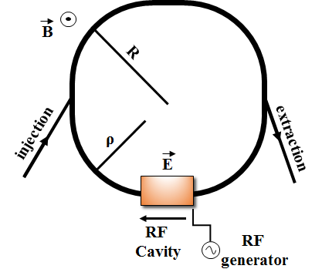
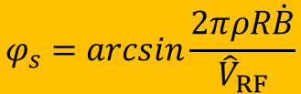

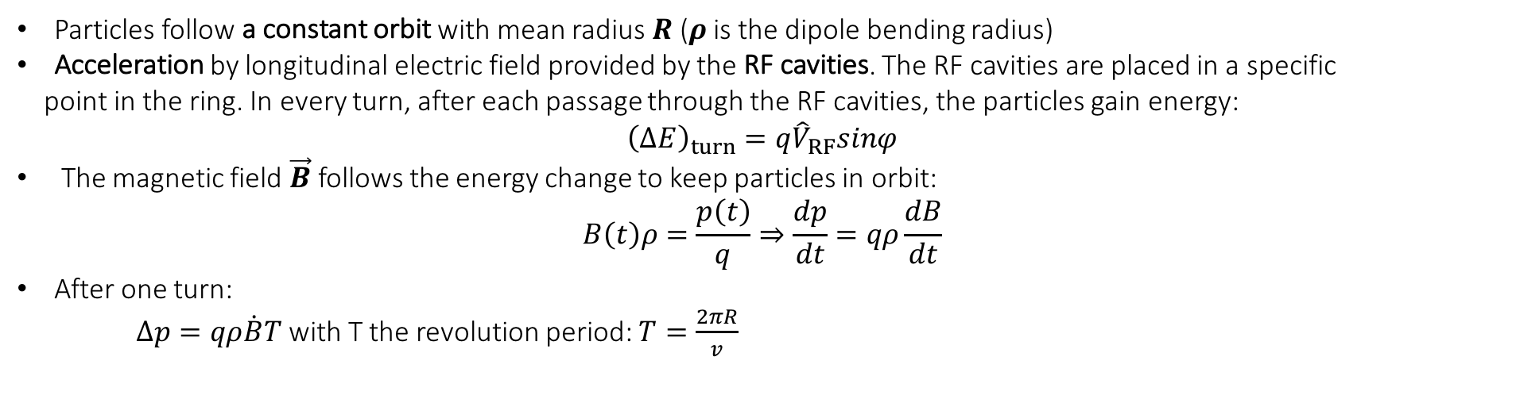

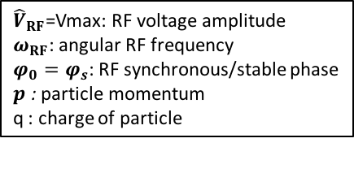
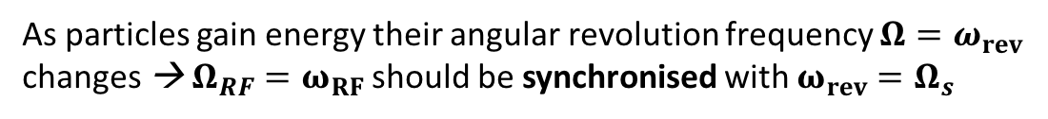


Synchrotrons
Particles follow a constant orbit with mean radius $R$ ($ρ$ is the dipole bending radius)
Acceleration by longitudinal electric field provided by the RF cavities. The RF cavities are placed in a specific
point in the ring. In every turn, after each passage through the RF cavities, the particles gain energy:
$${\left(ΔE\right)}_{turn}=q{\hat{V}}_{RF}sinφ$$
The magnetic field $\vec{B}$ follows the energy change to keep particles in orbit:
$$B\left(t\right)ρ=\frac{p\left(t\right)}{q}⇒\frac{dp}{dt}=qρ\frac{dB}{dt}$$
After one turn:
$∆p=qρ\dot{B}T$ with T the revolution period: $T=\frac{2πR}{v}$
${\hat{V}}_{RF}$=Vmax: RF voltage amplitude
$ω_{RF}$: angular RF frequency
$φ_{0}=φ_{s}$: RF synchronous/stable phase
$p$ : particle momentum
q : charge of particle
$${\left(ΔE\right)}_{turn}=q{\hat{V}}_{RF}sinφ=v∆p=vqρ\dot{B}\frac{2πR}{v}$$
$sinφ_{s}=\frac{2πρR\dot{B}}{{\hat{V}}_{RF}}$ or $sinφ_{s}=\frac{{\left(ΔE\right)}_{turn}}{q{\hat{V}}_{RF}}$
$$φ_{s}=arcsin\frac{2πρR\dot{B}}{{\hat{V}}_{RF}}$$
$$φ_{s}=arcsin\frac{{\left(ΔE\right)}_{turn}}{q{\hat{V}}_{RF}}$$
➔
As particles gain energy their angular revolution frequency ${Ω=ω}_{rev}$ changes → ${Ω_{RF}=ω}_{RF}$ should be synchronised with $ω_{rev}=Ω_{s}$
Synchronism condition ➔ $Ω_{RF}=hΩ_{s}$
$h$ - harmonic number: an integer number indicating the RF cycles per revolution period
⇨$h$ synchronous particles equally spaced along the ring following the
nominal (designed) orbit and having the nominal (designed) energy.

Slide 4
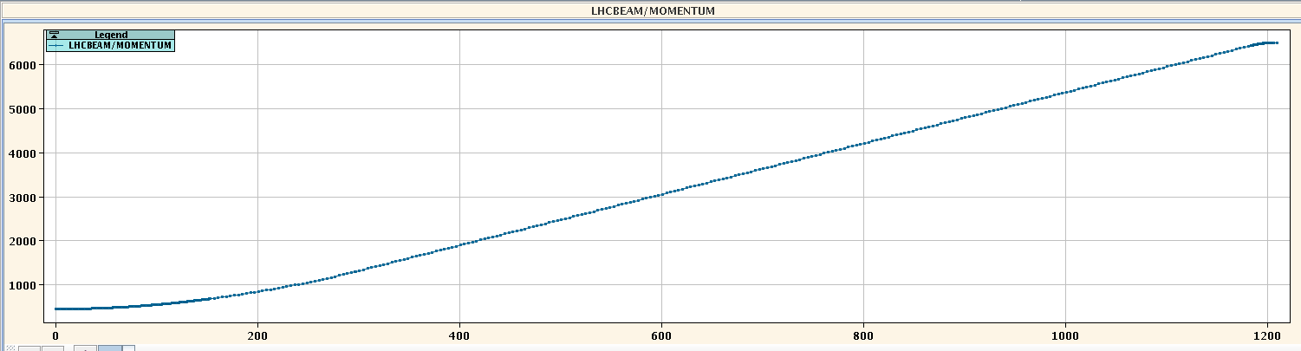
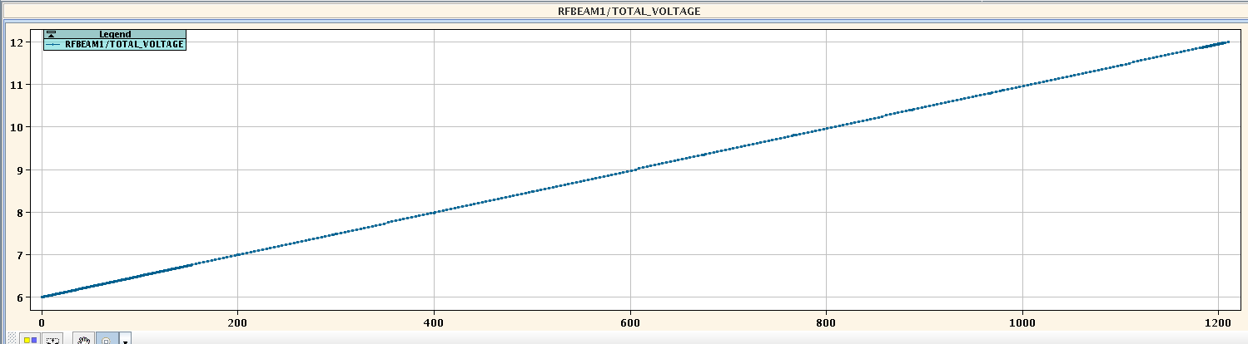
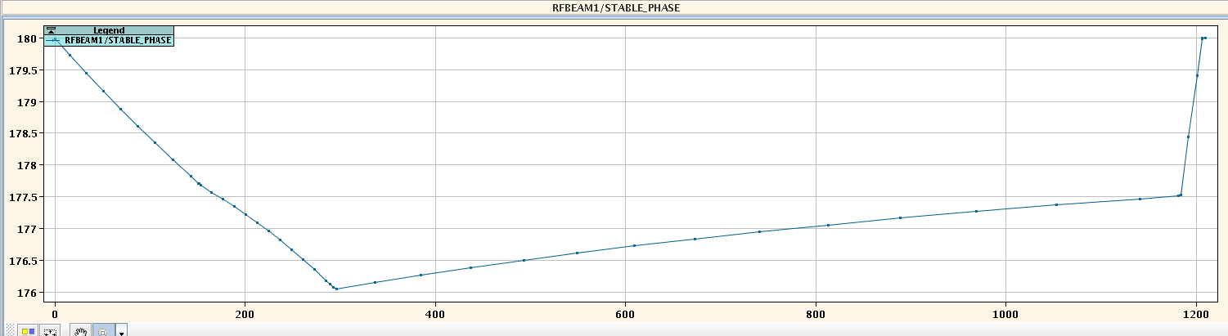




Synchronous phase
$$φ_{s}=arcsin\frac{{\left(ΔE\right)}_{turn}}{q{\hat{V}}_{RF}}$$
$$φ_{s}=arcsin\frac{2πρR\dot{B}}{{\hat{V}}_{RF}}$$
LHC momentum program
6500 GeV/c, flat top
Momentum, p [GeV/c]
450 GeV/c, flat bottom
12 MV
${\hat{V}}_{RF}$[MV]
LHC voltage program
6 MV
180°
180°, no acceleration
LHC stable phase
On average, in the LHC, synchronous particles gain around 0.5 MeV/turn during acceleration.
$φ_{s}$ [degrees]
176°
Ramp time [s]

Slide 5
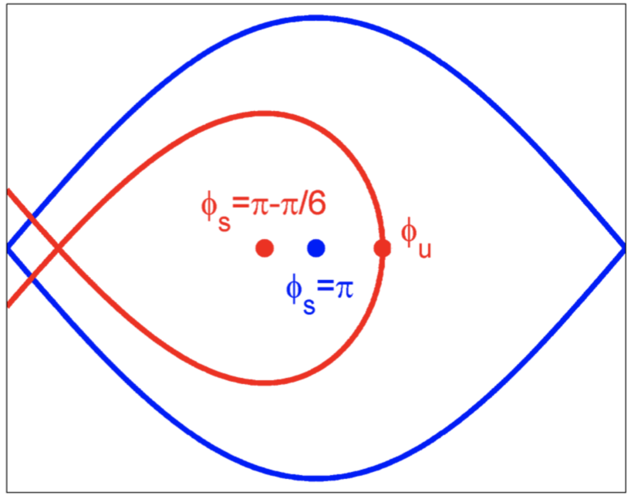

180°
180°, no acceleration
LHC stable phase
$φ_{s}$ [degrees]
176°
Ramp time [s]
Adiabatic transition between the stationary bucket, the accelerating bucket and back to the stationary bucket. If too fast ➔ particles get lost!!

Slide 6
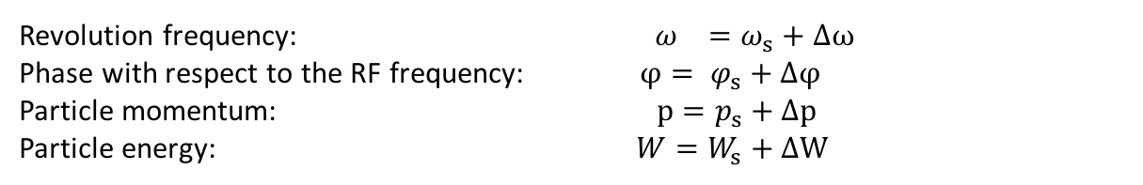
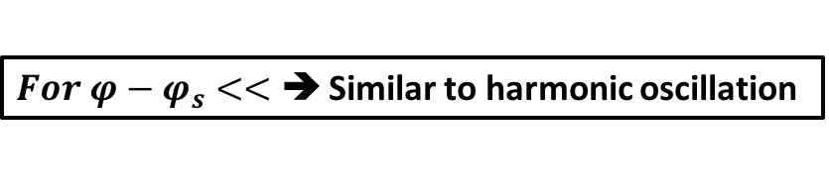
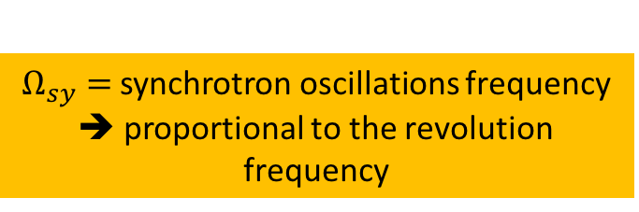

Longitudinal beam dynamics
The motion of any particle is described with respect to the synchronous one (defined with subscript $s$):
The longitudinal motion of the particles is described by the equations:
Revolution frequency: $ω_{}=ω_{s}+Δω$
Phase with respect to the RF frequency: $φ= φ_{s}+Δφ$
Particle momentum: $p=p_{s}+Δp$
Particle energy: $W=W_{s}+ΔW$
$$\dot{w}=\frac{qV_{max}Ω_{s}}{2πW_{s}} (sin⁡(Δφ+φ_{s})−sinφ_{s})$$ | Eq. 25
FIRST EQUATION OF MOTION
Valid for any phase difference.
Second order differential equation is non-linear
$$\dot{Δφ=}\frac{δ(Δφ)}{δt}={hΓ_{s}Ω}_{s}w$$ | Eq. 34
SECOND EQUATION OF MOTION
$$\ddot{Δφ}={hΓ_{s}Ω}_{s}\dot{w}$$ | Eq. 36
$For φ−φ_{s}<<$ ➔ Similar to harmonic oscillation
$$\dot{w}=\frac{qV_{max}Ω_{s}cosφ_{s}}{2πW_{s}} Δφ$$ | Eq. 35
FIRST EQUATION OF MOTION FOR SMALL PHASE AMPLITUDE OSCILLATIONS
$Ω_{sy}=$synchrotron oscillations frequency
➔ proportional to the revolution frequency
$$\ddot{Δφ}={hΓ_{s}Ω}_{s}\dot{w}$$ | Eq. 36
HARMONIC OSCILLATOR EQUATION TO DESCRIBE THE SYNCHROTRON OSCILLATIONS FOR SMALL AMPLITUDES
$$\ddot{Δφ}+Ω_{sy}^{2}Δφ=0$$ | Eq. 37

Slide 7
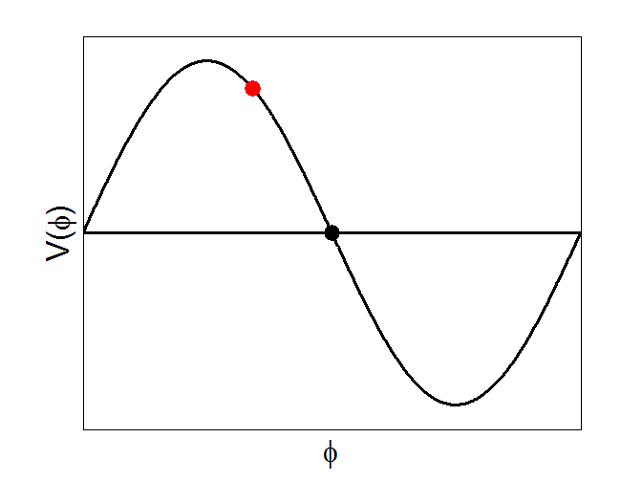
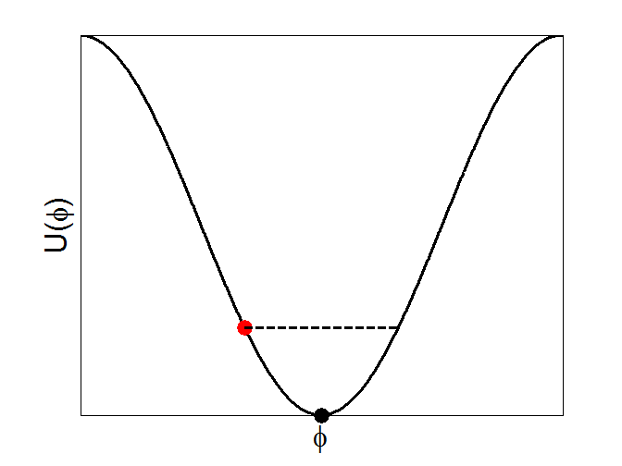
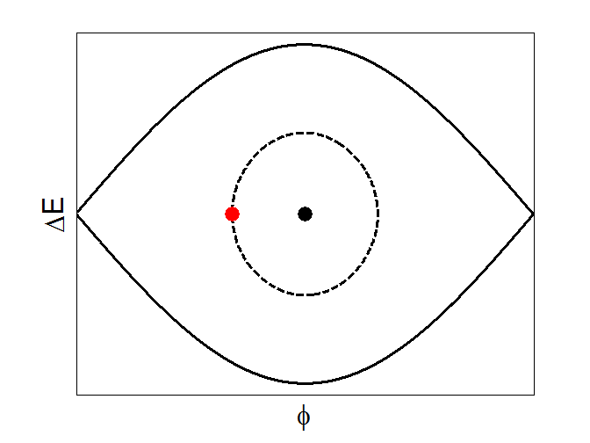



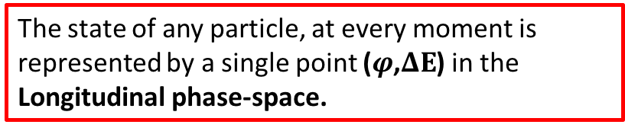
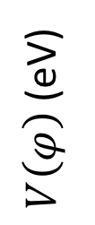

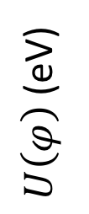
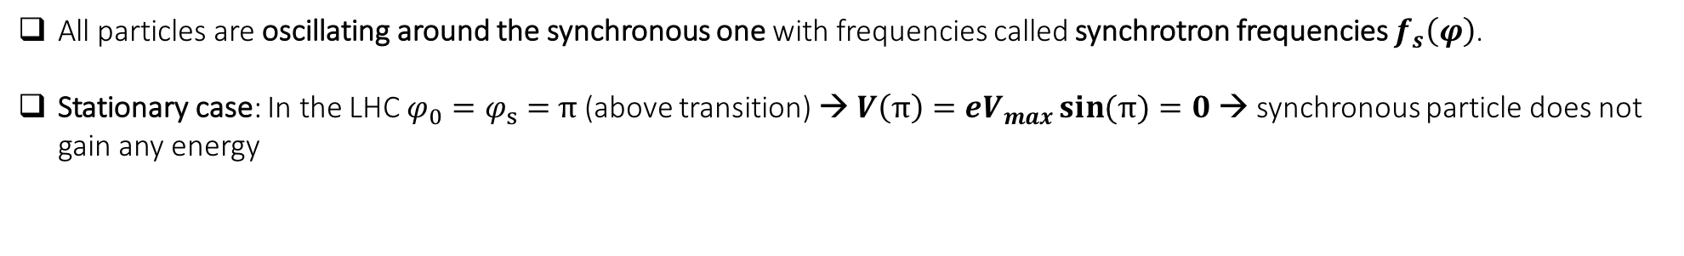

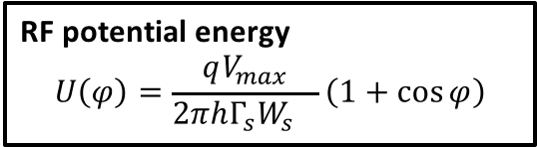
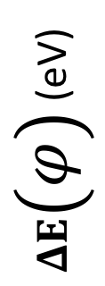
Single particle synchrotron motion – no acceleration
All particles are oscillating around the synchronous one with frequencies called synchrotron frequencies $f_{s}\left(φ\right)$.
Stationary case: In the LHC $φ_{0}=φ_{s}=$ $π$ (above transition) → $V\left(π\right)={eV}_{max}\sin{(π)}=0$ → synchronous particle does not gain any energy
RF potential energy
$$U\left(φ\right)=\frac{qV_{max}}{2πh{{Γ_{s}W}_{s}}_{}}\left(1+cos{φ}\right)$$
RF voltage $V\left(φ\right)={eV}_{max}\sin{(φ)}$
Longitudinal phase space ($φ$,$ΔE$)
$${\hat{V}}_{RF}$$
$V\left(φ\right)$ (eV)
RF period
$U\left(φ\right)$ (eV)
$ΔE\left(φ\right)$ (eV)
Synchronous particle, $φ_{0}$
Synchronous particle, $φ_{0}$
Synchronous particle, $φ_{0}$
$$φ$$
$$φ$$
$$φ$$
The state of any particle, at every moment is represented by a single point ($φ$,$ΔE$) in the Longitudinal phase-space.

Slide 8
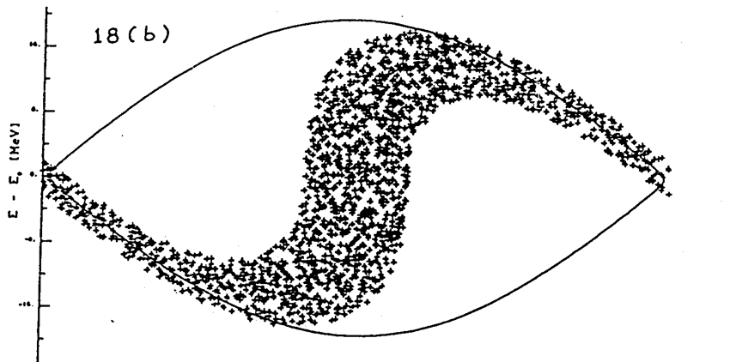
Large Amplitude Oscillations
For larger phase (or energy) deviations from the reference (i.e. synchronous) the second order differential equation is non-linear:
$$\dot{w}=\frac{qV_{max}Ω_{s}}{2πW_{s}} (sin⁡(Δφ+φ_{s})−sinφ_{s})$$ | Eq. 25
FIRST EQUATION OF MOTION
$$\dot{Δφ=}\frac{δ(Δφ)}{δt}={hΓ_{s}Ω}_{s}w$$ | Eq. 34
SECOND EQUATION OF MOTION
$$\ddot{Δφ}={hΓ_{s}Ω}_{s}\dot{w}$$ | Eq. 36
The restoring force cannot be linearized anymore and the differential equation has no analytic solution.

Slide 9
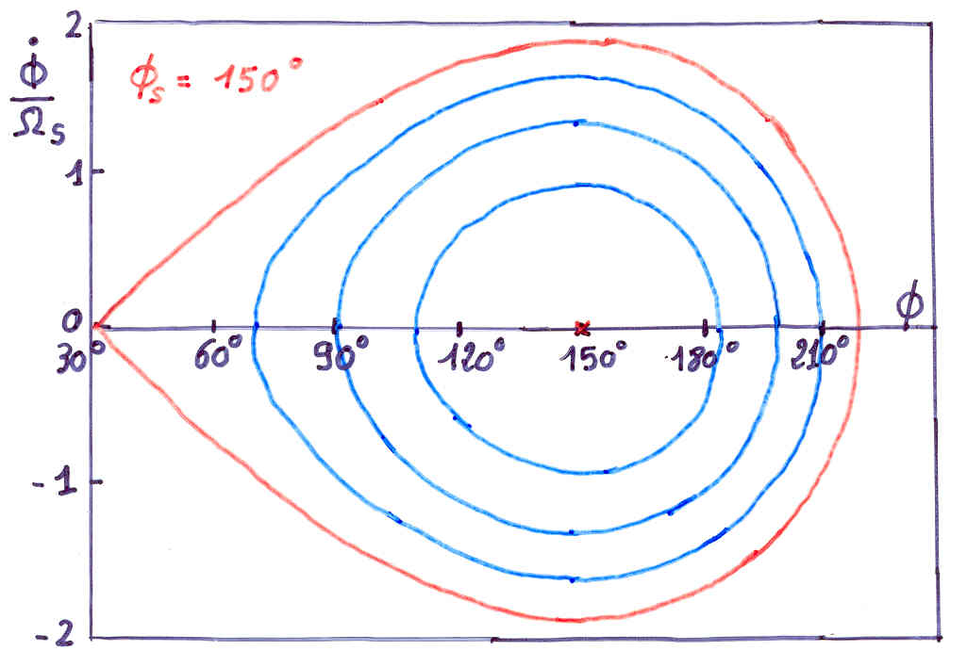
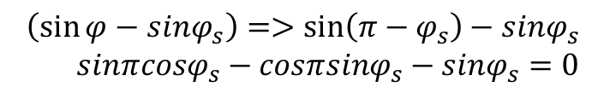



For $φ=π−φ_{s}$ : unstable fixed point
$$\left(\sin{φ}−sinφ_{s}\right)=>\sin\left(π−φ_{s}\right)−sinφ_{s}$$
$$sinπcosφ_{s}−cosπsinφ_{s}−sinφ_{s}=0$$
0 -1 sin $φ_{s}$
$$\ddot{Δφ}=0$$
No restoring force!! for Φ = π – Φ_{s} and for Φ = Φ_{s} (trivial case) … and for Φ_{u}
The synchrotron frequency ➔ 0

Slide 10

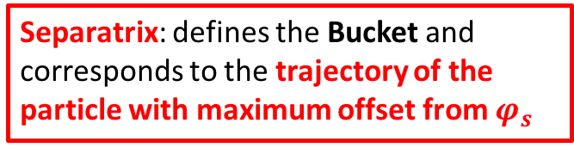

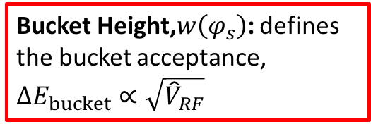
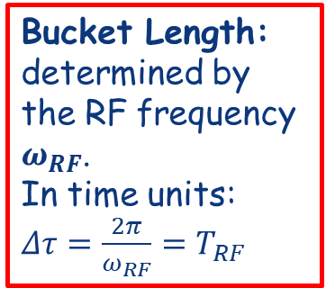
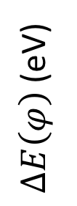

Single particle synchrotron motion – no acceleration
Stationary case: In the LHC $φ_{0}=φ_{s}=$ $π$ (above transition) → $V\left(π\right)={eV}_{max}\sin{(π)}=0$ → synchronous particle does not gain any energy
Longitudinal phase space ($φ$,$w$)
Separatrix: defines the Bucket and corresponds to the trajectory of the particle with maximum offset from $φ_{s}$
Bucket Height,$w\left(φ_{s}\right)$: defines the bucket acceptance, $ΔE_{bucket}∝\sqrt{{\hat{V}}_{RF}}$
$$∆E\left(φ_{s}\right)=ΔE_{bucket}$$
Bucket Length: determined by the RF frequency $ω_{RF}$.
In time units: $Δτ=\frac{2π}{ω_{RF}}=T_{RF}$
$∆E\left(φ\right)$ (eV)
The area enclosed by the separatrix is known as Bucket area. It is measured in electronvolt-seconds (eVs)
bucket length
$$φ$$

Slide 11


Single particle synchrotron motion – no acceleration
Stationary case: In the LHC $φ_{0}=φ_{s}=$ $π$ (above transition) → $V\left(π\right)={eV}_{max}\sin{(π)}=0$ → synchronous particle does not gain any energy
Longitudinal phase space ($φ$,$∆E$)
The area enclosed by the single particle trajectory gives the single particle emittance. It is measured in eVs.
$$ΔE_{particle}$$
$∆E\left(φ\right)$ (eV)
$$φ$$

Slide 12
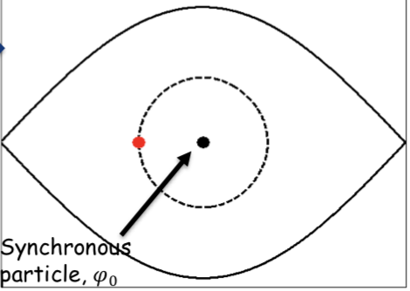

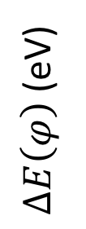
SYNCHROTRON FREQUENCY
As discussed before, particles bounded within the bucket are performing oscillations around the stable phase.
The synchrotron oscillation period is the time that takes to travel all around the closed trajectory (defined by the initial conditions) in phase space.
Particles at different distances from the synchronous particle (synchronous phase) will oscillate with different synchrotron frequencies in the longitudinal phase space.
The longer the bunch the larger the spread of synchrotron frequencies.
Large synchrotron frequency spreads within the bunch (i.e. large bunches) provide a self-stabilizing mechanism against coherent beam instabilities, called Landau damping.
Difference between synchrotron frequency and betatron frequency:
e.g. SPS
f_{syn} = 257 Hz
f_{betatron} = 26*43 kHz = 1118 kHz ~ 1 GHz
Where Q=26 and f_{rev}=43 KHz
The synchrotron frequency is much much smaller than the betatron frequency
f3
f2
$∆E\left(φ\right)$ (eV)
f1
$$φ$$

Slide 13
We have derived the value of the synchrotron frequency oscillations for particles close to the synchronous particle ➔ $∆φ=φ−φ_{s}<<$, Eq. 35’
$$f_{sy}=\frac{Ω_{sy}}{2π}=\frac{1}{2π}\sqrt{−\frac{q{hΓ_{s}V}_{max}cosφ_{s}}{2πW_{s}}}Ω_{s}^{}$$ | Eq. 35’
To evaluate the time needed for one full synchrotron oscillation, we start from the second equation of motion, Eq. 34:
$$\dot{Δφ=}\frac{δ(Δφ)}{δt}={hΓ_{s}Ω}_{s}w$$ | Eq. 34
Solve for dt:
$$dt=\frac{1}{{hΓ_{s}Ω}_{s}w }dφ$$ | Eq. 70
Assume now that an arbitrary particle in a single RF system follows in the phase space a trajectory with Hamiltonian:
$$H_{C}=\frac{1}{2}w^{2}+U\left(φ_{1}\right)=\frac{qV_{max}}{2πh{{Γ_{s}W}_{s}}_{}}\left(cosφ_{1}−cos{φ_{s}}+(φ_{1}−φ_{s})sinφ_{s}\right)$$ | Eq. 58
=0
where $φ_{1}$is the maximum phase deviation of the trajectory of the particle.

Slide 14
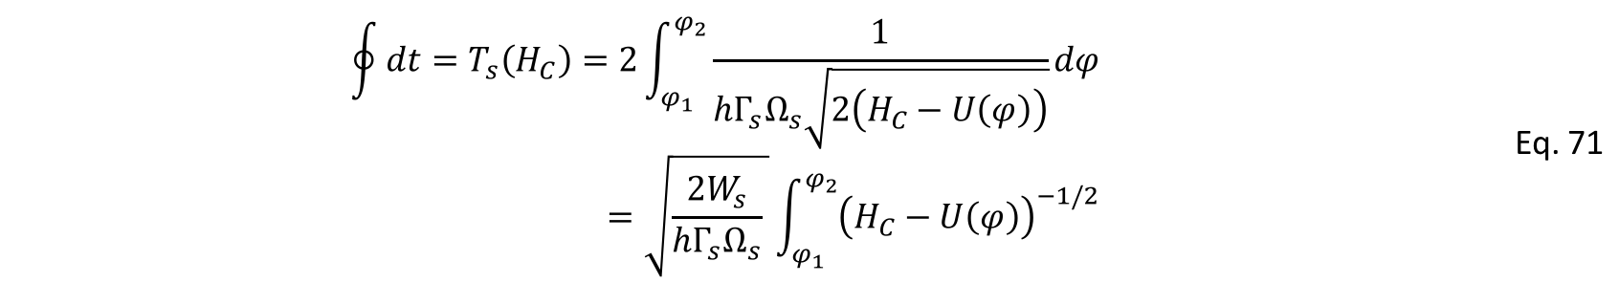

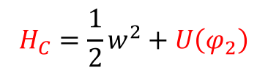


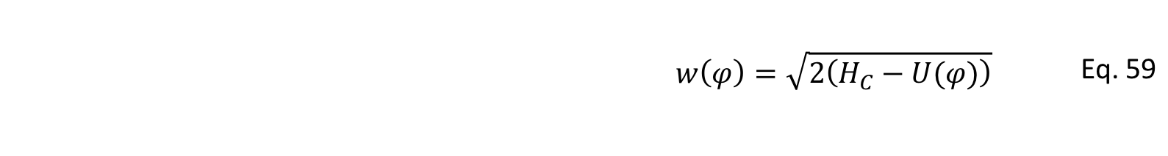
Using Eq. 57 where we have replaced Hsep ➔ Hc
$${w\left(φ\right)=\sqrt{2\left(H_{C}−U(φ)\right)} }_{}$$ | Eq. 59
And introducing the value of $w\left(φ\right)$ in Eq. 70, we get:
$$\oint{dt}=T_{s}\left(H_{C}\right)=2\int_{φ_{1}}^{φ_{2}}{\frac{1}{{hΓ_{s}Ω}_{s}\sqrt{2\left(H_{C}−U\left(φ\right)\right)}}}dφ=\sqrt{\frac{2W_{s}}{{hΓ_{s}Ω}_{s}} }\int_{φ_{1}}^{φ_{2}}{{\left(H_{C}−U\left(φ\right)\right)}^{−1/2}}$$ | Eq. 71
f3
f2
With $φ_{2}$ evaluated as $φ_{u}$ in Eq. 60, i.e.
f1
$$H_{C}=\frac{1}{2}w^{2}+U\left(φ_{2}\right)$$
=0
Replacing $H_{C}$, $U\left(φ_{}\right)$ and using the definition of $f_{sy}$ in Eq. 35’ we get:
$$φ_{1}$$
$$φ_{2}$$

Slide 15
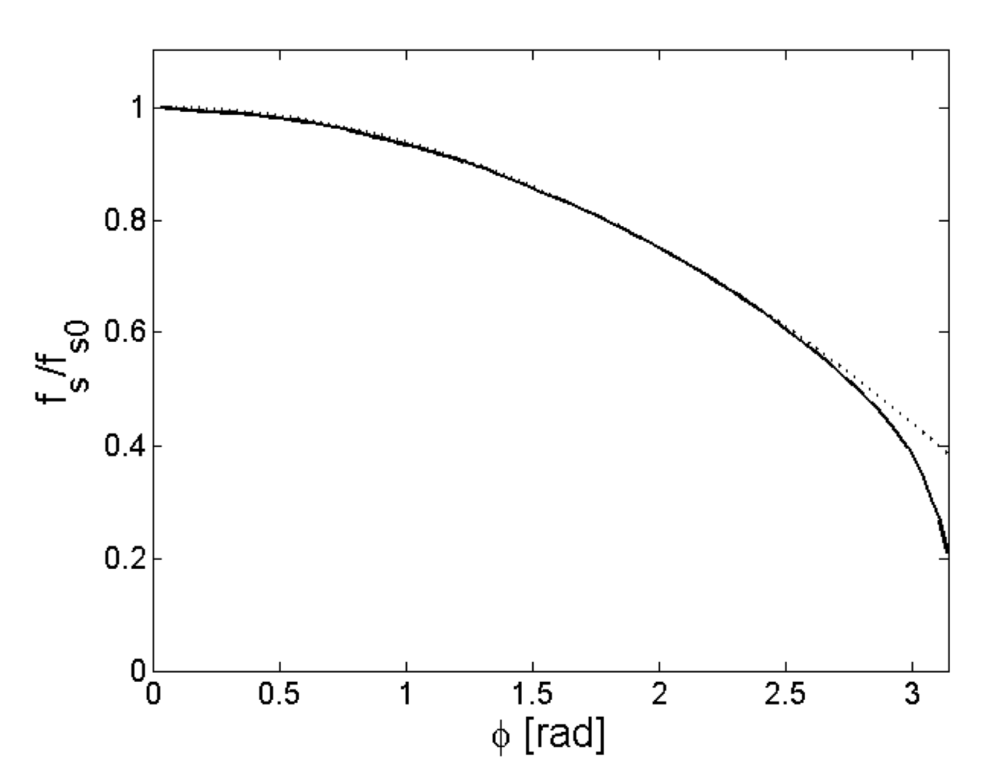

$$T_{s}\left(H_{C}\right)=\frac{\sqrt{2\left|cosφ_{s}\right|}}{Ω_{sy}}\int_{φ_{1}}^{φ_{2}}{{\left(cosφ_{1}−cosφ+\left(φ_{1}−φ\right)sinφ_{s}\right)}^{−1/2}}dφ$$ | Eq. 72
The synchrotron frequency for the stationary case $φ_{s}=π$ is:
$$T_{s}\left(Δφ_{1}\right)=\frac{1}{Ω_{sy}}\int_{{−Δφ}_{1}}^{{Δφ}_{1}}{\frac{d(Δφ)}{\sqrt{\sin^{2}\left(\frac{Δφ_{1}}{2}\right)−\sin^{2}\left(\frac{∆φ}{2}\right)}}}dφ$$ | Eq. 73
Where the Hamiltonian of the trajectory has been replaced by the Hamiltonian at the maximum phase deviation, and we have used that the trajectory is symmetric around$φ_{s}$ for the integration limits.
The angular synchrotron frequency as a function of the maximum phase deviation can be approximated by (after a tedious mathematical exercise):
$$Ω_{s}\left(Δφ_{1}\right)=Ω_{sy}\left(1−\frac{∆φ_{1}^{2}}{16}\right)$$ | Eq. 74 78
The synchrotron frequency versus the phase in the case of a single RF system and a stationary bucket. The exact curve (Eq. 73) is the solid line, the approximate solution is the dashed line.
Every particle in the bunch has a different synchrotron frequency
The spread in synchrotron frequencies is not bad for the beam but the opposite!! It helps damping collective effects ➔ Landau damping
Depending on the bunch emittance, the synchrotron frequency spread may vary a lot.
Solid line is the exact solution (Eq. 73)
Dotted line is the approximation (Eq. 74)
$$Δφ_{1}$$

Slide 16
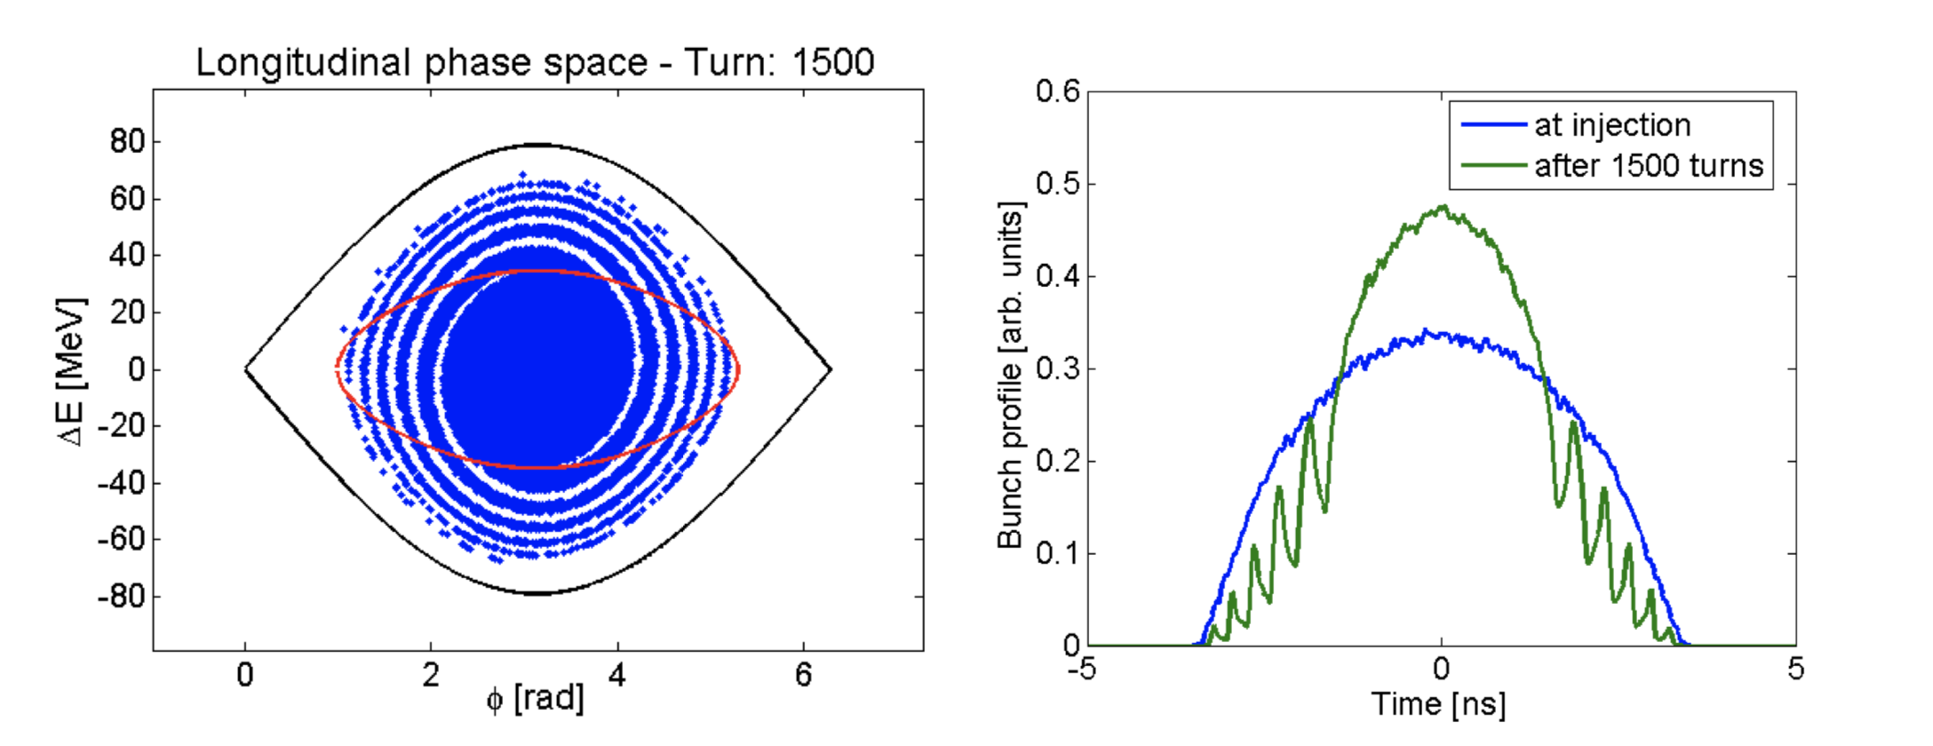
FILAMENTATION
The spread in synchrotron frequency is the responsible for the beam filamentation.
E.g. in case of a large bunch (occupies substantial fraction of the bucket area) that it is not matched to the bucket, for example the bunch is injected into another machine, the difference in frequencies leads to beam filamentation.
This process causes the mismatched bunch distribution to evolve into spirals, diluting the phase space density of the beam:
Filamentation after 1500 turns
Injected beam from a previous machine
Bucket from the receiving machine
For this machine 1500 turns = 11 synchrotron periods

Slide 17
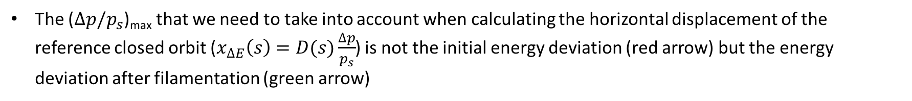
Filamentation after 1500 turns
Injected beam from a previous machine
Bucket from the receiving machine
For this machine 1500 turns = 11 synchrotron periods
The ($∆p/p_{s}$)_{max} that we need to take into account when calculating the horizontal displacement of the reference closed orbit ($x_{∆E}\left(s\right)=D(s)\frac{∆p}{p_{s}}$) is not the initial energy deviation (red arrow) but the energy deviation after filamentation (green arrow)

Slide 18
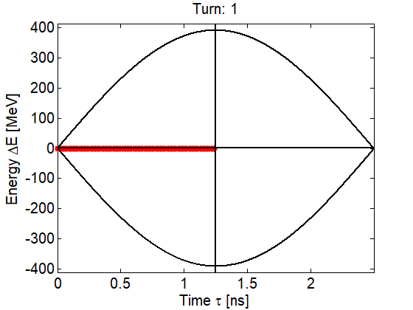
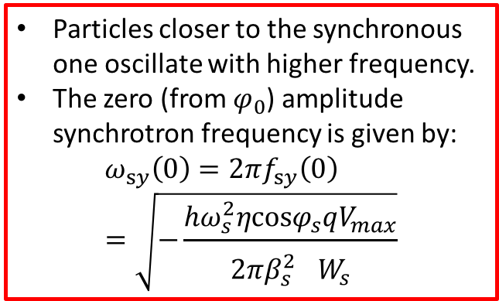
Single particle synchrotron motion – Synchrotron frequency distribution
Particles closer to the synchronous one oscillate with higher frequency.
The zero (from $φ_{0}$) amplitude synchrotron frequency is given by:
$$ω_{sy}\left(0\right)=2πf_{sy}\left(0\right)=\sqrt{−\frac{hω_{s}^{2}ηcosφ_{s}qV_{max}}{2π{β_{s}^{2}}^{}W_{s}}}$$

Slide 19
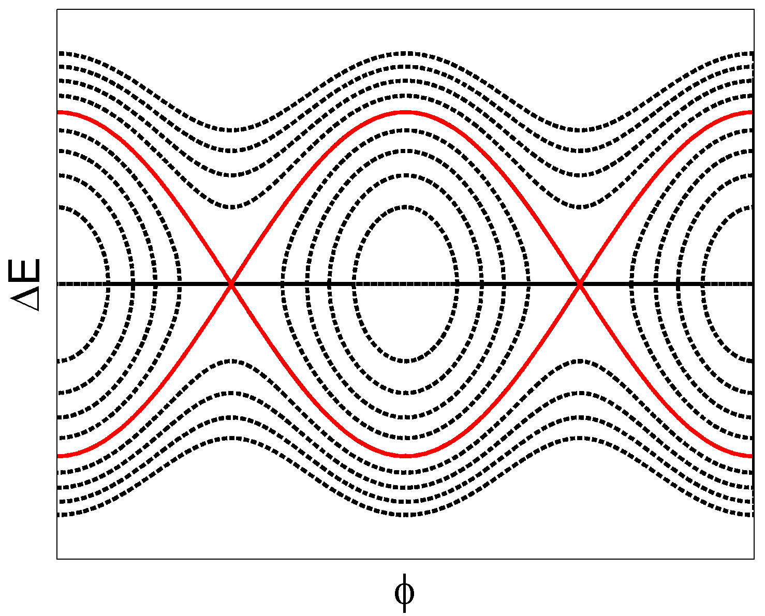

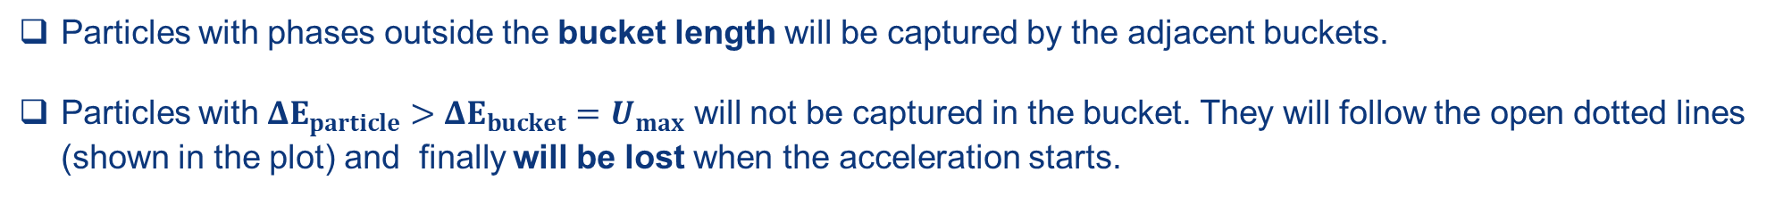
Single particle synchrotron motion – bucket losses
Particles with phases outside the bucket length will be captured by the adjacent buckets.
Particles with ${ΔE}_{particle}>{ΔE}_{bucket}=U_{max}$ will not be captured in the bucket. They will follow the open dotted lines (shown in the plot) and finally will be lost when the acceleration starts.
Trajectories of uncaptured
particles
The separatrix separates the open and the closed trajectories. Particles that are inside the bucket are grouped into Bunches.
$$ΔE_{bucket}$$
bucket length
RF cavities are used to accelerate and to bunch the particle beams.

Slide 20
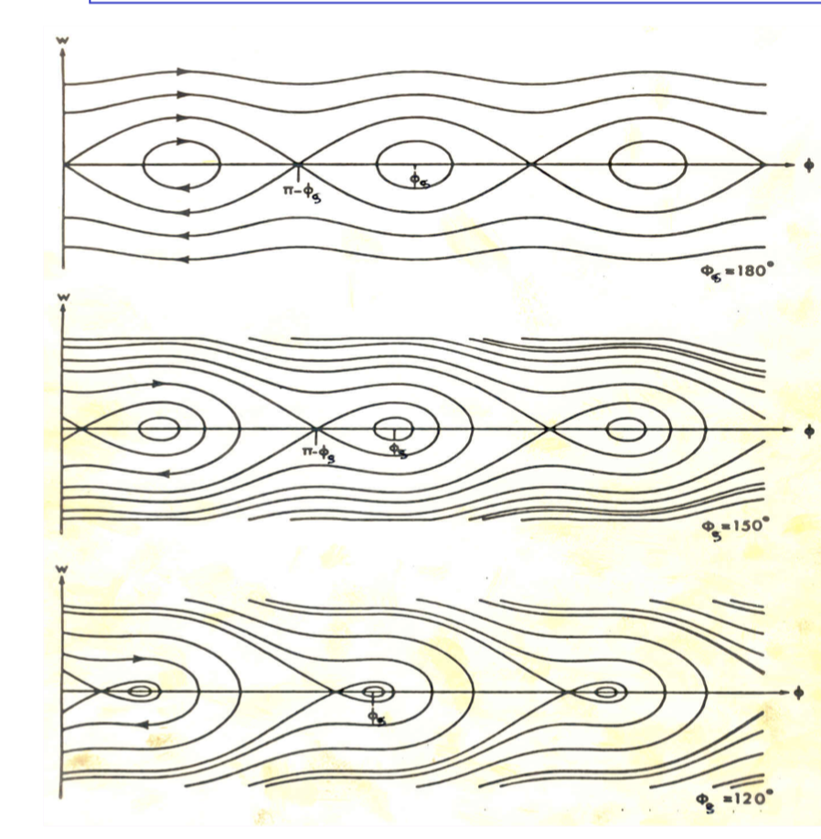

Slide 21
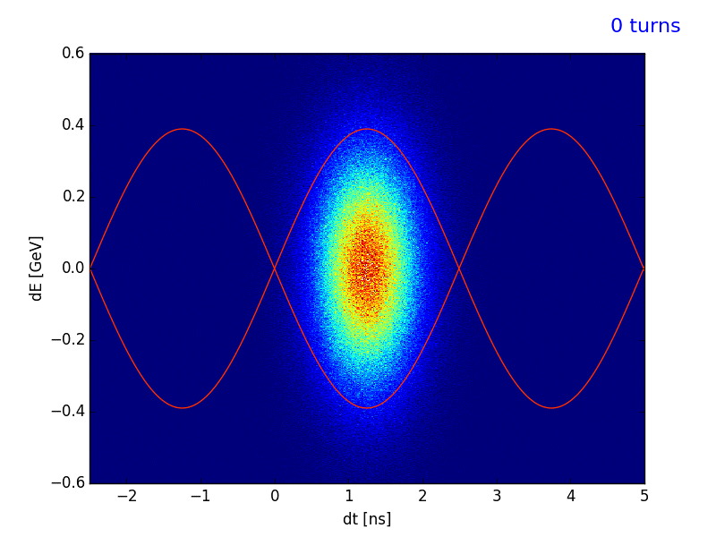
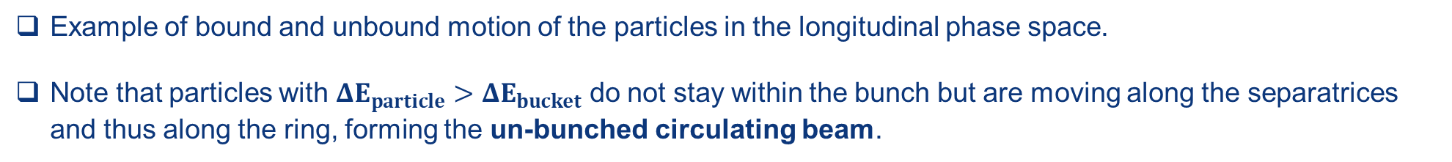
Single particle synchrotron motion – bucket losses
Example of bound and unbound motion of the particles in the longitudinal phase space.
Note that particles with ${ΔE}_{particle}>{ΔE}_{bucket}$ do not stay within the bunch but are moving along the separatrices and thus along the ring, forming the un-bunched circulating beam.
Bound and unbound particle motion
H. Timko, Simulations with BLonD

Slide 22
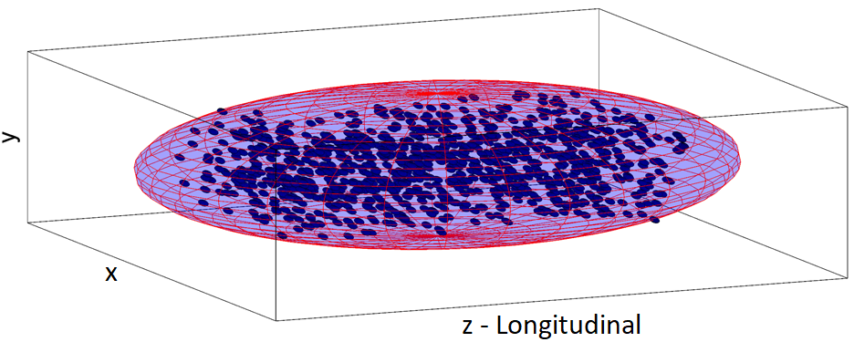
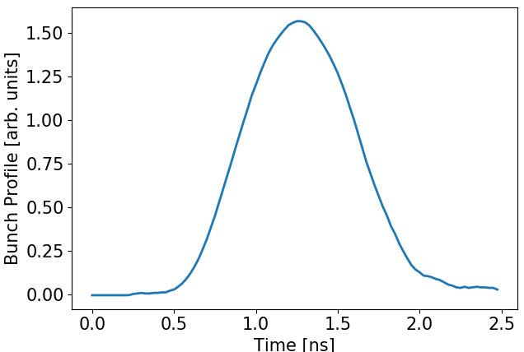

Bunch parameters
Bunches are formed from many particles (10⁹ – 10¹⁵ particles) → the description of the bunch and its motion is represented by statistical quantities.
  Bunch position (usually in seconds): position of the centroid of the
  bunch.
  Bunch length (usually in seconds): size of the bunch.
  Bunch emittance (in eVs): area in the longitudinal phase-space
  enclosed by a limiting single particle trajectory.
In the longitudinal plane we use the wall-current-monitors and a fast sampling
oscilloscope to measure the bunch profile which is the projection
of the bunch to the z-axis.
The statistical nature of the bunch parameters imply a strong dependence
on the particle distributions → different conventions of defining the
bunch parameters are used in the accelerators.
Projection to the z-axis
Bunch position
No direct measurement on the energy distribution ($ΔE$=w) of the particles within the bunch.
Bunch length

Slide 23
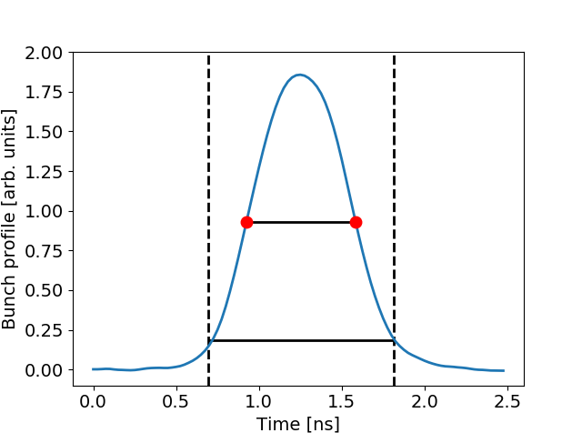

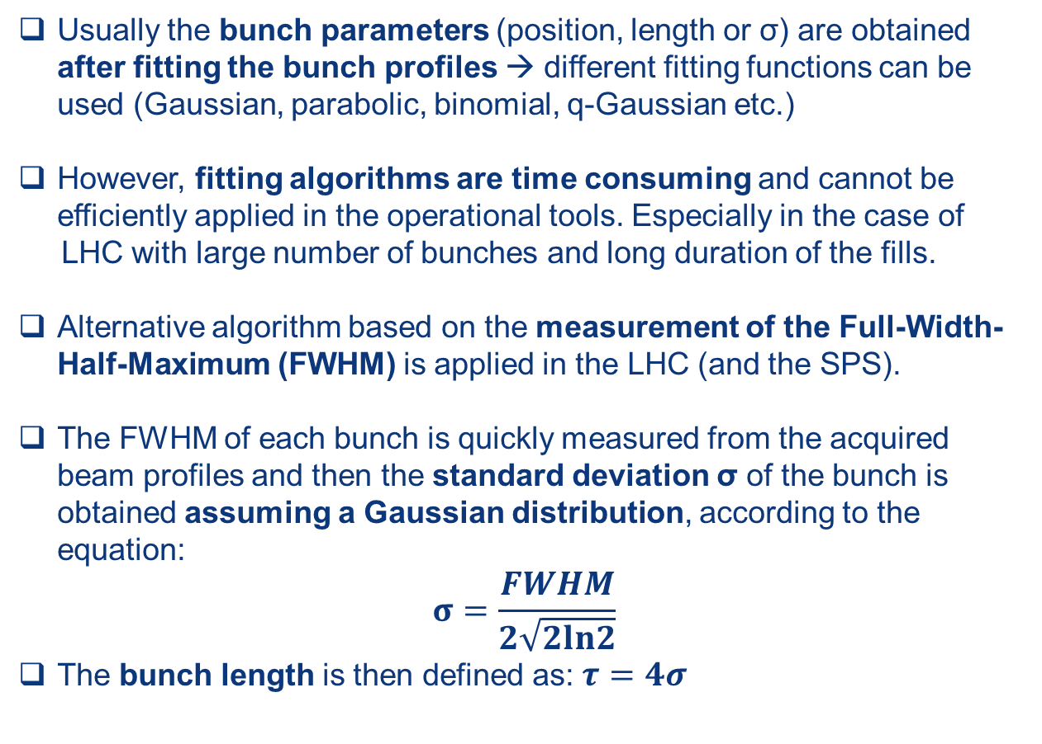
Bunch parameters – LHC conventions
Usually the bunch parameters (position, length or σ) are obtained after fitting the bunch profiles → different fitting functions can be used (Gaussian, parabolic, binomial, q-Gaussian etc.)
However, fitting algorithms are time consuming and cannot be efficiently applied in the operational tools. Especially in the case of
LHC with large number of bunches and long duration of the fills.
Alternative algorithm based on the measurement of the Full-Width-Half-Maximum (FWHM) is applied in the LHC (and the SPS).
The FWHM of each bunch is quickly measured from the acquired beam profiles and then the standard deviation σ of the bunch is obtained assuming a Gaussian distribution, according to the equation:
$$σ=\frac{FWHM}{2\sqrt{2ln2}}$$
The bunch length is then defined as: $τ=4σ$
FWHM
Bunch length
$$τ=4σ$$

Slide 24
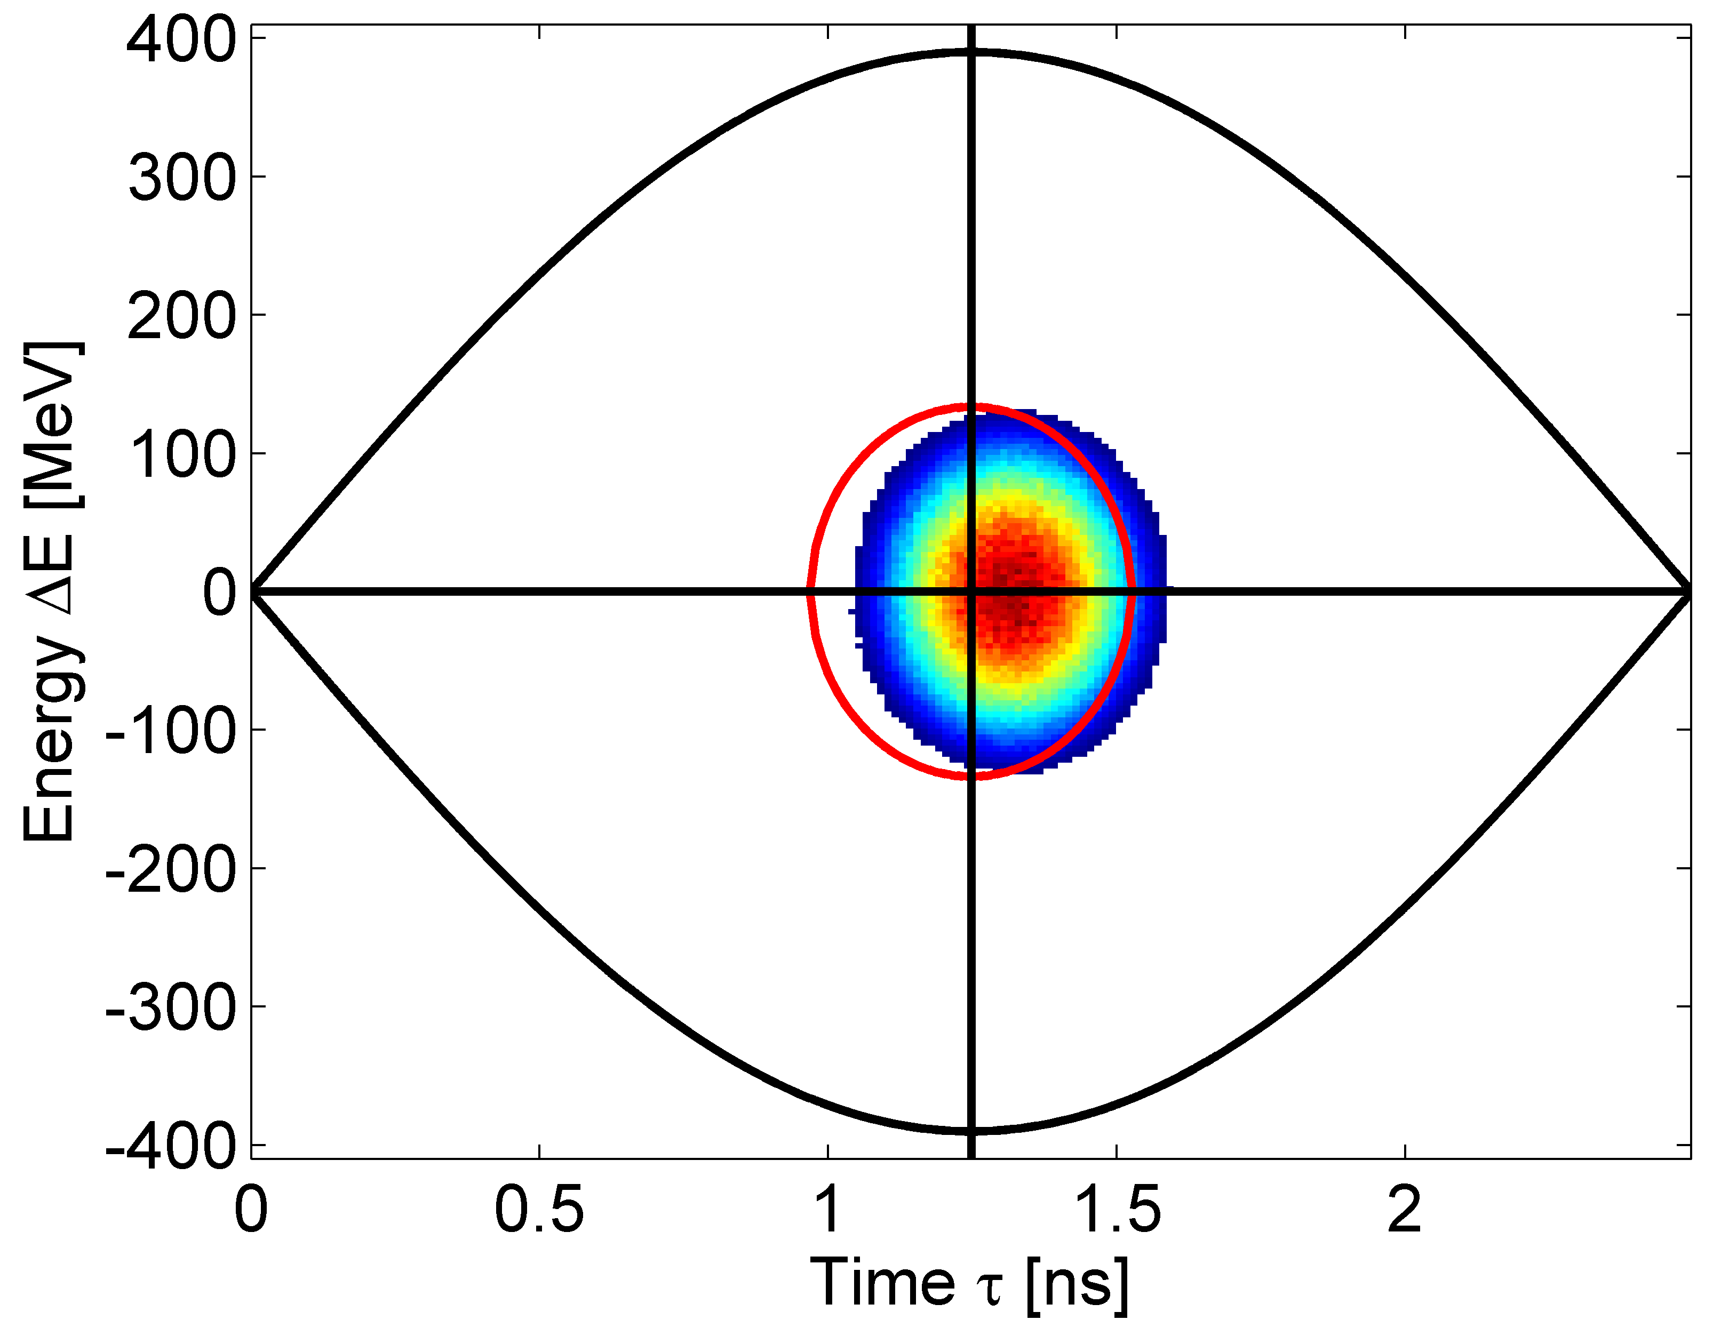
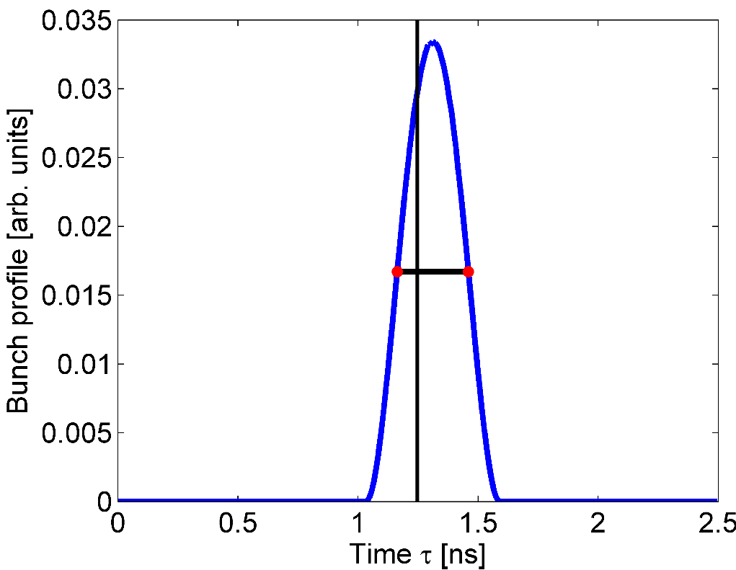






Phase error at injection
Injection of a bunch into the RF bucket with a phase error $φ_{err}=10°$ (or ${Δτ}_{err}={φ_{err}}/{ω_{RF}}=$ 0.07 ns in time)
$φ_{err}=10°$
$$σ=\frac{FWHM}{2\sqrt{2ln2}}=0.126 ns$$
⇨ $τ=4σ=0.5 ns$
$$FWHM=0.3 ns$$
$φ_{err}=$ 10°
Note that the size of the bunch in this example is much smaller than the one that is normally injected from the SPS into the LHC ($τ_{4σ}\sim 1.4−1.6 ns$)

Slide 25



Phase error at injection – Dipole oscillations
The bunch will initially start to oscillate as a whole with frequency close to the zero amplitude synchrotron frequency $f_{s0}$.
This bunch motion is called dipole oscillation
Projection into the Time axis. This is what can be measured in the machine using a wall-current monitor and a fast sampling oscilloscope.

Slide 26


Phase error at injection – Dipole oscillations
Summary plots of the bunch profiles are used to illustrate the bunch oscillations. The black lines on the plots show the centre of the RF bucket.
Waterfall plot: Each horizontal line corresponds to one acquisition of the same bunch. The colour code depicts the bunch profile density in arb. units.
Overlaying of all bunch profiles. Different colours correspond to different turns.

Slide 27




Phase error at injection – Dipole oscillations
After analysing the profiles i.e. fitting the bunches and getting the bunch parameters for each acquisition, we can plot the motion of the centroid of the bunch.
$$φ_{err}=10° or$$
$$Δτ=0.07 ns$$
The motion of the bunch centroid after injection into the RF bucket with a phase error shows a clear harmonic oscillation with frequency close to the zero amplitude synchrotron frequency $f_{s0}$.
Centre of the RF bucket
$$T_{s}\sim$$
$$1/f_{s0}$$

Slide 28




Phase error at injection – bunch filamentation
Particles having different synchrotron frequencies (fast for the particles around the centre of the bucket and slow for the ones injected close to the separatrix) will lead to the filamentation of the bunch and finally to the de-coherence of the bunch motion. Particles will adapt to the corresponding trajectories in the phase-space at the moment of injection resulting to observation of an emittance bunch blow-up.
After filamentation the bunch blows-up.
Larger initial phase error leads to bigger blow-up
De-coherence of the bunch motion → amplitude of the dipole oscillations damps to zero
$$τ_{4σ}=0.5 ns$$
$$τ_{4σ}=0.521 ns$$

Slide 29




Energy error at injection
Injection into the RF bucket with 30 MeV energy error → effect on the bunch is similar to the phase error case.
${ΔE}_{err}=30 MeV$
Note that the bunch is initial injected into the centre of the bucket (no phase error). These kind of plots can be used to distinguish between energy and phase errors.

Slide 30





The Synchrotron: Frequency Change
During the energy ramping, the particle velocity increases
(… which is why we call it an accelerator)
Which means the revolution frequency of the particles increases (except for e- which are fully relativistic)
And we have to adjust the external RF frequency in order to stay synchronised.
Revolution frequency and RF frequency are related by the “harmonic number”.
The harominic number is the number of RF wavelengths that fit around the ring.
hence :

Slide 31






The Synchrotron: Frequency Change
The RF frequency must follow the variation of the B field with the law :
At relativistic energies, (as soon as …)
We can treat f_{r} as constant.
which is true for LHC at high energy and for electrons from the start

Slide 32



Energy Gain in RF structures:
Transit Time Factor
The RF-field is oscillating field at frequency ω (amplitude is assumed to be constant all along the gap)
g
Consider a particle passing through the middle of the gap at time t=0 :
The total energy gain is:
… where we have introduce the so-called “transit time angle” 𝜃
defining the transit time factor T.
transit time factor ( 0 < T < 1 )

Slide 33



Energy Gain in RF structures:
Transit Time Factor
The total energy gain is:
g
Because of the changing RF amplitude with time (i.e. with position of the particle inside the cavity)
The net energy gain is reduced.
ideal case:
!
… wich means ... 𝜔 → 0 ... And / or g → 0
Thus, better go for el. static accelerators … or zero gap cavities .
Still we can optimise the transit time factor !!
w=0 ➔ electrostatic machine
Old cavity design with gap not optimised
Modern cavity design with gap optimised: small enough to reduce the transient time, but not so small to avoid break downs

Slide 34
Cavity Optimisation
→ for discharge reduction
→ cooling
→ transit time factor
Transit time factor & Cavity Optimisation
Defined as:
0 < T_{a} < 1
T_{a} → 1 for g → 0, smaller ω_{RF}
Important for low velocities (ions)
The design of a pill-box cavity should be optimised in order to improve its performances:
A nose cone can be introduced in order to concentrate the electric field around the axis,
Round shaping of the corners allows a better distribution of the magnetic field on the surface and a reduction of the Joule losses. It also prevent from multi-pactoring effects.
High conducting material (NbTi, Cu etc)
A good cavity is a cavity which efficiently transforms the RF power into accelerating voltage.
!
Old cavity design with gap not optimised
Modern cavity design with gap optimised: small enough to reduce the transient time, but not so small to avoid break downs

Slide 35







The phases are with respect to the RF voltage
New synchronous phase = $π−φ_{s}$
$$sinφ_{s}\text{=}\text{sin}\left(π−φ_{s}\right)$$
V($φ_{s}$)=V($π−φ_{s}$)
$$RF phase jump= π−2φ_{s}$$
$$φ_{s}$$
$${π−φ}_{s}$$

Slide 36







PS
Beam losses at transition
PS
Transition time
Beam intensity
Turn number
Time (or phase)
longitudinal distribution of the bunch as a function of time
(PS uses a method called 𝛾_{tr}-jump takes 500 𝜇s ➔ ~250 turns)

Slide 37


The deformation of the longitudinal phase space due to higher-order
phase space motion close to transition is often referred to as alpha
buckets. In Wiedeman's book (https://cds.cern.ch/record/2034423) is a
nice section on that topic, see p. 291:
https://link-springer-com.ezproxy.cern.ch/content/pdf/10.1007%2F978-3-319-18317-6_9.pdf

