Slide 1
LHC Machine Protection
LHC parameters for Machine Protection
Failure time scales and Machine Protection Systems
LHC Operation – a machine protection view
Machine Protection studies for the future
  Cold diode qualification
  Sc. magnet damage due to beam impact
Daniel Wollmann, CERN
Acknowledgments: G. D’Angelo, R. Denz, B. Lindstroem, A. Monteuuis, Y. Nie, A. Oslandsbotn, E. Ravaioli, R. Schmidt, J. Steckert, M. Vaananen, M. Valette, A. Verweij,
J. Uythoven, J. Wenninger, C. Wiesner, A. Will, M. Zerlauth

Slide 2
Outline
LHC parameters for Machine Protection
LHC Machine Protection Systems
LHC Operation – a machine protection view
Machine Protection studies for the future
  Cold diode qualification
  Sc. magnet damage due to beam impact

Slide 3
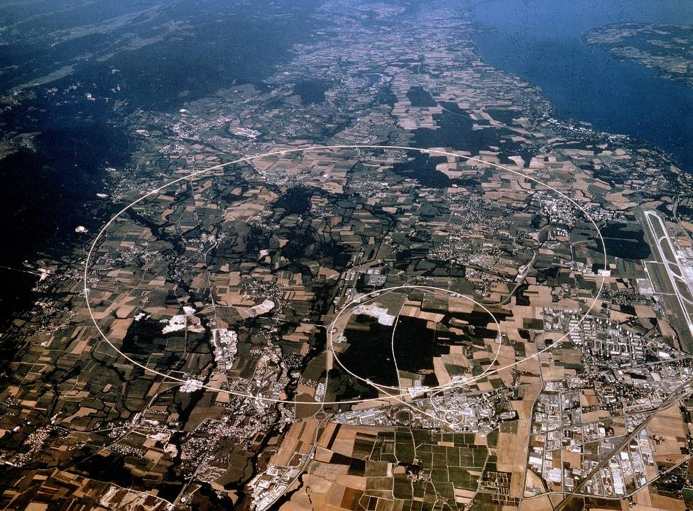
LHC pp and ions
7 TeV/c – up to now 6.5 TeV/c
26.8 km Circumference
Switzerland
Lake Geneva
LHC Accelerator
(100 m down)
LHCb
CMS
CERN-Prevessin
ALICE
SPS Accelerator
ATLAS
France
CERN Main Site

Slide 4
Beam dump blocks
IR5: CMS
LHC Layout
8 sectors
8 arcs
8 long straight sections (insertions) about 700 m long
1232 sc. main dipole magnets (r ≈ 2804 m): making the circle
IR4: RF + Beam instrumentation
IR6: Beam dumping system
IR3: Momentum Beam Cleaning (warm)
IR7: Betatron Beam Cleaning (warm)
IR8: LHC-B
IR2: ALICE
IR1: ATLAS
Courtesy R. Schmidt
Injection
Injection

Slide 5
LHC Parameters
 |  | Nominal | 2018 | HL-LHC
Proton energy | [TeV] | 7.0 | 6.5 | 7.0
Number of particles per bunch | - | 1.15 x 10¹¹ | ~1.15 x 10¹¹ | ~2.2 x 10¹¹
Number of bunches | - | 2808 | 2556 | 2760
Bunch spacing | [ns] | 25 | 25 | 25
Transvers normalized emittance | [um] | 3.75 | 2.0 - 3.0 | 2.5
b* in IP1 and IP5 | [m] | 0.55 | 0.3 … 0.25 | 0.15
Current in main dipoles | [kA] | 11.85 | 10.98 | 11.85
Stored energy per beam | [MJ] | 362 | 292 | 680
Stored energy per dipole circuit (154 dipoles) | [GJ] | 1.07 | ~0.92 (6MJ per dipole) | 1.07
Peak luminosity in IP1 & IP5 | x 10³⁴ [cm⁻²s⁻¹] | 1.0 | 2.2 | 17 (virtual) Leveled: 5
Integrated luminosity in IP1 & IP5 | [fb⁻¹] | - | 65 | 250/year
Integrated luminosity (total) | [fb⁻¹] | 300 | >150 (2009-2018) | 3000

Slide 6
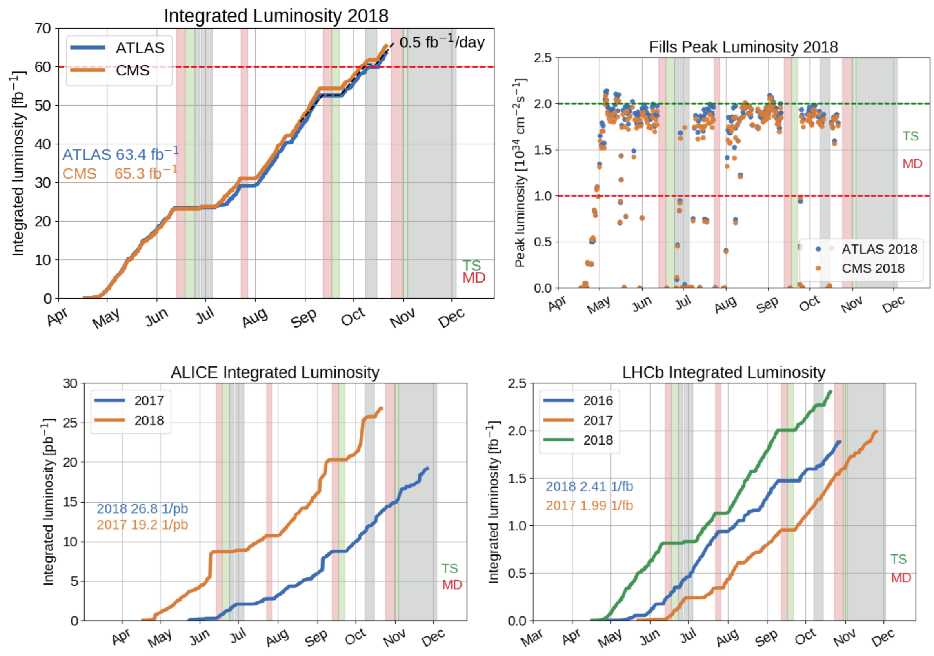
LHC Luminosity Production 2018
Courtesy J. Wenninger
xx

Slide 7
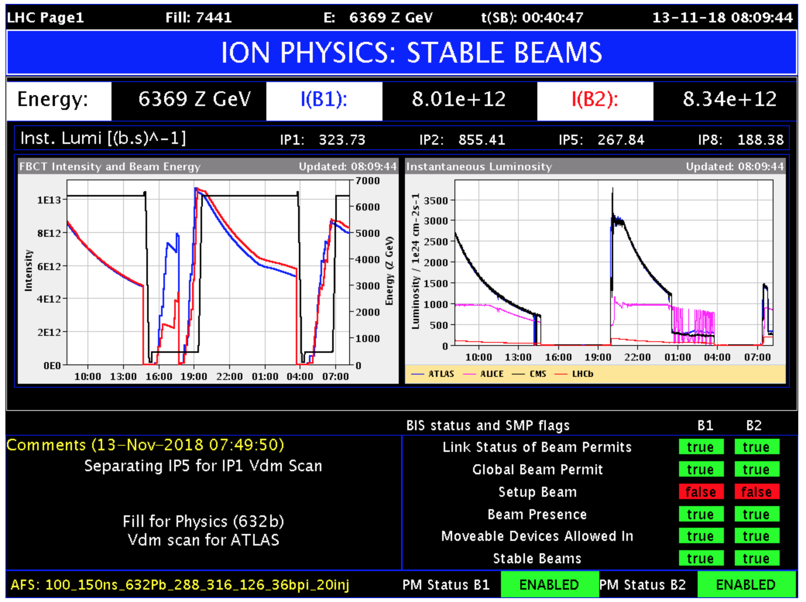
Pb-Pb ion run 2018
max ~ 620 Pb bunches (~ 11 MJ - 100ns spacing)
later ~790 Pb bunches (~14 MJ - 75 ns spacing),
assuming 1.7e10 charges/bunch, i.e. 2.1e8 Pb⁸²⁺/bunch

Slide 8

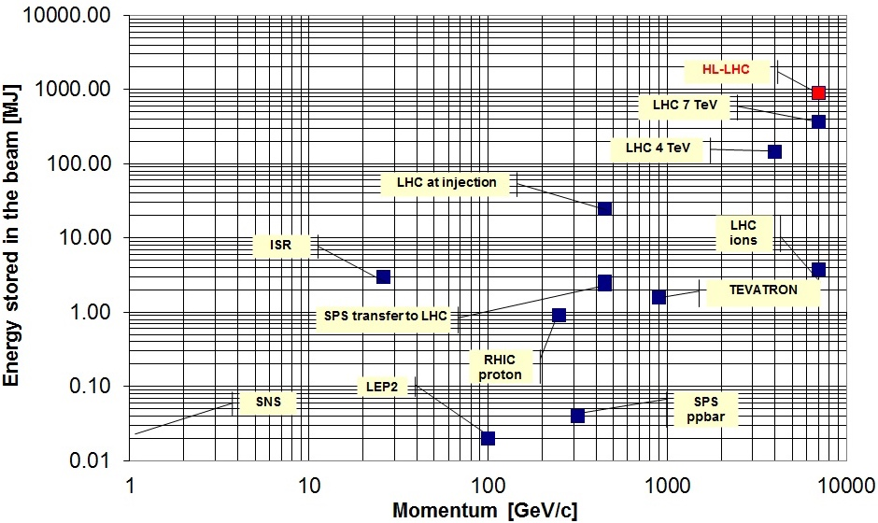


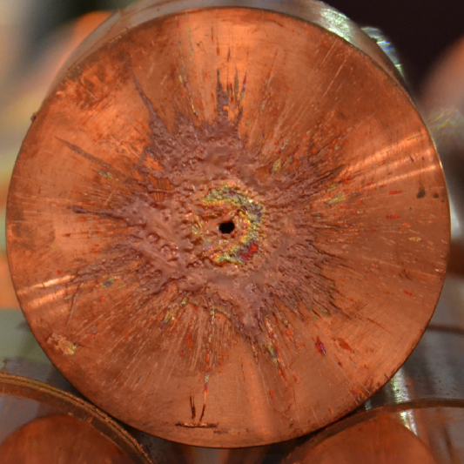
LHC Stored beam energy
LHC 2018
362 MJ stored beam energy:
90 kg TNT
8 l gasoline
15 kg chocolate
Drill 30 m long hole in solid copper block

Slide 9
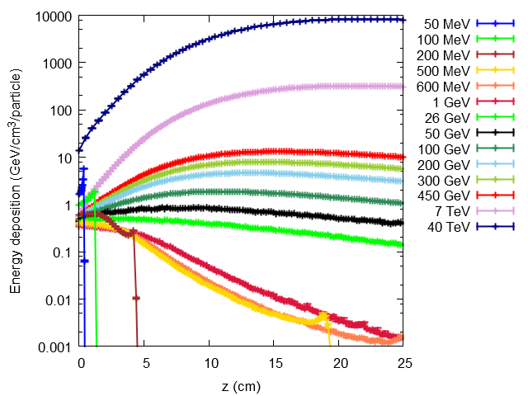
Damage due to instantaneous beam impact
Beam losses lead to energy deposition in materials
The energy deposition leads to a temperature increase
Material can change its material properties, deform, melt or vaporize.
Energy deposition due to impact of 50 MeV to 40 TeV protons in copper.
Sigma 0.2mm
Courtesy F. Burkart

Slide 10
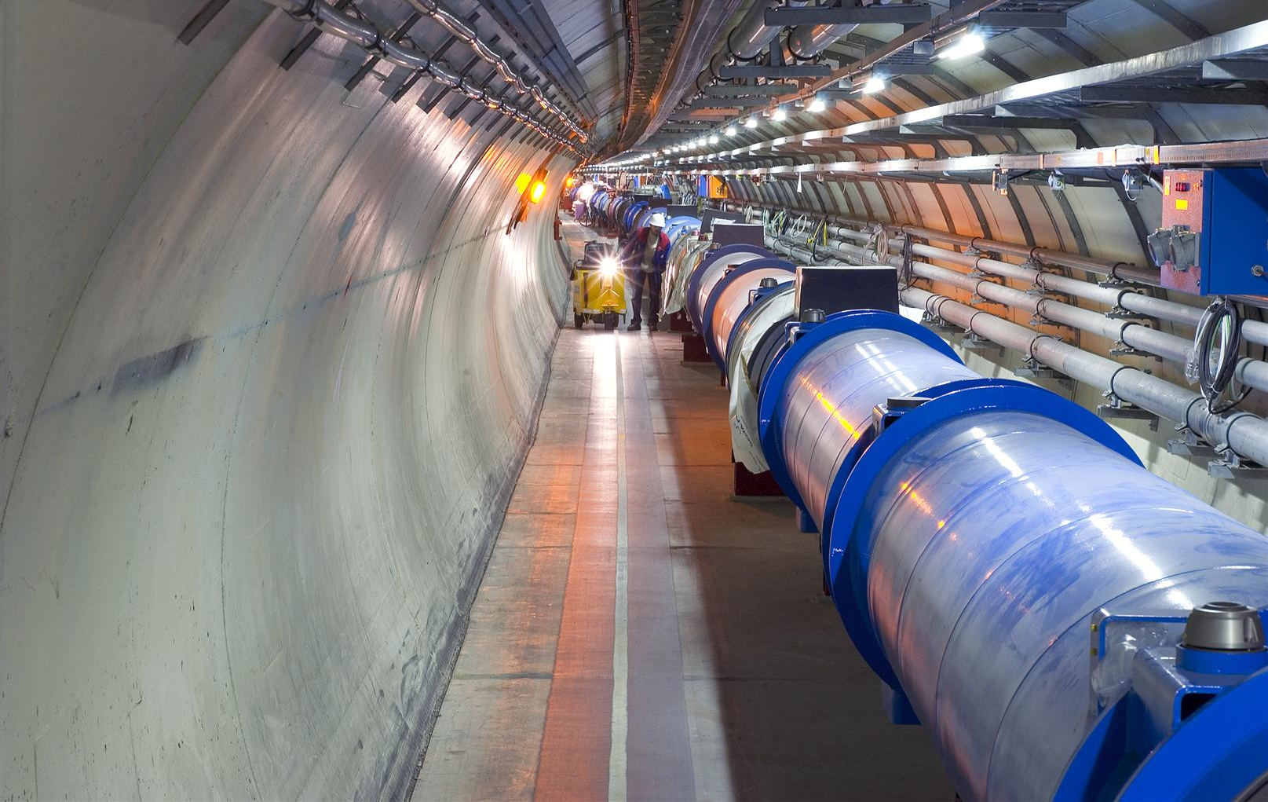
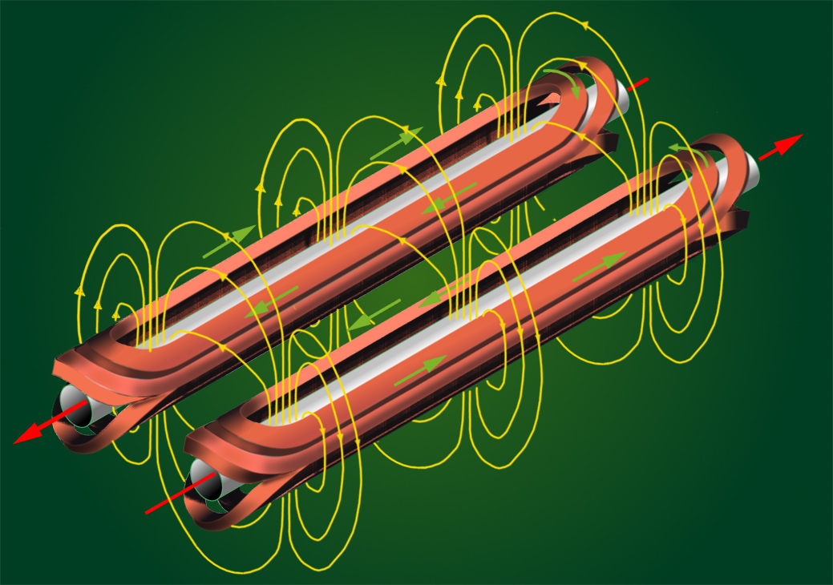
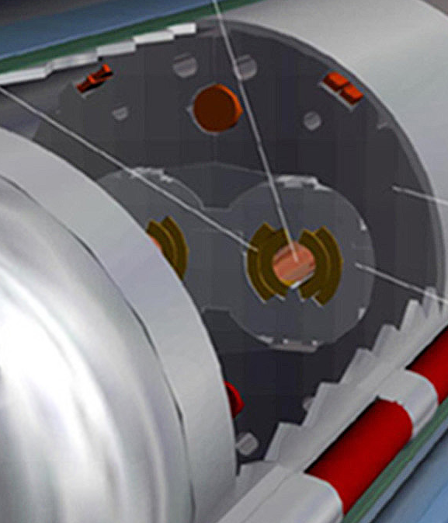
LHC main dipoles
Beam
362 MJ
1238 superconducting bending magnets.
NbTi.
Operated at 1.9 K.
I_{nom} = 11.85 kA (currently 10.98 kA)
B_{nom} = 8.33 T
E_{stored}= 6.9 MJ (currently 6 MJ)
R ≈ 2804 m

Slide 11

Energy stored in Magnet Powering System of the LHC
E_{kin}(v = 27 kn) ≈ E_{LHC} _{main circuits} (@6.5 TeV)

Slide 12
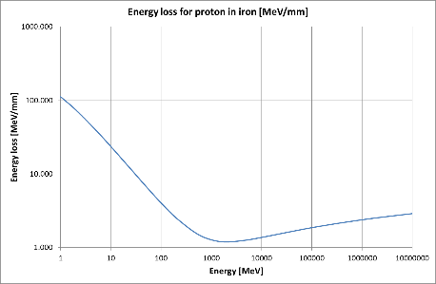
Small but already dangerous
Damage @ Linac4 with a 3 MeV beam – vacuum leak.
Failure combination:
  Beam misaligned
  Unlucky magnet setting / disabled interlock
  Aperture limitation at bellow
Energy loss from ionization
3 MeV L4
7 TeV
LHC
At such low energies, the local energy loss per proton is very high
⇒ Damage after some integration time
Courtesy J.B. Lallement

Slide 13

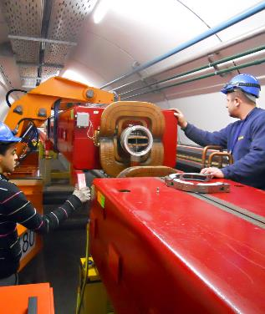
SPS dipole magnet
A real case from the 2018 SPS run !
Impact on the vacuum chamber of a 400 GeV beam of 3x10¹³ protons (2 MJ).
Event is due to an insufficient coverage of the SPS MPS (known !).
Vacuum chamber to atmospheric pressure, downtime ~ 3 days.
3 days downtime + dose to workers
1 event / 5-10 years

Slide 14
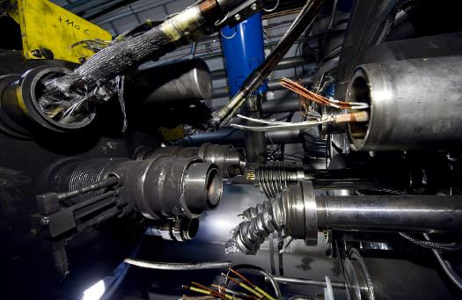
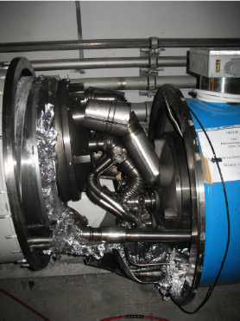
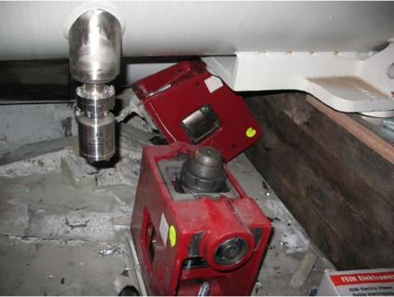
Release of 600MJ at the LHC
The 2008 LHC incident happened during test runs without beam.
A magnet interconnect was defect and the circuit opened. An electrical arc provoked a He pressure wave damaging ~600 m of LHC, polluting the beam vacuum over more than 2 km.
Arcing in the interconnection
1 year downtime + repair of 50 magnets + organization’s reputation 1 event / 1000? years

Slide 15
Outline
LHC parameters for Machine Protection (MP)
LHC Machine Protection Systems
LHC Operation – a machine protection view
Machine Protection studies for the future
  Cold diode qualification
  Sc. magnet damage due to beam impact

Slide 16
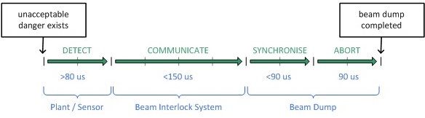
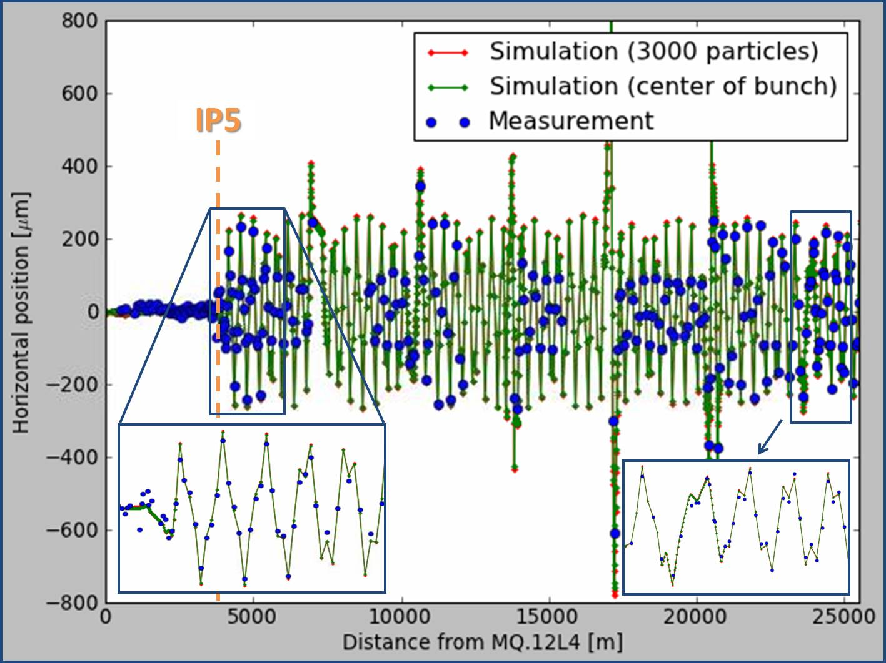
Assumptions for LHC MP systems
Ultra- Fast failures (< 3 turns):
  Beam injection from SPS to LHC.
  Beam extraction into dump channel.
  Missing beam-beam kick after dump of one beam.
Passive protection devices (TDI, TCDQ, Collimators etc.)
0.6σ single turn orbit perturbation measured @4TeV → 0.8σ @ 7Tev
Trajectory perturbation of beam 1 after dump of beam 2, 4TeV, 0.9e11p/b, 84b, 25ns, IP5-xing=68urad, 13.12.2012 08:26:54
Courtesy T. Baer

Slide 17
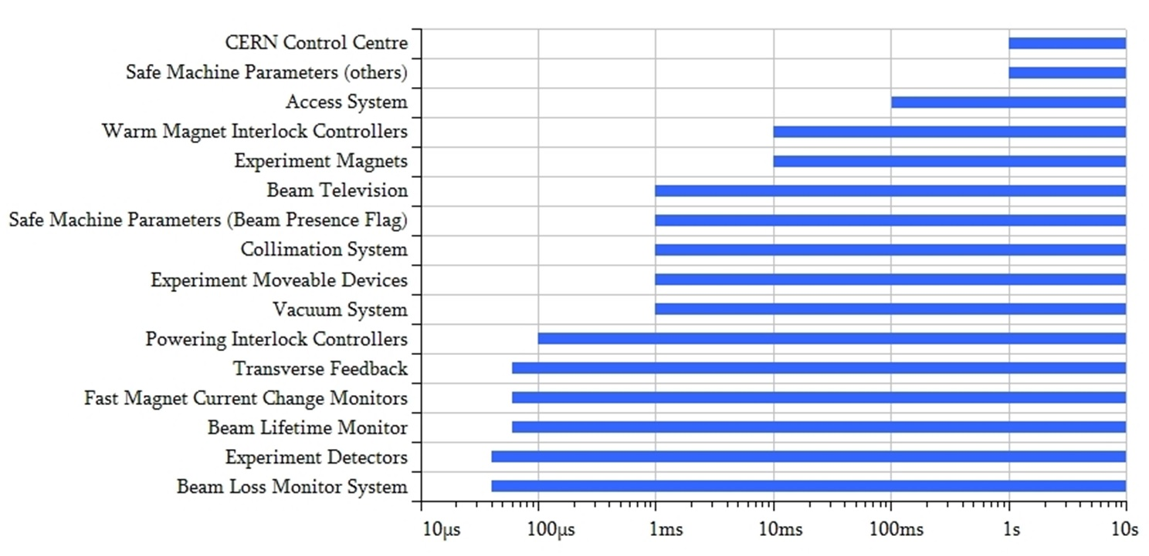
Assumptions for LHC MP systems
Ultra- Fast failures (< 3 turns):
  Beam injection from SPS to LHC.
  Beam extraction into dump channel.
  Missing beam-beam kick after dump of one beam.
Fast failures (< few milliseconds):
  Detected by: BLMs (>40us), FMCM (~100us), Beam Life Time monitor (~200-300us), …
  Equipment failure with fast effect on orbit: e.g. D1 separation dipole (IP1/5) fastest failure with circulating beam.
  UFOs.
Study new failure cases and impact of machine upgrades (e.g. HL-LHC).

Slide 18
Assumptions for LHC MP systems
Ultra- Fast failures (< 3 turns):
  Beam injection from SPS to LHC.
  Beam extraction into dump channel.
  Missing beam-beam kick after dump of one beam.
Fast failures (< few milliseconds):
  Detected by: BLMs (>40us), FMCM (~100us), Beam Life Time monitor (~200-300us), …
  Equipment failure with fast effect on orbit: e.g. D1 separation dipole (IP1/5) fastest failure with circulating beam.
  UFOs.
Slow Failures (> few milliseconds):
  Instabilities, Magnet quenches, Moving devices, …
  Multi-fold redundancy (BLM, PC, QPS, RF, … )
Protection versus Availability!

Slide 19
Machine Protection Systems @ the LHC
Quench Protection Systems → essential for sc. magnets
Beam Loss Monitor System (> 3600 ion. chambers) → the last safety net
Beam Position Monitors (BPMs monitor orbit) → operation + protection
Injection Protection System → delicate
LHC Beam Dumping System → never to fail
Collimation → beam cleaning and passive protection
Beam Interlocks System → links all the system
Powering Interlock System → link between magnets, PC, beam
Warm Magnet Interlock System → warm magnets
Fast Magnet Current Change Monitor → catches fastest failure
Software Interlock System → everything which is not in HW, easy to add
Beam Current Change Monitor (not yet deployed) → second safety net to be
Safe Machine Parameter → supervision of parameters, Setup Beam Flag allows for safe machine commissioning with intensity → automatic un-masking of interlocks above critical intensity

Slide 20

LHC Machine Protection System (MPS) architecture
nQPS /
MPS architecture is constantly evolving, today many 10.000 interlock conditions can request an abort of the beams
In addition every year some 100 major changes to operational systems that require tracking and follow-up (threshold changes, maintenance/ replacement of components, R2E, operational tools, procedures,…)

Slide 21
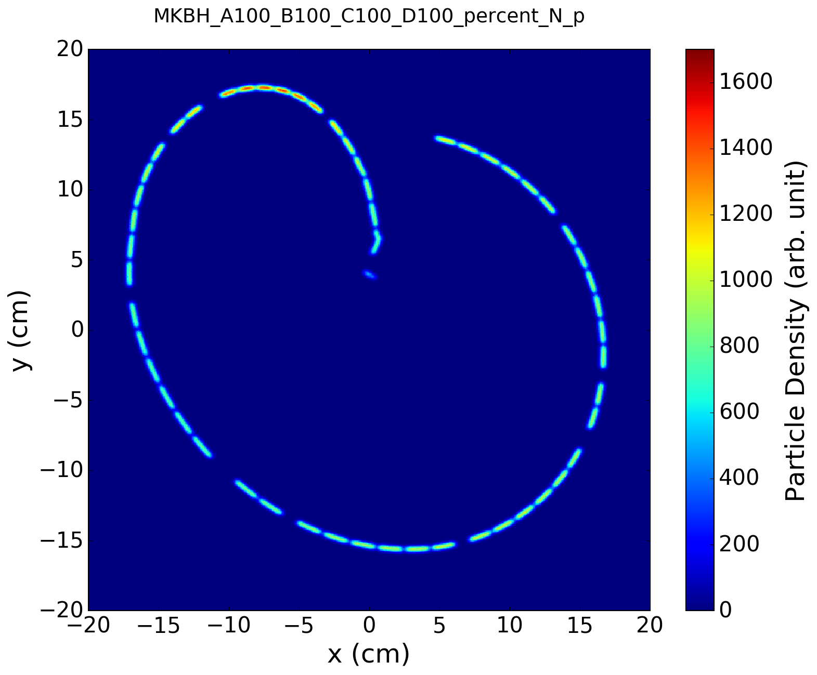
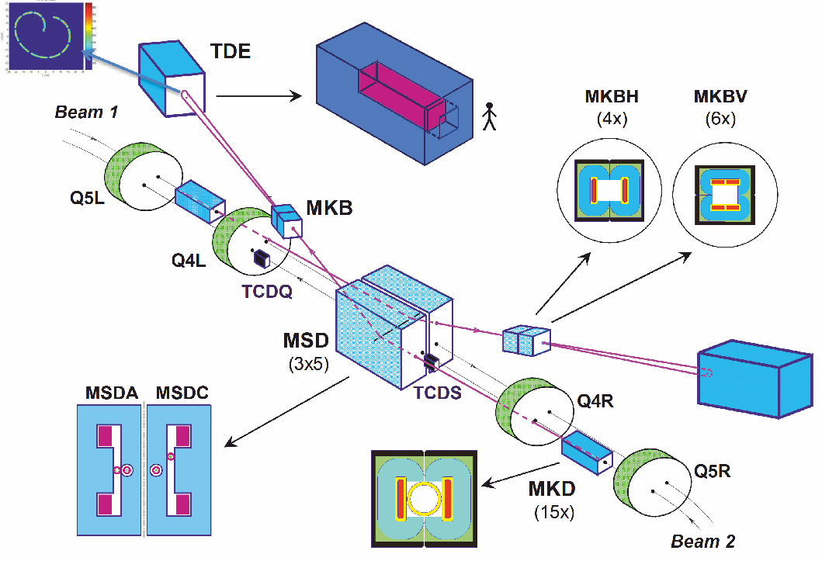
LHC Beam Dumping System
Nominal dilution pattern
Beam dump (TDE)
Dilution Kicker:
4 MKBH
6 MKBV
Extraction of the two circulating beams (also in case of emergency!), by a system of kicker magnets send into a dump block
3 ms gap (‘abort gap’) in the beam gives the kicker time to reach full field
15 DC septa magnets (MSD)
15 extraction kicker (MKD)
C. Bracco et al., LHC Performance Workshop, Chamonix, 26/01/2016
Total length (MKD to TDE): 976 m
Ultra-high reliability system !!

Slide 22
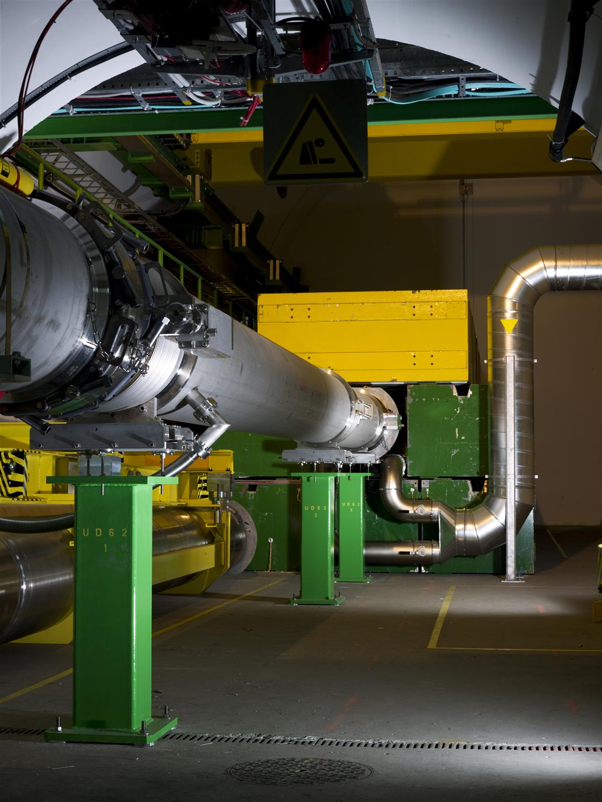
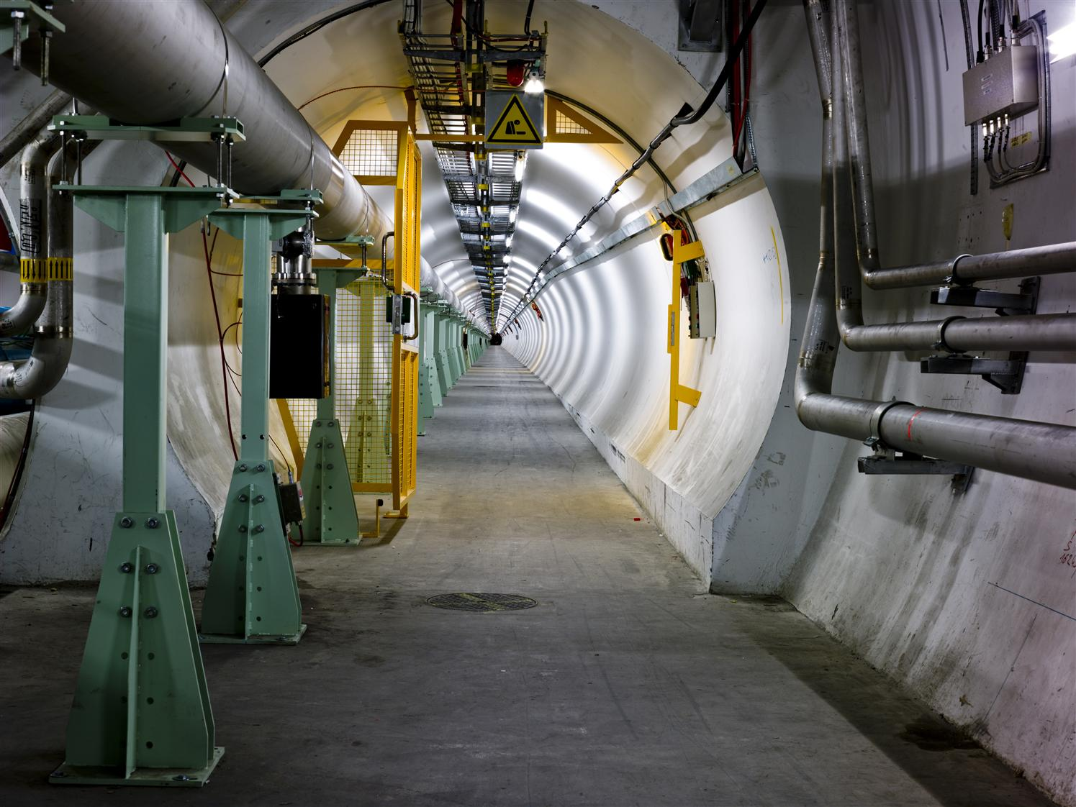
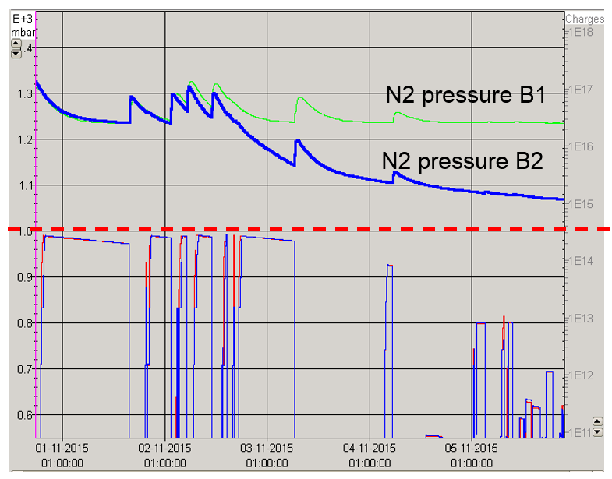
Beam dump line
~ 8m carbon block at the end.
Operated in N2 overpressure

Slide 23
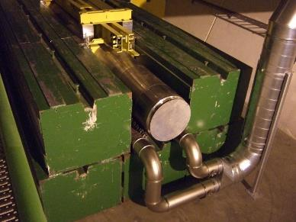
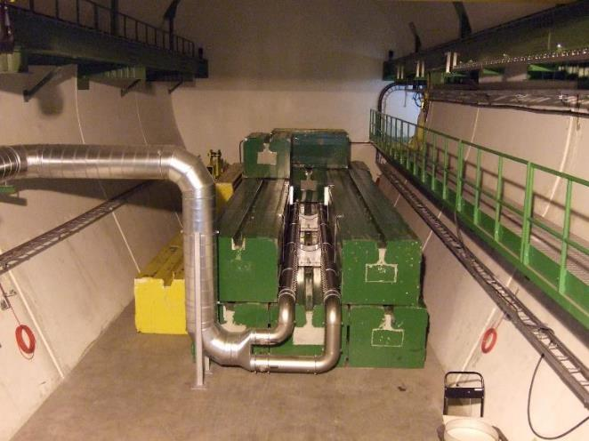
LHC dump block
The dump block is the only LHC element capable of absorbing the nominal beam
Low density graphite sheets

Slide 24
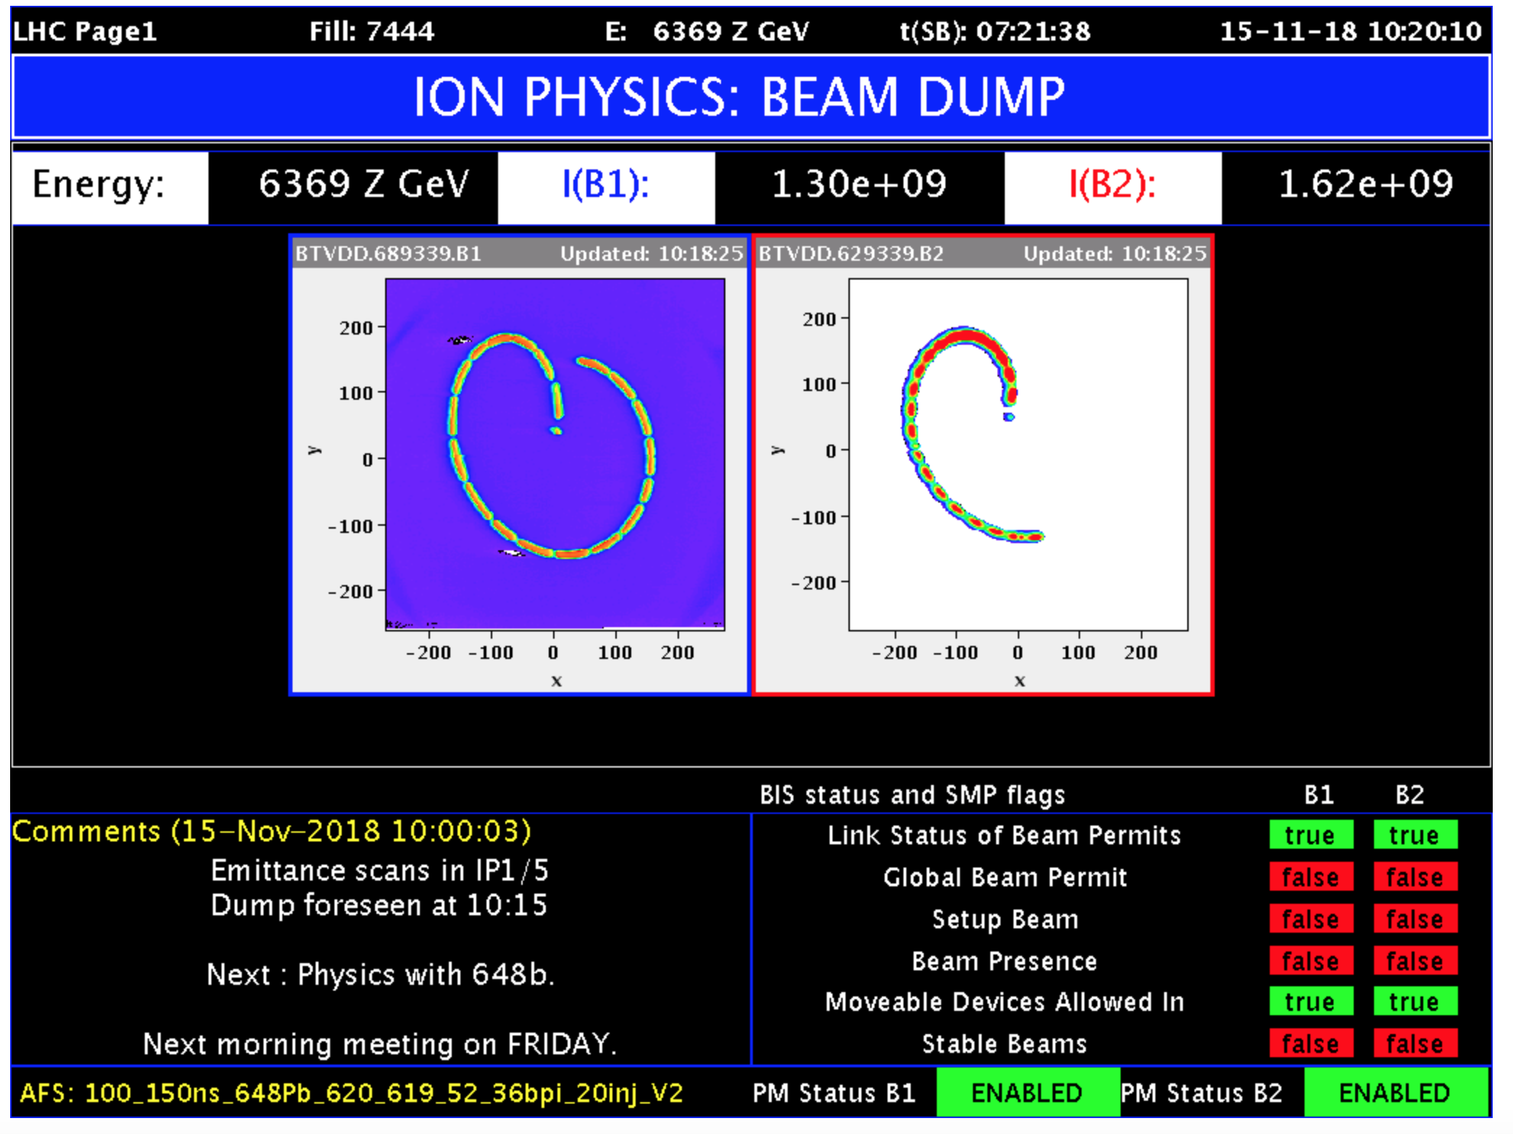
Beam dump with 648 Pb bunches

Slide 25
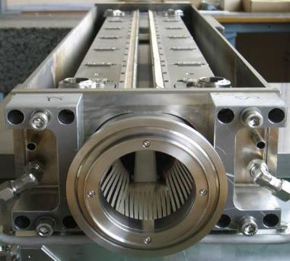
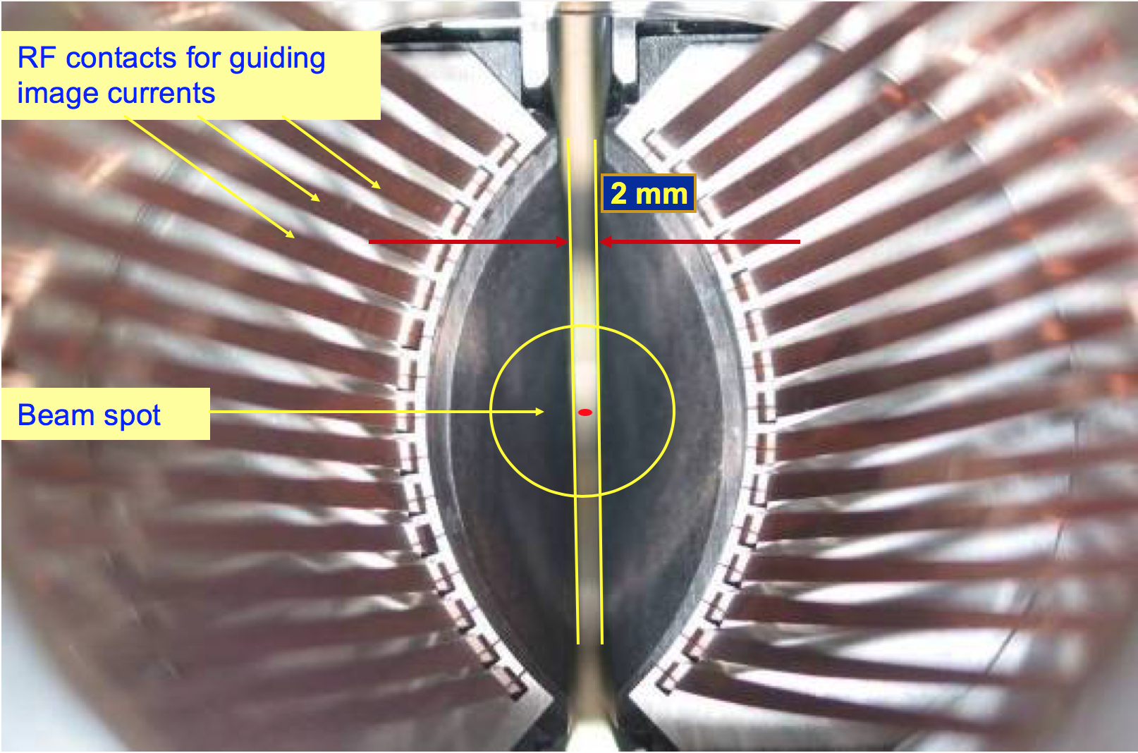
Collimators
1.2 m
beam
Courtesy R. W. Assmann
Aperture bottle necks defined by robust collimators (fibre reinforced carbon), shower absorption by tungsten collimators
Protection of critical elements like triplet magnets
about 100 moveable collimators are installed in LHC

Slide 26
Betatron beam cleaning
Primary
collimator
Secondary
collimators
Shower
absorbers
Tertiary
collimators
SC
Triplet
Cold aperture
Tertiary beam halo
+ hadronic showers
Circulating beam
Arc(s)
Cleaning insertion
Arc(s)
IP
Illustration drawing

Slide 27
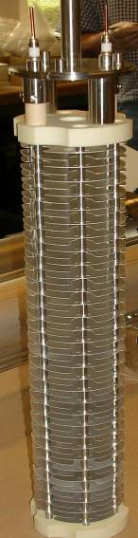
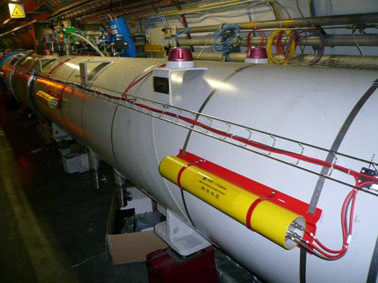
Beam Loss Monitor System
Ionization chambers to detect beam losses:
  Reaction time ~ ½ turn (40 us)
  Very large dynamic range (> 106)
There are ~3600 chambers distributed over the ring to detect abnormal beam losses and if necessary trigger a beam abort !
Very important beam instrumentation → last safety net

Slide 28
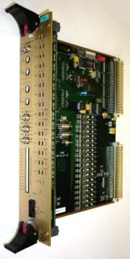
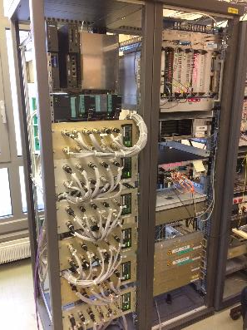
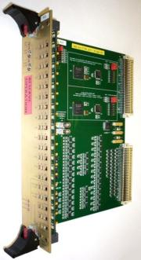
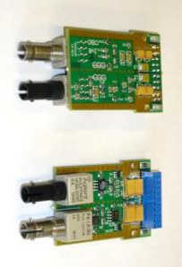
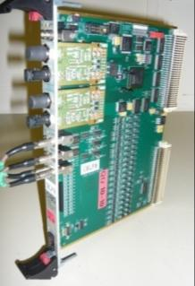
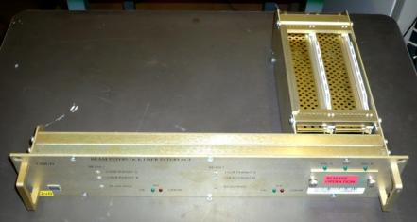
Magnet and Beam Interlock Systems
Custom made electronics developments for fast and reliable concentration and transmission of protection actions

Slide 29
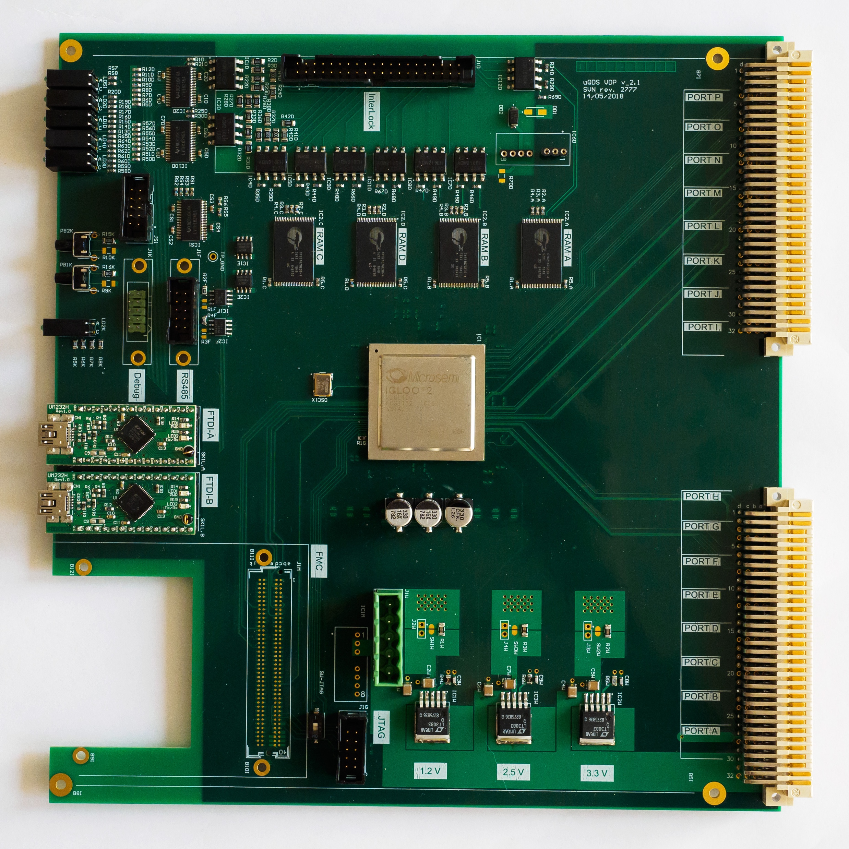
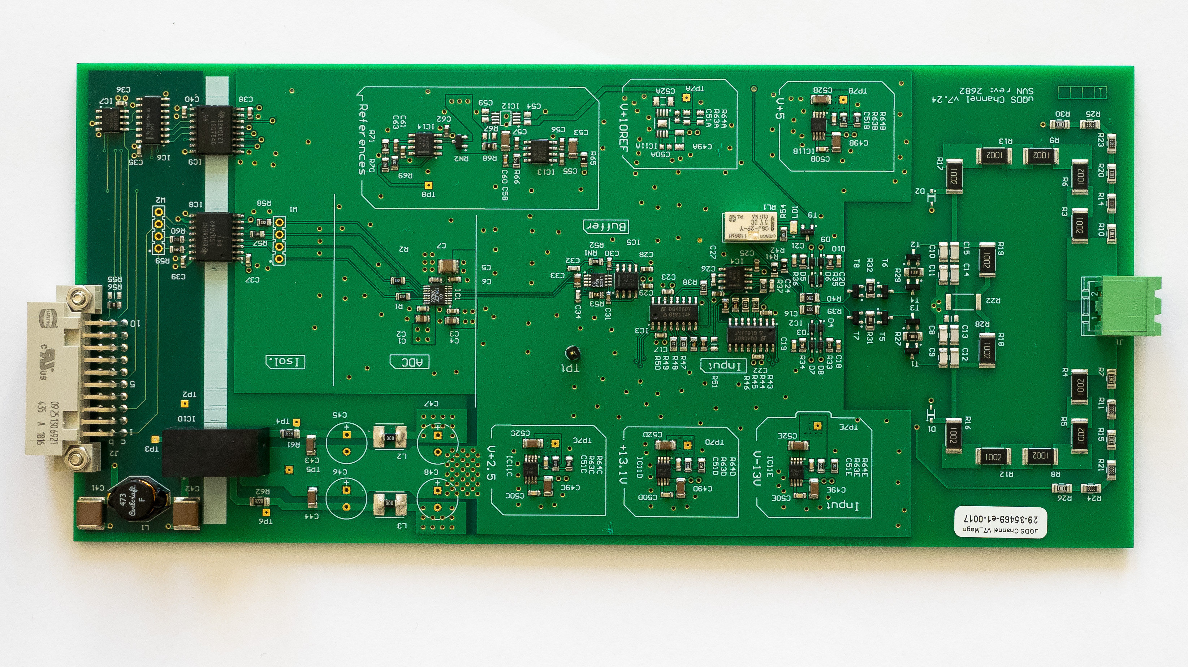
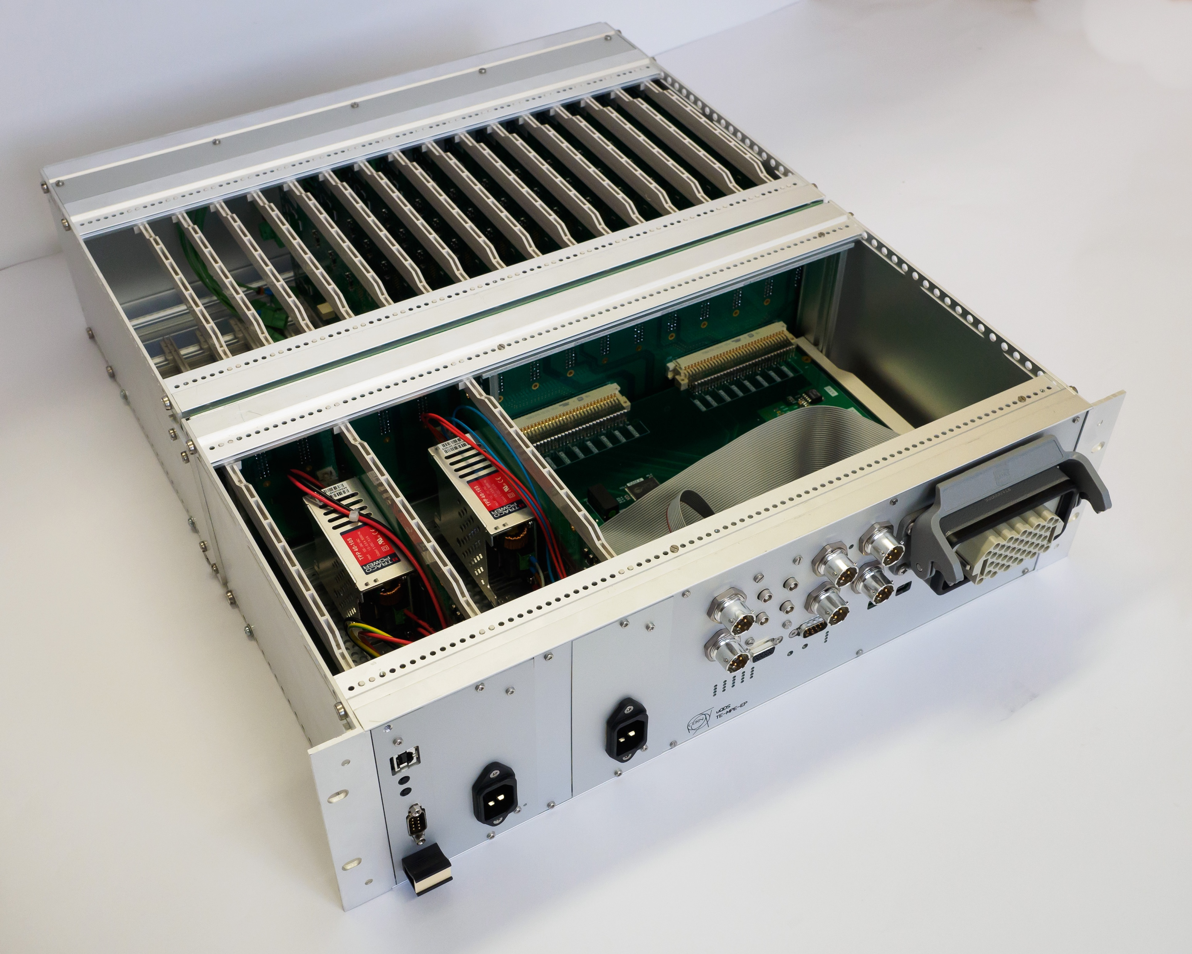
Next generation of Quench Detectors
8 channel quench detection system (uQDS)
Currently used to protect the new HL-LHC magnets in test stands
Frontend input channel v6.6
Digital evaluation unit
Courtesy J. Steckert
Redundant power supplies & digital part

Slide 30
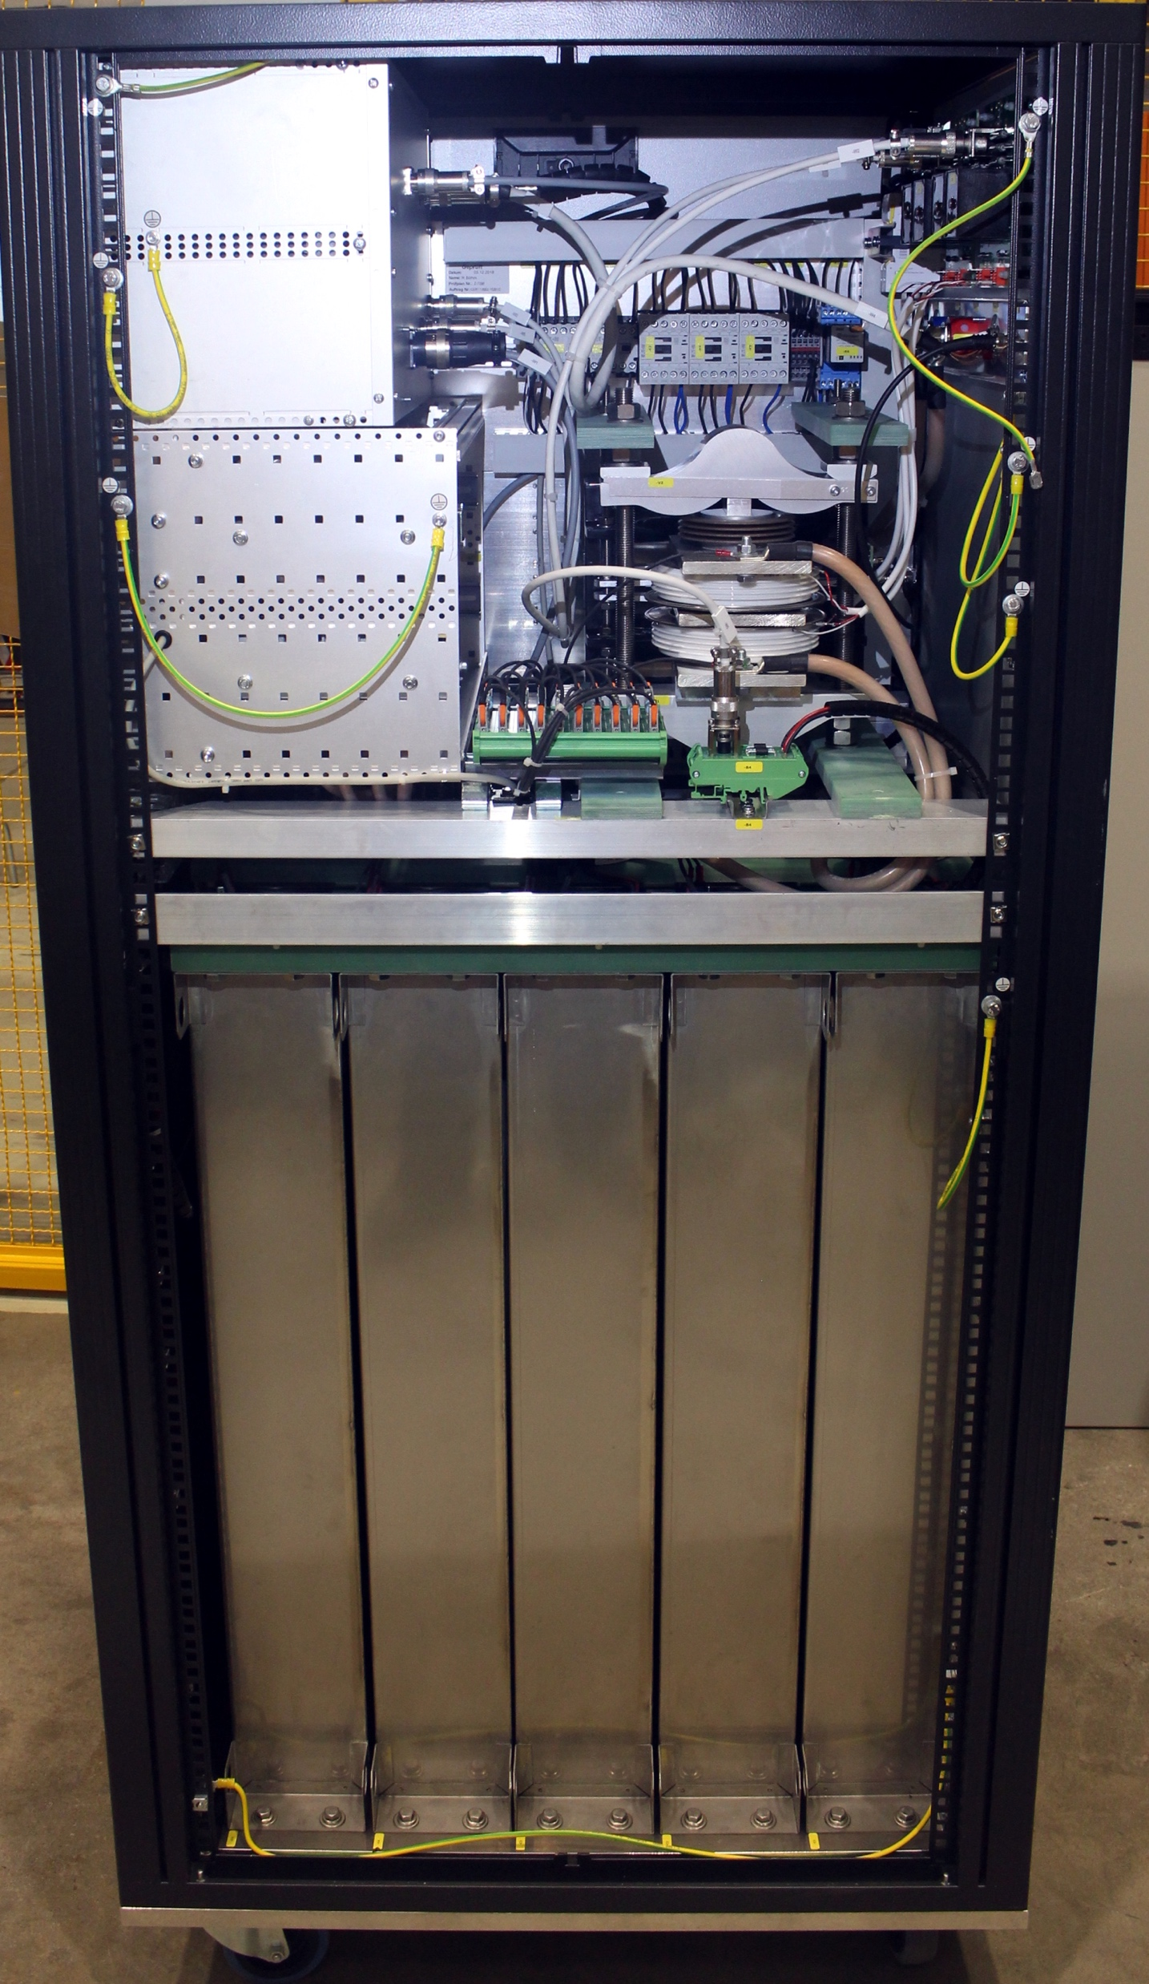
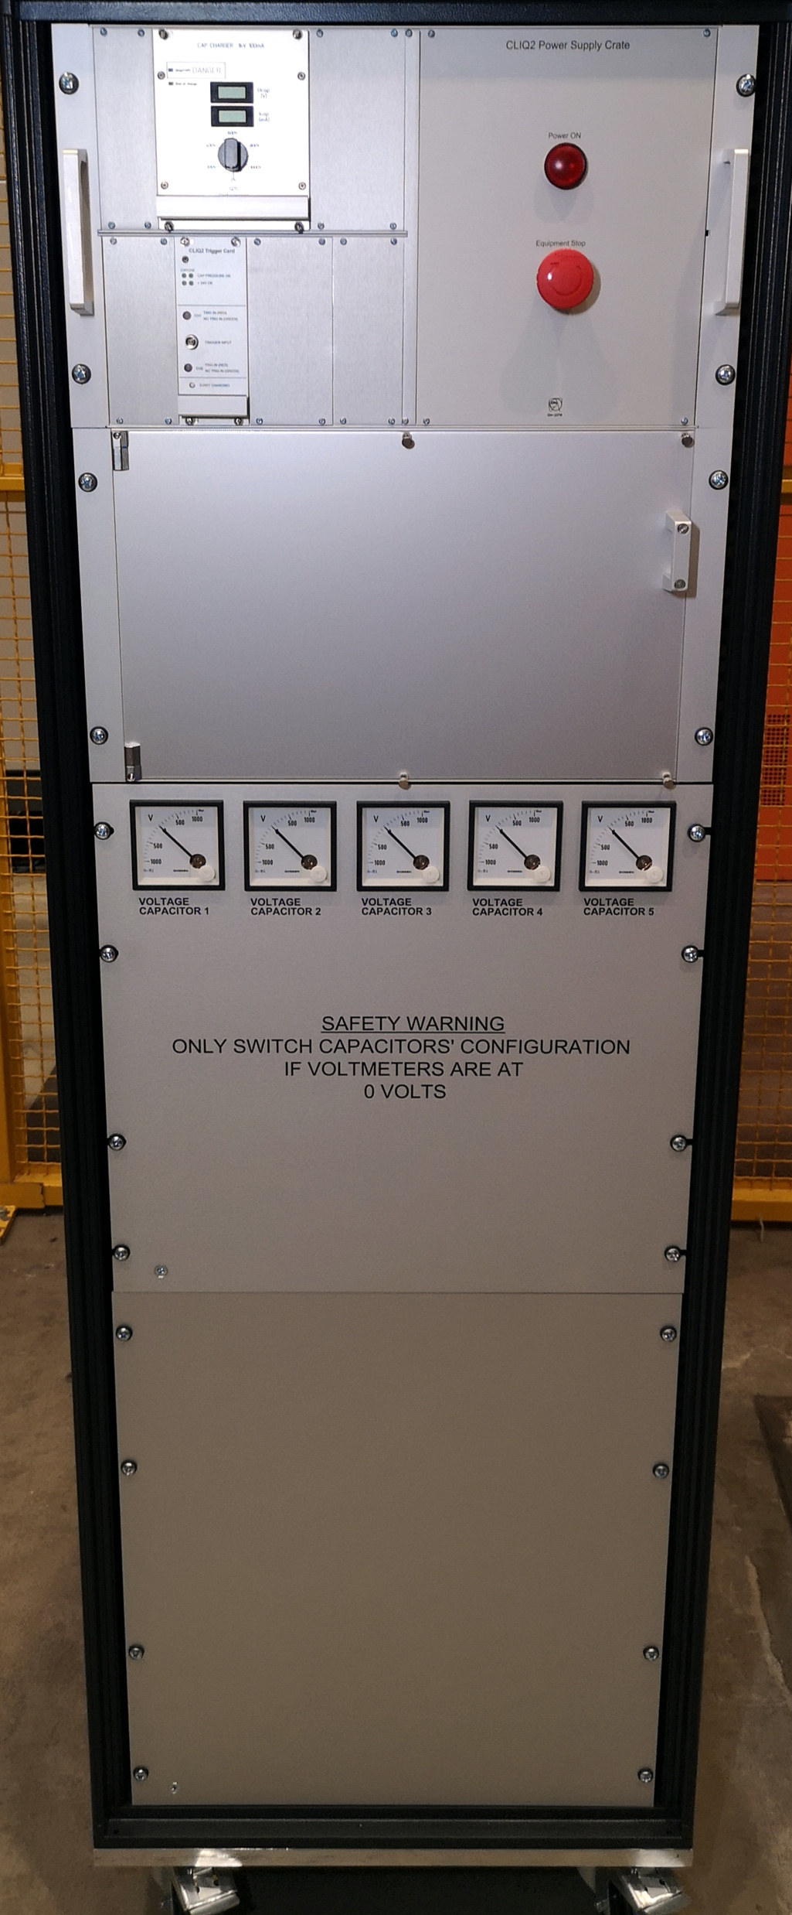
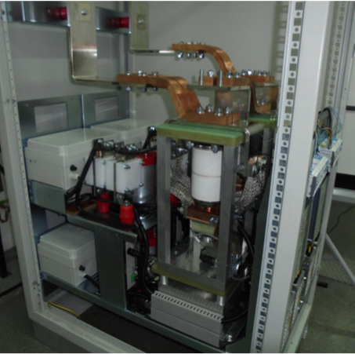
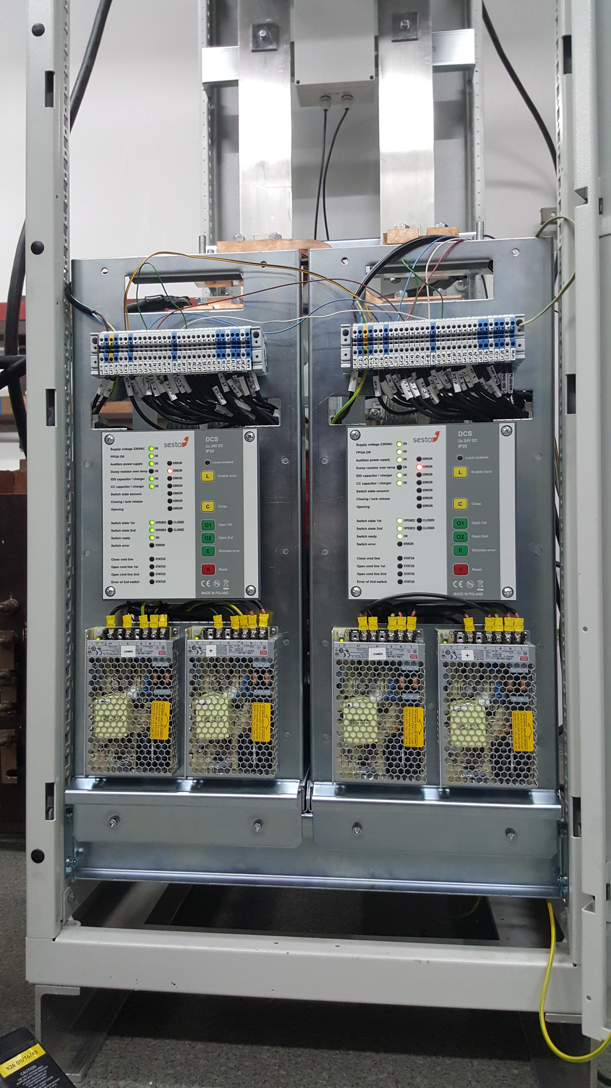
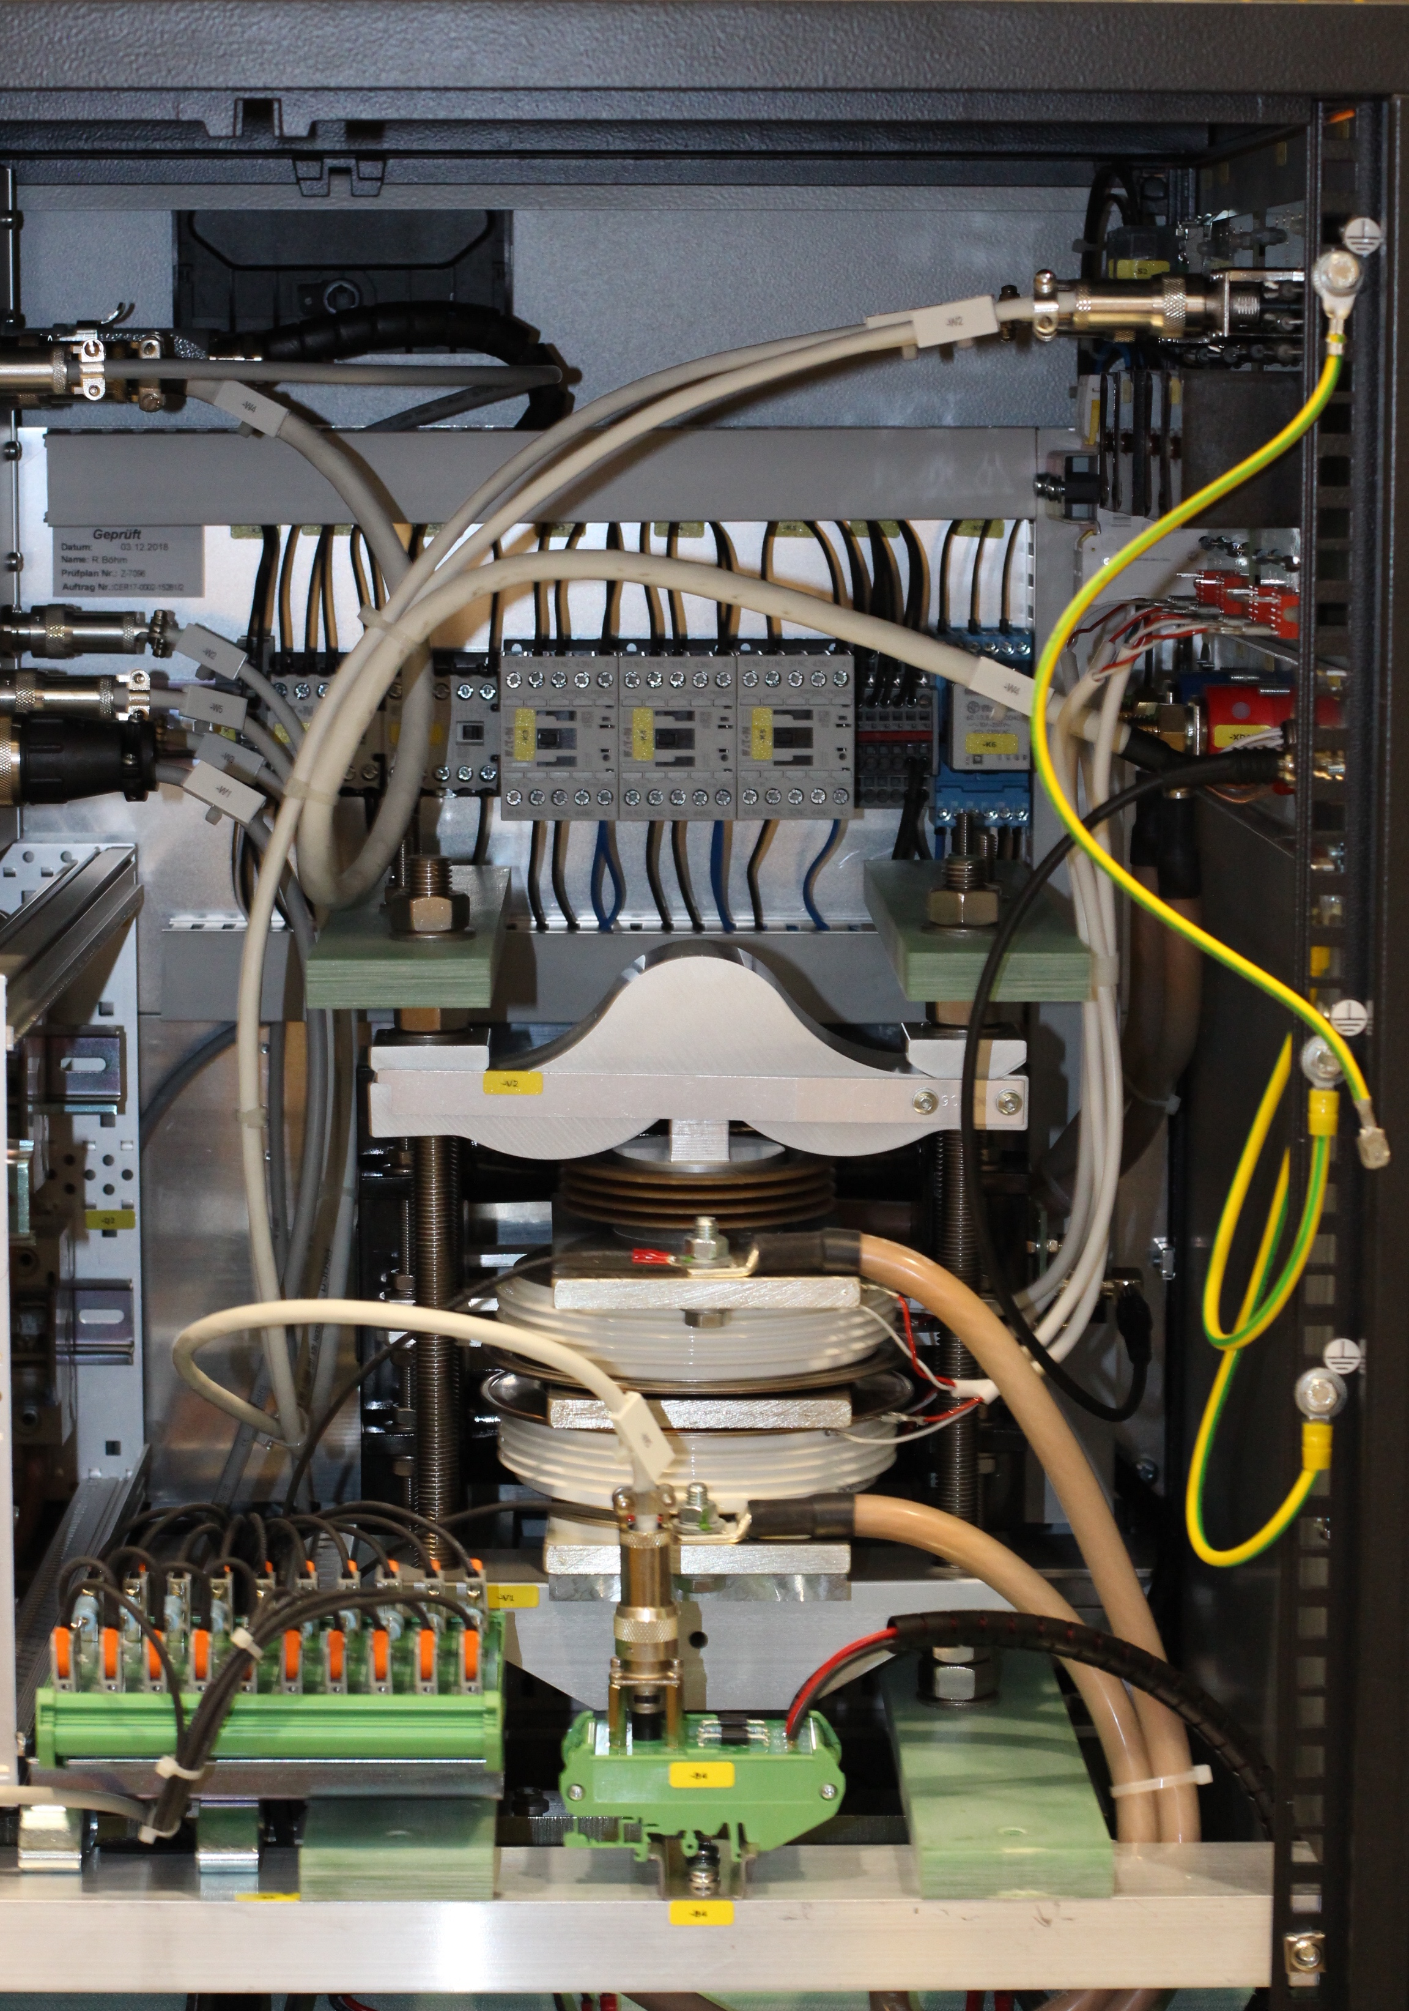
New protection systems for superconducting circuits
Prototype 2 kA electro-mechanical in-vacuum breaker based energy extraction system for HL-LHC
Coupling Loss Induced Quench systems developed @ CERN and built in industry for test stations and HL-LHC
Controls & Switches
Courtesy F. Rodriguez Mateos

Slide 31
Outline
LHC parameters for Machine Protection (MP)
Failure time scales and Machine Protection Systems
LHC Operation – a machine protection view
Machine Protection studies for the future
  Cold diode qualification
  Sc. magnet damage due to beam impact

Slide 32
Commissioning and re-validation of machine protection systems
Commissioning of each machine protection system is defined in detailed procedures, specifying the revalidations required after long/short stops
Commissioning with beam is followed by an intensity ramp-up
Technical stops require a partial re-validation and are followed by a fast intensity ramp-up

Slide 33
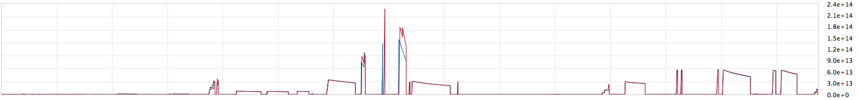
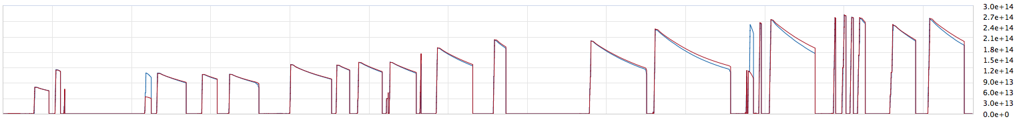
Intensity ramp-up 2017
Establish cycle
MP dominated
Intensity dominated
The plan: 3 - 12 - 72 - 300 - 600 - 900 - 1200 - 1800 - 2400 – 2550
26.05.
28.05.
03.06.
06.06.
23.05.
315 b
601 b
3/12 b
75 b
Scrubbing 07.-12.06.
12.06.
15.06.
17.06.
20.06.
2029 / 2173 / 2317 b
24.06.
1225 b
1561 / 1741 b
985 b
1225 b after 15 days (excl. scrubbing [1d], injector stop [2d], scrubbing week) – intensity ramp-up combined with beam commissioning
~2500 b after 24 days
Careful check of high energy beam dumps and documentation in 11 so-called check lists

Slide 34
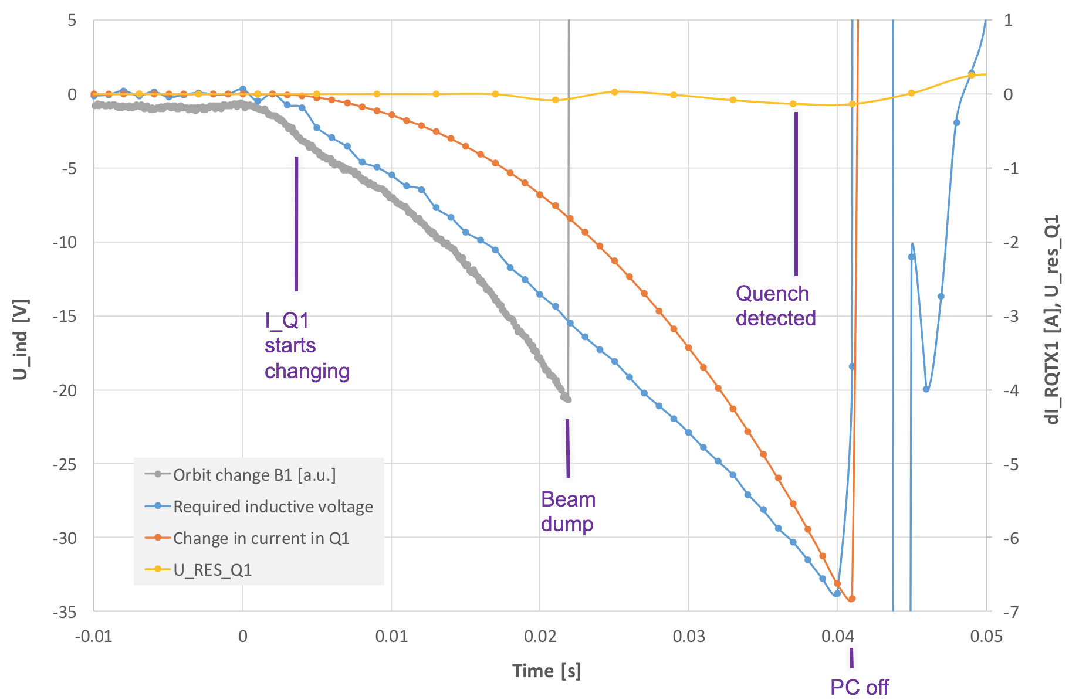
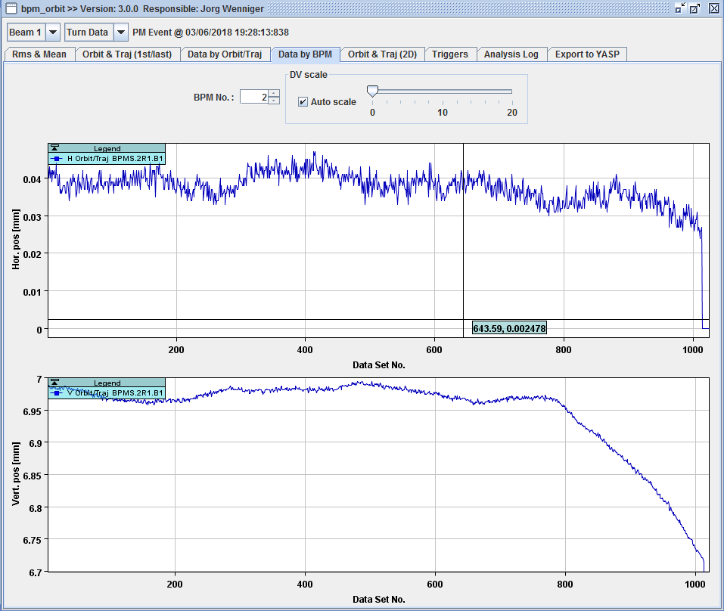
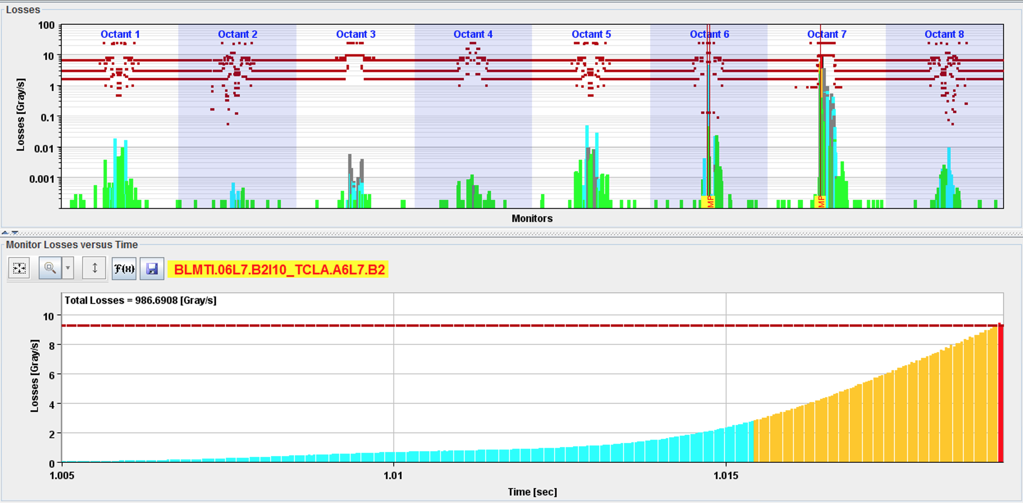
Quench of Triplet quadrupole
(RQX.R1, 03.06.2018)
Beams dumped by losses in collimators
Significant orbit movement in B1, but not B2
Quench detected only ~20 ms after beam dump
<10 um
18 ms
∼250 um
Offset=0.58 mm

Slide 35
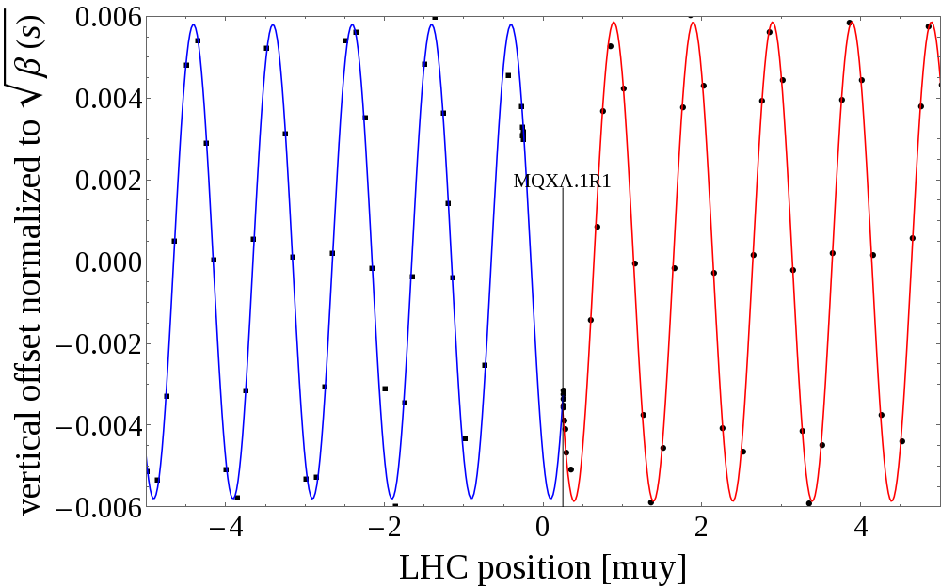
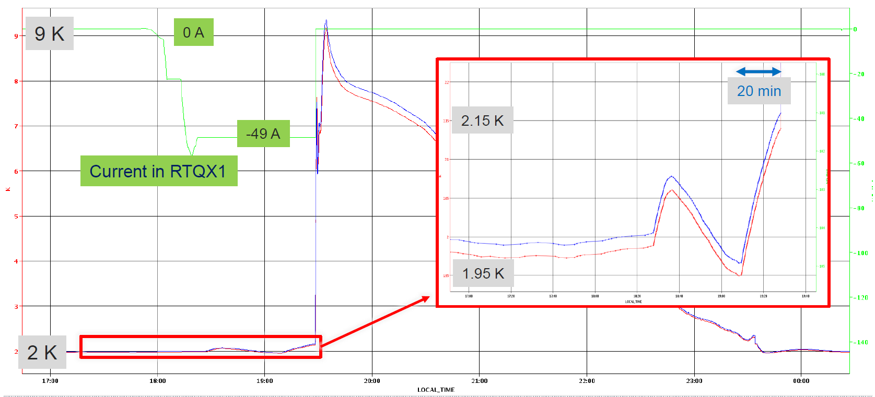
Quench of Triplet Quadrupole – Q&A
What was the source of the quench?
  Debris from the IP & regulation problems in cryogenic system, heating magnet to lambda point and leading to a very fast quench of a big part of the coil
Why was quench not detected earlier?
  Quench developed symmetrically, no symmetric quench detection for triplet magnets
Why were the beams not displaced symmetrically?
  Detailed magnetic simulations showed that the observed beam behavior / magnetic fields can be explained by current redistribution in the magnet cable during the quench, other effects are inter-filament and inter-strand coupling currents (but too small)
Origin of kick
Magnetic field induced in aperture
Temperatures in triplet
Courtesy B. Lindstroem, E. Ravaioli, A. Verweij

Slide 36


Beam induced quench causing periodic losses in collimation region
  Periodic losses during beam induced quench (~3ms) before beam dump
  Traced back to small orbit oscillation from skew dipole field (kick of ~14.3 m*0.7 mT) → quench heater firing

Slide 37



Quench heater discharge: Ultrafast current rise
Ultra fast effect, quench heaters reaching full current/field within less than 1/2 LHC turn
  Dipole: ~ 29 us; Triplet Quad: ~ 35 us
Spurious triggering of one QH unit cannot be excluded
Stronger effect in HL-LHC than in LHC due to more QH and larger beta functions
  Triplet (~8 km → ~21 km), D1 (~5 km → ~19 km) D2 (~1.7 → ~6.4 km)
For HL-LHC
Issue beam dump before triggering QH discharges
Reduce kicks strength from QH circuits by optimizing connection schemes
Interlock spurious firing of QHs

Slide 38
Outline
LHC parameters for Machine Protection (MP)
Failure time scales and Machine Protection Systems
LHC Operation – a machine protection view
Machine Protection studies for the future
  Cold diode qualification
  Sc. magnet damage due to beam impact

Slide 39



Cold diodes for the new Nb₃Sn HL-LHC triplet
Motivation:
Separation of cold and warm part of circuit
Fast transients do not enter the superconducting link and stay clear of the power converters
Expected total lifetime dose at foreseen position of installation in LHC tunnel:
12 kGy and
5 x 10¹³ cm⁻² 1MeV neq fluence
Courtesy F. Rodriguez Mateos, S. Yammine, F. M. Camara, A. Will

Slide 40



Irradiation of cold diodes for triplet
Three different cold diode types (LHC reference, thin n-base width and very thin n-base width) irradiated in CERN’s CHARM facility
Two stacks of four diodes (77K, 4K), and weekly measurement of forward characteristic up to 18 kA, turn on voltage, reverse blocking voltage
Two thermal cycles to study annealing after the end of the irradiation
A total of ~12 kGy and ~2.2e14 1MeVneq/cm² was accumulated
Very thin base width diodes chosen for HL-LHC inner triplet circuit

Slide 41
Outline
LHC parameters for Machine Protection (MP)
Failure time scales and Machine Protection Systems
LHC Operation – a machine protection view
Machine Protection studies for the future
  Cold diode qualification
  Sc. magnet damage due to beam impact

Slide 42

Motivation of the sc. magnet damage studies
Ultra-fast failures in HL-LHC
One such event per year in today’s LHC. No damage.
HL-LHC:
  increased bunch intensity from 1.15 x 10¹¹ ppb to 2.2 x 10¹¹ ppb
  reduced emittance (3.75 um rad → 2.5 um rad)
  Increased stored beam energy from 360 MJ to 690 MJ
  Failures become more critical
For HL-LHC beam, peak energy deposition of 100 Jcm⁻³ in the D1 magnet without mask^{[1]} and similar in Q5 are expected in case of an asynchronous beam dump^{[2]}.
Will the magnets survive?
What are the damage mechanisms and limits of superconducting magnets due to high intensity beam impact?
[1] A. Lechner et al., Protection of superconducting magnets in case of accidental beam losses during HL-LHC injection, In Proceedings of IPAC15
[2] B. Auchmann et al., Quench and Damage Levels for Q4 and Q5 Magnets near Point 6, CERN EDMS 1355063, 2014

Slide 43






Critical parts of superconducting magnets
Polyimide insulation (Nb-Ti magnets)
  Decomposition when exposed to high temperature
  Reduction of the dielectric strength
Nb-Ti strand/cables (LHC)
Nb₃Sn strand/cables (HL-LHC)
  Reduction of the J_{c} induced by:
  High temperature (e.g. diffusion)
  Mechanical stress, deformation and cracks
Image from C. Senatore, CAS Zuerich 2018

Slide 44



Sample holder & hotspots
Superconducting strands embedded in sheeted copper sample holder (held by vacuum grease)
Samples from one batch see the same beam
Hadronic showers cause increasing energy deposition when protons pass through the sample holder → similar to a failure case when beam-showers impact on a sc. magnet
Energy deposition and hotspots calculated with FLUKA based on measured beam parameters (intensity, beam size, offset)

Slide 45




Beam experiment at 4 K
20 Nb-Ti short strand samples: 50 mm, Ø 0.825 mm
30 Nb₃Sn short strand samples (RRP type): 50 mm, Ø 0.85 mm
40 YBCO tape samples: 60 mm x 4 mm x 0.2 mm
11 x 24 b (~3e12 p, sigma_{x,y}= 1.1 mm) @ 440 GeV
Hotspots up to 1250 K reached in strands
p+

Slide 46






Sample holder and samples after beam impact - visual inspection
B3 S6
B1 S6
Nb₃Sn, peak ~ 730 K /760 K
hot spot ~1200 K
B2 S8
Nb₃Sn, peak ~ 950 K
Beam imprints clearly visible in sample holder plates
Nb-Ti strands: no deformation observed after beam impact
Nb₃Sn strands:
  Beam impacted with slight offset → visible bending of samples for hotspots > ~700 K
  Breaking of copper matrix in some samples with hotspots > ~ 900 K
YBCO: de-coloration due to beam heating, copper layer damaged at high temperatures
YBCO tape, hot spot ~ 1030 K
YBCO tape, hot spot ~ 1100 K

Slide 47


Key results of cryogenic beam experiment: Nb-Ti
No degradation of critical current (I_{c}) observed
Measurements indicate significant reduction of RRR at beam impact position
  Reduced minimum quench energy (MQE) → potentially causing thermal instability of the strands / magnets
  RRR locally reduced below 100 for samples with hot spots > 800 K

Slide 48



Nb₃Sn: I_{c} degradation after beam impact
Significant I_{c} degradation from Sample S4 with peak temperatures > 460 K
No measurable transport current for peak temperatures
> 890 K → samples S9 and S10 destroyed
Inversion of degradation order (S4, S7, S5, S6, S8) due to effect of different sample holder design around sample S7 (thin copper sheets versus thick copper blocks) → reproduced in thermo-mechanical simulations
Similar behaviour observed in all three batches of strands (within the uncertainty of the experimental setup and the measurements)

Slide 49




Thermo-mechanical simulations
Simulation of stresses within the strand cross-section due to
thermal gradients and expansion caused by beam heating
the sample holder impacting on the strand due to its thermal expansion
Derive expected I_{c} for each strand based on literature scaling laws (Uni Twente Model, filament breaking limit, etc.)
Results:
Measured I_{c} degradation can be explained by the residual strain in the strands and the breaking of filaments.
Filament breaking can be observed for hotspots > 450 K (from sample S4) and is dominating the I_{c} degradation with increasing hotspot temperature
B_{c2} distribution from microscopic theory
Local lattice strain
Scaling laws
Axial strain
J_{c} distribution from microscopic theory + cracked filaments

Slide 50
Conclusion
LHC has been a game changer in respect to machine protection for particle colliders due to stored energy in magnet system and beams
Highly sophisticated and reliable machine protection system, which requires careful re-commissioning after long stops
High intensity dumps are carefully analyzed, criticality of failures is evaluated and extrapolated to HL-LHC beam intensities and operational conditions
Experimental studies have been performed to test damage limits of cold diodes and superconducting magnets

