Slide 1
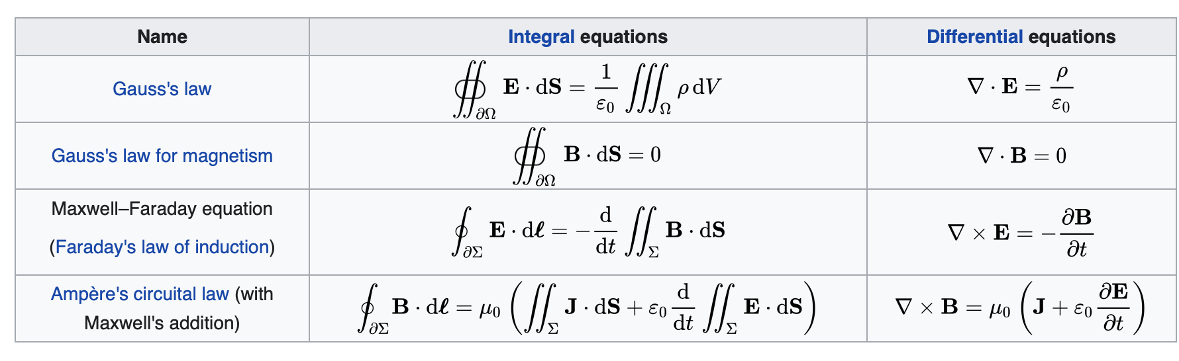

Slide 2
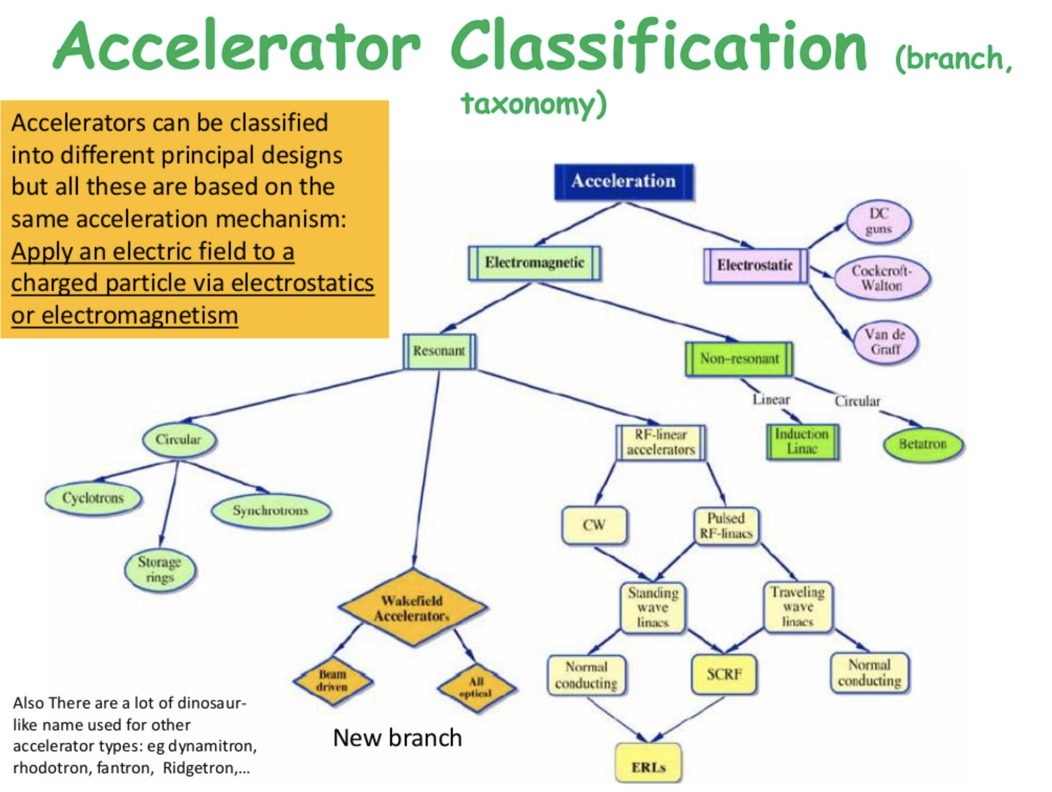
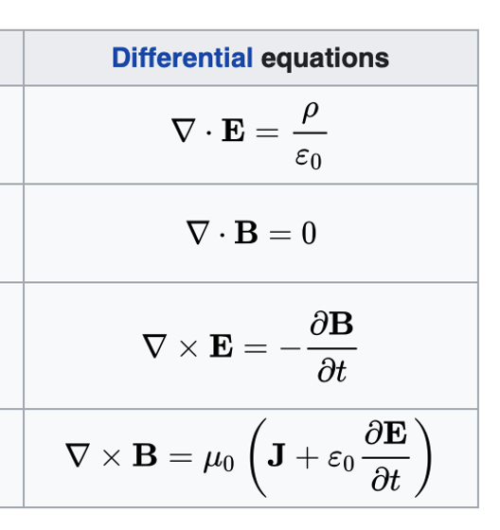

Slide 3

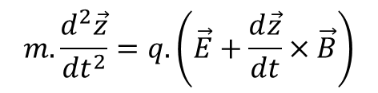
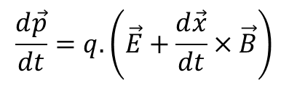
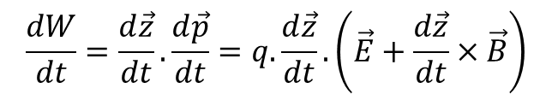
What is a LINAC
Introduction
LINear ACcelerator : A device where charged particles acquire energy moving on a linear path.
Acceleration related to the sum of the forces
Momentum
Energy gain !
Energy gain thanks to the electric field.

Slide 4

What is a LINAC
Introduction
LINear ACcelerator : A device where charged particles acquire energy moving on a linear path.
Type of the accelerated Particles
Type of the accelerating sturcture
Charge
Mass
Mainly:
Electrons
Protons and light ions
Heavy ions
Electric field for acceleration
Magnetic field for focusing/bending

Slide 5
Different type of LINACs
Introduction
Electric field
Static
Time Varying
Induction
Radio frequency Linac
What we will discuss during 4 hours !!!

Slide 6
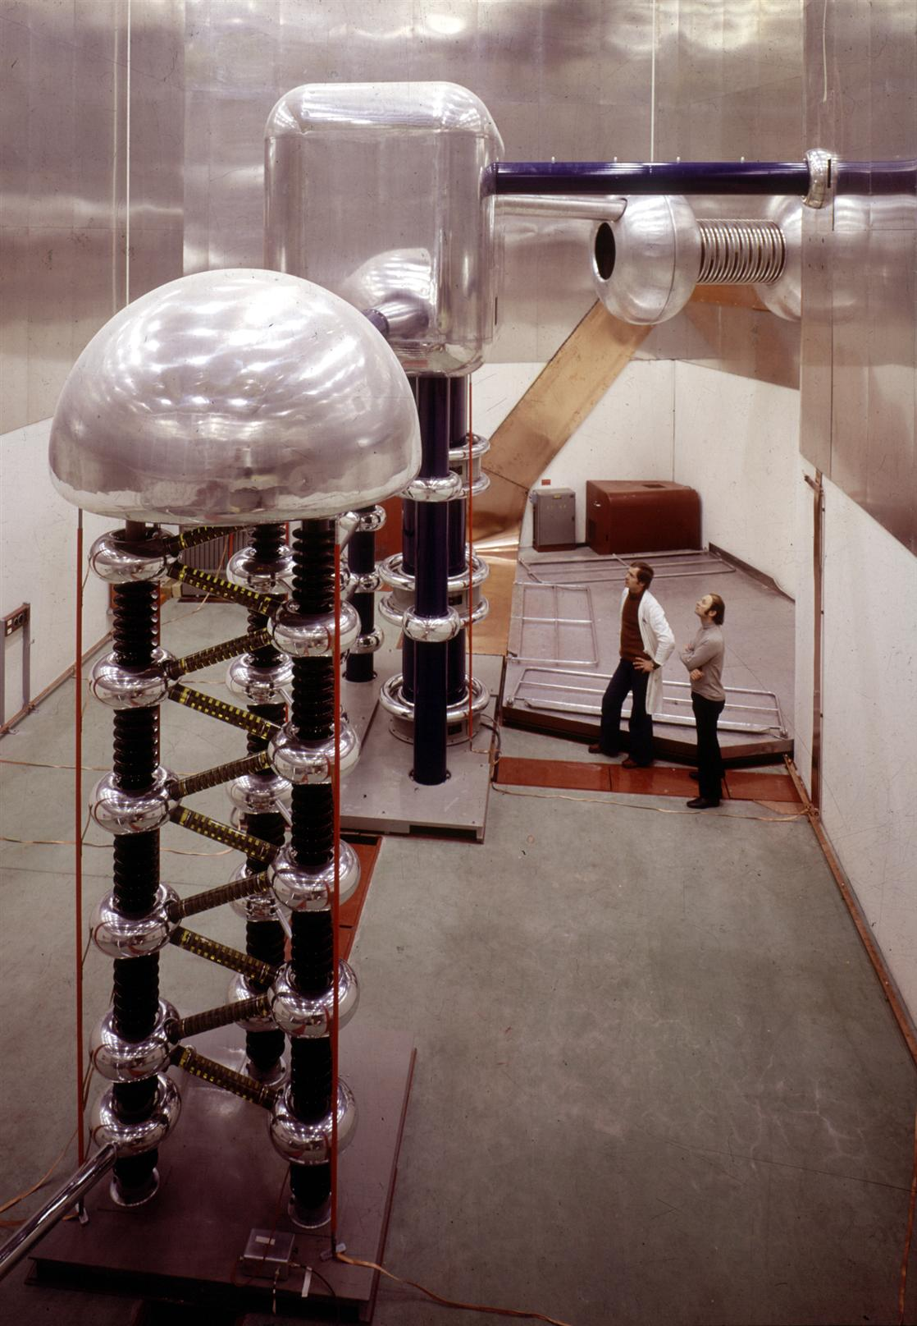
Example of a static Linac
Introduction
JUAS 2016
Constant potential difference (electric field)
Energy gain in [eV]
Acceleration limited to few MeV (electric field breakdown)
Still used in very first stage of acceleration
Picture : 750 kV Cockcroft-Walton
Linac2 injector at CERN from 1978 to 1992.

Slide 7
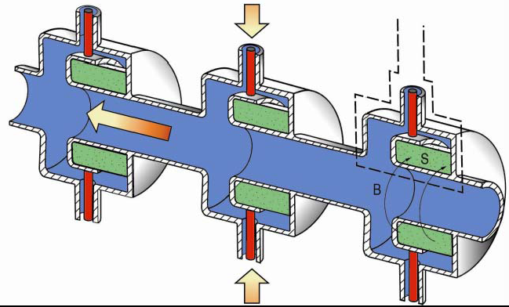
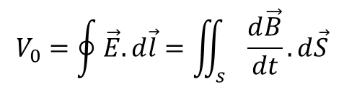
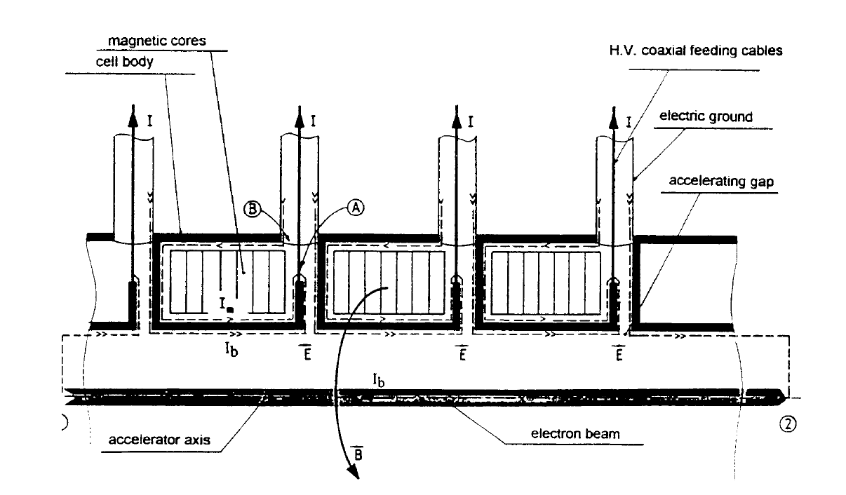
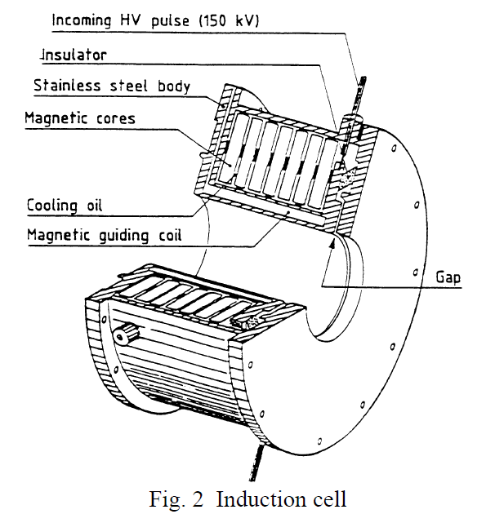
Principle of the induction linac
Introduction
JUAS 2016
A varying magnetic field can generate an electric field.

Slide 8

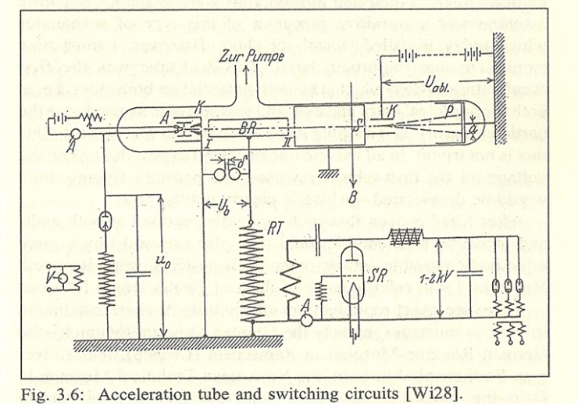
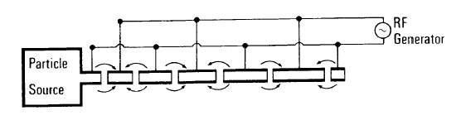
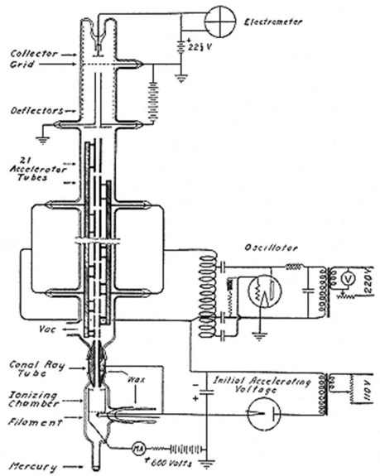
The first Radio Frequency Linac
Introduction
JUAS 2016
Acceleration by time varying electromagnetic field overcome the limitation of static fields.
First RF linac design and experiment – Wideroe Linac in 1928
K beam – 2*25 kV = 50 keV
First working Linac – Berkeley in 1931
Hg beam – 30*42 kV = 1.26 MeV

Slide 9
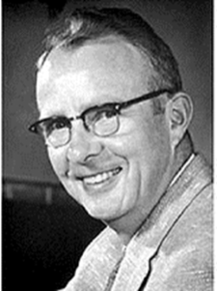
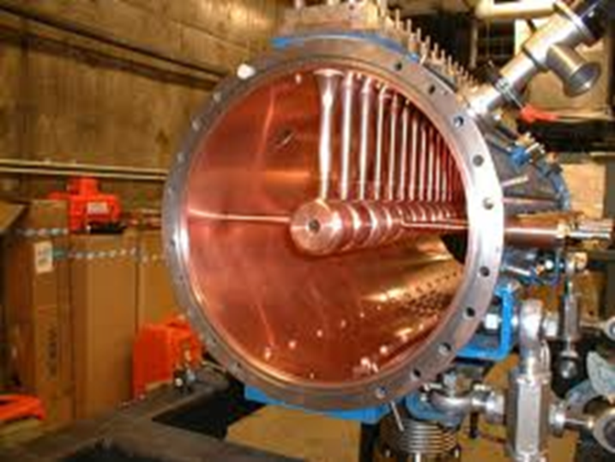
Big Jump in RF technology – 40’s
Introduction
JUAS 2016
Development of Radar technology during the WW II.
Competences and components in the MHz-GHz range.
From Wideroe to Alvarez
Drift tubes inside a cavity resonator
After WW II, 2.000 transmitters at 202.56 MHz from US army stocks
First Drift Tube Linac in 1955 from 4 to 32 MeV.
Bases of modern RF linac technology !!!

Slide 10
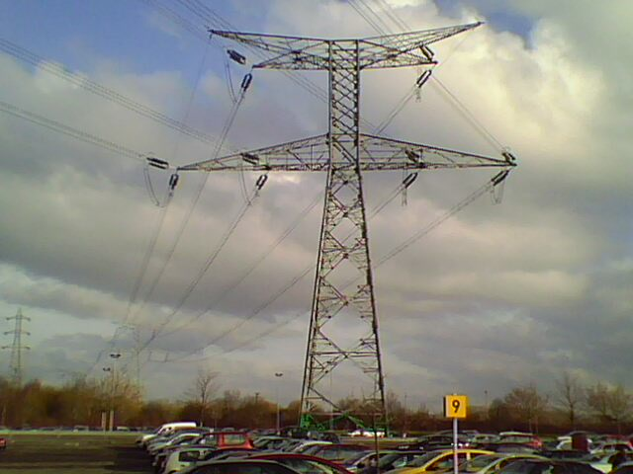
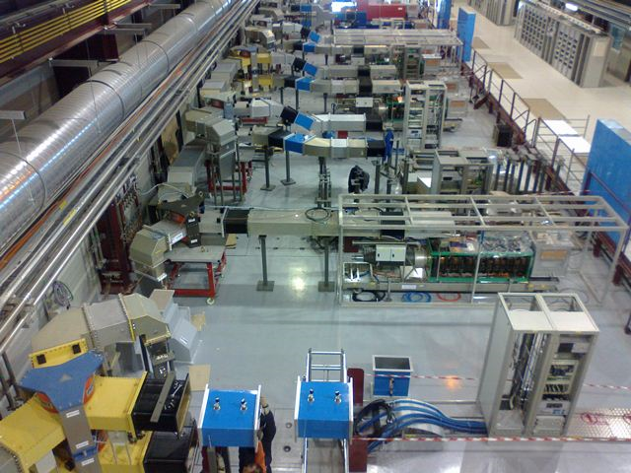
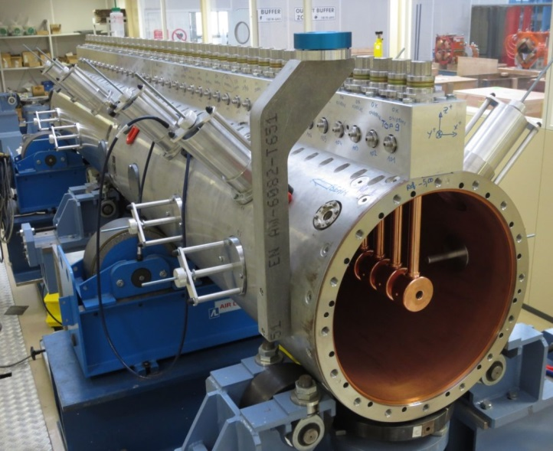
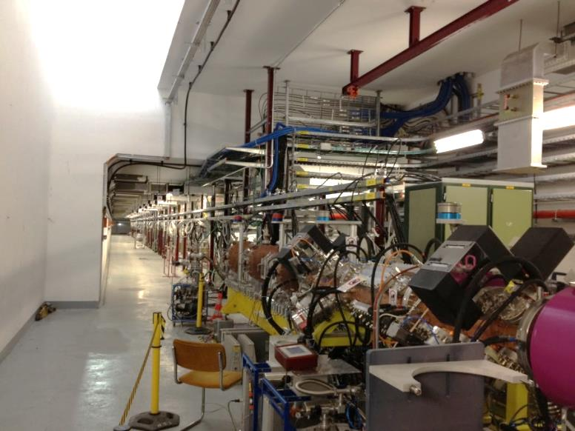

RF acceleration
From RF to acceleration
JUAS 2016
Converter
AC to DC

Slide 11
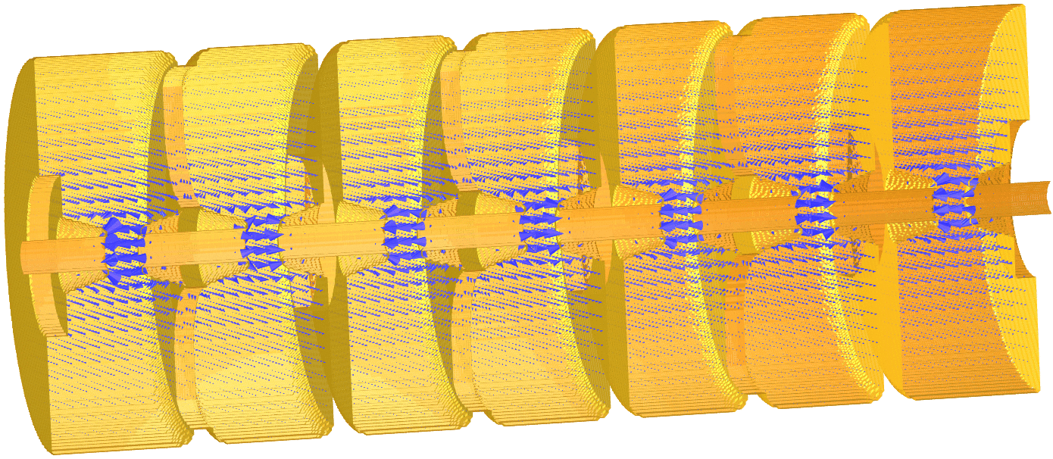
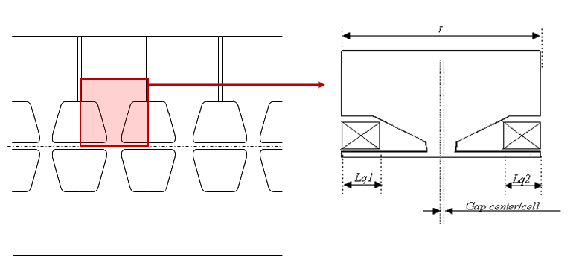
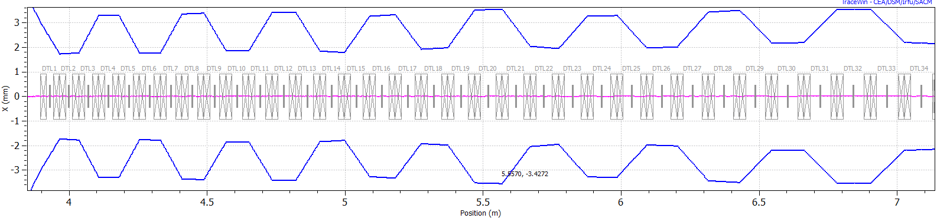
Designing an RF LINAC
From RF to acceleration
JUAS 2016
Cavity design
  Control the field pattern inside the cavity
  Minimize the Ohmic losses on the walls/maximize the stored energy
Beam dynamics design
  Control the timing btw field and particles
  Insure that the beam is kept in the smallest possible volume during acceleration

Slide 12

Electric field in a cavity
From RF to acceleration
JUAS 2016
Assuming that the solution of the wave equation in a bounded medium can be written as
Function of space
Function of time
Oscillating at freq. $ω/2π$
First step in cavity design: Concentrating the RF power on the beam path in the most efficient way. Tailor $E\left(x,y,z\right)$ by choosing the appropriate cavity geometry

Slide 13


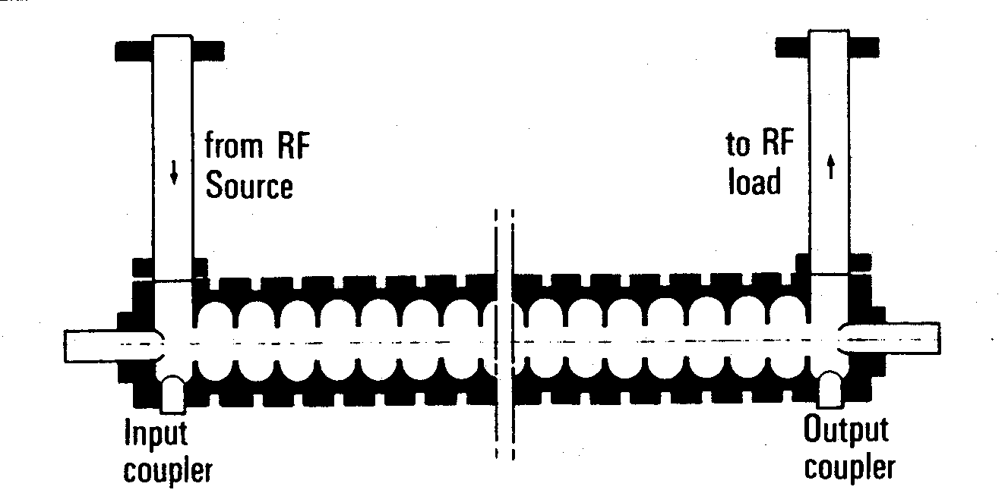
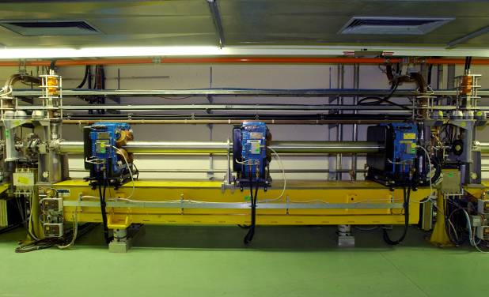
From RF to acceleration
One word on travelling wave cavities
JUAS 2016
These cavities are essentially used for acceleration of ultra-relativistic particles.
The longitudinal field component is:
is a space harmonic of the field, given by the cavity periodicity
Particle whose velocity is close to the phase velocity of the space harmonic exchanges energy with it. Otherwise, mean effect is null.
Constant cell length does not allow synchronism
Structures are long without space for transverse focusing

Slide 14
Cavity parameters
From RF to acceleration
Y
JUAS 2016
field
X – Horizontal plane
beam
Z – Beam direction
Cavity
L=cavity length
Average electric field
Shunt impedance
Quality factor
Filling time
Transit time factor
Effective shunt impedance

Slide 15

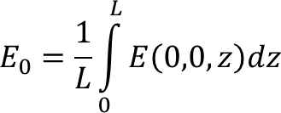
Average electric field
Cavity parameters
Average electric field
Shunt impedance
Quality factor
Filling time
Transit time factor
Effective shunt impedance
JUAS 2016
Average electric field: E₀ measured in V/m.
Average electric field on beam axis in the direction of the beam propagation at a given moment in time when E(t) is maximum.
x=0, y=0, z from 0 to L (cavity length)
Measure how much field is available for acceleration
Depends on the cavity shape, resonating mode and frequency

Slide 16
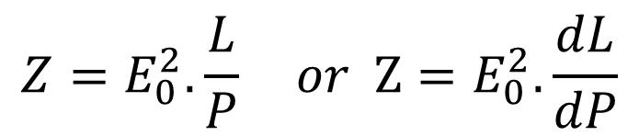
Shunt impedance
Cavity parameters
Average electric field
Shunt impedance
Quality factor
Filling time
Transit time factor
Effective shunt impedance
JUAS 2016
Shunt impedance (per unit of length): Z measured in Ω/m.
Defines the ratio of the average electric field squared (E₀²) to the power (P) per unit of length (L) dissipated on the walls surface.
Measure how well we concentrate the RF power in the useful region.
Independent on the field level and cavity length. Depends on cavity mode and geometry.

Slide 17
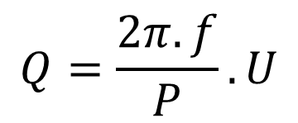
Quality factor
Cavity parameters
Average electric field
Shunt impedance
Quality factor
Filling time
Transit time factor
Effective shunt impedance
JUAS 2016
Quality factor: Q dimension-less.
Defines the ratio of the stored energy (U) to the power lost on the wall (P) in one RF cycle (f = frequency).
Q is a function of the geometry and of the surface resistance of the cavity material.
Examples at 700 MHz
Superconducting (niobium): Q=10¹⁰ (depends on temperature)
Normal conducting (copper): Q=10⁴ (depends on cavity mode)

Slide 18
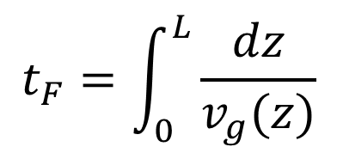
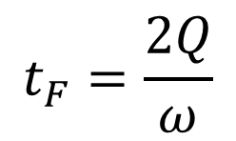
Filling time
Cavity parameters
Average electric field
Shunt impedance
Quality factor
Filling time
Transit time factor
Effective shunt impedance
JUAS 2016
Filling time: t_{F} measured in sec.
Two different definition for traveling or standing wave.
For TW: Time needed for the electromagnetic energy to fill the cavity of length L
For SW: Time it takes for the field to decrease by 1/e after the cavity has beam filled.
Velocity at which the energy propagate thru the cavity
How fast the stored energy is dissipated to the wall

Slide 19

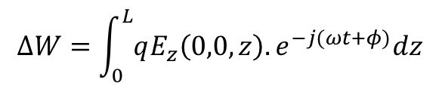
Transit time factor
Cavity parameters
Average electric field
Shunt impedance
Quality factor
Filling time
Transit time factor
Effective shunt impedance
JUAS 2016
Transit time factor: T dimension-less.
Defines the ratio of the energy gained in the time varying RF field to that in a DC field.
T is a measure of the reduction in energy gain caused by the sinusoidal time variation of the field in the gap.
Energy gain of a particle with charge q on axis at phase φ.

Slide 20


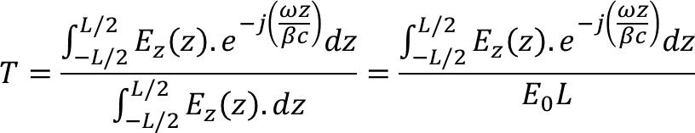
Transit time factor
Cavity parameters
Average electric field
Shunt impedance
Quality factor
Filling time
Transit time factor
Effective shunt impedance
JUAS 2016
Assuming a constant velocity thru the cavity (approximation!!!), we can relate position and time via
We can write the energy gain as
And define transit time factor as
T depends on the particle velocity and on the gap length.
It does not depend on the field.

Slide 21
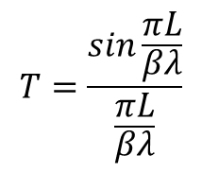
Transit time factor
Cavity parameters
Average electric field
Shunt impedance
Quality factor
Filling time
Transit time factor
Effective shunt impedance
JUAS 2016
NB: TTF depends on x and y (distance for the beam axis in cylindrical symmetry.
By default, TTF is on axis!
Exercise:
Calculate the TTF for a pillbox cavity where E_{z}=E₀
L=gap length
β= reduced velocity
λ= RF wavelength
Distance travelled during on RF period: βc/f = βλ
E_{z}
E₀
-L/2
-L/2
Tutorial !

Slide 22
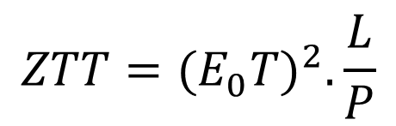
Effective shunt impedance
Cavity parameters
Average electric field
Shunt impedance
Quality factor
Filling time
Transit time factor
Effective shunt impedance
JUAS 2016
Effective shunt impedance: ZT².
More practical for accelerator designers who want to maximize the particle energy gain per unit power dissipation.
While the shunt impedance measures if the structure design is optimized,
the effective shunt impedance measures if the structure is optimized and adapated to the velocity of the particle to be accelerated.

Slide 23

Limit to the field in a cavity
Cavity parameters
Normal conducting
  Heating
  Electrical peak surface field (sparking)
Super conducting
  Quenching
  Magnetic field on the surface (in Niobium max 200 mT)
JUAS 2016
The Kilpatrick sparking criterion
Normal conducting – Large gap
W.D. Kilpatrick in the 50’s
Nowadays, the peak surface field up to 2 Kilpatrick
Tutorial !

Slide 24
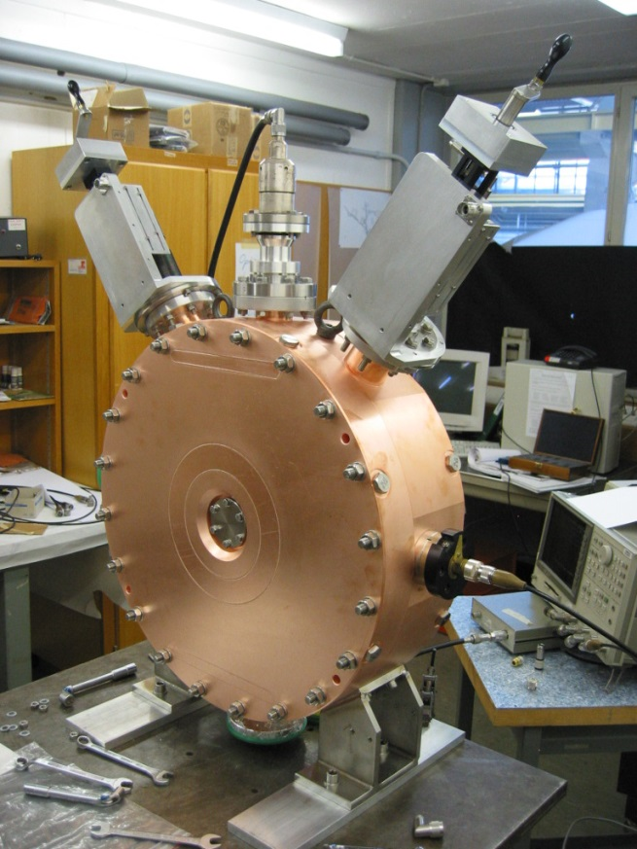
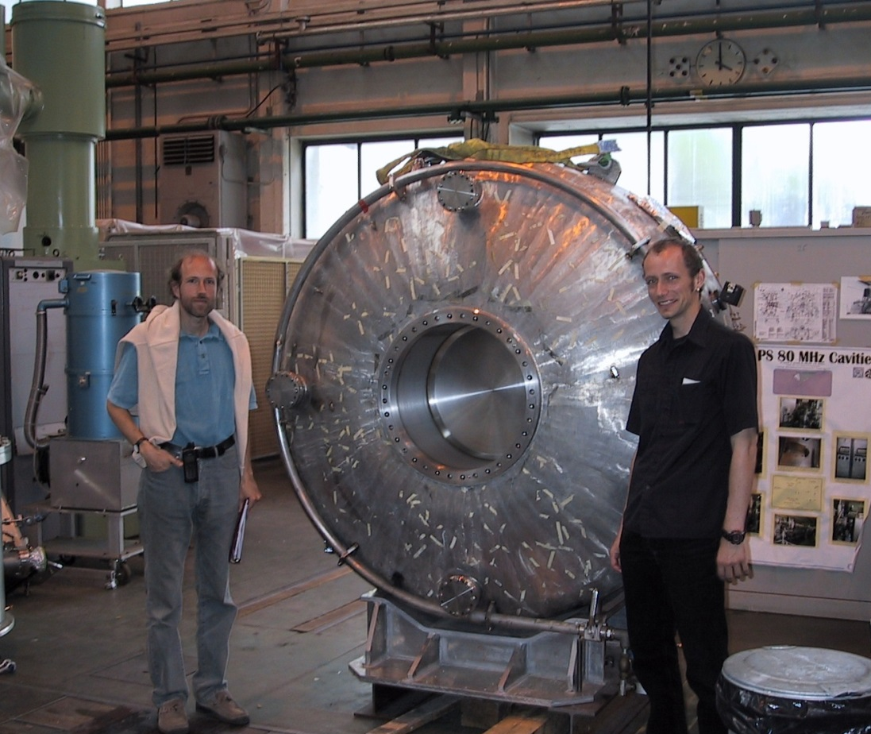
Example of cavities
Cavity parameters
JUAS 2016

Slide 25
Summary of Part1
Summary
JUAS 2016
First step to accelerating is to fill a cavity with electromagnetic energy to build a resonant field. In order to be the most efficient, one should:
Concentrate the field in the beam area
Minimize losses of RF power
Control the limiting factors to put energy into the cavity
  The is achieved by shaping the cavity in the appropriate way

Slide 26
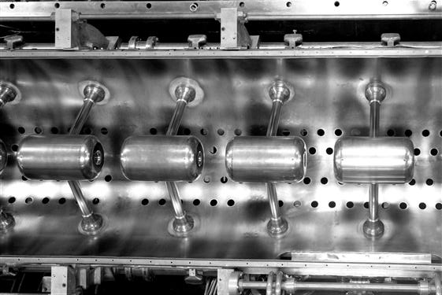
Part2: Cavities and Structures
Modes in resonant cavity
From a cavity to an accelerator
Examples of structures
JUAS 2016

Slide 27
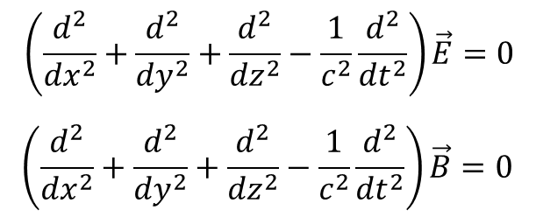
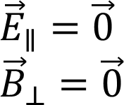
Wave equation
Cavity modes
Maxwell equation for electromagnetics waves
In free space the electromagnetic fieds are of the transverse electromagnetic, TEM type: Electric and magnetic field vectors are ⊥ to each other and to the direction of propagation !
In a bounded medium (cavity) the solution of the equation must satisfy the boundary conditions:

Slide 28


TE and TM modes
Cavity modes
TE mode (transverse electric): The electric field is perpendicular to the direction of propagation in a cylindrical cavity.
TM mode (transverse magnetic): The magnetic field is perpendicular to the direction of propagation in a cylindrical cavity.
m: azimuthal
n: radial
m: azimuthal
n: radial

Slide 29
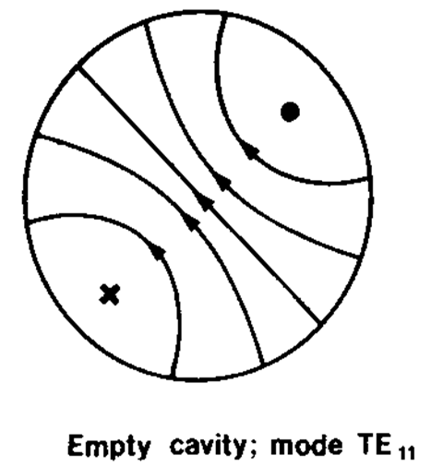
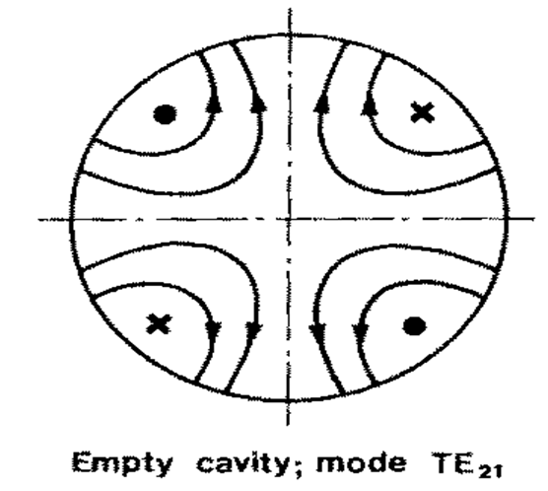
TE modes
Cavity modes
The two Transverse Electric modes for accelerating structures are:

Slide 30

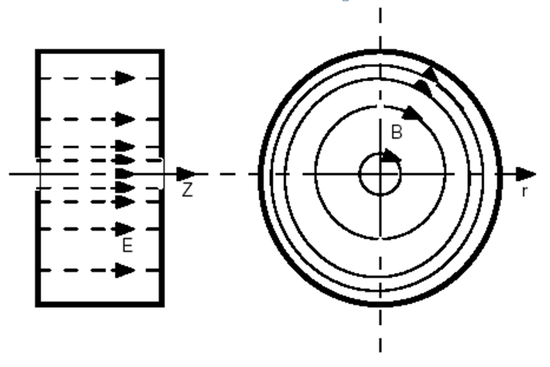
TM modes
Cavity modes
The most commonly used Transverse Magnetic mode for accelerating structures is:

Slide 31
TM modes
Cavity modes
The most commonly used for accelerating structures are the TM modes:
TM₀₁₀ : f=352.2 MHz
TM₀₁₁ : f=548 MHz
TM₀₂₀ : f=952 MHz

Slide 32
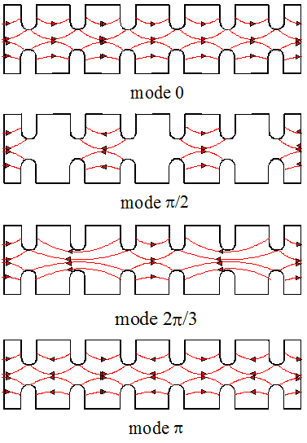
Standing Wave Modes
Structure modes
From a cavity to an accelerator
Mode 0 also called mode 2π.
For synchronicity and acceleration, particles must be in phase with the E field on axis (will be discussed more in details in part.3).
During 1 RF period, the particles travel over a distance of βλ.
The cell L lentgh should be:
Mode | L
2π | βλ
π/2 | βλ/4
2π/3 | βλ/3
π | βλ/2
Named from the phase difference between adjacent cells.

Slide 33
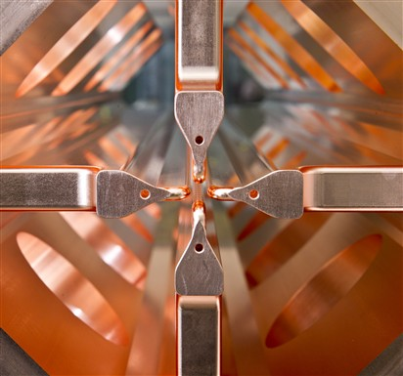
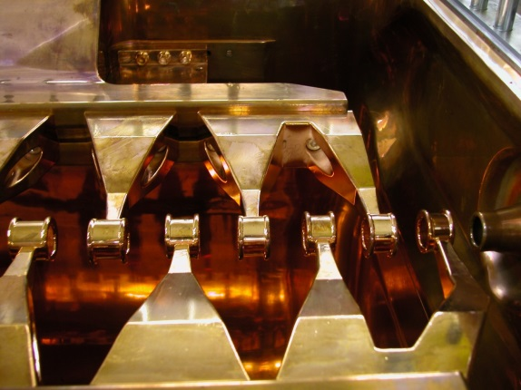
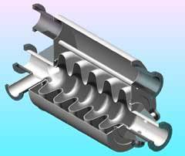
Basic accelerating structures
Basic structures
TE mode:
  Radio Frequency Quadrupole: RFQ
  Interdigital-H structure: IH
TM mode:
  Drift Tube Linac: DTL
  Cavity Coupled DTL: CCDTL
  PI Mode Structure: PIMS
  Superconducting cavities

Slide 34
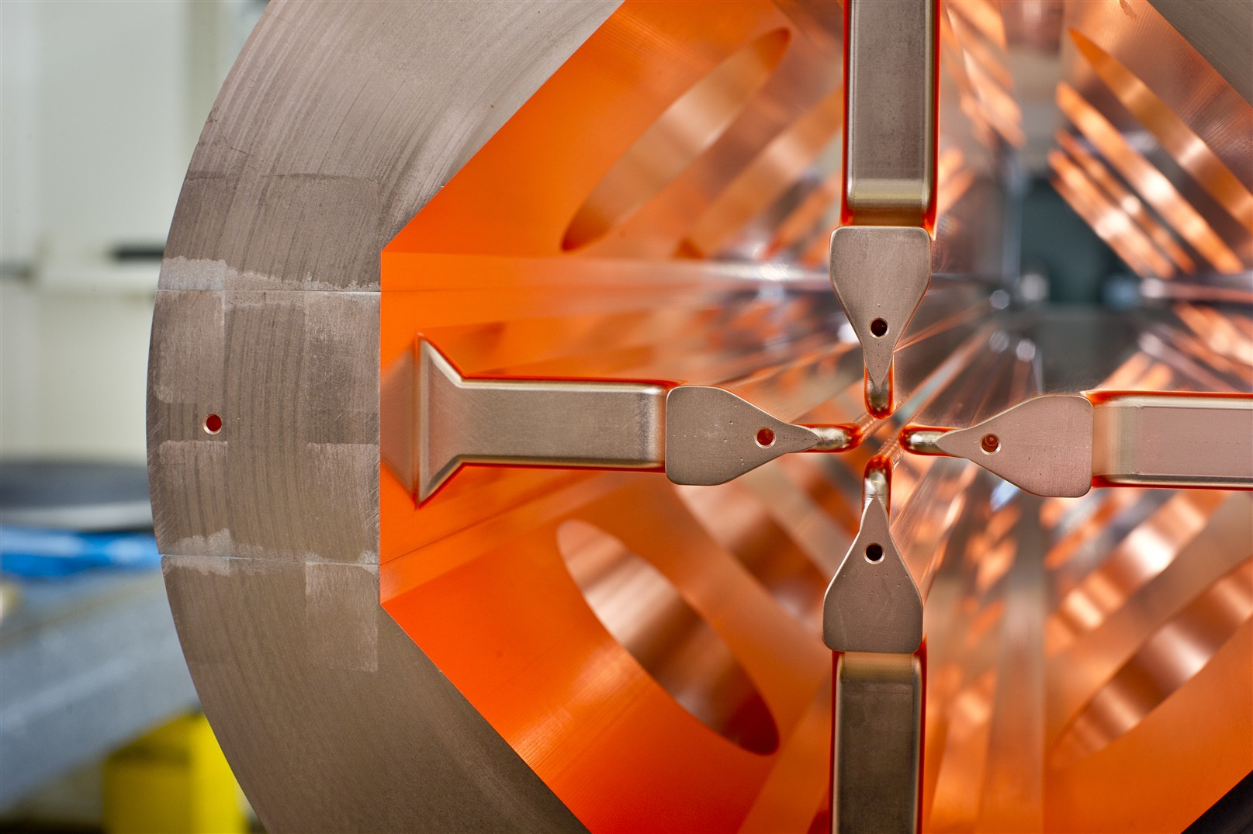
Radio Frequency Quadrupole
Basic structures
RFQ

Slide 35
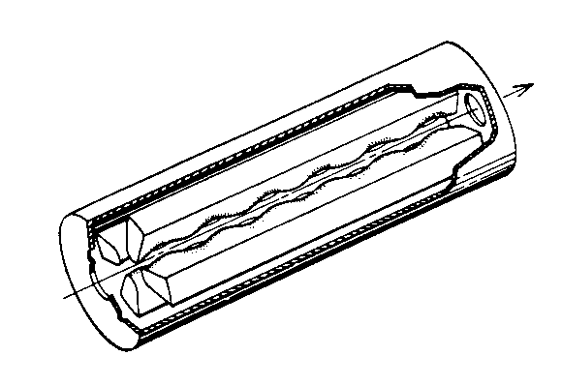
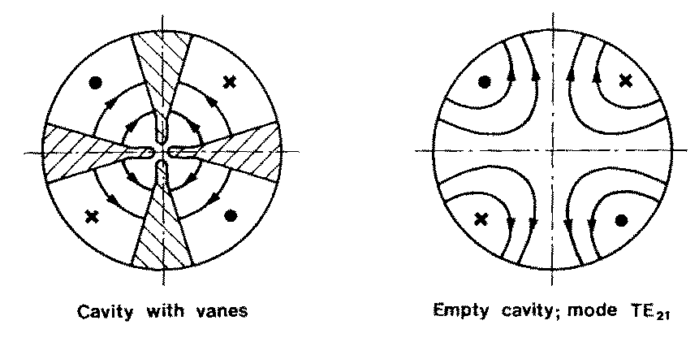
Radio Frequency Quadrupole
Basic structures
RFQ

Slide 36
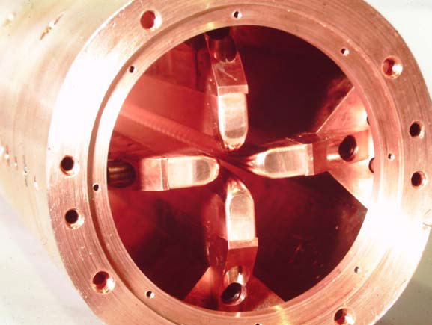



Radio Frequency Quadrupole
Basic structures
RFQ

Slide 37


4 vane-structure
Basic structures
RFQ
Capacitance between vanes, inductance in the intervane volume.
Each quadrant is a resonator
Frequency depends on cylinder dimensions.
Vane tip are machined by a computer controlled milling machine.
Need stabilization (problem of mixing with dipole mode TE11).

Slide 38








Radio Frequency Quadrupole
Basic structures
RFQ
-
-
+
+
+
-
-
-
-
-
-
+
-
+
+
+
+
+
-
+
-
+
+
-

Slide 39



Acceleration in RFQ
Basic structures
RFQ
longitudinal modulation on the electrodes creates a longitudinal component in the TE mode

Slide 40



RFQ parameters
Basic structures
RFQ
Focusing term
Acceleration term
a=bore radius
m=modulation
m₀=rest mass
β=reduced velocity
λ=wave length
f=frequency
k=wave number
V=vane voltage
I_{0,1}= zero and first order Bessel function

Slide 41

RFQ
Basic structures
RFQ
The resonating mode of the cavity is a focusing mode
Alternating the voltage on the electrodes produces an alternating focusing channel
A longitudinal modulation of the electrodes produces a field in the direction of propagation of the beam which bunches and accelerates the beam
Both the focusing as well as the bunching and acceleration are performed by the RF field
The RFQ is the only linear accelerator that can accept a low energy CONTINOUS beam of particles
1970 Kapchinskij and Teplyakov propose the idea of the radiofrequency quadrupole ( I. M. Kapchinskii and V. A. Teplvakov, Prib.Tekh. Eksp. No. 2, 19 (1970))
Acceleration
Bunching
Transverse focusing

Slide 42


Interdigital H structure
Basic structures
IH

Slide 43

Interdigital H structure
Basic structures
IH
Stem on alternating side of the drift tube force a longitudinal field between the drift tubes
Focalisation is provided by quadrupole triplets places OUTSIDE the drift tubes or OUTSIDE the tank

Slide 44
Interdigital H structure
Basic structures
IH
very good shunt impedance in the low beta region ((β ≅ 0.02 to 0.08 ) and low frequency (up to 200MHz)
not for high intensity beam due to long focusing period
ideal for low beta heavy ion acceleration

Slide 45


Drift Tube Linac
Basic structures
DTL

Slide 46


Drift Tube Linac
Basic structures
DTL
Tutorial !

Slide 47




Drift Tube Linac
Basic structures
DTL
Disc loaded structure
Operation in 2π mode
Add tubes for high shunt impedance
Remove the walls to increase coupling between cells
Particles are inside the tubes when the electric field is decelerating.
Quadrupole can fit inside the drift tubes.
β=0.04-0.5 (750 keV – 150 MeV)
Synchronism condition for 2π mode :
Cell length should increase to account for the beta increase
Ideal for low β – low W - high current

Slide 48


Drift Tube Linac
Basic structures
DTL
CERN Linac2 DTL
CERN Linac4 DTL

Slide 49


Coupled Cavity DTL
Basic structures
CCDTL

Slide 50

Coupled Cavity DTL
Basic structures
CCDTL

Slide 51


Side Coupled Cavity
Basic structures
SCL
multi-cell Standing Wave
structure in p/2 mode
frequency 800 - 3000 MHz
for protons (b=0.5 - 1)
Rationale: high beta ⇒ cells are longer ⇒ advantage for high frequencies
at high f, high power (> 1 MW) klystrons available ⇒ long chains (many cells)
long chains ⇒ high sensitivity to perturbations ⇒ operation in p/2 mode
Side Coupled Structure:
- from the wave point of view, p/2 mode
- from the beam point of view, p mode

Slide 52



Pi Mode Structure
Basic structures
PIMS
beam

Slide 53



Superconducting cavities
Some examples
Basic structures
SC cavities
Multi gap cavities (elliptical)
Operate in π mode
β>0.5-0.7
350-700 MHz (protons)
0.35-3 GHz (electrons)
Other SC cavities (spoke, HWR, QWR)
β>0.1
From 1 to 4 gaps.
Can be individually phased.
Space for transverse focusing in between
Ideal for low β - CW proton linacs.

Slide 54

Part3: Beam dynamics
Multi-particles beam
Longitudinal dynamics
  Acceleration
  Bunching
  Synchronicity
Transverse dynamics
JUAS 2016

Slide 55
Why beam dynamics?
Beam dynamics
LINAC: Accelerate particles on a linear path.
Accelerate particle beams in controlled condition : Generate a flux of particles at a precise energy and confined in a small volume in space.
-> We have to define how to accelerate and focus the beam
Main Linac parameters:
Particles
Output energy
Beam current
Frequency
Pulse length
Repetition rate

Slide 56

Multi-particles beam
Beam dynamics
Multi particles Beam
A bunch of particles is characterized by its distribution in the 6D-phase space.
Y
(x,x’)
X
(z,z’)
BEAM
(y,y’)
Z

Slide 57


Longitudinal dynamics
Beam dynamics
Longitudinal
Linac convention: Remember
Energy gain maximum when φ = 0
RF Signal
E₀
Deceleration
RF Phase (°)
Acceleration
The bunch should only see accelerating field !

Slide 58

Longitudinal dynamics
Beam dynamics
Longitudinal
Phase, time and longitudinal position of a particle are the same thing.
Always referring to the synchronous particle: A imaginary particle at exact velocity in synchronism with the Linac RF law.
Distance from bunch to bunch: βλ corresponds to 360° and 1 RF period in time 1/f.
Ex. at 352.2 MHz and protons at 50 MeV
β=0.314, λ=c/f, βλ=267 mm, T=2.84 ns.
In one RF period, a 50 MeV proton travels over 267 mm during 2.87 ns.
On the plot -> 4.5° -> -3.3 mm -> 3.55e⁻¹¹ s

Slide 59
Bunching
Beam dynamics
Longitudinal
More in details, effect on a bunch of particles
Synchronous Part.
RF Signal
E₀
RF Phase (°)
Late Part.
Early Part.
The synchronous part. gets the correct kick – by definition
The late part. gains slightly more energy
The early part. Gains slightly less energy.
Bunching / Focusing

Slide 60



Bunching
Beam dynamics
Longitudinal
RF Signal
E₀
Acceleration
& Bunching
Acceleration
& Debunching
RF Phase (°)
Deceleration
& Debunching
Deceleration
& Bunching
Energy gain for the synchronous particle
Energy gain for a particle with phase φ
For φ-φ_{s} small

Slide 61

Separatrix
Beam dynamics
Longitudinal
RF electric field as function of phase.
Potential of synchrotron oscillations
Trajectories in the longitudinal phase space each corresponding to a given value of the total energy (stationary bucket)
Tutorial !

Slide 62

Separatrix
Beam dynamics
Longitudinal
Equation for the canonically conjugated variables phase and energy with Hamiltonian (total energy of oscillation):
For each H we have different trajectories in the longitudinal phase space. Equation of the separatrix (the line that separates stable from unstable motion)
Maximum energy excursion of a particle moving along the separatrix

Slide 63


Separatrix
Beam dynamics
Longitudinal
Longitudinal acceptance

Slide 64



Long. phase advance
Beam dynamics
Longitudinal
By accelerating on the rising slope of the positive RF wave we have a longitudinal force keeping the beam bunched.
This force is characterized by the longitudinal phase advance.
Longitudinal phase advance per unit of length
Longitudinal phase advance per period
If a period is [Nβλ]
More details on phase advance in Transverse plane !!!

Slide 65
Synchronicity
Beam dynamics
Longitudinal
Adapting the cavity geometry to the velocity of the particle.
Case1 : β_{s}= β_{g} -> structure is continuously changing to adapt to the synchronous particle velocity change.
Case2 : β_{s}≈ β_{g} -> structure is adapted in step to the synchronous particle velocity change. Phase slippage.
Case3 : β_{s}= β_{g}≈1. Constant structure.

Slide 66
Synchronicity – Case1
Beam dynamics
Longitudinal
Case1 : β_{s}= β_{g} -> structure is continuously changing to adapt to the synchronous particle velocity change.
fix phase RF and gap lenght
the syncr. particle should travel a distance L in one RF period
assume that the particle goes to mid gap with the initial velocity.
at mid gap the particle velocity is increased by an amount corresponding to the effect of the integrated electric field times the transit time factor. ΔW=qE_{o}TL cos(Φ)
the particle drifts with this velocity till the end of the cell
and so on and so on..........

Slide 67
Synchronicity – Case1
Beam dynamics
Longitudinal

Slide 68


Synchronicity – Case2
Beam dynamics
Longitudinal
Case2 : β_{s}= β_{g} -> structure is adapted in step to the synchronous particle velocity change. Phase slippage
For simplifying the construction and therefore keeping the cost down, cavities are not individually tailored to the evolution of the beam velocity but they are constructed in blocks of identical cavities. It implies phase slippage.
Example of phase slippage: CERN design for a 352 MHz
SC linac.
Four sections:
β = 0.52 (120 - 240 MeV)
β = 0.7 (240 - 400 MeV)
β = 0.8 (400 MeV - 1 GeV)
β = 1 (1 - 2.2 GeV)

