Slide 1


Self-consistent beam dynamics and beam-matter interactions model of a compact proton therapy facility
Eliott Ramoisiaux, Eustache Gnacadja, Cédric Hernalsteens, Nicolas Pauly,
Robin Tesse, Arthur Vandenhoeke, Marion Vanwelde
This work has received funding from the Walloon Region (SPW-EER) Win²Wal program under grant agreement No. 1810110 and PIT program under grant agreement No. 7289.
BHPA - Friday February 7th 2020

Slide 2
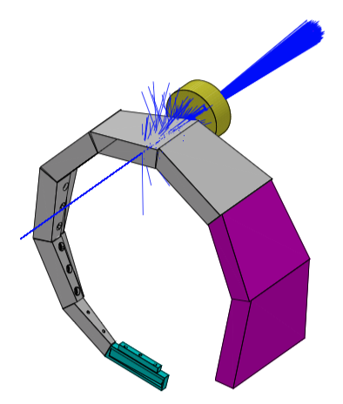
Introduction
Cyclotron based protontherapy beamlines and gantries
Magnetic transport
Beam-matter interactions
Energy range variations obtained through interaction of the beam with the degrader (Beryllium, Graphite and Aluminum).
Impacts:
  Beam scattering
  Activation of the machine and its surroundings
  Ambient dose
Need of a model coupling the beam dynamics and the beam-matter interactions.
A self-consistent model of the Proteus One machine has been developed with the BDSIM (Beam Delivery Simulation) that uses the Geant4 toolkit.

Slide 3
Model Description
P1E

Slide 4
Model Description
Exact maze geometry
“Regular” and “Low-Activation” concrete
Beamline and magnets in the rocket

Slide 5
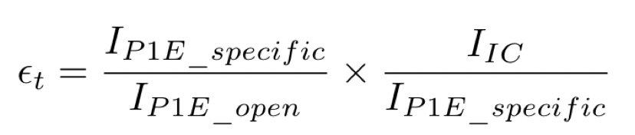
Model validation – Total efficiency
Excellent agreement is observed at all ranges
Validation of the overal model and degrader description
Beam-matter interactions are crucial

Slide 6
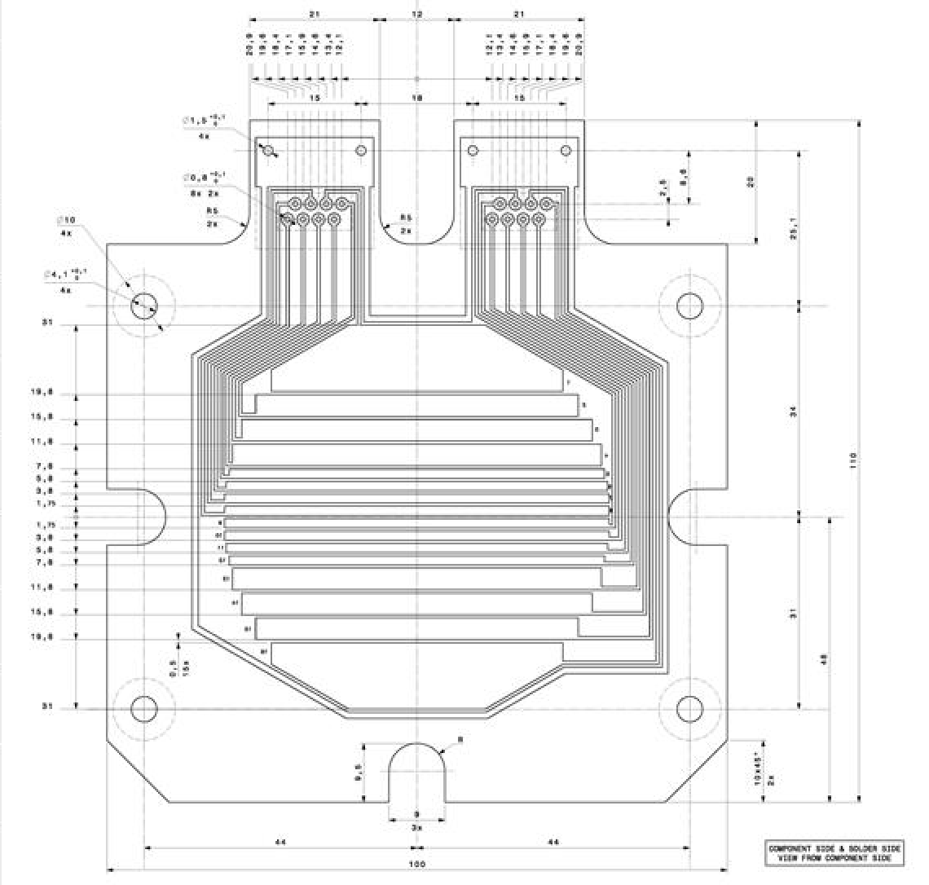
Model validation – Beam profiles
Beam Profile Monitors analysis
  Binning follows the exact geometry of the BPM
  Gaussian fit to extract the distribution sigma beam size
Aim to validate the details of the magnetic transport

Slide 7
Model validation – Beam profiles: P1G

Slide 8
Model validation – Beam profiles: P2G

Slide 9
Model validation – Beam profiles: P3G

Slide 10
Model validation – Beam profiles: P4G

Slide 11
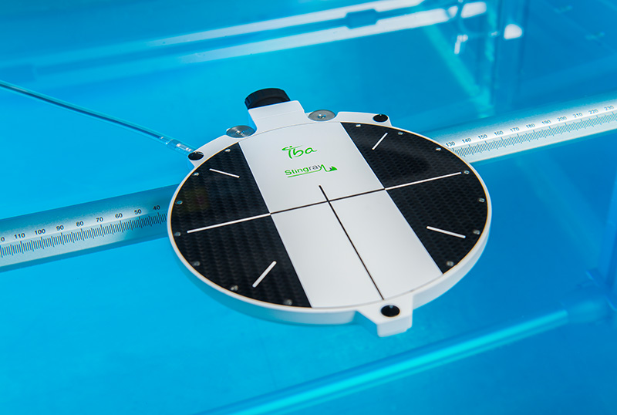
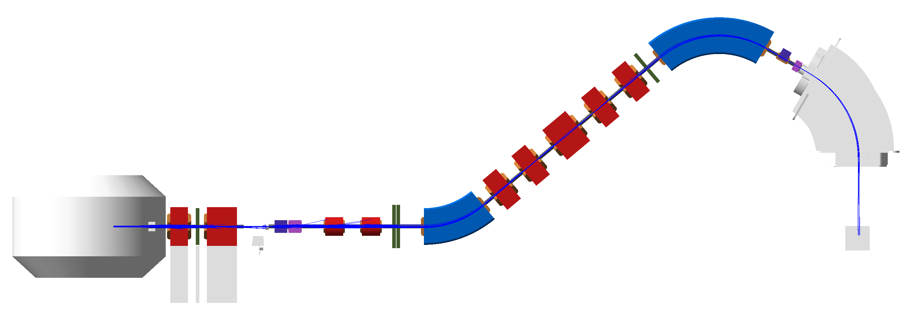
Model validation: Bragg peaks
The dose deposition of a pencil beam has been measured with a StingRay chamber.
A Monte-Carlo dose scorer (Geant4) has been included in the model inside of a water phantom.
The distal part of the simulated Bragg Peak has been fitted with a polynomial in order to extract its characteristics components (R90, R80, R20, distal fall-off…)
Aim to validate the clinical beam dose deposition and energy spectrum

Slide 12
Model validation: Bragg peaks

Slide 13
Model validation: Bragg peaks

Slide 14
Model validation: Bragg peaks

Slide 15
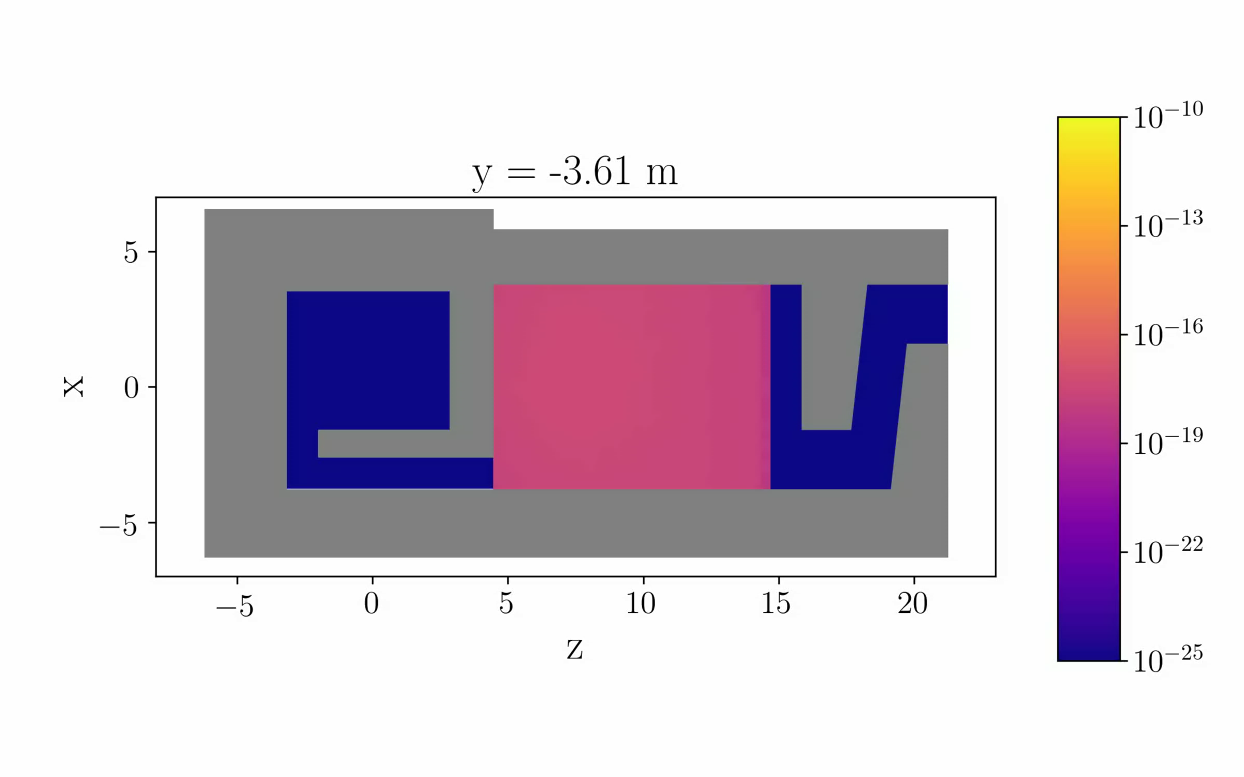
Using the model – Ambient dose
Ambient dose computation in the vault and treatment room.
Sv/p
Static model for the cyclotron losses

Slide 16
Using the model – Ambient dose
Ambient dose computation in the vault and treatment room.
Sv/p
Static model for the cyclotron losses

Slide 17
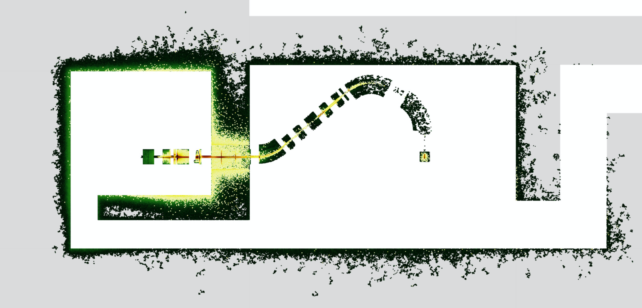
Using the model – Shielding activation
Locations of neutron (black $→$ green) and proton interactions (yellow $→$ red).

Slide 18
Using the model – Shielding activation
Ratio between concrete activation due to neutronic capture and clearance level.

Slide 19
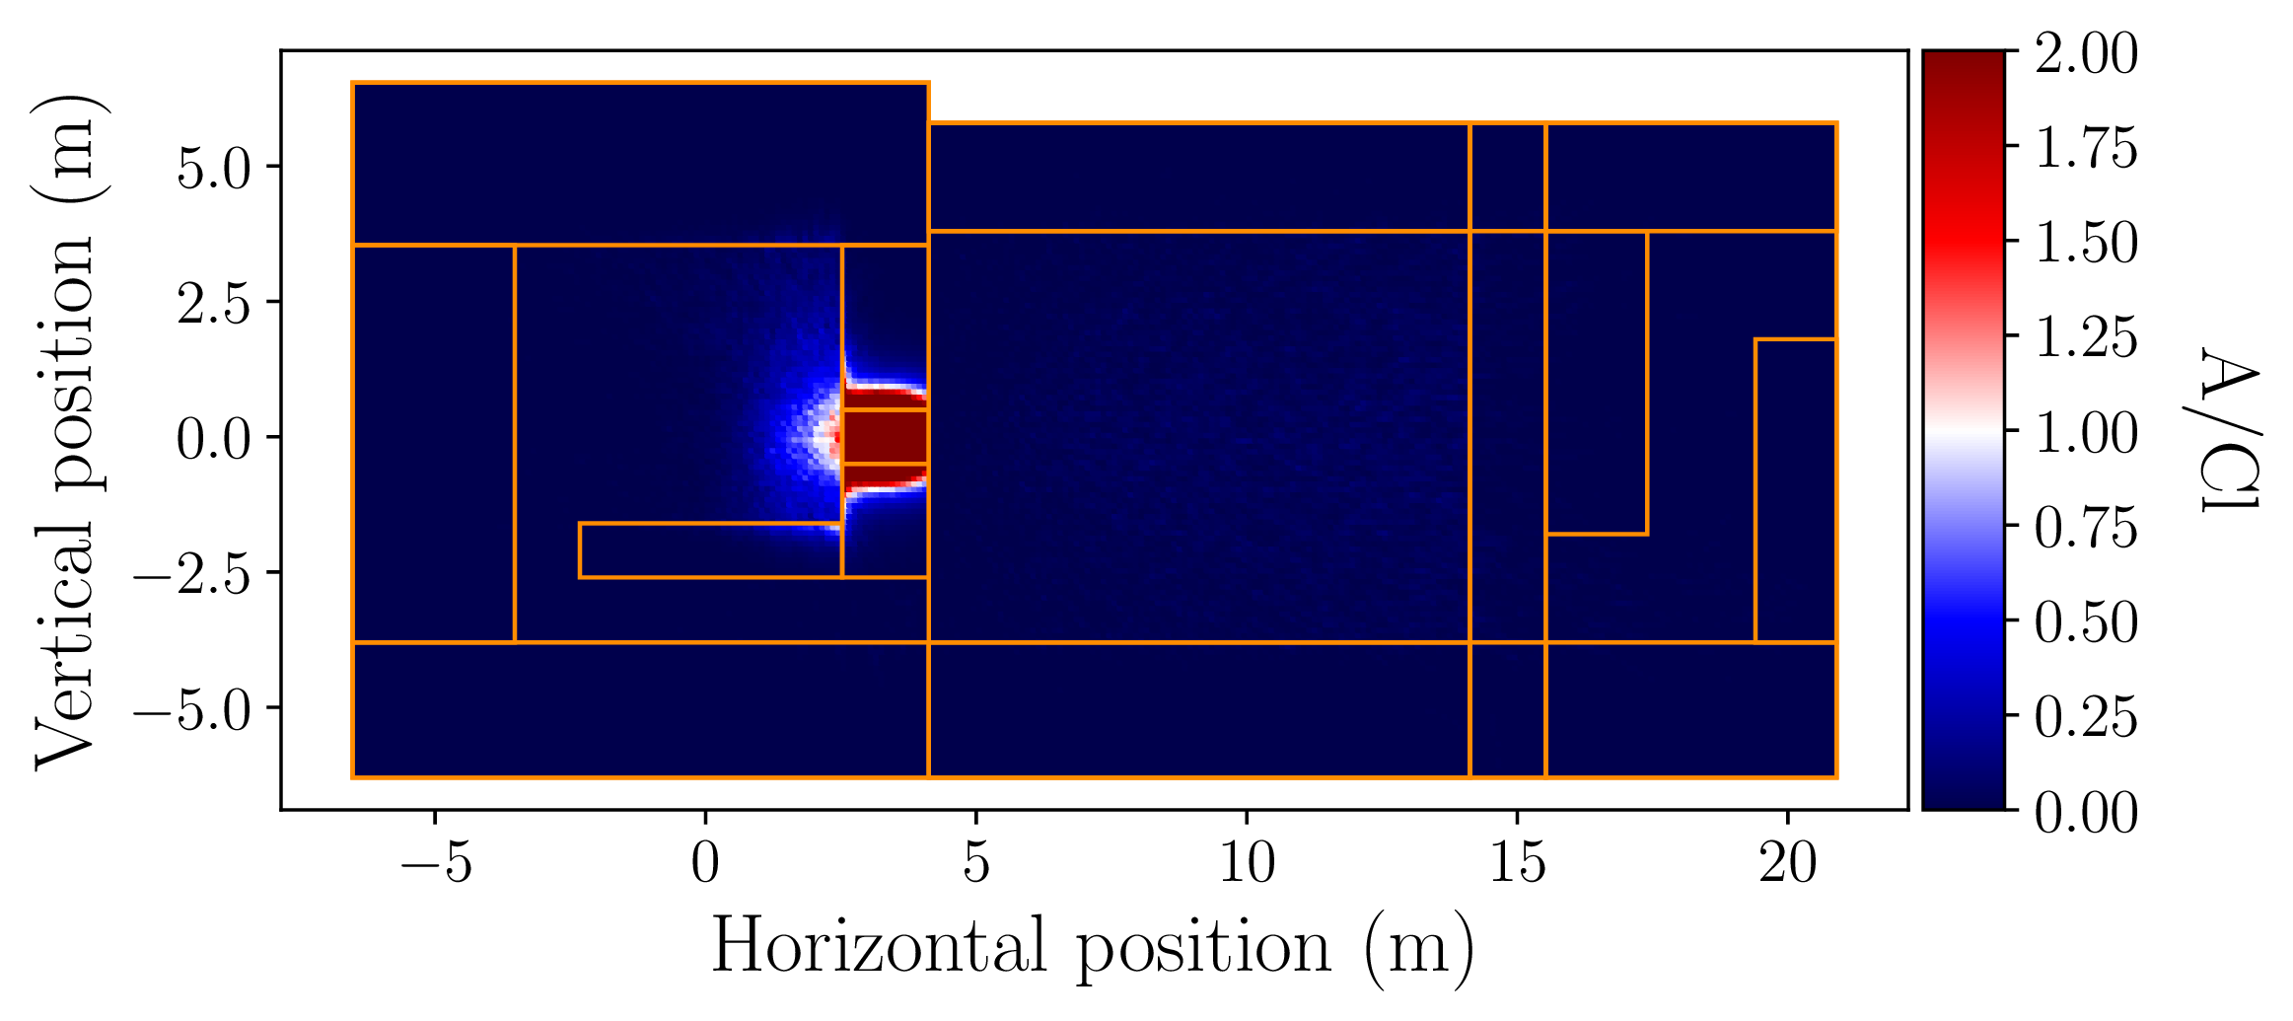
Using the model – Shielding activation
Ratio between concrete activation due to spallation reaction and clearance level.

Slide 20
Conclusion and Outlooks
A BDSIM realistic model of the Proteus One has been developed and validated.
  Beam optics: validated through efficiencies and beam profiles studies.
  Beam-matter interactions: validated through Bragg peaks analysis.
Excellent agreement with experimental data
The model was used to compute the ambient dose and the shielding activation.
  A wide variety of beam characteristics can be computed and used.
Next steps:
  Validation of the dose uniformity in Pencil Beam Scanning.
  Time-dependent activation study using FISPACT-II.
  Software development to read DICOM files and shoot real treatment plans.

Slide 21

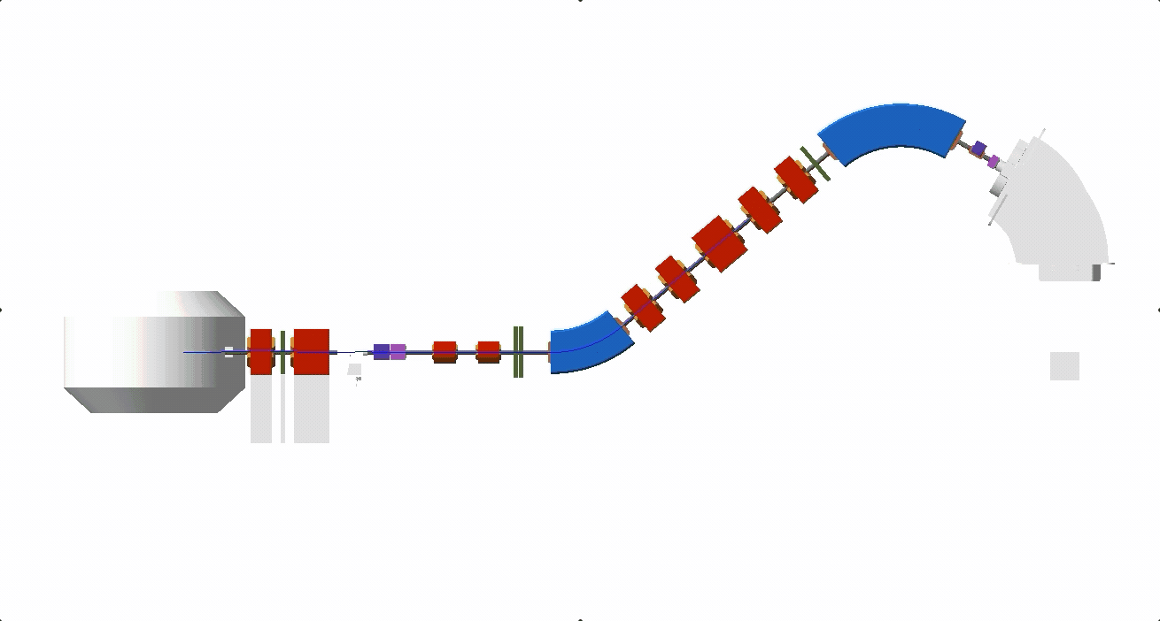
Thank you for your attention!
Any questions?
eliott.ramoisiaux@ulb.be

