Slide 1


Optimization of a proton therapy passive scattering eye treatment beamline toward improved clinical performances
Eustache Gnacadja, Cédric Hernalsteens, Carolina Fuentes, Quentin Flandroy, Nicolas Pauly, Eliott Ramoisiaux, Robin Tesse, Arthur Vandenhoeke, Marion Vanwelde
BHPA - February $7^{th}$ 2020

Slide 2
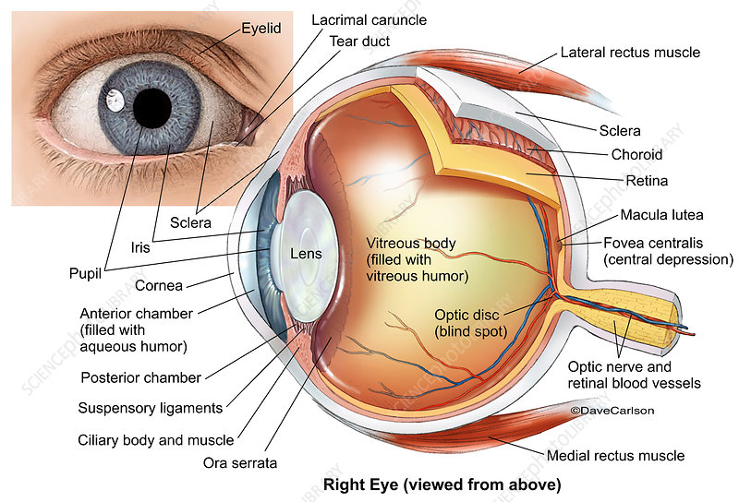
Context & challenges
Proton beams irradiation of eye tumors
  Uveal melanomas (most common primary eye cancer in adults)
  Mainly occurs in iris, ciliary body and choroid region

Slide 3
Context & challenges
Proton beams irradiation of eye tumors
  Uveal melanomas (most common primary eye cancer in adults)
  Mainly occurs in iris, ciliary body and choroid region
Shallow ( depth < 3cm) and small sizes (< 2cm)
  Low energy charged particle beams are very suitable
  Proton therapy is the Gold Standard in the field

Slide 4
Context & challenges
Proton beams irradiation of eye tumors
  Uveal melanomas (most common primary eye cancer in adults)
  Mainly occurs in iris, ciliary body and choroid region
Shallow ( depth < 3cm) and small sizes (< 2cm)
  Low energy charged particle beams are very suitable
  Proton therapy is the Gold Standard in the field
Eye is complex and heterogeneous
  Many critical organs (optic nerve, retina)
  Short patient gazing time during treatment
We need sharp dose profiles and high dose rate
at the same time

Slide 5
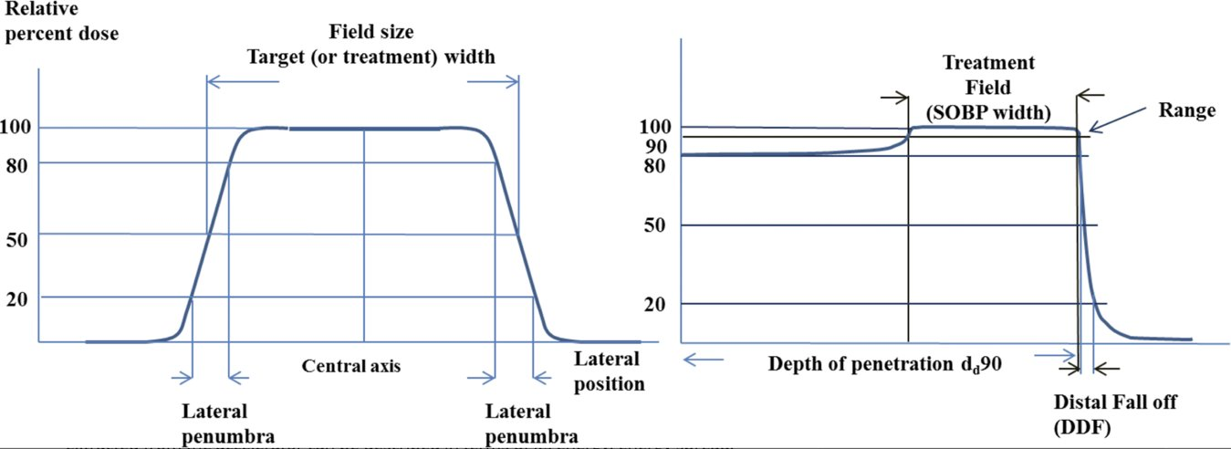
Context & challenges
Proton beams irradiation of eye tumors
Definition of the most important clinical parameters:
Lateral flatness
Lateral penumbra
Distal fall-off
SOBP flatness

Slide 6
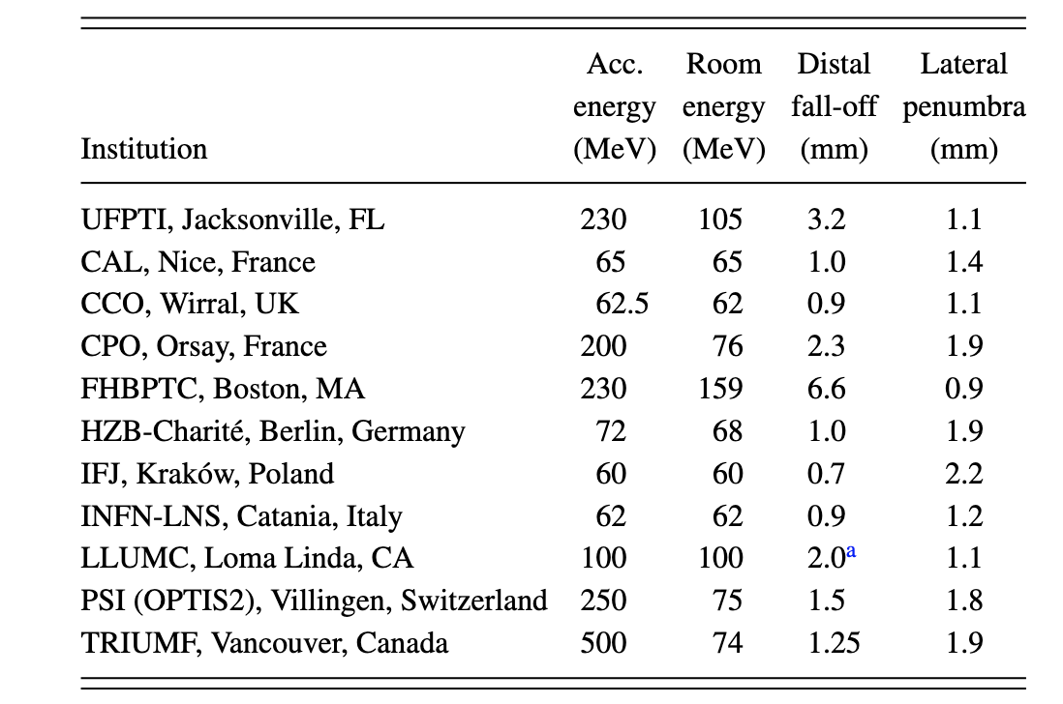
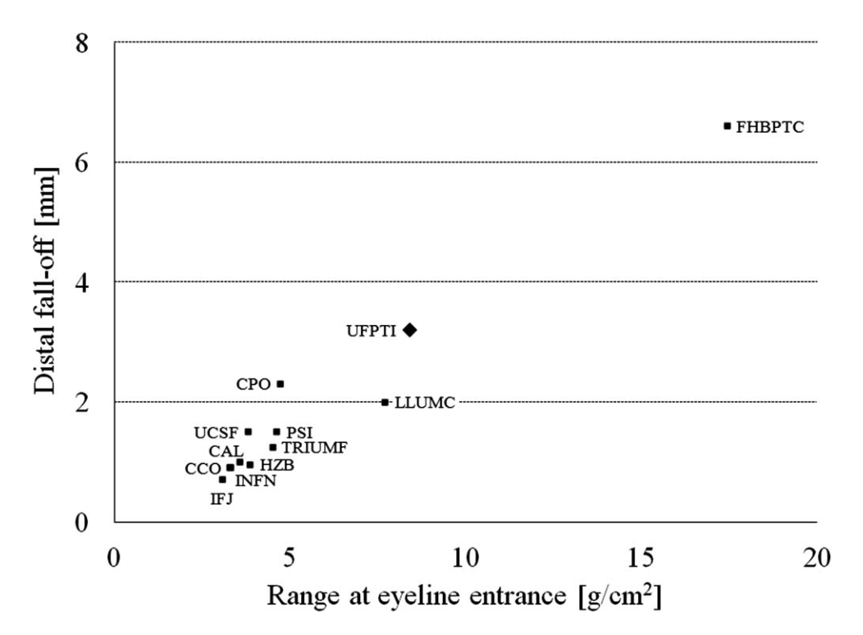
Context & challenges
Proton beams irradiation of eye tumors
    LIST OF PROTONTHERAPY CENTERS THAT TREAT EYE TUMORS

Slide 7
Context & challenges
Proton beams irradiation of eye tumors
    LIST OF PROTONTHERAPY CENTERS THAT TREAT EYE TUMORS

Slide 8
Context & challenges
Proton beams irradiation of eye tumors
    LIST OF PROTONTHERAPY CENTERS THAT TREAT EYE TUMORS

Slide 9
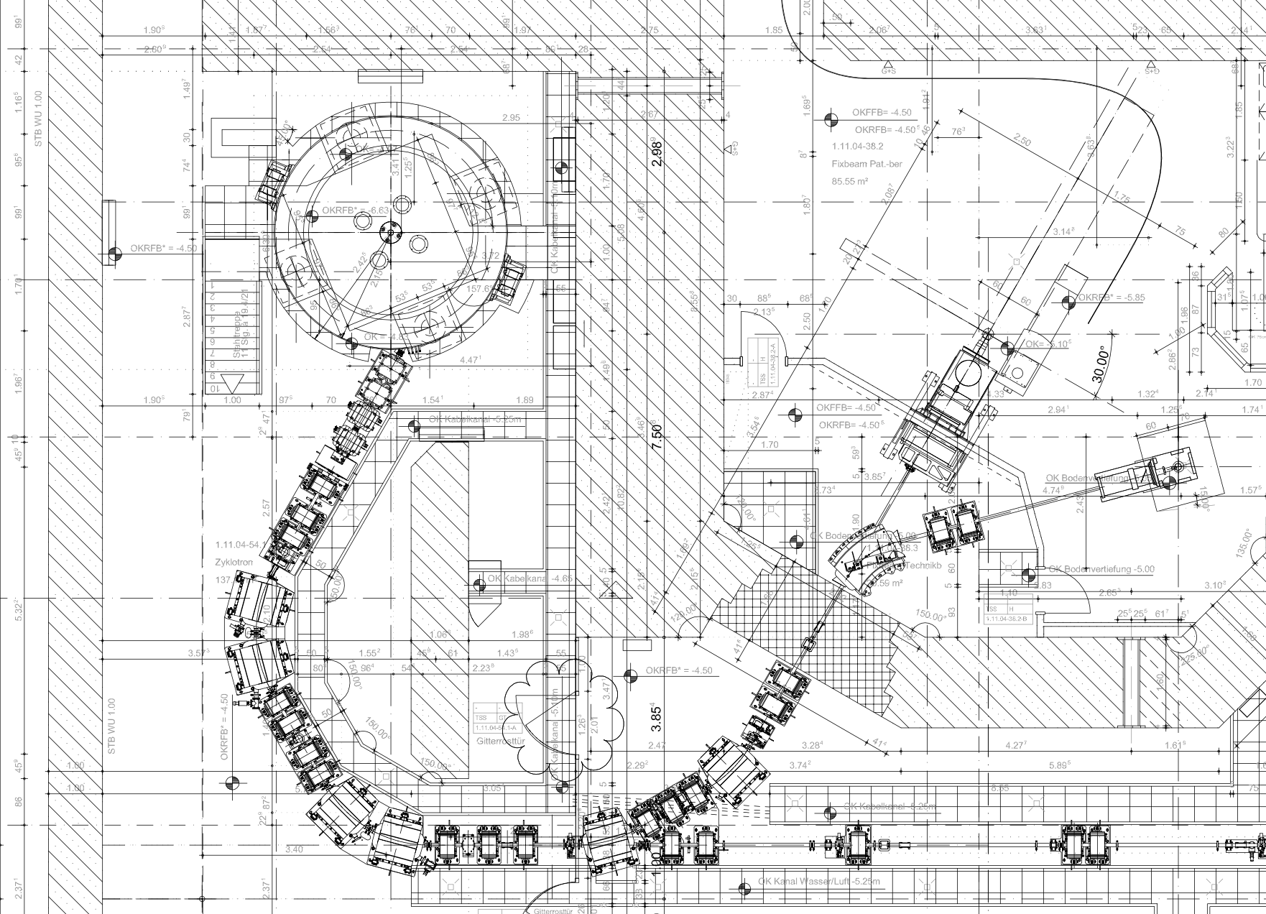
Context & challenges
AIM: Optimize the clinical performances of the eye beamline part of the IBA Proteus Plus system
- Proteus Plus is a multi-rooms facility
The “EYELINE” is in the first room, with the fixed beam treatment line
The same high energy cyclotron delivers clinical beams to all treatment rooms
  230 MeV at cyclo exit

Slide 10
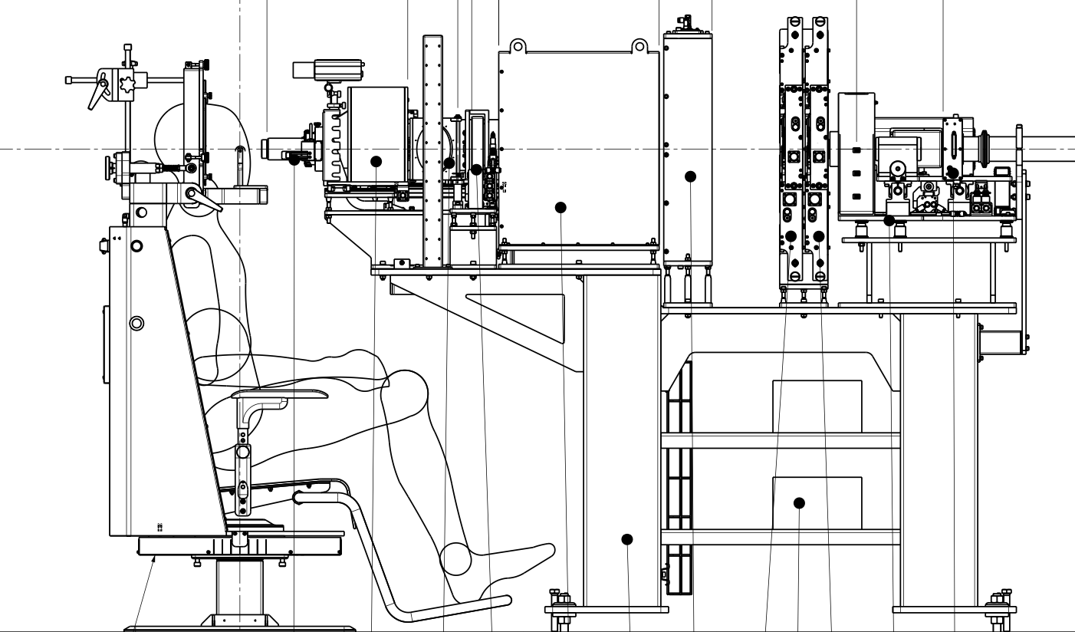
Context & challenges
AIM: Optimize the clinical performances of the eye beamline part of the IBA Proteus Plus system
EYE NOZZLE

Slide 11
Context & challenges
AIM: Optimize the clinical performances of the eye beamline part of the IBA Proteus Plus system
Target values for the clinical parameters to be optimzed
Lateral Penumbra (mm)​ | Lateral Flatness​ (%) | In-depth SOBP Uniformity​ (%) | Distal Fall-Off (mm)​ | Dose Rate​ (Gy/min)​
1.5 - 2 | 98 at skin​ | 98 | 1 - 2.2 | > 15​

Slide 12
Materials and Methods
Simulation tools:
  Beam Delivery Simulation (BDSIM)
    C++ library built on the top of GEANT4
    Allows particle tracking and beam-matter interations studies at the same time (self-consistent simulation)
  MANZONI (In-house fast particle tracking code)
    Python library, which implements proton beams propagation through beamlines and accelerator elements (Quadrupoles, Dipoles, Sextupoles, Drifts, …)

Slide 13
Materials and Methods
Workflow:
BDSIM
MANZONI
MANZONI + BDSIM
Beam degradation study
Beam optics at beamline entrance
Beam Transport System (BTS) optimization
Beam optics at nozzle entrance
Design of the nozzle
230 MeV pencil beam
Build a Monte-carlo model of the energy degradation part (degrader + collimator), to obtain a realistic beam distribution at the beamline entrance
Compute the required scattering and range shifting foils widths to achieve flat lateral profile, sharp penumbra and distal fall-off
Enhance the nozzle transmission by inserting a beam stop into the design
Track the beam through the BTS, and couple an optimizer to find the quadrupoles settings that maximize the beamline transmission

Slide 14
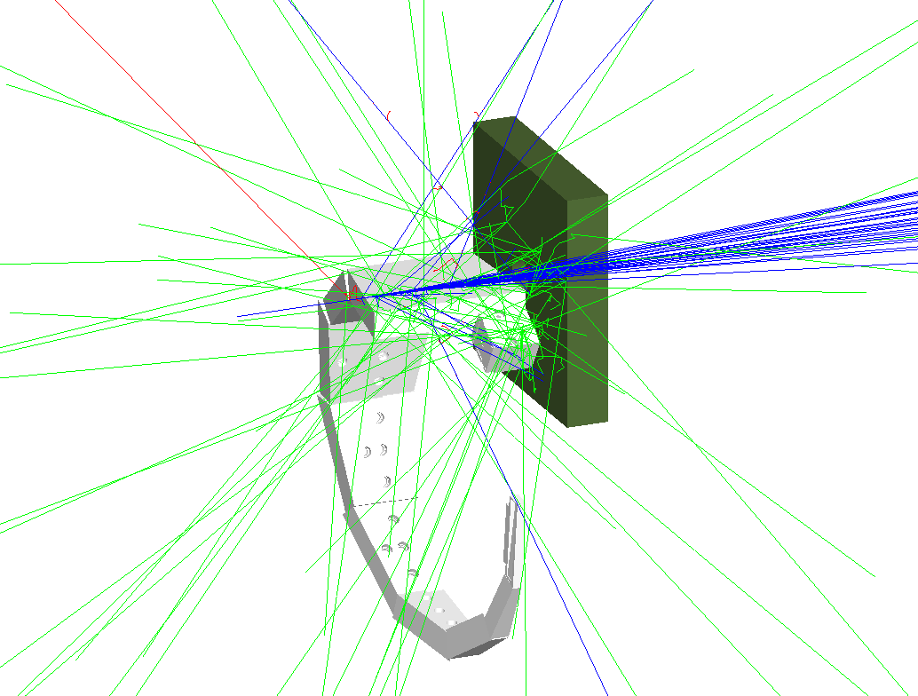
Beam distribution after degrader
The degrader wheel is composed of different materials
For a given beam energy, the appropriate angle is selected
based on a predefined calibration table

Slide 15
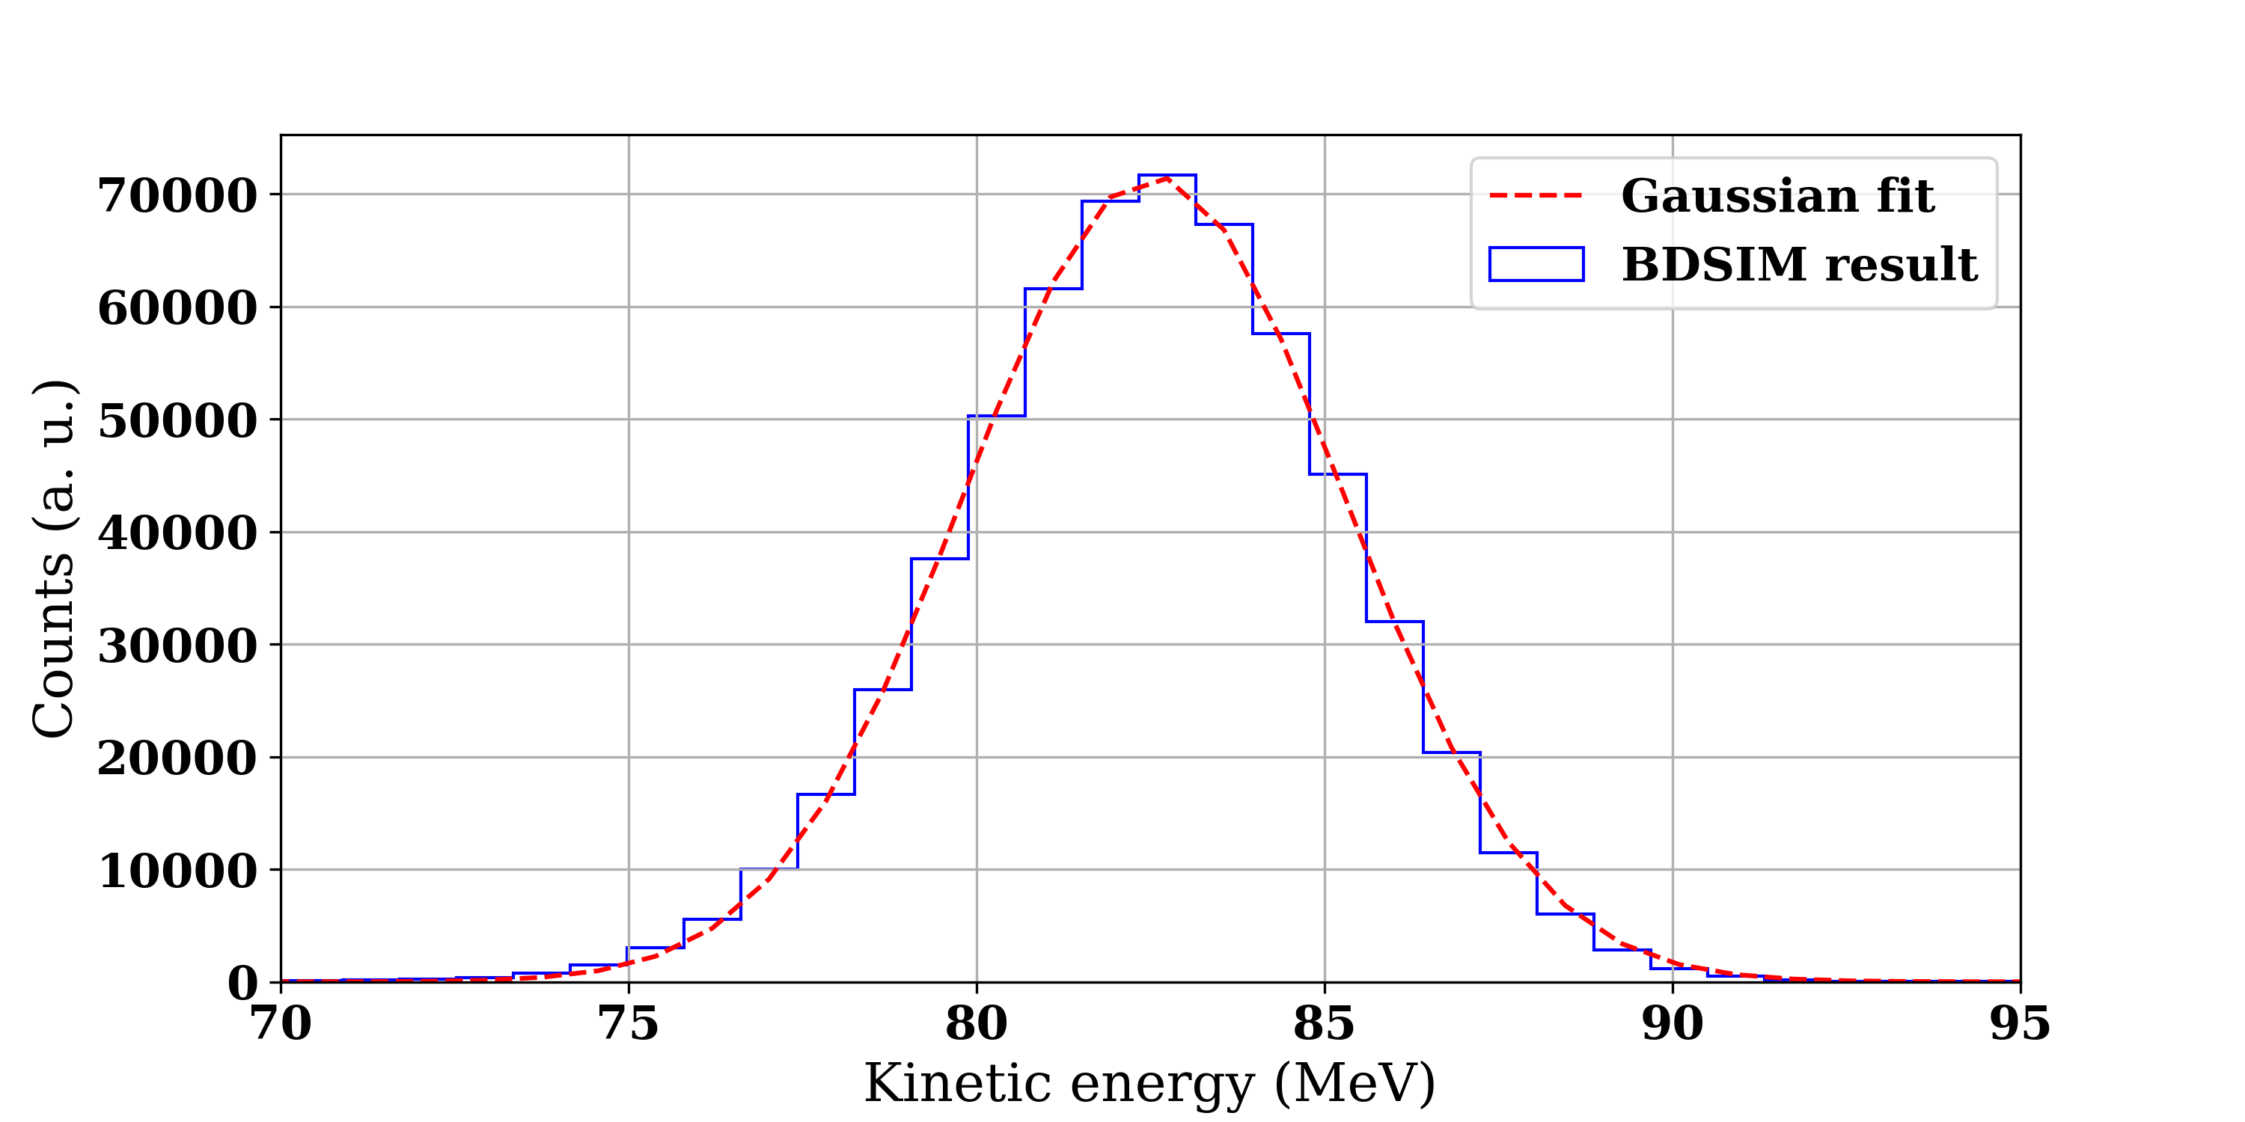
Beam distribution after degrader
The degrader wheel is composed of different materials
For a given beam energy, the appropriate angle is selected
based on a predefined calibration table
Energy distribution after collimator (E = 82.5 MeV)

Slide 16
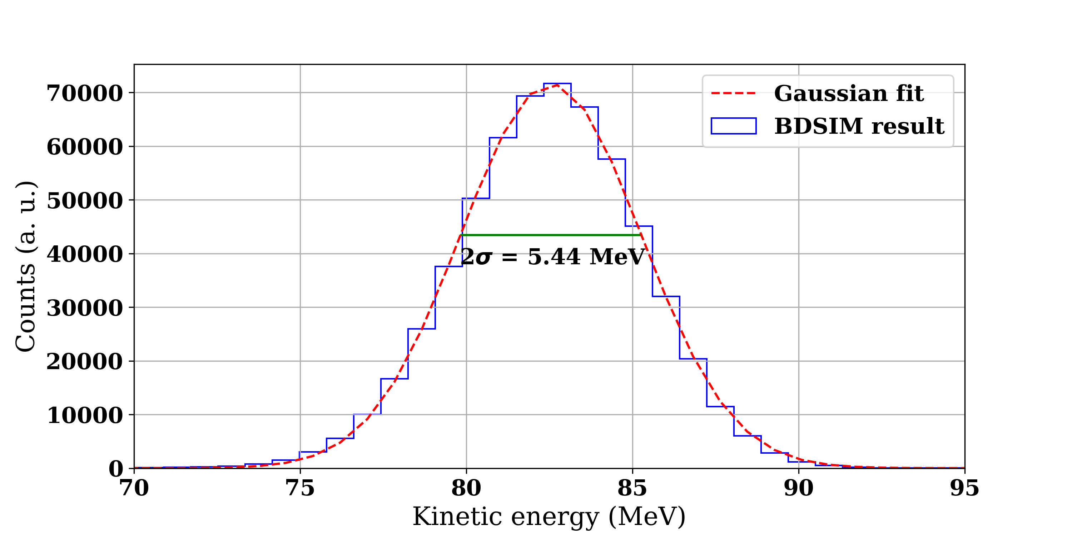
Beam distribution after degrader
The degrader wheel is composed of different materials
For a given beam energy, the appropriate angle is selected
based on a predefined calibration table
Energy distribution after collimator (E = 82.5 MeV)

Slide 17
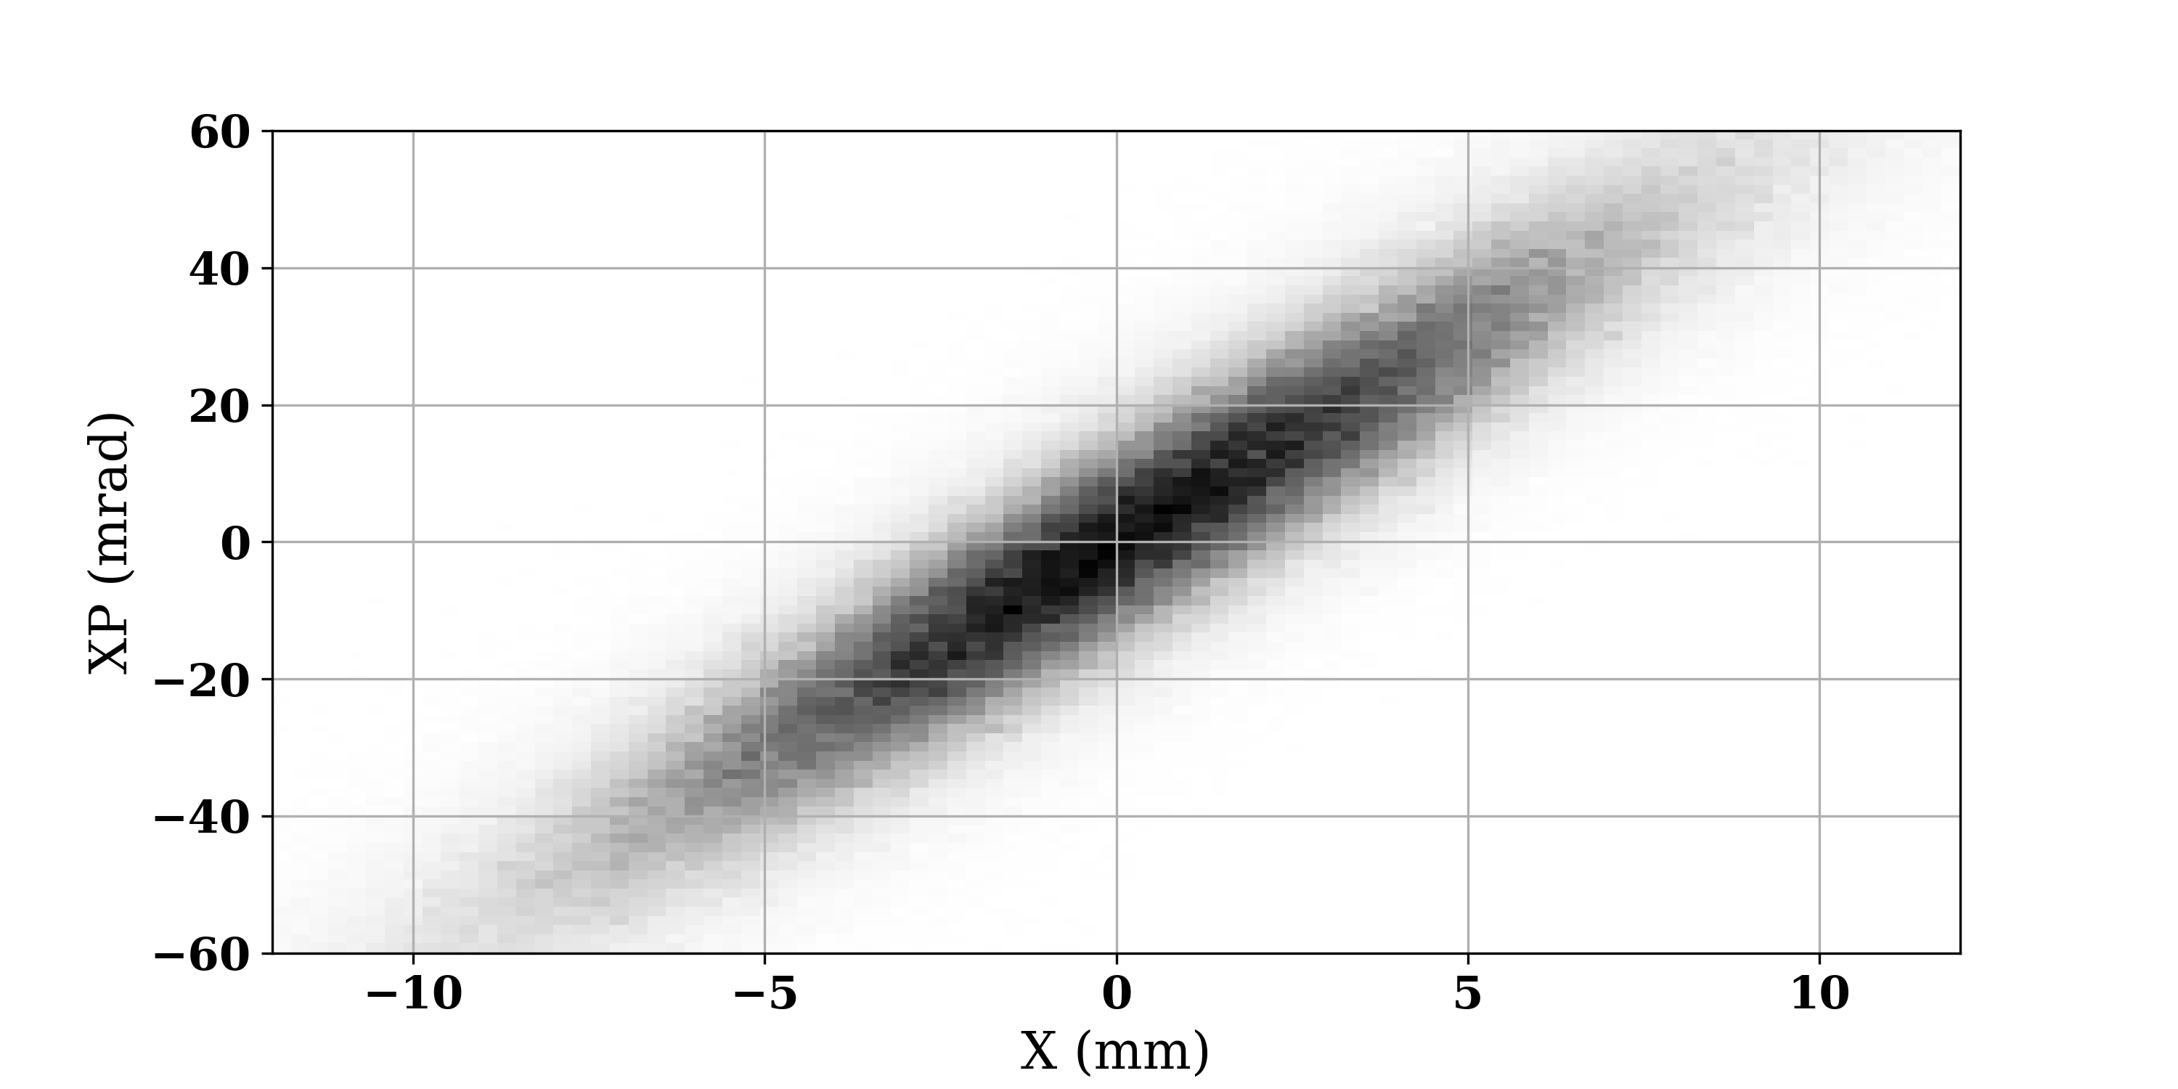
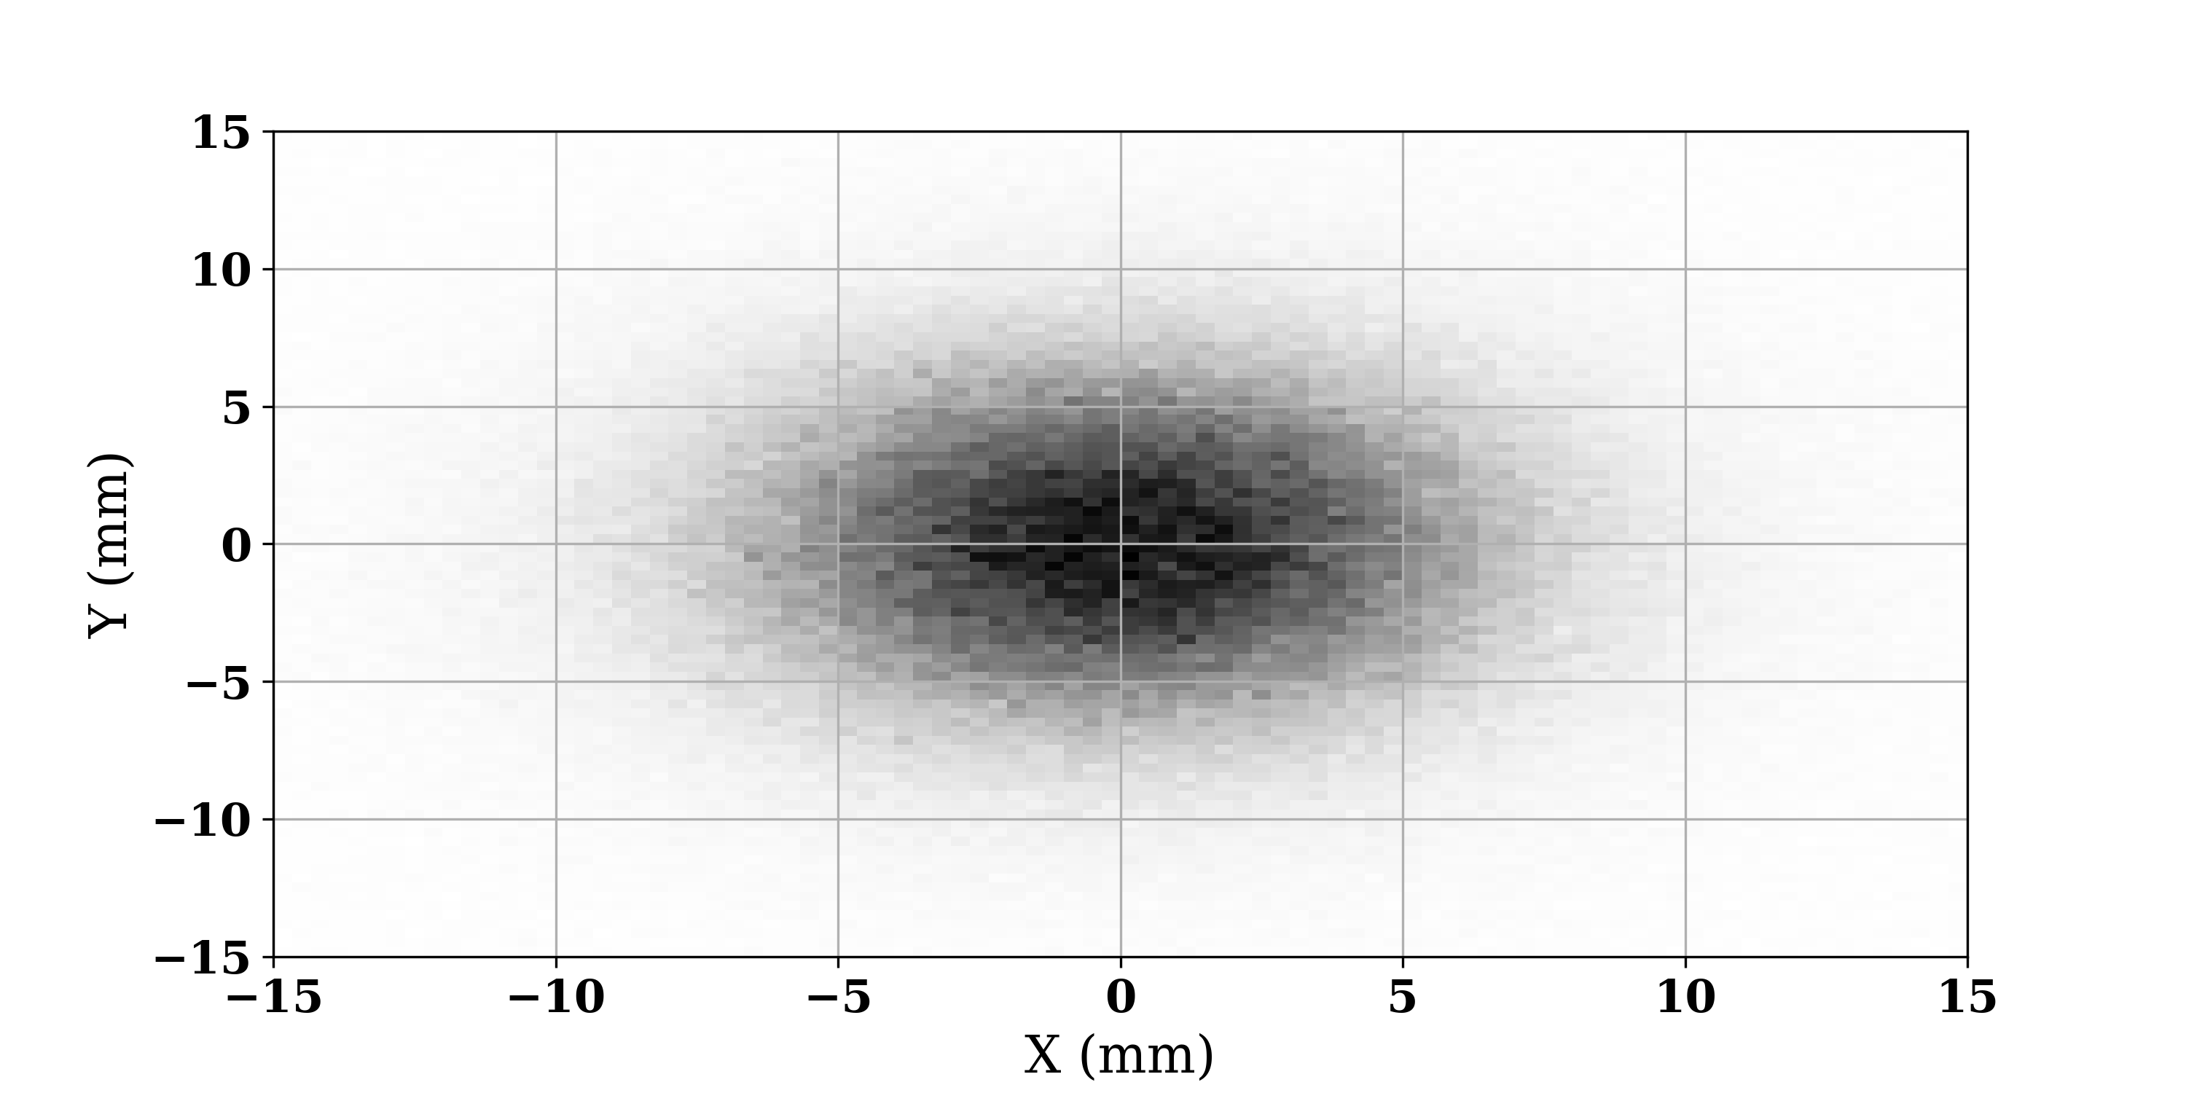
Beam distribution after degrader
The degrader wheel is composed of different materials
For a given beam energy, the appropriate angle is selected
based on a predefined calibration table
Spatial distribution after collimator (E = 82.5 MeV)
The degraded beam is significantly divergent
The spatial transverse distribution is bigaussian at the exit of the collimator
We can use this distribution to optimize the beamline

Slide 18
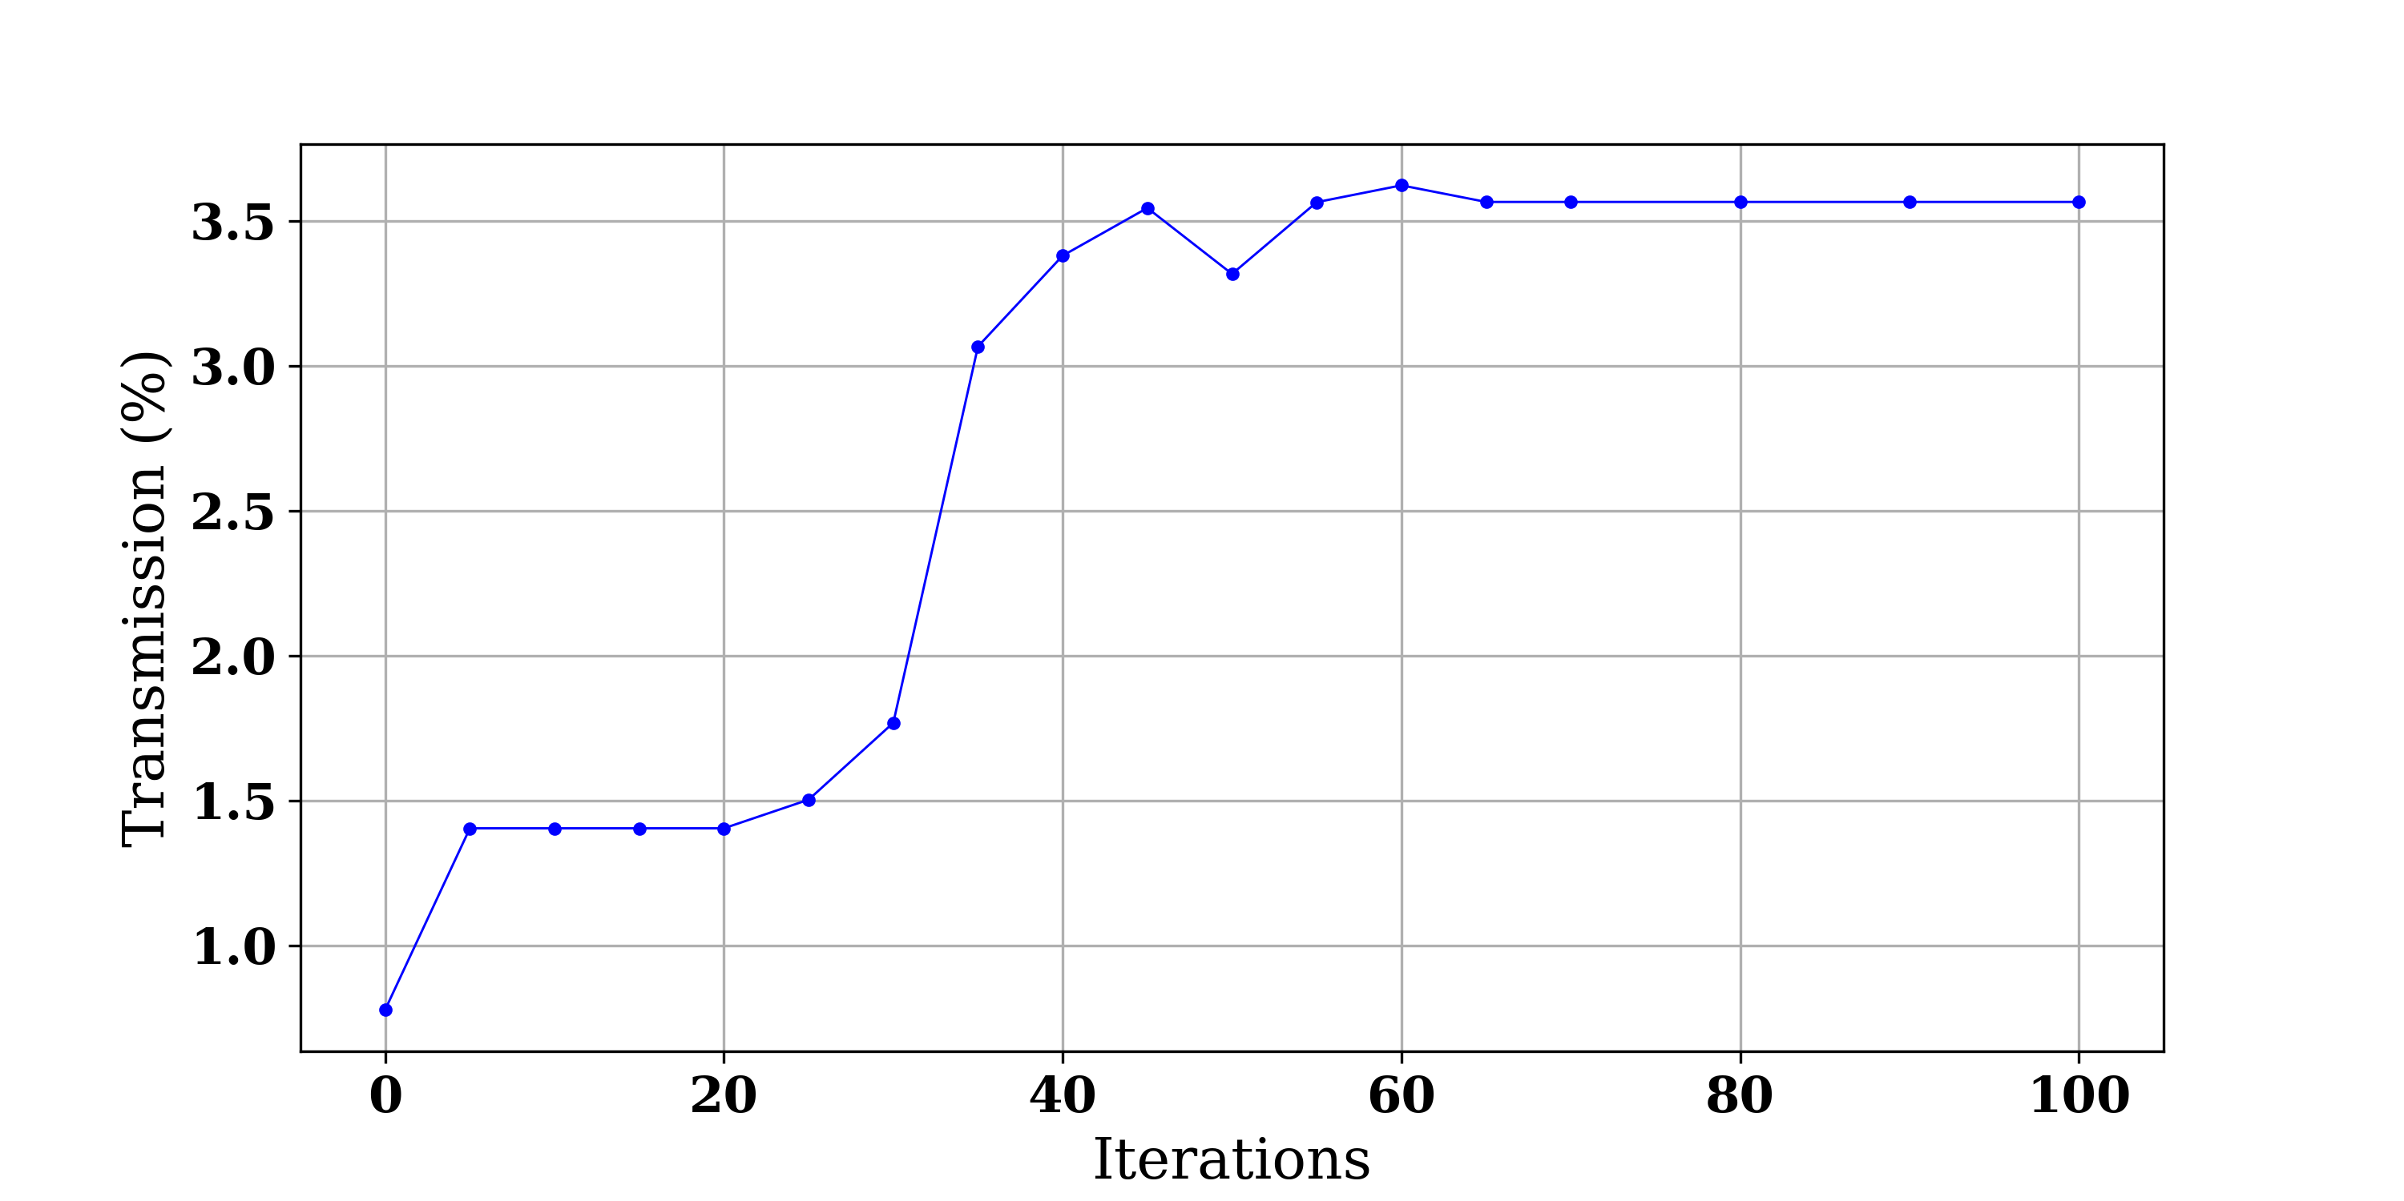
Beamline optimization
We defined the beamline in MANZONI, and used an optimizer to find the quadrupoles normalized gradients values that maximize the number of protons at the exit of the line
The transmission of the line is very low
Only 3.5 % of the beam arrives at the nozzle
Another significant part will be lost during scattering processes
➔ The nozzle must be designed in a way that limits beam losses

Slide 19
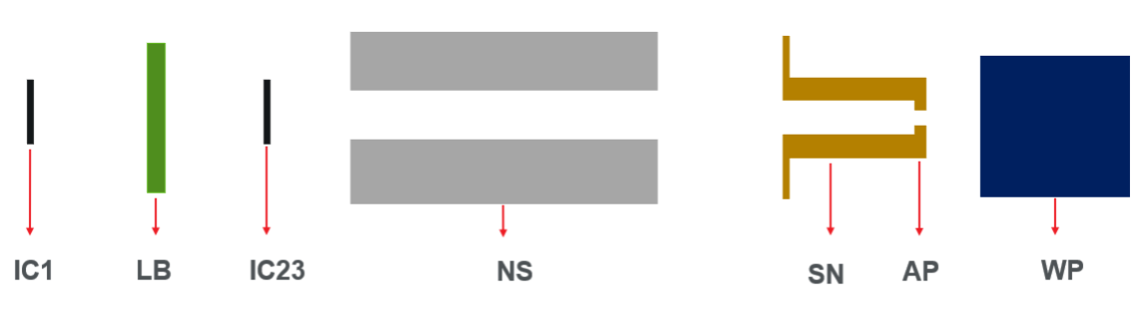
Design of the nozzle
Design 1: Single scattering mode
The beam is spread laterally using a thin tantalum (high Z material) foils
Range shifting and SOBP construction are done with Lexan (low Z material)

Slide 20
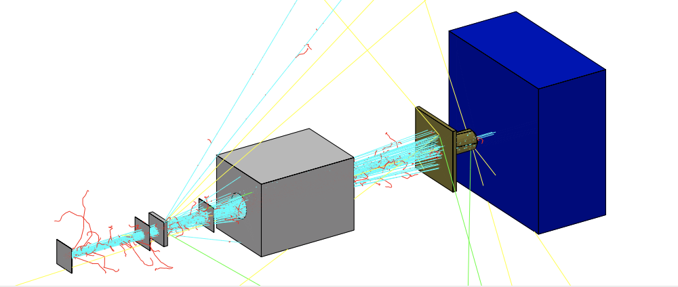
Design of the nozzle
Design 1: Single scattering mode
The beam is spread laterally using a thin tantalum (high Z material) foils
Range shifting and SOBP construction are done with Lexan (low Z material)
The minimal required tantalum thickness to achieve a 98% flatness in the uniform region is 1.2 mm
But the nozzle transmission is only 2% !

Slide 21
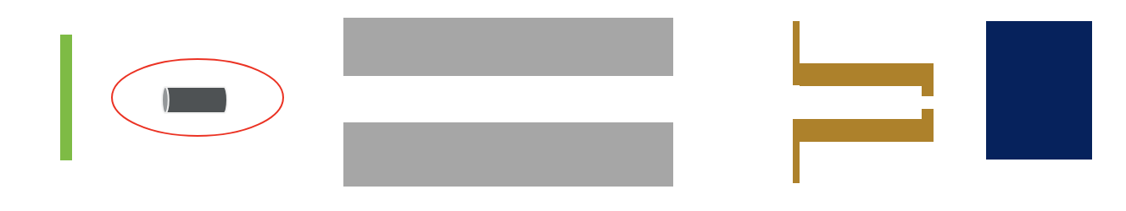
Design of the nozzle
Design 2: First scatterer coupled with a beam stop
A very thin tantalum foil gives an angle to the particles
- The beam stop cuts the central part of this scattered beam
- The propagation leads to a flat profile at isocenter

Slide 22
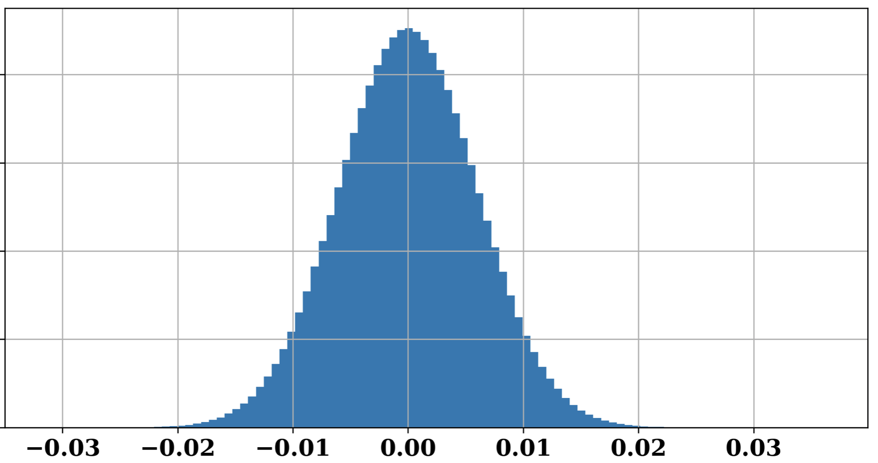
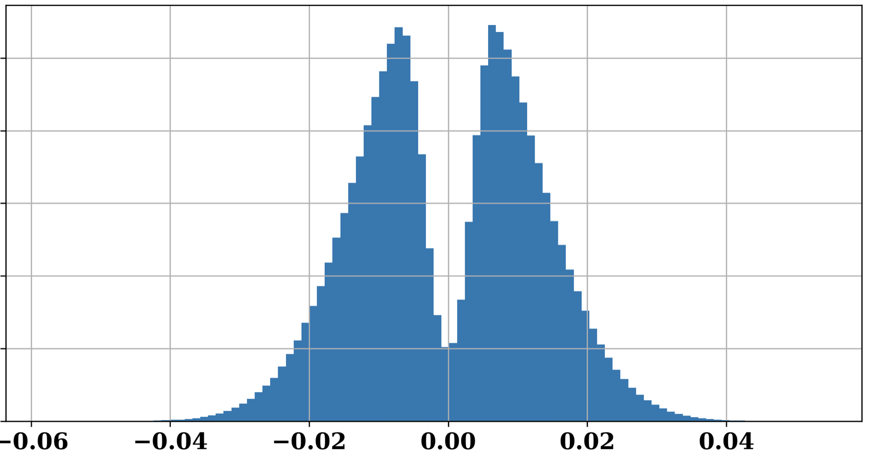
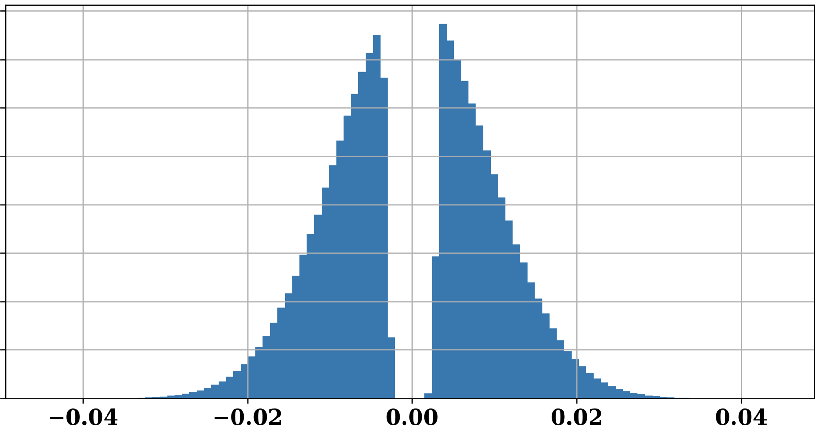
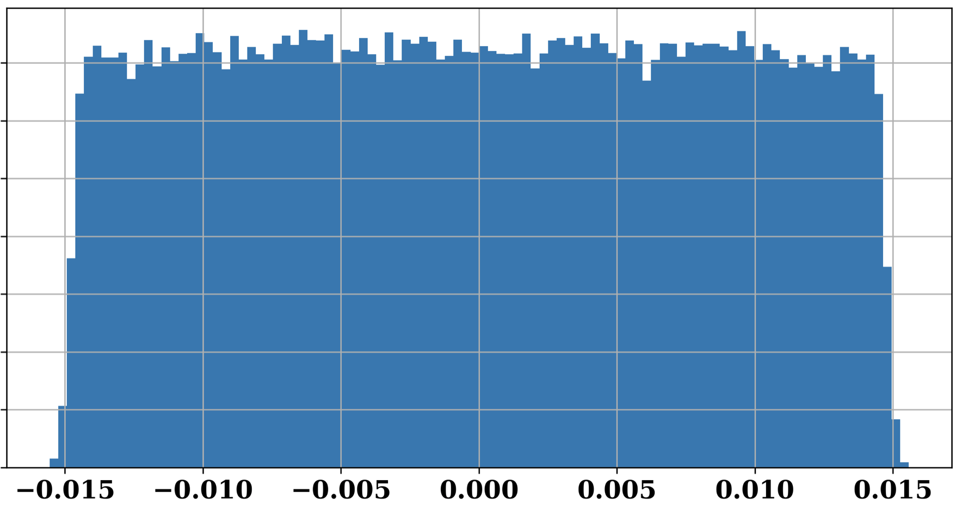
Design of the nozzle
Design 2: First scatterer coupled with a beam stop
A very thin tantalum foil gives an angle to the particles
- The beam stop cuts the central part of this scattered beam
- The propagation leads to a flat profile at isocenter
DESIGN PARAMETERS
The transmission is 8% with this design !
Ta thickness | Distance FS-BS | BS radius
0.18 mm | 40 cm | 3.5 mm

Slide 23
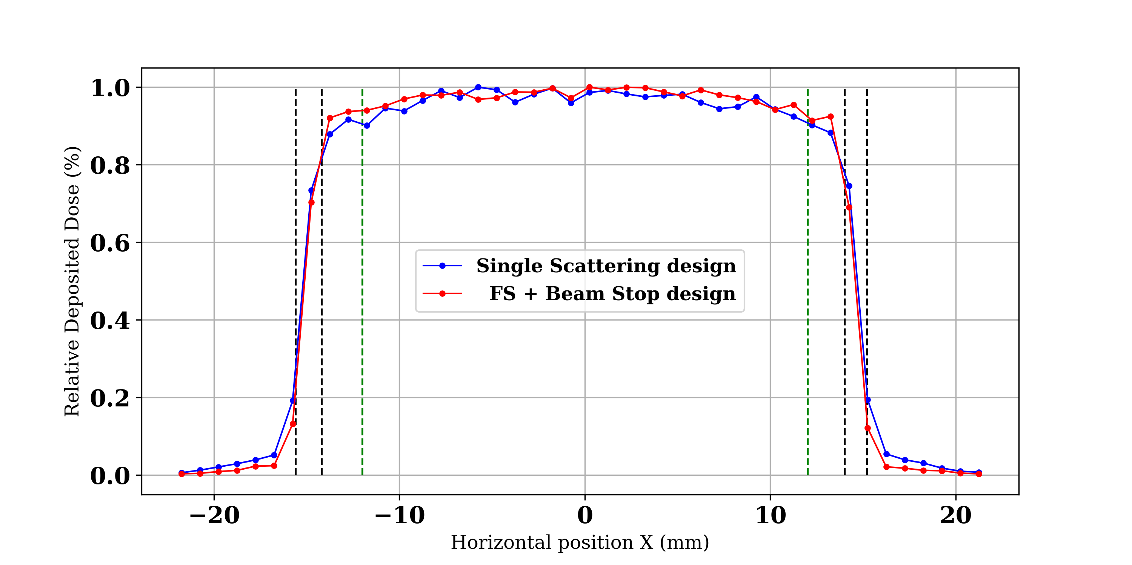
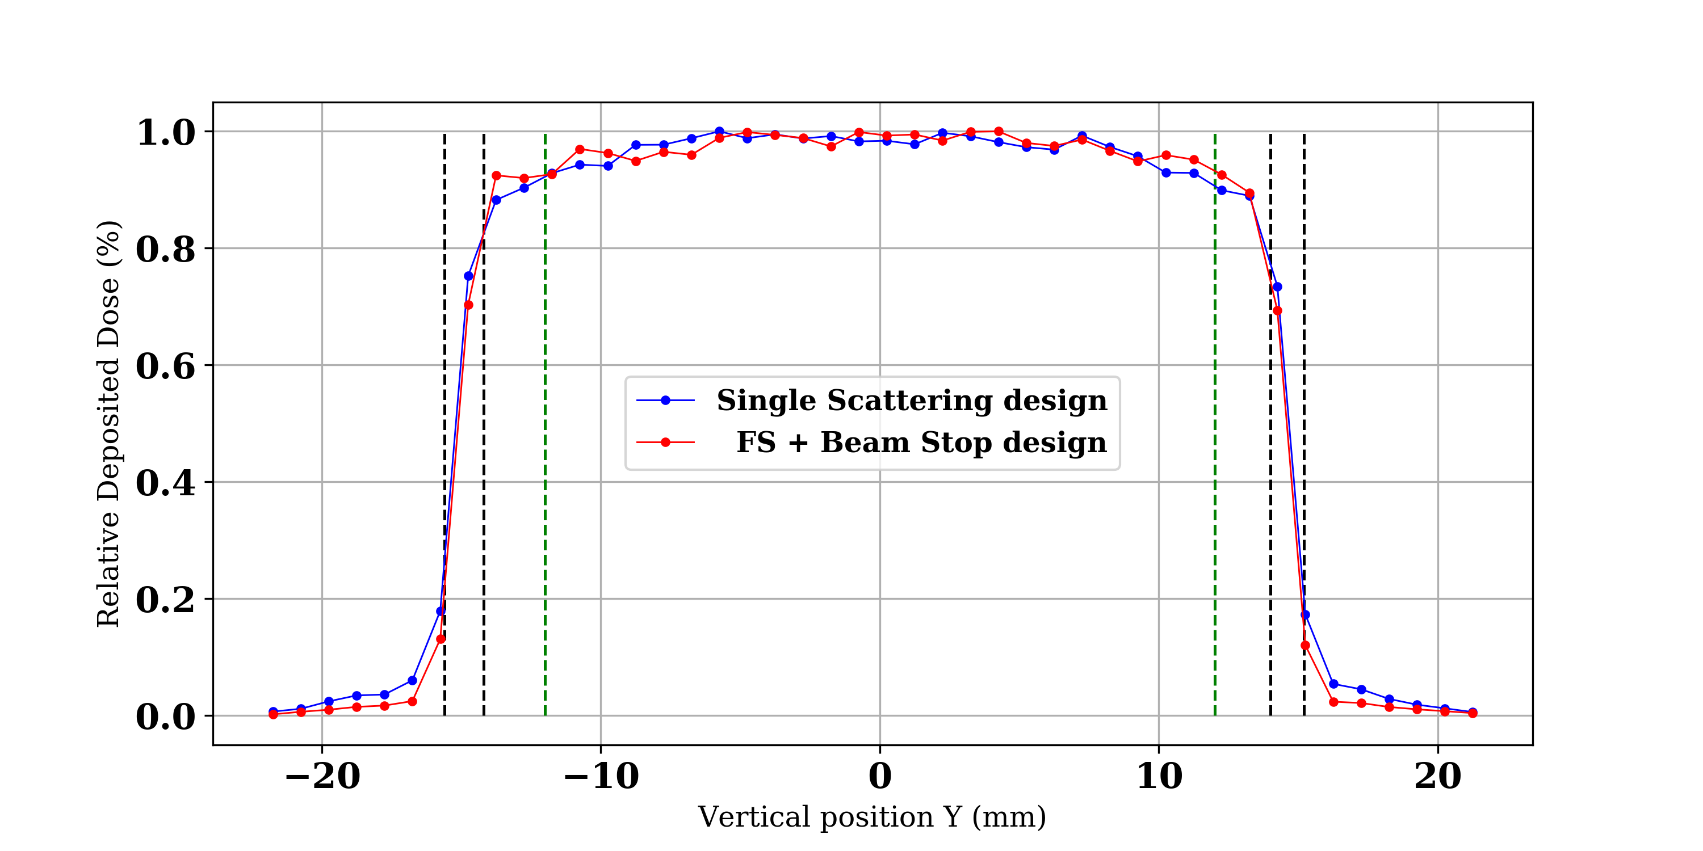
Design of the nozzle
Lateral profiles at skin (dose scorer in-depth thickness = 5 mm)
Horizontal (X) axis Vertical (Y) axis

Slide 24
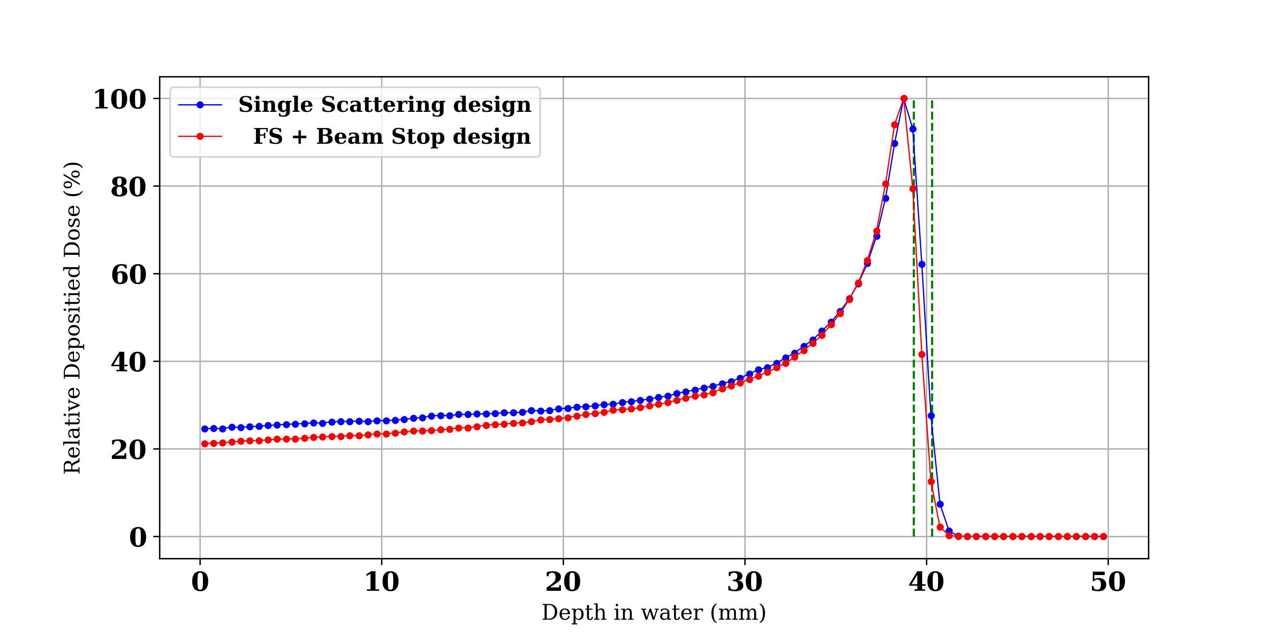
Design of the nozzle
Pristine Bragg Peaks
Lower dose at skin with the beam stop !

Slide 25
Design of the nozzle
Comparison of clinical performances of the two designs
Clinical parameter | Single Scattering design | FS + Beam Stop design
Lateral flatness | 97.5 % | 97.7 &
Lateral Penumbra | 1.2 mm | 1.15 mm
Pristine BP DFO | 1.38 mm | 1.3 mm
Nozzle transmission | 2 % | 8 %

Slide 26
Conclusion and outlooks
Single scattering high energy proton therapy systems offer the possibility to treat eye tumors with a very good lateral penumbra, but at the cost of high distal fall-off and very low dose rate
➔ All the clinical parameters must be optimized at the same time
Incorporating a BEAM STOP in the nozzle allows a significantly higher transmission, while keeping the same clinical performances
NEXT STEPS:
  Compare the simulations to experimental data to validate the design
  Simulations in Pencil Beam Scanning mode and compare the clinical performances to the ones of the actual passive scattering system

Slide 27
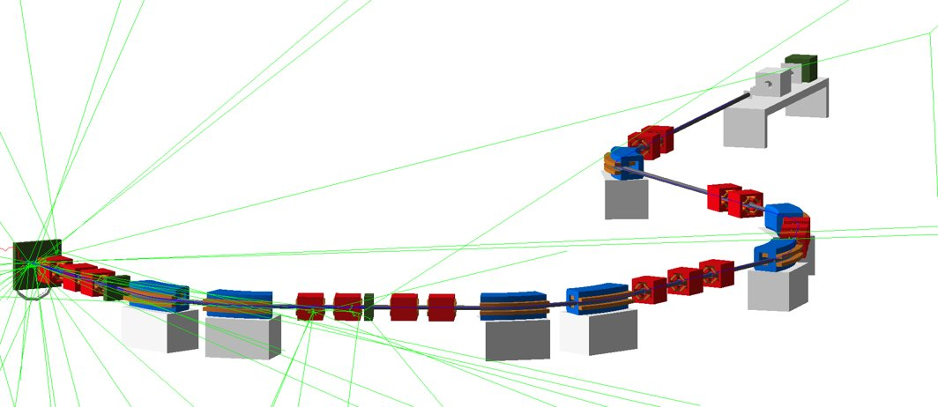
Thank you for your attention ! ☺
ANY QUESTION ?

Slide 28
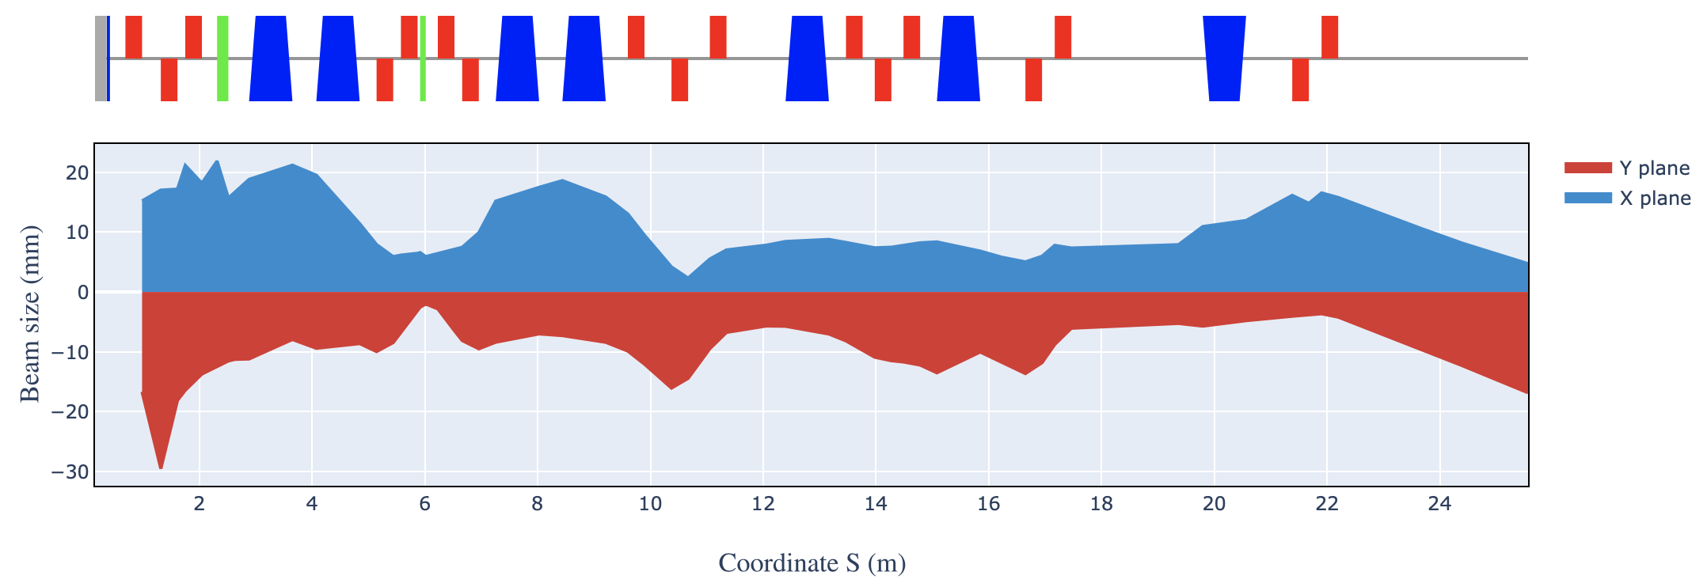
Beamline optimization
We defined the beamline in MANZONI, and used an optimizer to find the quadrupoles normalized gradients values that maximize the number of protons at the exit of the line
The transmission of the line is very low
Only 3.5 % of the beam arrives at the nozzle
Another significant part will be lost during scattering processes
➔ The nozzle must be designed in a way that limits beam losses

Slide 29
Outline
Context & challenges
Materials and methods
Beam distribution after degrader
Beamline transmission optimization
Design of the nozzle
Conclusion and Outlooks

