Slide 1
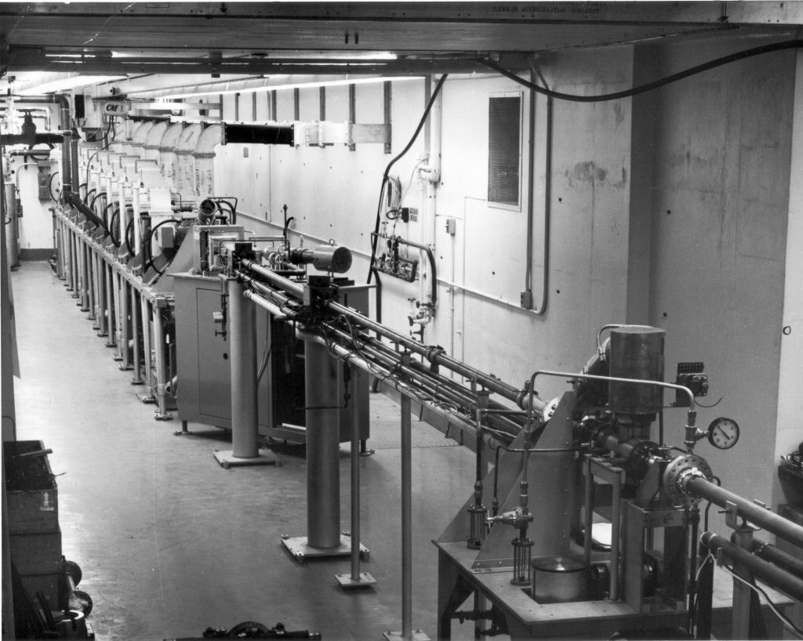





Zirconium Scattering Sensitivity in Neutron Transport Calculations of Multiplying Systems
Gregory Siemers^{1,3}, Y. Danon¹, A. Daskalakis², J. Hutchinson³, N. Thompson³
1. Rensselaer Polytechnic Institute – Troy, NY 12180
2. Naval Nuclear Laboratory – Niskayuna, NY 12309
3. Los Alamos National Laboratory – Los Alamos, NM 87545
LA-UR-23-30977
Notes:
Introduce myself, and the project topic

Slide 2
Presentation Overview
Motivation and Applications of Zirconium
Performance of Evaluated Libraries on Double and Quasi-Differential Experiments
Performance of Evaluated Libraries in Select ICSBEP Benchmarks
Performance of Evaluated Libraries in Preliminary Benchmark Configurations for IER-516: Zirconium Test Assembly (ZTA)
Conclusions and Recommended Experiments to Satisfy Zirconium Scattering Nuclear Data Needs
Notes:
Introduce agenda and topics to discuss throughout the talk

Slide 3
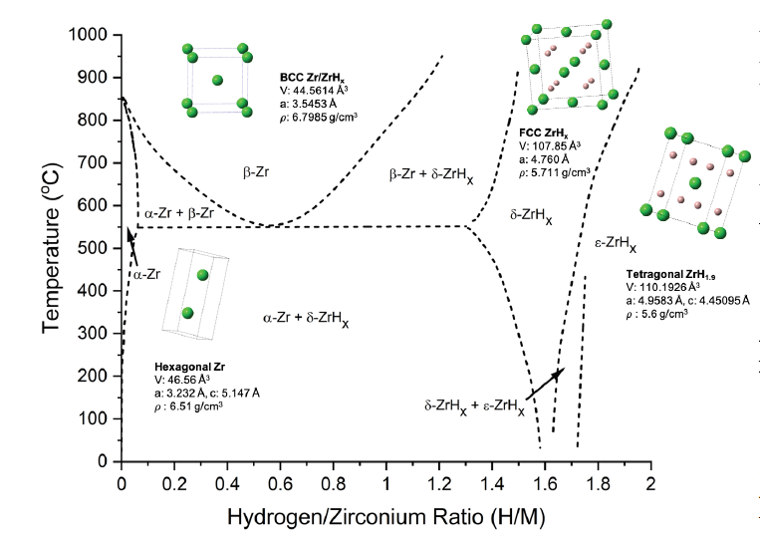
Motivation for Zirconium Investigation
Zirconium metal (in the form of Zircaloys) is used in nearly all commercial light water reactors as fuel rod cladding
  High importance to nuclear criticality safety¹ for numerous organizations
  Used for other structural materials in reactors such as springs, plugs, etc.
Zirconium Hydride (ZrH_{x}) being explored for advanced reactor concepts and is widely used in TRIGA reactors
  ε-phase and δ-phase ZrH_{x} of particular interest for highest ¹H content (1.6 - 2.0 w% ¹H)
[2]
¹Chambers, A. (2023) - Five Year Execution Plan – United States Department of Energy Nuclear Criticality Safety Program FY2024 though FY 2028
²C. Taylor, et. Al (2022) – Properties of Uranium-Zirconium Hydride Moderated Nuclear Fuel Synthesized by Powder Metallurgy. LA-UR-22-29969
Notes:
Quick reminder of the importance of Zr in the systems that are currently functioning around the world (ie all LWRs)
Start introducing discrepancies that exist within the major evaluated nuclear data libraries (ENDF, JEFF, JENDL)

Slide 4
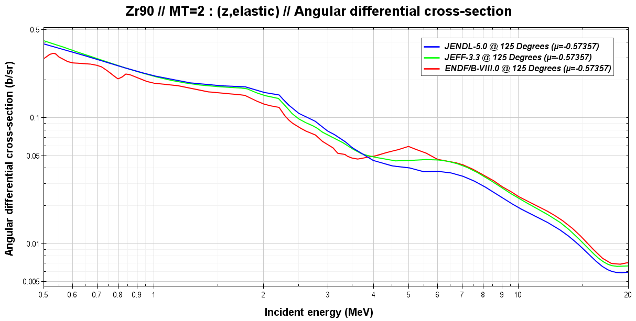
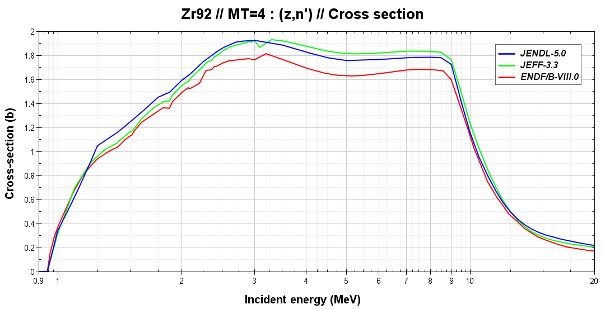

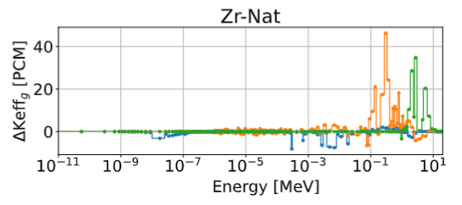
Discrepancies in Zr Evaluated Nuclear Data
Regions of highest importance and largest influence on criticality:
  ⁹⁰Zr double differential elastic scattering cross section 100 keV ≤ E_{n} ≤ 1.5 MeV
  ^{91,92,94}Zr double differential elastic scattering cross section 100 keV ≤ E_{n} ≤ 1.5 MeV
  ^{90,91,92,94}Zr inelastic scattering cross sections 100 keV ≤ E_{n} ≤ 1.5 MeV
Notes:
Demonstrate that differences are present in Zr scattering cross sections and angular distributions in current evaluated nuclear data

Slide 5
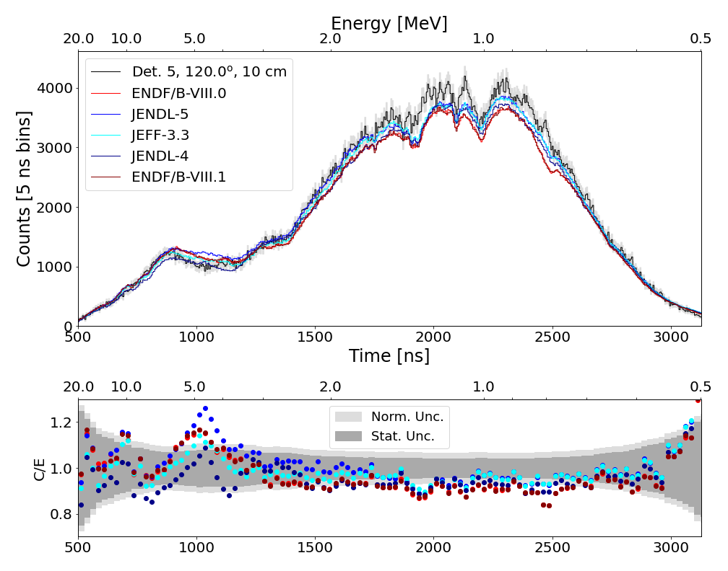
Discrepancies with RPI Scattering Measurements
A high energy quasi-differential scattering measurement on natural Zirconium samples was performed at the RPI LINAC in 2008¹
Discrepancies continue to be observed between evaluations and RPI measurement
  ENDF/B-VIII.0 and ENDF/B-VIII.1 beta 1 are underpredicting scattering at back angles below 2 MeV
  JENDL-5.0 and JEFF-3.3 double differential cross sections show better agreement with experimental data
¹D. P. Barry, G. Leinweber, R. C. Block, T. J. Donovan, Y. Danon, F. J. Saglime, A. M. Daskalakis, M. J. Rapp and R. M. Bahran, “Quasi-Differential Neutron Scattering in Zirconium from 0.5 to 20 MeV”, Nucl. Sci. Eng., vol. 172, no. 2, pp. 188-201, June, 2013
Notes:
Show disagreement between RPI Zr scattering data and endf evaluations at a back angle

Slide 6
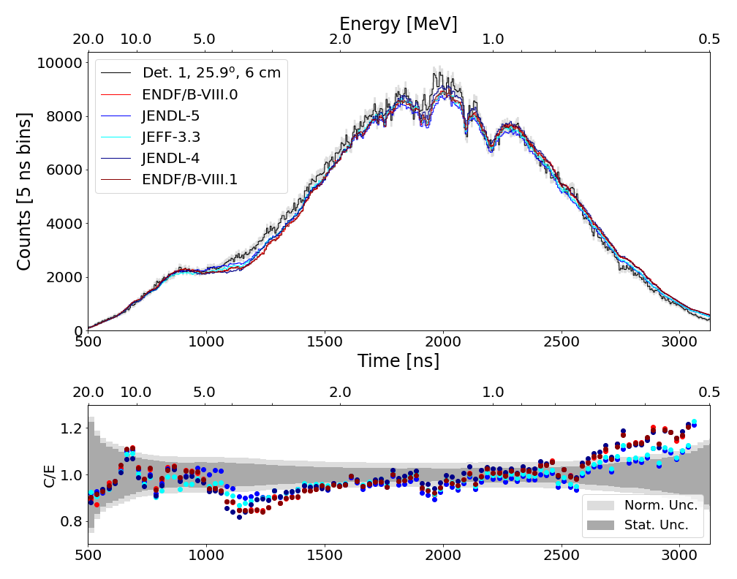
Discrepancies with RPI Scattering Measurements
ENDF/B-VIII.0 demonstrated larger amounts of forward scattering than JENDL-5.0 and JEFF 3.3 below 3 MeV
Experiment highlights difference in front and back-scattering ratio of ENDF/B evaluations
Further exploration into available double differential elastic scattering data needed
Notes:
Show disagreement between RPI Zr scattering data and endf evaluations at a forward angle

Slide 7
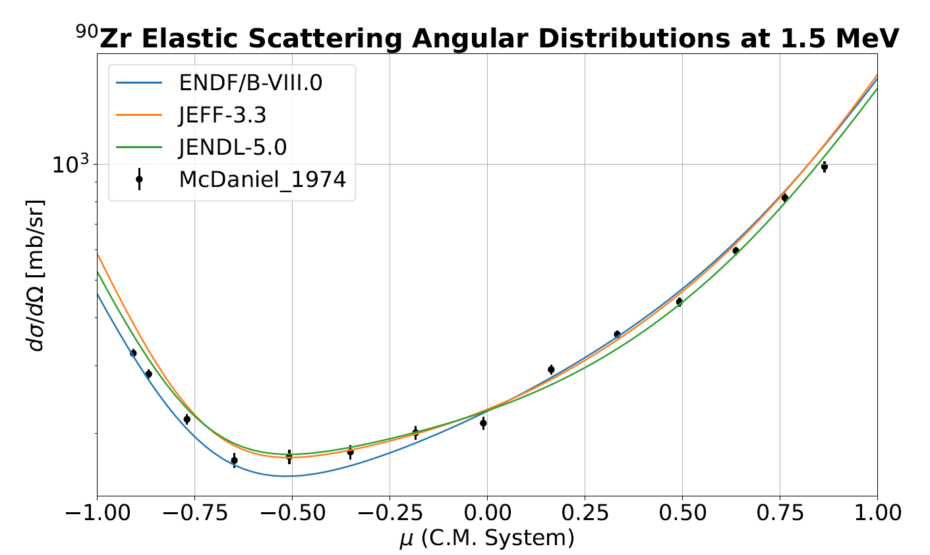
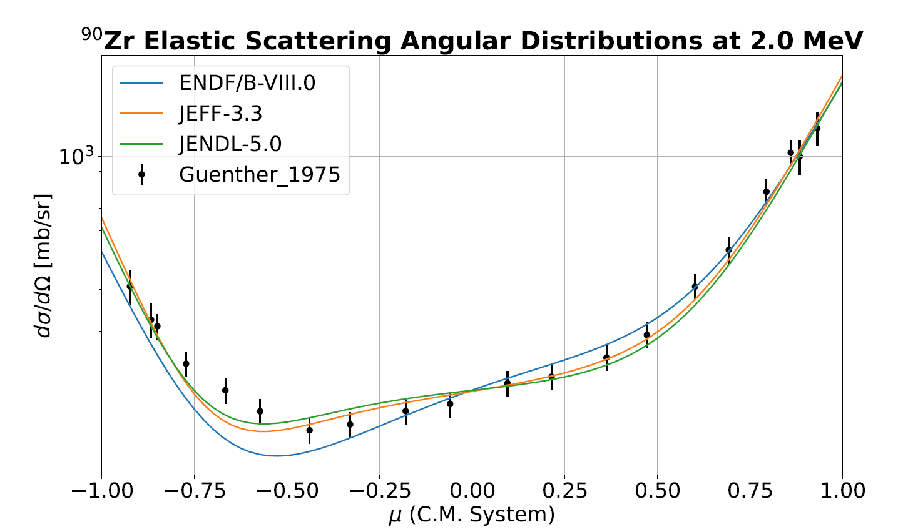
Investigation into Double-Differential Elastic Scattering Measurements of ⁹⁰Zr
⁹⁰Zr is the largest contributor to the natural Zirconium elastic scattering cross section
Mixed agreement between evaluations and 1.5 MeV McDaniel¹ data is observed
JENDL-5.0 and JEFF-3.3 evaluations observed to better represent Guenther² data at 2.0 MeV
¹F. D. McDaniel, J. D. Brandenberger, G. P. Glasgow, and H. G. Leighton Phys. Rev. C 10, 1087 (1974)
²P. Guenther, A. Smith, and J. Whalen Phys. Rev. C 12, 1797 (1975)
Notes:
Show differences in evaluations double differential elastic scattering cross sections for zr90. Highlight the need for data below 1.5 MeV.

Slide 8
Current Zr Nuclear Data Performance on Evaluated Integral Benchmark Experiments
Notes:
Change to ICSBEP results

Slide 9
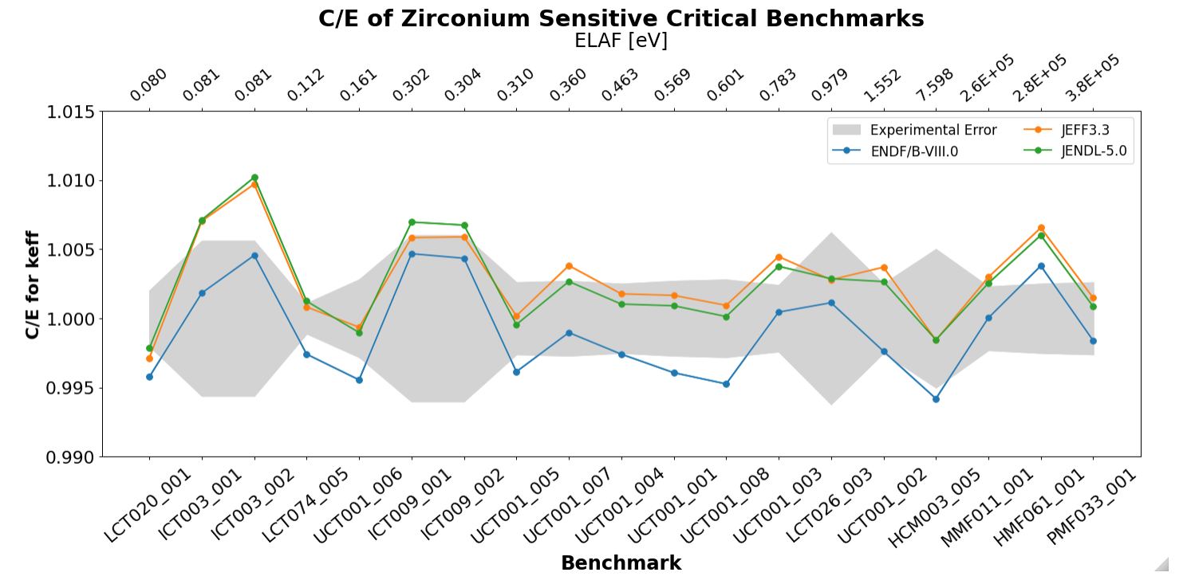
Current Zr ICSBEP Benchmark Experiments
Notes:
From all the benchmarks that exist for Zr these are the most sensitive/important. We see ~200 PCM in most sensitive cladding systems (LCT020, 021), ~600 PCM in most overall sensitive systems (UCT001 and ICT003 series)
The overall trend is that JEFF/JENDL are over predicting keff while ENDF is underpredicting (these are big thermal systems though, so this could be from many, many things that are not Zr) – and nearly all of these differences (that being the absolute differences in C/E from the Zr evaluations) are attributable to high energy (fission spectra) interactions

Slide 10
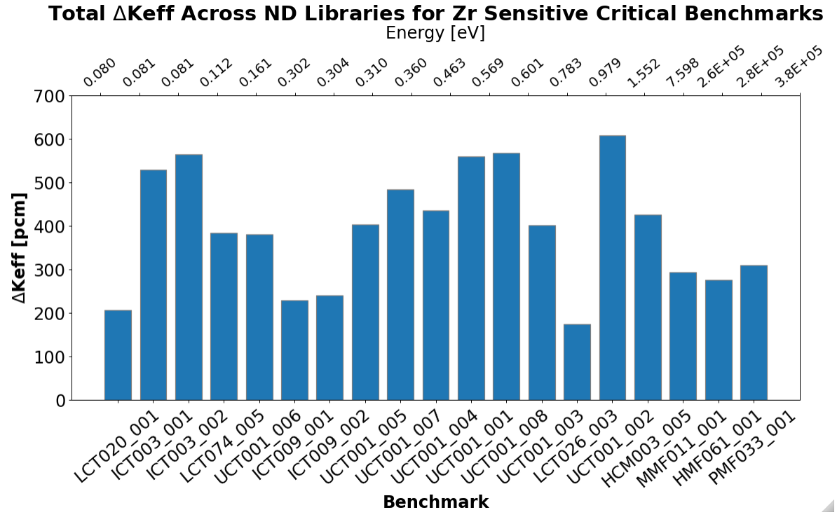
Strategy for Benchmark Sensitivity Analysis
Differences between evaluation in UCT series observed >600 PCM
Question at hand:
  What contributes to the different predicted eigenvalues?
Methodology developed to estimate contributions of cross section differences to system eigenvalue
Manual perturbation study of elastic scattering angular distributions (ESAD) used to estimate contribution of ESADs to eigenvalue
Notes:
Discuss plot on previous slide more with quantified results in delta keff, introduce how we are looking at thermal systems, but they are currently driven by fast neutron interactions (scattering) with zr

Slide 11
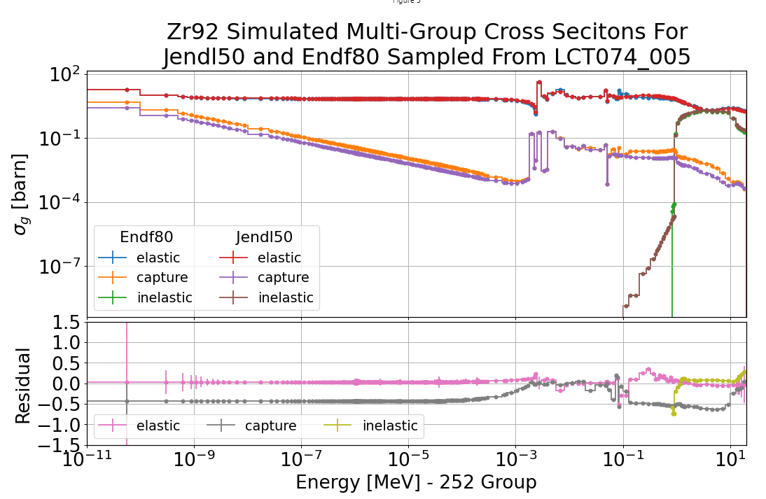
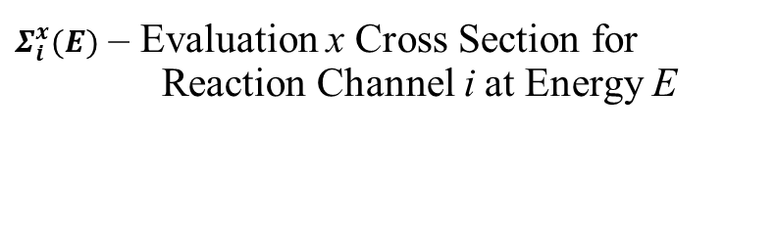
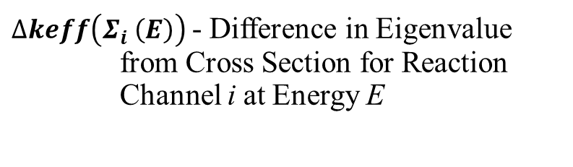
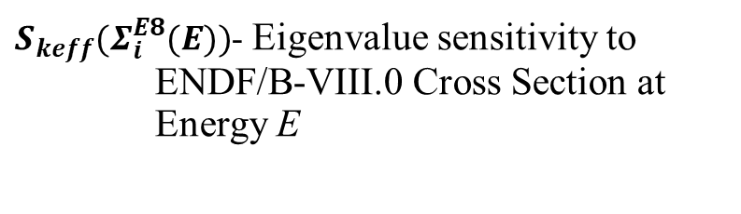
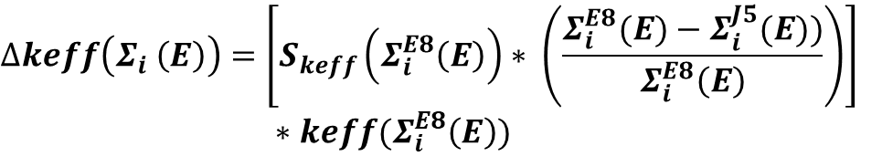
Integral Cross Section Eigenvalue
Sensitivity Methodology
Methodology developed with MCNP KSEN to propagate differences in cross sections between nuclear data evaluations to differences in the eigenvalues of critical benchmark experiments.
$$∆keff\left(Σ_{i} \left(E\right)\right)=\left[S_{keff}\left(Σ_{i}^{E8}\left(E\right)\right)∗ \left(\frac{Σ_{i}^{E8}(E)−Σ_{i}^{J5}(E))}{Σ_{i}^{E8}\left(E\right)}\right)\right]$$
$∗keff(Σ_{i}^{E8}\left(E\right))$
$∆keff\left(Σ_{i} \left(E\right)\right)$- Difference in Eigenvalue from Cross Section for Reaction Channel i at Energy E
$S_{keff}(Σ_{i}^{E8}(E))$- Eigenvalue sensitivity to ENDF/B-VIII.0 Cross Section at Energy E
$Σ_{i}^{x}(E)$ – Evaluation x Cross Section for Reaction Channel i at Energy E
Notes:
Explain methodology developed for extracting delta keff for all reactions at all energies for cross section differences in evaluated nuclear data libraries in benchmark systems
Show differences in cross sections between evaluations – set the stage for how these will translate to differences in the crits

Slide 12
Integral Cross Section Sensitivity Study Results
Results for the following benchmarks and nuclear data libraries are presented using the previously stated methodology:
  UCT001 – Case 2: LWBR SB Core Experiments
    Square lattice of ²³³U Fuel with ThO₂ blanket
  ICT003 – Case 1: TRIGA Mark II Critical Experiments
    ²³⁵U-ZrH_{x} fuel with 0.25in diameter central Zr metal rod and graphite reflector
Fast benchmarks (ZPPR) not shown due to modeling inaccuracy, and lower observable differences in predicted system eigenvalue than thermal systems
Note: y-axis of delta K_{eff} plots on the coming slides are not all on the same scale
Notes:
Description of the benchmark results that will be shown in the two slides following this. Discuss why ZPPR benchmarks will not be included in analysis

Slide 13
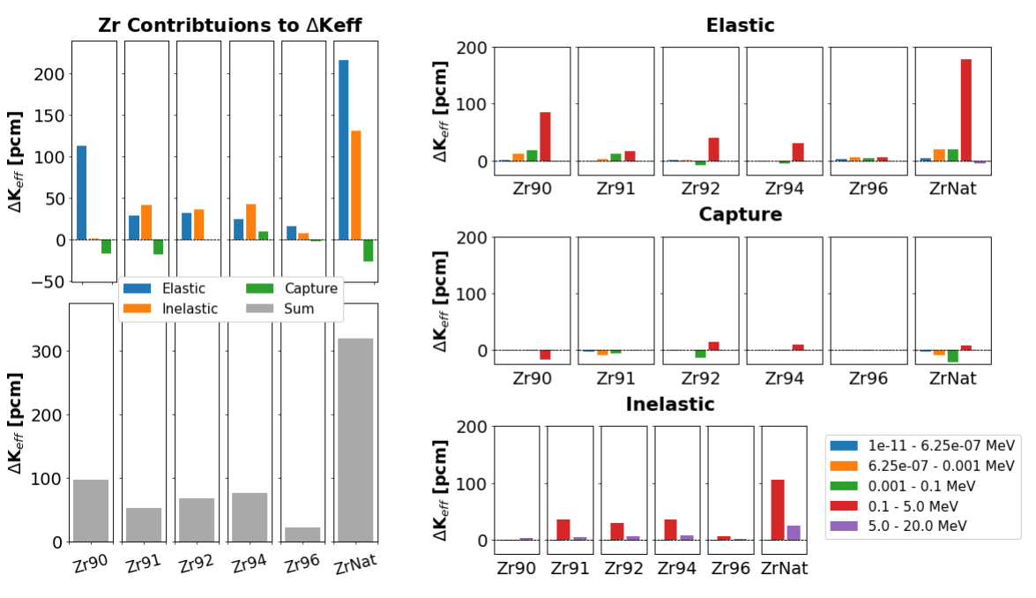
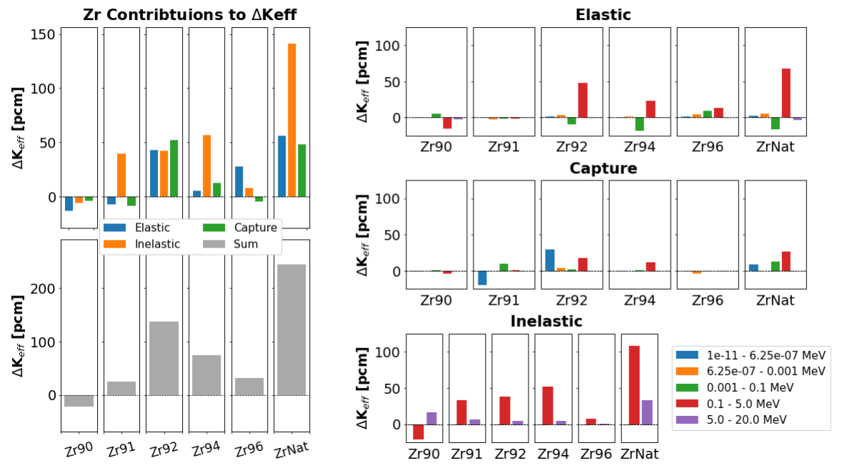
Eigenvalue Differences Observed in UCT001 Case 2
Delta K_{eff} Between Evaluations Primarily Driven by Differences in Zr Elastic and Inelastic Scattering Between 100 keV and 5 MeV
Notes:
We see that when we compare jendl5 to endf8 that there are large differences in 91,92 Zr thermal capture, and elastic/inelastic scattering in fission range
Also highlight how total amount of cross section delta keff is only about half of total discrepancy between evaluations – rest is coming from angular distributions
Highlight how different evaluations can have similar overall delta keff’s, but arrive at their answers in very different ways

Slide 14


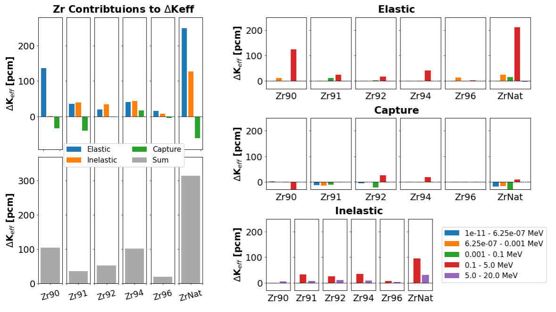
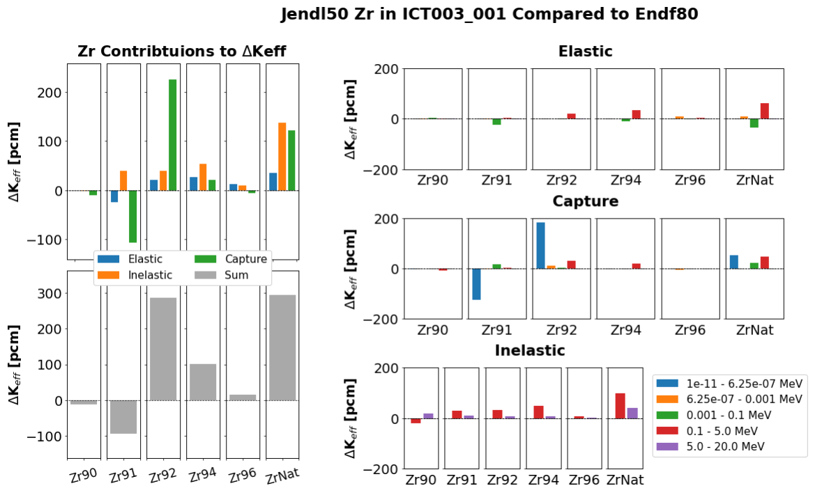
Eigenvalue Differences Observed in ICT003 Case 1
Delta K_{eff} Between Evaluations Primarily Driven by Differences in Zr Elastic and Inelastic Scattering Between 100 keV and 5 MeV
Notes:
We see that when we compare jendl5 to endf8 that there are large differences in 91,92 Zr thermal capture, and elastic/inelastic scattering in fission range
Also highlight how total amount of cross section delta keff is only about half of total discrepancy between evaluations – rest is coming from angular distributions
Highlight how different evaluations can have similar overall delta keff’s, but arrive at their answers in very different ways

Slide 15
Discussion on Integral Cross Section Contributions to Predicted Eigenvalue
Differences in JEFF-3.3 evaluation relative to ENDF/B-VIII.0 shown to be dominated by differences in:
  ⁹⁰Zr elastic scattering cross section (100 keV – 5 MeV)
  ^{91,92,94}Zr inelastic scattering cross section (100 keV – 5 MeV)
Differences in JENDL-5.0 evaluation relative to ENDF/B-VIII.0 shown to be dominated by differences in:
  ^{90,92,94}Zr elastic scattering cross section (100 keV – 5 MeV)
  ^{90,91,92,94}Zr inelastic scattering cross section (100 keV – 5 MeV)
Pre-evaluation tool developed also discovered potential compensating error in JENDL-5.0 evaluation regarding ^{91,92}Zr thermal capture cross section
Notes:
Discuss results from previous two slides. Highlight reaction channels contributing to differences in calculated values of system keff

Slide 16
Elastic Scattering Angular Distributions Contributions to System Eigenvalue
Notes:
Change topic to elastic scattering angular distributions

Slide 17
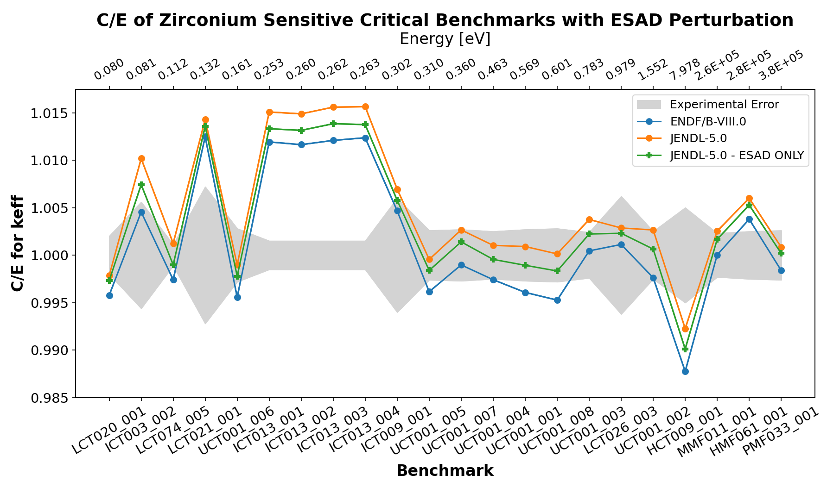
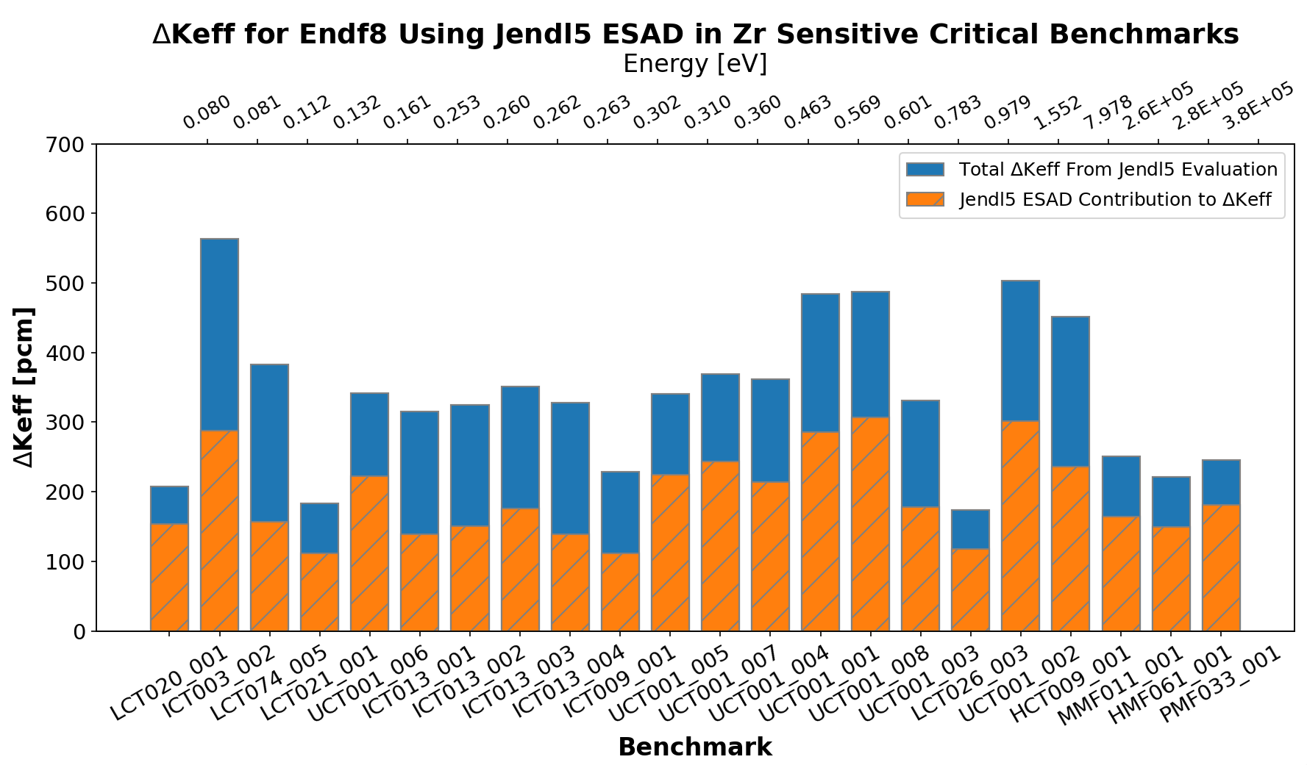
Elastic Scattering Angular Distribution Contribution to Eigenvalue Difference
*Energy in top x-axis corresponds to the energy corresponding to the average lethargy of a neutron causing fission*
Notes:
Showing a manual perturbation of ESAD. Swapping JENDL5 eval into ENDF8 ACE file (this is only AD, cross section MF3 unchanged).
Highlight how about 50% of delta keff is ESAD, and when we have reflection (even in thermal systems, these are cladded systems LCT020,21) we see ~75% delta keff from ESAD – super important and there is very little differential/quasi-differential data!!

Slide 18
Discussion on Elastic Scattering AD Results
Approximately 50% of predicted difference in system eigenvalue is attributable to the differences in elastic scattering angular distributions between JENDL-5.0 and ENDF/B-VIII.0 evaluations
Cladding cases (LCT020, LCT021, and LCT026) have increased sensitivity to ESAD – making up approximately 75% of difference in predicted system eigenvalues
Additional experiments (ICT013 suite, and HCT009) shown to further demonstrate impact of ESAD on differences in predicted system eigenvalue
Notes:
Highlight how about 50% of delta keff is ESAD, and when we have reflection (even in thermal systems, these are cladded systems LCT020,21) we see ~75% delta keff from ESAD – super important and there is very little differential/quasi-differential data!!

Slide 19
Current Zr Performance on IER-516 Preliminary Benchmark Configurations
Notes:
Change to discussing IER:516 – future critical experiments with Zr

Slide 20
Overview of IER-516: Zirconium Test Assembly
IER: 516 is an experimental campaign funded through NCSP to create a suite of critical and subcritical benchmark experiments for nuclear data validation of Zirconium Metal and Zirconium Hydride in all energy regions.
Preliminary design of critical configurations for IER-516 is underway for CED-1
At this time, the following cases have been explored:
  Varying sizes of Rocky Flat hemi-shell (spherical) HEU Core with varying spherical Zirconium reflector thicknesses
  Thor Core (Pu-alloy oblate-spheroid) with spherical Zirconium reflector
  Enormous discrepancies between nuclear data libraries observed during design
More cases involving different fuel sources and energy spectra will be the scope of work for this coming year
Notes:
Explain what 516 is, and discuss the progress that has been made at this time with HEU and Pu fast system design work

Slide 21
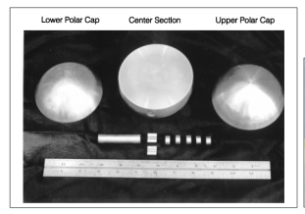
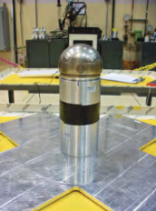
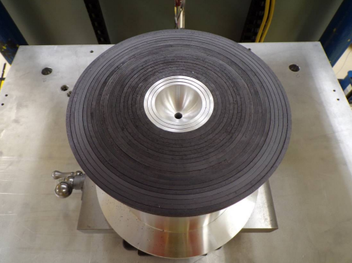
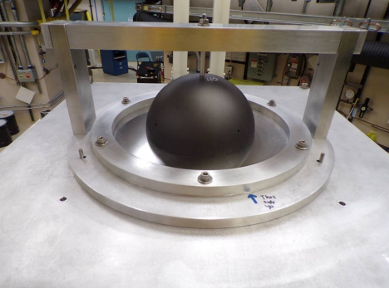
Visualization of Prospective Configurations
Rocky Flat Shells
Thor Core
Nesting hemi-shells of Uranium metal enriched to 93.16% ²³⁵U
Historically used at Rocky Flats Facility, now part of NCERC inventory
Used on vertical lift assemblies at NCERC, most recently for IER-488: MUSiC¹
Three-piece (total mass w/ plug ~9.8 kg) δ-phase Pu-alloy (93.5% ²³⁹Pu)
  Wide range of usable Pu masses is extremely useful for RTO measurements²
  Can also be used in critical measurements
[3]
[2]
¹Weldon, R. A., et al. IER-488: MUSiC Accomplishments and Goals. LA-UR-22-21185 (2022)
²Hutchinson, J, et al. A New Era of Nuclear Criticality Experiments: The First 10 Years of Radiation Test Object Operations at NCERC, NUCLEAR SCIENCE AND ENGINEERING · VOLUME 195 · S80–S98 · SUPPLEMENT 1 · 2021
³Thompson, N, et al. National Criticality Experiments Research Center (NCERC) Recent Measurements and Capabilities. LA-UR-19-25526 (2019)
[1]
[1]
Notes:
Slide on fuel and critical assembly capabilities at NCERC to provide visualization of IER 516 experimental planning

Slide 22
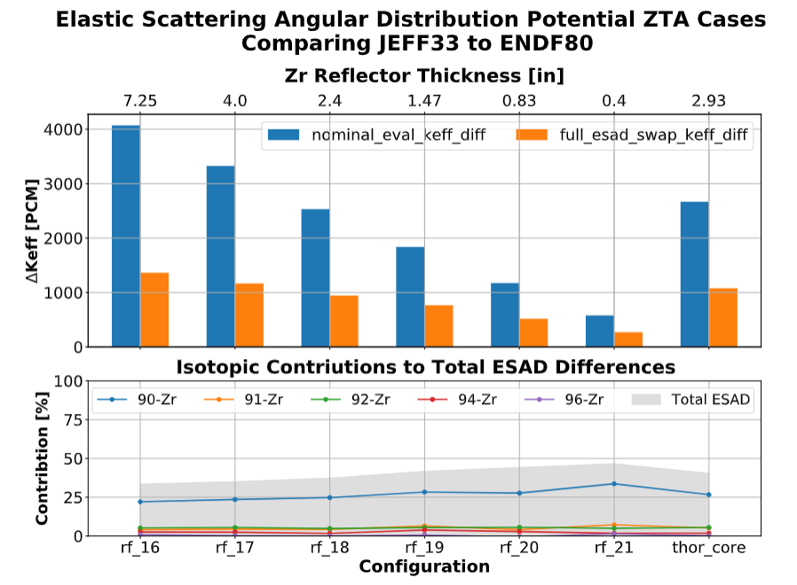
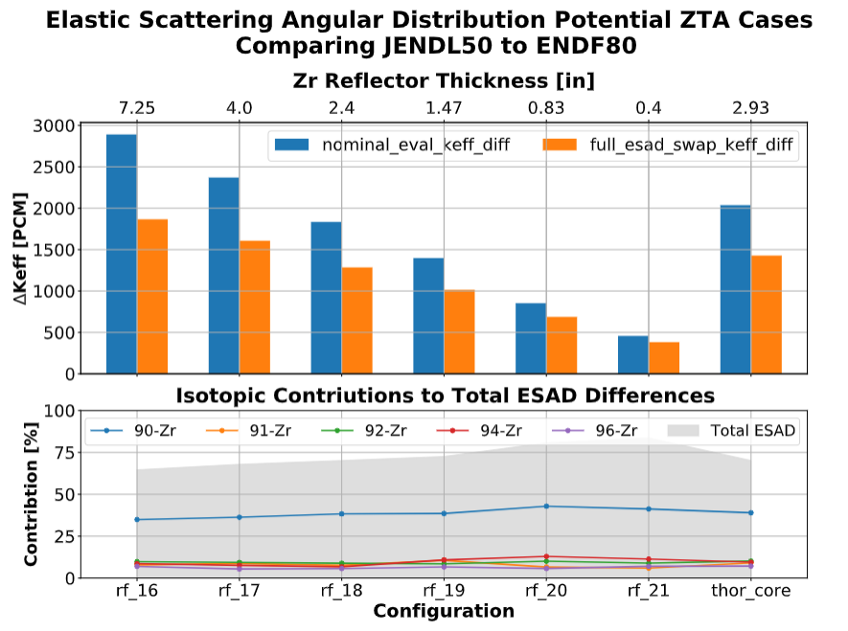
Elastic Scattering Angular Distribution Sensitivity
Notes:
Show some findings regarding the sensitivity to Zr in these newly designed systems, and the sensitivity to elastic scattering angular distributions alone (as a relative difference between JEFF/JENDL to ENDF8.

Slide 23
Discussion on Preliminary IER-516 Findings
Experimental configurations highly sensitive to elastic and inelastic double differential scattering cross sections are being developed
  These configurations increase the sensitivity to angular distributions by over 5x compared to current ICSBEP benchmarks
Sensitivity of eigenvalue from ⁹⁰Zr scattering dominates other isotopes contributions
Predictions of thick reflected HEU and Pu systems between JEFF-3.3, JENDL-5.0, and ENDF/B-VIII.0 observed to vary by over 4000 PCM in certain cases
  Observations further suggest:
    Largest differences are present between integral elastic and inelastic scattering cross sections of JEFF-3.3 evaluations compared to ENDF/B-VIII.0
    Large differences are present between elastic scattering angular distributions of JENDL-5.0 evaluations compared to ENDF/B-VIII.0, contributing to over 80% of eigenvalue difference
Notes:
Discuss the plots in the previous slide. JEFF >4000 PCM off compared to endf, ESAD makes up almost all of differences in calculations between jendl5 and endf8. New systems designed are seeing >5x scattering sensitivity compared to current icsbep systems.

Slide 24
Conclusions and Recommendations
Large discrepancies observed between current evaluated Zirconium isotope data and experimental scattering data
Differences in eigenvalue prediction of ICSBEP benchmarks between JEFF-3.3, JENDL-5.0, and ENDF/B-VIII.0 can reach 600 PCM
  Over 300 PCM demonstrated to be attributable to elastic scattering angular distributions and 200 PCM from integral elastic scattering cross section of ⁹⁰Zr (100 keV to 5 MeV)
Highly sensitive benchmark cases of IER-516: ZTA are being developed to validate Zirconium nuclear data
  Differences observed in current evaluations double differential elastic scattering cross sections exacerbated and experiments will provide validation
Measurements of ⁹⁰Zr double differential elastic scattering cross section – E_{n} < 1.5 MeV are needed to constrain future evaluations
Notes:
Conclude the talk with issues identified in Zr and lacks in current nuclear data. Validation program (ier 516) is underway but more differential and double differential nuclear data will be needed to resolve the differences in Zr stable isotope nuclear data evaluations

Slide 25
Acknowledgements
This work has been supported in part by:
U.S. Nuclear Regulatory Commission (NRC-HQ-60-17-G-0006)
Nuclear Criticality Safety Program, funded and managed by the National Nuclear Security Administration for the U.S. Department of Energy
Los Alamos National Laboratory
Naval Nuclear Laboratory
Notes:
Acknowledge collaborators on this project

