Slide 1


Using OpenMC to Model Time-of-Flight Quasi-Differential Scattering Experiments
Hunter Belanger¹, Adam Daskalakis², Greg Siemers¹, Michael Rapp², Devin Barry², and Yaron Danon¹
¹Rensselaer Polytechnic Institute, Gaerttner LINAC Center, Troy, NY 12180
²Naval Nuclear Laboratory, P.O. Box 1072, Schenectady, NY 12301-1072
Workshop on Elastic and Inelastic Neutron Scattering (WINS-2023)
October 10th-12th 2023, Troy, NY
Notes:
I am Hunter Belanger, a new assistant professor here at RPI in the nuclear engineering department.
My specialty is on the development of Monte Carlo methods for particle transport, and I have become very interested in using my expertise to help improve some of the modeling here at the LINAC.

Slide 2
Contents
RPI High Energy Scattering System and Simulation Needs
Difficulties with MCNP
Modeling High Energy Scattering with OpenMC
Graphite Sample Results
Iron Sample Results
Conclusions
1
Notes:
I will first describe our high energy scattering system, and our general simulation needs here at the RPI LINAC
Then I will talk about some of the general difficulties with using MCNP in an academic setting, and then about the possibility of modeling the HES with OpenMC
Results from both a graphite and iron simulation will be presented, using both OpenMC and MCNP (along with experimental data from previous experiments here).
Finally, I will provide some concluding remarks.

Slide 3
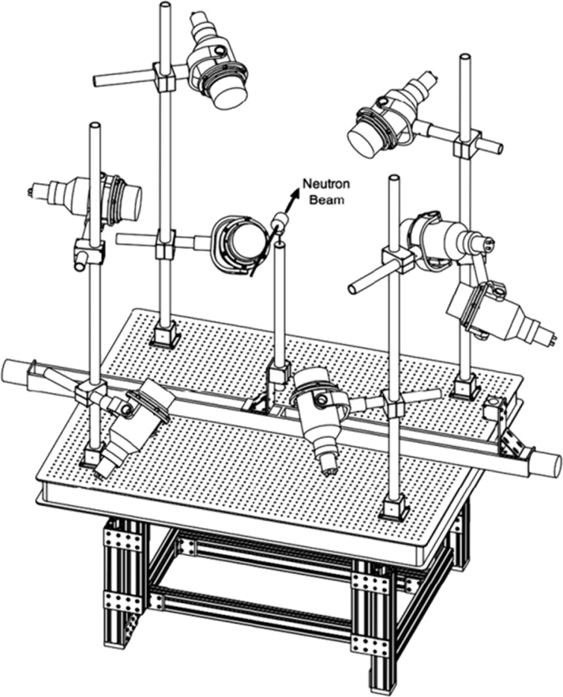
High Energy Scattering (HES) System
RPI LINAC has a HES system for quasi-differential scattering measurements
Uses the Time-of-Flight (ToF) method for determining neutron energies
Useful energy interval of 0.5 MeV to 20 MeV
2
Notes:
The HES system is used for quasi-differential scattering measurements, which is useful for evaluation validation. Not generally useful for trying to fit scattering distributions.
ToF method is used for determining neutron energies. The distance from the target to the sample, and sample to detectors is known. When combined with the time of the pulse and the time of the detector signal, the energy of neutrons can be determined.
The RPI system is useful for examining the 0.5 to 20 MeV energy interval for incident neutrons.
It consists of an array of 8 EJ301 liquid scintillators, which can be positioned at different angles with respect to the sample and the incident neutron beam.
This is an image of the HES system, looking down the neutron beam path towards a sample, which is being supported by a soft-drink can.

Slide 4
Monte Carlo Simulations of HES System
Monte Carlo simulations are used for both evaluation validation and experiment design
At the RPI LINAC, MCNP6 is generally used for these simulations
All researchers and students know how to use MCNP
F5 point detectors allow for reasonable statistics in a short period of time
3
Notes:
Monte Carlo simulations are used at both ends of the evaluation pipeline. Simulations can be run with different libraries (i.e. ENDF, JEFF, JENDL), and differences can be identified. These differences at different incident energies and scattering angles are used to determine the design of the experiment. For example, what scattering angles should be examined during an experiment ? Once the experiment has been performed, simulations are used to see which evaluation yields the best agreement with the experimental data (if any).
MCNP6 is generally used for these simulations at the LINAC. The students learn how to uses it in their courses, and the researchers here all (except for me) know how to use it.
Even with modern computers, simulations of the HES can be time consuming. MCNP has point detectors which are usually used for this simulation, and greatly reduces the required simulation time. The cylindrical scintillator is approximated as a single point, and the response at that point is calculated. This was particularly useful before the group had a computational cluster.

Slide 5
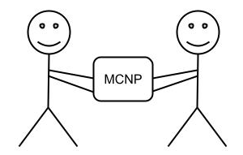
Difficulties with MCNP
Only US citizens can get it
Export control rules make cluster management tedious
Modifications can’t be shared
4
Notes:
While we have traditionally used MCNP, it has several short-comings, particularly in an academic setting.
For the most part, only US citizens can get a license for the code. This means that if a non-US citizen joins the research group, they can’t run any simulations. This is of course very harmful to student education !
Even for those with a license, the different versions (6.1, 6.2, 6.3) and the possible license modifications for source code access means that many different user groups and permissions need to be managed on a cluster. Additionally, the cluster manager must have a license for all possible combinations. It therefore quickly becomes a nightmare when regulating user access on a small cluster, even for a small group like ours.
Sometimes, we need to make modification to the source code to MCNP, in order to properly model certain systems. There are many examples of this in the literature (like MCNP-POLIMI). It is therefore impossible to distribute our changes for others to use. Our simulations, and therefore a portion of our experimental process cannot be reproduced. This is simply bad science.

Slide 6

Continuous energy Monte Carlo simulations for neutrons and photons
General 3D geometries
Tallies include flux, reaction rates, currents, heating, and pulse-height
Can share modifications to source code (or even contribute !)
Anyone is allowed access
But no point-detectors… yet
5
Notes:
This is where OpenMC comes in. It is a general 3D, continuous energy Monte Carlo code for performing neutron and photon particle transport simulations.
Development of OpenMC begin at MIT in early 2011. Since then, it has become a community project, where anyone may contribute (even you !). While originally written in Fortran, it was re-written in C++ in 2019.
Since it is open source, there are no export control restrictions. Non US citizens are therefore free to have the source, and download/use the code. This poses a HUGE advantage in an academic setting.
More importantly, we can modify it as we need, and then redistribute the modified version. This is better for the scientific method !
One fault with OpenMC, however, is that it doesn’t have point detectors, which I mentioned are heavily used when modeling most of our systems at the RPI LINAC, particularly the HES system. This could pose difficulties with generating enough statistics within a reasonable amount of time.
An important feature that was recently added (only a few months ago) was pulse-height tallies ! This is certainly a must for the LINAC, and makes adopting OpenMC more feasible.

Slide 7
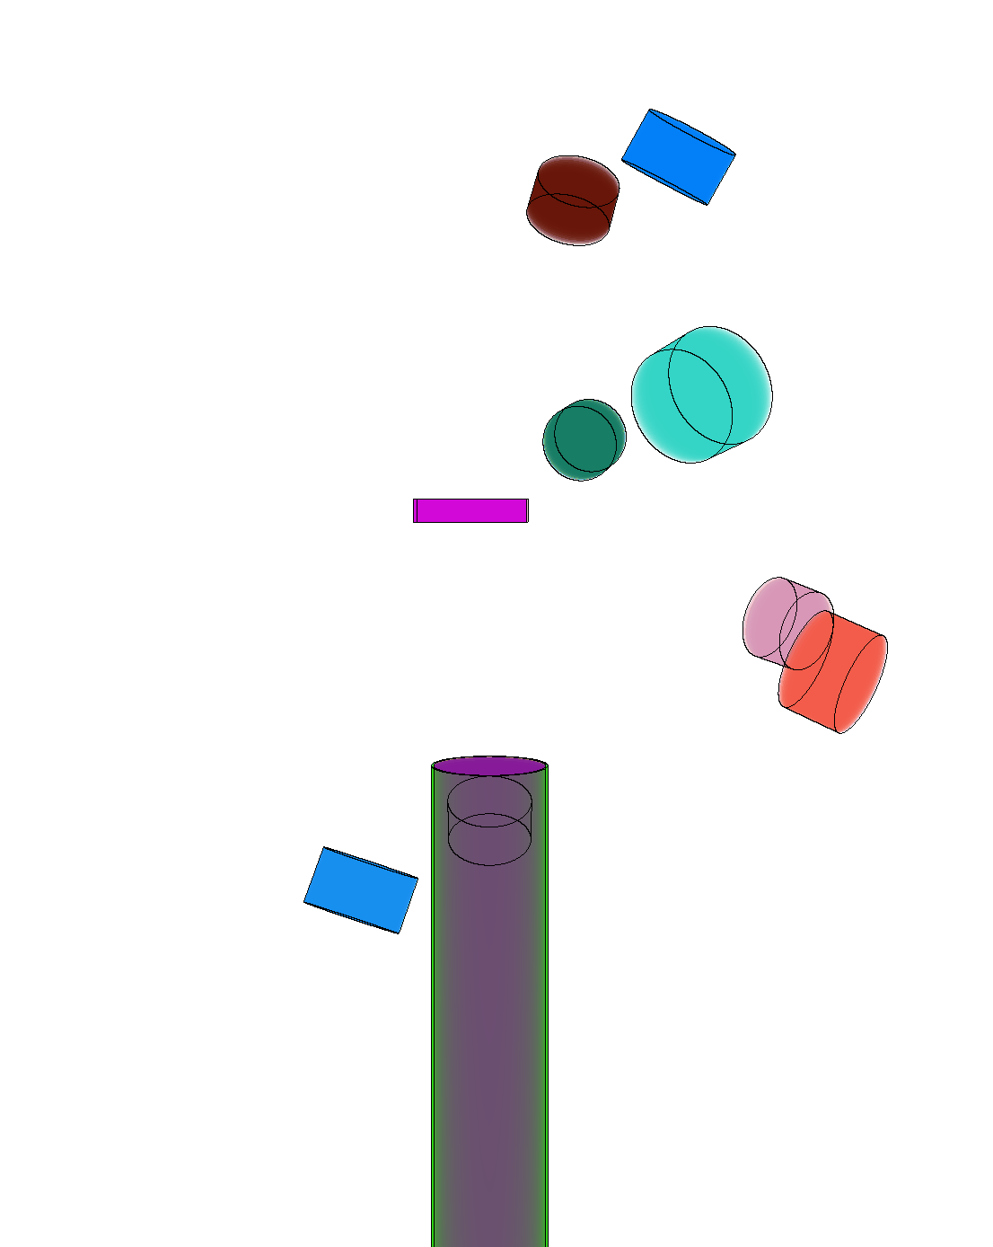
Modeling HES System with OpenMC
Due to the possible advantages of using OpenMC over MCNP, we wanted to test the performance and agreement of the two codes on the HES system here at the RPI LINAC.
Neutrons scattering with graphite and iron
Gamma production from neutron
interactions with iron
Used surface current tallies
ENDF/B-VIII.0 Library
6
Notes:
As OpenMC could pose many advantages to our group, we wanted to compare the use of OpenMC and MCNP for modeling our HES system.
We looked at modeling two different samples: one graphite sample, and one iron sample. For the graphite, we only are looking at the neutron signal in the detectors. For iron, we have looked at both the neutron signal and the gamma signal.
The model of the experimental setup has an array of 8 EJ301 scintillators. You can see the geometric setup on the slide (generated with OpenMC). The longer purple cylinder is the vacuum tube placed in front of the beam path and just before the sample.
Since OpenMC doesn’t have point detectors, we have instead used surface current tallies. We therefore model the entire cylinder of the scintillator of the detector, and tally when particles fly through the forward face of the cylinder. The other sides are ignored. We do not model the cascade in the scintillator, we just have an efficiency tabulated as a function of energy for the current tally. Particles which enter the cylinder are then killed.
We performed these simulations with the ENDF/B-VIII.0 library.

Slide 8
Neutrons Scattering with Graphite
7
Notes:
We will first look at the graphite simulations.

Slide 9
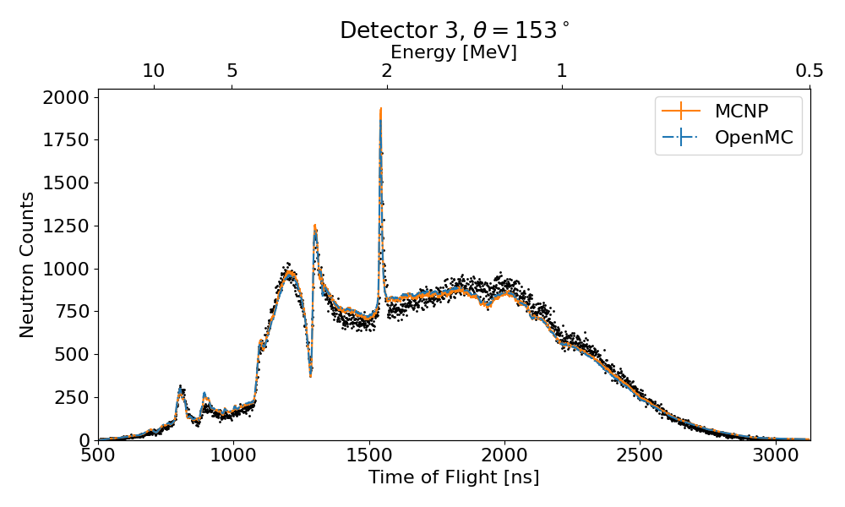
Graphite
8
Notes:
This is a back scattering detector response. We notice that the OpenMC and MCNP have excellent agreement.
In general, there is also good agreement with the experimental measurements, though we have a slightly flatter response between 1 and 2 MeV.

Slide 10
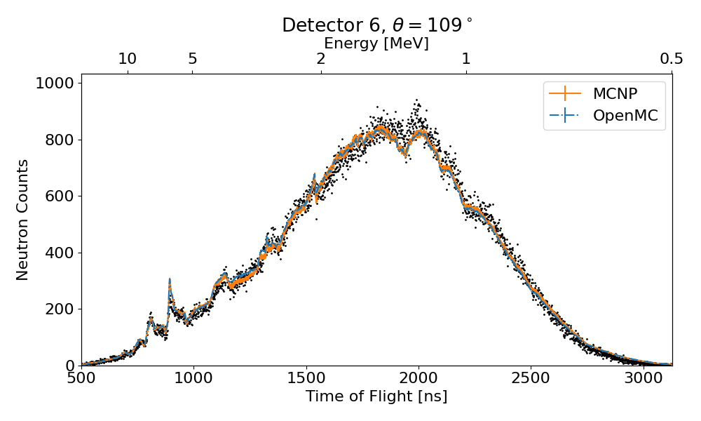
Graphite
9
Notes:
Another back angle detector, though not as extreme. In general, we see excellent agreement between OpenMC and MCNP, and also with experiment.
Near 1200ns, we see that there are some deviations though. If we zoom in… (go to next slide)

Slide 11
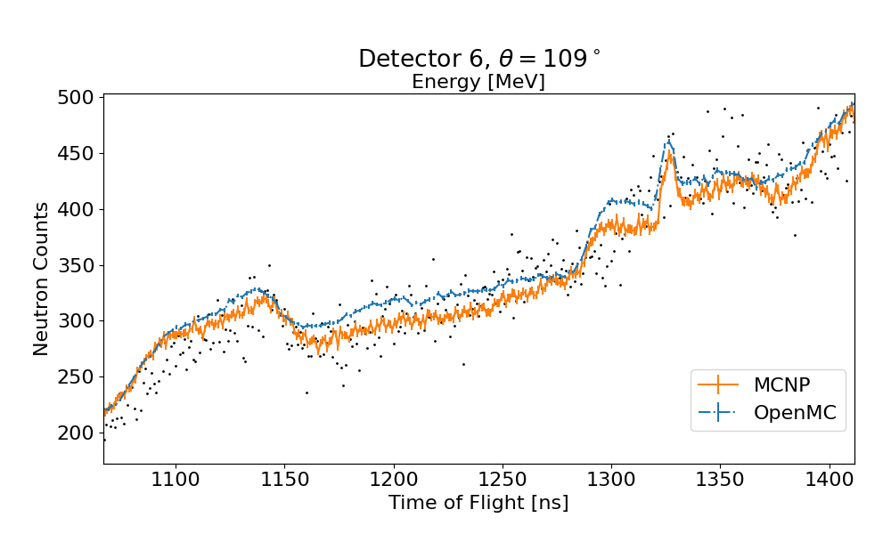
Graphite
10
Notes:
We see some areas with a slight disagreement between the two simulations.
One thing to mention is that OpenMC used 2ns time bins, and MCNP used 1ns time bins. This means the MCNP results have larger error bars, though even with this, the difference seems to be significant in some areas.
We note that MCNP and OpenMC don’t use exactly the same data representation.
MCNP uses ACE. OpenMC takes ACE files and generates an HDF5 file with a custom data format.
Also, while ENDF/B-VIII.0 was used for both, these are not necessarily starting from the same ACE files. If slightly different processing options or version of NJOY were used, the distributions could be slightly different.

Slide 12
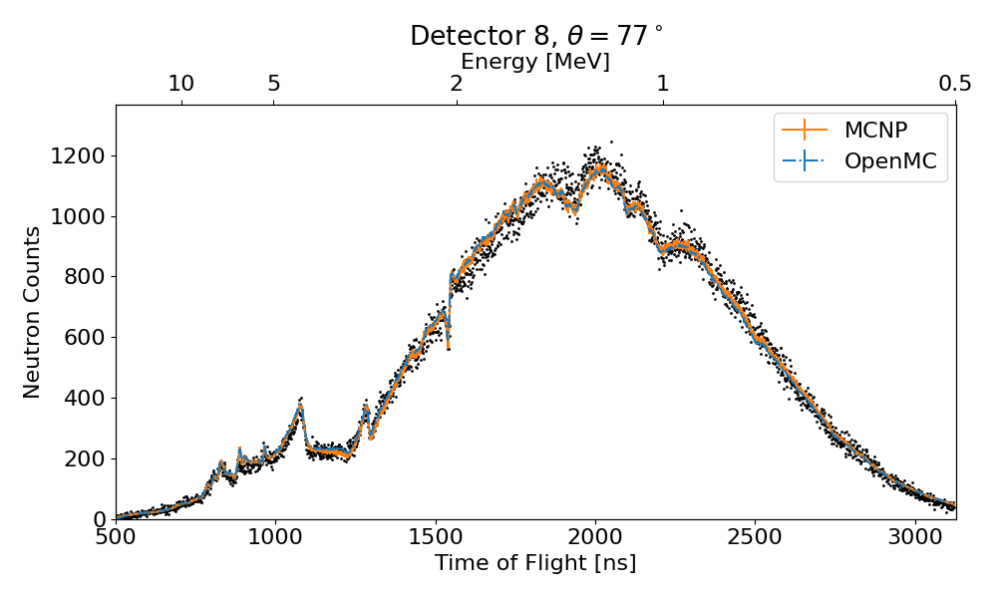
Graphite
11
Notes:
Here we have a forward scattering detector. Again, simulations in very good agreement, and both are also in good agreement with experiment.

Slide 13
Neutrons Scattering with Iron
12
Notes:
We will now look at the neutron response for iron.

Slide 14
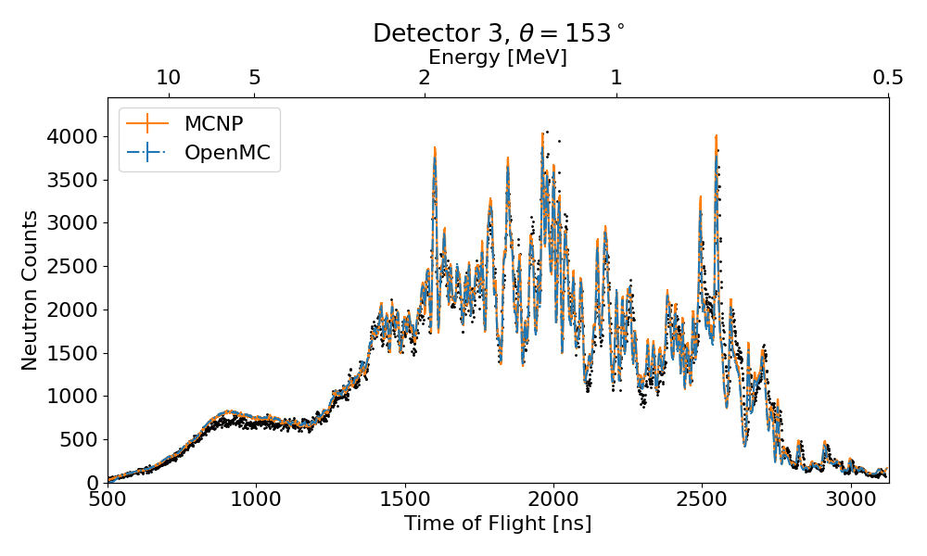
Iron
13
Notes:
Iron of course has far more resonances than carbon, so it is more interesting to examine.
With this back scattering angle, we see excellent agreement between OpenMC and MCNP.
While both simulations agree, there are general disagreements with the simulations and the data.

Slide 15
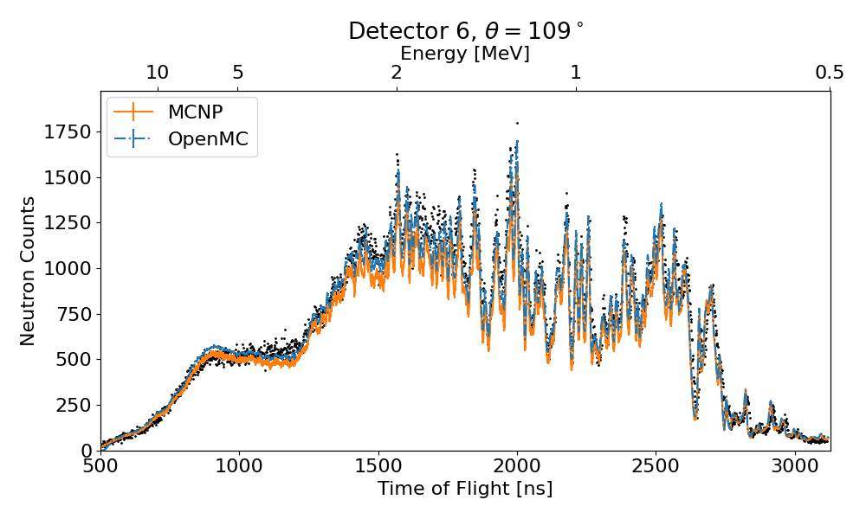
Iron
14
Notes:
For this detector, it appears as though MCNP is systematically lower than the OpenMC results., especially at higher energies.
If we zoom in… (go to next slide).

Slide 16
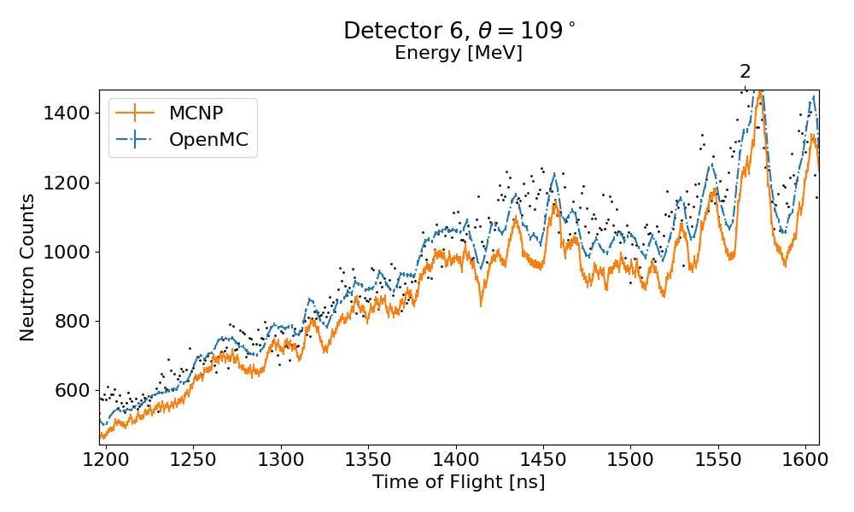
Iron
15
Notes:
There are certainly areas (see near 1400 ns) where MCNP does appear to be in disagreement with OpenMC.
In this particular case, OpenMC seems to have better agreement with the data.
Looking at shorter ToF (see near 1200 ns), there is a small disagreement, but it isn’t necessarily statistically significant there (only plotting 1-sigma error bars).

Slide 17
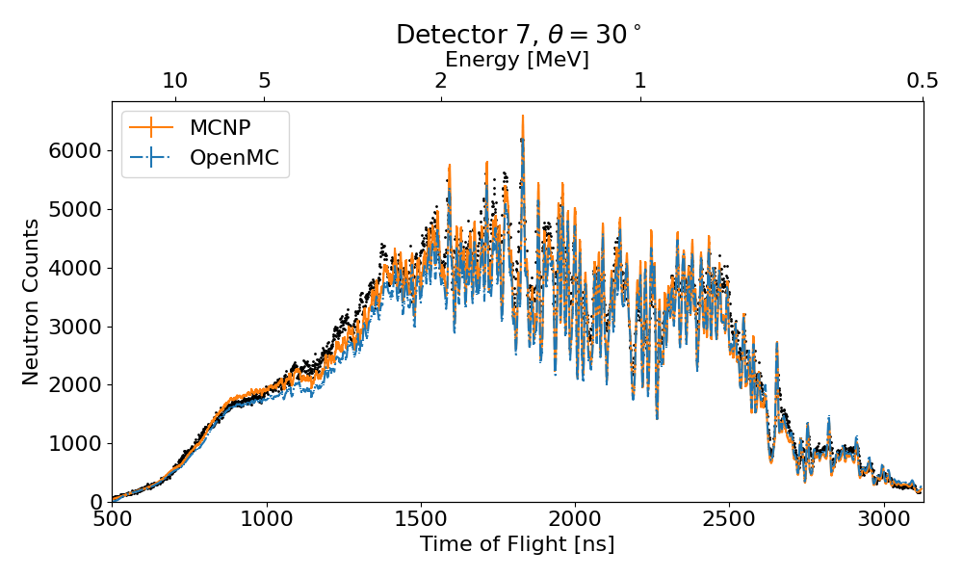
Iron
16
Notes:
In this forward detector for example, MCNP is higher than OpenMC at higher energies (10 – 2 MeV).
Bellow 2 MeV however, the two simulations are effectively identical.
Zooming in near 5 MeV… (next slide)

Slide 18
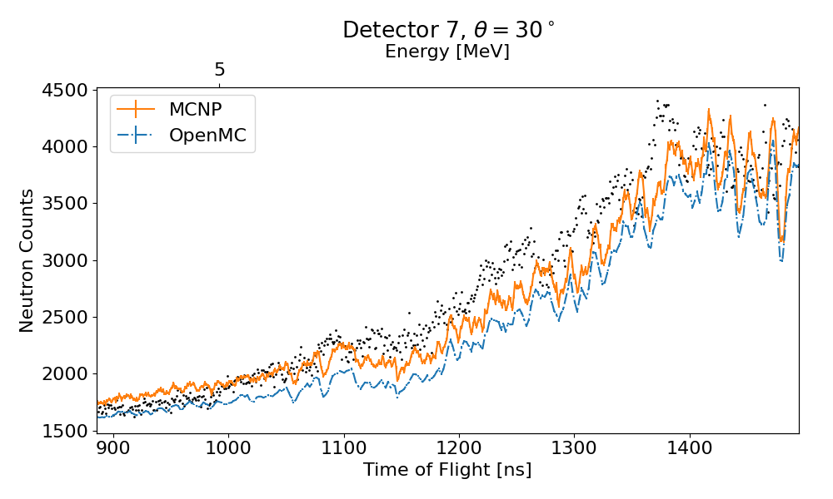
Iron
17
Notes:
We can see that these differences appear to be statistically significant.
These are in practice very small differences.
It could be something as simple as different versions of NJOY were used when processing the ACE files for the two codes.
Might also be due to very small differences in the integral cross sections at these energies.
Small differences in how the sampling of scattering distributions is handled between the two codes ?
For tabulated distributions like level inelastic, even if the two distributions are identical in the different codes, they can be interpreted and used slightly differently.
For elastic scattering, there might also be slightly different approximations being made in the scattering kernel between the two.

Slide 19
Gamma Production from Neutrons Scattering with Iron
18
Notes:
We will now take a look at the gamma response from the iron sample.
The efficiencies used for the gamma tallies were provided to me by Adam. He will speak more about how he got them.
Gamma efficiencies for the 8-bit data are being actively worked on.
While we are presenting experimental measurements with the simulations, we are mostly interested in the OpenMC and MCNP agreement.

Slide 20
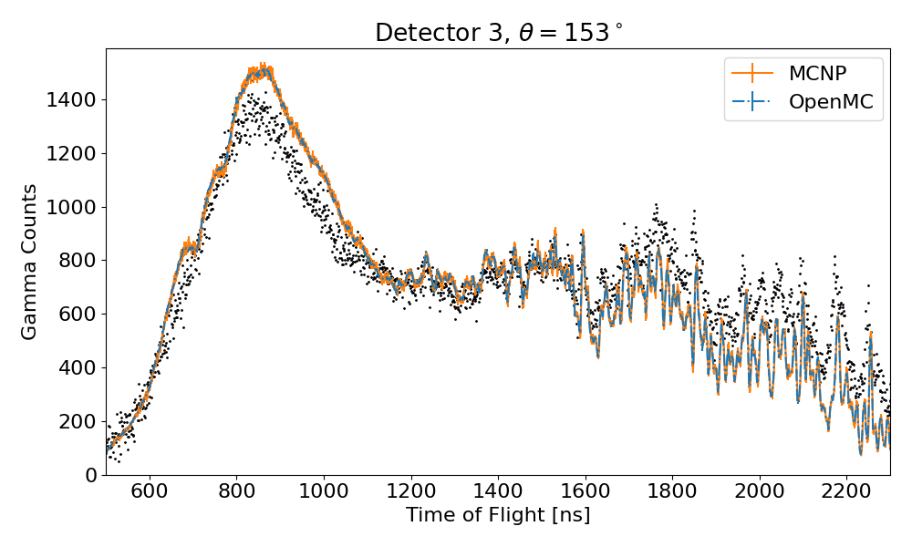
Iron
19
Notes:
While MCNP has larger error bars, the results of OpenMC and MCNP are in excellent agreement.
In Fe56, the gamma distribution for (n,n’1) has discrete energies, so it is a very simple distribution.
There is also a simple tabulated distribution for the angular distribution. There is far less therefore that could “go wrong” or that could be different between the two codes.

Slide 21
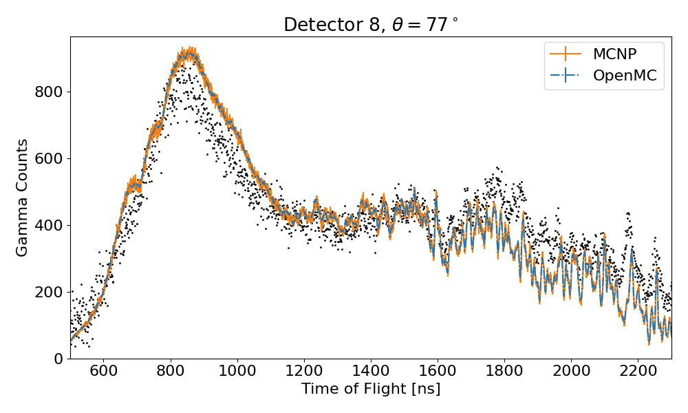
Iron
20
Notes:
Similar results on this forward detector.
Excellent agreement between the two codes.
Differences from the experimental data however.
Difficult to know if this is from problems in the evaluation, or the detector efficiencies that were used in the simulations.

Slide 22
Conclusions
OpenMC poses many potential advantages over MCNP
Simulated HES system for Graphite and Iron using OpenMC and MCNP
Both codes have good agreement with each other for both samples, with neutrons and gammas
  A few small differences were observed
Unable to give a fair performance comparison
  OpenMC used both MPI and OpenMP
  MCNP only used MPI
Would like point detectors in OpenMC !
We will be expanding use of OpenMC at the RPI LINAC moving forward
21
Notes:
While we traditionally use MCNP for performing simulations at the RPI LINAC, we have started looking at incorporating OpenMC into the mix.
OpenMC has the advantage of being open-source so we can distribute custom versions if needed, can contribute fixes if we find bugs, and even non-us citizens could use it.
Recent additions to OpenMC like pulse height tallies means it is likely possible to really start using it here at the LINAC.
Gaussian Energy Broadening is still missing, but I have added it myself, and am working on adding it. This is the power of OpenMC ! If you need something, you can add it yourself !
For the graphite and iron samples we simulated, both codes had very good agreement. The small differences which were seen could have multiple explanations, ranging from different versions of NJOY or different NJOY options, to different interpretations of the scattering distributions or approximations in the scattering kernels. Further tests will be performed (using same ACE files) to eliminate that possible difference.
Unfortunately, can’t give detailed performance comparison. Sims were run on our cluster, but OpenMC used both MPI and OpenMC, while MCNP is compiled to only use one or the other. Therefore, any time comparisons would not be fair.
It would certainly be more efficient to have point detectors in OpenMC to accelerate simulations of our systems. Maybe we will add this one day !?
These were very encouraging results however and demonstrate that OpenMC is certainly capable of replacing MCNP in our workflow for many of our simulations needs (though not all). We will be expanding our use of OpenMC here at the LINAC, using it to model other systems we have.

Slide 23
Thanks for listening !
Any questions ?
22

