Slide 1
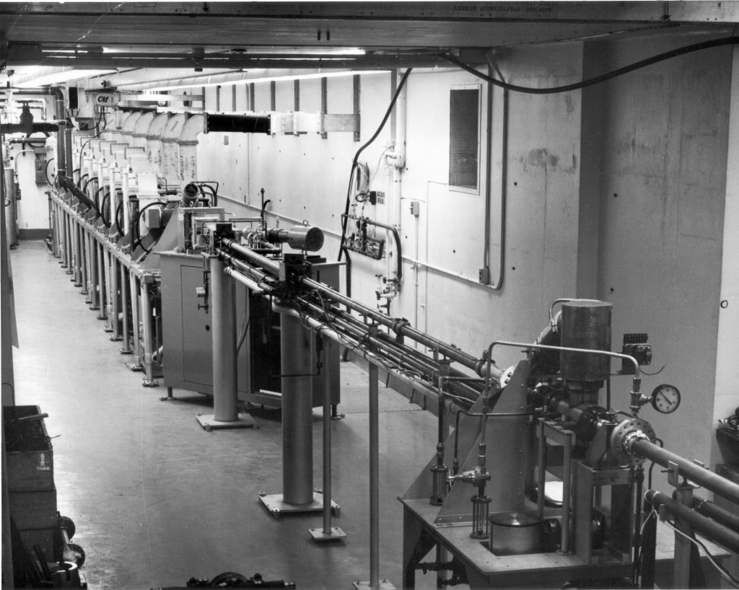



Quasi-Differential Neutron Scattering Measurements of ¹⁸¹Ta and Teflon from 1.5 to 20 MeV
Gregory Siemers^{1,3}, S. Singh¹, Y. Danon¹, A. Daskalakis², K. Cook^{1,2}, B. Wang¹, P. Brain^{1,3}, M. Rapp³
1. Rensselaer Polytechnic Institute – Troy, NY 12180
2. Naval Nuclear Laboratory – Niskayuna, NY 12309
3. Los Alamos National Laboratory – Los Alamos, NM 87545
Notes:
Introduce myself, co-authors, and the presentation topic.

Slide 2
Presentation Overview
Motivation for the Experiments Performed
Upgrades to the Experimental Apparatus for Measurements
Quasi-Differential Experimental Methodology
  Pulse Shape Discrimination
  Validation Measurement of Carbon
Preliminary Results
Future Studies
Notes:
Introduce the content and agenda for the presentation.

Slide 3
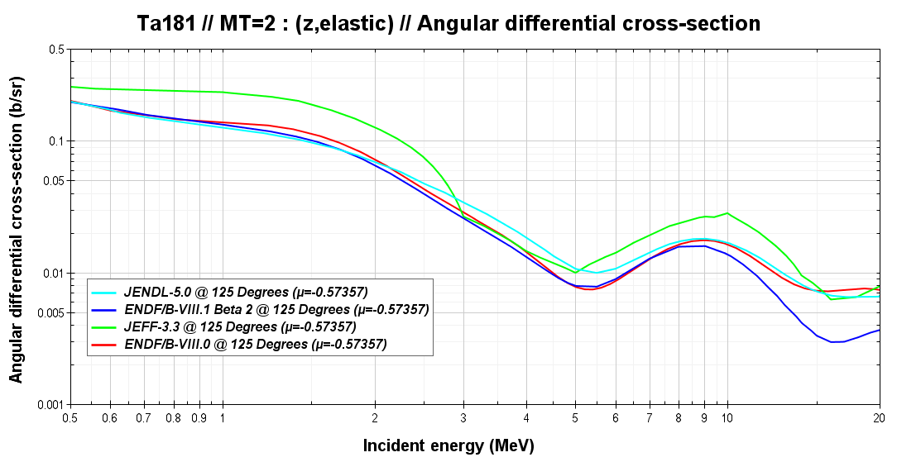
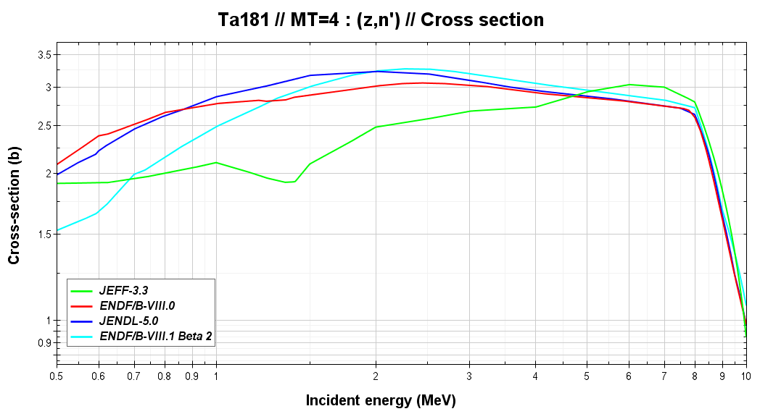
Motivation for RPI
Tantalum Experiment
Due to special material and nuclear properties ¹⁸¹Ta is relied on for the following applications:
  Neutron-producing targets for linear accelerators
  Recovering Uranium from fuel reprocessing¹
  Casting of molten Plutonium metal¹
¹⁸¹Ta neutronics must be thoroughly understood to enhance the realms of scientific research, criticality safety, and national security
¹Chambers, A. (2023) - Five Year Execution Plan – United States Department of Energy Nuclear Criticality Safety Program FY2024 though FY 2028
Notes:
Elaborate on motivators for the Ta measurements, show differences in current evaluations and discuss current applications.

Slide 4
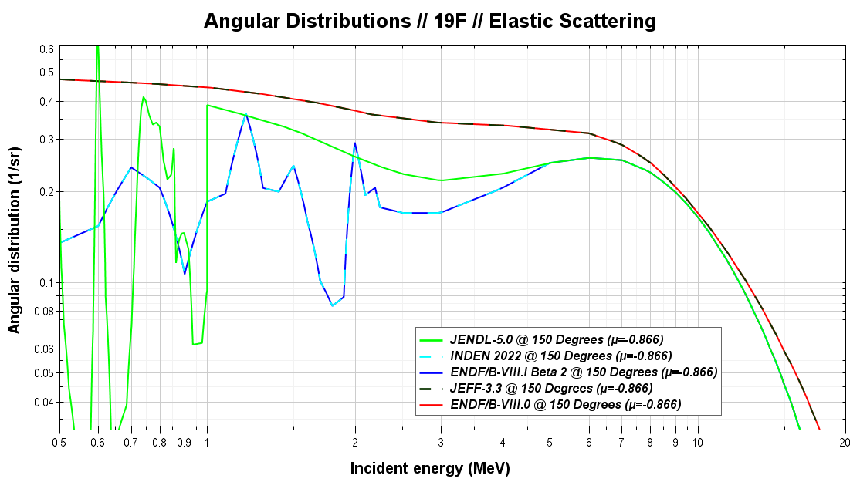
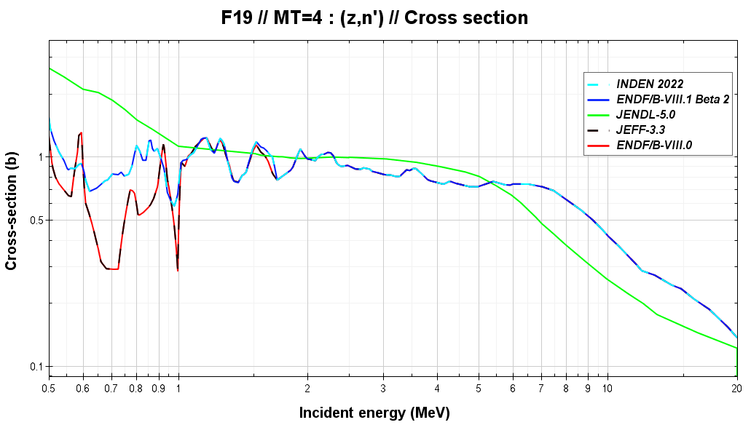
Motivation for RPI Teflon (CF₂) Experiment
Measuring Teflon allows for validation of the ¹⁹F evaluations
Fluorine is relied on heavily in salts for Generation – IV reactor concepts:
  Kairos Power – FHR
  TerraPower – SFR and Natrium
  Flibe LFTR (blanket and coolant)
Fluorine is an integral component of Uranium manufacturing/enrichment (UF₆)
Criticality safety, design, and operation of these reactor concepts are highly dependent on ¹⁹F neutronics
Notes:
Elaborate on motivators for the Teflon measurements, show differences in current evaluations and discuss current applications.

Slide 5
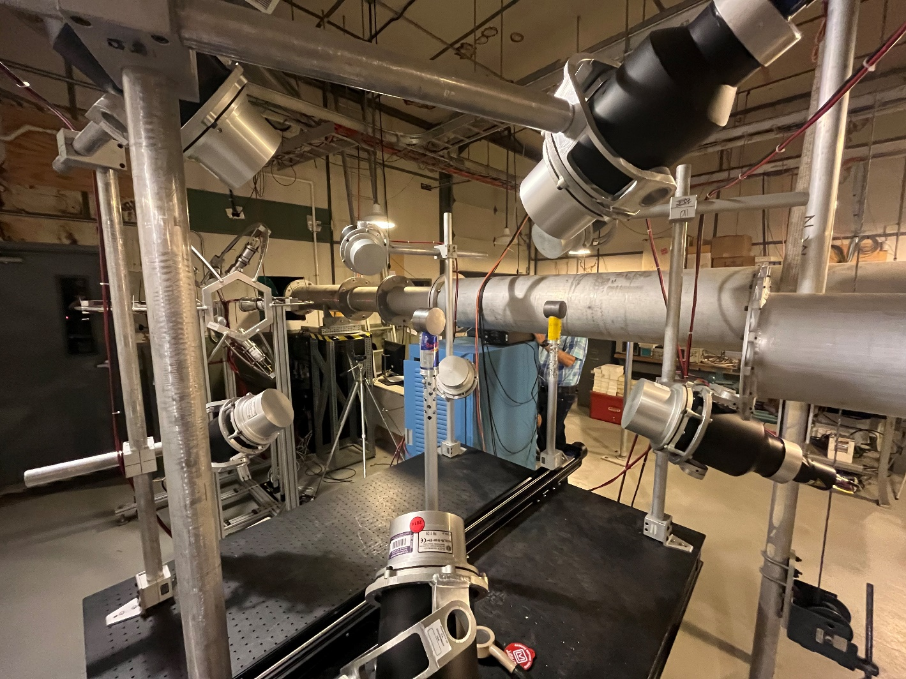
The RPI High Energy Neutron Scattering System
Close-to-ideal neutron scattering array located ~30m from the neutron-producing target constructed with:
Eight 5in diameter EJ-301 organic liquid scintillator proton recoil detectors
  Coupled to Photonis XP4572/B PMTs
Aluminum alloy detector mounting hardware and sample holder
A rigidly secured optical table allowing for seemingly infinite detector arrangements
Notes:
Introduce the high energy scattering system at RPI.

Slide 6
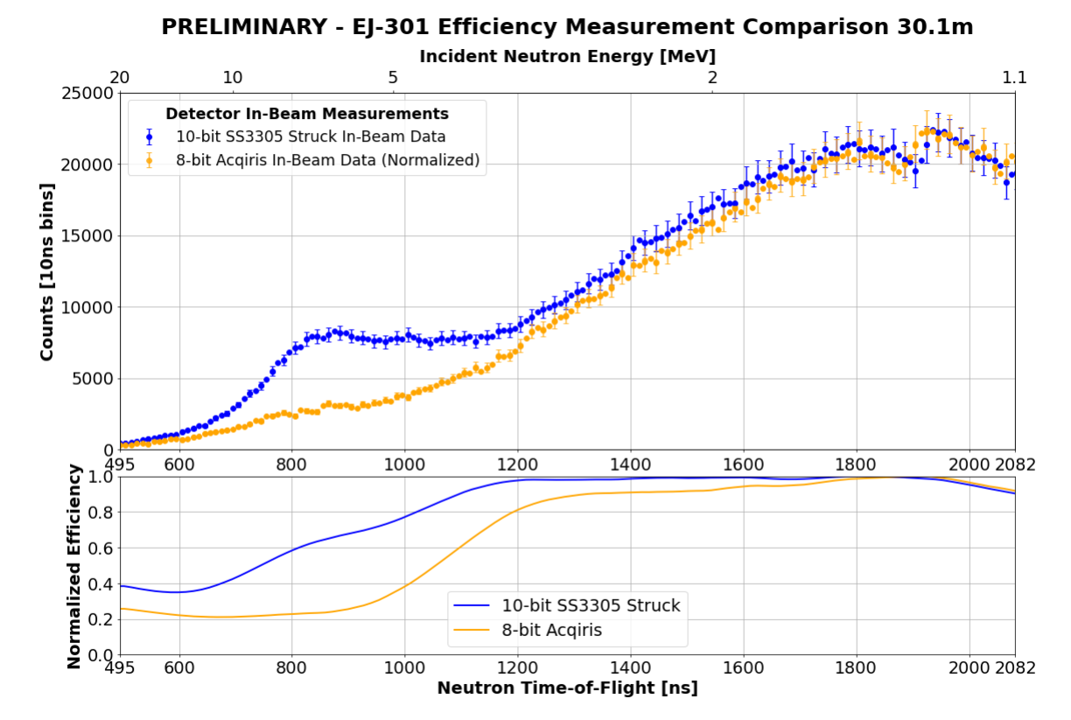
Upgrade to Struck SIS-3305 10-bit Digitizer
System upgraded from Agilent-Acqiris AP240 8-bit to Struck SIS-3305 10-bit digitizer
  Dynamic range of pulses increased from 256 bits to 1024 bits
  Sampling resolution increased from 1.0ns to 0.8ns
Upgrade yields increase in relative neutron detection efficiency of the system, largest gains in efficiency observed from 2 MeV – 20 MeV
Comparison generated using pulse shape discrimination methods¹ different from the results presented in this work
¹A. M. Daskalakis, E. J. Blain, B. J. McDermott, R. M. Bahran, Y. Danon, D. P. Barry, R. C. Block, M. J. Rapp, B. E. Epping and G. Leinweber, “Quasi-differential elastic and inelastic neutron scattering from iron in the MeV energy range”, Annals of Nuclear Energy, vol. 110, pp. 603 - 612, 2017
Notes:
Discuss the upgrade to the 10-bit digitizer. By increasing our dynamic range capability of incoming pulses we are improving our neutron detection efficiency and measurement capabilities at higher incident neutron energies.

Slide 7
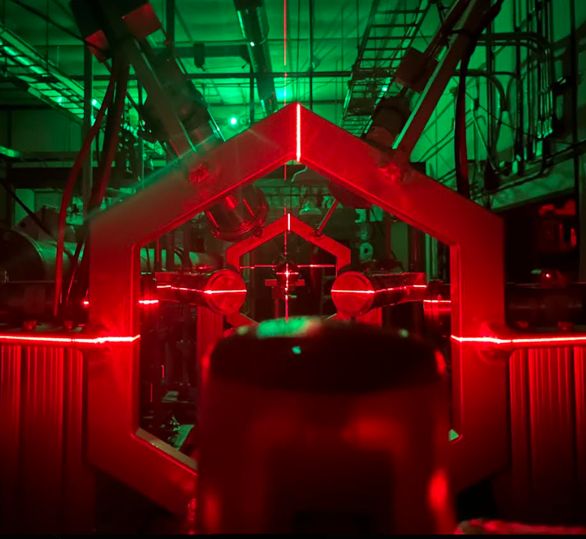
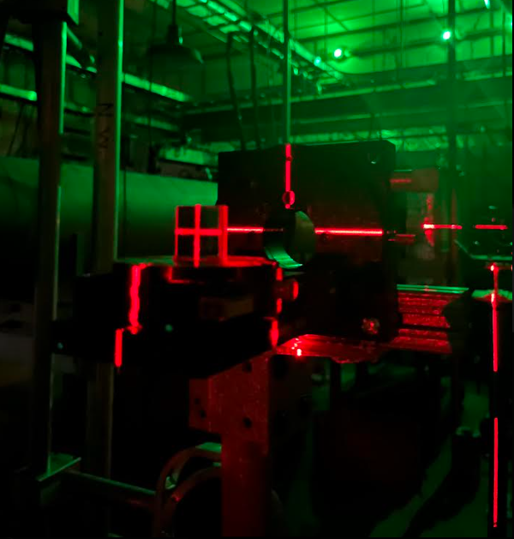
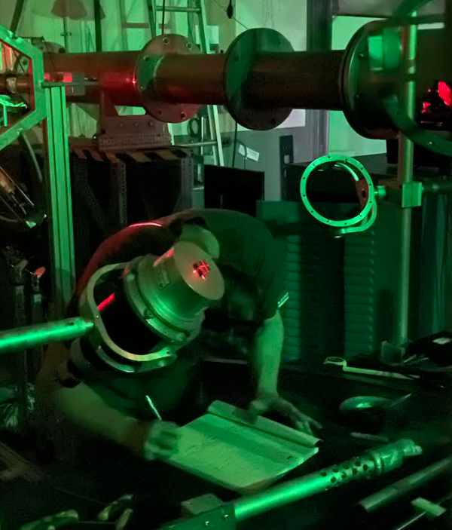
EJ-301 Detector Alignment Upgrade
Alignment procedure using a beamline-centered self-leveling laser, mirror, and optical coincidence implemented to more accurately position detectors for experiments.
Notes:
Show and discuss procedure for detector alignment.

Slide 8
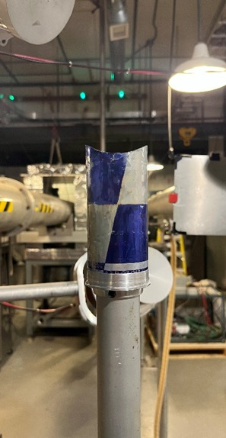
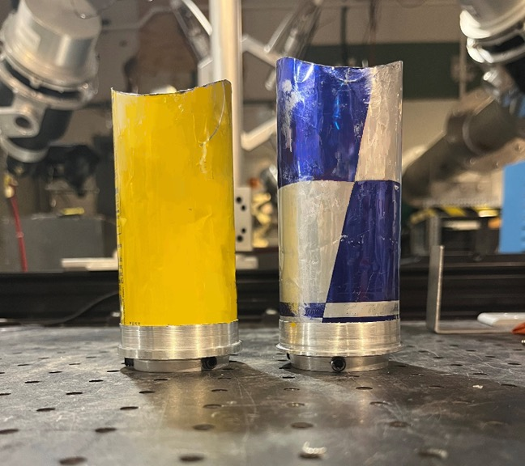
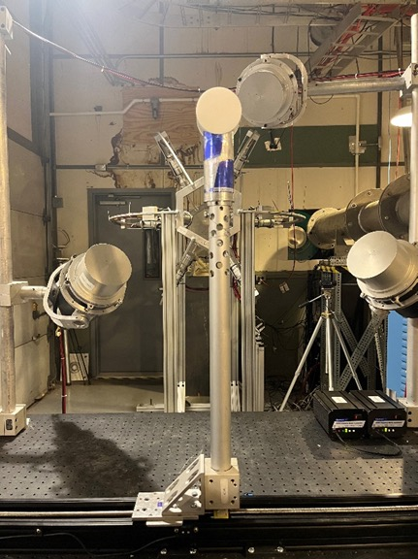
Sample Holder Upgrade
New fabricated aluminum ring/sleeve and securing mechanism are more rigid than previous solution – reducing sample position uncertainty
Notes:
Show and discuss new component of sample mounting.

Slide 9
Quasi-Differential Scattering Experimental Conditions and Data Analysis
Notes:
Transition to section discussing methodology and data analysis techniques used to obtain preliminary experimental results.

Slide 10
Quasi-Differential Measurement Methodology
Conduct differential neutron time-of-flight experiment on sample of interest, validation sample, and open beam
  Due to sample size, the experiment is dominated by multiple scattering interactions
Perform MCNP transport calculation of validation (Carbon) measurement using measured neutron flux and detector efficiencies
  This validates experimental geometry and reproduction of known validations sample
Perform MCNP transport calculation of sample of interest measurement using measured neutron flux and detector efficiencies
  Differences present in nuclear data evaluations of the sample of interest are compared to the experimental data to validate performance or show needs for improvement
Notes:
Outline the methodology of the quasi-differential measurement technique. Measurement is primarly used for validation of evaluated nuclear data performance but can also be used to improve evaluations (work done by P. Brain).

Slide 11
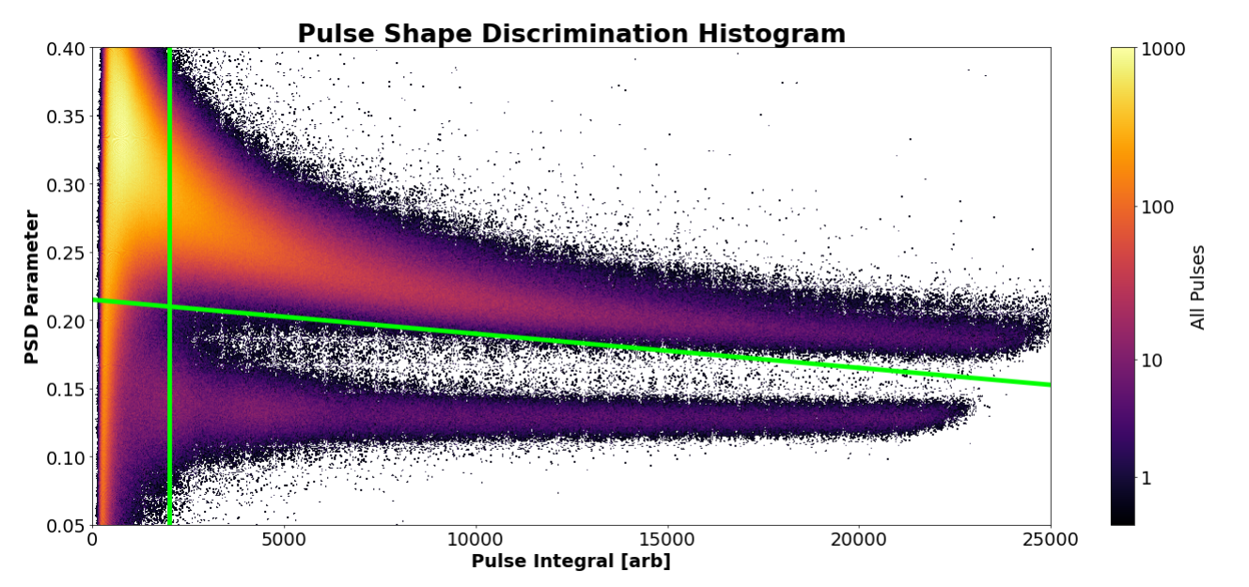
Pulse Shape Discrimination
Neutron and gamma pulses were separated based by the ratio of the tail integral of the pulse to the integral of the whole pulse
Only pulse integrals above of 2000 were used for preliminary analysis
Cut
Neutrons
Gammas
Notes:
Discuss pulse shape discrimination method that was used to obtain the preliminary experimental results presented in this talk.

Slide 12
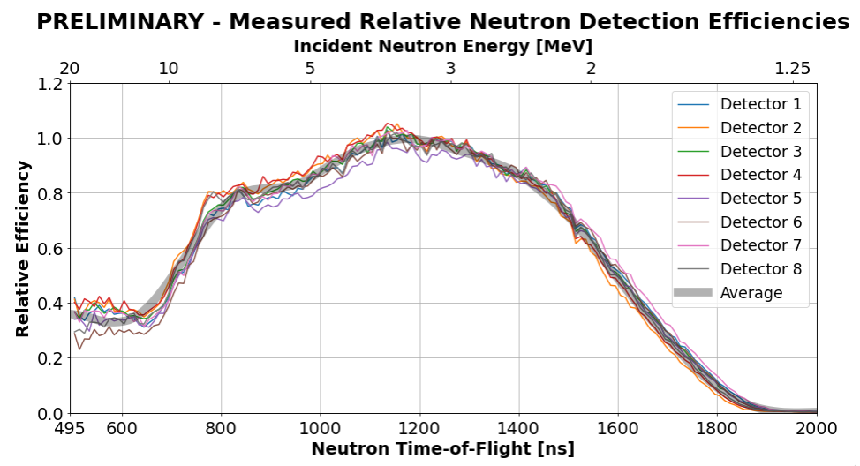
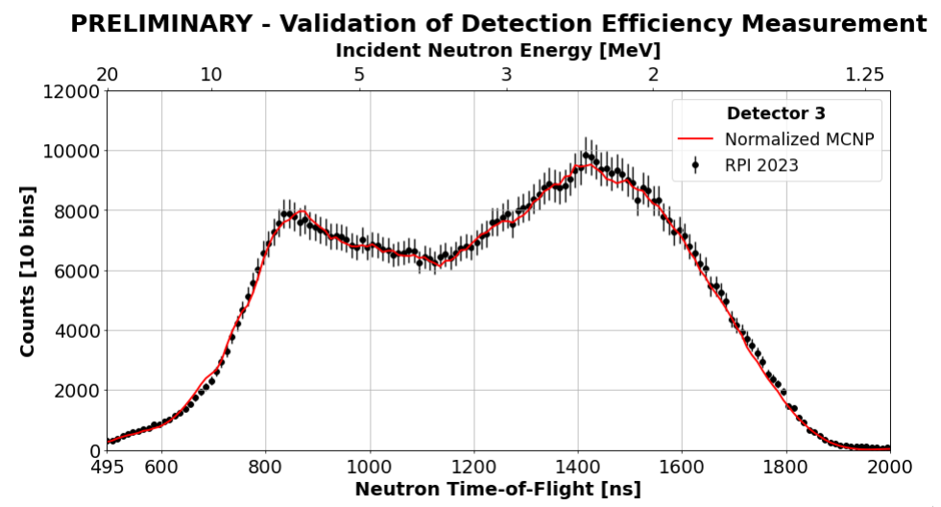
Detector Efficiency Determination
EJ-301 detector efficiencies obtained from experiment and validated with SCINFUL
  Further validated by reproducing detector efficiency measurement in MCNP6
  The average neutron detection efficiency of all measurements was used in preliminary analysis
Notes:
Discuss experimental and computational (SCINFUL) methodology used to generate detector efficiency for EJ 301 detectors in high energy scattering system. Validation of method is presented with replication of experiment with detector 3 and MCNP.

Slide 13
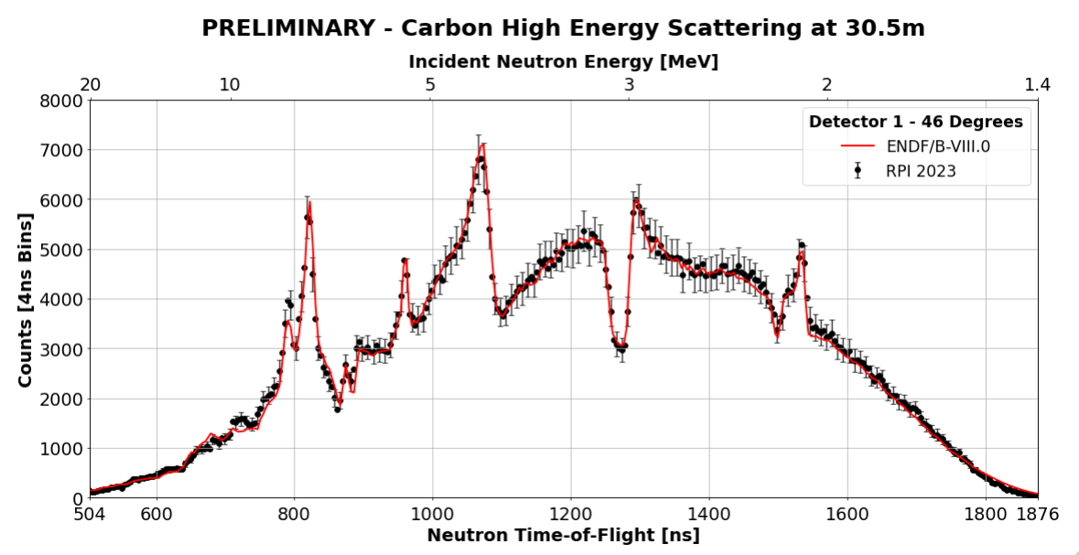
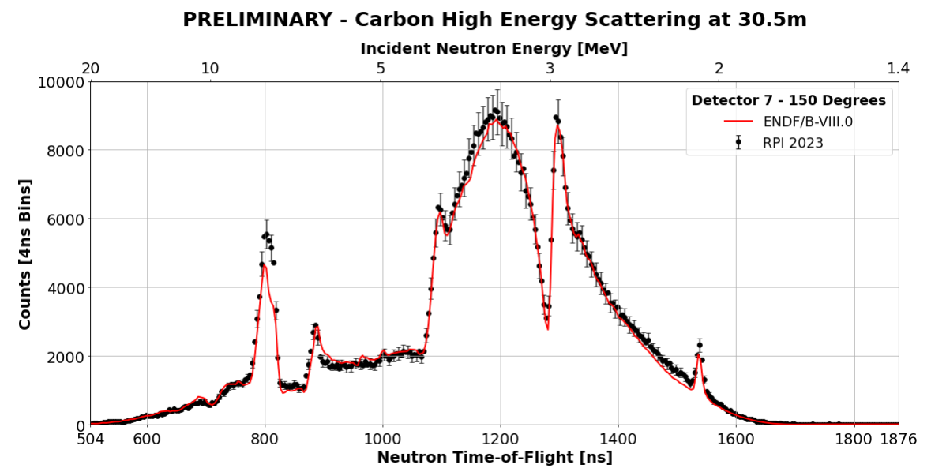
Validation Measurements of Carbon Sample
An accurate quantification of the systematic uncertainty associated with the measurement has yet to be quantified, an arbitrary systematic uncertainty of 6% was used as an estimate from analyses performed on previous measurements^{1,2}
E. Blain, Y. Danon, D. P. Barry, B. E. Epping, A. Youmans, M. J. Rapp, A. M. Daskalakis and R. C. Block, “Measurements of Neutron Scattering from a Copper Sample Using a Quasi-Differential Method in the Region from 2 keV to 20 MeV”, Nuclear Science and Engineering, vol. 196, no. 2, pp. 121-132, 2022, DOI:10.1080/00295639.2021.1961542
A. M. Daskalakis, E. J. Blain, B. J. McDermott, R. M. Bahran, Y. Danon, D. P. Barry, R. C. Block, M. J. Rapp, B. E. Epping and G. Leinweber, “Quasi-differential elastic and inelastic neutron scattering from iron in the MeV energy range”, Annals of Nuclear Energy, vol. 110, pp. 603 - 612, 2017, DOI:10.1016/j.anucene.2017.07.007
Notes:
Present a snapshot of the results from the carbon validation measurement performed. These data are from the carbon measured in the Teflon experiment. A statement and supporting literature are included on the uncertainty being used on the data for these experiments at the time of writing. Overall, the validation measurement was successful since we are predicting carbon well using MCNP, so we can move onto the sample of interest.

Slide 14
Preliminary Results from ¹⁸¹Ta and Teflon Scattering Experiments
Notes:
Change to section on the preliminary results from the Teflon and tantalum experiments.

Slide 15
Preliminary Results From ¹⁸¹Ta Experiment
First experiment presented is quasi-differential scattering measured from a 2.15in thick 3in diameter cylinder of ¹⁸¹Ta
Over 75 hours of data were collected during this experiment to obtain a high degree statistical accuracy
Nuclear data from the following evaluations were used in MCNP6 to perform the transport calculations of the experiment:
  ENDF/B-VIII.0
  ENDF/B-VIII.1 (Beta 2)
  JEFF-3.3
  JENDL-5.0
The estimation of 6% systematic uncertainty was also applied to these data
Notes:
Discuss the experimental conditions from the Ta measurement and what evaluations will be compared to the experimental data for validation. Reiterate the 6% systematic uncertainty was also used for the sample of interest data.

Slide 16
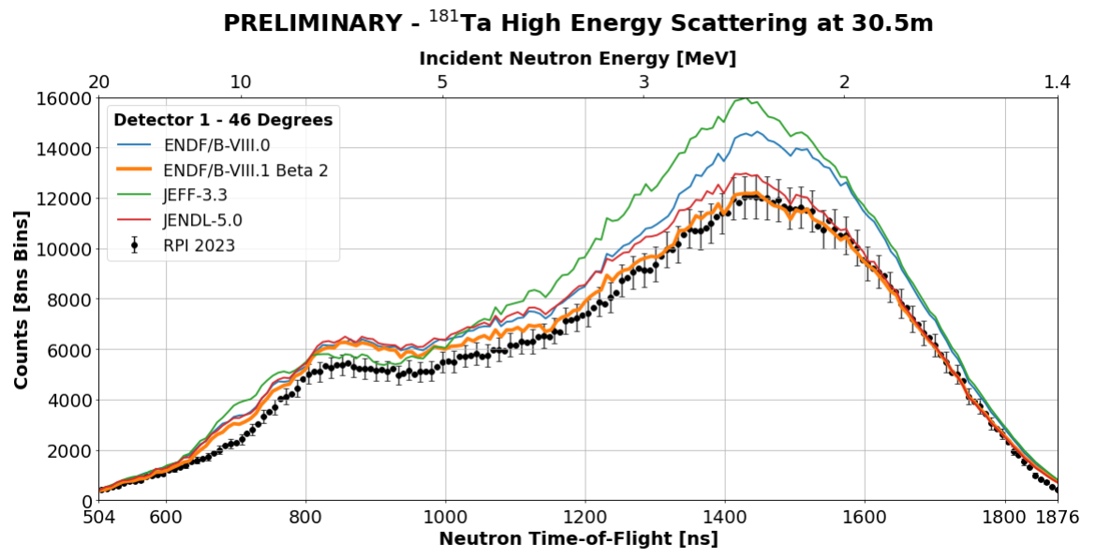
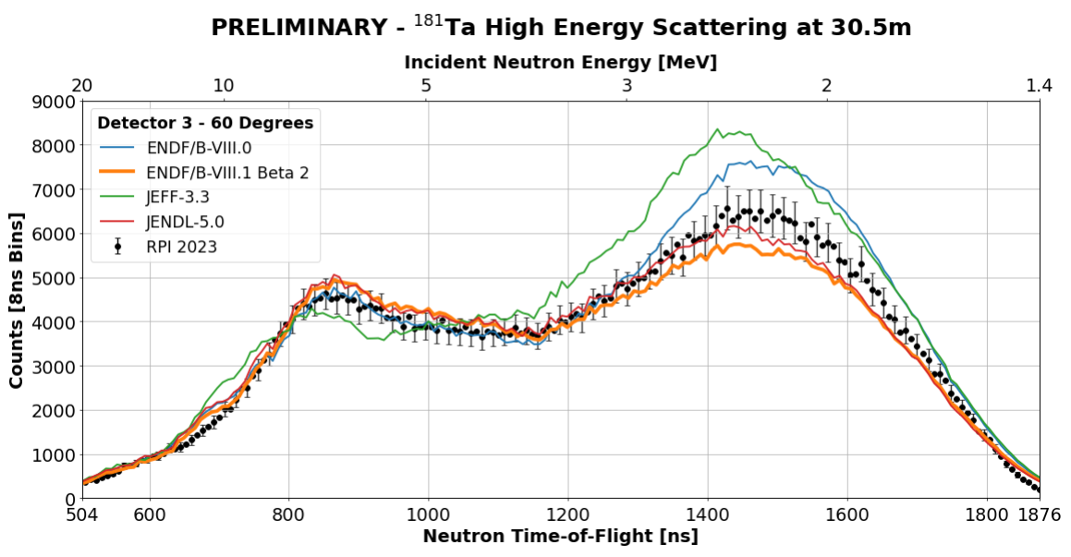
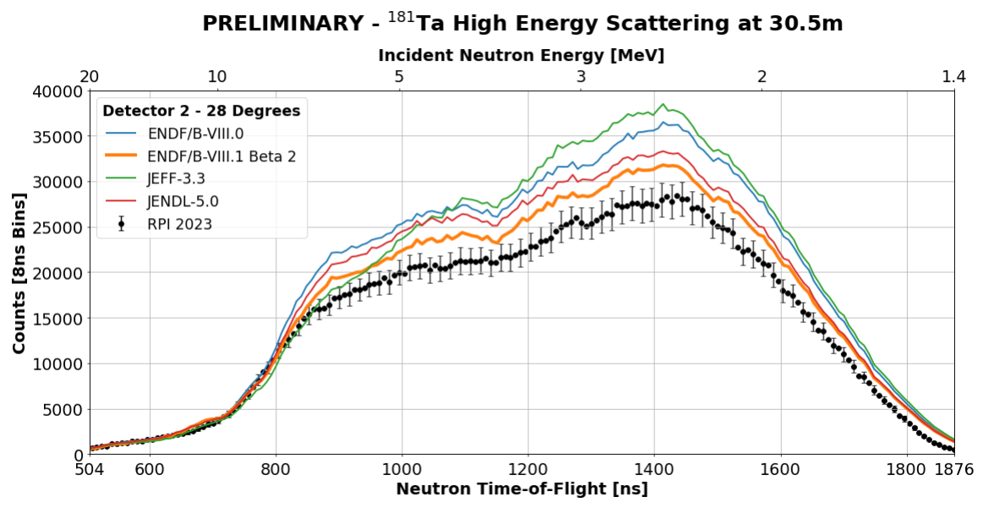
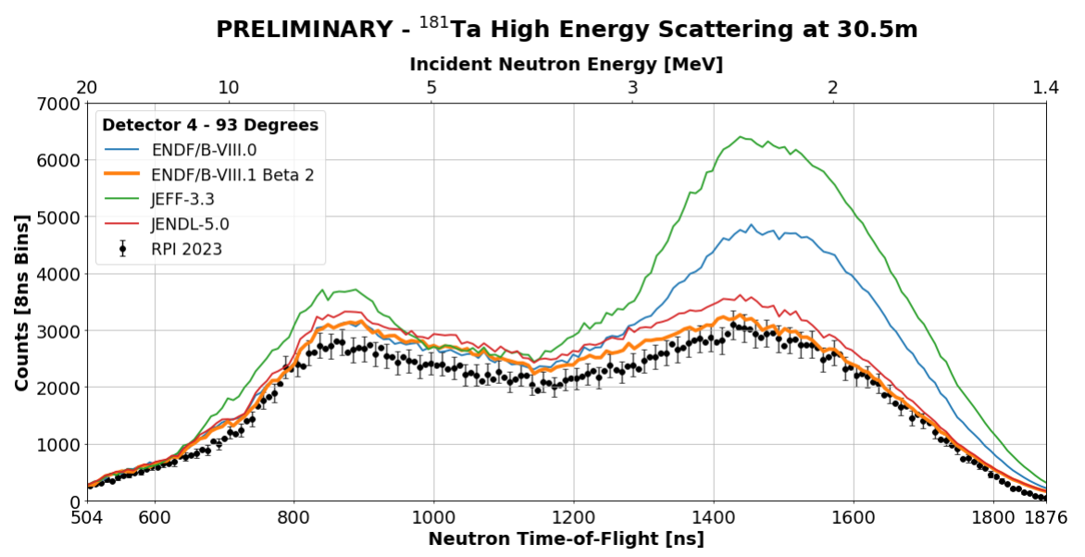
Notes:
Show preliminary results of Ta experiment.

Slide 17
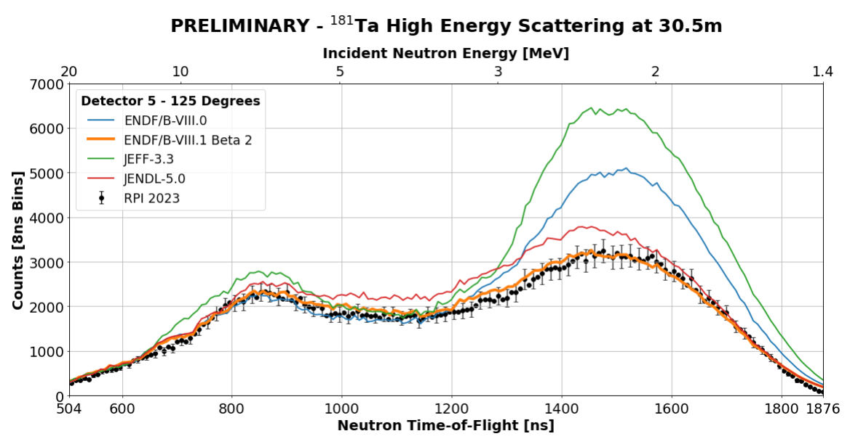
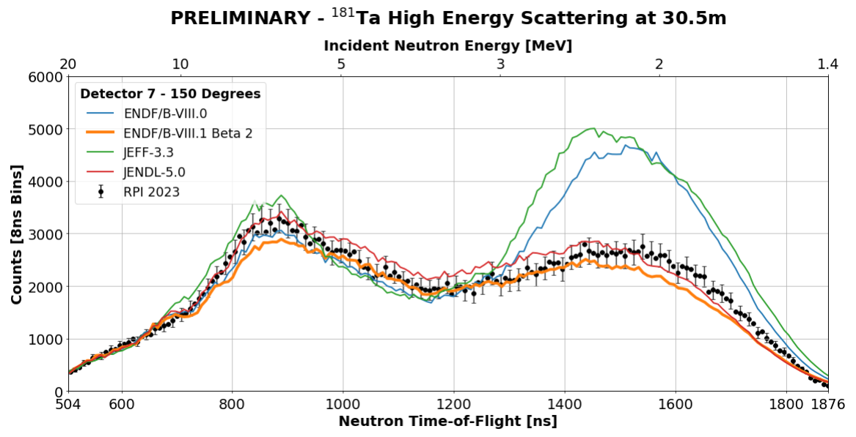
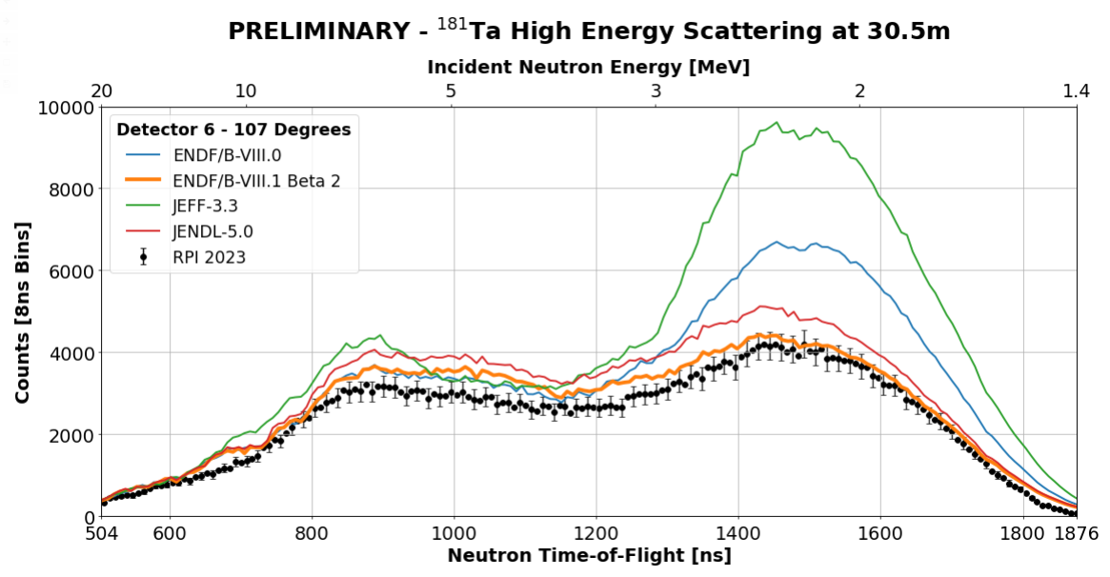
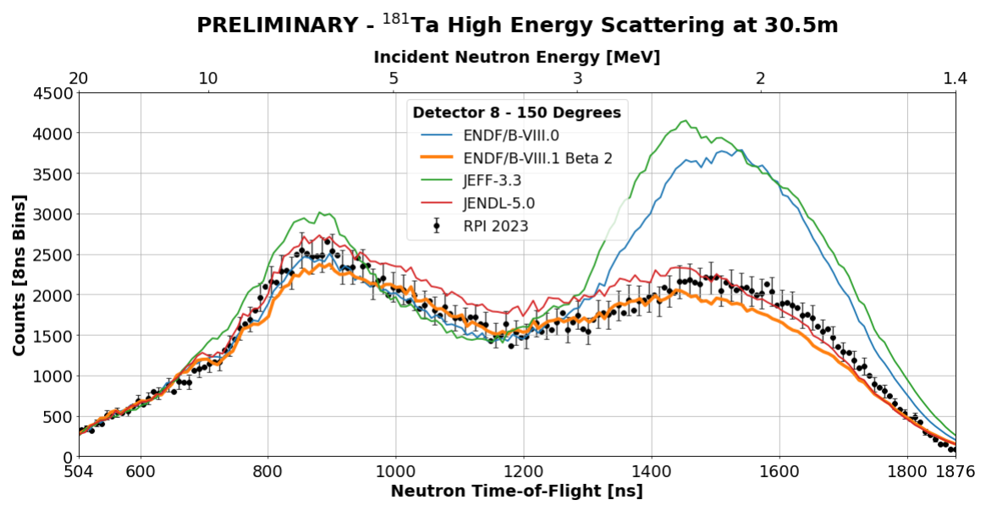
Notes:
Show preliminary results of Ta experiment.

Slide 18
Discussion on Preliminary ¹⁸¹Ta Results
ENDF/B-VIII.1 beta 2 evaluation best agrees with experimental data
  Shape of ENDF/B-VIII.1 beta 2 evaluation seems accurate at all angles, but magnitude issues observed at most forward angles
Large disagreements observed with ENDF/B-VIII.0 and JEFF-3.3 evaluations below 3 MeV
JENDL-5.0 evaluation follows experimental data and ENDF/B-VIII.I beta 2 in some places, but more disagreements observed compared to beta 2
Notes:
Discuss preliminary results of Ta experiment. Observe best agreement with endf81 beta 2 evaluation.

Slide 19
Preliminary Results From Teflon Experiment
First experiment presented is quasi-differential scattering measured from a 1.95in thick 3in diameter cylinder of Teflon
Over 135 hours of data were collected during this experiment to obtain a high degree statistical accuracy
Nuclear data from the following evaluations were used in MCNP6 to perform the transport calculations of the experiment:
  ENDF/B-VIII.0
  ENDF/B-VIII.1 (Beta 2)
  INDEN (2022 Evaluation)
  JEFF-3.3
  JENDL-5.0
The estimation of 6% systematic uncertainty was also applied to these data
Notes:
Discuss the experimental conditions from the Teflon measurement and what evaluations will be compared to the experimental data for validation. Reiterate the 6% systematic uncertainty was also used for the sample of interest data.

Slide 20
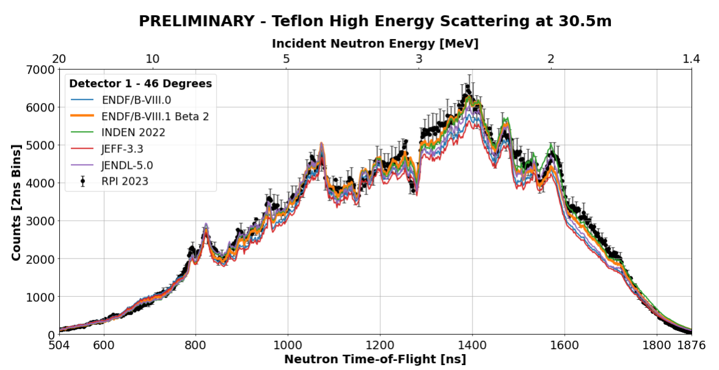
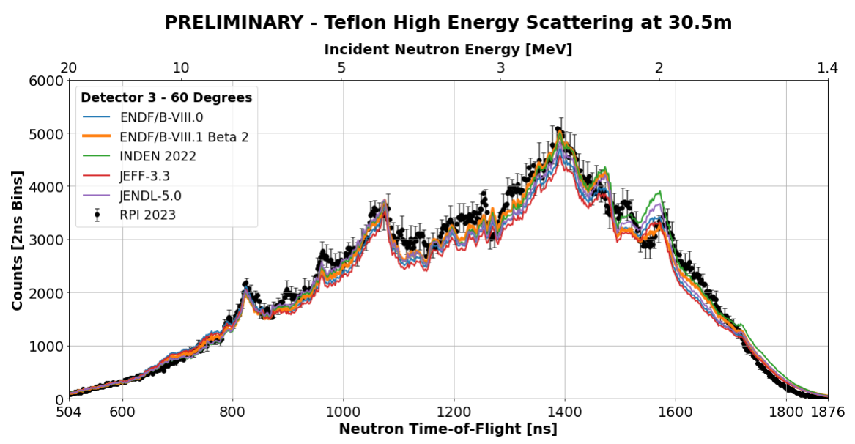
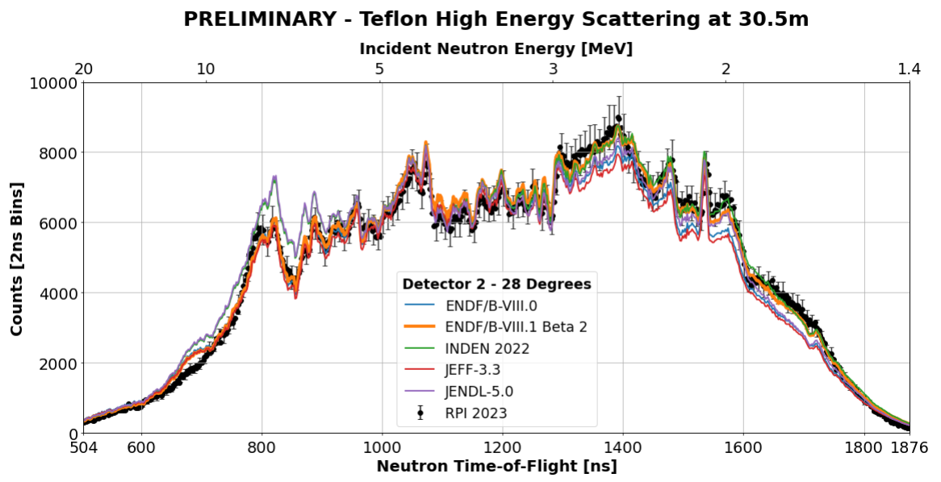
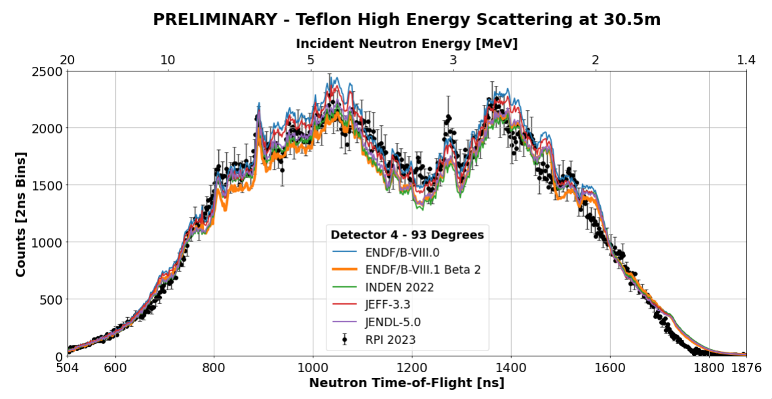
Notes:
Show preliminary results of Teflon experiment.

Slide 21
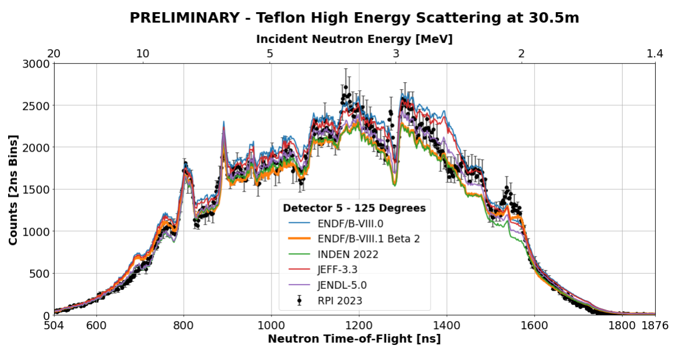
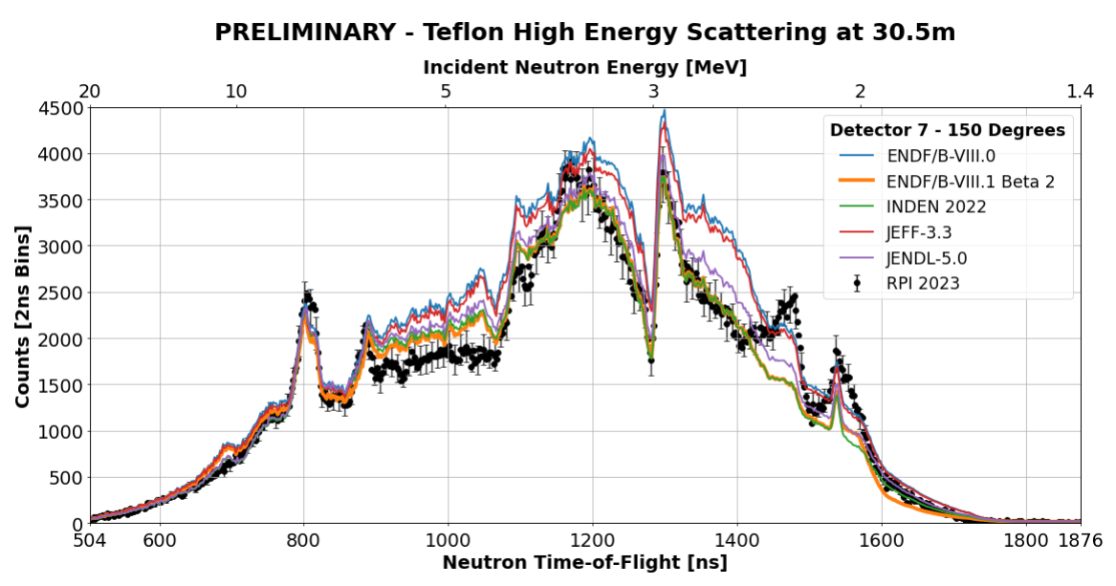
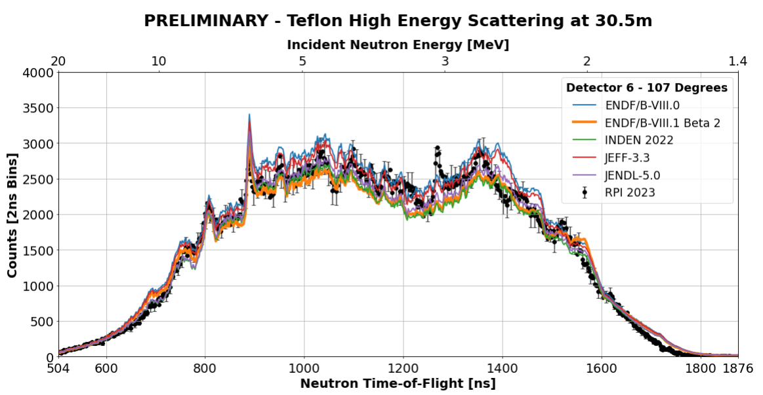
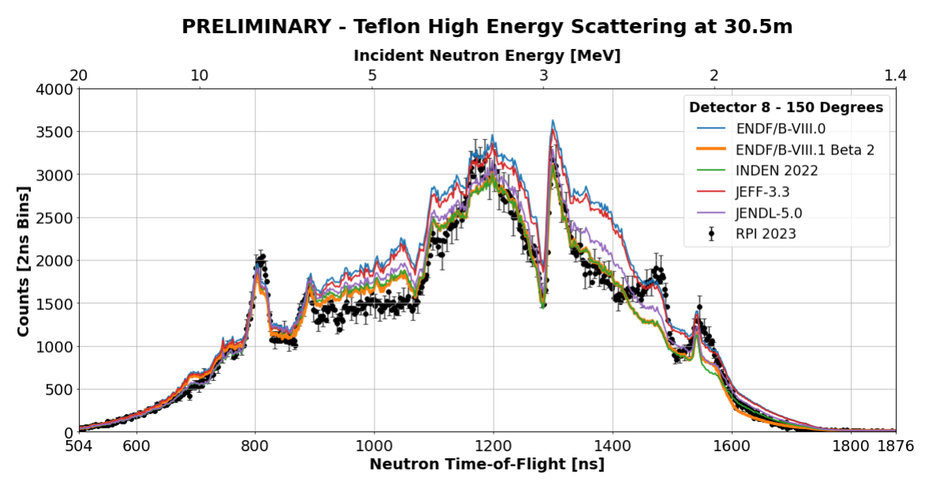
Notes:
Show preliminary results of Teflon experiment.

Slide 22
Discussion on Preliminary Teflon Results
INDEN and ENDF/B-VIII.1 beta 2 evaluations observed to have best agreement with experimental data
Evaluation and experimental agreement for forward angles is acceptable
  ENDF/B-VIII.0 and JEFF-3.3 performance inferior to other evaluations in most regions
Poor agreement between all evaluations observed at 150-degree detectors
  Largest issues in big resonances and 3.5-6 MeV energy region
Issues observed between 2 MeV and 3 MeV in 125-degree detector
Resonance missing in evaluations seen in 107-degree detector at 3.1 MeV
Notes:
Discuss preliminary results of Teflon experiment. Endf81 beta 2 and inden seem to agree best.

Slide 23
Future Studies Needed for Final
Experimental Results
Notes:
Change section to talk about future work

Slide 24
Discussion on Pulse Shape Discrimination
Numerous pulse shape analysis methodologies are being explored at RPI to classify low integral pulses with high confidence
  Goal: Increasing experimental region of interest to 0.5 MeV
Methods being explored included:
  Pulse shape classification methods using reference pulse shapes for gammas and neutrons^{1,2}
  Supervised and unsupervised neural networks
  Fourier filtering and frequency domain-based pulse shape analyses
  Continuous wavelet transform pulse shape analyses
A. M. Daskalakis, R. M. Bahran, E. J. Blain, B. J. McDermott, S. Piela, Y. Danon, D. P. Barry, G. Leinweber, R. C. Block, M. J. Rapp, R. Capote and A. Trkov, “Quasi-differential neutron scattering from ²³⁸U from 0.5 to 20 MeV”, Ann. Nucl. Energy, vol. 73, pp. 455-464, 2014, DOI:10.1016/j.anucene.2014.07.023
A. M. Daskalakis, E. J. Blain, B. J. McDermott, R. M. Bahran, Y. Danon, D. P. Barry, R. C. Block, M. J. Rapp, B. E. Epping and G. Leinweber, “Quasi-differential elastic and inelastic neutron scattering from iron in the MeV energy range”, Annals of Nuclear Energy, vol. 110, pp. 603 - 612, 2017, DOI:10.1016/j.anucene.2017.07.007
Notes:
Discuss psd methods which we are still exploring. Goal is to improve psd methods and confidence to have confidence to push region of experiment to 0.5 MeV.

Slide 25
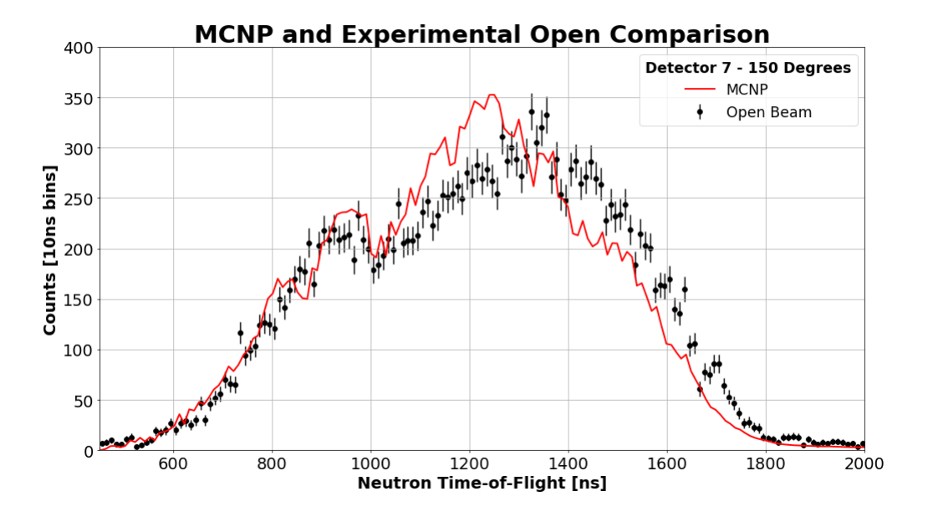
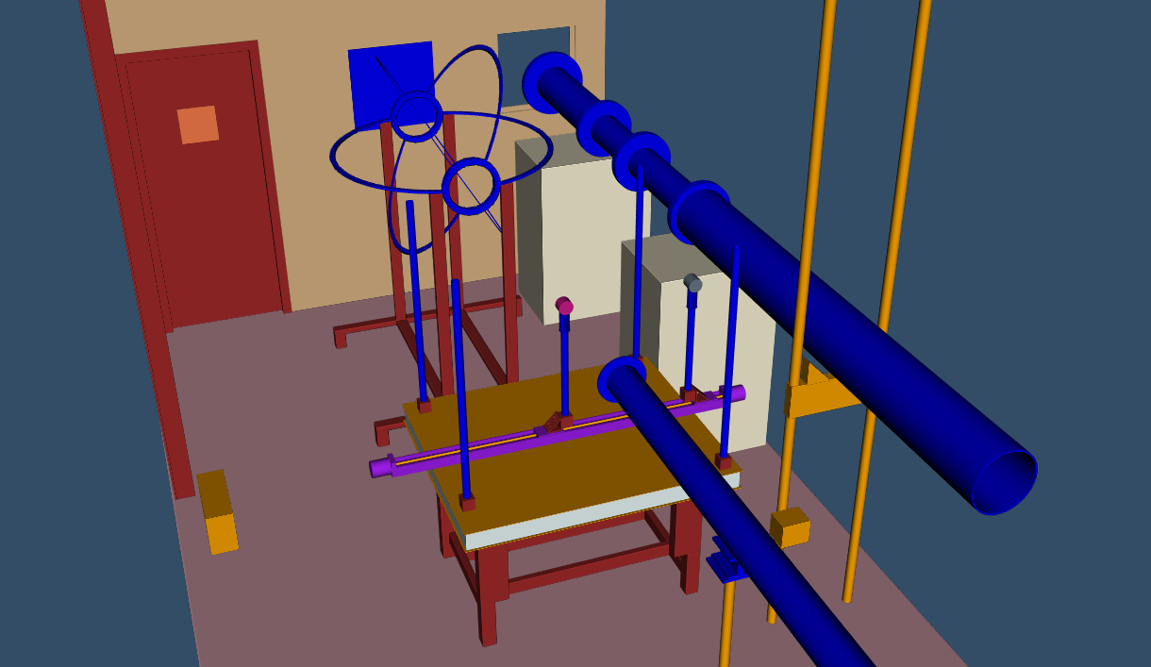
Improvements to MCNP Modeling
Improvements to the MCNP modeling of the experimental geometry are needed to further reduce the systematic uncertainty of the experiment using the normalization factor technique
Modeling of open beam needs improvement at 150-degree detector locations
Current Results
Future Implementation
Notes:
Discuss how mcnp model needs to be improved. Open at 150 degrees in not predicting well. Show preview of what new model looks like.

Slide 26
Acknowledgements
This work has been supported in part by:
U.S. Nuclear Regulatory Commission (NRC-HQ-60-17-G-0006)
Nuclear Criticality Safety Program, funded and managed by the National Nuclear Security Administration for the U.S. Department of Energy
Naval Nuclear Laboratory
Notes:
Acknowledge sponsors

