Slide 1
Using Neural Networks for Inelastic Neutron Scattering Cross-Sections Interpretation
Greg Henning, M. Kerveno, Ph. Dessagne
(Université de Strasbourg, Centre National de la Recherche Scientifique, IPHC UMR 7178, F-67000 Strasbourg, France)
In collaboration with Marie Vanstalle, Levana Gesson (Université de Strasbourg, CNRS, IPHC UMR 7178, F-67000 Strasbourg, France.)
With the help of Lucie Petit and Thomas Raymond (Master Students at Université de Strasbourg).
Greg Henning - WINS 2023 - Oct 10-12, 2023 - RPI, Troy NY, USA

Slide 2
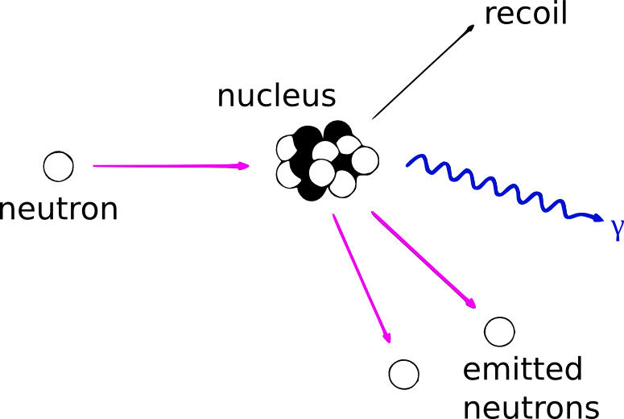
•••
Context: (n, n’ γ) cross section measurements
Motivations
Nuclear reactor developments rely on evaluated databases for numerical simulations.
However, these databases still present large uncertainties, preventing calculations from reaching the required precision [1].
An improvement of evaluated databases requires new measurements and better theoretical descriptions of involved reactions.
Additionally, with new fuel cycles using fast neutrons and/or different isotopes, current knowledge focused on ²³⁵U(n_{thermal},⁕) reaction is not enough to characterize properly Gen IV designs.
  Studies must be done on isotopes such as O, F, Na, Pb, ²³²Th, ²³³U, ²³⁹Pu, … with a focus on fast neutrons
[1] NEA/WPEC-26, "Uncertainty and Target Accuracy Assessment for Innovative Systems Using Recent Covariance Data Evaluations." (2008)
(n, n’ γ) cross section measurements
Inelastic neutron scattering are of great importance for the operation of a reactor as they modify the neutron spectrum, the neutron population, and produce new elements.
Constraining reaction models by measuring precisely exclusive (n,_xn γ) cross sections [2].
[2] "How to produce accurate inelastic cross sections from an indirect measurement method?" M. Kerveno et al., EPJ Nucl. Sci. Tech. 4, 23 (2018)
Greg Henning - WINS 2023 - Oct 10-12, 2023 - RPI, Troy NY, USA

Slide 3
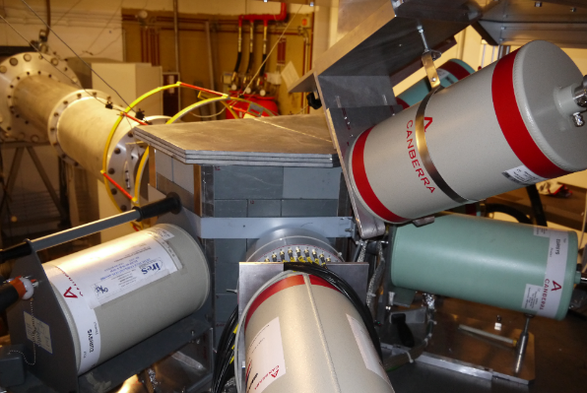
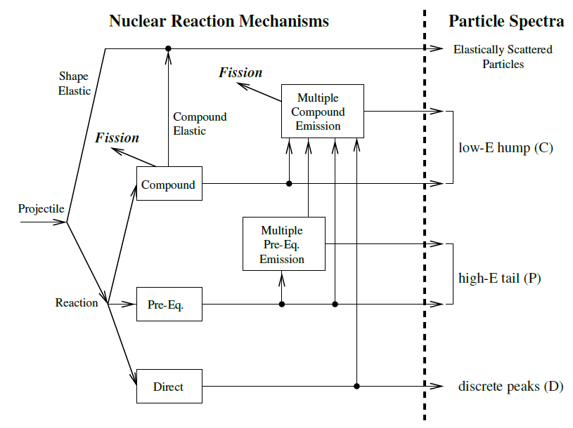
•••
Improving (n, n’) evaluation with exclusive (n, n’ γ) measurements
Measuring (n, n’γ) cross sections with GRAPhEME [1]
Installed at the Gelina facility (JRC-Geel).
30 m flight path.
Fission Chamber to measure incoming neutron flux.
6 planar HPGe, high efficiency and resolution at low E_{γ}.
Digital acquisition.
Measured : ²³⁵U, ²³²Th, ^{nat,182,183,184,186}W, ²³⁸U, ^{nat}Zr, ²³³U, ⁵⁷Fe, ²³⁹Pu
M. Kerveno et al,. EPJ Web of Conferences 239, 01023 (2020)
[1] "GRAPhEME : a setup to measure (n, xn γ) reaction cross sections." Greg Henning, et al.. Adv. in Nuc. Instr. Meas. Met. and App., 2015.
Inferring total (n, n’) cross section from (n, n’ γ) ones [2]
total (n, n’) σ computed by the model after constraining them with measurements
Relies on structure information, code accuracy.
Reaction models and codes
(input: structure, masses, optical potential, …)
Precise (n, n’ γ) experimental cross sections
[2] "How to produce accurate inelastic cross sections from an indirect measurement method?" M. Kerveno et al., EPJ Nuclear Sci. Technol. 4, 23 (2018)
Greg Henning - WINS 2023 - Oct 10-12, 2023 - RPI, Troy NY, USA

Slide 4
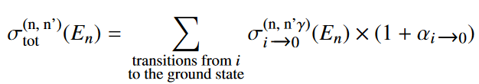
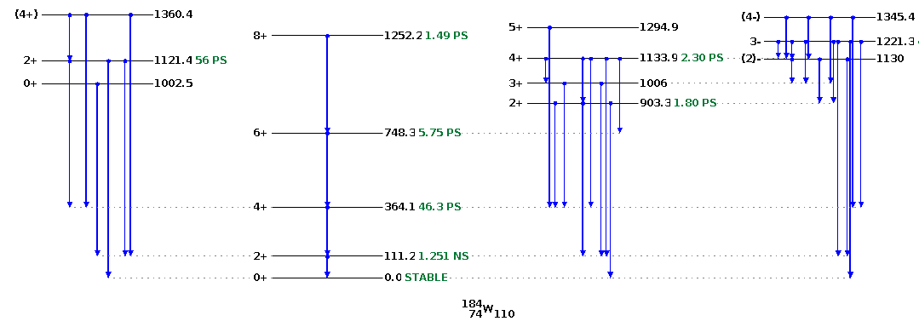
•••
Inferring total (n, n’) cross section from (n, n’ γ) ones
Weighted summation method:
Summing all transitions going to the ground state.
⚠ considering electronic conversion when summing (n, n'γ) cross sections.
[1] N. Dari Bako, et al. ND2022 - EPJ Web of Conf., 284 ,08005 (2023)
Greg Henning - WINS 2023 - Oct 10-12, 2023 - RPI, Troy NY, USA

Slide 5
•••
Inferring total (n, n’) cross section from (n, n’ γ) ones
Experimental limitations:
Not all transitions can be observed.
Workaround: use proxy transitions with appropriate Branching Ratio scaling.
Computed σ_{(n,n') total} is exact only up to a given E_{n}, above only a lower limit can be obtained.
This method can very quickly be limited, with a lot of scaling factors to compute just a lower bound of the σ_{(n, n')} .
Greg Henning - WINS 2023 - Oct 10-12, 2023 - RPI, Troy NY, USA

Slide 6

•••
Inferring total (n, n’) cross section from (n, n’ γ) ones
Going around some limitations:
Summing values with weights sounds like a task for a computer
Can the scaling coefficients (electronic conversion, BR, proxy...) be found automatically by a fit ?
Could a computer procedure maximize data usage (not only transitions to the g.s. or proxy of them) ?
💡 Using Neural Network
Using reaction code to generate training data set.
Input can be just (n, n' γ) cross sections, or be expanded by other variables (E_{n}, …)
The NN can be trained to predict different quantities and not just σ_{(n, n')}
Greg Henning - WINS 2023 - Oct 10-12, 2023 - RPI, Troy NY, USA

Slide 7
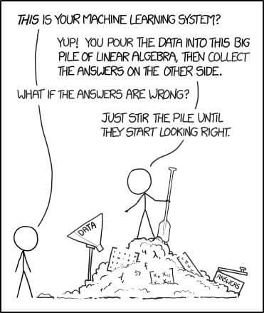
•••
Disclaimer
I have no specific training into Machine Learning / Neural Network / …
The work that I will now present is performed by following the How-to instructions as well as examples.
Greg Henning - WINS 2023 - Oct 10-12, 2023 - RPI, Troy NY, USA

Slide 8
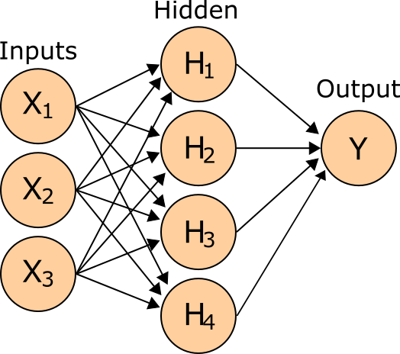

•••
Using Neural Network
Neural Network
A complex series of linear combination, with (sometime) activation function.
One input layer (input variables)
One or more Hidden layers
One (or more) Output.
Each node is fed the previous layer values with coefficients and function to produce the output :
Activation function may be f(x) = x, f(x) = max(0, x), f(x) = tanh(x), f(x) = 1 / (1 + exp(-x)), …
Once all the coefficients are determined, computing Y is simple math and fast.
Training the model is the long and technical part.
Objectives of this study : Train a Neural Network on Talys calculations to take (n, n' γ) cross sections as input and
produce cross sections in outputs.
Greg Henning - WINS 2023 - Oct 10-12, 2023 - RPI, Troy NY, USA

Slide 9
•••
Tools and ingredients
Tools
Talys 1.8 to compute cross sections
Python 3.8 and Jupyterlab 3.1 (running within WSL2 Ubuntu 20.04)
  Scikit-learn 1.3
  Matplotlib 3.4 for visualization
  Numpy 1.21 for data handling
Ingredients
σ_{(n, n')}, σ_{(n, n' γ)} and σ_{(n, n' Jπ)} computed by Talys for ¹⁸⁴W
Experimental (n, n' γ) cross sections (for ¹⁸⁴W)
Experimental ¹⁸⁴W(n, n' J^{π}) cross section from past experiment (via Exfor) [Guenther et al., 1982]
Documentation (https://scikit-learn.org/stable/modules/classes.html#module-sklearn.neural_network)
☕
Greg Henning - WINS 2023 - Oct 10-12, 2023 - RPI, Troy NY, USA

Slide 10
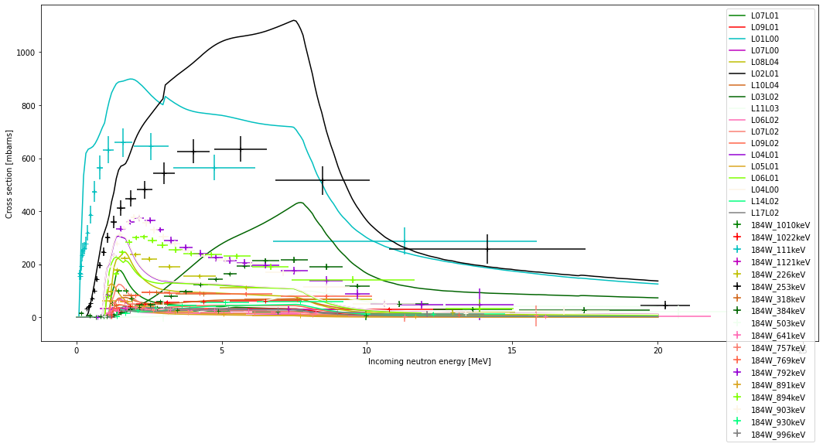
•••
Test case 1 : from (n, n' γ)s to (n, n' 2⁺₁)
Aim
(n, n' γ) cross sections measured with Grapheme are the only data of this kind → no point of comparison 😢
Using the NN to perform (n, n' γ)_{s} → (n, n' 2⁺₁) and compare with existing data [Guenther et al., 1982].
Collecting all (n, n'γ) cross section obtained experimentally and the matching Talys calculations.
Greg Henning - WINS 2023 - Oct 10-12, 2023 - RPI, Troy NY, USA

Slide 11
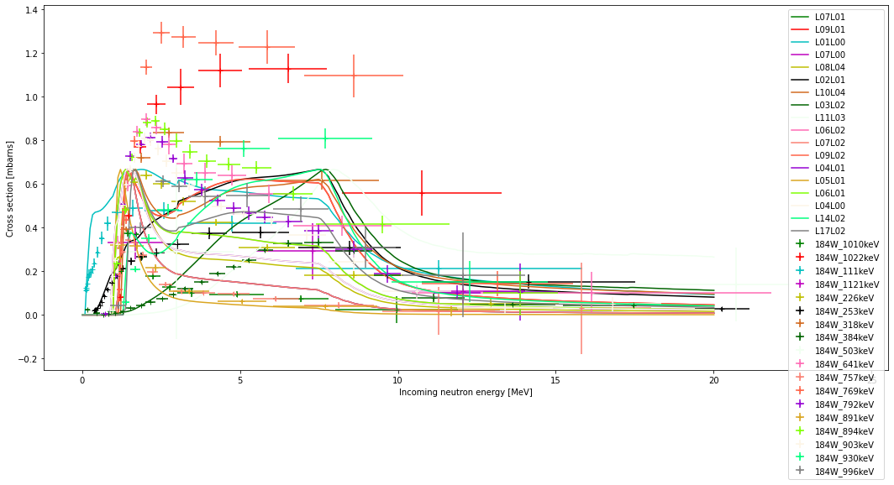
•••
Test case 1 : from (n, n' γ)s to (n, n' 2⁺₁)
Aim
(n, n' γ) cross sections measured with Grapheme are the only data of this kind → no point of comparison 😢
Using the NN to perform (n, n' γ)_{s} → (n, n' 2⁺₁) and compare with existing data [Guenther et al., 1982].
Collecting all (n, n'γ) cross section obtained experimentally and the matching Talys calculations.
Scaling them to 2/3 of the Talys maximum so that the NN input are between 0 and 1.
  We notice that some scaled experimental σ are larger than 1.
  It's okay, the NN can manage values larger than 1.
Greg Henning - WINS 2023 - Oct 10-12, 2023 - RPI, Troy NY, USA

Slide 12
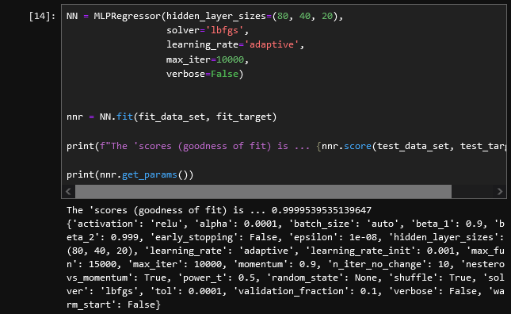
•••
Test case 1 : from (n, n' γ)s to (n, n' 2⁺₁)
Aim
(n, n' γ) cross sections measured with Grapheme are the only data of this kind → no point of comparison 😢
Using the NN to perform (n, n' γ)_{s} → (n, n' 2⁺₁) and compare with existing data [Guenther et al., 1982].
Collecting all (n, n'γ) cross section obtained experimentally and the matching Talys calculations.
Scaling them to 2/3 of the Talys maximum so that the NN input are between 0 and 1.
Training the model (input is split between Fit and Test series)
Greg Henning - WINS 2023 - Oct 10-12, 2023 - RPI, Troy NY, USA

Slide 13
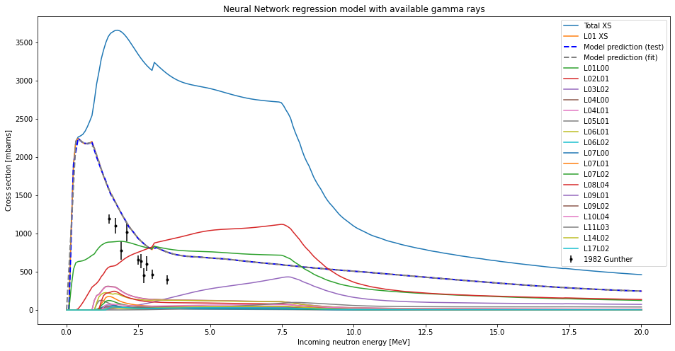
•••
Test case 1 : from (n, n' γ)s to (n, n' 2⁺₁)
Aim
(n, n' γ) cross sections measured with Grapheme are the only data of this kind → no point of comparison 😢
Using the NN to perform (n, n' γ)_{s} → (n, n' 2⁺₁) and compare with existing data [Guenther et al., 1982].
Collecting all (n, n'γ) cross section obtained experimentally and the matching Talys calculations.
Scaling them to 2/3 of the Talys maximum so that the NN input are between 0 and 1.
Training the model (input is split between Fit and Test series)
Testing...
Greg Henning - WINS 2023 - Oct 10-12, 2023 - RPI, Troy NY, USA

Slide 14
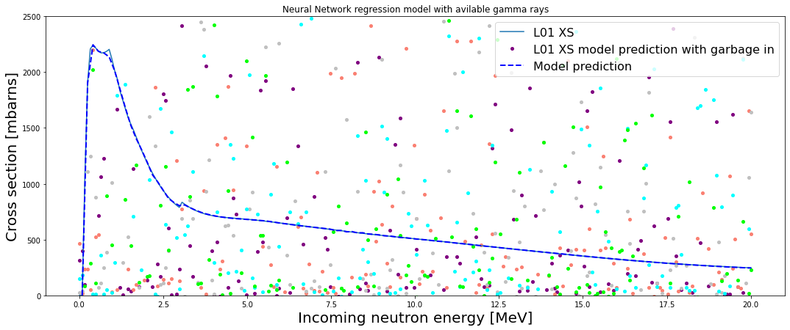
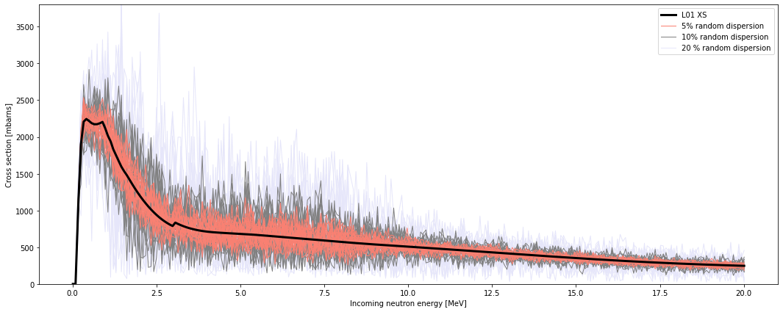
•••
Test case 1 : from (n, n' γ)s to (n, n' 2⁺₁)
Aim
(n, n' γ) cross sections measured with Grapheme are the only data of this kind → no point of comparison 😢
Using the NN to perform (n, n' γ)_{s} → (n, n' 2⁺₁) and compare with existing data [Guenther et al., 1982].
Testing
  Garbage in / garbage out
  Input variations around nominal value
Greg Henning - WINS 2023 - Oct 10-12, 2023 - RPI, Troy NY, USA

Slide 15
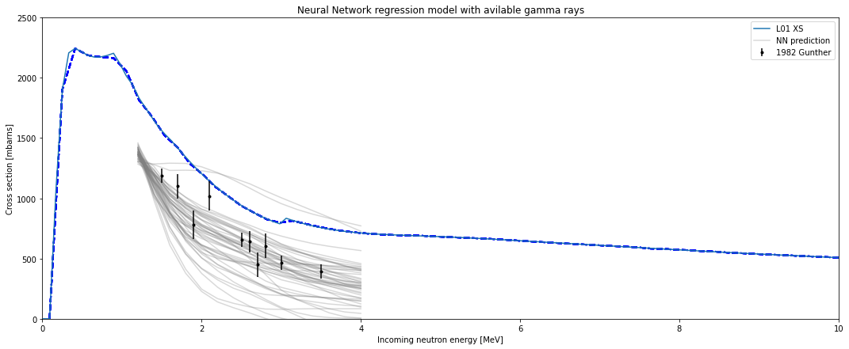
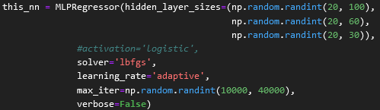
•••
Test case 1 : from (n, n' γ)s to (n, n' 2⁺₁)
Aim
(n, n' γ) cross sections measured with Grapheme are the only data of this kind → no point of comparison 😢
Using the NN to perform (n, n' γ)_{s} → (n, n' 2⁺₁) and compare with existing data [Guenther et al., 1982].
Testing
  Randomize hidden layers size and test the stability of prediction
Clear spread in results, but one can see that by using a large series of NN, a central value and uncertainty can be derived, that’s compatible with [Guenther].
Greg Henning - WINS 2023 - Oct 10-12, 2023 - RPI, Troy NY, USA

Slide 16
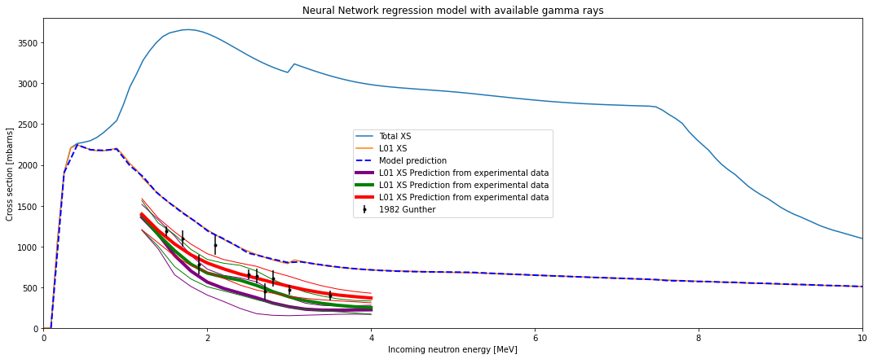
•••
Test case 1 : from (n, n' γ)s to (n, n' 2⁺₁)
Aim
(n, n' γ) cross sections measured with Grapheme are the only data of this kind → no point of comparison 😢
Using the NN to perform (n, n' γ)_{s} → (n, n' 2⁺₁) and compare with existing data [Guenther et al., 1982].
Result:
  With 3 different NN,
  Randomization of experimental values according to their uncertainty
  Extraction of central value and standard deviation.
σ_{L01} derived with NN trained on Talys from experimental σ_{(n,n'γ)} is compatible with previous reference.
This first case gives confidence in the experimental data and encourages us to continue investigating the use of NN.
Greg Henning - WINS 2023 - Oct 10-12, 2023 - RPI, Troy NY, USA

Slide 17
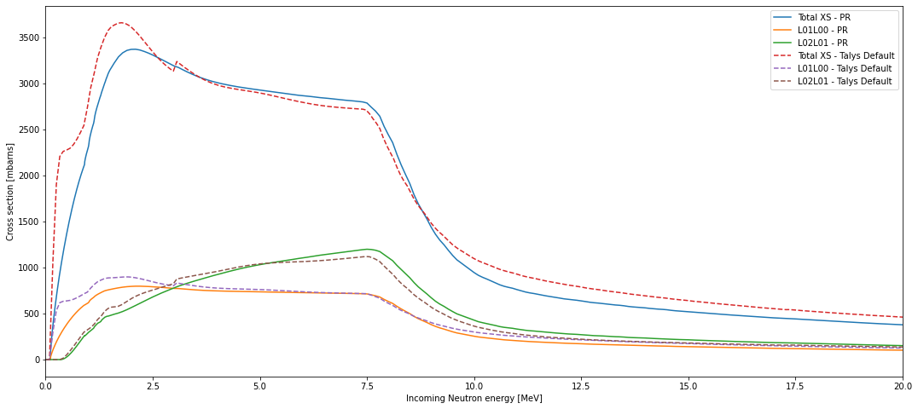
•••
Test case 2 : from (n, n' γ)s to (n, n' )
Aim
(n, n' γ) cross sections measured with Grapheme.
Combining them using NN into the total (n, n')
Using the same strategy as before.
  Data scaling,
  Multiple NN,
  Experimental σ_{(n,n'γ)} variation
Training the NNs on two different data set: Talys default and Pascal Romain's Calculation.
Greg Henning - WINS 2023 - Oct 10-12, 2023 - RPI, Troy NY, USA

Slide 18
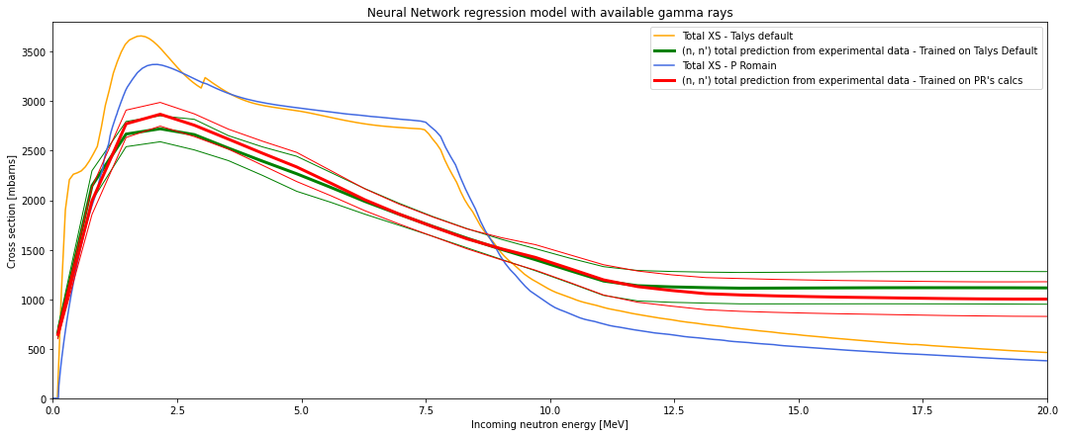
•••
Test case 2 : from (n, n' γ)s to (n, n' )
Aim
(n, n' γ) cross sections measured with Grapheme.
Combining them using NN into the total (n, n')
NNs trained on the two different inputs predict compatible σ(n,n').
NNs predictions are below Talys calculation in amplitude, an issue we know about from the L01L00 transition experimental σ.
NN derived total (n,n') cross section is consistent with what we see in the individual (n, n'γ)
Greg Henning - WINS 2023 - Oct 10-12, 2023 - RPI, Troy NY, USA

Slide 19
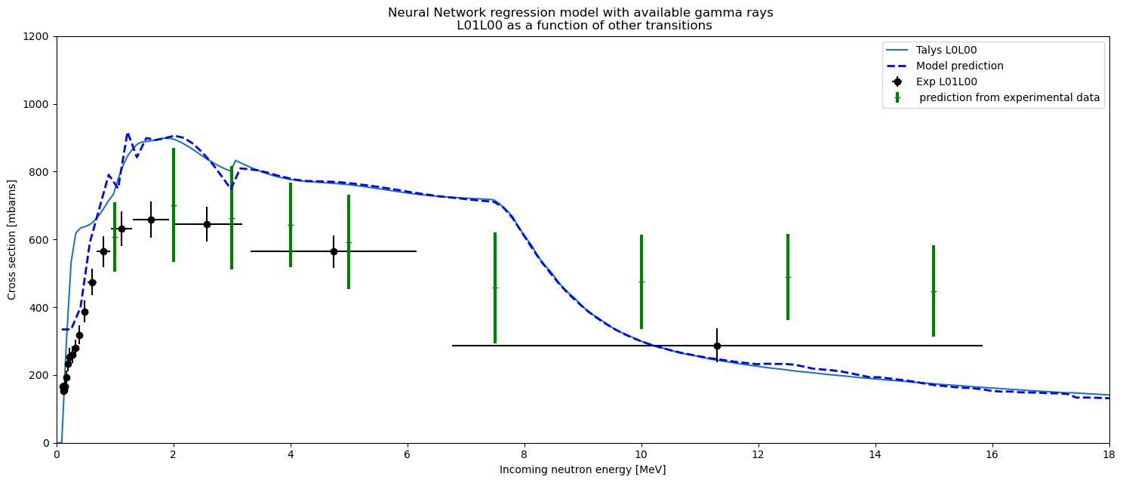
•••
Test case 3 : from (n, n' γ)s to (n, n' γ_{L01L00})
Why
(n, n' γ) cross section for 2+ -> g.s. is well below model prediction.
Can we check the consistency of all other measured gamma rays against this one ?
Many NNs trained on (n, n' γ_{LxxLyy}) → (n, n' γ_{L01L00}).
Not a very conclusive output : NN prediction is compatible with experimental (n, n' γ_{L01L00}) without being too far off from the Talys calculations.
NN derived 2+ → g.s. cross section is compatible with the one experimentally observed and with calculations...
Greg Henning - WINS 2023 - Oct 10-12, 2023 - RPI, Troy NY, USA

Slide 20
•••
Conclusion and perspectives
Aim
The objective was to try using Neural Networks to help interpret experimental (n, n' γ) cross sections
This is preliminary results, using NN naïvely
NN training using Talys calculations
First results
NN was able to turn (n, n'γ)s into (n,n' level) and (n, n') cross sections
Stability, consistency, … of NN was tested.
Interest
Quickly pivot data from (n, n'γ) to (n,n' level) (for example) to validate experimental data set when no direct comparison is possible.
Can be used to check consistency of data
Provide an experimental (n, n'γ) → (n, n') conversion constrained by models in a very fast way.
Outlook
Improve NN hyper parameters (discuss with experts – get trainning)
Still far away from using NNs or other Big Data large model to evaluate nuclear data, but it can be an interesting tool.
Collaboration with particle therapy team in IPHC, for large scale nuclear reaction cross section generation.
Greg Henning - WINS 2023 - Oct 10-12, 2023 - RPI, Troy NY, USA

