Slide 1

Neutron inelastic cross-sections on ⁴⁰Ca
Marian Boromiza¹, Catalin Borcea¹, Philippe Dessagne², Greg Henning², Maëlle Kerveno², Alexandru Negret¹, Markus Nyman³, Adina Olacel¹, Andreea Oprea³, Carlos Paradela³, Arjan Plompen³
¹Horia Hulubei National Institute for Physics and Nuclear Engineering, Bucharest-Magurele, Romania
²Universitẻ de Strasbourg, CNRS, IPHC Strasbourg, France
³European Commission, Joint Research Center, Geel, Belgium
*WORK SUPPORTED BY ROMANIAN FUNDING AGENCIES THROUGH RESEARCH GRANT PN-III-P1-1.1-PD-2021-0207
WINS2023, October 10-12, Troy

Slide 2
The content of this presentation
The content of this presentation
scientific motivation for performing the experiment
experimental setup
data analysis procedure
experimental results
WINS2023, October 10-12, Troy

Slide 3
The content of this presentation
scientific motivation for performing the experiment
experimental setup
data analysis procedure
experimental results
WINS2023, October 10-12, Troy

Slide 4
Scientific motivation - I
ADDRESSING NUCLEAR DATA NEEDS ON ⁴⁰Ca:
Inelastic scattering is one of the main neutron energy loss mechanisms inside a reactor
Main isotope: ⁴⁰Ca makes up 96.9% of natural calcium
LiF-CaF₂ melt - promising candidate for GEN IV Molten Salt Reactors (MSRs)
  fuel candidates for MSRs: fluorides of fissile (UF₄) and fertile (ThF₄) elements
  dissolved in carrier salts
  very good online processing capabilities of the burned fuel (via electrochemical
  separation of both uranium and thorium and most of the fission products)
Status of the experimental data prior to our experiment:
  only 3 (angle-integrated) γ-production cross section points at 17 and 22 MeV
  for the main transition (3736 keV)
  no angle-integrated data below 17 MeV
  one data set of differential (measured at 90º) cross section values
  one data set with level cross section values in the low neutron energy region (4-6 MeV)
WINS2023, October 10-12, Troy

Slide 5
Scientific motivation - II
AIDING THE THEORY SIDE:
Providing reliable and very low uncertainty reaction
observables for the continuous refinement of
reaction models
reaction codes: TALYS, EMPIRE...
The incident energy range of interest for our group: few hundreds keV to 20 MeV
mainly inelastic channel
WINS2023, October 10-12, Troy

Slide 6
Scientific motivation - III
EXPLORATORY STUDIES:
Not (really) covered in today’s talk!!!
WINS2023, October 10-12, Troy

Slide 7
Scientific motivation - III
EXPLORATORY STUDIES:
Not (really) covered in today’s talk!!!
“Surrogate”-type approach for the inelastic channel:
Inferring neutron cross sections from charged particles-induced reactions
TRY NO. 1:
²⁸Si(n, n'γ )²⁸Si vs ²⁵Mg(α, nγ )²⁸Si
²⁹Si*
A. Negret et al., Phys. Rev. C 88, 034604 (2013)
Bohr hypothesis for compound nucleus CN (which dominates at low incident energies)
WINS2023, October 10-12, Troy

Slide 8
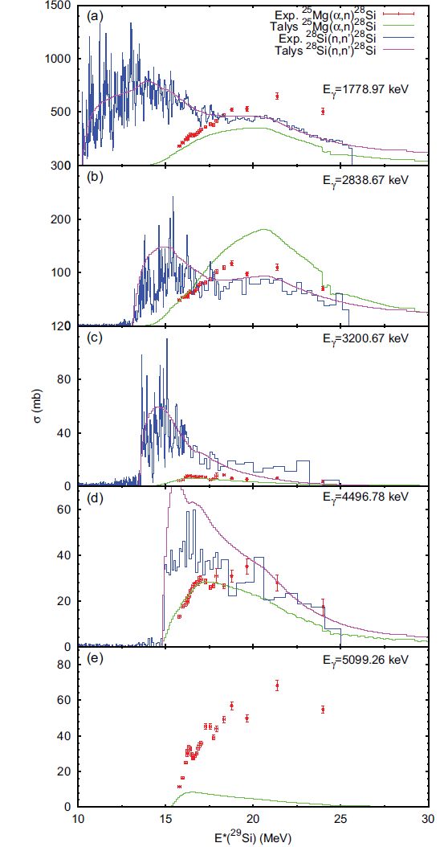
Scientific motivation - III
TAKE AWAY MESSAGE:
The γ-production cross sections excited in the two reactions are indeed of the same order of magnitude, BUT an attempt to directly relate the (n,n’) channel and its surrogate yields uncertainties of at least 50%.
FIG. 5 A. Negret, et al., Phys. Rev. C 88, 034604 (2013) Gamma production cross sections in the ²⁸Si(n, n’γ )²⁸Si and the ²⁵Mg(α, nγ )²⁸Si reactions as a function of the excitation energy in the compound nucleus ²⁹Si
WINS2023, October 10-12, Troy

Slide 9
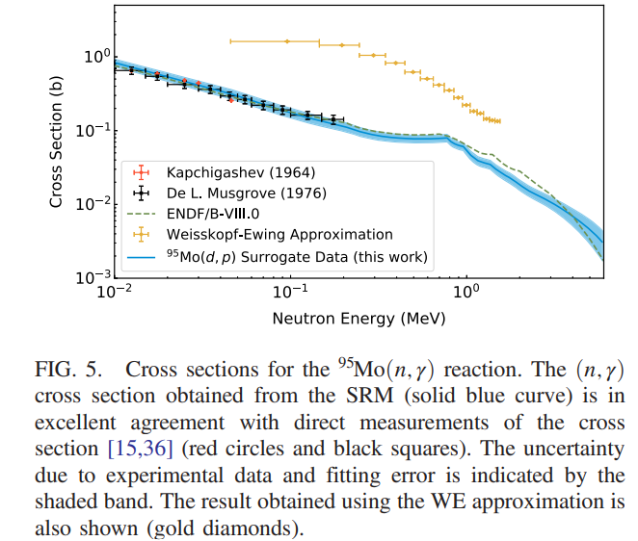
Scientific motivation - III
Surrogate study for ⁹⁵Mo(n,γ)
A. Ratkiewicz, J. E. Escher, et al. PHYSICAL REVIEW LETTERS 122, 052502 (2019)
WHY IS THIS NOT WORKING FOR THE INELASTIC CHANNEL?
It seems that for both capture and inelastic channels one needs, on a target-by-target basis, a very detailed handling of the CN spin-parity population differences
NOT TRIVIAL!!!
Oliver C. Gorton, J. E. Escher, PHYSICAL REVIEW C 107, 044612 (2023)
WINS2023, October 10-12, Troy

Slide 10
Scientific motivation - III
“Surrogate”-type approach for the inelastic channel:
Inferring neutron cross sections from proton-induced reactions
TRY NO. 2:
WINS2023, October 10-12, Troy

Slide 11
Scientific motivation - III
“Surrogate”-type approach for the inelastic channel:
Inferring neutron cross sections from proton-induced reactions
TRY NO. 2:
Minimize the OMP differences
WINS2023, October 10-12, Troy

Slide 12
Scientific motivation - III
“Surrogate”-type approach for the inelastic channel:
Inferring neutron cross sections from proton-induced reactions
TRY NO. 2:
Minimize the OMP differences
¹⁶O(n, n’γ)¹⁶O versus ¹⁶O(p, p’γ)¹⁶O
CN: ¹⁷O
CN: ¹⁷F
Not the same compound nucleus (as in the above study)
Now we make use of the isospin symmetry
WINS2023, October 10-12, Troy

Slide 13
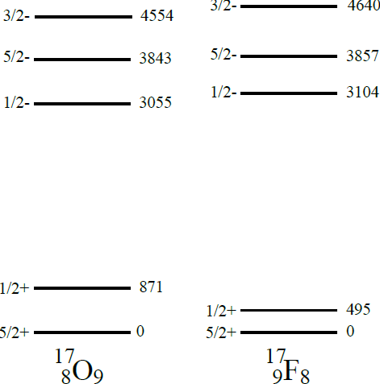
Scientific motivation - III
Partial level schemes of ¹⁷O and ¹⁷F mirror nuclei through which
the two corresponding neutron and proton reactions on ¹⁶O proceed
WINS2023, October 10-12, Troy

Slide 14
Scientific motivation - III
EXPLORATORY STUDIES:
“Surrogate”-type approach for the inelastic channel:
Inferring neutron cross sections from charged particles-induced reactions
TRY NO. 2:
NOT REALLY A SURROGATE!!!
WINS2023, October 10-12, Troy

Slide 15
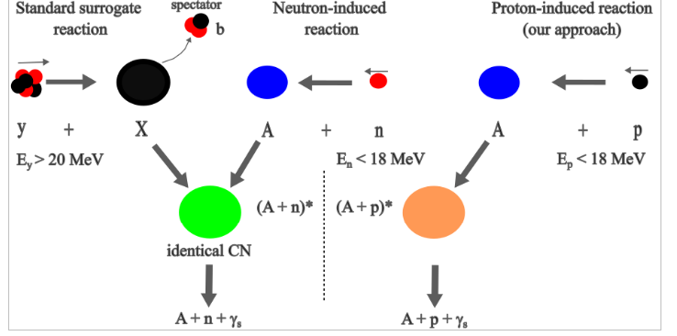
Scientific motivation - III
Complementary to “standard” surrogate!
- very different OMPs in the input channel
- identical residual/final nuclei
- Weisskopf-Ewing limit of CN reactions MUST hold
VERSUS
- extremely similar OMPs in the input channel
- different CN => nuclear structure-induced differences☹
- we do not really care about the Weisskopf-Ewing approximation☺
WINS2023, October 10-12, Troy

Slide 16
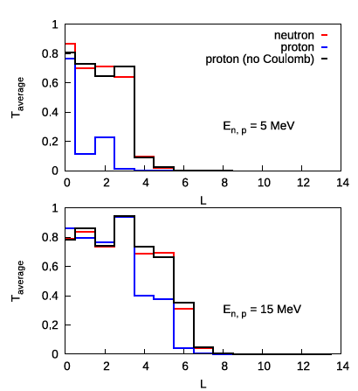
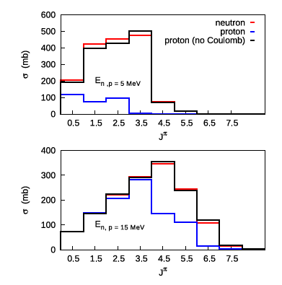
Scientific motivation - III
Results for ⁵⁸Ni
A. Olacel, M. Boromiza* et al., ., Phys. Rev. C 106, 024609 (2022)
Different reaction observables for 3 projectiles: a neutron, a proton and a proton whose Coulomb term was removed from the proton-⁵⁸Ni OMP
J populated in CN
Transmission coefficients populated in CN
WINS2023, October 10-12, Troy

Slide 17
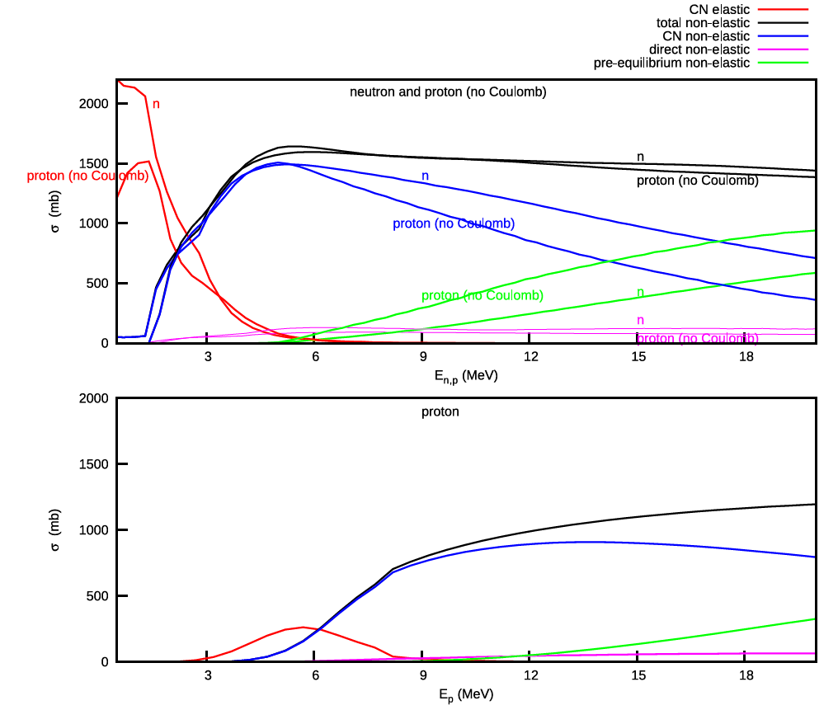
Scientific motivation - III
Different reaction contributions for 3 projectiles: a neutron, a proton and a proton whose Coulomb term was removed from the proton-⁵⁸Ni OMP
Results for ⁵⁸Ni
A. Olacel, M. Boromiza* et al., ., Phys. Rev. C 106, 024609 (2022)
WINS2023, October 10-12, Troy

Slide 18
Scientific motivation - III
Inferring the neutron inelastic channel from proton-induced cross sections
Inspired by the surrogate reactions method
A combination of experiment & theory
Nuclei studied so far:
- ¹⁶O & ²⁸Si: M. Boromiza et al., Phys. Rev. C 101, 024604 (2020)
⁵⁸Ni: A. Olacel, M. Boromiza* et al., Phys. Rev. C 106, 024609 (2022)
UP NEXT: ⁴⁰Ca!!!
WHY?
a) determining the neutron cross sections from a much simpler-to-measure reaction
b) extracting information about the isospin-dependent term & Lane consistency of the nucleon-target OMP
Not (really) covered in today’s talk!!!
THE GENERAL IDEA:
Starting from a Lane-consistent proton OMP, tune this potential on proton experimental data
Construct/infer a Lane-consistent neutron-like OMP from the proton case above
  drop its Coulomb term
  invert the sign of its Lane term
  …
Calculate proton-inferred neutron-like inelastic cross sections
Compare to the experimental data actually measured at GELINA
WINS2023, October 10-12, Troy

Slide 19
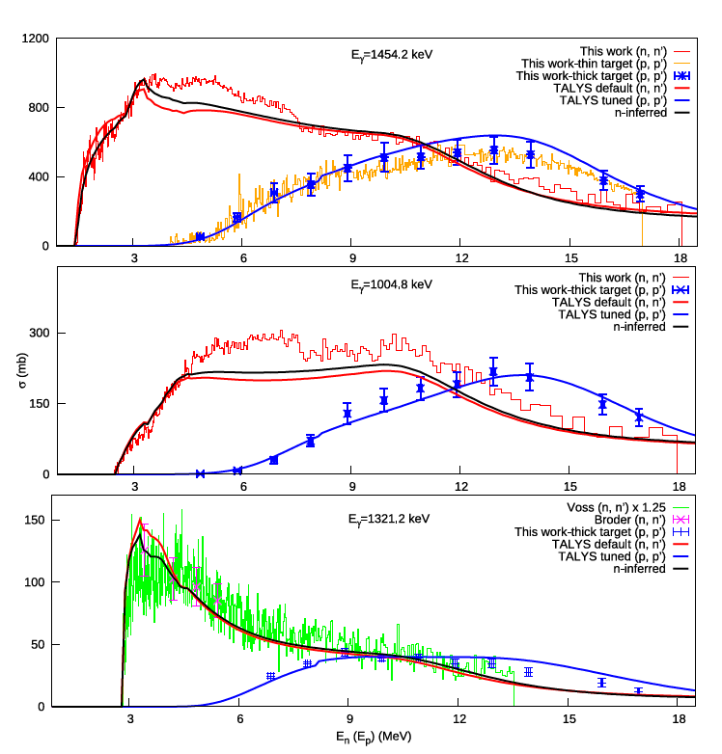
Scientific motivation - III
HOW WELL DOES THIS WORK?
thus far…
Results for ⁵⁸Ni
A. Olacel, M. Boromiza* et al., published in PRC (26 July, 2022)
WINS2023, October 10-12, Troy

Slide 20
Experimental setup
The content of this presentation
scientific motivation for performing the experiment
experimental setup
data analysis procedure
experimental results
WINS2023, October 10-12, Troy

Slide 21
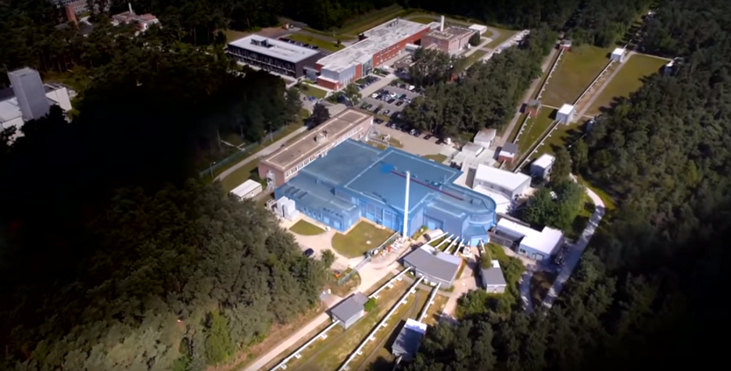
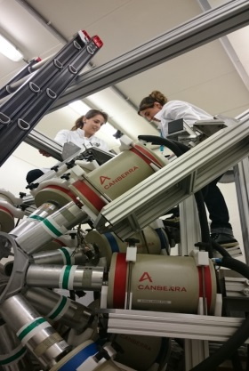
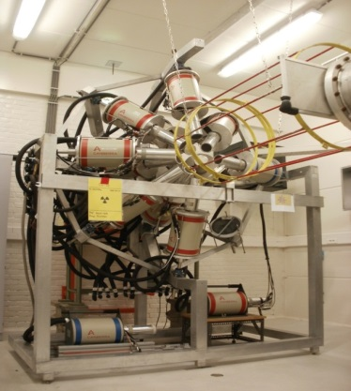
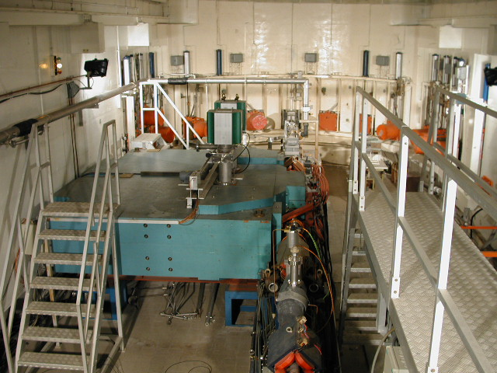
Experimental setup
Neutron inelastic scattering cross section measurements @ GELINA
WINS2023, October 10-12, Troy

Slide 22
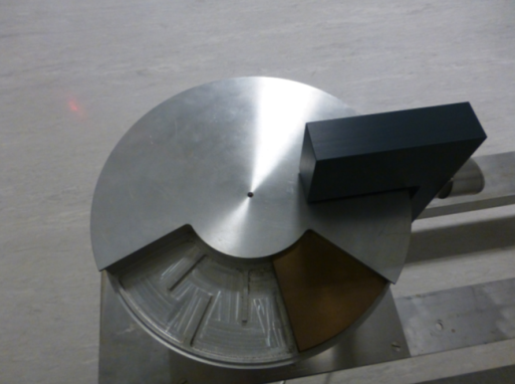
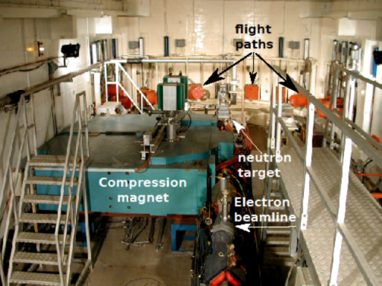
Experimental setup
GELINA
Geel Eelectron LiNear Accelerator
Linear accelerator
    E_{e} ≈ 70 – 140 MeV
    Δt < 1-2 ns
Rotating depleted uranium target
0 < E_{n} < 20 MeV
Multi-user facility
Flight paths and measurement
cabins: 10 ÷ 400 m
Time-of-Flight (ToF) technique
High resolution measurements
WINS2023, October 10-12, Troy

Slide 23
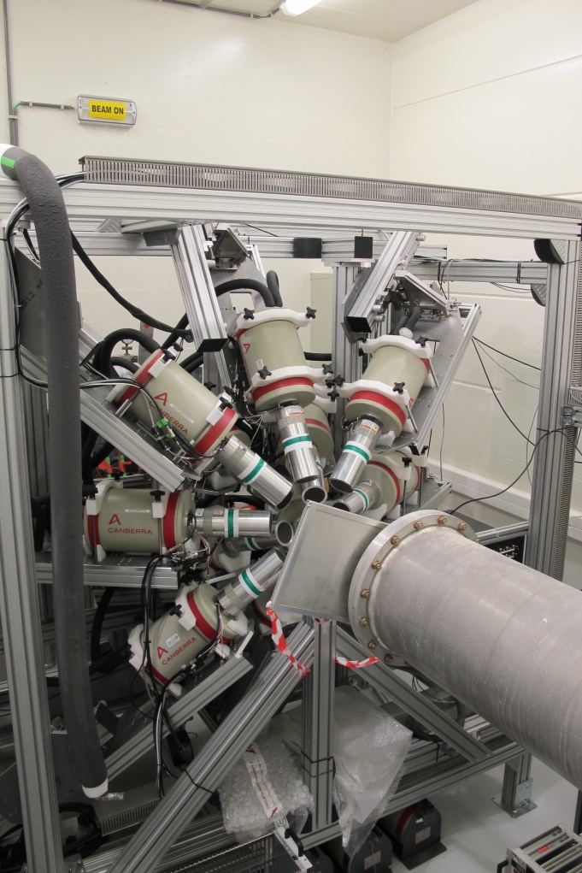
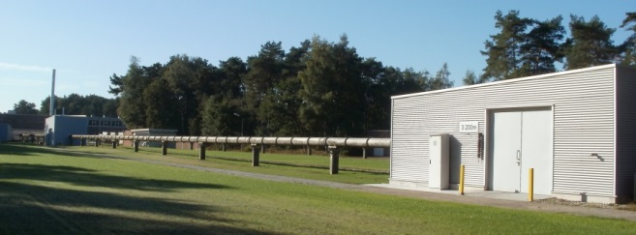
Experimental setup
Flight path 3 @ 100 m
  good neutron energy resolution
  @ 100 m: 3 keV at 1 MeV, 80 keV at 10 MeV
12 HPGe detectors @ 110º, 150º and 125º, d=17 cm
Large volume: relative efficiency 100%
FWHM typically ≈ 3 keV @ 1332 keV (⁶⁰Co)
Digital acquisition (ACQIRIS digitizers)
  12 bit amplitude resolution (4096 channels)
  420 MS/s (2.38 ns sampling period)
GAINS
Gamma Array for Inelastic Neutron Scattering
Target: calcium fluoride compound (CaF₂)
Fission chamber (with ²³⁵U deposits) to monitor
the neutron flux - ²³⁵U(n,f) normalization
Time of Flight (ToF) & γ-spectroscopy techniques:
  n time of flight → E_{n}
  pulse amplitude → E_{γ}
WINS2023, October 10-12, Troy

Slide 24
Preparing the experiment: main difficulties
The content of this presentation
Target preparation: compound CaF₂ (as ⁴⁰Ca has a 96.9 % natural abundance):
  Weak transitions: thick target
  Keep the γ self-attenuation + MSC to reasonable values
  2 mm thickness and 76 mm diameter (beam: 61 mm)
Very high energy γ rays: 3736 keV (3⁻),
3903 keV (2⁺) and 5248 keV (2⁺):
  large volume HPGe
  tricky efficiency extrapolation up to 4 or even 5 MeV
WINS2023, October 10-12, Troy

Slide 25
Preparing the experiment: main difficulties
The content of this presentation
⁴⁰Ca HPGe efficiency
WINS2023, October 10-12, Troy

Slide 26
Preparing the experiment: main difficulties
The content of this presentation
Target preparation: compound CaF₂ (as ⁴⁰Ca has a 96.9 % natural abundance):
  Weak transitions: thick target
  Keep the γ self-attenuation + MSC to reasonable values:
  2 mm thickness and 76 mm diameter (beam: 61 mm)
Very high energy γ rays: 3736 keV (3⁻),
3903 keV (2⁺) and 5248 keV (2⁺):
  large volume HPGe
  tricky efficiency extrapolation up to 4 or even 5 MeV
WINS2023, October 10-12, Troy

Slide 27
Preparing the experiment: main difficulties
The content of this presentation
Target preparation: compound CaF₂ (as ⁴⁰Ca has a 96.9 % natural abundance):
  Weak transitions: thick target
  Keep the γ self-attenuation + MSC to reasonable values:
  2 mm thickness and 76 mm diameter (beam: 61 mm)
Very high energy γ rays: 3736 keV (3⁻),
3903 keV (2⁺) and 5248 keV (2⁺):
  large volume HPGe
  tricky efficiency extrapolation up to 4 or even 5 MeV
3352 keV E0-totally converted☹
WINS2023, October 10-12, Troy

Slide 28
Preparing the experiment: main difficulties
The content of this presentation
⁴⁰Ca
WINS2023, October 10-12, Troy

Slide 29
Preparing the experiment: main difficulties
The content of this presentation
Target preparation: compound CaF₂ (as ⁴⁰Ca has a 96.9 % natural abundance):
  Weak transitions: thick target
  Keep the γ self-attenuation + MSC to reasonable values:
  2 mm thickness and 76 mm diameter (beam: 61 mm)
Very high energy γ rays: 3736 keV (3⁻),
3903 keV (2⁺) and 5248 keV (2⁺):
  large volume HPGe
  tricky efficiency extrapolation up to 4 or even 5 MeV
3352 keV E0-totally converted☹
WINS2023, October 10-12, Troy

Slide 30
Preparing the experiment: main difficulties
The content of this presentation
Target preparation: compound CaF₂ (as ⁴⁰Ca has a 96.9 % natural abundance):
  Weak transitions: thick target
  Keep the γ self-attenuation + MSC to reasonable values:
  2 mm thickness and 76 mm diameter (beam: 61 mm)
Very high energy γ rays: 3736 keV (3⁻),
3903 keV (2⁺) and 5248 keV (2⁺):
  large volume HPGe
  tricky efficiency extrapolation up to 4 or even 5 MeV
3352 keV E0-totally converted☹
Additional transitions? Maybe 754 keV…
WINS2023, October 10-12, Troy

Slide 31
Preparing the experiment: main difficulties
The content of this presentation
WINS2023, October 10-12, Troy

Slide 32
Preparing the experiment: main difficulties
The content of this presentation
Target preparation: compound CaF₂ (as ⁴⁰Ca has a 96.9 % natural abundance):
  Weak transitions: thick target
  Keep the γ self-attenuation + MSC to reasonable values:
  2 mm thickness and 76 mm diameter (beam: 61 mm)
Very high energy γ rays: 3736 keV (3⁻),
3903 keV (2⁺) and 5248 keV (2⁺):
  large volume HPGe
  tricky efficiency extrapolation up to 4 or even 5 MeV
3352 keV E0-totally converted☹
Additional transitions? Maybe 754 keV…
WINS2023, October 10-12, Troy

Slide 33
Preparing the experiment: main difficulties
The content of this presentation
Target preparation: compound CaF₂ (as ⁴⁰Ca has a 96.9 % natural abundance):
  Weak transitions: thick target
  Keep the γ self-attenuation + MSC to reasonable values:
  2 mm thickness and 76 mm diameter (beam: 61 mm)
Very high energy γ rays: 3736 keV (3⁻),
3903 keV (2⁺) and 5248 keV (2⁺):
  large volume HPGe
  tricky efficiency extrapolation up to 4 or even 5 MeV
3352 keV E0-totally converted☹
Additional transitions? Maybe 754 keV…
We expected Doppler broadenings of the peaks of interest: T_{1/2} of 41 ps (3736 keV) and 35 fs (3903 keV)
WINS2023, October 10-12, Troy

Slide 34
Preparing the experiment: main difficulties
The content of this presentation
SRIM stopping powers for ⁴⁰Ca:
-> yield around 0.5-1 ps stopping time
¹⁶O
3736 keV (41 ps)
(5 fs)
3903 keV (35 fs)
¹⁶O
⁴⁰Ca
(125 fs)
WINS2023, October 10-12, Troy

Slide 35
Preparing the experiment: main difficulties
The content of this presentation
Target preparation: compound CaF₂ (as ⁴⁰Ca has a 96.9 % natural abundance):
  Weak transitions: thick target
  Keep the γ self-attenuation + MSC to reasonable values:
  2 mm thickness and 76 mm diameter (beam: 61 mm)
Very high energy γ rays: 3736 keV (3⁻),
3903 keV (2⁺) and 5248 keV (2⁺):
  large volume HPGe
  tricky efficiency extrapolation up to 4 or even 5 MeV
3352 keV E0-totally converted☹
Additional transitions? Maybe 754 keV…
We expected Doppler broadenings of the peaks of interest: T_{1/2} of 41 ps (3736 keV) and 35 fs (3903 keV)
WINS2023, October 10-12, Troy

Slide 36
Preparing the experiment: main difficulties
The content of this presentation
Target preparation: compound CaF₂ (as ⁴⁰Ca has a 96.9 % natural abundance):
  Weak transitions: thick target
  Keep the γ self-attenuation + MSC to reasonable values:
  2 mm thickness and 76 mm diameter (beam: 61 mm)
Very high energy γ rays: 3736 keV (3⁻),
3903 keV (2⁺) and 5248 keV (2⁺):
  large volume HPGe
  tricky efficiency extrapolation up to 4 or even 5 MeV
3352 keV E0-totally converted☹
Additional transitions? Maybe 754 keV…
We expected Doppler broadenings of the peaks of interest: T_{1/2} of 41 ps (3736 keV) and 35 fs (3903 keV)
Possible contaminants from other reaction channels, mainly ⁴⁰Ca(n,p)⁴⁰K
WINS2023, October 10-12, Troy

Slide 37
Preparing the experiment: main difficulties
The content of this presentation
WINS2023, October 10-12, Troy

Slide 38
Data analysis
scientific motivation for performing the experiment
experimental setup
data analysis procedure
experimental results
WINS2023, October 10-12, Troy

Slide 39
Detection technique: γ spectroscopy
The content of this presentation
Neutron inelastic scattering reaction:
n + ^{A}_{Z}X_{N}
^{A+1}_{Z}X_{N+1}*
CN
^{A}_{Z}X_{N}* + n’
E_{n}=E_{th} ÷ ~20 MeV
E* ≈ E_{n} – E_{n}’
^{A}_{Z}X_{N} + γ
Inelastic cross section: detect outgoing neutrons or gammas
Direct access to Level cross sections
γ-production cross sections
Indirect access to
Level cross section + Total inelastic cross section
WINS2023, October 10-12, Troy

Slide 40
Data analysis
γ−spectroscopy measurements coupled with time of flight method
we extract cross sections normalized to the very well known ²³⁵U(n, fission) cross section
WINS2023, October 10-12, Troy

Slide 41
Data analysis
γ−spectroscopy measurements coupled with time of flight method
we extract cross sections normalized to the very well known ²³⁵U(n, fission) cross section
HPGe detectors
WINS2023, October 10-12, Troy

Slide 42
Data analysis
γ−spectroscopy measurements coupled with time of flight method
we extract cross sections normalized to the very well known ²³⁵U(n, fission) cross section
HPGe detectors
γ yield
WINS2023, October 10-12, Troy

Slide 43
Data analysis
γ−spectroscopy measurements coupled with time of flight method
we extract cross sections normalized to the very well known ²³⁵U(n, fission) cross section
HPGe detectors
γ yield
Fission chamber
WINS2023, October 10-12, Troy

Slide 44
Data analysis
γ−spectroscopy measurements coupled with time of flight method
we extract cross sections normalized to the very well known ²³⁵U(n, fission) cross section
HPGe detectors
γ yield + fission chamber yield
Fission chamber
WINS2023, October 10-12, Troy

Slide 45
Data analysis
γ−spectroscopy measurements coupled with time of flight method
we extract cross sections normalized to the very well known ²³⁵U(n, fission) cross section
HPGe detectors
γ yield + fission chamber yield
Fission chamber
HPGe detector efficiency
interpolation & extrapolation
(via simulations - MCNP 6)
Other corrections:
MSC coefficients
Fission chamber efficiency
- …
WINS2023, October 10-12, Troy

Slide 46
Data analysis
γ−spectroscopy measurements coupled with time of flight method
we extract cross sections normalized to the very well known ²³⁵U(n, fission) cross section
HPGe detectors
γ yield + fission chamber yield
Fission chamber
HPGe detector efficiency
interpolation & extrapolation
(via simulations - MCNP 6)
Other corrections:
MSC coefficients
Fission chamber efficiency
- …
Differential γ-production cross section
WINS2023, October 10-12, Troy

Slide 47
Data analysis
γ−spectroscopy measurements coupled with time of flight method
we extract cross sections normalized to the very well known ²³⁵U(n, fission) cross section
HPGe detectors
γ yield + fission chamber yield
Fission chamber
HPGe detector efficiency
interpolation & extrapolation
(via simulations - MCNP 6)
Other corrections:
MSC coefficients
Fission chamber efficiency
- …
Differential γ-production cross section
Angle-integrated γ-production cross section
WINS2023, October 10-12, Troy

Slide 48
Data analysis
γ−spectroscopy measurements coupled with time of flight method
we extract cross sections normalized to the very well known ²³⁵U(n, fission) cross section
HPGe detectors
γ yield + fission chamber yield
Fission chamber
HPGe detector efficiency
interpolation & extrapolation
(via simulations - MCNP 6)
Other corrections:
MSC coefficients
Fission chamber efficiency
- …
Differential γ-production cross section
Angle-integrated γ-production cross section
Level scheme
(ENSDF)
Level cross section
WINS2023, October 10-12, Troy

Slide 49
Data analysis
γ−spectroscopy measurements coupled with time of flight method
we extract cross sections normalized to the very well known ²³⁵U(n, fission) cross section
HPGe detectors
γ yield + fission chamber yield
Fission chamber
HPGe detector efficiency
interpolation & extrapolation
(via simulations - MCNP 6)
Other corrections:
MSC coefficients
Fission chamber efficiency
- …
Differential γ-production cross section
Angle-integrated γ-production cross section
Level scheme
(ENSDF)
Level cross section
Total inelastic cross section
WINS2023, October 10-12, Troy

Slide 50
Data analysis
γ−spectroscopy measurements coupled with time of flight method
we extract cross sections normalized to the very well known ²³⁵U(n, fission) cross section
HPGe detectors
γ yield + fission chamber yield
Fission chamber
HPGe detector efficiency
interpolation & extrapolation
(via simulations - MCNP 6)
Other corrections:
MSC coefficients
Fission chamber efficiency
- …
Differential γ-production cross section
Angle-integrated γ-production cross section
Level scheme
(ENSDF)
Level cross section
Total inelastic cross section
WINS2023, October 10-12, Troy

Slide 51
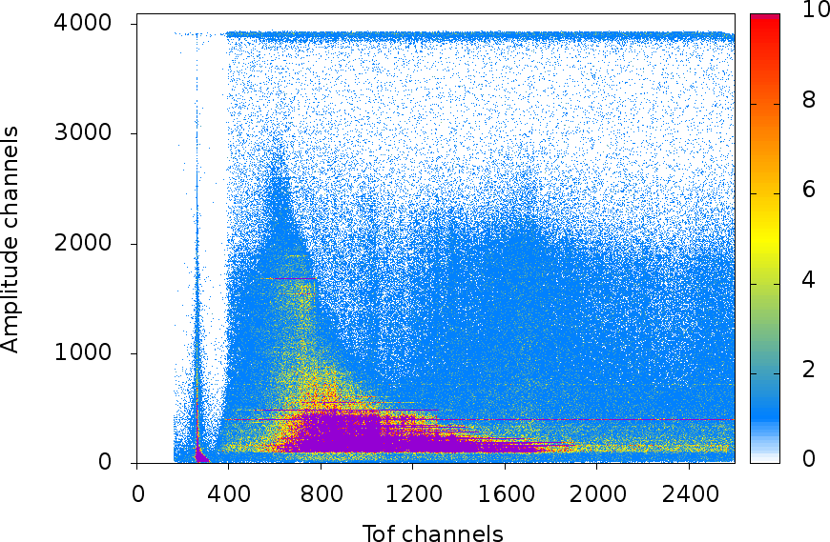
Data analysis
γ−spectroscopy measurements
The time-amplitude matrix of one HPGe detector
WINS2023, October 10-12, Troy

Slide 52
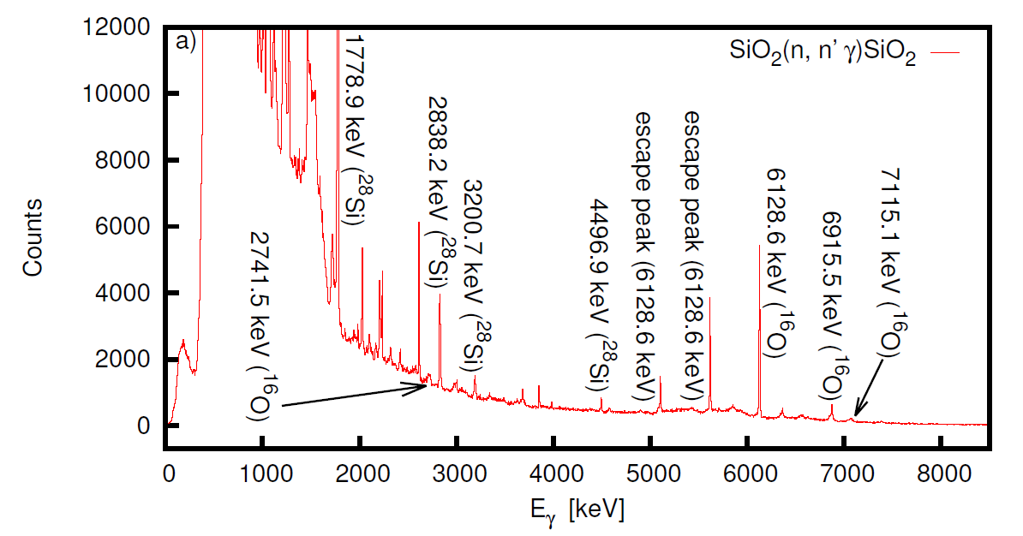
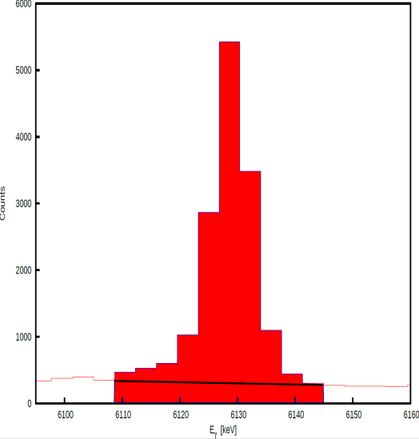
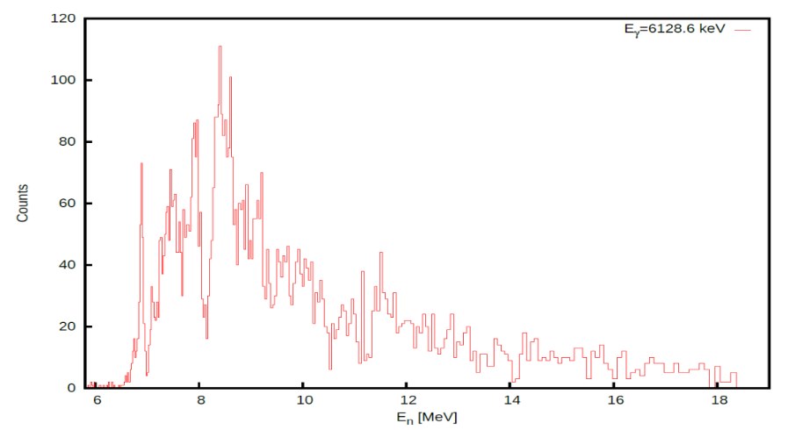
Data analysis
γ−spectroscopy measurements
The time-amplitude matrix of one HPGe detector
Eγ=6128 keV
Y₁₁₀(E_{k})
WINS2023, October 10-12, Troy

Slide 53
Data analysis
γ−spectroscopy measurements coupled with time of flight method
we extract cross sections normalized to the very well known ²³⁵U(n, fission) cross section
HPGe detectors
γ yield + fission chamber yield
Fission chamber
HPGe detector efficiency
interpolation & extrapolation
(via simulations - MCNP 6)
Other corrections:
MSC coefficients
Fission chamber efficiency
- …
Differential γ-production cross section
Angle-integrated γ-production cross section
Level scheme
(ENSDF)
Level cross section
Total inelastic cross section
WINS2023, October 10-12, Troy

Slide 54
Data analysis
γ−spectroscopy measurements coupled with time of flight method
we extract cross sections normalized to the very well known ²³⁵U(n, fission) cross section
HPGe detectors
γ yield + fission chamber yield
Fission chamber
HPGe detector efficiency
interpolation & extrapolation
(via simulations - MCNP 6)
Other corrections:
MSC coefficients
Fission chamber efficiency
- …
Differential γ-production cross section
Angle-integrated γ-production cross section
Level scheme
(ENSDF)
Level cross section
Total inelastic cross section
WINS2023, October 10-12, Troy

Slide 55
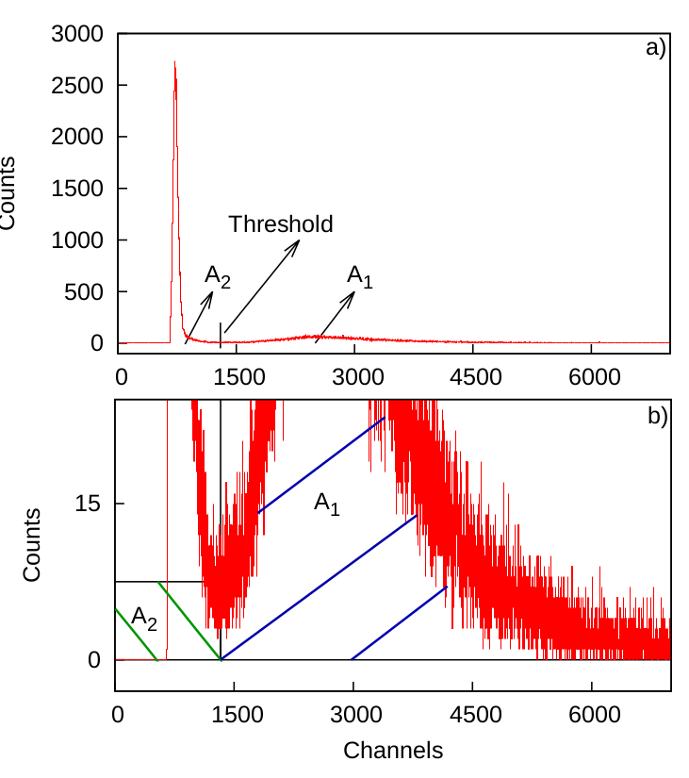
Data analysis
FC data analysis - very similar to HPGe detector’s case:
  FC time-amplitude matrix
  FC Amplitude spectrum
  FC ToF spectrum
  ….
FC amplitude spectrum
FC efficiency determination
WINS2023, October 10-12, Troy

Slide 56
Data analysis
ToF technique or calibration in time of flight
The time-amplitude matrix of one HPGe detector
WINS2023, October 10-12, Troy

Slide 57
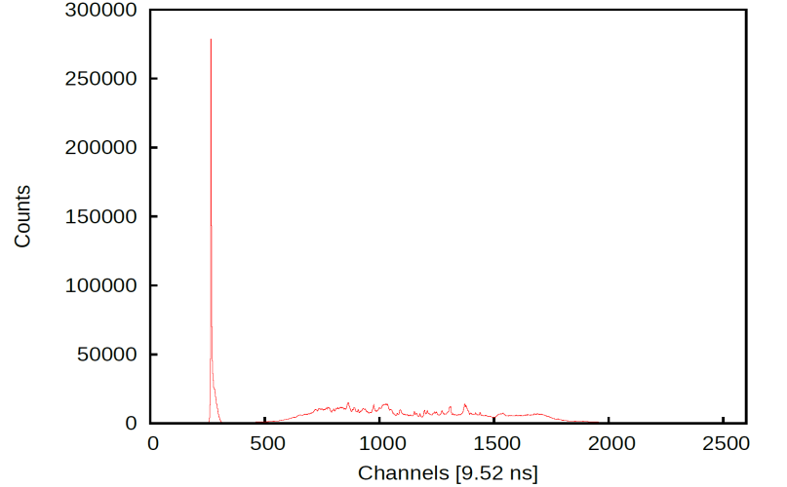

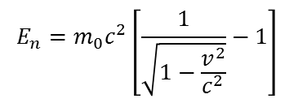
Data analysis
ToF technique or calibration in time of flight
The time-amplitude matrix of one HPGe detector
$t_{γ−flash}=\frac{d_{flight path}}{c}=\frac{19868.4 cm}{29.979 cm/ns}=662.743$ ns
$$E_{n}=m_{0}c^{2}\left[\frac{1}{\sqrt{1−\frac{v^{2}}{c^{2}}}}−1\right]$$
Figure out the neutron energy by using the
γ-flash as a time reference!!!
The tof spectrum of one HPGe detector
γ-flash
neutron events
265
WINS2023, October 10-12, Troy

Slide 58
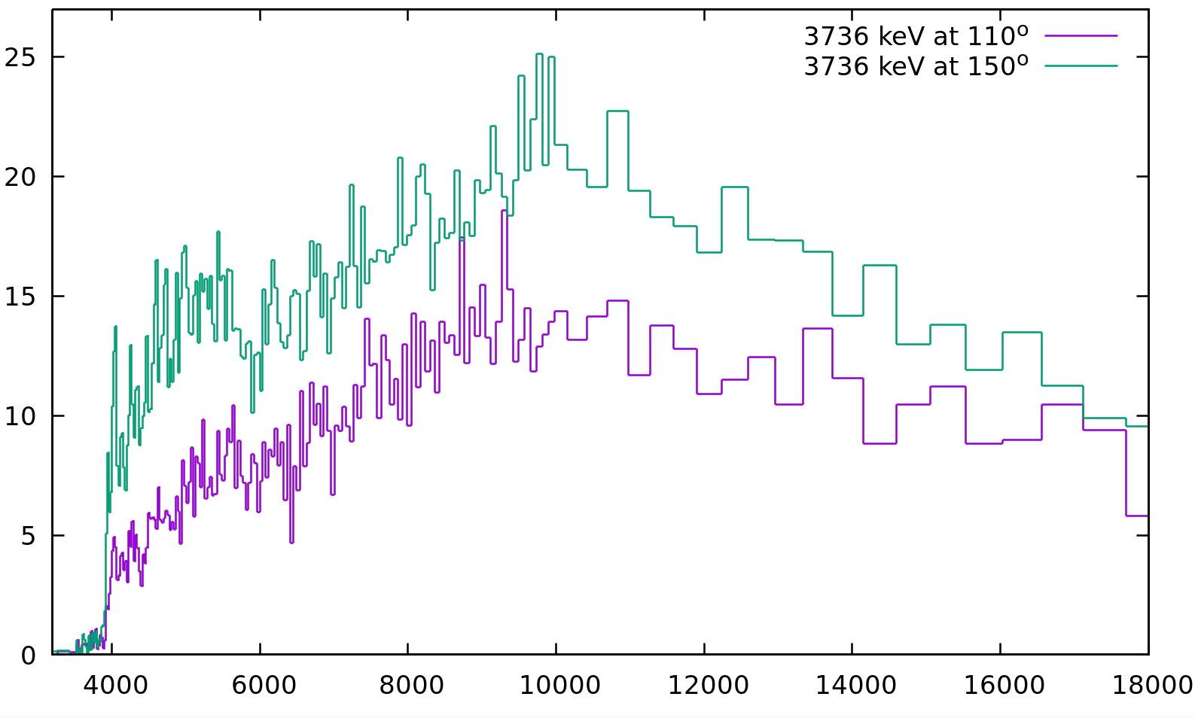

Data analysis
Differential γ−production cross sections (at 110º and 150º)
$\frac{dσ}{dΩ}$($θ_{i},E_{k})=\frac{1}{4π}\frac{Y_{j}(E_{k})}{Y_{FC}(E_{k})}\frac{ε_{FC}σ_{U}(E_{k})}{ε_{j}}\frac{t_{U}}{t_{s}}\frac{A_{U}}{A_{s}}\frac{1}{c_{ms}(E_{k})}$
Nota Bene! 110º and 150º are nodes (zeroes) of the 4th order Legendre Polynomials
WINS2023, October 10-12, Troy

Slide 59
Data analysis
Angle-integrated γ−production cross sections → our primary results
Angle integration based on Gaussian Quadrature Theorem
plus
Legendre Polynomials series expansion of the differential cross section
WINS2023, October 10-12, Troy

Slide 60
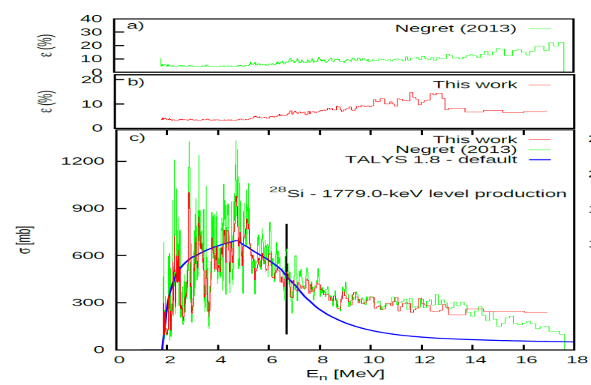
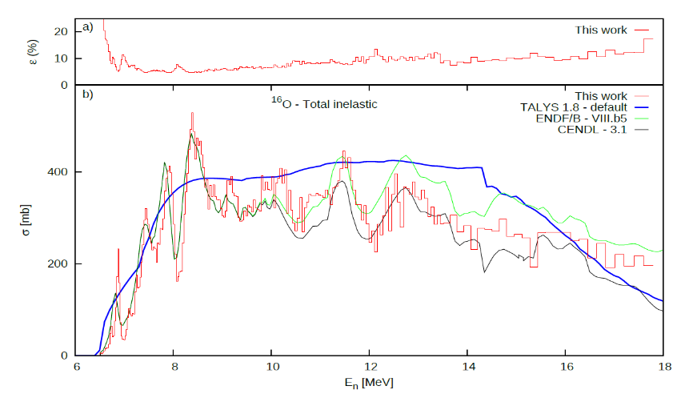
Data analysis
γ-production cross sections (primary results)
level cross section
total inelastic cross section
WINS2023, October 10-12, Troy

Slide 61
Data analysis
Total inelastic cross sections
Calculated based on the feeding of the ground state using the production cross section of the observed transitions.
WINS2023, October 10-12, Troy

Slide 62
Data analysis
Total inelastic cross sections
Calculated based on the feeding of the ground state using the production cross section of the observed transitions.
WINS2023, October 10-12, Troy

Slide 63
Data analysis
Total inelastic cross sections
Calculated based on the feeding of the ground state using the production cross section of the observed transitions.
WINS2023, October 10-12, Troy

Slide 64
Data analysis
Total inelastic cross sections
Calculated based on the feeding of the ground state using the production cross section of the observed transitions.
WINS2023, October 10-12, Troy

Slide 65
Data analysis
Total inelastic cross sections
Calculated based on the feeding of the ground state using the production cross section of the observed transitions.
E_{max}
WINS2023, October 10-12, Troy

Slide 66
Experimental results
scientific motivation for performing the experiment
experimental setup
data analysis procedure
experimental results
WINS2023, October 10-12, Troy

Slide 67
Experimental results
Two transitions in ⁴⁰Ca:
3736 keV ( the main transition)
3903 keV
(maybe also 754 keV)
Most probably also 109 keV and 197 keV from ¹⁹F
WINS2023, October 10-12, Troy

Slide 68
Experimental results
3736 keV: γ-production cross section
WINS2023, October 10-12, Troy

Slide 69
Experimental results
3903 keV: γ-production cross section
WINS2023, October 10-12, Troy

Slide 70
Experimental results
Total inelastic cross section on ⁴⁰Ca
WINS2023, October 10-12, Troy

Slide 71
Thank you for your attention!

Slide 72
BACKUP SLIDES

Slide 73
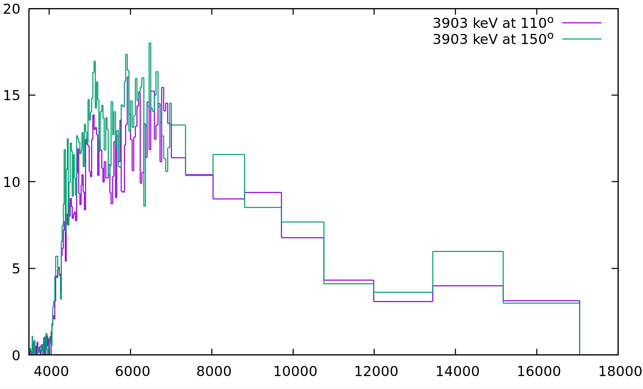
Data analysis
γ−ray emission anisotropy
3⁻ to 0⁺
^{E3}
2⁺ to 0⁺
^{E2}
WINS2023, October 10-12, Troy

