Slide 1
Causality, uncertainty and efficient exploration in a dynamic world
MPS/DLS Data Science Workshop, January 13, 2023
Rutgers University, Department of Statistics
(presenting research of Rong Chen, Ying Hung, Zijian Guo and Tirthankar Dasgupta)

Slide 2


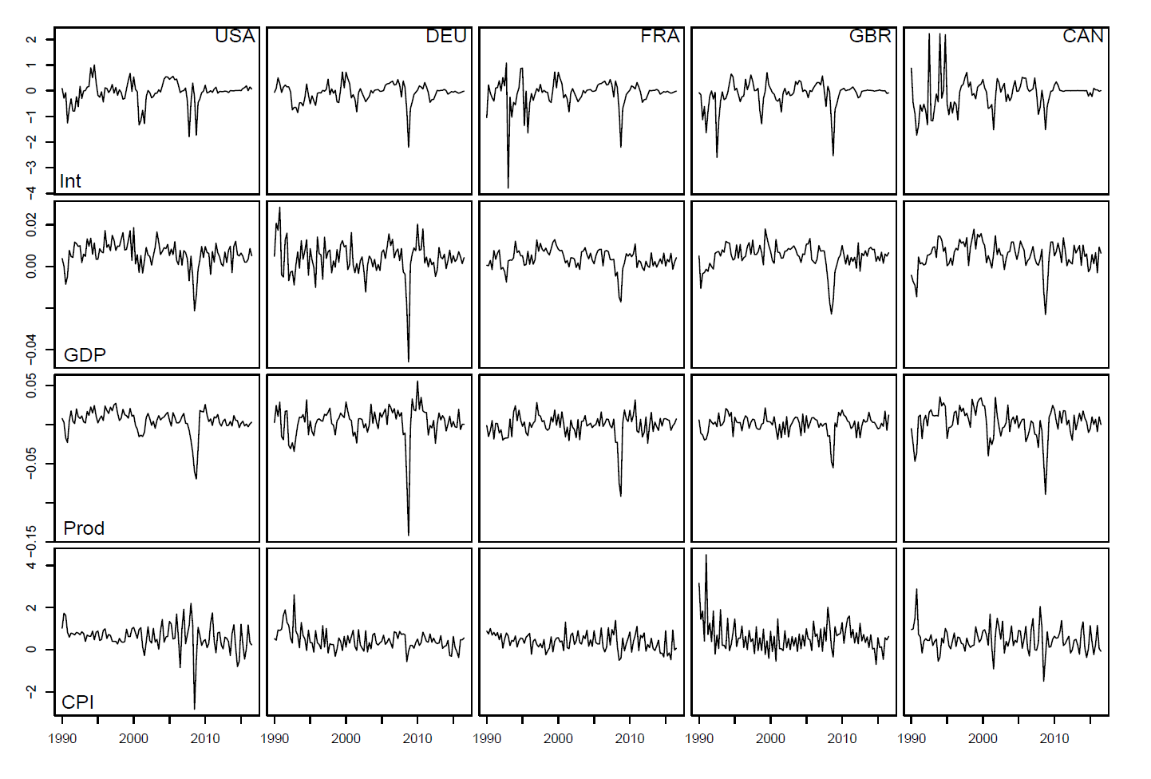
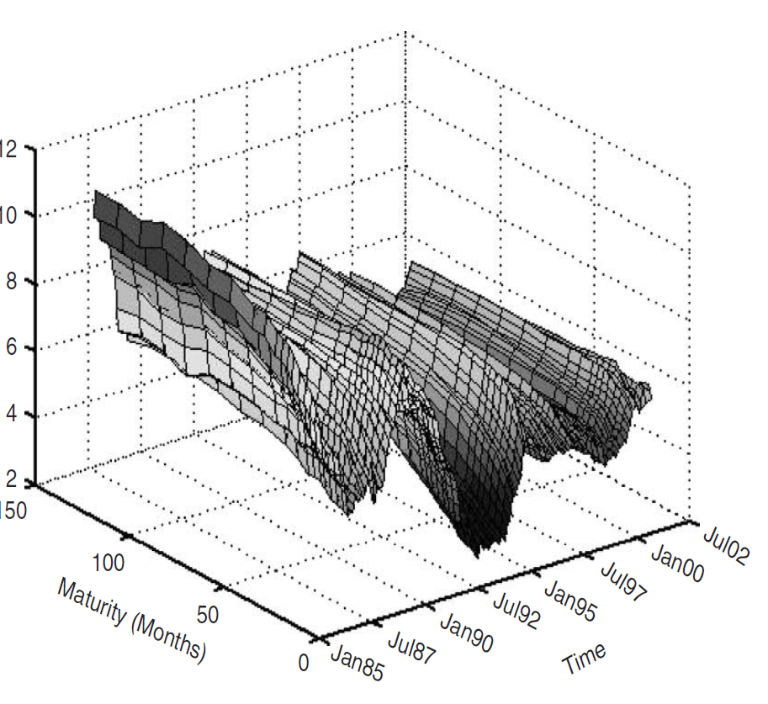
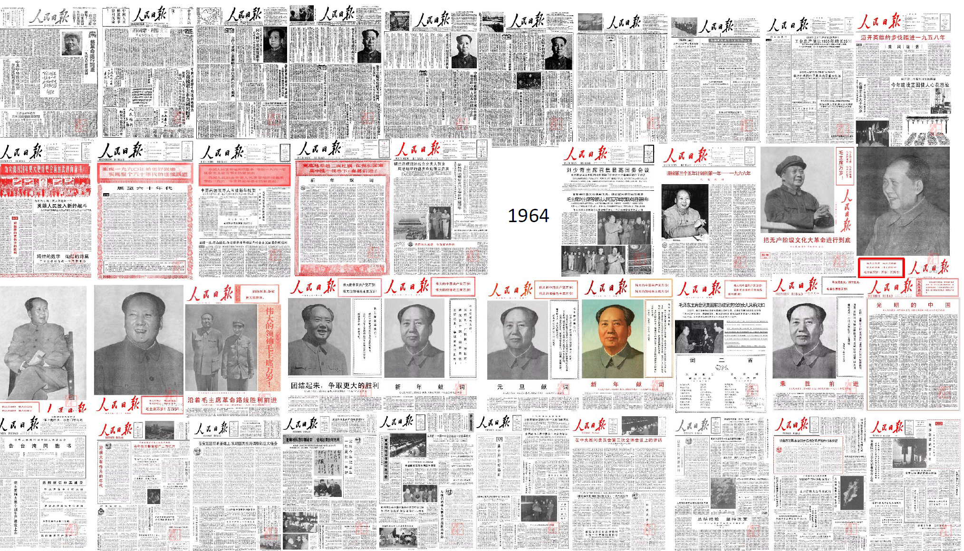
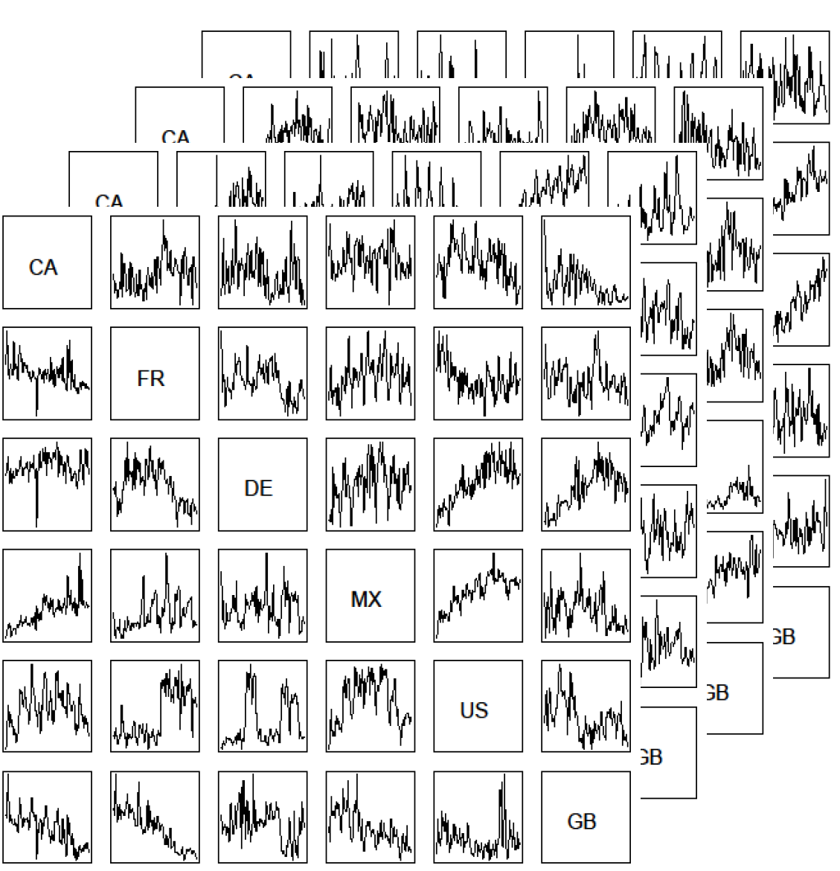
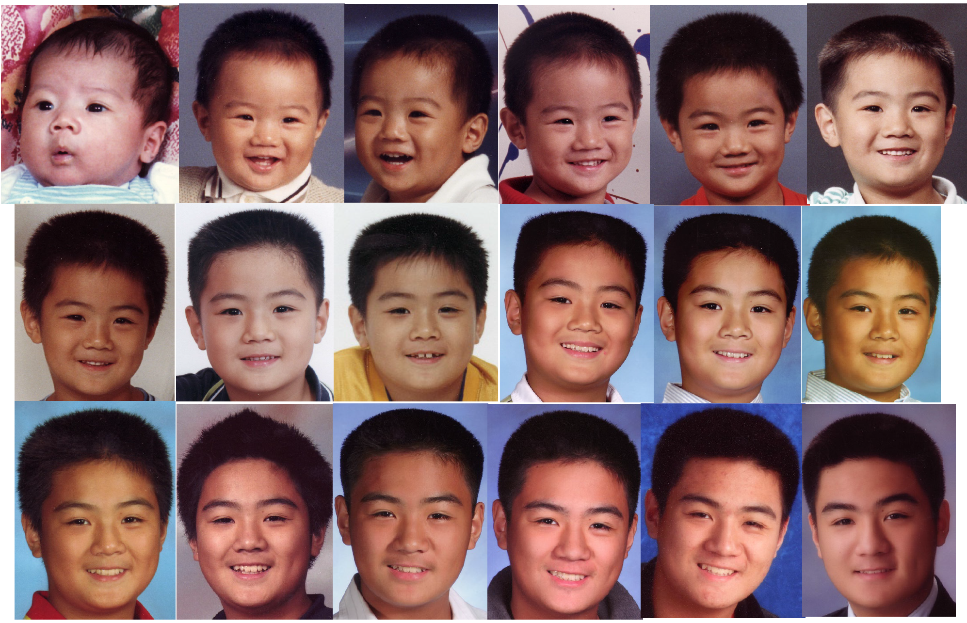
Rong Chen
Email: rongchen@stat.rutgers.edu
Department of Statistics
Time Series of Everything
Modern Data Types: functions, networks, text, images, shapes …
Often observed over time
Objectives: Dynamics, prediction …
USA DEU FRA GBR CAN
Interest rate curves over time
Your
Photo
INT
GPD
Interested in Collaborative Efforts in:
New applications
New data types
PROD
CPI
Matrix/Tensor TS
Text TS
Import/
Export
Volume
Of
Multiple
Categories
Functional TS
Growth of
Knowledge Graph
Chemical A
Chemical B
Chemical C
Drug A
Drug B
Disease X
Dynamic transport network
Image TS
Gene 1
Gene 1
Gene 1
Gene 1

Slide 3
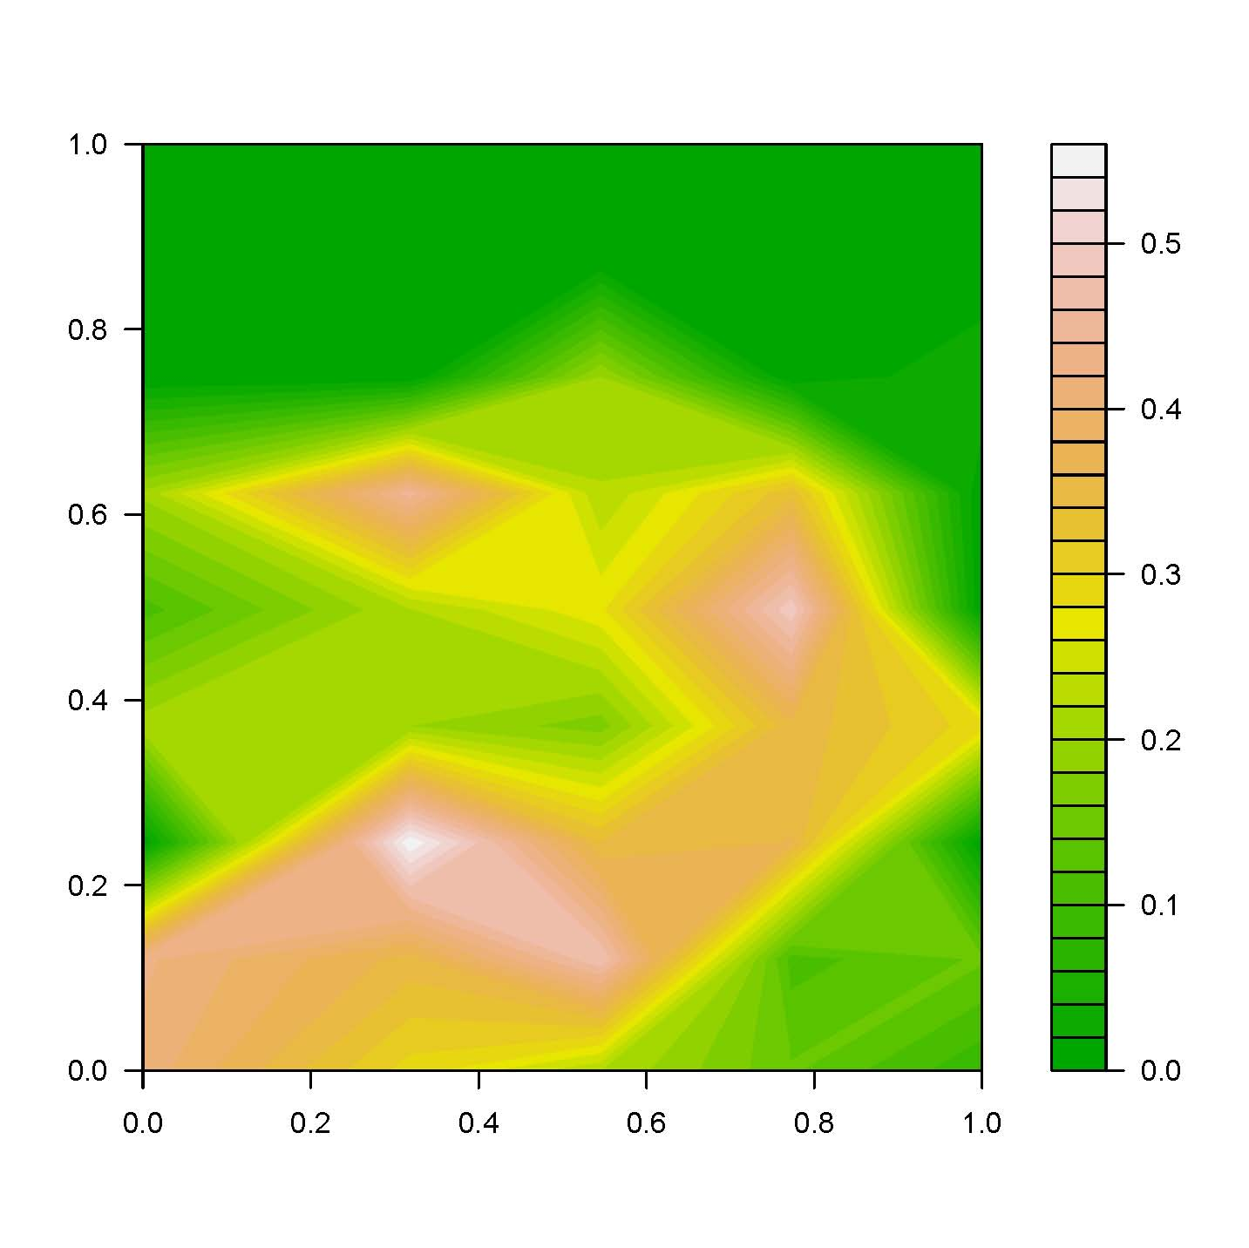
Exploration of complex surfaces: find “best” regions
Pressure
Temperature

Slide 4
A better strategy (space filling design and surrogate modeling)
Pressure
Yield = f(temp, pressure)

Slide 5
Adaptive/active learning (sequential design)
Pressure

Slide 6
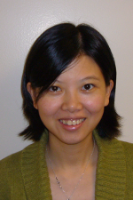
Experimental Design, Surrogate Modeling, and Uncertainty Quantification (Ying Hung)
Methodology | Examples of Applications
Efficient surrogate modeling by Gaussian processes (GP) Bayesian optimization and active learning Space-filling designs Modeling massive data by design-based subsampling New kernel functions for functional inputs in GP modeling Generalizations of GP models to non-Gaussian outputs | Analysis of complex computer simulations (deterministic and stochastic) Inverse scattering problems Optimal control in robotics Epidemiology simulations Molecular dynamics simulations Fluid dynamics simulations Optimal tuning in deep learning Bayesian optimization for branching and nested hyperparameters in deep learning Computer vision Bayesian methods for face tracking
Look forward to new interdisciplinary collaborations

Slide 7
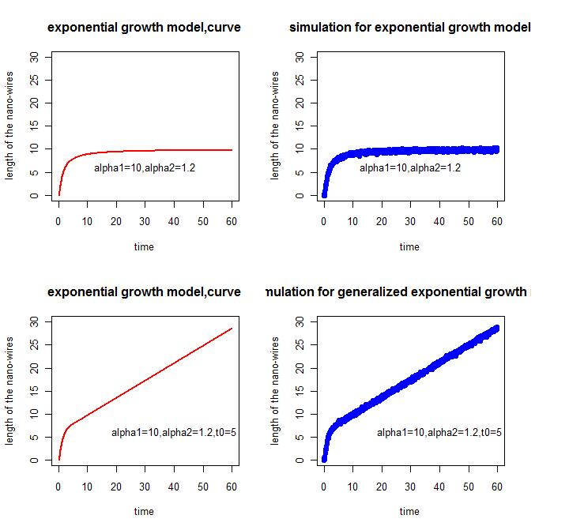
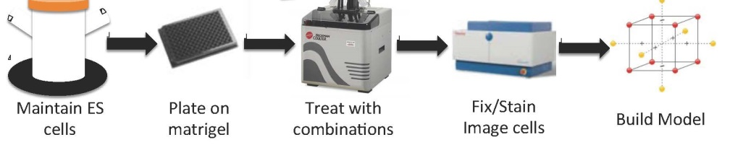
Exploration under resource constraints: optimal designs (Tirthankar Dasgupta)
Growth of nanowires
At what input points should I gather data?
7
Type 1 Diabetes and Regenerative Medicine
Converting stem cells to insulin-generating beta cells using 30 chemical modulators – explore 2^30 combinations and 30! orders

Slide 8




Association and causation
Treatment | Outcome |  | Total
 | Survived | Died
Took new drug (Treatment) | 12 | 1 | 13
Just kept under observation(Control) | 2 | 11 | 13
Total | 14 | 12 | 26
Outcome is associated with treatment; but not necessarily caused by treatment
To draw valid causal conclusions:
Need to make assumptions about the data generating procedure (design)
Need to adjust for confounders (observed and hidden)

Slide 9

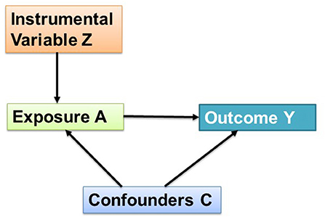
Zijian Guo’s research at the interface of machine learning and causal inference
Causal inference with hidden confounders
  Challenge: instrumental variables (IVs) may be invalid
  Research 1: valid IV selection+ uniformly valid inference robust to IV selection errors
  Research 2: machine learning (e.g., random forests) to detect invalid IVs
Learning from multiple source data
  Challenge: data heterogeneity and privacy constraints
  Research 1: capture shared associations across heterogeneous multi-source data
  Research 2: transfer learning+ learning the majority of the multi-source data
Valid?
Source: Rajput and Gupta (2020)

Slide 10

Tirthankar Dasgupta’s research in causal inference
But what if …..
????
Impute missing outcomes based on the known/assumed data generating mechanism (design)
Observed effect of neck exercise on headache (factual)
Unobserved (missing) effect of no exercise on headache (counterfactual)
Source: Google and https://www.youtube.com/watch?v=MI9o8SOxldY
Design-based causal inference: flexible, can be model-free or model-based, intuitive, different data types
Optimal/efficient designs
Combining inference from multiple sources

