Slide 1
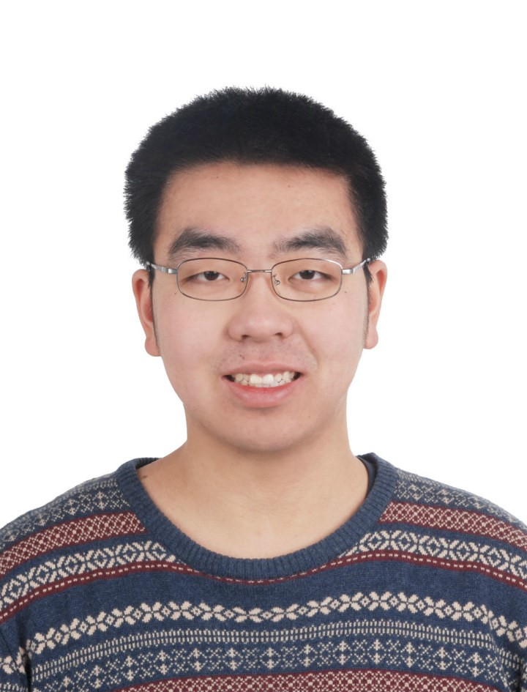






Guanyang Wang
Department of Statistics
Markov chain Monte Carlo (MCMC) method: one of the Top 10 algorithms from the 20th century
Bottleneck: slow convergence, hard to parallelize
Goal:
Faster algorithm
Parallelizable
Better theoretical understanding
Your
Photo
An awesome MCMC algorithm
Two thousand years later…..
Finally converges!
Existing/ongoing projects
Interested in Exploring Collaborative Efforts in:
Parallelization through unbiased MCMC
Efficient MCMC algorithm for sampling contingency tables
Optimize general-purpose samplers via neural networks
GPU implementation?
Quantum Monte Carlo algorithms?
Applications?
Can’t wait to hear your ideas!
Email: guanyang.wang@rutgers.edu

Slide 2
Minge Xie
Department of Statistics
Unraveling black-boxes of ML models for interpretable AI
(with Sijian Wang, Min Xu, & Linjun Zhang)
Black-box problem in AI:
  Lack of interpretability undermines our trust of ML models and results
Root cause:
  ML models often involve discrete/non-numerical parameters & non-numerical data, etc.
  Statistical inference is supposed to address model interpretation questions (using observed data), but until recently lack of tools/theories to handle these irregular problems
Examples:
Discrete/Nonnumerical parameters: # of clusters; # of neighbors/nodes; # of layers (in NN); Model A, B, ...; Tree partitions; etc.
Nonnumerical data: Graphical network; Image/voice/text data; etc.
We have developed a novel mathematical & computational tool:
Tackle crucial/pressing questions concerning irregular inference problems;
Use to unravel the black-boxes in several ML models for interpretable AI
  Deep neural network: discover the smallest model architecture (with quantified uncertainty)
  Ensemble tree: Principled random forest (with model interpretation and quantified uncertainty)

Slide 3
Sijian Wang
Department of Statistics
A²B³: AI-Assisted Biochemical/Biophysical/Biomedical Research
Automated quality control and assessment for large-scale biomedical database (with Stephen Burley and Chenghua Shao)
  Outlier detection and quality assessment for Protein Data Bank (PDB)
  PDB macromolecular crystal structure confidence assessment
AI-experiment-interactive system (with Min Xu, Minge Xie, Sagar Khare and Lu Wang)
  Protease specificity prediction
  Protein/drug design
  In-protein short-hydrogen bond prediction
  Infrared spectra construction for nucleic acids
  Structure-oriented graph convolution and sequence models
  Structure-oriented VAE/diffusion generative models
Look forward to new interdisciplinary collaborations

Slide 4
Min Xu
Department of Statistics
Add Erdos--Renyi random edges
Planted tree generative process
Observed data
Algorithm output
Learning the latent network growth process (with Harry Crane, Sijian Wang, Minge Xie)
Root and community inference (both Frequentist confidence set and Bayesian posterior probabilities)
Scalable algorithm based on Gibbs sampling (python package paper-network)
Can work with a variety of generative models
Can incorporate edge/node features
Our goal: expand model and method to make this more widely useful.

Slide 5
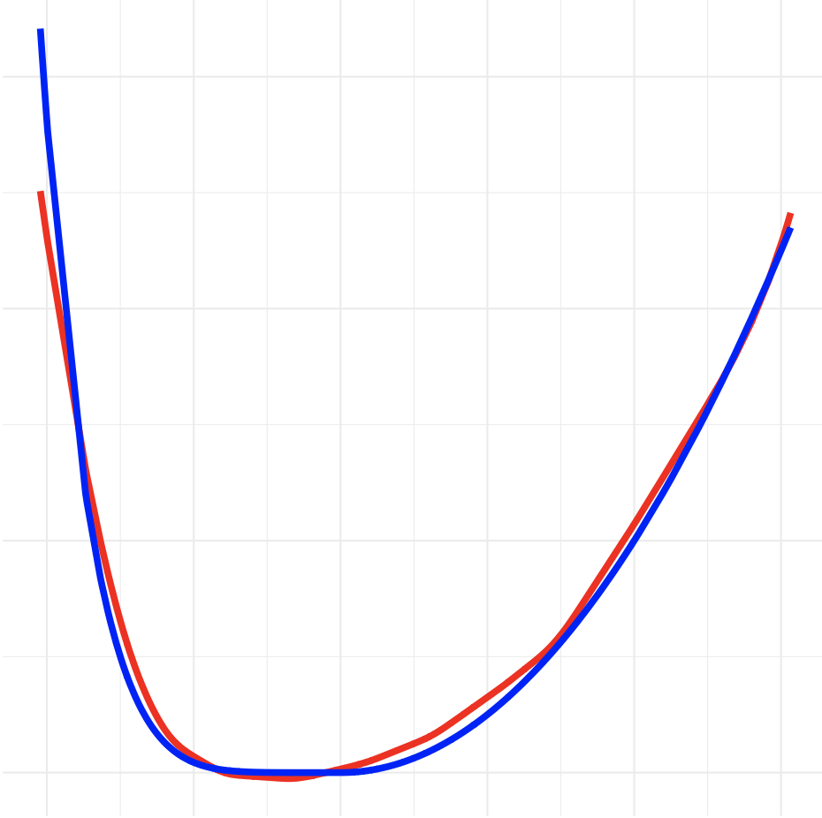
Min Xu
Noise is lighter-tailed on the left, heavier-tailed on the right.
Other ML/AI research in Rutgers Statistics:
High-dimensional statistics (Pierre Bellec, Cun-Hui Zhang, Zijian Guo, Qiyang Han)
Reinforcement learning (Koulik Khomaru)
Functional data analysis (Yaqing Chen, Rong Chen, Han Xiao)
Representation and contrastive learning (Linjun Zhang)
Differential privacy (Linjun Zhang, Ruobin Gong)
Conformal prediction (Minge Xie, Regina Liu, Rong Chen, Han Xiao)
And more … (see presentation from Tirthankar Dasgupta)

