Slide 1

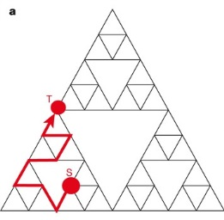
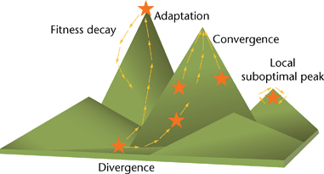
Unsupervised inference of graph properties with random walks
Alexandre V. Morozov
Department of Physics & Astronomy
Center for Quantitative Biology
Rutgers University
morozov@physics.rutgers.edu
January 13, 2023

Slide 2
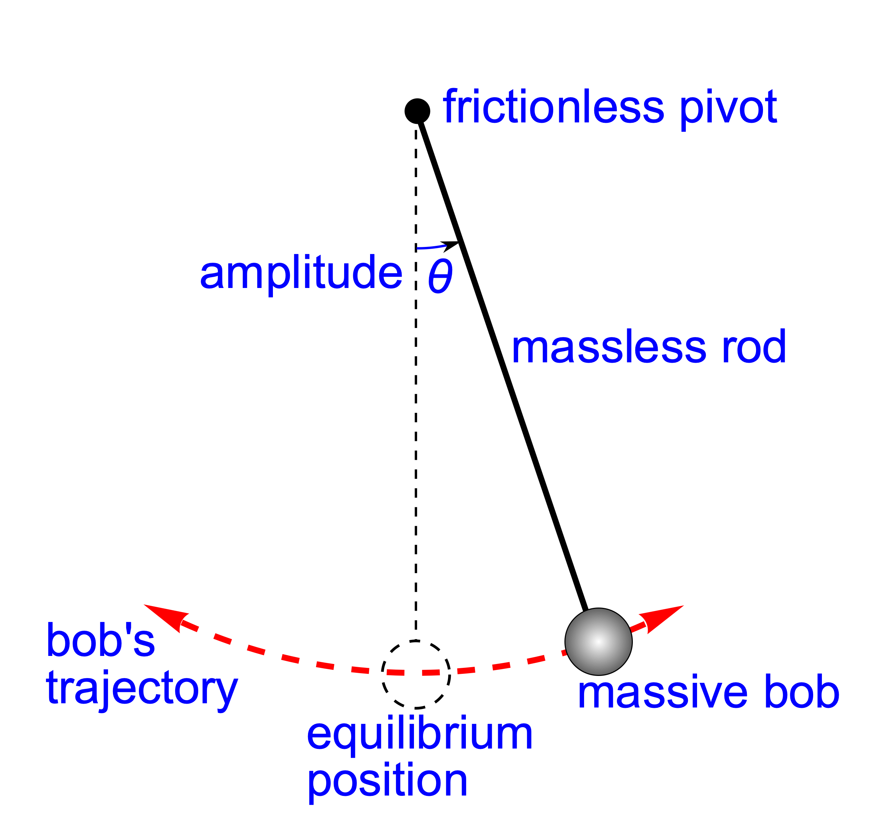
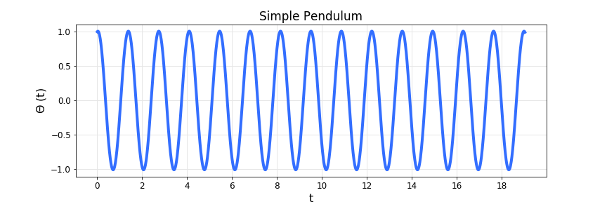
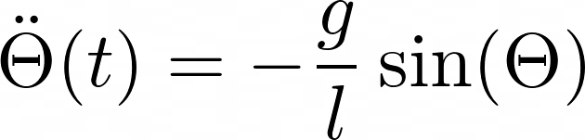
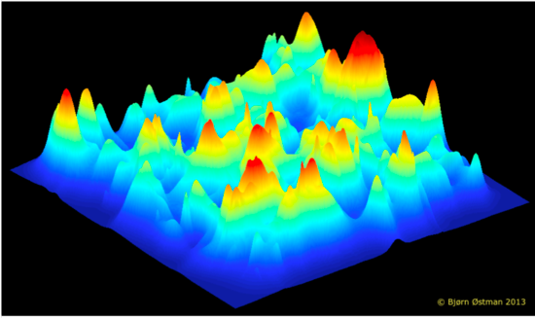
Current ML projects in my lab
Inference of governing equations and conservation laws from
time-series data:
Global optimization:
optimizer
F_{best}, S_{best}
Using random walks (coincidence counting) to do inference on
graphs and statistical mechanics systems

Slide 3
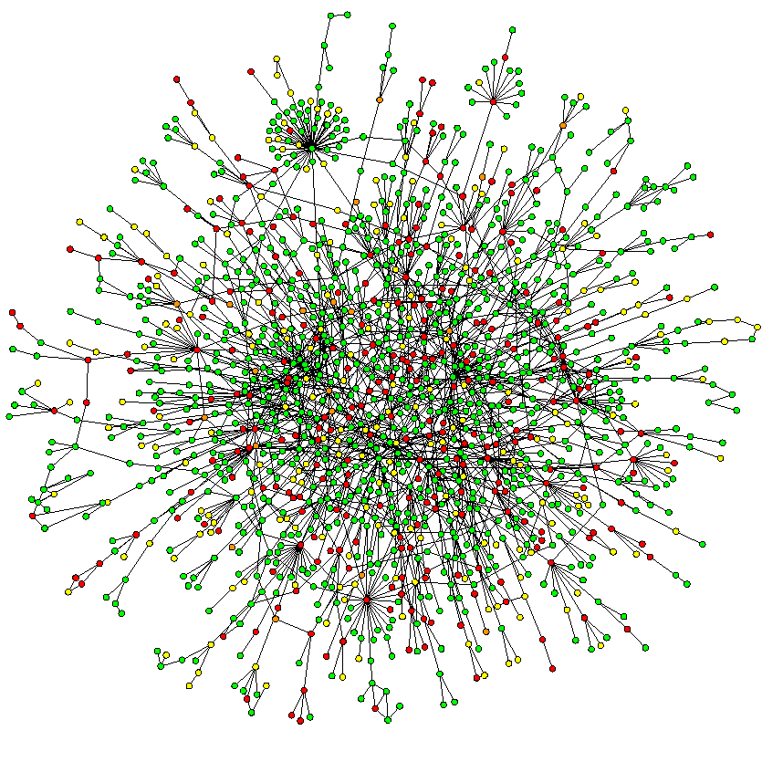
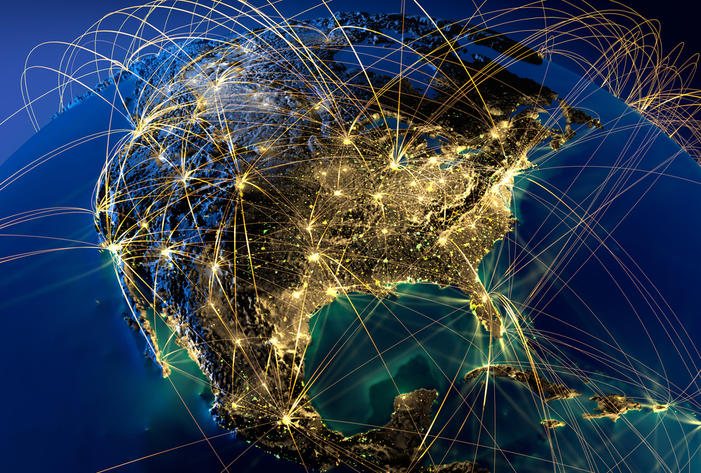


Scale-free Networks (commonly found)
Protein interactions
World Wide Web
Power-law distribution of the number of links:
Small world characteristics:
No characteristic scale, similar to fractals
Albert R, Barabasi A-L (2002) Rev Mod Phys 74, 47-97

Slide 4
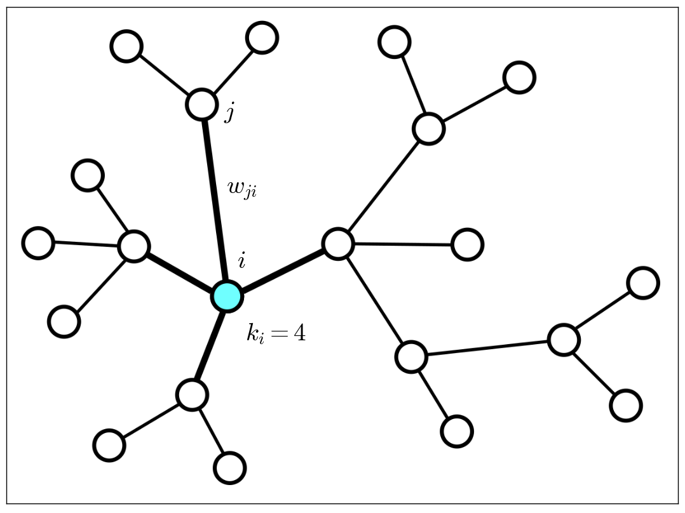


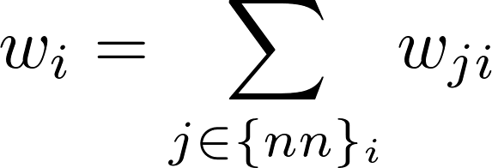
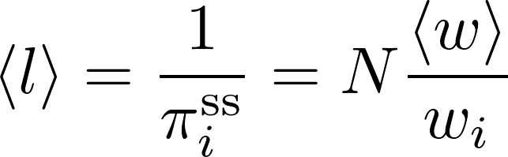
Return Statistics on Undirected Networks: Single Target
Total outward rate:
Average number of steps:

Slide 5

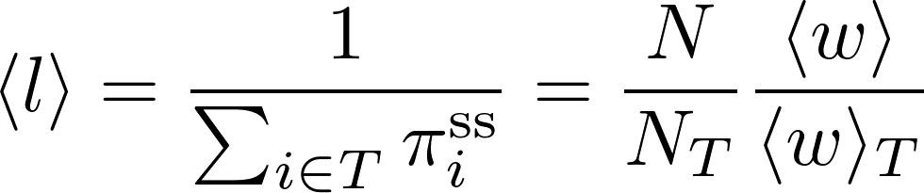

Return Statistics on Undirected Networks: Multiple Targets
Average number of steps:
is the total outward rate averaged over all targets

Slide 6
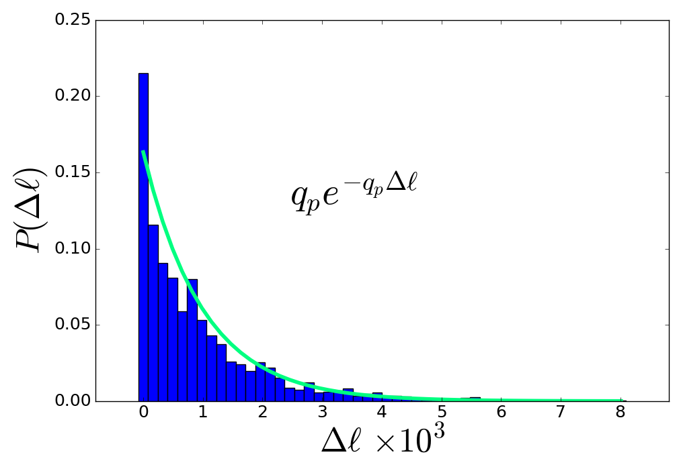

Nearly exponential distribution of return times
Erdos-Renyi random network with 10⁶ nodes and 10³ targets
Exact hitting rate:

Slide 7
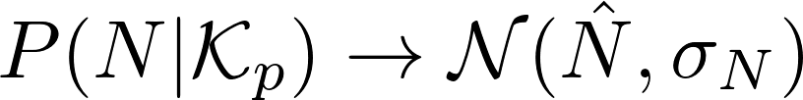


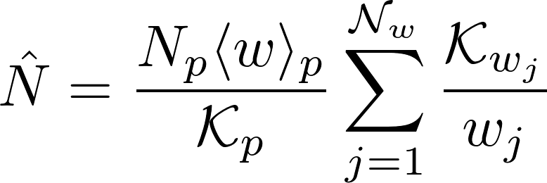
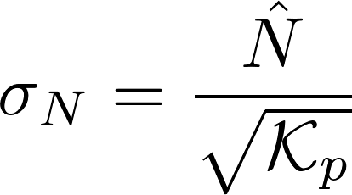
Inference of Global Properties: Network Size
Posterior probability for the network size:
visits to pseudotargets
Kion-Crosby W, Morozov AV (2018) Phys Rev Lett 121:038301

Slide 8
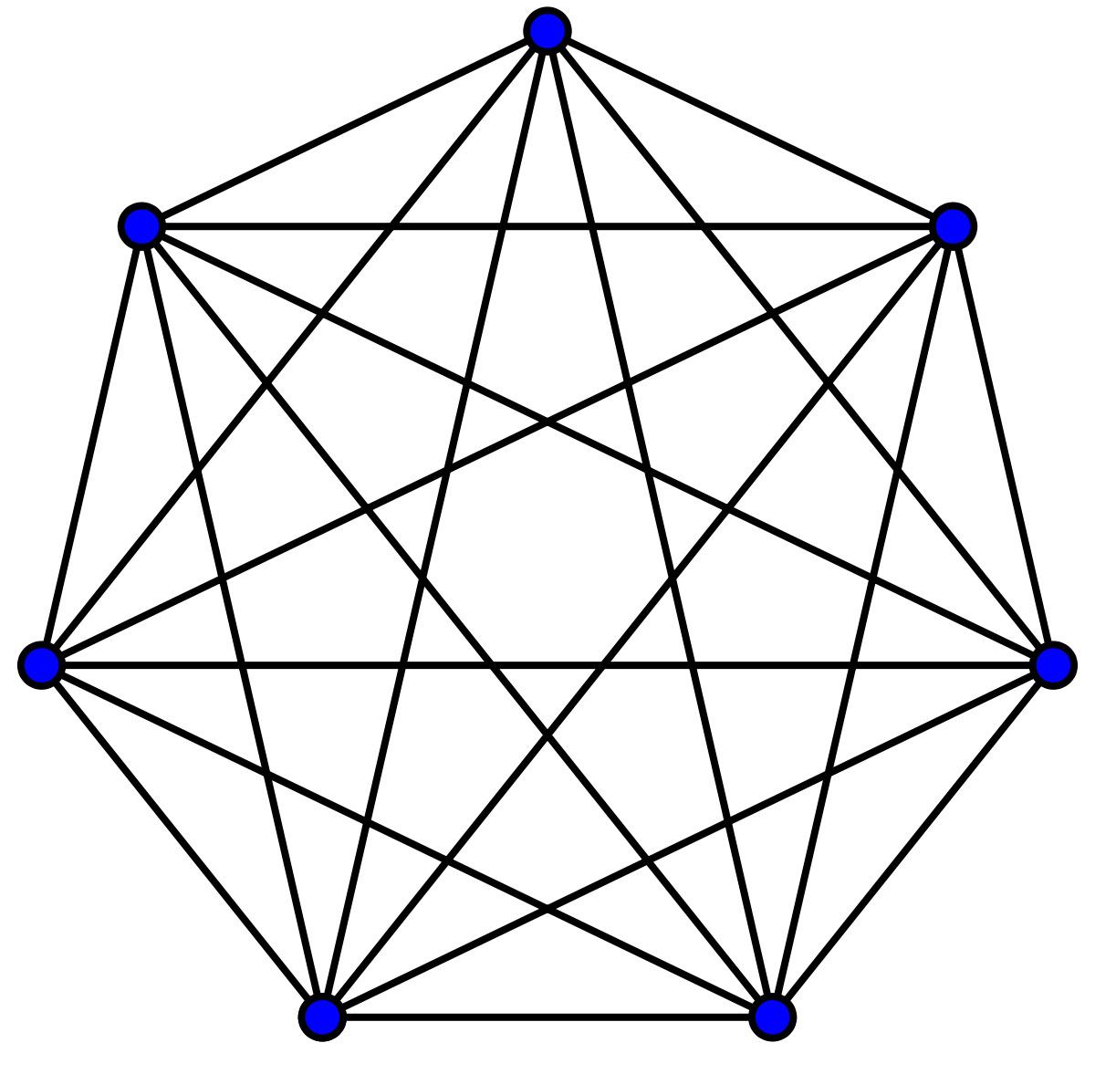

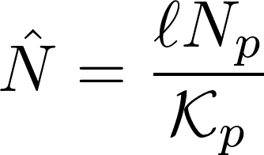
Inference of biological population sizes by random sampling
Idea: random sampling with replacement is equivalent to random walks on complete unweighted graphs
Population size estimate on regular networks:

Slide 9
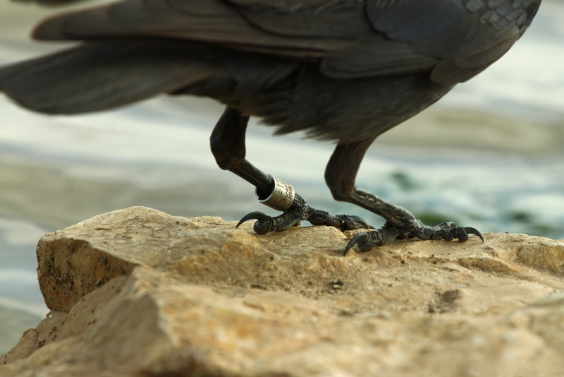
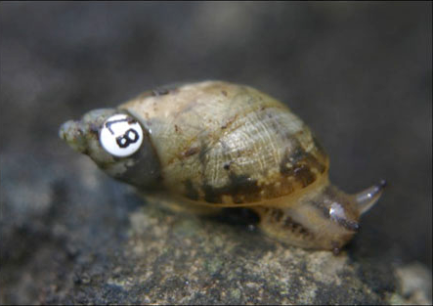



Mark and recapture technique of estimating population sizes
Jackdaw with a numbered aluminum ring
Marked amber snail
First visit
Second visit

Slide 10


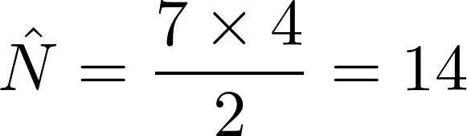
Mark and recapture technique of estimating population sizes
= number of animals in the population
= number of animals marked on the first visit
= total number of animals captured on the second visit
= number of recaptured animals that were marked
Lincoln–Petersen estimator:

Slide 11
Sequential capture and release - a new paradigm in estimating population sizes?
First visit
Second visit
Third visit
Fourth visit
mark
and so on …

Slide 12
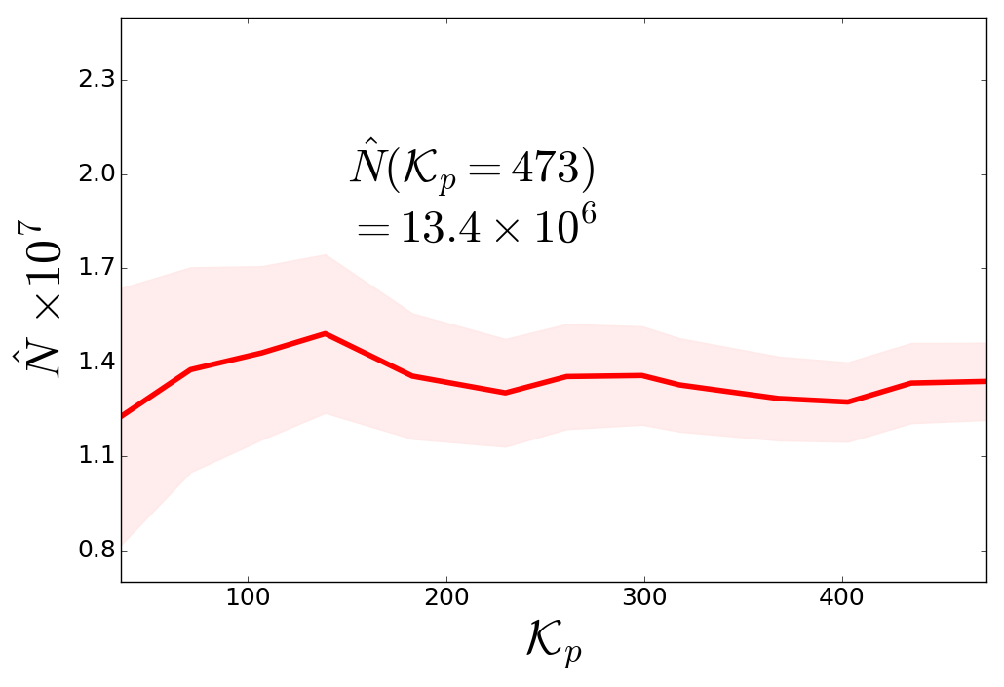


The Size of Wikipedia
pseudotargets
steps

Slide 13
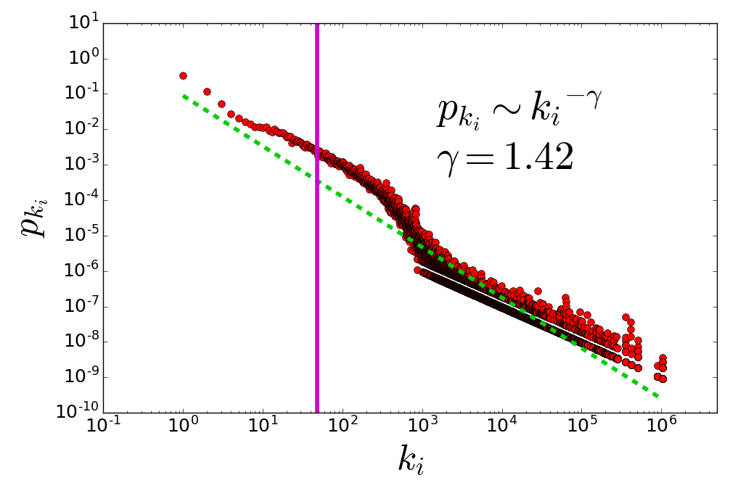
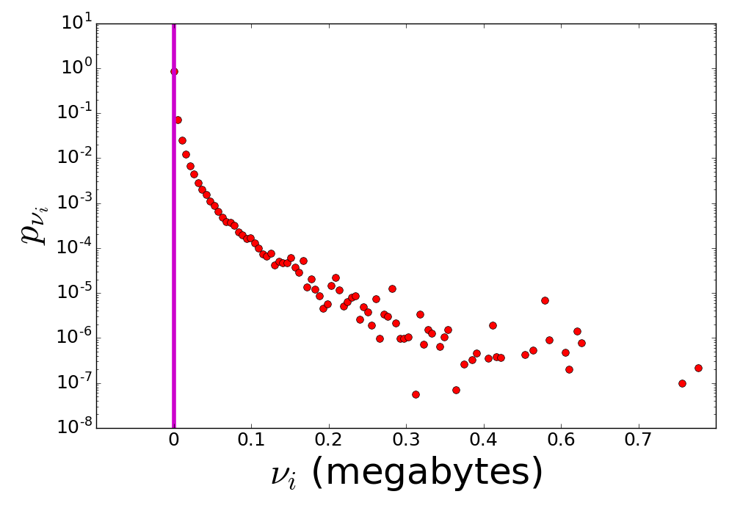
Wikipedia Statistics
steps
Wikipedia (English articles, circa 2018):
13.4 million pages (incl. 8.05 million redirect pages)
Each page connected to 48 other pages on average
Total size without redirect pages: 35.8 GB

Slide 14
Network Community Detection and Clustering

Slide 15
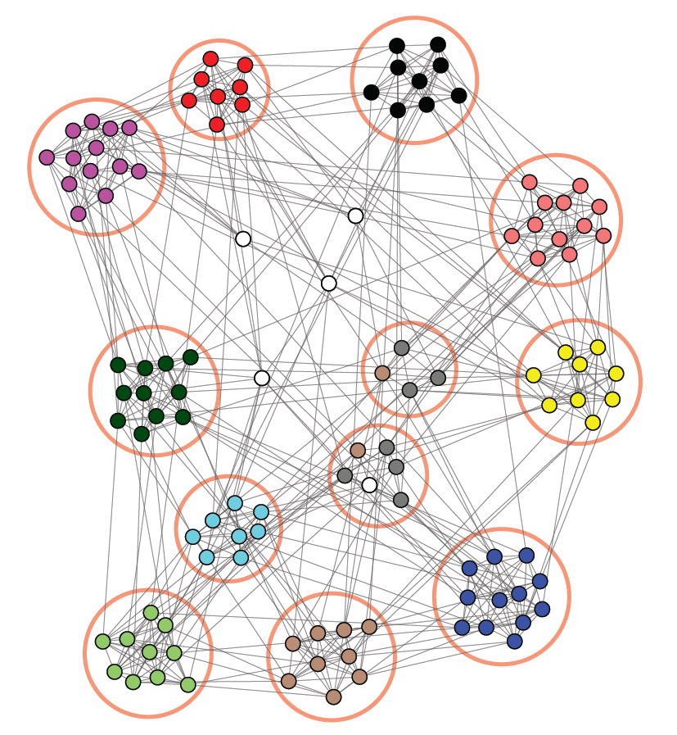
Network Communities
In Wikipedia, communities consist of pages on topics that are related to one another
In social networks, communities represent groups of people or organizations
In gene co-expression networks, communities represent sets of genes with similar expression profiles

Slide 16


Network Community Detection Algorithms
We have developed two community detection algorithms based on random walks:
Walk-Likelihood Algorithm (WLA): when the number of communities ($m$) is fixed
Walk-Likelihood Community Finder (WLCF): when the number of communities is unknown
WLA
$$m=4$$
WLCF
Ballal A, Kion-Crosby W, Morozov AV (2022) Phys Rev Res 4:043117
Notes:
Novelty of the method

Slide 17
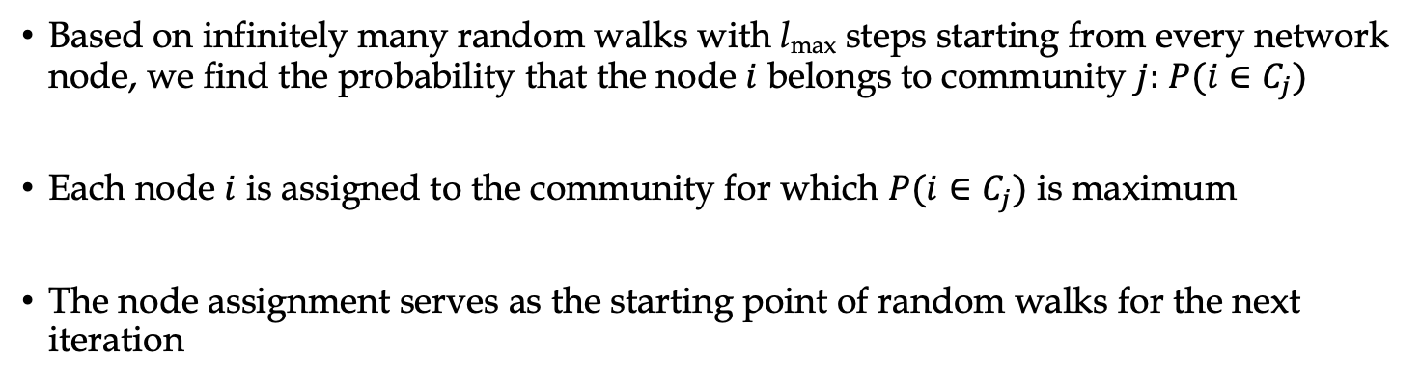
Walk-Likelihood Algorithm
Based on infinitely many random walks with l_{max} steps starting from every network node, we find the probability that the node $i$ belongs to community $j:$ $P(i∈C_{j})$
Each node $i$ is assigned to the community for which $P(i∈C_{j})$ is maximum
The node assignment serves as the starting point of random walks for the next iteration
Input: Initial network partition
Output: Optimal network partition
Notes:
Cartoon to show what I mean

Slide 18
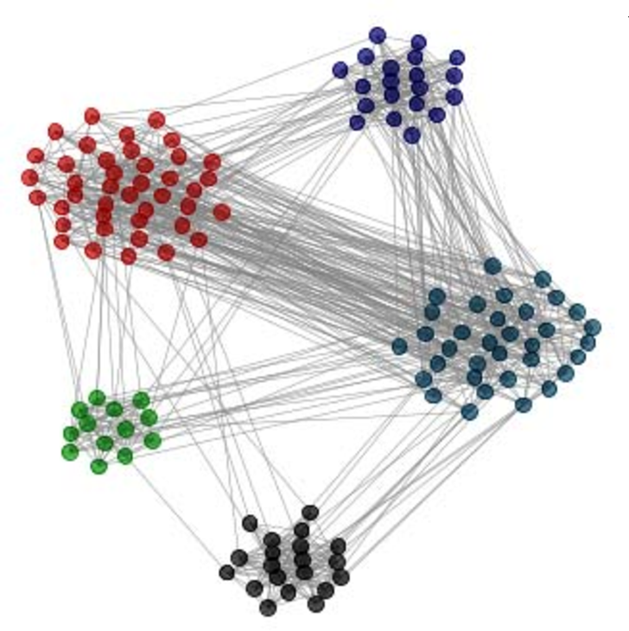

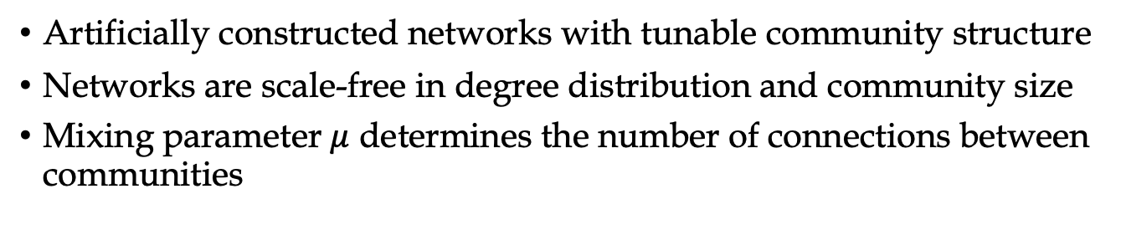
LFR Benchmark Networks
Artificially constructed networks with tunable community structure
Networks are scale-free in degree distribution and community size
Mixing parameter $μ$ determines the number of connections between communities
$$μ$$
Lancichinetti A, Fortunato S, Radicchi F (2008) Phys Rev E 78:046110

Slide 19
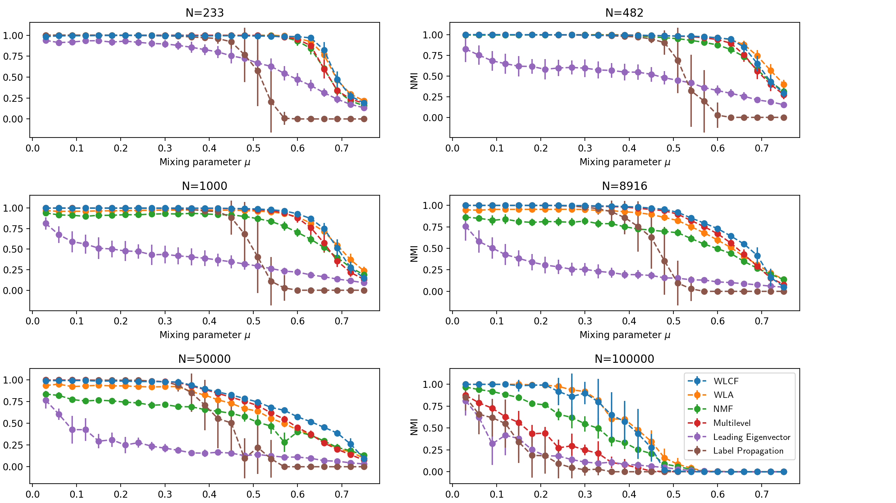

Comparison of Community Detection Algorithms on the LFR Benchmark
Normalized Mutual Information
Mixing Parameter $μ$
Notes:
Point at my curve

Slide 20
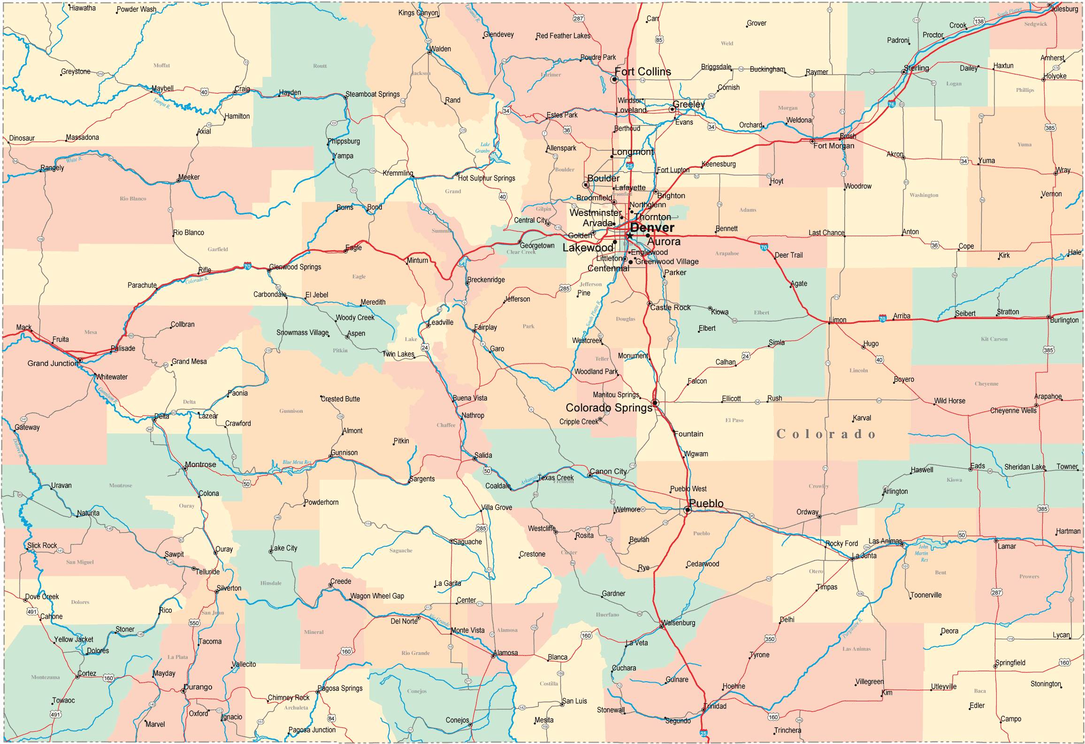
Colorado Road Network
Network of all roads in Colorado
Each junction/road marker is a node
Edge between two nodes if there is a direct road connecting them
Total of 435,666 nodes with 528,533 edges

Slide 21
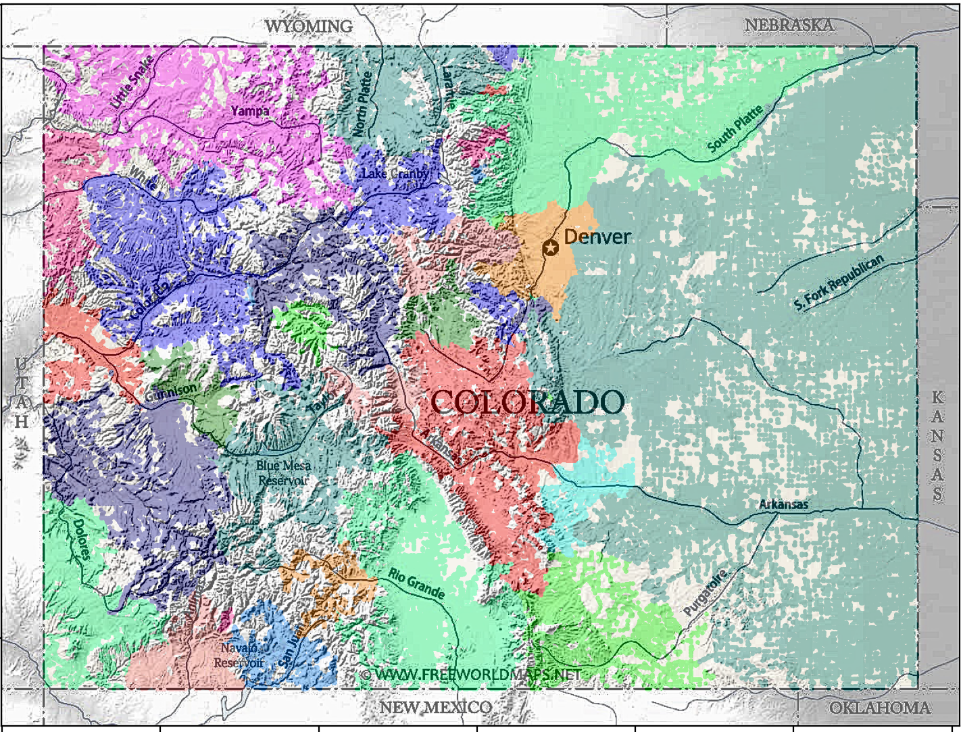
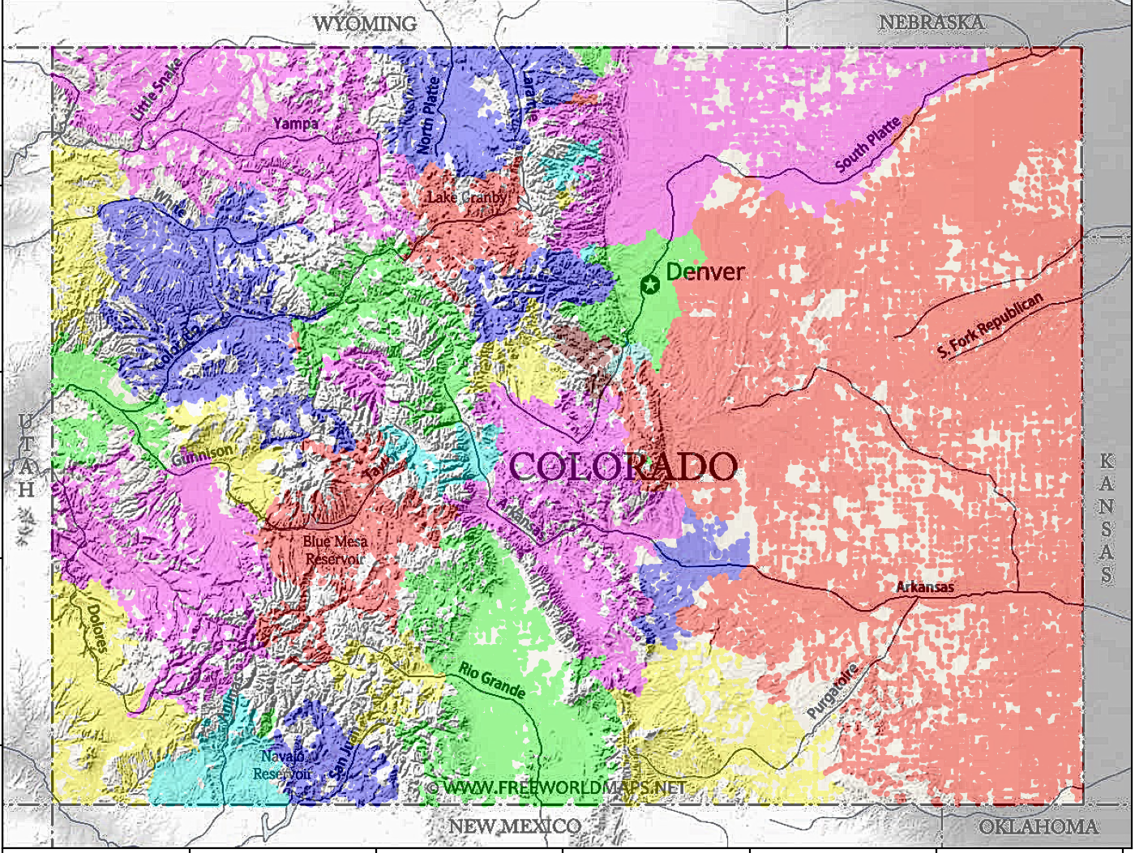
Colorado Road Network
36 Color-coded Communities:
Rocky mountains national park

Slide 22
Summary
Developed a Bayesian approach to inferring local and global network properties from small samples obtained by random walks
Developed two algorithms for finding community structure in networks: WLA (number of communities known) and WLCF (number of communities unknown)
Kion-Crosby W, Morozov AV (2018) Phys Rev Lett 121:038301
Ballal A, Kion-Crosby W, Morozov AV (2022) Phys Rev Res 4:043117

Slide 23
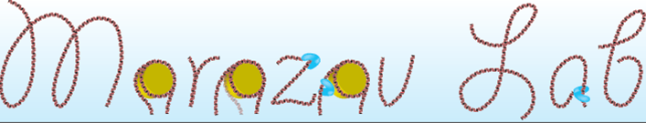
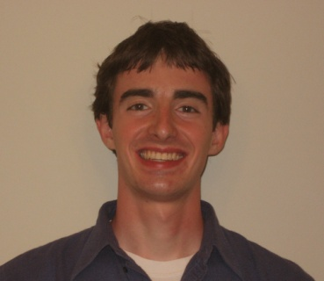


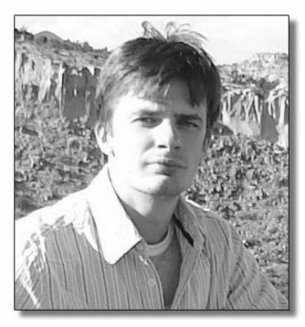
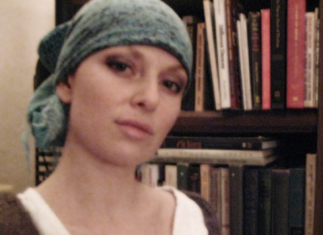

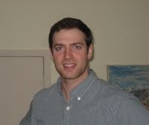
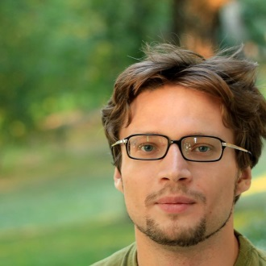
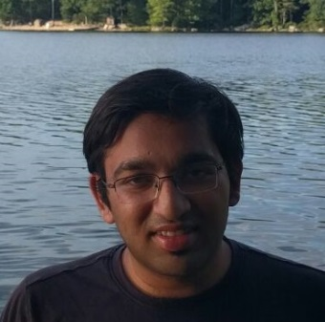
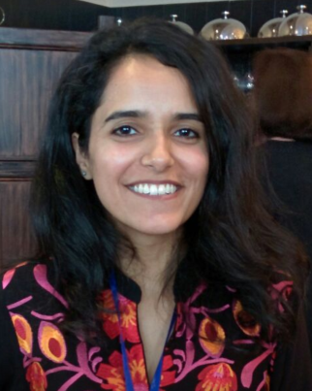
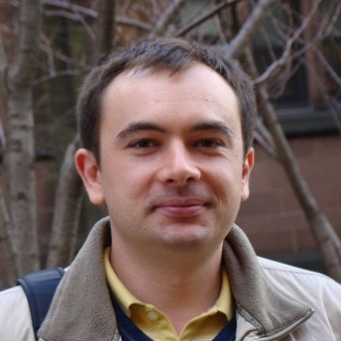




Former and current lab members:
Allan Haldane (Temple)
George Locke (Biogen)
Michael Manhart (ETH Zurich)
Dr. Denis Tolkunov (Berkeley)
Razvan Chereji (NIH/NICHD)
Julia Tsitron (NYC Parks & Recreation)
Willow Kion-Crosby (HIRI)
Pavel Khromov (Teza Technologies)
Aditya Ballal (UC Davis)
Unab Javed
Ted Malliaris
Funding:

Slide 24
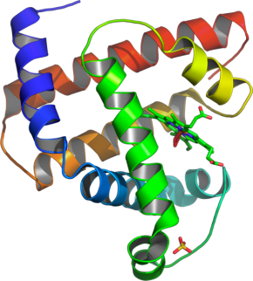
THANK YOU!
Notes:
Thank you for your attention!

